Slide 1
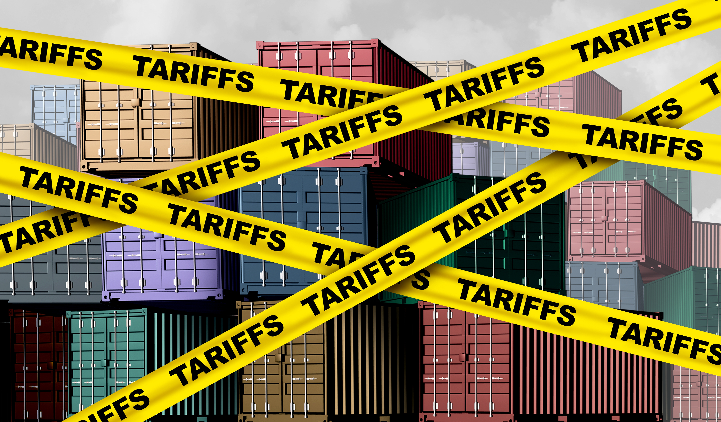

The Economy & Manufacturing
N. Marin Breakfast Club
Novato, CA
Jon Haveman, Ph.D.
NEED
June 12, 2025

Slide 2
Outline
Economic Indicators
Immigration
Tariffs
Big Picture: Uncertainty
Manufacturing

Slide 3
Economic Indicators

Slide 4
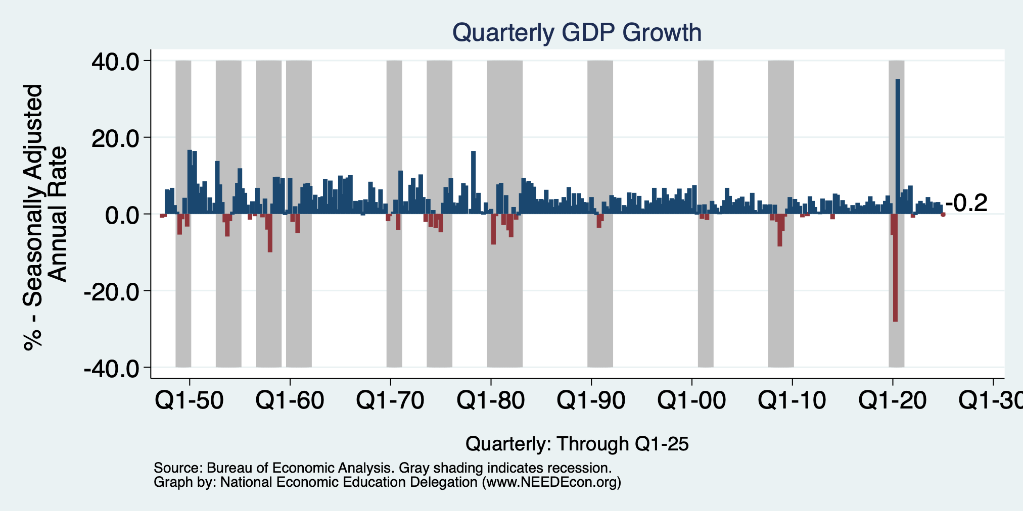
GDP: Quarterly Growth
Q2-2024: 3.0%
Q3-2024: 3.1%
Q4-2024: 2.4%
Q1-2025: -0.2%
Notes:
Graph: gdp_pot_grow.png
The Point: From 1990 – 2007, average annual US GDP growth pre-crisis is 2.94%. However, post-crisis US GDP growth is 2.19% (0.75 percentage points lower). Why is has the recovery been sluggish?
Note: At the recession’s height, the gap between quarterly GDP growth and potential growth was 2.5 percentage points.

Slide 5
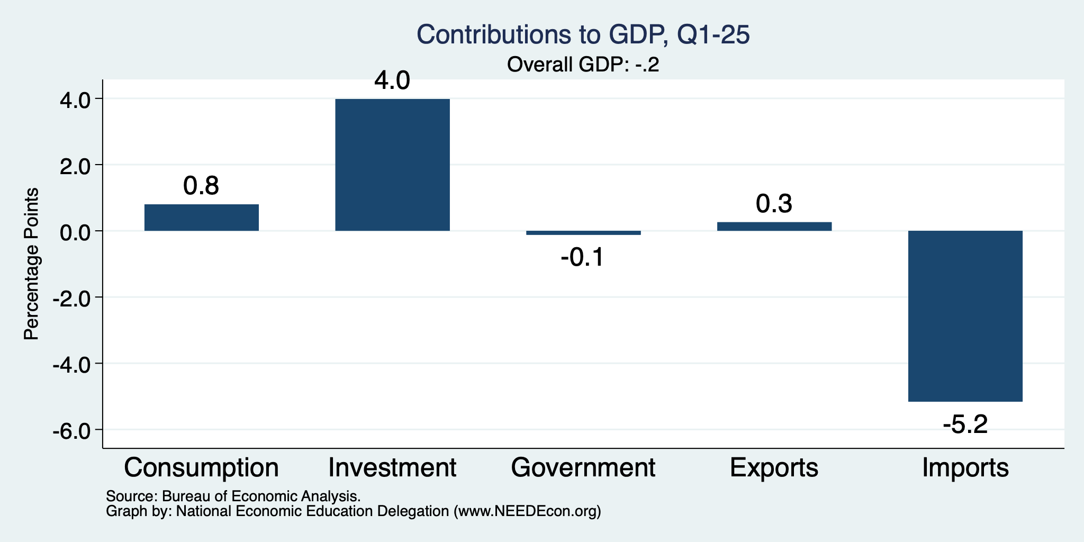
What Happened?
Normally
2.3%

Slide 6
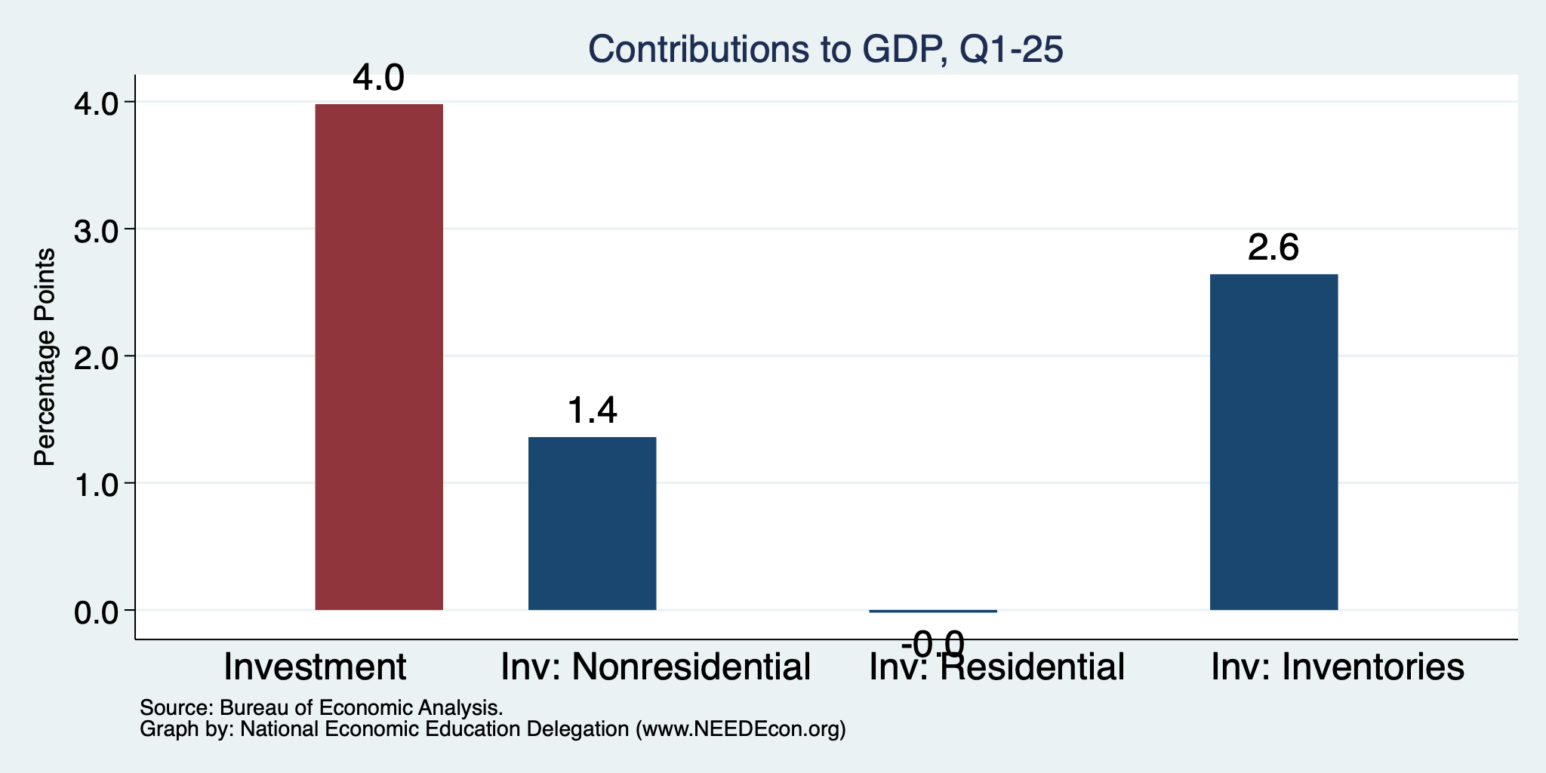
Imports Went Into Inventories
Normally
About 0%

Slide 7
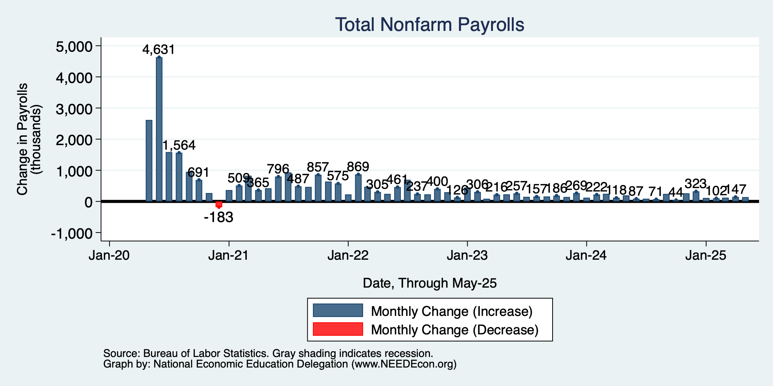
Monthly Changes in Nonfarm Employment
Feb: 102,000
March: 120,000
April: 147,000
May: 139,000
Notes:
PAYEMS.png

Slide 8
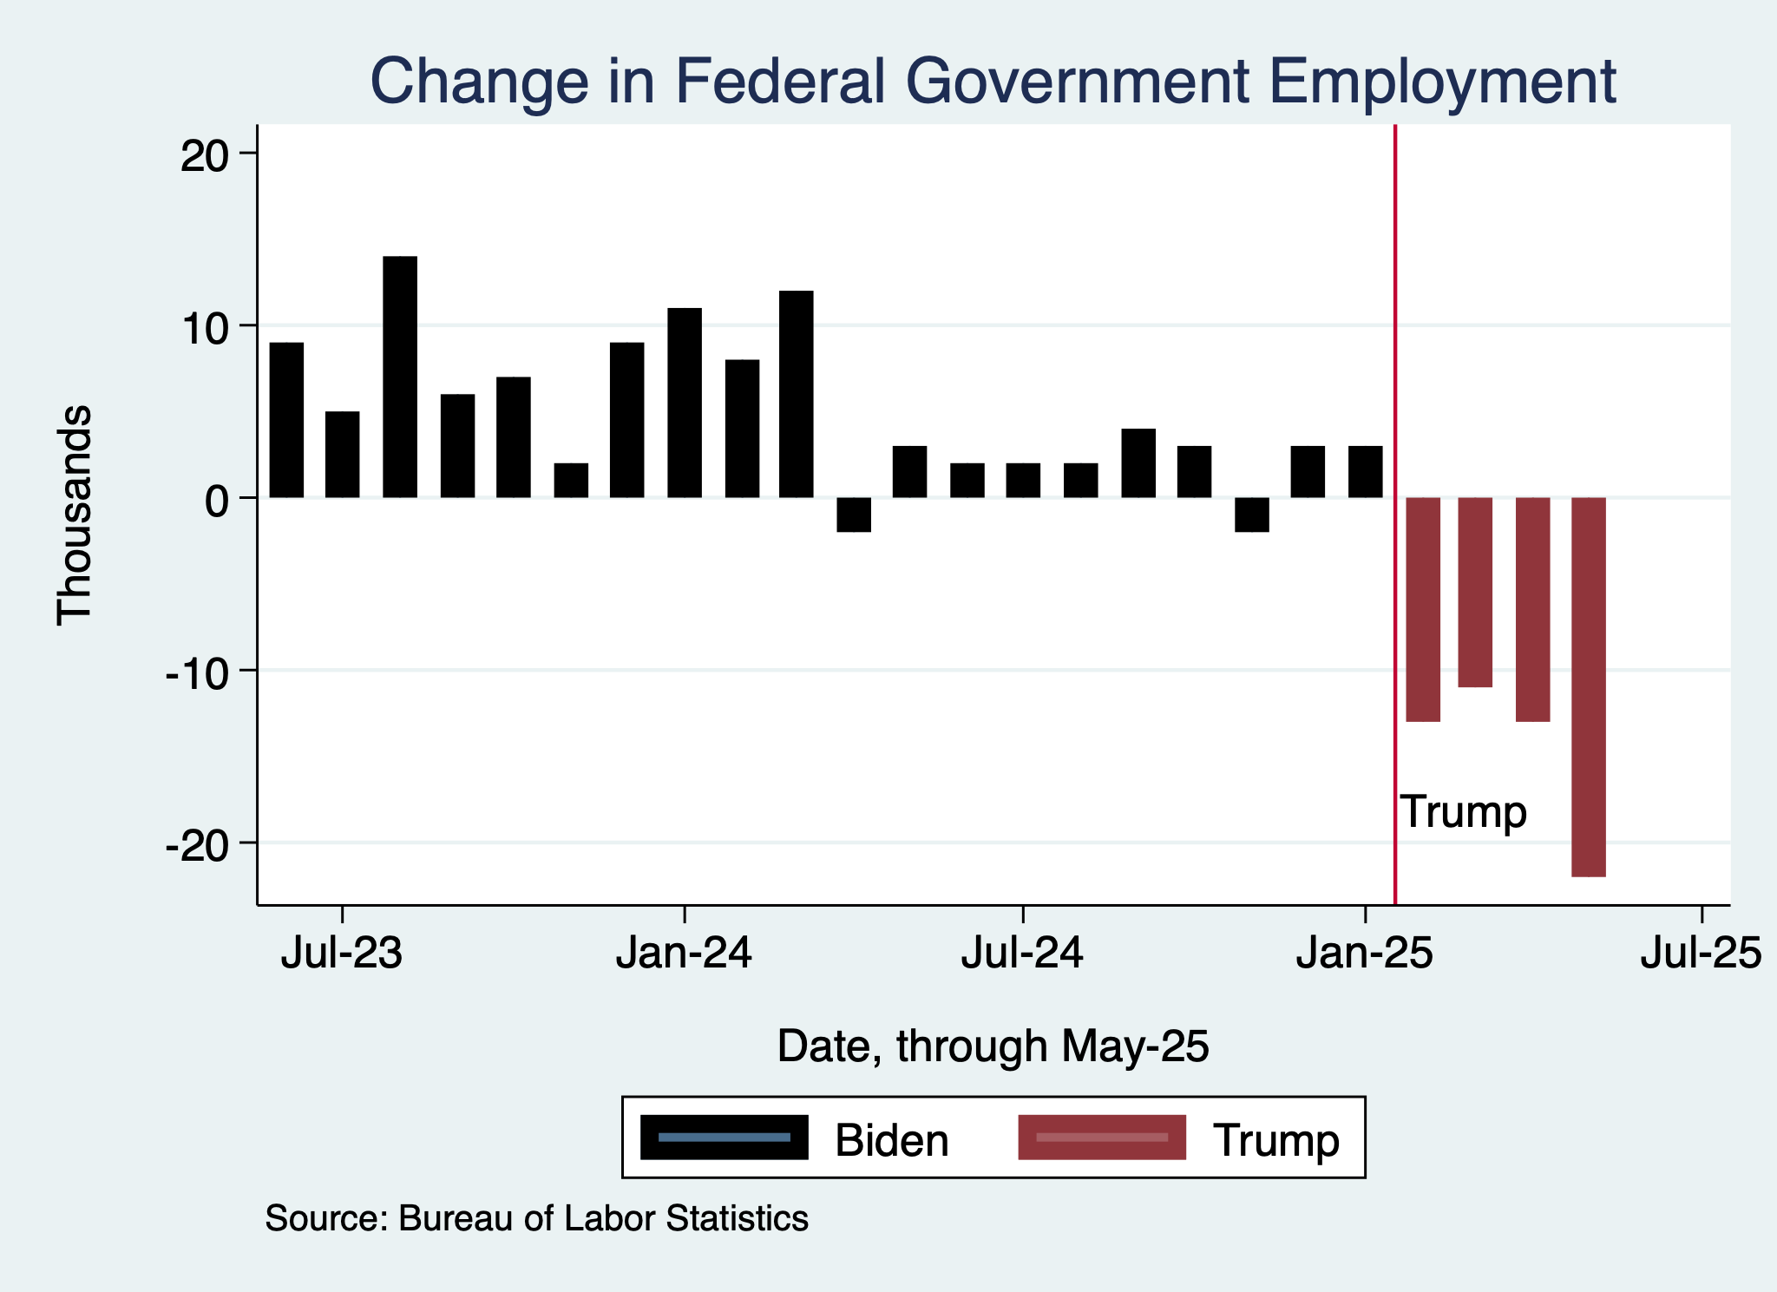
Monthly Changes in Nonfarm Employment
Notes:
PAYEMS.png

Slide 9
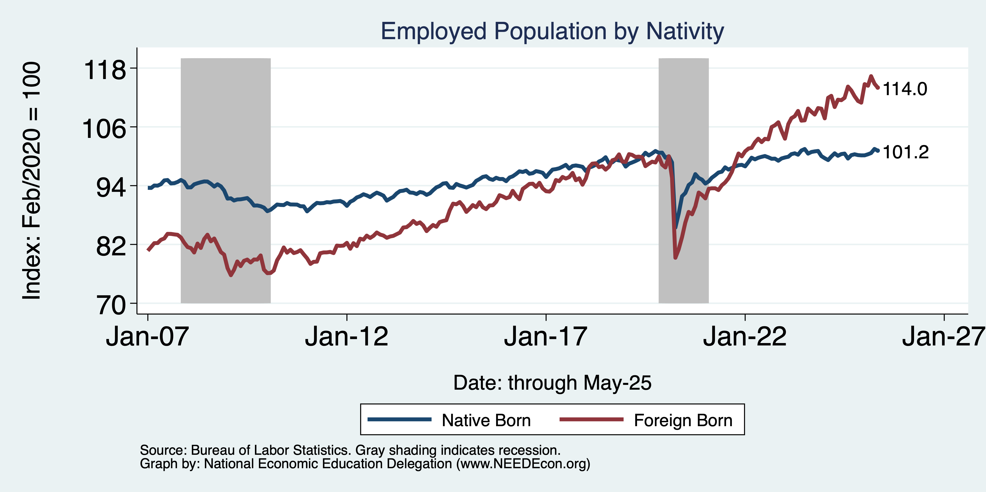
Immigrants to the Rescue?
Native: +1.9 million
Foreign Born: +4.0 million

Slide 10
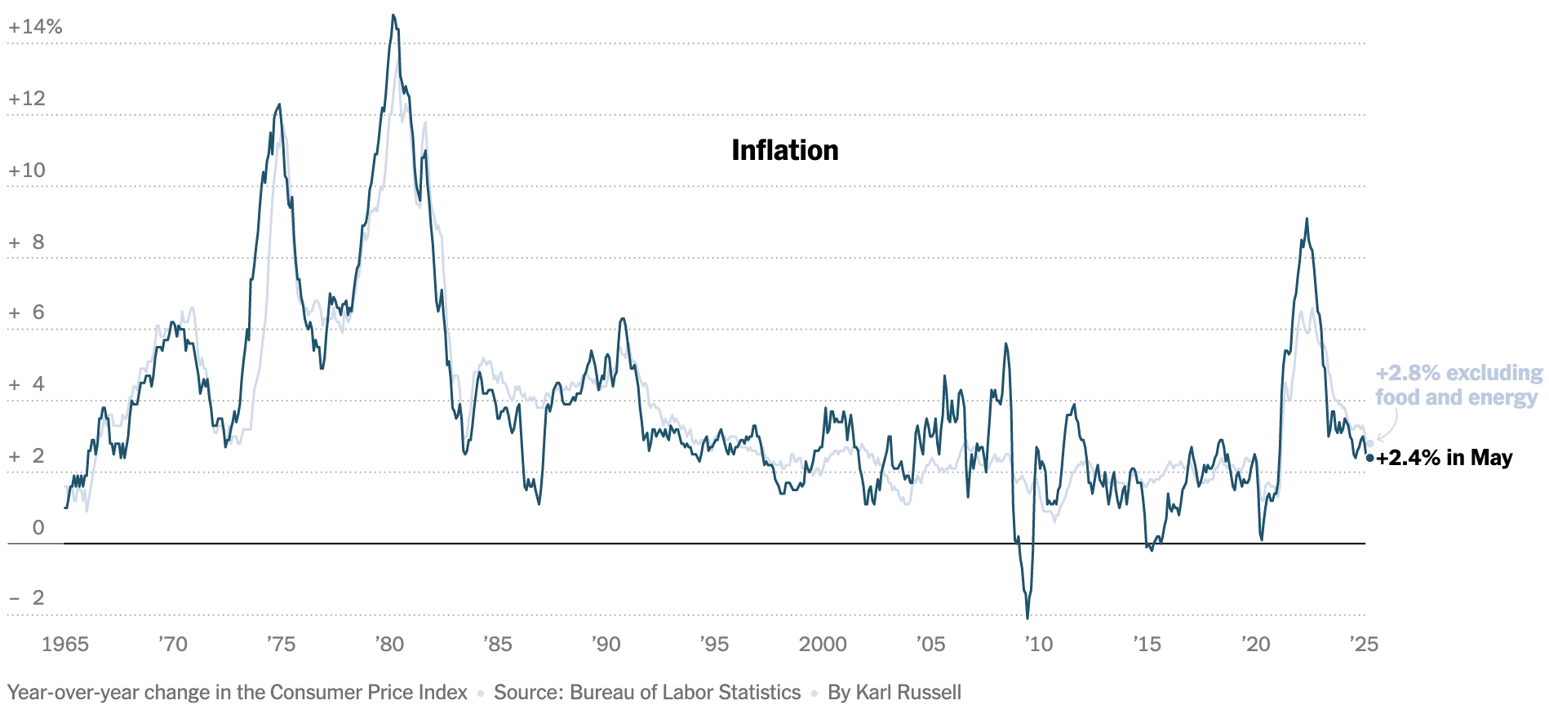
Inflation: Latest Figures
Source: NYTimes.com

Slide 11
Takeaways
Is a recession on the horizon?
  Maybe.
  Many indicators are in the black.
    2024 2nd half GDP growth was pretty good – 2.8% YoY.
    2025 Q1 < 0 is almost meaningless.
The problem?
  Uncertainties abound!

Slide 12
Uncertainties
Federal Government Policies
  How far will they go with immigration?
  How many federal employees will be laid off?
  How high will tariffs remain?
  Will Fed Chair Powell be replaced prematurely?

Slide 13
Since Inauguration: Policies = Anti-Growth
Tariffs
Deportations
Cuts to spending and employment
Threats to Fed Chair Powell

Slide 14
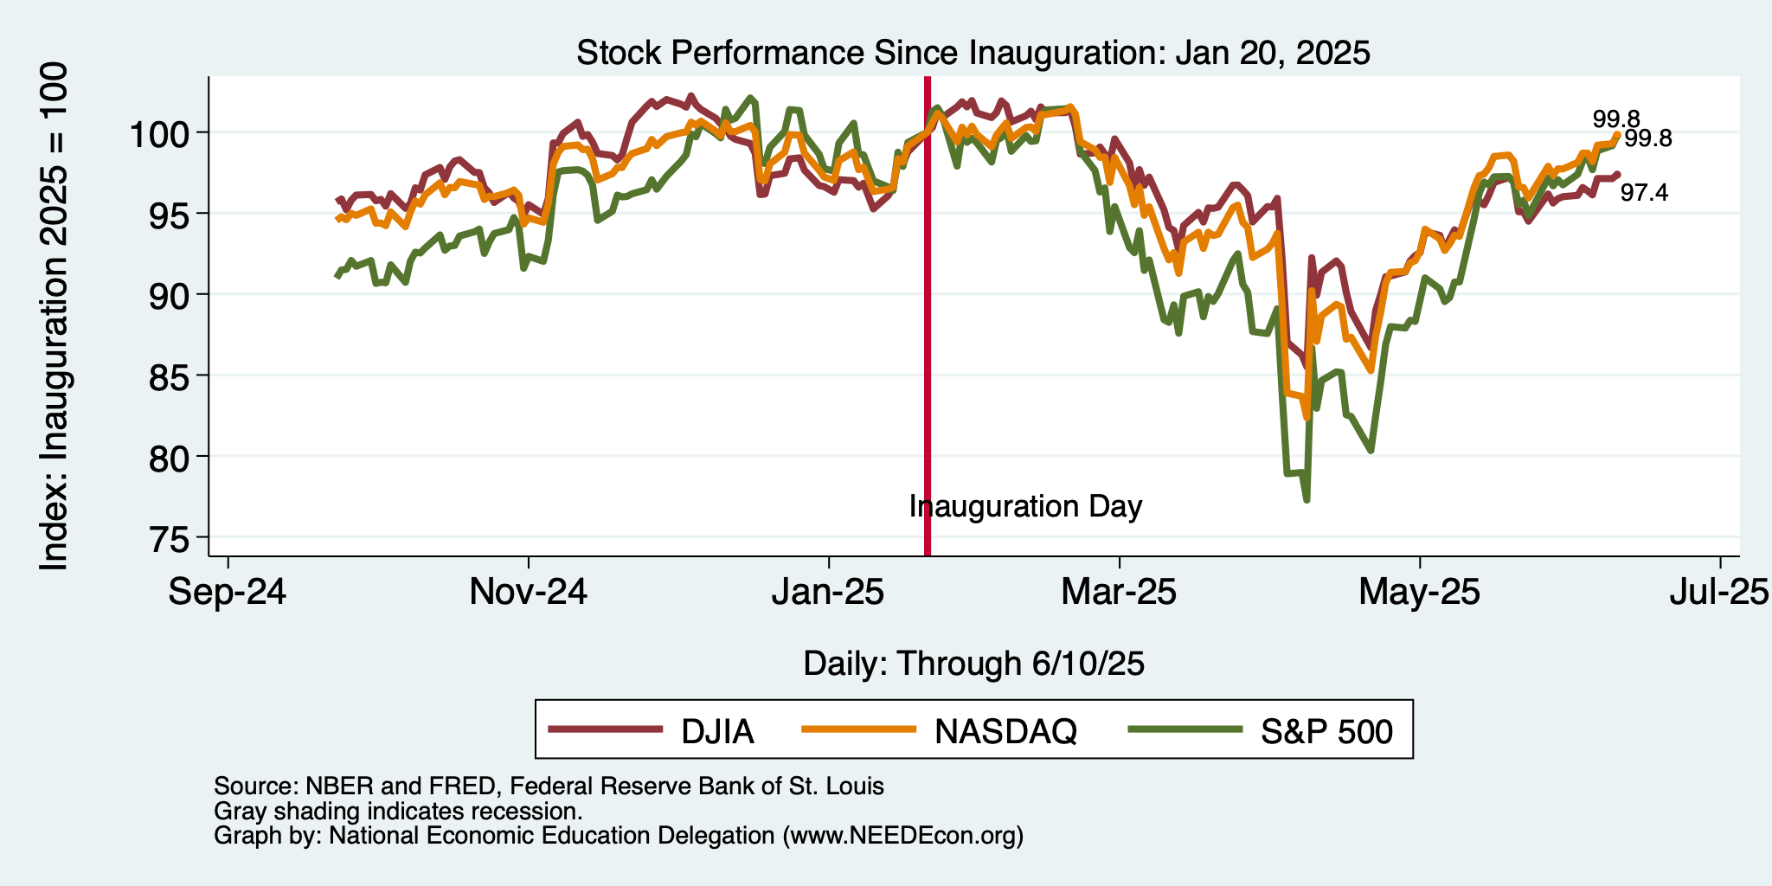
And Stock Markets Seem to Agree

Slide 15
Tariffs

Slide 16
Economic Effects of A Tariff
A tariff is a tax on imports. It causes:
  A rise in the price of the imported good in the importing country.
  A fall in the price of the imported good in the exporting country.
  The quantity imported to fall.
  Revenue for the tariff-levying government.
Almost always: the rise at home is much larger than the fall abroad
  We learned this from Trump’s tariffs in 2018.
  Trump’s tariffs caused US prices to rise, with hardly any perceptible fall in prices abroad.
    Sometimes prices rise on goods not subject to a tariff.
      Clothes dryers.

Slide 17
Economic Effects of A Tariff
Economists’ cost-benefit analysis quantifies these and shows that the costs exceed the benefits.
A tariff on one good can harm other industries.
A tariff on one country just causes displacement to another country.
Tariffs are NOT an effective tool to reduce the trade deficit.
Tariffs are NOT a good way to raise government revenue.
Retaliation from other countries makes tariffs even worse.
Corruption: tariffs can be selectively reduced.

Slide 18
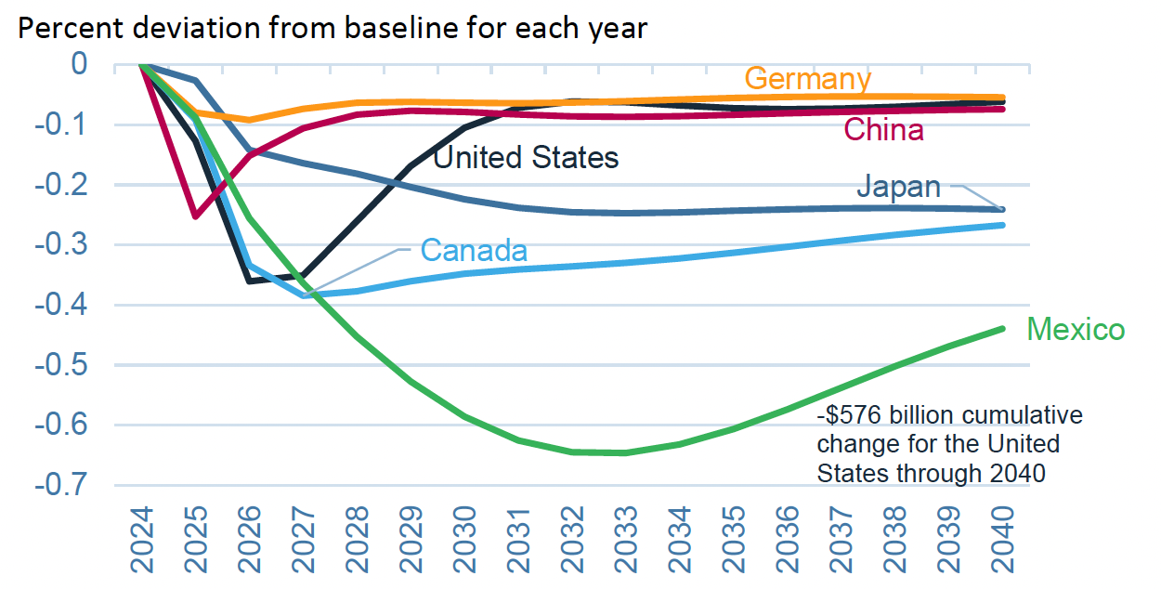
Effects of 10% Tariff on All US Imports
Real GDP
Notes:
Warwick McKibbin, Megan Hogan, and Marcus Noland, “The International Economic Implications of a Second Trump Presidency,” Working Paper 24-20, Peterson Institute of International Econnomics, September 2024.
https://www.piie.com/publications/working-papers/2024/international-economic-implications-second-trump-presidency

Slide 19
Immigration

Slide 20
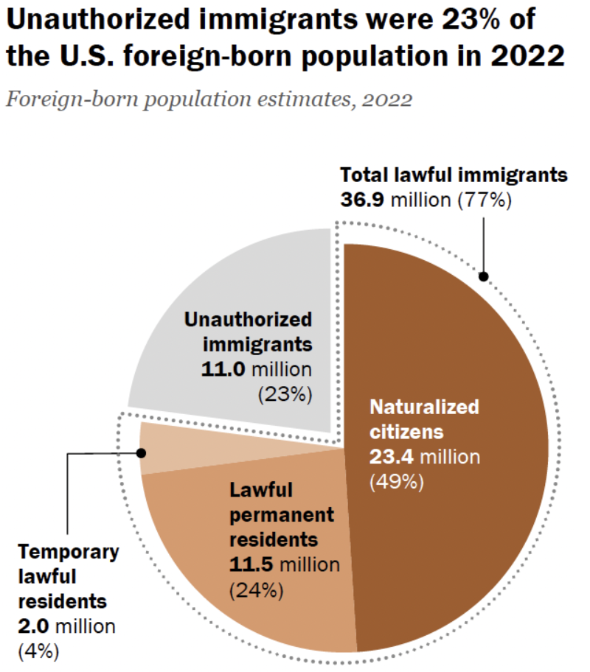
Total Foreign-Born (2022)
Population: 47.9 million
Total Foreign-Born (Current)
Population: 49.7 million
Source: Pew Research Center, What we know about unauthorized immigrants living in the U.S., July 22, 2024

Slide 21
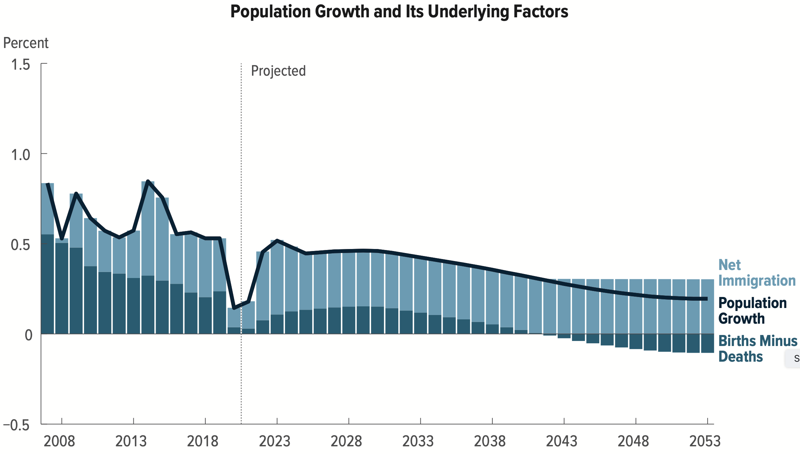
Is Immigration Saving the Day?
Source: CBO – The Demographic Outlook, 2023-2053

Slide 22
Mass Deportations
Immigrants work different jobs than do native-born workers.
Immigrants contribute to the local economy.
  GDP losses of up to $1.7 trillion annually.
Immigrants keep prices low: in particular, food!
Deportations impact tax revenues.
  $1,300 more in on average than out, annually.
  Unauthorized immigrants: $22.6 billion in social security and $5.7 billion in Medicare payments.
Deportations are expensive ($13,000 each).
  Total cost $315 billion.
They rob people of their dignity.

Slide 23
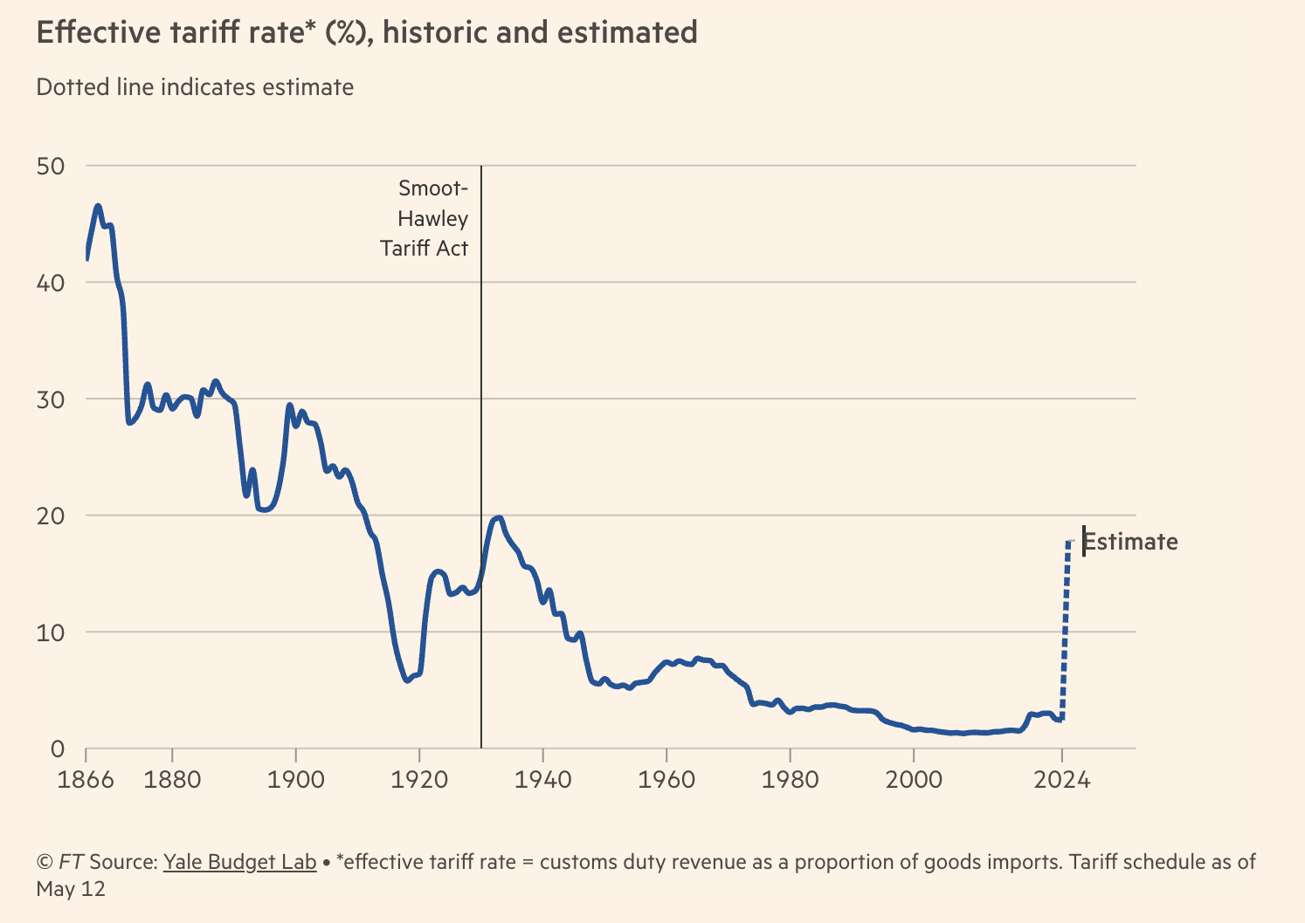
U.S. Tariff Level
Notes:
https://www.piie.com/blogs/realtime-economics/2025/trumps-trade-war-timeline-20-date-guide

Slide 24
Summary
Inflation: close to Fed’s 2% target, but a little stubborn.
  This is likely to change, and not for the better.
Current immigration and trade policies will exacerbate inflation.
Immigration: deportations tax the economy and are expensive.
  Many, many ag workers are unauthorized immigrants.
Tariffs: are a tax.
  Taxes raise prices. Period. Full Stop.
  Taxes often cost jobs. Tariffs likely will.

Slide 25
Biggest Problem: Uncertainty
Nobody knows how to plan into uncertainty.
  Business investment is particularly at risk.
Hardly anybody increases spending into uncertainty.
Other countries will look elsewhere if the U.S. is volatile.
  Tourists already are.
Outlook: is not good.
  Inflation is inevitable.
  Job losses are inevitable.

Slide 26
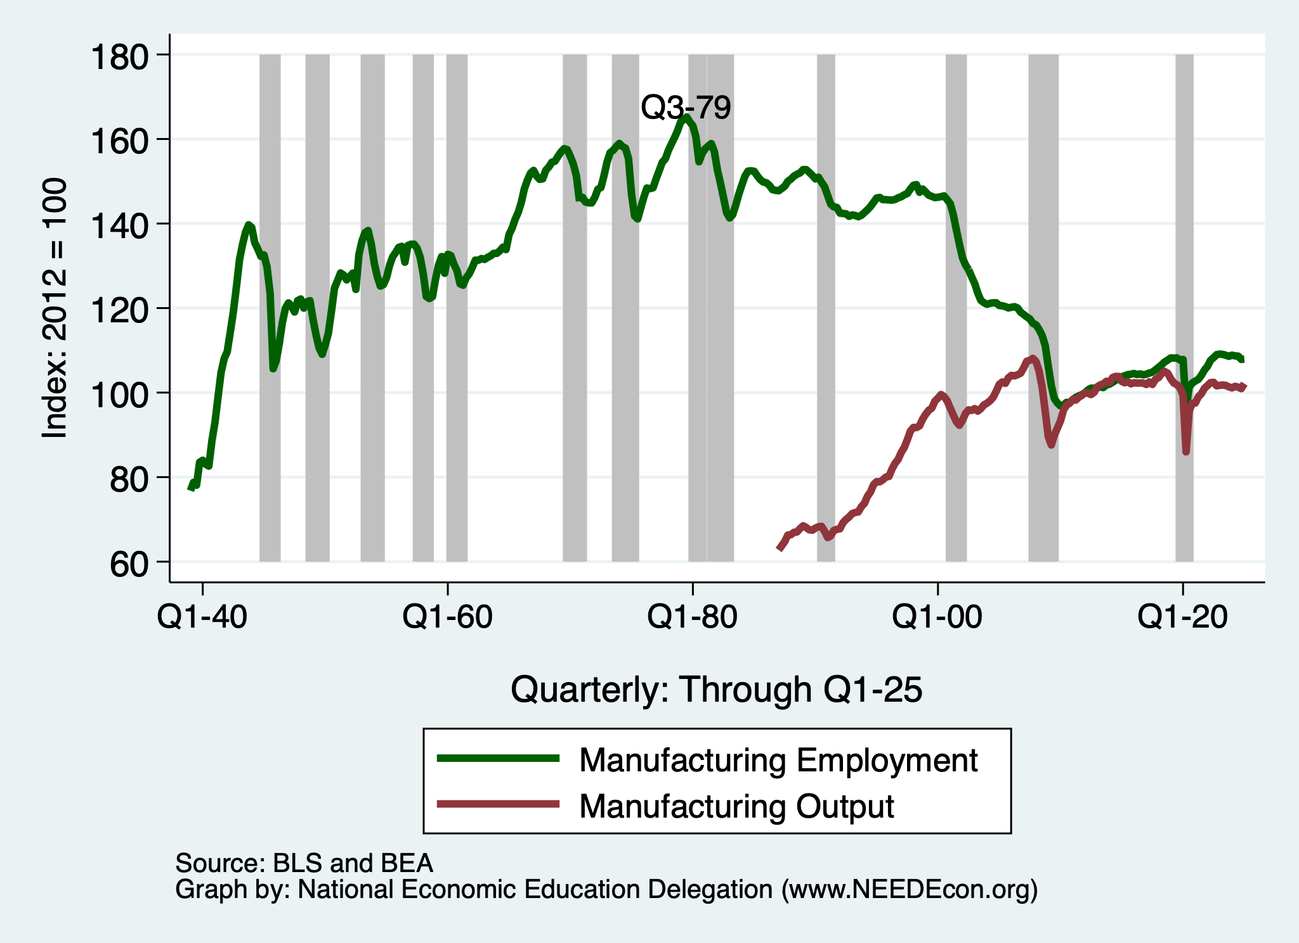
Manufacturing History

Slide 27
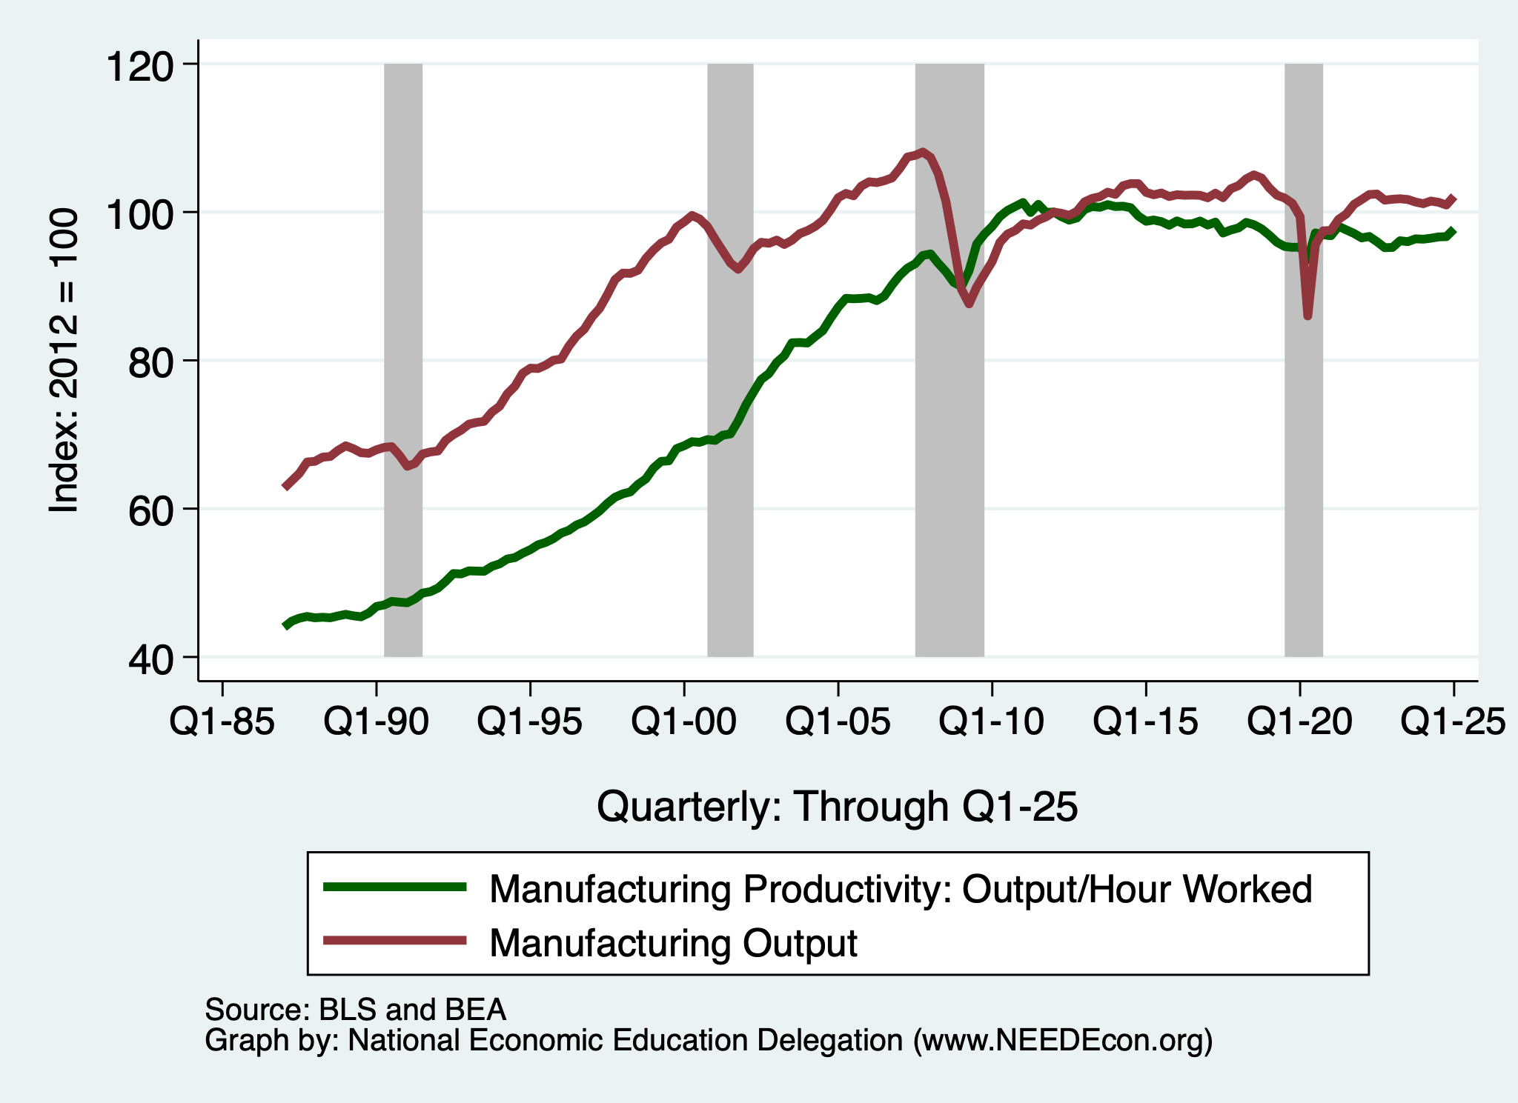
Manufacturing History: Productivity
It’s about technology,
Not trade.

Slide 28
Can We Bring Manufacturing Back?
I don’t think so.
  Costs, supply chain, labor supply
Going about it the wrong way.
  Uncertainty around tariffs doesn’t help.
  China provides a model.
  Biden had the right idea: Inflation Reduction Act, CHIPS Act.
Do we want to?

Slide 29
Thank you!
Any Questions?
www.NEEDEcon.org
Jon D. Haveman
Jon@NEEDEcon.org
Contact NEED: info@NEEDEcon.org
Submit a testimonial: www.NEEDEcon.org/testimonials.php
Become a Friend of NEED: www.NEEDEcon.org/friend.php

