Slide 1
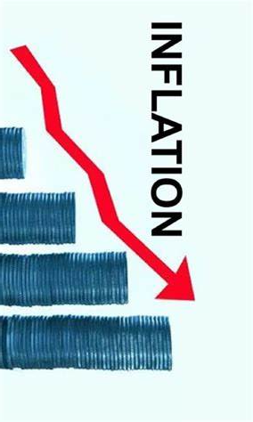
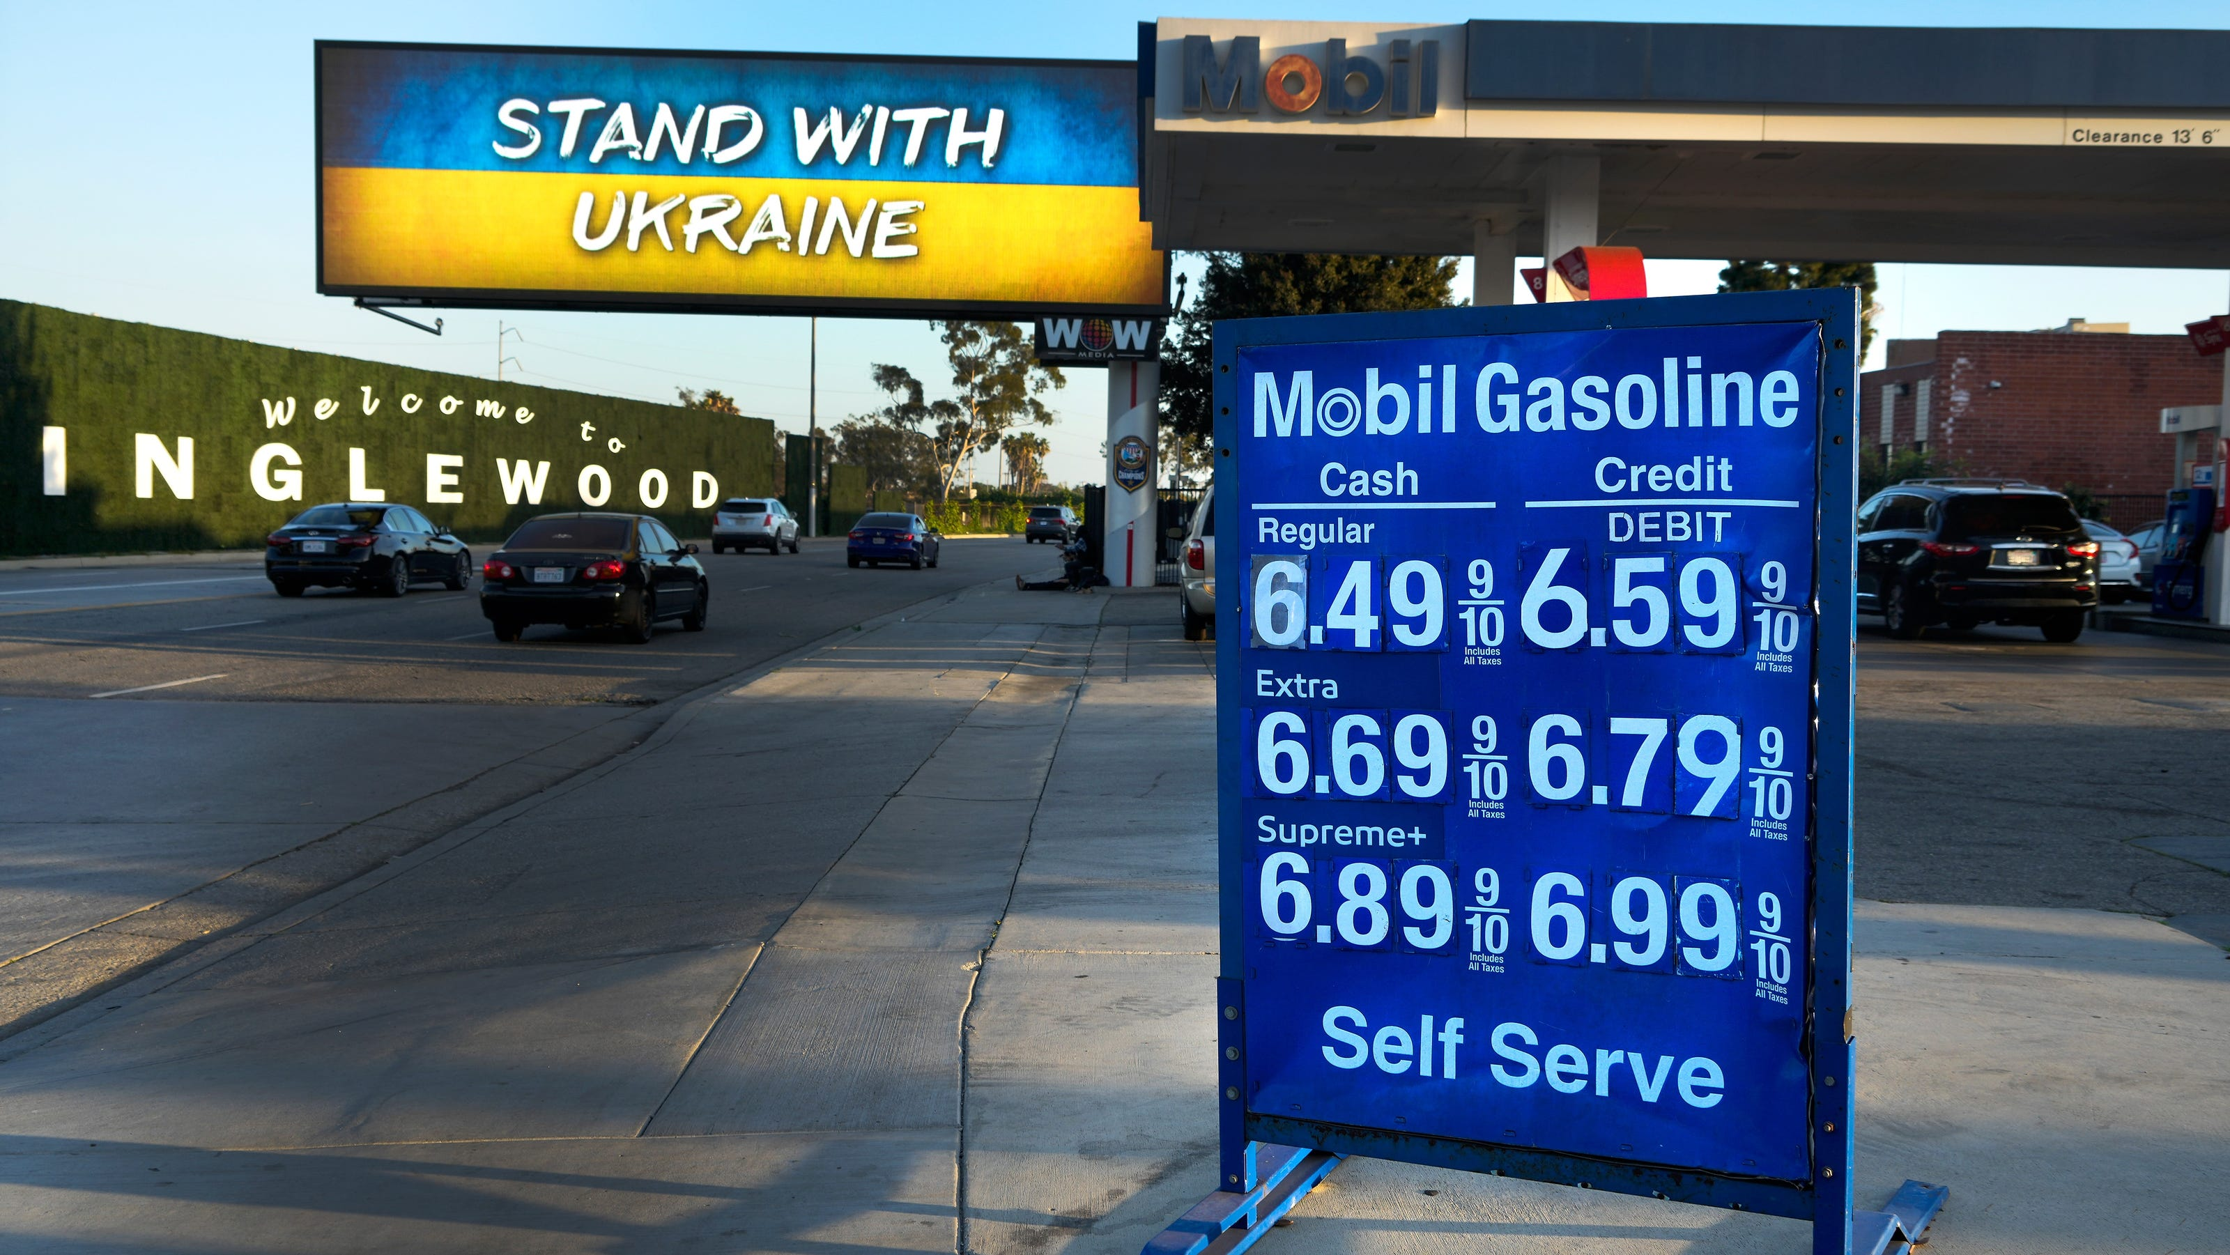
US Economic Update
California Community Colleges Real Estate Education Center
Jon Haveman, Ph.D.
NEED
April 19, 2023

Slide 2
Credits and Disclaimer
This slide deck was authored by:
  Jon D. Haveman, NEED
  Scott Baier, Clemson University
  Geoffrey Woglom, Amherst College (Emeritus)
  Brian Dombeck, Lewis & Clark College
  Doris Geide-Stevenson, Weber State
Disclaimer
  NEED presentations are designed to be nonpartisan.
  It is, however, inevitable that the presenter will be asked for and will provide their own views.
  Such views are those of the presenter and not necessarily those of the National Economic Education Delegation (NEED).

Slide 3
Outline
Economic Indicators
Inflation
Federal Reserve

Slide 4
Economic Indicators

Slide 5
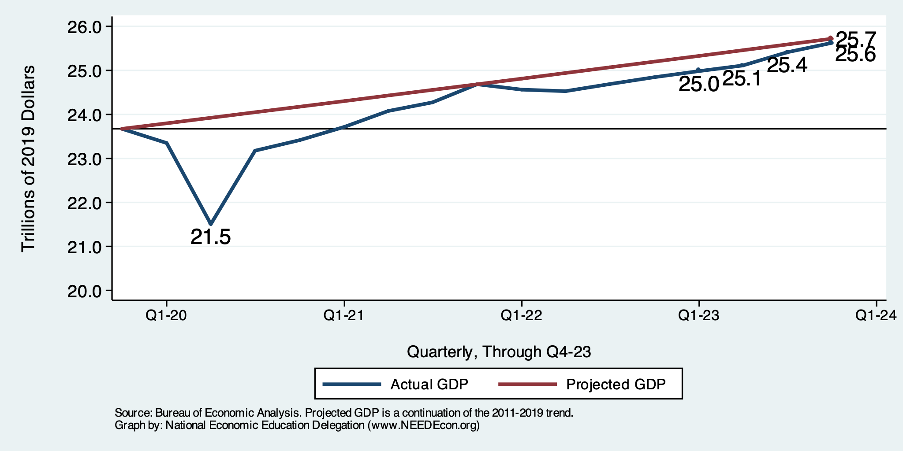
GDP Trajectory: Pandemic Recovery Complete!
GDP is:
< $0.1 Trillion below 2019 forecast.
$1.8 Trillion ABOVE 2019-Q4 level.

Slide 6
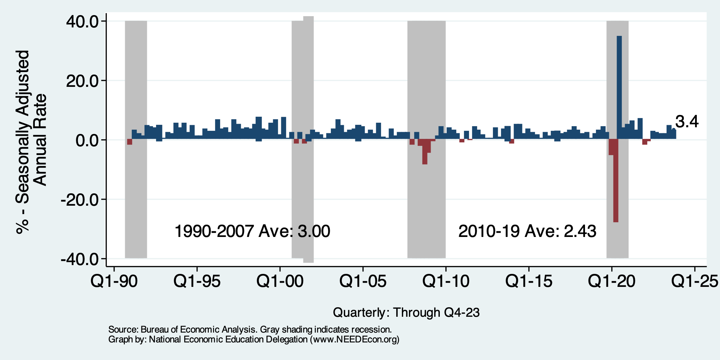
GDP: Quarterly Growth
Q1-2023: 2.2%
Q2-2023: 2.1%
Q3-2023: 4.9%
Q4-2023: 3.4%
Notes:
Graph: gdp_pot_grow.png
The Point: From 1990 – 2007, average annual US GDP growth pre-crisis is 2.94%. However, post-crisis US GDP growth is 2.19% (0.75 percentage points lower). Why is has the recovery been sluggish?
Note: At the recession’s height, the gap between quarterly GDP growth and potential growth was 2.5 percentage points.

Slide 7
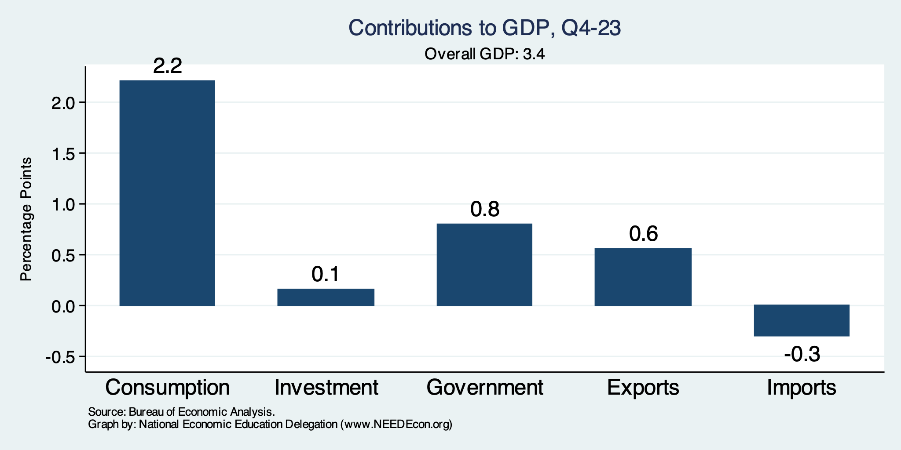
What Drove GDP to Such Growth?
Normally
2.3%

Slide 8
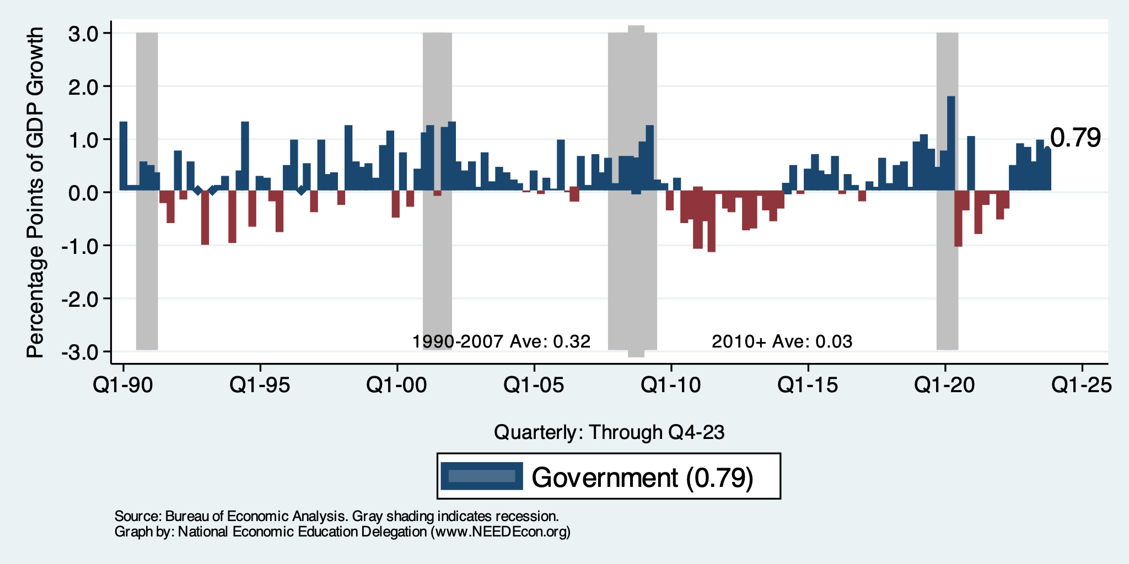
Contributions to GDP: Government
Notes:
Since 2010, average government spending growth is shrinking, resulting in a negative average contribution to GDP growth post-recession of -0.8 percentage points
Note that average quarterly government spending growth is 0.42% from 1990-2007 and -0.17% in 2010+ (annualized, 1990-2007 = 1.68%; 2010+ = -0.70%).

Slide 9
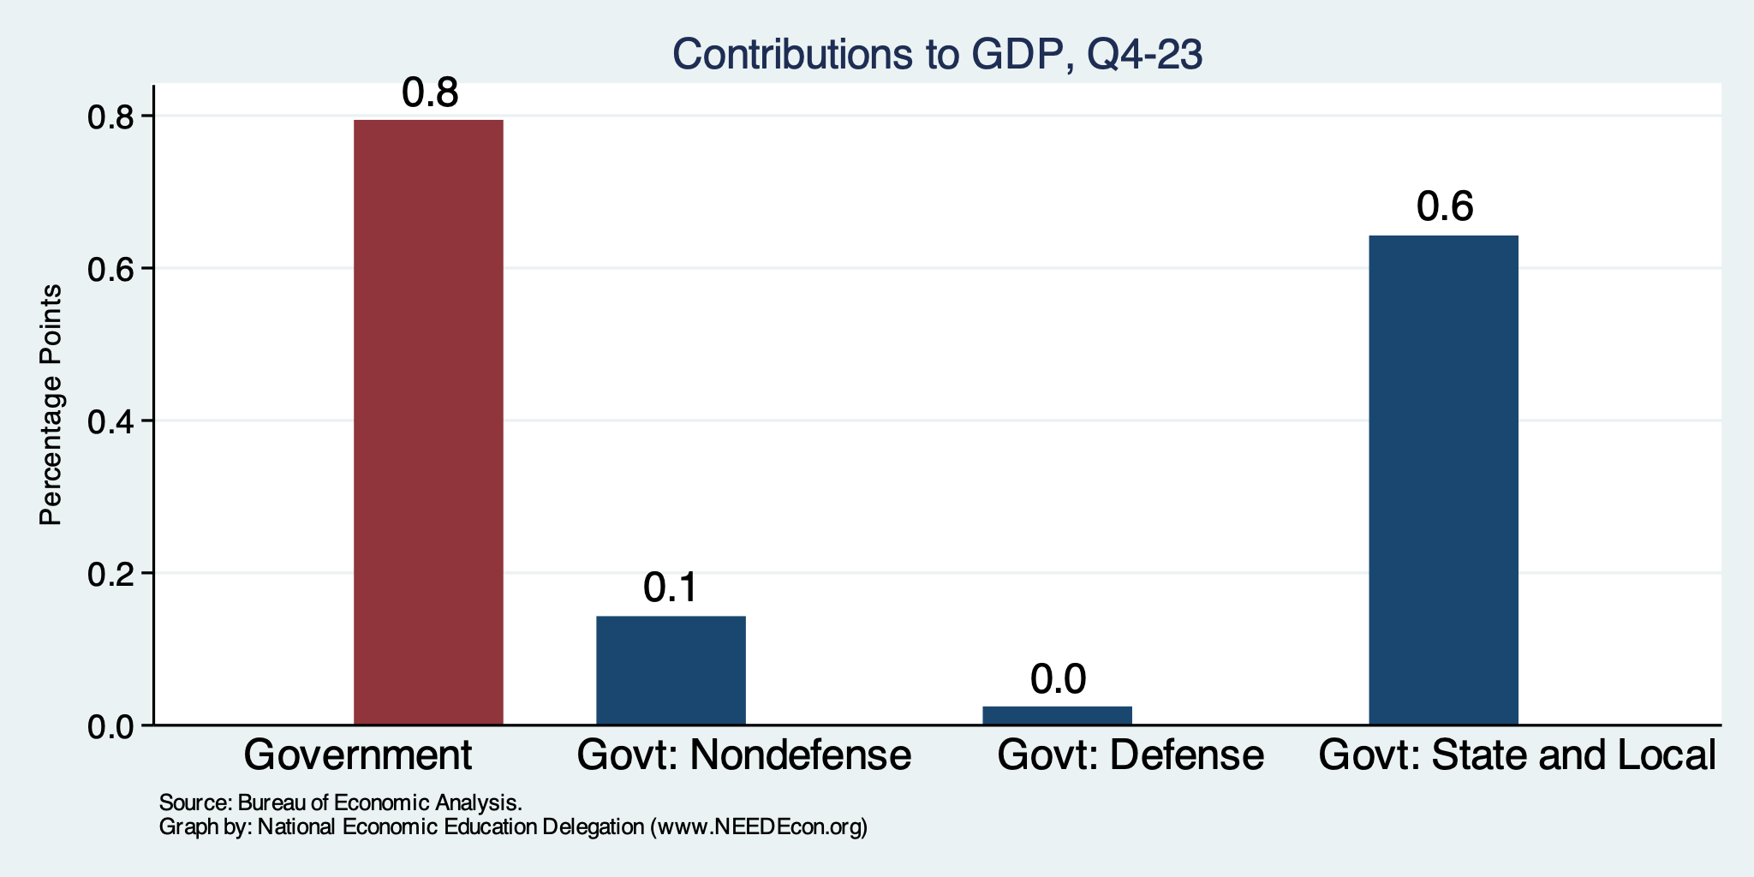
Sources of Government’s Contribution
Normally
0.55%
Normally
0.26%
Normally
0.0%
Normally
0.3%

Slide 10
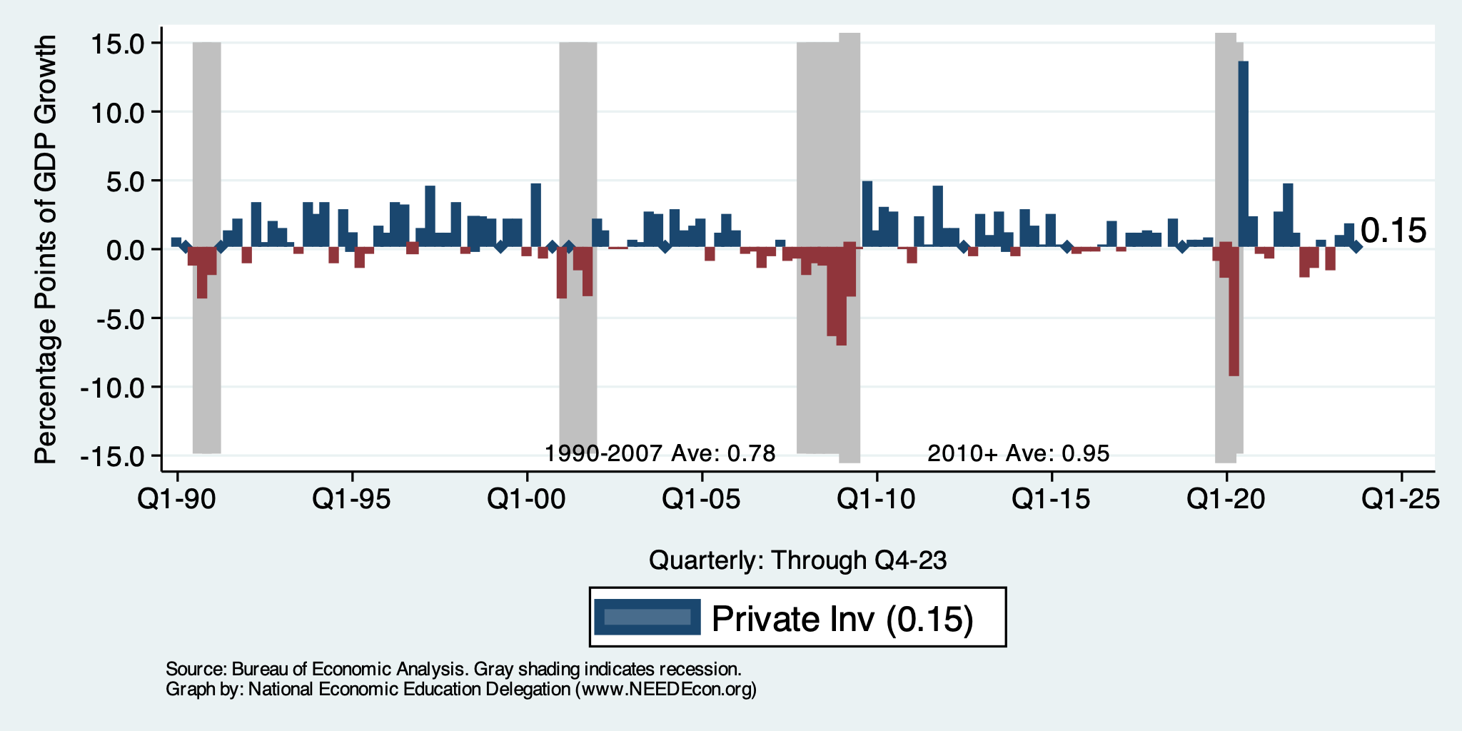
Contributions to GDP: Investment
Notes:
Since 2010, average government spending growth is shrinking, resulting in a negative average contribution to GDP growth post-recession of -0.8 percentage points
Note that average quarterly government spending growth is 0.42% from 1990-2007 and -0.17% in 2010+ (annualized, 1990-2007 = 1.68%; 2010+ = -0.70%).

Slide 11
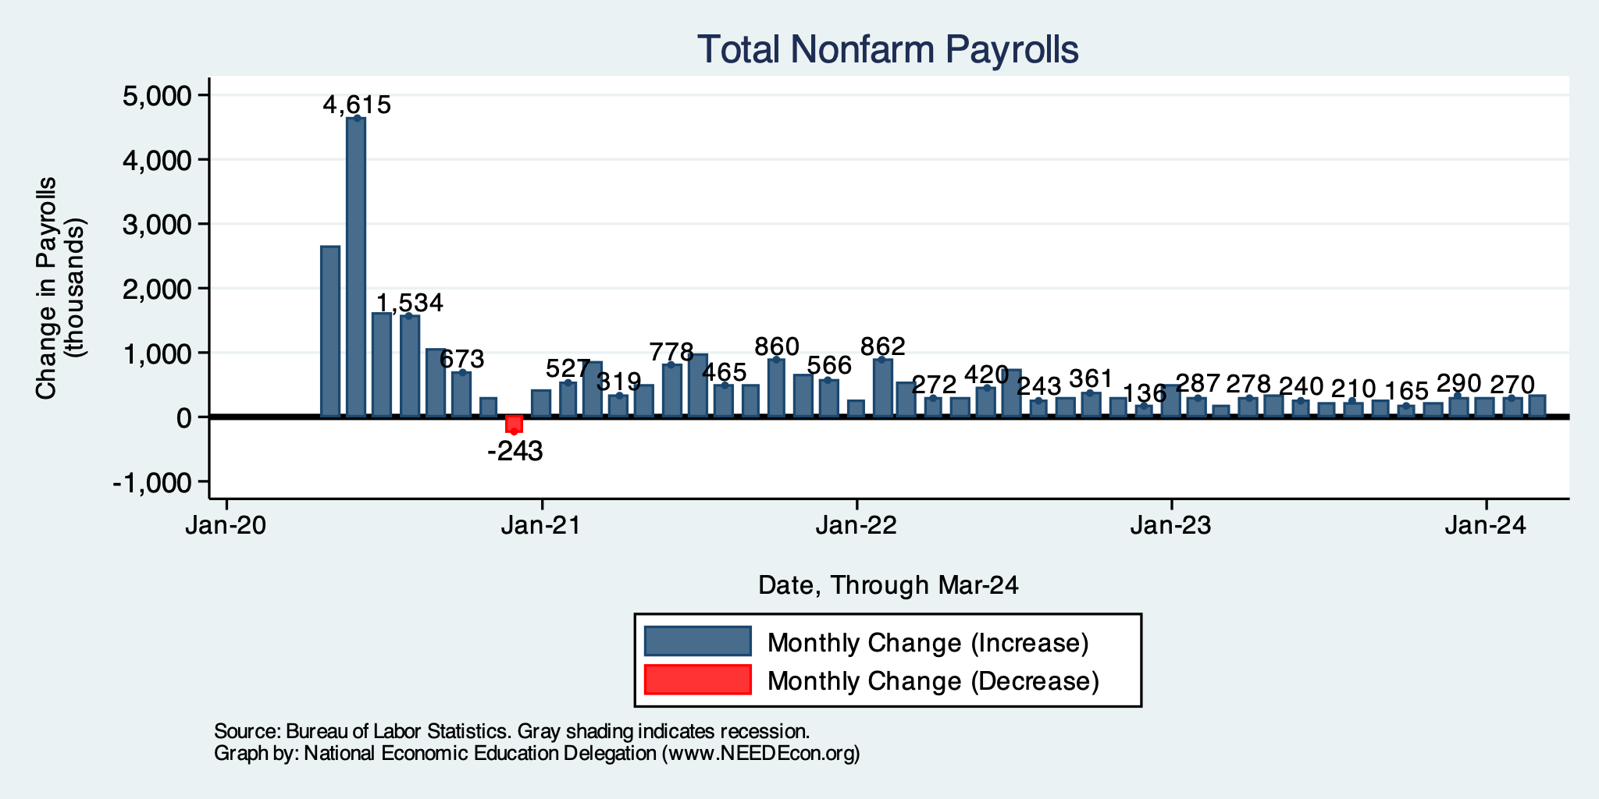
Monthly Changes in Nonfarm Employment
January: 256,000
February: 270,000
March: 303,000
Notes:
PAYEMS.png

Slide 12
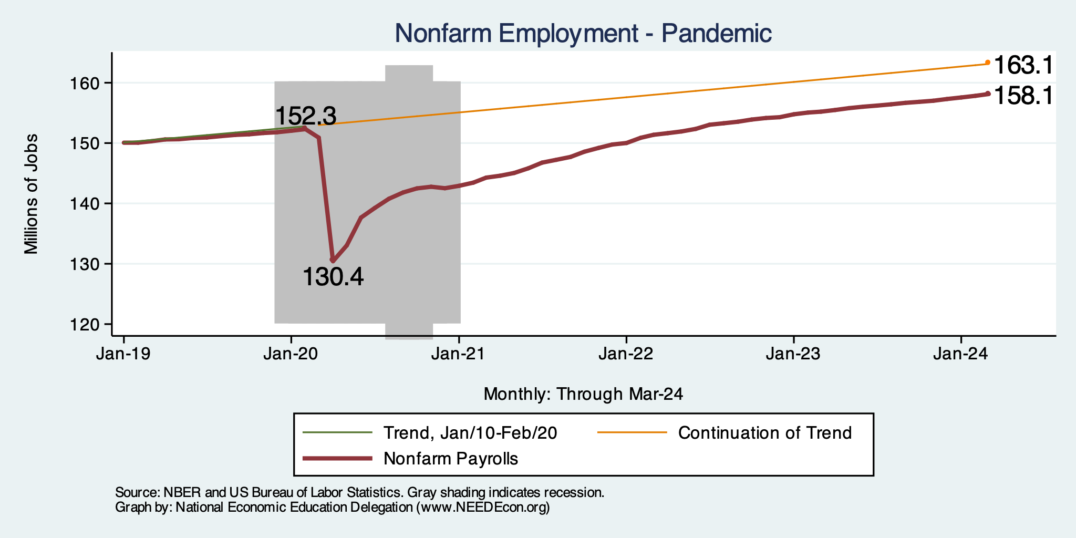
Employment Gap
5.8 Million ABOVE February, 2020.
5.0 Million BELOW where we should be.
Notes:
payroll_recent.png

Slide 13
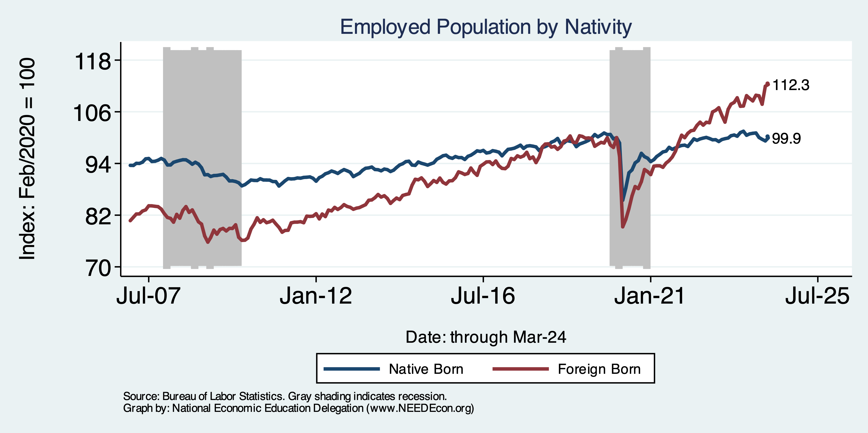
Immigrants to the Rescue?

Slide 14
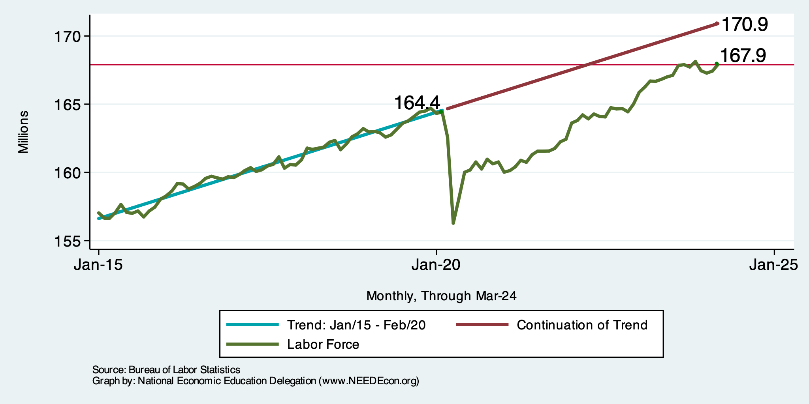
Where Have All the Workers Gone?
3.5 million ABOVE Feb 2020
3.0 million BELOW where we should be

Slide 15
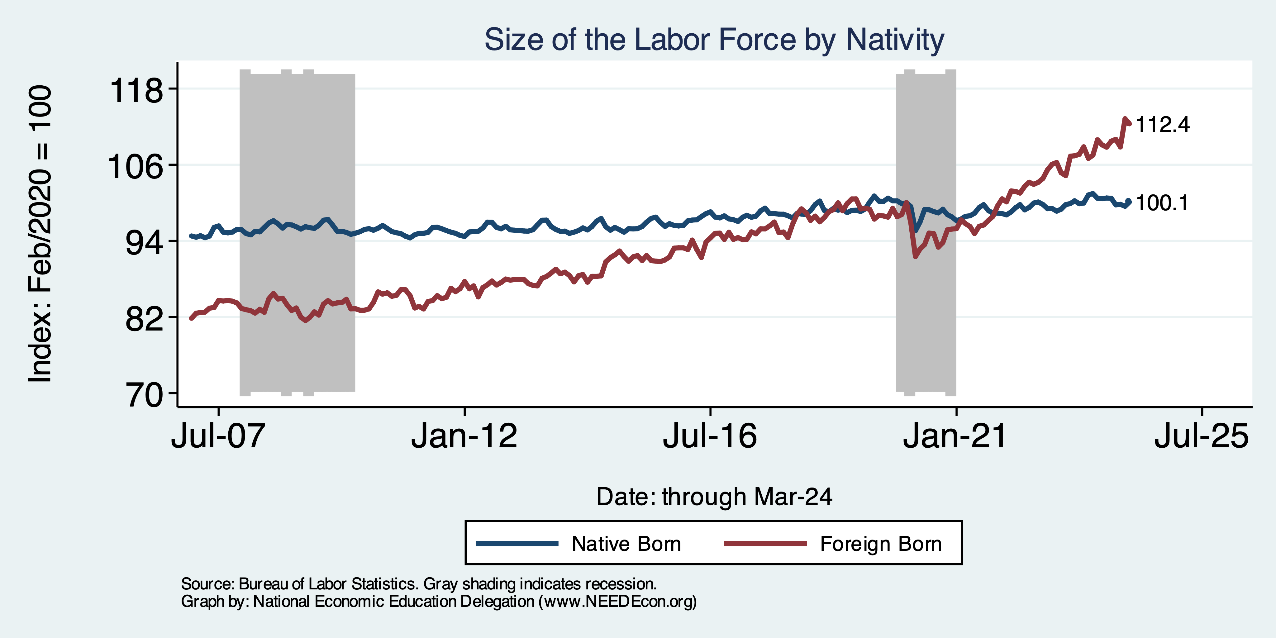
Immigrants to the Rescue?

Slide 16
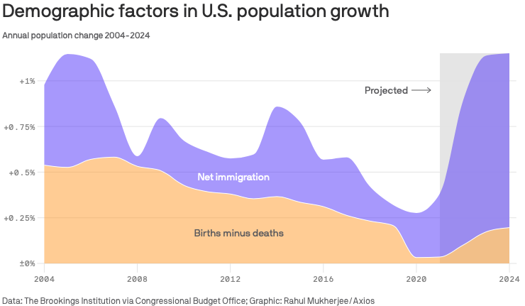
Is Immigration Saving the Day?
Source: https://www.axios.com/2024/03/13/immigration-economy-jobs-growth-good#

Slide 18
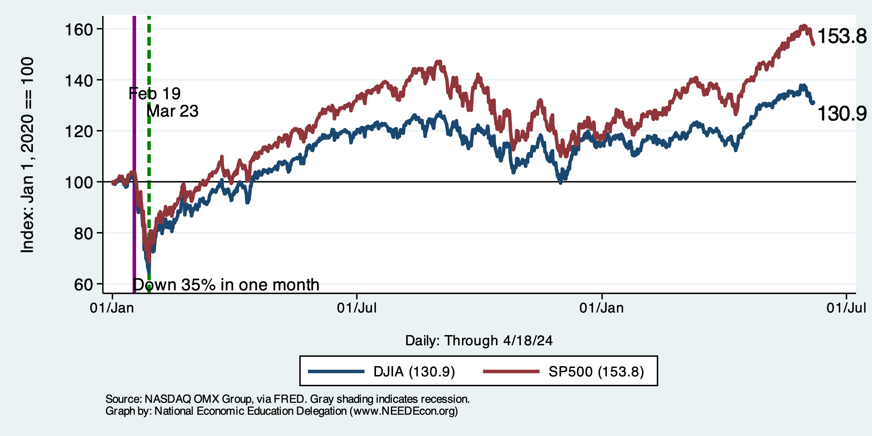
Stock Prices: Didn’t Like The Inflation #s
Notes:
Since the end of 2021, lost almost 15%

Slide 19
Inflation

Slide 20
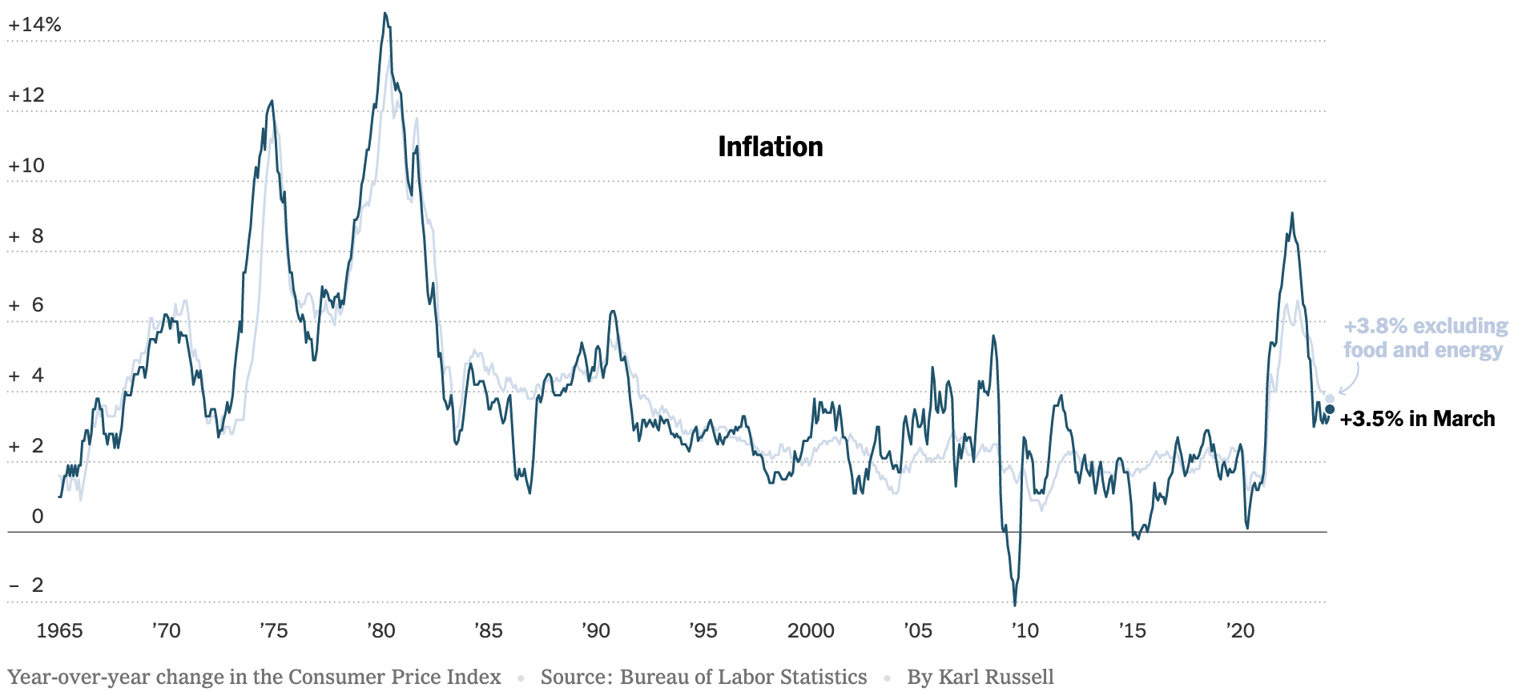
Inflation: Latest Figures
Source: NYTimes.com

Slide 21
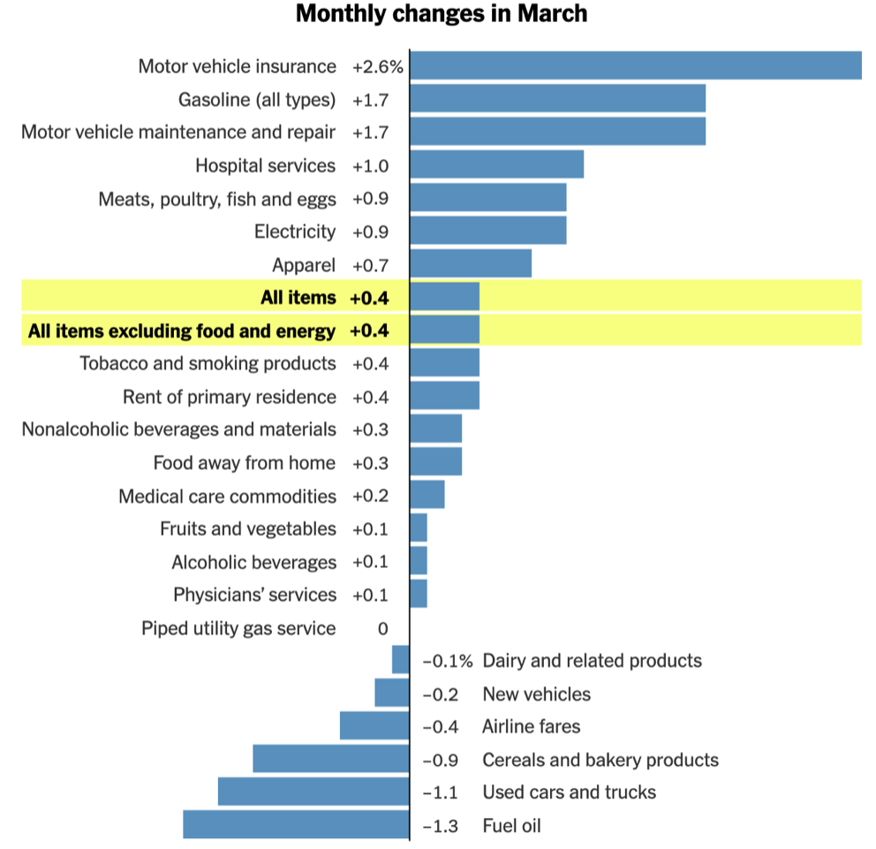
Which Prices?

Slide 22
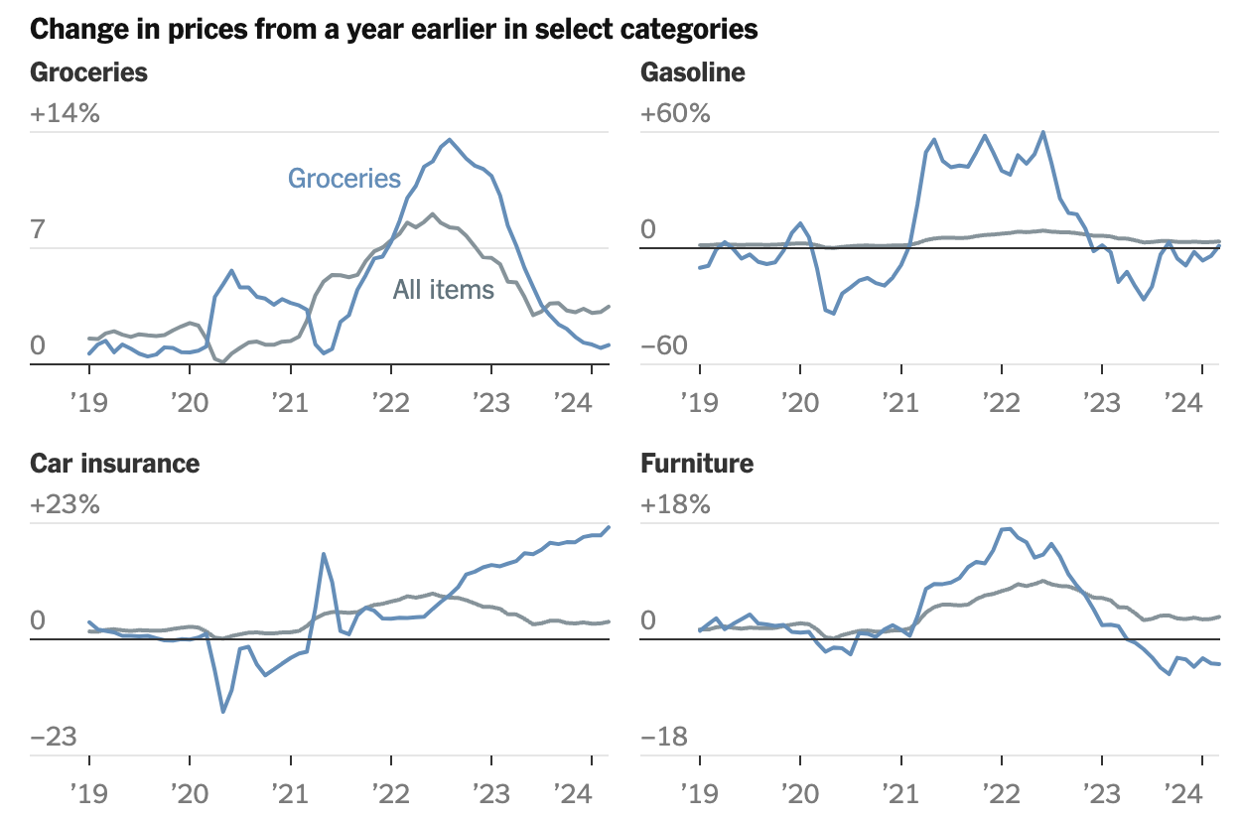

Slide 23
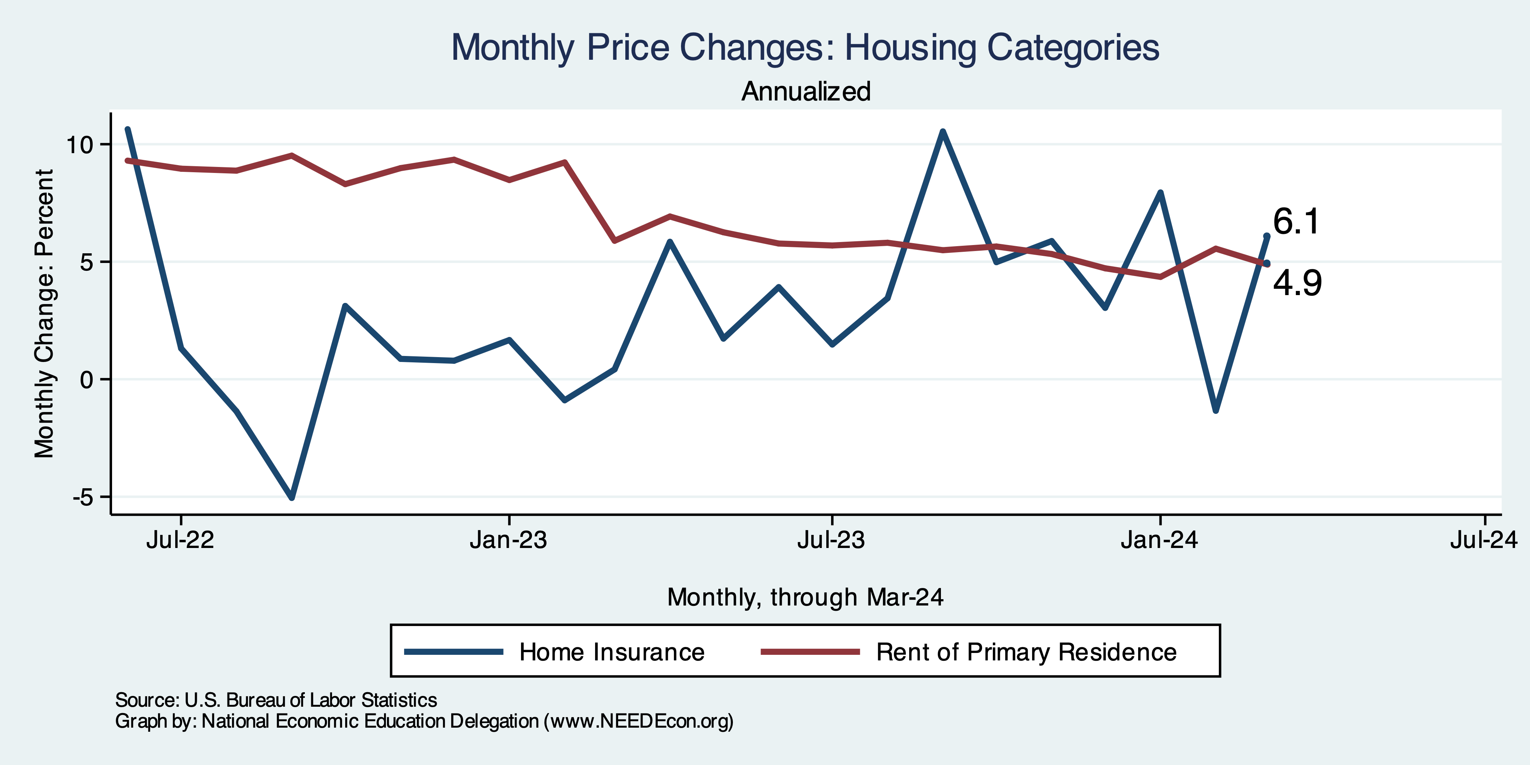
Housing is the Primary Problem

Slide 24
The Importance & Problems with Rents
Shelter is 36% of CPI
- 45% of Core CPI.
About half as much in PCE.
Notes:
Shelter is 36% of CPI and 45% of Core CPI. About half as much in PCE. CPI less shelter is 2.3% sine March of last year. Shelter is up 5.8%

Slide 25
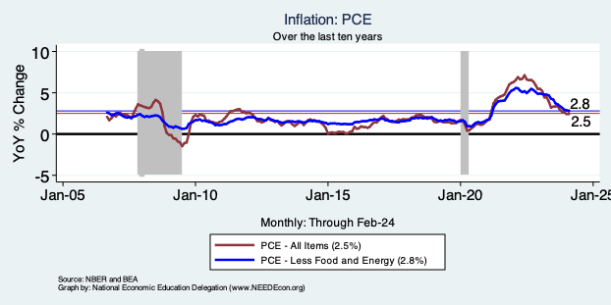
Fed’s Preferred Measure: PCE

Slide 26
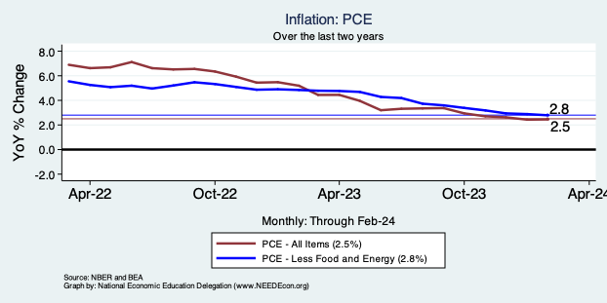
Fed’s Preferred Measure: PCE

Slide 27
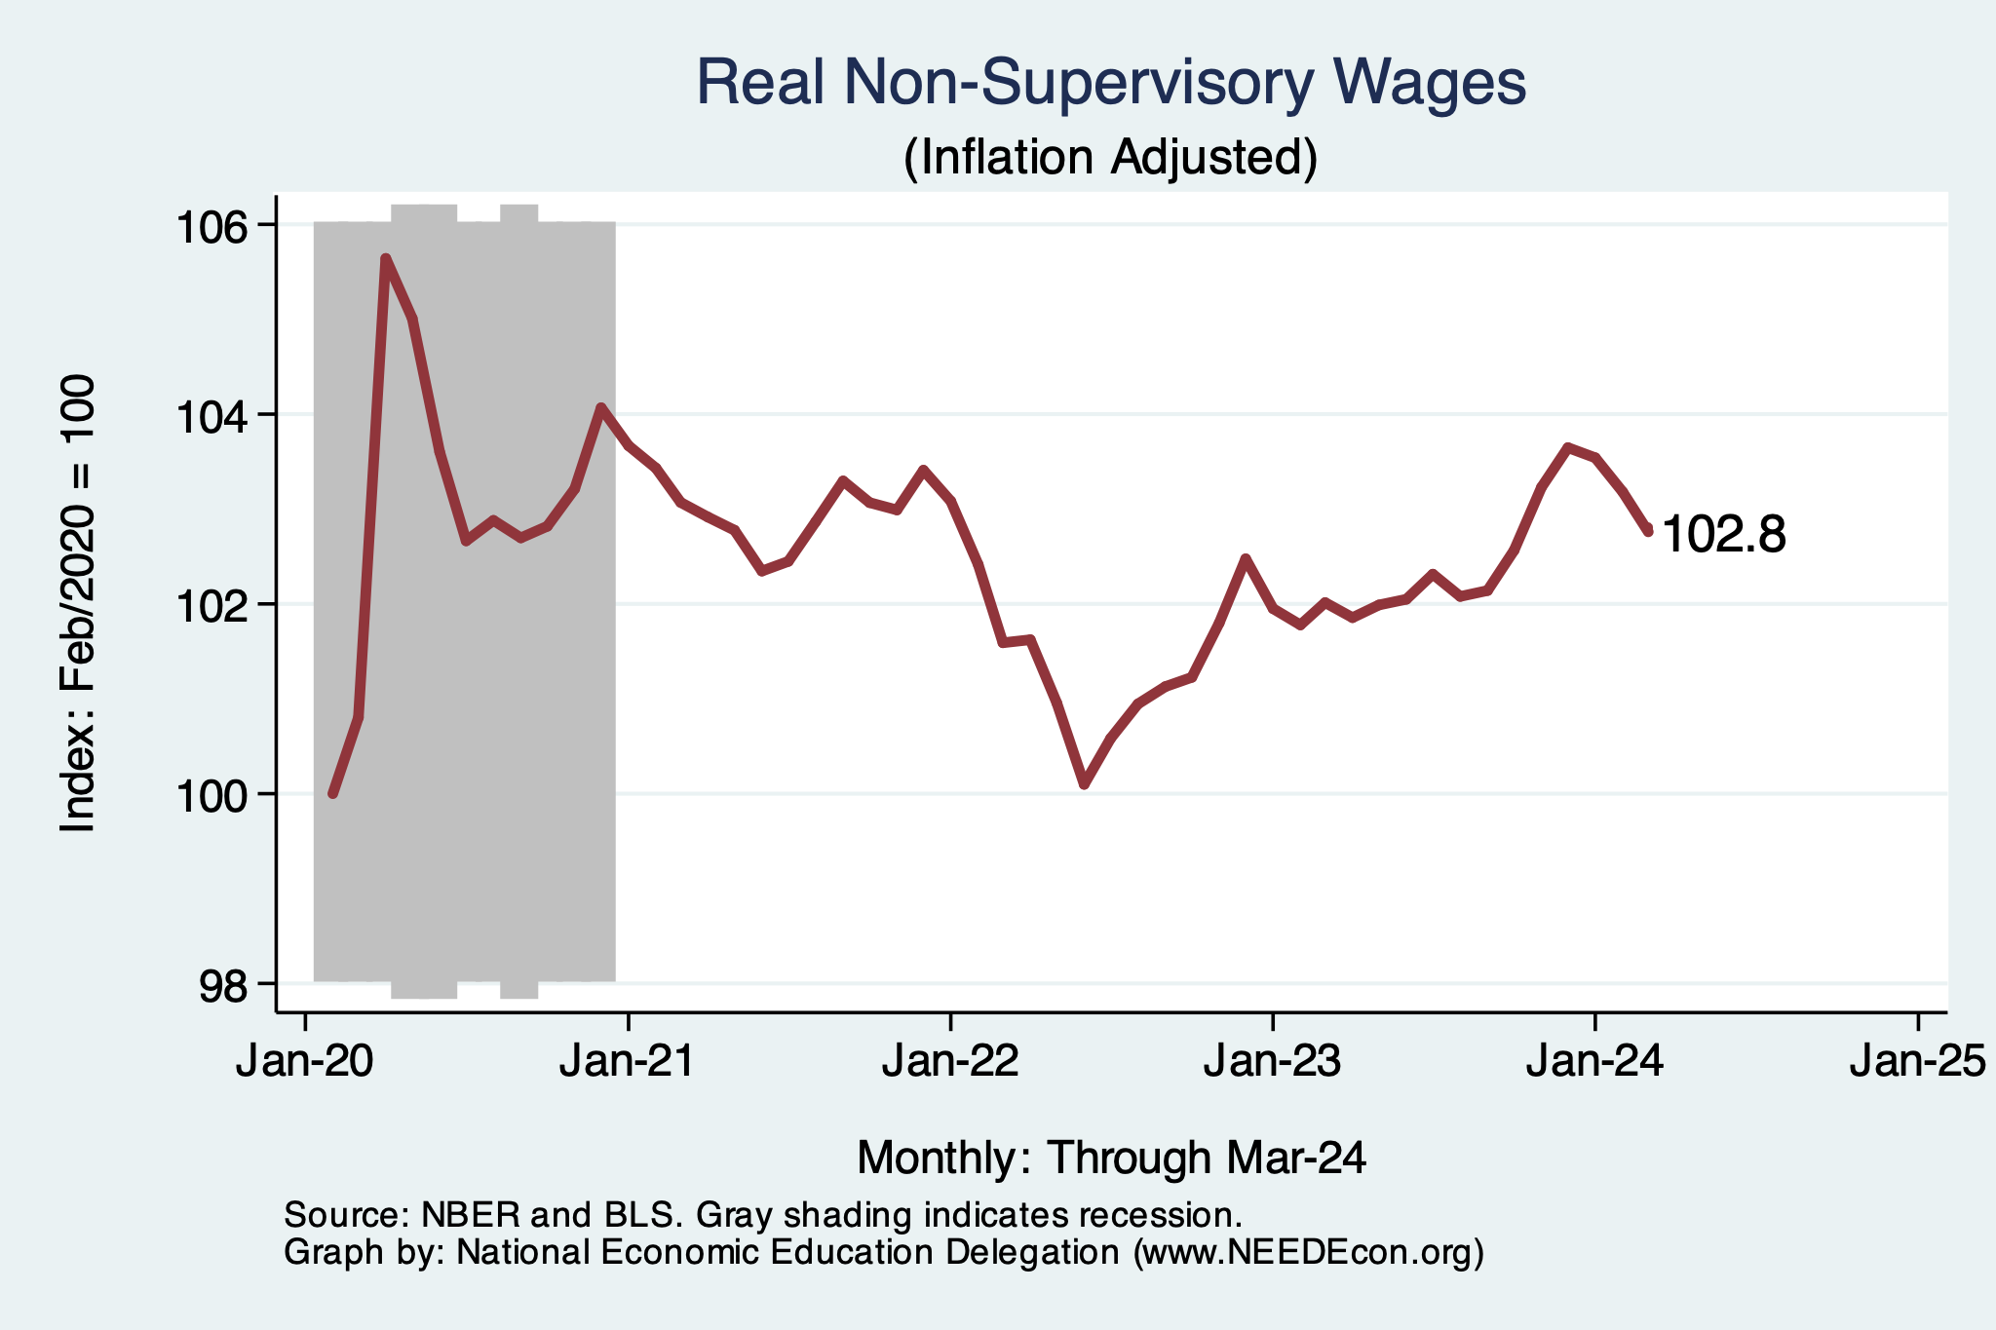
Wage Growth – Exceeds Inflation
Notes:
Is this necessary given the previous slide?

Slide 28
The “Nominal” Side
Inflation: A lot of progress on inflation, but the recent data are troubling.
But, this is not the popular view

Slide 29
High Prices versus Inflation

Slide 30
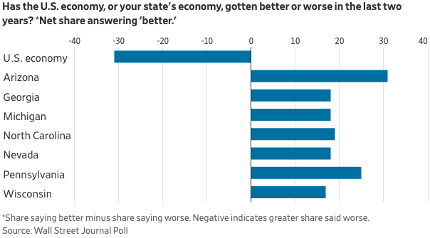
Mismatch: Feelings About the Economy
Source: What’s Wrong With the Economy? It’s You, Not the Data

Slide 31
The Fed: Conservative

Slide 32
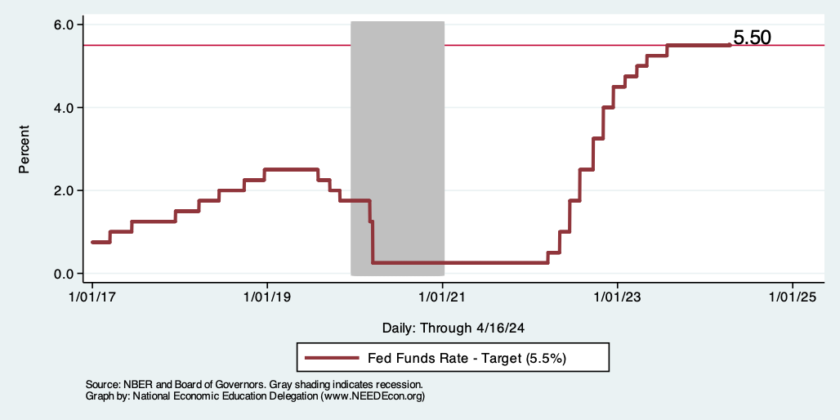
Federal Funds Rate
Notes:
The fed funds rate is the interest rate on overnight loans between banks. Think of it as the baseline interest rate on which banks base all other interest rates (e.g. mortgage rates)
FOMC lowers the fed funds rate during recessions and raises the fed funds rate during expansions
Fed funds rate peaked in the 1980s as then Chairman Paul Volcker sought to reign in “run away” inflation of the 1970s; doing so resulted in a recession in the early 1980s.
Since the 2008-09 recession, the fed funds rate has been kept near zero.
During the 2008-09 recession, Federal Reserve turned to unconventional tools to influence longer term interest rates to further stimulate the economy - QE
FedFunds.png

Slide 33
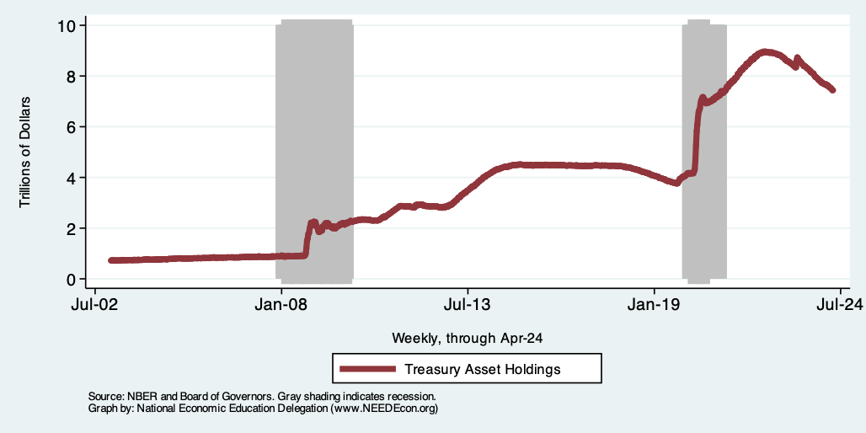
Fed: Reducing its Asset Holdings
Quantitative Tightening

Slide 34
What will the Fed Do?
Pending Developments:
Friday, April 26, BEA releases March PCE inflation
Wednesday May 1, next Fed Policy Meeting
May- June 12 full set of inflation and unemployment for April.
Wednesday, June 12 Fed policy meeting with new economic projections
Notes:
GDPNow 2.4%; blue chips consensus 1.5% implies 2.9%, or 2.7%

Slide 35
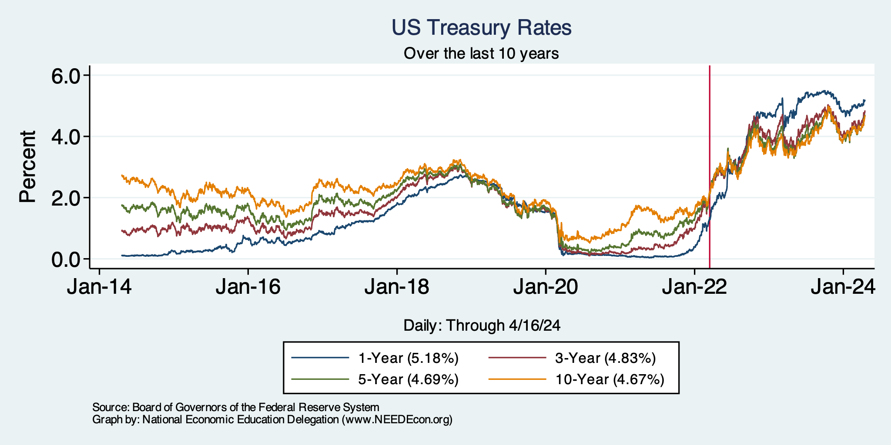
Treasuries
Notes:
treas_recent.png

Slide 36
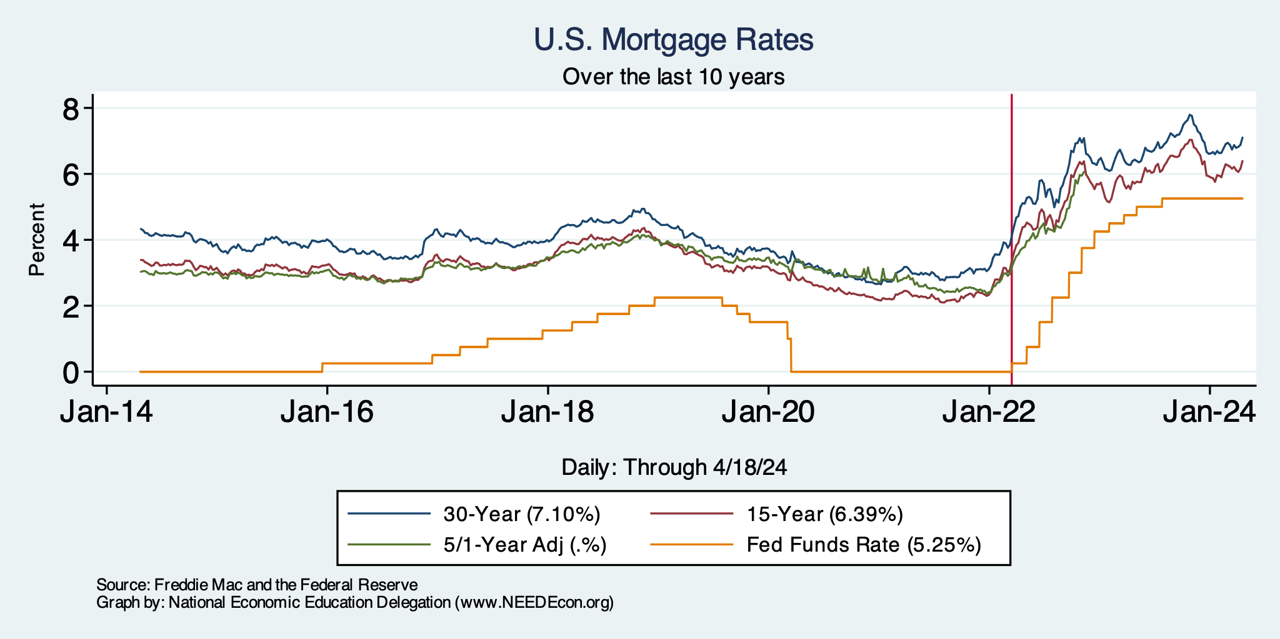
Mortgage Rates

Slide 37
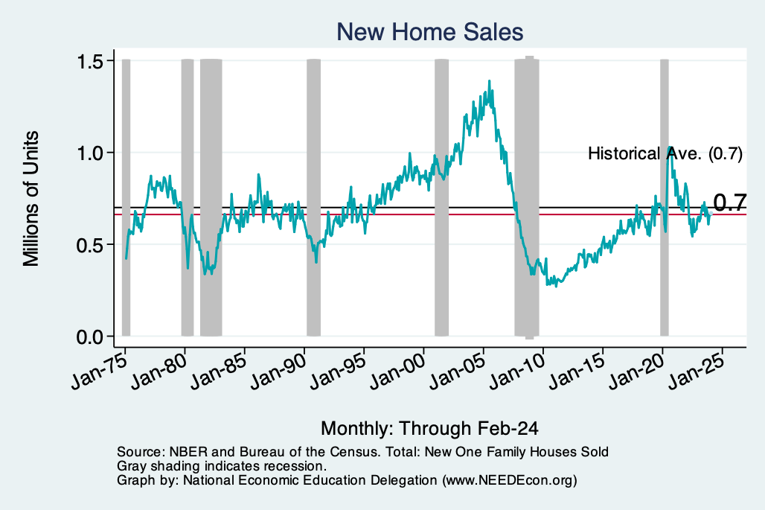
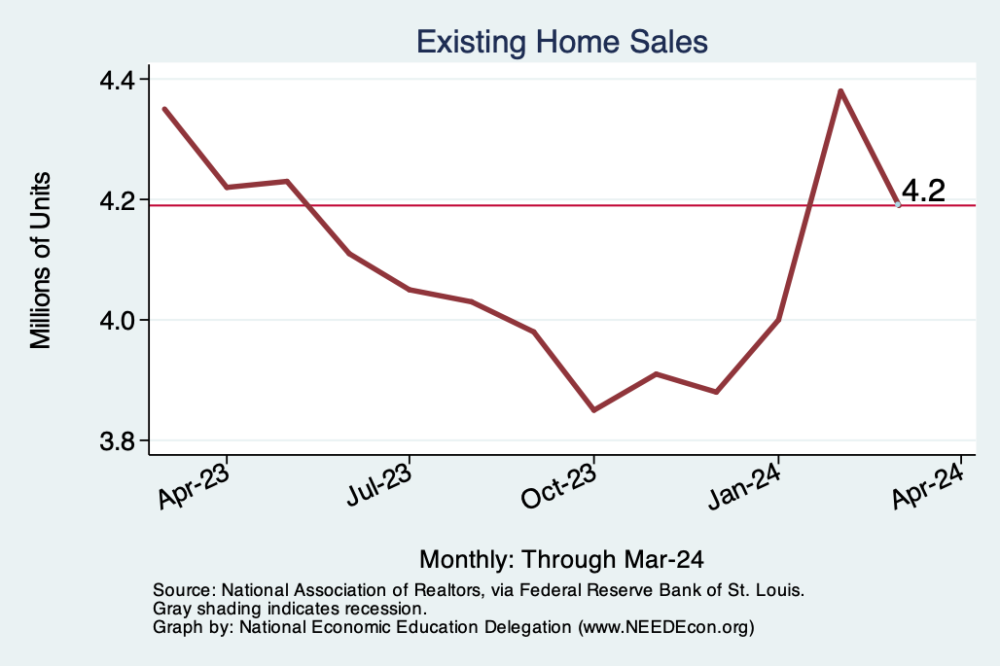
Home Sales are Not Horrible

Slide 38
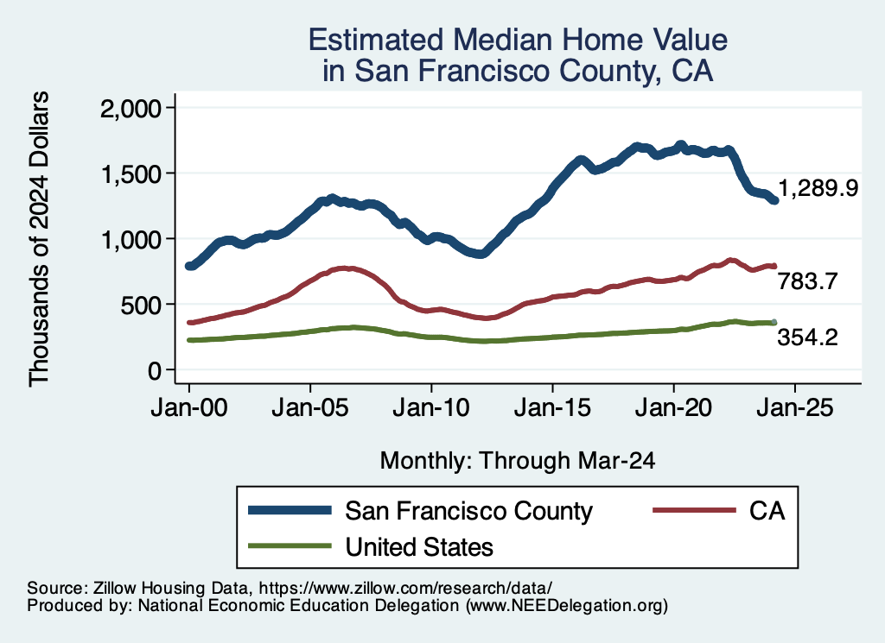
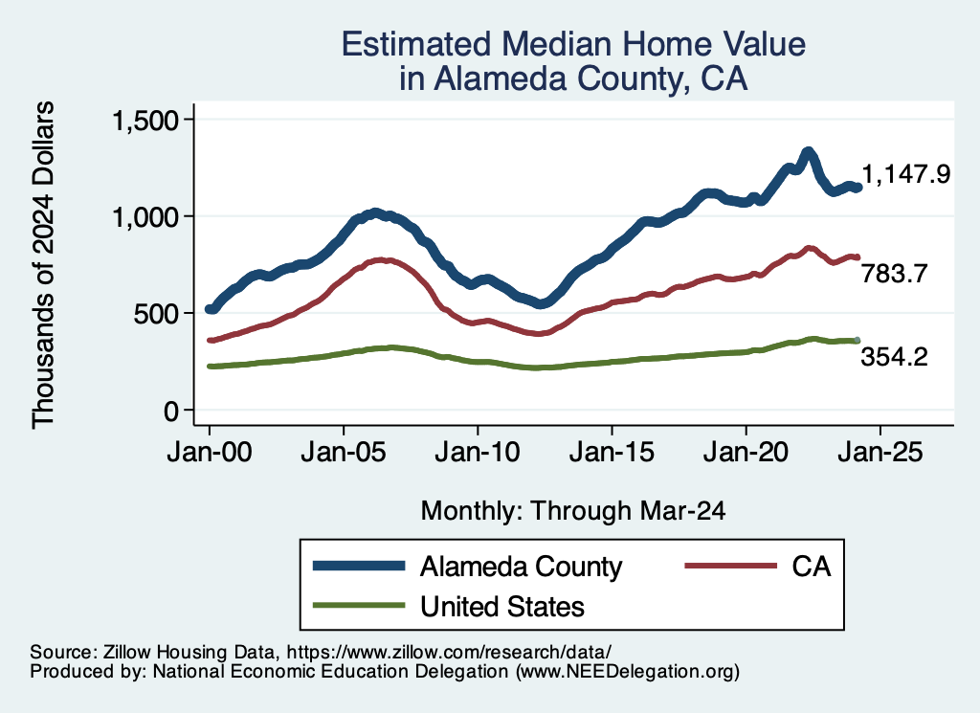
Home Prices … in Northern CA
Notes:
Charts:
homeprices_recession.png
housing.png

Slide 39
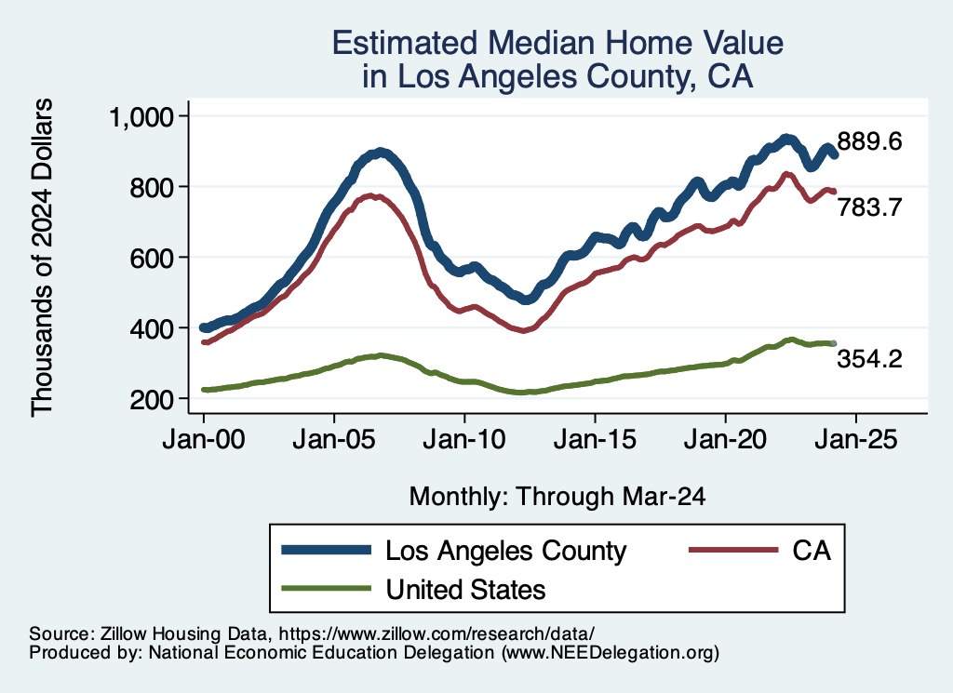
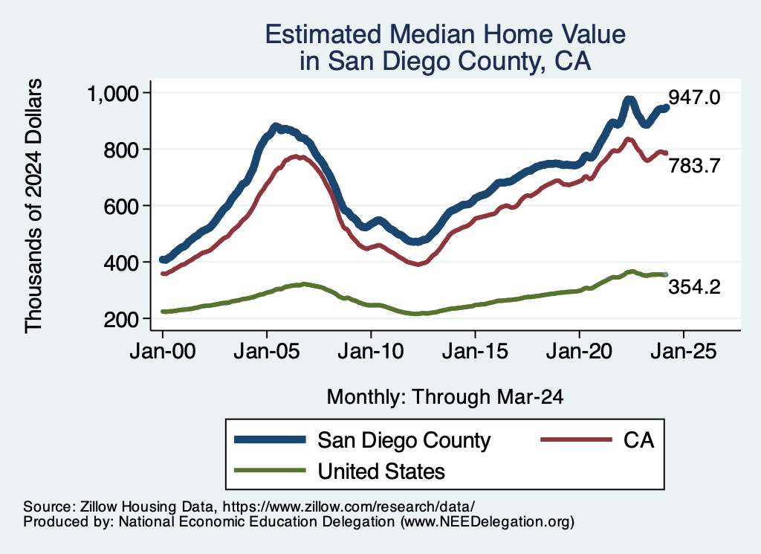
Home Prices … in Southern CA
Notes:
Charts:
homeprices_recession.png
housing.png

Slide 40
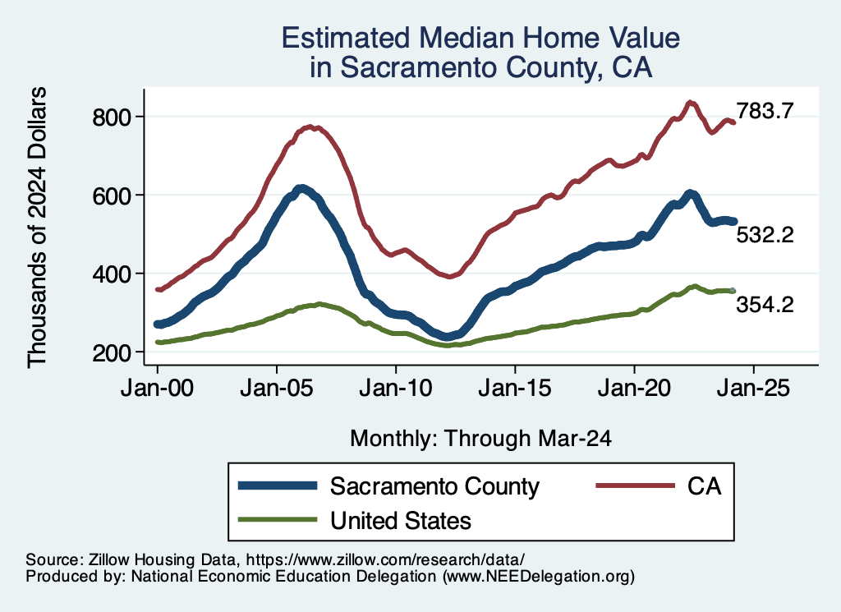
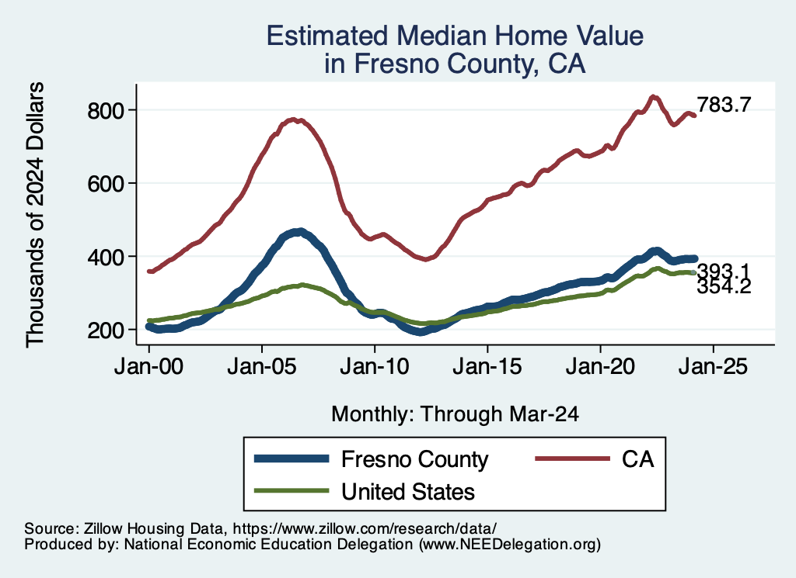
Home Prices … in The Central Valley
Notes:
Charts:
homeprices_recession.png
housing.png

Slide 41
If you’d like to see other geographies….
I have these graphs for all CA counties and cities.
I also have graphs of rents for cities.
If you would like some other geography, just let me know:
Jon@NEEDEcon.org

Slide 42
Takeaways
Is a recession on the horizon?
  No.
  Many indicators are in the black.
    2023 2nd half GDP growth was pretty good
Inflation
  Certainly trending in the wrong direction.
  Not worried about it.
    Driven by housing and insurance.
  Fed policy will continue to push against it.
  Likely to recover 2%ish by middle of next year.

Slide 43
Uncertainties
Conflicts in Ukraine and Israel.
  Global Supply Chains?
  Oil Prices?
  Aid to Ukraine and Israel?
    Total world aid $380 billion of which US total is $45 Billion.
Asset prices (stocks)
Household balance sheets
Fed Actions in a Political Year.

Slide 44
Thank you!
Any Questions?
www.NEEDEcon.org
Jon D. Haveman
Jon@NEEDEcon.org
Contact NEED: info@NEEDEcon.org
Submit a testimonial: www.NEEDEcon.org/testimonials.php
Become a Friend of NEED: www.NEEDEcon.org/friend.php

Slide 45
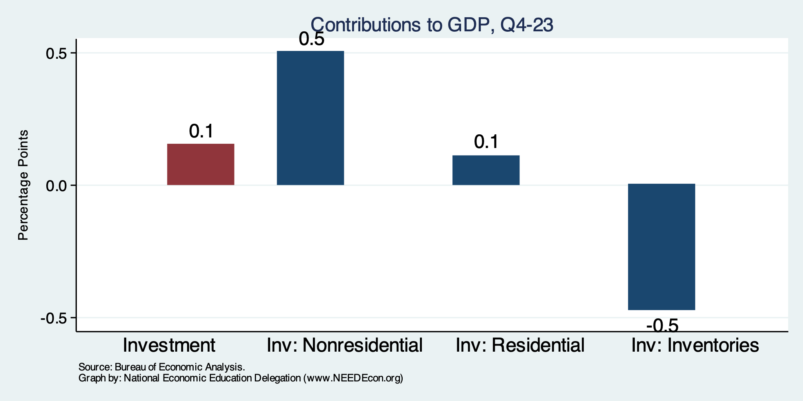
Sources of Investment’s Contribution
Normally
0.1%
Normally
0.5%
Normally
0.7%
Normally
0.6%

Slide 46
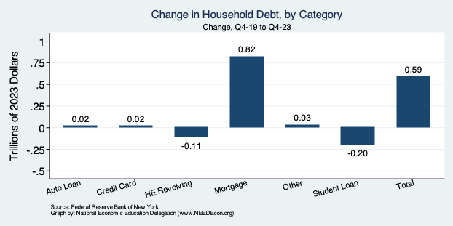
Household Debt: Change During the Pandemic

Slide 47
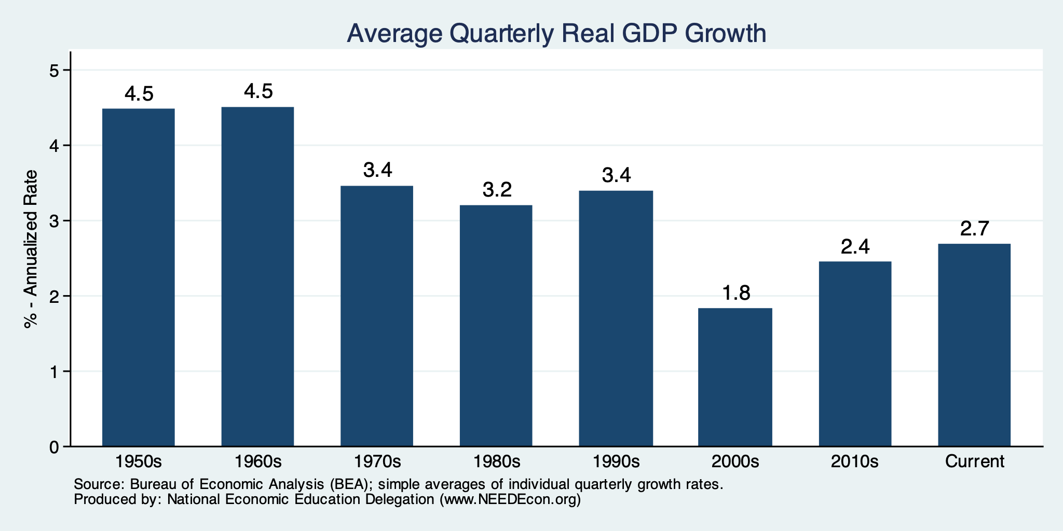
GDP Growth is Still Low

Slide 48
A Little Provocative: How do we drive growth?
Allow more immigration.
Develop a pro-growth immigration policy.
Invest:
  In people – education and safety net.
  In infrastructure.
  In knowledge – basic R&D.
  In a clean economy
Fix health care.

Slide 49
Is Immigration Saving the Day?
Source: https://www.axios.com/2024/03/13/immigration-economy-jobs-growth-good#

