Slide 1
Osher Lifelong Learning Institute, Winter 2022
Contemporary Economic Policy
Oklahoma State University
February-March, 2022
Jon Haveman, Ph.D.
National Economic Education Delegation

Slide 2
Course Outline
Contemporary Economic Policy
  Week 2 (2/15): US Economy & Coronavirus Economics
  Week 3 (2/22): Climate Change Economics (Simone Wegge, CUNY)
  Week 4 (3/1): Immigration Economics (Roger White, Whittier College)
  Week 5 (3/8): Infrastructure Economics (Mallika Pung, Univ. of New Mexico)
  Week 5 (3/15): Trade and Globalization (Alan Deardorff, Univ. of Michigan)
  Week 6 (3/22): The Black-White Wealth Gap (Me)

Slide 3
Submitting Questions
Please submit questions in the chat.
  I will try to handle them as they come up, but may take them in a bunch as time permits.
We will do a verbal Q&A once the material has been presented.
  And the questions in the chat have been addressed.

Slide 4
Trade and Globalization
Alan Deardorff
University of Michigan

Slide 5
Trade and Globalization
Alan V. Deardorff
University of Michigan
Presentation to Osher Lifelong Learning Institute
Oklahoma State University
March 15, 2022

Slide 6
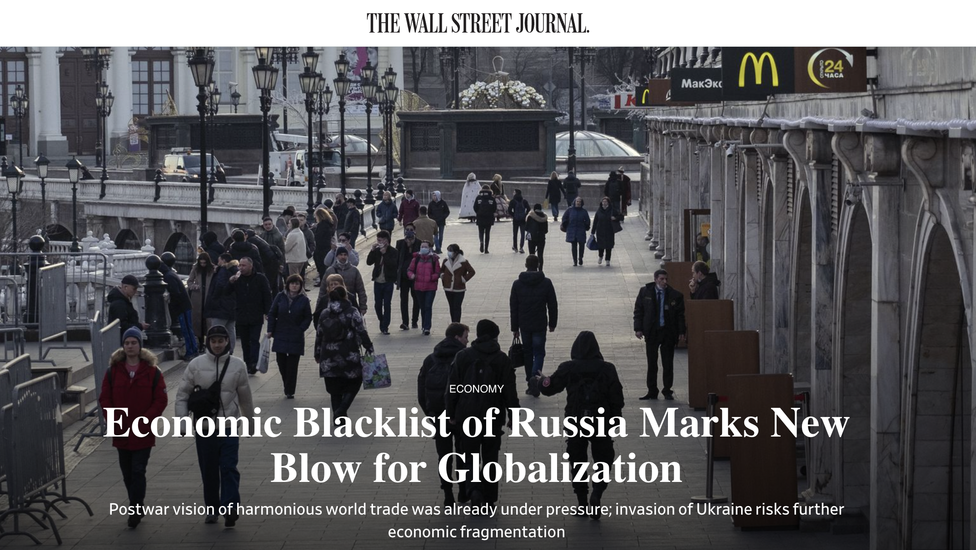
March 10, 2022
Notes:
Josh Zumbrun, “Economic Blacklist of Russia Marks New Blow for Globalization,” Wall Street Journal, March 10, 2022
https://www.wsj.com/articles/economic-blacklist-of-russia-marks-new-blow-for-globalization-11646940040?mod=itp_wsj&ru=yahoo

Slide 7
Impact of Russia-Ukraine War
How Russia-Ukraine war impacts globalization
  War itself disrupts trade, especially exports of
    Ukraine: wheat
    Russia: wheat, oil
  Economic sanctions by governments disrupt
    Financial linkages
    Trade
  Private companies stop dealing with Russia

Slide 8
Impact of Russia-Ukraine War
Financial sanctions by US, EU, UK, and others
  Frozen foreign-held assets of individuals, Putin and dozens of others
  Restrictions on Russia’s Central Bank’s use of international reserves
  Several Russian banks removed from the Swift international payments system
  Cut off many Russian banks from transactions and operations
  Long list of Russian companies banned or restricted
  Possible restrictions on Russia borrowing from IMF and World Bank
Notes:
Eir Noisoe and Valentina Pop, “Russia sanctions list: What the west imposed over the Ukraine invasion,” Financial Times, March 4, 2022.
https://www.ft.com/content/6f3ce193-ab7d-4449-ac1b-751d49b1aaf8

Slide 9
Impact of Russia-Ukraine War
Trade sanctions by governments
  Oil and other energy
    Germany puts Nord Stream 2 gas pipeline on hold
    US bans from Russia
    UK to phase out Russian oil by end of 2022
    EU to become independent from Russia by 2030
  EU bans steel imports from Russia
  US restricts exports to Russia, especially technology and military; later also to Belarus; later also luxury goods
  EU and UK impose export restrictions similar to US
  Ban on Russian air carriers by Canada, EU, US, UK
  G-7 to revoke Russia’s most favored nation status
    Permits them to raise tariffs on Russian goods
Notes:
https://bis.doc.gov/index.php/policy-guidance/country-guidance/russia-belarus

Slide 10
Impact of Russia-Ukraine War
Private Companies Stop Dealing in Russia, per NBC News Mar 11:
  Automotive: Ford, GM, Toyota, …
  Aviation: Airbus, Boeing, American, Delta, United, …
  Energy: BP, ExxonMobil, Shell
  Equipment: Caterpillar, Honeywell, Deere
  Food & Bev: Burger King, Coke, McDonalds, Starbucks,…
  Finance: Citigroup, Deutsche Bank, Vanguard, …
  Consumer goods: Proctor & Gamble, Unilever, Mars, …
  Leisure: Airbnb, Hilton, Expedia, …
  Logistics: DHL, FedEx, Maersk, UPS
  Media: Netflix, Roku, Disney, …
  Payment services: Amex, Visa, Western Union, …
  And many more: Consulting, Retail, Technology
Notes:
Haley Messenger and Noah Sheidlower, “Which companies have stopped doing business with Russia?” NBC News, updated Mar 11, 2022.
https://www.nbcnews.com/business/business-news/companies-stopped-business-russia-rcna19006

Slide 11
Outline
What is Globalization?
Pros and Cons of Trade
Trade Policies
The Role of Trade Agreements
(Effects of the Pandemic)

Slide 12
What Globalizations Is
Growth over time of many interactions between countries
  Trade
  Global Value Chains
  Foreign Direct Investment
  Financial Flows
  International Travel
  Migration
I will focus here on trade

Slide 13
Trade

Slide 14

Notes:
Our World in Data
https://ourworldindata.org/trade-and-globalization

Slide 15

Notes:
Our World in Data
https://ourworldindata.org/trade-and-globalization

Slide 16
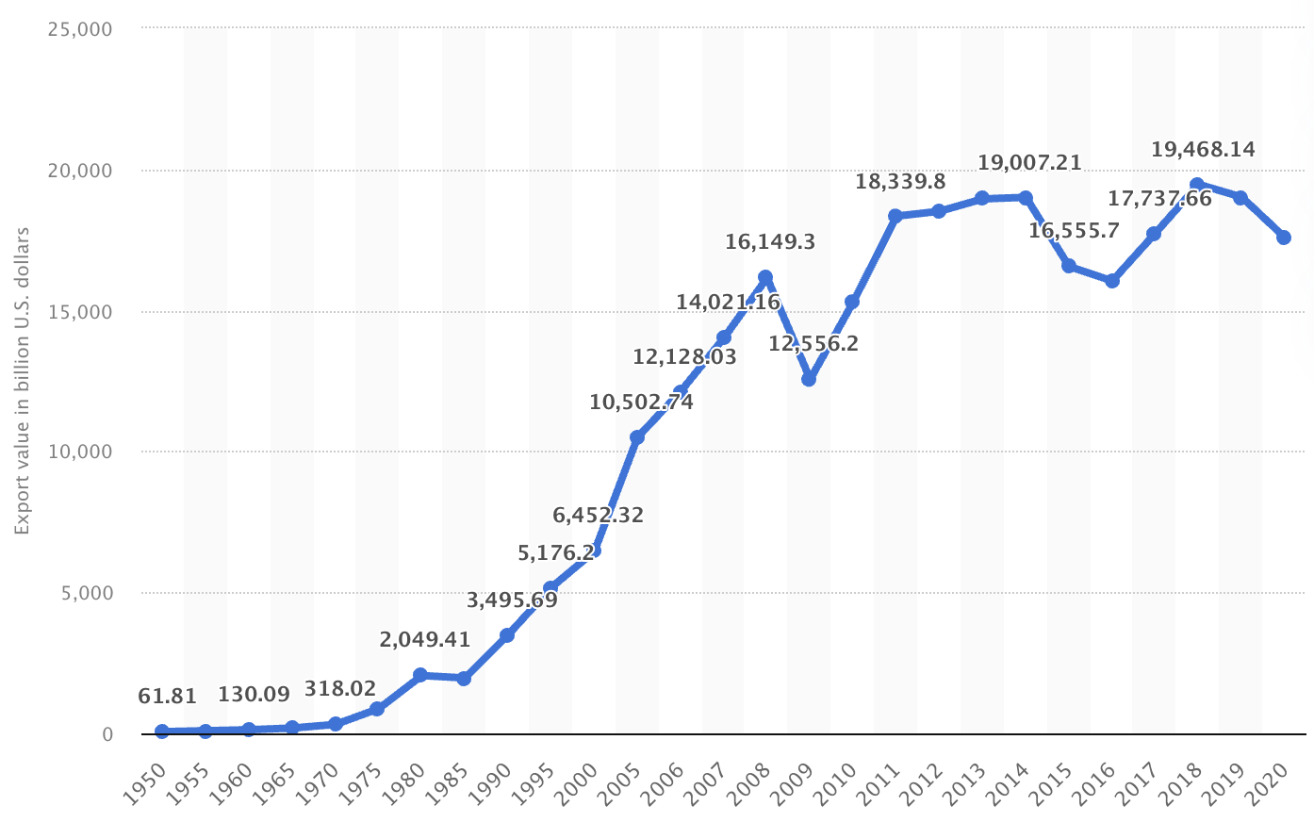
Export Volume Worldwide in Billions of US Dollars, 1950-2020
Source: Statista
Notes:
Statista
https://www.statista.com/statistics/264682/worldwide-export-volume-in-the-trade-since-1950/

Slide 17
Global Value Chains

Slide 18
Effects on Economies
Supply Chains
  Globalization has created long and complex international supply chains

Slide 19

NAFTA and the Auto Supply Chain
Black, Diamond, and Merrill, “One Tiny Widget’s Dizzying Journey Shows Just How Critical Nafta Has Become,” Bloomberg, February 2, 2017.

Slide 20

NAFTA and the Auto Supply Chain
Black, Diamond, and Merrill, “One Tiny Widget’s Dizzying Journey Shows Just How Critical Nafta Has Become,” Bloomberg, February 2, 2017.

Slide 21

NAFTA and the Auto Supply Chain
Black, Diamond, and Merrill, “One Tiny Widget’s Dizzying Journey Shows Just How Critical Nafta Has Become,” Bloomberg, February 2, 2017.

Slide 22

NAFTA and the Auto Supply Chain
Black, Diamond, and Merrill, “One Tiny Widget’s Dizzying Journey Shows Just How Critical Nafta Has Become,” Bloomberg, February 2, 2017.

Slide 23

NAFTA and the Auto Supply Chain
Black, Diamond, and Merrill, “One Tiny Widget’s Dizzying Journey Shows Just How Critical Nafta Has Become,” Bloomberg, February 2, 2017.

Slide 24

NAFTA and the Auto Supply Chain
Black, Diamond, and Merrill, “One Tiny Widget’s Dizzying Journey Shows Just How Critical Nafta Has Become,” Bloomberg, February 2, 2017.

Slide 25

Growth of Global Value Chains, 1970-2015
Source: World Development Report 2020
Notes:
World Bank
https://www.worldbank.org/en/publication/wdr20

Slide 26

Countries mentioned:
China
France
Italy
Japan
Malaysia
Singapore
Spain
Vietnam
Source: World Development Report 2020
Notes:
World Bank
https://www.worldbank.org/en/publication/wdr20

Slide 27
Supply Chains
Example: The iPhone assembled in China from parts:
Part | Come from
﻿Accelerometers | ﻿Germany, the US, South Korea, China, Japan, and Taiwan.
﻿Audio chips | ﻿US, UK, China, South Korea, Taiwan, Japan, and Singapore.
﻿Batteries | ﻿Samsung (South Korea), which has factories in eighty countries.
﻿Cameras | ﻿Qualcomm (US) and Sony (Japan), both with plants in many countries
﻿Chips ﻿for 3G/4G/LTE networking | ﻿Qualcomm (US)
﻿Compasses | ﻿AKM Semiconductor (Japan) with plants in the US, France, England, China, South Korea, and Taiwan.
﻿Glass screen | ﻿Corning (US) with plants in twenty-six countries.
﻿Gyroscopes | Switzerland
… and many more
Source: Krueger 2020, International Trade (What Everyone Needs to Know), p. 254
Notes:
Krueger, Anne O., International Trade (What Everyone Needs to Know) (p. 254). Oxford University Press, 2020

Slide 28

Source: World Bank
Notes:
World Bank
https://www.worldbank.org/en/publication/wdr2020

Slide 29
Pros and Cons of Globalization
Pros and Cons of Globalization
  Gains from Trade
    Theory of Comparative Advantage
    Other Sources of Gain from Trade
  Costs of Trade

Slide 30
Gains from Trade
Theory of Comparative Advantage

Slide 31
Comparative Advantage
The Theory of Comparative Advantage says:
  Countries can gain,
    By producing
      More than they need of what they do relatively best, and
      Less than they need of what they do relatively worst
    And exporting the extra to other countries in exchange for what they need
  By doing that, ALL countries can
    Get more of everything, if that’s what they want, and therefore
    Gain from trade
Illustration with a graph of just 2 countries & 2 goods

Slide 32
Comparative Advantage
If US & UK differ in what they can produce…
Cloth
US
Cloth
UK
Production Possibilities
Food
Food

Slide 33
Comparative Advantage
… Without trade, their consumption will also differ…
Cloth
US
Cloth
UK
Without trade
Consumption =
Production
C^{B}=P^{B}
C^{A}=P^{A}
Food
Food

Slide 34
Comparative Advantage
… With free trade, they specialize in what they do best…
Cloth
US
Cloth
UK
P^{B}
Free Trade
Production
C^{B}=P^{B}
C^{A}=P^{A}
P^{A}
Food
Food

Slide 35
Comparative Advantage
… And can consume more by trading.
Cloth
US
Cloth
UK
P^{B}
Trade
Free Trade
Consumption
C^{B}
C^{A}
C^{B}=P^{B}
Trade
C^{A}=P^{A}
P^{A}
Food
Food

Slide 36
Comparative Advantage
Thus countries both Gain from Trade
Cloth
US
Cloth
UK
P^{B}
Trade
Gain from Trade
C^{B}
C^{A}
C^{B}=P^{B}
Trade
C^{A}=P^{A}
P^{A}
Food
Food

Slide 37
Generality of Comparative Advantage
The Theory of Comparative Advantage requires:
  “Perfect competition” (i.e., all buyers and sellers are very small)
  Absence of market “distortions” (externalities, etc.)
    i.e., reasons why supplies and demands don’t reflect true costs and benefits
The Theory of Comparative Advantage does not require:
  Any limit on numbers of goods, factors, and countries
  That only final goods are traded (thus consistent with supply chains)
  That factors (labor, capital) be immobile between countries
    (However, the gains from trade then accrue to countries including their mobile-factor owners.)

Slide 38
Generality of Comparative Advantage
But note:
  Nothing in the theory says that everyone in each country gains
  Opening to trade requires
    Some industries to shrink or disappear while others expand
    Firms and workers in shrinking industries
      Certainly lose during the transition
      May be permanently worse off
    In example, losers are producers of
      Cloth in US
      Food in UK
Cloth
US
Cloth
UK
P^{B}
C^{B}=P^{B}
C^{A}=P^{A}
P^{A}
Food
Food

Slide 39
Gains from Trade
Other Sources of Gain from Trade

Slide 40
Other sources of Gain from Trade
Productivity (most productive firms expand and export)
Returns to scale (small countries can support larger firms)
Competition (monopolies in small countries lose market power)
Variety (buyers can access more choices)
Supply chains (firms can source parts from cheapest or best sources)
  (That’s really just the above, but within industries and firms.)
Technology (producers get access foreign technologies)

Slide 41
Costs of Trade

Slide 42
But there are Costs
Economic:
  When trade expands (or contracts)
    Some firms lose market share or shut down
    Other firms supplying inputs to those firms shrink or shut down
    Workers in both lose jobs
    Their communities lose customers
  Macroeconomic cost: Vulnerability to foreign recession/inflation
  Dependence on other countries’ willingness to trade
  Vulnerability to trade disruption
    Crisis induced (earthquake, flood, disease, war)
    Policy induced (sanctions, tariffs, export bans)
Non-economic
  Loss of cultural differences
  Spread of invasive species and plant disease
  Spread of human disease

Slide 43
Pause
Pause for
  Questions
  10-Minute Break
Next: Trade Policies

Slide 44
Trade Policies that Affect Globalization
Policies that Encourage It
  Tariff Reductions
  Trade Agreements
  Other
Policies that Discourage It
  Trump’s Tariffs
  Trade War

Slide 45
Policies that Encourage Globalization

Slide 46
Tariff Reductions

Slide 47

Source: Economist
Notes:
From an Economist “Barriers to Entry” article

Slide 48

Reduction in tariffs under GATT/WTO MFN.
G-7 wants to cancel this for Russia
Source: Quartz 2018
Notes:
Quartz, Kopf 2018
https://qz.com/1230399/a-history-of-tariffs-us-protectionism-in-one-230-year-chart/

Slide 49
Trade Agreements

Slide 50
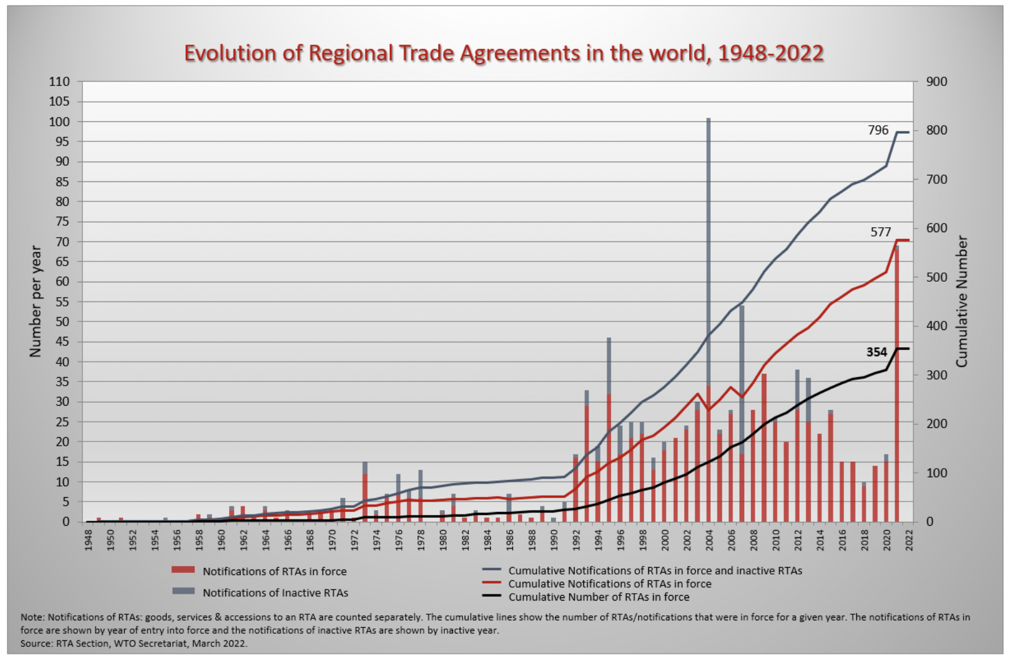
Source: WTO
Notes:
WTO
https://www.wto.org/english/tratop_e/region_e/region_e.htm#facts

Slide 51

European Union
Source: Europa.eu
Notes:
http://europa.eu/european-union/about-eu/money/euro_en

Slide 52

NAFTA (now USMCA)

Slide 53


MERCOSUR

Slide 54

CPTPP
=
Trans-Pacific Partnership minus US

Slide 55
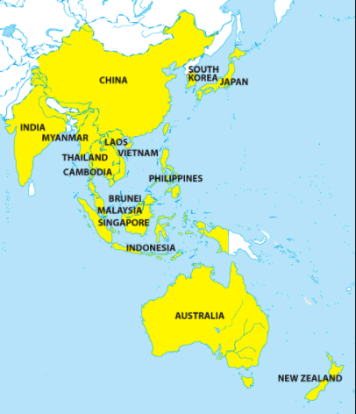
RCEP
=
Regional Comprehensive Economic Partnership
Notes:
China Briefing 2012
https://www.china-briefing.com/news/china-to-join-rcep-creating-massive-free-trade-area-with-asean-india-and-japan/

Slide 56
Other Policies to Encourage Globalization
IMF/World Bank
  Policy advice to open markets (the ”Washington Consensus”)
  Loans to countries conditional on
    Reducing trade barriers
    Permitting capital flows
GATT/WTO (World Trade Organization) [More on this later, if time]
  Negotiate reciprocal trade liberalization
  Settlement of trade disputes (usually about interfering with trade)
Bilateral Investment Treaties
  Better treatment of multinational corporations

Slide 57
Policies that Discourage Globalization

Slide 58
Trump’s Tariffs and Trade War

Slide 59

Source: Flaan & Pierce 2020
Notes:
Flaan and Pierce 2020
https://www.federalreserve.gov/econres/feds/files/2019086pap.pdf

Slide 60

Source: Flaan & Pierce 2020
Notes:
Flaan and Pierce 2020
https://www.federalreserve.gov/econres/feds/files/2019086pap.pdf

Slide 61

Source: CNBC.com
Notes:
SEPTEMBER 18, 2019 | Yen Nee Lee, CNBC.com
http://nbr.com/2019/09/18/these-4-charts-show-how-us-china-trade-has-changed-during-the-tariff-dispute/

Slide 62

Phase One Agreement Reductions Jan 2020
US tariffs on China
Agriculture
Industrial
China tariffs on US
Agriculture
Industrial
Source: Zheng et al. Oct 2021
Notes:
Zheng, Jian, Shudong Zhou, Xingzi Li, Antonio Domingos Padula, Will Martin, “Effects of Eliminating the US-China Trade War Tariffs,” 27 October 2021

Slide 63
Effects of Tariffs

Slide 64
Effects of a tariff
A tariff is a tax on imports. It causes
  A rise in the price of the imported good in the importing country
  A fall in the price of the imported good in the exporting country
  The quantity imported to fall
  The revenue of the tariff-levying government to rise
Almost always: the rise at home is much larger than the fall abroad
  That’s especially true if importing country is small
  But it’s also true if importing country is large, such as U.S.
  Example: Trump’s tariffs caused US prices to rise, with hardly any perceptible fall in prices abroad.

Slide 65
Effects of a tariff
The rise in price in the importing country causes
  A rise in price of competing goods produced there
  Benefits to those producers
  Harm to buyers of both the import and the competing goods
    Including producers that use the higher-priced goods as inputs
      Their prices also rise, hurting their buyers
  Employment changes:
    Increase in the protected industry
    Decrease in industries that use imports as inputs
  Example: Trump’s 25% tariff on steel
    Helps US steel firms and their workers
    Hurts US auto firms and workers
      and many other industries that use steel

Slide 66
Effects of a tariff
The fall in price in the exporting country causes
  Harm to sellers there
  Benefit to buyers there
  Shift of sales to other countries
If the tariff is on exports from only one country (e.g, China)
  Buyers shift to imports from other, more costly, countries (e.g., Vietnam)

Slide 67
Arguments for and against tariffs
If economists are so opposed to tariffs, why are they used?
Arguments for protection
  Many have been used, both past and present
  See the list in my Glossary of International Economics

Slide 68

Arguments for tariffs
National security
Government Revenue
Strategic trade policy
Distribution
Infant Industry
Source: Deardorffs’ Glossary of International Economics

Slide 69
Arguments against tariffs
Arguments against tariffs
  Economic gains from trade (see above)
  Tariffs prompt retaliation
  Some valid arguments for tariffs depend on information that is either
    Unavailable, or
    Available only from the protected industry
  Even when net beneficial, tariffs are politically hard to remove
  Lower tariffs and greater trade reduce the likelihood of war

Slide 70
The Role of Trade Agreements
Countries have negotiated trade agreements throughout history
  At least back to the 1500’s between the Ottoman Empire and the powers of Europe
  The first “free trade agreement” (FTA) was between Britain and France in 1860, soon followed by many more
    Removed tariffs on trade with each other
  US used “reciprocal trade agreements” starting in 1934 to reduce tariffs and dig out of the Great Depression
  US led negotiation of multilateral agreements via
    GATT (General Agreement on Tariffs and Trade) 1948
    WTO (World Trade Organization) 1995

Slide 71
The Role of Trade Agreements
Trade Agreements (both WTO & FTAs)
  Promote trade by
    Reducing tariffs
    Blocking policies that discriminate against imports
  But they also do much else, mostly to serve business interests:
    Permit anti-dumping duties to deter competition
    Protect intellectual property (patents, etc.)
    Allow investor action against governments

Slide 72
The Role of Trade Agreements
WTO
  164 member countries
  Includes
    China since 2001
    Russia since 2012
    Not Iran, N. Korea
  Headquarters Geneva, Switzerland

Slide 73


Slide 74



Slide 75
The Role of Trade Agreements
The WTO has
  Three Parts:
    GATT (Still exists, as largest part of WTO)
      limits tariffs
    GATS = General Agreement on Trade in Services
    TRIPs Agreement = Trade Related aspects of Intellectual Property Rights
  Two Basic Principles
    Most Favored Nation (Don’t discriminate among exporters)
    National Treatment (Don’t discriminate against imports)

Slide 76
The Role of Trade Agreements
The WTO’s Main Functions
  Negotiation of reduced trade barriers
    Tariffs (GATT did this well; WTO not)
    Removal of other barriers
  Dispute settlement
    Countries bring cases against others
    WTO “panels” and “Appellate Body” decide

Slide 77
The Role of Trade Agreements
WTO Dispute Settlement
  There have been 609 cases initiated since 1995 (as of 1/30/22)
  About 90% have been decided in favor of the complainant, both by (132) and against US (168)
  The mechanism has been unable to decided cases since December 10, 2019 when
    President Trump blocked appointments to Appellate Body
    President Biden has not changed this
Notes:
Case counts as of 2/2/22
https://www.wto.org/english/tratop_e/dispu_e/dispu_by_country_e.htm

Slide 78
Effects of the Pandemic
Effects of the Pandemic on Economies
  Travel halted
  Stock markets fell but came back strongly
  Factories shut down
  Supply chains were interrupted
  Trade plummeted but came back

Slide 79
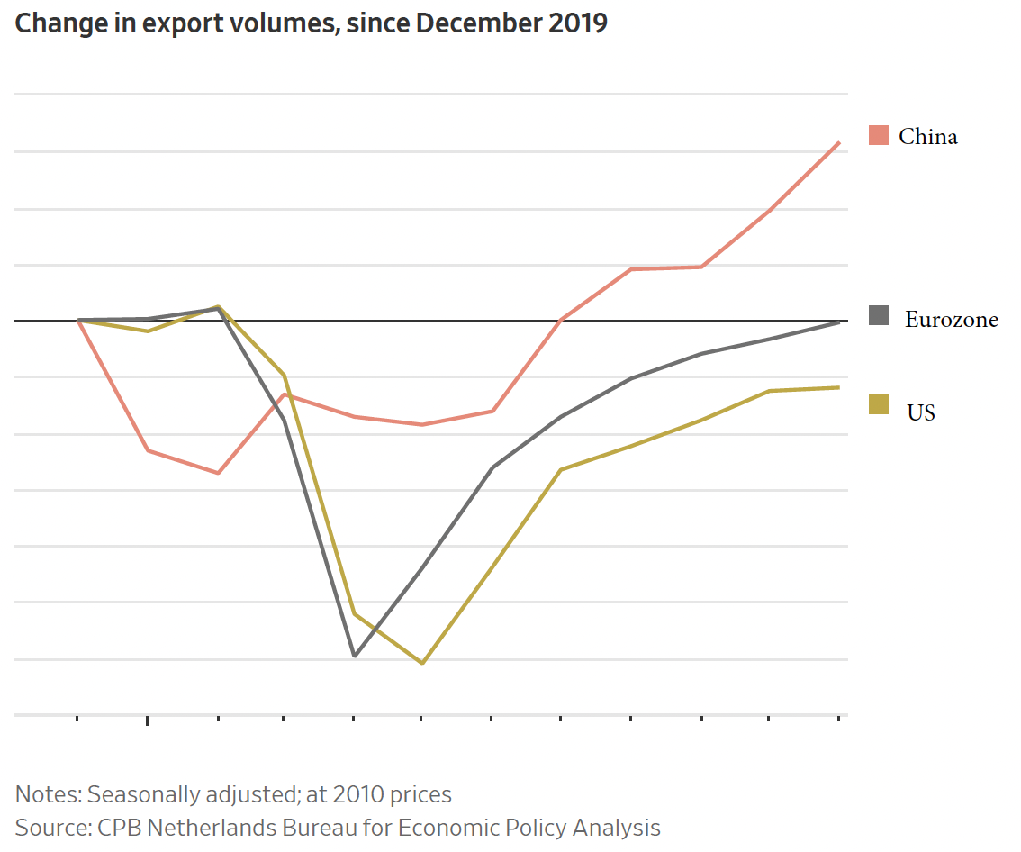
Source: Hannon, WSJ, Feb 25, 2021
Notes:
Hannon, Paul, "Global Trade Roars Back From Depths of Covid-19 Pandemic", Wall Street Journal,, February 25, 2021.

Slide 80
The Pandemic and Globalization
Trade and Covid-19
  Globalization helped it spread
  Trade in PPE and medical supplies helped to fight it
  Trade in vaccines is essential globally
  Trade policies have often interfered

Slide 81
Globalization’s Future?

Slide 82
Globalization’s Future?
Will trade, travel, etc. come back?
  Yes, partly
Will it reach the previous trend
  Probably not.
  It didn’t after the financial crisis
Will attitudes change?
  Yes.
  Firm’s will try to limit exposure
  Consumers will learn to live differently
Will economists’ views of globalization change?
  I think so.
    We still think globalization is good,
    But we’re learning that it needs to include greater protections for those who are hurt.

Slide 83
Thank you!
Thank you!
Any Questions?
Alan V. Deardorff
Ford School of Public Policy
University of Michigan
www.NEEDelegation.org

Slide 84

The B-W Wealth Gap
Mean is
7x Greater
Median is 8x Greater

Slide 85
Thank you!
Any Questions?
www.NEEDelegation.org
Alan Deardorff
alandear@umich.edu
Contact NEED: info@NEEDelegation.org
Submit a testimonial: www.NEEDelegation.org/testimonials.php
Become a Friend of NEED: www.NEEDelegation.org/friend.php

