Slide 1
Osher Lifelong Learning Institute, Fall 2023
Contemporary Economic Policy
West Virginia University
Fall, 2023
Jon Haveman, Ph.D.
National Economic Education Delegation

Slide 2
Available NEED Topics Include:
US Economy
Healthcare Economics
Climate Change
Economic Inequality
Economic Mobility
Trade and Globalization
Minimum Wages
Immigration Economics
Housing Policy
Federal Budgets
Federal Debt
Black-White Wealth Gap
Autonomous Vehicles
US Social Policy

Slide 3
Course Outline
Contemporary Economic Policy
  Week 1 (10/6): Economic Update (Geoffrey Woglom, Amherst College)
  Week 2 (10/13): Trade and Globalization (Avik Chakrabarti, U of Wisconsin Milwaukee)
  Week 3 (10/27): Economics of Immigration (Robert Gitter, Ohio Wesleyan)
  Week 4 (11/3): Monetary Policy (Geoffrey Woglom ,Amherst College)
  Week 5 (11/10): Federal Debt (Joseph Carolan, Oakland University)
  Week 6 (11/17): International Institutions (Alan Deardorff University of Michigan)

Slide 4
Submitting Questions
A verbal Q&A session will follow this presentation.
Slides will be available from the NEED website (https://needelegation.org/delivered_presentations.php)

Slide 5
Credits and Disclaimer
This slide deck was authored by:
  Avik Chakrabarti, University of Wisconsin-Milwaukee (UWM)
  Peter Eppinger, University of Tübingen
  James Lake, Southern Methodist University
  Michael Plouffe, University College London
  Swati Verma, ISID, New Delhi
This slide deck was reviewed by:
  Alan Deardorff, University of Michigan
  Ed Leamer, UCLA
Disclaimer
  NEED presentations are designed to be nonpartisan.
  It is, however, inevitable that the presenter will be asked for and will provide their own views.
  Such views are those of the presenter and not necessarily those of the National Economic Education Delegation (NEED).

Slide 6
Trade and Globalization
OLLI – West Virginia University
October 13, 2023
Avik Chakrabarti, Ph.D., University of Michigan, Ann Arbor
Associate Professor of Economics, University of Wisconsin-Milwaukee (UWM)
Affiliated Faculty, Northwestern Mutual Data Science Institute (NMDSI), UWM

Slide 7
What is Globalization?
The growing integration of the world’s:
  Economies
  Cultures
  Populations
Brought about by cross-border flows of:
  Goods and services
  Technology
  Investment
  People
  Information

Slide 8
What is Globalization
  Global Value Chains
TRADE
  Foreign Direct Investment
  Financial Flows
  Migration
  International Travel

Slide 9

Notes:
Our World in Data
https://ourworldindata.org/trade-and-globalization

Slide 10
What Drives Globalization?
Reduction in Transportation Costs
Advances in Technology
Cooperation across Countries

Slide 11
Global Value Chains
(GVCs)

Slide 12

Growth of Global Value Chains, 1970-2015
Source: World Development Report 2020
Notes:
World Bank
https://www.worldbank.org/en/publication/wdr20

Slide 13

NAFTA and the Auto Supply Chain
Black, Diamond, and Merrill, “One Tiny Widget’s Dizzying Journey Shows Just How Critical Nafta Has Become,” Bloomberg, February 2, 2017.

Slide 14

NAFTA and the Auto Supply Chain
Black, Diamond, and Merrill, “One Tiny Widget’s Dizzying Journey Shows Just How Critical Nafta Has Become,” Bloomberg, February 2, 2017.

Slide 15

NAFTA and the Auto Supply Chain
Black, Diamond, and Merrill, “One Tiny Widget’s Dizzying Journey Shows Just How Critical Nafta Has Become,” Bloomberg, February 2, 2017.

Slide 16

NAFTA and the Auto Supply Chain
Black, Diamond, and Merrill, “One Tiny Widget’s Dizzying Journey Shows Just How Critical Nafta Has Become,” Bloomberg, February 2, 2017.

Slide 17

NAFTA and the Auto Supply Chain
Black, Diamond, and Merrill, “One Tiny Widget’s Dizzying Journey Shows Just How Critical Nafta Has Become,” Bloomberg, February 2, 2017.

Slide 18

NAFTA and the Auto Supply Chain
Black, Diamond, and Merrill, “One Tiny Widget’s Dizzying Journey Shows Just How Critical Nafta Has Become,” Bloomberg, February 2, 2017.

Slide 19

Countries mentioned:
China
France
Italy
Japan
Malaysia
Singapore
Spain
Vietnam
Source: World Development Report 2020
Notes:
World Bank
https://www.worldbank.org/en/publication/wdr20

Slide 20
Supply Chains
Example: The iPhone assembled in China from parts:
Part | Come from
﻿Accelerometers | ﻿Germany, the US, South Korea, China, Japan, and Taiwan.
﻿Audio chips | ﻿US, UK, China, South Korea, Taiwan, Japan, and Singapore.
﻿Batteries | ﻿Samsung (South Korea), which has factories in eighty countries.
﻿Cameras | ﻿Qualcomm (US) and Sony (Japan), both with plants in many countries
﻿Chips ﻿for 3G/4G/LTE networking | ﻿Qualcomm (US)
﻿Compasses | ﻿AKM Semiconductor (Japan) with plants in the US, France, England, China, South Korea, and Taiwan.
﻿Glass screen | ﻿Corning (US) with plants in twenty-six countries.
﻿Gyroscopes | Switzerland
… and many more
Source: Krueger 2020, International Trade (What Everyone Needs to Know), p. 254
Notes:
Krueger, Anne O., International Trade (What Everyone Needs to Know) (p. 254). Oxford University Press, 2020

Slide 21

Source: World Bank
Notes:
World Bank
https://www.worldbank.org/en/publication/wdr2020

Slide 22
Pros and Cons of Globalization
Pros and Cons of Globalization
  Mutually Beneficial Trade
    Comparative Advantage
    Other Sources of Gains from Trade
  Costs of Trade

Slide 23

Mutually Beneficial Trade based on
Comparative Advantage

Slide 24
Comparative Advantage
The Principle of Comparative Advantage says:
  Countries can gain by
    Producing
      More than they need of what they do relatively best, and
      Less than they need of what they do relatively worst
    Exporting any excess to other countries in exchange for what they need
  All countries can
    Get more of everything, if that’s what they want, and therefore
    Gain from trade

Slide 25

Comparative Advantage

Slide 26
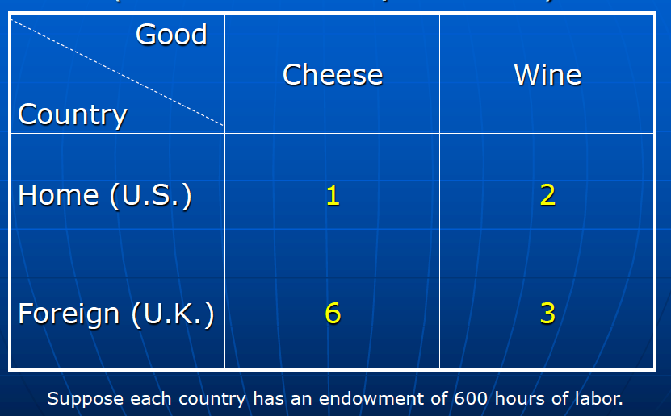
Paul Krugman’s illustration of
David Ricardo’s Principle of Comparative Advantage

Slide 27
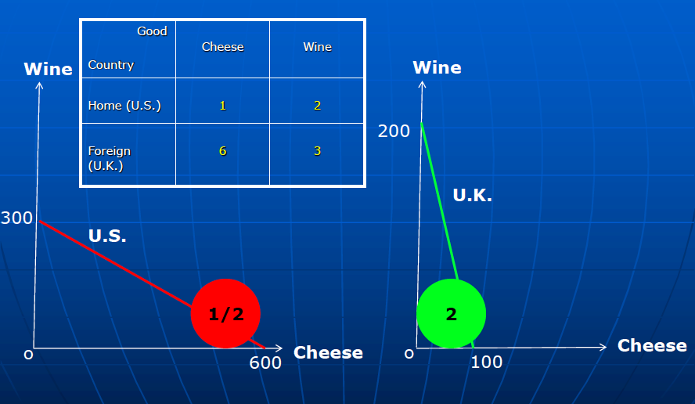
The Principle of Comparative Advantage

Slide 28
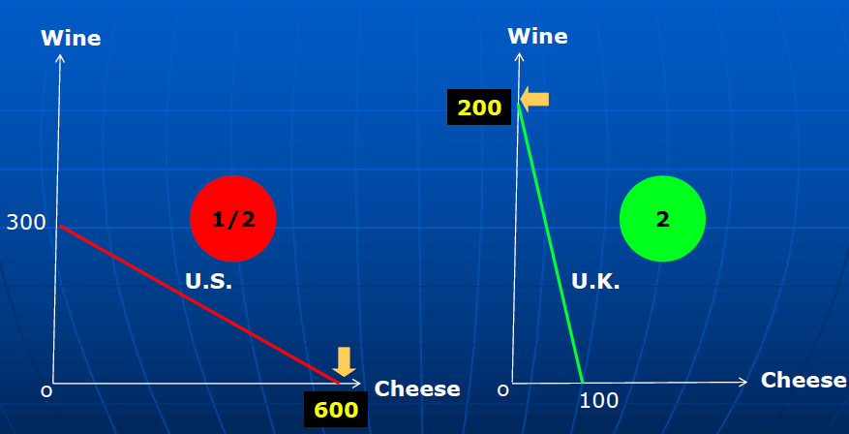
Specialization

Slide 29
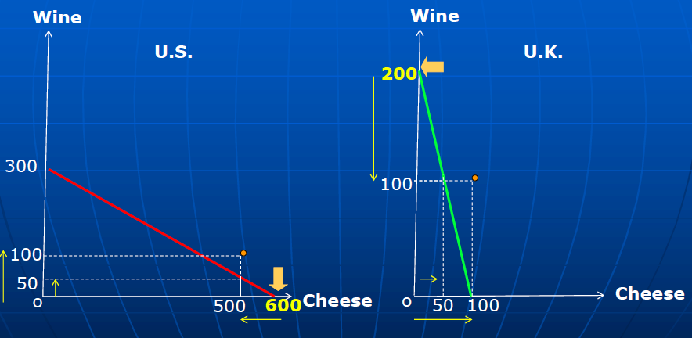
Mutually Beneficial Trade

Slide 30
Comparative Advantage
Without a mechanism for redistribution …
  Nothing in the theory says that everyone in each country gains
  Opening to trade requires
    Some industries to shrink or disappear while others expand
    Firms and workers in shrinking industries
      Certainly lose during the transition
      May be permanently worse off

Slide 31
Gains from Trade
Other sources of Gain from Trade

Slide 32
Other sources of Gain from Trade
Returns to scale (small countries can support larger firms)
Increased competition (monopolies in small countries lose market power)
Variety (buyers, both consumers and firms, can have more choices)
Efficiency (relatively productive firms expand and export)
Supply chains (firms can source parts from cheapest or best sources)
Learning (firms can have access to foreign technology)

Slide 33
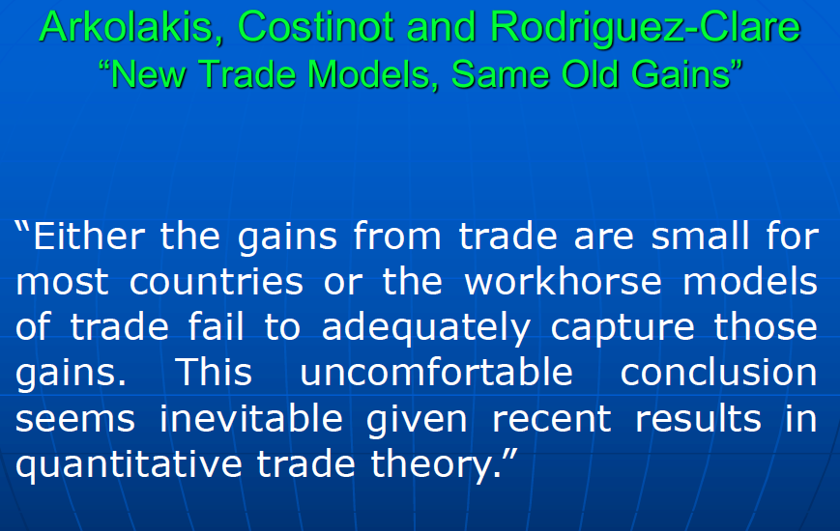
Other sources of Gain from Trade

Slide 34
Costs of Trade

Slide 35
But there are Costs
Economic:
  When trade expands (or contracts)
    Some firms lose market share or shut down
    Other firms supplying inputs to those firms shrink or shut down
    Workers in both lose jobs
    And their communities lose customers
  Macroeconomic cost: Vulnerability to foreign recession/inflation
  Dependence on other countries’ willingness to trade
  Vulnerability to trade disruption
    Crisis induced (earthquake, flood, disease, war)
    Policy induced (sanctions, tariffs, export bans)
Non-economic
  Loss of cultural differences
  Spread of invasive species and plant disease
  Spread of human disease

Slide 36
Trade Policies

Slide 37
Trade Policies that Affect Globalization
Policies that Encourage It
  Tariff Reductions
  Trade Agreements
  Other
Policies that Discourage It
  Tariffs
  Trade War

Slide 38
Trade Policies Encouraging Globalization

Slide 39
Tariff Reductions

Slide 40

Source: Economist
Notes:
From an Economist “Barriers to Entry” article

Slide 41

Reduction in tariffs under GATT/WTO MFN.
G-7 wants to cancel this for Russia
Source: Quartz 2018
Notes:
Quartz, Kopf 2018
https://qz.com/1230399/a-history-of-tariffs-us-protectionism-in-one-230-year-chart/

Slide 42
Trade Agreements

Slide 43
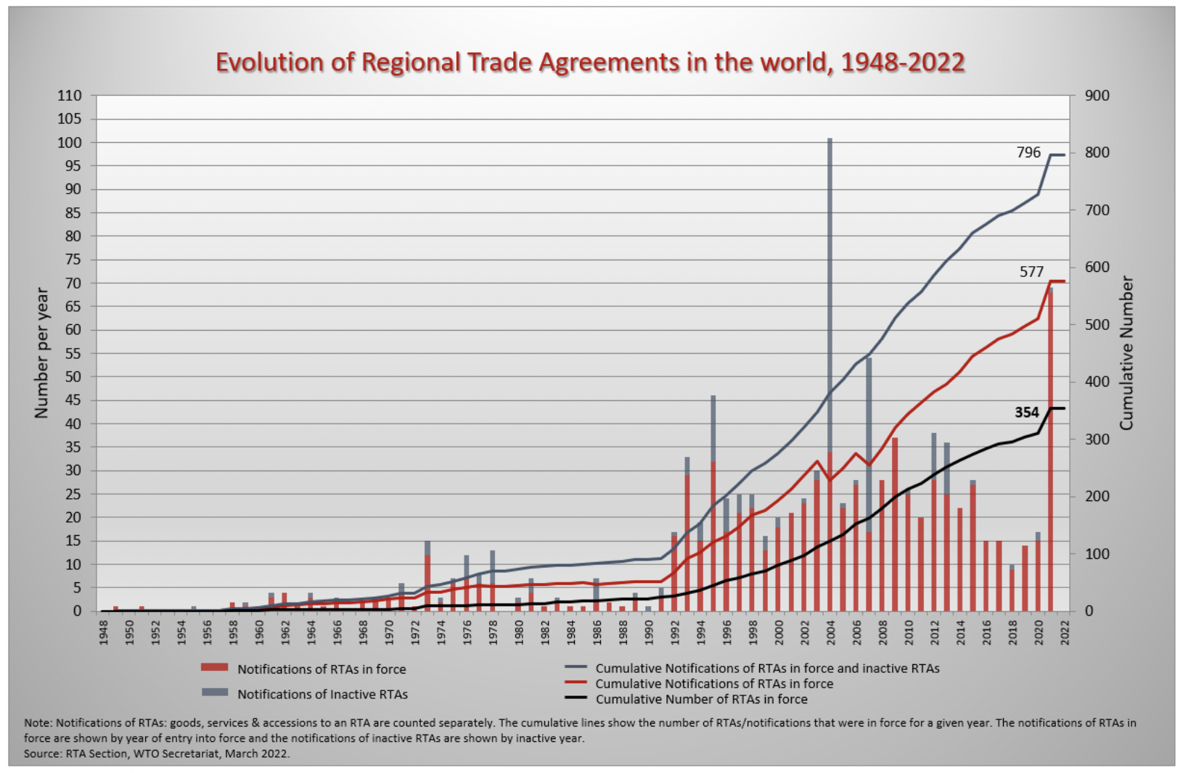
Surge in 2021 was mostly UK doing FTAs with former EU partners.
Source: WTO
Notes:
WTO
https://www.wto.org/english/tratop_e/region_e/region_e.htm#facts

Slide 44

European Union
Source: Europa.eu
Notes:
http://europa.eu/european-union/about-eu/money/euro_en

Slide 45

NAFTA (now USMCA)

Slide 46


MERCOSUR

Slide 47
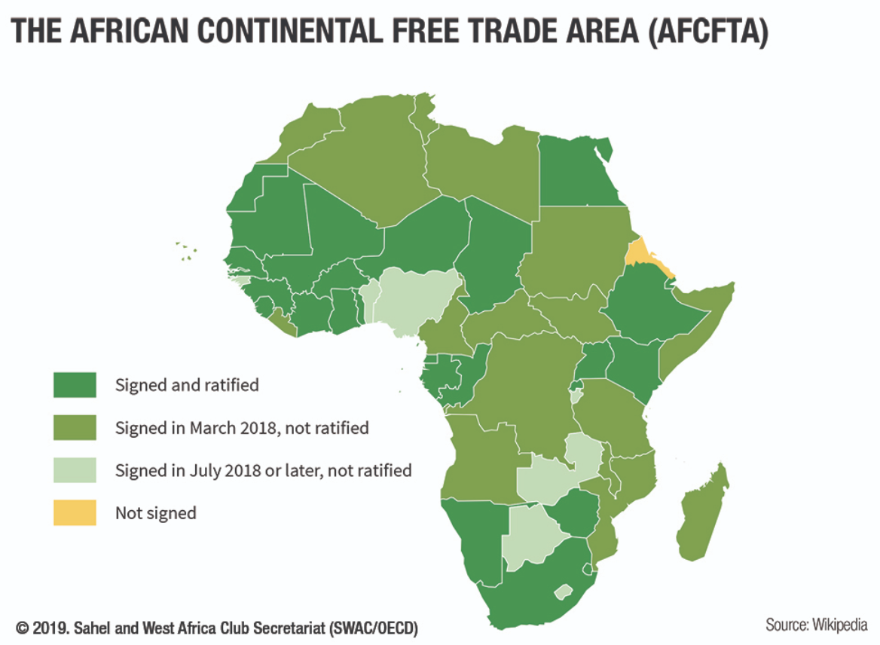
AfCFTA
Largest FTA, with 55 countries

Slide 48

CPTPP
=
Trans-Pacific Partnership minus US

Slide 49
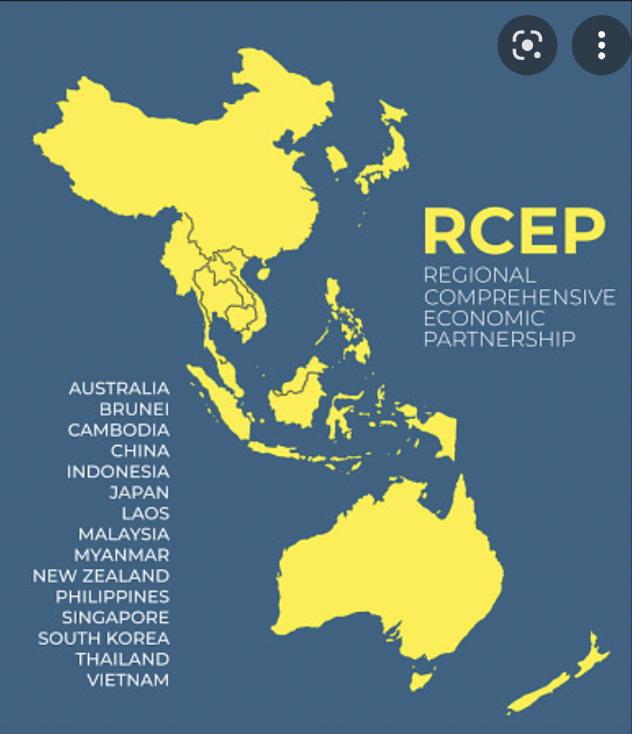
RCEP
=
Regional Comprehensive Economic Partnership

Slide 50
Other Policies to Encourage Globalization
IMF/World Bank
  Policy advice to open markets (the ”Washington Consensus”)
  Loans to countries conditional on
    Reducing trade barriers
    Permitting capital flows
GATT/WTO (World Trade Organization)
  Negotiate reciprocal trade liberalization
  Settlement of trade disputes (usually about interfering with trade)

Slide 51
Trade Policies Discouraging Globalization

Slide 52

Source: Flaan & Pierce 2020
Notes:
Flaan and Pierce 2020
https://www.federalreserve.gov/econres/feds/files/2019086pap.pdf

Slide 53

Source: Flaan & Pierce 2020
Notes:
Flaan and Pierce 2020
https://www.federalreserve.gov/econres/feds/files/2019086pap.pdf

Slide 54

Source: CNBC.com
Notes:
SEPTEMBER 18, 2019 | Yen Nee Lee, CNBC.com
http://nbr.com/2019/09/18/these-4-charts-show-how-us-china-trade-has-changed-during-the-tariff-dispute/

Slide 55

Phase One Agreement Reductions Jan 2020
US tariffs on China
Agriculture
Industrial
China tariffs on US
Agriculture
Industrial
Source: Zheng et al. Oct 2021
Notes:
Zheng, Jian, Shudong Zhou, Xingzi Li, Antonio Domingos Padula, Will Martin, “Effects of Eliminating the US-China Trade War Tariffs,” 27 October 2021

Slide 56
Effects of Tariffs

Slide 57
Effects of a tariff
A tariff is a tax on imports. It causes
  A rise in the price of the imported good in the importing country
  A fall in the price of the imported good in the exporting country
  The quantity imported to fall
  The revenue of the tariff-levying government to rise
Almost always: the rise at home is much larger than the fall abroad
  That’s especially true if importing country is small
  But it’s also true if importing country is as large as the U.S.
  Example: President Trump’s tariffs caused US prices to rise, with hardly any perceptible fall in prices abroad.

Slide 58
Effects of a tariff
The rise in price in the importing country causes
  A rise in price of competing goods produced there
  Benefits to those producers
  Harm to buyers of both the import and the competing goods
    Including producers that use the higher-priced goods as inputs
      Their prices also rise, hurting their buyers
  Employment changes:
    Increase in the protected industry
    Decrease in industries that use the protected product as inputs
  Example: President Trump’s 25% tariff on steel
    Helped US steel firms and their workers
    Hurt US auto firms and workers
      and many other industries that use steel

Slide 59
Effects of a tariff
The fall in price in the exporting country causes
  Harm to sellers there
  Benefit to buyers there
  Shift of sales to other countries
If the tariff is on exports from only one country (e.g, China)
  Buyers shift to imports from other, more costly, countries (e.g., Vietnam)

Slide 60
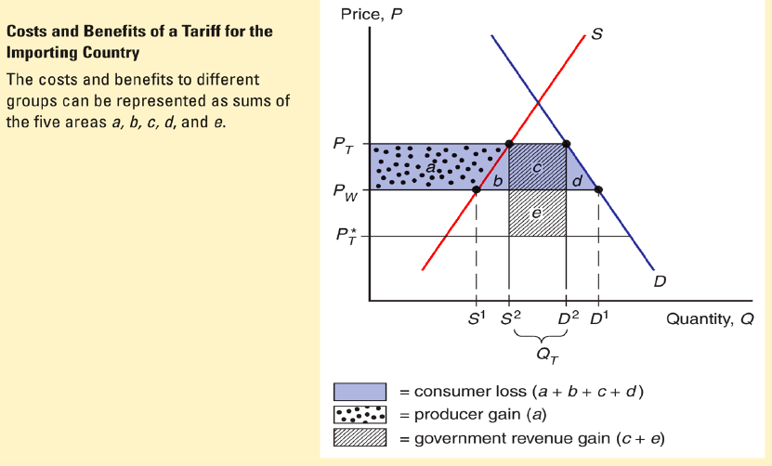
Costs and Benefits of Tariffs: Paul Krugman’s Illustration

Slide 61
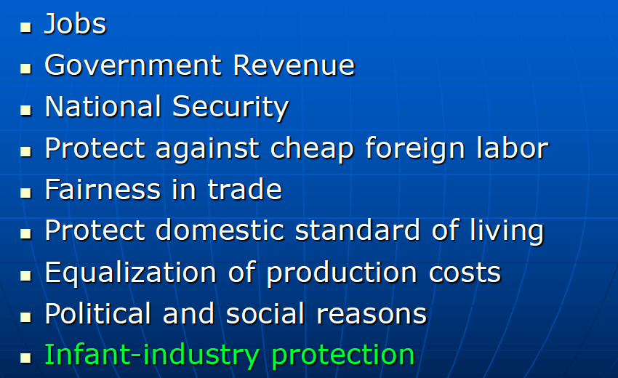
Arguments for tariffs

Slide 62
Arguments against tariffs
Arguments against tariffs
  Foregone gains from trade
  Tariffs prompt retaliation
  Even when beneficial, tariffs are politically hard to remove

Slide 63
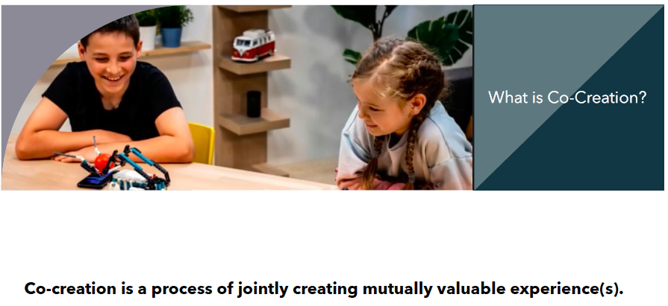
Co-Creation:
The Future of
Trade and
Globalization
Ref. Chakrabarti, A. and Ramaswamy, V.. Rethinking Ricardian'Sum of Enjoyments’:
Gains from Trade in a Co-Creational Economy. Ross School of Business Paper No. 1211.

Slide 64
Thank you!
Any Questions?
www.NEEDEcon.org
Avik Chakrabarti, Ph.D.
chakra@uwm.edu
Contact NEED: info@NEEDEcon.org
Submit a testimonial: www.NEEDEcon.org/testimonials.php
Become a Friend of NEED: www.NEEDEcon.org/friend.php

