Slide 1
Osher Lifelong Learning Institute, Spring 2023
Contemporary Economic Policy
University of Arizona
May-June, 2023
Jon Haveman, Ph.D.
National Economic Education Delegation

Slide 2
Available NEED Topics Include:
US Economy
Healthcare Economics
Climate Change
Economic Inequality
Economic Mobility
Trade and Globalization
Minimum Wages
Immigration Economics
Housing Policy
Federal Budgets
Federal Debt
Black-White Wealth Gap
Autonomous Vehicles
US Social Policy

Slide 3
Course Outline
Contemporary Economic Policy
  Week 1 (5/16): US Economy (Geoffrey Woglom, Amherst College)
  Week 2 (5/23): Monetary Policy (Geoffrey Woglom)
  Week 3 (5/30): Health Care Economics (Kelley Cullen, E. Washington University)
  Week 4 (6/6): Trade and Globalization (Alan Deardorff, University of Michigan)
  Week 5 (6/13): Trade Deficits and Exchange Rates (Alan Deardorff)
  Week 6 (6/20): Cryptocurrencies (Jon Haveman, NEED)

Slide 4
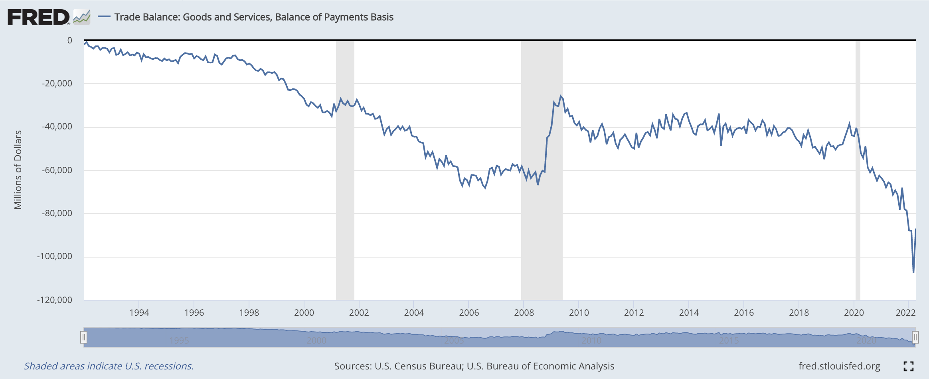
Trade Deficits and Exchange Rates

Slide 5
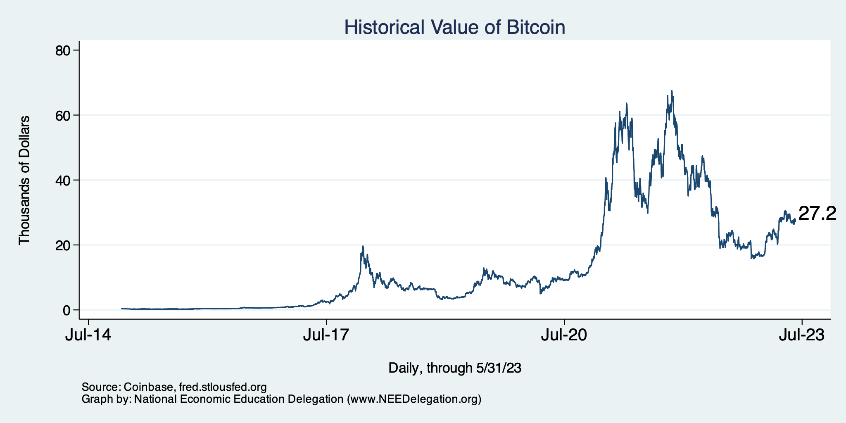
Bitcoins: What Is All the Excitement About?
Was

Slide 6
Submitting Questions
Please submit questions in the chat.
  I will try to handle them as they come up, but may take them in a bunch as time permits.
We will do a verbal Q&A once the material has been presented.
  And the questions in the chat have been addressed.
Slides will be available from the NEED website by tomorrow.
(https://NEEDEcon.org/delivered_presentations.php)

Slide 7
Trade and Globalization
Alan V. Deardorff
University of Michigan
Presentation to University of Arizona
June 6, 2023
Skip Russia Sanctions

Slide 8
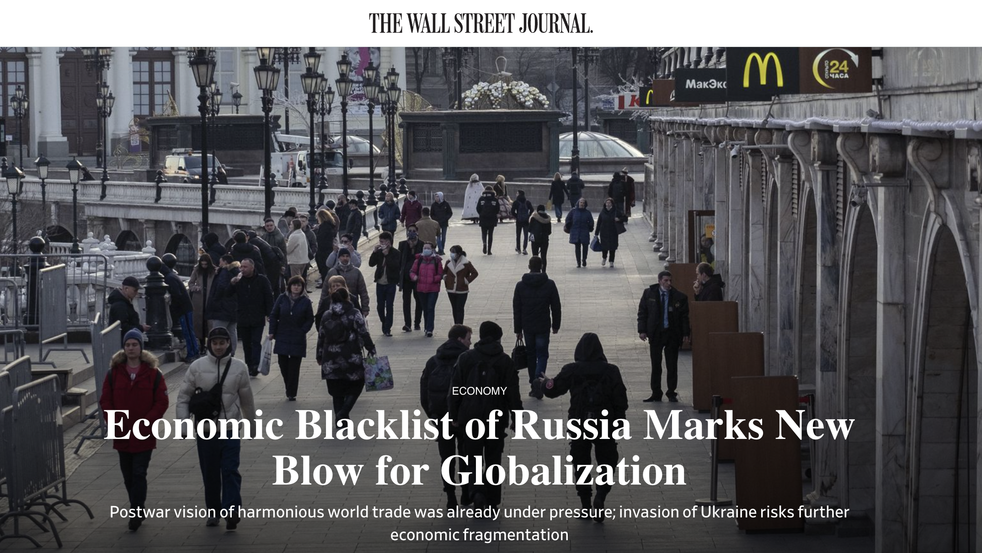
March 10, 2022
Notes:
Josh Zumbrun, “Economic Blacklist of Russia Marks New Blow for Globalization,” Wall Street Journal, March 10, 2022
https://www.wsj.com/articles/economic-blacklist-of-russia-marks-new-blow-for-globalization-11646940040?mod=itp_wsj&ru=yahoo

Slide 9
Impact of Russia-Ukraine War
How Russia-Ukraine war impacts globalization
  War itself disrupts trade, especially exports of
    Ukraine: wheat
    Russia: wheat, oil
  Economic sanctions by governments disrupt
    Financial linkages
    Trade
  Private companies stop dealing with Russia

Slide 10
Impact of Russia-Ukraine War
Financial sanctions by US, EU, UK, and others
  Frozen foreign-held assets of individuals, Putin and dozens of others
  Restrictions on Russia’s Central Bank’s use of international reserves
  Several Russian banks removed from the Swift international payments system
  Cut off many Russian banks from transactions and operations
  Long list of Russian companies banned or restricted
  Possible restrictions on Russia borrowing from IMF and World Bank
Notes:
Eir Noisoe and Valentina Pop, “Russia sanctions list: What the west imposed over the Ukraine invasion,” Financial Times, March 4, 2022.
https://www.ft.com/content/6f3ce193-ab7d-4449-ac1b-751d49b1aaf8

Slide 11
Impact of Russia-Ukraine War
Trade sanctions by governments
  Oil and other energy
    Germany puts Nord Stream 2 gas pipeline on hold
    US bans from Russia
    UK to phase out Russian oil by end of 2022
    EU to become independent from Russia by 2030
  EU bans steel imports from Russia
  US restricts exports to Russia, especially technology and military; later also to Belarus; later also luxury goods
  EU and UK impose export restrictions similar to US
  Ban on Russian air carriers by Canada, EU, US, UK
  G-7 to revoke Russia’s most favored nation status
    Permits them to raise tariffs on Russian goods
Notes:
https://bis.doc.gov/index.php/policy-guidance/country-guidance/russia-belarus

Slide 12
Russia Sanctions, Gov’t
Countries
Australia | Iceland | Singapore
Bahamas | Italy | Switzerland
Canada | Japan | Taiwan
EU | New Zealand | UK
Finland | Norway | US
France | Poland
Germany | S Korea
Source: Funakoshi et al, “Updated July 7, 2022” but includes from July 29
Notes:
Funakoshi, Minami, Hugh Lawson, and Kannaki Deka, “Tracking sanctions against Russia,” Reuters, March 9, 2022, updated July 7, 2022..
https://graphics.reuters.com/UKRAINE-CRISIS/SANCTIONS/byvrjenzmve/

Slide 13
Russia Sanctions, Gov’t
Russian Targets
Airlines | 2 |  | Generals | 1 |  | Oligarchs | 23
Banks | 9 |  | Government | 1 |  | Retail | 1
Cnt. Banks | 5 |  | Lawmakers | 2 |  | Ships | 5
Commodity | 1 |  | Lux. goods | 1 |  | Sv wlth fnd | 1
Companies | 19 |  | Media | 2 |  | Tax service | 1
Economy | 3 |  | Mil. Comps. | 14 |  | Tech | 1
Entities | 3 |  | Mining | 2 |  | Transit | 1
Finance | 1 |  | Oil | 2
Gas | 1 |  | Oil imports | 6
Source: Funakoshi et al, “Updated July 7, 2022” but includes from July 29
Notes:
Funakoshi, Minami, Hugh Lawson, and Kannaki Deka, “Tracking sanctions against Russia,” Reuters, March 9, 2022, updated July 7, 2022..
https://graphics.reuters.com/UKRAINE-CRISIS/SANCTIONS/byvrjenzmve/

Slide 14
Russia Sanctions, Gov’t
Countries announcing they would not use sanctions against Russia:
NOT using sanctions
India | Feb 24
Mexico | Mar 1
Brazil | Mar 1
China | Mar 2
Argentina | Mar 4
Indonesia | Mar 9
Turkey | Mar 13
S Africa | Mar 17
Serbia | Apr 21
Source: Bown
Notes:
Bown, Chad P. “Russia's war on Ukraine: A sanctions timeline,” Realtime Economic Issues Watch, Peterson Institute for International Economics, March 14, 20202, last updated July 18, 2022. [4p]
https://www.piie.com/blogs/realtime-economic-issues-watch/russias-war-ukraine-sanctions-timeline

Slide 15
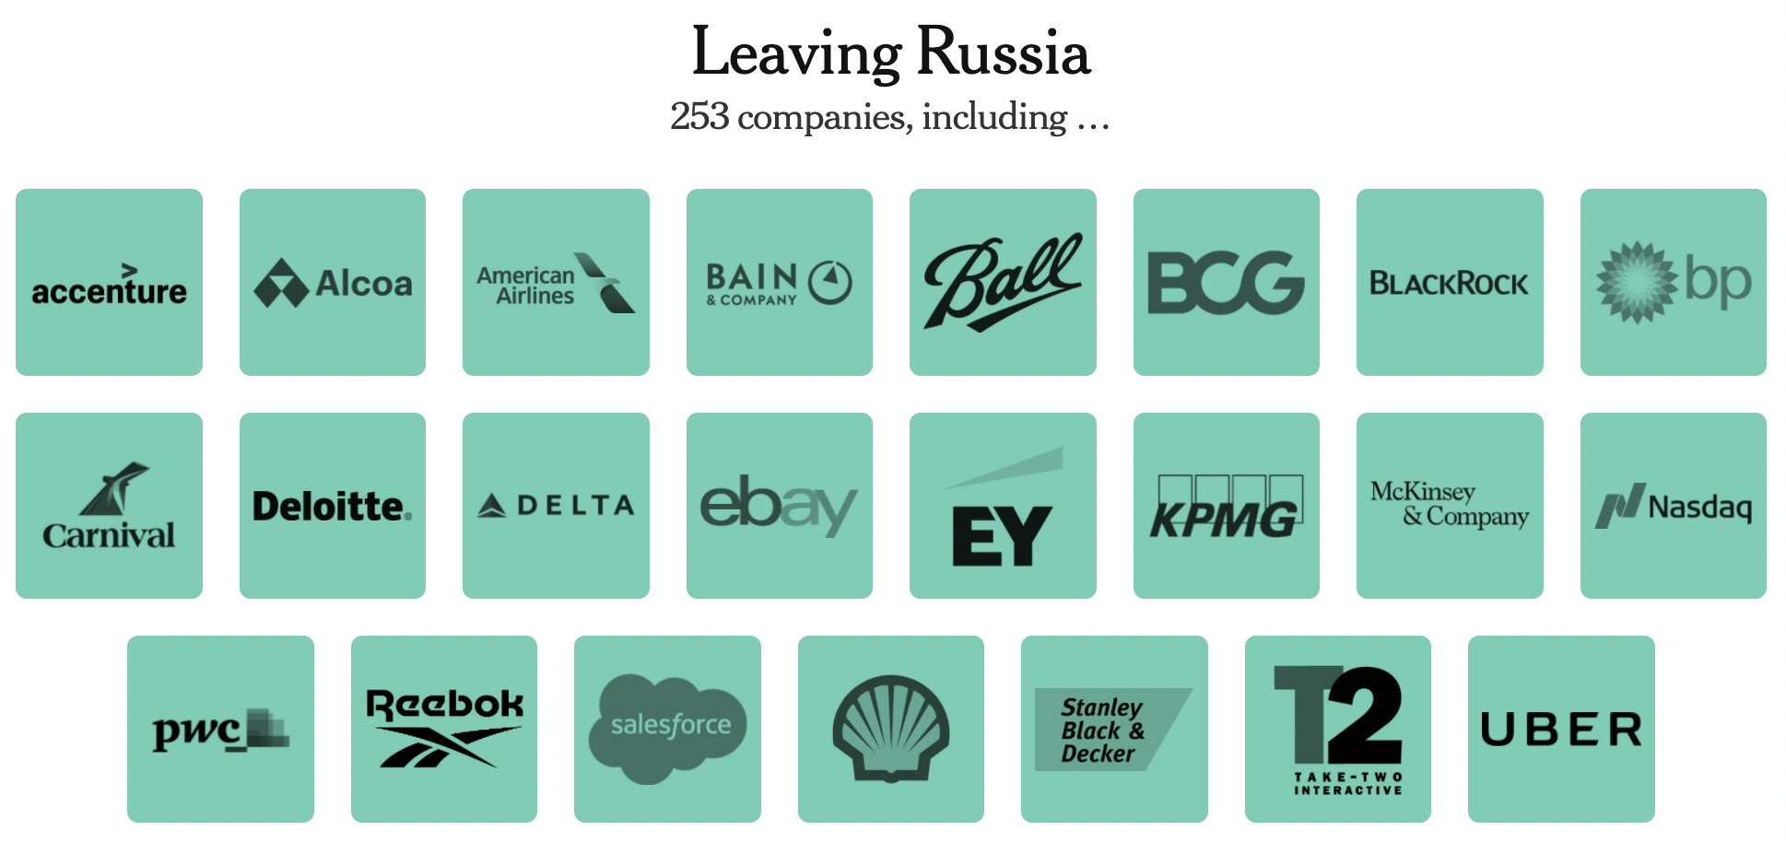
Source: New York Times, April 7, 2022
Notes:
Sonnenfeld, Jeffrey and Steven Tan, “Some of the Biggest Brands Are Leaving Russia. Others Just Can’t Quit Putin. Here’s a List.” New York Times, April 7, 2022.
https://www.nytimes.com/interactive/2022/04/07/opinion/companies-ukraine-boycott.html

Slide 16
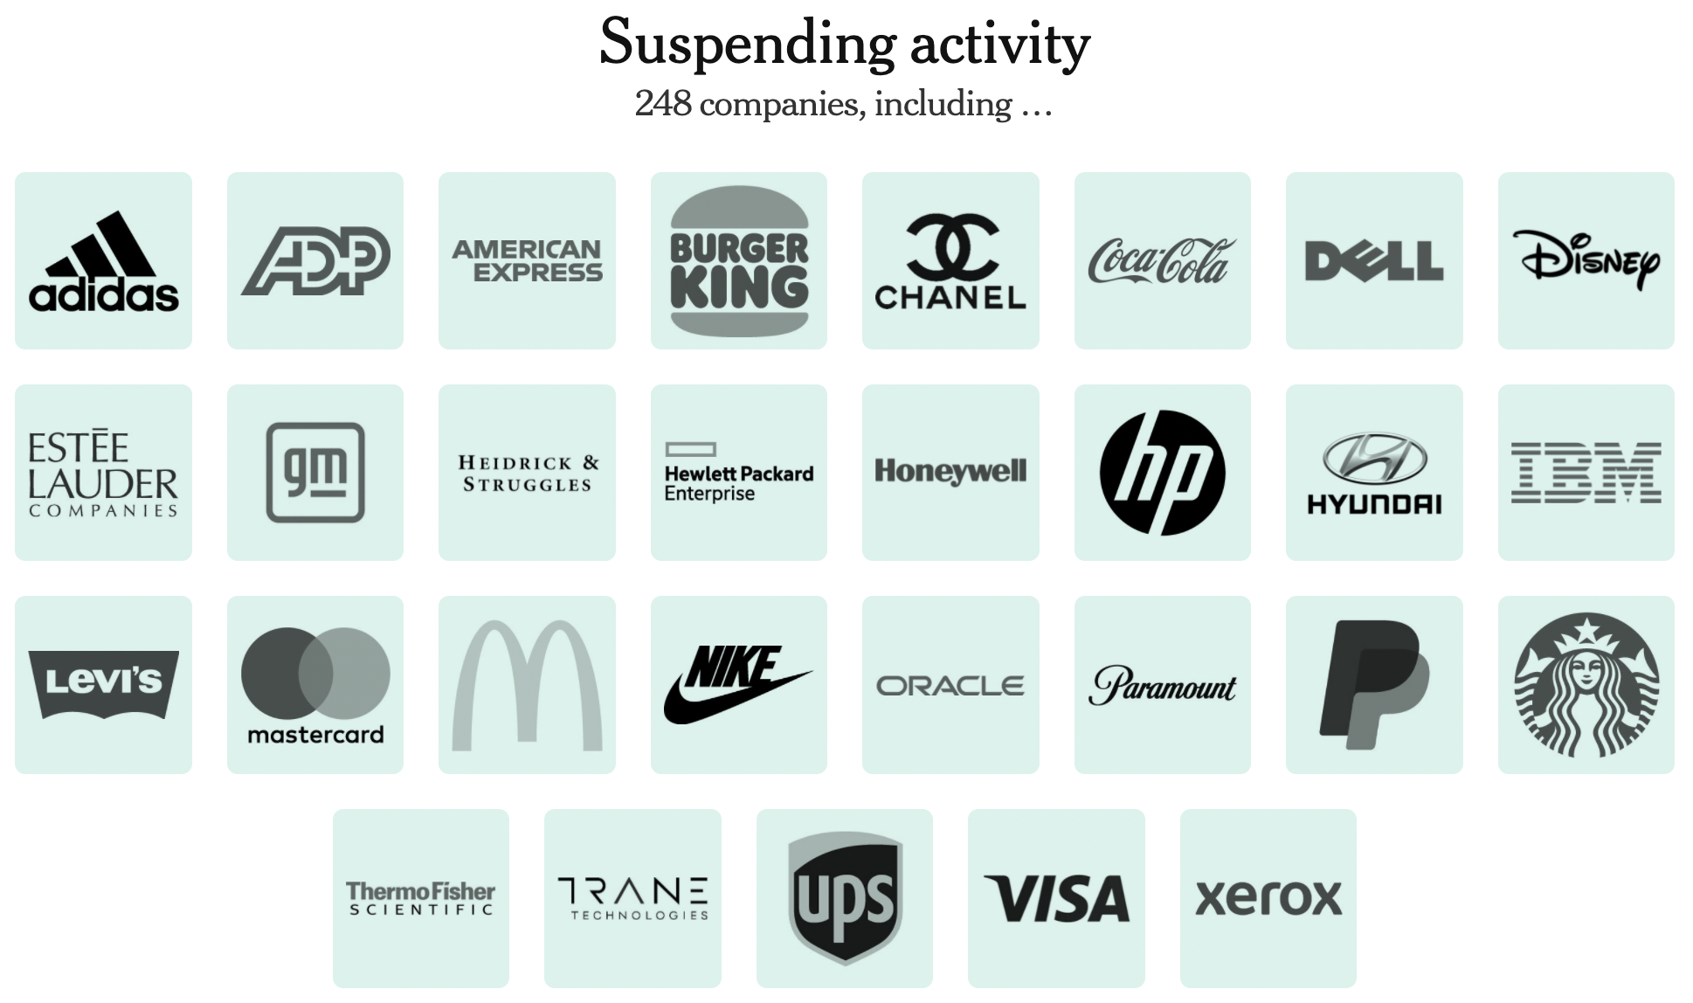
Sold all stores May 20. Stores will operate under new brand.
Source: New York Times, April 7, 2022
Notes:
Sonnenfeld, Jeffrey and Steven Tan, “Some of the Biggest Brands Are Leaving Russia. Others Just Can’t Quit Putin. Here’s a List.” New York Times, April 7, 2022.
https://www.nytimes.com/interactive/2022/04/07/opinion/companies-ukraine-boycott.html

Slide 17
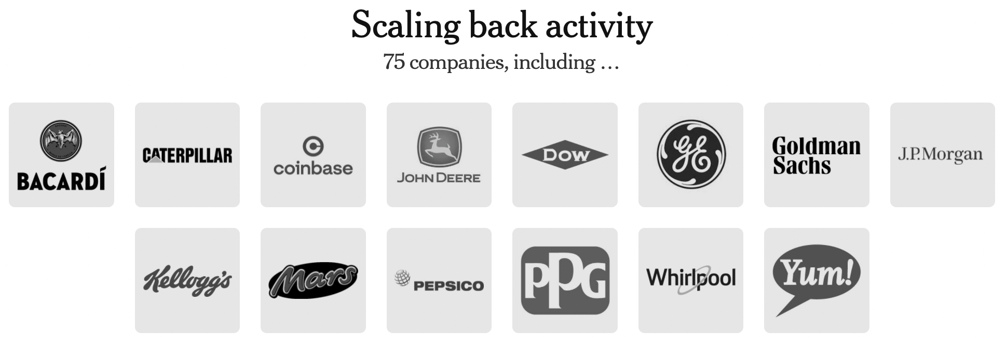
Source: New York Times, April 7, 2022
Notes:
Sonnenfeld, Jeffrey and Steven Tan, “Some of the Biggest Brands Are Leaving Russia. Others Just Can’t Quit Putin. Here’s a List.” New York Times, April 7, 2022.
https://www.nytimes.com/interactive/2022/04/07/opinion/companies-ukraine-boycott.html

Slide 18
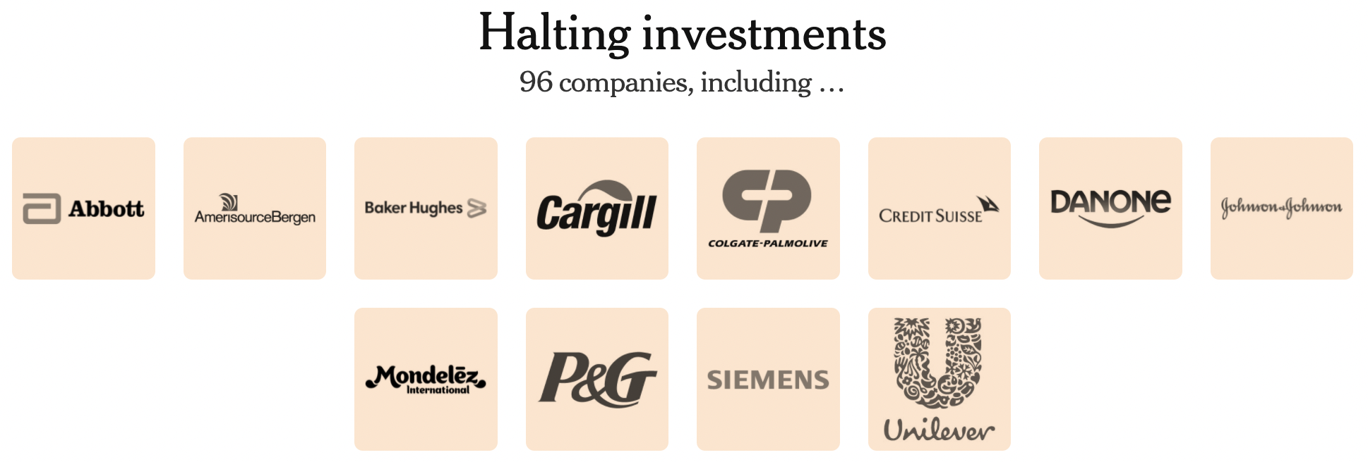
Source: New York Times, April 7, 2022
Notes:
Sonnenfeld, Jeffrey and Steven Tan, “Some of the Biggest Brands Are Leaving Russia. Others Just Can’t Quit Putin. Here’s a List.” New York Times, April 7, 2022.
https://www.nytimes.com/interactive/2022/04/07/opinion/companies-ukraine-boycott.html

Slide 19
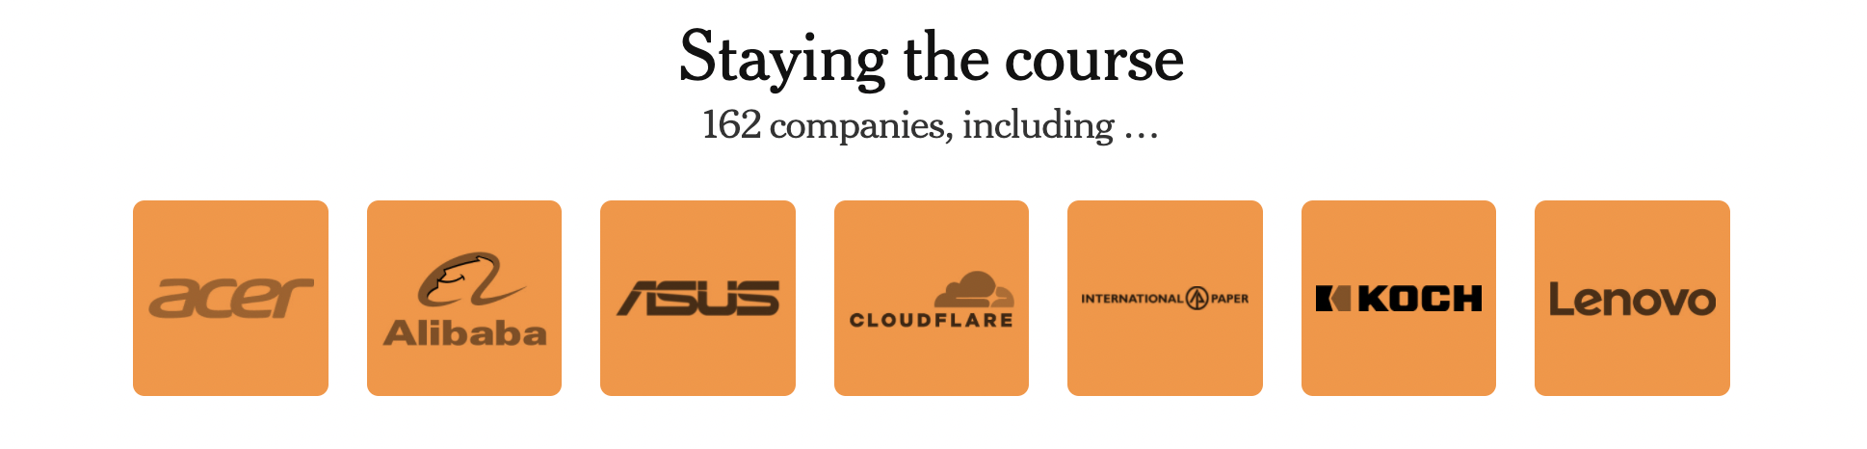
Source: New York Times, April 7, 2022
Notes:
Sonnenfeld, Jeffrey and Steven Tan, “Some of the Biggest Brands Are Leaving Russia. Others Just Can’t Quit Putin. Here’s a List.” New York Times, April 7, 2022.
https://www.nytimes.com/interactive/2022/04/07/opinion/companies-ukraine-boycott.html

Slide 20
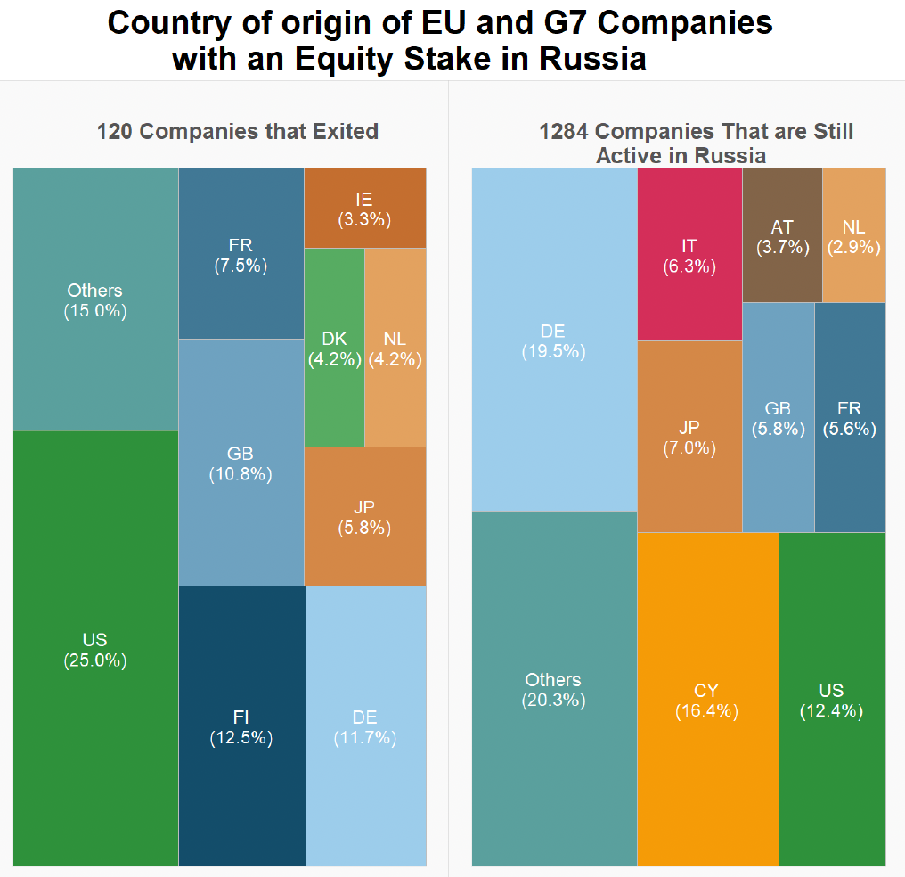
But…
Recent study reports:
“Less Than Nine Percent of
Western Firms Have Divested from Russia”
Source: Evenett and Pisani, December 20, 2022
Notes:
Simon J. Evenett and Niccolò Pisani, “Less Than Nine Percent of Western Firms Have Divested from Russia,” December 20, 2022
https://stgallen-endowment.us1.list-manage.com/track/click?u=4d3c72e64f71605940b148af0&id=02549618ae&e=1c71eb253a

Slide 21

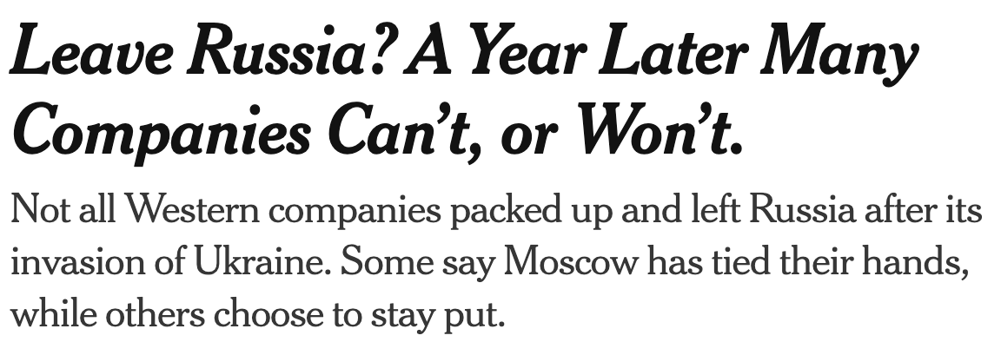
, March
, March 2, 2023:

Slide 22
Effect of Sanctions
Will they stop Russia?
  Clearly no
  Sanctions in the past have only sometimes worked
Will they reduce trade?
  They did
  But Russia’s role in trade is not large in most products
  Short-term effects are greater from the war itself
Notes:
Haley Messenger and Noah Sheidlower, “Which companies have stopped doing business with Russia?” NBC News, updated Mar 16, 2022.
https://www.nbcnews.com/business/business-news/companies-stopped-business-russia-rcna19006

Slide 23
Outline
What is Globalization?
Pros and Cons of Trade
Trade Policies
The Role of Trade Agreements & WTO (if time)

Slide 24
What Globalizations Is
Growth over time of many economic interactions between countries
  Trade
    Global Value Chains
  Foreign Direct Investment
  Financial Flows
  International Travel
  Migration
I will focus here on trade

Slide 25
Trade

Slide 26

Notes:
Our World in Data
https://ourworldindata.org/trade-and-globalization

Slide 27

Notes:
Our World in Data
https://ourworldindata.org/trade-and-globalization

Slide 28
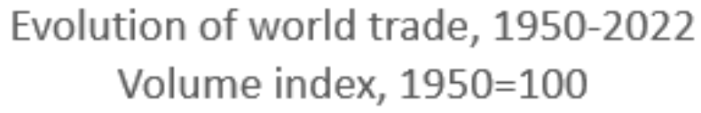
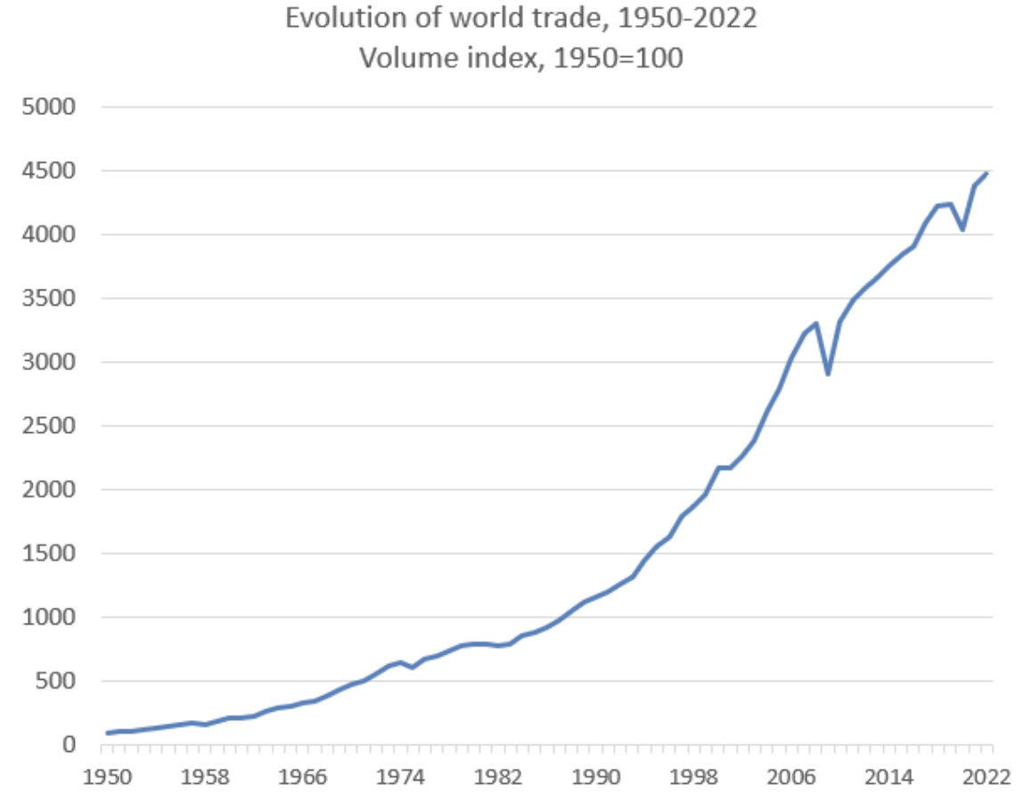
Evolution of World Trade, 1950-2022
Volume index, 1950=100
Source: WTO
Notes:
https://www.wto.org/english/res_e/statis_e/trade_evolution_e/evolution_trade_wto_e.htm

Slide 29

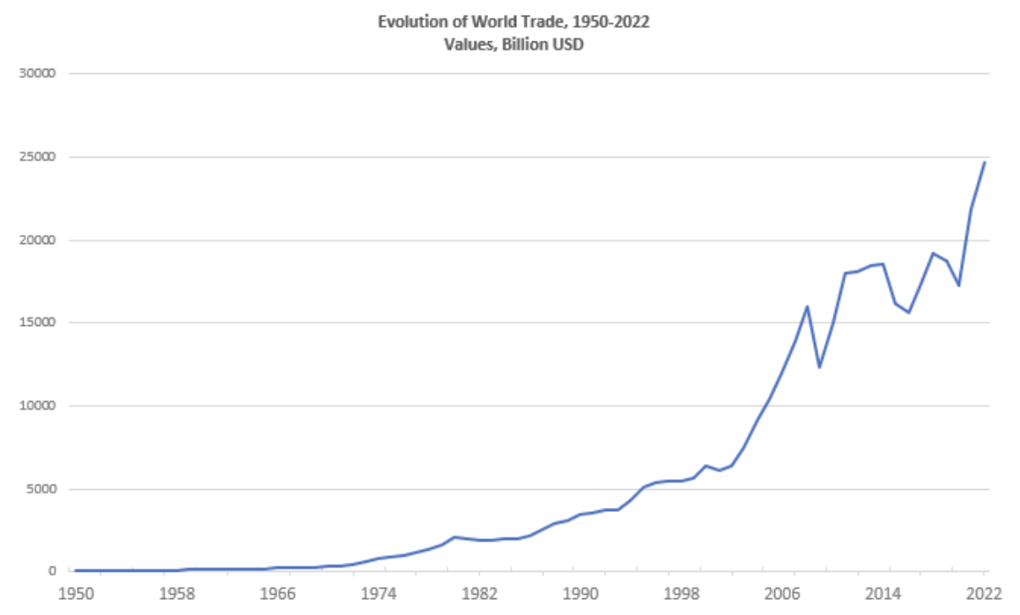
Evolution of World Trade, 1950-2022
Values, Billion USD
Source: WTO
Notes:
https://www.wto.org/english/res_e/statis_e/trade_evolution_e/evolution_trade_wto_e.htm

Slide 30
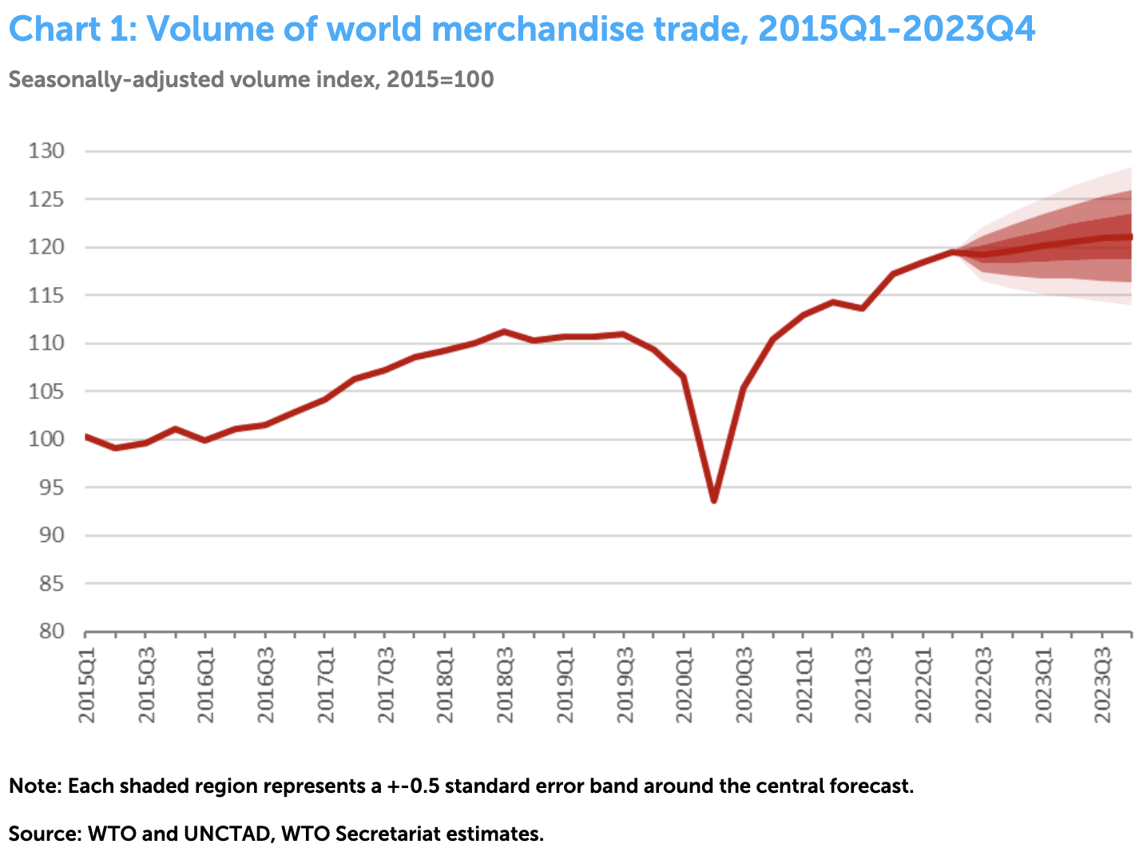
Ukraine War Started
Source: WTO
10/5/22
Notes:
WTO
https://www.wto.org/english/news_e/pres22_e/pr909_e.htm

Slide 31
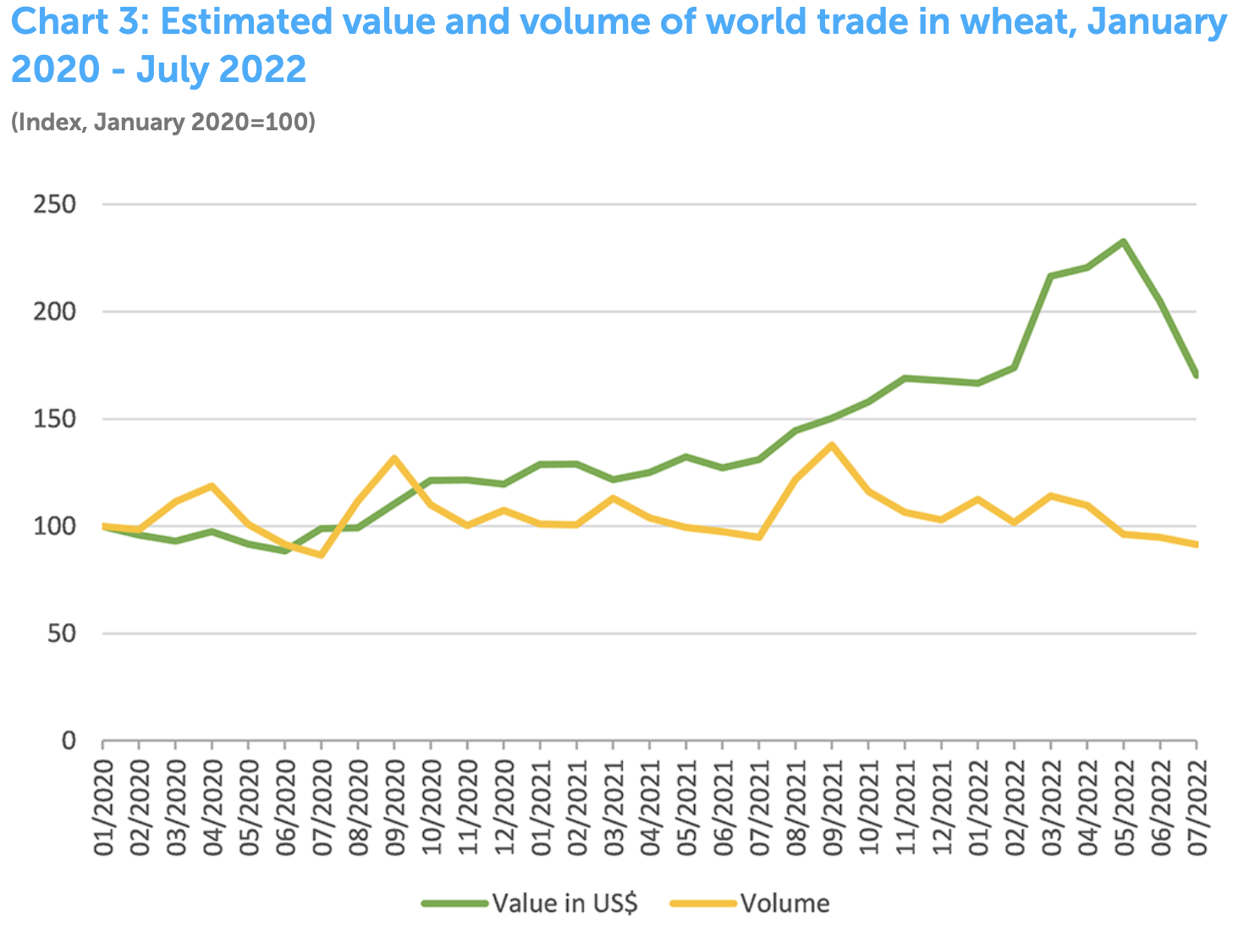
Ukraine War Started
Source: WTO
10/5/22
Notes:
WTO
https://www.wto.org/english/news_e/pres22_e/pr909_e.htm

Slide 32
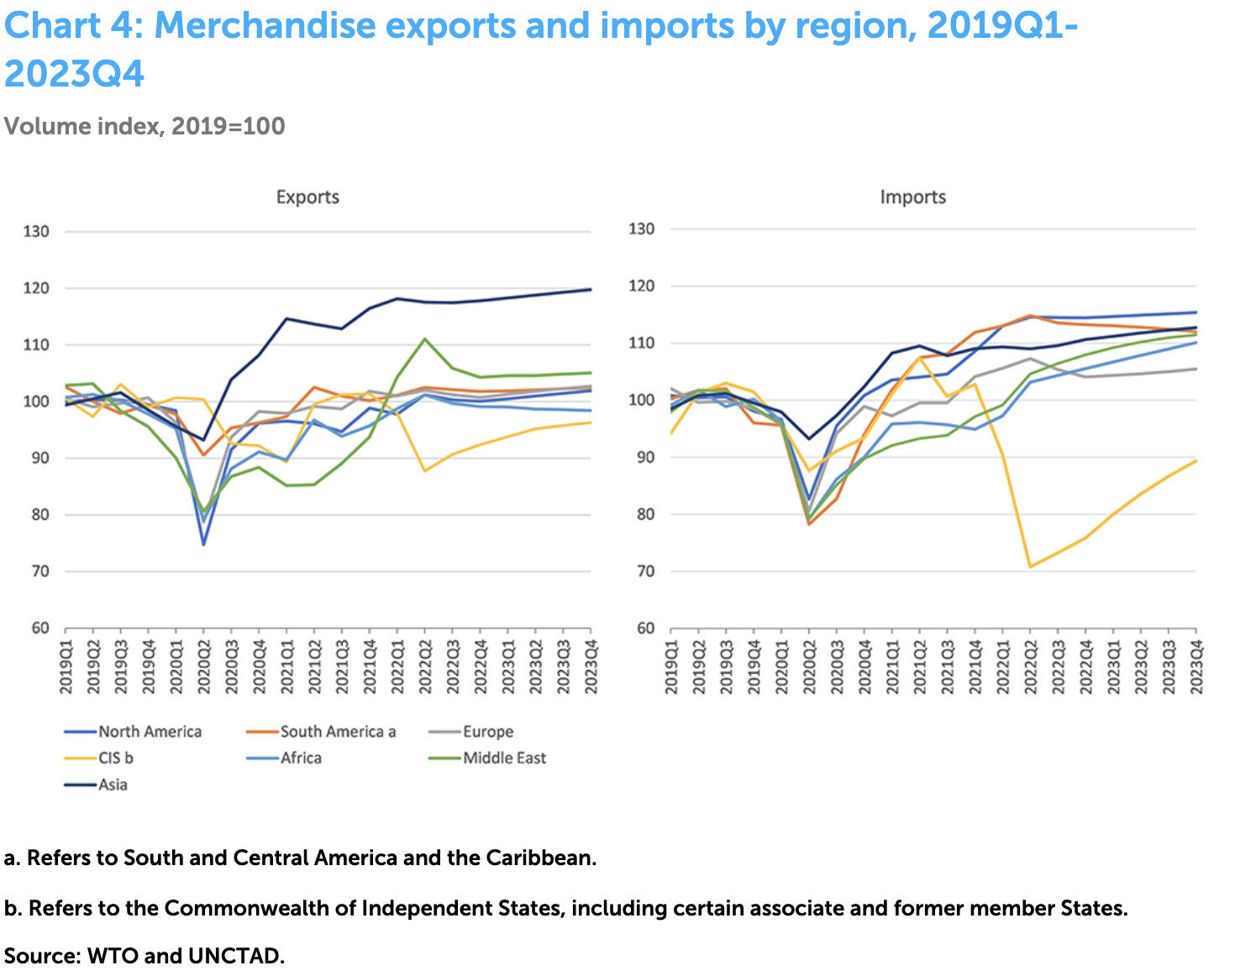
Ukraine War Started
Ukraine War Started
CIS (Russia +)
Source: WTO
10/5/22
Notes:
WTO
https://www.wto.org/english/news_e/pres22_e/pr909_e.htm

Slide 33
Global Value Chains

Slide 34
Effects on Economies
Supply Chains
  Globalization has created long and complex international supply chains

Slide 35

NAFTA and the Auto Supply Chain
Black, Diamond, and Merrill, “One Tiny Widget’s Dizzying Journey Shows Just How Critical Nafta Has Become,” Bloomberg, February 2, 2017.

Slide 36

NAFTA and the Auto Supply Chain
Black, Diamond, and Merrill, “One Tiny Widget’s Dizzying Journey Shows Just How Critical Nafta Has Become,” Bloomberg, February 2, 2017.

Slide 37

NAFTA and the Auto Supply Chain
Black, Diamond, and Merrill, “One Tiny Widget’s Dizzying Journey Shows Just How Critical Nafta Has Become,” Bloomberg, February 2, 2017.

Slide 38

NAFTA and the Auto Supply Chain
Black, Diamond, and Merrill, “One Tiny Widget’s Dizzying Journey Shows Just How Critical Nafta Has Become,” Bloomberg, February 2, 2017.

Slide 39

NAFTA and the Auto Supply Chain
Black, Diamond, and Merrill, “One Tiny Widget’s Dizzying Journey Shows Just How Critical Nafta Has Become,” Bloomberg, February 2, 2017.

Slide 40

NAFTA and the Auto Supply Chain
Black, Diamond, and Merrill, “One Tiny Widget’s Dizzying Journey Shows Just How Critical Nafta Has Become,” Bloomberg, February 2, 2017.

Slide 41

Growth of Global Value Chains, 1970-2015
Source: World Development Report 2020
Notes:
World Bank
https://www.worldbank.org/en/publication/wdr20

Slide 42

Countries mentioned:
China
France
Italy
Japan
Malaysia
Singapore
Spain
Vietnam
Source: World Development Report 2020
Notes:
World Bank
https://www.worldbank.org/en/publication/wdr20

Slide 43
Supply Chains
Example: The iPhone assembled in China from parts:
Part | Come from
﻿Accelerometers | ﻿Germany, the US, South Korea, China, Japan, and Taiwan.
﻿Audio chips | ﻿US, UK, China, South Korea, Taiwan, Japan, and Singapore.
﻿Batteries | ﻿Samsung (South Korea), which has factories in eighty countries.
﻿Cameras | ﻿Qualcomm (US) and Sony (Japan), both with plants in many countries
﻿Chips ﻿for 3G/4G/LTE networking | ﻿Qualcomm (US)
﻿Compasses | ﻿AKM Semiconductor (Japan) with plants in the US, France, England, China, South Korea, and Taiwan.
﻿Glass screen | ﻿Corning (US) with plants in twenty-six countries.
﻿Gyroscopes | Switzerland
… and many more
Source: Krueger 2020, International Trade (What Everyone Needs to Know), p. 254
Notes:
Krueger, Anne O., International Trade (What Everyone Needs to Know) (p. 254). Oxford University Press, 2020

Slide 44

Source: World Bank
Notes:
World Bank
https://www.worldbank.org/en/publication/wdr2020

Slide 45
Pros and Cons of Globalization
Pros and Cons of Globalization
  Gains from Trade
    Theory of Comparative Advantage
    Other Sources of Gain from Trade
  Costs of Trade

Slide 46
Gains from Trade
Theory of Comparative Advantage

Slide 47
Comparative Advantage
The Theory of Comparative Advantage says:
  Countries can gain,
    By producing
      More than they need of what they do relatively best, and
      Less than they need of what they do relatively worst
    And exporting the extra to other countries in exchange for what they need
  By doing that, ALL countries can
    Get more of everything, if that’s what they want, and therefore
    Gain from trade
Illustration with a graph of just 2 countries & 2 goods

Slide 48
Comparative Advantage
If US & UK differ in what they can produce…
Cloth
US
Cloth
UK
Production Possibilities
Food
Food

Slide 49
Comparative Advantage
… Without trade, their consumption will also differ…
Cloth
US
Cloth
UK
Without trade
Consumption =
Production
C^{B}=P^{B}
C^{A}=P^{A}
Food
Food

Slide 50
Comparative Advantage
… With free trade, they specialize in what they do best…
Cloth
US
Cloth
UK
P^{B}
Free Trade
Production
C^{B}=P^{B}
C^{A}=P^{A}
P^{A}
Food
Food

Slide 51
Comparative Advantage
… And can consume more by trading.
Cloth
US
Cloth
UK
P^{B}
Trade
Free Trade
Consumption
C^{B}
C^{A}
C^{B}=P^{B}
Trade
C^{A}=P^{A}
P^{A}
Food
Food

Slide 52
Comparative Advantage
Thus countries both Gain from Trade
Cloth
US
Cloth
UK
P^{B}
Trade
Gain from Trade
C^{B}
C^{A}
C^{B}=P^{B}
Trade
C^{A}=P^{A}
P^{A}
Food
Food

Slide 53
Sources of Comparative Advantage
Differences in countries’ production possibilities
These are due to differences in
  Resources
    Labor
    Land
    Capital
  Technologies (know-how)
Cloth
US
Cloth
UK
Food
Food

Slide 54
Generality of Comparative Advantage
The Theory of Comparative Advantage requires:
  “Perfect competition” (i.e., all buyers and sellers are very small)
  Absence of market “distortions” (externalities, etc.)
    i.e., reasons why supplies and demands don’t reflect true costs and benefits
The Theory of Comparative Advantage does not require:
  Any limit on numbers of goods, factors, and countries
  That only final goods are traded (thus consistent with supply chains)
  That factors (labor, capital) be immobile between countries
    (However, the gains from trade then accrue to countries including their mobile-factor owners.)

Slide 55
Generality of Comparative Advantage
Note:
  Nothing in the theory says that everyone in each country gains
  Opening to trade requires
    Some industries to shrink or disappear while others expand
    Firms and workers in shrinking industries
      Certainly lose during the transition
      May be permanently worse off
    In example, losers are producers of
      Cloth in US
      Food in UK
Cloth
US
Cloth
UK
P^{B}
C^{B}=P^{B}
C^{A}=P^{A}
P^{A}
Food
Food

Slide 56
Gains from Trade
Other Sources of Gain from Trade

Slide 57
Other sources of Gain from Trade
Productivity (most productive firms expand and export)
Returns to scale (small countries can support larger firms)
Competition (monopolies in small countries lose market power)
Variety (buyers, both consumers and firms, can access more choices)
Supply chains (firms can source parts from cheapest or best sources)
  (That’s really just the above, but within industries and firms.)
Technology (producers get access foreign technologies)

Slide 58
Costs of Trade

Slide 59
But there are Costs
Economic:
  When trade expands (or contracts)
    Some firms lose market share or shut down
    Other firms supplying inputs to those firms shrink or shut down
    Workers in both lose jobs
    And their communities lose customers
  Macroeconomic cost: Vulnerability to foreign recession/inflation
  Dependence on other countries’ willingness to trade
  Vulnerability to trade disruption
    Crisis induced (earthquake, flood, disease, war)
    Policy induced (sanctions, tariffs, export bans)
Notes:
https://www.history.com/news/silk-road-black-death

Slide 60
But there are Costs
Non-economic
  Loss of cultural differences
  Spread of invasive species and plant disease
  Spread of human disease
    Covid-19 came from China
    Black Death came from China and Far East along Silk Road trade route
      Killed 50 million in Europe 1346-1352
Notes:
https://www.history.com/news/silk-road-black-death

Slide 61
Pause
Pause for
  Questions
  5-Minute Break
Next: Trade Policies

Slide 62
Trade Policies that Affect Globalization
Policies that Encourage It
  Tariff Reductions
  Trade Agreements
  Other
Policies that Discourage It
  Trump’s Tariffs
  Trade War

Slide 63
Policies that Encourage Globalization

Slide 64
Tariff Reductions

Slide 65

Source: Economist
Notes:
From an Economist “Barriers to Entry” article

Slide 66
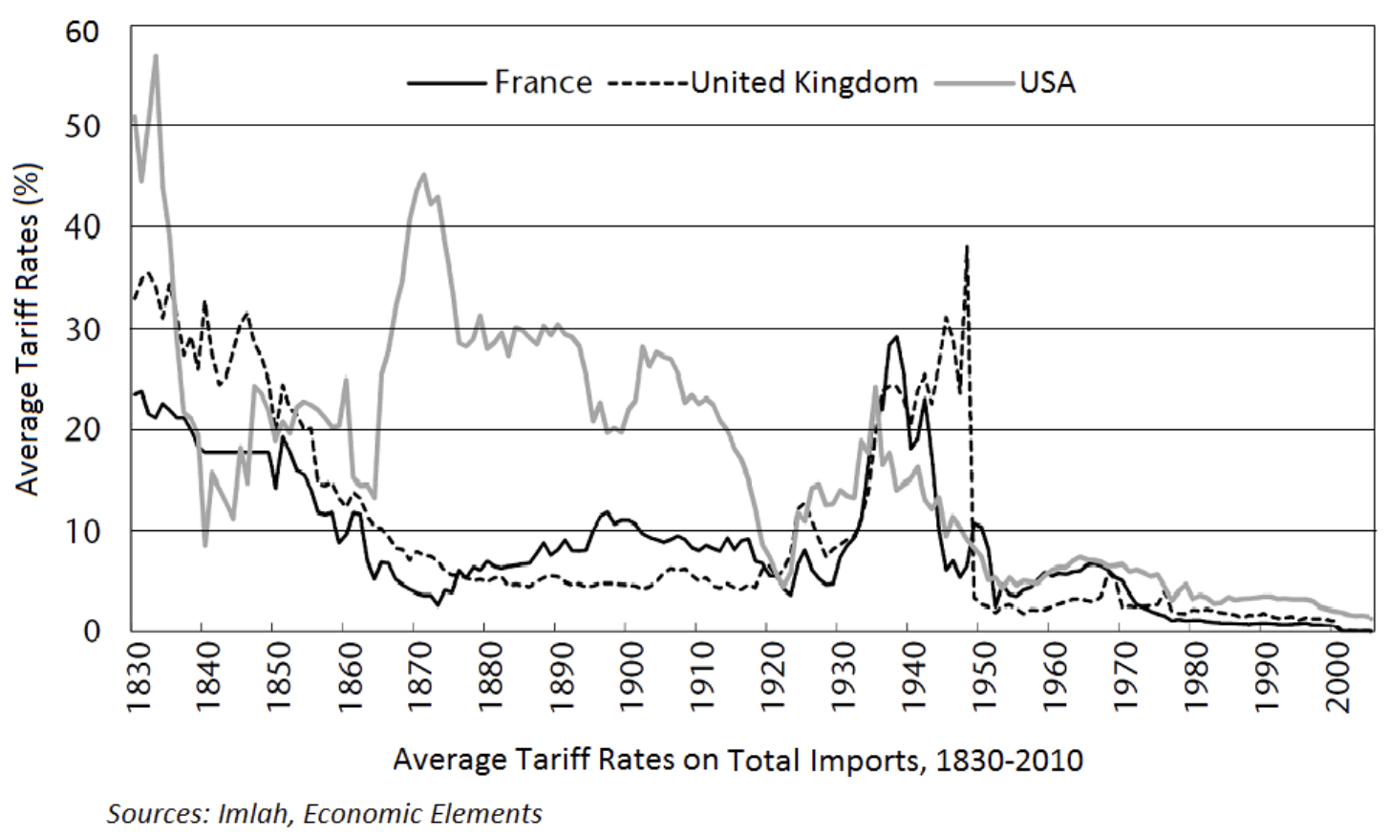
Average tariff rates (France, UK, US)
Source: Wikimedia Commons
Notes:
https://commons.wikimedia.org/wiki/File:Average_tariff_rates_%28France,_UK,_US%29.png

Slide 67

Reduction in tariffs under GATT/WTO MFN.
US, EU, & G7 revoked MFN for Russia April 2022
Smoot-Hawley Tariff of 1930
Source: Quartz 2018
Notes:
Quartz, Kopf 2018
https://qz.com/1230399/a-history-of-tariffs-us-protectionism-in-one-230-year-chart/
https://www.descartes.com/resources/knowledge-center/russia-loses-MFN-status-and-what-it-means

Slide 68
Trade Agreements

Slide 69
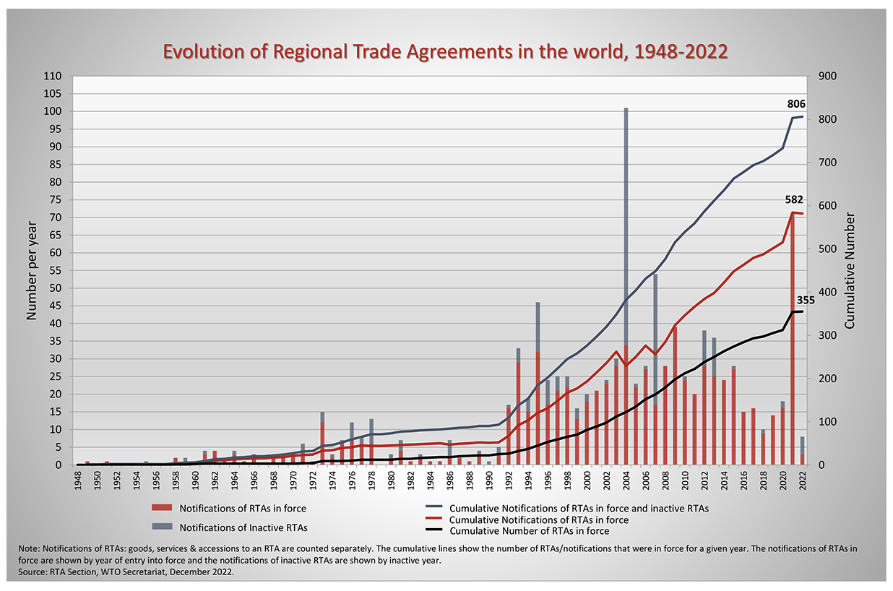
Surge in 2021 was mostly UK doing FTAs with former EU partners.
Source: WTO
Notes:
WTO
https://www.wto.org/english/tratop_e/region_e/region_e.htm#facts

Slide 70

European Union
Source: Europa.eu
Notes:
http://europa.eu/european-union/about-eu/money/euro_en

Slide 71

NAFTA (now USMCA)

Slide 72


MERCOSUR

Slide 73
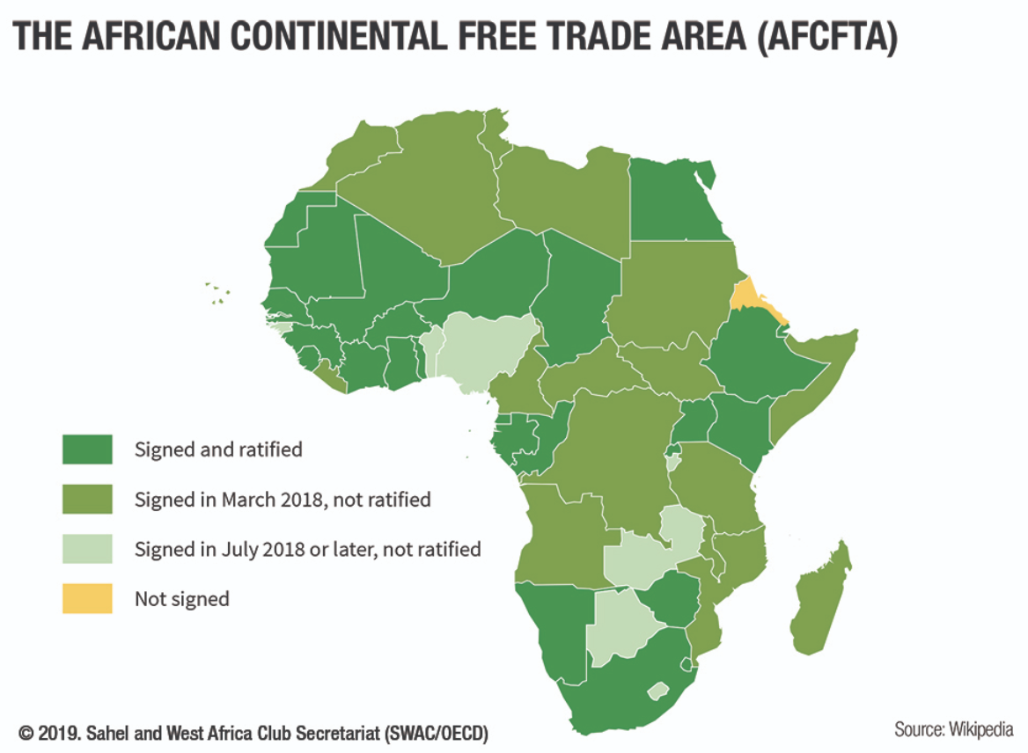
AfCFTA
Largest FTA, with 55 countries
44 ratified as of Oct 19, 2022

Slide 74

CPTPP
=
Trans-Pacific Partnership minus US
Applied to join:
China
Costa Rica
Ecuador
Taiwan
UK
Uruguay
Notes:
Applicants as of April 2, 2023:
https://www.piie.com/research/piie-charts/which-countries-are-cptpp-and-rcep-trade-agreements-and-which-want

Slide 75
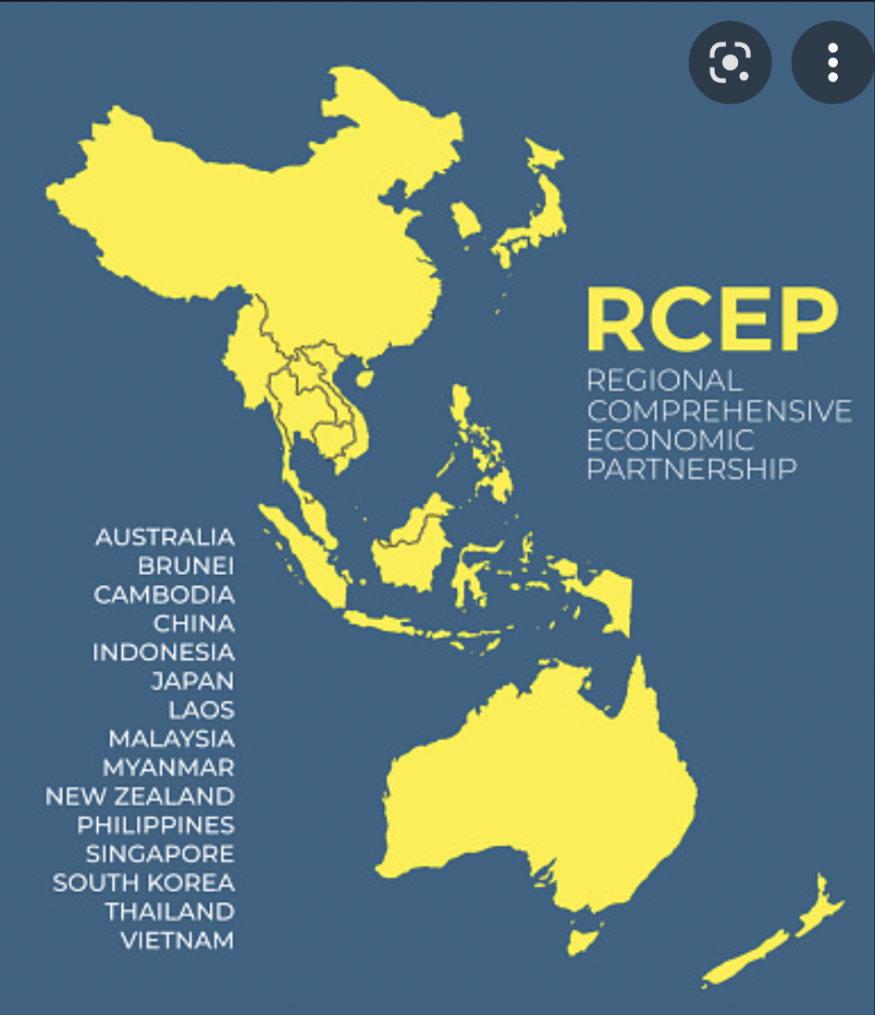
RCEP
=
Regional Comprehensive Economic Partnership

Slide 76
Other Policies to Encourage Globalization
IMF/World Bank
  Policy advice to open markets (the ”Washington Consensus”)
  Loans to countries conditional on
    Reducing trade barriers
    Permitting capital flows
GATT/WTO (World Trade Organization) [More on this later, if time]
  Negotiate reciprocal trade liberalization
  Settlement of trade disputes (usually about interfering with trade)
Bilateral Investment Treaties
  Better treatment of multinational corporations

Slide 77
Policies that Discourage Globalization

Slide 78
Trump’s Tariffs and Trade War

Slide 79

Source: Flaaen & Pierce 2020
Notes:
Flaaen and Pierce 2020
https://www.federalreserve.gov/econres/feds/files/2019086pap.pdf

Slide 80

Source: Flaaen & Pierce 2020
Notes:
Flaaen and Pierce 2020
https://www.federalreserve.gov/econres/feds/files/2019086pap.pdf

Slide 81

Source: CNBC.com
Notes:
SEPTEMBER 18, 2019 | Yen Nee Lee, CNBC.com
http://nbr.com/2019/09/18/these-4-charts-show-how-us-china-trade-has-changed-during-the-tariff-dispute/

Slide 82

Phase One Agreement Reductions Jan 2020
US tariffs on China
Agriculture
Industrial
China tariffs on US
Agriculture
Industrial
Other Features:
China to buy $200 billion more US exports
Promises:
  intellectual property protection,
  forced technology transfer,
  regulatory trade barriers
Source: Zheng et al. Oct 2021
Notes:
Zheng, Jian, Shudong Zhou, Xingzi Li, Antonio Domingos Padula, Will Martin, “Effects of Eliminating the US-China Trade War Tariffs,” 27 October 2021
Bown, Chad P., “US-China phase one tracker: China’s purchases of US goods,” PIIE, July 19, 2021
https://www.piie.com/research/piie-charts/us-china-phase-one-tracker-chinas-purchases-us-goods
Simon Lester and Huan Zhu, “The U.S.-China Phase One Trade Deal: On to Phase Two, or Time to Phase It Out?” Cato, March 22, 2021.
https://www.cato.org/blog/us-china-phase-one-deal-phase-two-or-time-phase-it-out

Slide 83
Effects of Tariffs

Slide 84
Effects of a tariff
A tariff is a tax on imports. It causes
  A rise in the price of the imported good in the importing country
  A fall in the price of the imported good in the exporting country
  The quantity imported to fall
  The revenue of the tariff-levying government to rise
Almost always: the rise at home is much larger than the fall abroad
  That’s especially true if importing country is small
  But it’s also true if importing country is as large as the U.S.
  Example: Trump’s tariffs caused US prices to rise, with hardly any perceptible fall in prices abroad.

Slide 85
Effects of a tariff
The rise in price in the importing country causes
  A rise in price of competing goods produced there
  Benefits to those producers
  Harm to buyers of both the import and the competing goods
    Including producers that use the higher-priced goods as inputs
      Their prices also rise, hurting their buyers
  Employment changes:
    Increase in the protected industry
    Decrease in industries that use the protected product as inputs
  Example: Trump’s 25% tariff on steel
    Helped US steel firms and their workers
    Hurt US auto firms and workers
      and many other industries that use steel

Slide 86
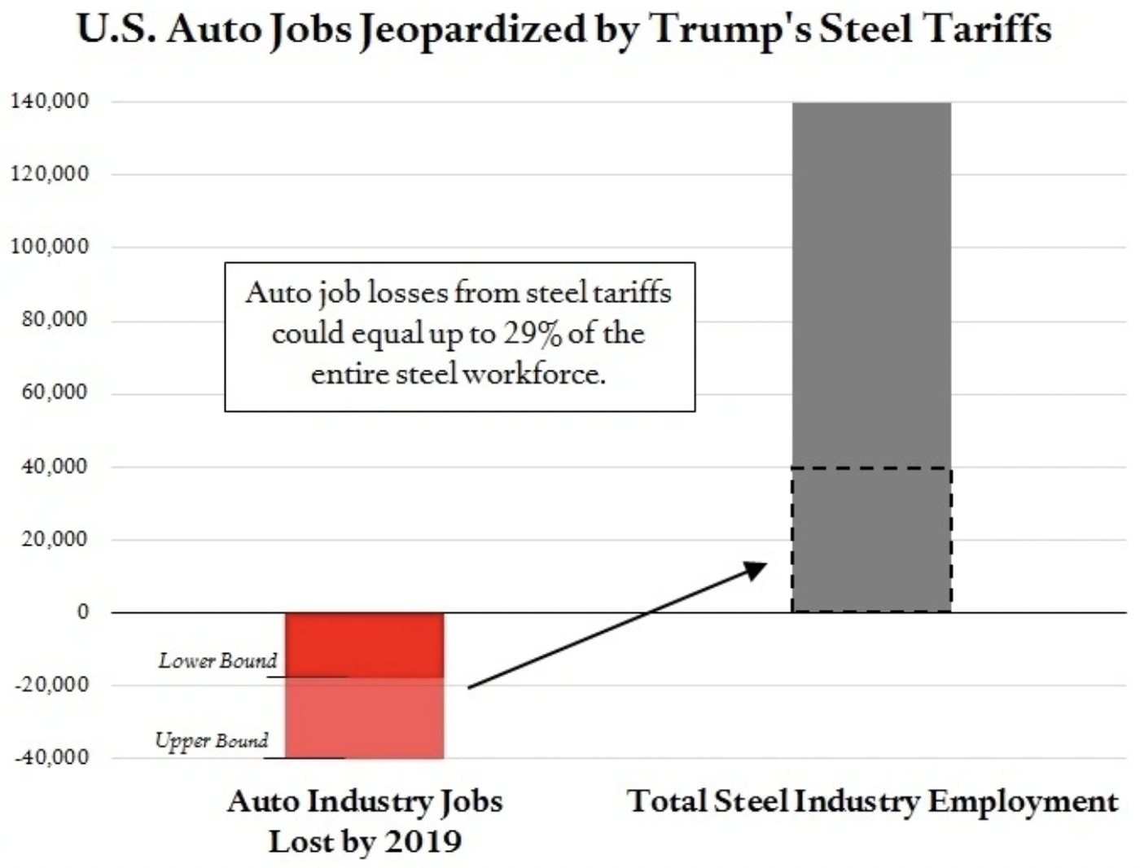
Effects of a tariff
Source: Steil & Rocca,
Council on Foreign Relations,
3/8/2018
Notes:
https://www.cfr.org/blog/trump-steel-tariffs-could-kill-40000-auto-jobs-equal-nearly-one-third-steel-workforce

Slide 87
Effects of a tariff
“Nationally, steel and aluminum tariffs resulted in at least 75,000 job losses in metal-using industries by the end of last year [2019],
  according to an analysis by Lydia Cox, a Ph.D. candidate in economics at Harvard University, and Kadee Russ, an economics professor at the University of California, Davis.”
Notes:
Rajesh Kumar Singh, “Trump steel tariffs bring job losses to swing state Michigan,” Reuters, October 9, 2020
https://www.reuters.com/article/us-usa-election-steel-insight/trump-steel-tariffs-bring-job-losses-to-swing-state-michigan-idUSKBN26U161
Kadee Russ and Lydia Cox, “Steel Tariffs and U.S. Jobs Revisited,” Econofact, February 6, 2020.
https://econofact.org/steel-tariffs-and-u-s-jobs-revisited
Calculated from Flaan and Pierce 2020
https://www.federalreserve.gov/econres/feds/files/2019086pap.pdf

Slide 88
Effects of a tariff
If the tariff is on exports from only one country (e.g, China)
  Buyers shift to imports from other, more costly, countries (e.g., Vietnam)
  Sellers shift to export to other countries that pay less
  Both lose a little

Slide 89
Arguments for and against tariffs
If economists are so opposed to tariffs, why are they used?
Arguments for protection
  Many have been used, both past and present
  Some are potentially valid, but better policies exist
  See the list in my Glossary of International Economics

Slide 90

Arguments for tariffs
National security
Government Revenue
Strategic trade policy
Distribution
Infant Industry
Source: Deardorffs’ Glossary of International Economics

Slide 91
Arguments against tariffs
Arguments against tariffs
  Economic gains from trade (see above)
  Tariffs prompt retaliation
  Some valid arguments for tariffs depend on information that is either
    Unavailable, or
    Available only from the protected industry
  Even when net beneficial, tariffs are politically hard to remove
  Lower tariffs and greater trade reduce the likelihood of war
Skip to Conclusions

Slide 92
The Role of Trade Agreements
Countries have negotiated trade agreements throughout history
  At least back to the 1500’s between the Ottoman Empire and the powers of Europe
  The first “free trade agreement” (FTA) was between Britain and France in 1860, soon followed by many more
    Removed tariffs on trade with each other
  US used “reciprocal trade agreements” starting in 1934 to reduce tariffs and dig out of the Great Depression
  US led negotiation of multilateral agreements via
    GATT (General Agreement on Tariffs and Trade) 1948
    WTO (World Trade Organization) 1995

Slide 93
The Role of Trade Agreements
Trade Agreements (both WTO & FTAs)
  Promote trade by
    Reducing tariffs
    Blocking policies that discriminate against imports
  But they also do much else, mostly to serve business interests:
    Permit anti-dumping duties to deter competition
    Protect intellectual property (patents, etc.)
    Allow investor action against governments

Slide 94
The Role of Trade Agreements
WTO
  164 member countries
  Includes
    China since 2001
    Russia since 2012
    Not Iran, N. Korea
  Headquarters Geneva, Switzerland

Slide 95


Slide 96



Slide 97
The Role of Trade Agreements
The WTO has
  Three Parts:
    GATT (Still exists, as largest part of WTO)
      limits tariffs
      Permits exceptions (anti-dumping, etc.)
    GATS = General Agreement on Trade in Services
    TRIPs Agreement = Trade Related aspects of Intellectual Property Rights
  Two Basic Principles
    Most Favored Nation (Don’t discriminate among exporters)
    National Treatment (Don’t discriminate against imports)

Slide 98
The Role of Trade Agreements
The WTO’s Main Functions
  Negotiation of reduced trade barriers
    Tariffs (GATT did this well; WTO has not)
    Removal of other barriers
  Dispute settlement
    Countries bring cases against others
    WTO “panels” and “Appellate Body” decide

Slide 99
The Role of Trade Agreements
WTO Negotiation
  Ministerial Meetings
    Held every ~2 years 1996-2017
    Most recent, #12, was delayed,
      But happened June 12-17, 2022, in Geneva
      Didn’t do much: Ended subsidies to illegal fishing
    Next, #13, will be in 2024, in United Arab Emirates
Notes:
Case counts as of 6/15/22
https://www.wto.org/english/tratop_e/dispu_e/dispu_by_country_e.htm

Slide 100
The Role of Trade Agreements
WTO Negotiation
  Agreements
    Multilateral (all members)
      None on tariffs
      A few on other measures (e.g., export subsidies in agriculture)
    Plurilateral (willing members)
      Government procurement
      Information technology
      Telecoms
      Financial services
Notes:
Case counts as of 6/15/22
https://www.wto.org/english/tratop_e/dispu_e/dispu_by_country_e.htm

Slide 101
The Role of Trade Agreements
WTO Dispute Settlement
  There have been 617 cases initiated since 1995 (as of 6/5/23)
  About 90% have been decided in favor of the complainant, both by US (132) and against US (168)
  The mechanism has been unable to decide cases since December 10, 2019 when
    President Trump blocked appointments to Appellate Body
    President Biden has not changed this
Notes:
Case counts as of 6/15/22
https://www.wto.org/english/tratop_e/dispu_e/dispu_by_country_e.htm

Slide 102
Globalization’s Future?

Slide 103
Globalization’s Future?
Will trade, travel, etc. come back?
  Yes, but never resume the pre-2008 growth
  They’ve been hit hard by financial crisis, trade war, pandemic, and now war
Will attitudes change?
  Yes.
  Firm’s will try to limit exposure (“just in case” instead of “just in time”)
  Consumers may learn to live differently
  Reported July 20: Biden administration wants “friend-shoring.” No mention yet of policies.
Will economists’ views of globalization change?
  I think so.
    We still think globalization is good overall,
    But we’re learning that it needs to include
      Reduced reliance on single sources
      Greater protections for those who are hurt.

Slide 104
Trade Deficits and Exchange Rates

Slide 105
Bitcoins: What Is All the Excitement About?
Was

Slide 106
Thank you!
Any Questions?
www.NEEDEcon.org
Alan Deardorff
alandear@umich.edu
Contact NEED: info@NEEDEcon.org
Submit a testimonial: www.NEEDEcon.org/testimonials.php
Become a Friend of NEED: www.NEEDEcon.org/friend.php

