Slide 1
Contemporary Trade Issues
OLLI, Santa Clara University
May, 2022
Adina Ardelean, Ph.D.

Slide 2
National Economic Education Delegation
Vision
One day, the public discussion of policy issues will be grounded in an accurate perception of the underlying economic principles and data.
Mission
NEED unites the skills and knowledge of a vast network of professional economists to promote understanding of the economics of policy issues in the United States.
NEED Presentations
Are nonpartisan and intended to reflect the consensus of the economics profession.

Slide 3
Who Are We?
Honorary Board: 54 members
2 Fed Chairs: Janet Yellen, Ben Bernanke
6 Chairs Council of Economic Advisers
Furman (D), Rosen (R), Bernanke (R), Yellen (D), Tyson (D), Goolsbee (D)
3 Nobel Prize Winners
Akerlof, Smith, Maskin
Delegates: 645+ members
At all levels of academia and some in government service
All have a Ph.D. in economics
Crowdsource slide decks
Give presentations
Global Partners: 48 Ph.D. Economists
Aid in slide deck development

Slide 4
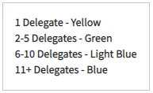
Where Are We?

Slide 5
Credits and Disclaimer
This slide deck was authored by:
Peter Eppinger, University of Tübingen
James Lake, Southern Methodist University
Michael Plouffe, University College London
Swati Verma, ISID, New Delhi
This slide deck was reviewed by:
Alan Deardorff, University of Michigan
Ed Leamer, UCLA
Disclaimer
NEED presentations are designed to be nonpartisan.
It is, however, inevitable that the presenter will be asked for and will provide their own views.
Such views are those of the presenter and not necessarily those of the National Economic Education Delegation (NEED).

Slide 6
Trade Summary
Trade and growth are positively related.
Gains from trade can be widespread (lower prices for consumers).
Losses from trade can be highly concentrated.

Slide 7
Outline
Distributional Impact of International Trade
Recent U.S. Trade Policy

Slide 8
DISTRIBUTIONAL IMPACTS

Slide 9
Intuition on Distributional Impacts
Jobs
U.S. imports more of some goods
Reduces jobs on those industries
U.S. exports more of other goods
Creates jobs in those industries
Are there different kinds of workers in these different industries?
Creates adjustment costs
Prices
LOWERS the price on imported products
RAISES the price on exported products
Who buys which products?

Slide 10
What Does the Data Say? Trade Benefits Some Workers
Trade liberalization raises wages at “most globalized” firms
Wages higher because
lower tariffs on imported inputs used by firm
lower tariffs on products sold by exporting firms

Slide 11
What Does the Data Say? Trade Hurts Some Workers
Some parts of US highly exposed to import competition.
Workers tend to be “stuck” in these locations and/or industries and lose jobs.
And, their communities lose customers.
Effects of Chinese import competition: 1990-2007
Higher unemp, lower labor force participation & wages in exposed locations
Accounts for nearly 25% of manuf employment decline
Effects of NAFTA-led US tariff cuts on Mexico
For workers without a college degree
Up to 8% point lower 1990s wage growth in highly exposed locations
Up to 17% point lower 1990s wage growth in highly exposed industries

Slide 12
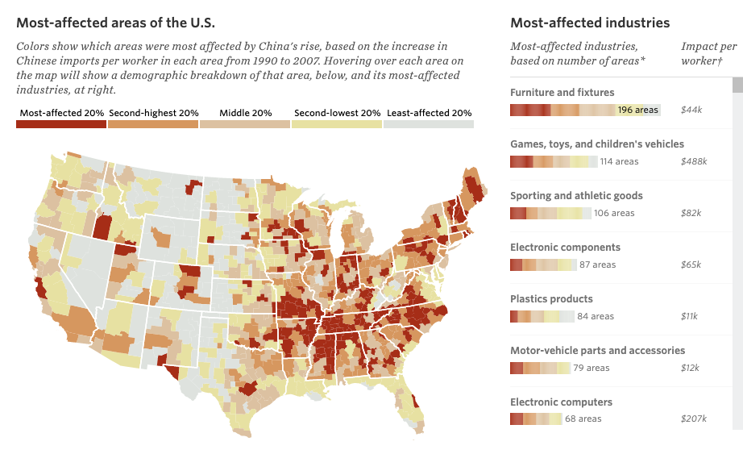
China Shock
Source: https://chinashock.info/
Notes:
.

Slide 13
What Are The Effects of Offshoring on Employment and Wages in the U.S.?
Two main effects on US workers expected in theory:
Negative relocation effect → Job losses and lower wages
Positive productivity effect: Cost savings increase competitiveness → Job growth and higher wages
Ambiguous net effect in theory
Extreme example for the productivity effect: Apple Inc.
Has offshored most production activities and become a “factoryless” firm
Employs 80,000 US workers in R&D, design, marketing,… (and growing)
Other concerns: inequality (skill bias), national security

Slide 14
Empirical Evidence on The Effects of Offshoring
Offshoring of manufactured goods and components
… might have positive or negative employment effects → mixed evidence
… tends to reduce domestic wages in offshored occupations
… hurts low-skilled workers more and can increase income inequality
… boosts industry output and firm productivity
Offshoring of services
… is a much smaller phenomenon (little data)
… seems to have more favorable, non-negative employment effects

Slide 15
Costs of Trade
We have known for almost 80 years that trade with low-wage countries will lower the earnings of low-wage workers as a group in the U.S.A. (Stolper-Samuelson 1941)
Perhaps more importantly, however, is that the adjustment costs, or what some call transition costs, are much larger than previously thought. People do not like to move and getting laid off can be very traumatic.
Recent economics studies have estimated the costs of trade across many different groups.
Inequality
Adjustment costs

Slide 16
Understanding Adjustment Costs
FIRMS
Searching for new workers
Training
Adjusting to the new employees/integration
Firing costs/severance pay
WORKERS
Psychological costs of leaving a job, friends
Loss of firm-specific or industry-specific skills
Search costs for a new job
Relocation costs (e.g. moving to a new location)

Slide 17
Estimates of Adjustment Costs
FIRMS
Estimates from developed countries suggests that costs are high
High adjustment costs cause firms to hire and fire in large groups, rather than gradually
Estimates from developing countries suggest that firm-level adjustment costs are much lower than in developed countries
WORKERS
New estimates in the last 10 years
Estimate costs by looking at wage differences and how many workers do NOT move. Adjustment costs must be at least that high

Slide 18
Estimated Costs to Workers of Changing Jobs

Slide 19
Characteristics of Adjustment Costs
Some regions get hit especially hard when imports increase
Production of some goods is highly concentrated geographically
USA: Detroit (autos), El Paso (apparel), South Carolina (Textiles)
Local unemployment rates can be very high, even when national rates are low
Term “adjustment costs” understates impact on affected workers
“Adjustment” may take a generation or more. Kids may take different jobs than parents
For affected workers, the effect may be permanent
Wages are never recovered
Psychic costs of job loss can be very long-lasting and affect families
Adjustment costs can reduce gains from trade significantly

Slide 20
Why Adjustment Costs Matter
Adjustment costs can undermine the popular support for trade
Falling popular support for trade in the face of concentrated losses threatens to “kill the goose that lays the golden egg”
Adjustment costs reduce welfare
Adjustment costs suggest potential for efficiency gains. If we can make (labor) markets more efficient, then the whole economy could realize significant gains

Slide 21
Distributional Impacts of Trade: Unemployment
Generally, trade theory has nothing to say about unemployment.
Trade is primarily about reallocating resources
Some sectors expand, other sectors decline
Labor, capital, land etc. move from import-competing to exporting sector
Typical assumption in trade theory models…
this reallocation happens costlessly and immediately
However, recent empirical evidence suggests otherwise.
Workers can face very large costs of moving between sectors or locations
Rising exposure to import competition can…
Increase unemployment, reduce labor force participation

Slide 22
Trade is Not a Driving Force of Unemployment
U.S. National Unemployment Rate
Import competition may contribute to factories closing and job loss, but there are many other factors that also contribute to job loss.
The national unemployment rate is driven by business cycles, and not by trade.
Over the same period shown in the graph, trade has been rising.

Slide 23
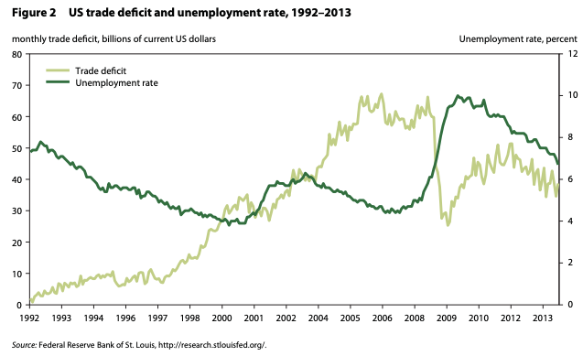
Trade Deficit and Unemployment
Source: Hufbauer et al. (2014) “NAFTA at 20: Misleading Charges and Positive Achievements”, PIIE

Slide 24
U.S. Trade Policy

Slide 25
US Tariffs, 1891-2017
Tokyo Round tariff cuts
Smoot-Hawley
GATT
established
Kennedy Round tariff cuts begin
Uruguay Round

Slide 26
US Trade Policy
Barriers against import surges and imports of unfairly traded products
Bilateral and multilateral trade agreements to increase market access for U.S. exports
Leadership in GATT/WTO
Non-discrimination

Slide 27
US Trade Policy in Practice: Congress
Constitution gives Congress exclusive power over trade policy
Frequently passes “Miscellaneous tariff bills” (MTB)
Temporarily remove tariffs on thousands of products
Sept 2018 MTB: chemicals, footwear, toasters, 1600 other products
Tariff Act of 1930 implemented the Smoot-Hawley tariffs
50% increase in US tariffs
Highest US tariffs over 1828-2018 period
Congress has delegated much authority to the Executive
Main historical uses of Executive authority
Negotiating reciprocal trade agreements (e.g. WTO and FTAs)
1934 Reciprocal Trade Agreements Act, now “trade promotion authority”
Temporary trade barriers (TTBs) via Tariff Act of 1930

Slide 28
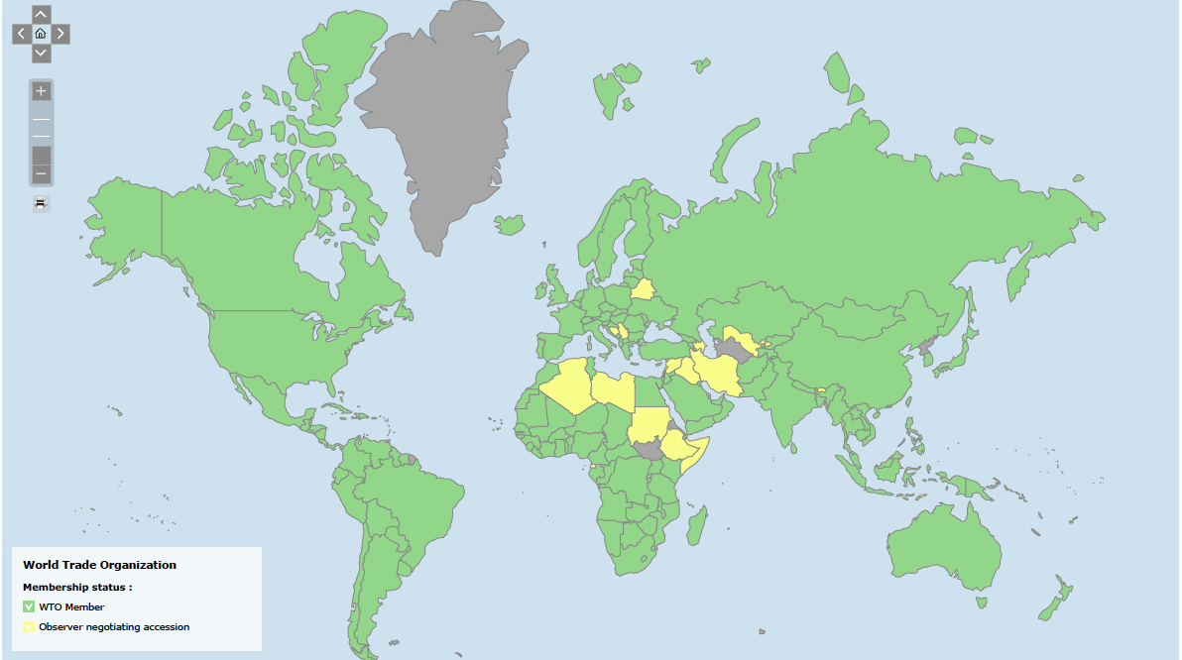
WTO
Multilateral Trade Agreement
164 member countries
Includes: China since 2001, Russia since 2012, Not Iran, N. Korea
Headquarters: Geneva, Switzerland
First established in 1947 as G.A.T.T. (23 member countries)
Last completed round of negotiations: Uruguay Round in 1994.

Slide 29
US Trade Policy in Practice: Congress & WTO
Congress passed legislation committing US to WTO rules
1994 Uruguay Round Agreements Act
WTO built on 1947 GATT rules
Basic rule: Most Favored Nation (MFN) principle
Impose same tariff, the “MFN tariff”, on all WTO members
Committed to upper bounds on these MFN tariffs
Average 2017 US MFN tariff (upper bound or applied): 3.4%

Slide 30
US Trade Policy in Practice: Congress & WTO
Key exceptions to principle of MFN tariffs
Free Trade Agreements (FTAs, e.g. NAFTA)
Eliminate tariffs between FTA members (for nearly all products in US FTAs)
Other rules: non-tariff barriers, product standards, trade disputes
US trade with FTA partners: 35% of imports, 42% of exports
Below MFN tariffs for developing countries
“GSP” program & other similar programs
TTBs
TTB tariffs can violate non-discrimination and upper bounds

Slide 31
WTO Dispute Settlement
Streamlined process to resolve trade disputes between member countries
WTO “panels” and “Appellate Body” decide
612 cases initiated since 1995
US has won 132 cases and lost 168 cases.
Unable to decide cases since December 10, 2019 when
President Trump blocked appointments to Appellate Body
President Biden has not changed this.

Slide 32
The Role of Trade Agreements
Promote trade by
Reducing tariffs
Blocking policies that discriminate against imports
They also do more, mostly to serve business interests:
Permit anti-dumping duties to deter competition
Protect intellectual property
Allow investor action against governments
Recent U.S. Trade Agreements:
KORUS (March 15, 2012)
USCMA: renegotiation of NAFTA (July 1, 2020)

Slide 33
NAFTA
Went into effect on January, 1, 1994.
Overall trade and cross-border investment has increased.
Tight integration of North American supply chains.
The effect on jobs and wages:
At most 5% of annual job churn, ~ 200,000 jobs
188,000 new jobs each year due to increased exports to Mexico.
New jobs pay 7-15% more than the import-competing jobs.
No significant effect on US wages in the manufacturing sector.
Increased imports benefited consumers and US firms, raising their productivity.
Modest positive impact on U.S. GDP.
Source: Hufbauer et al. (2014) “NAFTA at 20: Misleading Charges and Positive Achievements”, PIIE

Slide 34
USCMA
Stricter environmental policies and requirements for wages
Encouraged digital trade and curbed state-owned enterprises
Additional requirements for autos to qualify for NAFTA’s low tariffs:
The North American content requirements in cars increased from 62.5% to 75%.
70% of producer’s steel and aluminum purchases must originate in North America
A certain percent of qualifying vehicles must be produced by employees making an average of $16 per hour.
Increased U.S. access to Canadian dairy market by about 3.6%.
Eliminated investor-state disputes between US and Canada.

Slide 35
US Trade Policy in Practice: Bureaucracy
Until recently, most frequent use of new US tariffs: TTBs
Anti-dumping duties (AD)
Tariffs imposed on foreign firms selling below fair value
Countervailing duties (CVD)
Tariffs imposed on foreign firms receiving foreign government subsidies
ADs and CVDs processes managed by bureaucracy
Congress delegated this power in Tariff Act of 1930
Department of Commerce and USITC both have veto power
USITC: US International Trade Commission
ADs and CVDs imposed on 928 occasions 1980-2016
Sep 2018: USITC rules against ADs in the Boeing-Bombardier CS100 dispute
Aug 2018: AD on large diameter welded pipe from Canada & other countries
Sept 2018: CVD on Vietnamese laminated woven sacks

Slide 36
US Trade Policy in Practice: Executive
Trump administration use of executive authority
Safeguard tariffs (Trade Act of 1974, Section 201)
If USITC agree import surge → major injury to industry: Executive power for temporary tariffs
Tariffs on imports of $8.5bn solar panels, $1.8bn washing machines
Historically: rare, used 11 previous times, last was 2002 Bush steel tariffs
National security tariffs (Trade Expansion Act of 1962, Section 232)
If Commerce Department investigation finds evidence, Executive can impose tariffs
Tariffs on $48bn of steel & aluminum imports
Historically: excluding oil imports, only used once
1986 Reagan administration: metal-cutting and metal-forming machine tools

Slide 37
US Trade Policy in Practice: Executive
Unfair trade practices tariffs (Trade Act of 1974, Section 301)
USTR established by the Trade Expansion Act of 1962
and elaborates policies for the President and conducts negotiations
USTR investigates unfair trade practices by foreign countries
Aug. 2017: investigation into Chinese practices over US IP and technology
Historically: used systematically pre-WTO, but rarely since WTO (122 since 1974; 1 since 2001)

Slide 38
Su mmary of recent applications of barriers against import surges and imports of unfairly traded products
Trade Act of 1974
Section 201 (surges): solar cells, washing machines
Section 301 (non-market activity): China forced technology transfer
Trade Expansion Act of 1962
Section 232 (national security): steel and aluminum
Trade Act of 1930
Anti-dumping and countervailing duties (cover about 80% of steel from China)

Slide 39
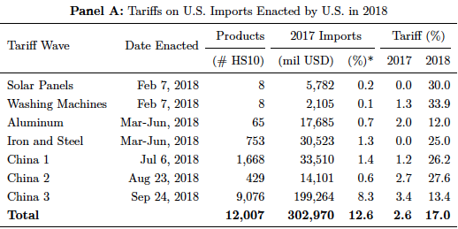
Trump’s Trade Actions
Fajgelbaum et al. (2019), The Return to Protectionism, NBER Working paper # 25638, March 2019

Slide 40
US Trade Policy in Practice: Retaliation
National security tariffs on steel & aluminum
EU, CAN, MEX, CHN have retaliated with tariffs
Proportionate to their US exports of steel & aluminum
Targeted retaliation
Industries reliant on foreign markets (e.g. pork)
Farmers (fruits & nuts), household goods (ketchup, mowers)
Politics: KY bourbon, WI ginseng & Harleys, CA Levi jeans
Unfair trade practices tariffs on China
EX: Soybeans and cars (largest and 3rd largest US exports to China), chemicals, medical equip, oil

Slide 41
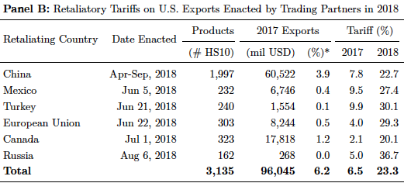
Retaliation to Trump’s Trade Actions
Fajgelbaum et al. (2019), The Return to Protectionism, NBER Working paper # 25638, March 2019

Slide 42
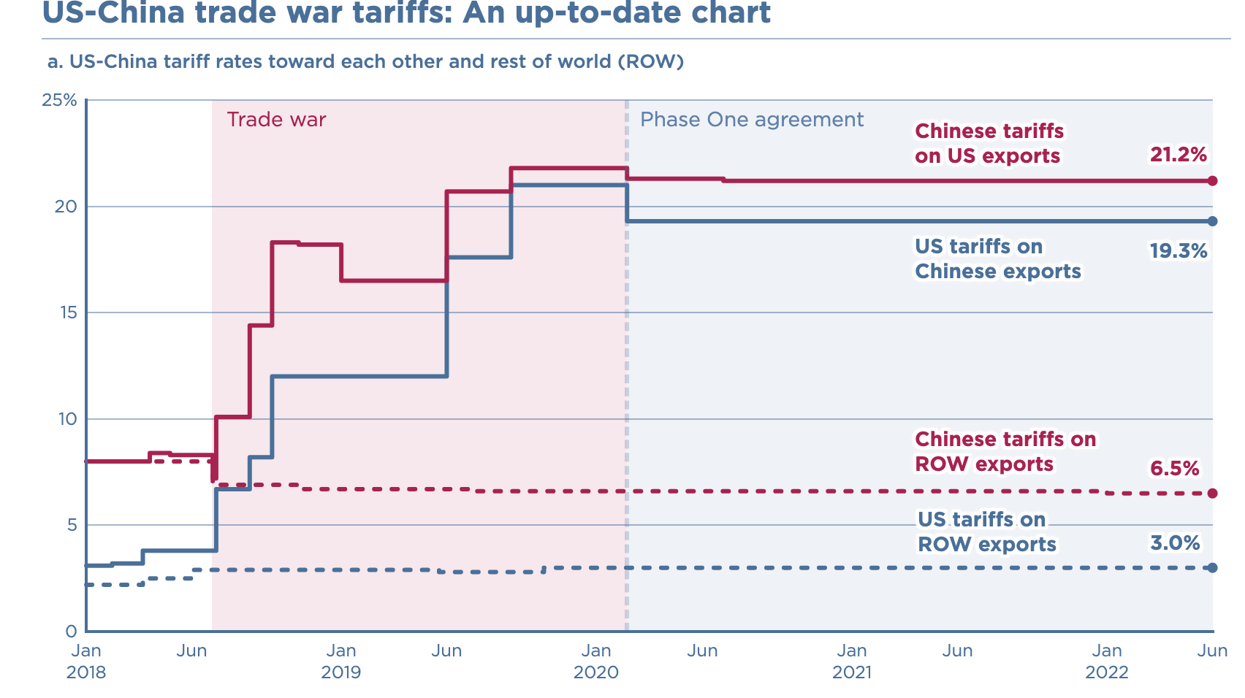
Source: Chad. P Brown, Peterson Institute of International Economics

Slide 43
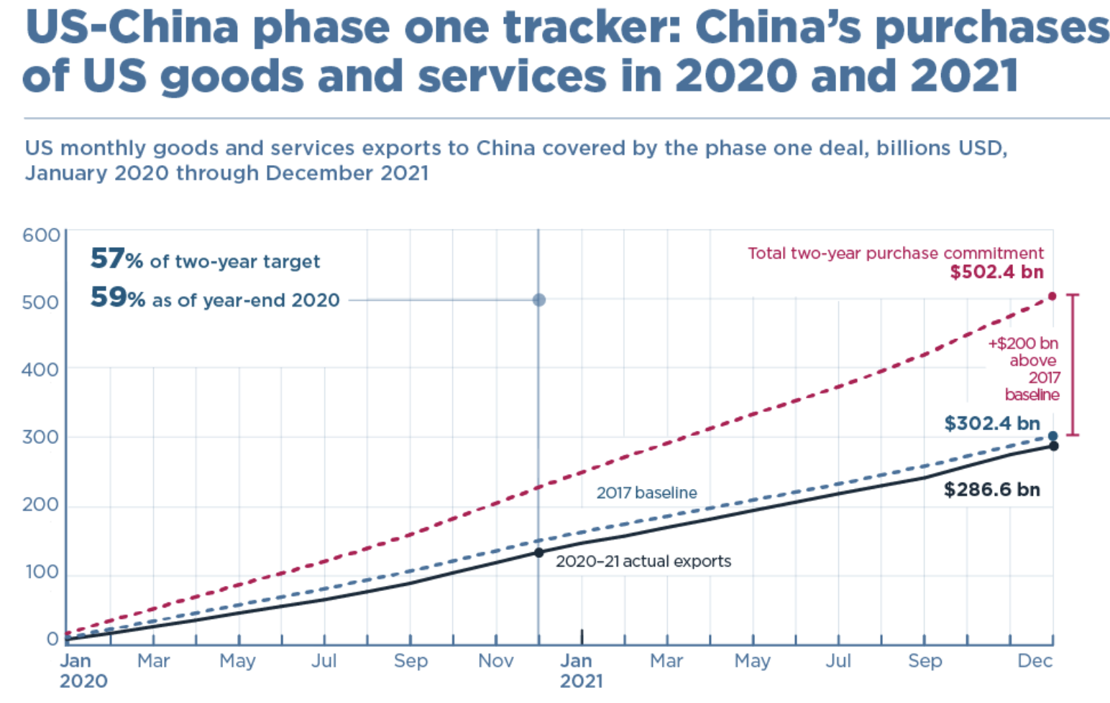
Source: Chad. P Brown, Peterson Institute of International Economics

Slide 44
Effects of Tariffs - Prices
Tariffs are taxes on imports.
Tariffs raise prices in the importing country.
Final goods (consumers)
Intermediate goods (producers who use imported inputs)
Rising prices distort consumption and production decisions
Tariffs can lower prices of the imported good in the exporting country.
The rise in the importing country is much larger than the fall abroad.
It depends on the size of the importing country.
Trump’s tariffs caused US prices to rise, without any fall in prices above.

Slide 45
Effects of Tariffs – Producers and Workers
The price increase in the importing country:
benefits domestic producers of the tariffed good.
harms buyers of the higher-priced good
Households
Firms that use the good as input: which raises the price of other goods, hurting their buyers
increases employment in the protected industry
decreases employment in industries that use the protected product as input.
Tariffs lower overall welfare, while generating very large gains for small groups
Tariffs are generally considered to be an inefficient way to help those people who are hurt by trade

Slide 46
Effects of Tariffs – Tires
In September 2009, President Barack Obama imposed new safeguard duties on car and truck tires imported from China
The existing tariffs of 3-4% were increased by an additional 35% the first year, 30% in the second year, and 25% in the third year.
The price of tires increased and U.S. importers shifted their source of supply away from China to U.S. tire producers and other countries such as Indonesia.
One study estimates that:
Consumers lost $1,112 million per year
The U.S. tire producers gained $295 million per year
1,200 jobs were “saved” in the American tire industry where the average worker’s compensation is $40,000 per year
The consumer cost of each job “saved” is about $926,000 per year.
3,731 jobs lost in the retail sector.
Hufbauer G. and Lowry S. (2012) US Tire Tariffs: Saving Few Jobs at High Cost, PIIE Policy Brief PB12-9

Slide 47
Effects of Tariffs – Washing Machines
In 2018, President Trump imposed global safeguard duties on washing machines.
The price of washing machines increased in the U.S increased by 12%.
The prices of dryers (bundled with washing machines) also increased, even if they were not subject to tariffs.
The estimated effects:
Main beneficiaries: Whirlpool (reported 200 new jobs added).
Consumers lost $1.55 billion.
Tariff revenue increased by about $82 million.
The consumer cost per job “created” was about $817,000 per year.
LG and Samsung relocated washing machine production to the U.S.
LG: Clarksville, Tennessee, 2019 – 600 new jobs
Samsung: Newberry, South Carolina, 2018 – 1,000 new jobs
Flaaen et al. (2020) “The Production Relocation and Price Effects of US Trade Policy: The Case of Washing Machines”, AER, 110(7)

Slide 48
Effects of Tariffs – Solar Panels
In 2018, President Trump imposed global safeguard duties on solar panels at the request of US companies that faced intense import competition from China.
US-based companies benefited:
Suniva (Chinese-owned manufacturing in Georgia),
SolarWorld (German-owned, later French-owned),
14 US manufacturing firms: CBS Solars
Consumers were hurt by higher prices of solar panels
Solar panel installers were hurt, led by Solar Energy Industry Association:
Loss of jobs and delay and cancellations of investment in solar energy

Slide 49
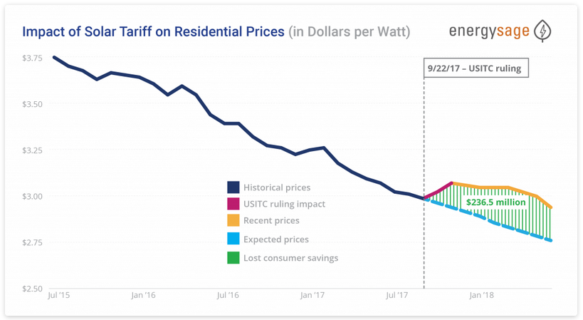
Notes:
EnergySage.com: https://news.energysage.com/2018-us-solar-tariff-impact-prices/

Slide 50
Effects of Tariffs
Tariffs invite retaliation, lowering demand for our exports.
Tariffs on only one country’s exports (e.g. China) shift imports from other, more costly countries (e.g. Vietnam) rather than increase domestic production.
Import protection can increase U.S. employment, but the change is more than offset by employment loss due to higher input prices in other industries and retaliation.

Slide 51
US Trade Policy in Practice: Winners and Losers
National security tariffs on steel & aluminum
Winners: US steel producers (Nucor, United States Steel, AK Steel) & workers
BEA: 140,000 jobs in steel producing industries
Losers #1: US consumers, including steel-consuming US firms
BEA: 2 million jobs in US industries where steel >= 5% of inputs
US industries targeted by foreign retaliation
Industry | Countries | Share of US exports
Pork | China, Mexico | 44%
Apples | China, Mexico, India | 37%
Nuts | China, India | 12%
Whiskies (e.g. KY bourbon) | EU, Canada, Mexico | 53%
Mineral water, coffee, ketchup | Canada | About 50%

Slide 52
Effects of Tariffs – Exporters
The decrease in price in the exporting country:
Harms sellers
Benefits buyers there or in other countries
Shifts sales to other countries.

Slide 53
Effects of U.S. – China Trade War
Consumers paid higher prices (complete pass-through of tariffs to prices)
Recent estimates suggest that the U.S. wages (adjusted for inflation) decreased, on average, by 1% across all U.S. counties.
Overall lower aggregate real income in both U.S. and China (not by large magnitudes relative to GDP).
Fajgelbaum P. and Khandelwal A. (2021) “The Economic Impacts of the US-China Trade War “

Slide 54
Fajgelbaum et al. (2019), The Return to Protectionism, NBER Working paper # 25638, March 2019

Slide 55
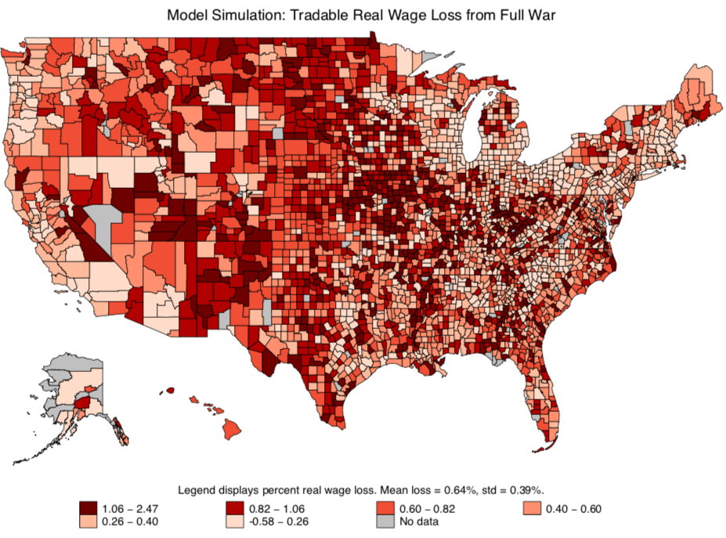
Fajgelbaum et al. (2019), The Return to Protectionism, NBER Working paper # 25638, March 2019

Slide 56
General Consensus of Economists on Tariffs

Slide 57
Arguments for Tariffs
If economists are so opposed to tariffs, why are they used?
National Security
Government revenue
Infant Industry
Strategic trade policy
Political Economy of Protection
Some of valid arguments for tariffs depend on information that is unavailable or available only to the protected industry
Even when net beneficial, tariffs are politically hard to remove.

Slide 58
Directed Support: Adjustment Costs
The most efficient way to help those hurt by trade is through direct payments
Trade Adjustment Assistance (TAA) is an example of an attempt at this principle
TAA includes some retraining funds and extended unemployment benefits
Not generally considered to be very successful
Underfunded
Hard to determine who is hurt by trade and not other factors
Larger direct payments would be most effective and efficient
Notes:
The most efficient way to offset the adjustment costs would be directed support to those who have lost a job and are struggling to find a new one.

Slide 59
Summary
Trade is beneficial, but it can generate losses and adjustments costs for some groups in the economy.
Tariffs reduce trade overall, thus imposing widespread losses to both producers (who use imported inputs) and consumers (who buy lower-priced imported goods).
More direct policies can be more efficient and save gains from trade.

Slide 60
Th e Future of Globalization?
Globalization Reversal or Slowbalization?
During 2022 IMF and World Bank Spring Meetings:
Jerome Powell, Fed Chairman noted that it is unclear if the world is witnessing a reversal of globalization, but the pace of globalization is certainly slowing down.
Kristalina Georgieva, IMF Managing Director argued that it is too early to “buy a coffin” for globalization. The world has achieved so much because of the integrated global economy, and it is irresponsible to make the world poorer.
A New Global Map:
Globalization needs to be more agile and resilient to shocks:
Less reliance on single sources by firms
Europe’s embrace of “open strategic autonomy” or U.S.’s “friendshoring”
Greater protections for those who are hurt.

Slide 61
Thank you!
Any Questions?
www.NEEDelegation.org
Adina Ardelean
<atardelean@scu.edu>
Contact NEED: info@needelegation.org
Submit a testimonial: www.NEEDelegation.org/testimonials.php
Become a Friend of NEED: www.NEEDelegation.org/friend.php

