Slide 1
Contemporary Trade Issues
OLLI, Santa Clara University
May, 2022
Adina Ardelean, Ph.D.

Slide 2
National Economic Education Delegation
Vision
One day, the public discussion of policy issues will be grounded in an accurate perception of the underlying economic principles and data.
Mission
NEED unites the skills and knowledge of a vast network of professional economists to promote understanding of the economics of policy issues in the United States.
NEED Presentations
Are nonpartisan and intended to reflect the consensus of the economics profession.

Slide 3
Who Are We?
Honorary Board: 54 members
2 Fed Chairs: Janet Yellen, Ben Bernanke
6 Chairs Council of Economic Advisers
Furman (D), Rosen (R), Bernanke (R), Yellen (D), Tyson (D), Goolsbee (D)
3 Nobel Prize Winners
Akerlof, Smith, Maskin
Delegates: 645+ members
At all levels of academia and some in government service
All have a Ph.D. in economics
Crowdsource slide decks
Give presentations
Global Partners: 48 Ph.D. Economists
Aid in slide deck development

Slide 4
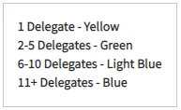
Where Are We?

Slide 5
Credits and Disclaimer
This slide deck was authored by:
Peter Eppinger, University of Tübingen
James Lake, Southern Methodist University
Michael Plouffe, University College London
Swati Verma, ISID, New Delhi
This slide deck was reviewed by:
Alan Deardorff, University of Michigan
Ed Leamer, UCLA
Disclaimer
NEED presentations are designed to be nonpartisan.
It is, however, inevitable that the presenter will be asked for and will provide their own views.
Such views are those of the presenter and not necessarily those of the National Economic Education Delegation (NEED).

Slide 6
Outline
Globalization
International Trade
Offshoring
The Benefits and Costs of Trade
The U.S. Trade Deficit

Slide 7
What is Globalization?
The growing interdependence of the world’s:
Economies
Cultures
Populations
Brought about by cross-border flows of:
Goods and services
Technology
Investment
People
Information

Slide 8
What Drives Globalization?
Transportation
Technology
International Cooperation

Slide 9
Transportation

Slide 10
Technology

Slide 11
International Cooperation

Slide 12
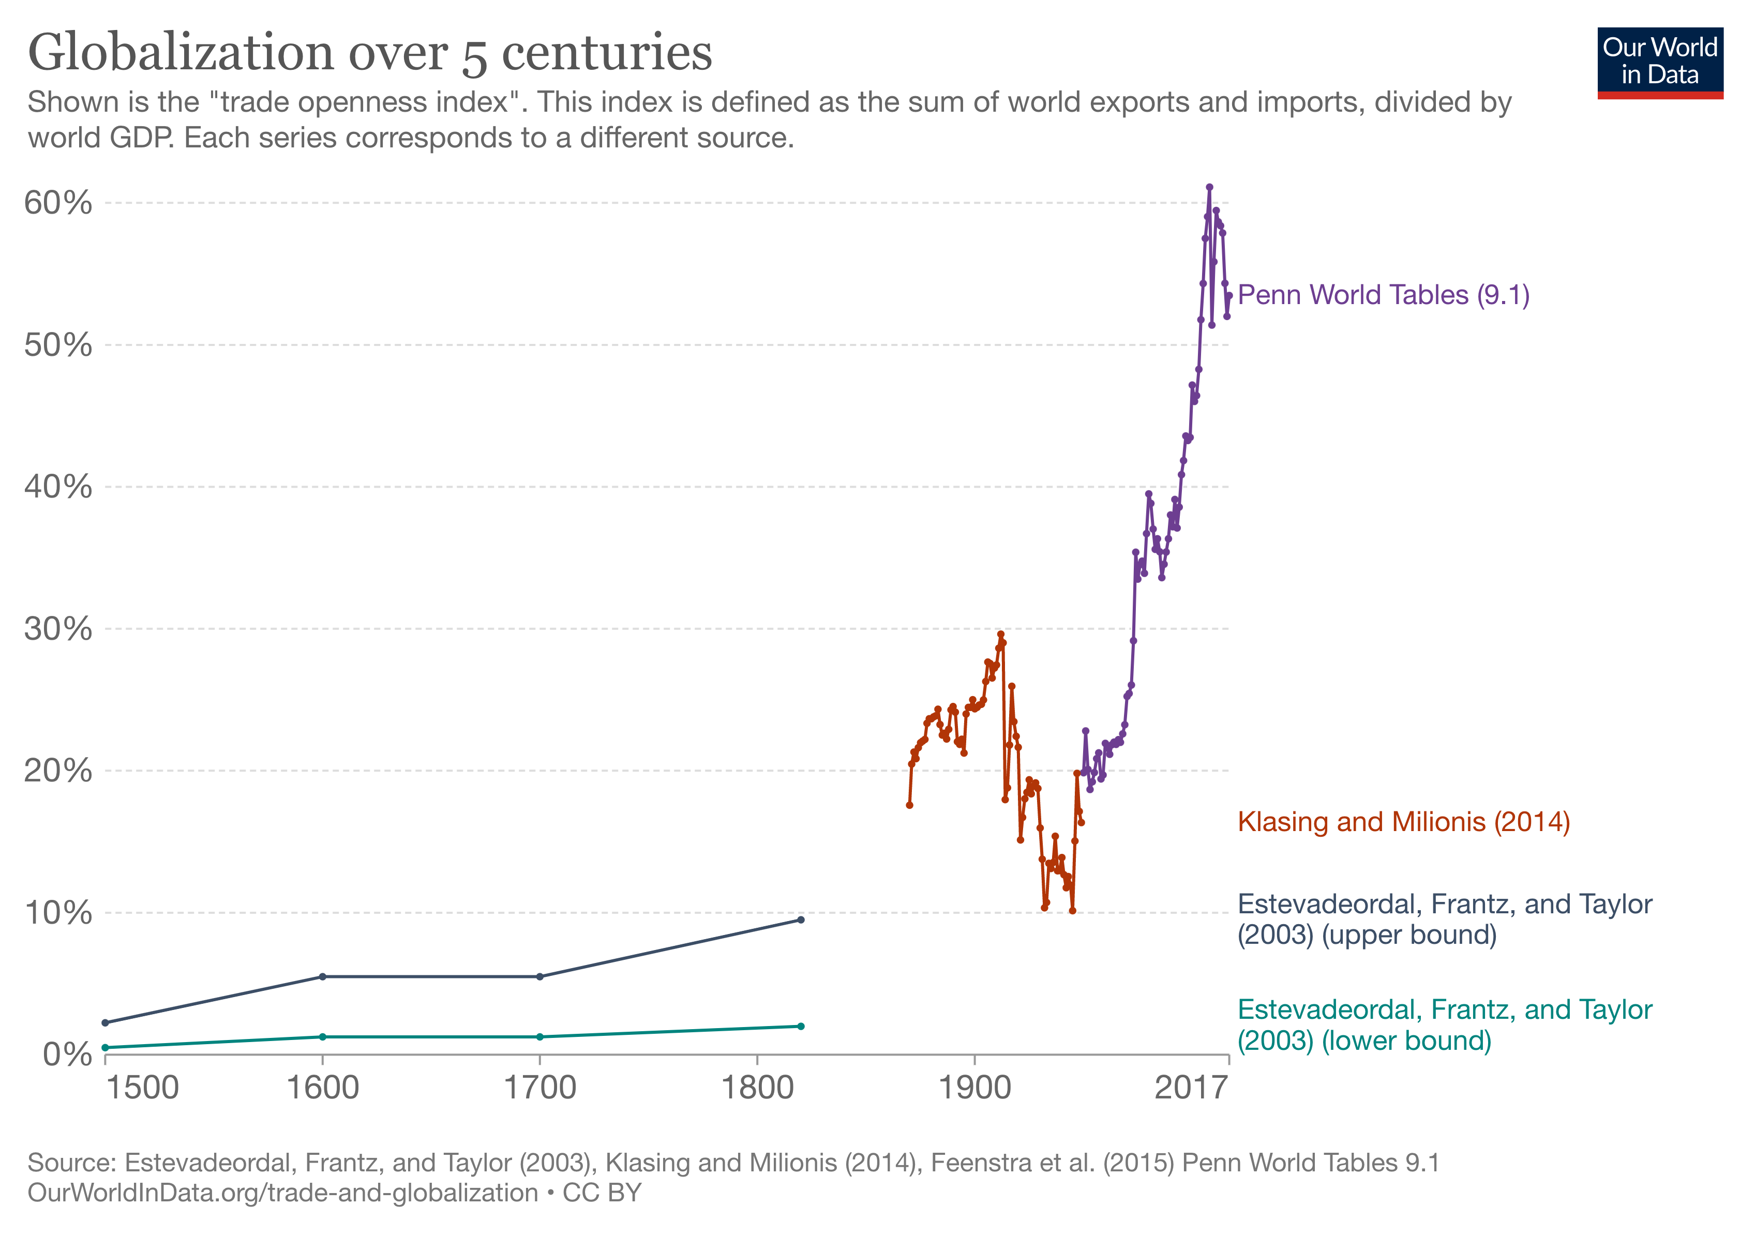

Slide 13
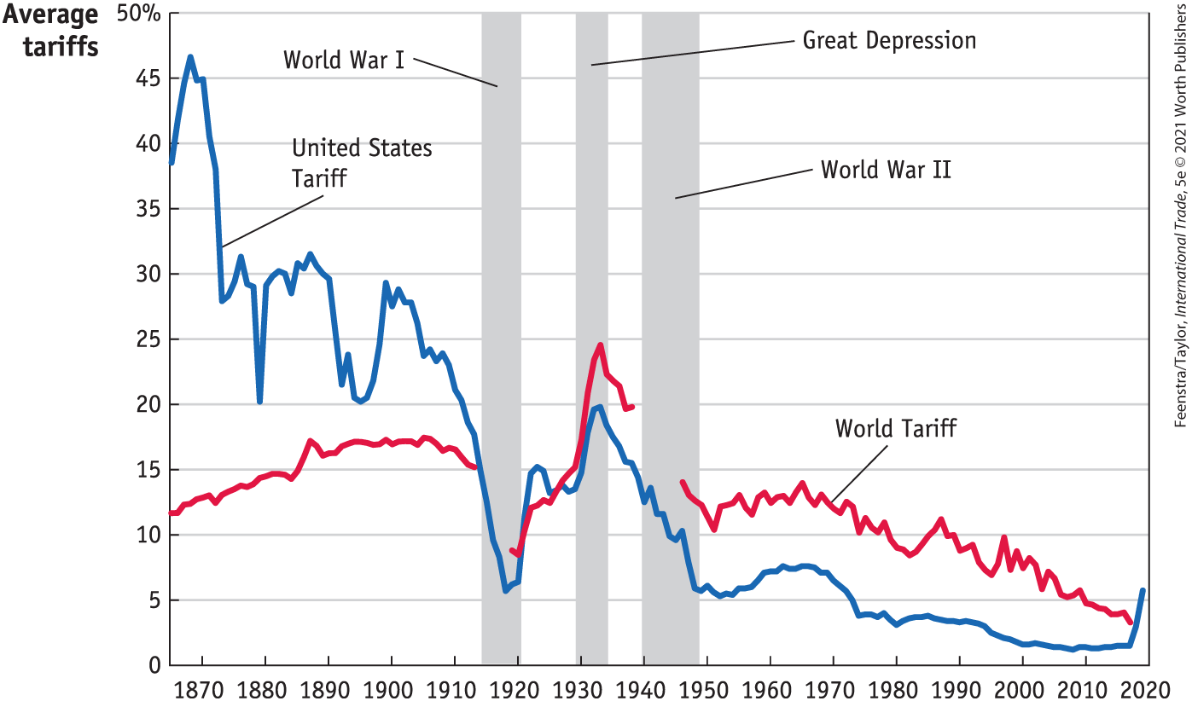
Tariffs, 1860-2019
Source: International Economics, 5e | Feenstra/Taylor, Worth Publishers

Slide 14
International Cooperation – Ending?

Slide 15
Russia – Ukraine War
How the war affects globalization
The war and trade sanctions disrupt trade (wheat, oil)
Financial sanctions by governments disrupt financial linkages
Private companies cease or reduce their operations in Russia

Slide 16
Russia and Ukraine Trade
Russia’s trade in 2019:
Total trade represents a small share of world trade (1.7%).
Trade(% of GDP): 49.44%
Fuels represent 51.95 % of their exports.
Top 5 destinations are: China, Netherlands, Germany, Belarus, Turkey
Top 5 exporters: China, Germany, Belarus, United States and Italy.
Ukraine’s trade in 2018:
Trade (% of GDP): 90.41%
Top export products: cereals (sunflower, wheat, maize) and metals
Top 5 destinations are: Russia, Poland, Italy, Turkey, and Germany
Top 5 exporters: Russia, China, Germany, Belarus, and Poland
Data Source: World Integrated Trade Solution

Slide 17
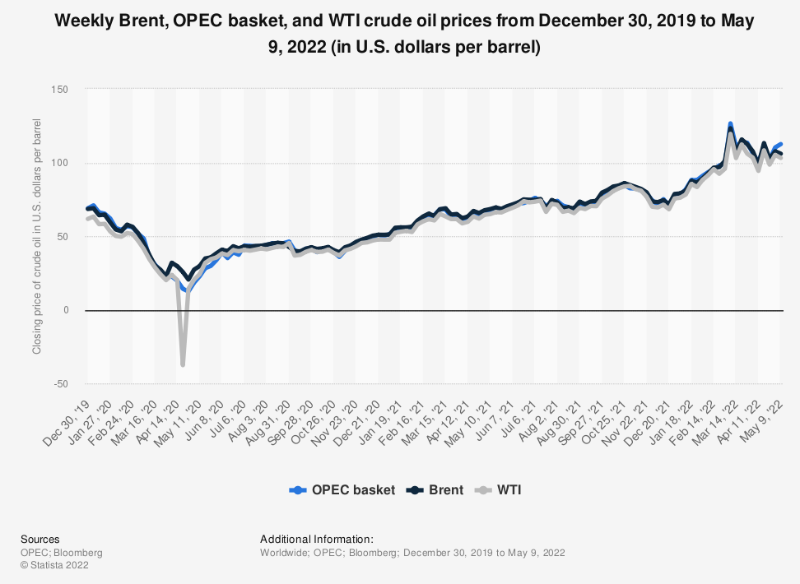
Oil Price

Slide 18
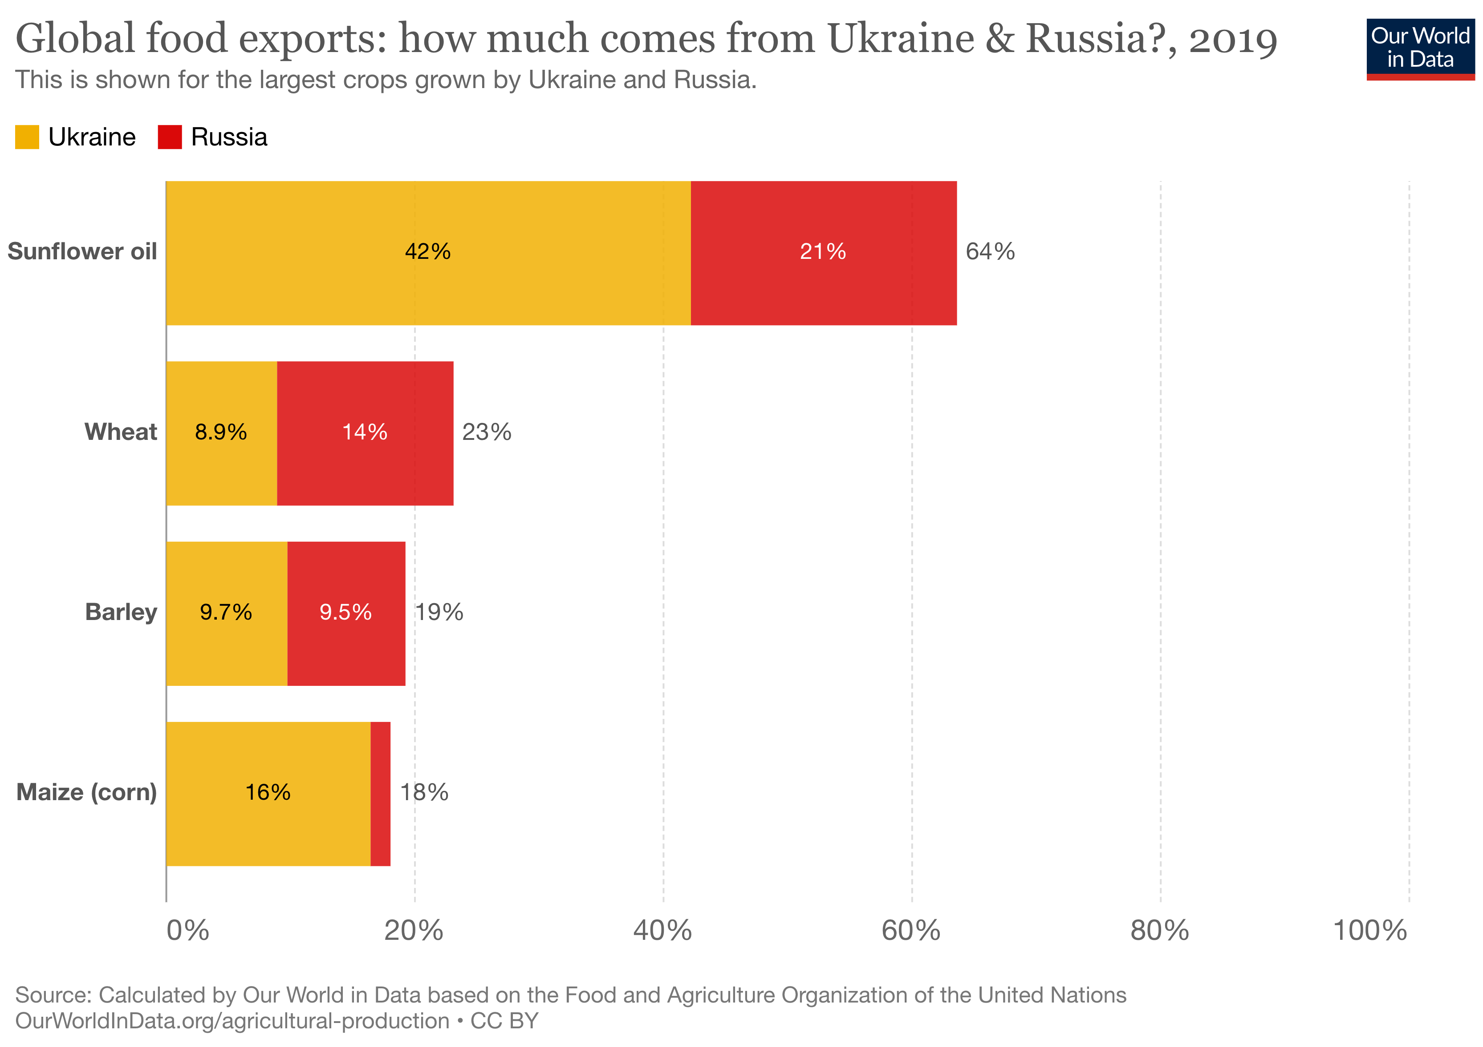
Russia and Ukraine Food Exports

Slide 19
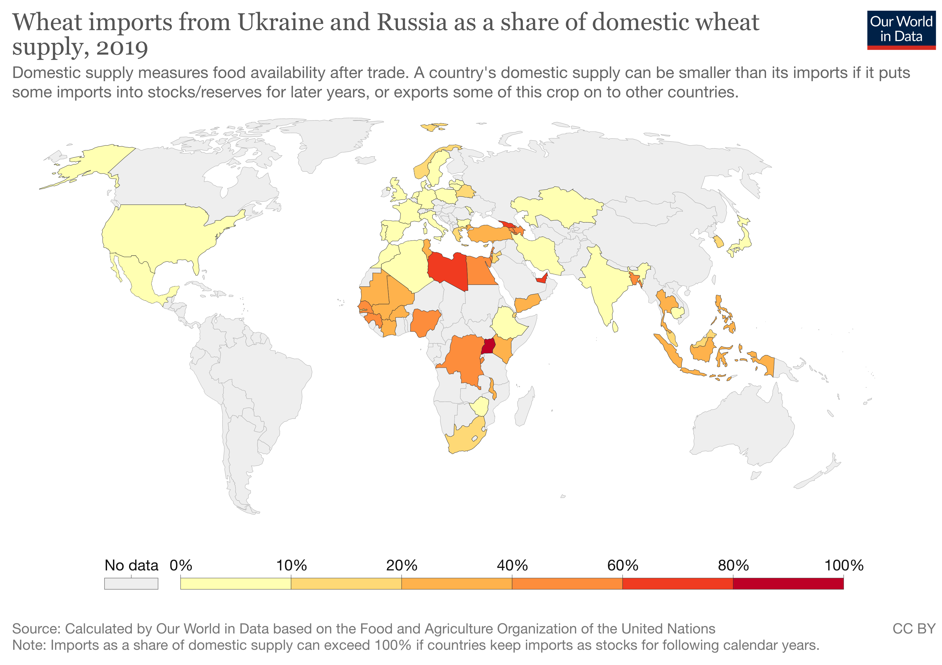

Slide 20
Effect of Sanctions
It too early to say whether the sanctions will work.
Past sanctions have sometimes worked.
Preliminary evidence suggests that the Russian economy is holding up (The Economist, May 2022):
Russian consumer prices have increased by more than 10%.
The Russian economy is shrinking (predicted 5% GDP decline)
The rouble is back to its level before the war started (bolstered by capital controls and high interest rates)
Since the invasion, Russia exported at least $65 billion dollars worth of fossil fuels
If Russia becomes more isolated, these unprecedented sanctions will get Russia to withdraw, but it is not guaranteed.

Slide 21
International Trade
Exports and Imports
Notes:
In the following slides I will talk about US International Trade and its importance in the US economy.

Slide 22
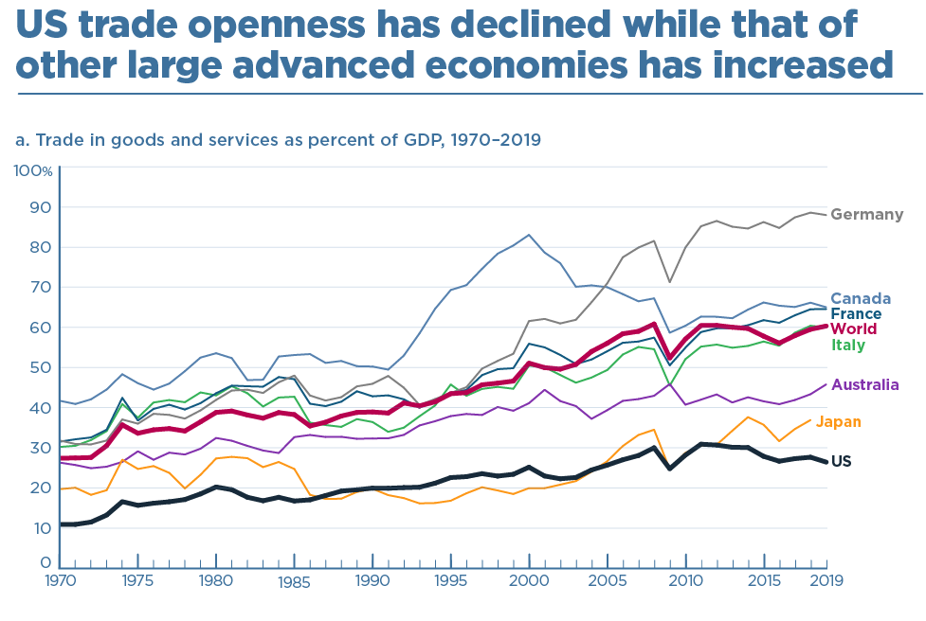

Slide 23
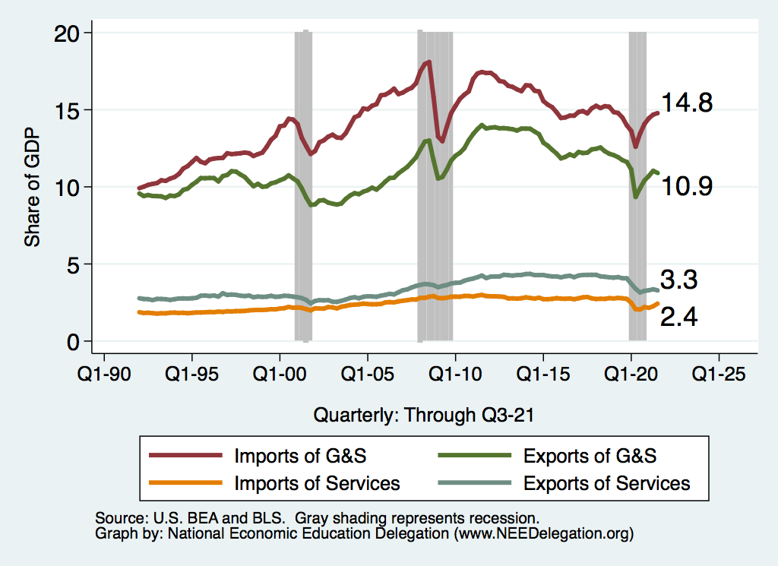
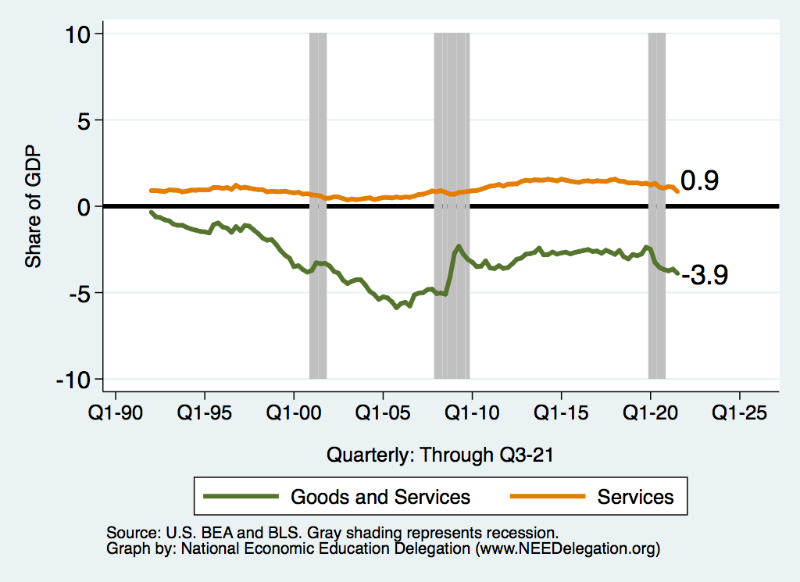
Importance of US Trade
US trade as % of GDP
US trade balance as % of GDP

Slide 24
What do we Export? ($1.51 Trillion in 2019)
Rank | U.S. Export Product | % of Total Exports
1 | Machinery and appliances | 13.7%
2 | Mineral fuels and oils, and products | 13.2%
3 | Electrical machinery and equipment | 10.8%
4 | Vehicles and their parts | 8.68%
5 | Instruments and apparatus | 6.71%
Source: The Observatory of Economic Complexity at MIT

Slide 25
What do we Import? ($2.37 Trillion in 2019)
Rank | U.S. Import Product | % of Total Imports
1 | Machinery and appliances | 15.7%
2 | Electrical machinery and equipment | 13.9%
3 | Vehicles and their parts | 13%
4 | Mineral fuels and oils, and products | 8.34%
5 | Pharmaceutical products | 5.35%
Source: The Observatory of Economic Complexity at MIT

Slide 26
Top US Trade Partners (Goods, 2019)
Top 5 US export destinations
Top 5 US import sources
Rank | Export Destination | % of Total Exports
1 | Canada | 16.8 %
2 | Mexico | 15.6 %
3 | China | 6.82 %
4 | Japan | 4.61 %
5 | Germany | 3. 91 %
Rank | Import Source | % of Total Imports
1 | China | 18.1 %
2 | Mexico | 15.2 %
3 | Canada | 13.2 %
4 | Japan | 5.6 %
5 | Germany | 5.47 %

Slide 27
Global Value Chains (Offshoring)

Slide 28
Offshoring – A New Form of Globalization
Notes:
Global value chains (GVCs) account for almost 50% of global trade today. Over the past 30 years, they have helped poor countries grow faster, lifting many out of poverty.

Slide 29
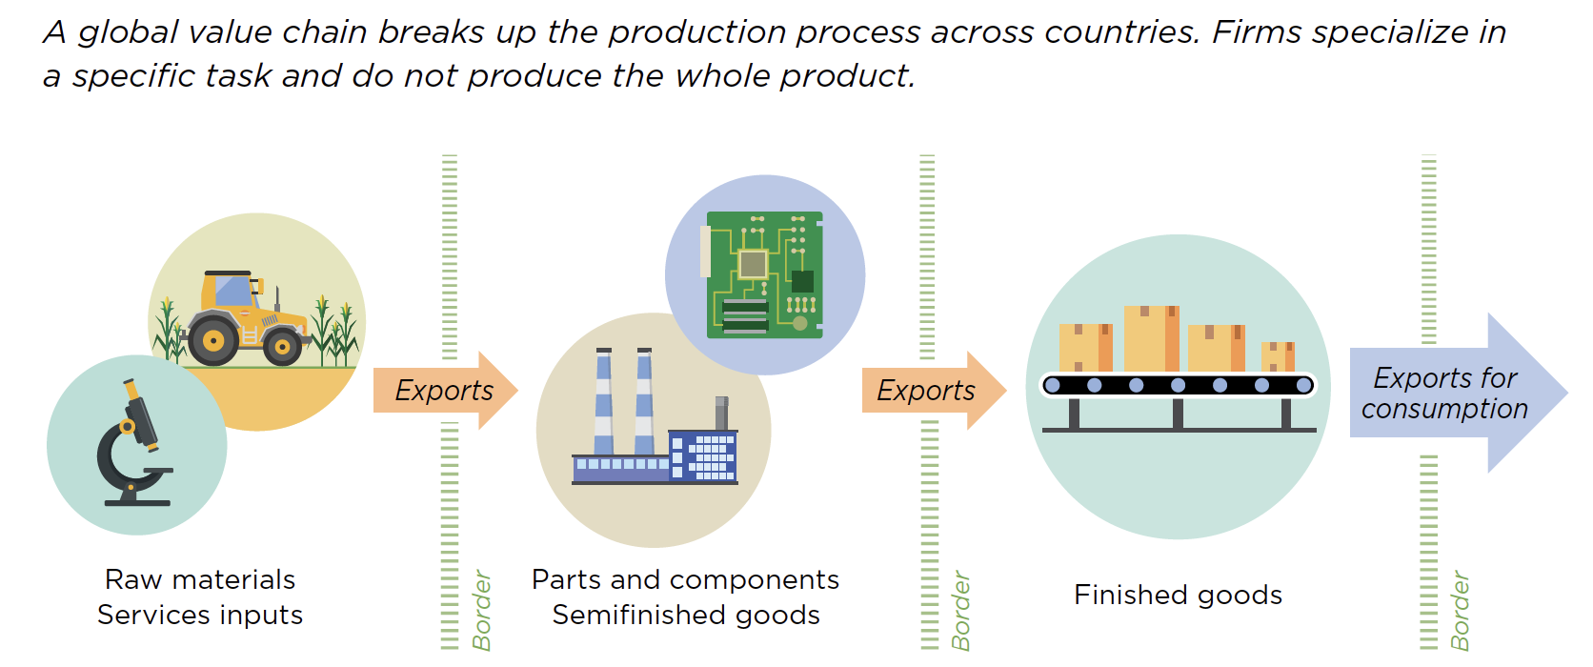
What is Offshoring?
Source: World Development Report, 2020

Slide 30
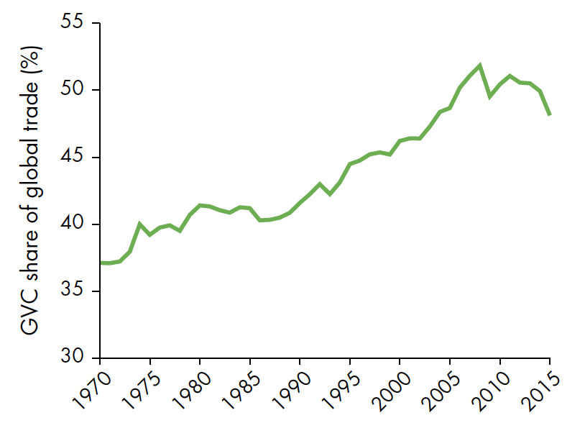
Related to Trade
Offshoring overlaps with trade because it
… typically involves imports of intermediate goods (components) or services
Still: Offshoring is important by itself
Hard to imagine almost any manufactured consumer good in the US without offshoring (imported inputs)
Has distinct implications for US firms, employment, and welfare
Source: World Development Report, 2020

Slide 31
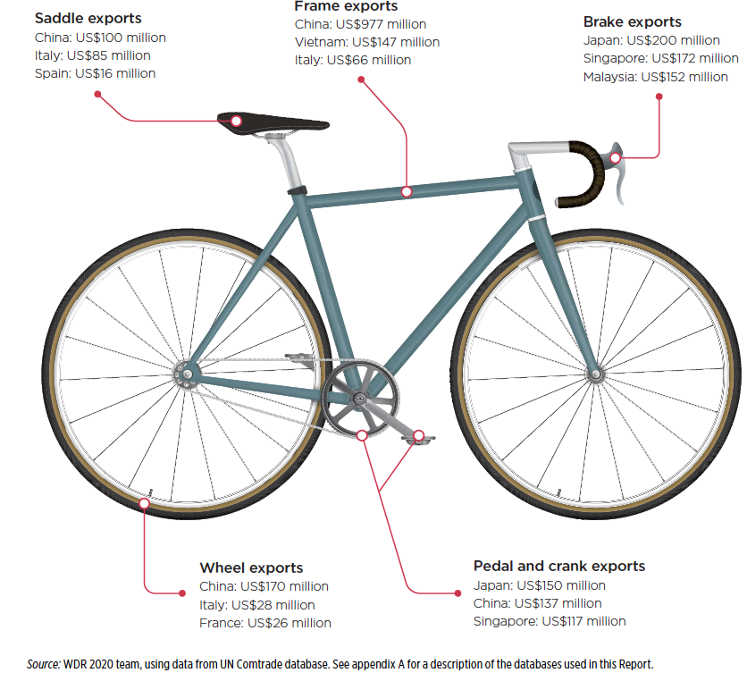
An Example: Bicycles
Parts and components from suppliers all over the world:
China
Japan
Italy, France, Spain
Malaysia
…
Source: World Development Report, 2020

Slide 32
An Example: The Boeing 787 Dreamliner
Parts and components from suppliers all over the world:
Japan
Italy
China
Australia
…

Slide 33
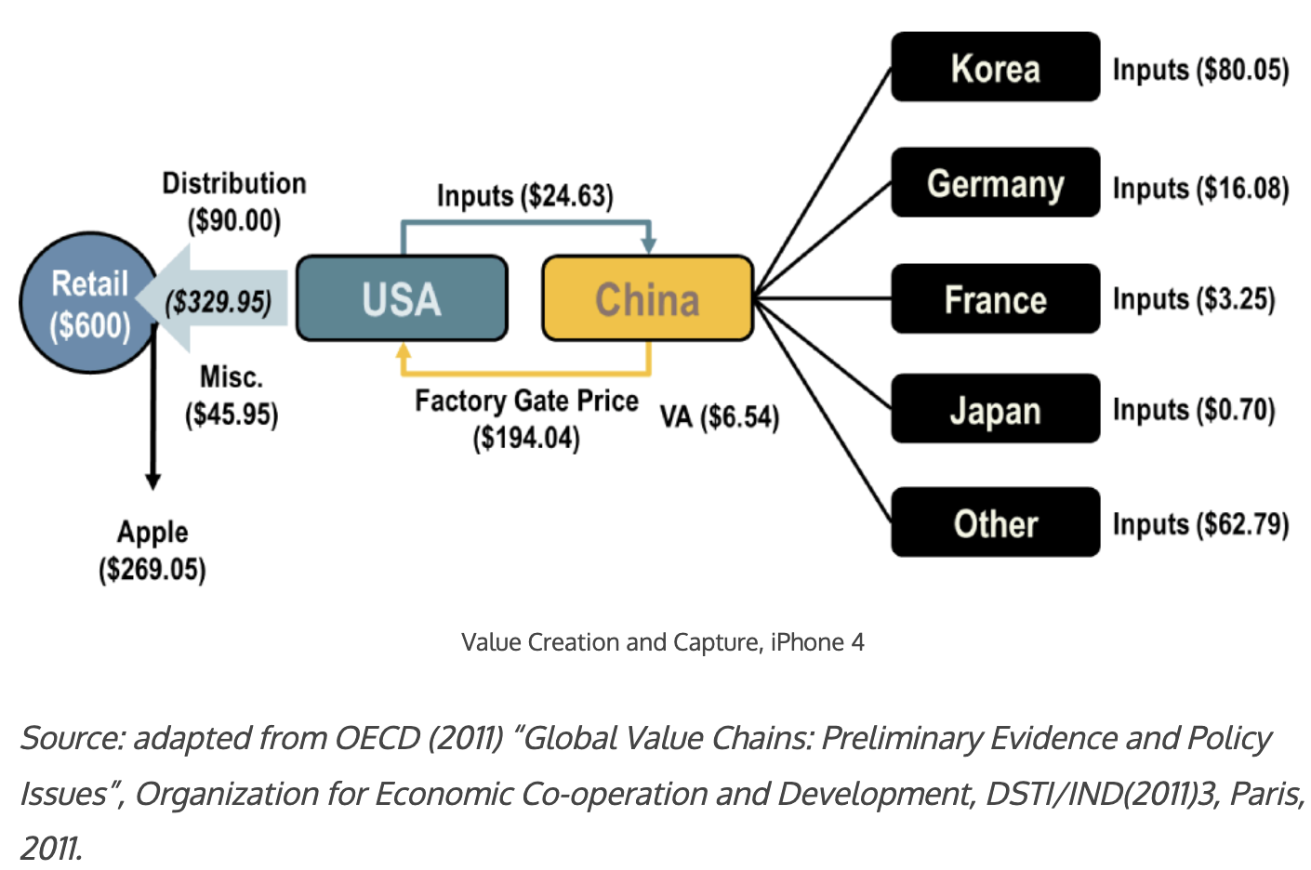
An Example: The iPhone 4
Source: The Geography of Transport Systems, 5th edition by Jean-Paul Rodrigue

Slide 34
How Much Offshoring Has Happened?
Offshoring is hard to measure
Three indicators for its rise:
Share of foreign value added in US exports increased from 11% to 15% (1995-2011)
Import share of other business services rose from 12% to 20% in the US (1999-2016)
Related party trade: Intra-firm offshoring makes up 51-53% of US imports (2005-16)

Slide 35
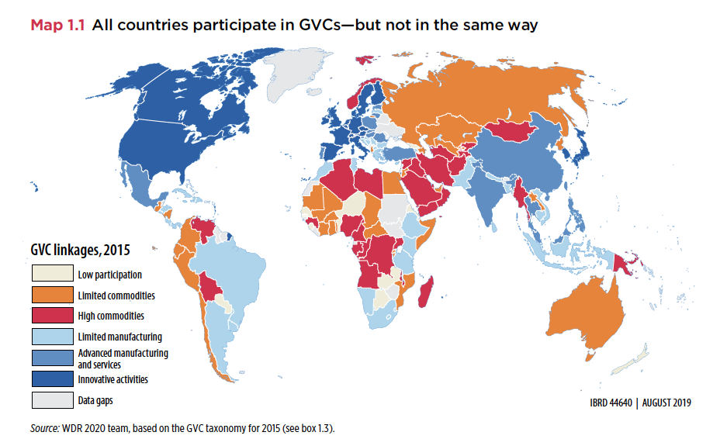
How Much Offshoring Has Happened?
Source: World Development Report, 2020

Slide 36
Why Do Countries Trade?
Competition
Varieties
Efficiency

Slide 37
Why Might Efficiency Differ Across Countries?
Labor
Skilled or unskilled
Technology
Some countries have firms that produce some goods well
Other countries have firms that produce other goods well
Environment
Cold/Warm Wet/Dry Sunny/Cloudy
Land
Rocky, soil, fertile, barren
Tundra, desert, grasslands, forest

Slide 38
Comparative Advantage and Specialization
Comparative advantage
Scarce resources: can't produce unlimited amounts of goods
Export goods where production advantage largest (or disadvantage weakest)
Non-econ example: Babe Ruth
Top pitcher during 1916-1918. But best hitter of all time!
Scarce resources: training time
Post 1918, Babe Ruth specialized as hitter
Econ example: US-UK trade in 1951
For same output, US used less resources than UK in each of 26 manuf sectors!
But, US net exporter to UK only for sectors where it’s advantage largest
UK net exporter to US for goods where it’s disadvantage weakest

Slide 39
Benefits of Specialization
For goods where US production advantage weakest…
US can consume these goods by either
Importing them from UK
Producing them and reducing production of goods exported to UK
Key point
US can consume more of these goods by importing them from UK
Analogous story true for UK
Trade increases size of economic pie for both countries

Slide 40
Comparative Advantage - Summary
Every country has a good or a set of goods that it is RELATIVELY better at producing.
Those are the goods that it will export.
It will import the other goods.
There are exceptions.
Varieties and competition
May find countries trading the same goods back and forth.
Every country…

Slide 41
Trade Contributes to Growth
EFFICIENCY:
Allocates production across countries efficiently so that countries can specialize in what they are best at producing.
Most productive firms expand and export
Varieties
More choice for consumers.
Better inputs for our production.
Competition
Brings in cheaper goods.
Makes consumers better off.
Economies of Scale
Trade makes some industries bigger, more cost efficient. Lowers prices.

Slide 42
How to Think About Imports
Think about international trade as the introduction of a new technology.
Soy Beans
(Exports)
Laptops/iPhones
(Imports)

Slide 43
Why Do Firms Engage in Offshoring?
Main motive for offshoring: Costs savings
Firms benefit from international specialization along global value chains
Typically US firms seek cheap labor → Prime offshoring destinations: Low-wage countries like China (14%) and Mexico (10% of US imports of intermediate goods in 2011)
Classic examples:
Automotive parts offshored to Mexico
Call centers offshored to India
But also: Access to raw materials, intermediate goods, or specific technologies → EU (20%) and Canada (17%)

Slide 44
Why is the public turning against trade?
Gains from trade are very large for the economy, BUT
Not always noticeable by consumers. Why are prices lower at WalMart?
Not always that large per consumer: consumers might save $50/year on some imported goods
For 300 million consumers, $50/year would be $15 billion per year savings to the country!
Costs of trade are very high for some workers and groups, and these costs have not been sufficiently appreciated or addressed by policymakers (or economists!)

Slide 45
Distributional Impacts of Trade: Basic Insights
Previous slides
Trade increases “the size of the pie” for each country
Ignores how trade impacts distribution of the pie in each country
Basic insights from trade theory
If trade decreases demand for a factor, it generally loses from trade
Factors “stuck” in import-competing locations/industries
Mobile factors but used intensively in import-competing locations/industries
If trade increases demand for a factor, it generally benefits from trade
Factors “stuck” in exporting locations/industries
Mobile factors but used intensively in exporting locations/industries
Trade benefits consumers via lowers prices of imported goods
Some consumers may benefit more than others

Slide 46
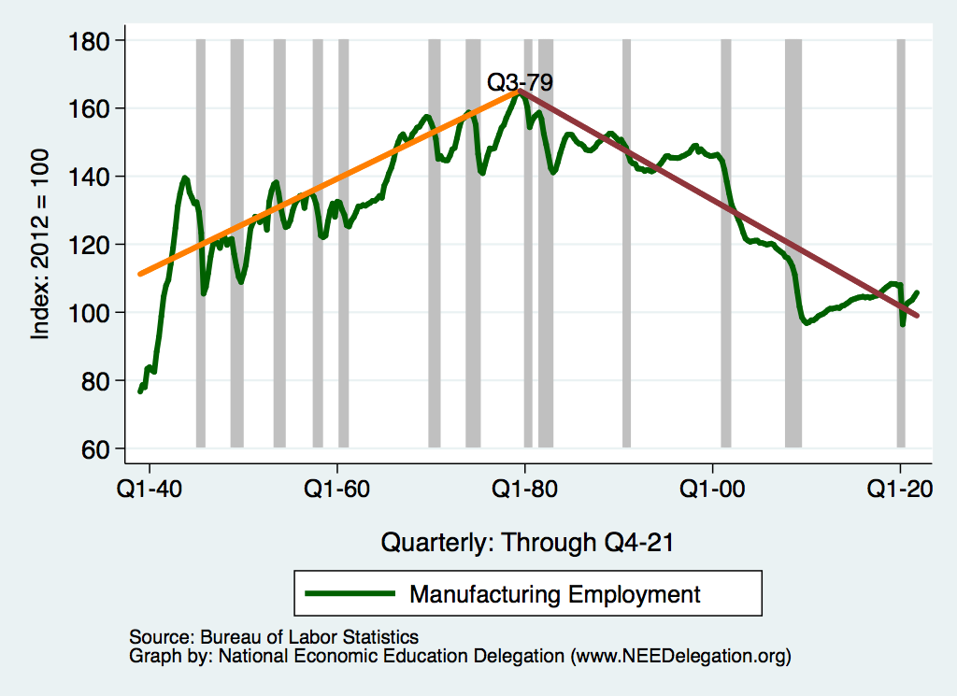
The Basic Issue: Inverted V of Jobs in Manuf.

Slide 47
“International Trade is Surely a Contributor!”

Slide 48
But There is No V in the Fraction of Jobs in Manufacturing

Slide 49
And Manufacturing Output Keeps on Growing

Slide 50
And Manufacturing Productivity is on the Rise

Slide 51
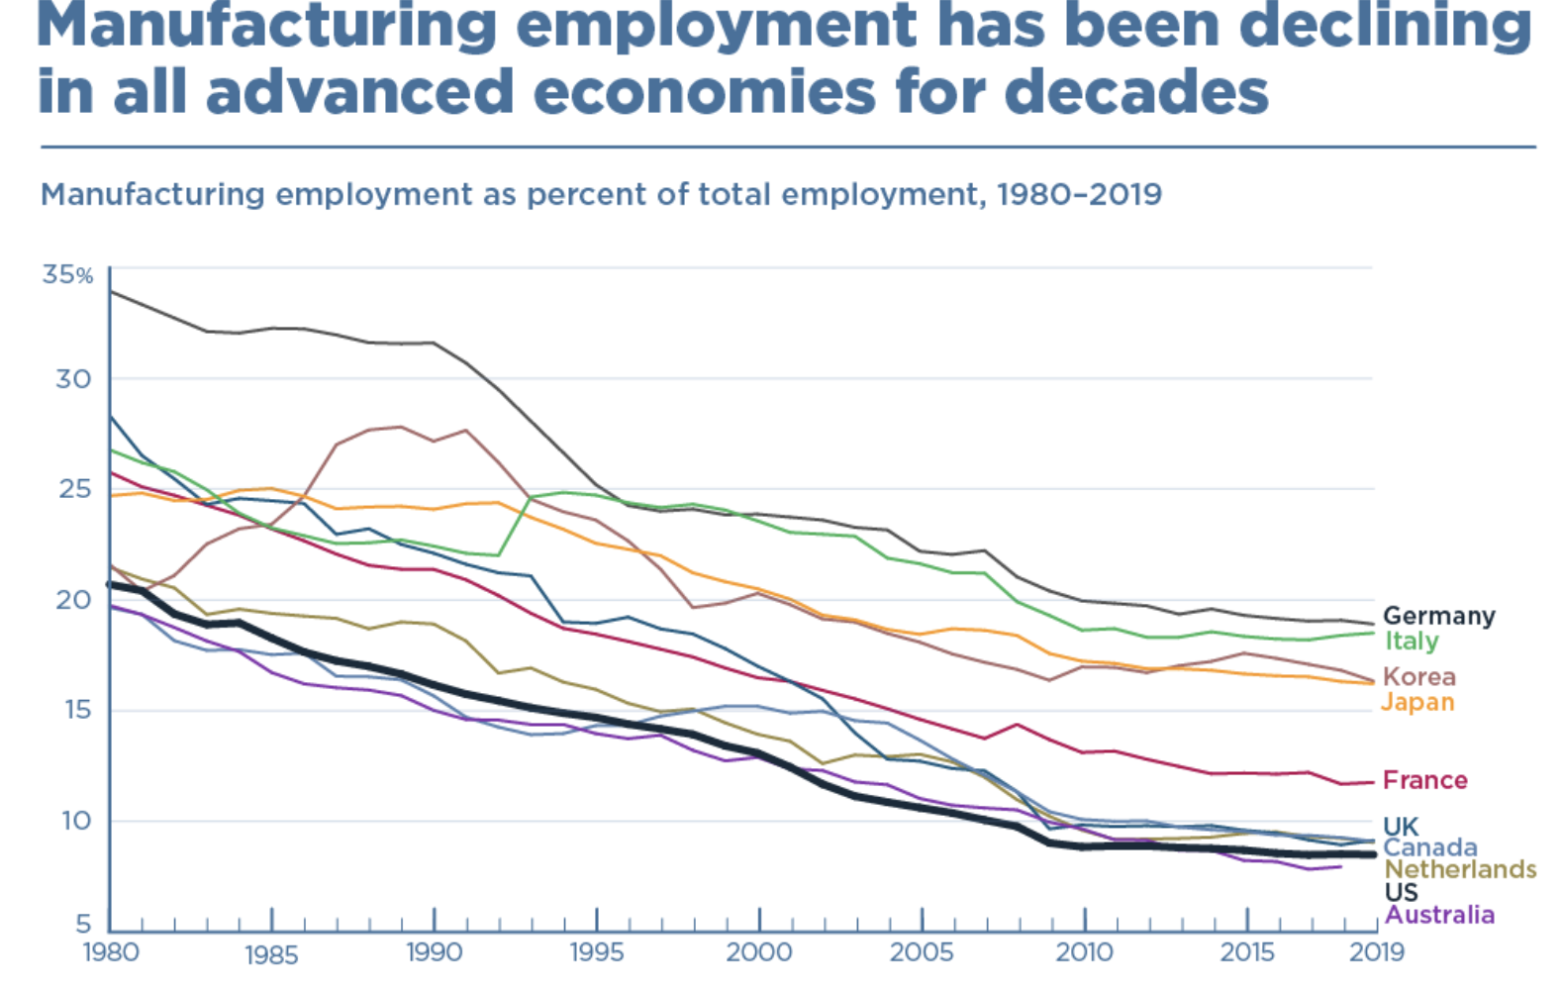
Source: Peterson Institute for International Economics

Slide 52
Another Problem: Trade Deficit in 2021
Massive Trade Deficit
3.7% of US GDP
$859.1 billion (goods and services)
$1,090 billion (goods)
Massive Trade Deficit with China
$355.3 billion (goods)
Source: Bureau of Economic Analysis, Dept. of Commerce

Slide 53
How to Think About the Trade Deficit
A trade deficit is when:
VALUE of imports > VALUE of exports.
Why does this happen?
International transactions include:
Imports and exports of goods and services - Current Account
ALSO: imports and exports of assets (investments) - Capital Account
The TRADE DEFICIT only looks at the Current Account

Slide 54
Trade and Investment Flows Balance Out

Slide 55
Exchange Rates Prevent an Overall Deficit
As the trade deficit grows:
The price of the dollar declines.
As the price of the dollar declines:
Investing in the United States becomes more attractive.
As investing in the US is more attractive:
The financial account surplus grows.
The financial account surplus offsets the trade deficit.
Balance on international accounts is restored.

Slide 56
Balanced Budgets & Increased Savings
Reducing federal borrowing would reduce pressure on trade deficits.
More savings would mean more domestic investment and less borrowing from abroad.

Slide 57
US Savings and the Trade Deficit
Savings
Trade Deficit

Slide 58
General Agreement Among Economists

Slide 59
Bilateral Trading Relationships

Slide 60
Bilateral Trade Deficits are Unimportant
Natural result of an overall trade deficit.
Likely result from specialization.
Can be exaggerated by mismeasurement of bilateral trade flows.
Value added vs total value
Are unlikely to be a result of foreign country’s trade policies.

Slide 61
Summary
Trade and growth are positively related.
Gains from trade can be widespread (lower prices for consumers).
Losses from trade can be highly concentrated.

Slide 62
Thank you!
Any Questions?
www.NEEDelegation.org
Adina Ardelean
<atardelean@scu.edu>
Contact NEED: info@needelegation.org
Submit a testimonial: www.NEEDelegation.org/testimonials.php
Become a Friend of NEED: www.NEEDelegation.org/friend.php

