Slide 1
Osher Lifelong Learning Institute, Winter 2022
Contemporary Economic Policy
Johns Hopkins University
Fall, 2022
Host: Jon Haveman, Ph.D.
National Economic Education Delegation

Slide 2
Available NEED Topics Include:
US Economy
Healthcare Economics
Climate Change
Economic Inequality
Economic Mobility
Trade and Globalization
Minimum Wages
Immigration Economics
Housing Policy
Federal Budgets
Federal Debt
Black-White Wealth Gap
Autonomous Vehicles
Healthcare Economics

Slide 3
Course Outline: Johns Hopkins University
Contemporary Economic Policy
Week 1 (11/3): The Black-White Wealth Gap (Jon Haveman, NEED)
Week 2 (11/10): Economic Inequality (Adina Ardelean, Santa Clara Univ.)
Week 3 (11/17): Economics of Immigration (Jennifer Alix-Garcia, Oregon State Univ.)
Week 4 (12/1): U.S. Economic Update (Jon Haveman, NEED)
Week 5 (12/8): Trade and Globalization (Adina Ardelean, Santa Clara Univ.)
Week 6 (12/15): Climate Change Economics (Sarah Jacobson, Williams College)

Slide 4
Submitting Questions
Please submit questions in the chat.
I will try to handle them as they come up, but may take them in a bunch as time permits.
I will catch up on the questions in the chat before starting up again after the break.
We will do a verbal Q&A once the material has been presented.
And the questions in the chat have been addressed.

Slide 5
Contemporary Trade Issues
OLLI, Johns Hopkins University
December , 2022
Adina Ardelean, Ph.D.

Slide 6
Outline
Globalization
The Benefits and Costs of Trade and Offshoring
Trade Policies

Slide 7
What is Globalization?
The growing interdependence of the world’s:
Economies
Cultures
Populations
Brought about by cross-border flows of:
Goods and services
Technology
Investment
People
Information

Slide 8
What Drives Globalization?
Transportation
Technology
International Cooperation

Slide 9
Transportation

Slide 10
Technology

Slide 11
International Cooperation

Slide 12
International Trade
Exports and Imports

Slide 13
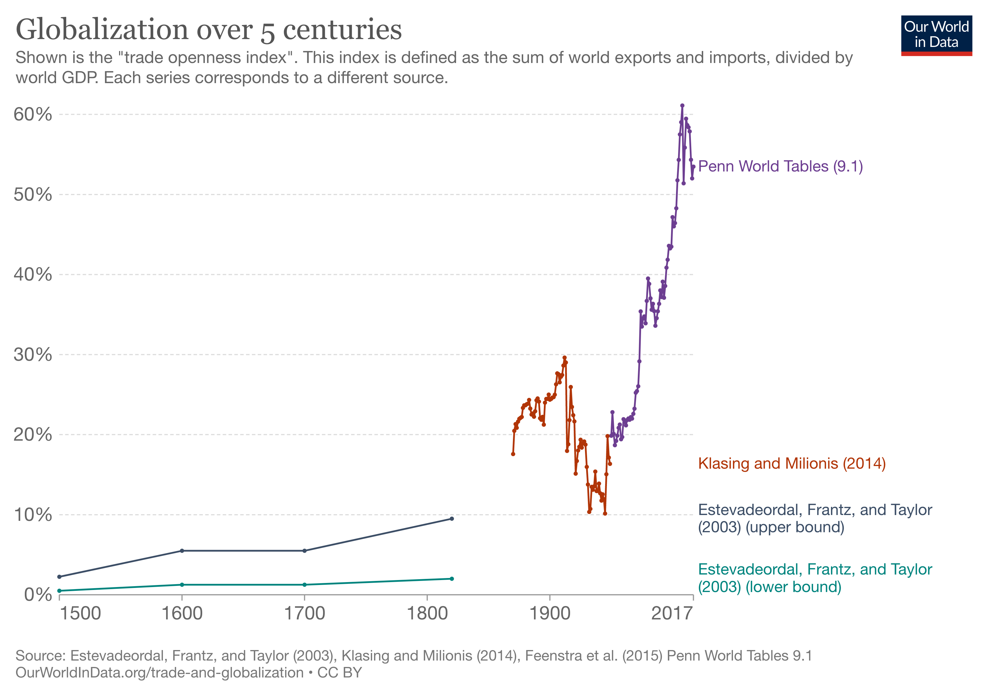

Slide 14
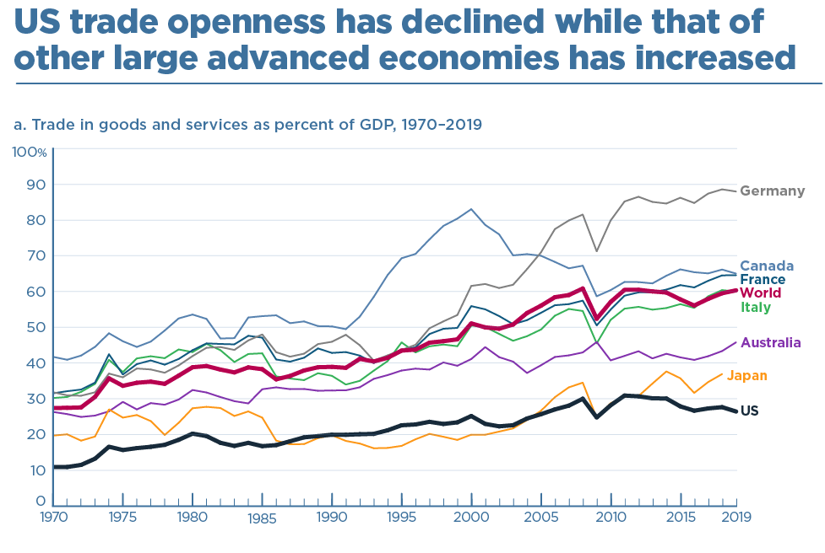

Slide 15
What do we Export? ($1.51 Trillion in 2019)
Rank | U.S. Export Product | % of Total Exports
1 | Machinery and appliances | 13.7%
2 | Mineral fuels and oils, and products | 13.2%
3 | Electrical machinery and equipment | 10.8%
4 | Vehicles and their parts | 8.68%
5 | Instruments and apparatus | 6.71%
Source: The Observatory of Economic Complexity at MIT

Slide 16
What do we Import? ($2.37 Trillion in 2019)
Rank | U.S. Import Product | % of Total Imports
1 | Machinery and appliances | 15.7%
2 | Electrical machinery and equipment | 13.9%
3 | Vehicles and their parts | 13%
4 | Mineral fuels and oils, and products | 8.34%
5 | Pharmaceutical products | 5.35%
Source: The Observatory of Economic Complexity at MIT

Slide 17
Top US Trade Partners (Goods, 2019)
Top 5 US export destinations
Top 5 US import sources
Rank | Export Destination | % of Total Exports
1 | Canada | 16.8 %
2 | Mexico | 15.6 %
3 | China | 6.82 %
4 | Japan | 4.61 %
5 | Germany | 3. 91 %
Rank | Import Source | % of Total Imports
1 | China | 18.1 %
2 | Mexico | 15.2 %
3 | Canada | 13.2 %
4 | Japan | 5.6 %
5 | Germany | 5.47 %

Slide 18
Global Value Chains (Offshoring)

Slide 19
Offshoring – A New Form of Globalization

Slide 20
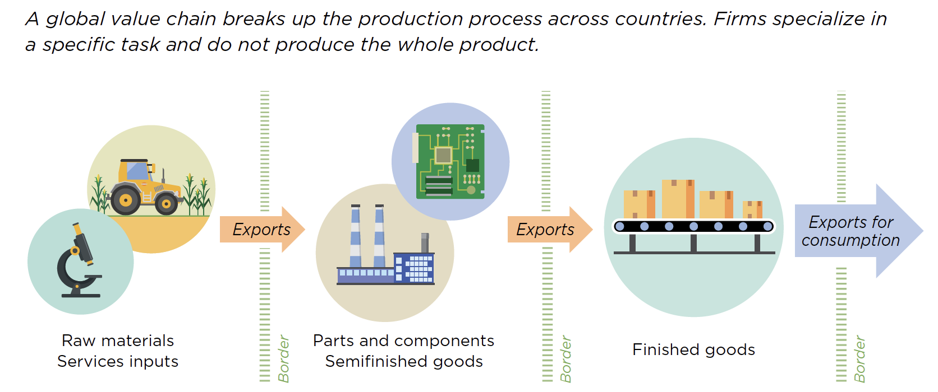
What is Offshoring?
Source: World Development Report, 2020

Slide 21
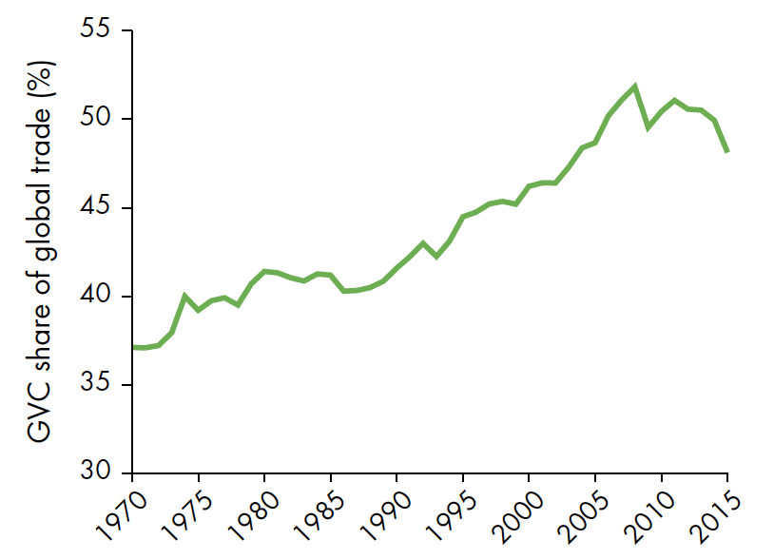
Related to Trade
Offshoring overlaps with trade because it
… typically involves imports of intermediate goods (components) or services
Still: Offshoring is important by itself
Hard to imagine almost any manufactured consumer good in the US without offshoring (imported inputs)
Has distinct implications for US firms, employment, and welfare
Source: World Development Report, 2020

Slide 22
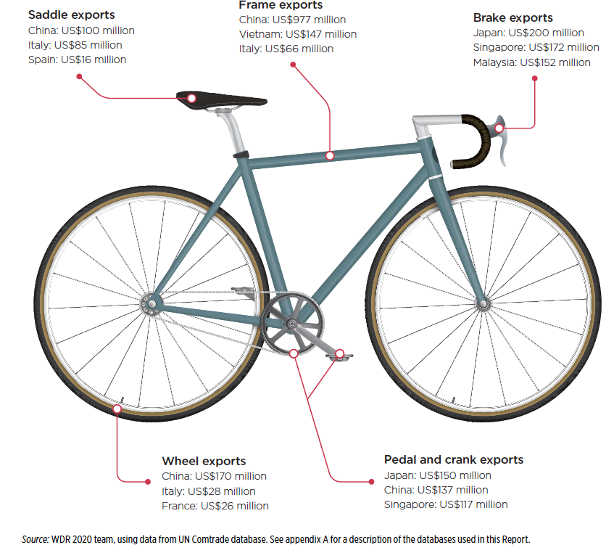
An Example: Bicycles
Parts and components from suppliers all over the world:
China
Japan
Italy, France, Spain
Malaysia
…
Source: World Development Report, 2020

Slide 23
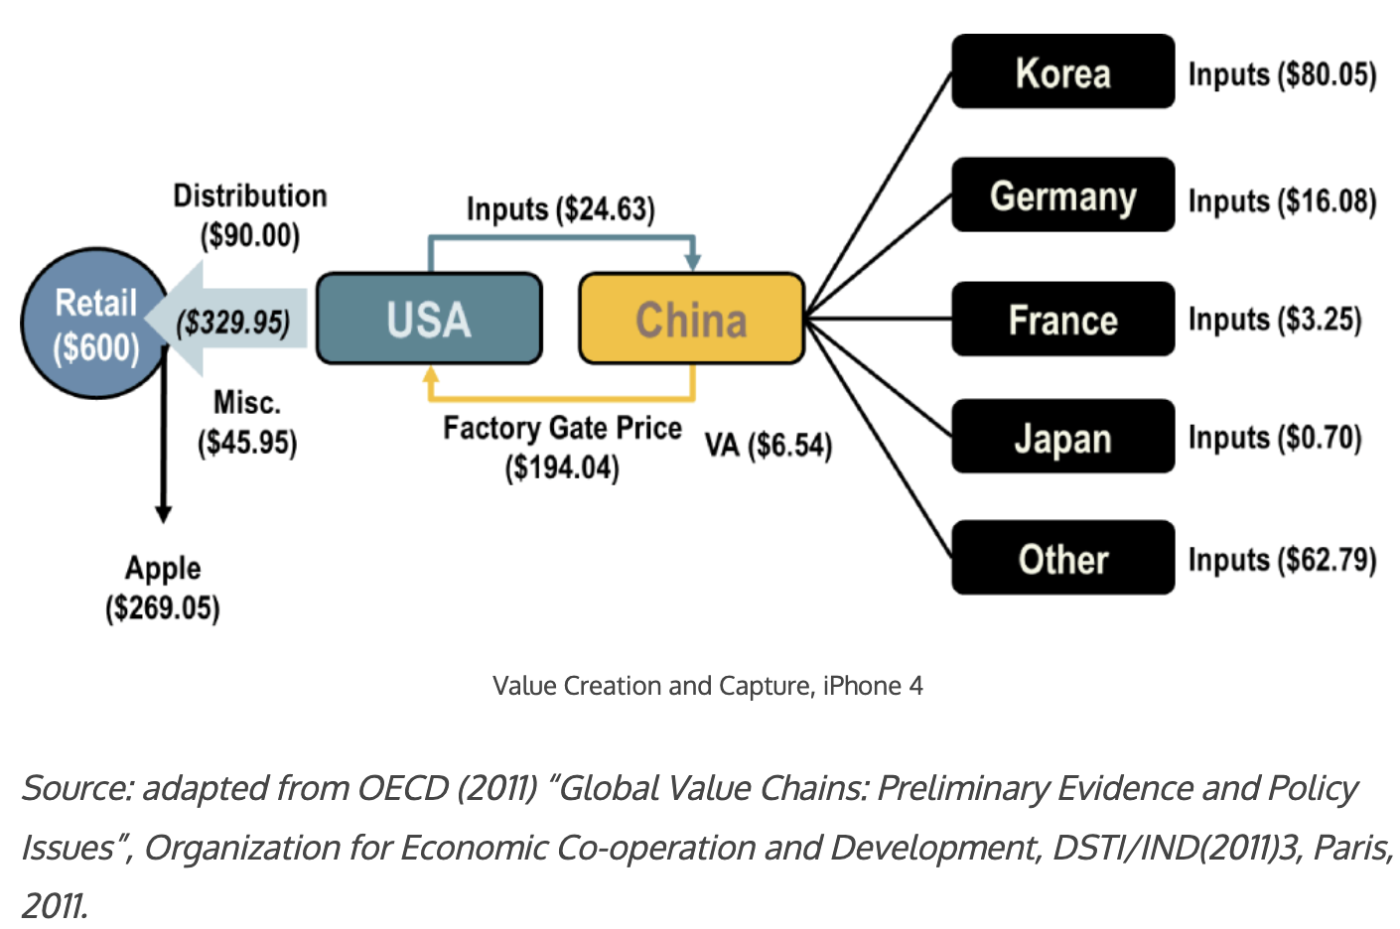
An Example: The iPhone 4
Source: The Geography of Transport Systems, 5th edition by Jean-Paul Rodrigue

Slide 24
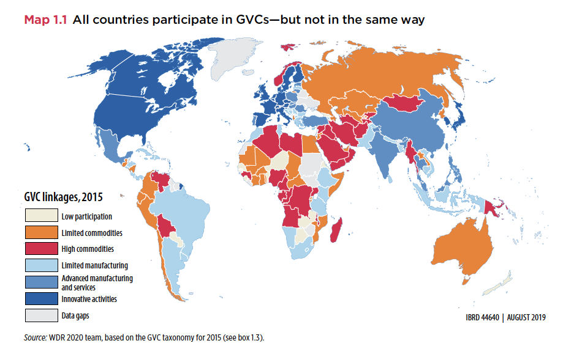
How Much Offshoring Has Happened?
Source: World Development Report, 2020

Slide 25
Why Do Countries Trade?
Competition
Varieties
Efficiency

Slide 26
Why Might Efficiency Differ Across Countries?
Labor
Skilled or unskilled
Technology
Some countries have firms that produce some goods well
Other countries have firms that produce other goods well
Environment
Cold/Warm Wet/Dry Sunny/Cloudy
Land
Rocky, soil, fertile, barren
Tundra, desert, grasslands, forest

Slide 27
Comparative Advantage and Specialization
Comparative advantage
Scarce resources: can't produce unlimited amounts of goods
Export goods where production advantage largest (or disadvantage weakest)
Non-econ example: Babe Ruth
Top pitcher during 1916-1918. But best hitter of all time!
Scarce resources: training time
Post 1918, Babe Ruth specialized as hitter
Econ example: US-UK trade in 1951
For same output, US used less resources than UK in each of 26 manuf sectors!
But, US net exporter to UK only for sectors where it’s advantage largest
UK net exporter to US for goods where it’s disadvantage weakest

Slide 28
Benefits of Specialization
For goods where US production advantage weakest…
US can consume these goods by either
Importing them from UK
Producing them and reducing production of goods exported to UK
Key point
US can consume more of these goods by importing them from UK
Analogous story true for UK
Trade increases size of economic pie for both countries

Slide 29
Comparative Advantage - Summary
Every country has a good or a set of goods that it is RELATIVELY better at producing.
Those are the goods that it will export.
It will import the other goods.
There are exceptions.
Varieties and competition
May find countries trading the same goods back and forth.
Every country…

Slide 30
Trade Contributes to Growth
EFFICIENCY:
Allocates production across countries efficiently so that countries can specialize in what they are best at producing.
Most productive firms expand and export
Varieties
More choice for consumers.
Better inputs for our production.
Competition
Brings in cheaper goods.
Makes consumers better off.
Economies of Scale
Trade makes some industries bigger, more cost efficient. Lowers prices.

Slide 31
Why Do Firms Engage in Offshoring?
Main motive for offshoring: Costs savings
Firms benefit from international specialization along global value chains
Typically US firms seek cheap labor → Prime offshoring destinations: Low-wage countries like China (14%) and Mexico (10% of US imports of intermediate goods in 2011)
Classic examples:
Automotive parts offshored to Mexico
Call centers offshored to India
But also: Access to raw materials, intermediate goods, or specific technologies → EU (20%) and Canada (17%)

Slide 32
Why is the public turning against trade?
Gains from trade are very large for the economy, BUT
Not always noticeable by consumers. Why are prices lower at WalMart?
Not always that large per consumer: consumers might save $50/year on some imported goods
For 300 million consumers, $50/year would be $15 billion per year savings to the country!
Costs of trade are very high for some workers and groups, and these costs have not been sufficiently appreciated or addressed by policymakers (or economists!)

Slide 33
Costs of Trade
Economic:
When trade expands (or contracts)
Some firms lose market share or shut down
Other firms supplying inputs to those firms shrink or shut down
Workers in both lose jobs
And their communities lose customers
Macroeconomic cost: Vulnerability to foreign recession/inflation
Dependence on other countries’ willingness to trade
Vulnerability to trade disruption
Crisis induced (earthquake, flood, disease, war)
Policy induced (sanctions, tariffs, export bans)
Non-economic
Loss of cultural differences
Spread of invasive species and plant disease
Spread of human disease

Slide 34
Trade Policy

Slide 35
Trade Policies that Affect Globalization
Policies that Encourage It
Tariff Reductions
Trade Agreements
Other
Policies that Discourage It
Tariffs
Trade War

Slide 36
Trade Policies Encouraging Globalization

Slide 37
Tariff Reductions

Slide 38
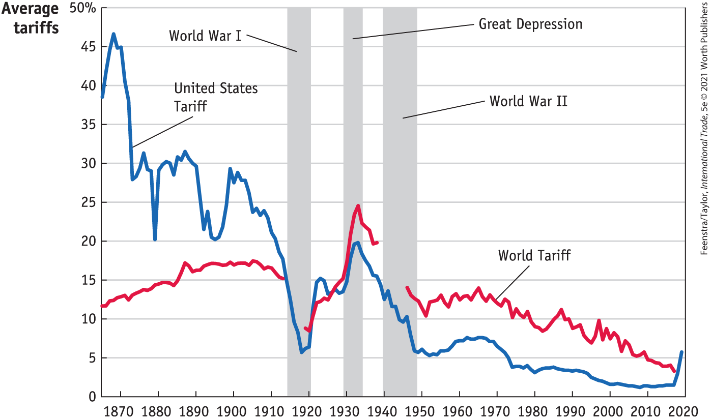
Tariffs, 1860-2019
Source: International Economics, 5e | Feenstra/Taylor, Worth Publishers

Slide 39
Trade Agreements

Slide 40
The Role of Trade Agreements
Promote trade by
Reducing tariffs
Blocking policies that discriminate against imports
They also do more, mostly to serve business interests:
Permit anti-dumping duties to deter competition
Protect intellectual property
Allow investor action against governments
Recent U.S. Trade Agreements:
KORUS (March 15, 2012)
USCMA: renegotiation of NAFTA (July 1, 2020)

Slide 41
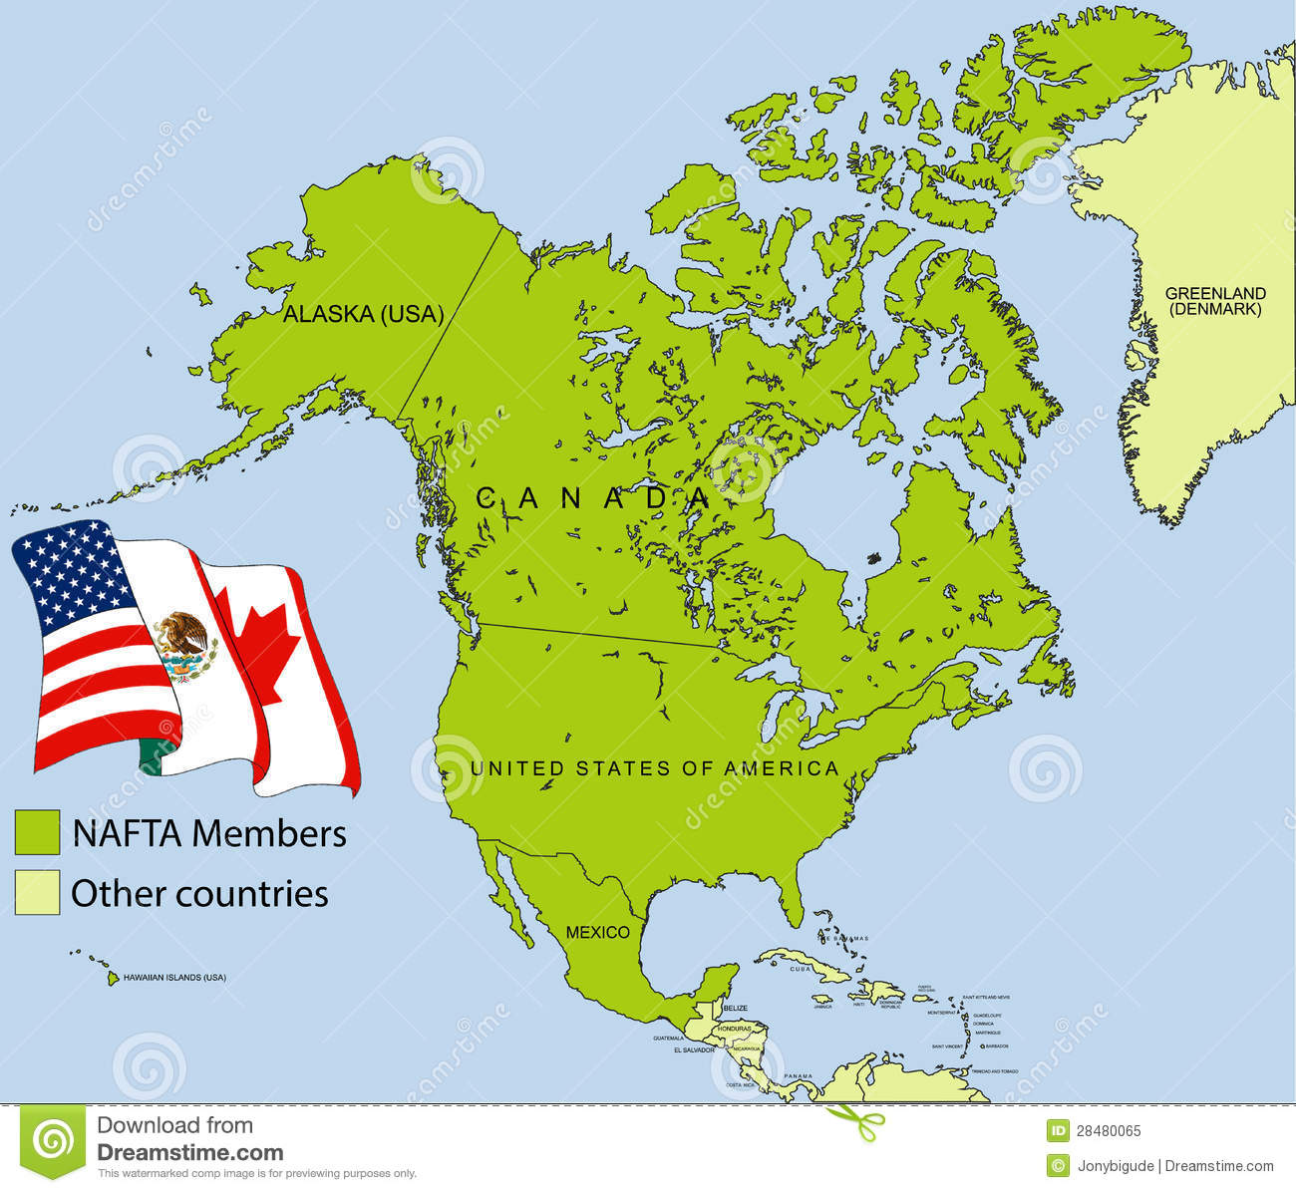
NAFTA (now USMCA)

Slide 42
NAFTA
Went into effect on January, 1, 1994.
Overall trade and cross-border investment has increased.
Tight integration of North American supply chains.
The effect on jobs and wages:
At most 5% of annual job churn, ~ 200,000 jobs
188,000 new jobs each year due to increased exports to Mexico.
New jobs pay 7-15% more than the import-competing jobs.
No significant effect on US wages in the manufacturing sector.
Increased imports benefited consumers and US firms, raising their productivity.
Modest positive impact on U.S. GDP.
Source: Hufbauer et al. (2014) “NAFTA at 20: Misleading Charges and Positive Achievements”, PIIE

Slide 43
USCMA
Stricter environmental policies and requirements for wages
Encouraged digital trade and curbed state-owned enterprises
Additional requirements for autos to qualify for NAFTA’s low tariffs:
The North American content requirements in cars increased from 62.5% to 75%.
70% of producer’s steel and aluminum purchases must originate in North America
A certain percent of qualifying vehicles must be produced by employees making an average of $16 per hour.
Increased U.S. access to Canadian dairy market by about 3.6%.
Eliminated investor-state disputes between US and Canada.

Slide 44
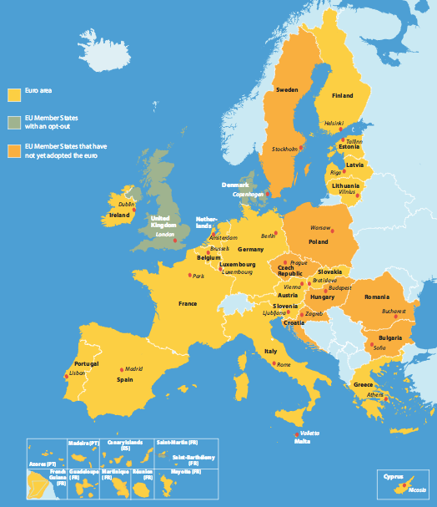
European Union
Source: Europa.eu
Notes:
http://europa.eu/european-union/about-eu/money/euro_en

Slide 45
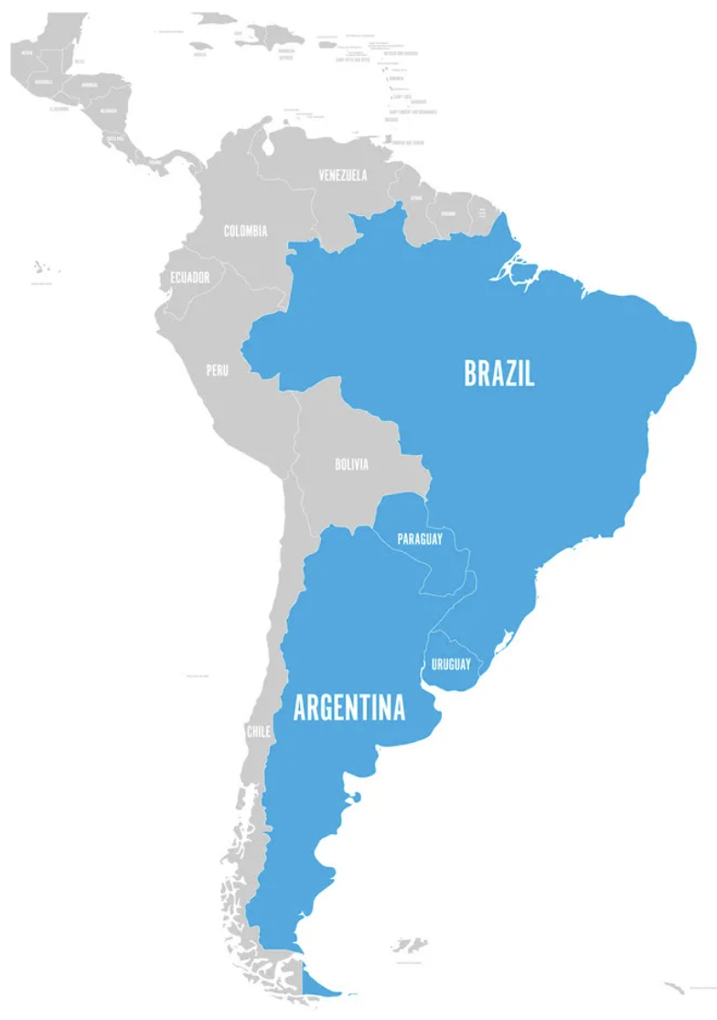
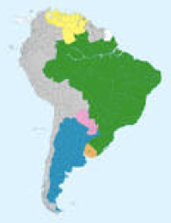
MERCOSUR

Slide 46
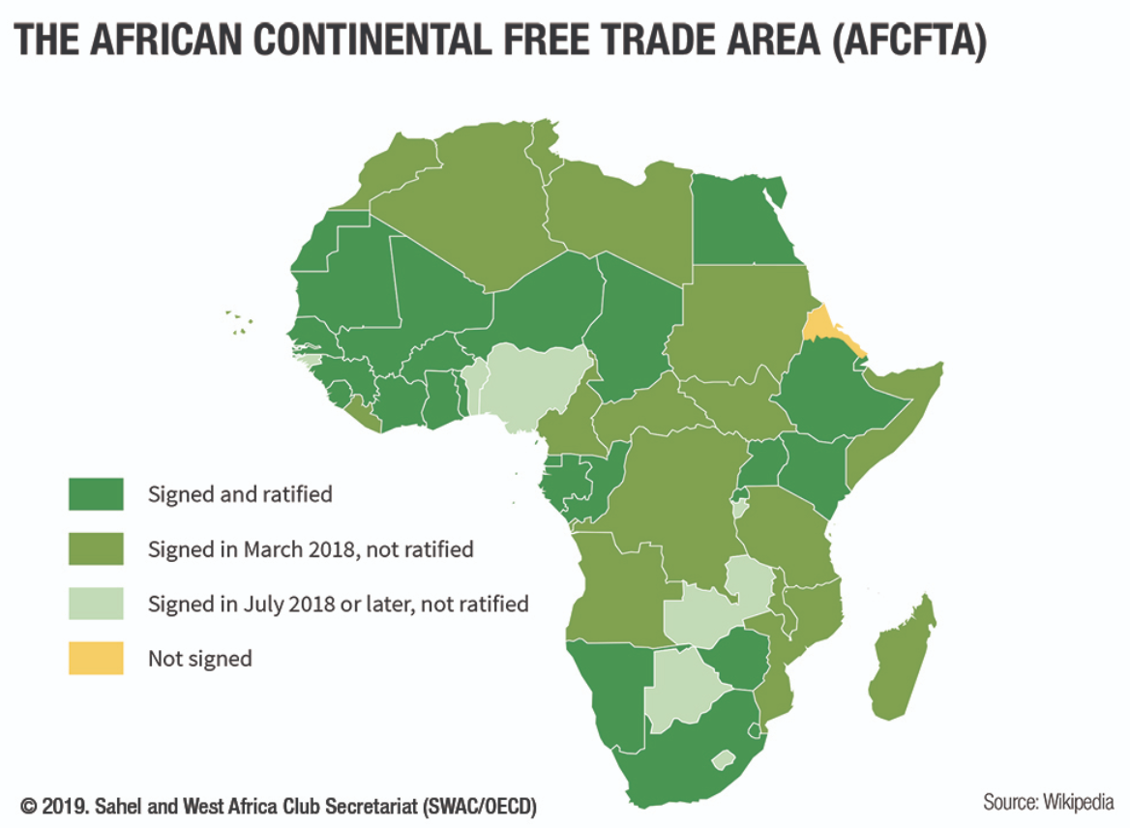
AfCFTA Largest FTA, with 55 countries

Slide 47
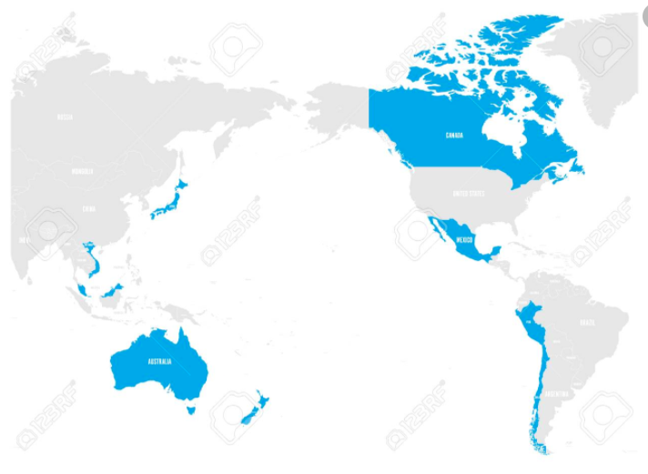
CPTPP = Trans-Pacific Partnership minus US

Slide 48
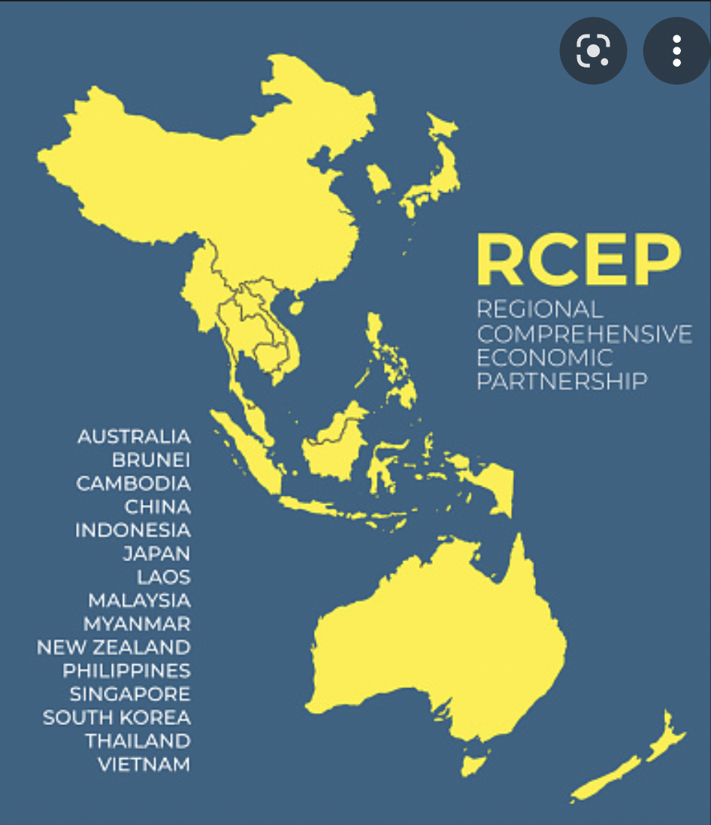
RCEP = Regional Comprehensive Economic Partnership (January, 2022)

Slide 49
Other Policies to Encourage Globalization
IMF/World Bank
Policy advice to open markets (the ”Washington Consensus”)
Loans to countries conditional on
Reducing trade barriers
Permitting capital flows
GATT/WTO (World Trade Organization)
Negotiate reciprocal trade liberalization
Settlement of trade disputes (usually about interfering with trade)
Bilateral Investment Treaties
Better treatment of multinational corporations

Slide 50
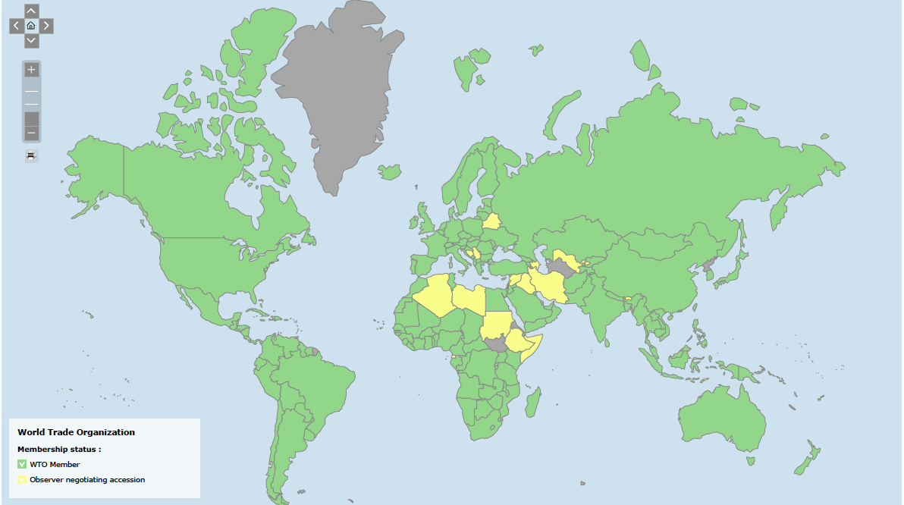
WTO
Multilateral Trade Agreement
164 member countries
Includes: China since 2001, Russia since 2012, Not Iran, N. Korea
Headquarters: Geneva, Switzerland
First established in 1947 as G.A.T.T. (23 member countries)
Last completed round of negotiations: Uruguay Round in 1994.

Slide 51
Trade Policies Discouraging Globalization

Slide 52
Trump’s Tariffs and Trade War

Slide 53
Recent U.S. Tariffs
Trade Act of 1974
Section 201 (surges): solar cells, washing machines
Section 301 (non-market activity): China forced technology transfer
Trade Expansion Act of 1962
Section 232 (national security): steel and aluminum
Trade Act of 1930
Anti-dumping and countervailing duties (cover about 80% of steel from China)

Slide 54
US Trade Policy: Retaliation
National security tariffs on steel & aluminum
EU, CAN, MEX, CHN have retaliated with tariffs
Proportionate to their US exports of steel & aluminum
Targeted retaliation
Industries reliant on foreign markets (e.g. pork)
Farmers (fruits & nuts), household goods (ketchup, mowers)
Politics: KY bourbon, WI ginseng & Harleys, CA Levi jeans
Unfair trade practices tariffs on China
EX: Soybeans and cars (largest and 3rd largest US exports to China), chemicals, medical equip, oil

Slide 55
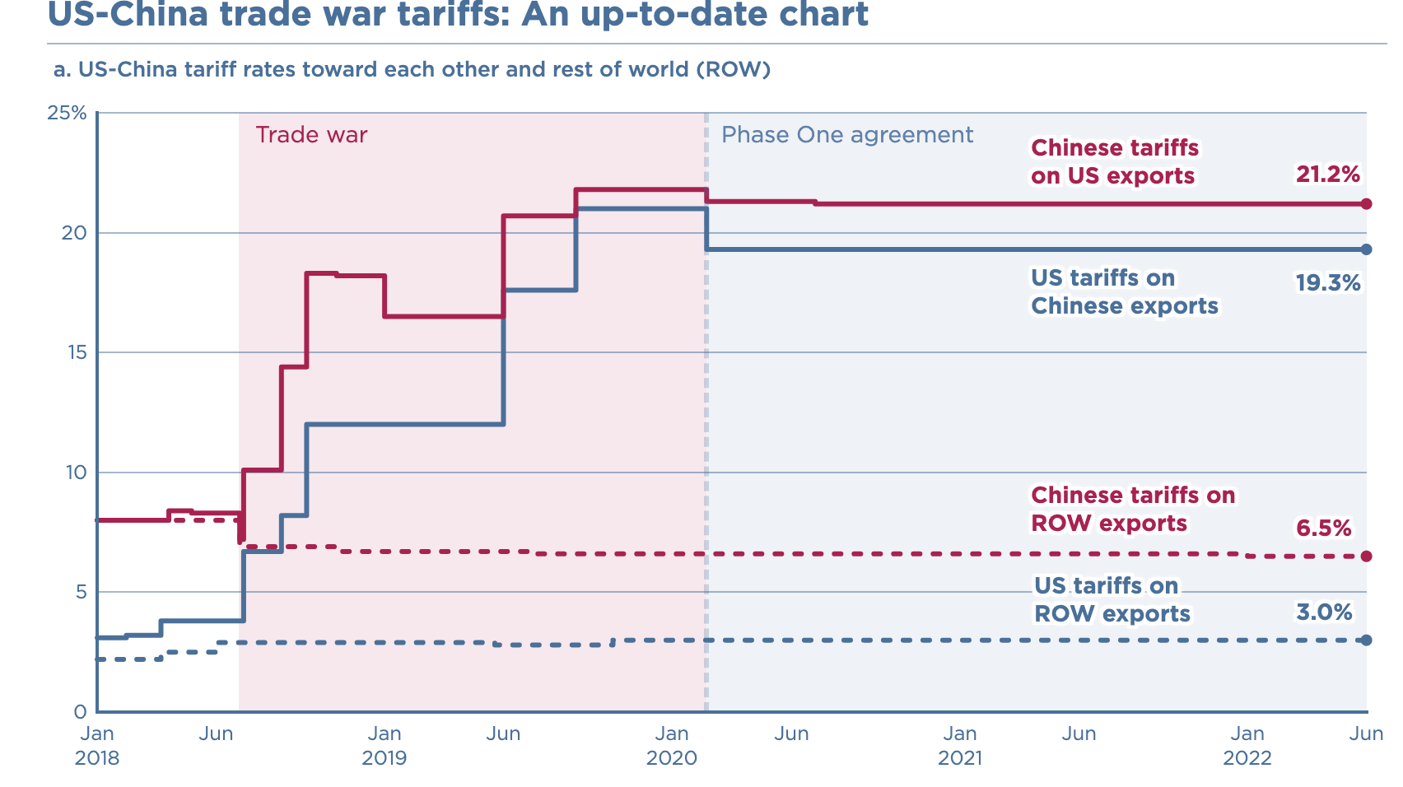
Source: Chad. P Brown, Peterson Institute of International Economics

Slide 56
Effects of Tariffs - Prices
Tariffs are taxes on imports.
Tariffs raise prices in the importing country.
Final goods (consumers)
Intermediate goods (producers who use imported inputs)
Rising prices distort consumption and production decisions
Tariffs can lower prices of the imported good in the exporting country.
The rise in the importing country is much larger than the fall abroad.
It depends on the size of the importing country.
Trump’s tariffs caused US prices to rise, without any fall in prices abroad.

Slide 57
Effects of Tariffs – Producers and Workers
The price increase in the importing country:
benefits domestic producers of the tariffed good.
harms buyers of the higher-priced good
Households
Firms that use the good as input: which raises the price of other goods, hurting their buyers
increases employment in the protected industry
decreases employment in industries that use the protected product as input.
Tariffs lower overall welfare, while generating very large gains for small groups
Tariffs are generally considered to be an inefficient way to help those people who are hurt by trade

Slide 58
Effects of Tariffs – Washing Machines
In 2018, President Trump imposed global safeguard duties on washing machines.
The price of washing machines increased in the U.S by 12%.
The prices of dryers (bundled with washing machines) also increased, even if they were not subject to tariffs.
The estimated effects:
Main beneficiaries: Whirlpool (reported 200 new jobs added).
Consumers lost $1.55 billion.
Tariff revenue increased by about $82 million.
The consumer cost per job “created” was about $817,000 per year.
LG and Samsung relocated washing machine production to the U.S.
LG: Clarksville, Tennessee, 2019 – 600 new jobs
Samsung: Newberry, South Carolina, 2018 – 1,000 new jobs
Flaaen et al. (2020) “The Production Relocation and Price Effects of US Trade Policy: The Case of Washing Machines”, AER, 110(7)

Slide 59
Effects of Tariffs – Solar Panels
In 2018, President Trump imposed global safeguard duties on solar panels at the request of US companies that faced intense import competition from China.
US-based companies benefited:
Suniva (Chinese-owned manufacturing in Georgia),
SolarWorld (German-owned, later French-owned),
14 US manufacturing firms: CBS Solars
Consumers were hurt by higher prices of solar panels
Solar panel installers were hurt, led by Solar Energy Industry Association:
Loss of jobs and delay and cancellations of investment in solar energy
Notes:
Solar panels: 85% of employment in distribution and installation

Slide 60
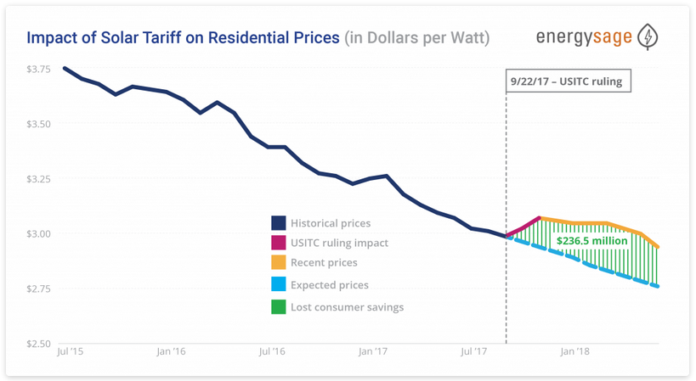
Notes:
EnergySage.com: https://news.energysage.com/2018-us-solar-tariff-impact-prices/

Slide 61
Effects of Tariffs
Tariffs invite retaliation, lowering demand for our exports.
Import protection can increase U.S. employment, but the change is more than offset by employment loss due to higher input prices in other industries and retaliation.

Slide 62
US Trade Policy in Practice: Winners and Losers
National security tariffs on steel & aluminum
Winners: US steel producers (Nucor, United States Steel, AK Steel) & workers
BEA: 140,000 jobs in steel producing industries
Losers #1: US consumers, including steel-consuming US firms
BEA: 2 million jobs in US industries where steel >= 5% of inputs
US industries targeted by foreign retaliation
Industry | Countries | Share of US exports
Pork | China, Mexico | 44%
Apples | China, Mexico, India | 37%
Nuts | China, India | 12%
Whiskies (e.g. KY bourbon) | EU, Canada, Mexico | 53%
Mineral water, coffee, ketchup | Canada | About 50%

Slide 63
Effects of a tariff
The fall in price in the exporting country causes
Harm to sellers there
Benefit to buyers there
Shift of sales to other countries
If the tariff is on exports from only one country (e.g, China)
Buyers shift to imports from other, more costly, countries (e.g., Vietnam)

Slide 64
Arguments for Tariffs
If economists are so opposed to tariffs, why are they used?
National Security
Government revenue
Infant Industry
Strategic trade policy
Political Economy of Protection

Slide 65
Arguments against tariffs
Arguments against tariffs
Economic gains from trade (see above)
Tariffs prompt retaliation
Some valid arguments for tariffs depend on information that is either
Unavailable, or
Available only from the protected industry
Even when net beneficial, tariffs are politically hard to remove
Lower tariffs and greater trade reduce the likelihood of war

Slide 66
Summary
Trade and growth are positively related.
Gains from trade can be widespread (lower prices for consumers) and losses from trade can be highly concentrated.
Tariffs reduce trade overall, thus imposing widespread losses to both producers (who use imported inputs) and consumers (who buy lower-priced imported goods).
More direct policies to help those hurt by trade can be more efficient and save gains from trade.

Slide 67
Th e Future of Globalization?
Globalization Reversal or Slowbalization?
During 2022 IMF and World Bank Spring Meetings:
Jerome Powell, Fed Chairman noted that it is unclear if the world is witnessing a reversal of globalization, but the pace of globalization is certainly slowing down.
Kristalina Georgieva, IMF Managing Director argued that it is too early to “buy a coffin” for globalization. The world has achieved so much because of the integrated global economy, and it is irresponsible to make the world poorer.
A New Global Map:
Globalization is good overall but needs to be more agile and resilient to shocks:
Less reliance on single sources by firms
Greater protections for those who are hurt.
Europe’s embrace of “open strategic autonomy” or U.S.’s “friendshoring”

Slide 68
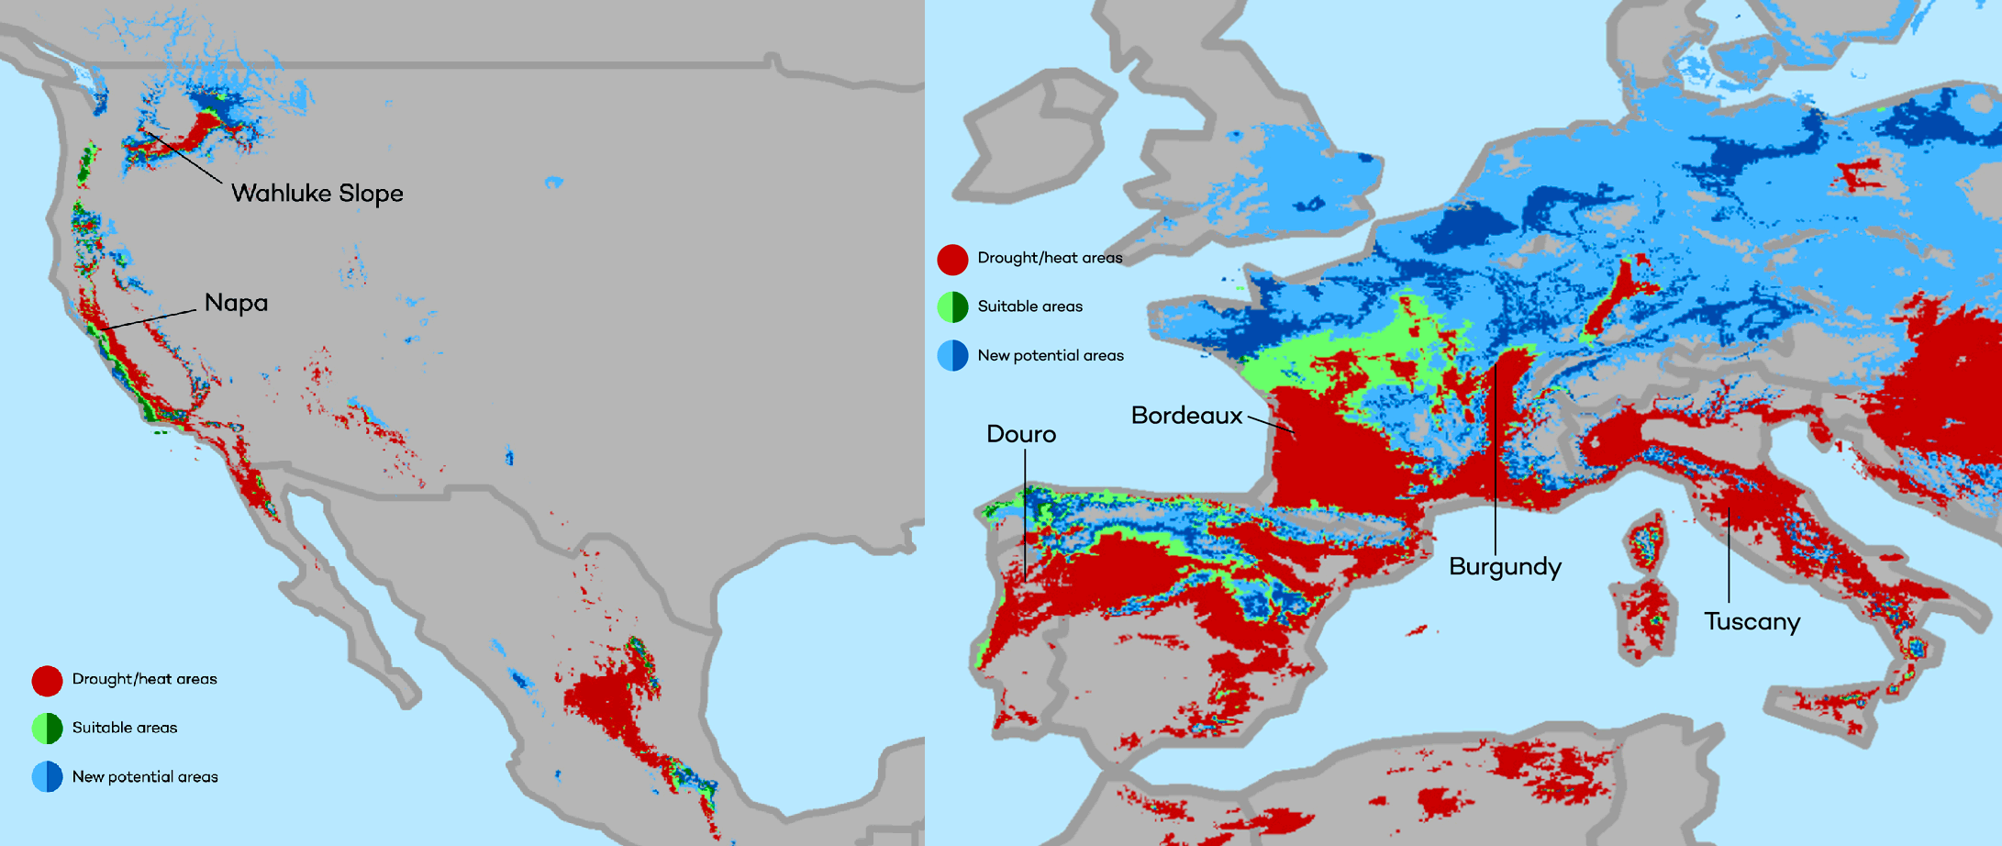
Climate Change: Sarah Jacobson
The changing map of the world’s wine-growing regions.

Slide 69
Thank you!
Any Questions?
www.NEEDelegation.org
Adina Ardelean, Ph.D.
atardelean@scu.edu
Contact NEED: info@needelegation.org
Submit a testimonial: www.NEEDelegation.org/testimonials.php
Become a Friend of NEED: www.NEEDelegation.org/friend.php

