Slide 1
Osher Lifelong Learning Institute
Eckerd College, Spring 2022
Trade and Globalization
Alan Deardorff
University of Michigan
May 19, 2022

Slide 2
National Economic Education Delegation
Vision
One day, the public discussion of policy issues will be grounded in an accurate perception of the underlying economic principles and data.
Mission
NEED unites the skills and knowledge of a vast network of professional economists to promote understanding of the economics of policy issues in the United States.
NEED Presentations
Are nonpartisan and intended to reflect the consensus of the economics profession.

Slide 3
Who Are We?
Honorary Board: 54 members
2 Fed Chairs: Janet Yellen, Ben Bernanke
6 Chairs Council of Economic Advisers
Furman (D), Rosen (R), Bernanke (R), Yellen (D), Tyson (D), Goolsbee (D)
3 Nobel Prize Winners
Akerlof, Smith, Maskin
Delegates: 651+ members
At all levels of academia and some in government service
All have a Ph.D. in economics
Crowdsource slide decks
Give presentations
Global Partners: 49 Ph.D. Economists
Aid in slide deck development

Slide 4
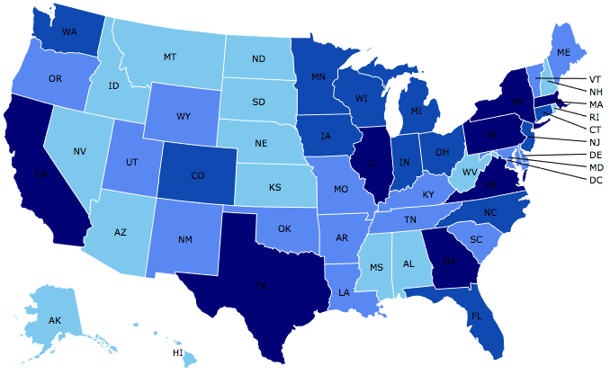
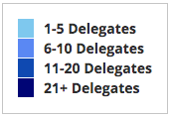
Where Are We?

Slide 5
Available NEED Topics Include:
Coronavirus Economics
US Economy
Climate Change
Economic Inequality
Economic Mobility
Trade and Globalization
Minimum Wages
Immigration Economics
Housing Policy
Federal Budgets
Federal Debt
Black-White Wealth Gap
Autonomous Vehicles
US Social Policy

Slide 6
Submitting Questions
Please submit questions of clarification in the chat.
I will try to handle them as they come up.
We will do a verbal Q&A once the material has been presented.
OLLI allowing, we can stay beyond the end of class to have further discussion.
Slides will be available from the NEED website tomorrow (https://needelegation.org/delivered_presentations.php)

Slide 7
Thank you!
Any Questions?
www.NEEDelegation.org
Alan Deardorff
alandear@umich.edu
Contact NEED: info@NEEDelegation.org
Submit a testimonial: www.NEEDelegation.org/testimonials.php
Become a Friend of NEED: www.NEEDelegation.org/friend.php

