Slide 1
Trade and Globalization
Alan V. Deardorff
University of Michigan
Presentation to New Albany, OH, Kiwanis
February 10, 2022

Slide 2
National Economic Education Delegation
Vision
One day, the public discussion of policy issues will be grounded in an accurate perception of the underlying economic principles and data.
Mission
NEED unites the skills and knowledge of a vast network of professional economists to promote understanding of the economics of policy issues in the United States.
NEED Presentations
Are nonpartisan and intended to reflect the consensus of the economics profession.

Slide 3
Outline
What is Globalization?
Pros and Cons of Trade
Effects of Tariffs
Effects of the Pandemic

Slide 4
What Globalizations Is
Growth over time of many interactions between countries
Trade
Global Value Chains
Foreign Direct Investment
Financial Flows
International Travel
Migration
I will focus here on trade

Slide 5
Trade

Slide 6
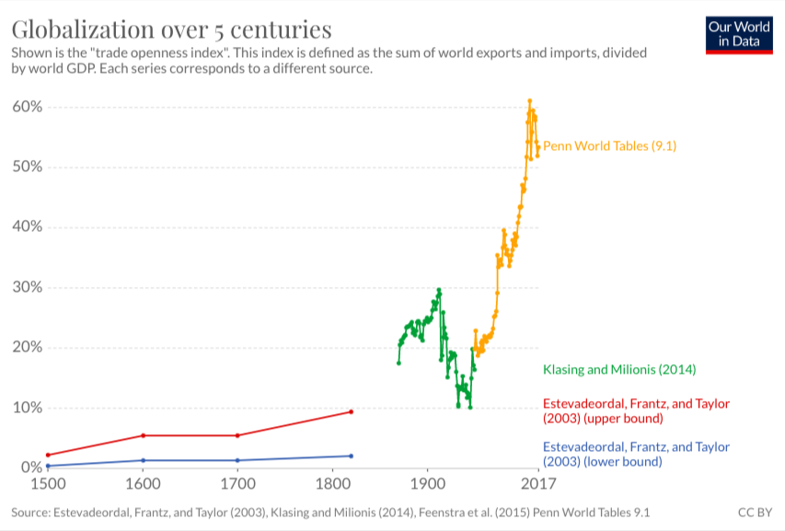
Notes:
Our World in Data
https://ourworldindata.org/trade-and-globalization

Slide 7
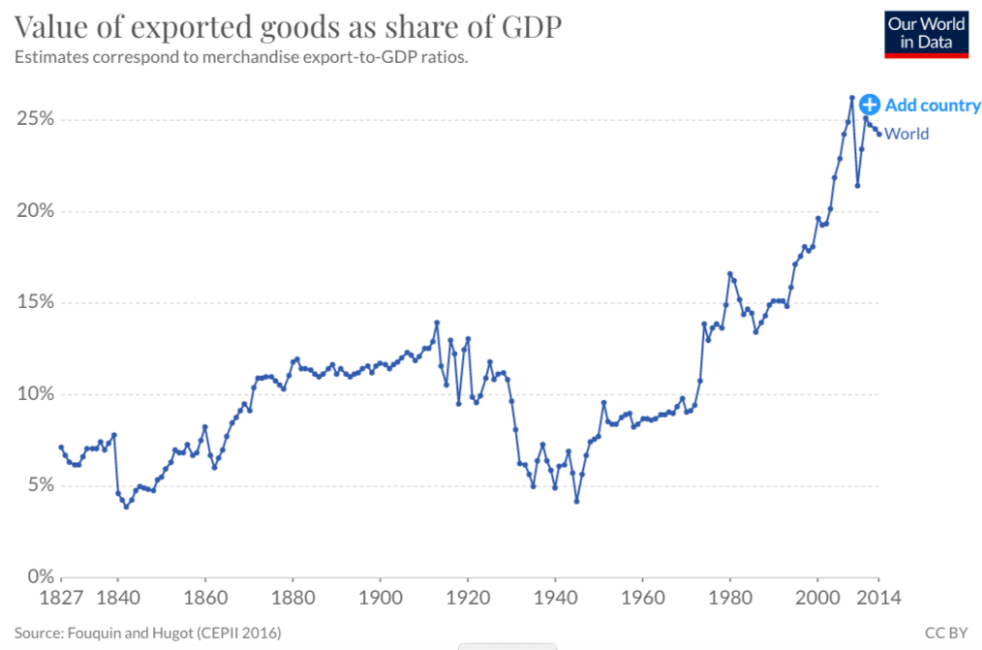
Notes:
Our World in Data
https://ourworldindata.org/trade-and-globalization

Slide 8
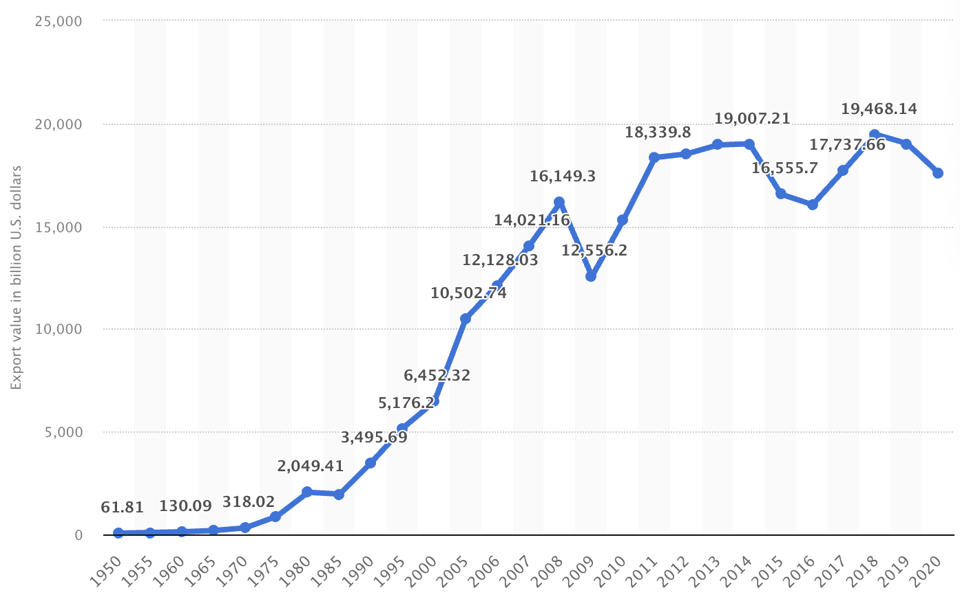
Export Volume Worldwide in Billions of US Dollars, 1950-2020
Source: Statista
Notes:
Statista
https://www.statista.com/statistics/264682/worldwide-export-volume-in-the-trade-since-1950/

Slide 9
Global Value Chains

Slide 10
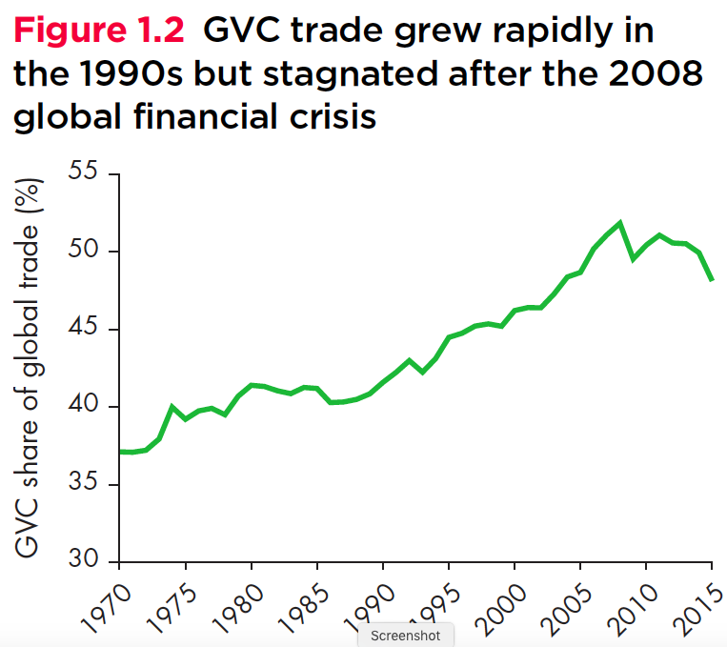
Growth of Global Value Chains, 1970-2015
Source: World Development Report 2020
Notes:
World Bank
https://www.worldbank.org/en/publication/wdr20

Slide 11
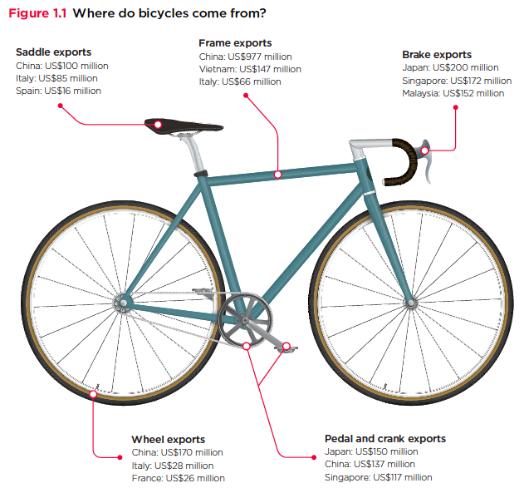
Countries mentioned:
China
France
Italy
Japan
Malaysia
Singapore
Spain
Vietnam
Source: World Development Report 2020
Notes:
World Bank
https://www.worldbank.org/en/publication/wdr20

Slide 12
Supply Chains
Example: The iPhone assembled in China from parts:
Part | Come from
﻿Accelerometers | ﻿Germany, the US, South Korea, China, Japan, and Taiwan.
﻿Audio chips | ﻿US, UK, China, South Korea, Taiwan, Japan, and Singapore.
﻿Batteries | ﻿Samsung (South Korea), which has factories in eighty countries.
﻿Cameras | ﻿Qualcomm (US) and Sony (Japan), both with plants in many countries
﻿Chips ﻿for 3G/4G/LTE networking | ﻿Qualcomm (US)
﻿Compasses | ﻿AKM Semiconductor (Japan) with plants in the US, France, England, China, South Korea, and Taiwan.
﻿Glass screen | ﻿Corning (US) with plants in twenty-six countries.
﻿Gyroscopes | Switzerland
… and many more
Source: Krueger 2020, International Trade (What Everyone Needs to Know), p. 254
Notes:
Krueger, Anne O., International Trade (What Everyone Needs to Know) (p. 254). Oxford University Press, 2020

Slide 13
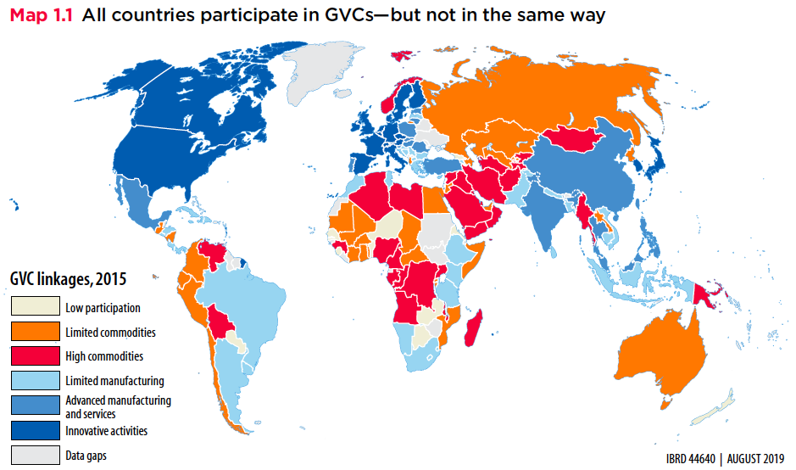
Source: World Bank
Notes:
World Bank
https://www.worldbank.org/en/publication/wdr2020

Slide 14
Pros and Cons of Globalization
Pros and Cons of Globalization
Gains from Trade
Theory of Comparative Advantage
Other Sources of Gain from Trade
Costs of Trade

Slide 15
Gains from Trade Theory of Comparative Advantage

Slide 16
Comparative Advantage
The Theory of Comparative Advantage says:
Countries can, by producing
More than they need of what they do relatively best, and
Less than they need of what they do relatively worst
And exporting the extra to other countries in exchange for what they need
All countries can
Get more of everything if that’s what they want, and
Gain from trade

Slide 17
Other sources of Gain from Trade
Productivity (most productive firms expand and export)
Returns to scale (small countries can support larger firms)
Competition (monopolies in small countries lose market power)
Variety (buyers can access more choices)
Supply chains (firms can source parts from cheapest or best sources)
(That’s really just the above, but within industries and firms.)
Technology (producers get access foreign technologies)

Slide 18
Costs of Trade

Slide 19
But there are Costs
Economic:
When trade expands (or contracts)
Some firms lose market share or shut down
Other firms supplying inputs shrink of shut down
Workers in both lose jobs
Their communities lose customers
Macroeconomic cost: Vulnerability to foreign recession/inflation
Non-economic
Dependence on other countries willingness to trade
Loss of cultural differences
Vulnerability to trade disruption
Crisis induced (earthquake, flood, disease)
Policy induced (sanctions, tariffs, export bans)

Slide 20
Trade Policies that Affect Globalization
Policies that Encourage It
Tariff Reductions
Trade Agreements
Other
Policies that Discourage It
Trump’s Tariffs
Trade War
I’ll focus on these

Slide 21
Trump’s Tariffs and Trade War

Slide 22
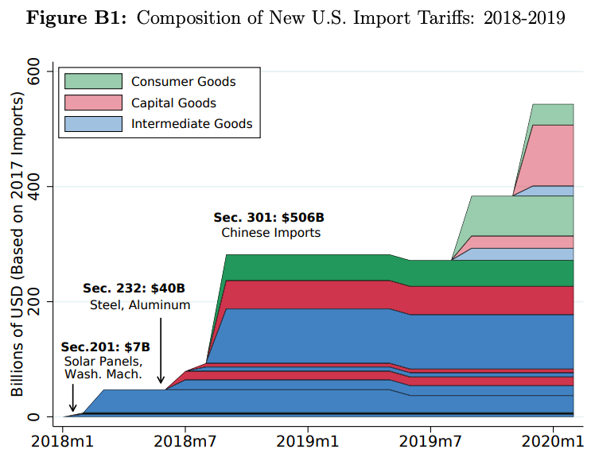
Source: Flaan & Pierce 2020
Notes:
Flaan and Pierce 2020
https://www.federalreserve.gov/econres/feds/files/2019086pap.pdf

Slide 23
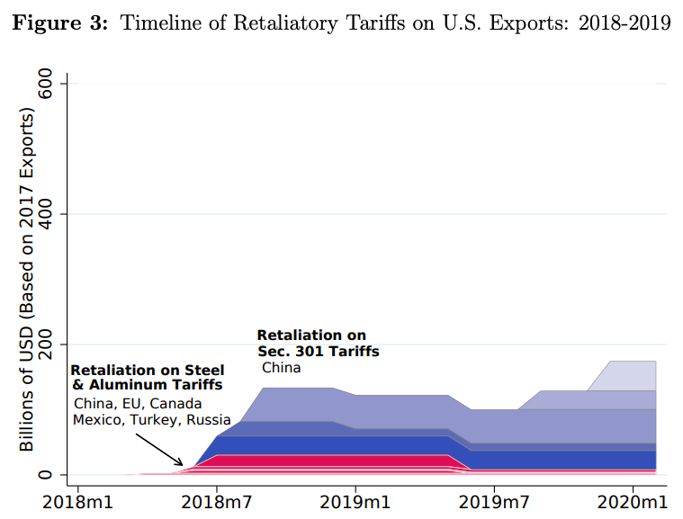
Source: Flaan & Pierce 2020
Notes:
Flaan and Pierce 2020
https://www.federalreserve.gov/econres/feds/files/2019086pap.pdf

Slide 24
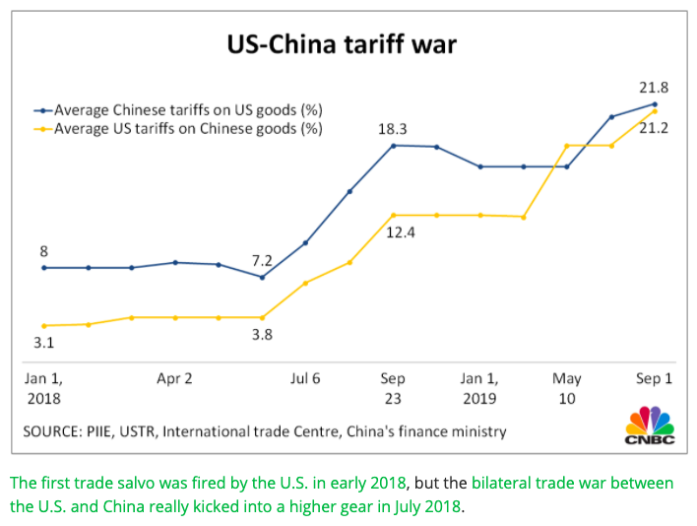
Source: CNBC.com
Notes:
SEPTEMBER 18, 2019 | Yen Nee Lee, CNBC.com
http://nbr.com/2019/09/18/these-4-charts-show-how-us-china-trade-has-changed-during-the-tariff-dispute/

Slide 25
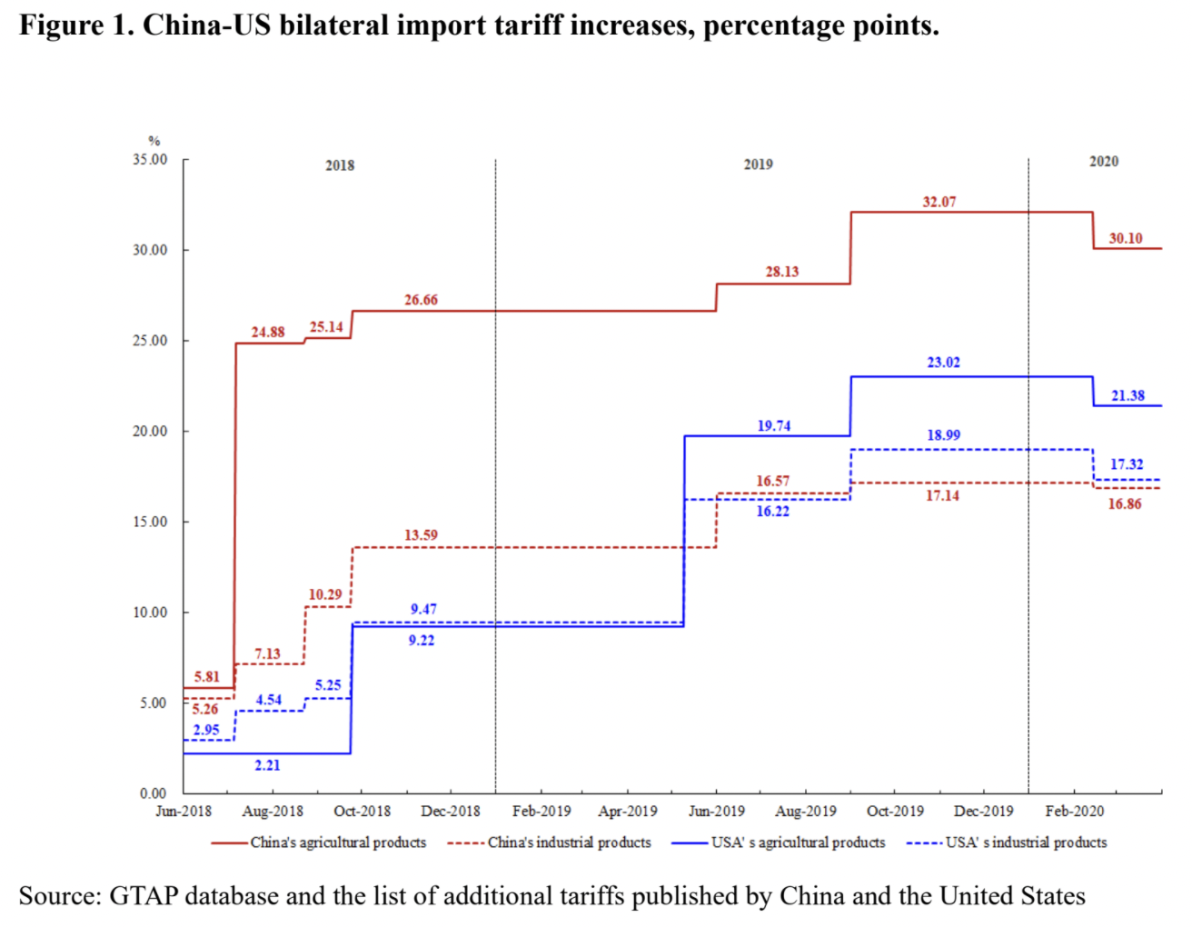
Phase One Agreement Reductions Jan 2020
US tariffs on China
Agriculture
Industrial
China tariffs on US
Agriculture
Industrial
Source: Zheng et al. Oct 2021
Notes:
Zheng, Jian, Shudong Zhou, Xingzi Li, Antonio Domingos Padula, Will Martin, “Effects of Eliminating the US-China Trade War Tariffs,” 27 October 2021

Slide 26
Effects of Tariffs

Slide 27
Effects of a tariff
A tariff is a tax on imports. It causes
A rise in the price of the imported good in the importing country
A fall in the price of the imported good in the exporting country
The quantity imported to fall
The revenue of the tariff-levying government to rise
Almost always: the rise at home is much larger than the fall abroad
That’s especially true if importing country is small
But it’s also true if importing country is large, such as U.S.
Example: Trump’s tariffs caused US prices to rise, with hardly any perceptible fall in prices abroad.

Slide 28
Effects of a tariff
The rise in price in the importing country causes
A rise in price of competing goods produced there
Benefits to those producers
Harm to buyers of both the import and the competing goods
Including producers that use the higher-priced goods as inputs
Their prices also rise, hurting their buyers
Employment changes
Increase in the protected industry
Decrease in industries that use imports as inputs
Example: Trump’s 25% tariff on steel
Helps US steel firms and their workers
Hurts US auto firms and workers
and many other industries that use steel

Slide 29
Effects of the Pandemic
Effects of the Pandemic on Economies
Travel halted
Stock markets fell but came back strongly
Factories shut down
Supply chains were interrupted
Trade plummeted but came back

Slide 30
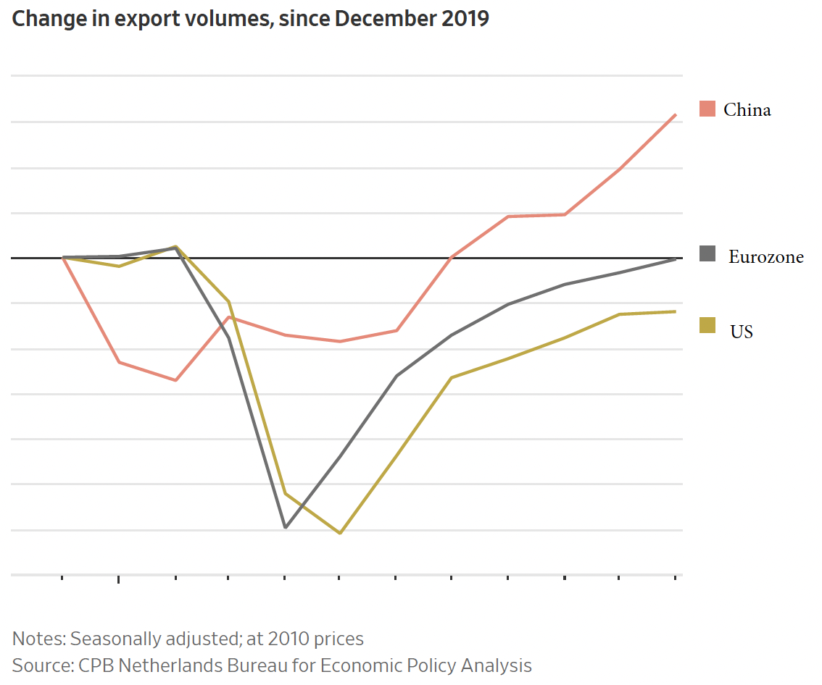
Source: Hannon, WSJ, Feb 25, 2021
Notes:
Hannon, Paul, "Global Trade Roars Back From Depths of Covid-19 Pandemic", Wall Street Journal,, February 25, 2021.

Slide 31
The Pandemic and Globalization
Trade and Covid-19
Globalization helped it spread
Trade in PPE and medical supplies helped to fight it
Trade in vaccines is essential globally
Trade policies have often interfered

Slide 32
Globalization’s Future?

Slide 33
Globalization’s Future?
Will trade, travel, etc. come back?
Yes, partly
Will it reach the previous trend
Probably not.
It didn’t after the financial crisis
Will attitudes change?
Yes.
Firm’s will try to limit exposure
Consumers will learn to live differently
Will economists’ views of globalization change?
I think so.
We still think globalization is good,
But we’re learning that it needs to include greater protections for those who are hurt.

Slide 34
Thank you!
Any Questions?
Alan V. Deardorff
Ford School of Public Policy
University of Michigan
www.NEEDelegation.org

