Slide 1
Osher Lifelong Learning Institute, Winter 2022
Contemporary Economic Policy
University of Hawaii, Manoa
February-March, 2022
Jon Haveman, Ph.D.
National Economic Education Delegation

Slide 2
Available NEED Topics Include:
Coronavirus Economics
US Economy
Climate Change
Economic Inequality
Economic Mobility
Trade and Globalization
Minimum Wages
Immigration Economics
Housing Policy
Federal Budgets
Federal Debt
Black-White Wealth Gap
Autonomous Vehicles
US Social Policy

Slide 3
Course Outline
Contemporary Economic Policy
  Week 1 (2/4): US Economy & Coronavirus Economics
  Week 2 (2/11): Federal Debt (Geoffrey Woglom, Amherst College)
  Week 3 (2/18): Economic Inequality (Stephanie Seguino, Univ of. Vermont)
  Week 4 (2/25): Trade and Globalization (Alan Deardorff, Univ. of Michigan)
  Week 5 (3/4): Climate Change (Sarah Jacobson)
  Week 6 (3/11): Health Economics (Me)

Slide 4
Submitting Questions
Please submit questions in the chat.
  I will try to handle them as they come up, but may take them in a bunch as time permits.
We will do a verbal Q&A once the material has been presented.
  And the questions in the chat have been addressed.

Slide 5
Trade and Globalization
Alan Deardorff, Ph.D.
University of Michigan

Slide 6
Trade and Globalization
Alan V. Deardorff
University of Michigan
Presentation to Osher Lifelong Learning Institute
University of Hawaii, Manoa
February 25, 2022

Slide 7
Outline
What is Globalization?
Pros and Cons of Trade
Trade Policies
The Role of Trade Agreements
(Effects of the Pandemic)

Slide 8
What Globalizations Is
Growth over time of many interactions between countries
  Trade
  Global Value Chains
  Foreign Direct Investment
  Financial Flows
  International Travel
  Migration
I will focus here on trade

Slide 9
Trade

Slide 10

Notes:
Our World in Data
https://ourworldindata.org/trade-and-globalization

Slide 11

Notes:
Our World in Data
https://ourworldindata.org/trade-and-globalization

Slide 12
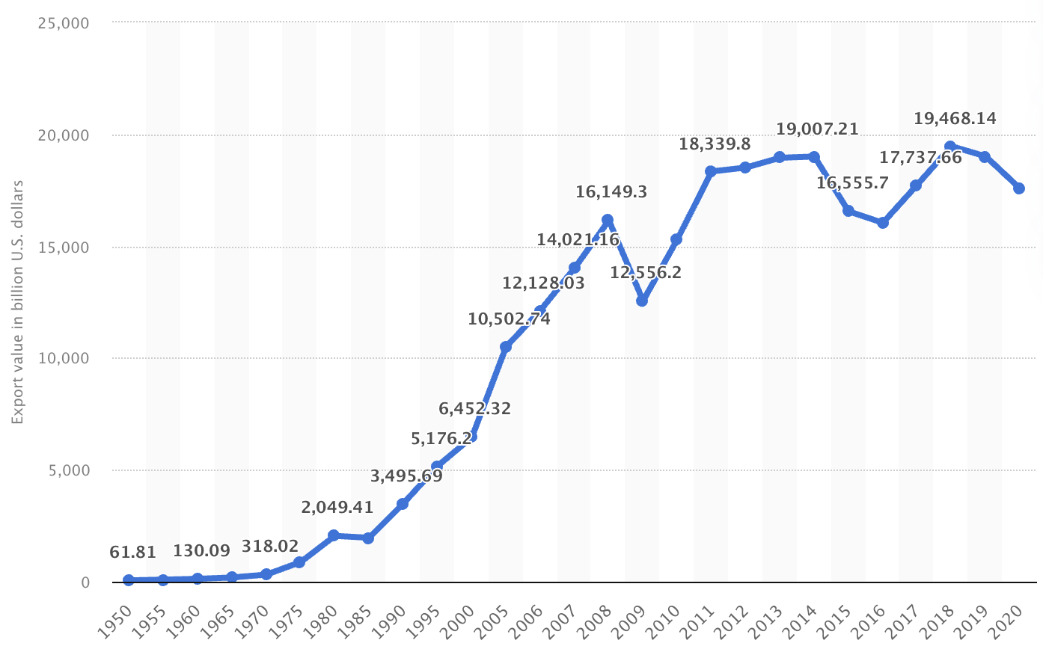
Export Volume Worldwide in Billions of US Dollars, 1950-2020
Source: Statista
Notes:
Statista
https://www.statista.com/statistics/264682/worldwide-export-volume-in-the-trade-since-1950/

Slide 13
Global Value Chains

Slide 14
Effects on Economies
Supply Chains
  Globalization has created long and complex international supply chains

Slide 15

NAFTA and the Auto Supply Chain
Black, Diamond, and Merrill, “One Tiny Widget’s Dizzying Journey Shows Just How Critical Nafta Has Become,” Bloomberg, February 2, 2017.

Slide 16

NAFTA and the Auto Supply Chain
Black, Diamond, and Merrill, “One Tiny Widget’s Dizzying Journey Shows Just How Critical Nafta Has Become,” Bloomberg, February 2, 2017.

Slide 17

NAFTA and the Auto Supply Chain
Black, Diamond, and Merrill, “One Tiny Widget’s Dizzying Journey Shows Just How Critical Nafta Has Become,” Bloomberg, February 2, 2017.

Slide 18

NAFTA and the Auto Supply Chain
Black, Diamond, and Merrill, “One Tiny Widget’s Dizzying Journey Shows Just How Critical Nafta Has Become,” Bloomberg, February 2, 2017.

Slide 19

NAFTA and the Auto Supply Chain
Black, Diamond, and Merrill, “One Tiny Widget’s Dizzying Journey Shows Just How Critical Nafta Has Become,” Bloomberg, February 2, 2017.

Slide 20

NAFTA and the Auto Supply Chain
Black, Diamond, and Merrill, “One Tiny Widget’s Dizzying Journey Shows Just How Critical Nafta Has Become,” Bloomberg, February 2, 2017.

Slide 21

Growth of Global Value Chains, 1970-2015
Source: World Development Report 2020
Notes:
World Bank
https://www.worldbank.org/en/publication/wdr20

Slide 22

Countries mentioned:
China
France
Italy
Japan
Malaysia
Singapore
Spain
Vietnam
Source: World Development Report 2020
Notes:
World Bank
https://www.worldbank.org/en/publication/wdr20

Slide 23
Supply Chains
Example: The iPhone assembled in China from parts:
Part | Come from
﻿Accelerometers | ﻿Germany, the US, South Korea, China, Japan, and Taiwan.
﻿Audio chips | ﻿US, UK, China, South Korea, Taiwan, Japan, and Singapore.
﻿Batteries | ﻿Samsung (South Korea), which has factories in eighty countries.
﻿Cameras | ﻿Qualcomm (US) and Sony (Japan), both with plants in many countries
﻿Chips ﻿for 3G/4G/LTE networking | ﻿Qualcomm (US)
﻿Compasses | ﻿AKM Semiconductor (Japan) with plants in the US, France, England, China, South Korea, and Taiwan.
﻿Glass screen | ﻿Corning (US) with plants in twenty-six countries.
﻿Gyroscopes | Switzerland
… and many more
Source: Krueger 2020, International Trade (What Everyone Needs to Know), p. 254
Notes:
Krueger, Anne O., International Trade (What Everyone Needs to Know) (p. 254). Oxford University Press, 2020

Slide 24

Source: World Bank
Notes:
World Bank
https://www.worldbank.org/en/publication/wdr2020

Slide 25
Pros and Cons of Globalization
Pros and Cons of Globalization
  Gains from Trade
    Theory of Comparative Advantage
    Other Sources of Gain from Trade
  Costs of Trade

Slide 26
Gains from Trade
Theory of Comparative Advantage

Slide 27
Comparative Advantage
The Theory of Comparative Advantage says:
  Countries can gain,
    By producing
      More than they need of what they do relatively best, and
      Less than they need of what they do relatively worst
    And exporting the extra to other countries in exchange for what they need
  By doing that, ALL countries can
    Get more of everything, if that’s what they want, and therefore
    Gain from trade
Illustration with a graph of just 2 countries & 2 goods

Slide 28
Comparative Advantage
If US & UK differ in what they can produce…
Cloth
US
Cloth
UK
Production Possibilities
Food
Food

Slide 29
Comparative Advantage
… Without trade, their consumption will also differ…
Cloth
US
Cloth
UK
Without trade
Consumption =
Production
C^{B}=P^{B}
C^{A}=P^{A}
Food
Food

Slide 30
Comparative Advantage
… With free trade, they specialize in what they do best…
Cloth
US
Cloth
UK
P^{B}
Free Trade
Production
C^{B}=P^{B}
C^{A}=P^{A}
P^{A}
Food
Food

Slide 31
Comparative Advantage
… And can consume more by trading.
Cloth
US
Cloth
UK
P^{B}
Trade
Free Trade
Consumption
C^{B}
C^{A}
C^{B}=P^{B}
Trade
C^{A}=P^{A}
P^{A}
Food
Food

Slide 32
Comparative Advantage
Thus countries both Gain from Trade
Cloth
US
Cloth
UK
P^{B}
Trade
Gain from Trade
C^{B}
C^{A}
C^{B}=P^{B}
Trade
C^{A}=P^{A}
P^{A}
Food
Food

Slide 33
Generality of Comparative Advantage
The Theory of Comparative Advantage requires:
  “Perfect competition” (i.e., all buyers and sellers are very small)
  Absence of market “distortions” (externalities, etc.)
    i.e., reasons why supplies and demands don’t reflect true costs and benefits
The Theory of Comparative Advantage does not require:
  Any limit on numbers of goods, factors, and countries
  That only final goods are traded (thus consistent with supply chains)
  That factors (labor, capital) be immobile between countries
    (However, the gains from trade then accrue to countries including their mobile-factor owners.)

Slide 34
Generality of Comparative Advantage
But note:
  Nothing in the theory says that everyone in each country gains
  Opening to trade requires
    Some industries to shrink or disappear while others expand
    Firms and workers in shrinking industries
      Certainly lose during the transition
      May be permanently worse off
    In example, losers are producers of
      Cloth in US
      Food in UK
Cloth
US
Cloth
UK
P^{B}
C^{B}=P^{B}
C^{A}=P^{A}
P^{A}
Food
Food

Slide 35
Gains from Trade
Other Sources of Gain from Trade

Slide 36
Other sources of Gain from Trade
Productivity (most productive firms expand and export)
Returns to scale (small countries can support larger firms)
Competition (monopolies in small countries lose market power)
Variety (buyers can access more choices)
Supply chains (firms can source parts from cheapest or best sources)
  (That’s really just the above, but within industries and firms.)
Technology (producers get access foreign technologies)

Slide 37
Costs of Trade

Slide 38
But there are Costs
Economic:
  When trade expands (or contracts)
    Some firms lose market share or shut down
    Other firms supplying inputs to those firms shrink or shut down
    Workers in both lose jobs
    Their communities lose customers
  Macroeconomic cost: Vulnerability to foreign recession/inflation
  Dependence on other countries’ willingness to trade
  Vulnerability to trade disruption
    Crisis induced (earthquake, flood, disease)
    Policy induced (sanctions, tariffs, export bans)
Non-economic
  Loss of cultural differences
  Spread of invasive species and plant disease
  Spread of human disease

Slide 39
Pause
Pause for
  Questions
  5-Minute Break
Next: Trade Policies

Slide 40
Trade Policies that Affect Globalization
Policies that Encourage It
  Tariff Reductions
  Trade Agreements
  Other
Policies that Discourage It
  Trump’s Tariffs
  Trade War

Slide 41
Policies that Encourage Globalization

Slide 42
Tariff Reductions

Slide 43

Source: Economist
Notes:
From an Economist “Barriers to Entry” article

Slide 44

Source: Quartz 2018
Notes:
Quartz, Kopf 2018
https://qz.com/1230399/a-history-of-tariffs-us-protectionism-in-one-230-year-chart/

Slide 45
Trade Agreements

Slide 46
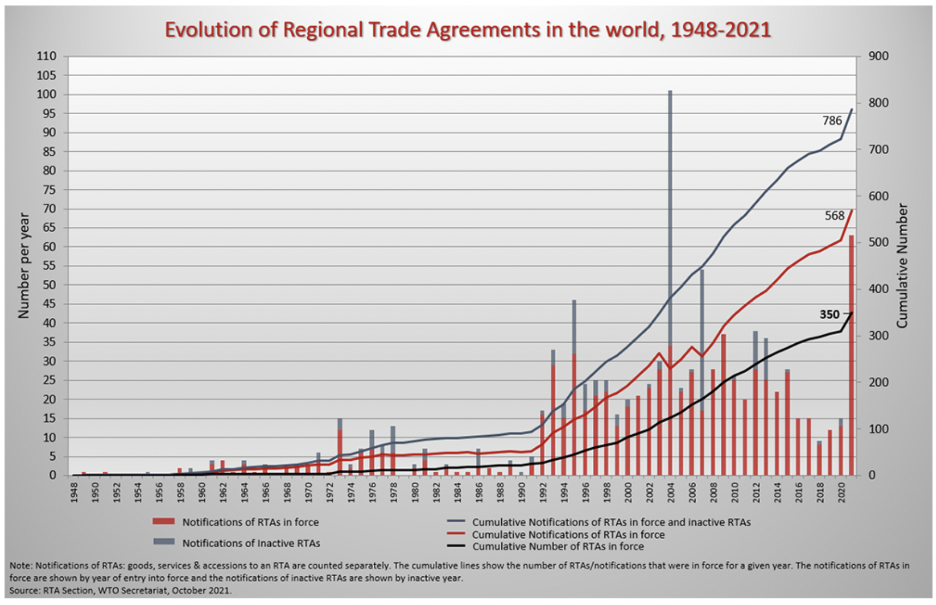
Source: WTO
Notes:
WTO
https://www.wto.org/english/tratop_e/region_e/region_e.htm#facts

Slide 47

European Union
Source: Europa.eu
Notes:
http://europa.eu/european-union/about-eu/money/euro_en

Slide 48

NAFTA (now USMCA)

Slide 49


MERCOSUR

Slide 50

CPTPP
=
Trans-Pacific Partnership minus US

Slide 51
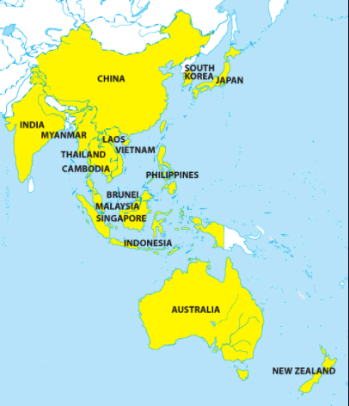
RCEP
=
Regional Comprehensive Economic Partnership
Notes:
China Briefing 2012
https://www.china-briefing.com/news/china-to-join-rcep-creating-massive-free-trade-area-with-asean-india-and-japan/

Slide 52
Other Policies to Encourage Globalization
IMF/World Bank
  Policy advice to open markets (the ”Washington Consensus”)
  Loans to countries conditional on
    Reducing trade barriers
    Permitting capital flows
GATT/WTO (World Trade Organization) [More on this later, if time]
  Negotiate reciprocal trade liberalization
  Settlement of trade disputes (usually about interfering with trade)
Bilateral Investment Treaties
  Better treatment of multinational corporations

Slide 53
Policies that Discourage Globalization

Slide 54
Trump’s Tariffs and Trade War

Slide 55

Source: Flaan & Pierce 2020
Notes:
Flaan and Pierce 2020
https://www.federalreserve.gov/econres/feds/files/2019086pap.pdf

Slide 56

Source: Flaan & Pierce 2020
Notes:
Flaan and Pierce 2020
https://www.federalreserve.gov/econres/feds/files/2019086pap.pdf

Slide 57

Source: CNBC.com
Notes:
SEPTEMBER 18, 2019 | Yen Nee Lee, CNBC.com
http://nbr.com/2019/09/18/these-4-charts-show-how-us-china-trade-has-changed-during-the-tariff-dispute/

Slide 58

Phase One Agreement Reductions Jan 2020
US tariffs on China
Agriculture
Industrial
China tariffs on US
Agriculture
Industrial
Source: Zheng et al. Oct 2021
Notes:
Zheng, Jian, Shudong Zhou, Xingzi Li, Antonio Domingos Padula, Will Martin, “Effects of Eliminating the US-China Trade War Tariffs,” 27 October 2021

Slide 59
Effects of Tariffs

Slide 60
Effects of a tariff
A tariff is a tax on imports. It causes
  A rise in the price of the imported good in the importing country
  A fall in the price of the imported good in the exporting country
  The quantity imported to fall
  The revenue of the tariff-levying government to rise
Almost always: the rise at home is much larger than the fall abroad
  That’s especially true if importing country is small
  But it’s also true if importing country is large, such as U.S.
  Example: Trump’s tariffs caused US prices to rise, with hardly any perceptible fall in prices abroad.

Slide 61
Effects of a tariff
The rise in price in the importing country causes
  A rise in price of competing goods produced there
  Benefits to those producers
  Harm to buyers of both the import and the competing goods
    Including producers that use the higher-priced goods as inputs
      Their prices also rise, hurting their buyers
  Employment changes:
    Increase in the protected industry
    Decrease in industries that use imports as inputs
  Example: Trump’s 25% tariff on steel
    Helps US steel firms and their workers
    Hurts US auto firms and workers
      and many other industries that use steel

Slide 62
Effects of a tariff
The fall in price in the exporting country causes
  Harm to sellers there
  Benefit to buyers there
  Shift of sales to other countries
If the tariff is on exports from only one country (e.g, China)
  Buyers shift to imports from other, more costly, countries (e.g., Vietnam)

Slide 63
Arguments for and against tariffs
If economists are so opposed to tariffs, why are they used?
Arguments for protection
  Many have been used, both past and present
  See the list in my Glossary of International Economics

Slide 64

Arguments for tariffs
National security
Government Revenue
Strategic trade policy
Distribution
Infant Industry
Source: Deardorffs’ Glossary of International Economics

Slide 65
Arguments against tariffs
Arguments against tariffs
  Economic gains from trade (see above)
  Tariffs prompt retaliation
  Some valid arguments for tariffs depend on information that is either
    Unavailable, or
    Available only from the protected industry
  Even when net beneficial, tariffs are politically hard to remove
  Lower tariffs and greater trade reduce the likelihood of war

Slide 66
The Role of Trade Agreements
Countries have negotiated trade agreements throughout history
  At least back to the 1500’s between the Ottoman Empire and the powers of Europe
  The first “free trade agreement” (FTA) was between Britain and France in 1860, soon followed by many more
    Removed tariffs on trade with each other
  US used “reciprocal trade agreements” starting in 1934 to reduce tariffs and dig out of the Great Depression
  US led negotiation of multilateral agreements via
    GATT (General Agreement on Tariffs and Trade) 1948
    WTO (World Trade Organization) 1995

Slide 67
The Role of Trade Agreements
Trade Agreements (both WTO & FTAs)
  Promote trade by
    Reducing tariffs
    Blocking policies that discriminate against imports
  But they also do much else, mostly to serve business interests:
    Permit anti-dumping duties to deter competition
    Protect intellectual property (patents, etc.)
    Allow investor action against governments

Slide 68
The Role of Trade Agreements
WTO
  164 member countries
  Includes
    China since 2001
    Russia since 2012
    Not Iran, N. Korea
  Headquarters Geneva, Switzerland

Slide 69


Slide 70



Slide 71
The Role of Trade Agreements
The WTO has
  Three Parts:
    GATT (Still exists, as largest part of WTO)
      limits tariffs
    GATS = General Agreement on Trade in Services
    TRIPs Agreement = Trade Related aspects of Intellectual Property Rights
  Two Basic Principles
    Most Favored Nation (Don’t discriminate among exporters)
    National Treatment (Don’t discriminate against imports)

Slide 72
The Role of Trade Agreements
The WTO’s Main Functions
  Negotiation of reduced trade barriers
    Tariffs (GATT did this well; WTO not)
    Removal of other barriers
  Dispute settlement
    Countries bring cases against others
    WTO “panels” and “Appellate Body” decide

Slide 73
The Role of Trade Agreements
WTO Dispute Settlement
  There have been 609 cases initiated since 1995 (as of 1/30/22)
  About 90% have been decided in favor of the complainant, both by (132) and against US (168)
  The mechanism has been unable to decided cases since December 10, 2019 when
    President Trump blocked appointments to Appellate Body
    President Biden has not changed this
Notes:
Case counts as of 2/2/22
https://www.wto.org/english/tratop_e/dispu_e/dispu_by_country_e.htm

Slide 74
Effects of the Pandemic
Effects of the Pandemic on Economies
  Travel halted
  Stock markets fell but came back strongly
  Factories shut down
  Supply chains were interrupted
  Trade plummeted but came back

Slide 75
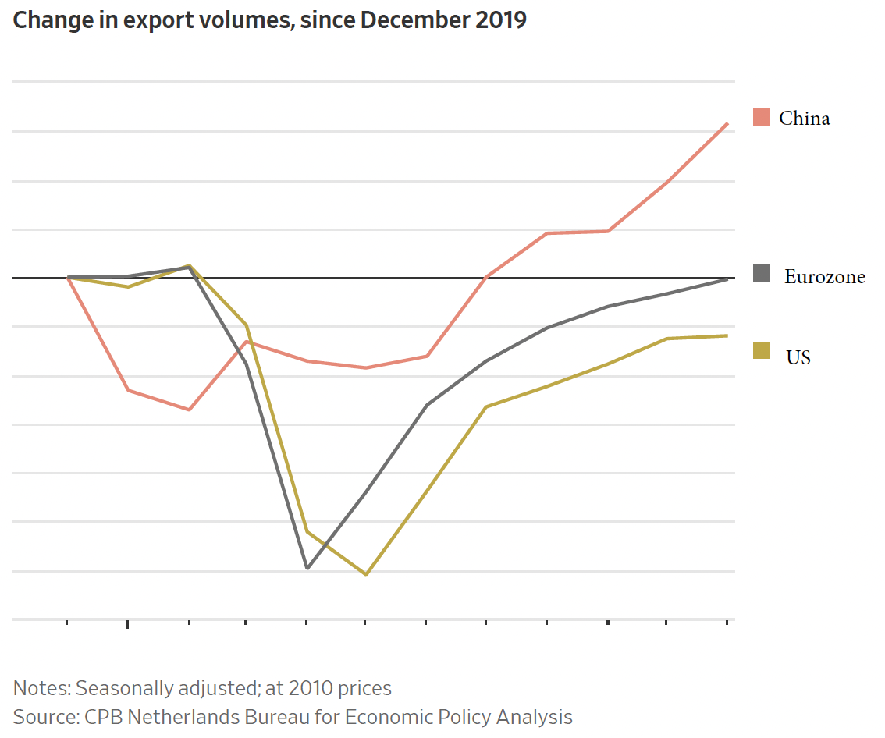
Source: Hannon, WSJ, Feb 25, 2021
Notes:
Hannon, Paul, "Global Trade Roars Back From Depths of Covid-19 Pandemic", Wall Street Journal,, February 25, 2021.

Slide 76
The Pandemic and Globalization
Trade and Covid-19
  Globalization helped it spread
  Trade in PPE and medical supplies helped to fight it
  Trade in vaccines is essential globally
  Trade policies have often interfered

Slide 77
Globalization’s Future?

Slide 78
Globalization’s Future?
Will trade, travel, etc. come back?
  Yes, partly
Will it reach the previous trend
  Probably not.
  It didn’t after the financial crisis
Will attitudes change?
  Yes.
  Firm’s will try to limit exposure
  Consumers will learn to live differently
Will economists’ views of globalization change?
  I think so.
    We still think globalization is good,
    But we’re learning that it needs to include greater protections for those who are hurt.

Slide 79
Thank you!
Thank you!
Any Questions?
Alan V. Deardorff
Ford School of Public Policy
University of Michigan
www.NEEDelegation.org

Slide 80
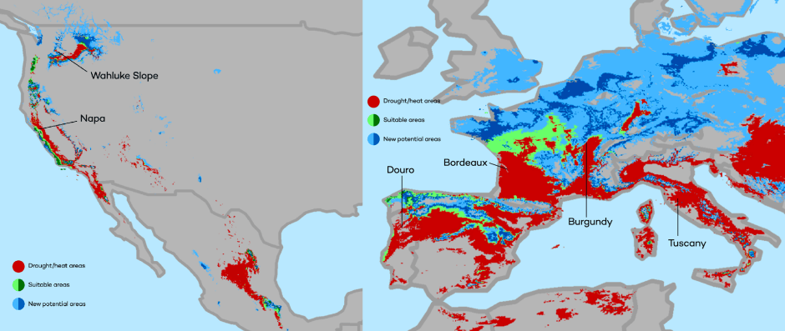
Climate Change Economics: Sarah Jacobson
The changing map of the world’s wine-growing regions.

Slide 81
Thank you!
Any Questions?
www.NEEDelegation.org
Alan Deardorff
alandear@umich.edu
Contact NEED: info@NEEDelegation.org
Submit a testimonial: www.NEEDelegation.org/testimonials.php
Become a Friend of NEED: www.NEEDelegation.org/friend.php

