Slide 1
Trade and Globalization
Rotary Club, Florence, Kentucky
July 19, 2021
Hasan Faruq, Ph.D.
Professor of Economics
Xavier University

Slide 2
National Economic Education Delegation
Vision
One day, the public discussion of policy issues will be grounded in an accurate perception of the underlying economic principles and data.
Mission
NEED unites the skills and knowledge of a vast network of professional economists to promote understanding of the economics of policy issues in the United States.
NEED Presentations
Are nonpartisan and intended to reflect the consensus of the economics profession.

Slide 3
Who Are We?
Honorary Board: 47 members
2 Fed Chairs: Janet Yellen, Ben Bernanke
6 Chairs Council of Economic Advisers
Furman (D), Rosen (R), Bernanke (R), Yellen (D), Tyson (D), Goolsbee (D)
3 Nobel Prize Winners
Akerlof, Smith, Maskin
Delegates: 500+ members
At all levels of academia and some in government service
All have a Ph.D. in economics
Crowdsource slide decks
Give presentations
Global Partners: 45 Ph.D. Economists
Aid in slide deck development

Slide 4
Credits and Disclaimer
The original slide deck was authored by:
Peter Eppinger, University of Tübingen
James Lake, Southern Methodist University
Michael Plouffe, University College London
Swati Verma, ISID, New Delhi
The original slide deck was reviewed by:
Alan Deardorff, University of Michigan
Ed Leamer, UCLA
Disclaimer
NEED presentations are designed to be nonpartisan.
Any views expressed are those of the presenter and not necessarily those of the National Economic Education Delegation (NEED).
Some edits to the slide deck were made by the presenter (Hasan Faruq); any errors in these edits were unintentional and the presenter’s sole responsibility.

Slide 5
Outline
Why do we trade?
Comparative Advantage
Who gains and loses from trade?
Impact of trade wars
U.S. and China (2018 onwards)

Slide 6
Why do we trade?
True Story:
I recently bought a shirt from the mall
with the label “Made in Bangladesh”.
Wouldn’t it be easier to make the shirt
locally?

Slide 7
Why do we trade?
Cost:
Import from China saves us on average 10% in price.
iPhone 12 production cost in China $373!
How much would it cost to make an entire iPhone 12 in the USA?

Slide 8
Why do we trade?
Warren Buffett famously eats breakfast
at McDonald’s everyday.
Would it make more sense for him to make his own breakfast everyday if he could make it better/cheaper himself?

Slide 9
Why do we trade?
Key Concepts
Comparative Advantage:
The ability to make something relatively efficiently
Different countries may have different comparative advantage due to differences in labor, weather, resources, etc.
Export (i.e. selling to other countries):
Each country exports the products they have comparative advantage in producing

Slide 10
Winners and Losers from Trade
Consumers:
Producers/Businesses:

Slide 11
Winners and Losers from Trade
Consumers:
Lower Prices
New Varieties (US vs. Japanese cars)
Quality (German engineering)

Slide 12
Winners and Losers from Trade
Businesses:
US industries that use imported input/parts
US manufacturing industries buy steel from Brazil, Mexico, China, etc.
US exporters
New Markets (China is the largest buyer of US corn, soybeans, etc.)
US importers
Job losses (25% of manufacturing jobs lost between 1990-2007 due to trade with China)
Psychological costs
Question: Is trade the main reason for the decline in US manufacturing?

Slide 13
Winners and Losers from Trade
Net Effect of Trade:
Benefits for U.S. consumers: $100,000 per lost manufacturing job
Costs of trade are very high for some workers
Net effect of trade is positive.

Slide 14
US China Trade War

Slide 15
US China Trade War
Key Concepts
Tariffs:
Taxes on foreign products
Foreign products become more expensive to U.S. consumers
President Trump’s tariffs covered 12.6% of U.S. imports.
China, Canada, EU, South Korea and Mexico were the biggest targets.
Trade deficit:
Exports < Import

Slide 16
US China Trade War
Source: Peterson Institute for International Economics

Slide 17
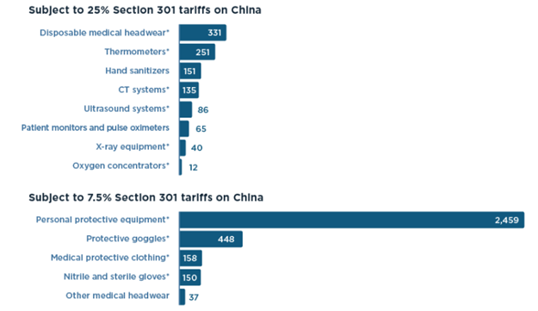
US China Trade War
US tariff on Chinese medical equipment

Slide 18
US China Trade War
Other U.S. tariffs (e.g. steel)
Winners:
US producers (United States Steel, AK Steel) & workers
Losers:
US consumers/steel-consuming US firms
2.4 million jobs in US industries where steel >= 5% of inputs
140,000 jobs in steel producing industries
Also, US exports of soybean, corn, etc. to China decreased due to retaliatory tariffs from China

Slide 19
US China Trade War
Effect on the U.S. economy
Loss of $1.4 billion real income per month in 2018 (Amiti, Redding, and Weinstein, 2018, NBER Working Paper 25672)
Decrease in consumption growth by 3.8% (and job growth) in the top 25% of counties that were hit by Chinese retaliation (Waugh, 2019, NBER Working Paper 26353)

Slide 20
General Consensus of Economists on Tariffs

Slide 21
Trade Summary
Why countries trade
Comparative advantage (i.e. ability to produce something relatively efficiently)
Winners and losers of trade
Winners: US consumers, US exporters, US businesses that use imported inputs
Losers: US businesses who compete with imports from other countries
Net effect of trade is positive.
US-China Trade War
Recent studies suggest that US-China trade war had a negative impact on the U.S. economy.

Slide 22
Thank you!
Any Questions?
www.NEEDelegation.org
Hasan Faruq, PhD
faruqh@xavier.edu
Contact NEED: Info@NEEDelegation.org
Submit a testimonial: www.NEEDelegation.org/testimonials.php
Follow NEED: www.NEEDelegation.org/friends.php
Notes:
That’s all I have. Thanks for being here in person and online. If you have any questions, you can email me at my Xavier email address here, or you can ask them now.

