Slide 1
National Economic Education Delegation
Vision
One day, the public discussion of policy issues will be grounded in an accurate perception of the underlying economic principles and data.
Mission
NEED unites the skills and knowledge of a vast network of professional economists to promote understanding of the economics of policy issues in the United States.
NEED Presentations
Are nonpartisan and intended to reflect the consensus of the economics profession.

Slide 2
International Trade and the Pandemic: Gainers and Losers
Alan V. Deardorff
University of Michigan
CIX 680 Exchange
Walnut Creek, CA
September 15, 2021
Notes:
After first reviewing how international trade normally benefits and harms different groups within the economy and why, this talk will turn to how trade and trade policy have responded to the pandemic. The Covid-19 virus has caused major changes in trade that differ across countries and time. Governments have also responded differently, both as infections spread and later as vaccines became available. Trade policies for dealing with the pandemic have contributed to the diversity across countries and populations in the hardship that the pandemic has caused.

Slide 3
Overview
Cases of the Pandemic
Started in China
Spread to the world in five waves, so far
Hit
The Americas and Europe especially hard
Later, developing countries, esp. India
Deaths surged early and then grew more slowly than cases as treatments improved

Slide 4
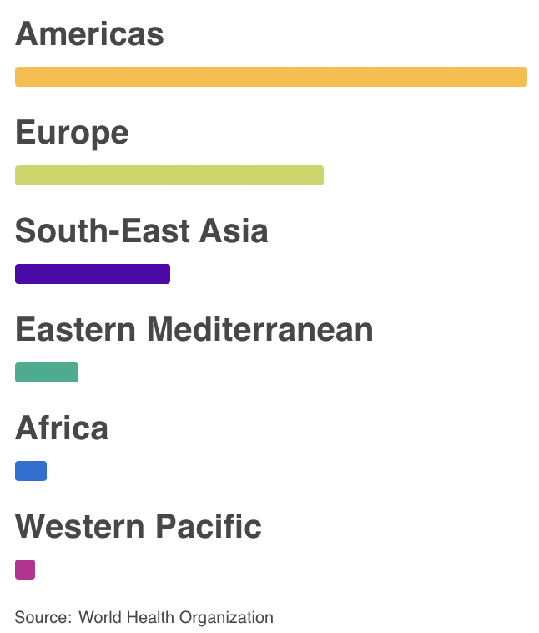
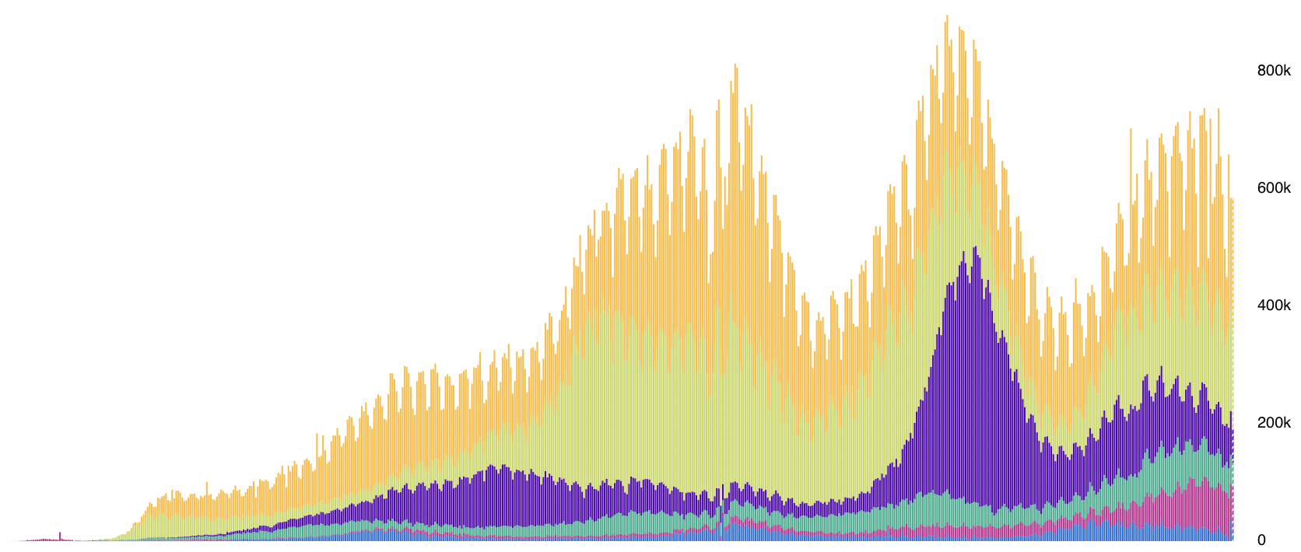
Cases
Daily Confirmed Cases
Apr. Jul. Oct. Jan. Apr. Jul.
Source: WHO Coronavirus Disease (COVID-19) Dashboard as of Sep 12, 2021
Notes:
WHO Coronavirus Disease (COVIC-19) Dashboard
https://covid19.who.int/?gclid=CjwKCAiAuoqABhAsEiwAdSkVVNd67qw_hEb4v9v3UxACJd_csZMJl8Yc5UjaAIYt53KJWSQiXZPlRxoCm0kQAvD_BwE

Slide 5
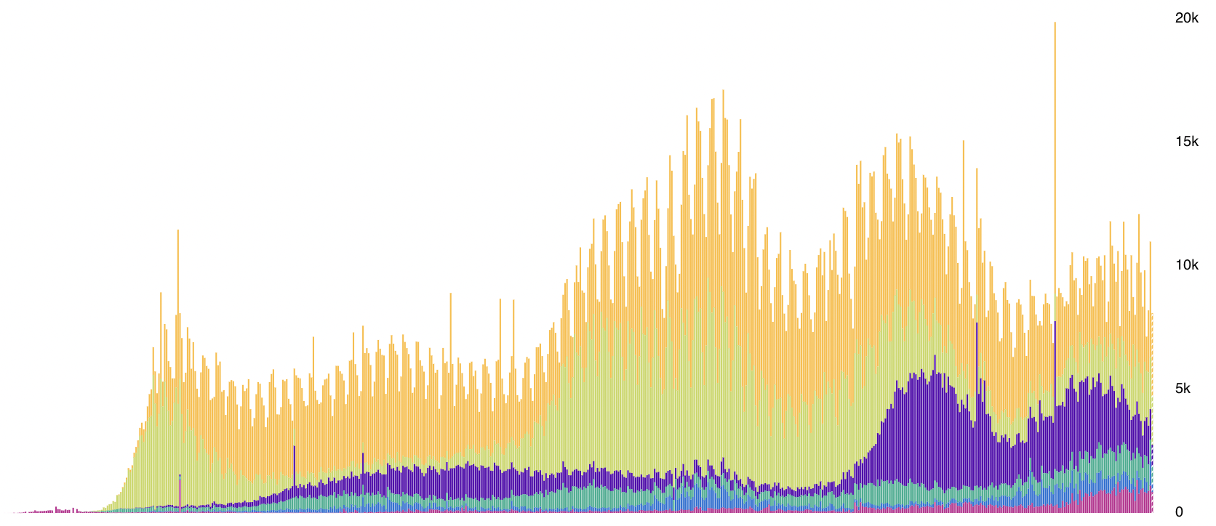
Deaths
Daily Deaths
Apr. Jul. Oct. Jan. Apr. Jul.
Source: WHO Coronavirus Disease (COVID-19) Dashboard as of Sep 12, 2021
Notes:
WHO Coronavirus Disease (COVIC-19) Dashboard
https://covid19.who.int/?gclid=CjwKCAiAuoqABhAsEiwAdSkVVNd67qw_hEb4v9v3UxACJd_csZMJl8Yc5UjaAIYt53KJWSQiXZPlRxoCm0kQAvD_BwE

Slide 6
Overview
What Happened to Trade
International trade fell drastically
First for China
Then for the world, while China’s trade rebounded
World trade has now mostly recovered

Slide 7
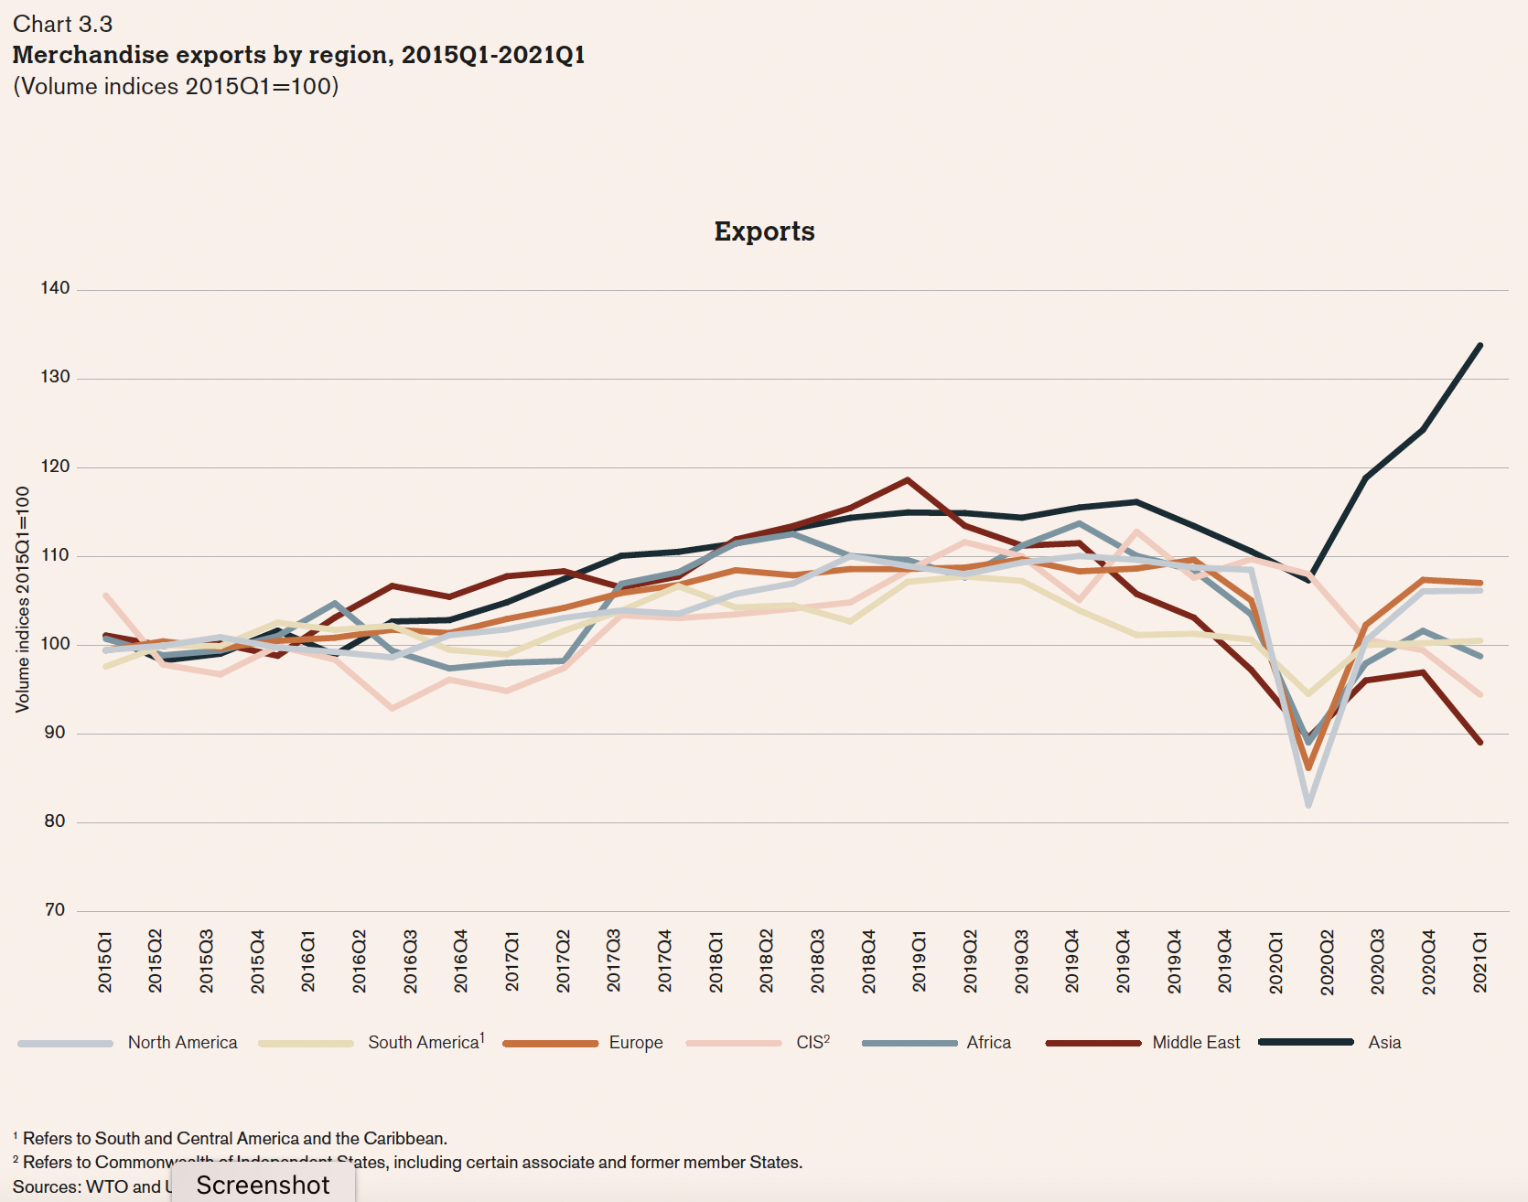
ASIA
2020
NORTH AMERICA
Source: WTO
Notes:
World Trade Organization, Chapters II and III of World Trade Statistical Review 2021, pp. 10-39.
https://www.wto.org/english/res_e/statis_e/wts2021_e/wts2021_e.pdf

Slide 8
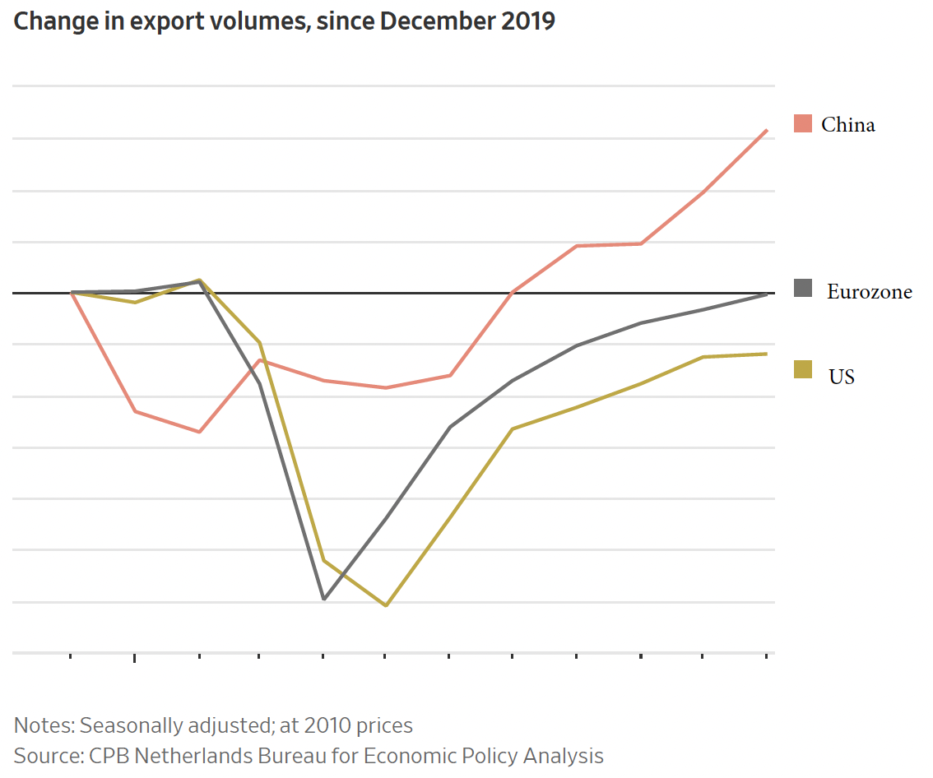
Source: Hannon, WSJ, Feb 25, 2021
Notes:
Hannon, Paul, "Global Trade Roars Back From Depths of Covid-19 Pandemic", Wall Street Journal,, February 25, 2021.

Slide 9
Overview
What Happened to Trade Policy
Included both
Import facilitation, and
Export restriction
Both highest for medical and high for food
Facilitation was somewhat more common than restriction
Both began before cases surged

Slide 10
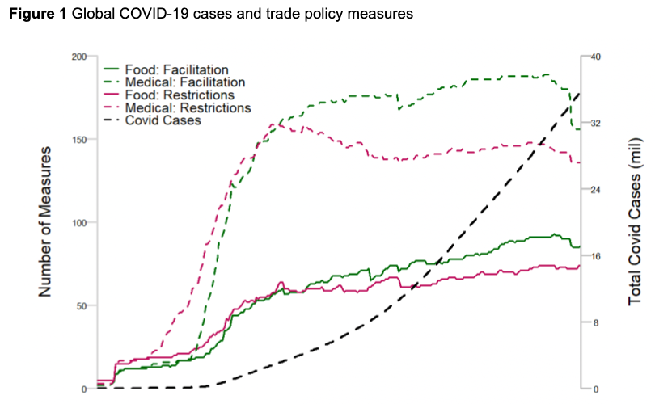
Medical
Food
Source: Evenett et al.
Notes:
Evenett, Simon, Matteo Fiorini, Johannes Fritz, Bernard Hoekman, Piotr Lukaszuk, Nadia Rocha,Michele Ruta, Filippo Santi, Anirudh Shingal, “Trade policy responses to the COVID-19 pandemic: Evidence from a new dataset,” VOXEU, December 11, 2020.
https://voxeu.org/article/trade-policy-responses-covid-19-pandemic-new-dataset

Slide 11
Overview
Outline
Pros and Cons of Trade
Globalization
Winners and losers from trade and trade policy
The Pandemic and Trade
Did trade cause the pandemic?
How did trade matter for winners and losers?
The Pandemic and Trade Policies
How did pandemic change trade policies
How did trade policies matter for winners and losers?

Slide 12
Trade Pros and Cons

Slide 13
Globalization
How and why trade has grown
Trade grew, then fell, then grew vastly
Tariffs and other barriers have fallen
Both transport and communication have become cheaper

Slide 14
Notes:
https://ourworldindata.org/grapher/globalization-over-5-centuries?country=~OWID_WRL

Slide 15
US Tariffs, 1891-2017
Tokyo Round tariff cuts
Smoot-Hawley
GATT
established
Kennedy Round tariff cuts begin
Uruguay Round
Notes:
From NEED trade deck

Slide 16
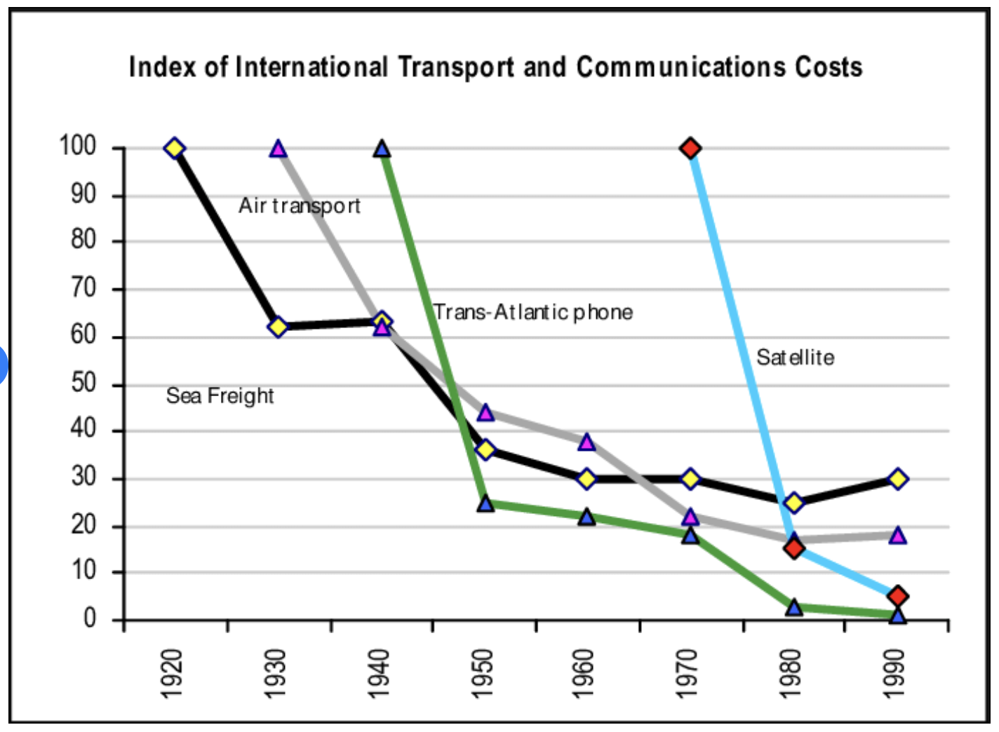
Transport and Communication Costs
Note that this show only to 1990, before the Internet.
Notes:
van der Zee, Frans A., “East Asian Growth: ICT for Growth and Cohesion in a Global Knowedge-based Econoomy,” Technical report, European Commission, 2012.
https://www.researchgate.net/figure/Declining-international-transport-and-communications-costs-19201990_fig2_272620921

Slide 17
Pros and Cons of Trade
Pros
Reduces cost-of-living world-wide
Fills shortages in some countries with others’ surpluses
Cons
Changes internationally hurt some while helping others
Economists’ almost universal view: Pros > Cons
Trade is beneficial overall for all countries
Trade restrictions are harmful
Tariffs on imports, export taxes
Bans on exports, imports
But there are always losers from changes in trade who need policies to help them

Slide 18
Pros of Trade
Comparative advantage
Source goods where relative costs are lowest
Each country produces and exports what they do best
Costs and prices fall world-wide
Increased competition
More firms compete, reducing monopoly pricing
Economies of large-scale production
With larger markets firms reap economies of scale
Costs fall

Slide 19
Pros of Trade
Access to greater variety
Products can be better-tailored to users needs
Consumers get what they want most
Producers get what they need most
Increased productivity
Firms learn state-of-the-art technologies from foreign firms
Most productive firms expand while others contract

Slide 20
Cons of Trade
Changes in trade (up or down) disrupt
Businesses
Jobs
Communities that lose factories to
Imports
Movement to produce abroad

Slide 21
Cons of Trade
Dependence on foreign supply and demand
Trade can be disrupted by
Natural disasters (earthquakes, floods, etc.)
Policies (export and import bans or taxes)
International cartels (oil crises of the 1970s)
Vulnerable to others’ economies, diseases
Recession in export markets causes recession at home
Exchange rate changes can cause inflation, unemployment
Infectious diseases spread through trade
Notes:
Salvatore Babones, “The ‘Chinese Virus’ Spread Along the New Silk Road,” Foreign Policy, April 6, 2020.
https://foreignpolicy.com/2020/04/06/chinese-coronavirus-spread-worldwide-on-new-silk-road/

Slide 22
Cons of Trade
Income distribution
In rich countries like the US, aside from effects on their particular employers and industries
Low-wage workers lose to competition with lower wages abroad.
High-wage workers gain.
Owners of capital gain generally, because capital is mobile and labor is not.
(These effects could be dampened or reversed by policy, but mostly they are not, as the winners dominate policy.)

Slide 23
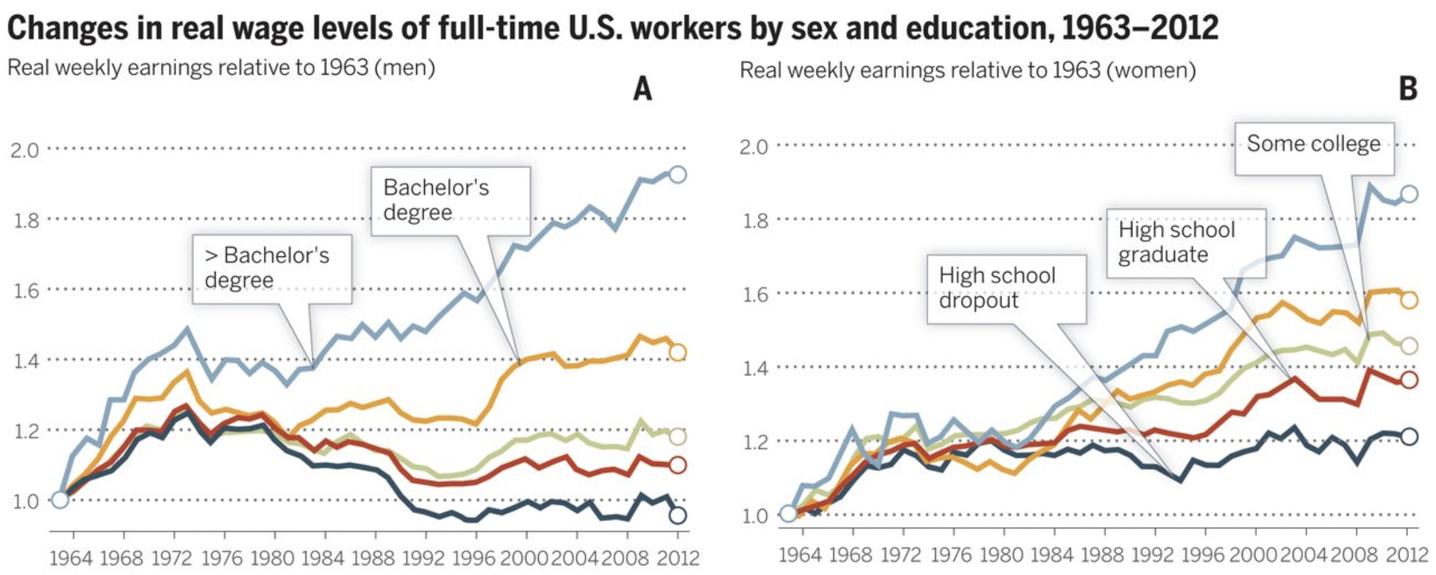
Cons of Trade
Note: Research suggests that these changes are about 1/3 due to trade, 2/3 due to technological change.
Notes:
Roser, Max and hamed MoNagdy, “Returns to Education,” Our World in Data
https://ourworldindata.org/returns-to-education
Downloaded 9/12/21

Slide 24
Winners and Losers from Tariffs
At the “micro” level of an import tariff on a product
Price in the importing country rises
Price in the exporting countries falls
In the importing country
Competing sellers gain
Buyers lose
Government collects revenues
In the exporting counties
Sellers lose
Buyers gain

Slide 25
Winners and Losers from a Tariff
Market for an Imported Good
Price of Import
Home price rises
Helping home sellers
Hurting home buyers
Home price with tariff
Tariff
Foreign Supply of Imports
Free trade price
Foreign price with tariff
Foreign price falls
Hurting foreign sellers
Helping foreign buyers
Home Demand for Imports
Home government collects tariff revenue
Quantity imported

Slide 26
Winners and Losers from a Export Ban
Market for an Exported Good
Price of Export
Foreign price rises
Helping foreign sellers
Hurting foreign buyers
Home Supply of Exports
Foreign price with ban
Home price falls
Hurting home sellers
Helping home buyers
Free trade price
Home price with ban
Foreign Demand for Exports
Quantity exported

Slide 27
The Pandemic and Trade

Slide 28
Causes of the Pandemic
Does trade cause new infections?
No. These arise from mutations, often in animals and then spread to humans
Does trade spread infections?
Yes. Trade requires movement of people across borders, carrying infections
The Black Death (bubonic plague)
“is believed to have been spread by both land and sea, originating in China and following the trade routes to Europe and the Middle East.”
The 1918 Spanish Flu: but spread more by soldiers than by trade
Notes:
Salvatore Babones, “The ‘Chinese Virus’ Spread Along the New Silk Road,” Foreign Policy, April 6, 2020.
https://foreignpolicy.com/2020/04/06/chinese-coronavirus-spread-worldwide-on-new-silk-road/

Slide 29
Causes of the Pandemic
Studies Relate Globalization and Spread of Pandemic
Zimmermann et al. find, across countries:
Infection rate rises with globalization
Transmission speed rises with globalization
Fatalities fall with globalization
(but probably because globalization is correlated with higher incomes and thus better treatment)
Farzanegan et al. report similarly
Notes:
Zimmermann, Klaus F., Gokhan Karabulut, Mehmet Huseyin Bilgin, and Asli Cansin Doker, “Inter-country distancing, globalisation and the coronavirus pandemic,” World Economy 43(6), June 2020, pp. 1484-1498.
Farzanegan, Mohammad Reza, Mehdi Feizi, and Hassan F. Gholipour, “Globalization and Outbreak of COVID-19: An Empirical Analysis,” CESifo Working Paper No. 8315, May 2020.

Slide 30
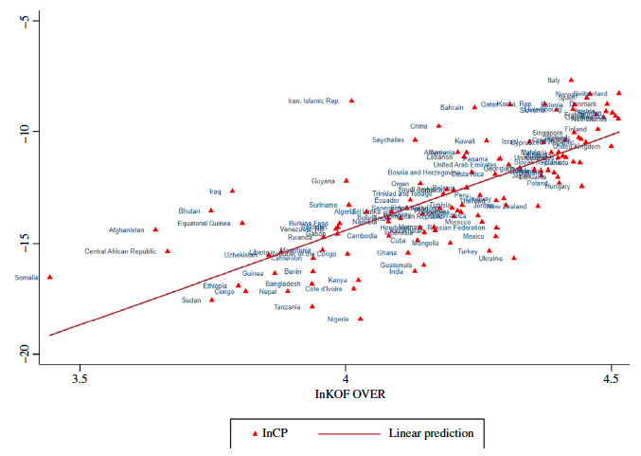
Infection rates rise with globalization
Infection Rate
(Globalization)
Source: Zimmermann et al. (2020)
Notes:
Zimmermann, Klaus F., Gokhan Karabulut, Mehmet Huseyin Bilgin, and Asli Cansin Doker, “Inter-country distancing, globalisation and the coronavirus pandemic,” World Economy 43(6), June 2020, pp. 1484-1498.

Slide 31
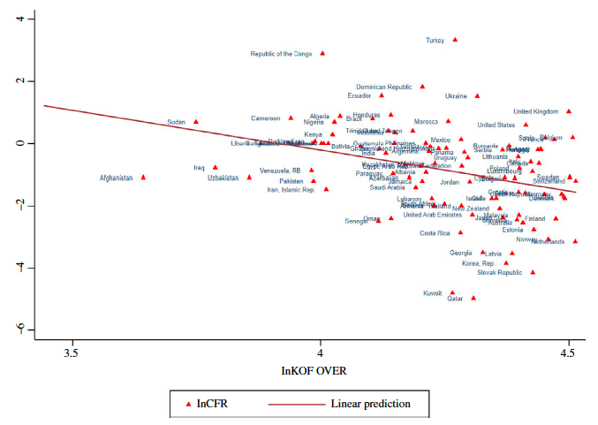
Fatalities fall with globalization
Fatality Ratio
(Globalization)
(Globalization)
Source: Zimmermann et al. (2020)
Notes:
Zimmermann, Klaus F., Gokhan Karabulut, Mehmet Huseyin Bilgin, and Asli Cansin Doker, “Inter-country distancing, globalisation and the coronavirus pandemic,” World Economy 43(6), June 2020, pp. 1484-1498.

Slide 32
Causes of the Pandemic
Globalization and Spread of Pandemic
Note that globalization is not just trade
It includes
International trade and investment
International tourism
International students
Migration
International transportation
Notes:
Zimmermann, Klaus F., Gokhan Karabulut, Mehmet Huseyin Bilgin, and Asli Cansin Doker, “Inter-country distancing, globalisation and the coronavirus pandemic,” World Economy 43(6), June 2020, pp. 1484-1498.

Slide 33
How Trade Mattered

Slide 34
How Trade Mattered
China gained
Tourist destinations lost
Transport industry disrupted
Industries and consumers suffered shortages

Slide 35
How Trade Mattered
China gained
After first being hurt by its own shut-downs
China’s exports rose to new heights
China was, and is, main supplier of PPE

Slide 36
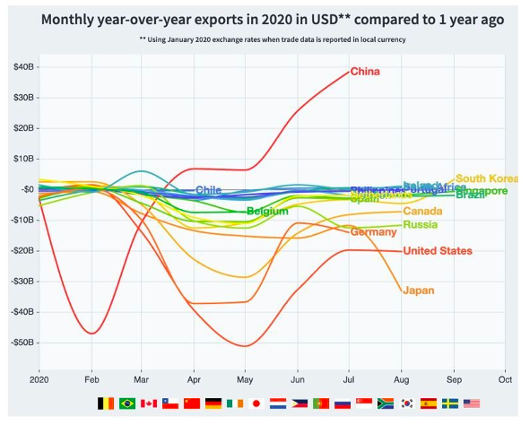
Source: World Economic Forum
Nov 8, 2020
Notes:
How COVID-19 has affected trade, in 8 charts, World Economic Forum, Nov 8, 2020
https://www.weforum.org/agenda/2020/11/how-covid-19-has-reshuffled-international-trade/

Slide 37
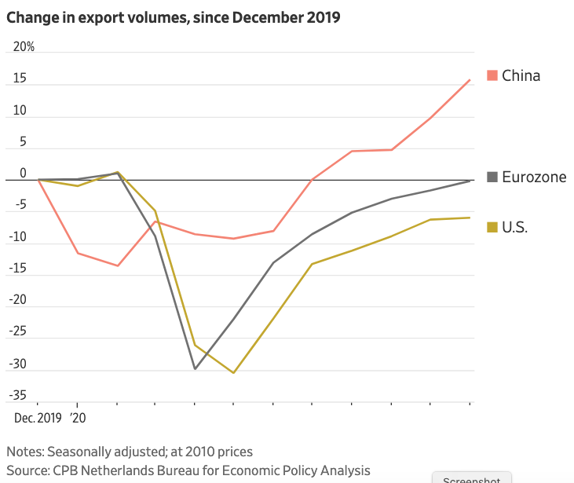
Source: Wall Street Journal
Feb 26, 2021
Notes:
Hannon, Paul, “Global Trade Roars Back From Depths of Covid-19 Pandemic,” Wall Street Journal, February 26, 2021.
https://www.wsj.com/articles/global-trade-roars-back-from-depths-of-covid-19-pandemic-11614253037?mod=itp_wsj&ru=yahoo

Slide 38
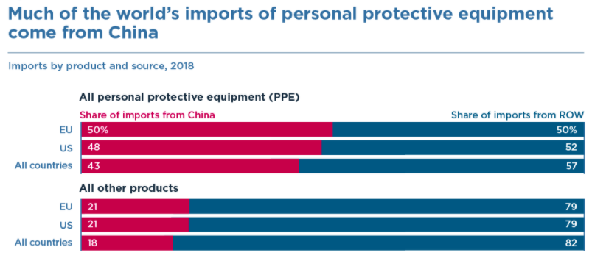
Source: Bown (2020)
Notes:
Bown (2020), “COVID-19: China's exports of medical supplies provide a ray of hope,” PIIE
https://www.piie.com/blogs/trade-and-investment-policy-watch/covid-19-chinas-exports-medical-supplies-provide-ray-hope

Slide 39
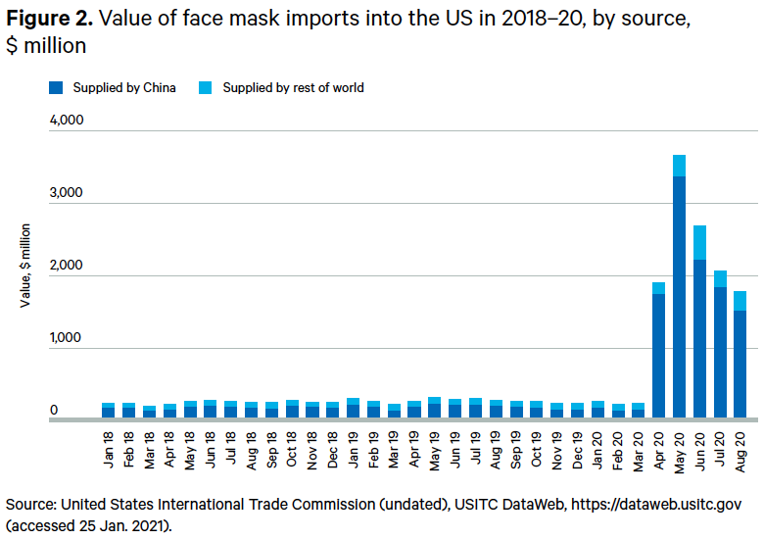
Source: Evenett (2021)
Notes:
Evenett, Simon J., “Trade policy and medical supplies during COVID-19,” Briefing Paper, Global Economy and Finance Program, Chatham House, April 2021
https://www.globaltradealert.org/reports/67

Slide 40
How Trade Mattered
Tourist destinations suffered
True across the world
Countries differ in reliance on tourism
Small countries are most dependent
But important parts of large countries suffer too

Slide 41
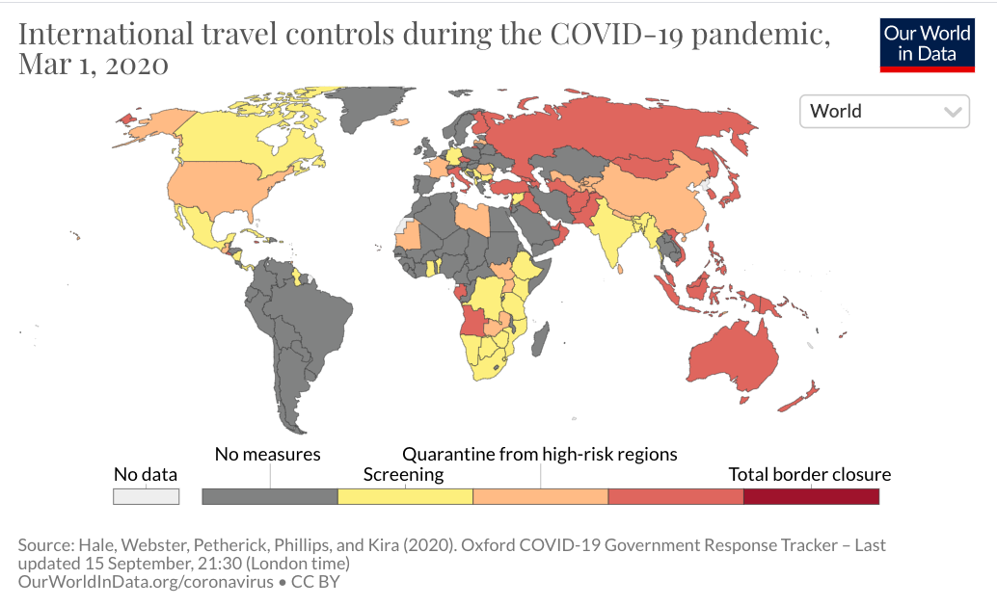
International travel controls during the COVID-19 pandemic, Mar 1, 2020
Notes:
Our World in Data
https://ourworldindata.org/grapher/international-travel-covid

Slide 42
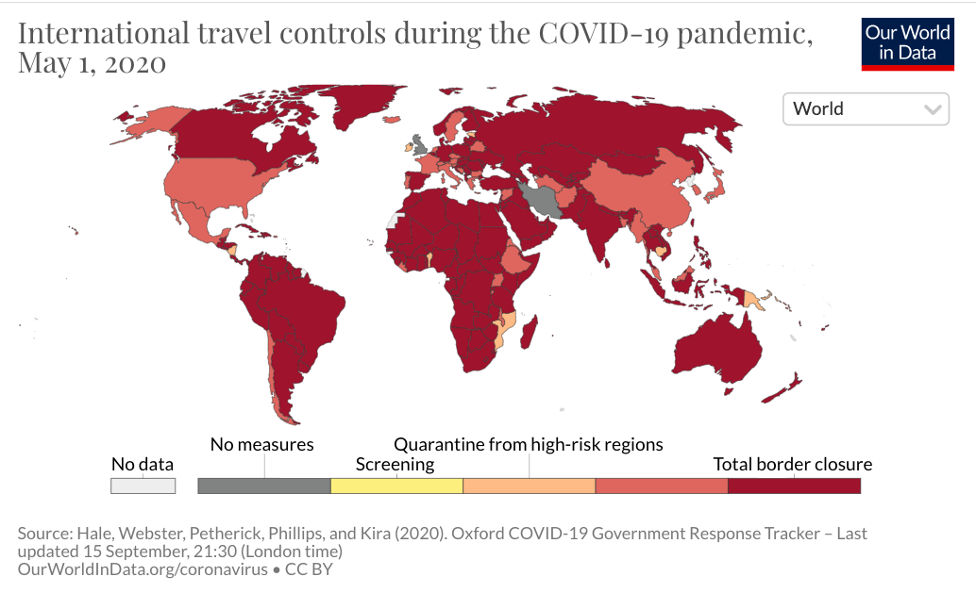
International travel controls during the COVID-19 pandemic, May 1, 2020
Notes:
Our World in Data
https://ourworldindata.org/grapher/international-travel-covid

Slide 43
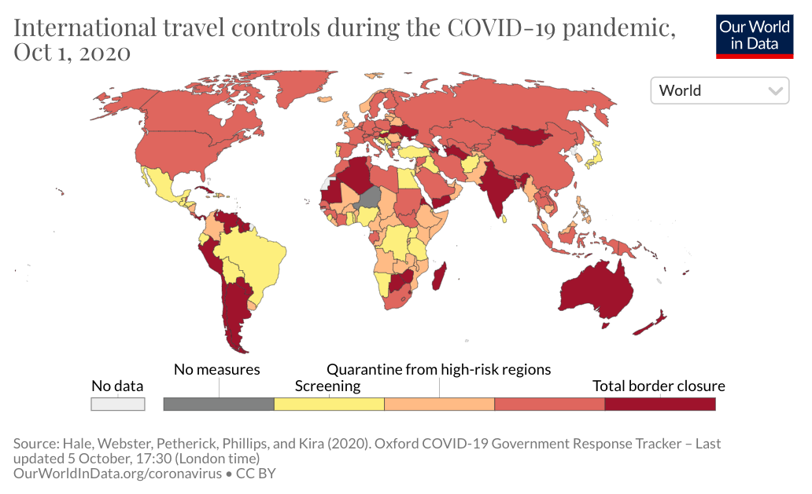
International travel controls during the COVID-19 pandemic, Oct 1, 2020
Notes:
Our World in Data
https://ourworldindata.org/grapher/international-travel-covid

Slide 44
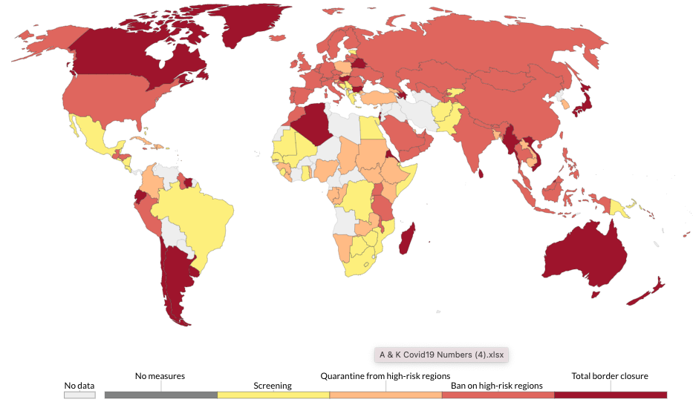
International travel controls during the COVID-19 pandemic, May 15, 2021
Notes:
Our World in Data
https://ourworldindata.org/grapher/international-travel-covid

Slide 45
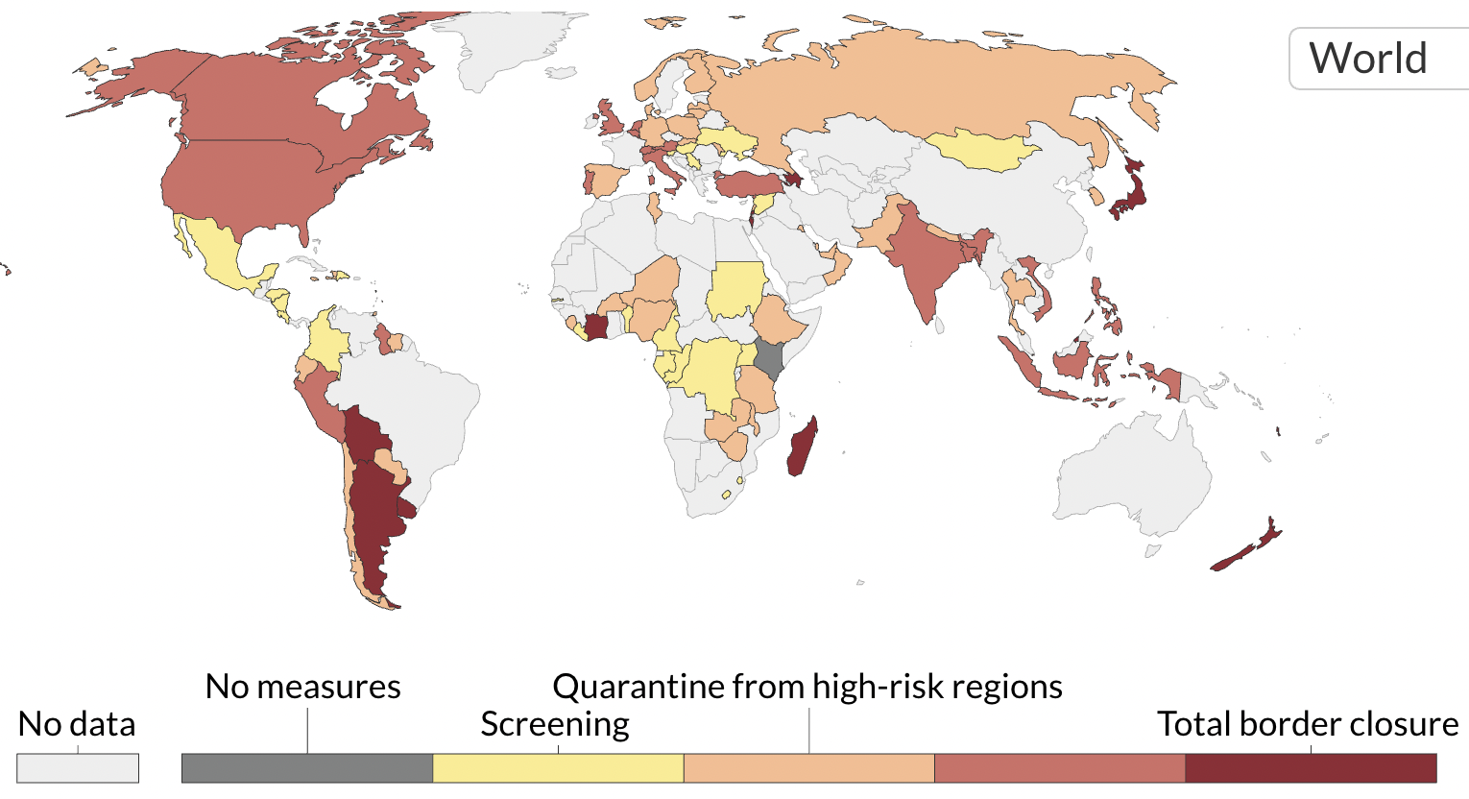
International travel controls during the COVID-19 pandemic, Sep 10, 2021
Notes:
Our World in Data
https://ourworldindata.org/grapher/international-travel-covid

Slide 46
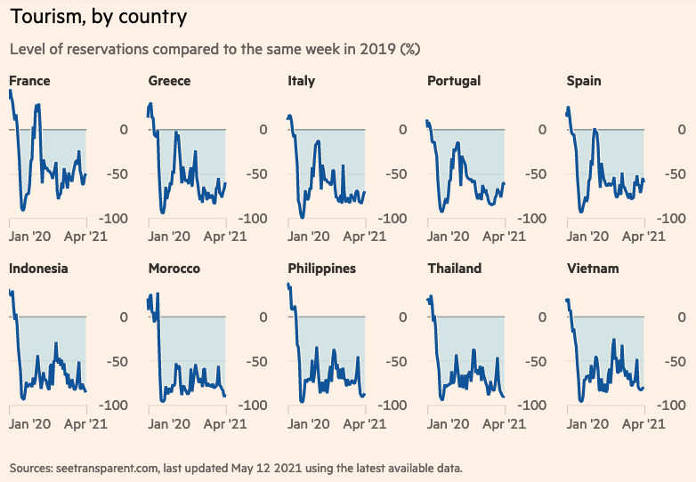
Source: FT 5/14/21
Notes:
“Pandemic crisis: Global economic impact tracker,” Financial Times, May 14, 2021
https://www.ft.com/content/272354f2-f970-4ae4-a8ae-848c4baf8f4a

Slide 47
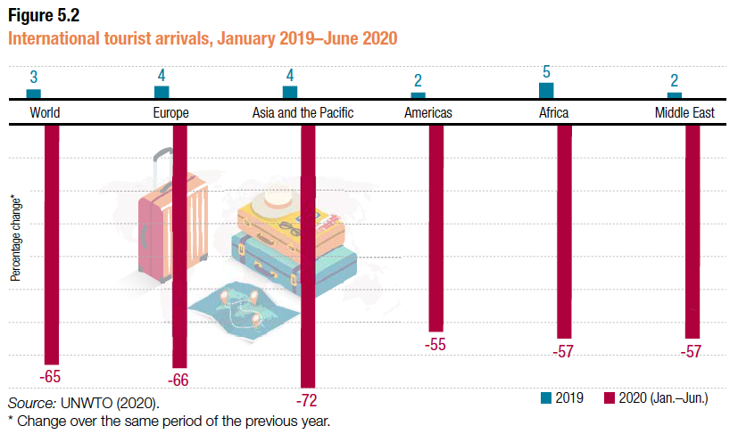
Source: UNCTAD
Notes:
UNCTAD,
https://unctad.org/webflyer/impact-covid-19-pandemic-trade-and-development-transitioning-new-normal Impact of the Covid-19 Pandemic on Trade and Development, 2020.

Slide 48
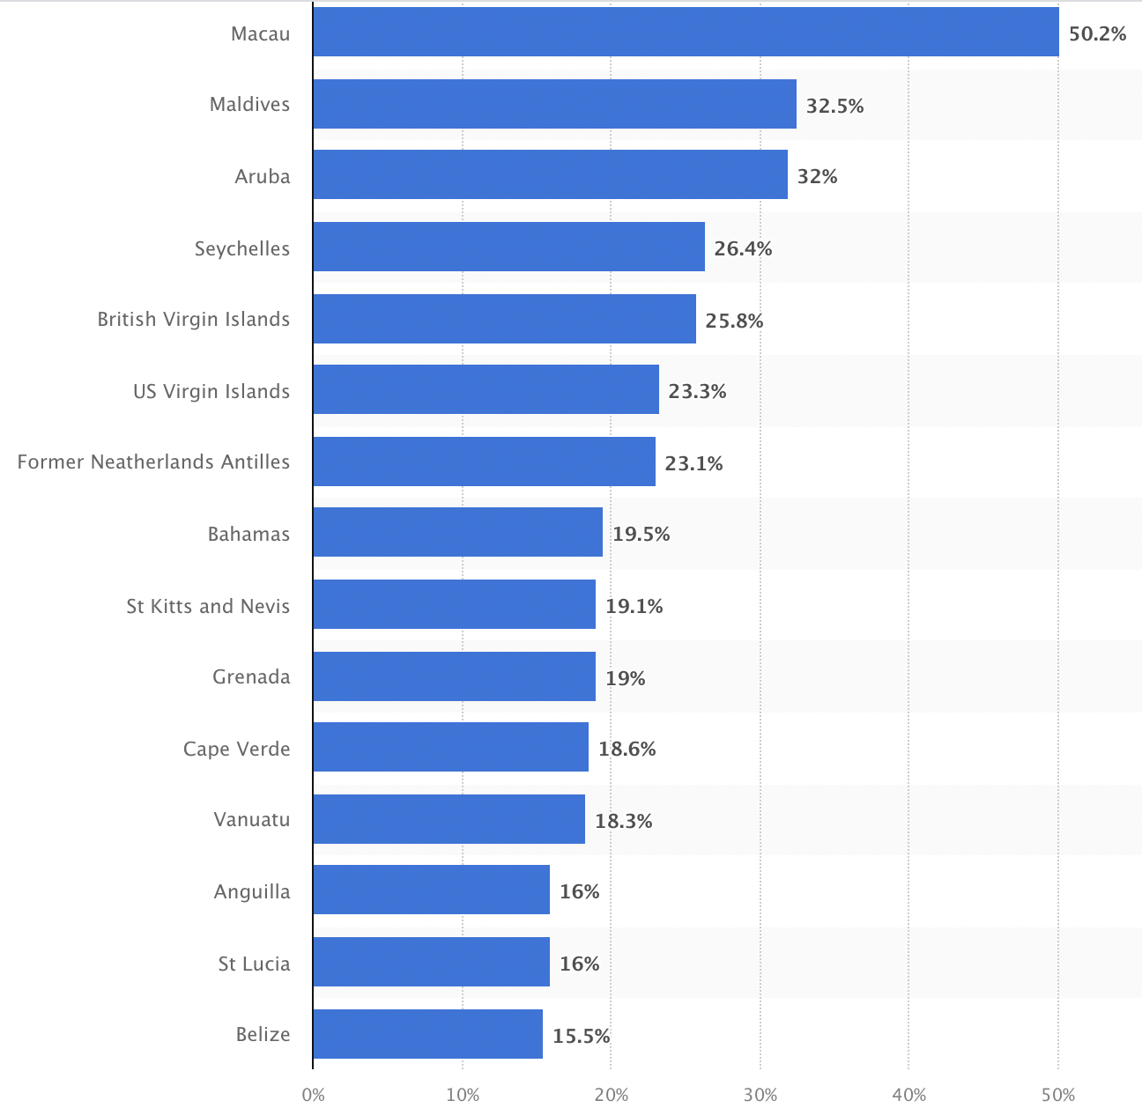
Countries with the highest share of GDP generated by direct travel and tourism worldwide in 2019
Source: Statista
Share of GDP from travel and tourism
Notes:
https://www.statista.com/statistics/1100368/countries-highest-gdp-travel-tourism/

Slide 49
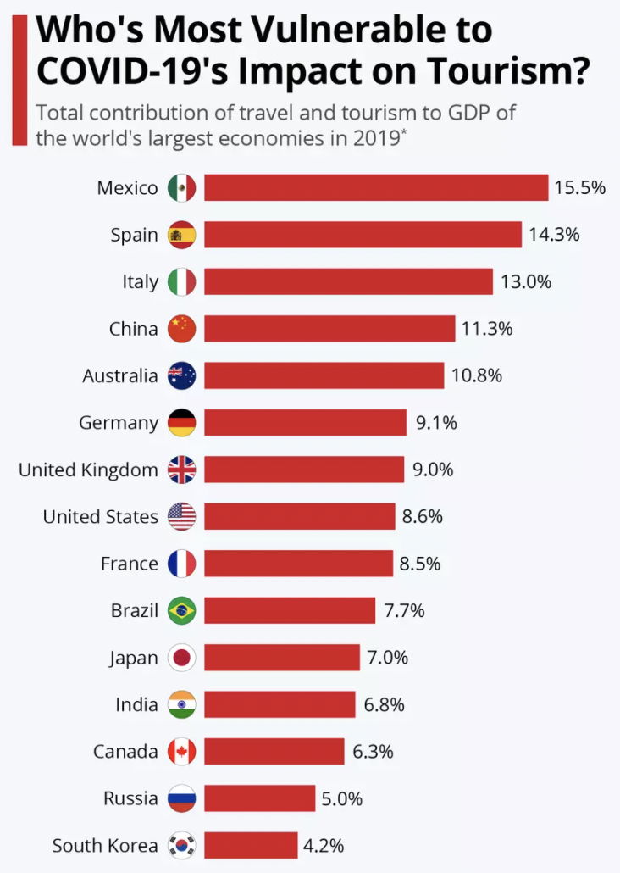
Source: WEF, via Statista
Notes:
Richter, Felix, “COVID-19: These countries are most at risk from falling tourism,” World Economic Forum, July 27, 2020.
https://www.weforum.org/agenda/2020/07/coronavirus-covid19-travel-tourism-gdp-economics/

Slide 50
How Trade Mattered
Transport industry disrupted
Initial fall in trade reduced demand
Crews on ships were trapped aboard
Trade recovery has brought much of transport back
Costs and prices have risen

Slide 51
How Trade Mattered
Shipping by Sea
Drop in trade reduced demand at first
Then increased demand for restocking
Pandemic added restrictions
At ports
For crews
Shipping rates rose

Slide 52
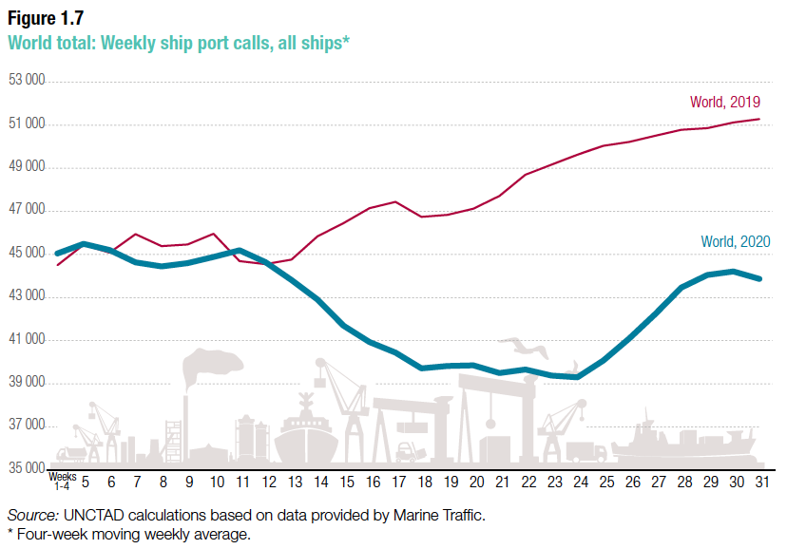
Source: UNCTAD
Notes:
UNCTAD,
https://unctad.org/webflyer/impact-covid-19-pandemic-trade-and-development-transitioning-new-normal Impact of the Covid-19 Pandemic on Trade and Development, 2020.

Slide 53
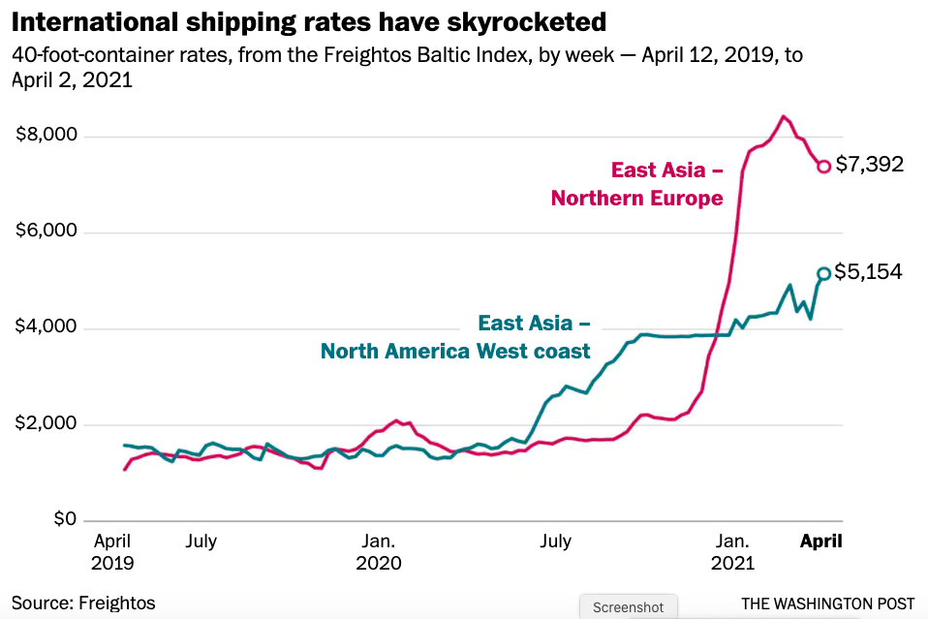
Source: Telford & Bogage, Apr 9, 2021
Notes:
Telford, Taylor and Jacob Bogage, “Essential, invisible: Covid has 200,000 merchant sailors stuck at sea,” Washington Post, April 9, 2021.
https://www.washingtonpost.com/health/2021/04/09/maritime-workers-pandemic-global-trade/?utm_campaign=wp_todays_headlines&utm_medium=email&utm_source=newsletter&wpisrc=nl_headlines&carta-url=https%3A%2F%2Fs2.washingtonpost.com%2Fcar-ln-tr%2F31d1102%2F6072c8a89d2fda1dfb4b2316%2F597273baade4e21a847d94bd%2F46%2F57%2F6072c8a89d2fda1dfb4b2316

Slide 54
How Trade Mattered
Shipping by Air
This too was hurt, as fewer passenger flights also carried less cargo

Slide 55
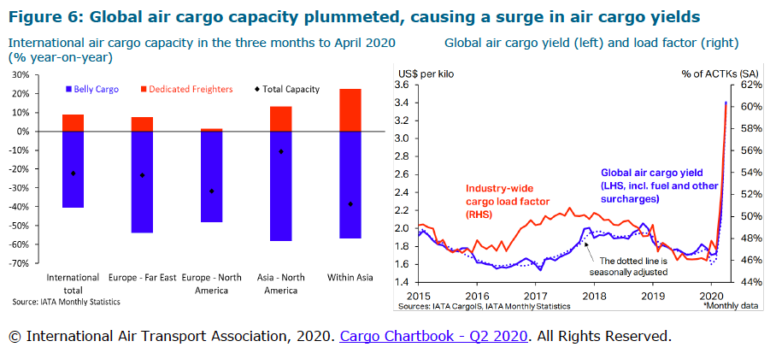
Source: WTO (2020)
Notes:
WTO, “Trade Costs in the Time of Global Pandemic,” information note, World Trade Organization, August 12, 2020.
https://www.wto.org/english/tratop_e/covid19_e/trade_costs_report_e.pdf

Slide 56
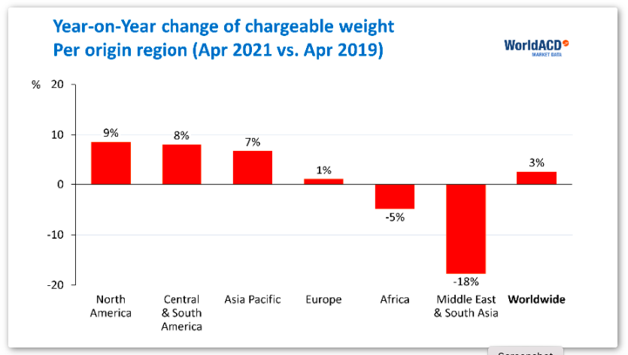
Year-on-
2-Year
Source: AJOT May 17, 2021
Notes:
AJOT, “Air cargo volumes back to normal, rates still go up, but drop 12% year-on-year,” American Journal of Transportation, May 17, 2021
https://ajot.com/news/air-cargo-volumes-back-to-normal-rates-still-go-up-but-drop-12-year-on-year

Slide 57
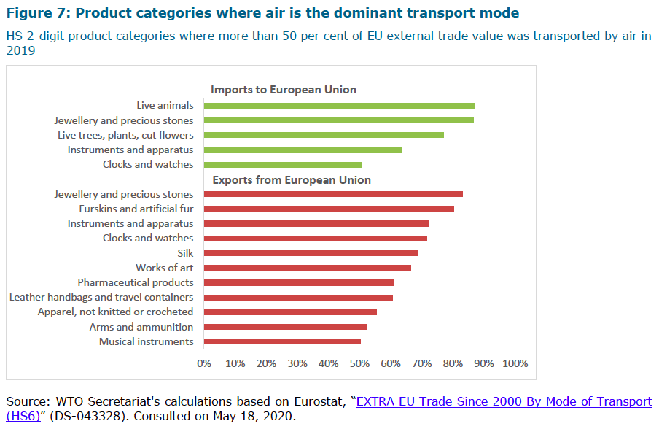
Source: WTO
(2020)
Notes:
WTO, “Trade Costs in the Time of Global Pandemic,” information note, World Trade Organization, August 12, 2020.
https://www.wto.org/english/tratop_e/covid19_e/trade_costs_report_e.pdf

Slide 58
How Trade Mattered
Shortages
First from reduced China exports
Then other shut-downs, worldwide
Factories lack inputs and can’t produce
Computer chips especially
Prices rise, but buyers still must do without
Economic models may miss this:
$$Supply ≠Demand$$

Slide 59
How Trade Mattered
Shortages in the News
NYT, Aug 30, 2021:

Slide 60
How Trade Mattered
Shortages in the News
Today Show, Sep 14: “Paper shortages are impacting schools, grocery stores and more”
Reuters, Sep 13: “From zippers to glass, shortages of basic goods hobble U.S. economy
Detroit Free Press: “Toy makers: There's going to be a major shortage this holiday season”
FT, Aug 23: “Executives warn of growing container ship shortages”
WSJ, Aug 20: “Toyota to Cut Output as Chip Shortage Finally Catches Up to It”
FT, Dec 9, 2020: “Honda closes UK plant as logjam at ports causes parts shortage”
FT, Oct 31, 2020: “Container shortage exposes India’s struggle to recover from virus”
WSJ, Mar 18, 2020: “Trump’s Tariffs Leave the U.S. Short on Vital Medical Supplies”

Slide 61
How Trade Mattered
Who Loses from Shortages
Both buyers and sellers
Hard to see anyone who gains. Sellers of competing products, perhaps, if they don’t also have a shortage

Slide 62
How Trade Policies Mattered

Slide 63
How Trade Policies Mattered
There were many changes in trade policy prompted by the pandemic
Tariff reductions to improve access (PPE, medical supplies, etc.)
Export restrictions to keep needed goods at home

Slide 64
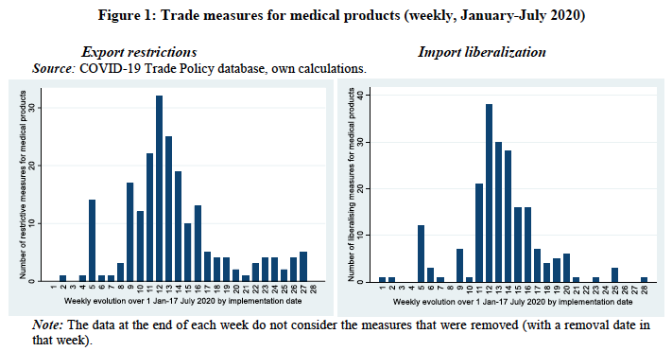
Source: Hoekman et al. (2020)
Notes:
Hoekman, Bernard, Anirudh Shingal, Varun Eknath and Viktoriya Ereshchenko, “COVID-19, public procurement regimes and trade policy,” EUI Working Paper RSCAS 2020/72, European University Institute, November 2020.
https://cadmus.eui.eu/bitstream/handle/1814/68839/RSCAS_2020_72.pdf?sequence=1&isAllowed=y

Slide 65
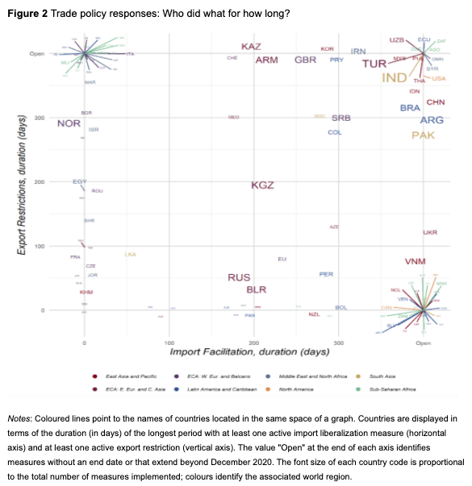
Countries with only export restriction, extending beyond 2020
Trade Policy Responses: Who did what for how long?
Countries with both import facilitation and export restriction, extending beyond 2020
USA
Inc. Italy
Inc. India
Brazil
China
Countries differ greatly in the nature of their interventions
Countries with only import facilitation, extending beyond 2020
Inc. Canada
Source: Evenett et al., Dec 2020
Notes:
Evenett, Simon, Matteo Fiorini, Johannes Fritz, Bernard Hoekman, Piotr Lukaszuk, Nadia Rocha,Michele Ruta, Filippo Santi, Anirudh Shingal, “Trade policy responses to the COVID-19 pandemic: Evidence from a new dataset,” VOXEU, December 11, 2020.
https://voxeu.org/article/trade-policy-responses-covid-19-pandemic-new-dataset

Slide 66
Export Policies
Effects on Trade Policies

Slide 67
Effects on Export Policies
Export Policies
There were export bans by many countries on
Medical supplies
Food
Other
Some were temporary, but many others were not
Only a few countries had policies to encourage exports

Slide 68
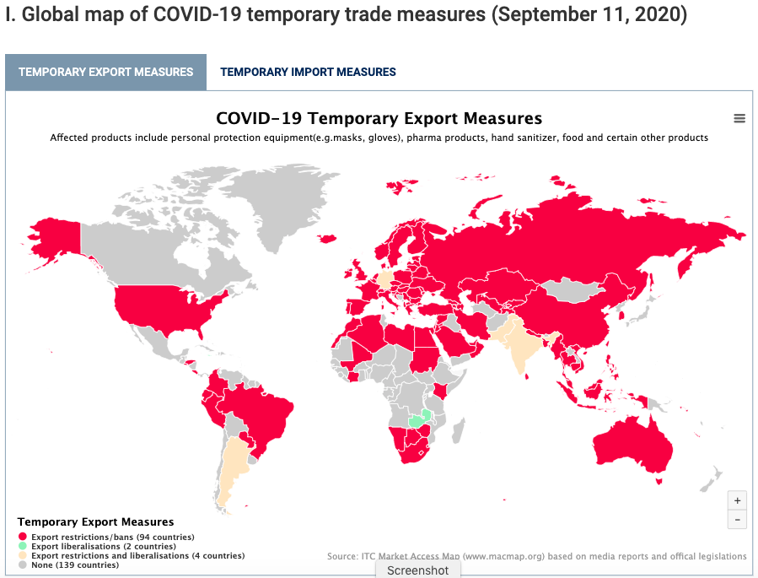
Source: ITC
Notes:
ITC Market Access Map
https://www.macmap.org/covid19

Slide 69
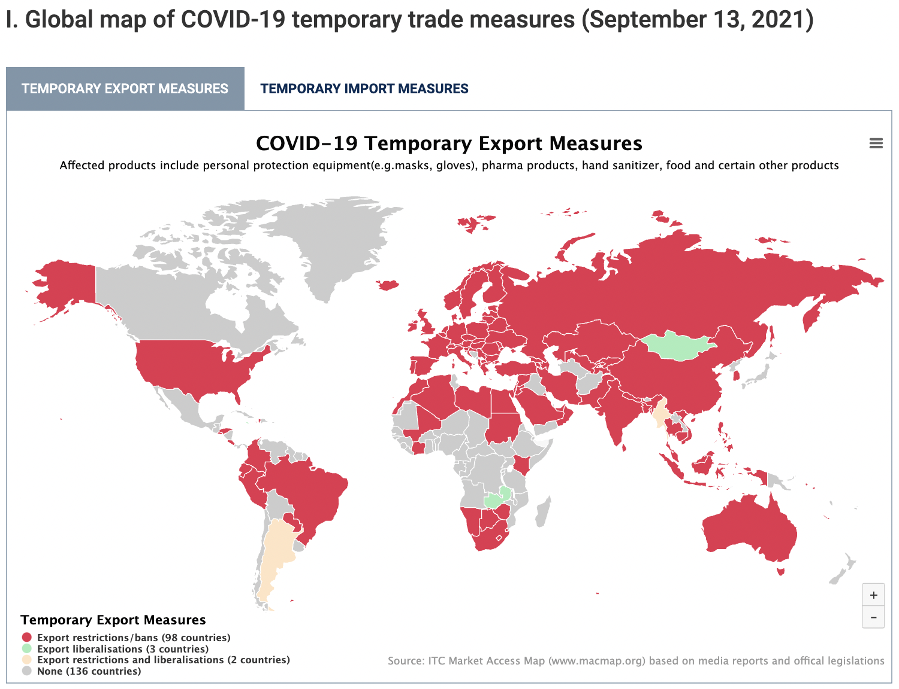
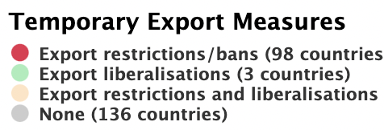
Source: ITC
Notes:
ITC Market Access Map
https://www.macmap.org/covid19

Slide 70
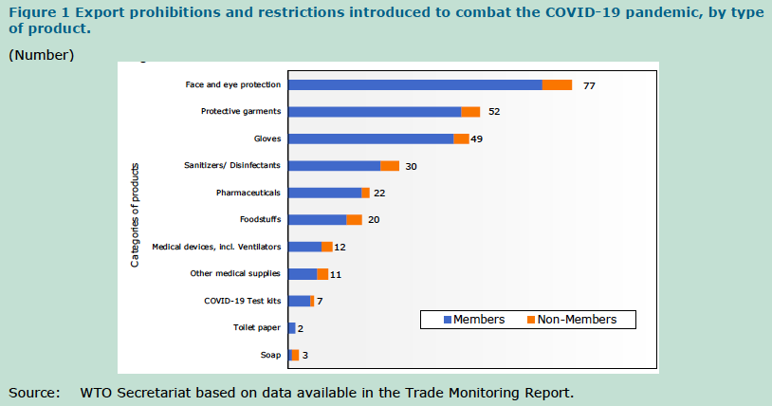
Source: WTO (2020)
Notes:
WTO, “Report on G-20 Trade Measures (Mid-October 2019 to Mid-May 2020),” World Trade Organization, June 29, 2020.
https://www.wto.org/english/news_e/news20_e/report_trdev_jun20_e.pdf

Slide 71
Import Policies
Effects on Trade Policies

Slide 72
Effects on Import Policies
Effects of the Pandemic on Import Policies
Import expansion
Tariff reductions
Import contraction
Tariff increases
Import bans
Government procurement

Slide 73
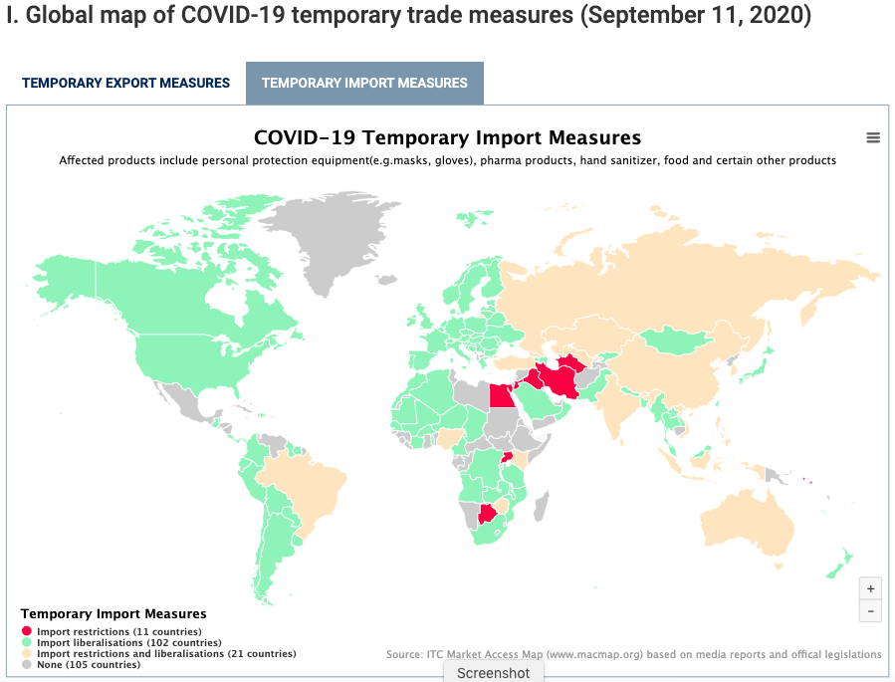
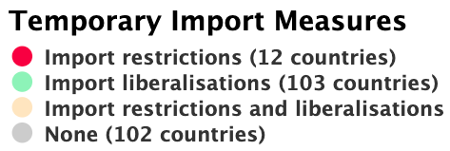
Source: ITC
Notes:
ITC Market Access Map
https://www.macmap.org/covid19

Slide 74
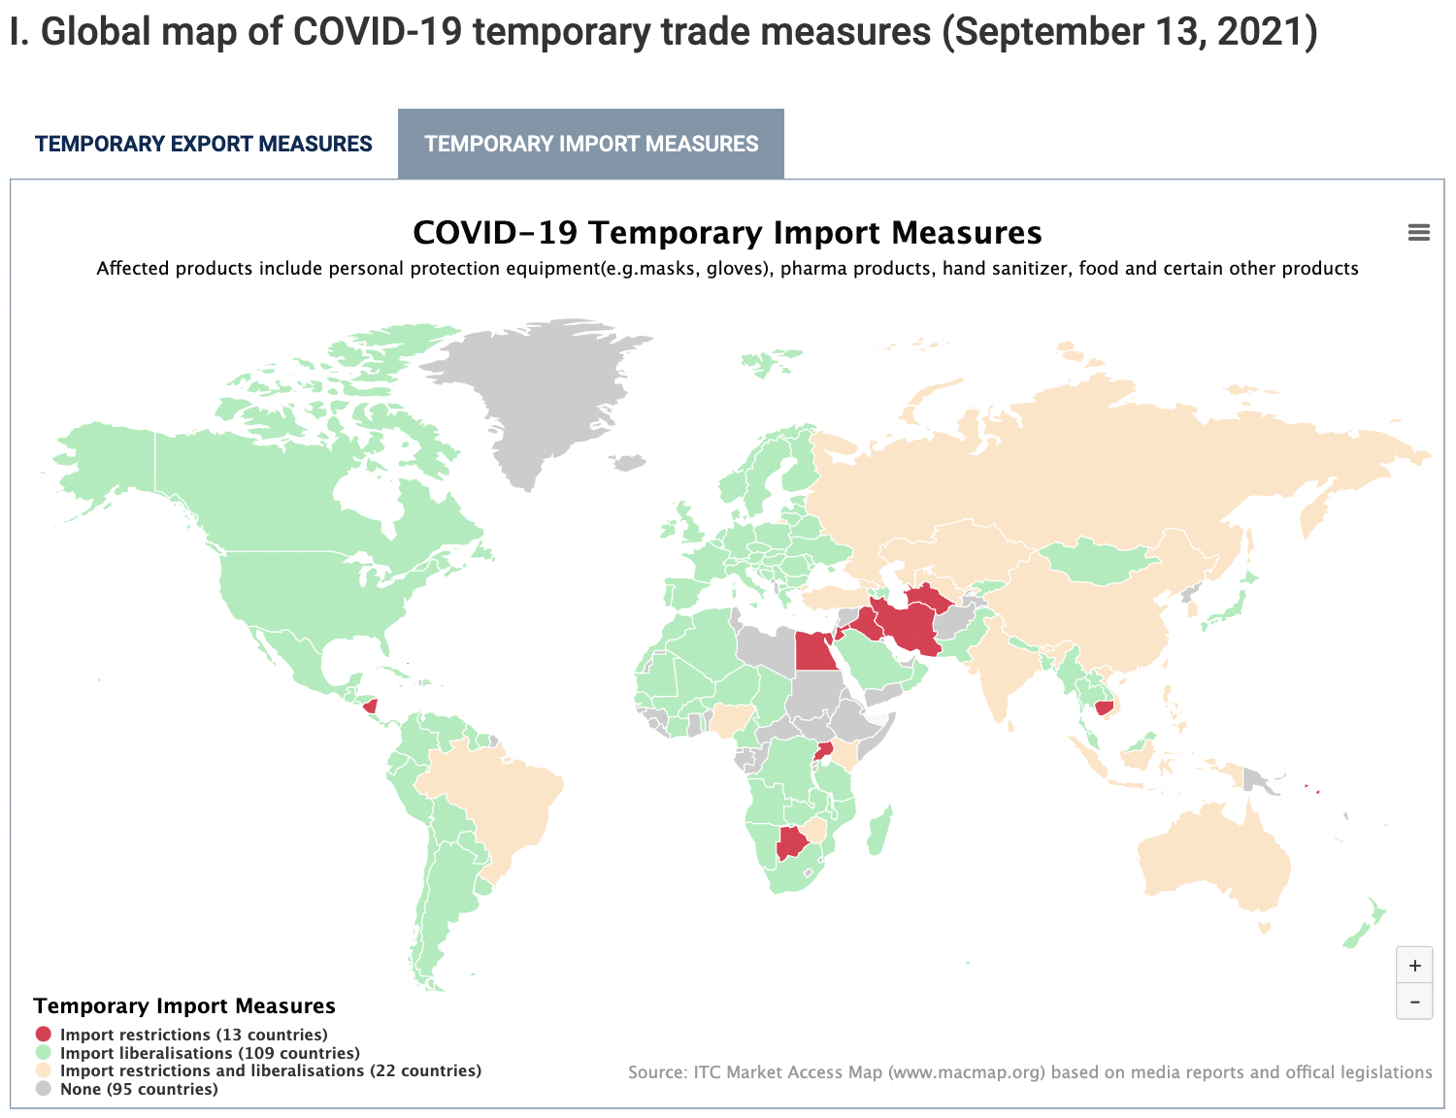
Source: ITC
Notes:
ITC Market Access Map
https://www.macmap.org/covid19

Slide 75
Role of Trade During Pandemic
Vaccines
Vaccine industry relies heavily on trade
Trade concerns
Distribution to the poorest countries
Vaccine nationalism
Notes:
“Trade in Medical Goods in the Context of Tackling COVID-19: Developments in the First Half of 2020,” Information Note, World Trade Organization, December 22, 2020
https://www.wto.org/english/tratop_e/covid19_e/medical_goods_update_e.pdf

Slide 76
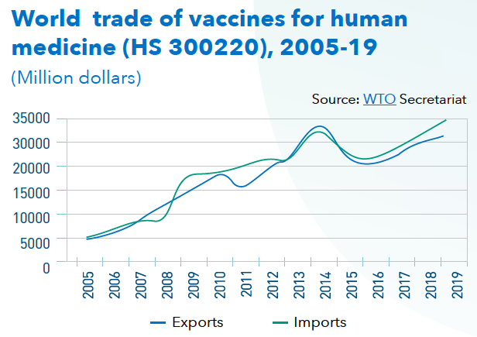
Source: WTO, Dec 22, 2020
Notes:
WTO, “Developing and Delivering Covid-19 Vaccines around the World,” information note, World Trade Organization, December 22, 2020.
https://www.wto.org/english/tratop_e/covid19_e/vaccine_report_e.pdf

Slide 77
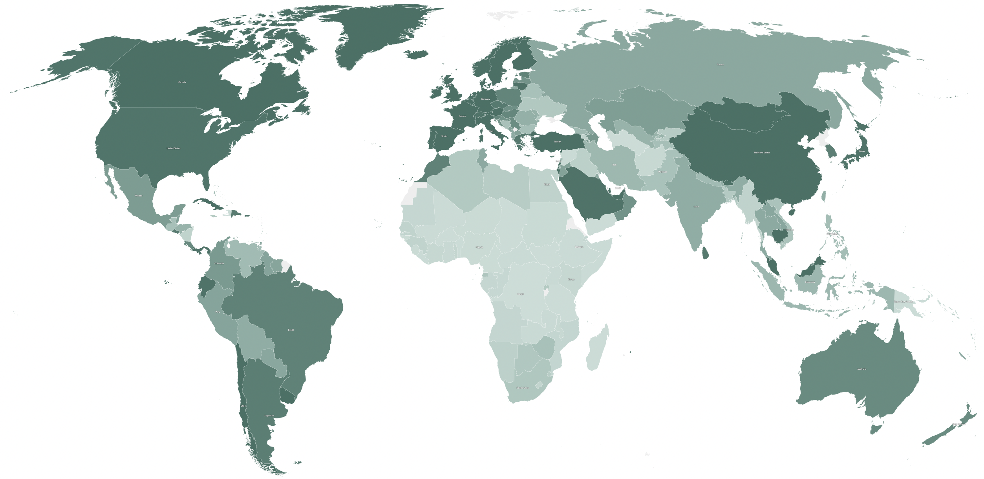
Source: Holder, NYTR, Sep 14, 2021
Notes:
Holder, Josh, “Tracking Coronavirus Vaccinations Around the World,” New York Times, updated Sep 14, 2021.
https://www.nytimes.com/interactive/2021/world/covid-vaccinations-tracker.html

Slide 78
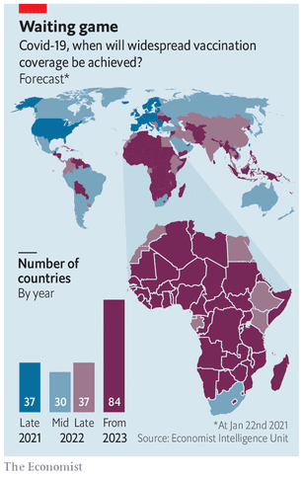
Source: Economist Feb 6. 2021
Notes:
Economist, “Africa’s recovery from covid-19 will be slow,” The Economistci, Febuary 6, 2021
https://www.economist.com/middle-east-and-africa/2021/02/06/africas-recovery-from-covid-19-will-be-slow

Slide 79
Vaccine Nationalism
Vaccine Nationalism
Some countries seek to restrict exports of vaccines until their own populations are served.
On Jan 29, the EU announced export controls on COVID-19 vaccines
US only in May announced it would export vaccines
India exported many, but stopped when their cases surged
I have had audience members hope that the US will not export vaccines until all Americans are vaccinated
If this were done, it would slow the world’s progress toward managing the pandemic
Notes:
https://iccwbo.org/media-wall/news-speeches/study-shows-vaccine-nationalism-could-cost-rich-countries-us4-5-trillion/
https://foreignpolicy.com/2021/02/02/vaccine-nationalism-harms-everyone-and-protects-no-one/
https://www.theguardian.com/commentisfree/2021/feb/02/vaccine-nationalism-hiv-covid
https://www.newscientist.com/article/mg24933201-800-vaccine-nationalism-will-leave-everyone-more-at-risk-of-coronavirus/
https://fortune.com/2021/01/31/covid-vaccine-nationalism-coronavirus-pandemic-length-when-will-it-end/

Slide 80
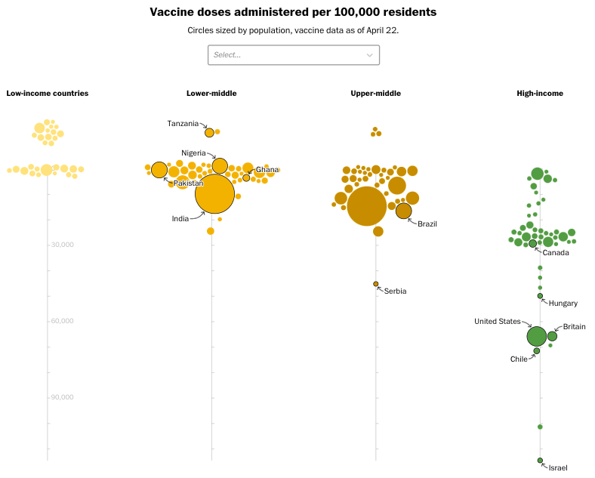
Source: Washington Post Apr 22, 2021
Notes:
Mirza, Atthar and Emily Rauhala, “Here’s just how unequal the global coronavirus vaccine rollout has been,” Washington Post, April 22, 2021.
https://www.washingtonpost.com/world/interactive/2021/coronavirus-vaccine-inequality-global/?utm_campaign=wp_todays_headlines&utm_medium=email&utm_source=newsletter&wpisrc=nl_headlines&carta-url=https%3A%2F%2Fs2.washingtonpost.com%2Fcar-ln-tr%2F3205385%2F6083ec299d2fda39cec7c8a4%2F597273baade4e21a847d94bd%2F15%2F57%2F6083ec299d2fda39cec7c8a4

Slide 81
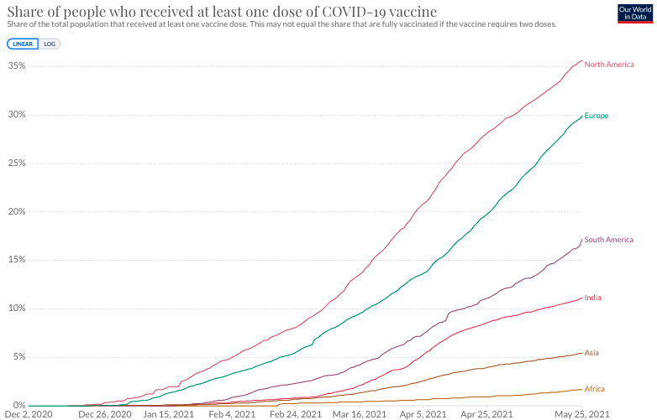
Notes:
https://ourworldindata.org/covid-vaccinations

Slide 82
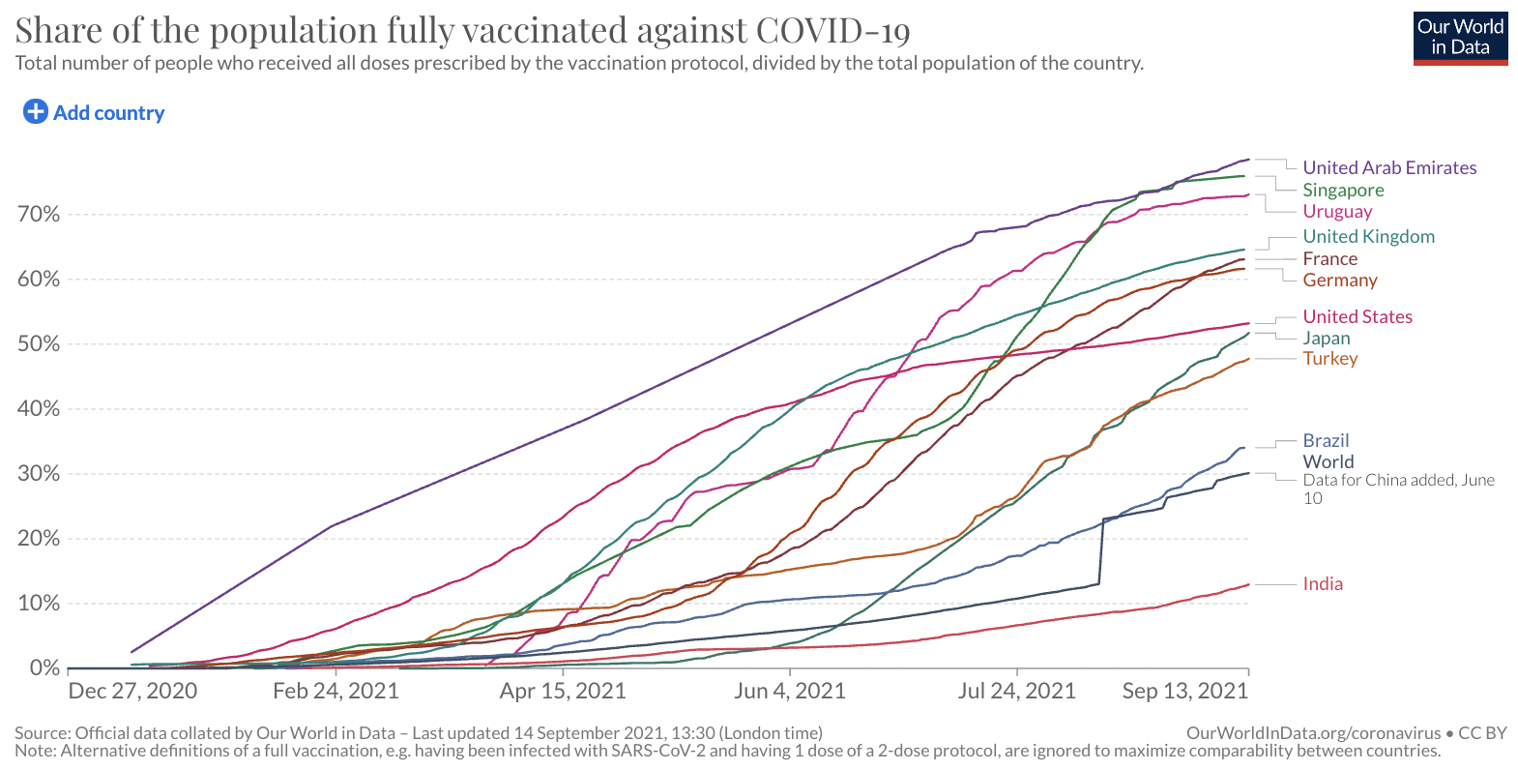
Notes:
https://ourworldindata.org/covid-vaccinations

Slide 83
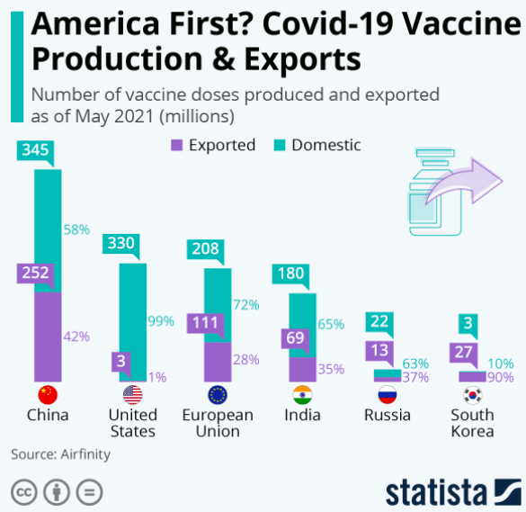
Source: Statista
May 26, 2021
Notes:
Source: Statista May 26, 2021
https://www.statista.com/chart/24555/vaccine-doses-produced-and-exported/

Slide 84
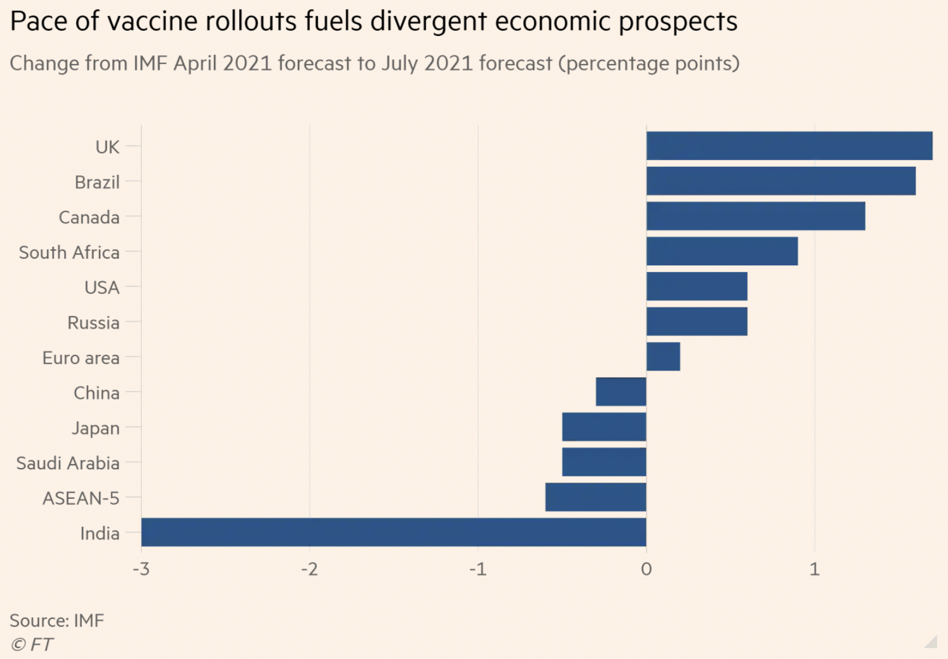
Source: FT
Jul 27, 2021
Notes:
Politi, James and Colby Smith, “Vaccine inequality threatens global economic recovery, IMF warns,” Financial Times, July 27, 2021.
https://www.ft.com/content/28f8c13d-2dc3-4106-a48e-4c628f392a09

Slide 85
Vaccine Nationalism
COVAX
An initiative launched the World Health Organization, the European Commission, and France to provide vaccines to people in all countries regardless of wealth
May 17, 2021: “The COVAX Facility will deliver its 65 millionth vaccine dose this week. It should’ve been at least its 170 millionth. The time to donate excess doses is now.”
Notes:
https://iccwbo.org/media-wall/news-speeches/study-shows-vaccine-nationalism-could-cost-rich-countries-us4-5-trillion/
https://foreignpolicy.com/2021/02/02/vaccine-nationalism-harms-everyone-and-protects-no-one/
https://www.theguardian.com/commentisfree/2021/feb/02/vaccine-nationalism-hiv-covid
https://www.newscientist.com/article/mg24933201-800-vaccine-nationalism-will-leave-everyone-more-at-risk-of-coronavirus/
https://fortune.com/2021/01/31/covid-vaccine-nationalism-coronavirus-pandemic-length-when-will-it-end/

Slide 86
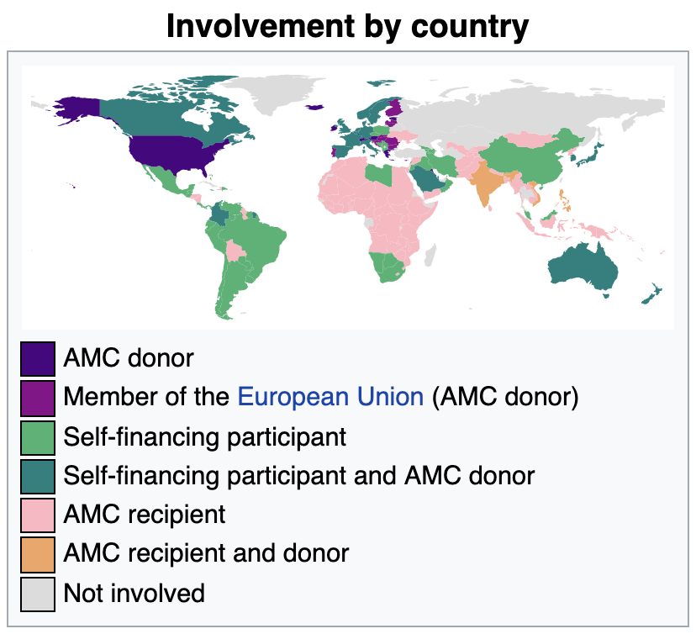
Source: Wikipedia Sep 14, 2021
Notes:
https://en.wikipedia.org/wiki/COVAX

Slide 87
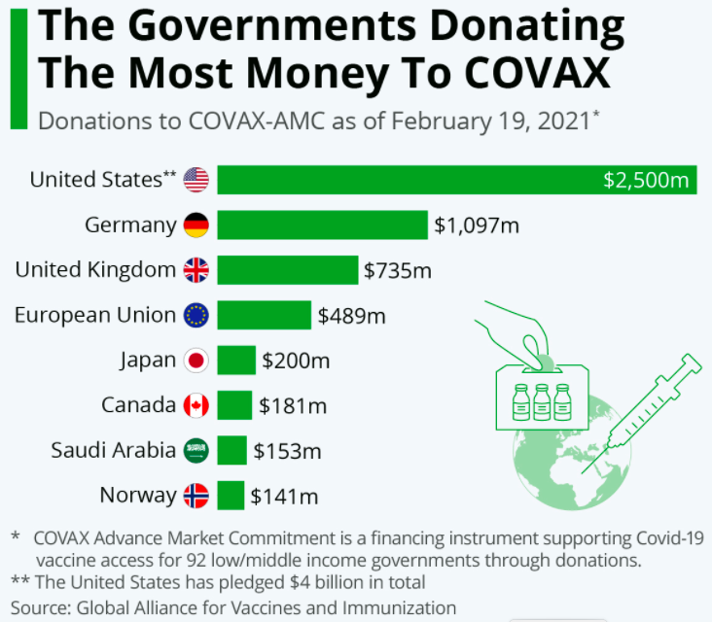
Source: McCarthy, Feb 22, 2021
Notes:
McCarthy, Niall, “The Governments Donating The Most Money To COVAX,” Statista, Feb 22, 2021
https://www.statista.com/chart/24244/donations-to-covax-by-country/

Slide 88
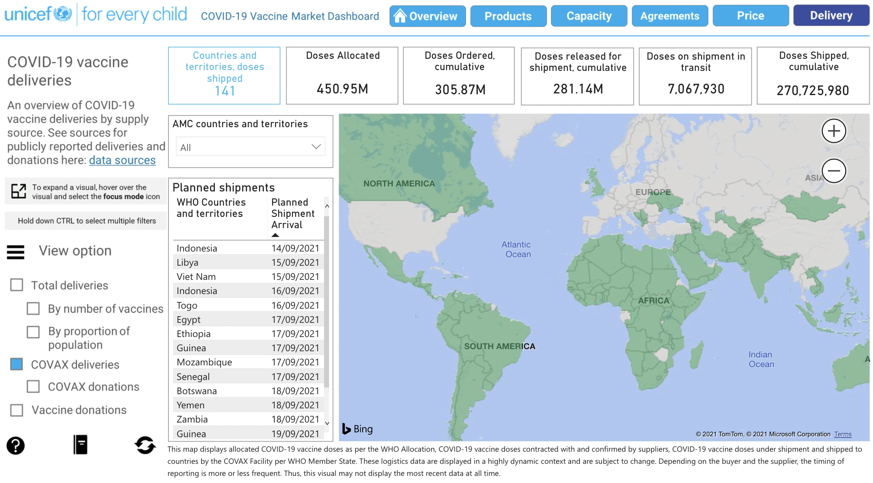
Source:
UNICEF
Covid-19 Vaccine Market Dashboard
Sep 14, 2021
Notes:
https://app.powerbi.com/view?r=eyJrIjoiNmE0YjZiNzUtZjk2OS00ZTg4LThlMzMtNTRhNzE0NzA4YmZlIiwidCI6Ijc3NDEwMTk1LTE0ZTEtNGZiOC05MDRiLWFiMTg5MjAyMzY2NyIsImMiOjh9&pageName=ReportSectiona329b3eafd86059a947b

Slide 89
Conclusion
International trade is beneficial overall, but there are both winners and losers
The pandemic has massively disrupted global trade, with even more winners and especially losers
Some forms of trade – especially vaccines – are crucial for dealing with the pandemic

Slide 90
Thank you!
Thank you!
Any Questions?
Alan V. Deardorff
Ford School of Public Policy
University of Michigan
www.NEEDelegation.org

