Slide 1
Osher Lifelong Learning Institute, Fall 2025
Contemporary Economic Policy
University of Minnesota
Host: Geoffrey Woglom, Ph.D.
Director, National Economic Education Delegation

Slide 2
Course Schedule
The Economics of Public Policy Issues
Week 1 (10/20): Economic Update & Central Bank Independence Geoffrey Woglom, Amherst College
Week 2 (10/27): Climate Change Economics Sarah Jacobson, Williams College
Week 3 (11/3) AI and Inequality Geoffrey Woglom, Amherst College
Week 4 (11/10): Health Care Economics, Robert Rebelein, Vassar College
Week 5 (11/17): Trade and Globalization, Adina Ardelan, Santa Clara University

Slide 3
Submitting Questions
Submit questions in the chat or by raising your digital hand.
I will try to handle them as they come up.
We will do a verbal Q&A once the material has been presented.
Slides will be available from the NEED website tomorrow (https://needelegation.org/delivered_presentations.php).

Slide 4
Globalization and Trade
OLLI, University of Minnesota
November 17 , 2025
Adina Ardelean, Ph.D.

Slide 5
Outline
Globalization
The Benefits and Costs of Trade and Offshoring
Trade Policies

Slide 6
What is Globalization?
The growing interdependence of the world’s:
Economies
Cultures
Populations
Brought about by cross-border flows of:
Goods and services
Technology
Investment
People
Information

Slide 7
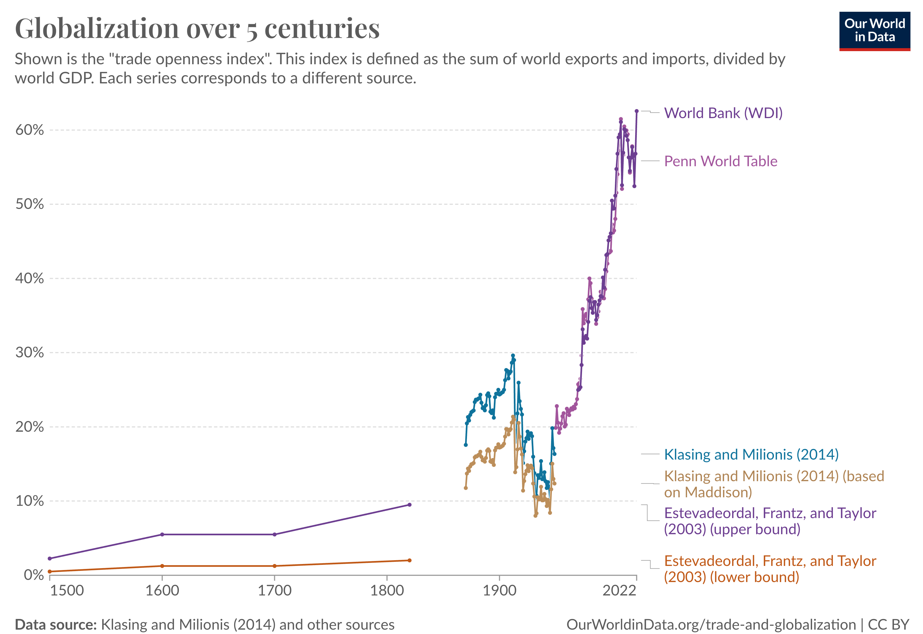
Source: https://ourworldindata.org/international-trade

Slide 8
What Drives Globalization?
Transportation
Technology
International Cooperation

Slide 9
International Trade
Exports and Imports

Slide 10
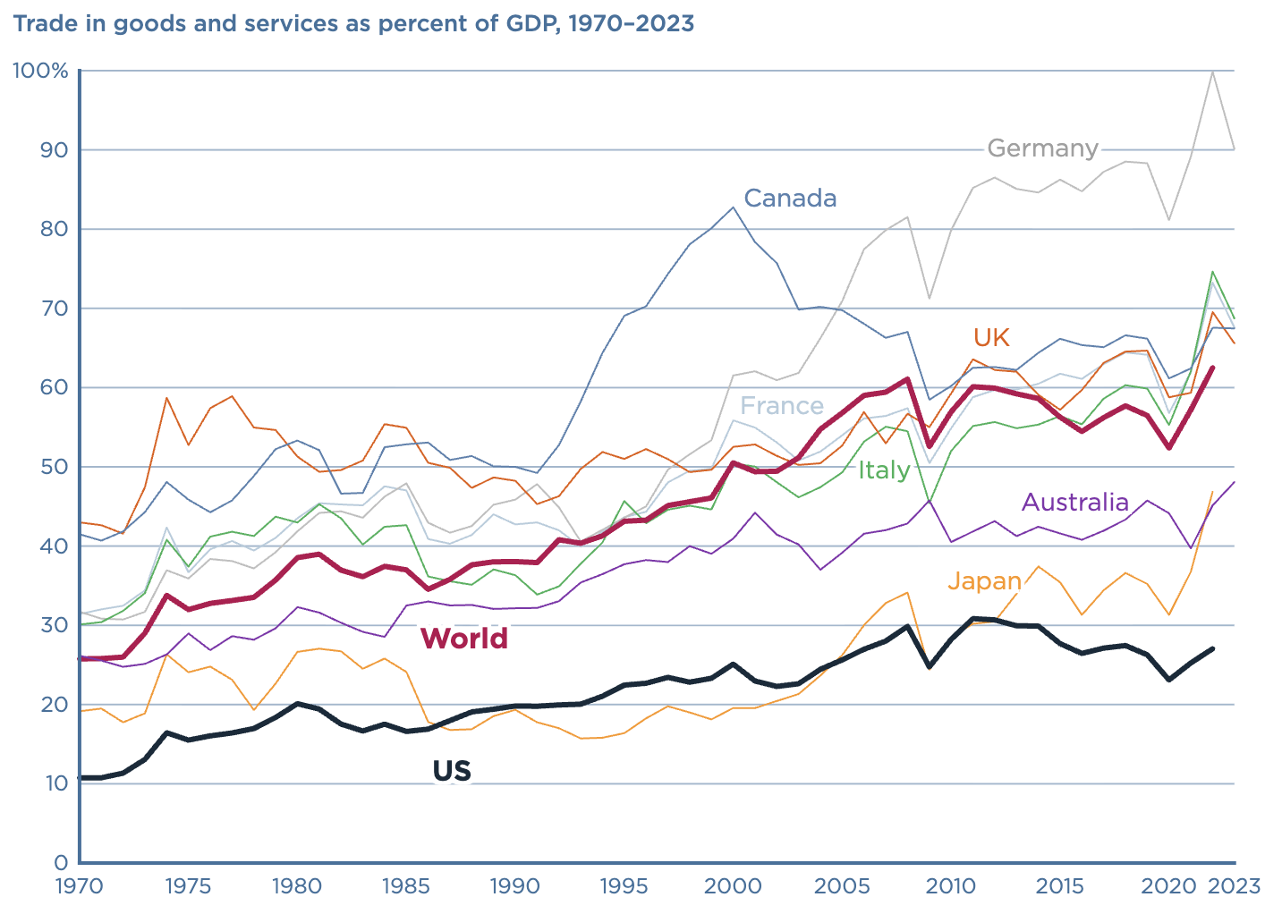
Trade Openness Across Countries
Source: https://www.piie.com/microsites/globalization/what-is-globalization

Slide 11
Global Value Chains (Offshoring)

Slide 12
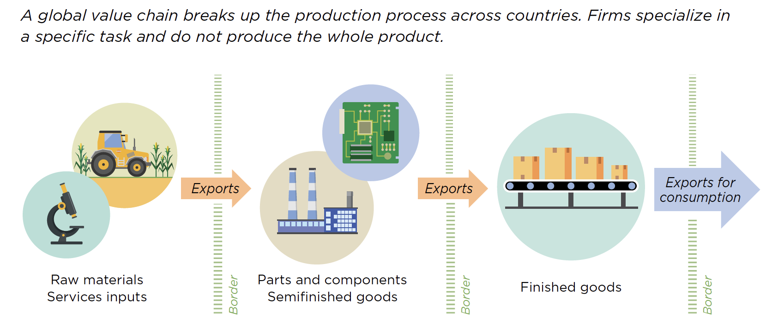
What is Offshoring?
Source: World Development Report, 2020

Slide 13
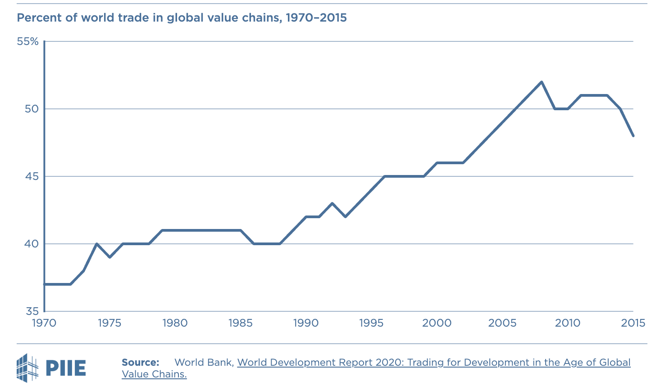
Growth of Global Value Chains
Source: https://www.piie.com/microsites/globalization/what-is-globalization

Slide 14
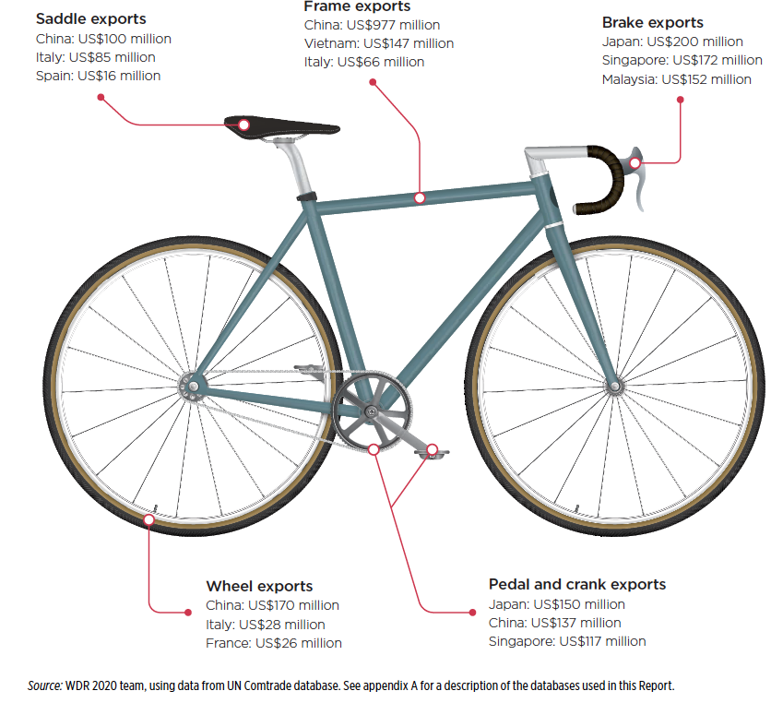
An Example: Bicycles
Parts and components from suppliers all over the world:
China
Japan
Italy, France, Spain
Malaysia
…
Source: World Development Report, 2020

Slide 15
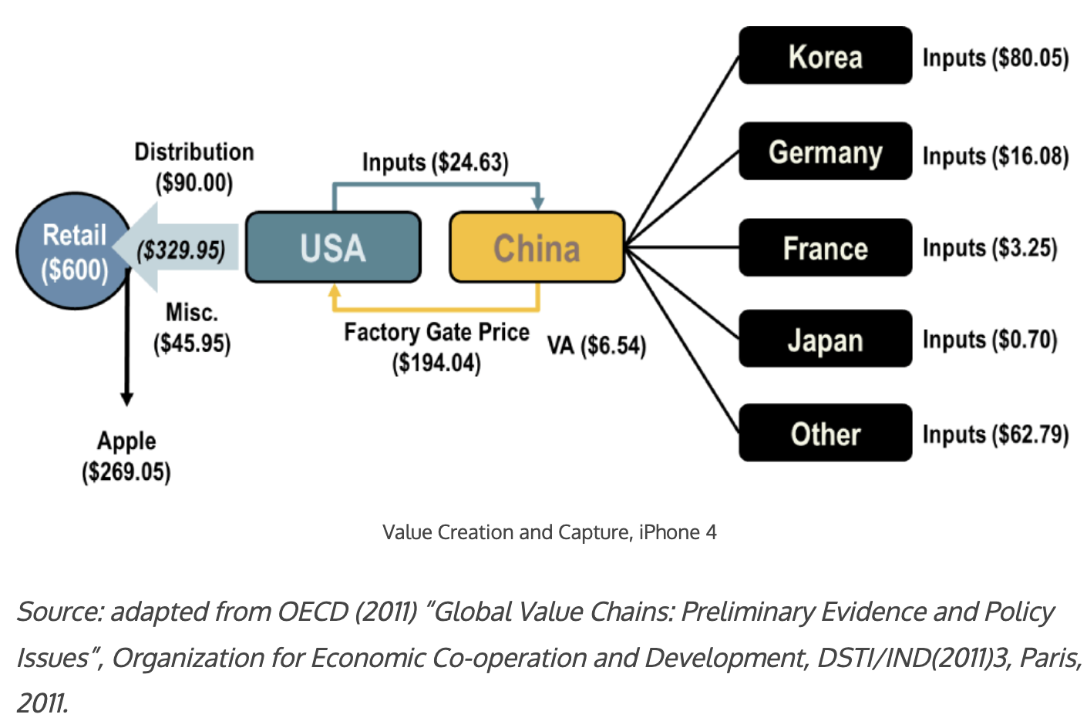
An Example: The iPhone 4
Source: The Geography of Transport Systems, 5th edition by Jean-Paul Rodrigue

Slide 16
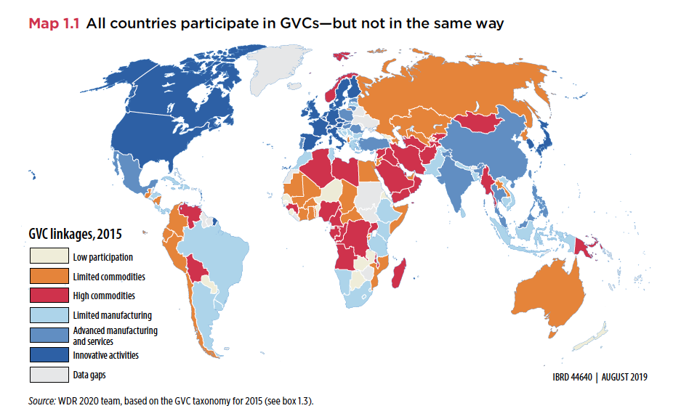
How Much Offshoring Has Happened?
Source: World Development Report, 2020

Slide 17
What are the Gains From Trade?
Mutually Beneficial Trade through Comparative Advantage:
Scarce resources: can't produce unlimited amounts of goods
Produce and export goods where production advantage largest (or disadvantage weakest)
All countries can consume more and thus gains from trade.
Other Sources of Gains from Trade:
Scaled up businesses
Lower prices through increased competition
Wider set of product varieties available and better quality
Efficient supply chains
Learning about foreign technology, business practices, etc.
Innovation

Slide 18

Why is the public turning against trade?
Gains from trade are very large for the economy, BUT
Not always noticeable by consumers. Why are prices lower at WalMart?
Not always that large per consumer: consumers might save $50/year on some imported goods
For 300 million consumers, $50/year would be $15 billion per year savings to the country!
Costs of trade are very high for some workers, regions, and groups, and these costs have not been sufficiently appreciated or addressed by policymakers (or economists!)

Slide 19
Costs of Trade
Economic:
When trade expands (or contracts)
Some firms lose market share or shut down
Other firms supplying inputs to those firms shrink or shut down
Workers in both lose jobs
And their communities lose customers
Macroeconomic cost: Vulnerability to foreign recession/inflation
Dependence on other countries’ willingness to trade
Vulnerability to trade disruption
Crisis induced (earthquake, flood, disease, war)
Policy induced (sanctions, tariffs, export bans)
Non-economic
Loss of cultural differences
Spread of invasive species and plant disease
Spread of human disease

Slide 20
Trade Policy

Slide 21
Trade Policies that Affect Globalization
Policies that Encourage It
Tariff Reductions
Trade Agreements
Other
Policies that Discourage It
Tariffs
Trade War

Slide 22
Tariff Reductions

Slide 23
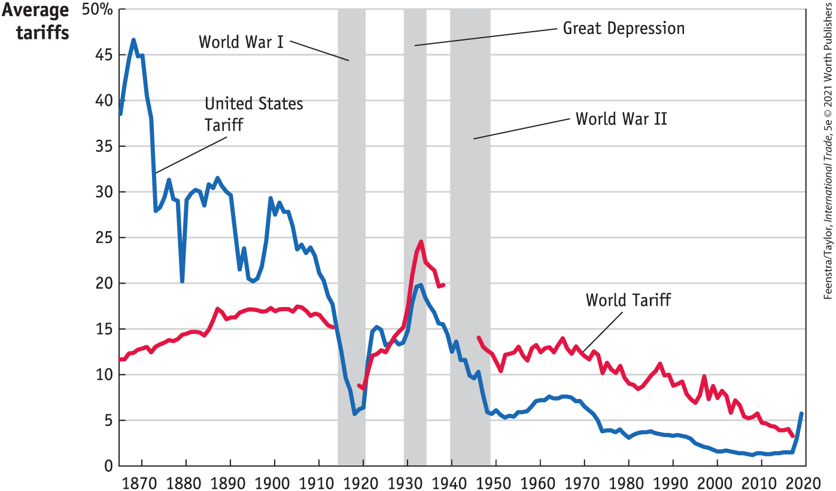
Tariffs, 1860-2019
Source: International Economics, 5e | Feenstra/Taylor, Worth Publishers

Slide 24
The Role of Trade Agreements
Promote trade by
Reducing tariffs
Blocking policies that discriminate against imports
They also do more, mostly to serve business interests:
Permit anti-dumping duties to deter unfair competition
Protect intellectual property
Allow investor action against governments
Trade Agreements:
EU, USMCA, Mercosur, AfCFTA, CPTPP, RCEP
There trade agreements have proliferated:
The number of regional trade deals has grown dramatically, from only a few dozens in 1990 to hundreds in force today.
Notes:
CPTPP - Comprehensive and Progressive Agreement for Trans Pacific Partnership - 12 members (14% of global GDP)
RCEP- Regional Comprehensive Economic Partnership - 10 ASEAN countries and 5 FTA partners including China (30% of global GDP)
AfCFTA - 55 countries, 1.3 billion people, 3% of global GDP
Mercosur: Argentina, Bolivia, Brazil. Paraguay, Venezuela (suspended since 2016)

Slide 25
Institutions that Encourage Globalization
IMF/World Bank
Policy advice to open markets (the ”Washington Consensus”)
Loans to countries conditional on
Reducing trade barriers
Permitting capital flows
GATT/WTO (World Trade Organization)
Negotiate reciprocal trade liberalization
Settlement of trade disputes (usually about interfering with trade)
Bilateral Investment Treaties
Better treatment of multinational corporations

Slide 26
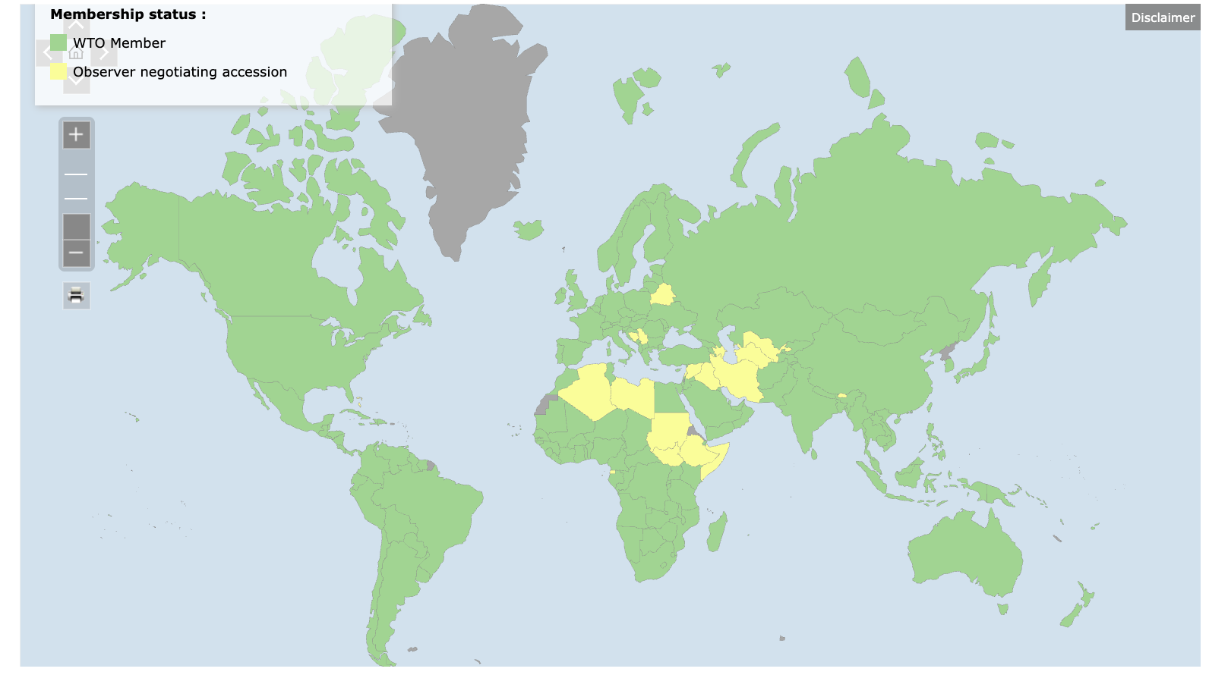
WTO
Multilateral Trade Agreement
166 member countries
Headquarters: Geneva, Switzerland
First established in 1947 as G.A.T.T. (23 member countries)
Last completed round of negotiations: Uruguay Round in 1994.
Recently WTO is at ”crossroads”:
Dispute settlement paralysis
Rulebook is outdated for 21st century trade
Geopolitical tensions
The erosion of US leadership
The rise of regionalism

Slide 27
Tariff Effects

Slide 28
Economic Effects of a Tariff on Prices
A tariff is a tax on imports. It causes
A rise in the price of the imported good in the importing country
A fall in the price of the imported good in the exporting country
The quantity imported to fall
Revenue for the tariff-levying government
Almost always: the rise at home is much larger than the fall abroad
That’s especially true if importing country is small
But it’s also true if importing country is as large as the U.S.
We learned this from Trump’s tariffs in 2018.
Example: Trump’s tariffs caused US prices to rise, with hardly any perceptible fall in prices abroad.

Slide 29
Effects of a Tariff on the Economy
The rise in price in the importing country causes
A rise in price of competing goods produced there
Benefits to those producers
Harm to buyers of both the import and the competing goods
Including producers that use the higher-priced goods as inputs
Their prices also rise, hurting their buyers
Employment changes:
Increase in the protected industry
Decrease in industries that use the protected product as inputs
Notes:
Example of 25% on steel

Slide 30
Effects of a Tariff on the Economy
Economists’ cost-benefit analysis quantifies these and shows that
Unless there are market distortions, the costs of a tariff always exceed the benefits
Even when distortions give potential for tariff to be net beneficial
It is just as likely to be net harmful
And there does exist another policy, not a tariff, that would be better
But
Costs of tariffs are spread over many buyers, and are small for each
Benefits of tariffs are concentrated for domestic producers and are large for each
That’s often why we
Get tariffs
Find them very hard to remove

Slide 31
Effects of a Tariff
If a tariff is on exports of only one country (e.g., China), then
Some imports shift to another country
Price rises by less, to that other country’s higher cost
Retaliation
Other countries place tariffs on US exports
Trade war that started in 2018 continues and gets worse
Politics of tariffs
Political forces favor tariffs
Tariffs were reduced during 1934-1995 only by slow reciprocal negotiation among countries

Slide 32
Possible Economic Arguments for Tariffs
Possible arguments for tariffs
National Defense – strategic resource. Do we need the capacity to make our own computer chips, just in case?
“Infant” Industry
Unfair trade practices of exporting countries

Slide 33
Trump I Tariffs and the Trade War

Slide 34
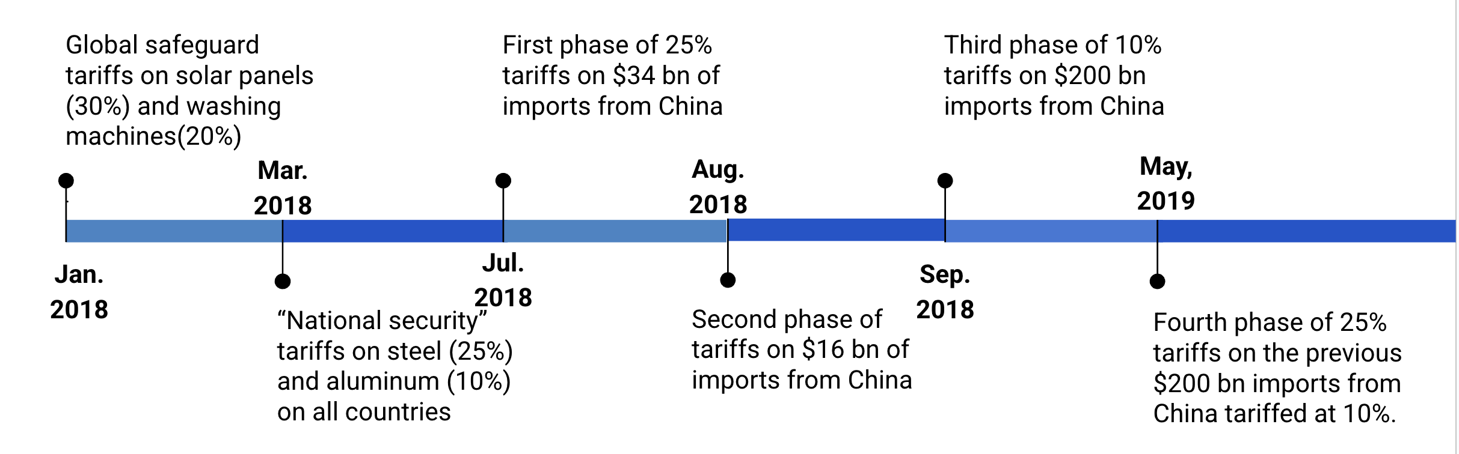
Trump I Tariffs & Trade War
Notes:
Safeguards – Section 201 of US Tariff code
National Security: Section 232 of US Tariff code
Unfair trade practices: Section 301 provisions of the Trade Act provide a domestic procedure through which interested persons may petition the U.S. Trade Representative to investigate a foreign government act, policy, or practice and take appropriate action

Slide 35
Tariffs on Washing Machines
The price of washing machines increased in the U.S. by 12% the next month.
The price of dryers (bundled with washing machines) also increased by 12%, even if they were not subjected to tariffs.
Consumers lost $1.5 billion annually.
Annual tariff revenue increased by about $82 million.
1,800 new jobs reported
The consumer cost per job “created” was about $817,000 per year.
Coincides with LG and Samsung opening plants in the U.S.
LG: Clarksville, Tennessee in 2019: 600 new jobs
Samsung: Newberry, South Carolina, 2018: 1,500 new jobs
Source: Flaaen, Hortacsu and Tinterlnot (2020) “The Production Relocation and Price Effects of US Trade Policy: The Case of Washing Machines”, American Economic Review, 110(7)
Notes:
The 2018 washer tariffs cost American consumers $817,000 for every one job created.

Slide 36
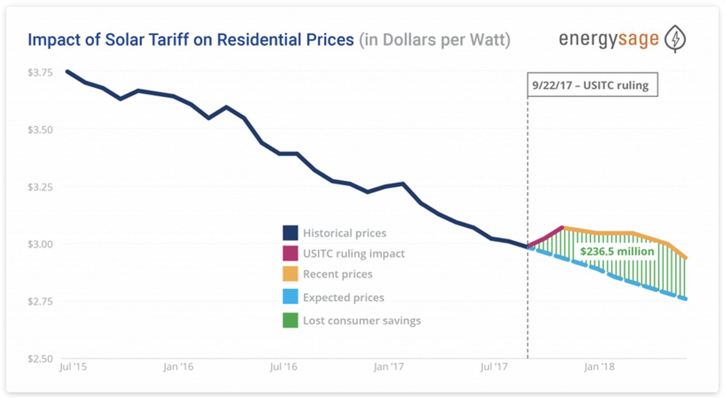
Tariffs on Solar Panels
Consumers were hurt by higher prices of solar panels:
Solar prices increased by 43-57% compared to the global average.
U.S.-based companies that supported the tariffs:
First Solar (U.S.), Suniva (Chinese owned), SolarWorld Americas (acquired by SunPower, San Jose, CA)
According to the Solar Energy Industries Association:
62,000 workers were laid off or never hired
10.5 gigawatts of solar capacity lost
$19 billion in private sector investment lost
Foreign companies build factories in the U.S.:
Hanwha (South Korea) in Whitfield County, GA
JinkoSolar (China) in Jacksonville, FL
Notes:
https://seia.org/research-resources/high-cost-tariffs/
https://www.nytimes.com/2019/07/10/business/economy/companies-tariffs-winners.html

Slide 37
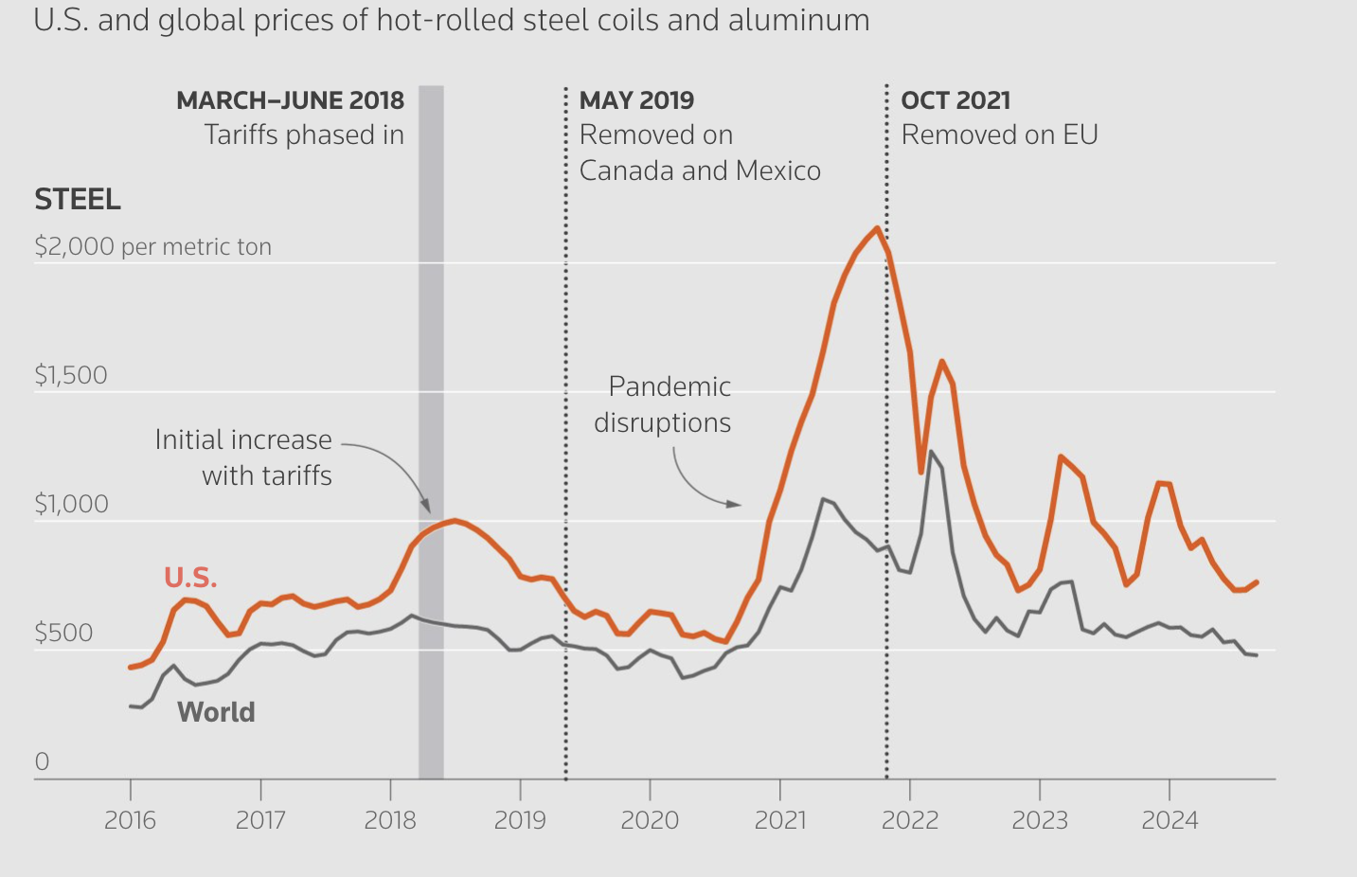
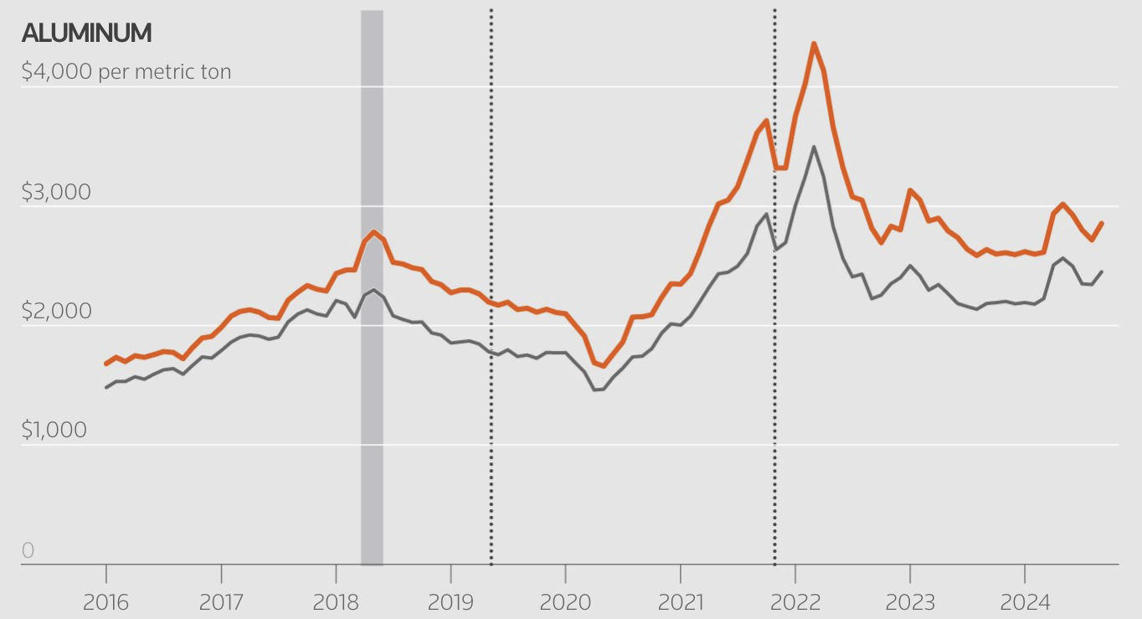
Tariffs on Metals
The price of steel and aluminum increased shortly after the tariff.
The domestic production increased (steel production increased by 6 million metric tons and aluminum by 350,000 metric tons in 2019 compared to 2017).
The number of jobs in iron, steel and aluminum mills rose temporarily by 6% and 5%, respectively from 2017 to 2019.
Downstream industries (e.g. auto) faced higher input costs.
Several studies estimated that the increased costs driven by tariffs may have resulted in 75,000 fewer manufacturing jobs.
Notes:
https://www.reuters.com/graphics/TRUMP-TARIFFS/STEEL/gdpznwgdzpw/

Slide 38
Tariffs on Metals - Retaliation
The EU, Canada, Mexico, and China have retaliated with tariffs proportionate to their U.S. exports of steel & aluminum
US industries targeted by foreign retaliation:
Industry | Countries
Pork | China, Mexico
Apples | China, Mexico, India
Fruits and Nuts | China, India
Whiskies (e.g. KY bourbon) | EU, Canada, Mexico
Mineral water, coffee, ketchup | Canada
Motorboats, yachts, motorcycles (Harley-Davidson) | EU

Slide 39
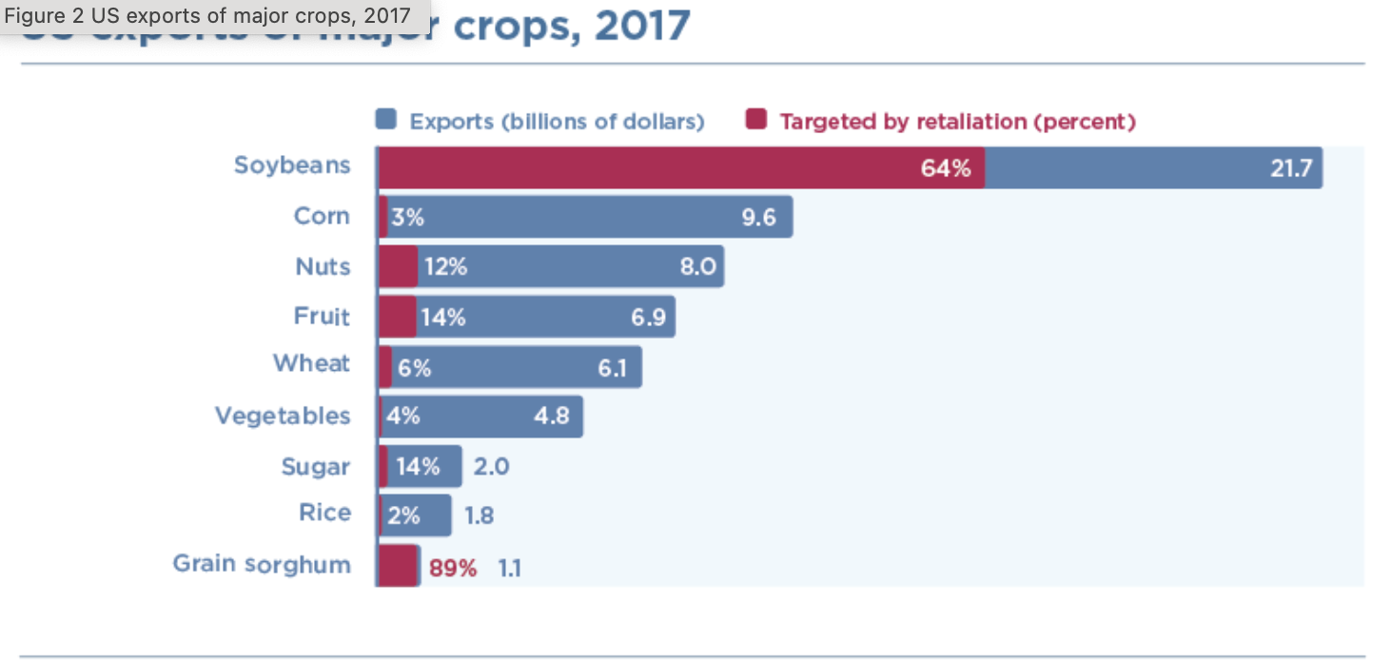
Subsidies to American Farmers
$12 billion subsidy to help American farmers for their lost export sales.
Notes:
https://www.piie.com/blogs/trade-and-investment-policy-watch/2018/first-tariffs-then-subsidies-soybeans-illustrate

Slide 40
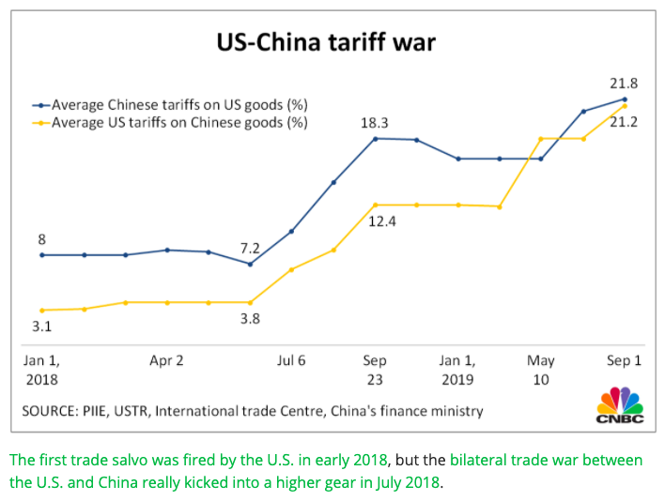
US-China Tariff War – Tariff Rates
Source: CNBC.com
Notes:
SEPTEMBER 18, 2019 | Yen Nee Lee, CNBC.com
http://nbr.com/2019/09/18/these-4-charts-show-how-us-china-trade-has-changed-during-the-tariff-dispute/

Slide 41
U.S.- China Trade War
Tariffs were fully-passed through to US import prices, but only partially to retail prices: retail margins decreased, and American consumers still paid higher prices.
Net decrease in manufacturing employment due to tariffs (the negative effects of higher input prices and retaliatory tariffs outweighed the benefits to protected industries)
Overall lower aggregate real income in both U.S. and China (small magnitudes relative to GDP)
A 2024 study found that the tariffs failed to provide economic help to the heartland:
import tariffs had “ neither a sizable nor a significant effect on US employment in regions with newly-protected sectors” and foreign retaliation “by contrast had clear negative employment impacts, particularly agriculture.”
Notes:
The data is clear: the tariffs were paid by US consumers, not China, it hurt our own manufacturing employment, and a 2024 study showed it failed to help the heartland."
https://www.nber.org/system/files/working_papers/w25638/w25638.pdf
https://www.nber.org/papers/w26396
https://www.federalreserve.gov/econres/feds/files/2019086pap.pdf
https://www.nber.org/papers/w32082#fromrss
https://taxfoundation.org/research/all/federal/trump-tariffs-trade-war/#:~:text=A%20March%202019%20National%20Bureau,of%20higher%20after%2Dduty%20prices.

Slide 42
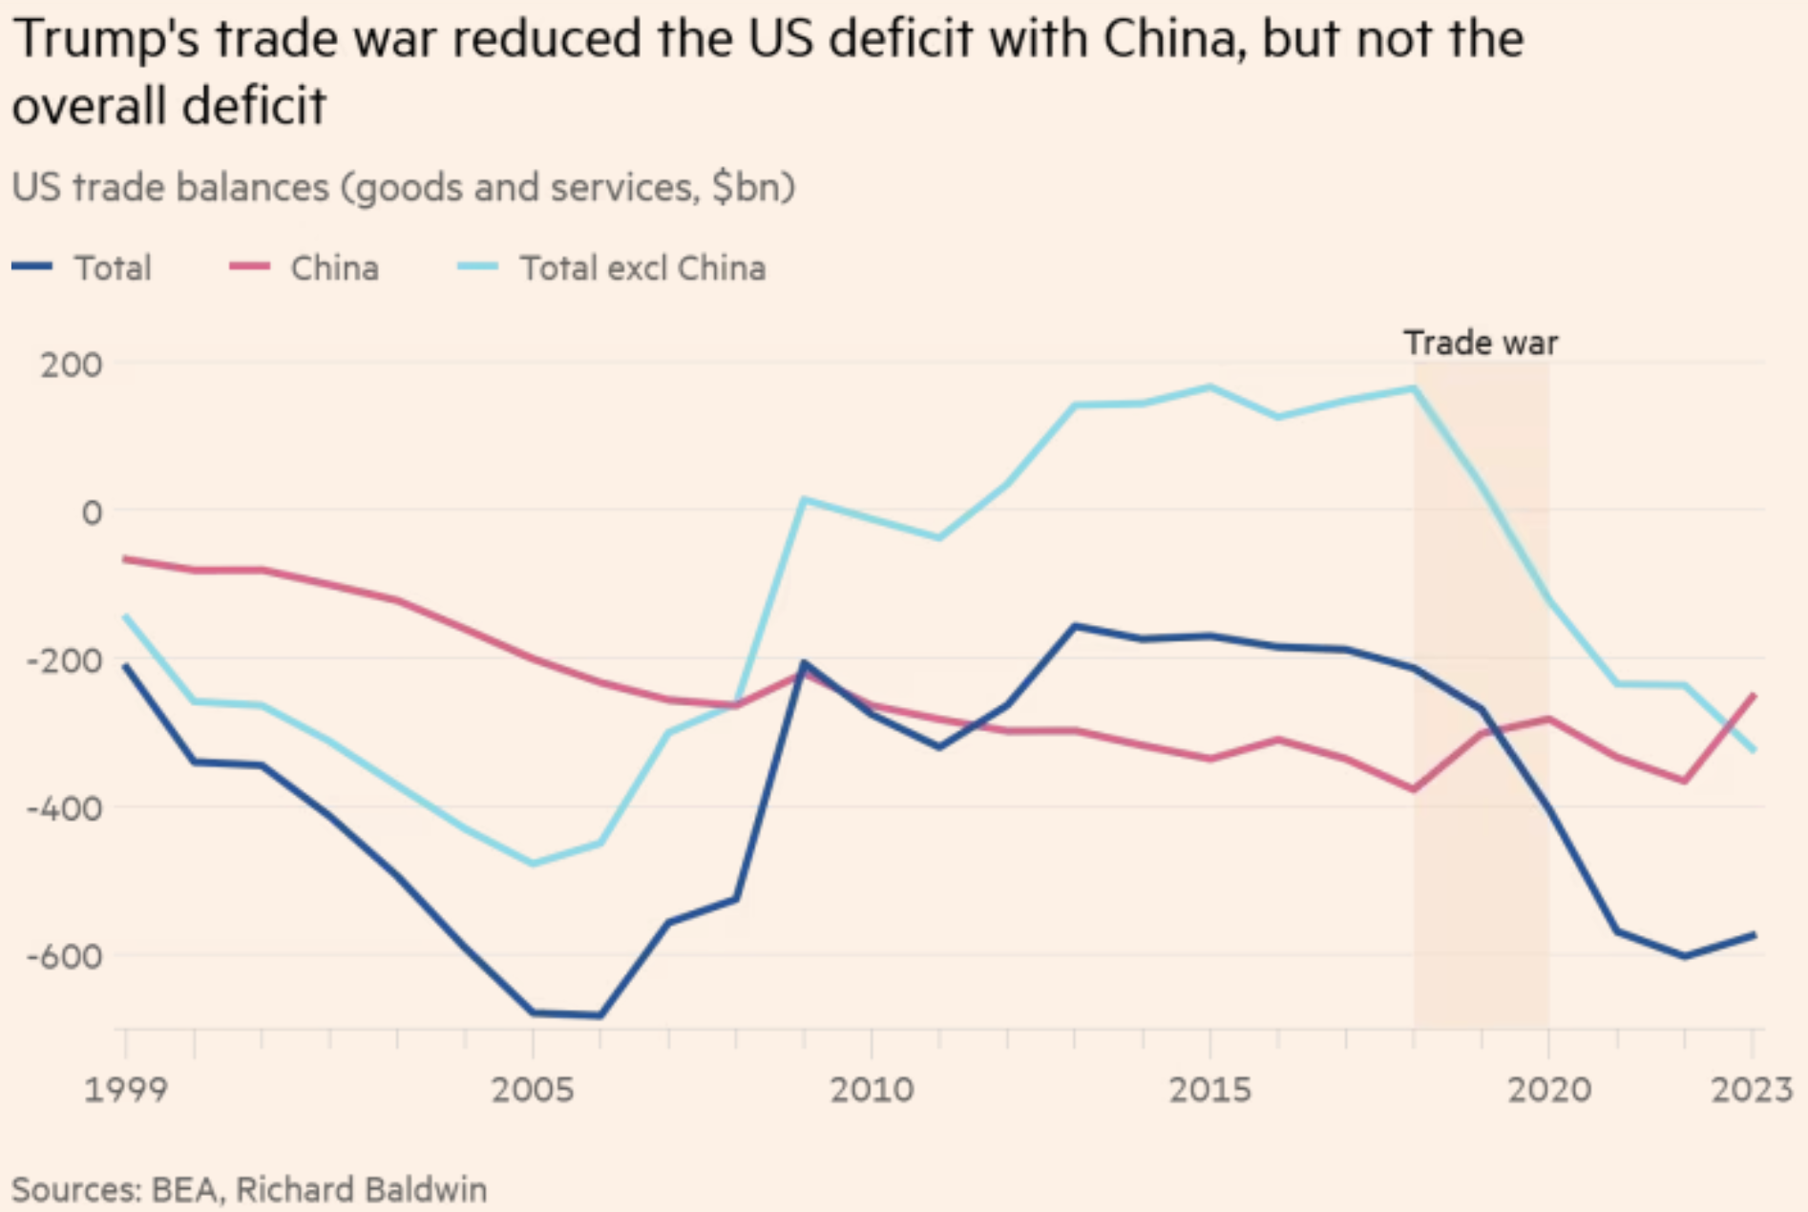
US Trade Balance with China and the World
Deficit
Source:
FT 1/4/25
Notes:
Tett, Gillian, “‘That is Maganomics’: where Trump is taking America on trade,” Financial Times, January 4, 2025.
https://www.ft.com/content/8a97792f-69f9-4885-afdd-4380a2d81dd8

Slide 43
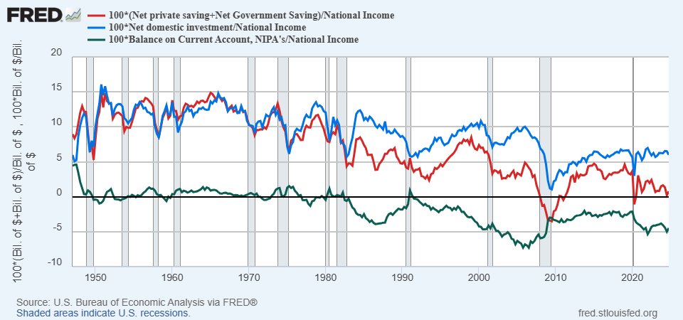
History of Saving, Investment and Trade Balance
Persistent Trade Deficits Start in the 1980s
Notes:
This chart shows the deep macroeconomic theory of why tariffs don't fix trade deficits. The green line, our trade balance, is locked to the gap between our national saving (red line) and our investment (blue line). We'll discuss the takeaway, but you don't need to be an economist to see the three lines move together

Slide 44
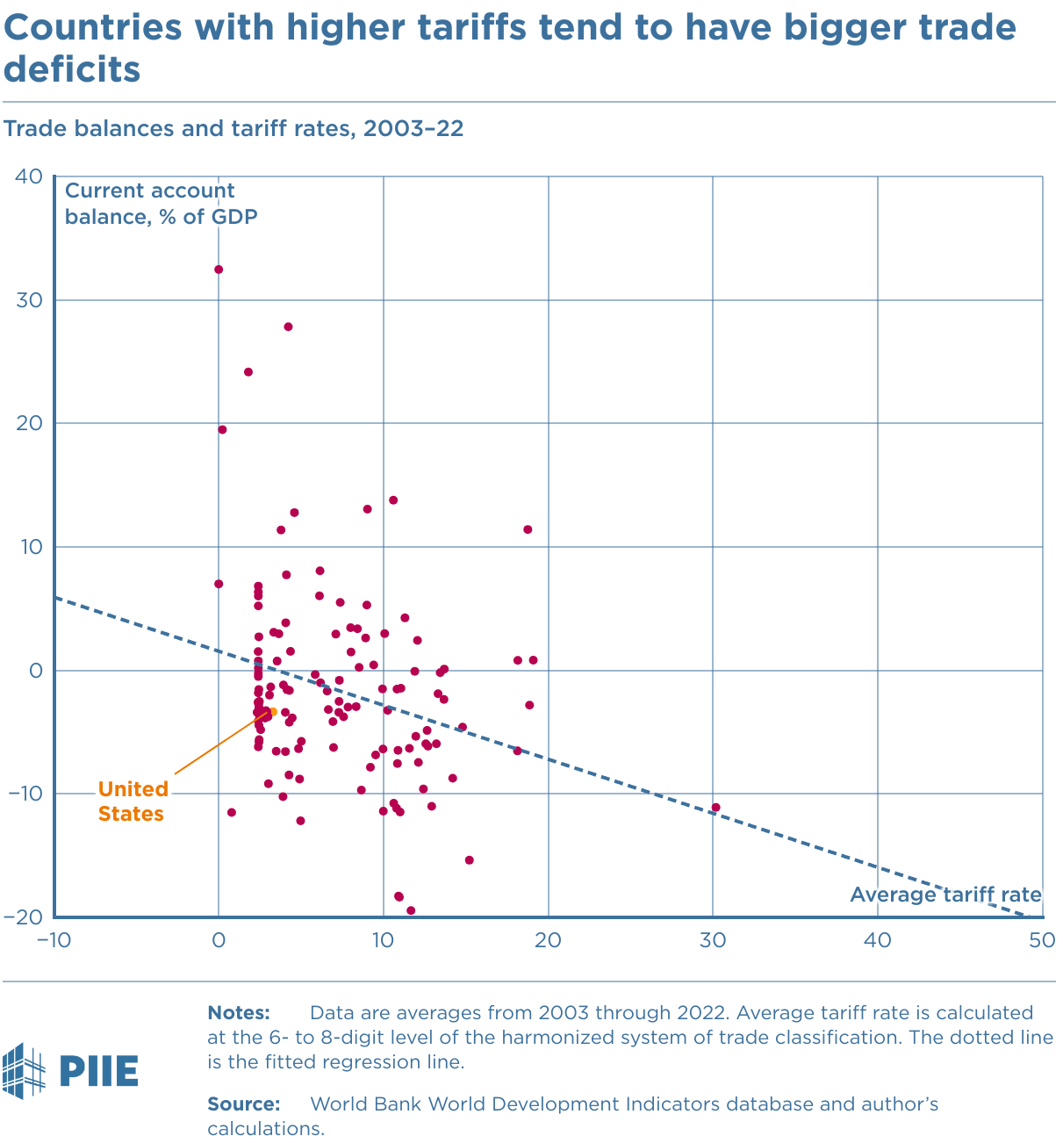
Effects of a Tariff
Do tariffs reduce a trade deficit?
Trump thinks so, but the US deficit grew under him (see above)
A trade deficit equals Expenditure minus Income or Savings minus Domestic Investment
There is no reason for tariffs to reduce expenditure
And unless in a recession, also no reason for tariffs to raise income
Tariffs reduce imports but also reduce exports.
So NO!
Source: Peterson Institute for International Economics (PIIE)
Notes:
Tariffs are the wrong tool for the job. A trade deficit isn't a scoreboard; it's a macroeconomic number. It’s the gap between our national saving and our national investment
The negative correlation in figure 1 likely arises from the effect of a country’s stage of development on both its tariff rate and its trade balance.
Higher tariffs => lower imports => appreciate US dollar => reduce exports.

Slide 45
Trump I Tariffs & Trade War
Summary
Trump placed tariffs of 25% on steel and 10% on aluminum
Trump placed multiple tariffs on China exports, covering at least ¾ of their exports to US
On request, he exempted some products and firms
Imports from China fell while imports from others rose
US trade deficit did not shrink
Data show no fall in foreign export prices, so tariffs were paid by US buyers

Slide 46
Trump II Tariffs

Slide 47
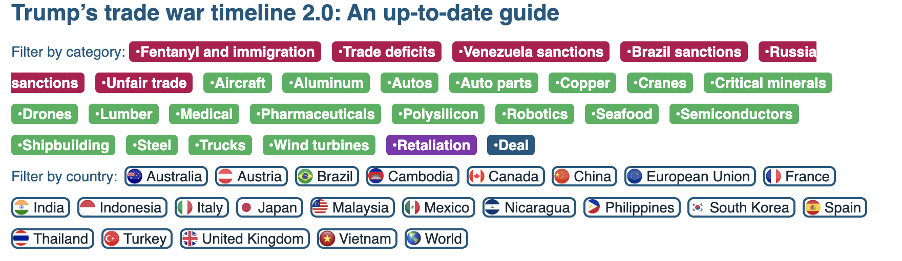
Trump II Tariff Actions and Plans
“To me the most beautiful word in the dictionary is ‘tariff’”
Notes:
McCormick, “Trump Calls Tariffs the ‘Most Beautiful Word’,” WSJ, 10/14/24
https://www.wsj.com/livecoverage/harris-trump-election-10-16-2024/card/trump-calls-tariffs-the-most-beautiful-word--YMVPAupw4EjBRp6yobOy
Swanson, “Harris and Trump Embrace Tariffs, Though Their Approaches Differ,” New York Times, Aug 27, 2024.
https://www.nytimes.com/2024/08/27/us/politics/trump-harris-tariffs.html
Toomey, “About Trump’s ‘Reciprocal’ Tariffs,” WSJ, 10/27/24
https://www.wsj.com/opinion/about-trumps-reciprocal-tariffs-he-wants-to-raise-taxes-and-thinks-im-the-stupid-one-5dc3c56c?mod=itp_wsj
Krugman, “Donald Trump on the Dollar, in His Own Words. NYT, 9/9/24
https://www.nytimes.com/2024/09/09/opinion/trump-tariffs-reserve-currency.html
Economist, “Donald Trump is poised to smash Mexico with tariffs,” 11/7/24
https://www.economist.com/the-americas/2024/11/07/donald-trump-is-poised-to-smash-mexico-with-tariffs
Ewing, “Trump’s Tariffs Could Deal a Blow to Mexico’s Car Factories,” NYT, 11/12/24
https://www.nytimes.com/2024/11/12/business/economy/trump-mexico-trade-tariffs-car-factories.html

Slide 48
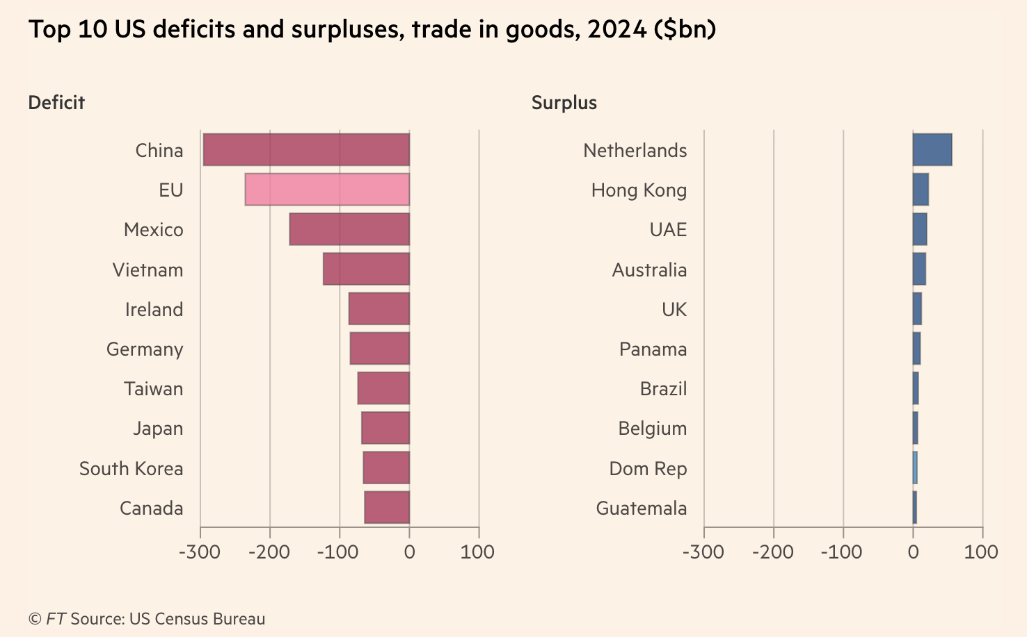
Reciprocal Trade and Tariffs
Trade deals with China, Vietnam, EU, South Korea, ,Japan
Notes:
https://www.piie.com/blogs/realtime-economics/2025/trumps-trade-war-timeline-20-date-guide
US-UK trade deal: which includes the potential for the UK to lower tariffs on US beef, and a US quota of 100,000 vehicles for the UK to export to the US at a tariff rate of 10 percent (and not the 25 percent additional tariff resulting from the Section 232 investigation).

Slide 49

Example, Lesotho (2022 data)
(EX-IM)/EX= ($236m-$7m)/$236m=0.97
“Reciprocal” Tariff = 0.5(.97)= .485,
49% tariff rate (actually, 50%)
Facts about Lesotho:
GDP per capita =$1,073;
Population= 2.1 million
Trade balance= -$349 million
Average eff. tariff rate against US = 10%
https://wits.worldbank.org/CountryProfile/en/USA
https://www.imf.org/en/Publications/WEO/weo-database/2024/October
Notes:
A simple 'reciprocal' tariff policy leads to absurd outcomes, like charging a 49% tariff on Lesotho, one of the poorest countries on Earth.
99% textiles. 2000 African Growth and Opportunity Act 0 tariffs on textiles

Slide 50
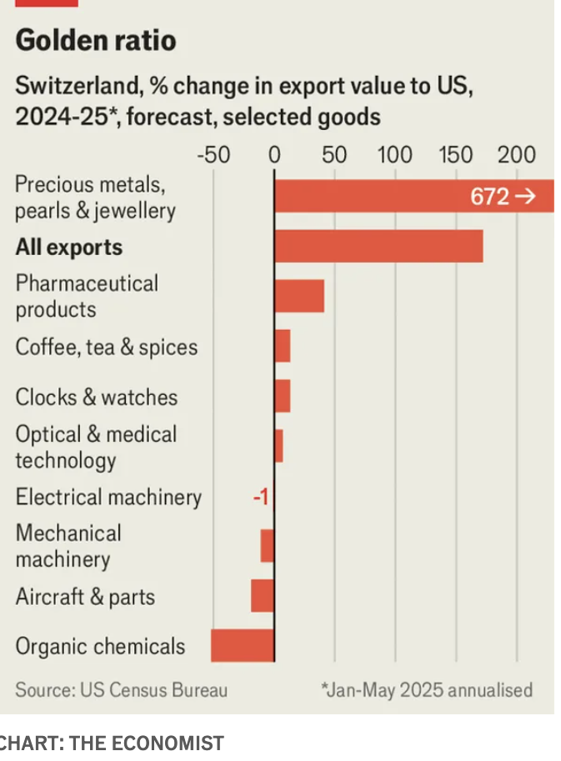
Example, Switzerland
39% on all products except for gold and pharmaceuticals
Facts:
Trade balance with the US in 2024: $48bn
Trade surplus increased to $54bn in 2025
Zero tariffs on all industrial goods
Source: ”A tariff avalanche catches Switzerland unawares”, The Economist, Aug, 2025

Slide 51
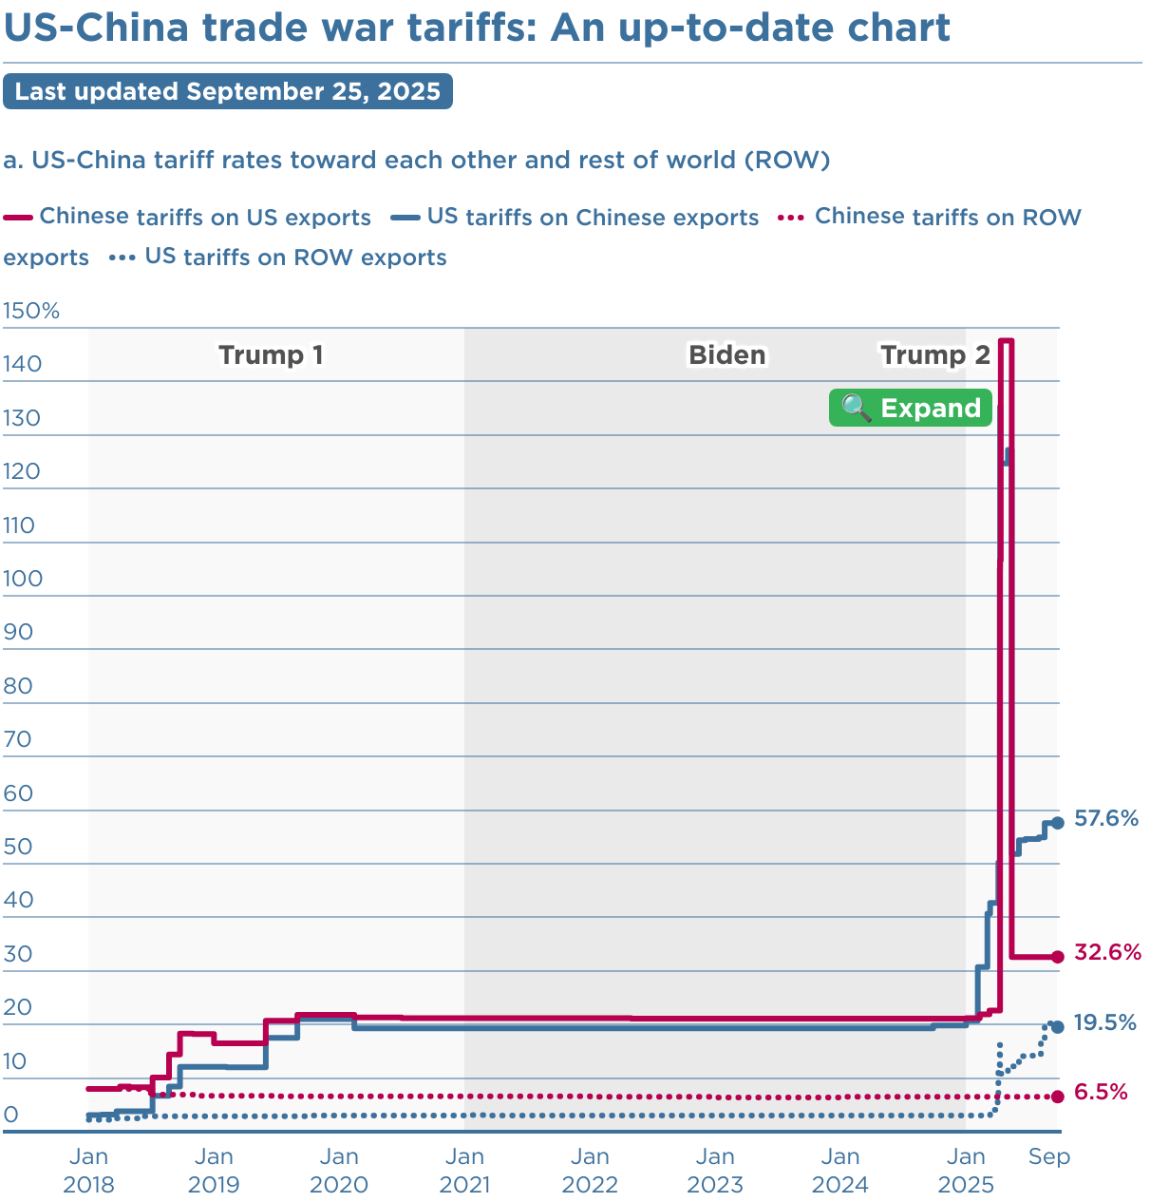
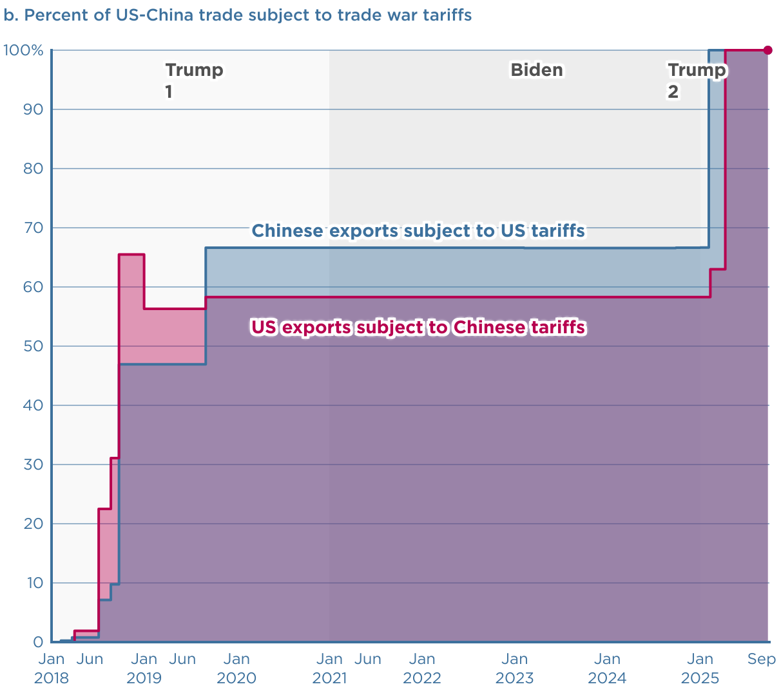
Source: Peterson Institute for International Economics (PIIE)
Notes:
https://www.piie.com/blogs/realtime-economics/2025/trumps-trade-war-timeline-20-date-guide

Slide 52
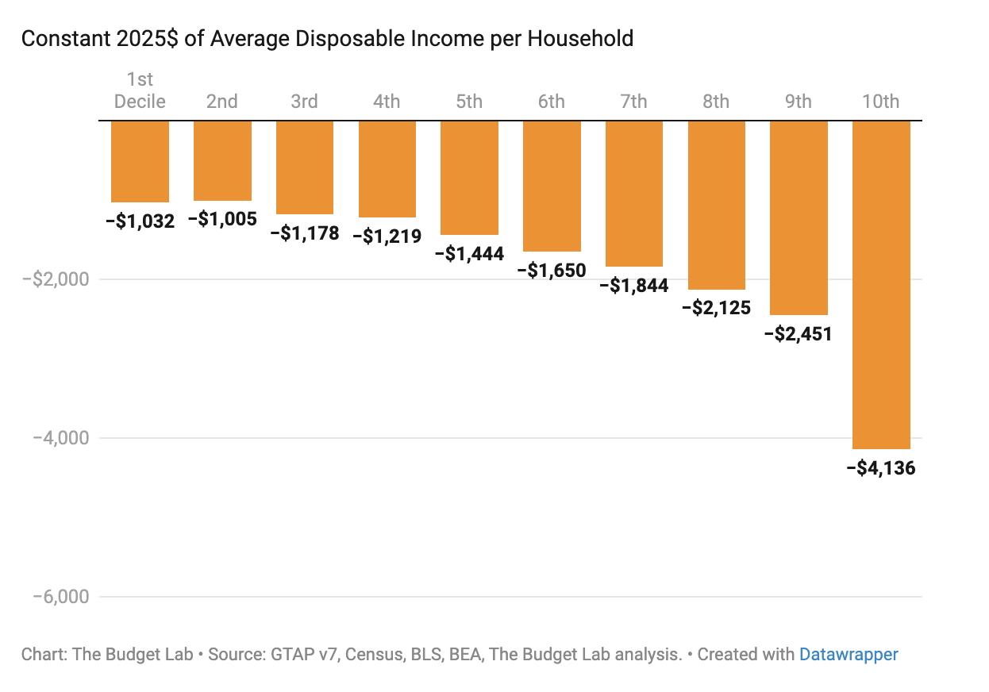
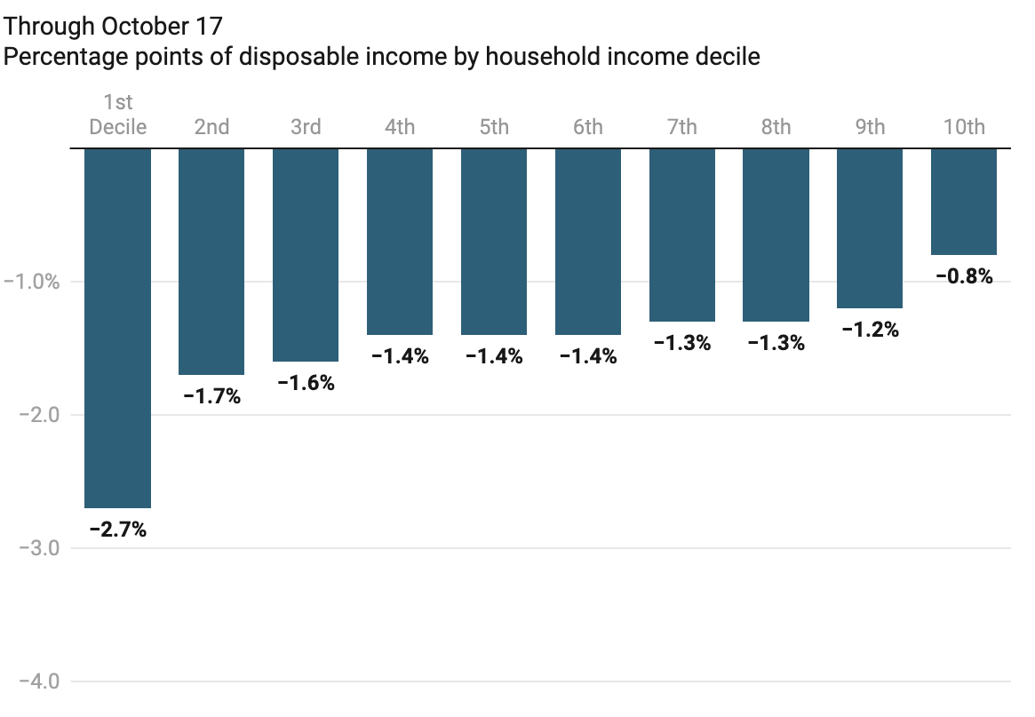
Effects of Tariffs on Households
Source: Yale Budget Lab
Notes:
https://budgetlab.yale.edu/research/where-we-stand-fiscal-economic-and-distributional-effects-all-us-tariffs-enacted-2025-through-April
Price increase of 2.3% in the short-run.

Slide 53
Effects of a Tariff
Government revenue
Could Trump’s proposed tariffs replace the US income tax?
NO!
Researchers estimates that all 2025 tariffs to date would raise about $2.7tr over 10 years if they stayed into effect.
US federal income tax revenue in 2023 was $2.18tr
So, his tariffs would collect MUCH less than the income tax.
Notes:
https://budgetmodel.wharton.upenn.edu/issues/2025/4/10/economic-effects-of-president-trumps-tariffs
https://budgetlab.yale.edu/research/where-we-stand-fiscal-economic-and-distributional-effects-all-us-tariffs-enacted-2025-through-april

Slide 54
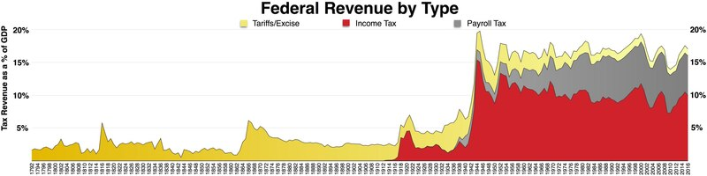
History of the Source of Federal Revenues
1913; Sixteenth Amendment. The Congress shall have the power to lay and collect taxes on incomes, from whatever source derived…
1930; Smoot Hawley Tariff.
1935; Social Security and Payroll taxes.
https://en.wikipedia.org/wiki/File:Federal_taxes_by_type.pdf

Slide 55
Summary
Trade and growth are positively related.
Gains from trade are large but spread thin across millions of consumers while losses are highly concentrated on a few workers, firms, and communities.
Tariffs reduce trade overall, thus imposing widespread losses to both producers (who use imported inputs) and consumers (who buy lower-priced imported goods).
More direct policies to help those hurt by trade can be more efficient and save gains from trade.

Slide 56
Th e Future of Globalization?
Geopolitics overrides Economics:
Countries prioritize national security and strategic competition over free trade
The rules-based system of the World Trade Organization is being challenged.
The Rise of Regional Trade Blocs:
We’ll see trade expansion within regional blocs (e.g. North America, Europe, Southeast Asia) because of geopolitical tensions and a shift towards resilience of global supply chains.
New Technology Makes “Local” Possible:
AI is revolutionizing manufacturing and design which will erode the old advantage of cheap labor making it possible to produce closer to the consumer.

Slide 57
Thank you!
Any Questions?
www.NEEDEcon.org
Adina Ardelean, Ph.D.
atardelean@scu.edu
Contact NEED: info@NEEDEcon.org
Submit a testimonial: www.NEEDEcon.org/testimonials.php
Become a Friend of NEED: www.NEEDEcon.org/friend.php

