Slide 1
Osher Lifelong Learning Institute, Fall 2005
Contemporary Economic Policy
Northwestern University
Host: Geoffrey Woglom, Ph.D.
National Economic Education Delegation

Slide 2
Course Schedule
Inequality and Public Policy
Week 1 (10/14): The New Inequality, Geoffrey Woglom, Amherst College
Week 2 (10/21): Economics of Immigration, Robert Gitter, Ohio Wesleyan University
Week 3 (10/28): Trade and Inequality Geoffrey Woglom, Amherst College
Week 4 (11/04): The Black-White Wealth Gap, Jon Haveman, Exec. Director, NEED
Week 5 (11/11): Climate Change Economics Sarah Jacobson, Williams College
Week 6 (11/18): AI and Inequality Geoffrey Woglom, Amherst College

Slide 3
Geographic Distribution of Government Transfers
https://eig.org/great-transfermation

Slide 4
Outline
Overview of the economic analysis of the causes of post 1980 rise in income inequality.
Zero in on Trade and Manufacturing.
The China shock of 2001-2005.
Look at why trade dislocations are politically important.
The interaction among the different factors that led to the relative decline in labor relative to corporate power.

Slide 5
Income Inequality: the Long View
1940
1980
Great Compression
Great Divergence
Source: https://wid.world/

Slide 6
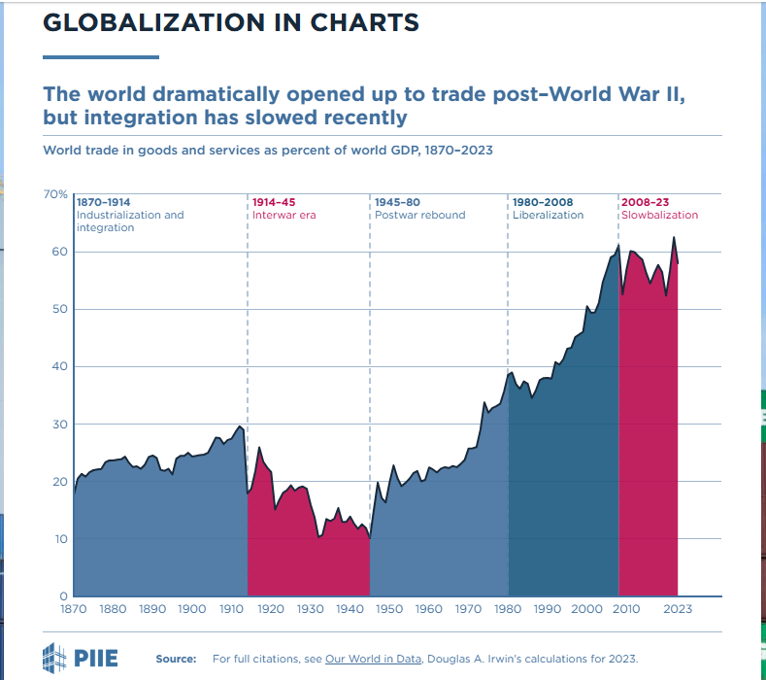
World Trade: the Long View
The growth in income inequality does coincide with the period of rapid liberalization and high globalization
But income inequality was falling when globalization was rising, eventually reaching high levels
Trade as the sole source of inequality doesn’t quite fit

Slide 7
Economist Views Post 1980 Wage Inequality
Ranking of Causes
Skill-biased Technological Change.
Declining market power of unions relative to corporations,
International Trade.
Immigration.
But, there is substantial disagreement of relative importance.
There is an emerging agreement that growing wage inequality was related to the relative supply and demand for skilled workers

Slide 8
Supply and Demand for Skill
The “Race” between education and technology.
Supply depends on educational attainment.
Demand
Skill-Biased Technological Change that raised the productivity skilled labor; e.g. spread sheets and financial services.
Trade, where exports are more skill intensive and imports are less.

Slide 9
Supply of High-Skilled Workers
1980
D. Autor, C. Goldin, and L. Katz, Extending the Race between Education and Technology” NBER Working Paper, 1/11/2020

Slide 10
Wage Inequality is Associated with Skills
HSD = High School Dropout
HSG = High School Graduate
SMG = Some College
CLG = College Graduate
GTC = Greater Than College
Takeaways starting in 1980:
High Skill workers real wages rise.
Low Skill workers real wages fall.
https://shapingwork.mit.edu/research/skills-tasks-and-technologies-implications-for-employment-and-earnings/

Slide 11
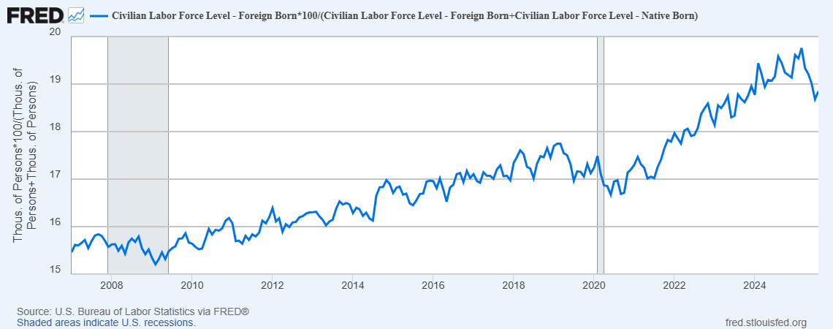
Immigration & the Supply of low-skilled workers
Immigration ?
In 1980, foreign-born population was 6%
In 2023, immigrants more likely to lack less than HS, but as likely to hold a BA
FYI: 40% of US Nobel Prize Winners are immigrants.

Slide 12
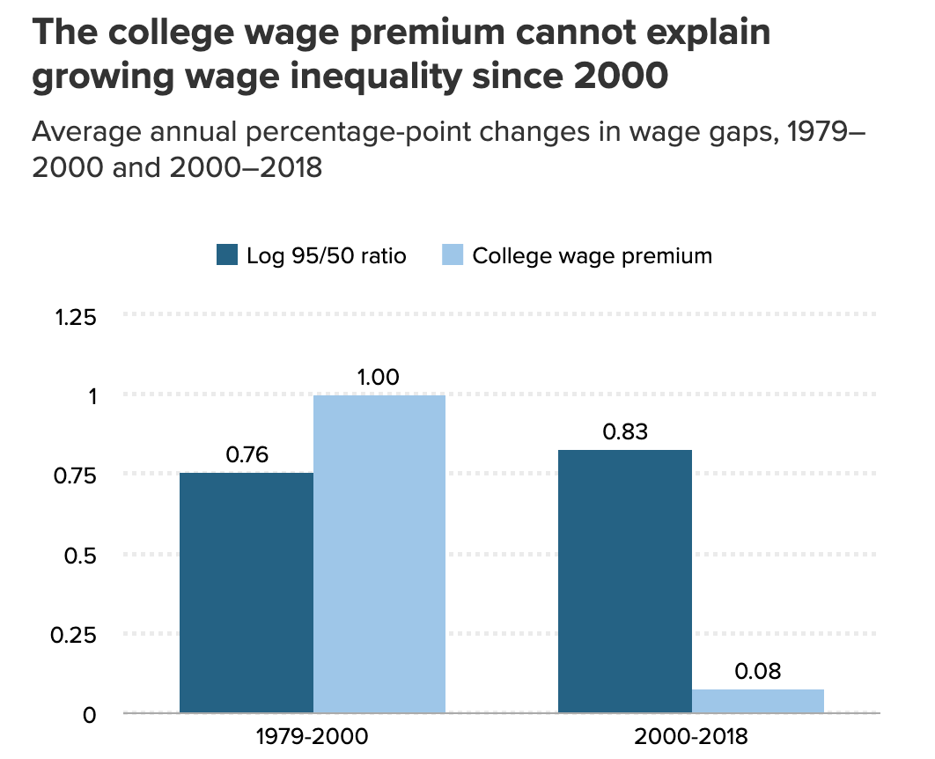
Problems with Skill & Education as the Main Factor.
https://www.cbo.gov/system/files/2024-09/60342-Trends-Income.pdf
https://www.epi.org/blog/higher-returns-on-education-cant-explain-growing-wage-inequality/

Slide 13
The Economics of Trade
The Economics of International Trade is not different than trade within a country; shifting supply and demand.
Adam Smith and the Pin Factory: Given difference in workers, specialization leads to cost savings.
David Ricardo generalized the gains to specialization by specifying workers should so what the do relatively the best (comparative advantage).
Why does Patrick Mahomes hire a teenager to mow his lawn?
Note specialization requires large markets to take advantage of specialization

Slide 14

Example, Lesotho (2022 data)
Bilateral: (EX-IM)/EX= ($236m-$7m)/$236m=0.97
“Reciprocal” Tariff = 0.5(.97)= .485,
49% tariff rate (actually, 50%)
Facts about Lesotho:
GDP/Pop =$1,073;
Population 2.1 million
Trade balance -$349 million
Average eff. tariff rate against US = 10%
PreTrump no tariffs on African countries
Lowered to 15% in July
https://wits.worldbank.org/CountryProfile/en/USA
https://www.imf.org/en/Publications/WEO/weo-database/2024/October
Notes:
99% textiles. 2000 African Growth and Opportunity Act 0 tariffs on textiles

Slide 15
Generally Agreed On Effects of Opening to Trade
Trade leads to winners and losers, but eventually the dollar gains exceed losses.
Winners:
Export industries and their workers.
Consumers and domestic firms importing intermediate goods due to lower prices.
Losers: Imports competing industries and their workers
Without compensation from winners to losers there must be net losers.

Slide 16
Why the “Eventually?”
Transition costs
Workers and capital have to be moved from import competing industries to export or to other domestic industries.
Temporarily unemployed labor and capital is an added costs.
“Generally agreed …” looks at losers and winners after workers and capital have moved.
Pre 2000 View: with Labor Mobility High (at least relative to Europe), transition costs not too high

Slide 17
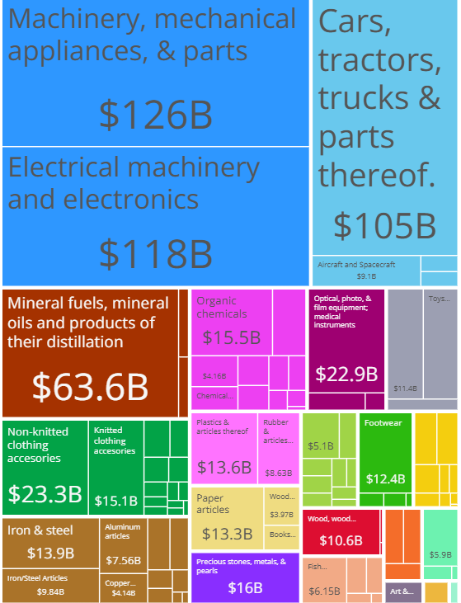
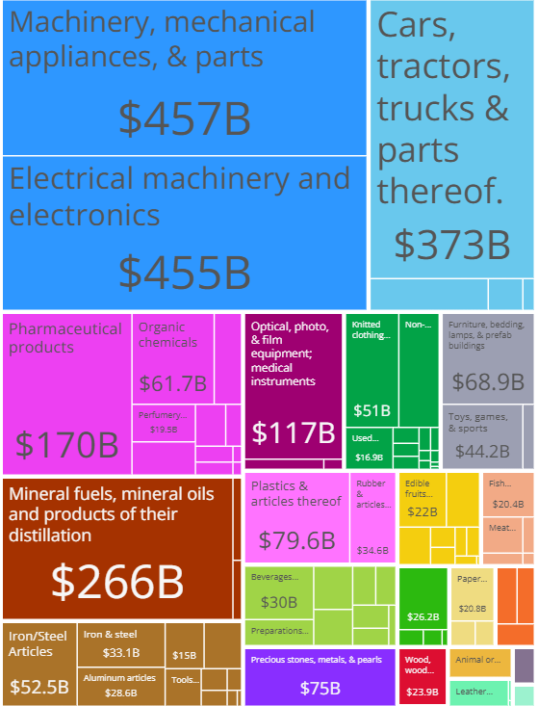
Composition of US Goods Imports
Only 40% of imports are on consumer goods. “Global Supply Chains.”
1995, Total $757B
2023, Total $3T

Slide 18
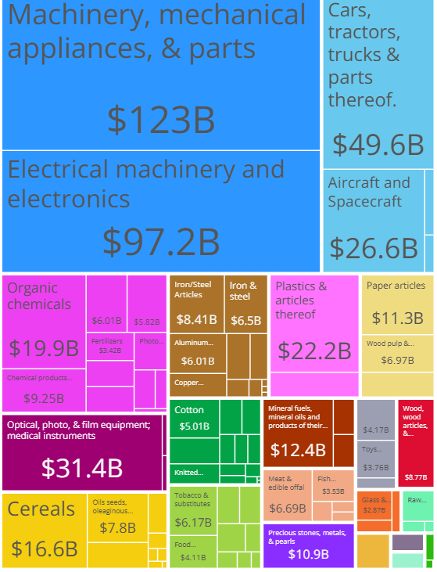
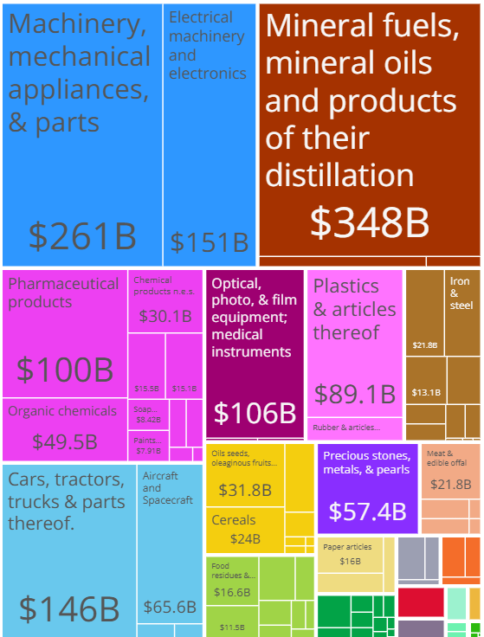
Composition of US Goods Exports
1995, Total $615B
2023, Total $1.86T
https://oec.world/en/profile/country/usa

Slide 19
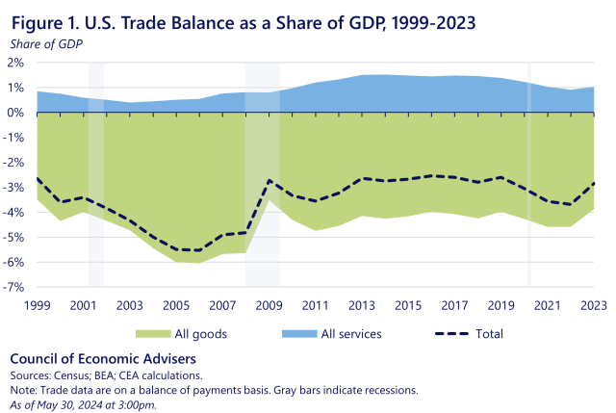
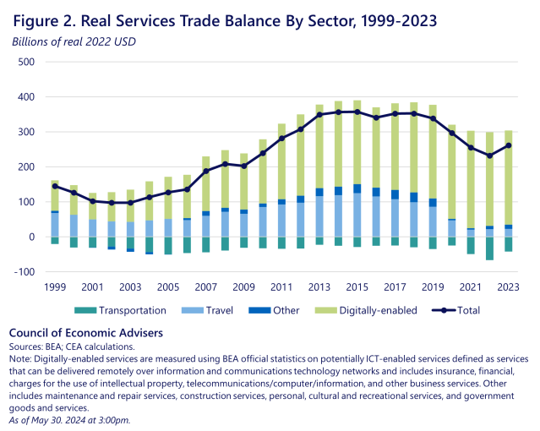
Don’t Forget Services

Slide 20
Changes in the Composition of Trade
Goods Exports: Growth in Oil and Minerals.
Goods Imports: Relative importance hasn’t changes much, but…
The share of exports in GDP between 1995 and 2023 is about the same, while the share of imports has increased by over 2 percentage points.
One Big exception: Growth in service exports, particularly digitally enabled services, suggests service exports are more skill intensive.
But what about Manufacturing?

Slide 21
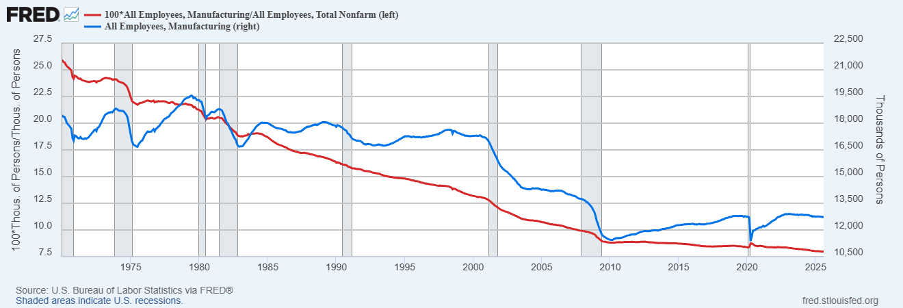
Focus on Manufacturing: Employment

Slide 22
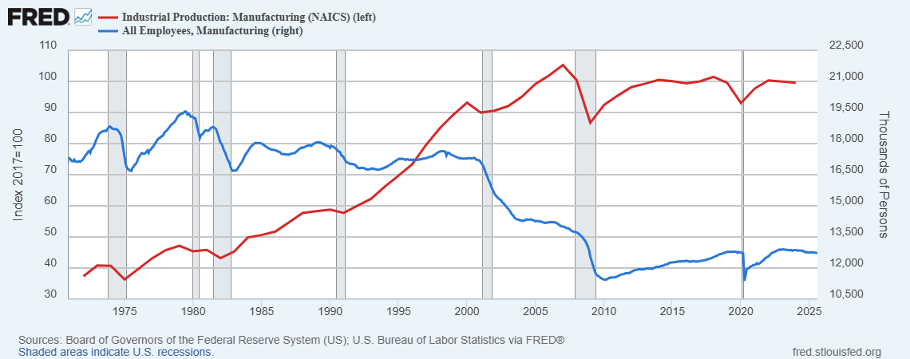
Real Output and Employment in Manufacturing

Slide 23
Summary: Post 1980 Changes in Manufacturing
Employment as a share of total employment falls throughout the period.
Employment doesn’t decline much until 2000, and stabilizes at a much lower level in about 2019
Real manufacturing output increases continuously until 2008.
The last two points imply that from 2000 productivity in manufacturing grew rapidly. Due to:
Import competition?
Technological change and automation?
Change in the composition of workers to higher levels of skill?
Or, all 3?

Slide 24
Evidence of Increasing Skill Levels

Slide 25
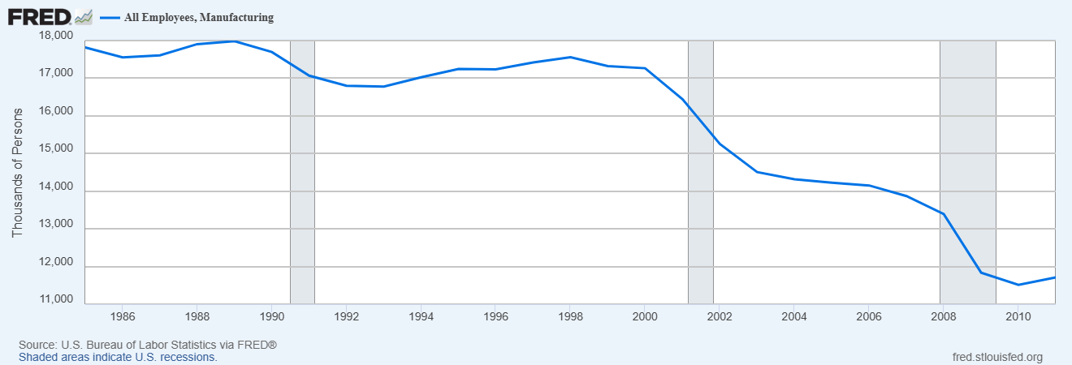
The China Shock: 2000-2010
China Joins WTO in December of 2001
https://www.nber.org/system/files/working_papers/w21906/w21906.pdf

Slide 26
Autor, Dorn, Hanson (2016); “ Prevailing View”
2000 Economist View of the Effects of Increasing Trade
Free Trade leads to more gains than losses
Trade was not the major cause of the decline in manufacturing employment nor in the rise of inequality.
Increasing trade would affect low-skilled wages generally and not by trade-exposed workers specifically.
Worker mobility was high.
Given 4, increasing trade should provide gains for most.

Slide 27
Autor et. al.’s Conclusion
While these results do not at all suggest that international trade is in the aggregate harmful to nations-indeed, China's unprecedented rise from widespread poverty bears testimony to trade's transformative economic power-it makes clear that trade not only has benefits but also significant costs. These include distributional costs, which theory has long recognized, and adjustment costs, which the literature has tended to downplay.
China shock showed that a rapid influx of imports can cause harm that is geographically concentrated and long lasting to communities with import competing industries.

Slide 28
But, Here Is Another Fact to Keep in Mind
Growing Inequality within the US and most industrial countries coincided with a reduction in World Inequality

Slide 29
Autor, et. al. Reexamination (2021)
Effects of the China Shock through 2019
Only net migration out of affected areas are foreign born and native born aged 25-39, “implying that exit from work is a primary means of adjustment.”
Many of the affected areas “have suffered absolute declines in average real incomes.”
“Because of the distinctiveness of the China trade shock…some see it as holding few lessons for policymakers. Such characterizations are mistaken. Large, localized contractions in labor demand—for example, …, and ongoing automation and roboticization—are unfortunately common events.”
https://www.nber.org/papers/w29401

Slide 30
China Shock and Change in Employment

Slide 31
The China Shock and Deaths of Despair
http://www.justinrpierce.com/index_files/pierce_schott_aeri_2020.pdf

Slide 32
How Did We Let This Happen?
Partly, because of the “exorbitant” privilege combined with industrializing Asia.
Japan, South Korea and China followed a similar playbook.
Develop the industrial sector through subsidies, tariffs and an “undervalued” currency.
Sort of an “Infant Industry” argument.

Slide 33
How to Undervalue Your Currency
Restrict domestic consumption to generate an increase in National saving and a trade surplus.
Normally a trade surplus would lead to an increase in the supply of dollars on foreign exchange markets and a fall in the value of the dollar (or rise in the value of your currency).
Offset the rise in the value of the your currency by buying US financial assets, e.g., US Treasury bonds. (which also helps to restrict domestic consumption).

Slide 34
The Chinese Example
Bigger Trade Surplus
Rise in the Value of the Yuan
Bigger Trade Surplus
Fall in the Value of the Yuan
Chinese Consumption: 2003, 46.0% of GDP; 2007, 39.9%
Holding of US Treasury Bonds: 2003, $147b; 2007, $471b

Slide 35
Why Didn’t the US Respond?
Cheap Chinese goods kept US inflation low and benefited US consumers.
Low US interest rates made the job of financing the deficit easier.
Diplomatic reasons: “The US wants a prosperous China.”
Instead, the Fed cut interest rate to raise domestic spending enough to accommodate growing imports, while maintaining domestic production.
But manufacturing took a big hit.

Slide 36
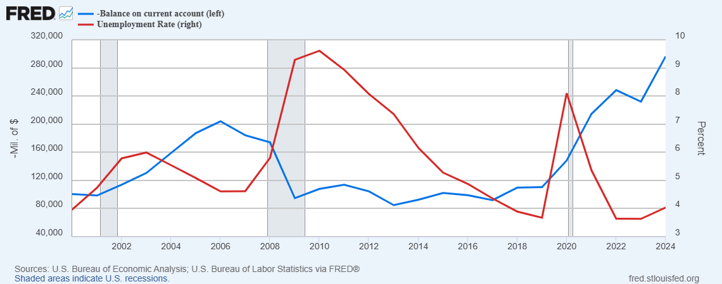
Doesn’t the Rising Trade Deficit Cause Unemployment?
How Could Unemployment Fall with Trade Deficit Rising?

Slide 37
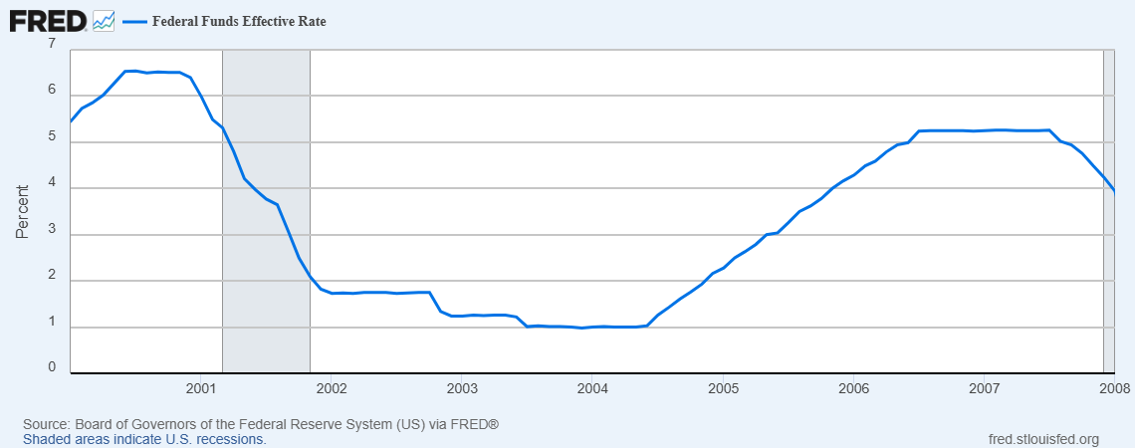
The Fed to the Rescue

Slide 38
But Why Are Adverse Effects of Trade Different?
Autor, et. al. 2021:
“Economists have long known that individuals are scarred by job loss. Displaced workers earn significantly less than similar workers who are not displaced, even years after displacement.”
“Presumably, job loss is equally scarring no matter whether the underlying cause of displacement is import competition, technological change …, government regulation, or some other factor.”
For example,…

Slide 39


The Sad Demise of the Fedora
The Culprit: JFK

Slide 40
Merrimack Valley Hat Company
Founded in 1838 in Amesbury Massachusetts.
In the 1940s, largest manufacturer of felt hats employing 500 workers locally and another 1500 at other locations.
Post WWII the company struggles with declining demand eventually closing in 1970.
The abandoned factory remains vacant until the late 1980s, when the factory is converted to luxury condominiums, a process that was ongoing in 2018.

Slide 41
How is the Plight of Merrimack different from that of Bethlehem Steel?
In both cases, workers, firms and geographic locations suffer long lasting “scarring.”
Dani Rodrik, heterodox Harvard trade economist, has what I think is the answer.
“There is broad consensus within the economics profession that technology and broad institutional changes (such as the decline in unionization or labor power) have played a larger role. Yet somehow the adverse effects of trade and globalization have become politically salient in a way that many of the other determinants have not.”
https://www.nber.org/system/files/working_papers/w29507/w29507.pdf

Slide 42
Fairness and Inequality
Rodrik quoting Angus Deaton:
“inequality is not the same thing as unfairness … it is the latter that has incited so much political turmoil in the rich world today. Some of the processes that generate inequality are widely seen as fair. But others are deeply and obviously unfair, and have become a legitimate source of anger and disaffection.”
Rodrik picks up the argument
“But international trade renders what is illegal (and illegitimate) in a national setting to be suddenly legal (and, in the eyes of many economists and technocrats, fully legitimate). A firm cannot import child workers and put them to work at home; but it is perfectly able to do so when it employs those child workers abroad (directly, or through a subcontractor). An economist looks at this, and sees gains from trade.”

Slide 43
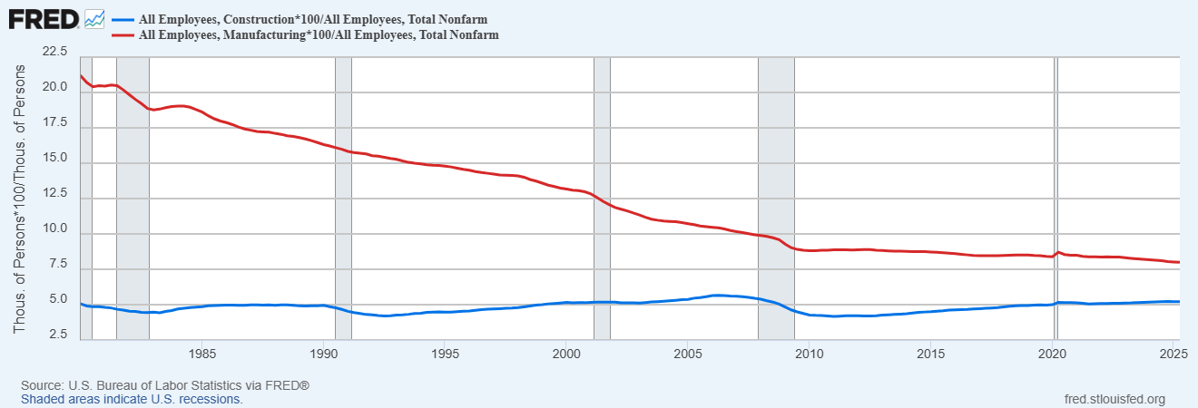
Interactive Effects
1980:
Man. 32.3 % unionized
Const. 30.9% unionized
2024::
Man. 7.8% % unionized
Const. 10.3%% unionized

Slide 44
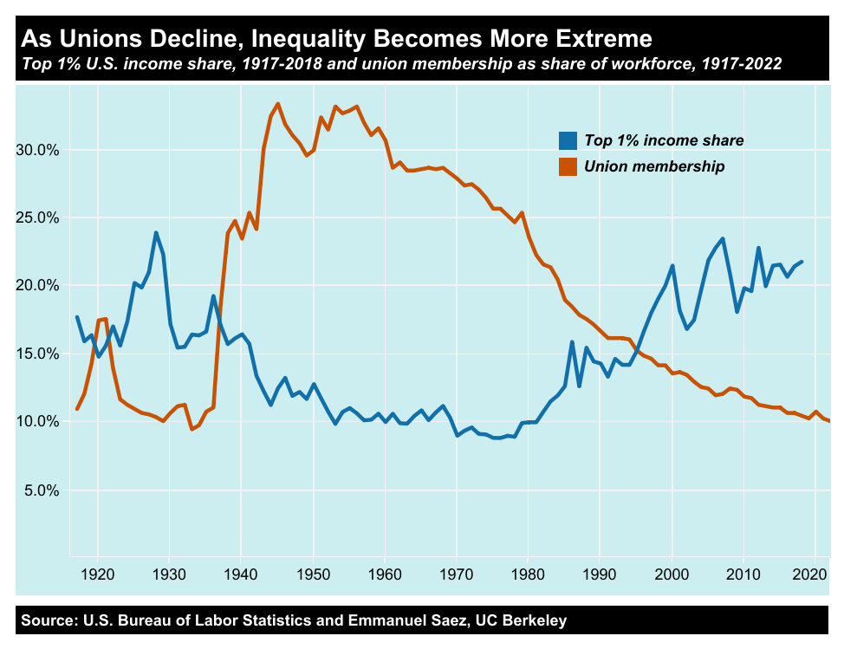
An Indirect Effect of the Decline in Manufacturing

Slide 45
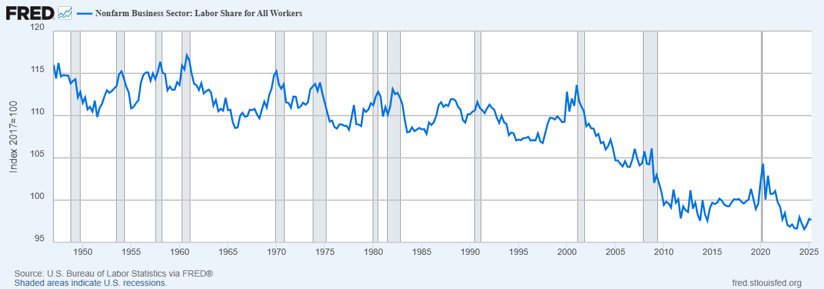
Measures of Corporate and Labor Power
https://www.janeeckhout.com/wp-content/uploads/ARE.pdf

Slide 46
Characteristics of Union Households Changed
H. Farber, et.al., Quarterly Journal of Economics, August 2021, v. 136, iss. 3, pp. 1325-138H.Faber, et.al.

Slide 47
Will Trump’s Tariffs Create New Jobs?
In some, protected industries, yes, e.g. steel and aluminum.
But, the overall net effect on jobs is likely to be negative due to:
Increased costs for business, remember consumer goods are less than 40% of all imports.
Policy Uncertainty delaying investment decisions.
Tariffs are a tax increase that will lead to some decrease in consumer spending.

Slide 48
What Should Be Done?
Our massive trade deficits are unhealthy.
But trade deficits are caused by too little national savings and most of this is due to government budget deficits.
Find the political will to raise taxes and reduce government spending.
Fed can maintain full employment by lowering interest rates
Step in early to slowdown (perhaps not stop) large job displacements (AI effects?)
Focus training efforts on the young,
Wish I had something more concrete and more politically feasible.

Slide 49
The Rise of a Heterodox Critic
Michael Pettis (based in a Chinese University!), The Great Rebalancing, 2013.
In the WSJ, April 30, 2025
Letting other countries take the lead in manufacturing harms the American economy. The U.S. accommodates other countries’ successful industrial policies by absorbing their negative consequences—namely, by absorbing global savings imbalances, running trade deficits and offshoring manufacturing.
U.S. leaders must adopt a strategic approach to industrial policy…and, more important, by reversing the U.S. role in absorbing global trade and capital imbalances.

Slide 50
Preview of AI
First, no one really knows the effects.
Second, the big difference in the effects of AI is that it breaks the close link between “skill” and eduacational attainment.

Slide 51
Next Week: Net Worth by Age and Race
Source: https://www.brookings.edu/blog/up-front/2020/02/27/examining-the-black-white-wealth-gap/

Slide 52
Let’s Hear from You!
Geoffrey Woglom
grwoglom@amherst.edu
Contact NEED: Info@NEEDEcon.org
Submit a testimonial: www.NEEDEcon.org/testimonials.php
Support NEED: www.NEEDEcon.org/donate.php

