Slide 1
Tariffs: Who Wins, Who Loses and Why It Matters
Adina Ardelean
Santa Clara University
Presentation to OLLI SCU
June 2, 2025

Slide 2
What Is a Tariff?
A tariff is a tax on imports.
A 10% tariff on all imports would mean that
  Whatever the foreign exporter charges for a product,
  US buyers will pay an extra 10% to the US government.
Might the seller charge a lower price because of the tariff?
  Perhaps, but when Trump used tariffs in 2018 on steel and China, they did not.

Slide 3
Outline
US Tariff History
Trump I Tariffs
Tariff Effects in General
Trump II Tariff Actions
Effects of Trump II Tariffs

Slide 4
US Tariff History

Slide 5
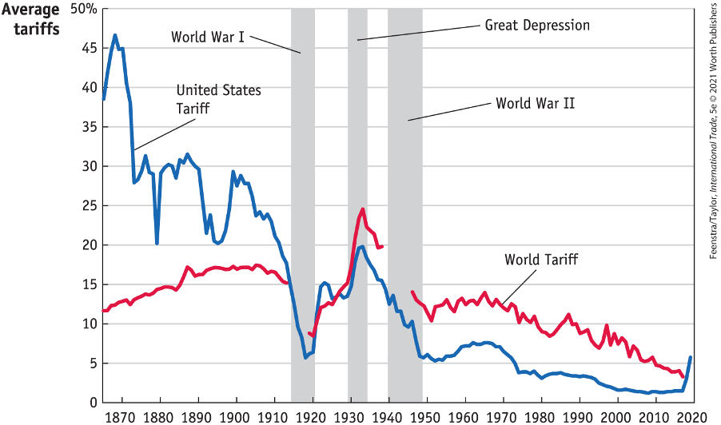
US Tariff History, 1860-2020
Source: Feenstra/Taylor, International Trade, 5e
Notes:
Late 1800s: growing influence of free trade advocates.
1913: Underwood-Simmons Tariff Act lowered tariffs and introduced the income tax, a more reliable source of revenue, reducing the government’s reliance on tariff revenue.
1930: The Smoot-Hawley Tariff Act, aimed to protect farmers and business from foreign competition, significantly raised tariffs on importing goods leading to retaliatory tariffs from other countries and a collapse in global trade and a worsening of the Great Depression.
1934: Reciprocal Trade Agreements Act empowered the President to negotiate trade agreements with other countries, allowing for reciprocal tariff reductions and promoting a shift towards freer trade.
1947: GATT
1995: WTO

Slide 6
Trump I Tariffs and the Trade War

Slide 7
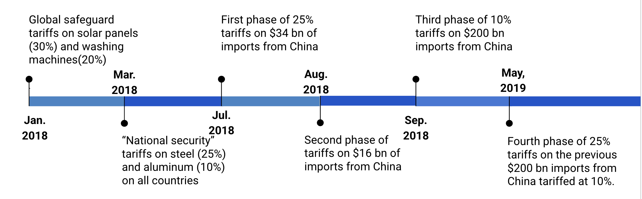
Trump I Tariffs & Trade War
Notes:
Safeguards – Section 201 of US Tariff code
National Security: Section 232 of US Tariff code
Unfair trade practices: Section 301 provisions of the Trade Act provide a domestic procedure through which interested persons may petition the U.S. Trade Representative to investigate a foreign government act, policy, or practice and take appropriate action

Slide 8
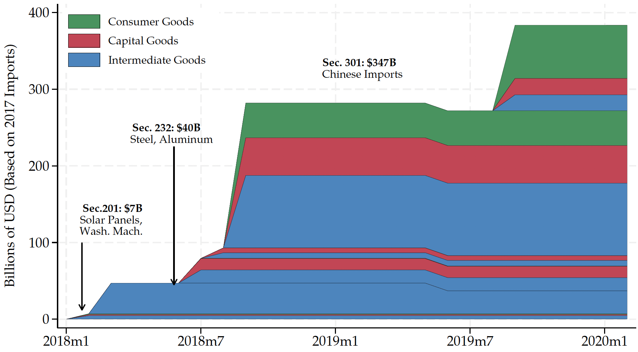
Trump I Tariffs - US Imports Covered
480
US imports from China in 2017, per World Bank:
$480 billion
Source: Flaaen & Pierce 2020
Notes:
SEPTEMBER 18, 2019 | Yen Nee Lee, CNBC.com
http://nbr.com/2019/09/18/these-4-charts-show-how-us-china-trade-has-changed-during-the-tariff-dispute/

Slide 9
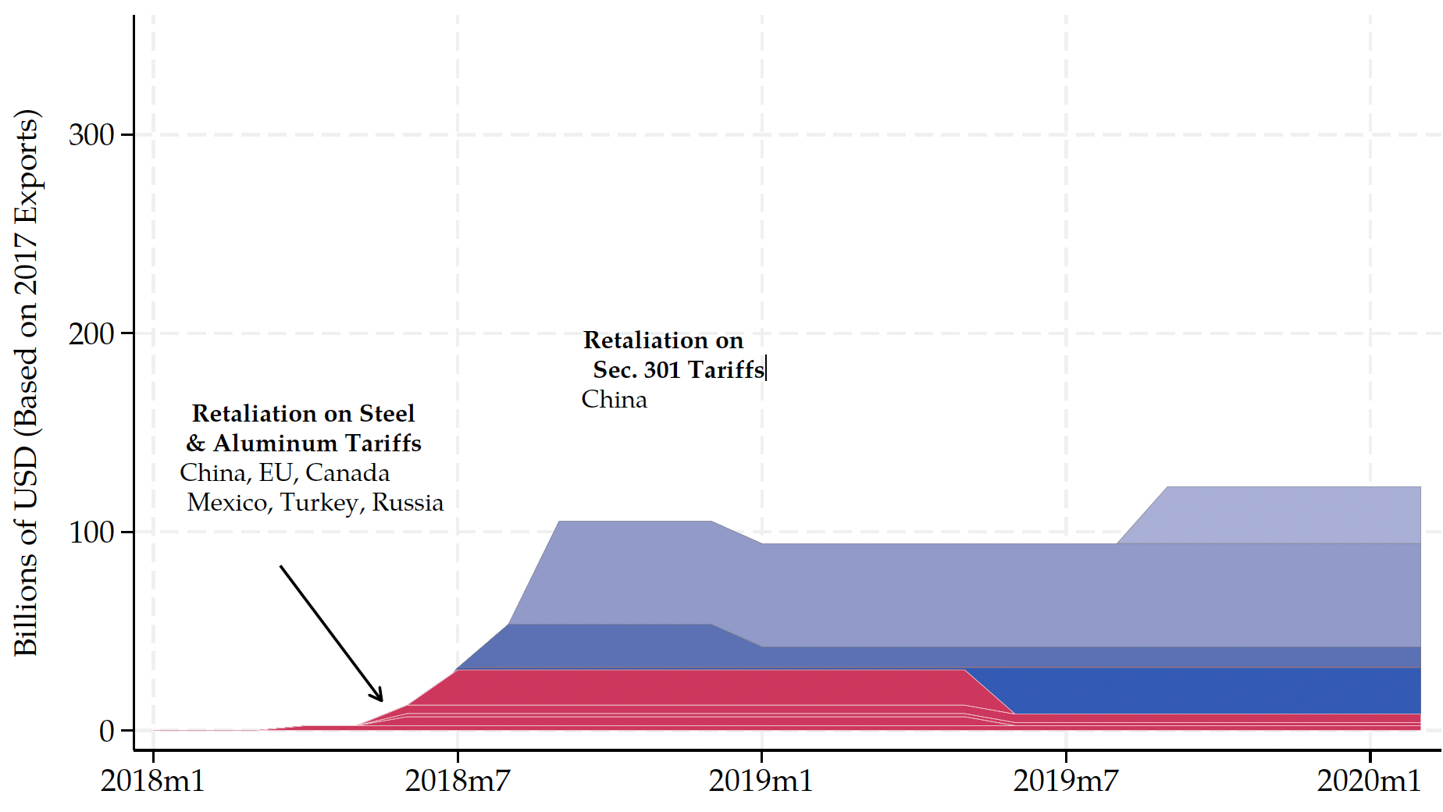
Trump I Tariff Retaliation - US Exports Covered
US exports to China in 2017, per World Bank:
$154 billion
154
Source: Flaaen & Pierce 2020
Notes:
SEPTEMBER 18, 2019 | Yen Nee Lee, CNBC.com
http://nbr.com/2019/09/18/these-4-charts-show-how-us-china-trade-has-changed-during-the-tariff-dispute/
Red: response to metal tariffs
Blue: unfair trade practices (3 phases – 3 shades)

Slide 10
Tariffs on Washing Machines
The price of washing machines increased in the U.S. by 12% the next month.
The price of dryers (bundled with washing machines) also increased by 12%, even if they were not subjected to tariffs.
Consumers lost $1.5 billion annually.
Annual tariff revenue increased by about $82 million.
1,800 new jobs reported
The consumer cost per job “created” was about $817,000 per year.
Coincides with LG and Samsung opening plants in the U.S.
  LG: Clarksville, Tennessee in 2019: 600 new jobs
  Samsung: Newberry, South Carolina, 2018: 1,500 new jobs
Notes:
Source: Flaaen, Hortacsu and Tinterlnot (2020) “The Production Relocation and Price Effects of US Trade Policy: The Case of Washing Machines”, American Economic Review, 110(7)

Slide 11
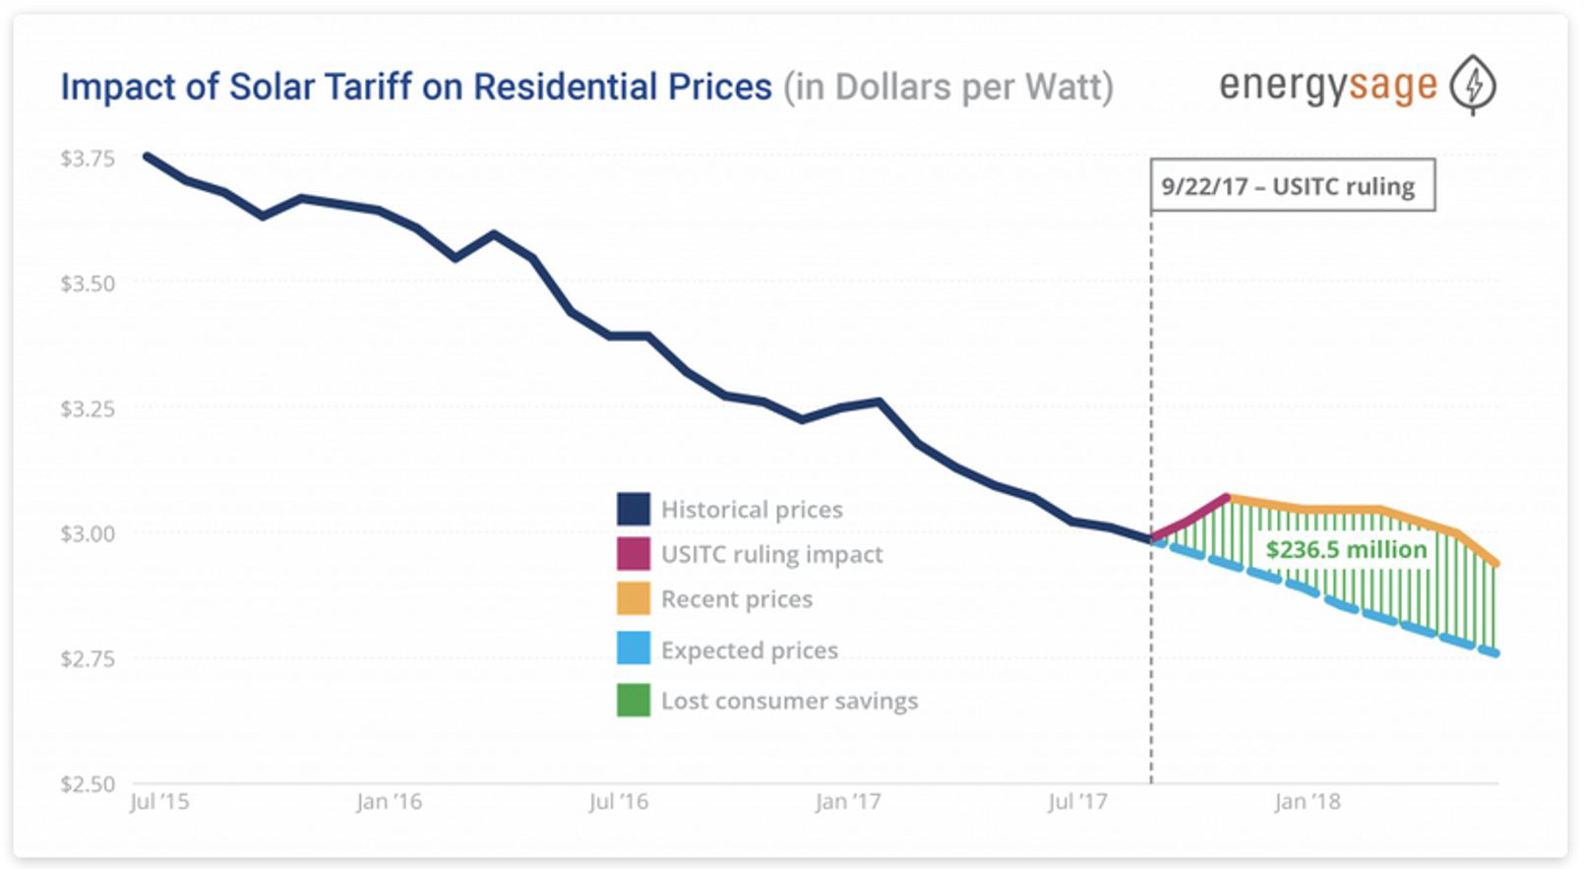
Tariffs on Solar Panels
Consumers were hurt by higher prices of solar panels:
  Solar prices increased by 43-57% compared to the global average.
U.S.-based companies that supported the tariffs:
  First Solar (U.S.), Suniva (Chinese owned), SolarWorld Americas (acquired by SunPower, San Jose, CA)
According to the Solar Energy Industries Association:
  62,000 workers were laid off or never hired
  10.5 gigawatts of solar capacity lost
  $19 billion in private sector investment lost
Foreign companies build factories in the U.S.:
  Hanwha (South Korea) in Whitfield County, GA
  JinkoSolar (China) in Jacksonville, FL
Notes:
https://seia.org/research-resources/high-cost-tariffs/
https://www.nytimes.com/2019/07/10/business/economy/companies-tariffs-winners.html

Slide 12
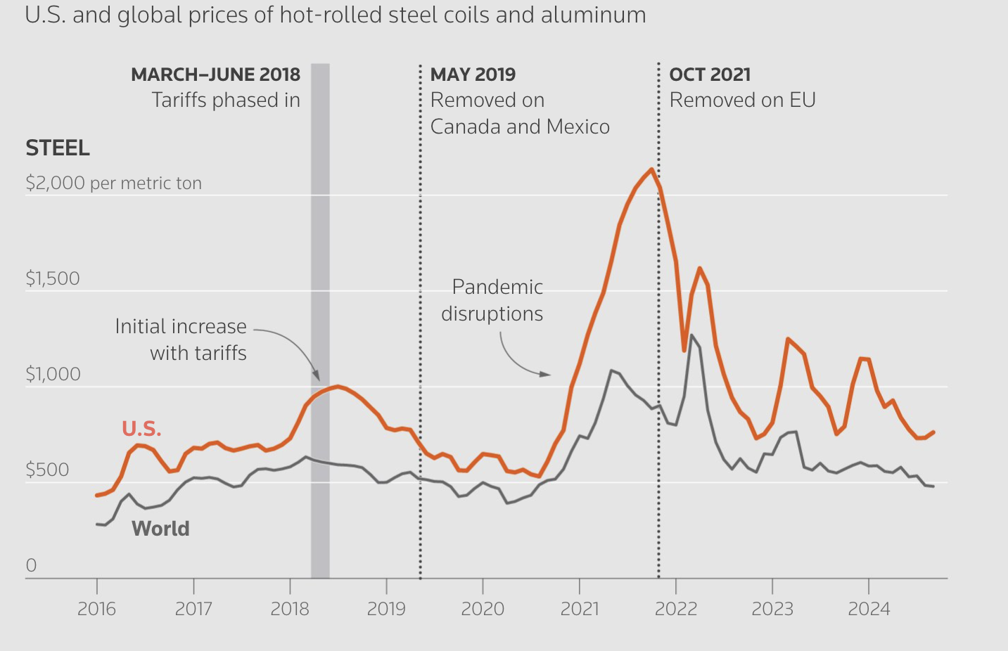
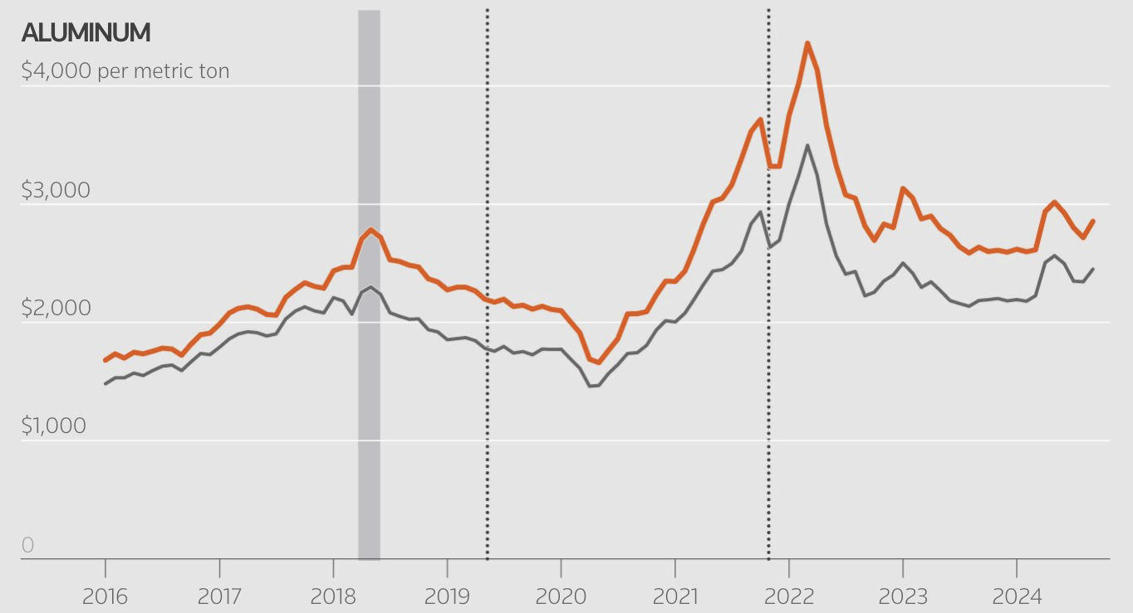
Tariffs on Metals
The price of steel and aluminum increased shortly after the tariff.
The domestic production increased (steel production increased by 6 million metric tons and aluminum by 350,000 metric tons in 2019 compared to 2017).
The number of jobs in iron, steel and aluminum mills rose temporarily by 6% and 5%, respectively from 2017 to 2019.
Downstream industries (e.g. auto) faced higher input costs.
Several studies estimated that the increased costs driven by tariffs may have resulted in 75,000 fewer manufacturing jobs.
Notes:
https://www.reuters.com/graphics/TRUMP-TARIFFS/STEEL/gdpznwgdzpw/

Slide 13
Tariffs on Metals - Retaliation
The EU, Canada, Mexico, and China have retaliated with tariffs proportionate to their U.S. exports of steel & aluminum
US industries targeted by foreign retaliation:
Industry | Countries
Pork (reliant on foreign markets) | China, Mexico
Apples | China, Mexico, India
Fruits and Nuts | China, India
Whiskies (e.g. KY bourbon) | EU, Canada, Mexico
Mineral water, coffee, ketchup | Canada
Motorboats, yachts, motorcycles (Harley-Davidson) | EU

Slide 14
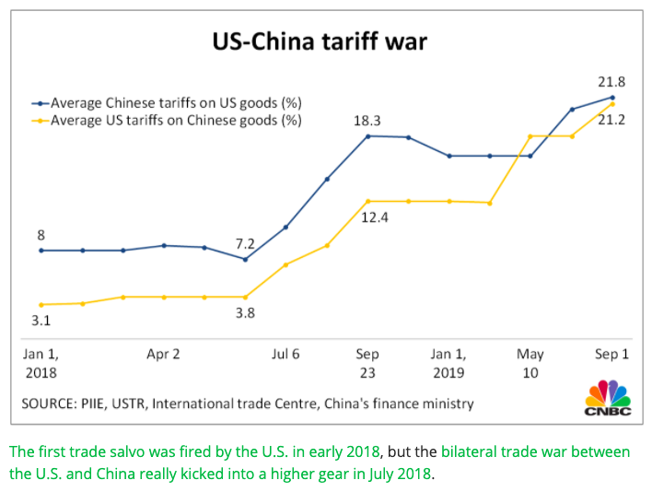
US-China Tariff War – Tariff Rates
Source: CNBC.com
Notes:
SEPTEMBER 18, 2019 | Yen Nee Lee, CNBC.com
http://nbr.com/2019/09/18/these-4-charts-show-how-us-china-trade-has-changed-during-the-tariff-dispute/

Slide 15
U.S.- China Trade War
Tariffs were fully-passed through to US import prices, but only partially to retail prices: retail margins decreased, and American consumers still paid higher prices.
Net decrease in manufacturing employment due to tariffs (the negative effects of higher input prices and retaliatory tariffs outweighed the benefits to protected industries)
Overall lower aggregate real income in both U.S. and China (small magnitudes relative to GDP)
A 2024 study found that the tariffs failed to provide economic help to the heartland: import tariffs had “ neither a sizable nor a significant effect on US employment in regions with newly-protected sectors” and foreign retaliation “by contrast had clear negative employment impacts, particularly agriculture.”
Notes:
https://www.nber.org/system/files/working_papers/w25638/w25638.pdf
https://www.nber.org/papers/w26396
https://www.federalreserve.gov/econres/feds/files/2019086pap.pdf
https://www.nber.org/papers/w32082#fromrss
https://taxfoundation.org/research/all/federal/trump-tariffs-trade-war/#:~:text=A%20March%202019%20National%20Bureau,of%20higher%20after%2Dduty%20prices.

Slide 16
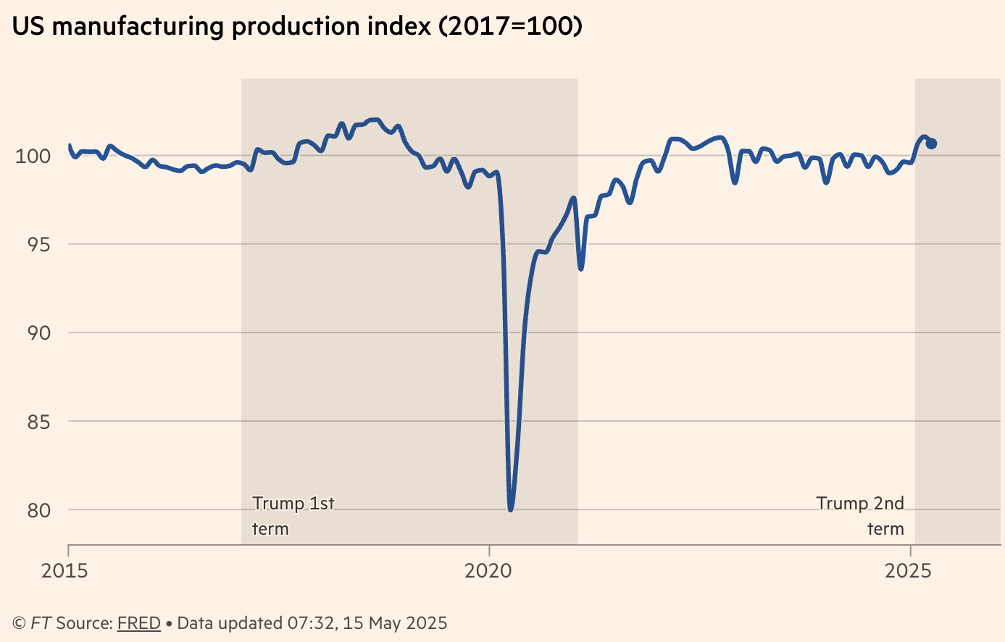
U.S.Manufacturing Production
Notes:
https://www.nber.org/system/files/working_papers/w25638/w25638.pdf
https://www.nber.org/papers/w26396
https://www.federalreserve.gov/econres/feds/files/2019086pap.pdf
https://www.nber.org/papers/w32082#fromrss
https://taxfoundation.org/research/all/federal/trump-tariffs-trade-war/#:~:text=A%20March%202019%20National%20Bureau,of%20higher%20after%2Dduty%20prices.

Slide 17
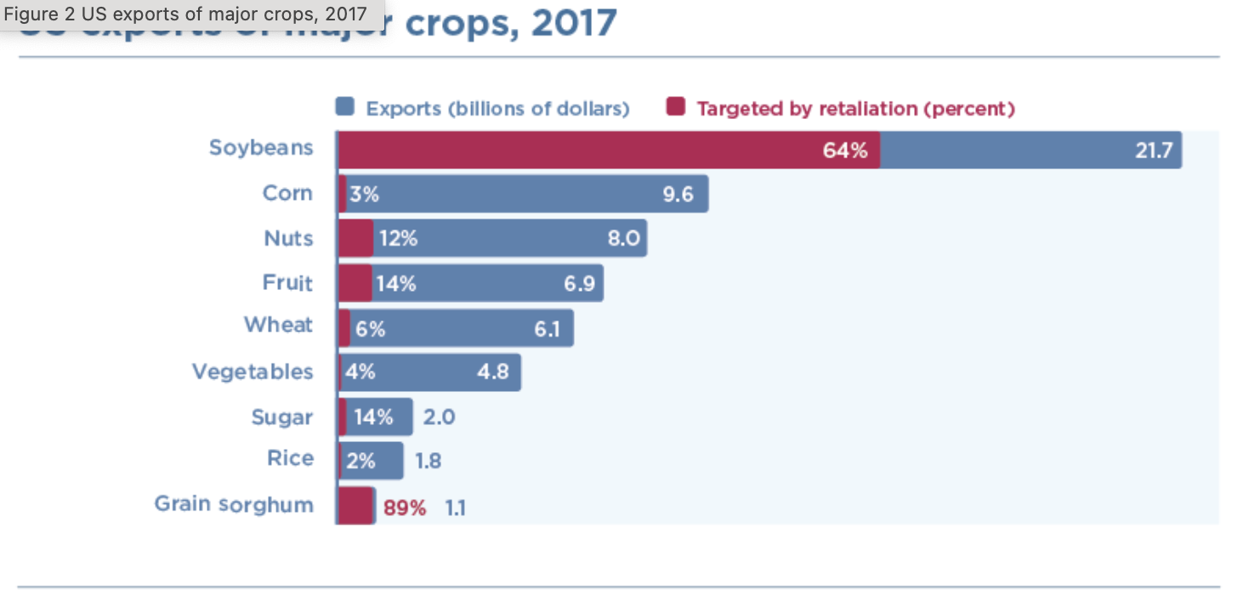
Subsidies to American Farmers
$12 billion subsidy to help American farmers for their lost export sales.
Notes:
https://www.piie.com/blogs/trade-and-investment-policy-watch/2018/first-tariffs-then-subsidies-soybeans-illustrate

Slide 18
Trump Tariff Exemptions
Both the metals tariffs and the China tariffs permitted certain products and product categories to be exempted, through an application process to Commerce (metals) and USTR (China), if certain criteria are satisfied.
  Whether tariffs would impose significant harm on American business interests
  Whether substitute products were available outside China
  Whether the products were “strategically important” to China”

Slide 19
Trump Tariff Exemptions
Requests for exemption
  Metals tariffs: “Commerce Department received nearly 500,000 exclusion requests”
  China tariffs: USTR “fielded more than 50,000 requests”
Lobbying Congress on trade issues increased once Mr. Trump took office
Biden maintained Trump’s tariffs, but it
  gradually wound down the exclusions for China tariffs
  continued to grant them for tariffs on steel and aluminum.
Notes:
Swanson, “Trump’s Trade Agenda Could Benefit Friends and Punish Rivals,” NYT, 11/24/24
https://nytimes.com/2024/11/23/us/politics/trump-tariff-exemptions.html

Slide 20
Trump Tariff Exemptions
Trump administration’s decisions on exclusions were mysterious and arbitrary.
  “Tariff exemptions were given
    to Bibles but not to textbooks,
    to salmon but not to pollock,
    to children’s car seats but not to baby cribs.
  The decisions were not subject to appeal.”
Notes:
Swanson, “Trump’s Trade Agenda Could Benefit Friends and Punish Rivals,” NYT, 11/24/24
https://nytimes.com/2024/11/23/us/politics/trump-tariff-exemptions.html

Slide 21
Trump Tariff Exemptions
Issues with the exemptions
  “Firms hiring lobbyists were less likely to have steel tariff exemptions approved.”
  Study found:
    Contributions to Republicans made China exemptions more likely
    Contributions to Democrats made China exemptions less likely
    Author quoted as saying the exclusion process was “a very effective spoils system”
  Renewal of exemptions were uncertain and came late enough to create uncertainty.
Notes:
Keynes, Soumaya, “Your guide to how to dodge a tariff,” FT, 11/15/24
https://www.ft.com/content/f9e4cc47-5b70-4beb-85df-a49a9f03181c
Armstrong, Dan, “Politically Connected Corporations Received More Exemptions from U.S. Tariffs on Chinese Imports, Study Finds,” Lehigh News, October 8,, 2024
https://www2.lehigh.edu/news/politically-connected-corporations-received-more-exemptions-from-us-tariffs-on-chinese-imports
Swanson, “Trump’s Trade Agenda Could Benefit Friends and Punish Rivals,” NYT, 11/24/24
https://nytimes.com/2024/11/23/us/politics/trump-tariff-exemptions.html
Ben Unglesbee, “Biden administration extends China tariff exclusions — again,” SupplyChainDive, January 4, 2024.
https://www.supplychaindive.com/news/biden-administration-extends-china-tariff-exclusions-May-2024/703510/

Slide 22
Tariff Effects

Slide 23
Economic Effects of a Tariff
A tariff is a tax on imports. It causes
  A rise in the price of the imported good in the importing country
  A fall in the price of the imported good in the exporting country
  The quantity imported to fall
  Revenue for the tariff-levying government
Almost always: the rise at home is much larger than the fall abroad
  That’s especially true if importing country is small
  But it’s also true if importing country is as large as the U.S.
    We learned this from Trump’s tariffs in 2018.
    Example: Trump’s tariffs caused US prices to rise, with hardly any perceptible fall in prices abroad.

Slide 24
Effects of a Tariff
The rise in price in the importing country causes
  A rise in price of competing goods produced there
  Benefits to those producers
  Harm to buyers of both the import and the competing goods
    Including producers that use the higher-priced goods as inputs
      Their prices also rise, hurting their buyers
  Employment changes:
    Increase in the protected industry
    Decrease in industries that use the protected product as inputs
Notes:
Example of 25% on steel

Slide 25
Effects of a Tariff
Economists’ cost-benefit analysis quantifies these and shows that
  Unless there are market distortions, the costs of a tariff always exceed the benefits
  Even when distortions give potential for tariff to be net beneficial
    It is just as likely to be net harmful
    And there does exist another policy, not a tariff, that would be better
  But
    Costs of tariffs are spread over many buyers, and are small for each
    Benefits of tariffs are concentrated for domestic producers and are large for each
    That’s often why we
      Get tariffs
      Find them very hard to remove

Slide 26
Possible Economic Arguments for Tariffs
Possible arguments for tariffs
  National Defense – strategic resource. Do we need the capacity to make our own computer chips, just in case?
  “Infant” Industry
  Unfair trade practices of exporting countries

Slide 27
Effects of a Tariff
Politics of tariffs
  Political forces favor tariffs
  Tariffs were reduced during 1934-1995 only by slow reciprocal negotiation among countries

Slide 28
Effects of a Tariff
If a tariff is on exports of only one country (e.g., China), then
  Some imports shift to another country
  Price rises by less, to that other country’s higher cost

Slide 29
Other effects of a Tariff
Income distribution
  Tariffs, especially on China, raise prices of the products disproportionately bought by low-income consumers, hurting them more than high-income consumers
Retaliation
  Other countries place tariffs on US exports
  Trade war that started in 2018 continues and gets worse
Corruption
  Historically, tariffs prompted both smuggling and bribes to customs officers
  Today, in the US, those are less likely.
  But requests for exemptions from tariffs may be accompanied by favors or political contributions

Slide 30
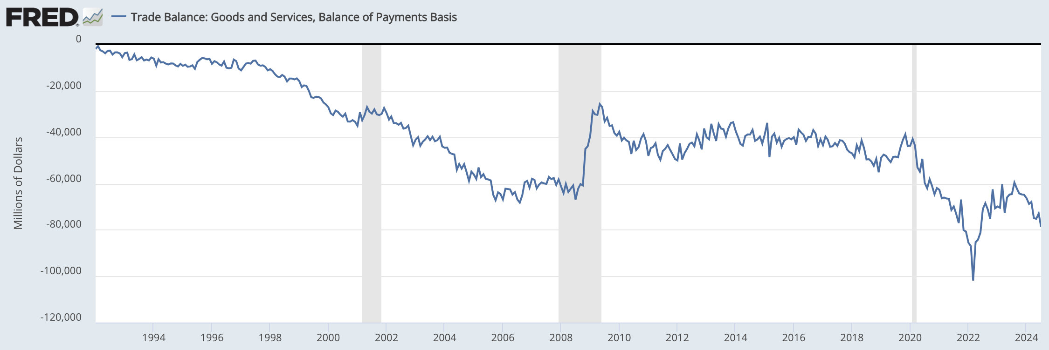
US Trade Balance = Exports minus Imports
Clinton
Bush
Obama
Trump
Biden
Note the zero. This whole thing is negative – a trade deficit! – and getting mostly larger since 1992.
Recessions
Notes:
FRED,
https://fred.stlouisfed.org/series/BOPGSTB
Sep 30, 2024

Slide 31
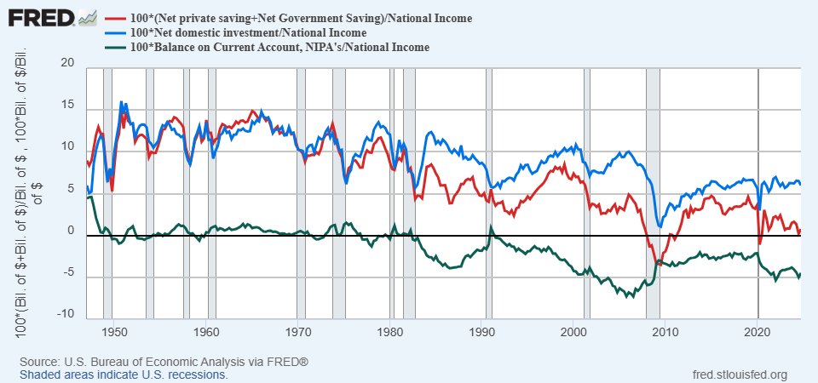
History of Saving, Investment and Trade Balance
Persistent Trade Deficits Start in the 1980s

Slide 32
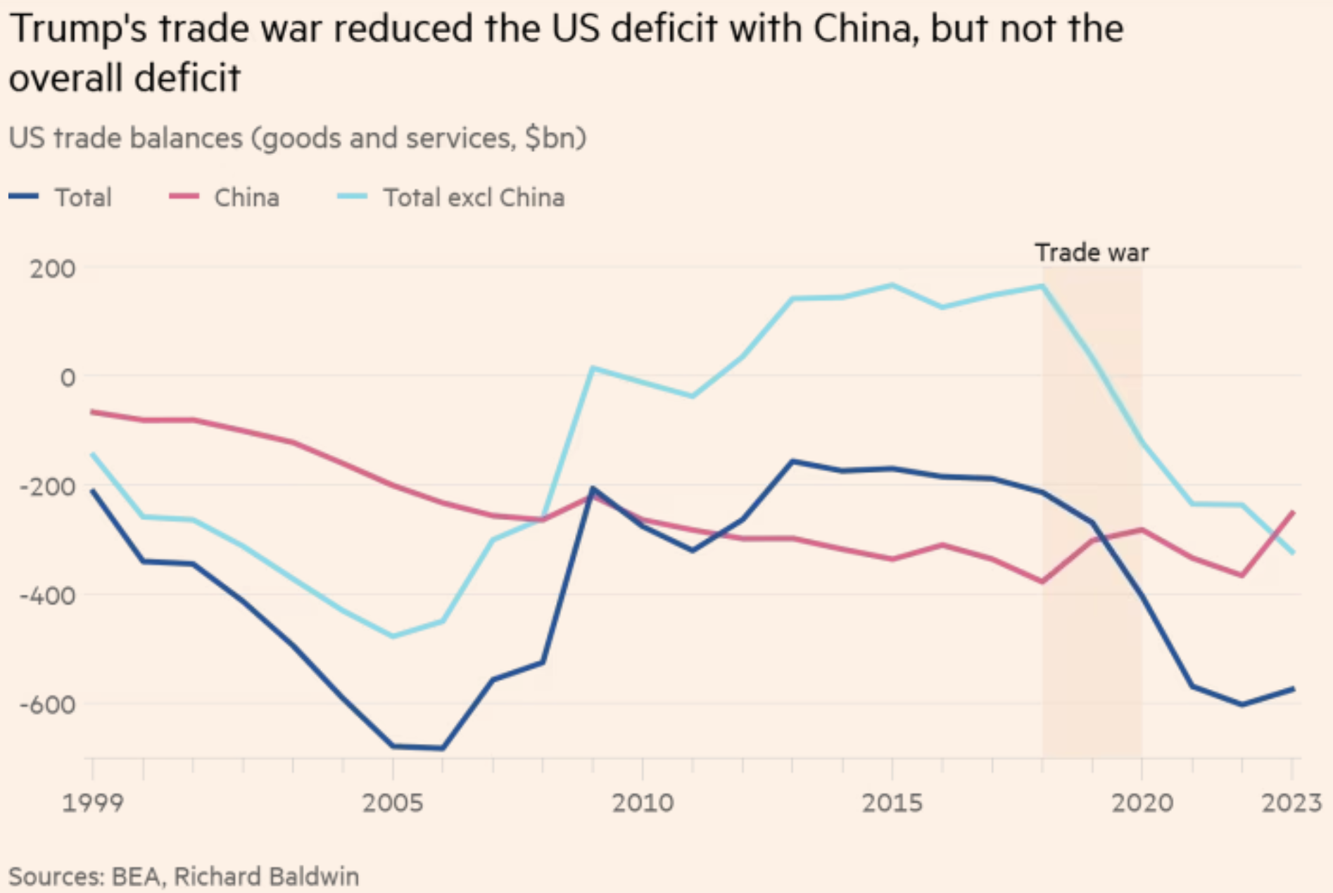
US Trade Balance with China and the World
Deficit
Source:
FT 1/4/25
Notes:
Tett, Gillian, “‘That is Maganomics’: where Trump is taking America on trade,” Financial Times, January 4, 2025.
https://www.ft.com/content/8a97792f-69f9-4885-afdd-4380a2d81dd8

Slide 33
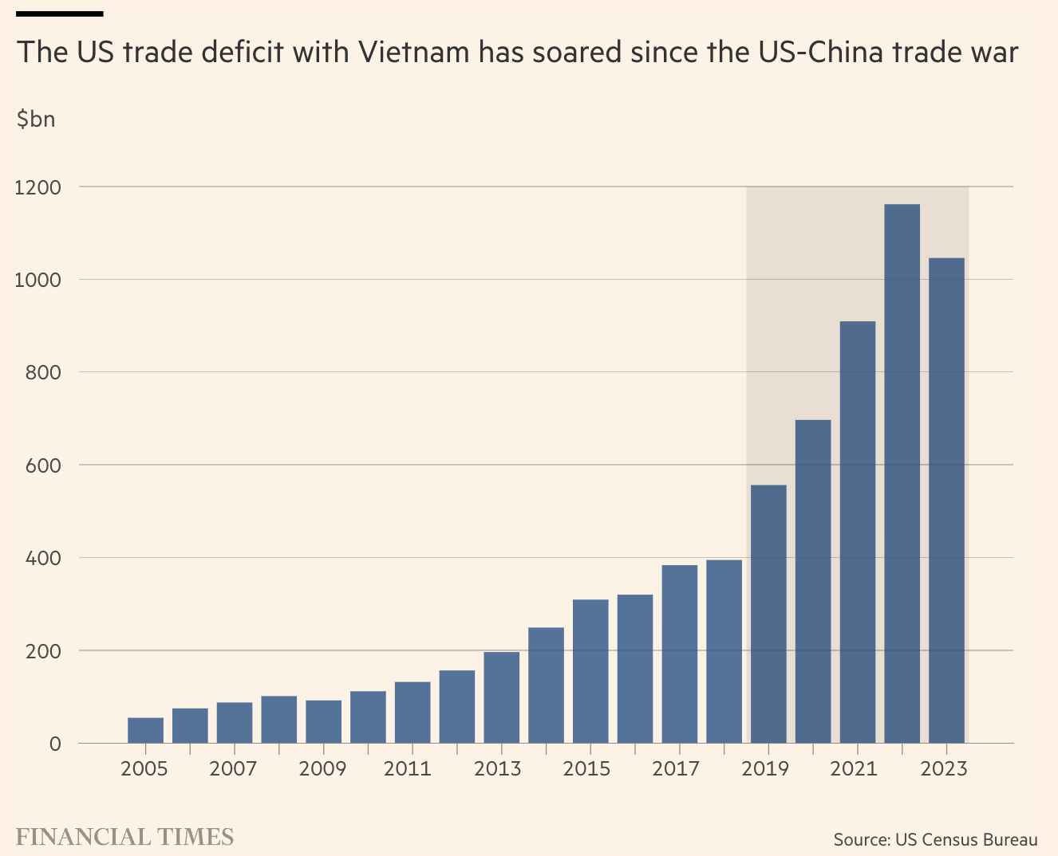
US Trade Balance with Vietnam
Notes:
Lakshmi, “Why Vietnam risks ending up a big loser from Trump’s tariffs,” FT, 11/17/24
https://www.ft.com/content/4f9f11dd-2278-49a6-9e70-b87916667fbe

Slide 34
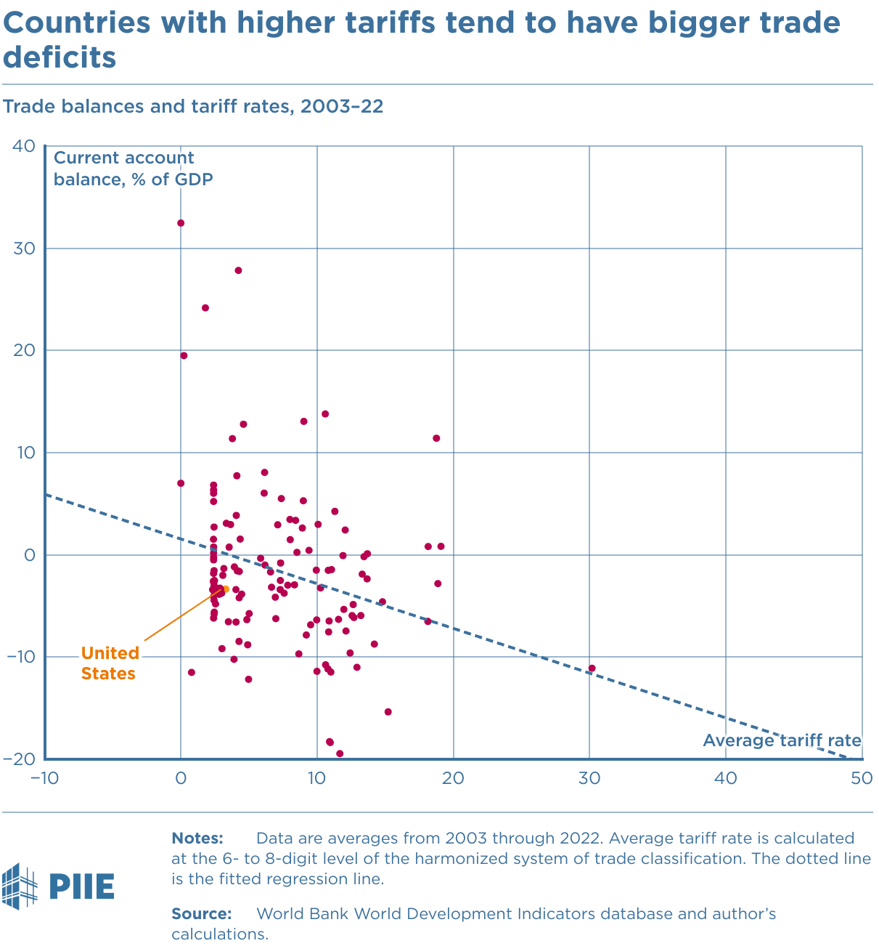
Effects of a Tariff
Do tariffs reduce a trade deficit?
  Trump thinks so, but the US deficit grew under him (see above)
  A trade deficit equals Expenditure minus Income or Savings minus Domestic Investment
  There is no reason for tariffs to reduce expenditure
  And unless in a recession, also no reason for tariffs to raise income
  Tariffs reduce imports but also reduce exports.
  So NO!
Source: Peterson Institute for International Economics (PIIE)
Notes:
The negative correlation in figure 1 likely arises from the effect of a country’s stage of development on both its tariff rate and its trade balance.
Higher tariffs => lower imports => appreciate US dollar => reduce exports.

Slide 35
Trump I Tariffs & Trade War
Summary
  Trump placed tariffs of 25% on steel and 10% on aluminum
  Trump placed multiple tariffs on China exports, covering at least ¾ of their exports to US
  On request, he exempted some products and firms
  Imports from China fell while imports from others rose
  US trade deficit did not shrink
  Data show no fall in foreign export prices, so tariffs were paid by US buyers

Slide 36
Trump II Tariffs

Slide 37
Trump II Tariff Actions and Plans
“To me the most beautiful word in the dictionary is ‘tariff’”
Fentanyl and Immigration (action on China, Canada, and Mexico)
Steel and Aluminum (action on all countries)
Copper (national security investigation)
Lumber ( national security investigation, biggest exporter is Canada)
Reciprocal Trade and Tariffs (all countries)
Tariffs on countries that impose digital services tax on American companies (targets EU countries, Turkey, UK, Canada)
Autos and auto parts
Pharmaceuticals, Semiconductors, Critical minerals, Trucks, Aircraft (national security investigations)
Notes:
McCormick, “Trump Calls Tariffs the ‘Most Beautiful Word’,” WSJ, 10/14/24
https://www.wsj.com/livecoverage/harris-trump-election-10-16-2024/card/trump-calls-tariffs-the-most-beautiful-word--YMVPAupw4EjBRp6yobOy
Swanson, “Harris and Trump Embrace Tariffs, Though Their Approaches Differ,” New York Times, Aug 27, 2024.
https://www.nytimes.com/2024/08/27/us/politics/trump-harris-tariffs.html
Toomey, “About Trump’s ‘Reciprocal’ Tariffs,” WSJ, 10/27/24
https://www.wsj.com/opinion/about-trumps-reciprocal-tariffs-he-wants-to-raise-taxes-and-thinks-im-the-stupid-one-5dc3c56c?mod=itp_wsj
Krugman, “Donald Trump on the Dollar, in His Own Words. NYT, 9/9/24
https://www.nytimes.com/2024/09/09/opinion/trump-tariffs-reserve-currency.html
Economist, “Donald Trump is poised to smash Mexico with tariffs,” 11/7/24
https://www.economist.com/the-americas/2024/11/07/donald-trump-is-poised-to-smash-mexico-with-tariffs
Ewing, “Trump’s Tariffs Could Deal a Blow to Mexico’s Car Factories,” NYT, 11/12/24
https://www.nytimes.com/2024/11/12/business/economy/trump-mexico-trade-tariffs-car-factories.html

Slide 38
Fentanyl and Immigration
  Use of International Emergency Economic Powers Act
  Feb 1: Announced tariffs of 25% on Canada and Mexico and 10% on China if they didn’t stop flows of illegal people and drugs across the borders
    After talks with leaders, he postponed the tariffs on Canada and Mexico for one month
      On Feb 24 “he said he is ‘going forward’ with the tariffs next week.
    The 10% additional tariff on China
      Went into effect Feb 4
      China retaliated with more tariffs, export controls on US (took effect on Feb.10)
  Feb 1: Announced repeal of “de minimis” tariff-free policy on imports from China
    For years, imports under $800 have entered US tariff free
    Feb 5: Paused the repeal as packages piled up at customs
    May 2: Reinstated.
  Mar 4: US tariffs go into effect on Mexico and Canada and are raised on Chinese imports to 20%
  Mar 6: US exempts imports from Canada and Mexico under USMCA.
Notes:
https://www.piie.com/blogs/realtime-economics/2025/trumps-trade-war-timeline-20-date-guide

Slide 39
Steel and Aluminum
  Section 232 tariffs
  Feb 10: Trump announced new 25% tariffs on steel and aluminum from all countries, to take effect on March 12.
  Mar. 12: The tariff on steel and aluminum goes into effect.
  Mar. 12: Canada announces plans to retaliate on Mar. 13 by imposing 25% tariffs on C$29.8 bn of US goods such as steel and aluminum products, tools, computer, display monitors, sport equipment, and cast-iron products.
  Mar. 12: EU also announces plans to retaliate on $28bn worth of US goods such as whiskey, motorcycles, motorboats in the first phase and beer, poultry, beef, soybeans and produce in the second phase. Delayed to mid-April.
  Apr. 9: EU member states agree on retaliatory tariffs but put on hold for 90 days.
Notes:
https://www.piie.com/blogs/realtime-economics/2025/trumps-trade-war-timeline-20-date-guide

Slide 40
Reciprocal Trade and Tariffs
Apr. 2: US announces to impose baseline 10% tariff on all countries and additional “reciprocal” tariffs on countries that contribute to large, persistent US trade deficits.
Apr. 4: China announces a 34% retaliatory tariff and other measures.
Apr. 5: US imposes 10% tariffs on imports from nearly all countries.
Apr. 8: US announces an additional 50% tariffs on Chinese imports (84% + 20%)
Apr. 9:
  US imposes the additional country-specific tariffs (1-74%)
  China announces additional 50% tariff
  US pauses the country-specific tariffs for 90 days, increased tariffs on Chinese imports to 125%
Apr 11: Semiconductors, smartphones and consumer electronics are exempted.
Apr. 12: China increases its tariffs on American imports to 125%.
May 8 & 12: US-UK trade deal and a reduction of Chinese tariffs announced
To be Continued …
Notes:
https://www.piie.com/blogs/realtime-economics/2025/trumps-trade-war-timeline-20-date-guide
US-UK trade deal: which includes the potential for the UK to lower tariffs on US beef, and a US quota of 100,000 vehicles for the UK to export to the US at a tariff rate of 10 percent (and not the 25 percent additional tariff resulting from the Section 232 investigation).

Slide 41
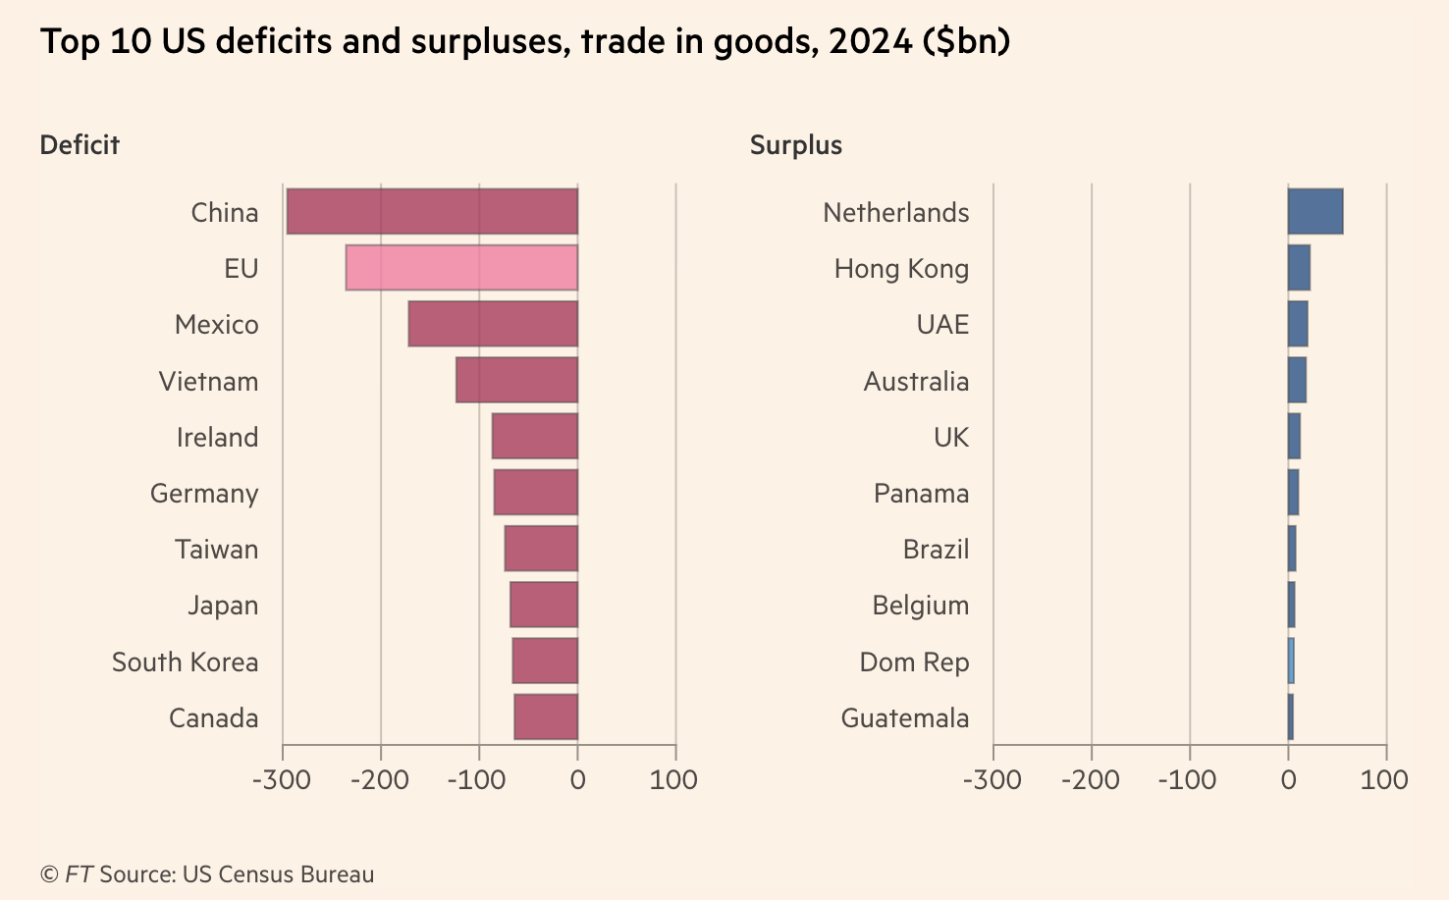
Reciprocal Trade and Tariffs
Notes:
https://www.piie.com/blogs/realtime-economics/2025/trumps-trade-war-timeline-20-date-guide
US-UK trade deal: which includes the potential for the UK to lower tariffs on US beef, and a US quota of 100,000 vehicles for the UK to export to the US at a tariff rate of 10 percent (and not the 25 percent additional tariff resulting from the Section 232 investigation).

Slide 42

Example, Lesotho (2022 data)
(EX-IM)/EX=
($236m-$7m)/$236m=0.97
“Reciprocal” Tariff = 0.5(.97)= .485,
49% tariff rate (actually, 50%)
Facts about Lesotho:
GDP per capita =$1,073;
Population= 2.1 million
Trade balance= -$349 million
Average eff. tariff rate against US = 10%
https://wits.worldbank.org/CountryProfile/en/USA
https://www.imf.org/en/Publications/WEO/weo-database/2024/October
Notes:
99% textiles. 2000 African Growth and Opportunity Act 0 tariffs on textiles

Slide 43
Auto Tariffs
Mar 26: US announces 25% tariffs (under section 232) on automobiles and certain auto parts (exemptions for USMCA-compliant auto and auto parts)
Apr. 3: The auto tariffs go into effect, but the auto part tariffs are delayed.
Apr. 3: Canada announces retaliations on non-USMCA compliant vehicles from the US and non-Canadian and non-Mexican content in the USMCA compliant vehicles.
Apr. 9: Canadian tariffs go into effect.
Notes:
https://www.piie.com/blogs/realtime-economics/2025/trumps-trade-war-timeline-20-date-guide

Slide 44
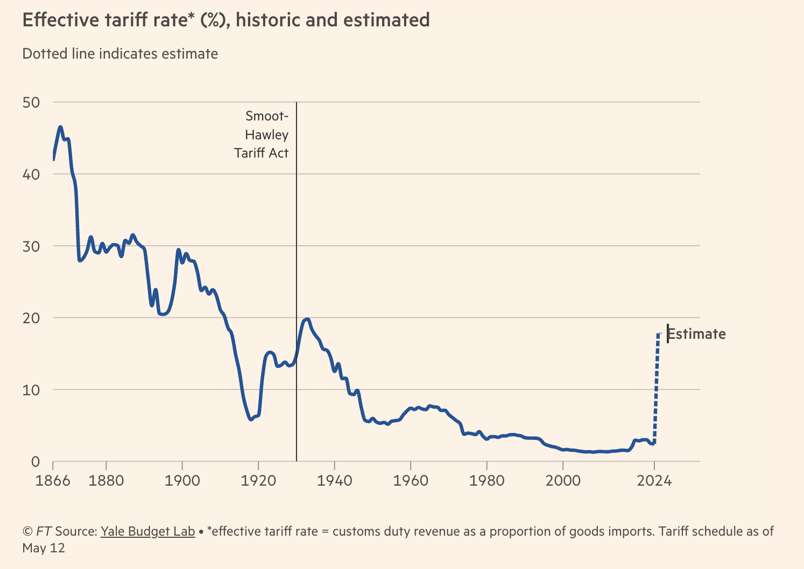
US Tariff Level
Notes:
https://www.piie.com/blogs/realtime-economics/2025/trumps-trade-war-timeline-20-date-guide

Slide 45
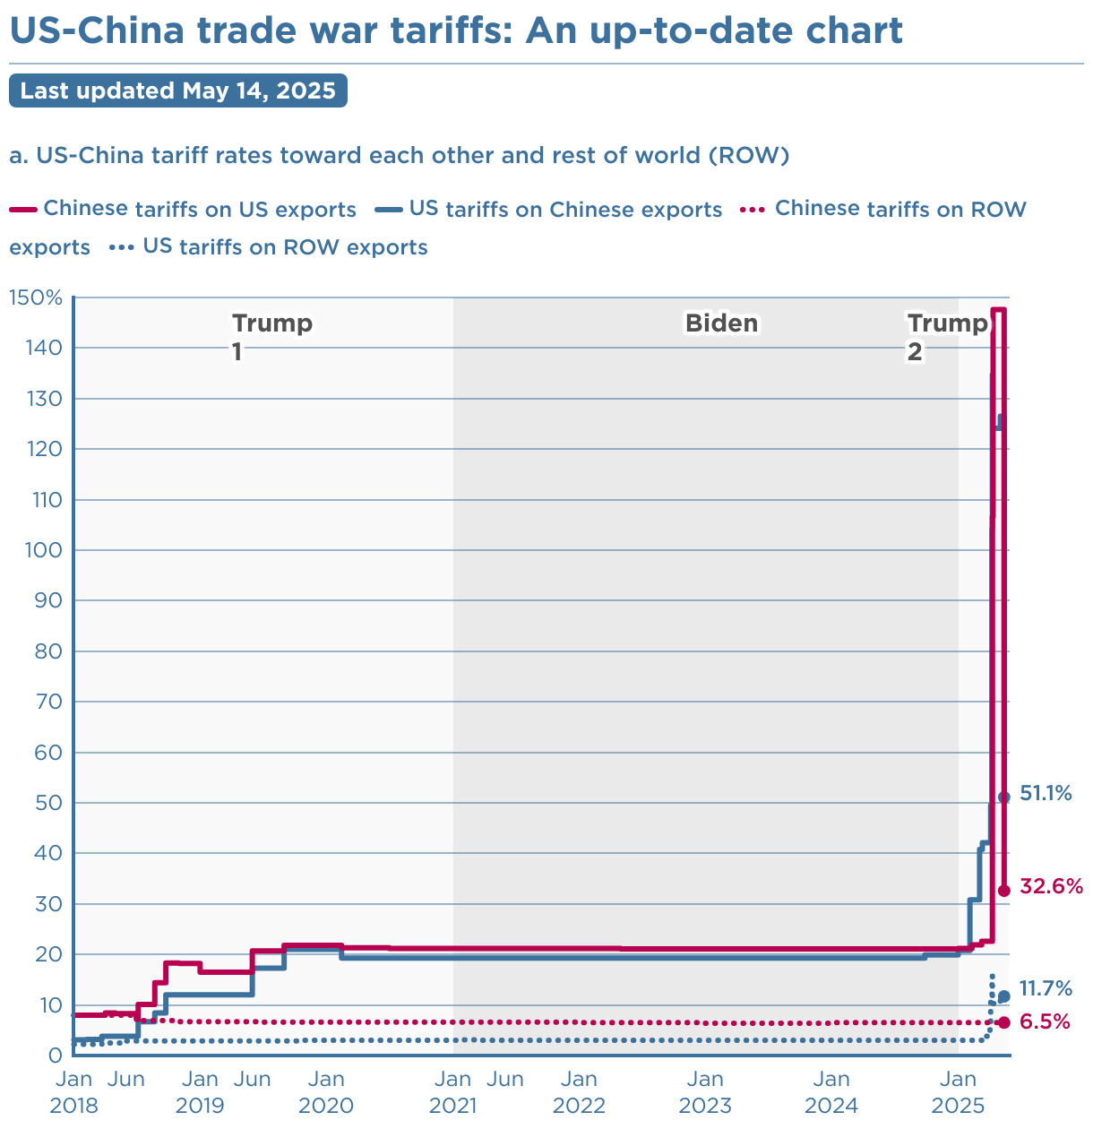
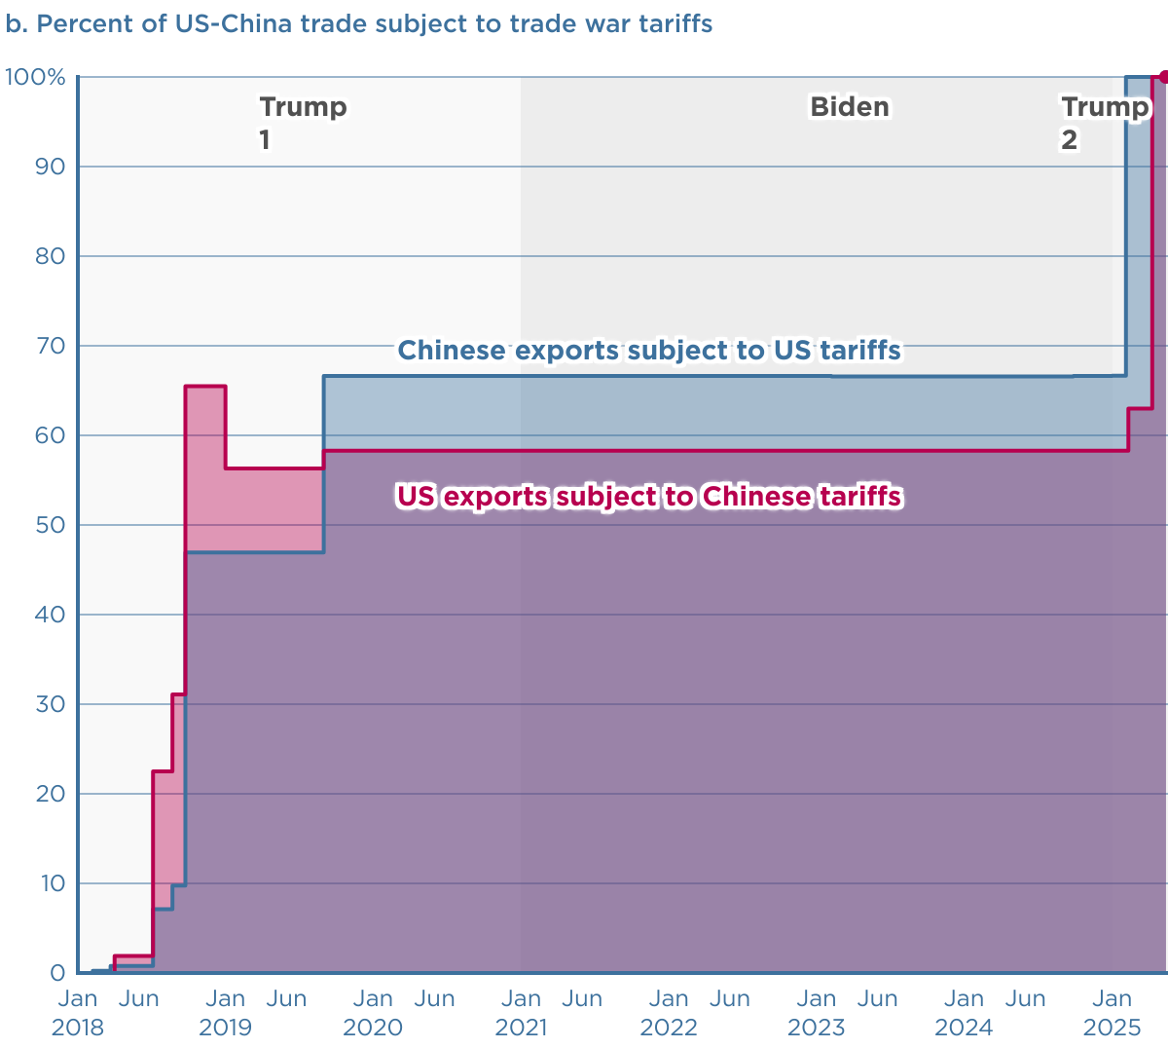
Source: Peterson Institute for International Economics (PIIE)
Notes:
https://www.piie.com/blogs/realtime-economics/2025/trumps-trade-war-timeline-20-date-guide

Slide 46
Tariff Level Since January 20, 2025
US tariffs on
  Chinese imports increased 1.5 times, a jump of 30.4 percentage points.
  All goods imported from the rest of the world increased from 3% to 11.7%
  This is the highest average tariff level since the Great Depression of the 1930s.
Chinese tariffs on
  US imports increased by more than 50%, by 11.4 percentage points.
  All goods from the rest of the world are 6.5%.
Notes:
https://www.piie.com/blogs/realtime-economics/2025/trumps-trade-war-timeline-20-date-guide

Slide 47
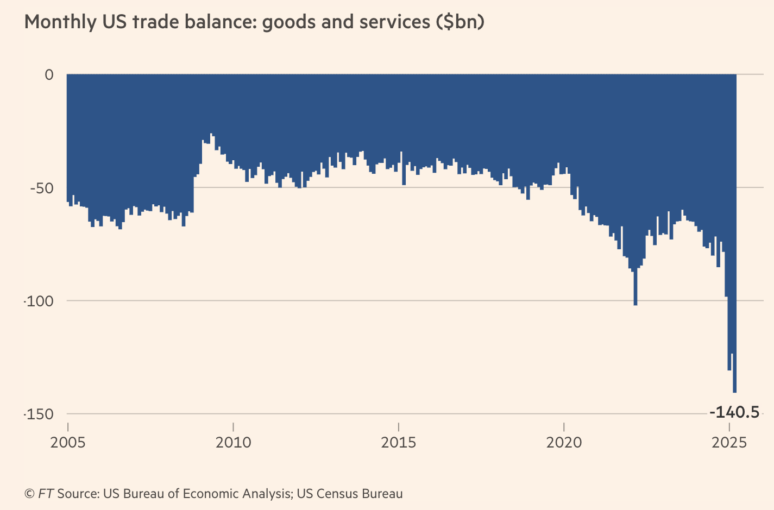
US Trade Deficit
Notes:
https://www.piie.com/blogs/realtime-economics/2025/trumps-trade-war-timeline-20-date-guide

Slide 48
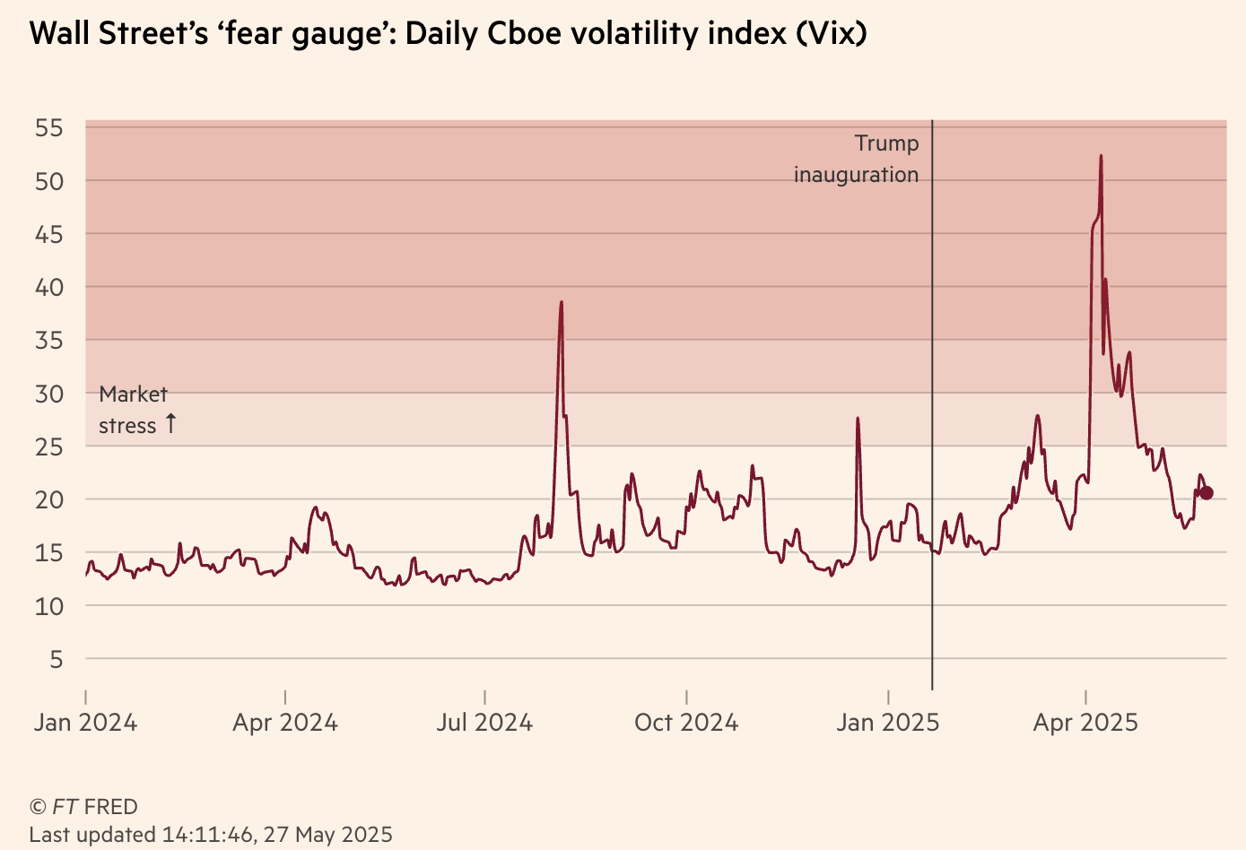
US Stock Market Volatility
Notes:
https://www.piie.com/blogs/realtime-economics/2025/trumps-trade-war-timeline-20-date-guide

Slide 49
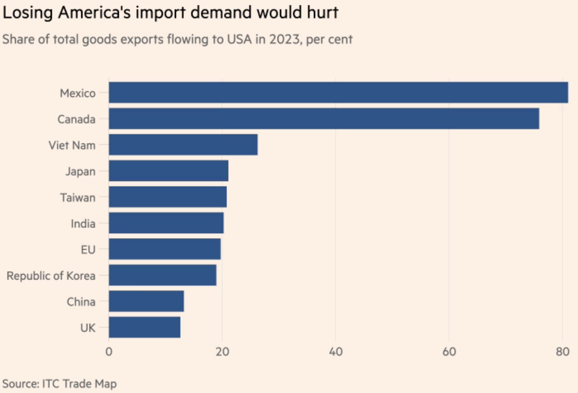
What Countries will Be Hurt?
Source:
Keynes, FT, 11/15/24
Notes:
Keynes, Soumaya, “Your guide to how to dodge a tariff,” FT, 11/15/24
https://www.ft.com/content/f9e4cc47-5b70-4beb-85df-a49a9f03181c

Slide 50
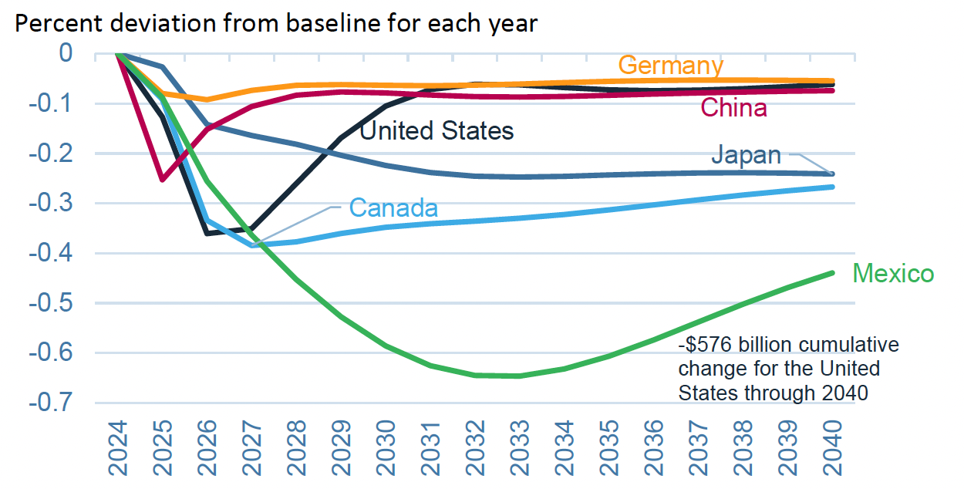
Effects of 10% Tariff on All US Imports
Real GDP
Notes:
Warwick McKibbin, Megan Hogan, and Marcus Noland, “The International Economic Implications of a Second Trump Presidency,” Working Paper 24-20, Peterson Institute of International Econnomics, September 2024.
https://www.piie.com/publications/working-papers/2024/international-economic-implications-second-trump-presidency

Slide 51
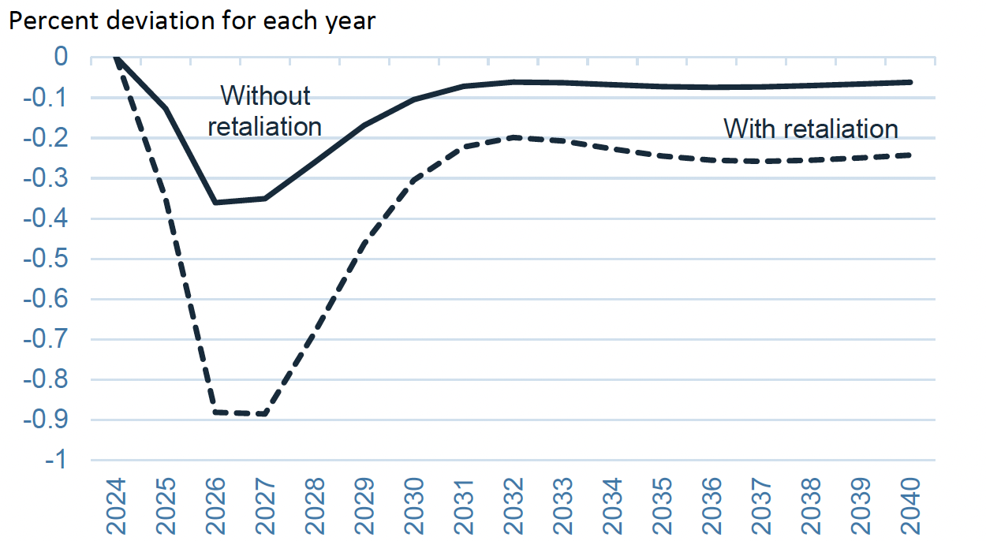
Effects of 10% Tariff on All US Imports
US GDP with and without Retaliation
Notes:
Warwick McKibbin, Megan Hogan, and Marcus Noland, “The International Economic Implications of a Second Trump Presidency,” Working Paper 24-20, Peterson Institute of International Econnomics, September 2024.
https://www.piie.com/publications/working-papers/2024/international-economic-implications-second-trump-presidency

Slide 52
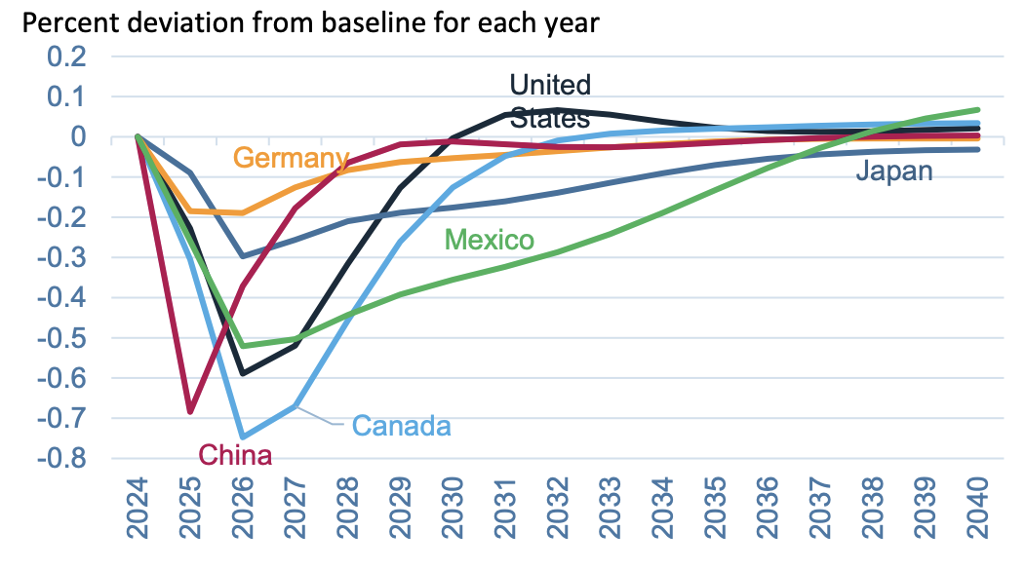
Effects of 10% Tariff on All US Imports
Employment
Notes:
Warwick McKibbin, Megan Hogan, and Marcus Noland, “The International Economic Implications of a Second Trump Presidency,” Working Paper 24-20, Peterson Institute of International Econnomics, September 2024.
https://www.piie.com/publications/working-papers/2024/international-economic-implications-second-trump-presidency

Slide 53
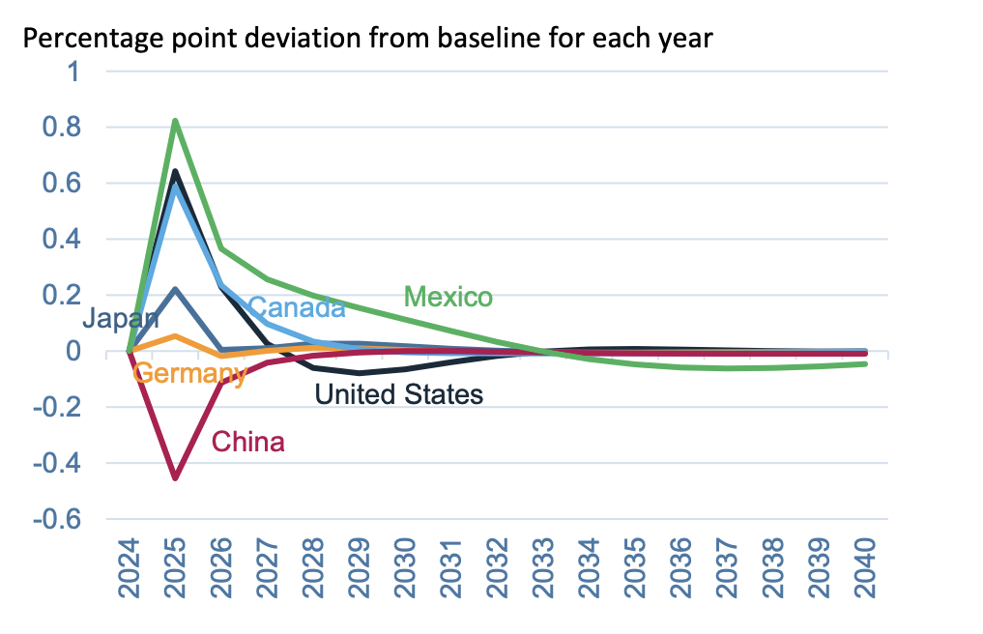
Effects of 10% Tariff on All US Imports
Inflation
Notes:
Warwick McKibbin, Megan Hogan, and Marcus Noland, “The International Economic Implications of a Second Trump Presidency,” Working Paper 24-20, Peterson Institute of International Econnomics, September 2024.
https://www.piie.com/publications/working-papers/2024/international-economic-implications-second-trump-presidency

Slide 54
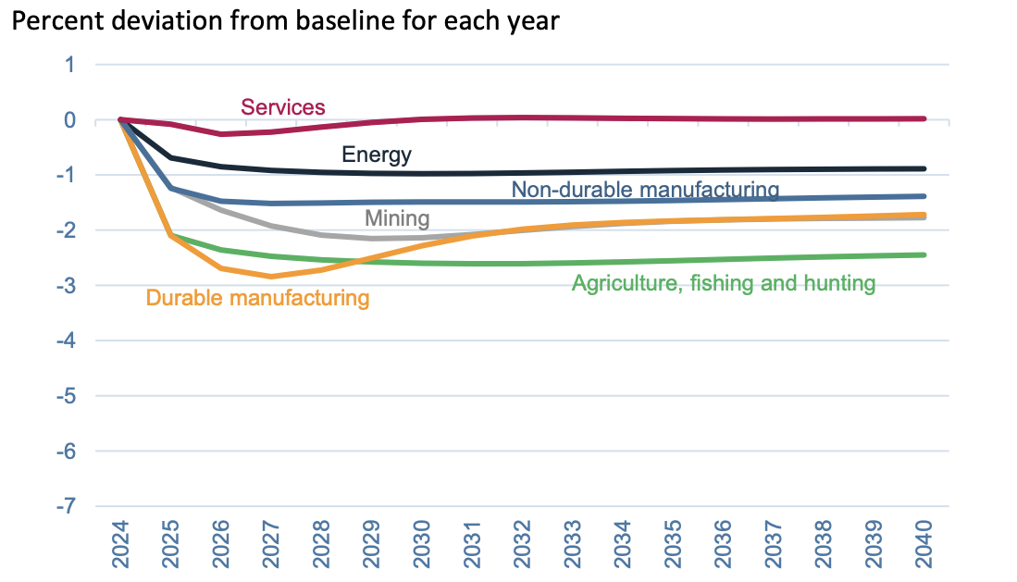
Effects of 10% Tariff on All US Imports
Sectoral Production
Notes:
Warwick McKibbin, Megan Hogan, and Marcus Noland, “The International Economic Implications of a Second Trump Presidency,” Working Paper 24-20, Peterson Institute of International Econnomics, September 2024.
https://www.piie.com/publications/working-papers/2024/international-economic-implications-second-trump-presidency

Slide 55
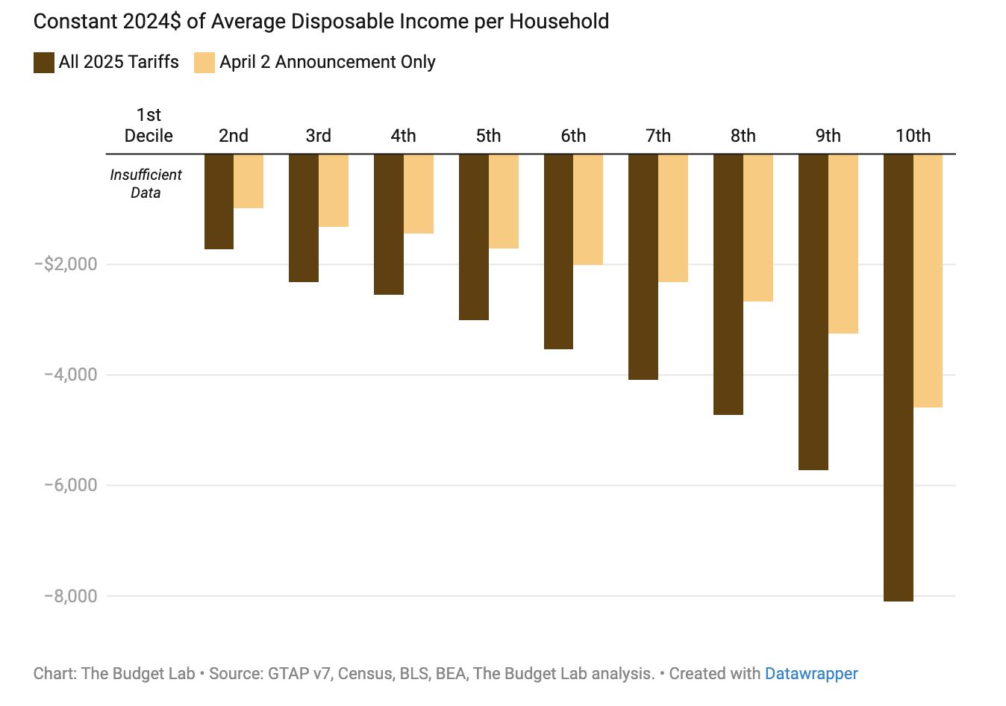
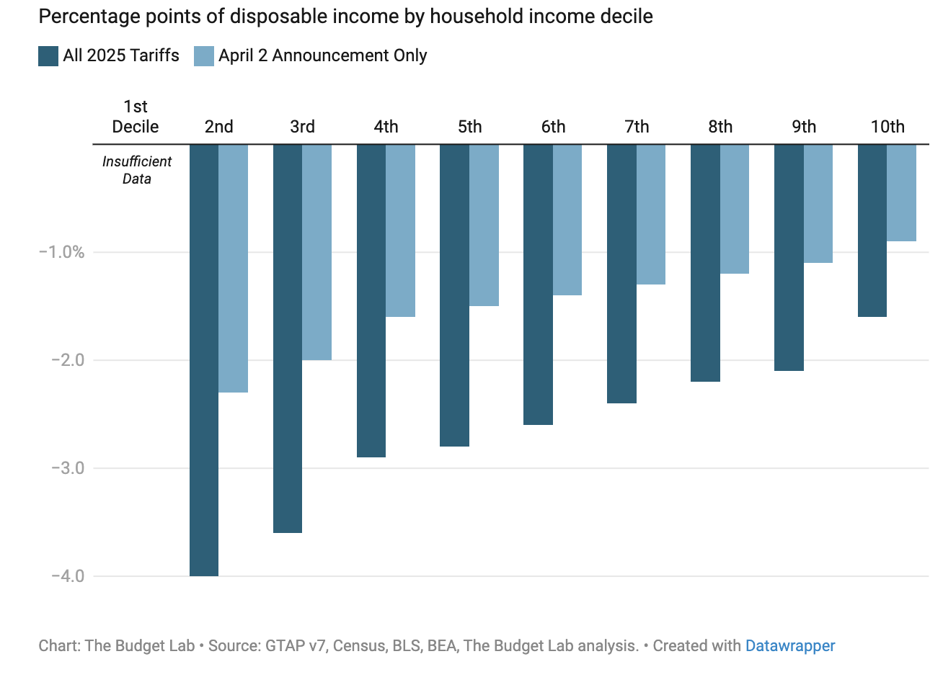
Effects of Tariffs on Households
Notes:
https://budgetlab.yale.edu/research/where-we-stand-fiscal-economic-and-distributional-effects-all-us-tariffs-enacted-2025-through-April
Price increase of 2.3% in the short-run.

Slide 56
Effects of a Tariff
Government revenue
  Could Trump’s proposed tariffs replace the US income tax?
  NO!
  Researchers estimates that all 2025 tariffs to date would raise between $3.1tr – $4.5 tr over 10 years if they stayed into effect.
  US federal income tax revenue in 2023 was $2.18tr
  So his tariffs would collect MUCH less than the income tax.
  Tariff revenue can lower the budget deficit, raising national savings rate.
Notes:
https://budgetmodel.wharton.upenn.edu/issues/2025/4/10/economic-effects-of-president-trumps-tariffs
https://budgetlab.yale.edu/research/where-we-stand-fiscal-economic-and-distributional-effects-all-us-tariffs-enacted-2025-through-april

Slide 57
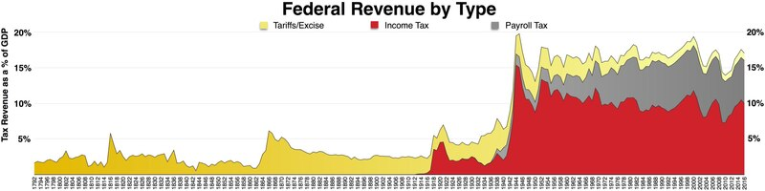
History of the Source of Federal Revenues
1913; Sixteenth Amendment. The Congress shall have the power to lay and collect taxes on incomes, from whatever source derived…
1930; Smoot Hawley Tariff.
1935; Social Security and Payroll taxes.
https://en.wikipedia.org/wiki/File:Federal_taxes_by_type.pdf

Slide 58
Summaryy
Tariffs will:
not eliminate the US trade deficit. Increase in national savings could reduce the trade deficit.
decrease US manufacturing production and employment.
Increase in prices for households, hurting the poor relatively the most.
increase US government revenue, but not enough to offset other tax cuts.
negatively impact US economic growth

Slide 59
Thank you!
Questions?

