Slide 1
Osher Lifelong Learning Institute, Summer 2026
Contemporary Economic Policy Issues
OLLI – Dominican University, San Rafael
July, 2026
Host: Jon Haveman
National Economic Education Delegation

Slide 2
Available NEED Topics Include:
US Economy
Healthcare Economics
Climate Change
Economic Inequality
Economic Mobility
Trade and Globalization
Minimum Wages
Immigration Economics
Saving Social Security
Federal Budgets
Federal Debt
Black-White Wealth Gap
Autonomous Vehicles
Healthcare Economics

Slide 3
Course Outline
Contemporary Economic Policy
  Week 1 (7/8): US Economic Update
  Week 2 (7/15): The Economics of Immigration
  Week 3 (7/22): Saving Social Security (Geof Woglom, Amherst College)
  Week 4 (7/29): Tariff Economics (Jon Haveman, NEED)

Slide 4
Submitting Questions
Submit questions in the chat.
  I will try to handle them as they come up.
We will do a verbal Q&A once the material has been presented.
Slides will be available from the NEED website shortly. (https://needecon.org/delivered_presentations.php).
Also: Break at 10:55 for 5 minutes.

Slide 5
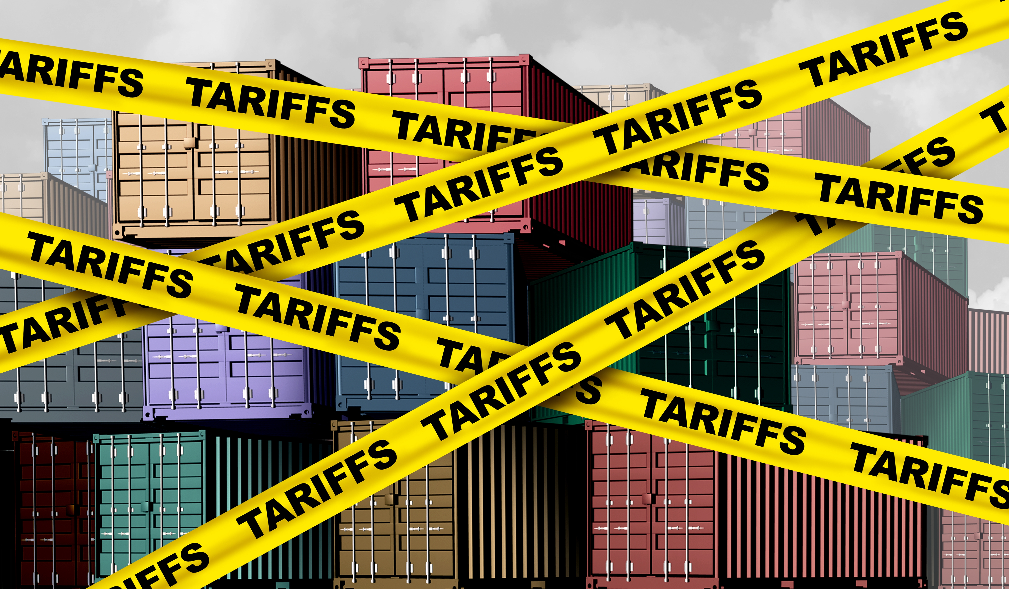
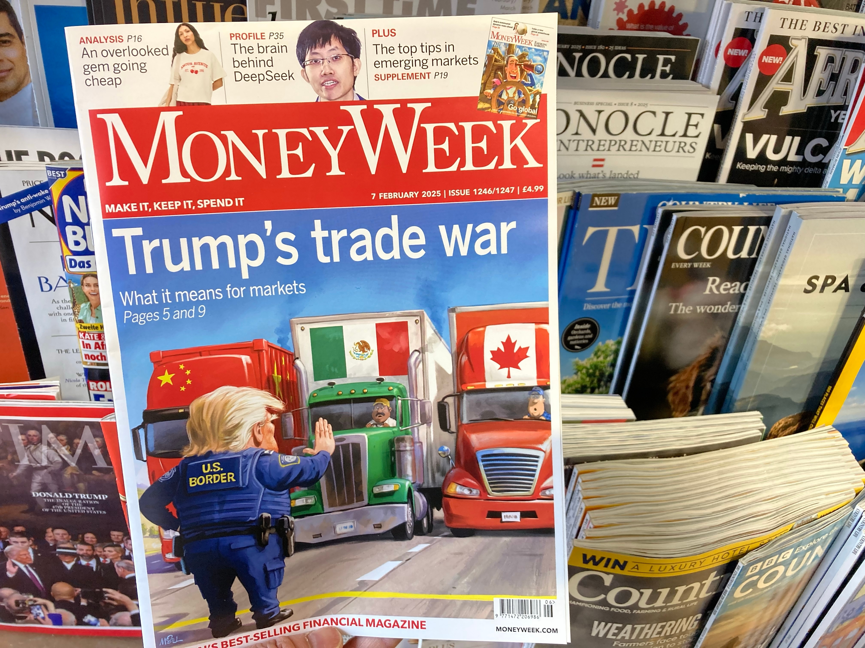
Trade Talk: The Latest on U.S. Tariffs
OLLI – Dominican University
San Rafael
July 29, 2026
Jon Haveman, Ph.D.
NEED, Executive Director

Slide 6
What Is a Tariff?
A tariff is a tax on imports.
  Paid to the government by the importer.
A 10% tariff on all imports would mean that:
  Whatever the foreign exporter charges for a product,
  US buyers will pay an extra 10% to the US government.
Domestic suppliers can also charge 10% more.
  And that’s kind of the whole point.

Slide 7
US Tariff History

Slide 8
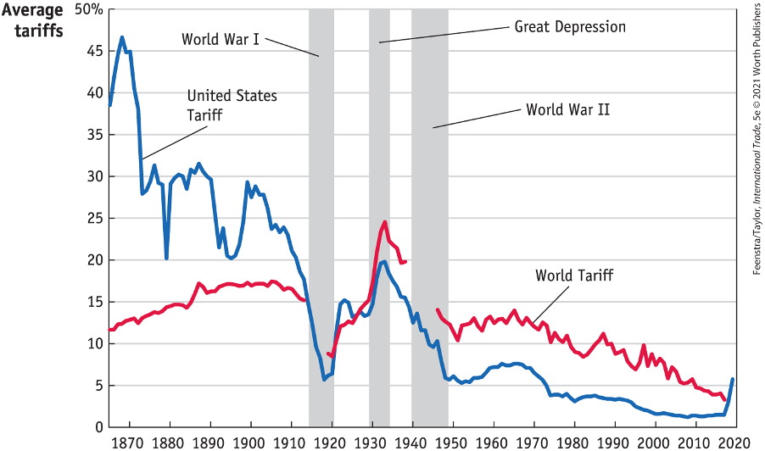
US Tariff History, 1860-2020
Source: Feenstra/Taylor, International Trade, 5e
Notes:
Late 1800s: growing influence of free trade advocates.
1913: Underwood-Simmons Tariff Act lowered tariffs and introduced the income tax, a more reliable source of revenue, reducing the government’s reliance on tariff revenue.
1930: The Smoot-Hawley Tariff Act, aimed to protect farmers and business from foreign competition, significantly raised tariffs on importing goods leading to retaliatory tariffs from other countries and a collapse in global trade and a worsening of the Great Depression.
1934: Reciprocal Trade Agreements Act empowered the President to negotiate trade agreements with other countries, allowing for reciprocal tariff reductions and promoting a shift towards freer trade.
1947: GATT
1995: WTO

Slide 9
Why Are We Even Talking About Tariffs?

Slide 10
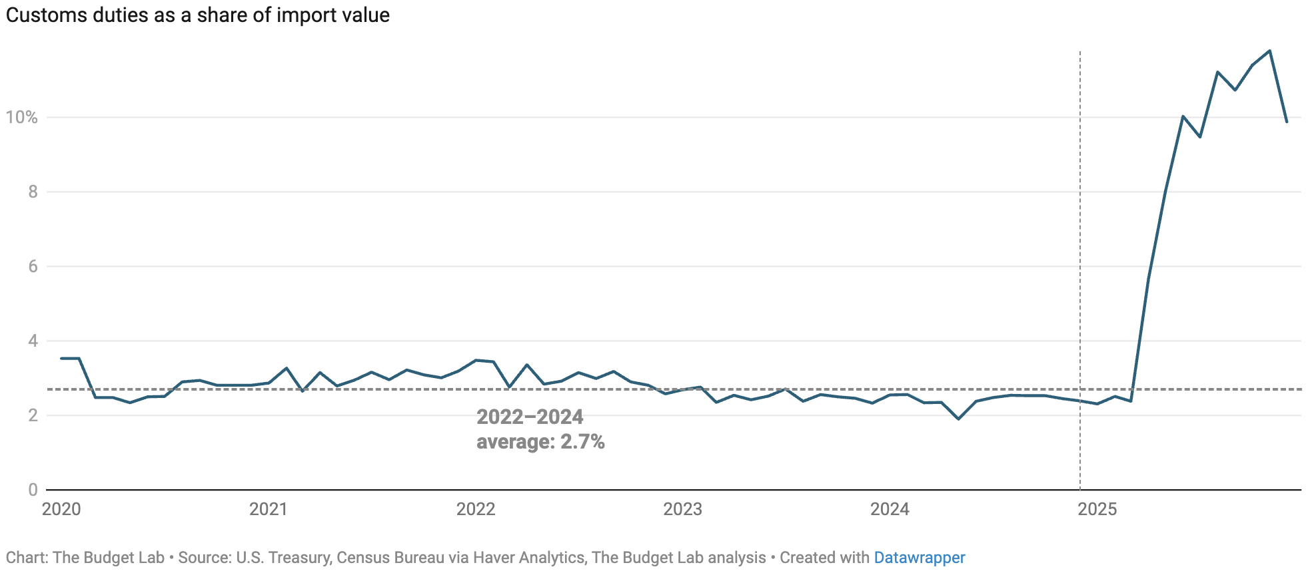
Recent Change In Tariffs
“Tariffs is the most beautiful word in the dictionary.”
- President Donald Trump

Slide 11
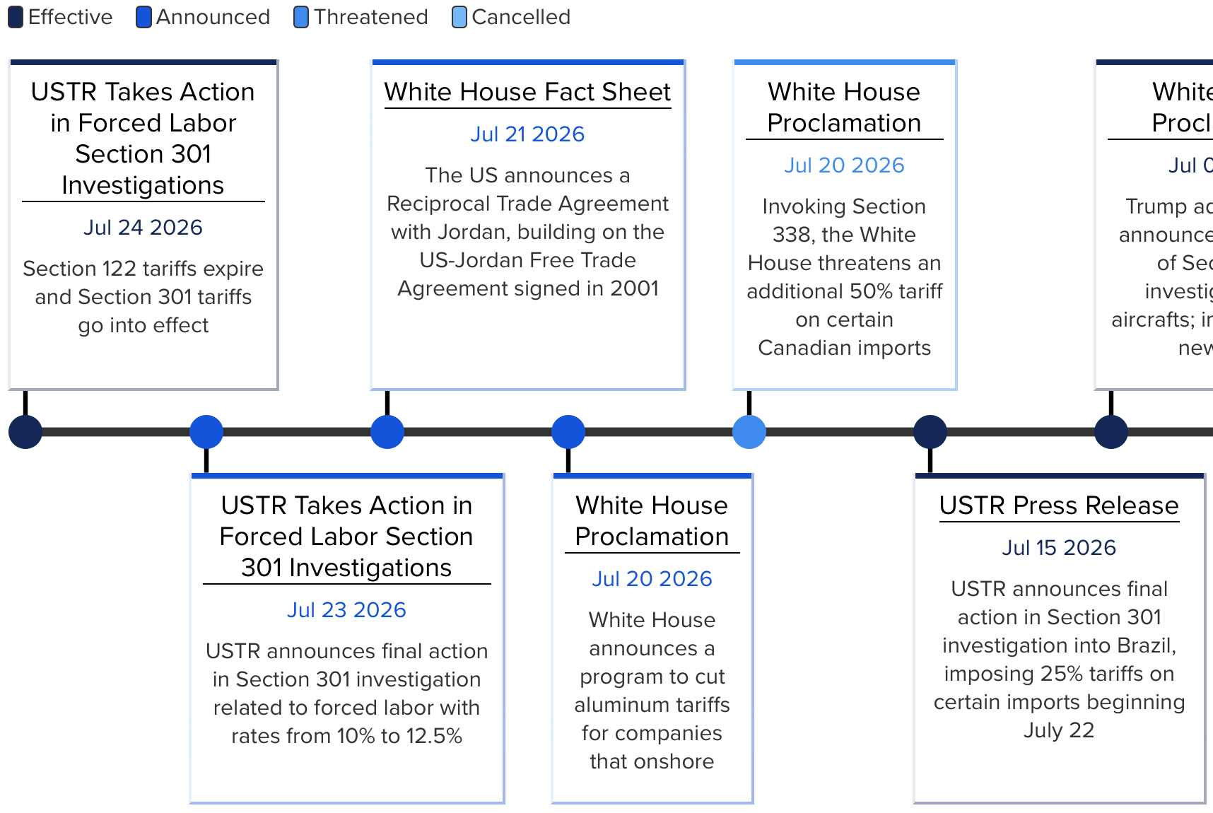
In The Last Couple of Weeks

Slide 12
Provisions of U.S. Tariff Law

Slide 13
Provisions of U.S. Trade Law (part 1)
The Tariff Act of 1930, The Trade Expansion Act of 1962, and the Trade Act of 1974 describe conditions under which the United States can apply tariffs:
  Section 201 (of the Trade Act of 1974): Safeguard Tariff
  Section 232 (of the Trade Expansion Act of 1962): National Security
  Section 301 (of the Trade Act of 1974): Trade Agreements
  Section 122 (of the Trade Act of 1974): Balance of Payments
  Section 338 (of the Tariff Act of 1930): Discriminatory Trade

Slide 14
Provisions of U.S. Trade Law (part 2)
Section 201: Safeguard Tariff
  Allows temporary duties and other trade measures if the U.S. International Trade Commission determines that a surge in imports is a substantial cause or threat of serious injury to a U.S. industry.
Section 232: National Security
  Allows the adjustment of imports by using tariffs or quotas if the Department of Commerce finds that certain products are imported in such quantities or circumstances that threaten to impair U.S. national security.
Section 301: Trade Agreements
  Allows the suspension of trade agreement concessions or the imposition of import restrictions if a U.S. trading partner is violating trade agreement commitments or engaging in discriminatory or unreasonable practices that burden or restrict U.S. commerce.

Slide 15
Provisions of U.S. Trade Law (part 3)
Section 122: Balance of Payments
  Permits the president to impose temporary import surcharges (up to 15% for 150 days, unless extended by Congress) to address "fundamental international payment problems" or significant dollar depreciation.
Section 338: Discriminatory Trade
  Empowers the president to impose new or additional duties (up to 50%) on products from countries that discriminate against U.S. commerce.

Slide 16
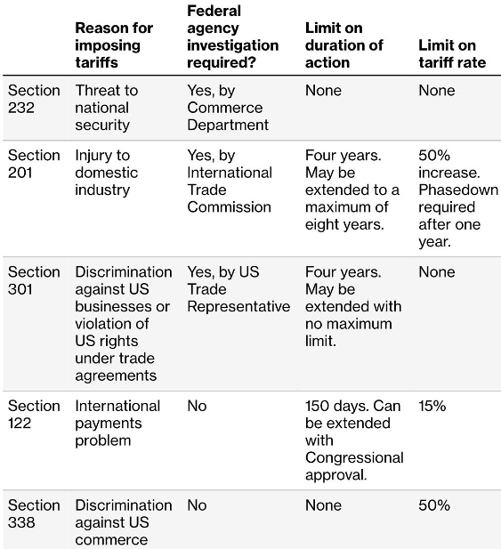
Provisions of U.S. Trade Law:
- Some Details
Source: Congressional Research Service, Bloomberg

Slide 17
Liberation Day Tariffs: IEEPA
International Emergency Economic Powers Act (IEEPA)
  Emergency Powers: Grants the president authority to deal with unusual and extraordinary foreign threats upon declaring a national emergency.
  Permitted Actions: Allows for the regulation, blocking, or prohibition of international economic transactions and import/export property.
  Taxation Exclusion: Lacks explicit text or constitutional authorization for imposing revenue-generating tariffs or duties, which remain under Congressional purview.
Liberation Day tariffs invalidated in Feb. 2026 by the Supreme Court.

Slide 18
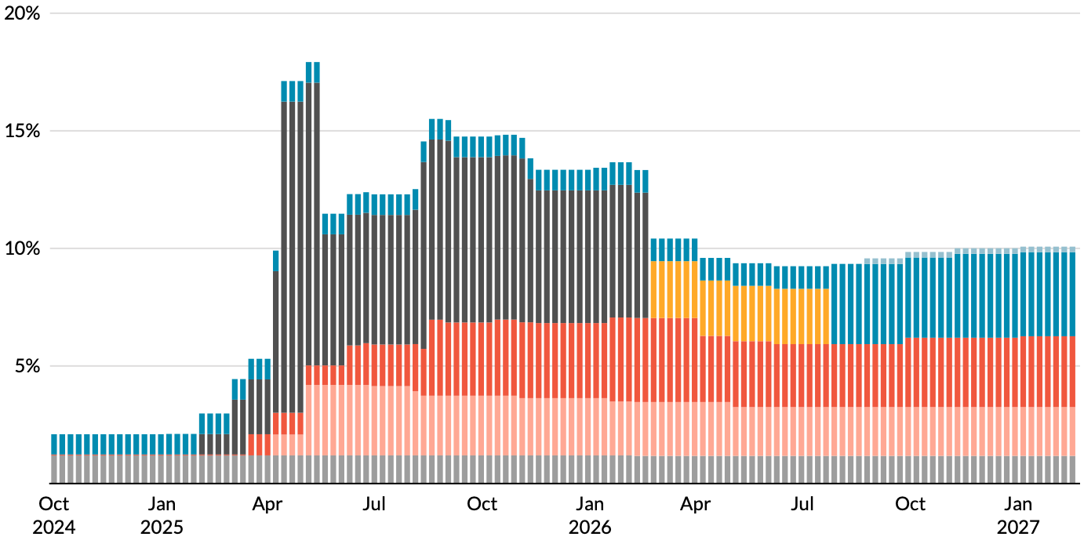
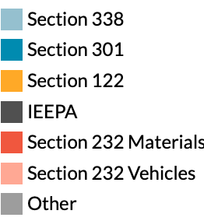
Tariffs by Type
Supreme Court
Ruling
Source: https://taxpolicycenter.org/features/tracking-trump-tariffs
Notes:
Late 1800s: growing influence of free trade advocates.
1913: Underwood-Simmons Tariff Act lowered tariffs and introduced the income tax, a more reliable source of revenue, reducing the government’s reliance on tariff revenue.
1930: The Smoot-Hawley Tariff Act, aimed to protect farmers and business from foreign competition, significantly raised tariffs on importing goods leading to retaliatory tariffs from other countries and a collapse in global trade and a worsening of the Great Depression.
1934: Reciprocal Trade Agreements Act empowered the President to negotiate trade agreements with other countries, allowing for reciprocal tariff reductions and promoting a shift towards freer trade.
1947: GATT
1995: WTO

Slide 19
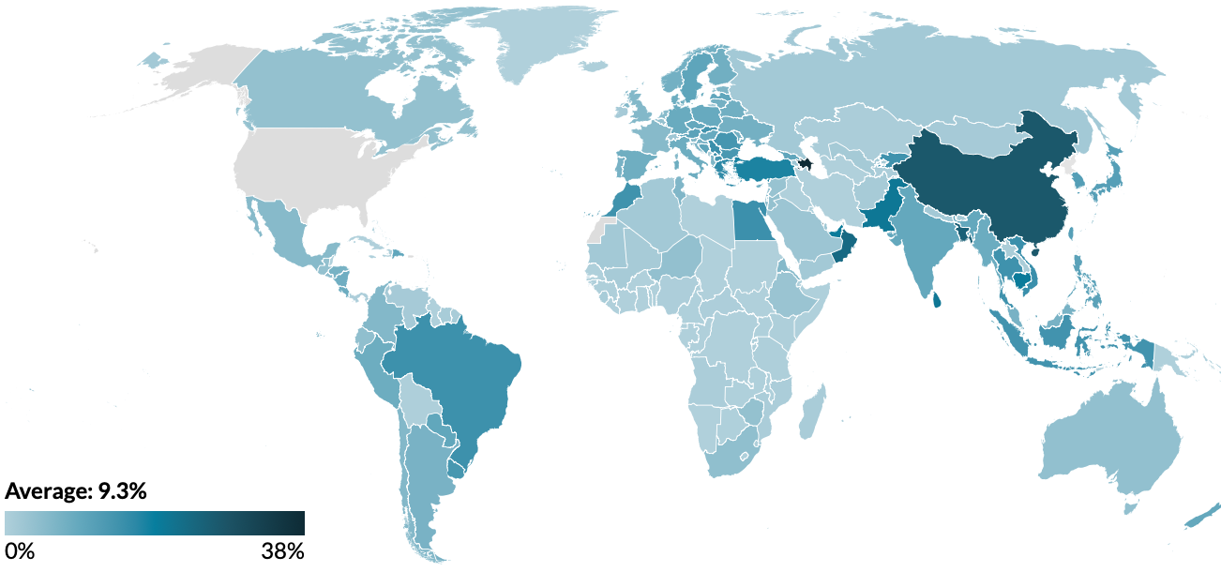
Average Tariff Rate, by Country (July 6, 2026)
Source: https://taxpolicycenter.org/features/tracking-trump-tariffs

Slide 20
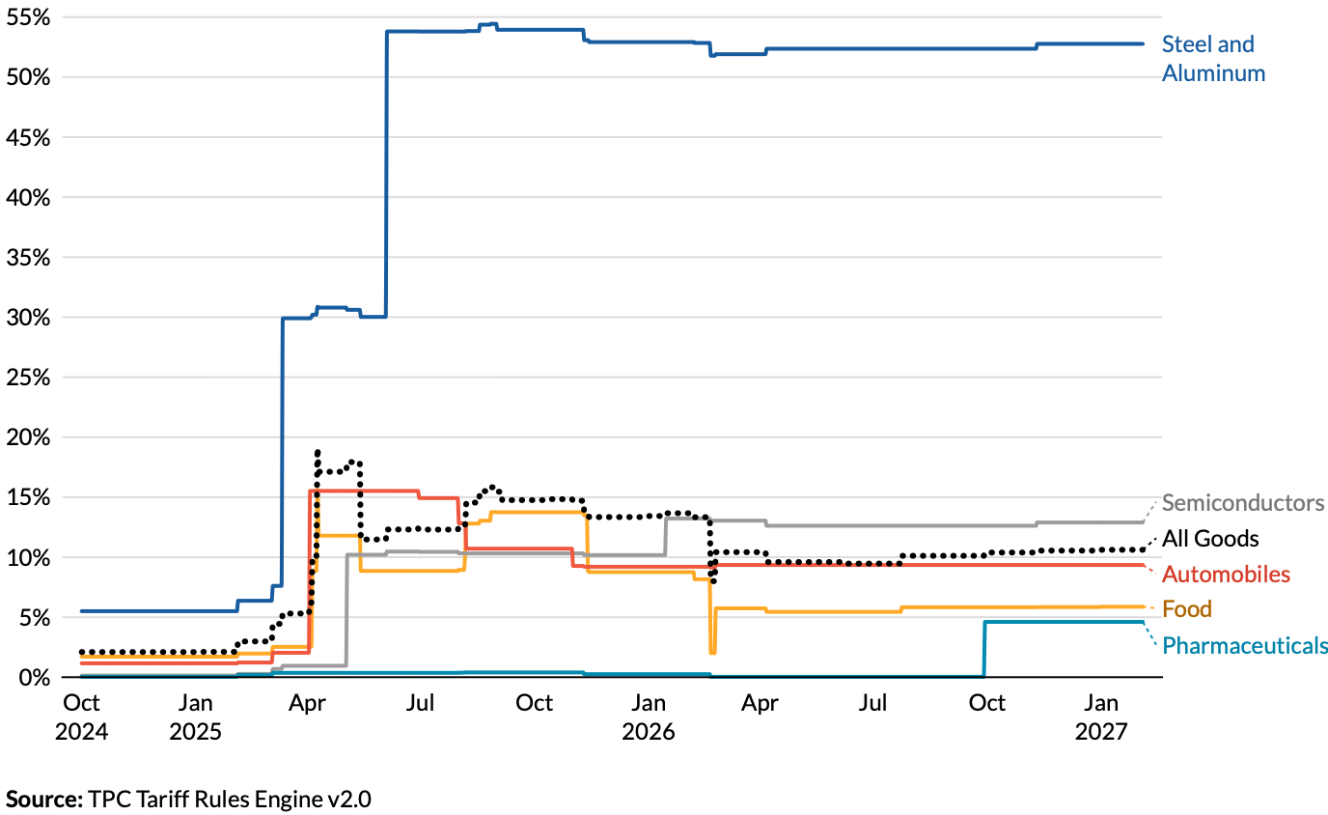
Average Tariff Rate, by Selected Goods
Future ->
Source: https://taxpolicycenter.org/features/tracking-trump-tariffs

Slide 21
Tariff Effects

Slide 22
Economic Effects of a Tariff
A tariff is a tax on imports. It causes:
  A rise in the price of the imported good in the importing country,
  A fall in the price of the imported good in the exporting country,
  The quantity imported to fall, and
  Revenue for the tariff-levying government.
Almost always: the rise at home is much larger than the fall abroad.
  That’s especially true if importing country is small.
  But it’s also true if importing country is as large as the U.S.
    We learned this from Trump’s tariffs in 2018.
      Trump’s first administration tariffs caused US prices to rise, with hardly any perceptible fall in prices abroad.

Slide 23
Effects of a Tariff
The rise in price in the importing country causes:
  A rise in the price of import competing goods.
    Benefits to those producers.
    Harm to buyers of both the imported and domestic goods.
      Including producers that use the higher-priced goods as inputs.
        Their prices also rise, hurting their buyers.
  Employment changes:
    Increase in the protected industry.
    Decreases in industries that use the protected product as inputs.
Notes:
Example of 25% on steel

Slide 24
Are Tariffs A Good Idea?
Generally, economists don’t think so, but there are some reasons for them:
  National Defense – strategic resource
    Do we need the capacity to make our own computer chips, just in case?
    What about steel and aluminum?
  “Infant” Industry
  Unfair trade practices of exporting countries

Slide 25
President Trump’s Reasons for Tariffs
Our exports are being treated unfairly.
Bring back manufacturing employment.
Raising revenue – replace the income tax?
  Foreign companies would pay the tariffs (so he alleges).
National security
Foreign policy leverage

Slide 26
Unfair Treatment

Slide 27
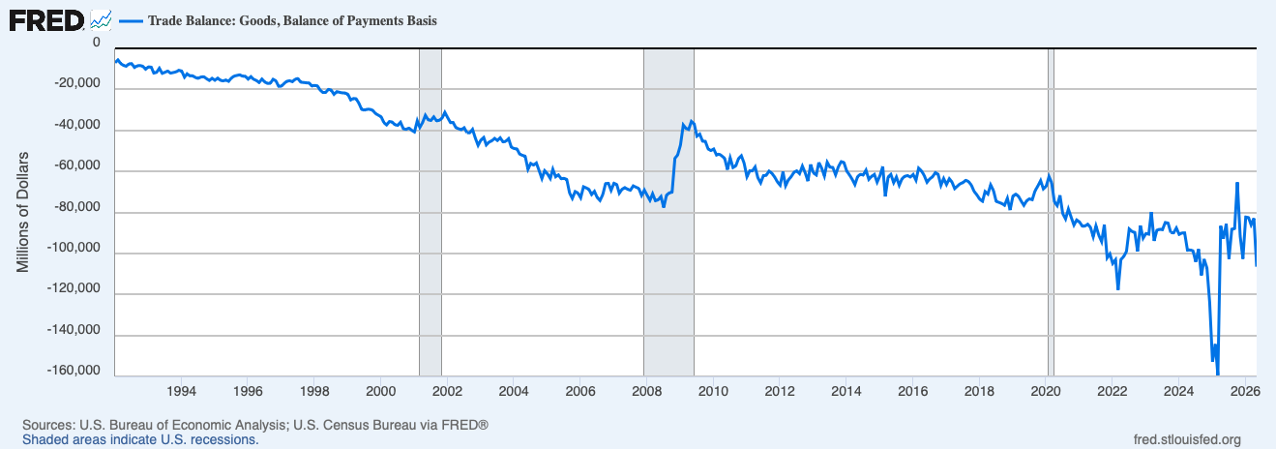
Evidence of Unfair Treatment: Trade Deficit
Y-axis is all big
Negative numbers:
Deficit
Trade Deficit: Imports > Exports

Slide 28
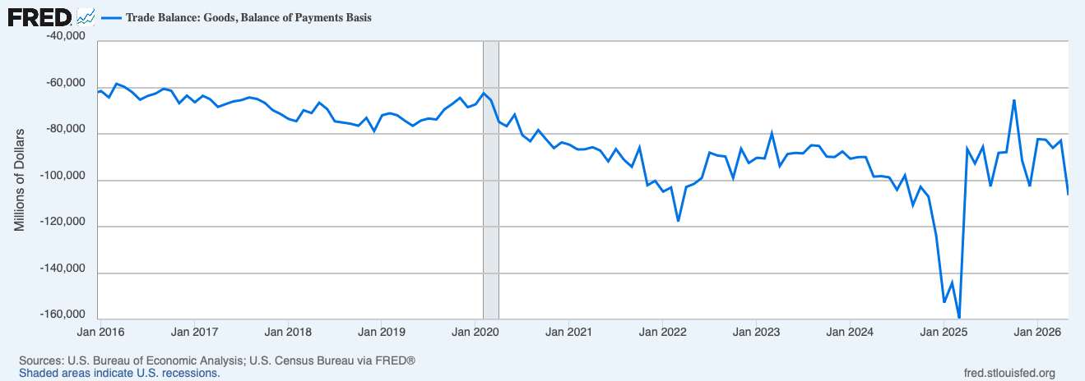
US Trade Deficit – Mixed Results with Tariffs
Most Recent
Trade War
Start of Trade Wars
Notes:
https://www.piie.com/blogs/realtime-economics/2025/trumps-trade-war-timeline-20-date-guide

Slide 29
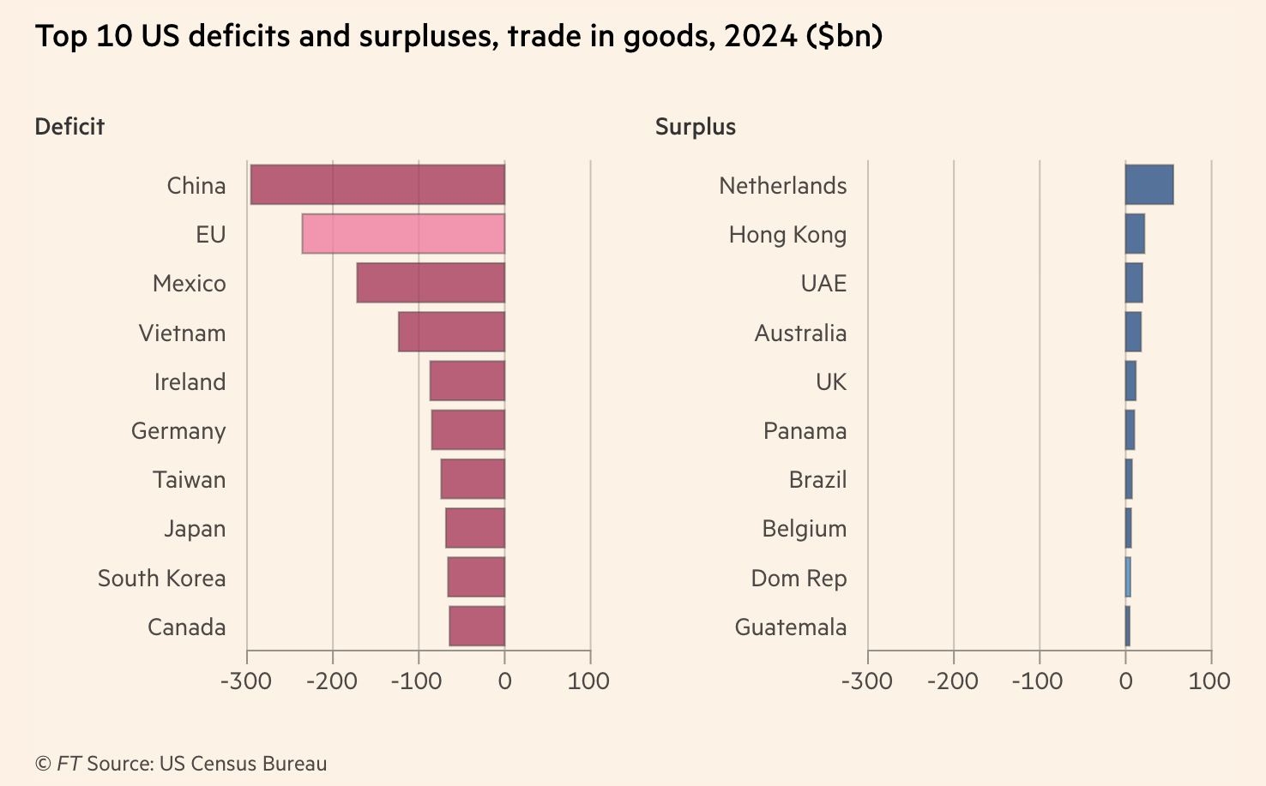
Reciprocal Trade and Tariffs
Formula:
Tariff = Exports-Imports
Exports
Notes:
https://www.piie.com/blogs/realtime-economics/2025/trumps-trade-war-timeline-20-date-guide
US-UK trade deal: which includes the potential for the UK to lower tariffs on US beef, and a US quota of 100,000 vehicles for the UK to export to the US at a tariff rate of 10 percent (and not the 25 percent additional tariff resulting from the Section 232 investigation).

Slide 30

Example, Lesotho (2022 data)
“Reciprocal” Tariff = 50%
Total trade: $240 Million
Facts about Lesotho:
GDP per capita =$1,073;
Population= 2.1 million
Trade balance= -$234 million
Average tariff rate against US = 10%
https://www.imf.org/en/Publications/WEO/weo-database/2024/October, https://wits.worldbank.org/CountryProfile/en/USA
Notes:
99% textiles. 2000 African Growth and Opportunity Act 0 tariffs on textiles

Slide 31
Is A Trade Deficit A Result of Unfair Treatment?
Intuitive, but no.
Have to look at the whole picture.
We trade not only goods and services, but also investment funds.
  The United States is a very attractive investment market.
  Selling Treasury securities to foreigners is an export.
  So we run an investment trade surplus.
Investment trade surplus = goods and services trade deficit
  Why? Exchange rates.
Will tariffs lower the trade deficit? No.

Slide 32
Trade Deficits are Driven by Investment Flows and Tariffs Can NOT “Fix” Them

Slide 33
Also… Exports
Lower imports make exports more expensive in foreign markets.
How?
  If fewer people are buying imports, the dollar appreciates.
    Fewer dollars available for those wanting to buy our exports.
  If the dollar appreciates, it takes more foreign currency to buy U.S. exports.
    Making exports more expensive.
Tariffs:
  Lower imports.
  But they also lower exports.
  Won’t necessarily reduce the trade deficit.

Slide 34
Tariffs on Washing Machines in Trump I
The price of washing machines increased in the U.S. by 12% the next month.
The price of dryers (bundled with washing machines) also increased by 12%, even though they were not subjected to tariffs.
Consumers lost $1.5 billion annually.
Annual tariff revenue increased by about $82 million.
1,800 new jobs reported.
The consumer cost per job “created” was about $817,000 per year.
Coincides with LG and Samsung opening plants in the U.S.
  LG: Clarksville, Tennessee in 2019: 600 new jobs
  Samsung: Newberry, South Carolina, 2018: 1,500 new jobs
Notes:
Source: Flaaen, Hortacsu and Tinterlnot (2020) “The Production Relocation and Price Effects of US Trade Policy: The Case of Washing Machines”, American Economic Review, 110(7)

Slide 35
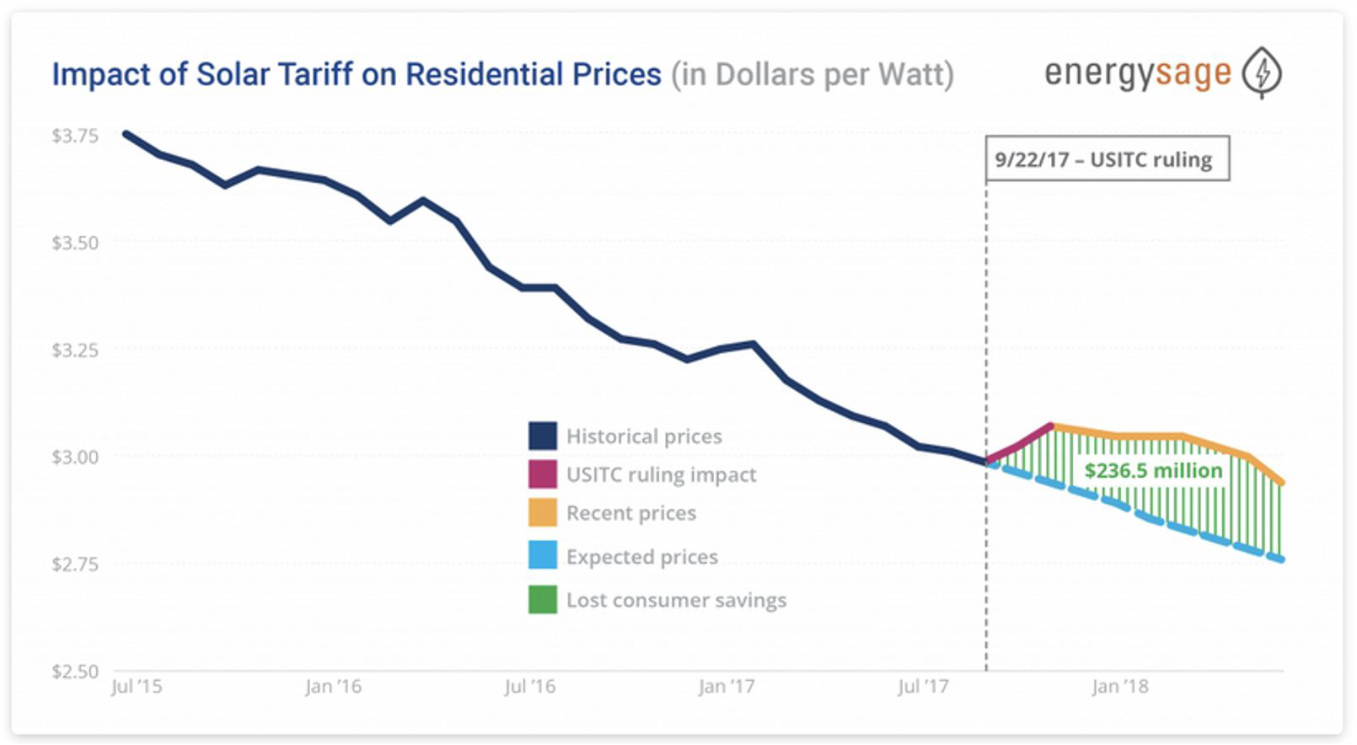
Tariffs on Solar Panels
Consumers were hurt by higher prices of solar panels:
  Solar prices increased by 43-57% compared to the global average.
According to the Solar Energy Industries Association:
  62,000 workers were laid off or never hired,
  10.5 gigawatts of solar capacity lost, and
  $19 billion in private sector investment lost.
Foreign companies build factories in the U.S.:
  Hanwha (South Korea) in Whitfield County, GA
  JinkoSolar (China) in Jacksonville, FL
Notes:
https://seia.org/research-resources/high-cost-tariffs/
https://www.nytimes.com/2019/07/10/business/economy/companies-tariffs-winners.html

Slide 36
Reciprocal Trade and Tariffs
Notes:
https://www.piie.com/blogs/realtime-economics/2025/trumps-trade-war-timeline-20-date-guide
US-UK trade deal: which includes the potential for the UK to lower tariffs on US beef, and a US quota of 100,000 vehicles for the UK to export to the US at a tariff rate of 10 percent (and not the 25 percent additional tariff resulting from the Section 232 investigation).

Slide 37
The Trouble with Bilateral Trade Deficit (1)
The goal of the tariff on a country-by-country basis is to bring bilateral trade deficits to zero.
The tariff plan displays a basic misunderstanding of the reasons why nations trade in the first place.
Reasons that imply the United States will run deficits with some trade partners (bilateral deficits) and surpluses with others (bilateral surpluses).

Slide 38
The Trouble with Bilateral Trade Deficit (2)
The reasons reflect the operation of comparative advantage.
For example, the US imports aluminum from countries that can produce it most efficiently, while embodying it in exports where it has the advantage, such as aircraft.
This will tend to lower US trade deficits with efficient aluminum producers and raise them with aircraft importers.

Slide 39
The Trouble with Bilateral Trade Deficit (3)
Trade barriers certainly can influence bilateral trade balances.
To think that every persistent bilateral balance is due to unfair treatment of our exports misunderstands the basic reason why countries trade.
Countries trade to specialize in goods and services they are best at producing, which naturally means having possibly persistent surpluses with some trade partners and deficits with others.

Slide 40
The Trouble with Bilateral Trade Deficit (4)
Trying to squash every bilateral balance to zero through brute-force tariffs is to levy taxes on international trade exactly where it provides the most benefits.
Yet, this is what Trump's tariff numbers are designed to do.

Slide 41
Bring Back Manufacturing

Slide 42
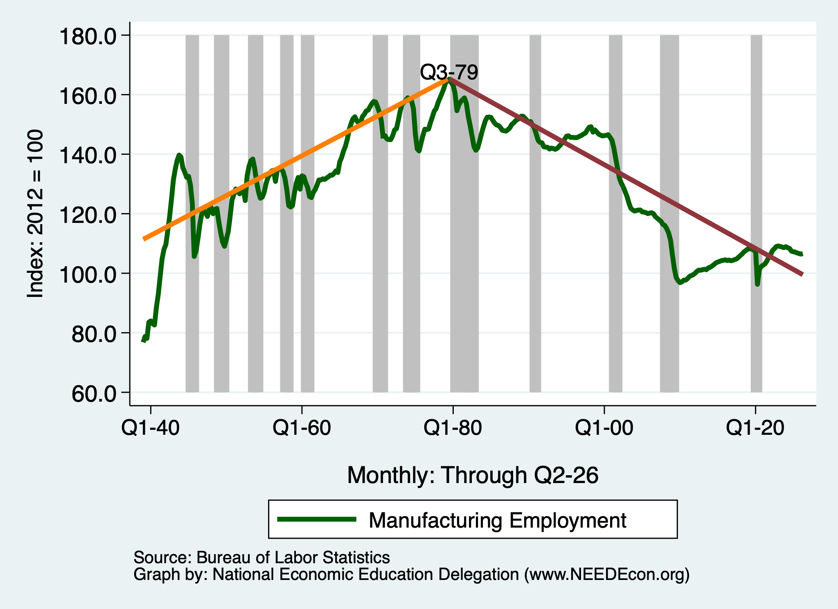
Growth in Manufacturing Employment?

Slide 43
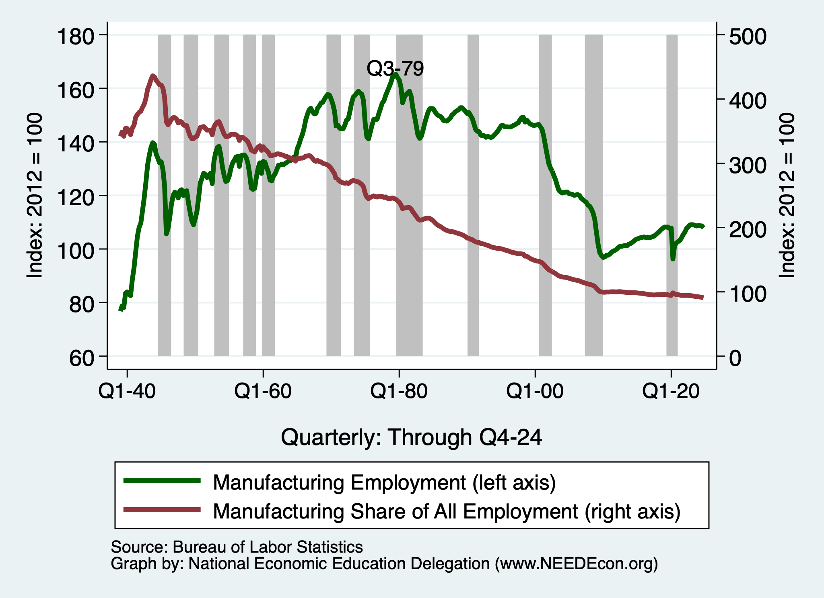
What is Happening to Manufacturing Employment?
Since 1979, manufacturing
employment has fallen by
about 1/3.

Slide 44
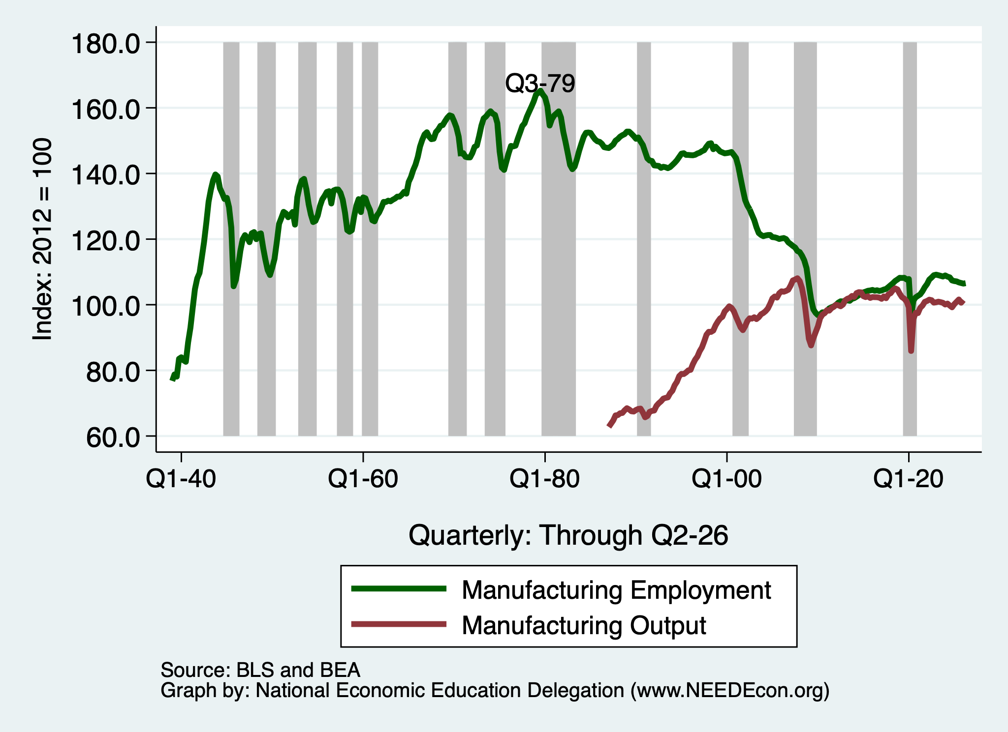
Growth in Manufacturing Output!

Slide 45
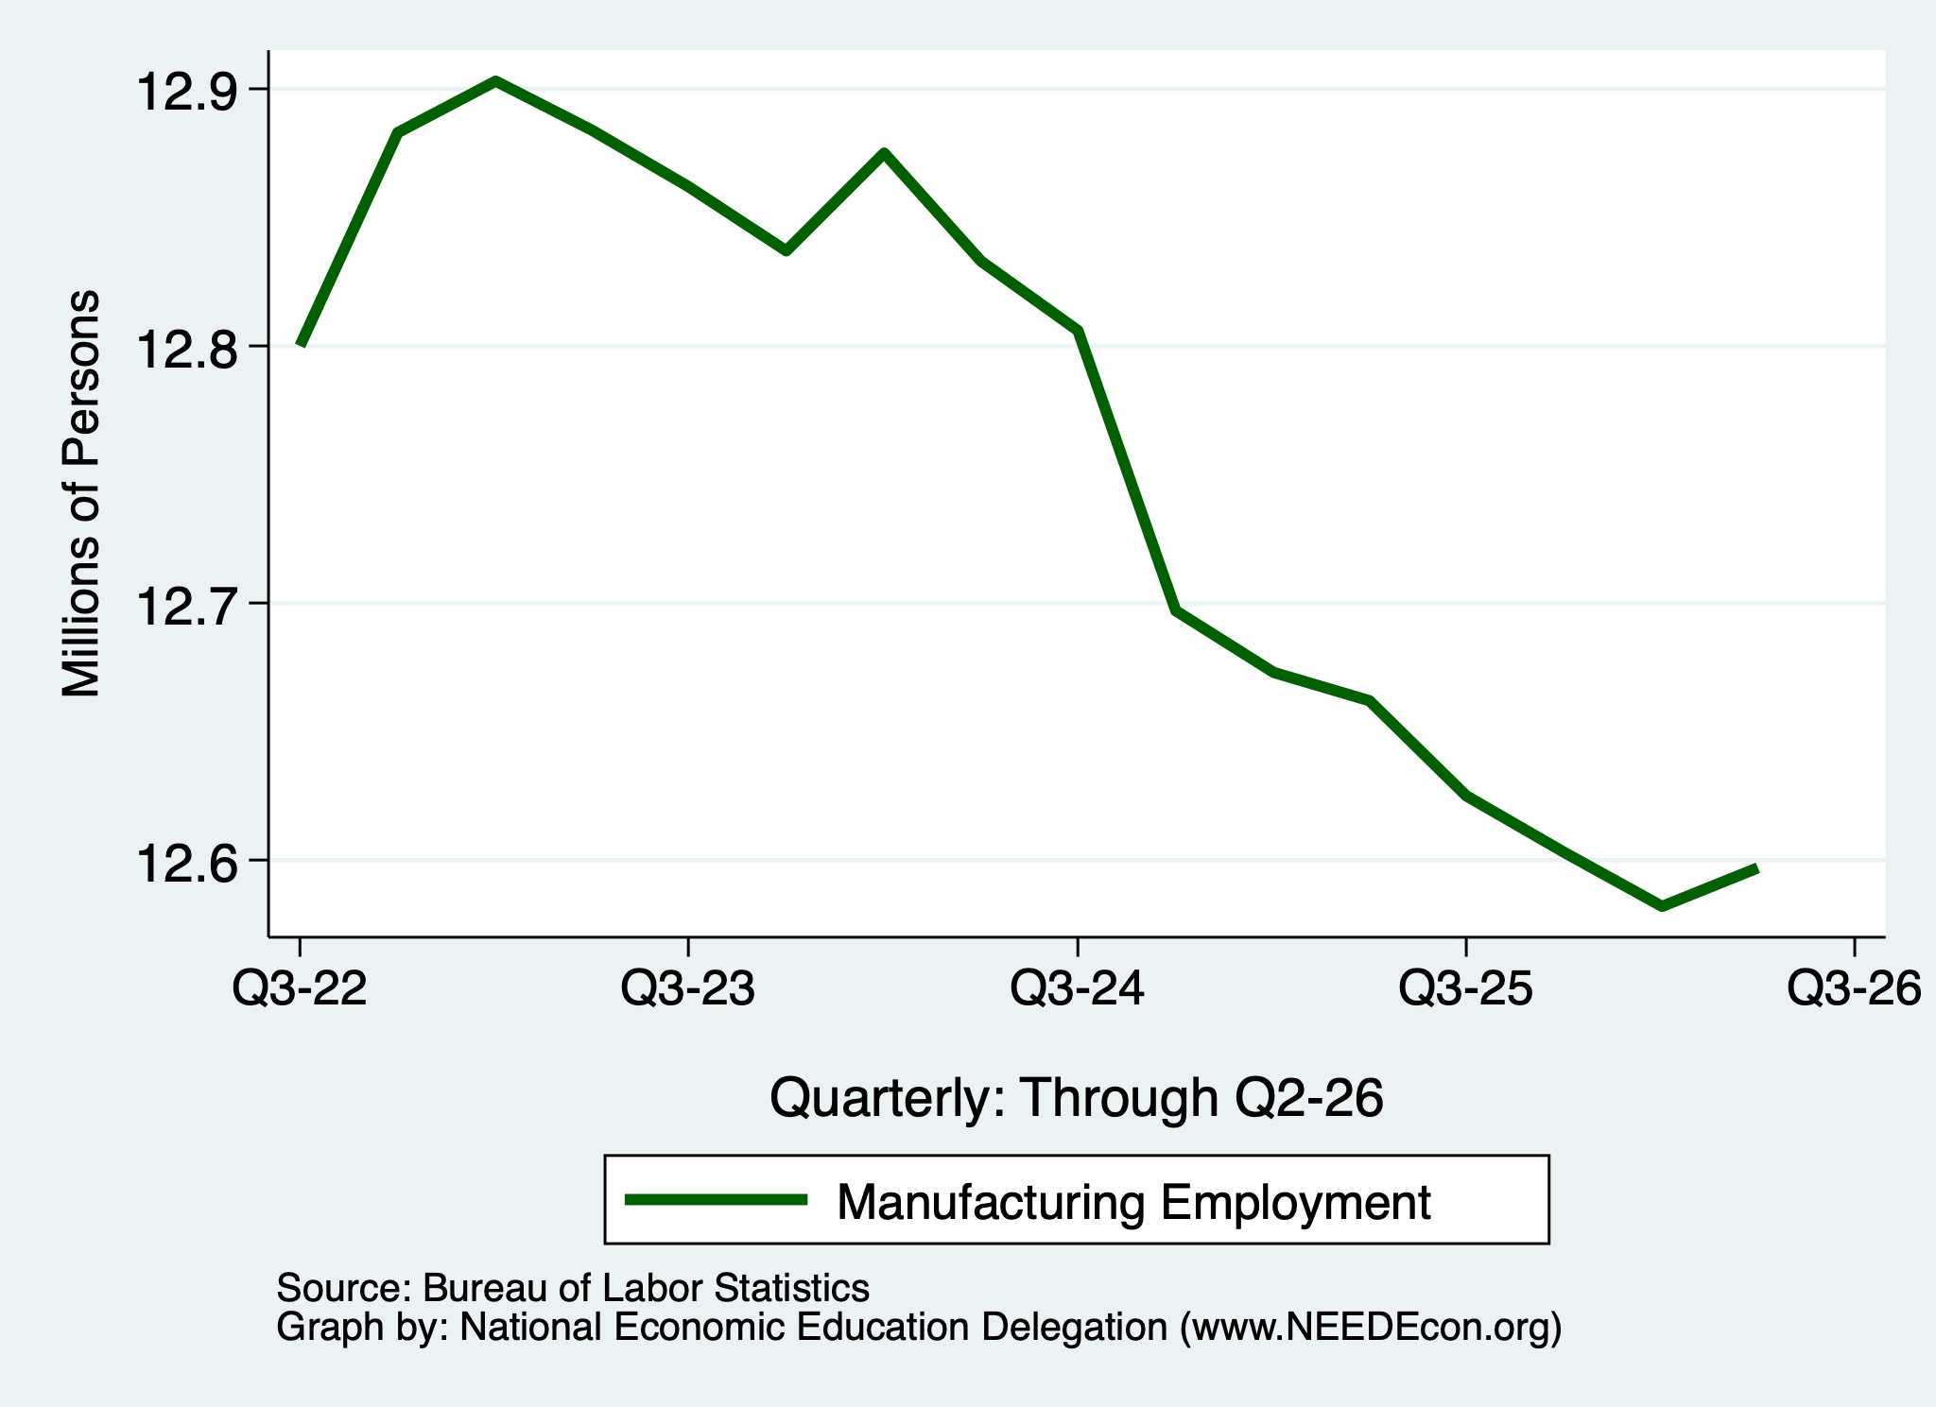
Growth in Manufacturing Employment?
Liberation Day

Slide 46
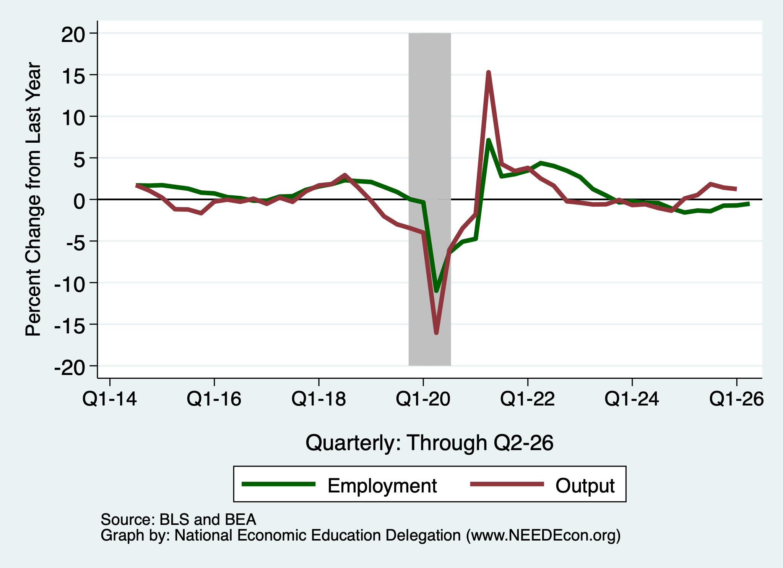
Growth in Manufacturing Employment?

Slide 47
Tariffs and Manufacturing?
The argument has intuitive appeal.
  But doesn’t stand up to scrutiny.
Intuition: Making imports more expensive makes domestically produced goods more appealing.
But... Exports.
  We import clothing, toys, and furniture.
  We export airplanes and light trucks.
We can’t just make more of the one without sacrificing some of the other – limited resources.
And… Retaliation.

Slide 48
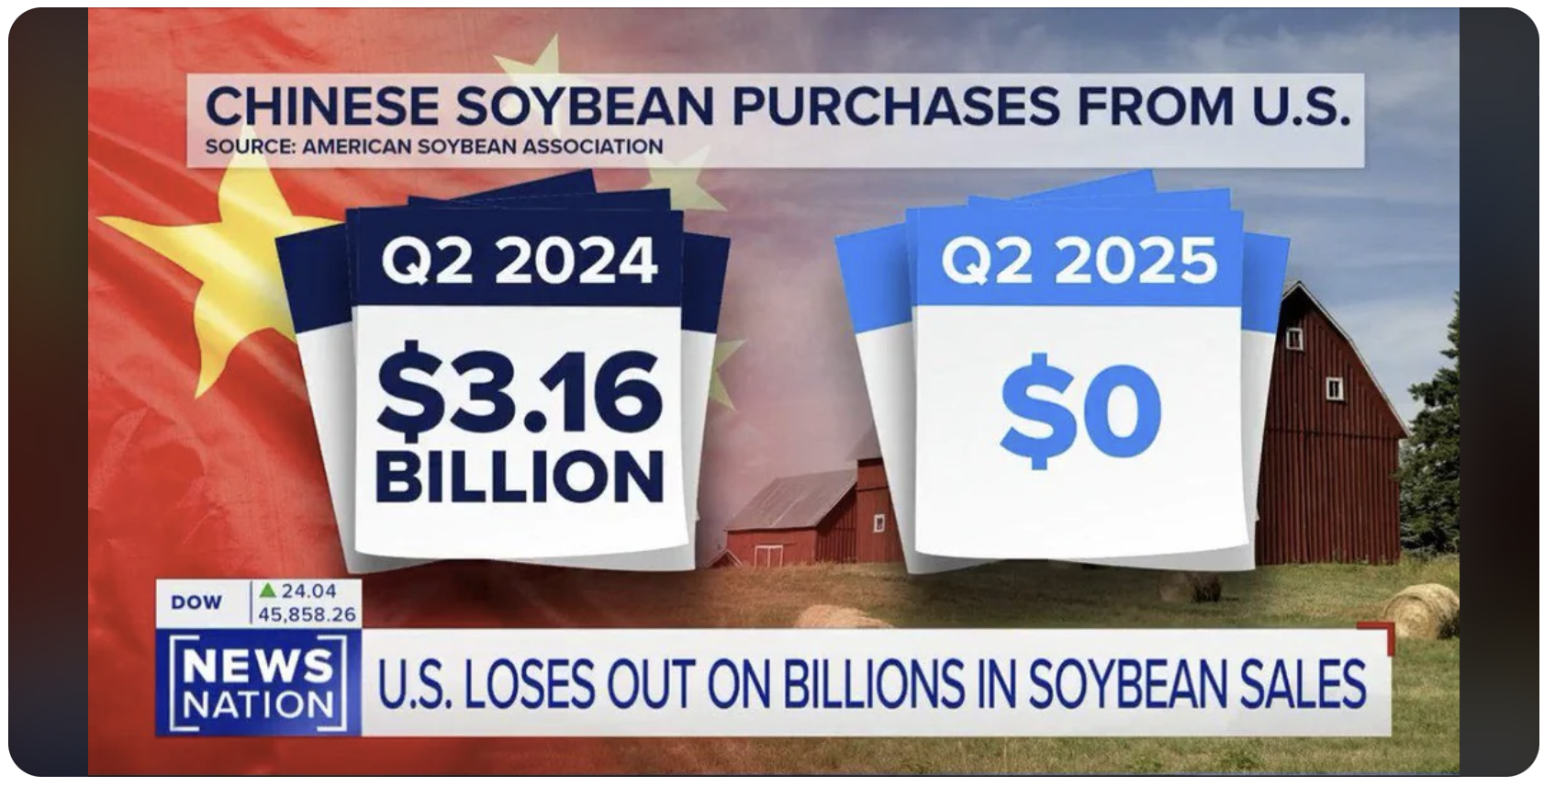

Slide 49
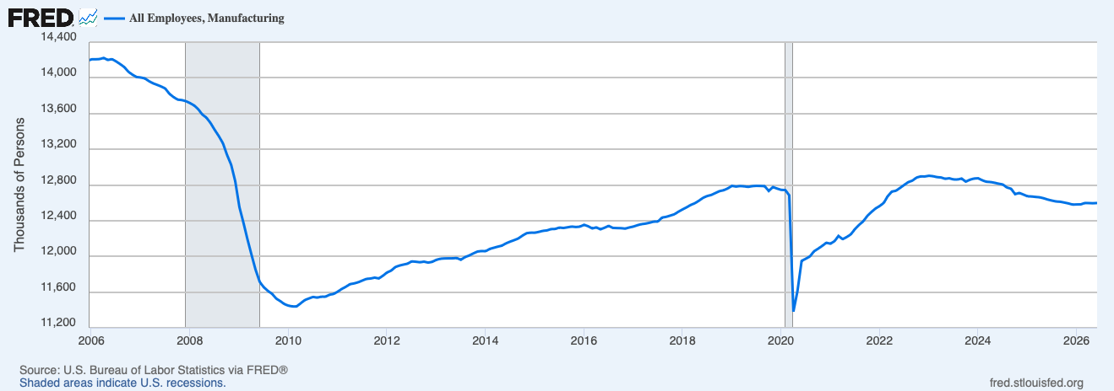
U.S. Manufacturing Employment
Effect of tariffs?
Notes:
https://www.nber.org/system/files/working_papers/w25638/w25638.pdf
https://www.nber.org/papers/w26396
https://www.federalreserve.gov/econres/feds/files/2019086pap.pdf
https://www.nber.org/papers/w32082#fromrss
https://taxfoundation.org/research/all/federal/trump-tariffs-trade-war/#:~:text=A%20March%202019%20National%20Bureau,of%20higher%20after%2Dduty%20prices.

Slide 50
Raising Revenue

Slide 51
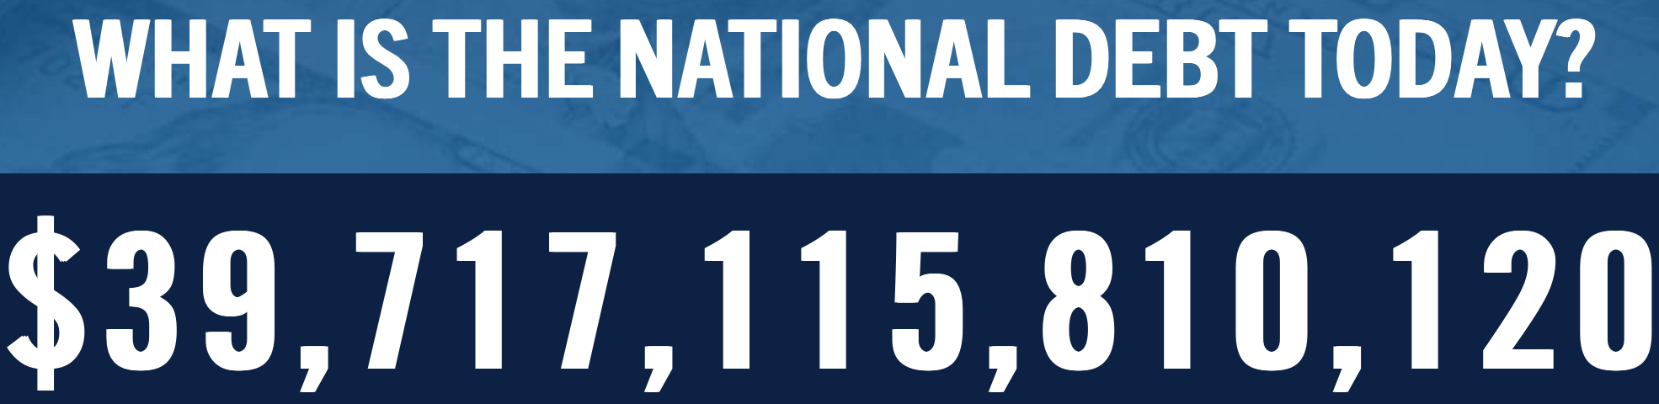
Source: https://www.pgpf.org/national-debt-clock/

Slide 52
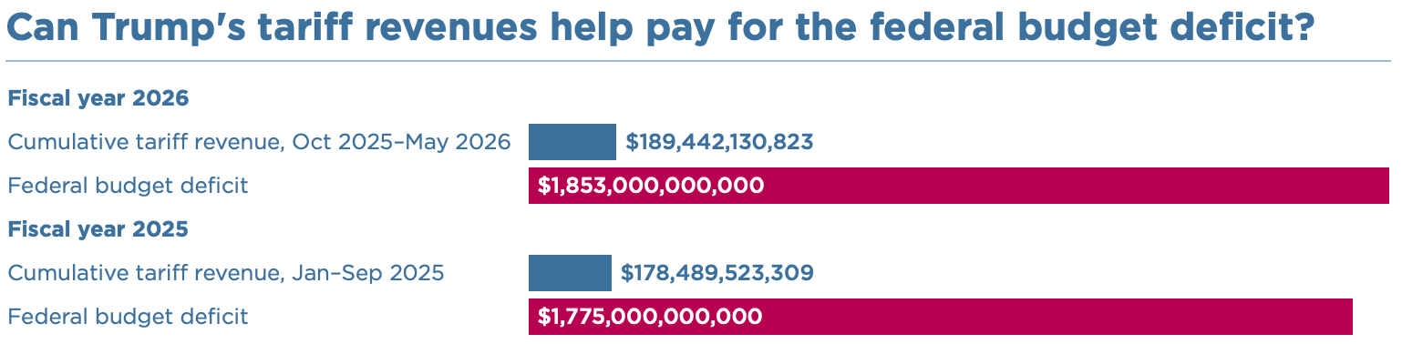
Raising Revenues?
Deficit? That’s almost 10 year’s worth of tariff revenue.
Eliminate the income tax?
  $2.4 Trillion in 2024 = 15 years of tariff revenues

Slide 53
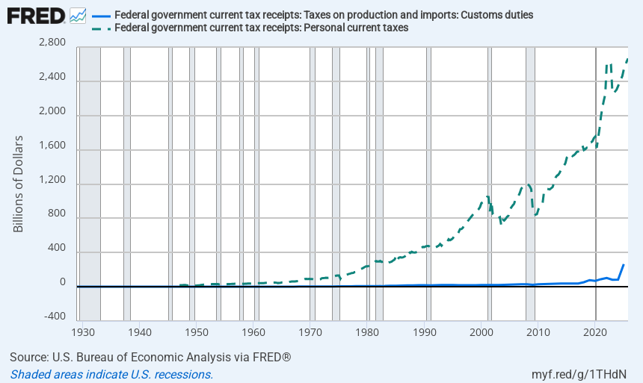
Replace The Personal Income Tax?

Slide 54
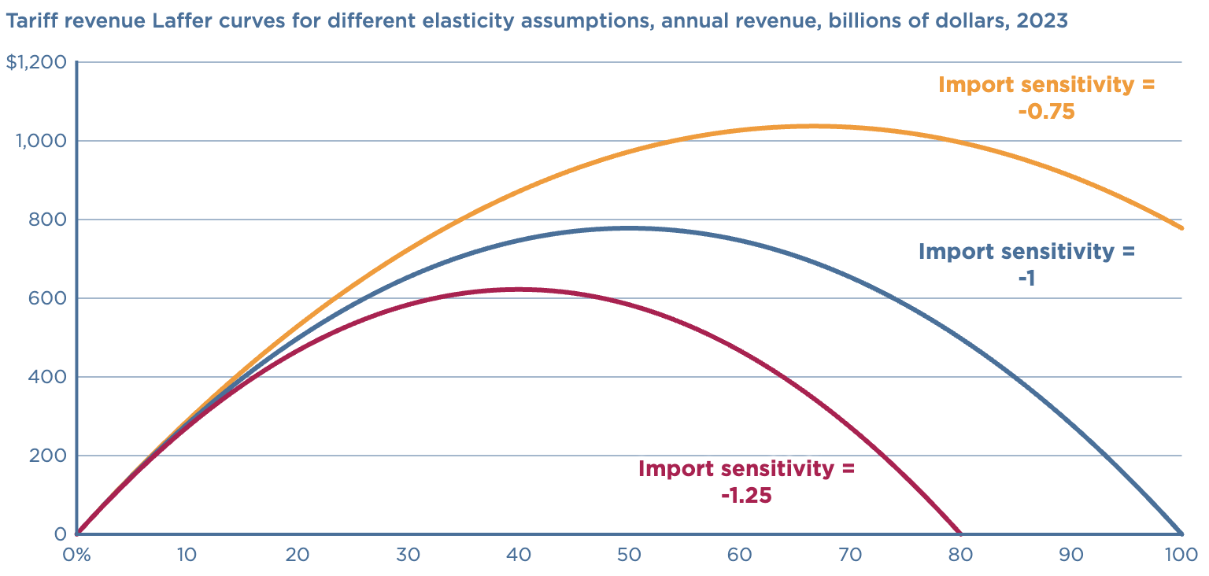
Replacing the Income Tax?
Revenue peaks well below
size of the income tax.
Peak revenue at 50%.
https://www.piie.com/blogs/realtime-economics/2024/can-trump-replace-income-taxes-tariffs

Slide 55
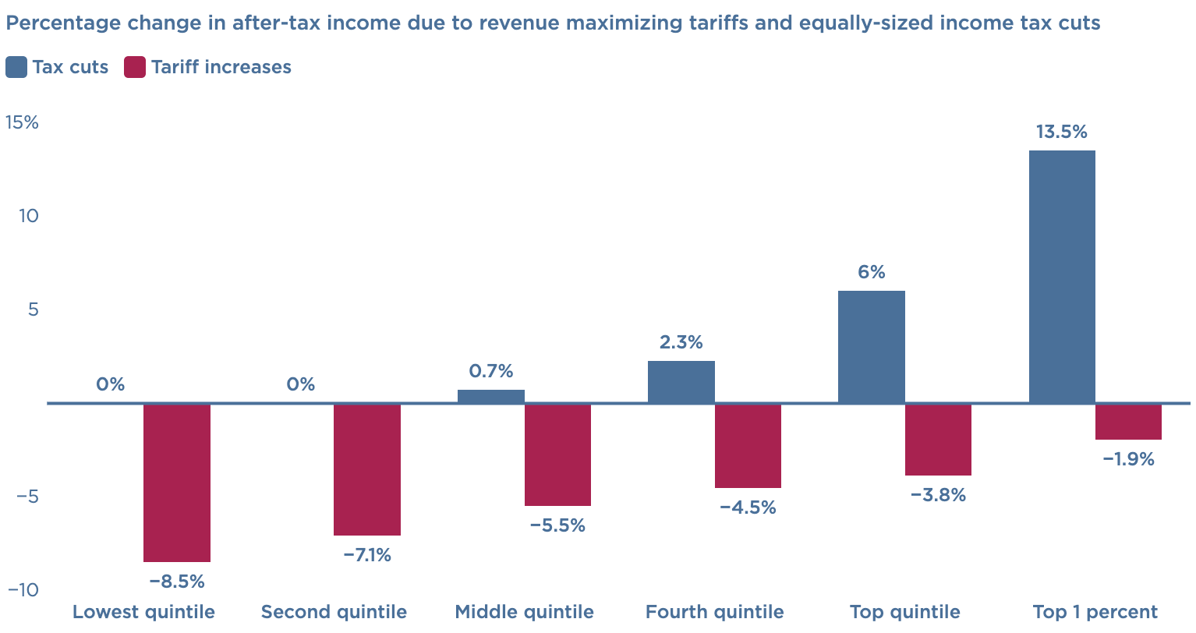
Replacing the Income Tax?
Using tariff revenue to offset the income tax is regressive.
The % decline in income would be largest for low-income households.
https://www.piie.com/blogs/realtime-economics/2024/can-trump-replace-income-taxes-tariffs

Slide 56
National Security

Slide 57
Steel and Aluminum Tariffs
If you put a tariff on something, its price goes up.
What other manufacturing industries use steel or aluminum?
ALL OF THEM!!
So, by putting tariffs on steel and aluminum, you jeopardize other industries.
Is it worth it? Maybe.

Slide 58
Tariffs on Metals in Trump 1
The prices of steel and aluminum increased shortly after the tariff was implemented.
The number of jobs in iron, steel, and aluminum mills rose temporarily by about 12,000, from 2017 to 2019.
Downstream industries (e.g., auto) faced higher input costs.
  Several studies estimated that the increased costs driven by tariffs may have resulted in 75,000 fewer manufacturing jobs.
Notes:
https://www.reuters.com/graphics/TRUMP-TARIFFS/STEEL/gdpznwgdzpw/

Slide 59
Tariffs on Metals - Retaliation
The EU, Canada, Mexico, and China retaliated with tariffs proportionate to their U.S. exports of steel & aluminum.
US industries targeted by foreign retaliation:
Industry | Countries
Pork (reliant on foreign markets) | China, Mexico
Apples | China, Mexico, India
Fruits and Nuts | China, India
Whiskies (e.g. KY bourbon) | EU, Canada, Mexico
Mineral water, coffee, ketchup | Canada
Motorboats, yachts, motorcycles (Harley-Davidson) | EU

Slide 60
Who Pays?

Slide 61
The President Said Chinese Firms Would Pay!
There are three things that could happen with tariffs and prices:
  1. Foreign firms could lower their prices.
  2. Importing firms could lower their prices.
  3. Domestic consumers could pay more.
Evidence from the last trade war (2018-2020):
  3. Domestic consumers paid the vast majority of the tariff (90%+).
  It’s sometimes worse than that: Clothes washers and dryers.

Slide 62
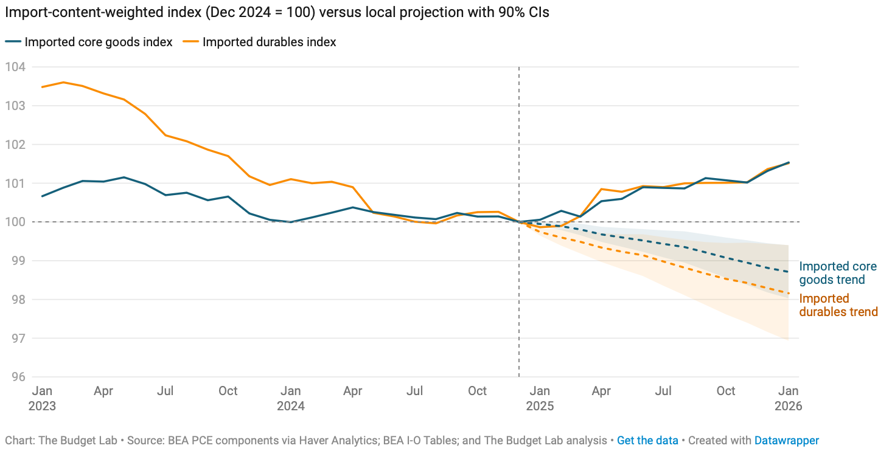
What About Prices?
Increasingly, it’s consumers.
Source: https://budgetlab.yale.edu/research/tracking-economic-effects-tariffs

Slide 63
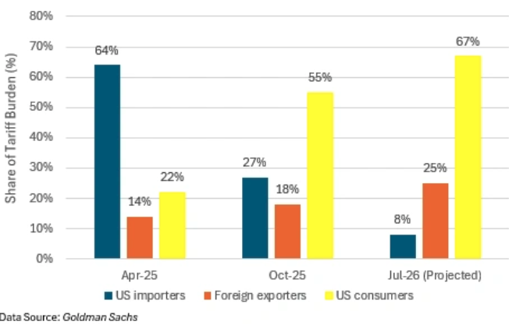
Changing Incidence of Trump’s Tariffs
Source: https://www.cfr.org/article/who-pays-trumps-tariffs

Slide 64
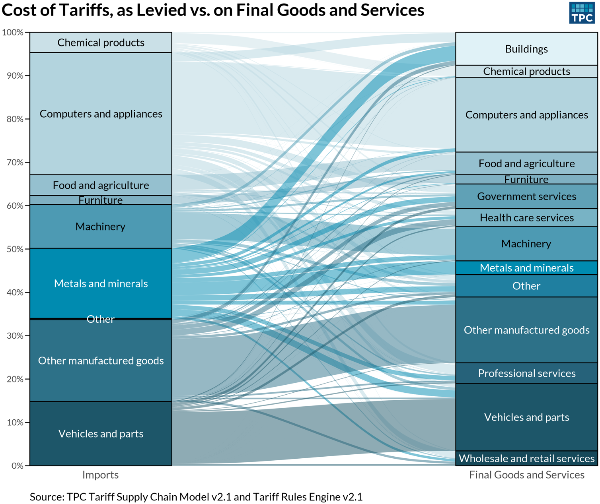
Incidence of Trump’s Tariffs
Source: https://www.cfr.org/article/who-pays-trumps-tariffs

Slide 65
To Review:

Slide 66
President Trump’s Reasons for Tariffs
Our exports are being treated unfairly.
  Not a problem that tariffs will fix.
Bring back manufacturing employment.
  Benefits some and harms others.
Raising revenue – replace the income tax?
  Will raise some, but will harm poorer households.
National security
  Maybe, but at what cost?
Is China paying?
  So far, some, but not much.

Slide 67
Why is He Really Imposing Tariffs?
Who knows?!
To exert U.S. power and elicit submission from other countries.
To force submission by domestic businesses.

Slide 68
Other effects of a Tariff
Income distribution
  Tariffs, especially on China, raise prices of the products disproportionately bought by low-income consumers, hurting them more than high-income consumers
Retaliation
  Other countries place tariffs on US exports
  Trade war that started in 2018 continues and gets worse
Corruption
  Historically, tariffs prompted both smuggling and bribes to customs officers.
  Today, in the US, those are less likely.
  But requests for exemptions from tariffs may be accompanied by favors or political contributions.

Slide 69
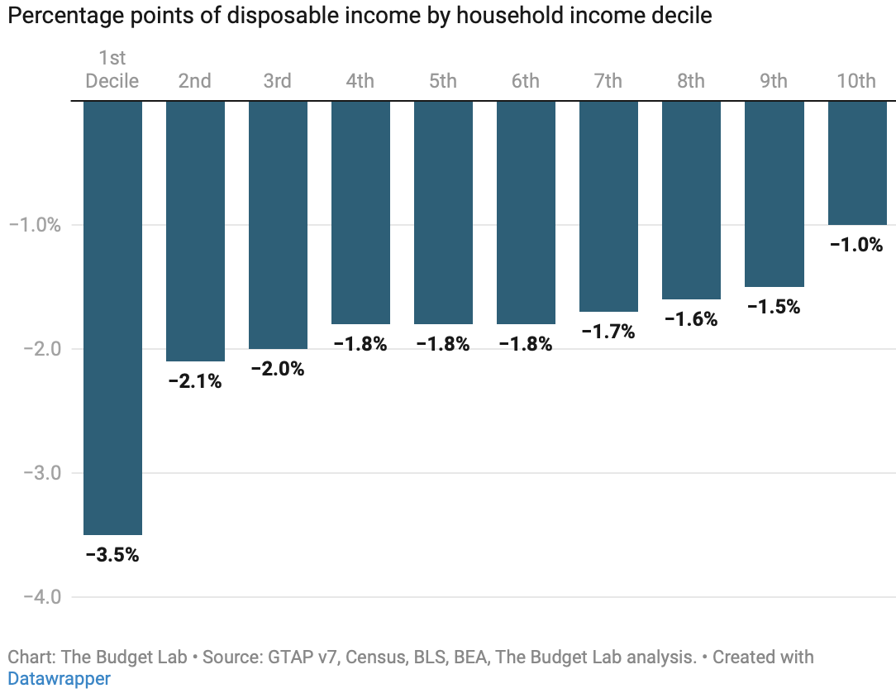
Effects of Tariffs on Households, As of 9/3
Poorer Richer
Notes:
https://budgetlab.yale.edu/research/where-we-stand-fiscal-economic-and-distributional-effects-all-us-tariffs-enacted-2025-through-April
Price increase of 2.3% in the short-run.

Slide 70
Other effects of a Tariff
Income distribution
  Tariffs, especially on China, raise prices of the products disproportionately bought by low-income consumers, hurting them more than high-income consumers.
Retaliation
  Other countries place tariffs on US exports.
  Trade war that started in 2018 continues and gets worse.
Corruption
  Historically, tariffs prompted both smuggling and bribes to customs officers.
  Today, in the US, those are less likely.
  But requests for exemptions from tariffs may be accompanied by favors or political contributions.

Slide 71
That Brings us to Tariffs and Democracy

Slide 72
Tariffs and Democracy
Power to tax rests with Congress.
  Perhaps understanding the temptation to corruption?
  Wresting this power from Congress and putting it in the hands of one person is anathema to democracy.
    Lack of accountability.
Empowers Lobbyists and Corporations
  There is an application process for exemptions.
  SOME injured parties get relief.

Slide 73
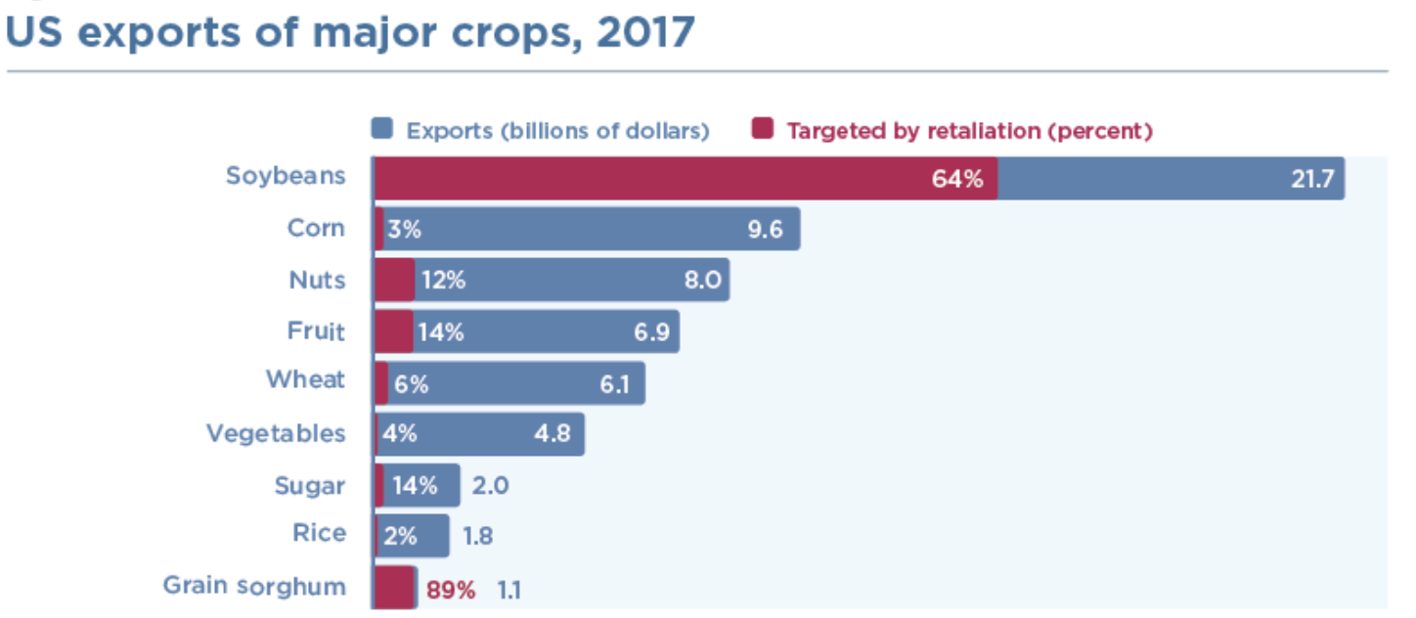
Subsidies to American Farmers
$12 billion subsidy to help American farmers for their lost export sales.
Notes:
https://www.piie.com/blogs/trade-and-investment-policy-watch/2018/first-tariffs-then-subsidies-soybeans-illustrate

Slide 74
Tariff Exemptions
Both the metals tariffs and the China tariffs permitted certain products and product categories to be exempted.
  Whether tariffs would impose significant harm on American business interests.
  Whether substitute products were available outside China.
  Whether the products were “strategically important” to China.

Slide 75
Trump Tariff Exemptions (Spoils system?)
Trump administration’s decisions on exclusions were mysterious and arbitrary.
  “Tariff exemptions were given
    to Bibles but not to textbooks,
    to salmon but not to pollock,
    to children’s car seats but not to baby cribs.
  The decisions were not subject to appeal.”
  Study found:
    Contributions to Republicans made China exemptions more likely.
    Contributions to Democrats made China exemptions less likely.
    Author quoted as saying the exclusion process was “a very effective spoils system”.
Notes:
Swanson, “Trump’s Trade Agenda Could Benefit Friends and Punish Rivals,” NYT, 11/24/24
https://nytimes.com/2024/11/23/us/politics/trump-tariff-exemptions.html

Slide 76
Where do Things Stand?

Slide 77
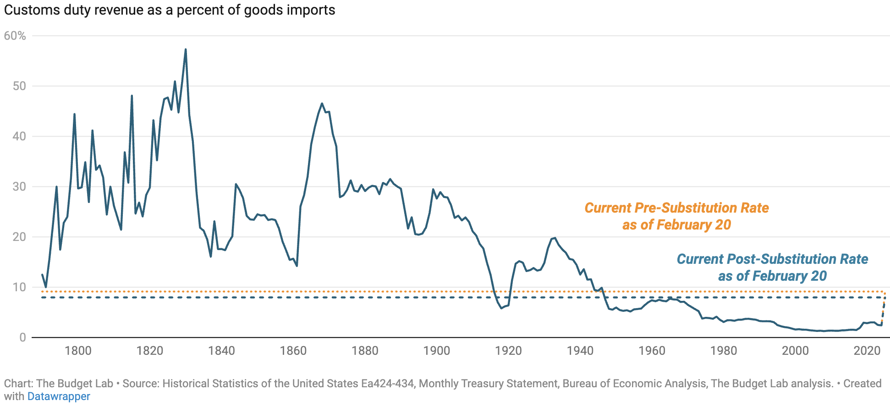
Average Effective Tariffs
Supreme Court just played Whack-A-Mole.
Out with IEEPA
In with Sections 122, 232, and 301, and 338
2.4

Slide 78
Summary
Tariffs will:
  Not eliminate the U.S. trade deficit (in the long run).
    Increase in national savings could reduce the trade deficit.
  Not eliminate bilateral trade deficits.
  Decrease U.S. manufacturing production and employment.
  Increase prices for households, hurting the poor the most.
  Increase U.S. government revenues, but not enough to offset other tax cuts.
  Negatively impact U.S. economic growth.

Slide 79
Thank you!
Any Questions?
www.NEEDEcon.org
Jon D. Haveman, Ph.D.
Jon@NEEDEcon.org
Contact NEED: info@NEEDEcon.org
Submit a testimonial: www.NEEDEcon.org/testimonials.php
Support NEED: www.NEEDEcon.org/donate.php

