Slide 1
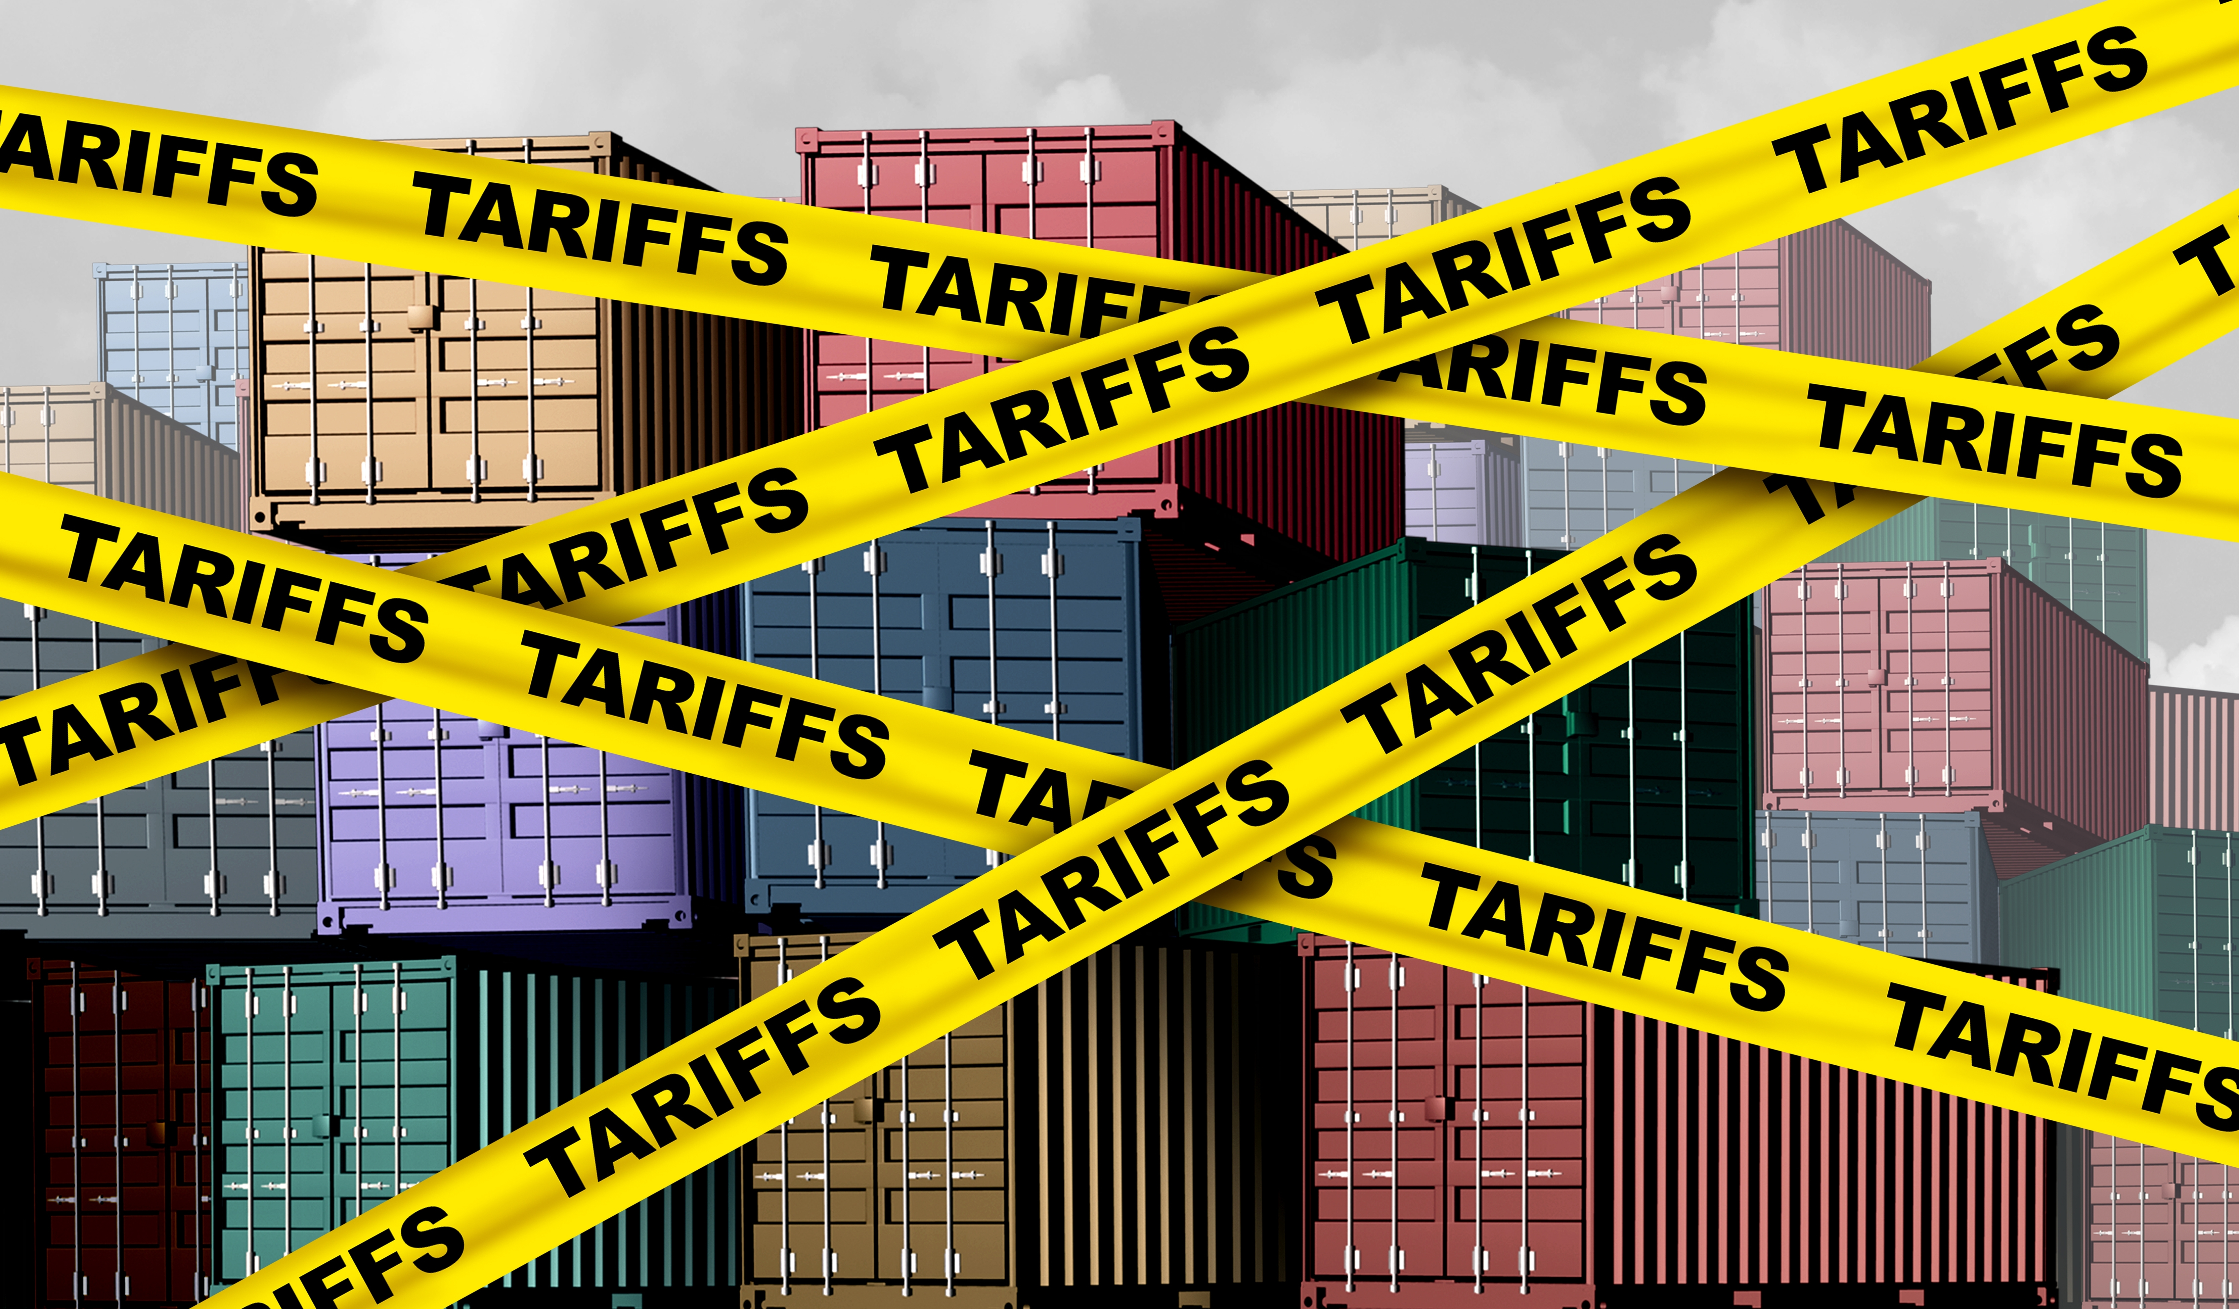
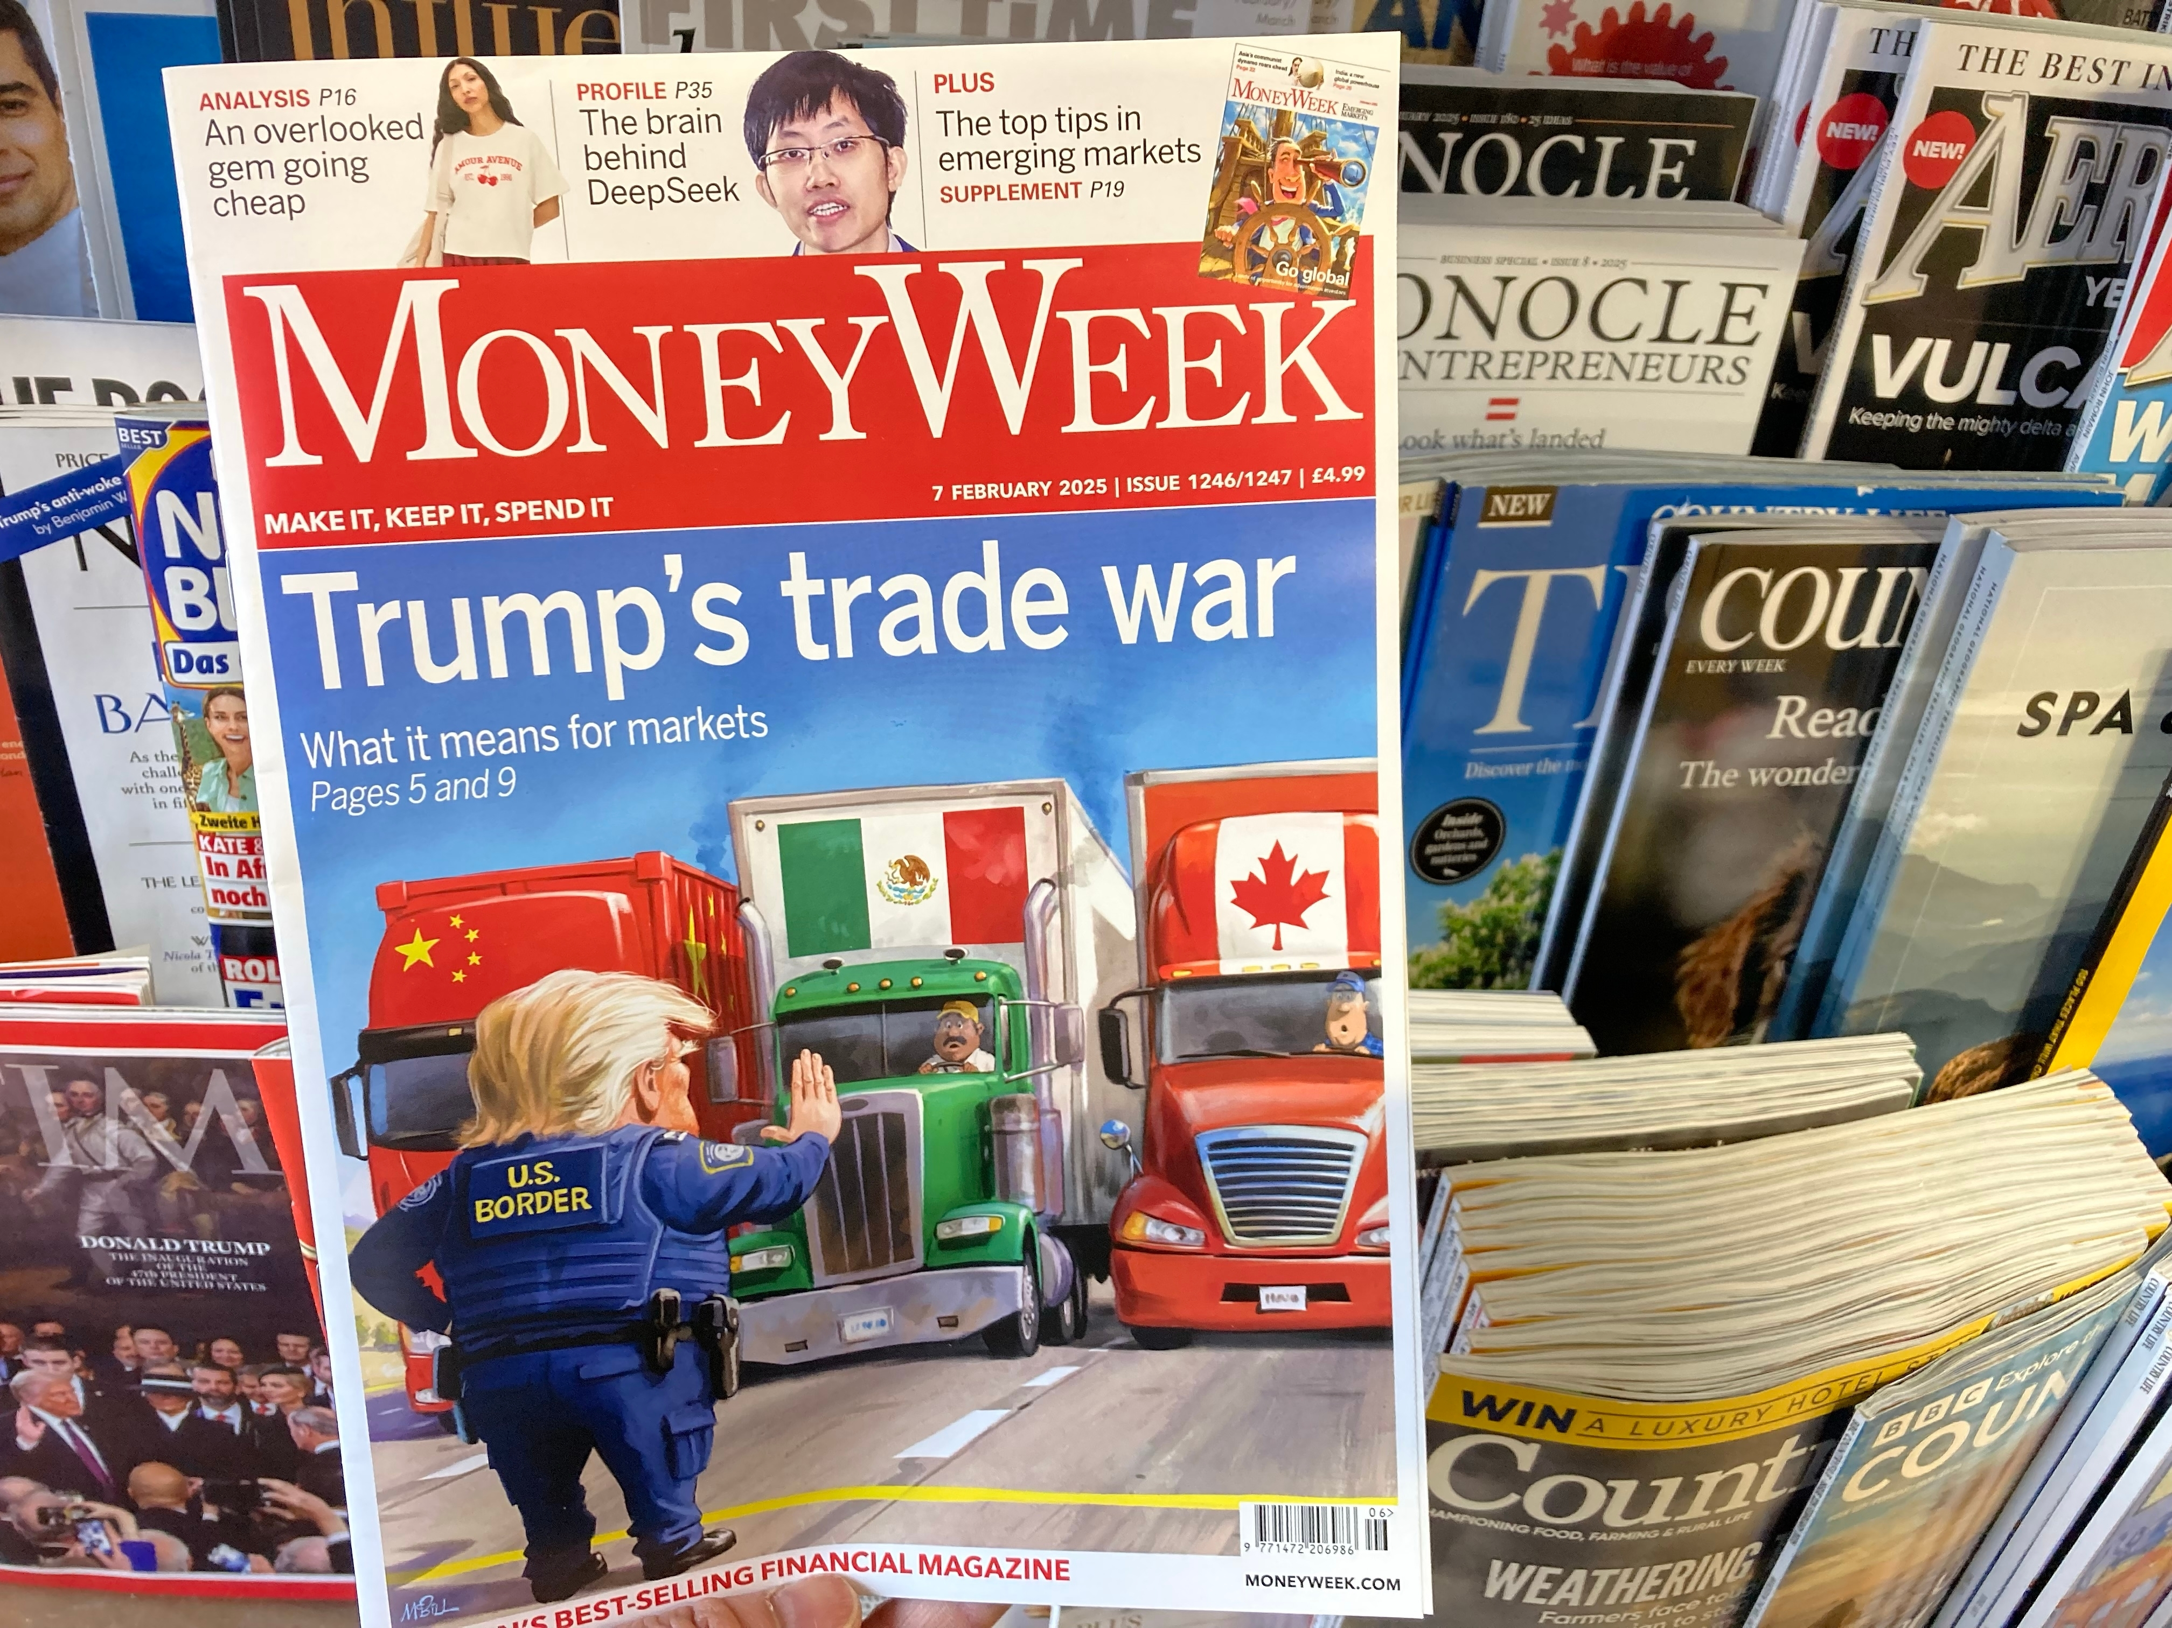
Trade Talk: The Latest on U.S. Tariffs
Ross Valley Rotary Club
San Rafael
August 5, 2026
Jon Haveman, Ph.D.
NEED, Executive Director

Slide 2
Why Are We Talking About Tariffs?
Liberation Day
Recent Canadian Tariffs
Bilateral tariffs
  Super simple formula
  Different tariffs for different countries
  Some very high tariffs > 50%
50-100% on:
  Hockey Sticks
  Seaweed
  Animal hides
  Dog leashes
  Knit hats
  Saddlery
  Plywood
  aluminum

Slide 3
About Tariffs

Slide 4
What Is a Tariff?
A tariff is a tax on imports.
  Paid to the government by the importer.
A 10% tariff on all imports would mean that:
  Whatever the foreign exporter charges for a product,
  US buyers will pay an extra 10% to the US government.
Domestic suppliers can also charge 10% more.
  And that’s kind of the whole point.

Slide 5
Economic Effects of a Tariff
A tariff is a tax on imports. It causes:
  A rise in the price of the imported good in the importing country,
  A fall in the price of the imported good in the exporting country,
  The quantity imported to fall, and
  Revenue for the tariff-levying government.
Almost always: the rise at home is much larger than the fall abroad.
  That’s especially true if importing country is small.
  But it’s also true if importing country is as large as the U.S.
    We learned this from Trump’s tariffs in 2018.
      Trump’s first administration tariffs caused US prices to rise, with hardly any perceptible fall in prices abroad.

Slide 6
Effects of a Tariff
The rise in price in the importing country causes:
  A rise in the price of import competing goods.
    Benefits to those producers.
    Harm to buyers of both the imported and domestic goods.
      Including producers that use the higher-priced goods as inputs.
        Their prices also rise, hurting their buyers.
  Employment changes:
    Increase in the protected industry.
    Decreases in industries that use the protected product as inputs.
Notes:
Example of 25% on steel

Slide 7
Are Tariffs A Good Idea?
Generally, economists don’t think so, but there are some reasons for them:
  National Defense – strategic resource
    Do we need the capacity to make our own computer chips, just in case?
    What about steel and aluminum?
  “Infant” Industry
  Unfair trade practices of exporting countries

Slide 8
US Tariff History

Slide 9
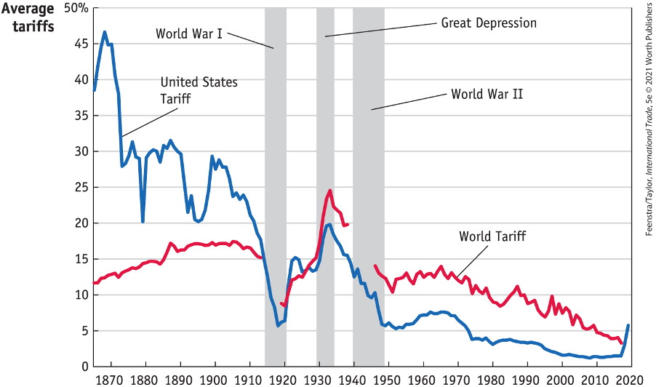
US Tariff History, 1860-2020
Source: Feenstra/Taylor, International Trade, 5e
Notes:
Late 1800s: growing influence of free trade advocates.
1913: Underwood-Simmons Tariff Act lowered tariffs and introduced the income tax, a more reliable source of revenue, reducing the government’s reliance on tariff revenue.
1930: The Smoot-Hawley Tariff Act, aimed to protect farmers and business from foreign competition, significantly raised tariffs on importing goods leading to retaliatory tariffs from other countries and a collapse in global trade and a worsening of the Great Depression.
1934: Reciprocal Trade Agreements Act empowered the President to negotiate trade agreements with other countries, allowing for reciprocal tariff reductions and promoting a shift towards freer trade.
1947: GATT
1995: WTO

Slide 10
Why Are We Even Talking About Tariffs Now?

Slide 11
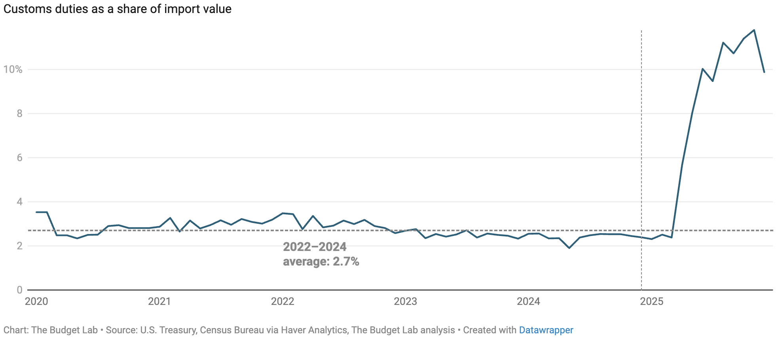
Recent Change In Tariffs
“Tariffs is the most beautiful word in the dictionary.”
- President Donald Trump

Slide 12
Provisions of U.S. Tariff Law

Slide 13
Provisions of U.S. Trade Law (part 1)
The Tariff Act of 1930, The Trade Expansion Act of 1962, and the Trade Act of 1974 describe conditions under which the United States can apply tariffs:
  Section 201 (of the Trade Act of 1974): Safeguard Tariff
  Section 232 (of the Trade Expansion Act of 1962): National Security
  Section 301 (of the Trade Act of 1974): Trade Agreements
  Section 122 (of the Trade Act of 1974): Balance of Payments
  Section 338 (of the Tariff Act of 1930): Discriminatory Trade

Slide 14
Liberation Day Tariffs: IEEPA
International Emergency Economic Powers Act (IEEPA)
  Emergency Powers: Grants the president authority to deal with unusual and extraordinary foreign threats upon declaring a national emergency.
  Permitted Actions: Allows for the regulation, blocking, or prohibition of international economic transactions and import/export property.
  Taxation Exclusion: Lacks explicit text or constitutional authorization for imposing revenue-generating tariffs or duties, which remain under Congressional purview.
Liberation Day tariffs invalidated in Feb. 2026 by the Supreme Court.

Slide 15
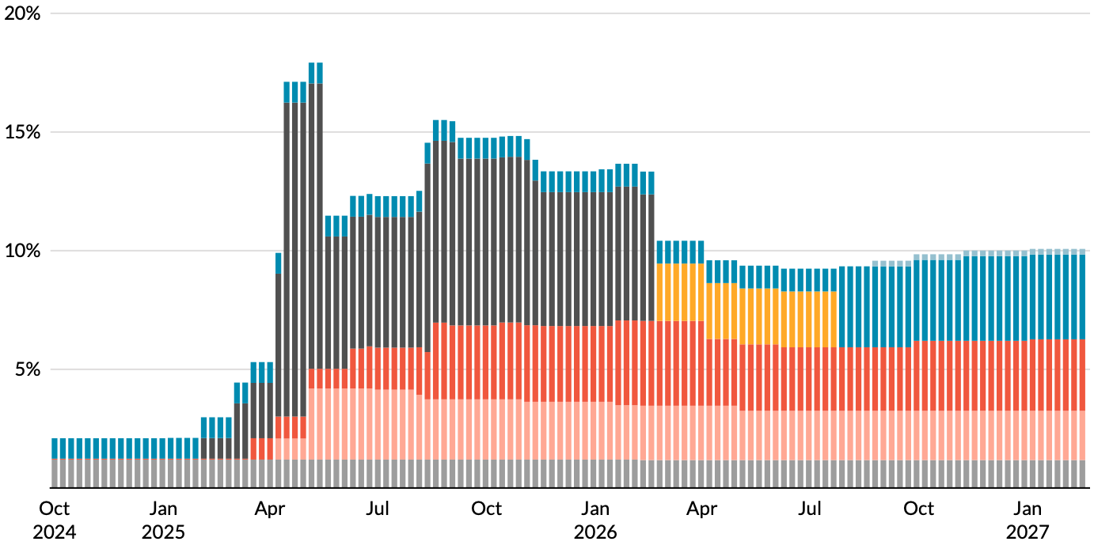
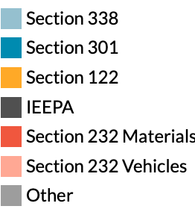
Tariffs by Type
Supreme Court
Ruling
Source: https://taxpolicycenter.org/features/tracking-trump-tariffs
Notes:
Late 1800s: growing influence of free trade advocates.
1913: Underwood-Simmons Tariff Act lowered tariffs and introduced the income tax, a more reliable source of revenue, reducing the government’s reliance on tariff revenue.
1930: The Smoot-Hawley Tariff Act, aimed to protect farmers and business from foreign competition, significantly raised tariffs on importing goods leading to retaliatory tariffs from other countries and a collapse in global trade and a worsening of the Great Depression.
1934: Reciprocal Trade Agreements Act empowered the President to negotiate trade agreements with other countries, allowing for reciprocal tariff reductions and promoting a shift towards freer trade.
1947: GATT
1995: WTO

Slide 16
President Trump’s Reasons for Tariffs
Our exports are being treated unfairly.
Bring back manufacturing employment.
Raising revenue – replace the income tax?
  Foreign companies would pay the tariffs (so he alleges).
National security
Foreign policy leverage

Slide 17
Unfair Treatment

Slide 18
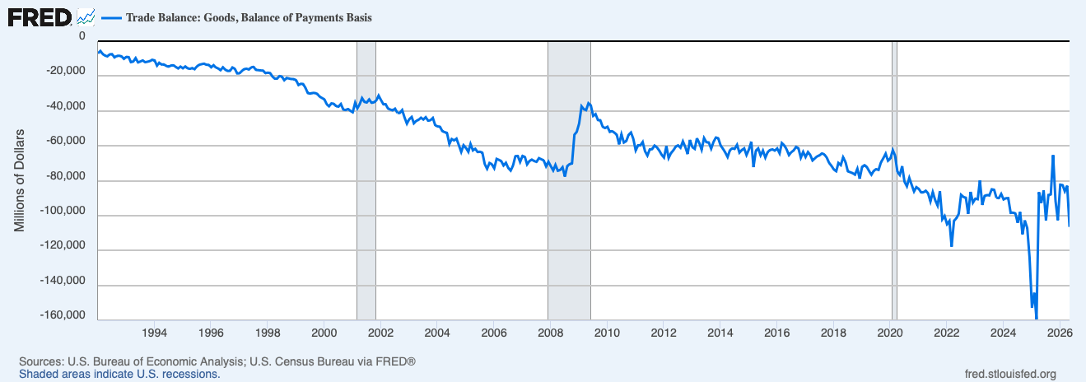
Evidence of Unfair Treatment: Trade Deficit
Y-axis is all big
Negative numbers:
Deficit
Trade Deficit: Imports > Exports

Slide 19
Is A Trade Deficit A Result of Unfair Treatment?
Intuitive, but no.
Have to look at the whole picture.
We trade not only goods and services, but also investment funds.
  The United States is a very attractive investment market.
  Selling Treasury securities to foreigners is an export.
  So we run an investment trade surplus.
Investment trade surplus = goods and services trade deficit
  Why? Exchange rates.
Will tariffs lower the trade deficit? No.

Slide 20
Trade Deficits are Driven by Investment Flows and Tariffs Can NOT “Fix” Them

Slide 21
Also… Exports
Lower imports make exports more expensive in foreign markets.
How?
  If fewer people are buying imports, the dollar appreciates.
    Fewer dollars available for those wanting to buy our exports.
  If the dollar appreciates, it takes more foreign currency to buy U.S. exports.
    Making exports more expensive.
Tariffs:
  Lower imports.
  But they also lower exports.
  Won’t necessarily reduce the trade deficit.

Slide 22
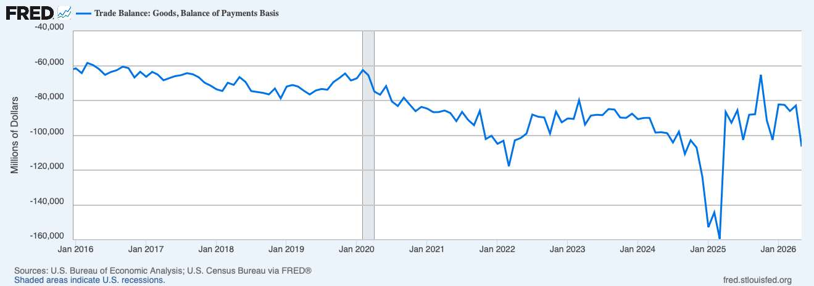
US Trade Deficit – Mixed Results with Tariffs
Most Recent
Trade War
Start of Trade Wars
Notes:
https://www.piie.com/blogs/realtime-economics/2025/trumps-trade-war-timeline-20-date-guide

Slide 23
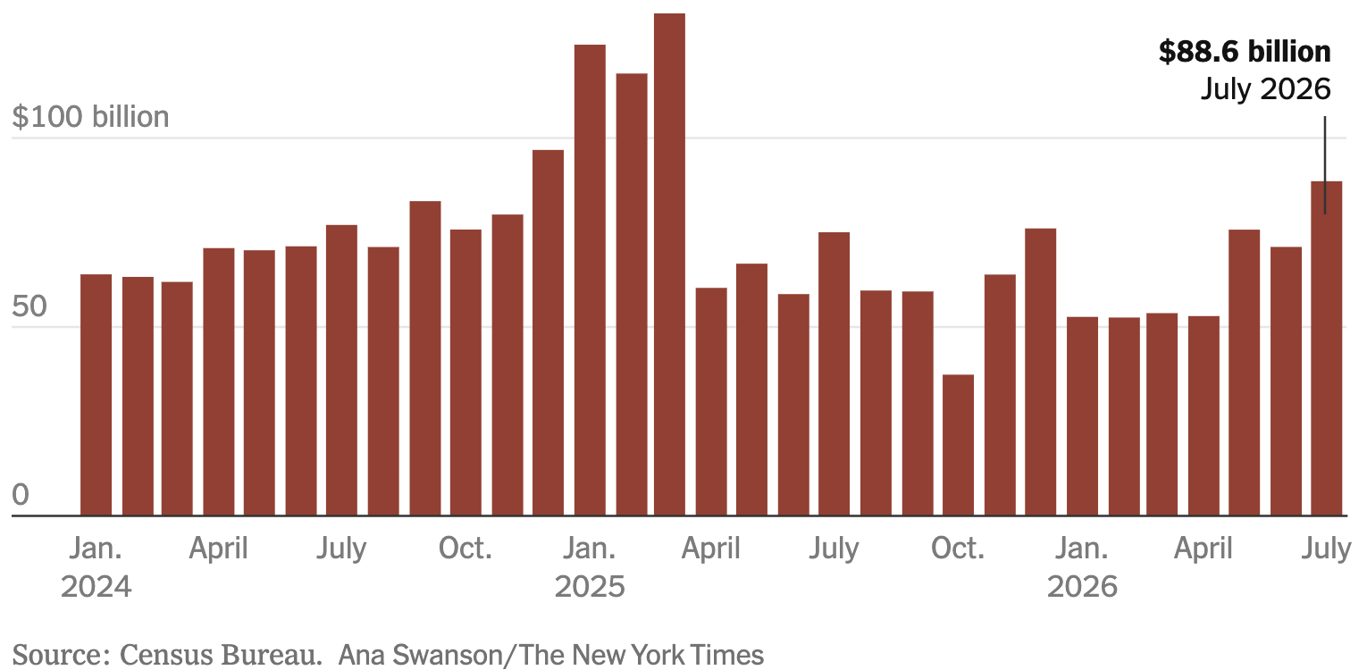
U.S. Trade Deficit in Goods and Services

Slide 24
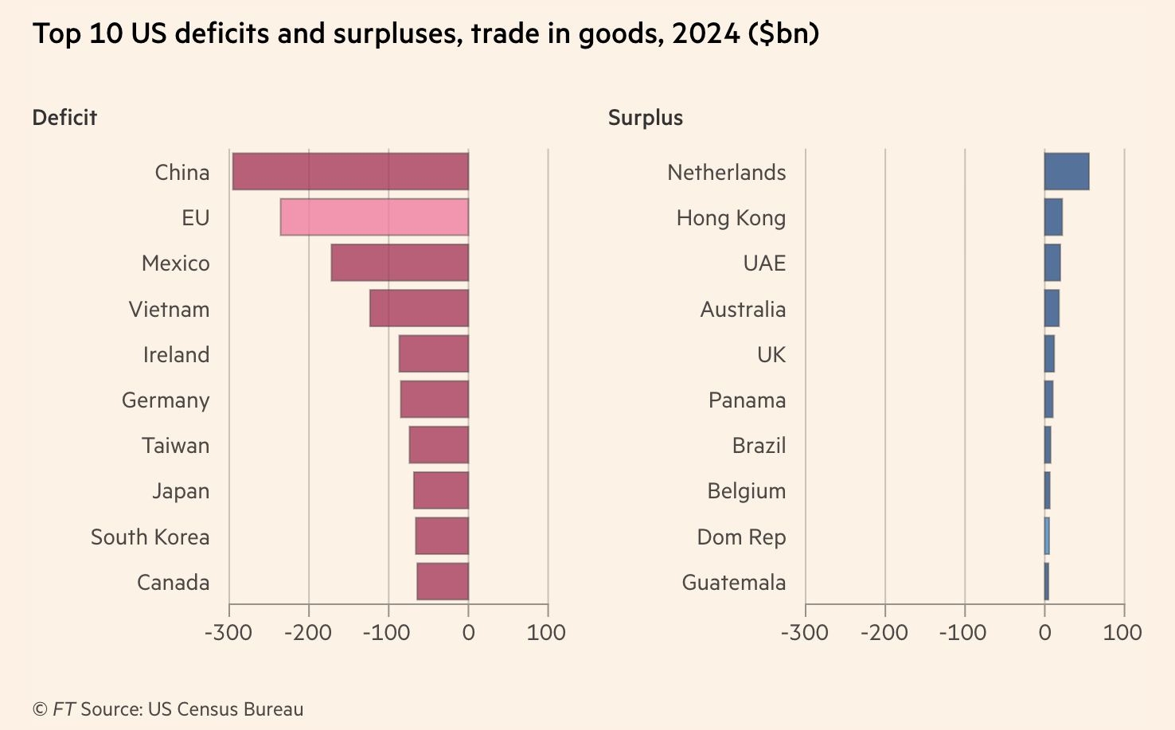
Reciprocal Trade and Tariffs
Notes:
https://www.piie.com/blogs/realtime-economics/2025/trumps-trade-war-timeline-20-date-guide
US-UK trade deal: which includes the potential for the UK to lower tariffs on US beef, and a US quota of 100,000 vehicles for the UK to export to the US at a tariff rate of 10 percent (and not the 25 percent additional tariff resulting from the Section 232 investigation).

Slide 25
Bring Back Manufacturing

Slide 26
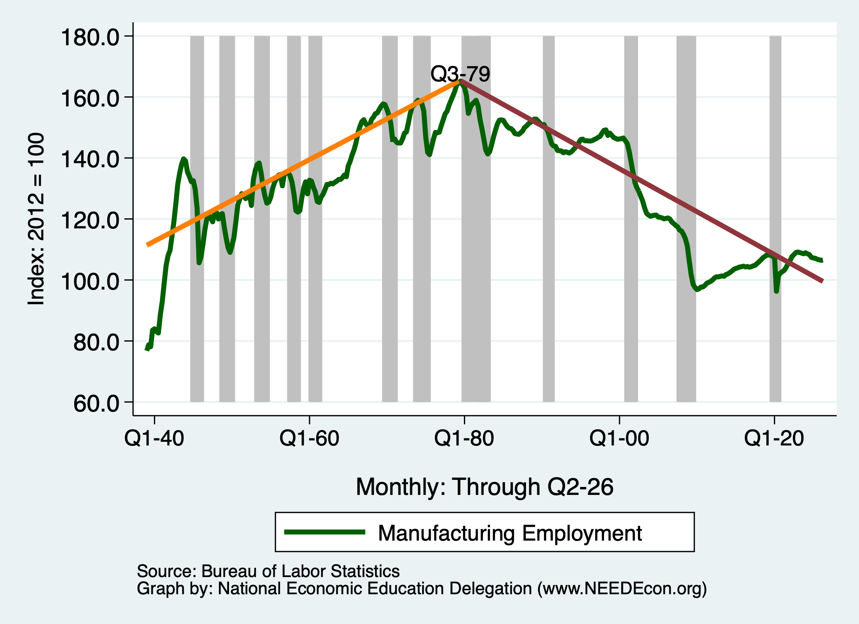
Growth in Manufacturing Employment?

Slide 27
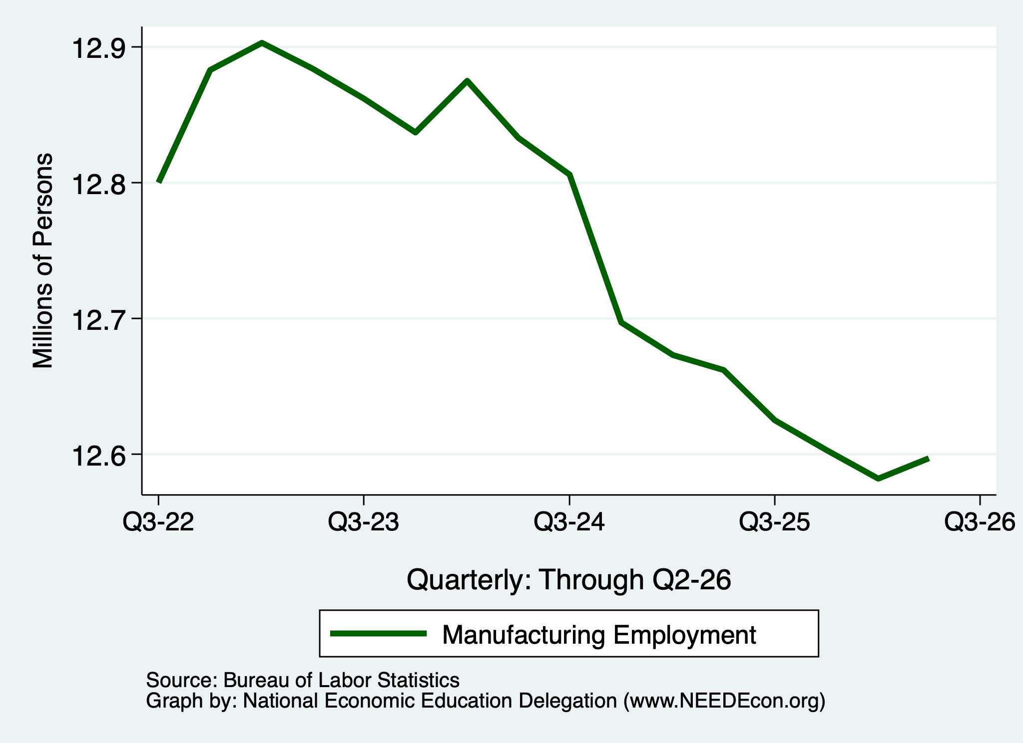
Growth in Manufacturing Employment?
Liberation Day

Slide 28
Tariffs and Manufacturing?
The argument has intuitive appeal.
  But doesn’t stand up to scrutiny.
Intuition: Making imports more expensive makes domestically produced goods more appealing.
But... Exports.
  We import clothing, toys, and furniture.
  We export airplanes and light trucks.
We can’t just make more of the one without sacrificing some of the other – limited resources.
And… Retaliation.

Slide 29
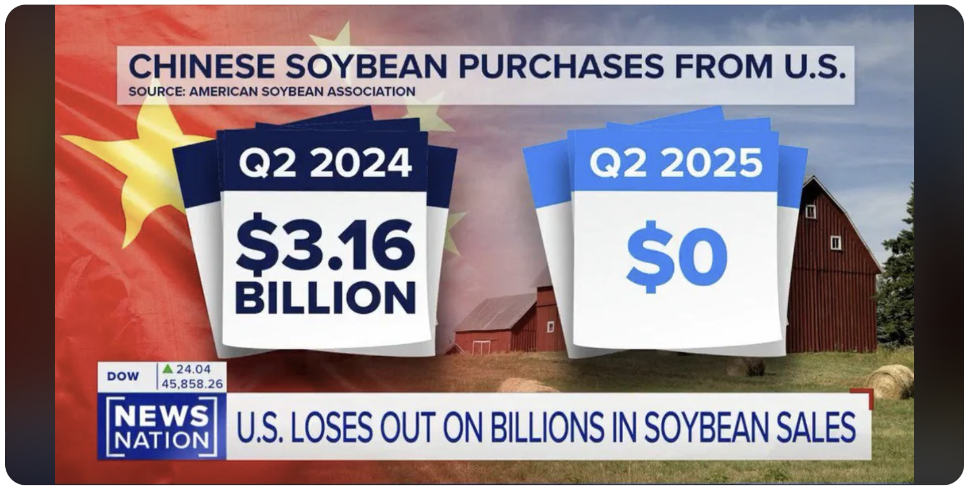

Slide 30
Raising Revenue

Slide 31
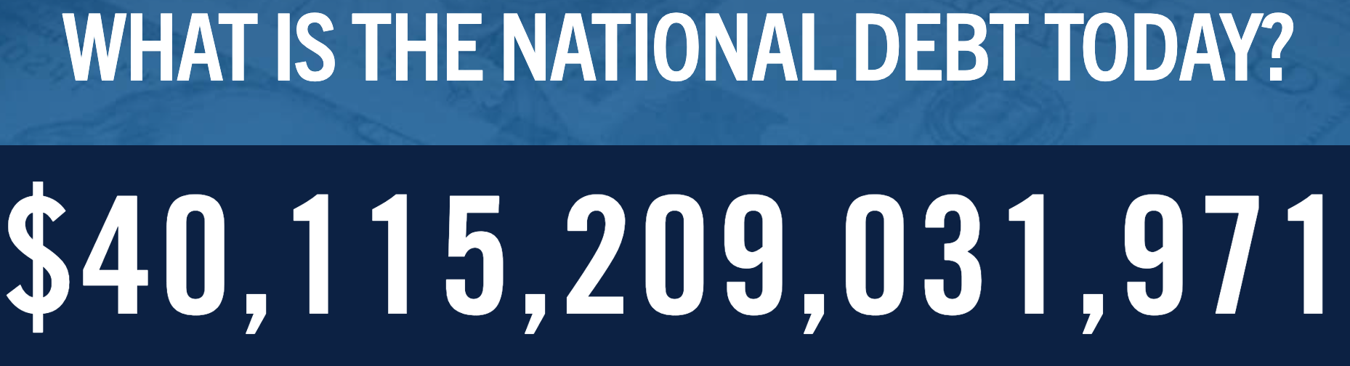
Source: https://www.pgpf.org/national-debt-clock/

Slide 32
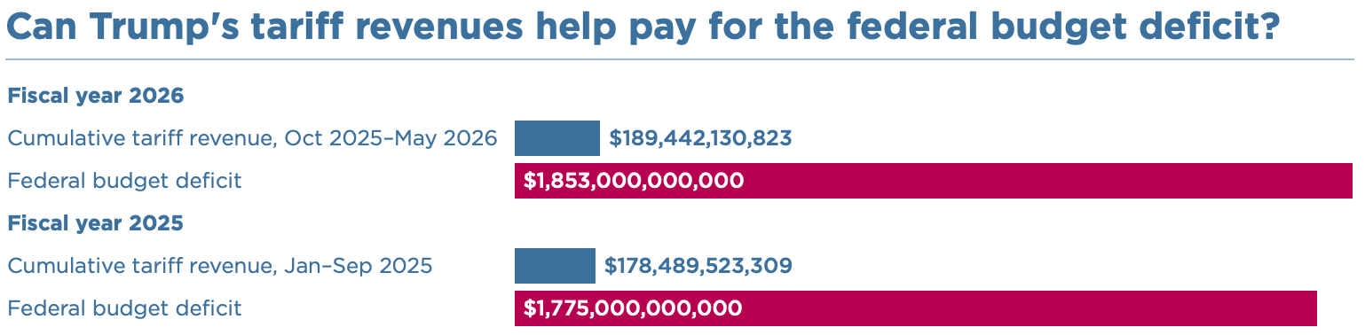
Raising Revenues?
Deficit? That’s almost 10 year’s worth of tariff revenue.
Eliminate the income tax?
  $2.4 Trillion in 2024 = 15 years of tariff revenues

Slide 33
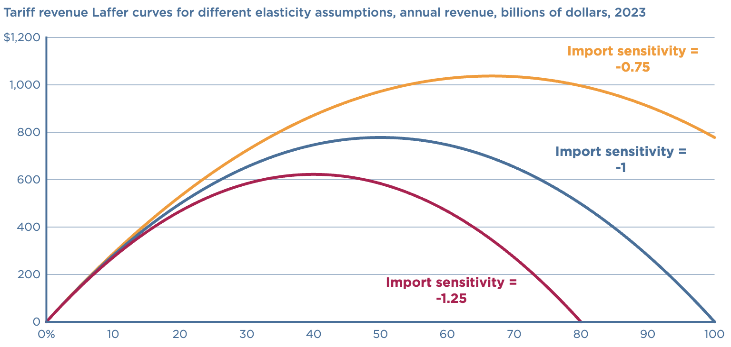
Replacing the Income Tax?
Revenue peaks well below
size of the income tax.
Peak revenue at 50%.
https://www.piie.com/blogs/realtime-economics/2024/can-trump-replace-income-taxes-tariffs

Slide 34
National Security

Slide 35
Steel and Aluminum Tariffs
If you put a tariff on something, its price goes up.
What other manufacturing industries use steel or aluminum?
ALL OF THEM!!
So, by putting tariffs on steel and aluminum, you jeopardize other industries.
Is it worth it? Maybe.

Slide 36
Tariffs on Metals in Trump 1
The prices of steel and aluminum increased shortly after the tariff was implemented.
The number of jobs in iron, steel, and aluminum mills rose temporarily by about 12,000, from 2017 to 2019.
Downstream industries (e.g., auto) faced higher input costs.
  Several studies estimated that the increased costs driven by tariffs may have resulted in 75,000 fewer manufacturing jobs.
Notes:
https://www.reuters.com/graphics/TRUMP-TARIFFS/STEEL/gdpznwgdzpw/

Slide 37
Who Pays?

Slide 38
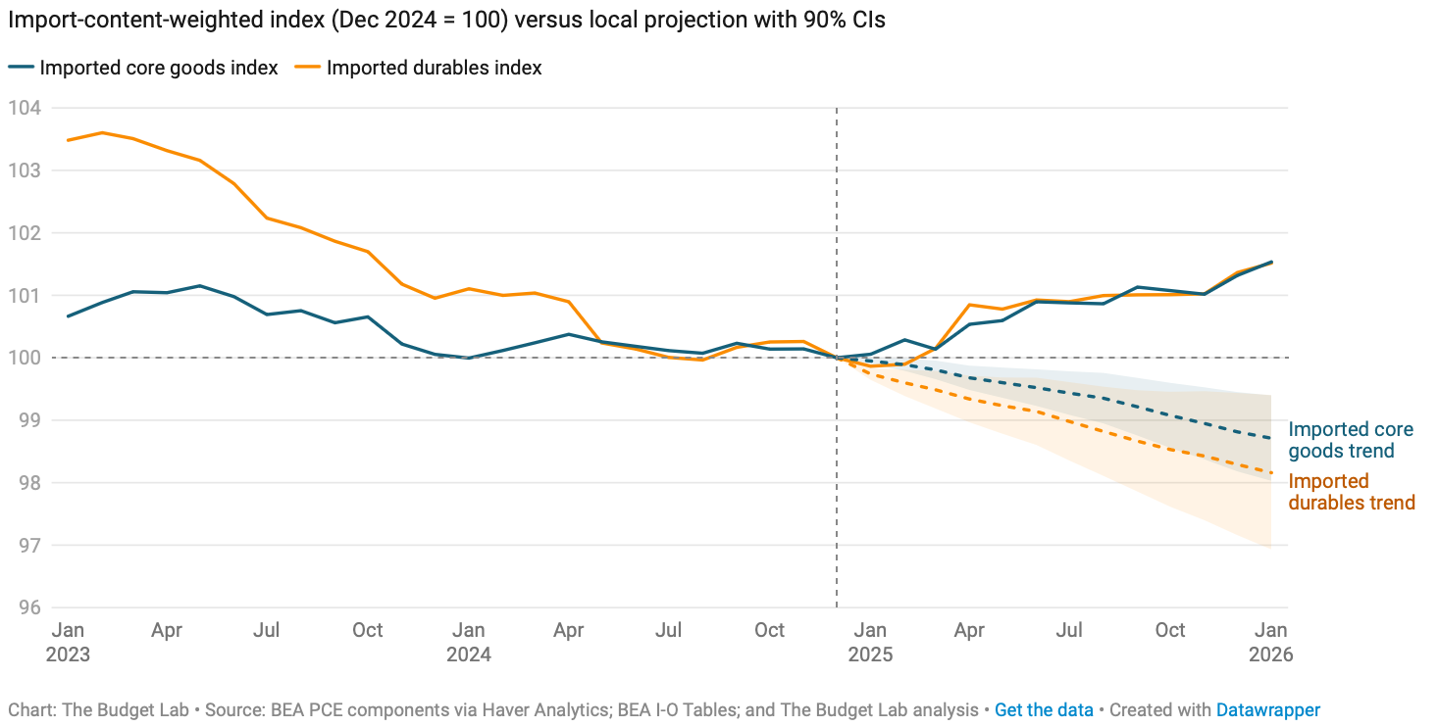
What About Prices?
Increasingly, it’s consumers.
Source: https://budgetlab.yale.edu/research/tracking-economic-effects-tariffs

Slide 39
To Review:

Slide 40
President Trump’s Reasons for Tariffs
Our exports are being treated unfairly.
  Not a problem that tariffs will fix.
Bring back manufacturing employment.
  Benefits some and harms others.
Raising revenue – replace the income tax?
  Will raise some, but will harm poorer households.
National security
  Maybe, but at what cost?
Is China paying?
  So far, some, but not much.

Slide 41
Why is He Really Imposing Tariffs?
Who knows?!
To exert U.S. power and elicit submission from other countries.
To force submission by domestic businesses.

Slide 42
Summary
Tariffs will:
  Not eliminate the U.S. trade deficit (in the long run).
    Increase in national savings could reduce the trade deficit.
  Not eliminate bilateral trade deficits.
  Decrease U.S. manufacturing production and employment.
  Increase prices for households, hurting the poor the most.
  Increase U.S. government revenues, but not enough to offset other tax cuts.
  Negatively impact U.S. economic growth.

Slide 43
Thank you!
Any Questions?
www.NEEDEcon.org
Jon D. Haveman, Ph.D.
Jon@NEEDEcon.org
Contact NEED: info@NEEDEcon.org
Submit a testimonial: www.NEEDEcon.org/testimonials.php
Support NEED: www.NEEDEcon.org/donate.php

