Slide 1
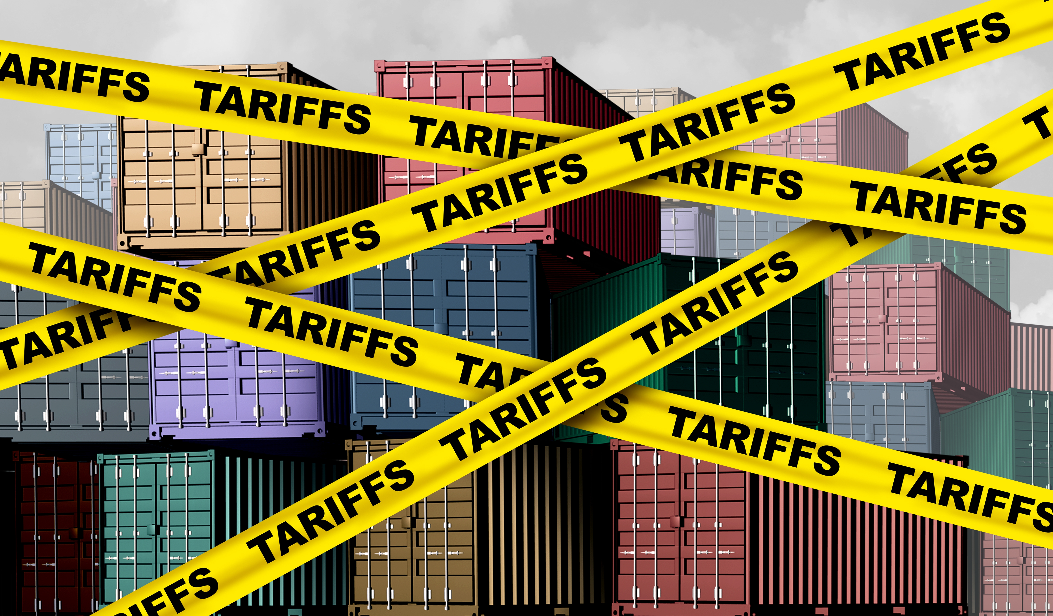
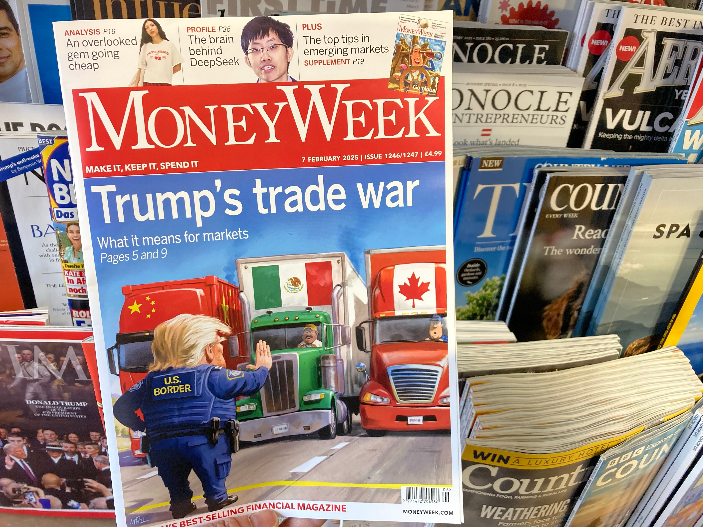
Trade Talk: The Latest on U.S. Tariffs
Conference on Democracy
Marin Academy
March 18, 2026
Jon Haveman, Ph.D.
NEED, Executive Director

Slide 2
What Is a Tariff?
A tariff is a tax on imports.
  Paid to the government by the importer.
A 10% tariff on all imports would mean that:
  Whatever the foreign exporter charges for a product,
  US buyers will pay an extra 10% to the US government.
Domestic suppliers can also charge 10% more.
  And that’s kind of the whole point.

Slide 3
US Tariff History

Slide 4
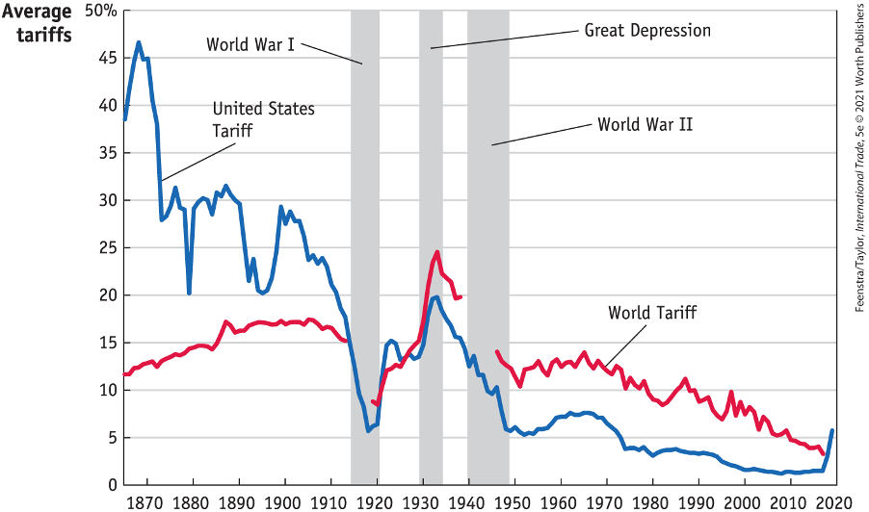
US Tariff History, 1860-2020
Source: Feenstra/Taylor, International Trade, 5e
Notes:
Late 1800s: growing influence of free trade advocates.
1913: Underwood-Simmons Tariff Act lowered tariffs and introduced the income tax, a more reliable source of revenue, reducing the government’s reliance on tariff revenue.
1930: The Smoot-Hawley Tariff Act, aimed to protect farmers and business from foreign competition, significantly raised tariffs on importing goods leading to retaliatory tariffs from other countries and a collapse in global trade and a worsening of the Great Depression.
1934: Reciprocal Trade Agreements Act empowered the President to negotiate trade agreements with other countries, allowing for reciprocal tariff reductions and promoting a shift towards freer trade.
1947: GATT
1995: WTO

Slide 5
Why Are We Even Talking About Tariffs?

Slide 6
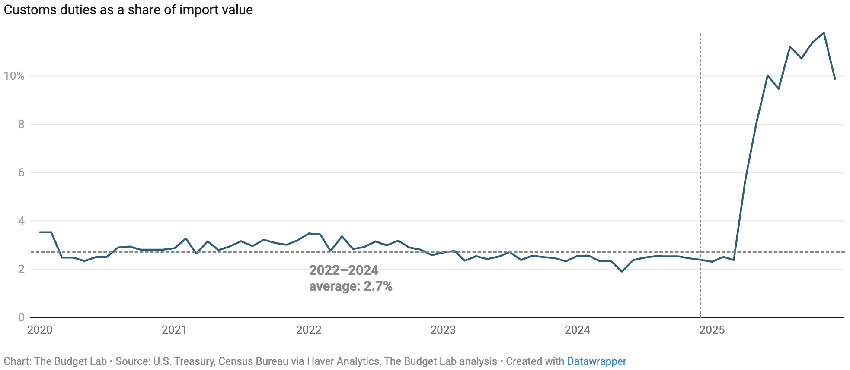
Recent Change In Tariffs
“Tariffs is the most beautiful word in the dictionary.”
- President Donald Trump

Slide 7
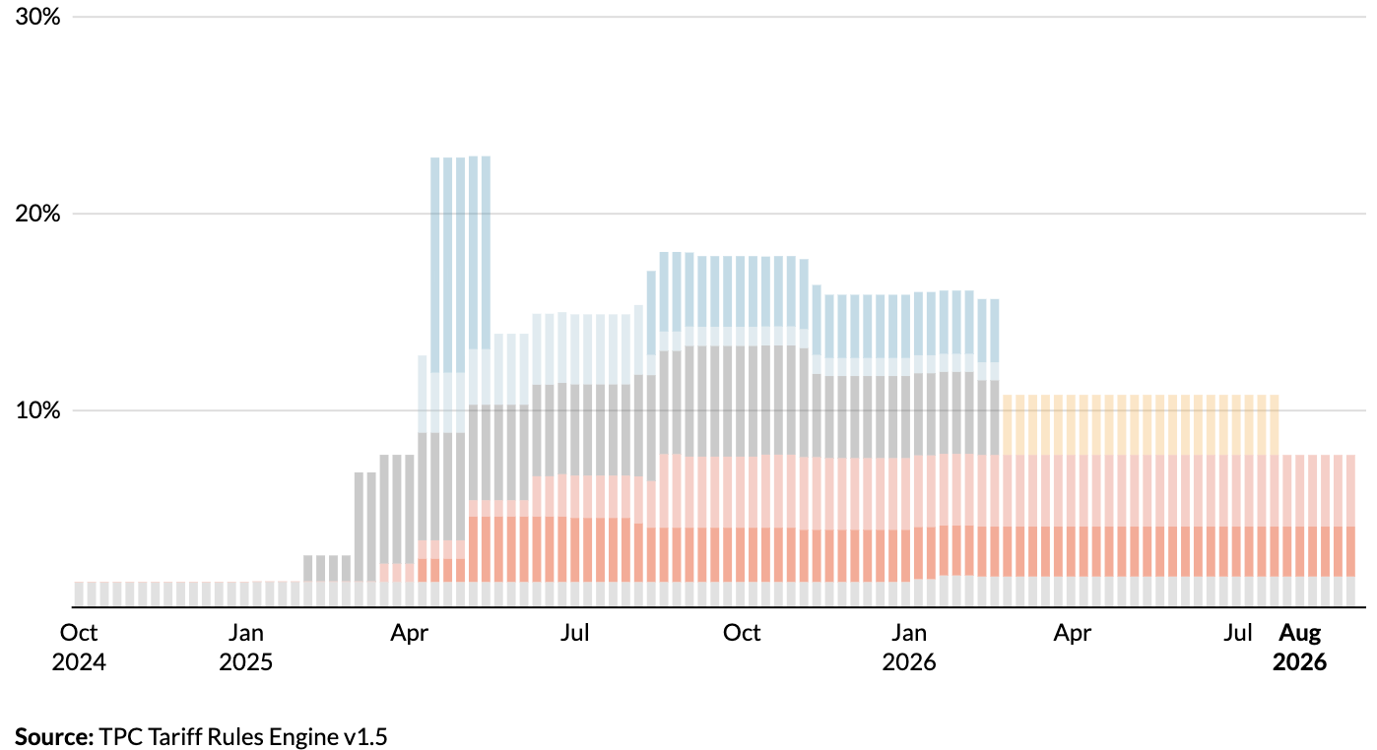
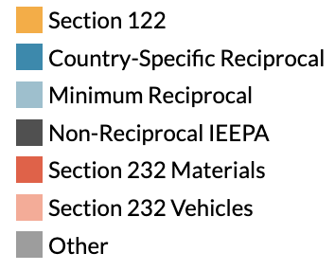
Tariffs by Type
Supreme Court
Ruling
Source: https://taxpolicycenter.org/features/tracking-trump-tariffs
Notes:
Late 1800s: growing influence of free trade advocates.
1913: Underwood-Simmons Tariff Act lowered tariffs and introduced the income tax, a more reliable source of revenue, reducing the government’s reliance on tariff revenue.
1930: The Smoot-Hawley Tariff Act, aimed to protect farmers and business from foreign competition, significantly raised tariffs on importing goods leading to retaliatory tariffs from other countries and a collapse in global trade and a worsening of the Great Depression.
1934: Reciprocal Trade Agreements Act empowered the President to negotiate trade agreements with other countries, allowing for reciprocal tariff reductions and promoting a shift towards freer trade.
1947: GATT
1995: WTO

Slide 8
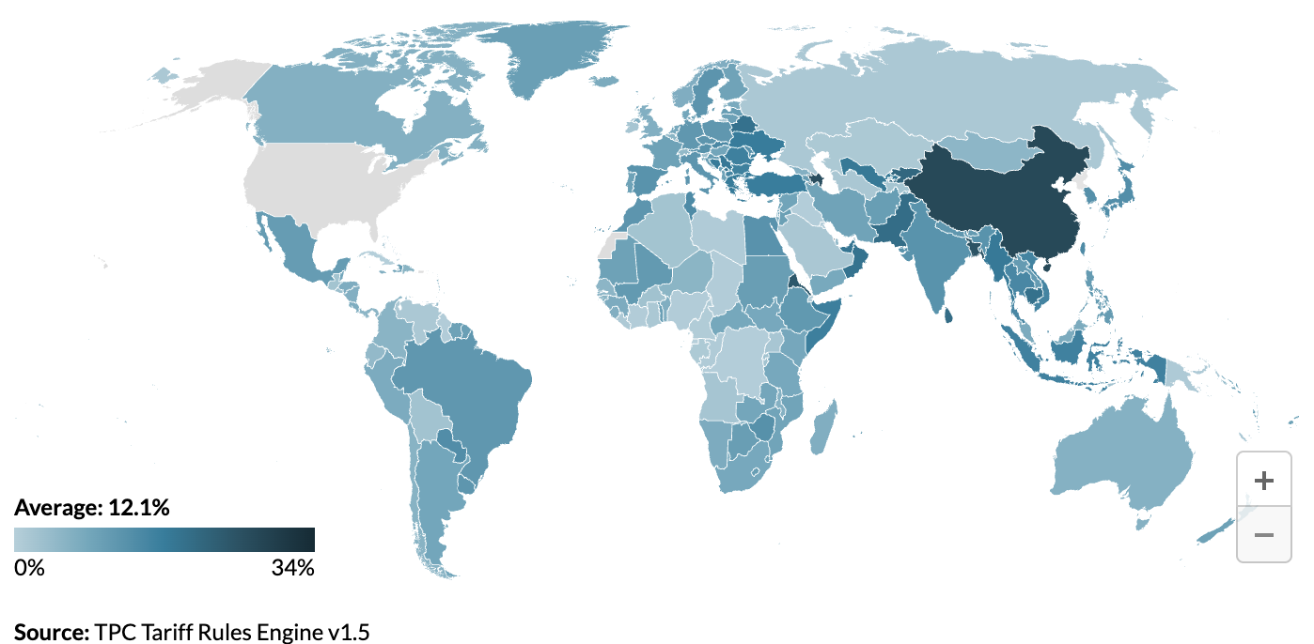
Average Tariff Rate, by Country
Source: https://taxpolicycenter.org/features/tracking-trump-tariffs

Slide 9
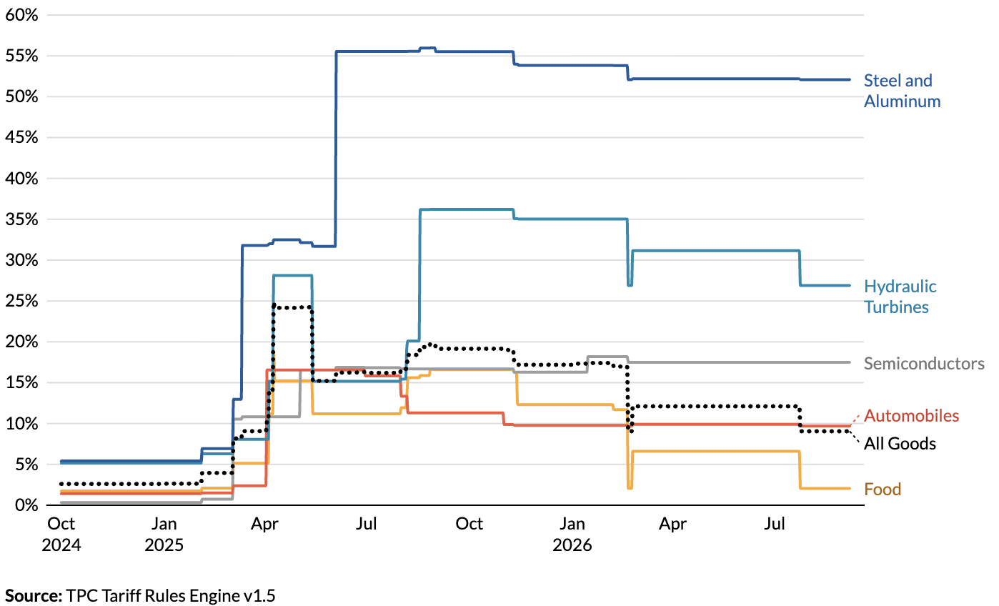
Average Tariff Rate, by Selected Goods
Future ->
Source: https://taxpolicycenter.org/features/tracking-trump-tariffs

Slide 10
Are Tariffs A Good Idea?
Generally, economists don’t think so, but there are some reasons for them:
  National Defense – strategic resource
    Do we need the capacity to make our own computer chips, just in case?
    What about steel and aluminum?
  “Infant” Industry
  Unfair trade practices of exporting countries

Slide 11
President Trump’s Reasons for Tariffs
Our exports are being treated unfairly.
Bring back manufacturing employment.
Raising revenue – replace the income tax?
  Foreign companies would pay the tariffs.
National security
Foreign policy leverage

Slide 12
Unfair Treatment

Slide 13
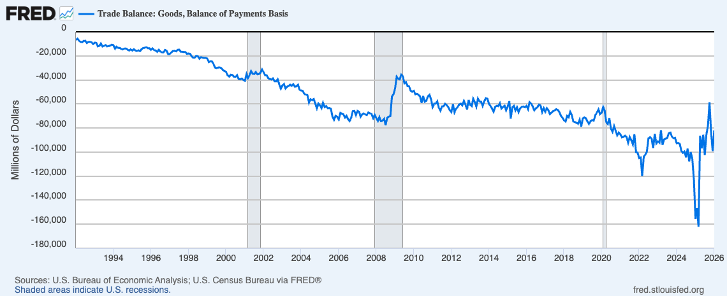
Evidence of Unfair Treatment: Trade Deficit
Y-axis is all big
Negative numbers:
Deficit
Trade Deficit: Imports > Exports

Slide 14
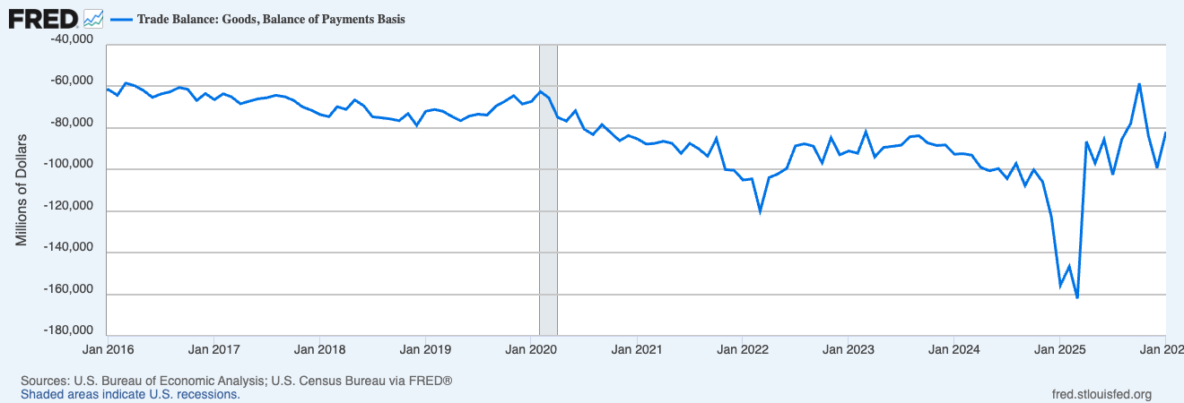
US Trade Deficit – Mixed Results with Tariffs
Most Recent
Trade War
Start of Trade Wars
Notes:
https://www.piie.com/blogs/realtime-economics/2025/trumps-trade-war-timeline-20-date-guide

Slide 15
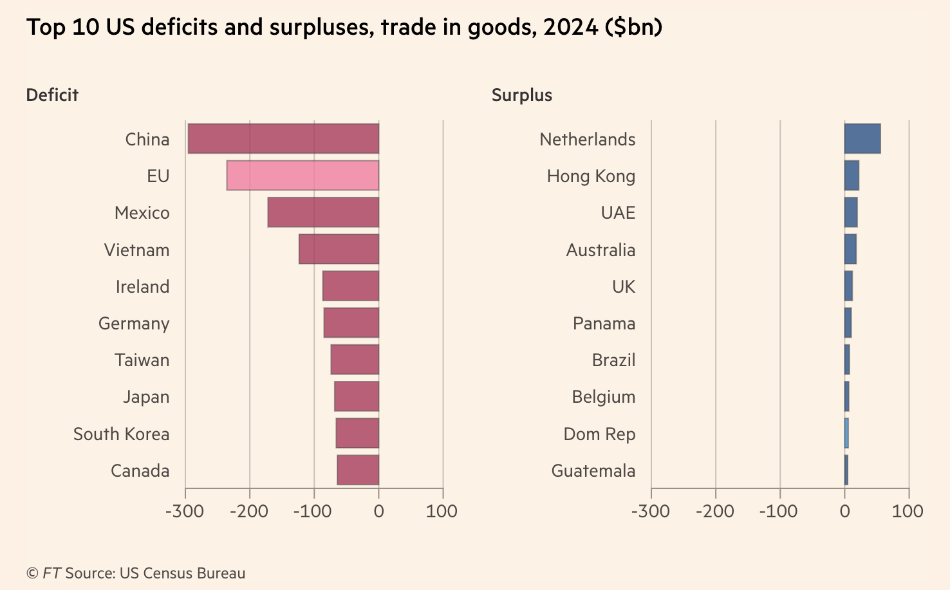
Reciprocal Trade and Tariffs
Formula:
Tariff = Exports-Imports
Exports
Notes:
https://www.piie.com/blogs/realtime-economics/2025/trumps-trade-war-timeline-20-date-guide
US-UK trade deal: which includes the potential for the UK to lower tariffs on US beef, and a US quota of 100,000 vehicles for the UK to export to the US at a tariff rate of 10 percent (and not the 25 percent additional tariff resulting from the Section 232 investigation).

Slide 16

Example, Lesotho (2022 data)
“Reciprocal” Tariff = 50%
Total trade: $240 Million
Facts about Lesotho:
GDP per capita =$1,073;
Population= 2.1 million
Trade balance= -$234 million
Average tariff rate against US = 10%
https://www.imf.org/en/Publications/WEO/weo-database/2024/October, https://wits.worldbank.org/CountryProfile/en/USA
Notes:
99% textiles. 2000 African Growth and Opportunity Act 0 tariffs on textiles

Slide 17
Is A Trade Deficit A Result of Unfair Treatment?
Intuitive, but no.
Have to look at the whole picture.
We trade not only goods and services, but also investment funds.
  The United States is a very attractive investment market.
  Selling Treasury securities to foreigners is an export.
  So we run an investment trade surplus.
Investment trade surplus = goods and services trade deficit
  Why? Exchange rates.
Will tariffs lower the trade deficit? No.

Slide 18
Trade Deficits are Driven by Investment Flows and Tariffs Can NOT “Fix” Them

Slide 19
Also… Exports
Lower imports make exports more expensive in foreign markets.
How?
  If fewer people are buying imports, the dollar appreciates.
    Fewer dollars available for those wanting to buy exports.
  If the dollar appreciates, it takes more foreign currency to buy U.S. exports.
    Making exports more expensive.
Tariffs:
  Lower imports.
  But they also lower exports.
  Won’t necessarily reduce the trade deficit.

Slide 20
Bring Back Manufacturing

Slide 21
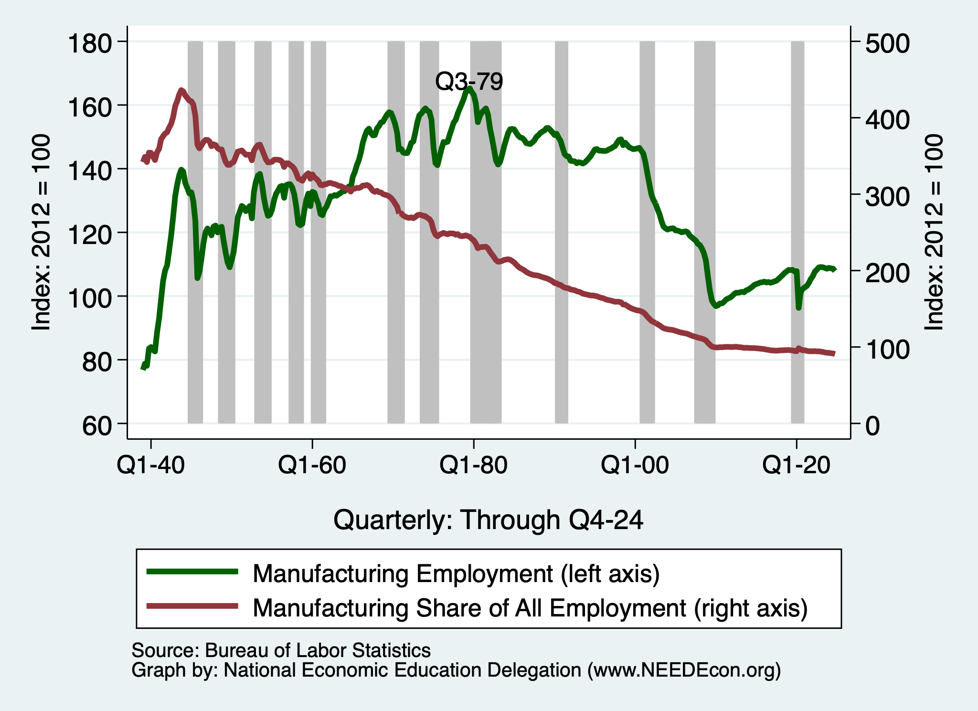
What is Wrong with Manufacturing Employment?
Since 1979, manufacturing
employment has fallen by
about 1/3.

Slide 22
Tariffs and Manufacturing?
The argument has intuitive appeal.
  But doesn’t stand up to scrutiny.
Intuition: Making imports more expensive makes domestically produced goods more appealing.
But... Exports.
  We import clothing, toys, and furniture.
  We export airplanes and light trucks.
We can’t just make more of the one without sacrificing some of the other – limited resources.
And… Retaliation.

Slide 23
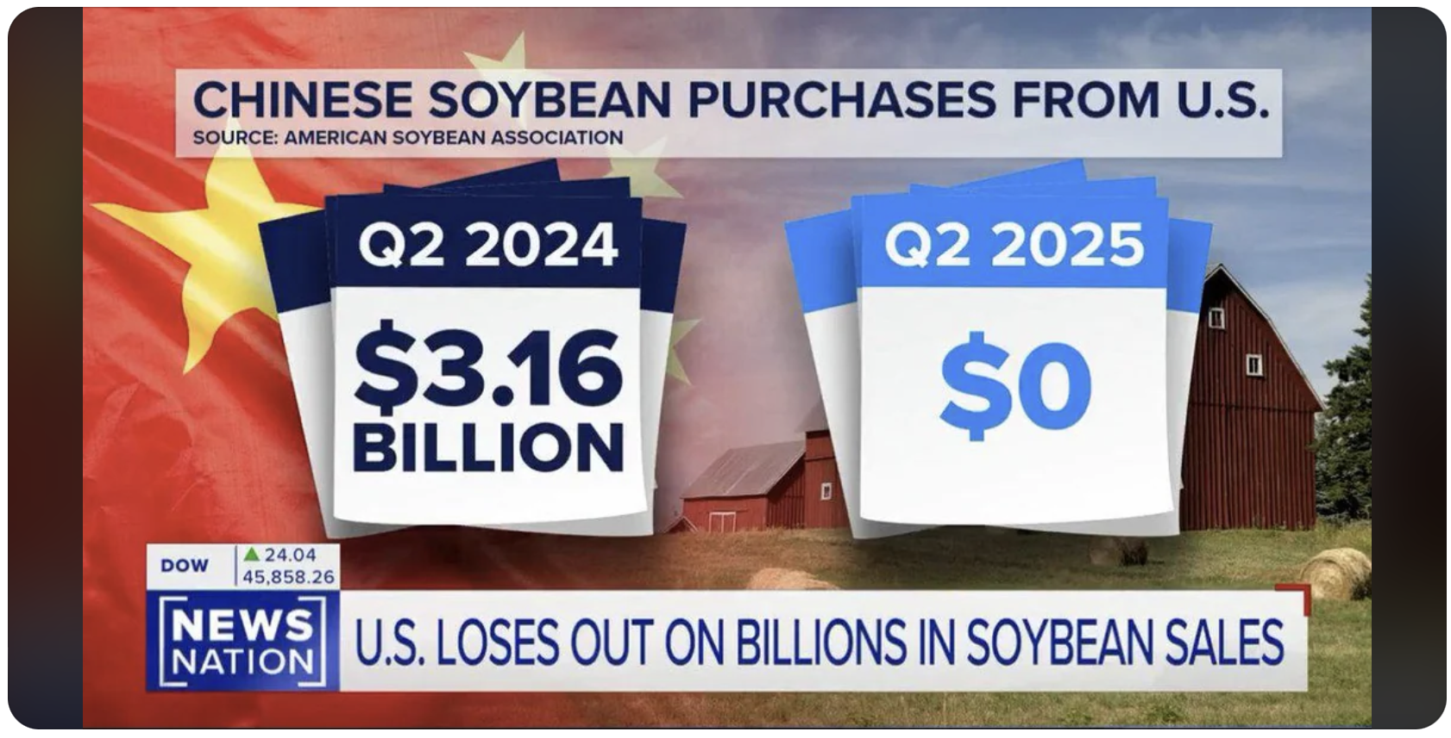

Slide 24
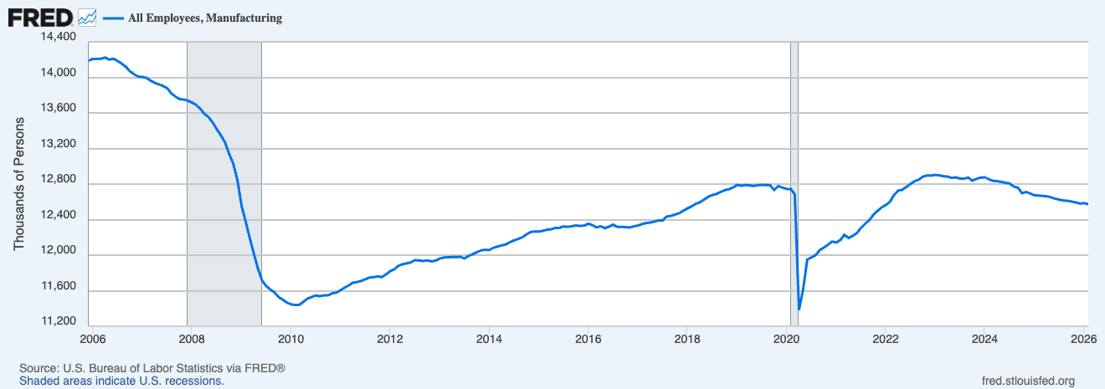
U.S. Manufacturing Employment
Effect of tariffs?
Notes:
https://www.nber.org/system/files/working_papers/w25638/w25638.pdf
https://www.nber.org/papers/w26396
https://www.federalreserve.gov/econres/feds/files/2019086pap.pdf
https://www.nber.org/papers/w32082#fromrss
https://taxfoundation.org/research/all/federal/trump-tariffs-trade-war/#:~:text=A%20March%202019%20National%20Bureau,of%20higher%20after%2Dduty%20prices.

Slide 25
Raising Revenue

Slide 26
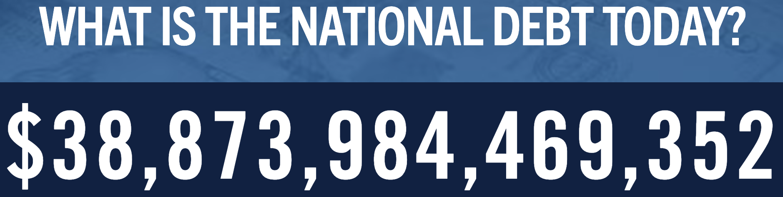
Source: https://www.pgpf.org/national-debt-clock/

Slide 27
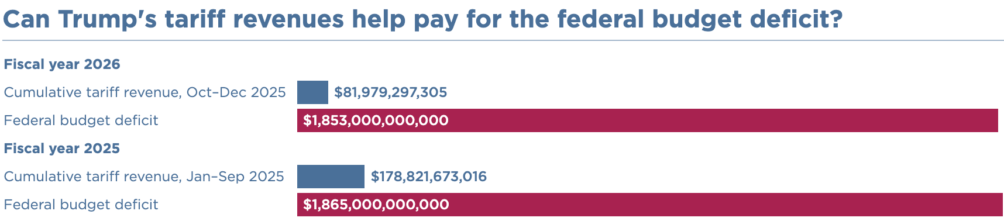
Raising Revenues?
Deficit? That’s 5 year’s worth of tariff revenue.
Eliminate the income tax?
  $2.4 Trillion in 2024 = 10 years of tariff revenues

Slide 28
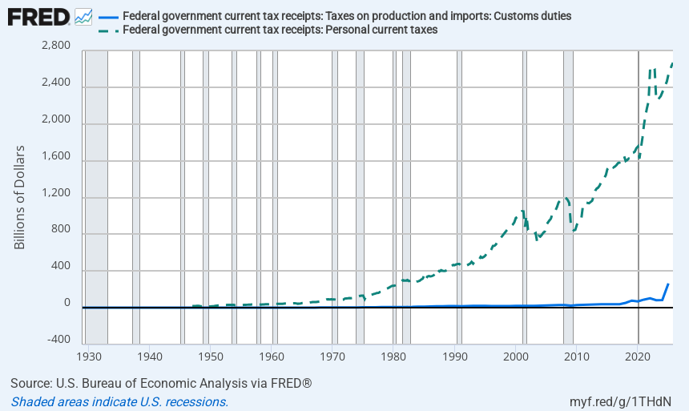
Replace The Personal Income Tax?

Slide 29
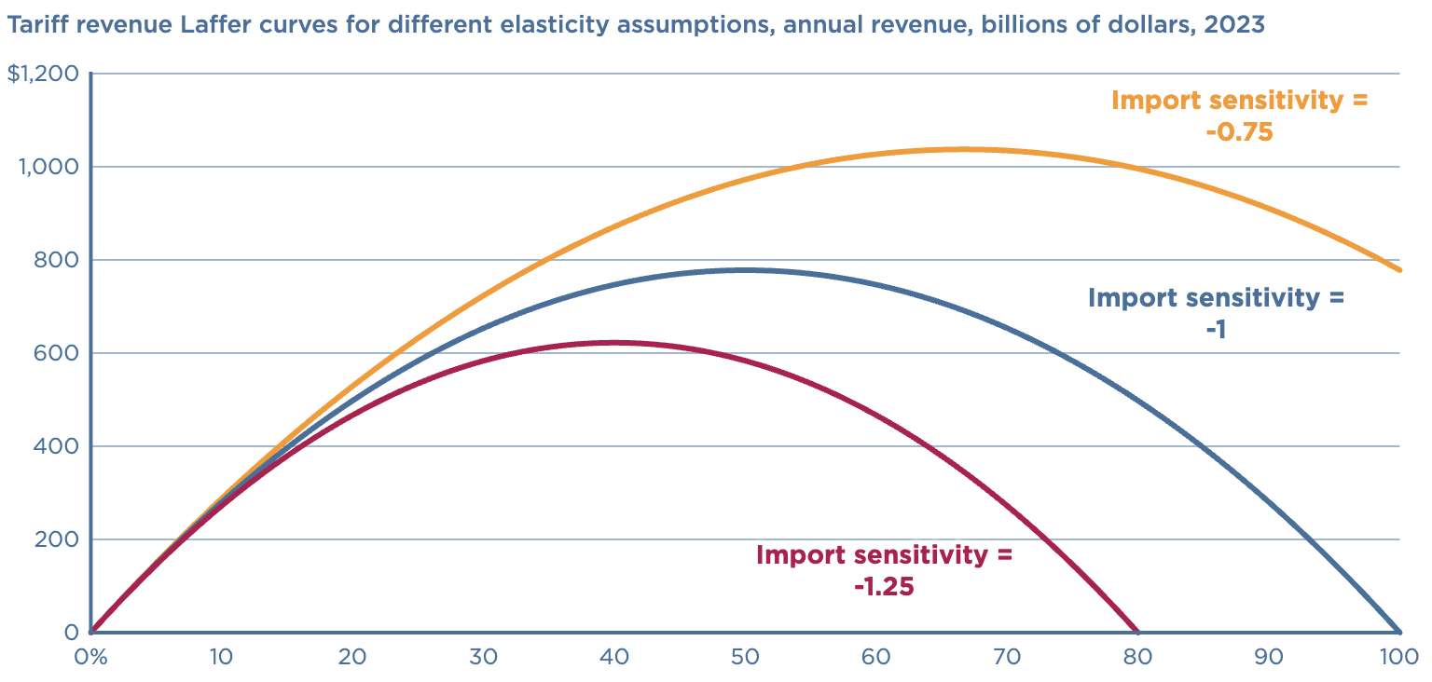
Replacing the Income Tax?
Revenue peaks well below
size of the income tax.
Peak revenue at 50%.
https://www.piie.com/blogs/realtime-economics/2024/can-trump-replace-income-taxes-tariffs

Slide 30
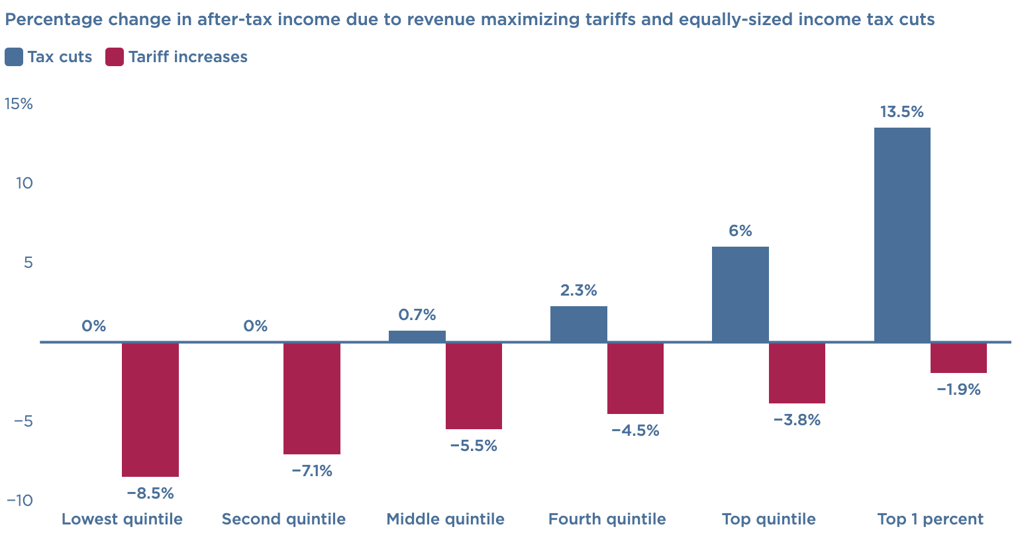
Replacing the Income Tax?
Using tariff revenue to offset the income tax is regressive.
The % decline in income would be largest for low-income households.
https://www.piie.com/blogs/realtime-economics/2024/can-trump-replace-income-taxes-tariffs

Slide 31
National Security

Slide 32
Steel and Aluminum Tariffs
If you put a tariff on something, its price goes up.
What other manufacturing industries use steel or aluminum?
ALL OF THEM!!
So, by putting tariffs on steel and aluminum, you jeopardize other industries.
Is it worth it? Maybe.

Slide 33
Tariffs on Metals in Trump 1
The prices of steel and aluminum increased shortly after the tariff was implemented.
The number of jobs in iron, steel, and aluminum mills rose temporarily by about 12,000, from 2017 to 2019.
Downstream industries (e.g., auto) faced higher input costs.
  Several studies estimated that the increased costs driven by tariffs may have resulted in 75,000 fewer manufacturing jobs.
Notes:
https://www.reuters.com/graphics/TRUMP-TARIFFS/STEEL/gdpznwgdzpw/

Slide 34
Who Pays?

Slide 35
The President Said Chinese Firms Would Pay!
There are three things that could happen with tariffs and prices:
  1. Foreign firms could lower their prices.
  2. Importing firms could lower their prices.
  3. Domestic consumers could pay more.
Evidence from the last trade war (2018-2020):
  3. Domestic consumers paid the vast majority of the tariff (90%+).
  It’s sometimes worse than that: Clothes washers and dryers.

Slide 36
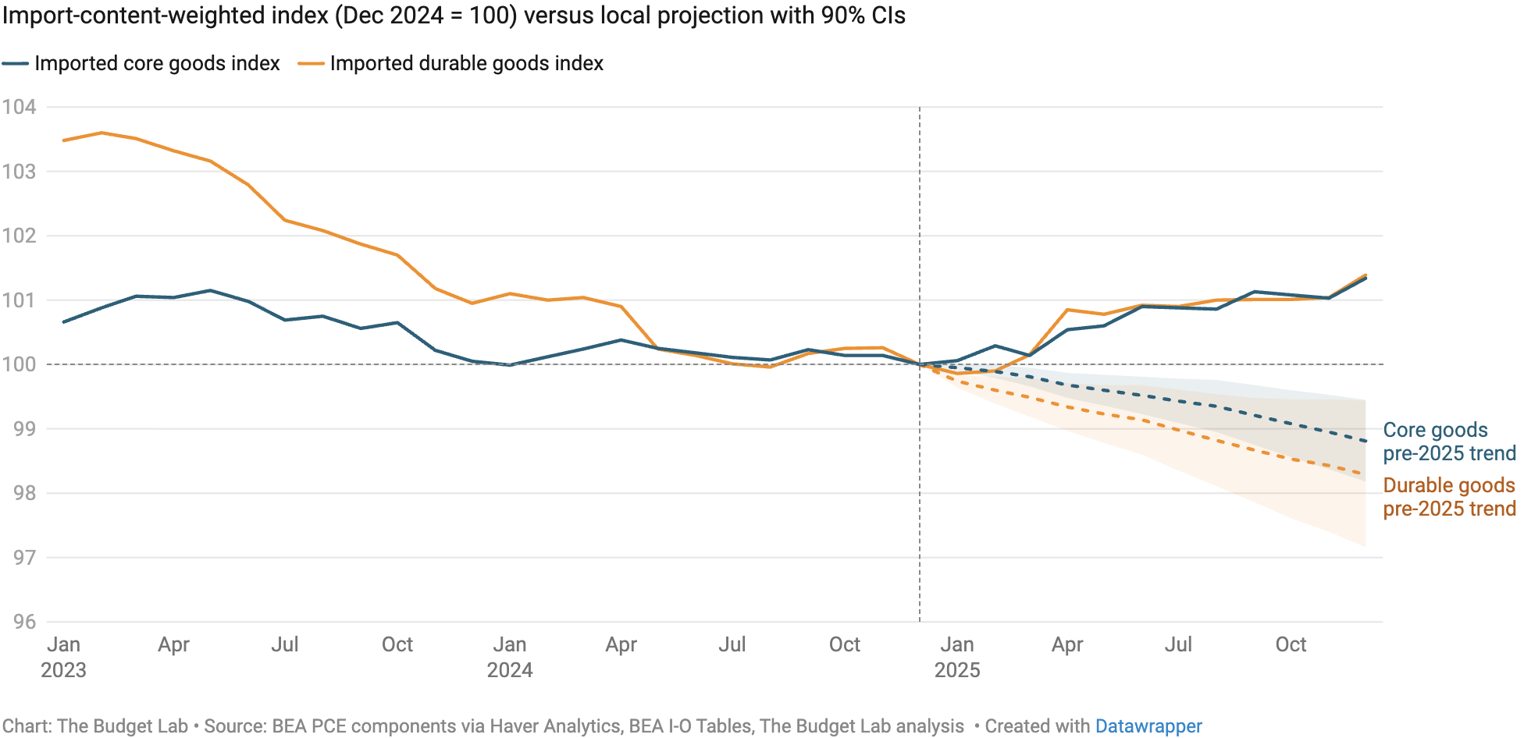
What About Prices?
Increasingly, it’s consumers.
Source: https://budgetlab.yale.edu/research/tracking-economic-effects-tariffs

Slide 37
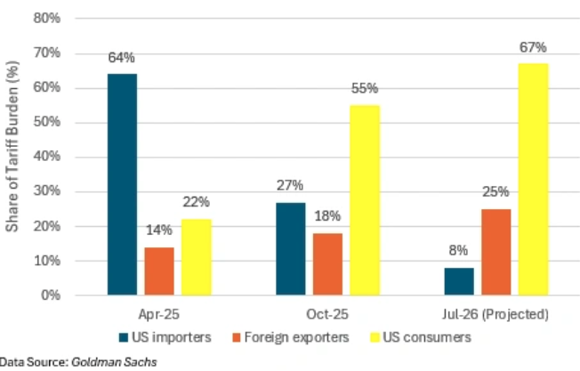
Changing Incidence of Trump’s Tariffs
Source: https://www.cfr.org/article/who-pays-trumps-tariffs

Slide 38
To Review:

Slide 39
President Trump’s Reasons for Tariffs
Our exports are being treated unfairly.
  Not a problem that tariffs will fix.
Bring back manufacturing employment.
  Benefits some and harms others.
Raising revenue – replace the income tax?
  Will raise some, but will harm poorer households.
National security
  Maybe, but at what cost?
Is China paying?
  So far, some, but not much.

Slide 40
Other effects of a Tariff
Income distribution
  Tariffs, especially on China, raise prices of the products disproportionately bought by low-income consumers, hurting them more than high-income consumers
Retaliation
  Other countries place tariffs on US exports
  Trade war that started in 2018 continues and gets worse
Corruption
  Historically, tariffs prompted both smuggling and bribes to customs officers.
  Today, in the US, those are less likely.
  But requests for exemptions from tariffs may be accompanied by favors or political contributions.

Slide 41
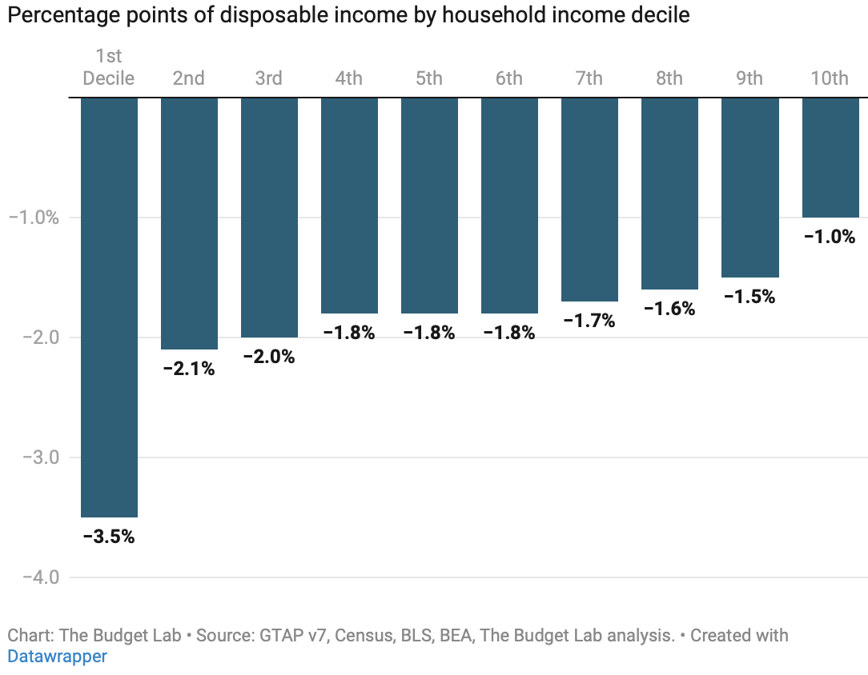
Effects of Tariffs on Households, As of 9/3
Poorer Richer
Notes:
https://budgetlab.yale.edu/research/where-we-stand-fiscal-economic-and-distributional-effects-all-us-tariffs-enacted-2025-through-April
Price increase of 2.3% in the short-run.

Slide 42
Other effects of a Tariff
Income distribution
  Tariffs, especially on China, raise prices of the products disproportionately bought by low-income consumers, hurting them more than high-income consumers.
Retaliation
  Other countries place tariffs on US exports.
  Trade war that started in 2018 continues and gets worse.
Corruption
  Historically, tariffs prompted both smuggling and bribes to customs officers.
  Today, in the US, those are less likely.
  But requests for exemptions from tariffs may be accompanied by favors or political contributions.

Slide 43
That Brings us to Tariffs and Democracy

Slide 44
Tariffs and Democracy
Power to tax rests with Congress.
  Perhaps understanding the temptation to corruption?
  Wresting this power from Congress and putting it in the hands of one person is anathema to democracy.
    Lack of accountability.
Empowers Lobbyists and Corporations
  There is an application process for exemptions.
  SOME injured parties get relief.

Slide 45
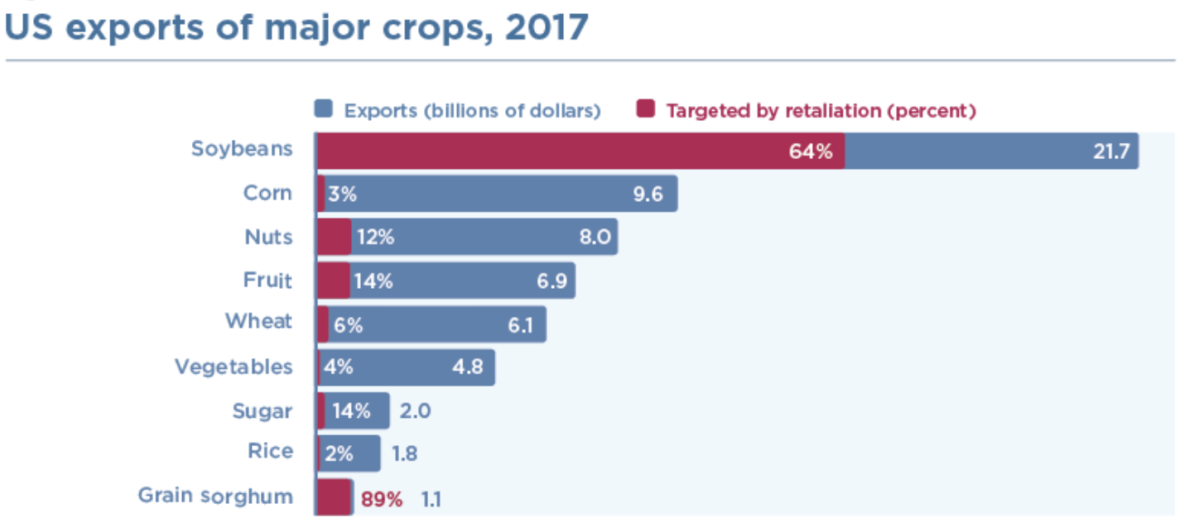
Subsidies to American Farmers
$12 billion subsidy to help American farmers for their lost export sales.
Notes:
https://www.piie.com/blogs/trade-and-investment-policy-watch/2018/first-tariffs-then-subsidies-soybeans-illustrate

Slide 46
Trump Tariff Exemptions
Both the metals tariffs and the China tariffs permitted certain products and product categories to be exempted.
  Whether tariffs would impose significant harm on American business interests.
  Whether substitute products were available outside China.
  Whether the products were “strategically important” to China.

Slide 47
Trump Tariff Exemptions (Spoils system?)
Trump administration’s decisions on exclusions were mysterious and arbitrary.
  “Tariff exemptions were given
    to Bibles but not to textbooks,
    to salmon but not to pollock,
    to children’s car seats but not to baby cribs.
  The decisions were not subject to appeal.”
  Study found:
    Contributions to Republicans made China exemptions more likely.
    Contributions to Democrats made China exemptions less likely.
    Author quoted as saying the exclusion process was “a very effective spoils system”.
Notes:
Swanson, “Trump’s Trade Agenda Could Benefit Friends and Punish Rivals,” NYT, 11/24/24
https://nytimes.com/2024/11/23/us/politics/trump-tariff-exemptions.html

Slide 48
Where do Things Stand?

Slide 49
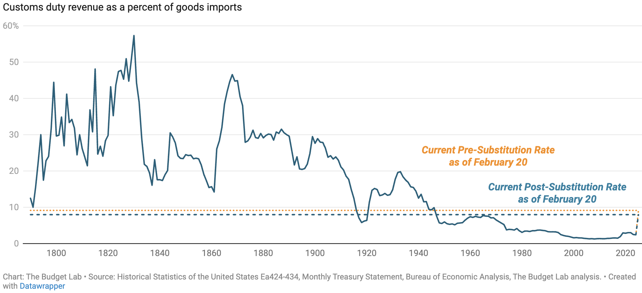
Average Effective Tariffs
Supreme Court just played Whack-A-Mole.
Out with IEEPA
In with Sections 122, 232, and 301
2.4

Slide 50
Summary
Tariffs will:
  Not eliminate the U.S. trade deficit (in the long run).
    Increase in national savings could reduce the trade deficit.
  Decrease U.S. manufacturing production and employment.
  Increase prices for households, hurting the poor the most.
  Increase U.S. government revenues, but not enough to offset other tax cuts.
  Negatively impact U.S. economic growth.

Slide 51
Thank you!
Any Questions?

