Slide 1
Osher Lifelong Learning Institute, Summer 2024
Contemporary Economic Policy Issues
University of Minnesota
Andrew W. Stevens, Ph.D. (awstevens@wisc.edu)
National Economic Education Delegation

Slide 2
National Economic Education Delegation
Vision
  One day, the public discussion of policy issues will be grounded in an accurate perception of the underlying economic principles and data.
Mission
  NEED unites the skills and knowledge of a vast network of professional economists to promote understanding of the economics of policy issues in the United States.
NEED Presentations
  Are nonpartisan and intended to reflect the consensus of the economics profession.

Slide 3
Course Outline
Contemporary Economic Policy Issues
  Week 2 (6/13): Climate Change Economics (Andrew W. Stevens, University of Wisconsin–Madison)
  Week 3 (6/20): Federal Debt and Deficits (Joseph Carolan, Oakland University)
  Week 4 (6/27): Economics of Immigration (Robert Gitter, Ohio Wesleyan)

Slide 4
Submitting Questions
Submit questions in the chat.
  I will try to handle them as they come up and/or address them during the Q&A at the end of the presentation
We will do a verbal Q&A once the material has been presented.
Slides will be available from the NEED website tonight (https://needelegation.org/delivered_presentations.php).

Slide 5
Credits and Disclaimer
This slide deck was authored by:
  Shana Mcdermott, Trinity University
  Sarah Jacobson, Williams College
  Sharon Shewmake, Western Washington University
This slide deck was reviewed by:
  Jason Shogren, University of Wyoming
  Walter Thurman, North Carolina State University
Disclaimer
  NEED presentations are designed to be nonpartisan.
  It is, however, inevitable that the presenter will be asked for and will provide their own views.
  Such views are those of the presenter and not necessarily those of the National Economic Education Delegation (NEED).

Slide 6
Outline
Climate change science
Impacts of climate change
Economics of responding to climate change
Addressing the sources of our emissions
Climate change policy
Policy in action

Slide 7
But First: What Is Economics?
Economics is about making choices under scarcity.
  Individuals and firms
How do goods and services get allocated among entities in society?
How is value created by trade?
How do “market failures” restrict that value creation?

Slide 8
Economics Informs Almost Everything
Prices
Incentives
Externalities
Cost-Benefit Analysis
Growth
Inflation
Interest Rates
Climate Change
International Trade
Immigration
Housing
Education
Health Care
Gun Control

Slide 9
How Can Economists Contribute to
Thinking about Climate Change?
By assessing behavioral reactions to climate change.
By measuring the damage and estimating the economic costs of fighting climate change.
By designing smart policies that minimize costs.
  Balance economic growth with GHG emission mitigation.

Slide 10
Climate Change

Slide 11
The Atmospheric Greenhouse Effect
Sun
Atmosphere
Light reflected back
onto earth
Light reflected back
into space

Slide 12
A Climate Change Ladder
Emissions
Mitigation (a.k.a. Abatement)
Adaptation
Damages

Slide 13

Atmospheric CO₂ Concentrations Up To Now
Source: NOAA
Notes:
https://gml.noaa.gov/ccgg/trends/

Slide 14


Greenhouse Gas Emissions: 1990-2019
Source: IPCC
Notes:
https://www.ipcc.ch/report/ar6/wg3/ Summary for Policymakers Figure SPM.1

Slide 15

Emissions Trajectories into the Future
Source: IPCC Assessment Report 5
Notes:
Figure SPM.11 from the Summary for Policymakers of AR5

Slide 16
What Do Greenhouse Gas Emissions
Do to the Planet?
Increased temperatures
  Sea level rise
  Storm surges
Altered precipitation patterns
More variable weather
More / more powerful storms
Carbon dissolves in ocean

Slide 17
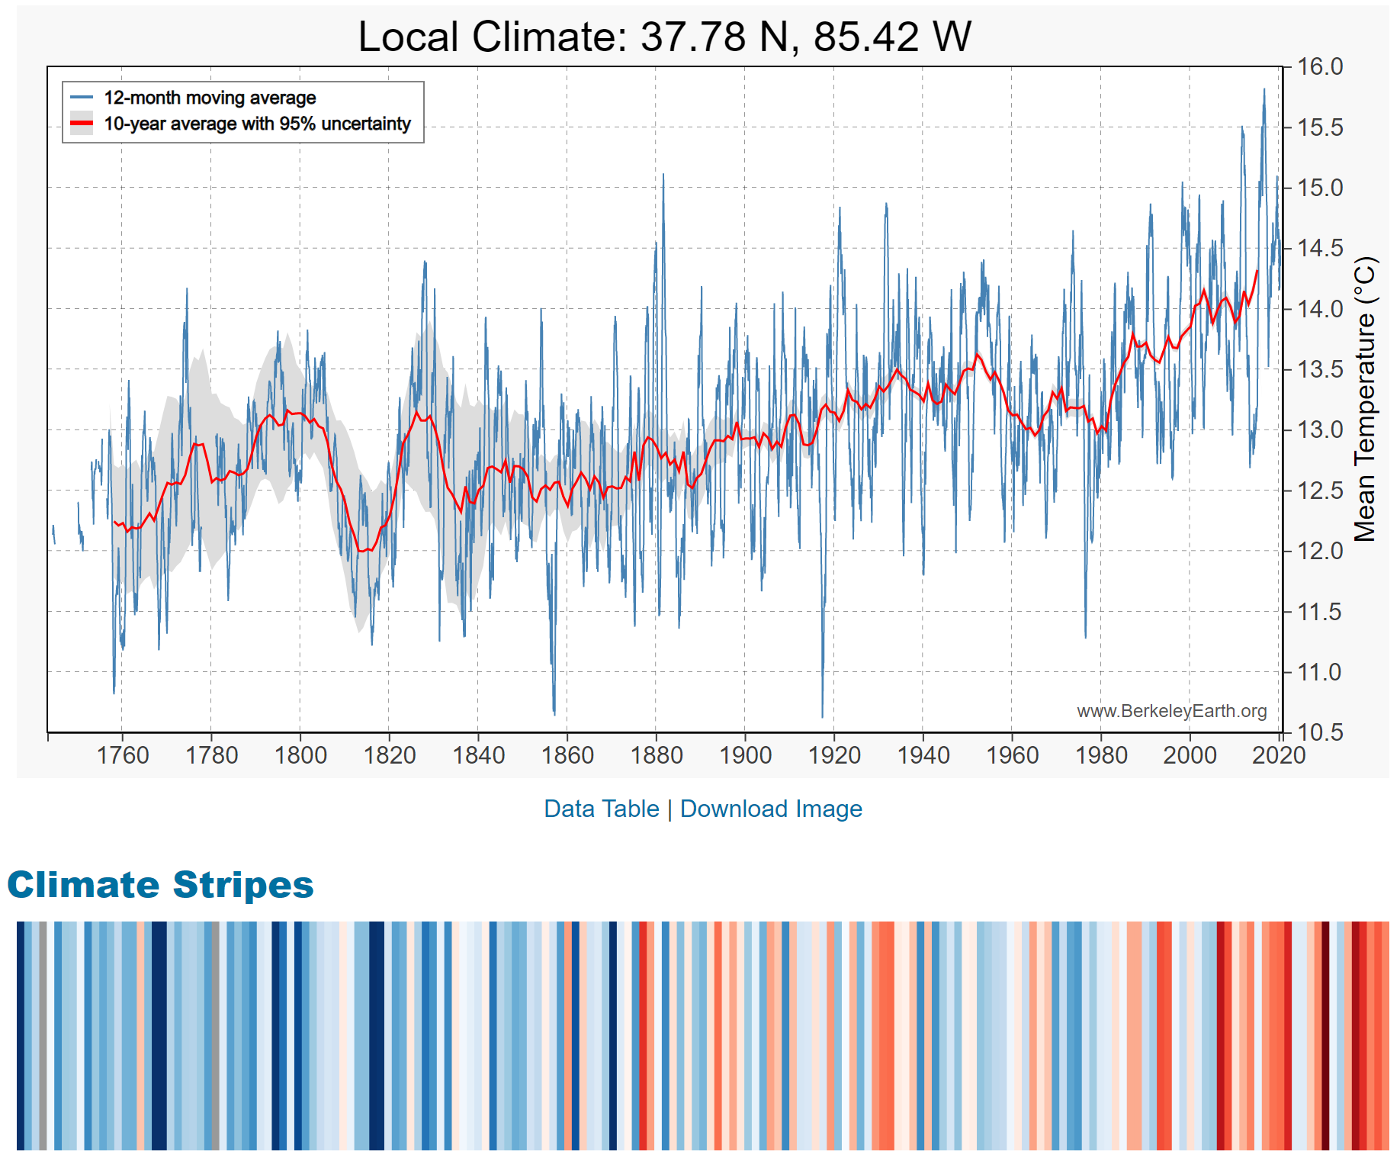
These Changes Are Already Underway
Use http://berkeleyearth.lbl.gov/city-list/ to see the temperature history of a city!
Here’s Louisville, KY.
Source: IPCC Assessment Report 5
Notes:
http://berkeleyearth.lbl.gov/city-list/

Slide 18
How Much Pollution Does Society Want?
Analogy: How Many Oranges Does Society Want?
People grow and sell oranges for a price that at least covers costs (supply).
People will not pay more for them than what they consider to be their value (demand).
Prices let supply and demand balance out. The price settles where:
This is the “right” number of oranges for society.
Prices reflect scarcity and the social value of the resource.
# of oranges people want to sell = # of oranges people want to buy
Notes:
Simple Supply and demand game.
Ask who likes oranges and then ask how much a few students would pay for an orange right now.
If I supply them for some price in the middle – who gets them?
Not everybody who wants an orange.
- This also illustrates how value gets created with trade

Slide 19
Electricity Is Different From Oranges
Many sources of electricity generate pollution.
Pollution is an EXTERNALITY:
  a side effect (cost or benefit) that affects someone
  else when something is bought or sold.
  This is a market failure.
The price of electricity does not reflect all of the costs.
  Electricity is too cheap.
  There is too much pollution.

Slide 20

Social Cost of Carbon
Cost above price paid.
The expected cost of damages from each unit of greenhouse gas emissions.
Current EPA estimate: ~$51 per metric ton of CO₂.
  About $157/car per year.
  $32 Billion for all vehicles in the US.
Social cost of carbon will increase over time.
Notes:
18.07 lbs/mile
2204.62 lbs/metric ton
1.8 cents/mile

Slide 21
Externalities
An externality occurs when market activity affects people outside of a market.
  Market activity SPILLS OVER onto others.
  A negative externality occurs when a cost spills over.
  A positive externality occurs when a benefit spills over.

Slide 22
Examples of Externalities
Negative Externalities:
  Heating your house
  Smoking
  Getting a dog
  Pig farming
Positive Externalities
  Education
  Growing apples
  Getting a vaccination
  Basic scientific research

Slide 23
Addressing a Negative Externality
Set thermostat to:
68 degrees
$.14/Kwh
Social cost = $.02/Kwh
$.16/Kwh
Set thermostat to:
65 degrees
The social cost of $.02/Kwh has been INTERNALIZED.

Slide 24
Impacts of Climate Change

Slide 25
Global Warming Indicators

Slide 26
How These Impacts Affect Humans
Agriculture
Fisheries
Coastal damages
Direct health effects, including sickness and death (temperature & drought; also pollution)
Indirect health effects (vector-borne disease)
Reduced fresh water availability
Wildfires
Shifting zones for important ecosystems, and desertification
Reduced worker productivity
Increased violence
Some of these may cause human migration and/or conflict
Notes:
This could be a series of slides with pictures for each one

Slide 27

How Damages Will Vary Globally:
Mortality as an Example
Notes:
Carleton et al. 2021: https://papers.ssrn.com/sol3/papers.cfm?abstract_id=3674927

Slide 28

How Damages Will Vary in the US
Notes:
Hsiang, S., Kopp, R., Jina, A., Rising, J., Delgado, M., Mohan, S., Rasmussen, D.J., Muir-Wood, R., Wilson, P., Oppenheimer, M., Larsen, K., Houser, T., 2017. Estimating economic damage from climate change in the United States. Science 356, 1362-1369.
“County-level median values for average 2080 to 2099 RCP8.5 impacts. Impacts are changes relative to counterfactual “no additional climate change” trajectories.”

Slide 29
Adaptation Reduces Damages
Adaptation: costly action that reduce damages from climate change.
The net damage cost to society is the cost of adaptation plus the cost of remaining damages.
People and firms will take some actions on their own, up to the point where they find it worthwhile.
Some adaptation requires government involvement.

Slide 30
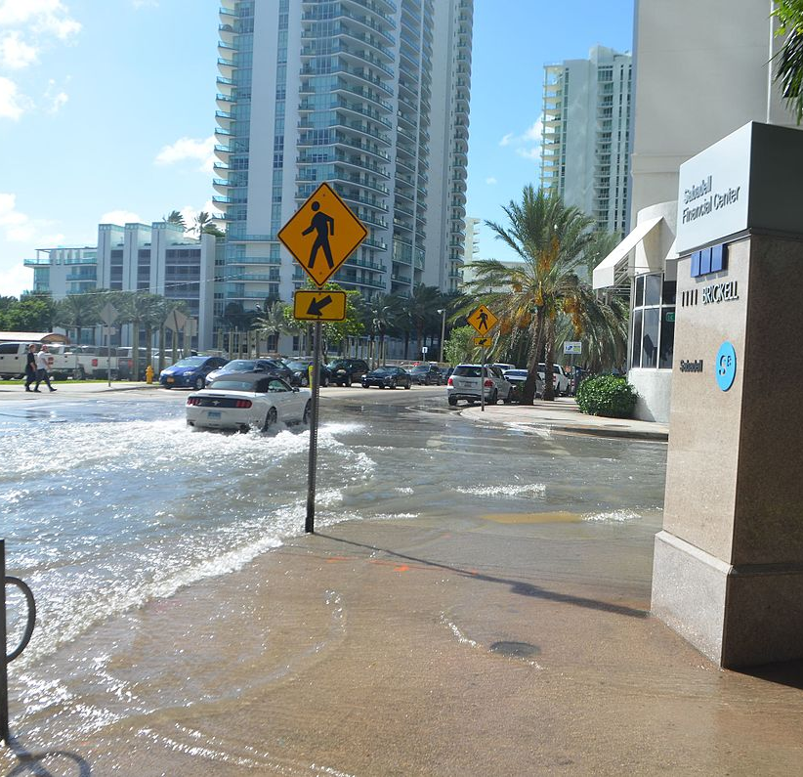
Real Estate Markets
Sea level rise
Wildfire risk
Extreme weather events
  Hurricanes
  Extreme rainfall
  Drought
Water supplies, electricity reliability
Residential markets affected
Turnover leading indicator
This Photo by Unknown Author is licensed under CC BY-SA
Notes:
Add pictures or replace words with pictures

Slide 31

Individual-Level Adaptation
Perhaps you…
  Stay inside more.
  Turn on the air conditioning.
Farmers may:
  Plant at different times.
  Plant new crops.
Businesses may:
  Give outdoor workers water / shade breaks.
Everyone might:
  Think about moving to a safer place.
Notes:
Could be one or several slides with images to represent

Slide 32
Public Adaptation
Governments can help:
  When collective action is less costly than everyone acting alone.
  When individual action is not possible or likely.
  When some people can’t protect themselves.
Sea walls
Ecosystems that provide protection
Supporting low-income and vulnerable populations
Moving residents of a town
Notes:
Could be one or several slides with images to represent

Slide 33
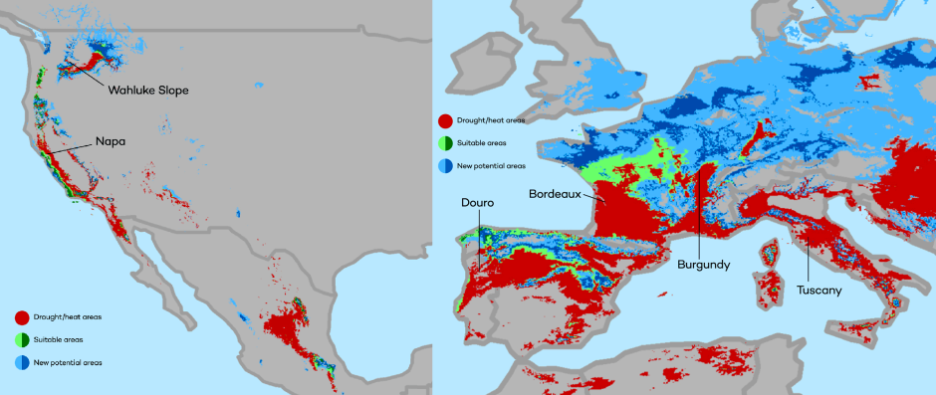
Market-Based Adaptation
Prices and costs influence behavior.
  Where to live.
  Where/when/what to plant.
Avoid barriers to market adjustment.
  Trade barriers, immigration restrictions, federal flood insurance, agricultural subsidies, and zoning regulations.
The changing map of the world’s wine-growing regions.

Slide 34

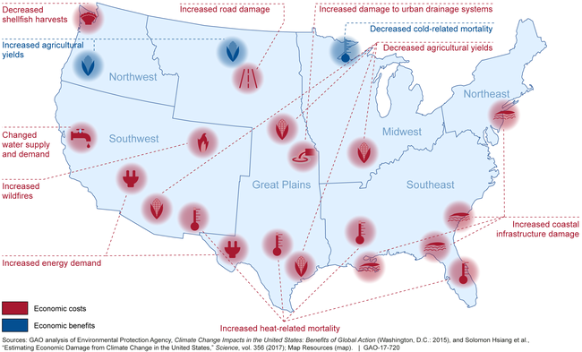
Most Vulnerable People and Places
Tropical areas
Low-lying coastal areas
Low-income people
Notes:
Add pictures or replace words with pictures

Slide 35
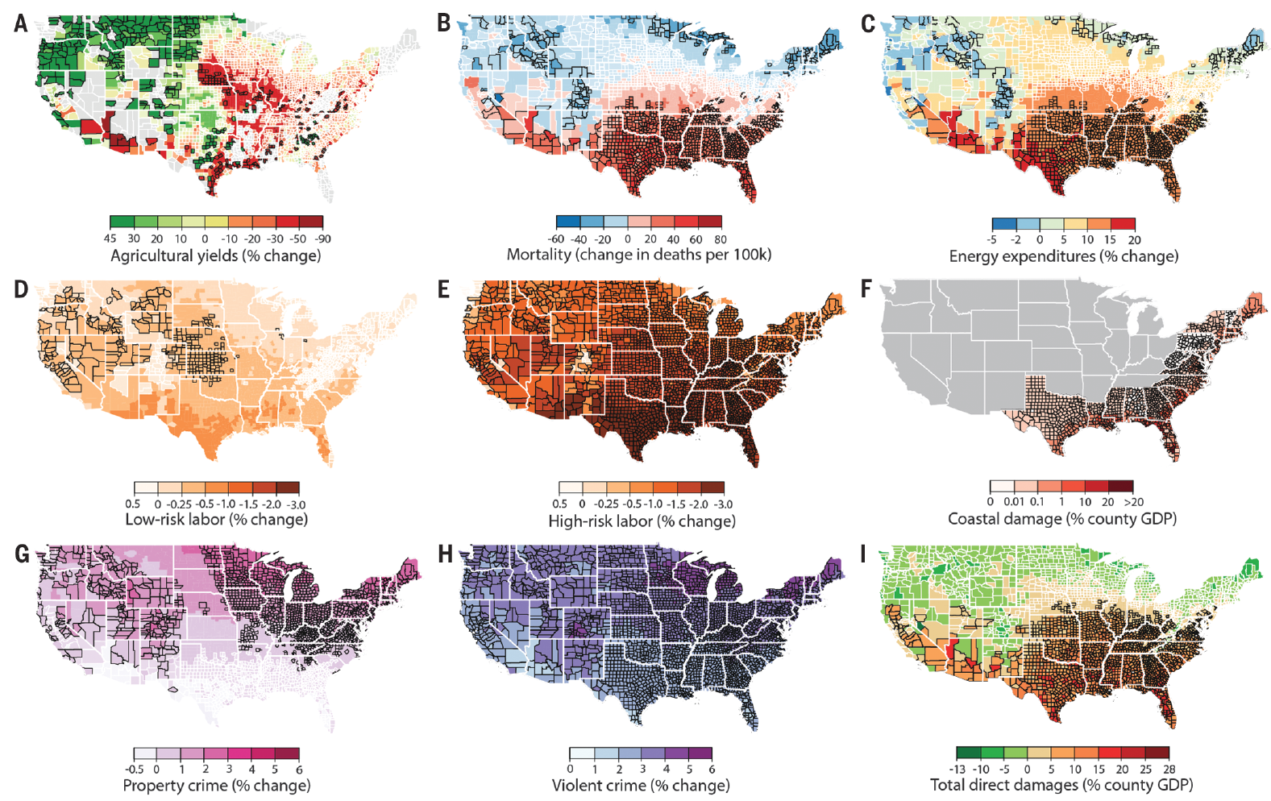
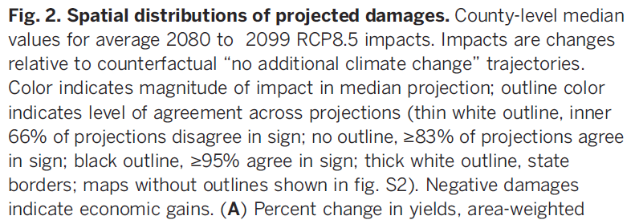
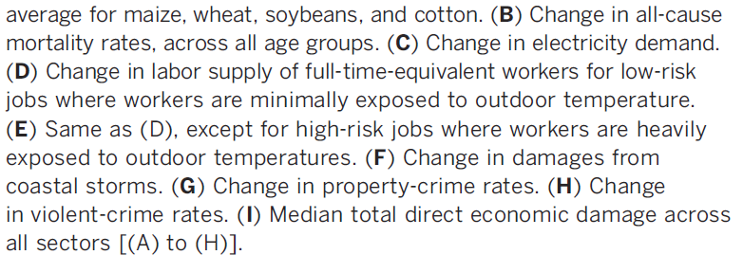
Projected Effects Vary Across the U.S. but Are Estimated at 1.2% of GDP per 1C Increase

Slide 36
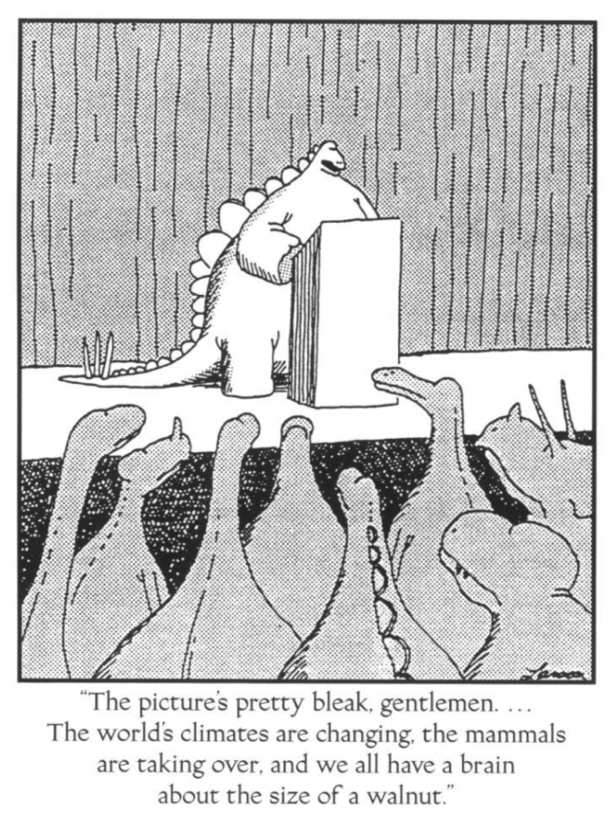

Slide 37
Economics of Responding to Climate Change

Slide 38
International Climate Policy Goals
Intergovernmental Panel on Climate Change (IPCC)
  Global effort to fight climate change
  Reports on consensus of climate science, including economics
IPCC report in 2007:
  Recommended goal: < 2 degrees C (3.6 degrees F)
  Industrialized countries should reduce GHG emissions between 25% and 40% below 1990 levels by 2020.
2016 Paris Agreement:
  Basic goal of 2 degrees C: requires 40-70% GHG reduction 2010 → 2050
  Reach goal of 1.5 degrees C: requires 70-95% GHG reduction 2010 → 2050
IPCC report in 2018:
  Temperature has already increased by 1.0 degrees C - Recommended: < 1.5 C

Slide 39
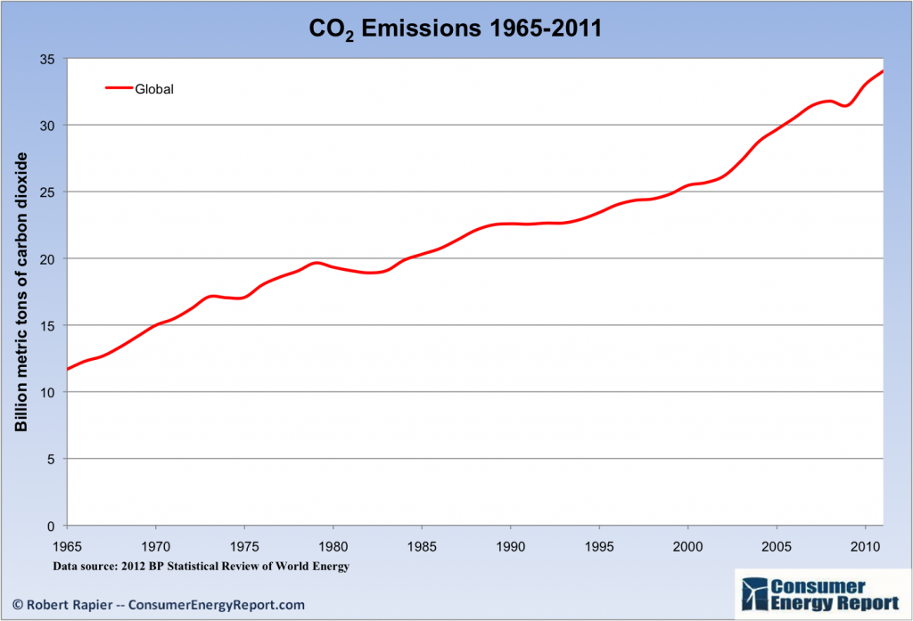
Recent Progress on Climate Goals
IPCC’s Fifth Assessment Report (2014)
  Goals from previous report (2007) were met!
  … but mainly because of the Great Recession…
  … which is not the preferred method of reducing emissions.
Notes:
Could use this graph of emissions over time or energy use over time, as it clearly shows a dip where the recession is; from the US Energy Information Administration International Energy Outlook

Slide 40
How Economists Decide How Much to Fight
Climate Change
Cost Benefit Analysis
Expected costs of reducing emissions
Weigh:
Expected damages from allowing climate change

Slide 41
Cost-Benefit Analysis of Fighting Climate
Change
Most economic models suggest the costs of keeping warming below 2°C are relatively small.
  Costs amount to 1-4% of GDP by 2030.
Costs of acting to keep warming below 2°C are almost certainly less than future economic damages they would avoid.
  Damages estimated to be between: 7 - 20% of worldwide GDP.
Caveats:
  Putting a monetary value on priceless things
  Inequality
  Uncertainty and risk

Slide 42
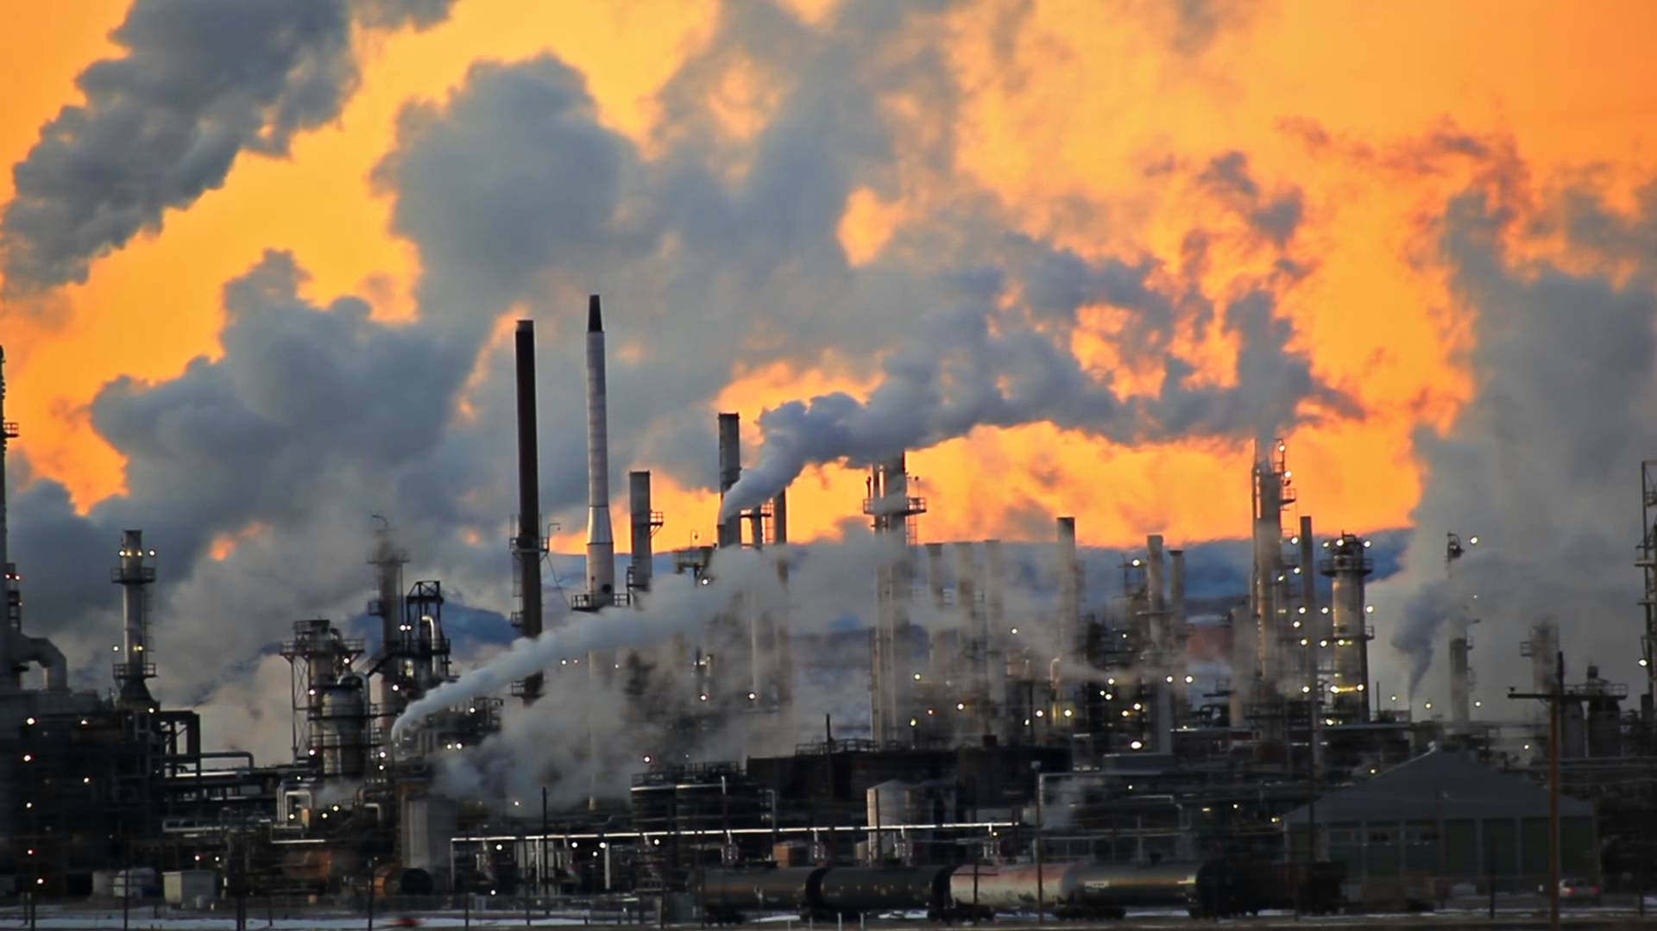
Present Value of a Future $100 Cost or Benefit
“
It is better to be roughly right
than precisely wrong.
- John Maynard Keynes
“

Slide 43
This is What Precisely Wrong Looks Like
The changing map of the world’s wine-growing regions.

Slide 44
Economic Growth and Climate Change Action
Are Compatible
Abating greenhouse gas emissions is costly…
… but climate change damages are even more costly.
Economic growth comes with consequences that we have to deal with, including climate consequences.
Economies with environmental regulations can still be dynamic.
Goal: design policies that reach climate goals at the least possible cost.

Slide 45
Reducing Emissions

Slide 46
Global Net Emissions
Are What We Care About
For climate impacts, we don’t care where they are emitted, only how much.
  There may be other local impacts.
Gross emissions (greenhouse gas sources): how much greenhouse gases (including CO2) we put out.
Greenhouse gas sinks: ways to pull CO2 out of the air.
  Existing: oceans, forests.
  Increase sinkage by planting trees, or other measures.

Slide 47

Sources of the Global Flow of Emissions

Slide 48

Sources of the Global Stock of Emissions

Slide 49

Sources of the Global Stock of Emissions

Slide 50


How Does This Look Per Capita (Per Person)?
Notes:
https://www.ipcc.ch/report/ar6/wg3/ Summary for Policymakers Figure SPM.2

Slide 51

Total US Greenhouse Gas Emissions by Economic Sector in 2020
Notes:
https://www.epa.gov/ghgemissions/sources-greenhouse-gas-emissions

Slide 52

U.S. Electricity Sources
Notes:
Source: U.S. Energy Information Administration, Annual Energy Outlook 2020 (AEO2020) Reference case

Slide 53
Which Emissions Should We Cut?
List all possible ways to reduce emissions
Figure out how much each can reduce in total
Figure out how much each costs per unit of emissions reduced
Line them up in order: cheapest to costliest (“marginal abatement cost curve”)
  → Tackle first the cheapest ones!

Slide 54

Example Abatement Cost Curve
(Don’t trust these numbers, this is just to show the idea)
Notes:
McKinsey report: https://www.mckinsey.com/business-functions/sustainability/our-insights/impact-of-the-financial-crisis-on-carbon-economics-version-21

Slide 55


Newer Estimated Abatement Cost Curve
Notes:
IPCC AR6 Working Group 3 Summary for Policymakers
Figure SPM.7: Overview of mitigation options and their estimated ranges of costs and potentials in 2030.

Slide 56

Newer Estimated Abatement Cost Curve
Notes:
IPCC AR6 Working Group 3 Summary for Policymakers
Figure SPM.7: Overview of mitigation options and their estimated ranges of costs and potentials in 2030.

Slide 57
Costs and Barriers Can Be Difficult to Assess
Difficult to project future costs for new technology
  Costs of renewables have been dropping fast
Investments in research and development and infrastructure (e.g., EV charging) can lower future costs
Barrier to expanding renewable energy: intermittency
  Battery technology under development

Slide 58
Geoengineering and Carbon Capture
Technical pathways to reduce climate change without reducing emissions
Carbon capture: captures CO2 emissions and stores them or “utilizes” them (for energy, pressure, etc.)
  Not yet proven at scale
Solar geoengineering: make the atmosphere reflect more light to regain earlier thermal balance
  Totally theoretical
  Potentially risky

Slide 59
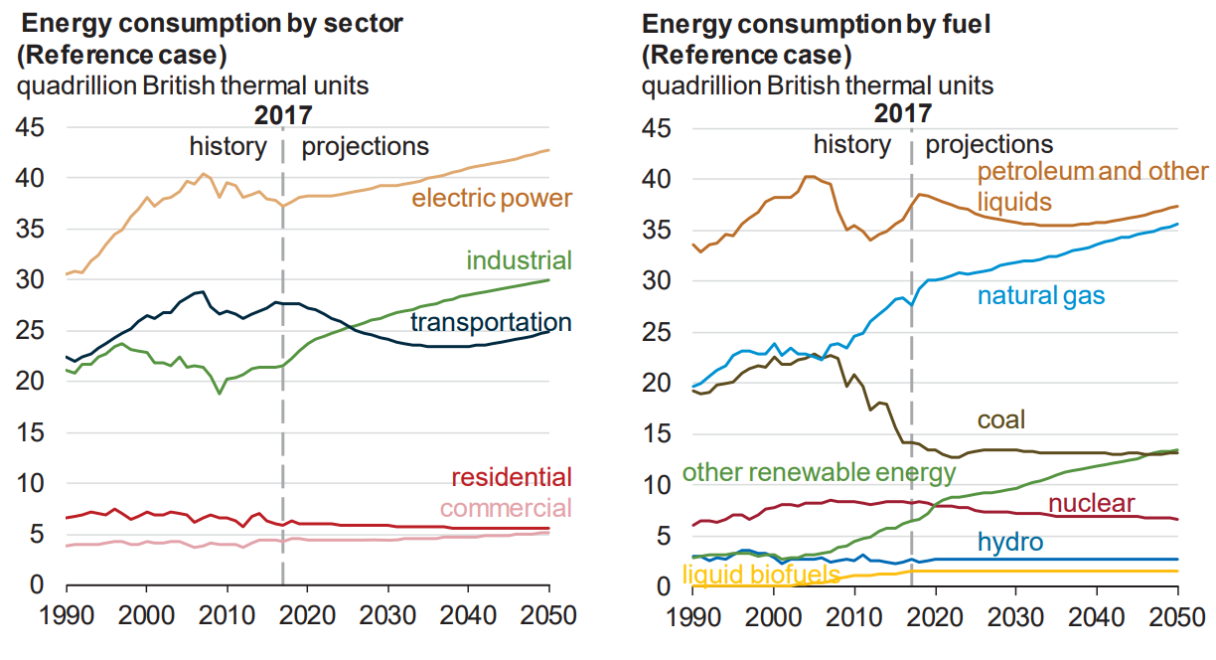
Fossil Fuels Dominate U.S. Energy Production
Notes:
US Energy Information Agency Annual Energy Outlook 2018

Slide 60
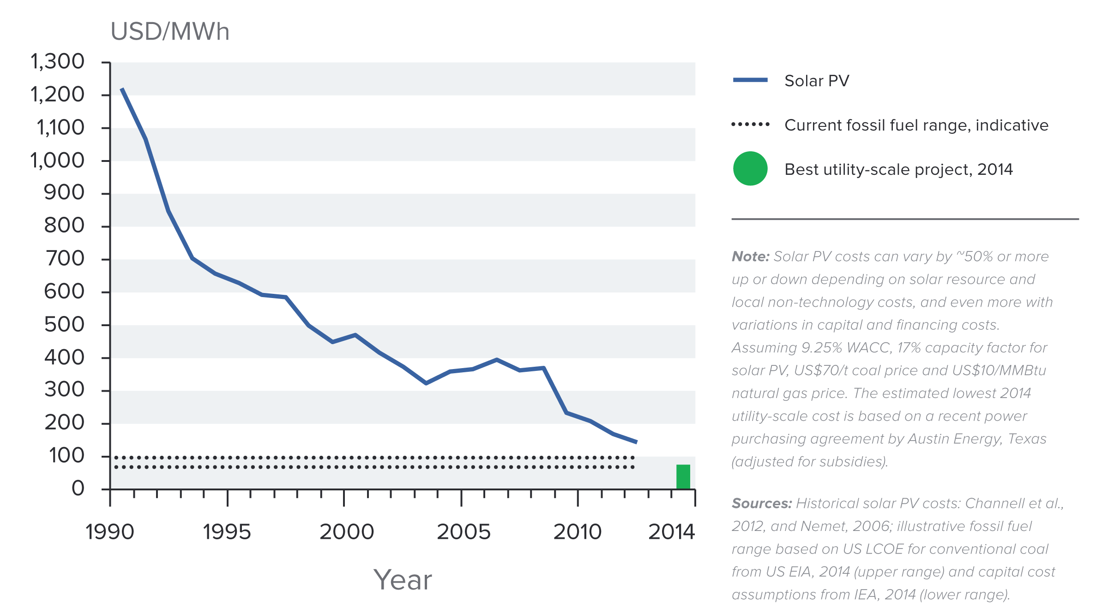
Indicative Solar Costs Over Time
Notes:
Source: New Climate Economy Report

Slide 61
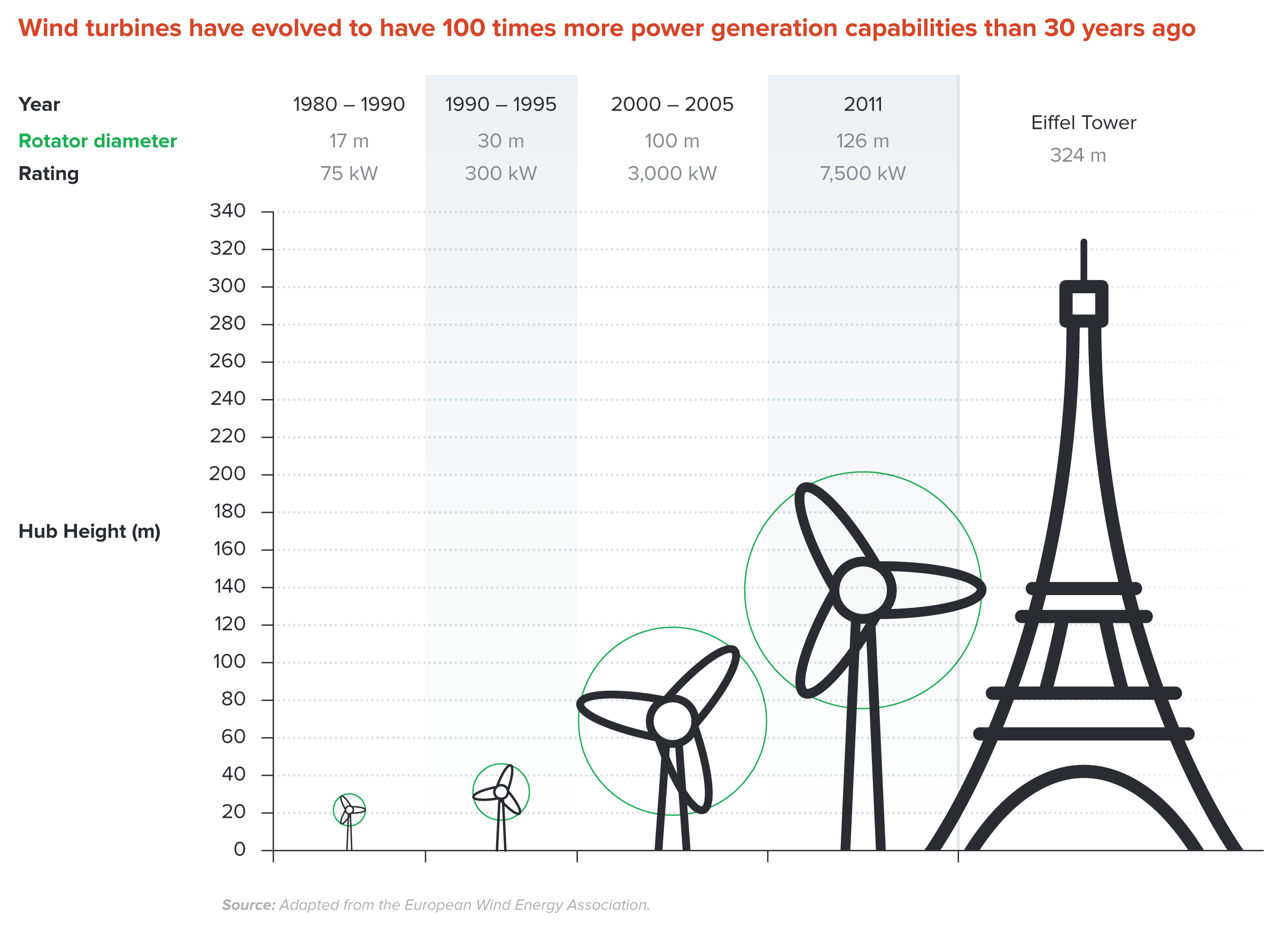
Wind Turbines Have 100 Times More Power
Generation Capabilities Than 30 Years Ago
Notes:
Source: New Climate Economy Report

Slide 62


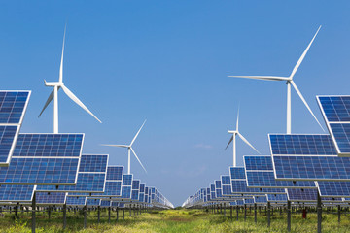
Challenges with Renewable Energy
It’s intermittent - only produced if there is sun or wind.
Energy is needed all day and night, with peak times.
Limited w/o storage.
  Creative storage options are under development.

Slide 63
Climate Change Policy

Slide 64
Policies That Reduce Emissions Directly
Command and control regulation
  Emissions standards or limits (e.g., Clean Water Act discharge limits)
  Tech standards (e.g., require scrubbers on power plants)
Incentive-based policies
  Putting a price on emissions – leveling the playing field!
    Tax or cap & trade
    Subsidizing green energy (e.g., feed-in tariffs)

Slide 65
Command and Control vs. Incentive-Based Regulation
Efficiency
  Both can achieve the same amount of emissions reduction.
  Incentive-based policies can achieve emissions reduction at much lower cost.
Equity
  Both have may regressive impacts (low-income families bear costs that are a larger percent of their incomes vs hi-income families)
    However, new evidence increasingly questions this.
  Cap and trade and carbon tax can generate revenues that can be used to offset the regressivity.
    E.g.: “carbon dividend”
  Command and control regulations do not.

Slide 66
Efficiency: CAFÉ vs Carbon Tax
CAFÉ = Corporate Average Fuel Efficiency
  A fuel economy standard mandating that an auto‐maker’s vehicle fleet must meet minimum fuel economy standards.
Horse Race
  Tax on fuel applies to ALL vehicles, not just new.
  Rebound Effect:
    Driving a more efficient vehicle lowers the cost per mile driven
      leading to more miles driven.
  Slower turnover of inefficient vehicles: higher cost of new.
Summary
  A given level of emission reductions costs 3-14 times more with CAFÉ standards than under a comparable carbon tax.

Slide 67
How Does a Carbon Tax Work?
Choose activities to be covered (e.g., electricity sector, all emitters, etc.).
Set tax level.
  Optimally, it represents the social cost of polluting.
Polluters must pay a tax for every unit emitted.
  Polluters with low abatement costs will abate to avoid the tax
  Polluters with high abatement costs will pollute and pay the tax

Slide 68
How Does Cap and Trade Work?
Choose activities to be covered (e.g., electricity sector, all emitters, etc.).
Set maximum emissions level (“cap”).
That many pollution permits are issued.
  Can be auctioned off or given to polluters
Every polluter in a covered sector must have a permit for every unit of pollution.
Polluters buy and sell (“trade”) permits on a market as they wish.
  Polluters with low abatement costs will make / save money by abating and selling / not buying permits
  Polluters with high abatement costs will buy permits and pollute

Slide 69
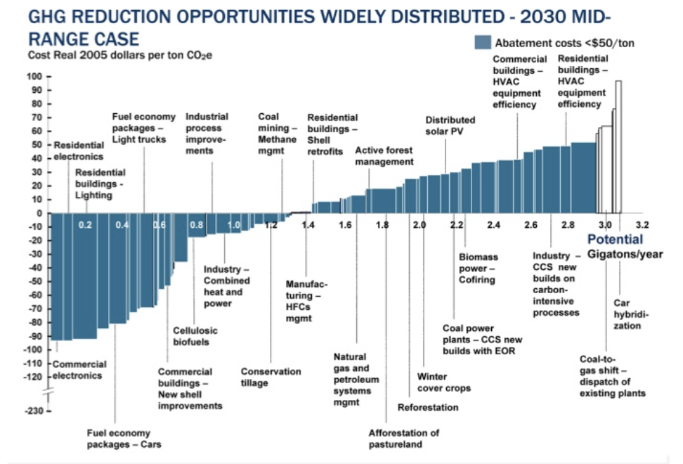
Putting a Price on Carbon
Suppose a Social Cost
Of Carbon of $50
Notes:
Shana: perhaps another infographic is beneficial here. Reintroduce the original cost graph. Fade out the costs and leave the MAC. Then introduce a price. If it’s cheaper to abate, then firms will do that, otherwise they will buy a permit or pay the tax. I know this is super simplified. I introduce specifics at the start of the emissions trading section and the tax section below.

Slide 70
Putting a Price on Carbon
TAX
=
Permit Price =
Carbon Price
MAC
Abate
Buy permit
or pay tax
CAP
Notes:
Shana: perhaps another infographic is beneficial here. Reintroduce the original cost graph. Fade out the costs and leave the MAC. Then introduce a price. If it’s cheaper to abate, then firms will do that, otherwise they will buy a permit or pay the tax. I know this is super simplified. I introduce specifics at the start of the emissions trading section and the tax section below.

Slide 71

Carbon Prices: the Good and Bad
Good:
  Provide price signal to lower emissions.
  They yield low-cost reductions in emissions.
  They spur innovation in clean technologies.
Bad:
  Firms might leave to flee regulation.
  It is necessary to monitor emissions.
  Potentially regressive
    Costs may weigh more heavily on low-income households.

Slide 72
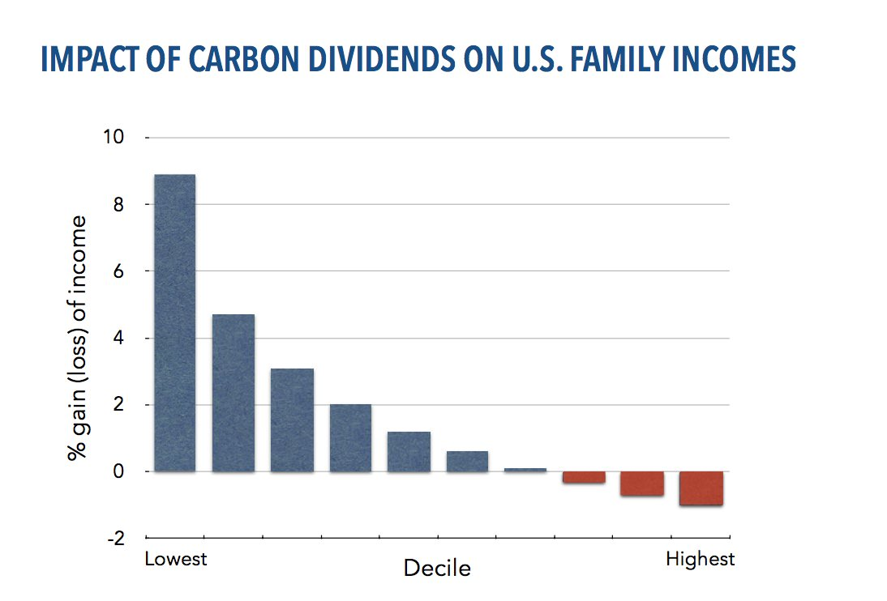
Revenue Dividend Eliminates Regressivity
Source: U.S. Treasury, 2017

Slide 73
Carbon Tax and Cap & Trade: the Differences
 | Carbon Tax | Cap & Trade
Carbon Price | Certain | Uncertain
Emissions | Uncertain | Certain
Ease of Implementation | May be easier to implement
Additional concerns | Always generates revenue May require legislation to change | May be more susceptible to lobbying Only generates revenue if government sells permits Cap can be changed by regulator

Slide 74
Carbon Tax and Cap & Trade: the Differences
 | Carbon Tax | Cap & Trade
Carbon Price | Certain | Uncertain
Emissions | Uncertain | Certain
Ease of Implementation | May be easier to implement
Additional concerns | 1) Always generates revenue 2) May require legislation to change 3) Predictability | 1) Susceptible to lobbying. 2) Only generates revenue if government sells permits. 3) Cap can be changed by regulator. 4) Less certainty over future. 5) Regulations reduce efficacy of Cap & Trade

Slide 75
One Other Thing: Cap and Trade vs. Carbon Tax
Emissions regulations and Cap and Trade can work at cross purposes.
  Regulations that lower emissions from big polluters…
    Lower the demand for permits
    Lowers the price of permits
    Reduces incentives for other industries to cut emissions
Regulations can undermine the effectiveness of Cap and Trade.
The same is not true of a carbon tax.
  Though regulations might cut tax revenue, revenue is not the goal of the carbon tax.

Slide 76
Implications of a $50/ton Price on Carbon
A doubling of the price of coal-fired electricity.
  Makes solar, wind, and nuclear much more attractive from a cost perspective.
Add $230/year to the cost of driving a gasoline-powered car.
  Makes walking, biking, carpooling, public transportation much more attractive.
Add $1/year to the cost of banking services.
The current average price of carbon emissions is just $2.
  This…has virtually no effect.

Slide 77
Examples of Other Policies that Reduce Emissions
Research and development subsidies
Renewable energy mandates (e.g., renewable portfolio standards)
Energy efficiency mandates and subsidies (e.g. CAFE fuel economy standards)
Grid / infrastructure improvements
Public transportation
Land use / zoning policies

Slide 78
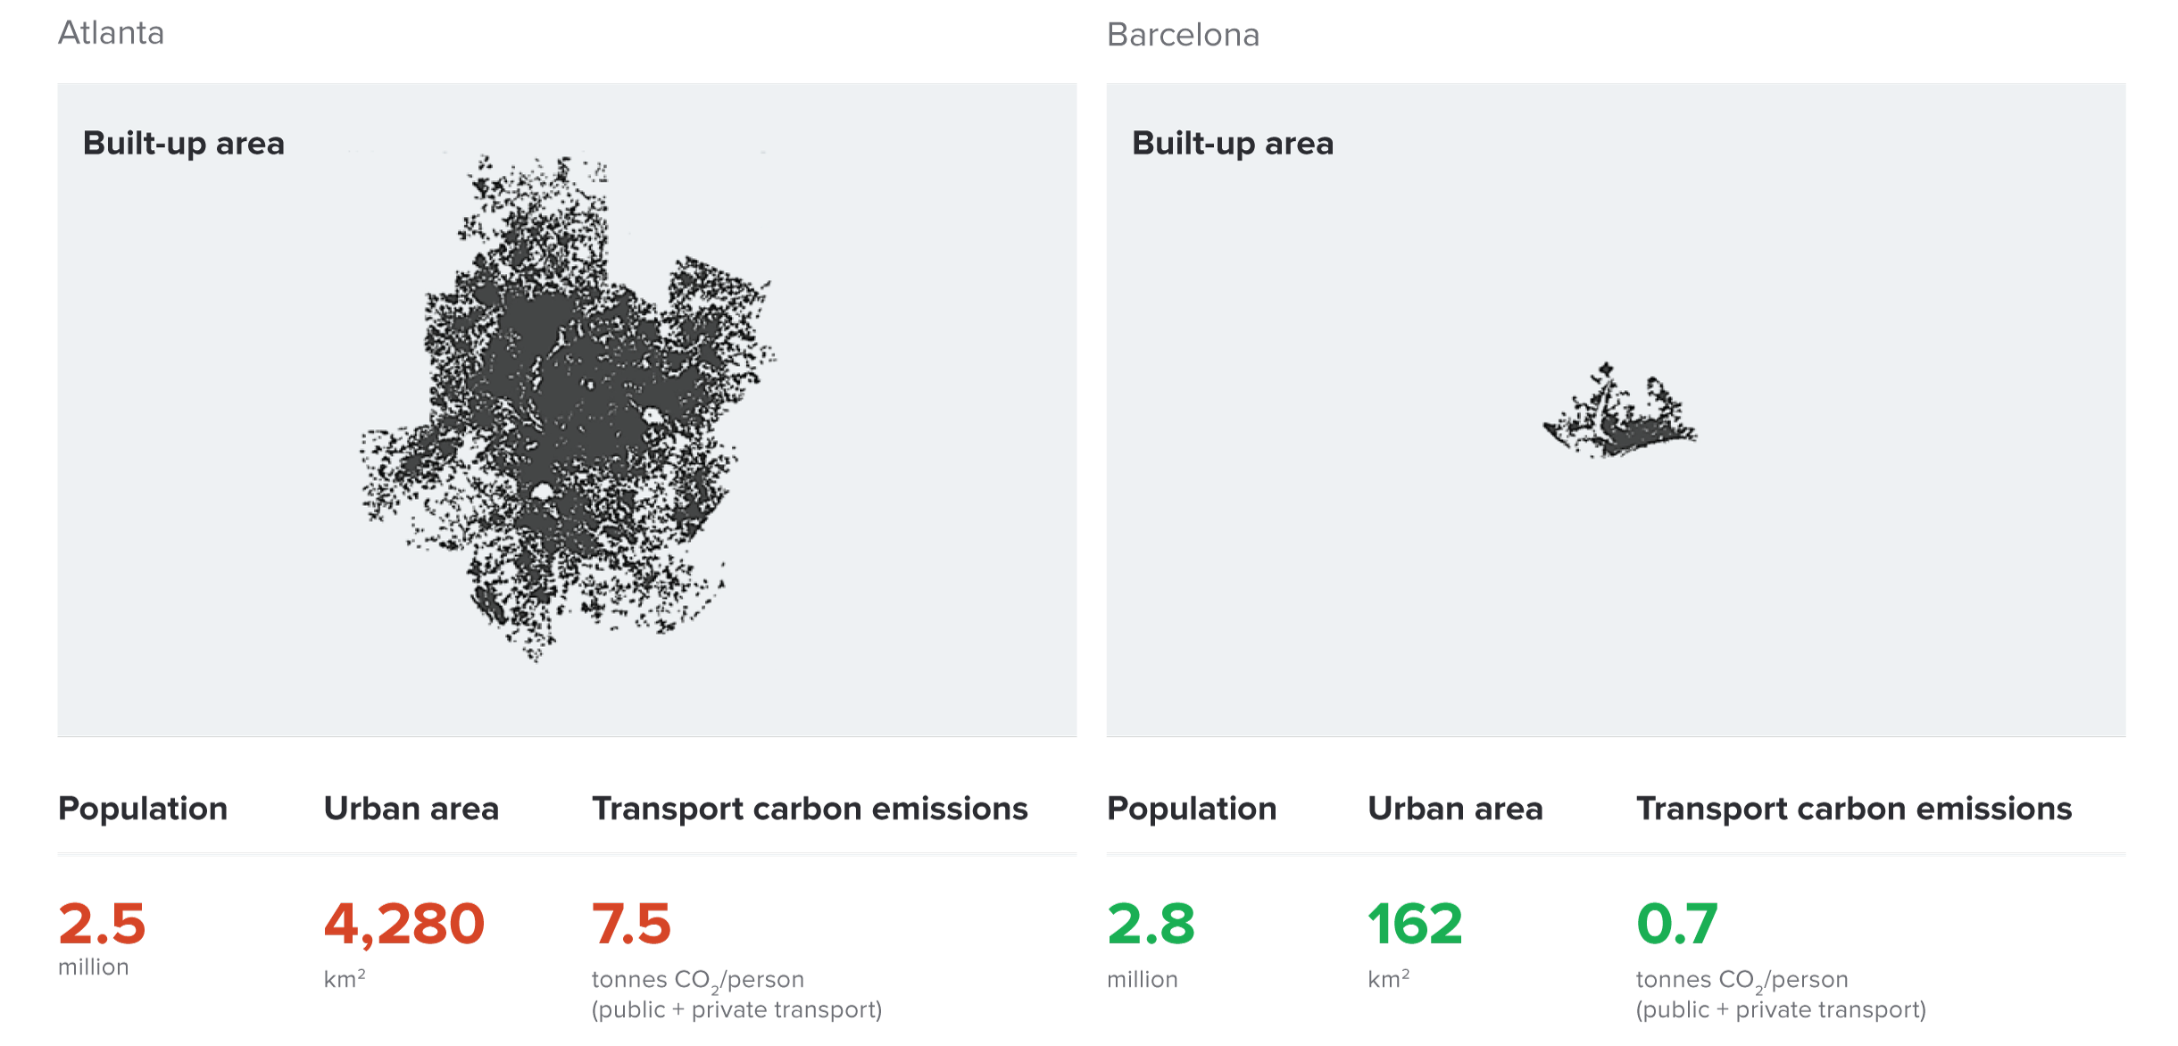
Atlanta and Barcelona Have Similar Populations but Very Different Carbon Productivity
Atlanta
Barcelona
Source: New Climate Economy Report, 2014
Notes:
Source: New Climate Economy Report

Slide 79
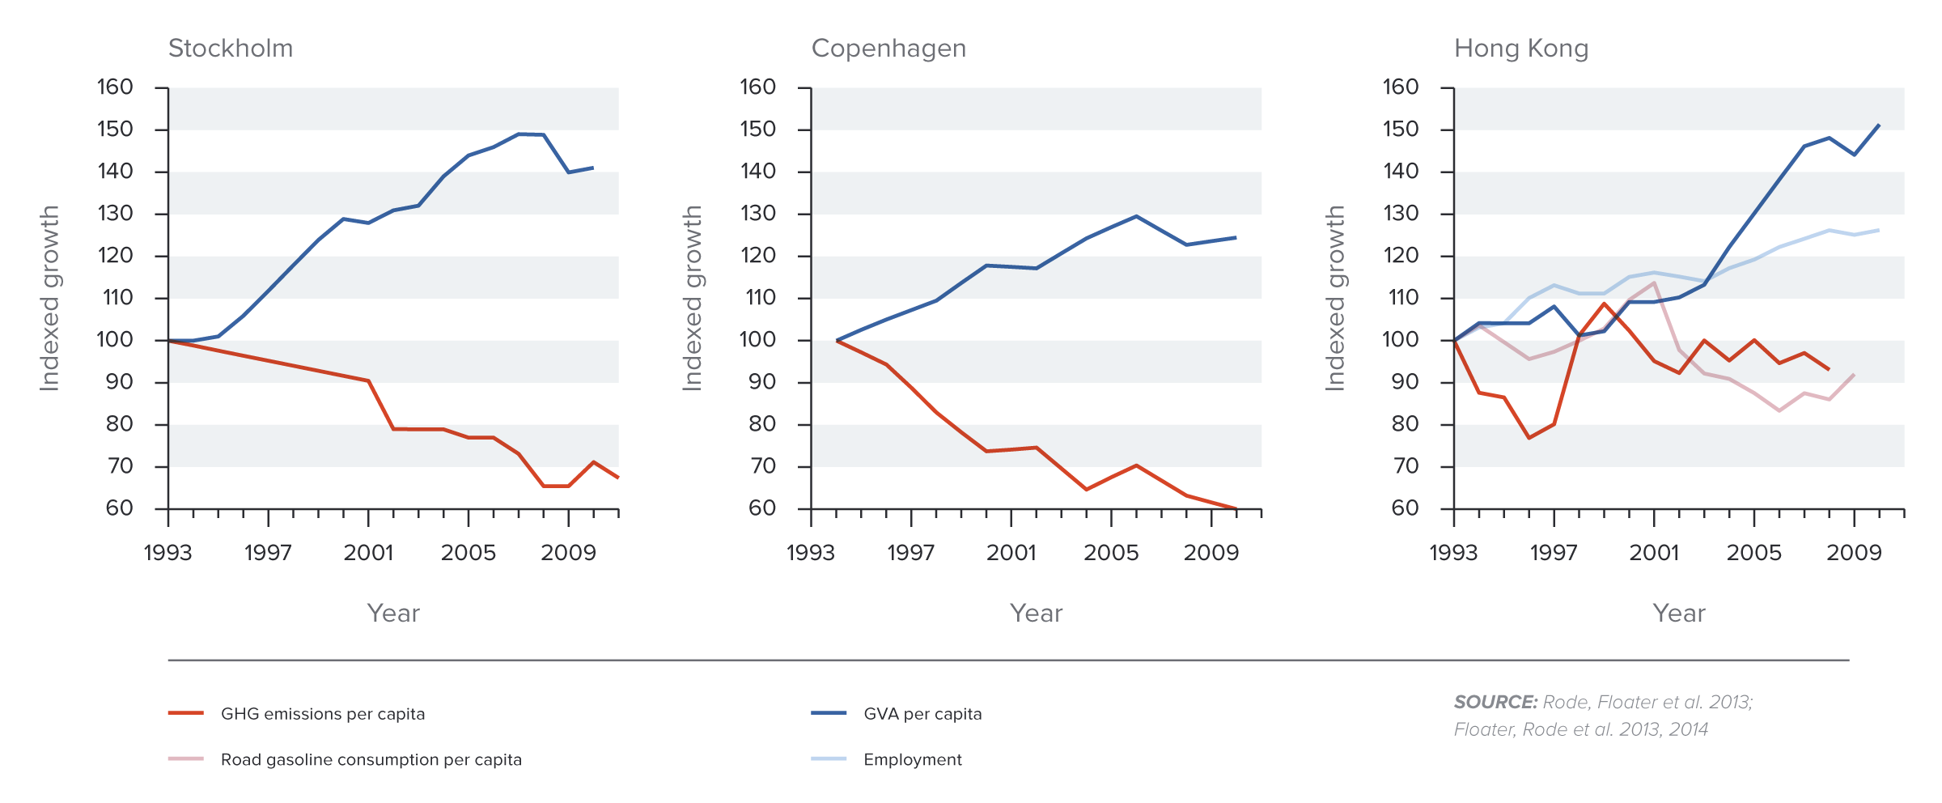
Compact and Connected Urban Pathways Can Go
Hand-in-hand with Economic Growth
Stockholm
Copenhagen
Hong Kong
Notes:
Source: New Climate Economy Report

Slide 80
Climate Change Policy in Action

Slide 81
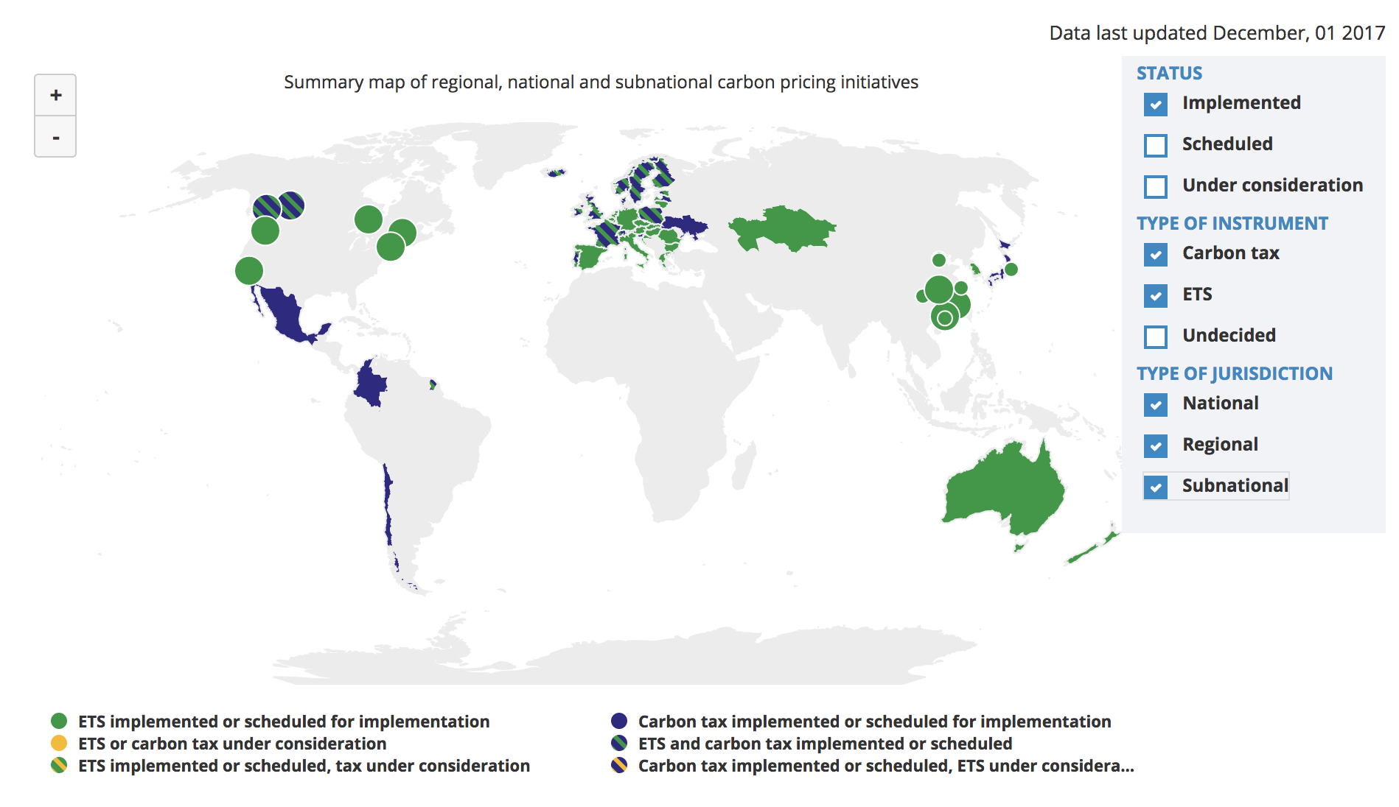
Carbon Policies Across the World
ETS = Emissions Trading System = Cap and Trade
Source: World Bank Carbon - Pricing Dashboard

Slide 82
Cap and Trade
Notes:
Does NEED want transition (section-starter) slides to maybe ALL look like this? If not, maybe these slides should be plain text like the rest of them?

Slide 83
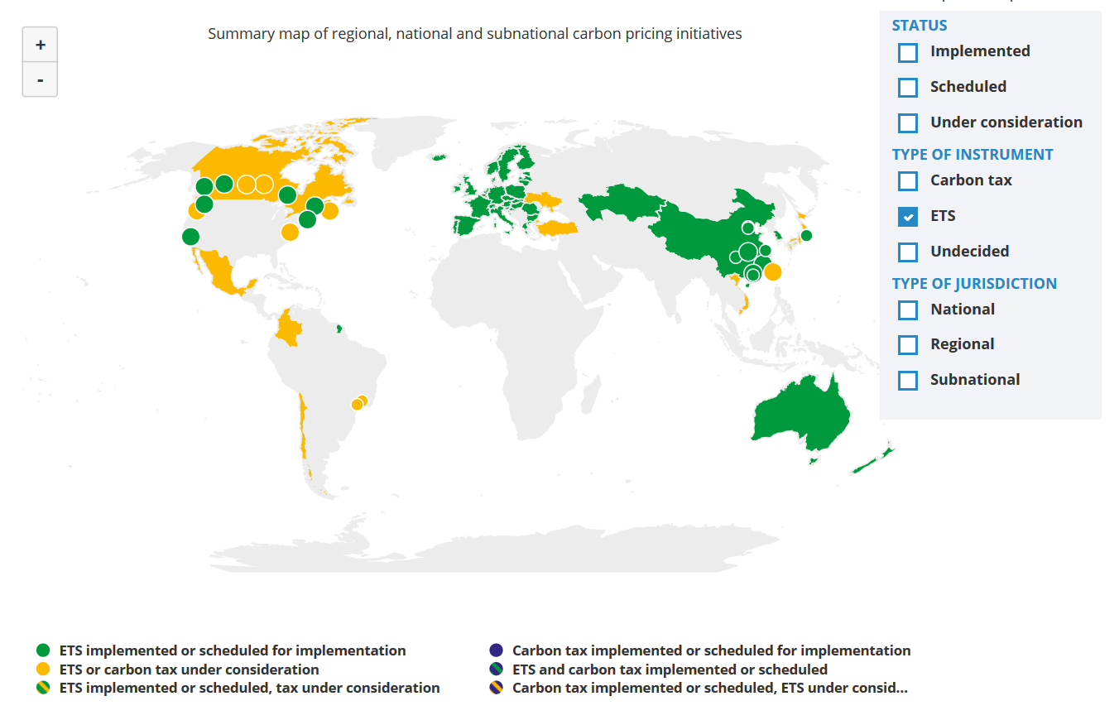
Cap and Trade Policies Around the World
ETS = Emissions Trading System = Cap and Trade
Source: World Bank - Carbon Pricing Dashboard

Slide 84

European Union’s Emissions Trading Scheme
4%
of global greenhouse gas emissions
Circa 2005

Slide 85
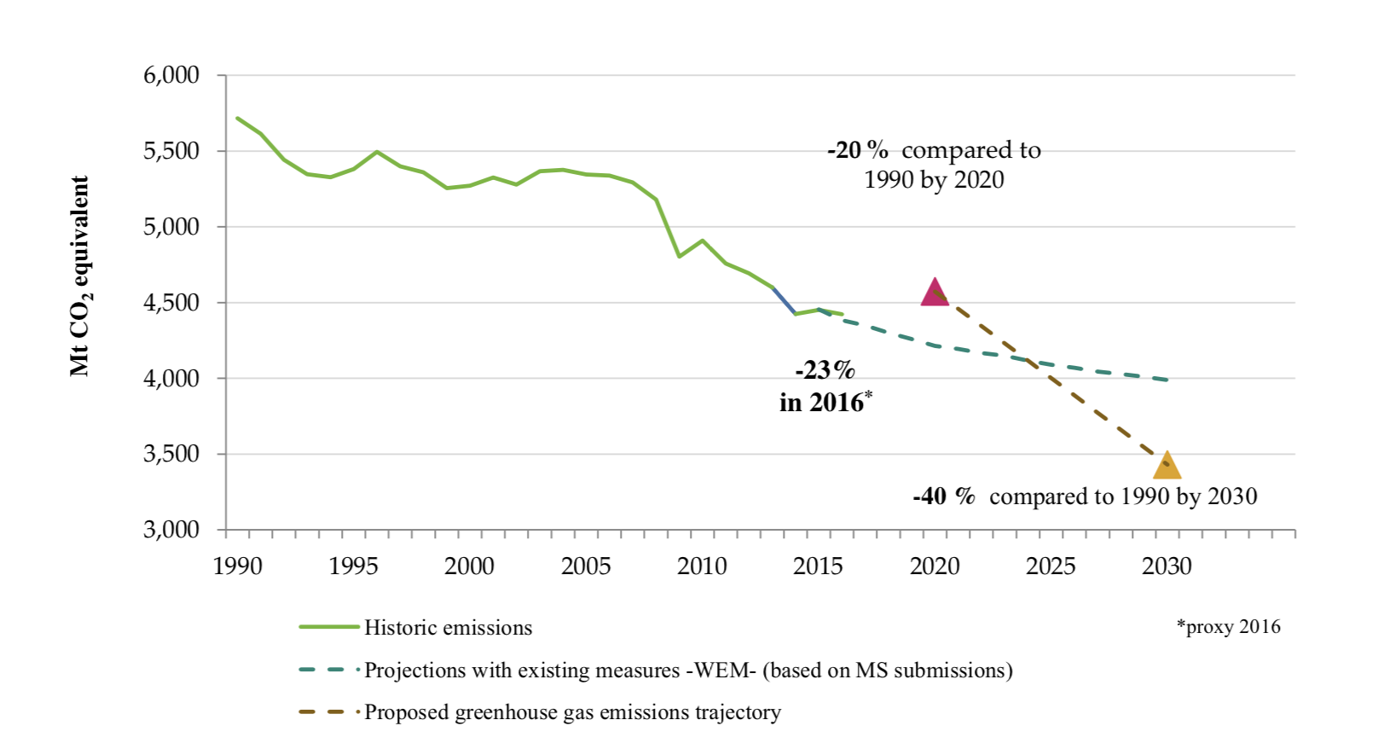
Progress Towards Meeting Europe 2020 And 2030 Targets (EU Total GHG Emissions)
Notes:
Source: “REPORT FROM THE COMMISSION TO THE EUROPEAN PARLIAMENT AND THE COUNCIL Implementing the Paris Agreement - Progress of the EU towards the at least -40% target” https://eur-lex.europa.eu/legal-content/EN/TXT/?uri=COM%3A2016%3A707%3AFIN

Slide 86
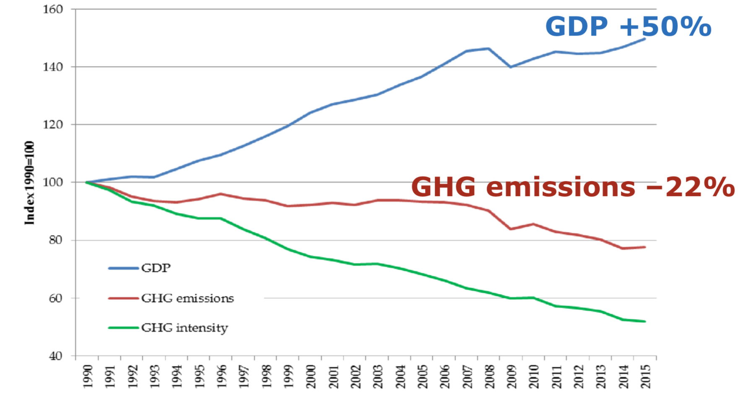
EU Has Decoupled Economic Growth from Greenhouse Gas Emissions
European Commission
Cap & Trade ->
Climate Action
Notes:
Source: “REPORT FROM THE COMMISSION TO THE EUROPEAN PARLIAMENT AND THE COUNCIL Implementing the Paris Agreement - Progress of the EU towards the at least -40% target” https://eur-lex.europa.eu/legal-content/EN/TXT/?uri=COM%3A2016%3A707%3AFIN

Slide 87

California’s Cap and Trade System: 2012+
0.7%
of global greenhouse gas emissions

Slide 88
California’s System Is Flexible
California’s goals:
  Reduce emissions to 1990 levels by 2020
  An 80% reduction in emissions from 1990 levels by 2030
California’s Tools:
  Cap and Trade
  Renewable Portfolio Standard
  Clean Cars Program
  Low Carbon Fuel Standard

Slide 89
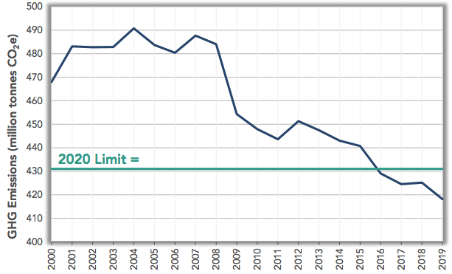
CA Relative to Goals: How Are We Doing?

Slide 90
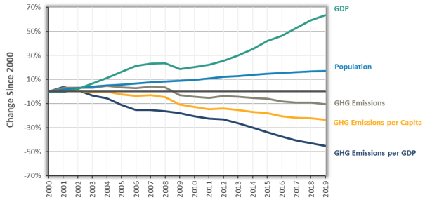
Change in California GDP, Population, and
GHG Emissions since 2000
Cap & Trade ->
Source: CA Air Resources Board
Notes:
This would be nice animated.
Source: https://www.arb.ca.gov/newsrel/newsrelease.php?id=933

Slide 91
RGGI: the Regional Greenhouse Gas Initiative
Participants: Connecticut, Delaware, Maine, Maryland, Massachusetts, New Hampshire, New York, Rhode Island, and Vermont
  7% of US emissions
Covers power plants
First implemented in 2009
Caused emissions reduction of 24% below what they would have been

Slide 92
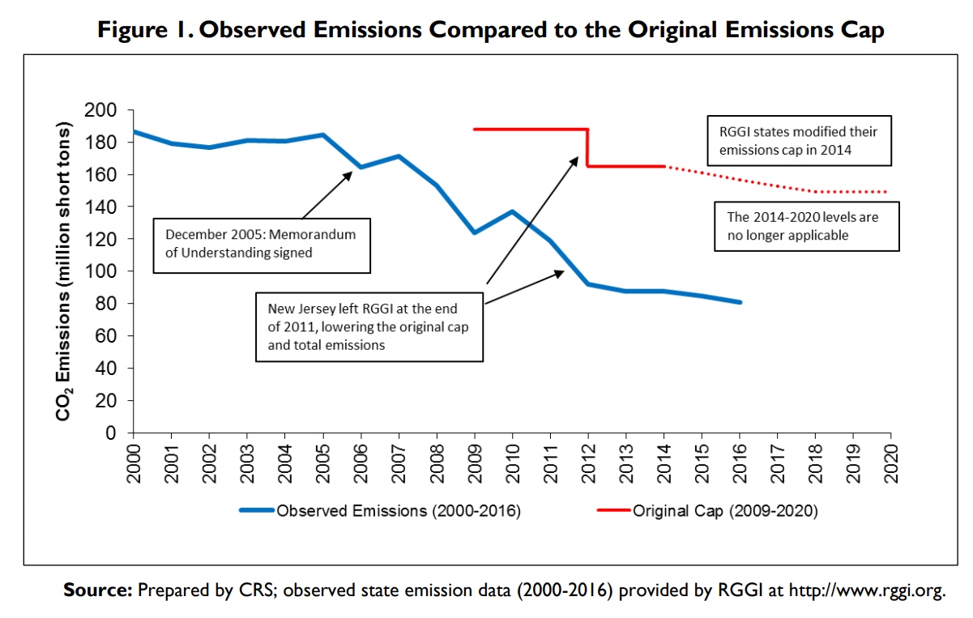
RGGI’s Effect on Emissions
Notes:
Source: Ramseur, 2015

Slide 93
Carbon Tax
Notes:
Does NEED want transition (section-starter) slides to maybe ALL look like this? If not, maybe these slides should be plain text like the rest of them?

Slide 94
Worldwide Carbon Taxes
28
carbon tax programs
25
national jurisdictions
covered
5.5%
of global greenhouse gas emissions

Slide 95

British Columbia’s Carbon Tax Policy
0.1%
of global greenhouse gas emissions

Slide 96

“
Tax the pollution we do not want, and return the money for what we do want — money in people’s pockets, jobs and investment.
- B.C. Government - Carbon Tax Brochure
“

Slide 97
British Columbia's Tax on Carbon
Notes:
Source for slide: https://www2.gov.bc.ca/gov/content/environment/climate-change/planning-and-action/carbon-tax

Slide 98
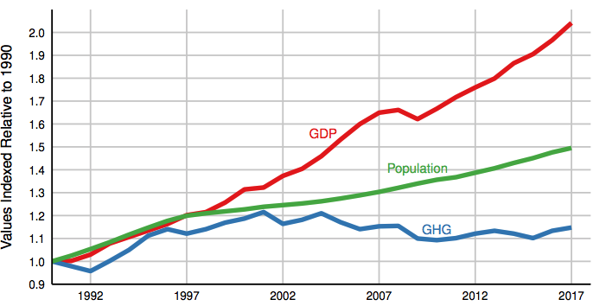
Relative Greenhouse Gas Emissions, GDP & Population Size: British Columbia
Carbon Tax ->
Notes:
http://www.env.gov.bc.ca/soe/indicators/sustainability/ghg-emissions.html

Slide 99

Sweden’s Carbon Tax Policy
Oldest Carbon Tax

Slide 100
Sweden’s Carbon Tax Policy
Started in 1991
Currently at $140/ton

Slide 101
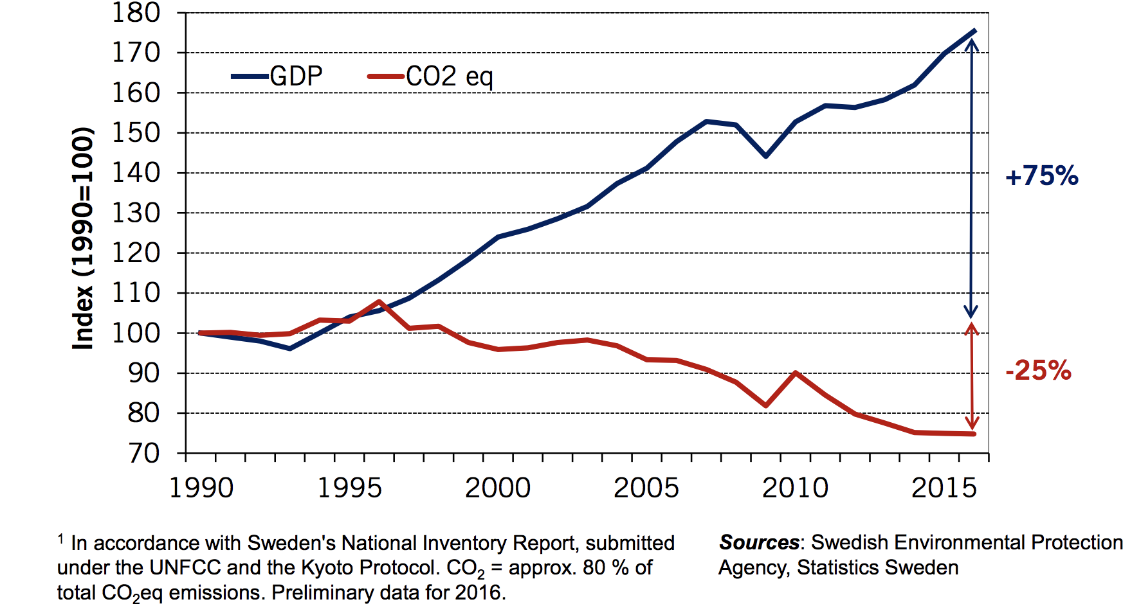
Real GDP and Domestic CO₂eq Emissions¹
In Sweden, 1990-2016
Notes:
Source: http://www.government.se/492fd9/contentassets/18ed243e60ca4b7fa05b36804ec64beb/170925-aakerfeldt-panel-debate-tuscon-gcet.pdf

Slide 102

U.S. Carbon Tax Plans
Climate Leadership Council
Citizens Climate Lobby
States and municipalities: Washington state, Oregon,
Washington, DC
CO₂

Slide 103
Summary
Climate change is real, is caused by human actions, and has impacts we’re already feeling.
We need to reduce emissions to balance the costs of action against the costs of inaction.
Scientists and the IPCC recommend that we work to keep warming below 1.5 degrees celsius.
  Economists believe that this goal is well worth the costs!

Slide 104
Summary – continued
There are many ways to reduce emissions.
Economics-inspired policies can help us do this at the lowest cost.
Taxes and cap and trade are proven effective tools to fight climate change!
Other tools may also be necessary.

Slide 105

“
Economic policies will be central to accomplishing
the goals we choose.
- Harris and Roach (2007)
“

Slide 106
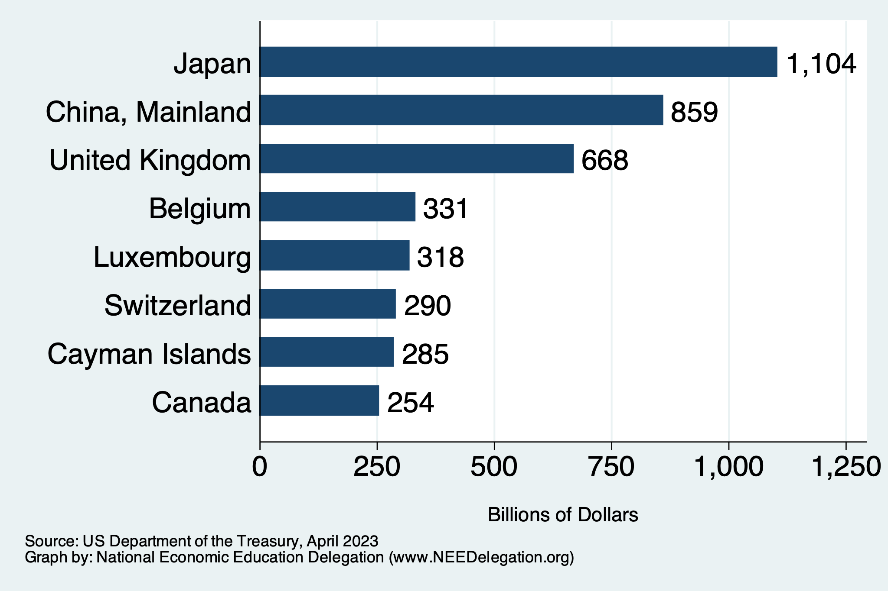
Next week: Who Holds US Debt?
https://ticdata.treasury.gov/Publish/mfh.txt

Slide 107
Thank you!
Any Questions?
www.NEEDEcon.org
Andrew W. Stevens, Ph.D.
awstevens@wisc.edu
Contact NEED: info@NEEDEcon.org
Submit a testimonial: www.NEEDEcon.org/testimonials.php
Become a Friend of NEED: www.NEEDEcon.org/friend.php

