Slide 1

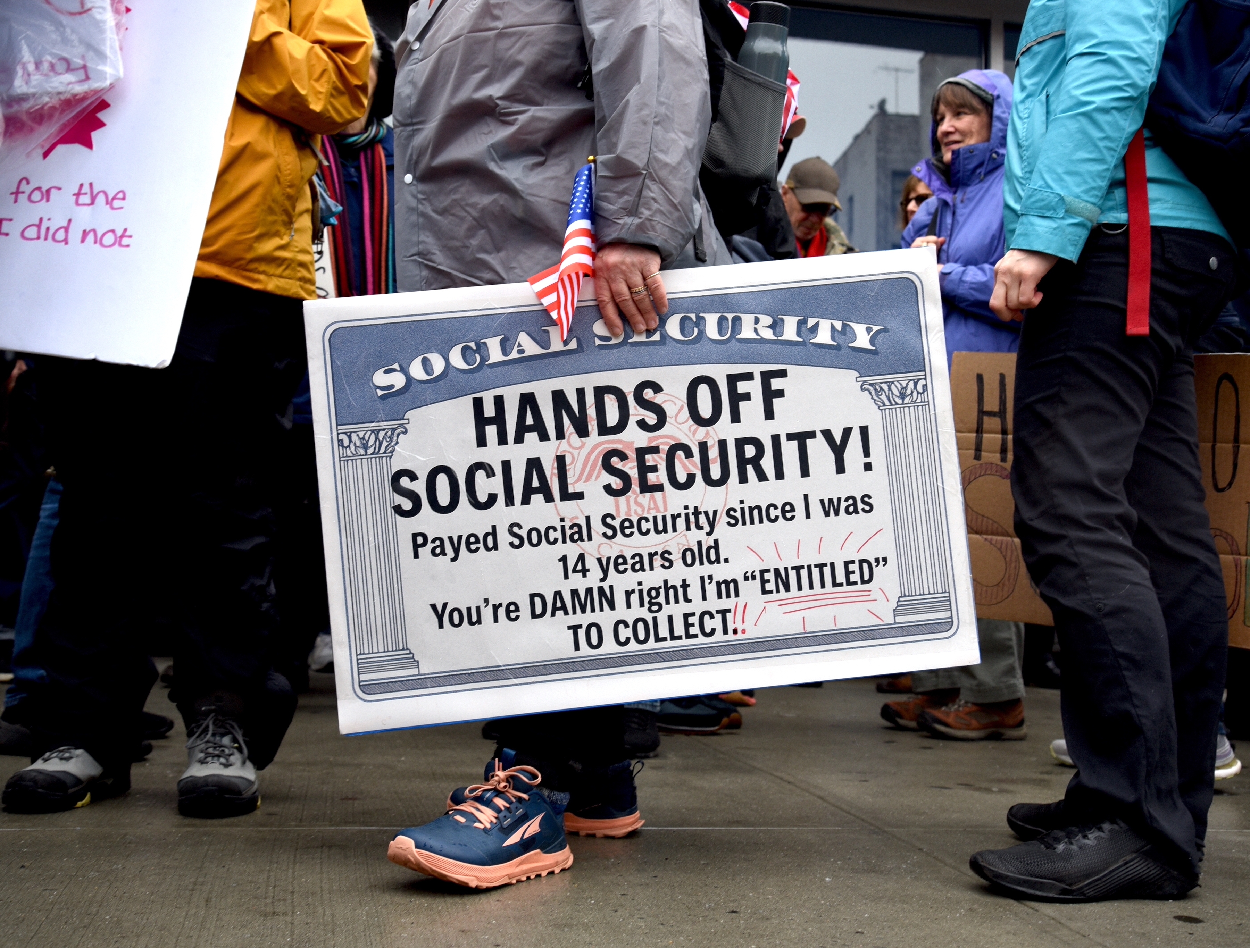
Social Security – Hard Choices (?)
Parkway United Church of Christ
Town and Country, MO
April 26, 2026
Jon Haveman, Ph.D.
NEED

Slide 2
Outline
What is Social Security?
How Does Social Security Work?
What is The Trouble with Social Security?
Available Solutions

Slide 3
What is Social Security?

Slide 4
What is Social Security?
Social Security is a federal social insurance program that provides financial support to workers and their families.
Different benefits:
Retirement Benefits: Social Security provides monthly payments to qualified retirees based on their lifetime earnings.
Disability Benefits: It provides financial support to individuals who are unable to work due to a disability.
Survivor Benefits: Social Security offers benefits to the families of deceased workers, including spouses and children.

Slide 5
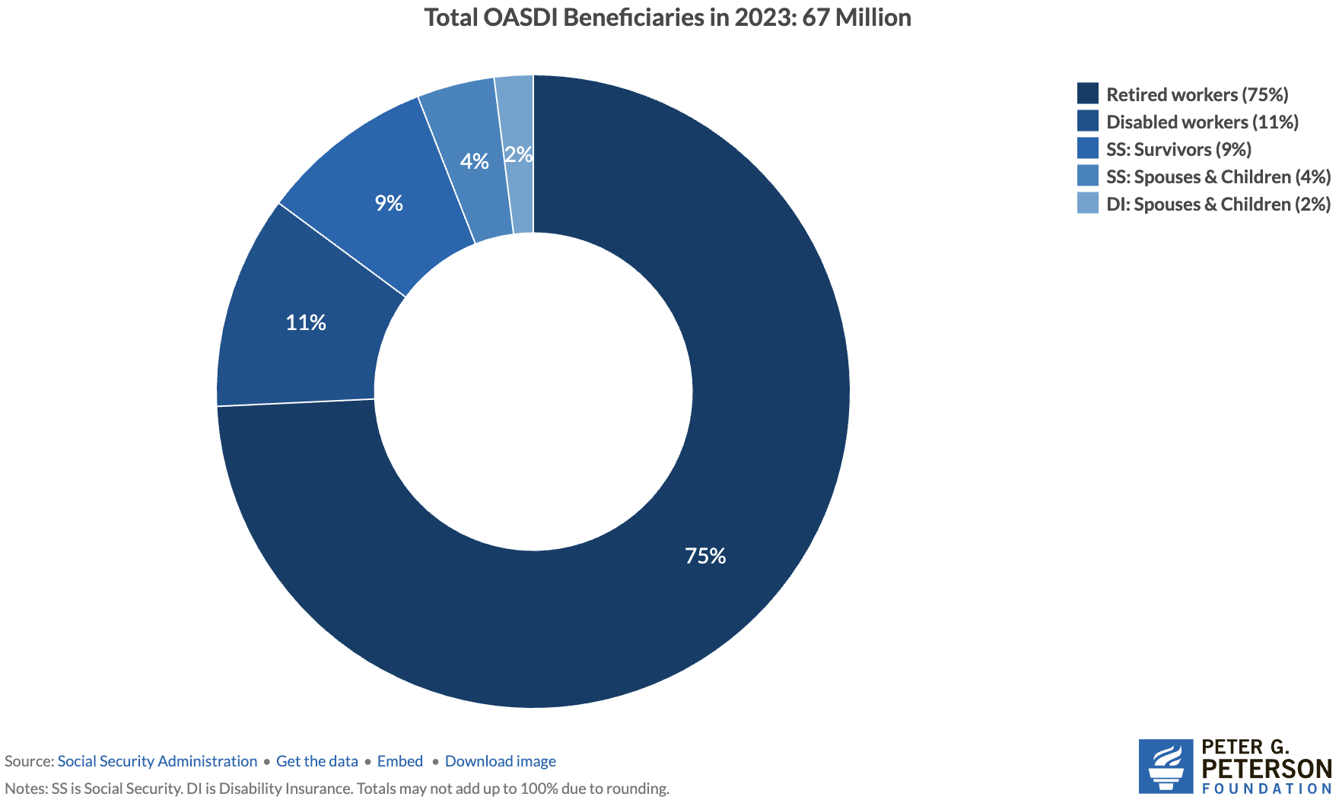
Numbers of Different Types of SS Beneficiaries
6.0 million
7.4 million
52.3 million

Slide 6
Social Security’s Origins
A part of the social safety net.
Created in 1935 to provide economic security to the nation’s elderly.
Expanded in 1939 to include dependent benefits.
Benefits to families that have lost a breadwinner.
Expanded in 1950 to provide support for people with disabilities.
Expanded in 1974 to provide Supplemental Security Income.
Can supplement regular social security benefits.
Today, it is the largest federal program.
In FY 2024, spending was $1.25 trillion, or 22.4% of total federal spending.
By comparison, national defense was $997 billion.

Slide 7
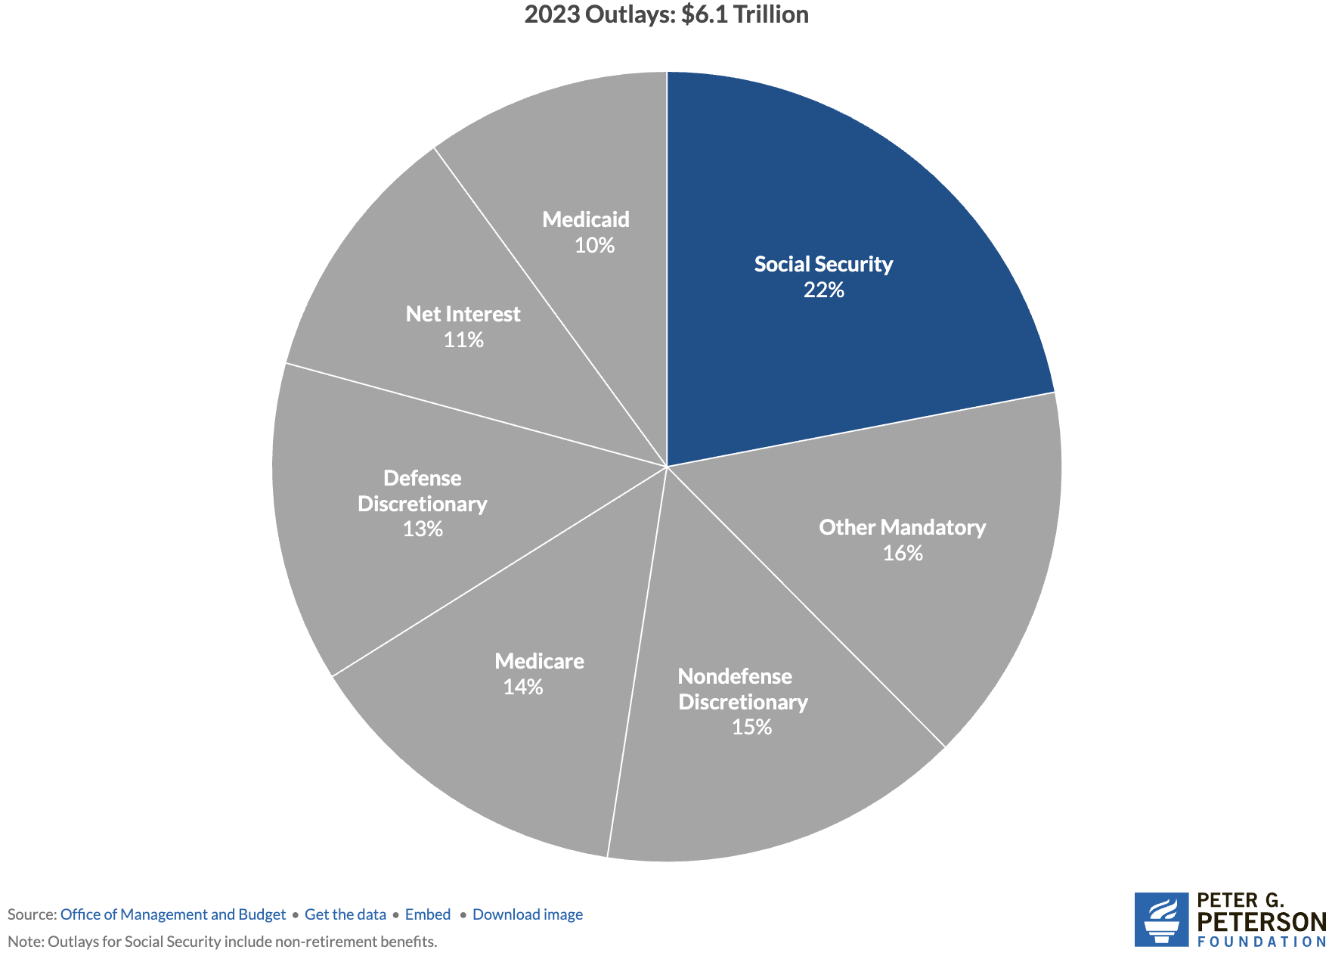
Soc Sec is The Single Largest Gov’t Program
Source: https://www.pgpf.org/article/9-facts-about-social-security-and-the-need-to-strengthen-it/

Slide 8
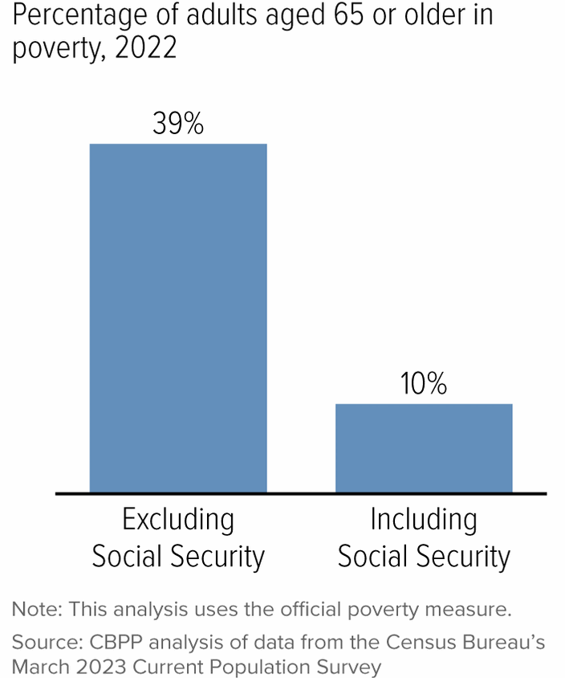
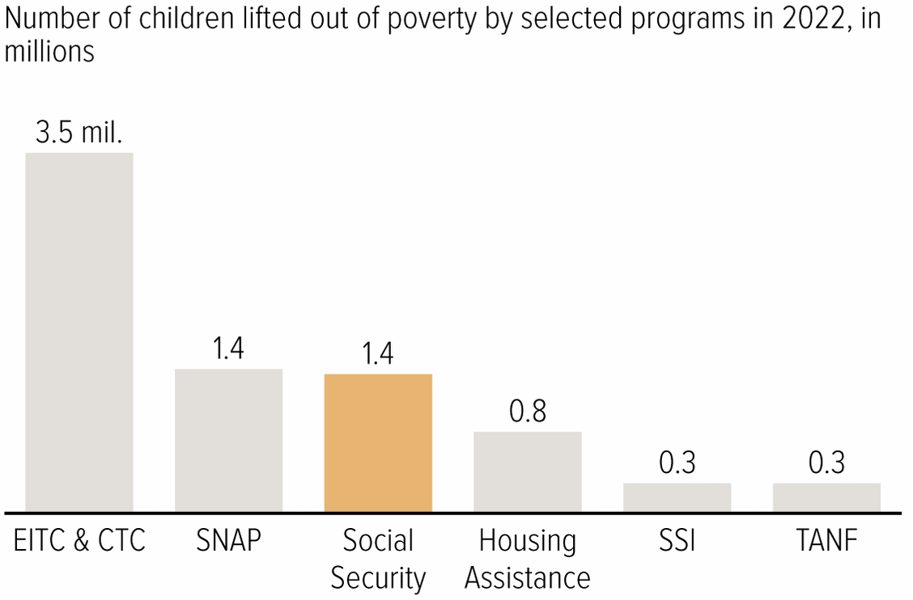
Soc Sec Significantly Reduces Poverty

Slide 9
Is Social Security Good for Just The Beneficiaries?
No, it also benefits broader society.

Slide 10
Economic Impacts on Individuals and Families
Poverty reduction
Good investment for society.
Reduces income inequality among the elderly
Increases social mobility
Income stability
Helps households plan for the future.
Enables older adults to maintain independence
Reduces caregiving burdens on family members.
Consumer spending
Supports businesses and the local economy.

Slide 11
How Does it Work?

Slide 12
The Mechanics of Social Security
“pay-as-you-go” system
Payroll taxes are collected from current workers.
These pay for the benefits of the currently retired, or otherwise eligible.
Taxes
Payroll taxes amount to 12.4% of earnings.
Workers pay 6.2% of earnings as payroll taxes.
Employers also pay 6.2% of worker’s earnings.
Earnings Cap. Not all earnings are subject to payroll taxes.
In 2026, only the first $184,500 of earnings are taxed.
Earnings above that level are not taxed.

Slide 13
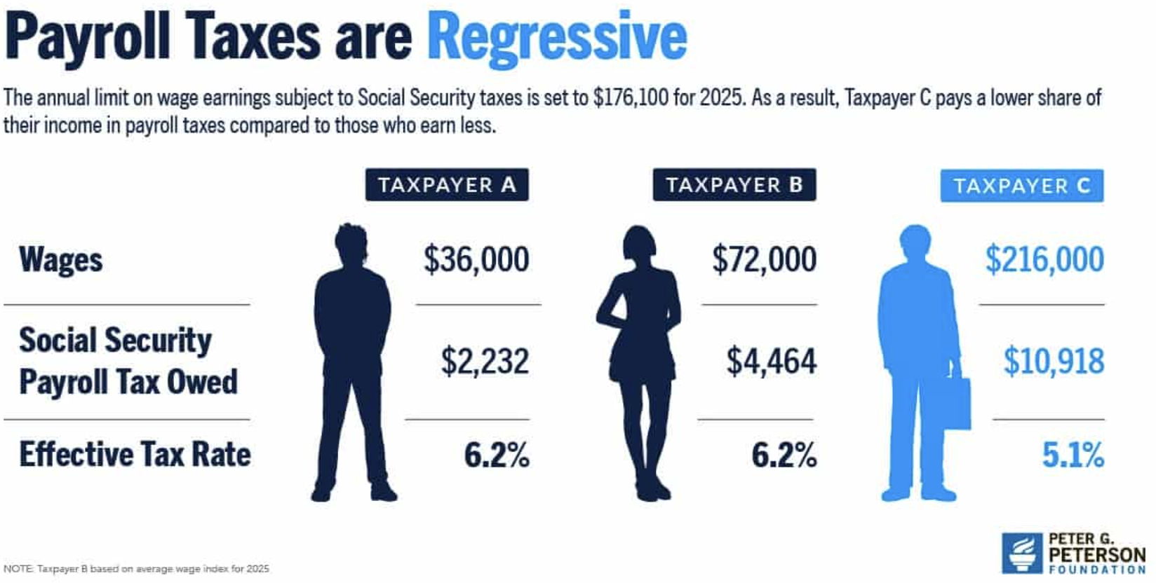
The Cap Causes The Tax Rate to Fall w/Income

Slide 14
What if Payroll Taxes Don’t Match Benefits?
The Trust Fund
If revenues exceed benefits, the excess is placed in a trust fund.
If benefits exceed revenues, the excess is taken out of the trust fund.
The funds in the trust are invested in nonmarketable U.S. Treasuries.
So, really just bookkeeping.
When did the Trust Fund start?
The OASI Trust Fund was created in 1939. (Old Age & Survivors Ins)
The Disability Trust Fund was created in 1956.

Slide 15
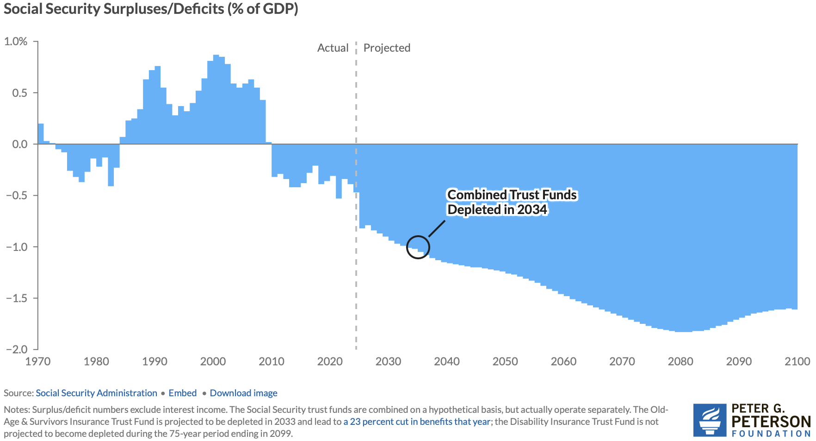
Annual Contributions to the Fund Vary
Social Security
Amendments Act
Of 1983

Slide 16
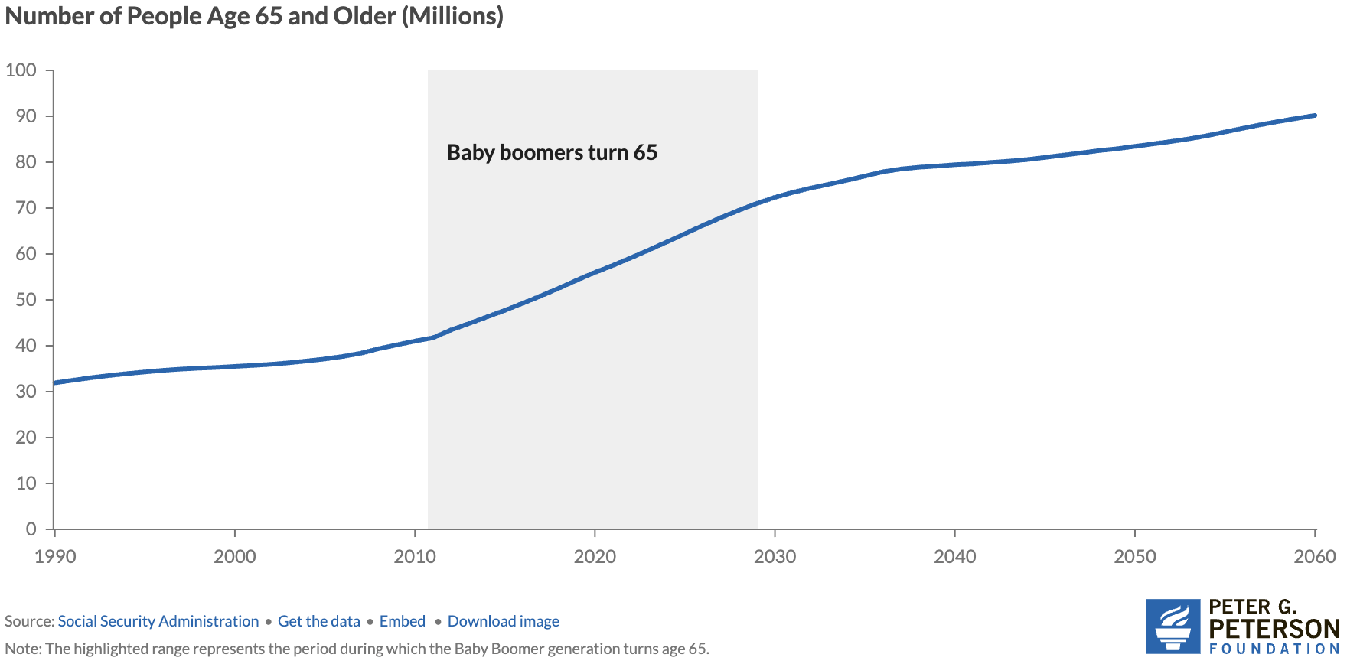
Why the Change in Direction? Aging Population
Source: https://www.pgpf.org/article/how-does-social-security-work/

Slide 17
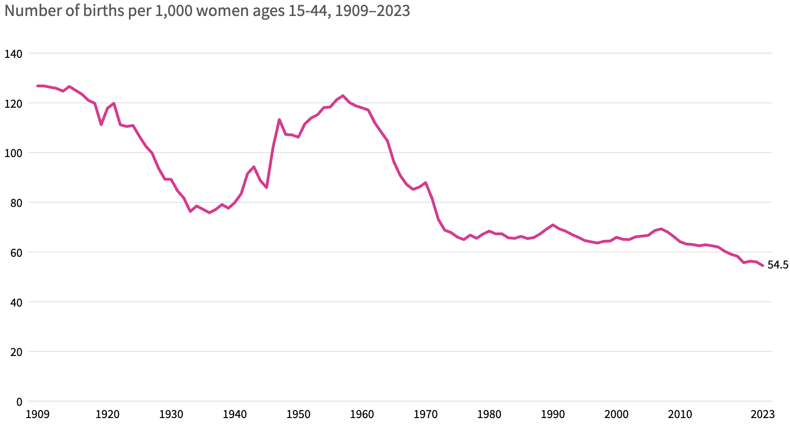
Lower Births = Slower Labor Force Growth
Source: https://usafacts.org/articles/how-have-us-fertility-and-birth-rates-changed-over-time/

Slide 18
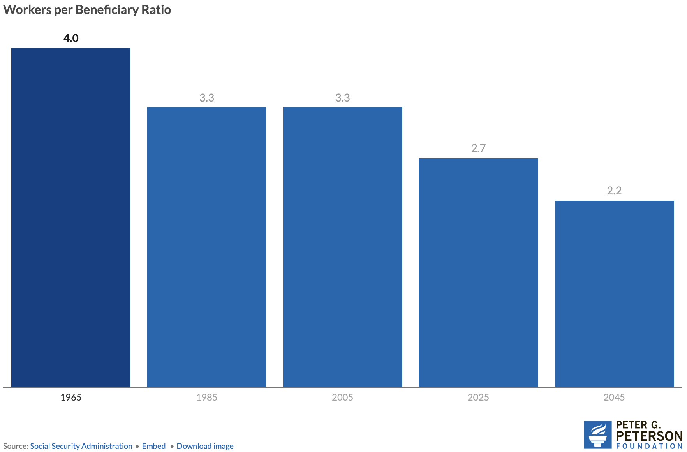
Number of Covered Workers per Beneficiary
Now

Slide 19
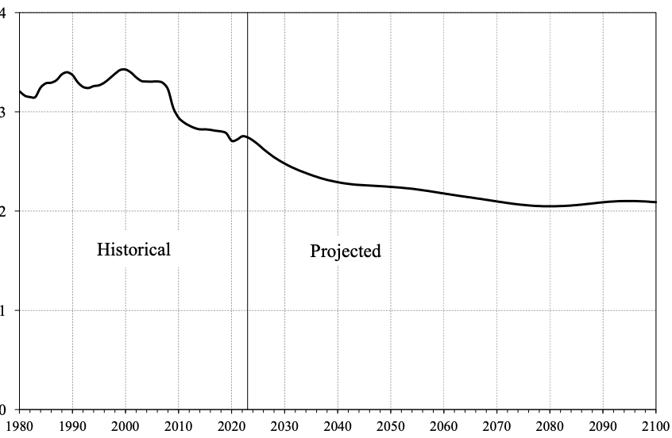
Number of Covered Workers per Beneficiary
Baby boomers started retiring.
Source: https://www.ssa.gov/OACT/TR/2024/tr2024.pdf

Slide 20
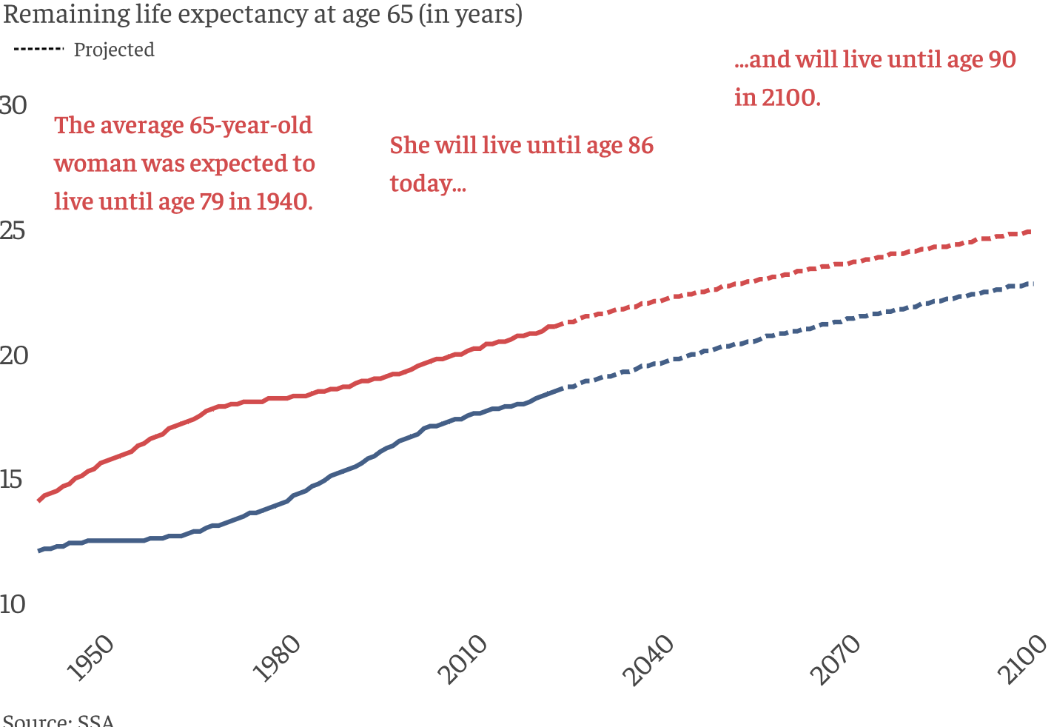
Life Expectancy Continues to Rise

Slide 21
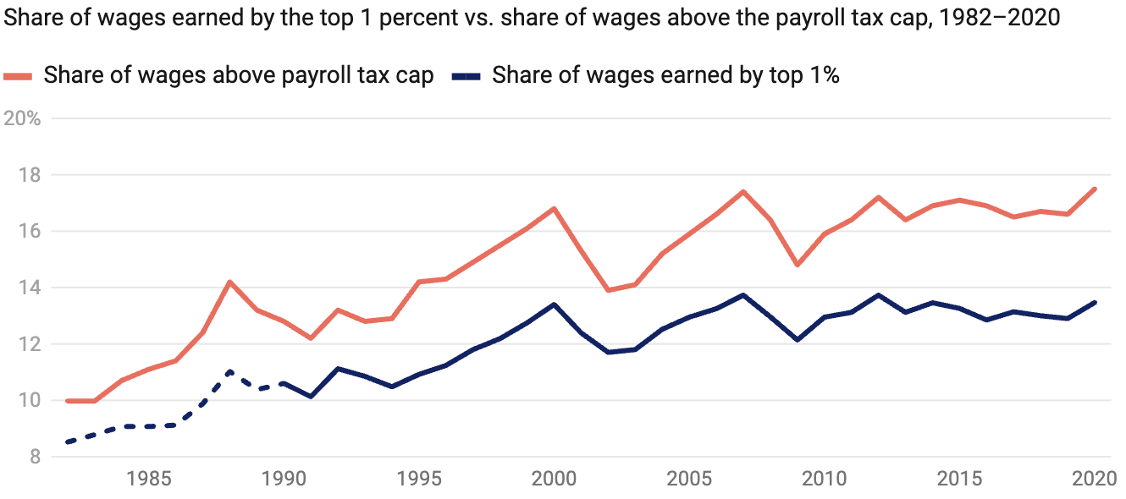
Increased Wage Inequality Is A Problem
Source: https://www.americanprogress.org/article/increased-wage-inequality-has-reduced-social-securitys-revenue
Notes:
The effect on net revenues is to reduce them.
https://www.americanprogress.org/article/the-effect-of-rising-inequality-on-social-security/#:~:text=Rising%20income%20inequality%20poses%20a,that%20higher%2Dearning%20workers%20receive.

Slide 22
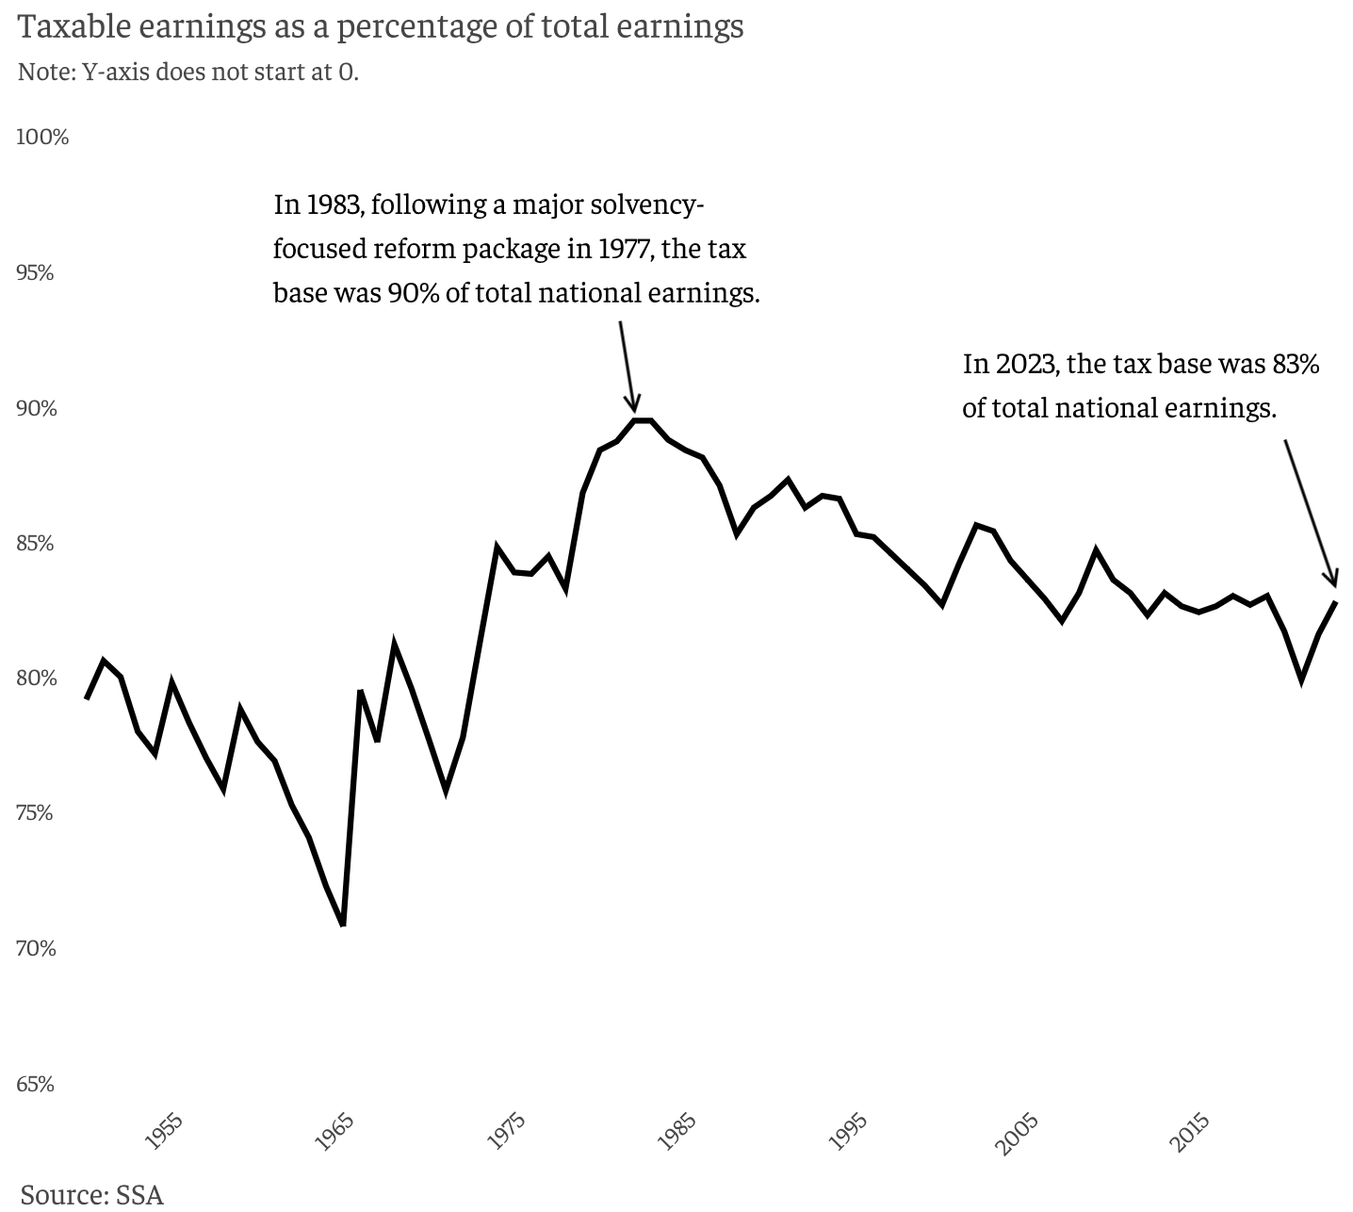
Tax Base is Dwindling
90%
83%

Slide 23
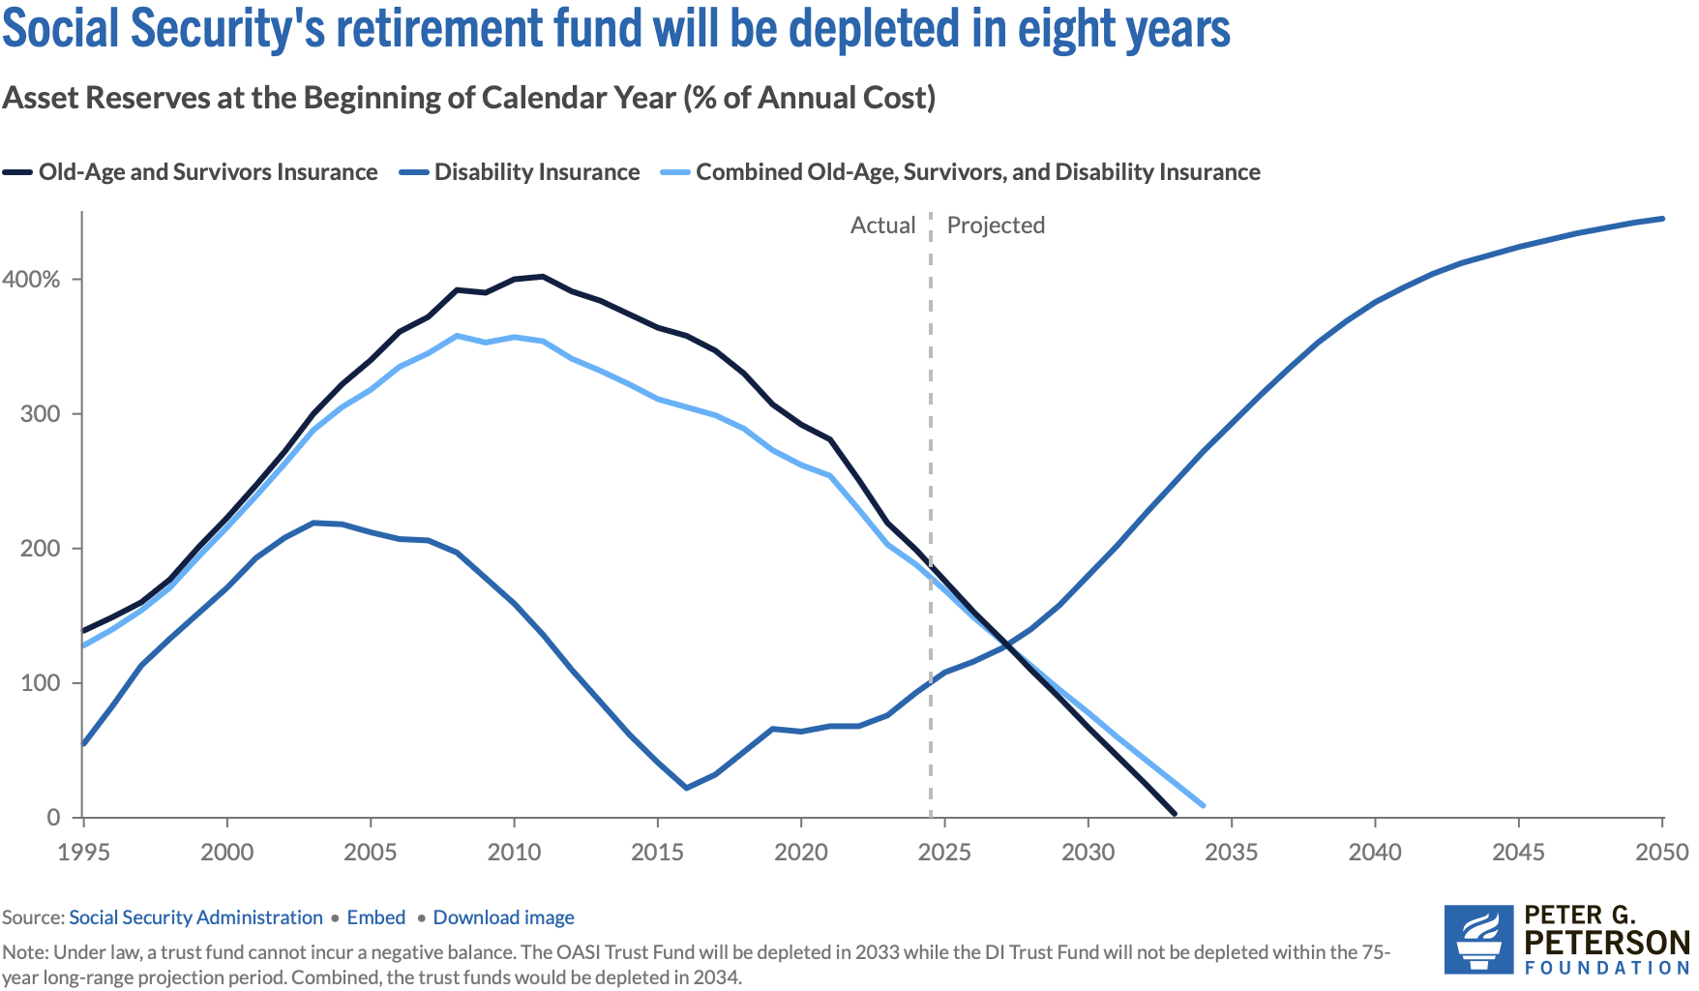
Trajectory of Funds

Slide 24
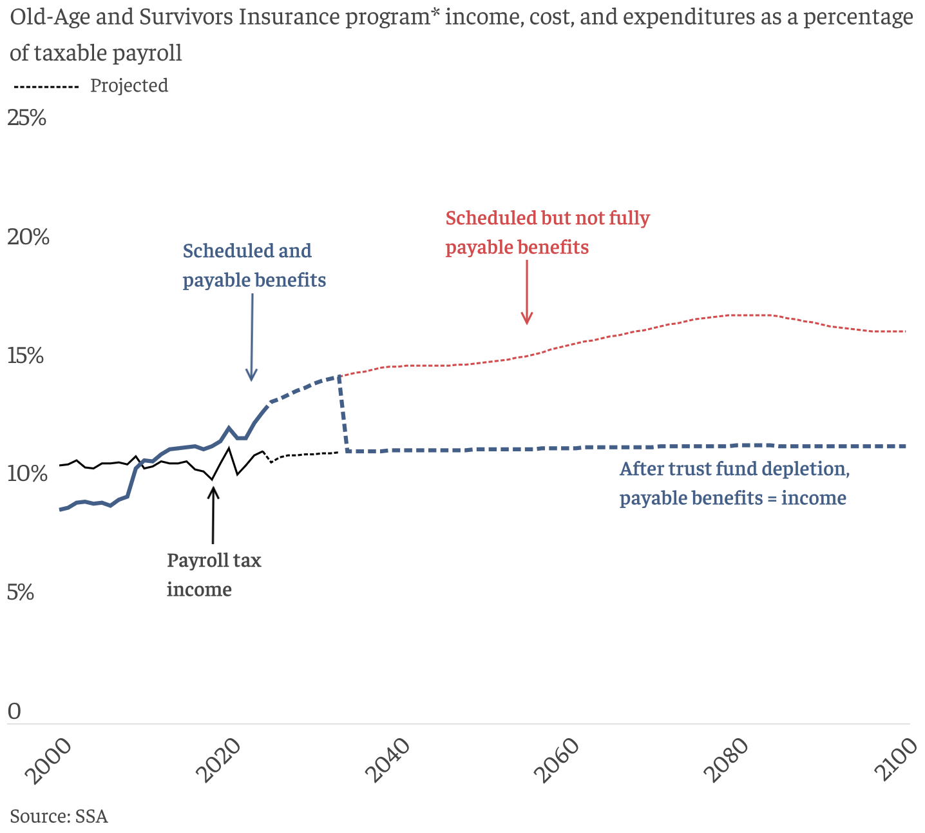
What Happens When The Trust Fund Runs Out?
Benefit Cut: 26%
2098
Trust Fund Exhaustion, 2033
Benefit Cut: 18%

Slide 25
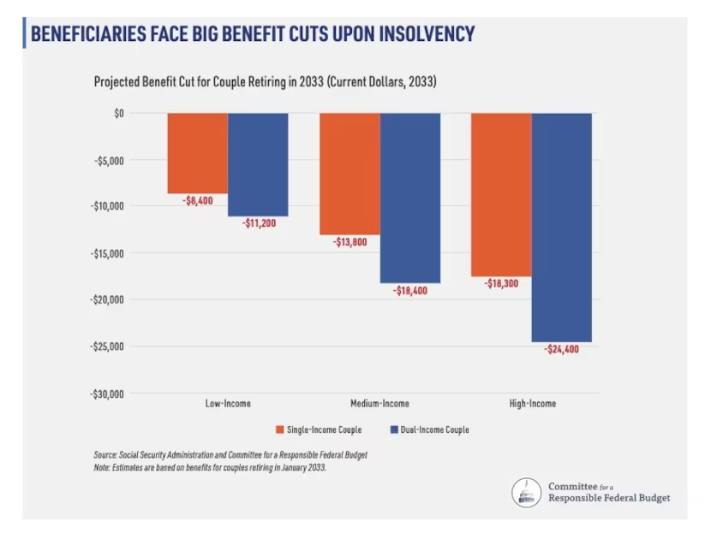
An Idea of the Implications

Slide 26
Where Does the Money Come From?
Payroll taxes
Taxes on benefits
Interest earnings
Trust funds

Slide 27
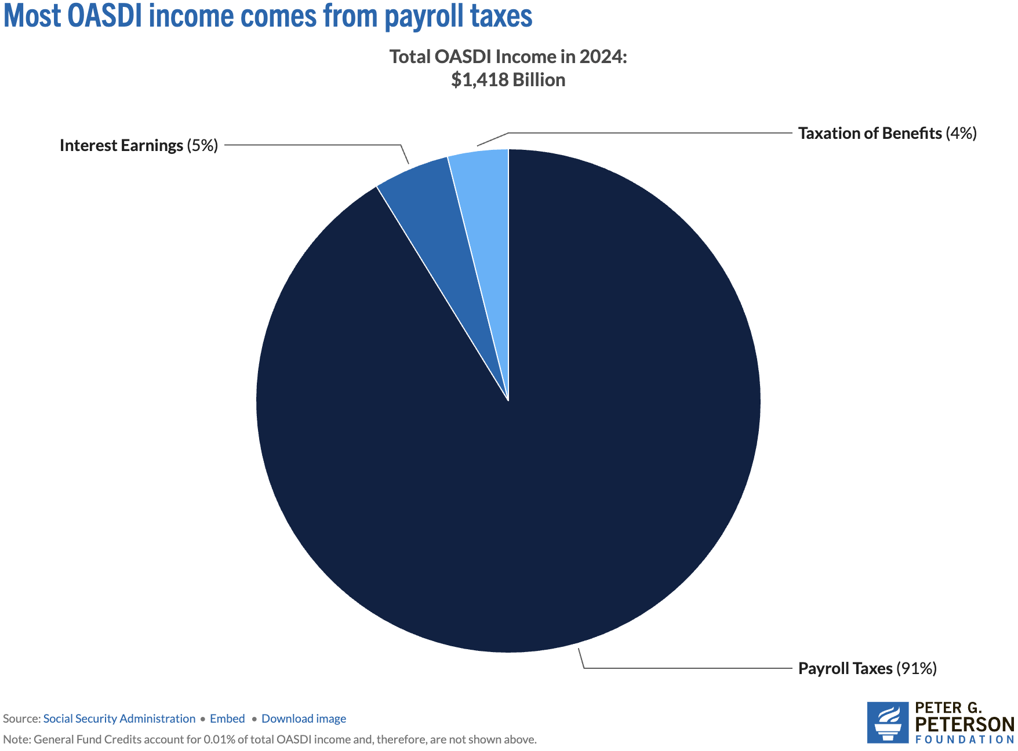
Sources of SS Revenue

Slide 28
Where Does The Money Go?

Slide 29
Where Does The Money Go?
Different benefits:
Retirement Benefits
Disability Benefits
Survivor Benefits
Supplemental Security Income (SSI)
We will focus on retirement benefits.

Slide 30
What Determines my SS Benefit (PIA)? (Primary Insurance Amount)
Your work history.
You need 40 work credits to qualify.
In 2025, 1 credit = $1,810 in earnings.
Put another way: 10 years with social security earnings in each year of $21,720.
Your (capped) earnings history.
Indexed (to wages) earnings from the 35 highest-earning years.
Your birth year.
Determines your FRA – Full Retirement Age.
Born before 1960, it is 66-67, after 1960, it is 67.
Your claiming age.
Claiming at 62 instead of 67 reduces your benefit by 30%.
Higher if you wait until 70.
Increases approximately 8% each year that you wait.

Slide 31
What Determines my SS Payment Size (PIA)? (Primary Insurance Amount – PIA) (Adjusted Indexed Monthly Earnings - AIME)
Earnings History
Age at Which You Start Receiving SS
AIME is calculated using your 35 highest years of indexed earnings.
These earnings are then adjusted for wage inflation.
The AIME is used to determine your PIA, which is the amount you would receive if you start receiving benefits at your full retirement age.
You can start receiving benefits as early as age 62, but your monthly payment will be reduced if you choose to start before your full retirement age.
Waiting to start benefits until after your full retirement age (between 66 and 67, depending on your year of birth) will increase your monthly payment.
You receive the highest possible benefit by waiting until age 70.

Slide 32
How Big are Payments?
In 2025:
the average payment was $2,002.
Maximum if claim at age 62 was $2,831.
Maximum if claim at age 70 was $5,108.
Special minimum Social Security benefit:
For long-term, low-wage workers.
Minimum for 11 years of work: $52.10
Maximum for 30 years of work: $1,093.10

Slide 33
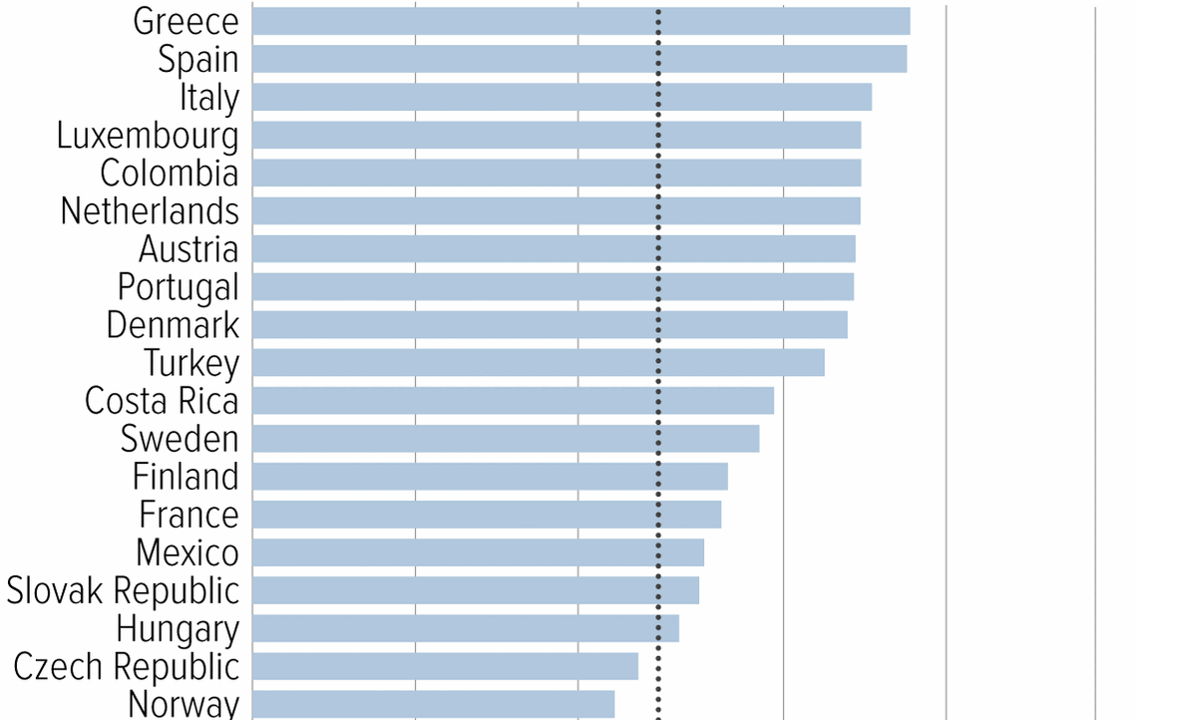
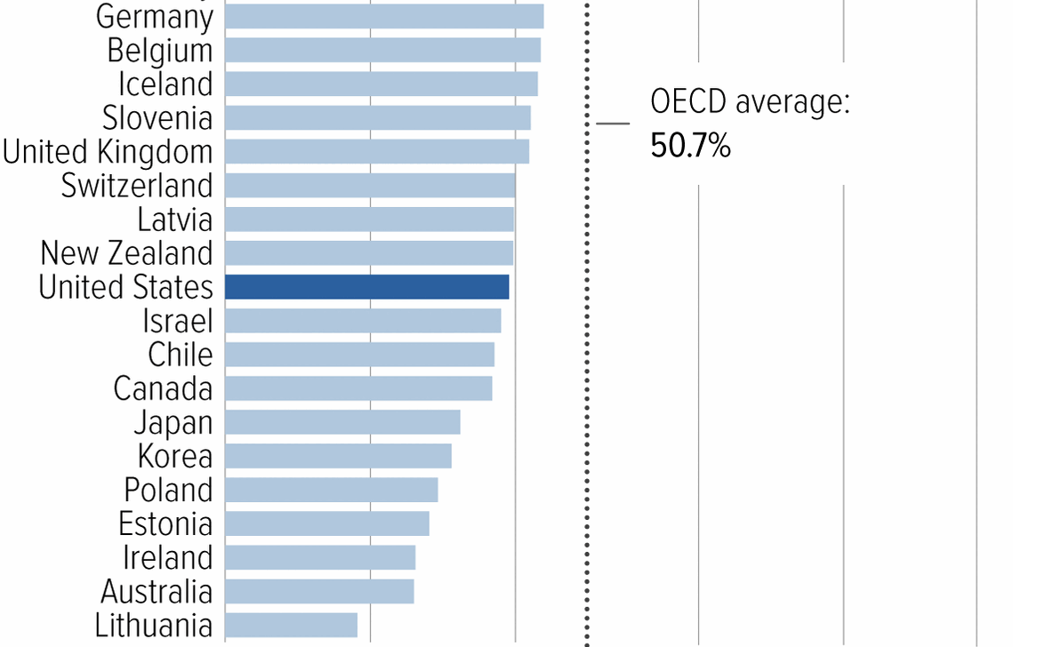
Social Security Benefits are Comparatively Low
Source: https://www.cbpp.org/research/social-security/top-ten-facts-about-social-security

Slide 34
Remember: We Have A Problem

Slide 35
Trust Finds Are Running Out
Source: https://www.pgpf.org/article/social-security-faces-serious-financial-shortfalls-and-other-takeaways-from-the-trustees-report/

Slide 36
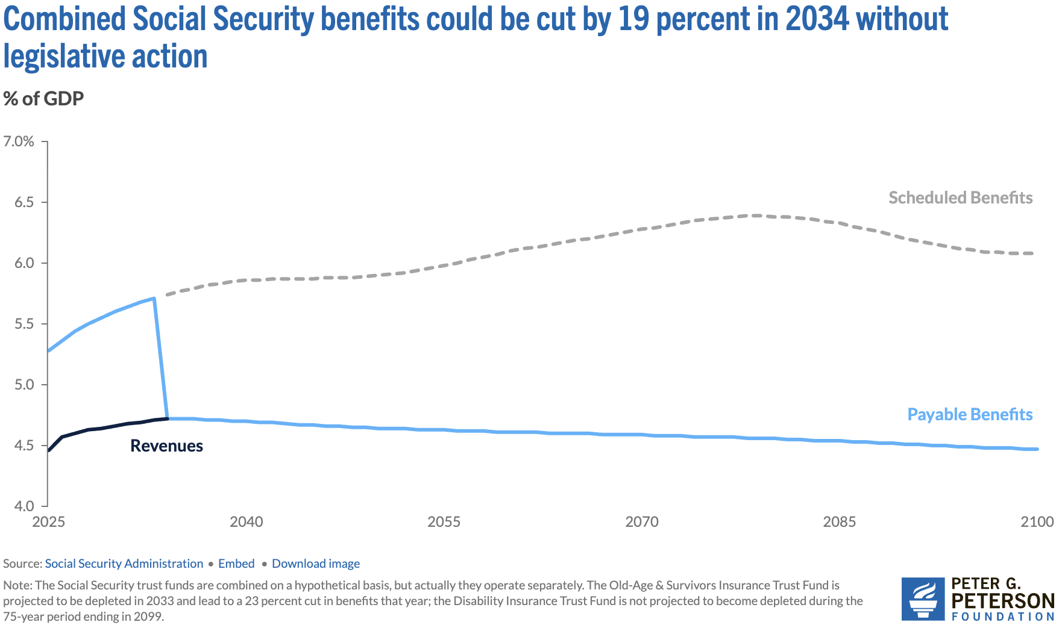
At Which Point, Benefits exceed Revenue
Benefit Cut: 27%
2098
Trust Fund Exhaustion, 2034
Benefit Cut: 19%

Slide 37
So, We Have A Problem
Benefit Cut: 26%
2098
Trust Fund Exhaustion, 2033
Benefit Cut: 18%

Slide 38
Hard Choices (?)

Slide 39
Let’s Cut to the Chase…
Solving the social security problem is simple:
Backfill out of general revenues!
Why won’t this happen?
Politics!
Our debt situation.
Maybe it shouldn’t.

Slide 40
Let’s Consider Some Other Options
Changes to revenues
Changes to benefits

Slide 41
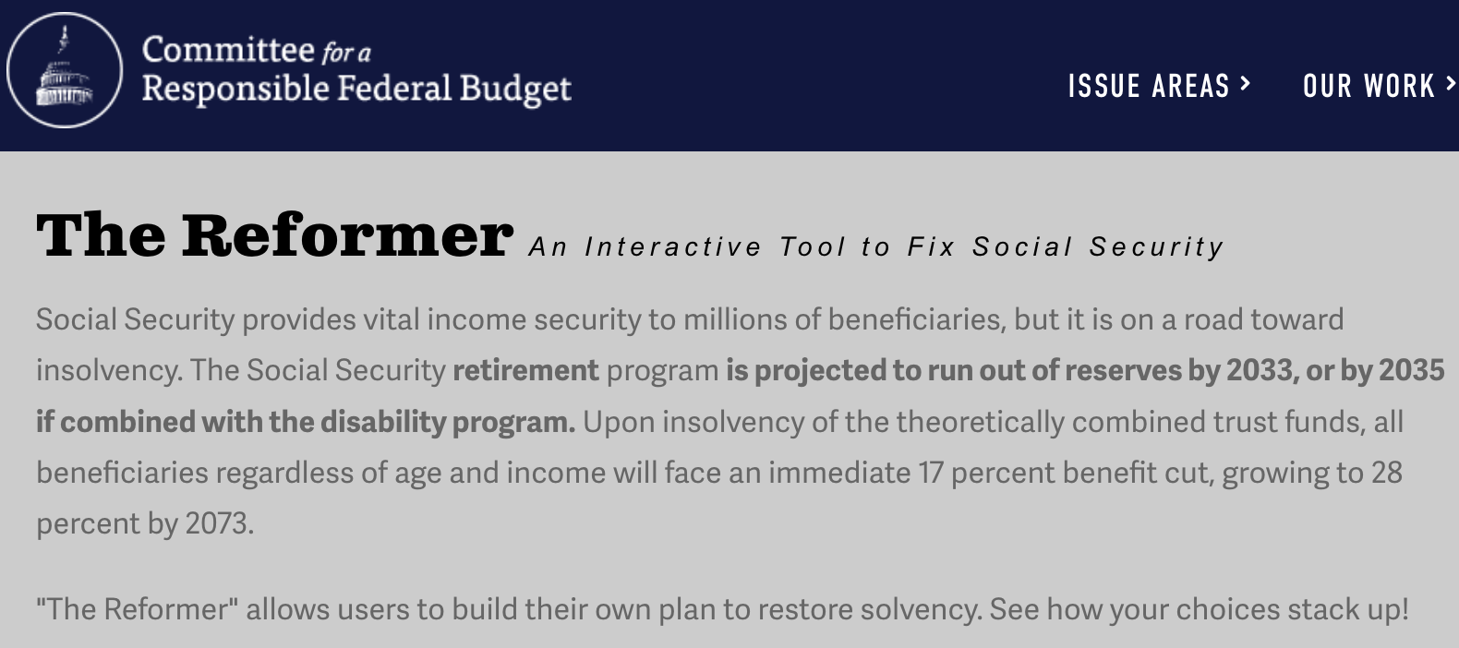
The Following Simulations Brought to you by:
https://www.crfb.org/socialsecurityreformer/

Slide 42
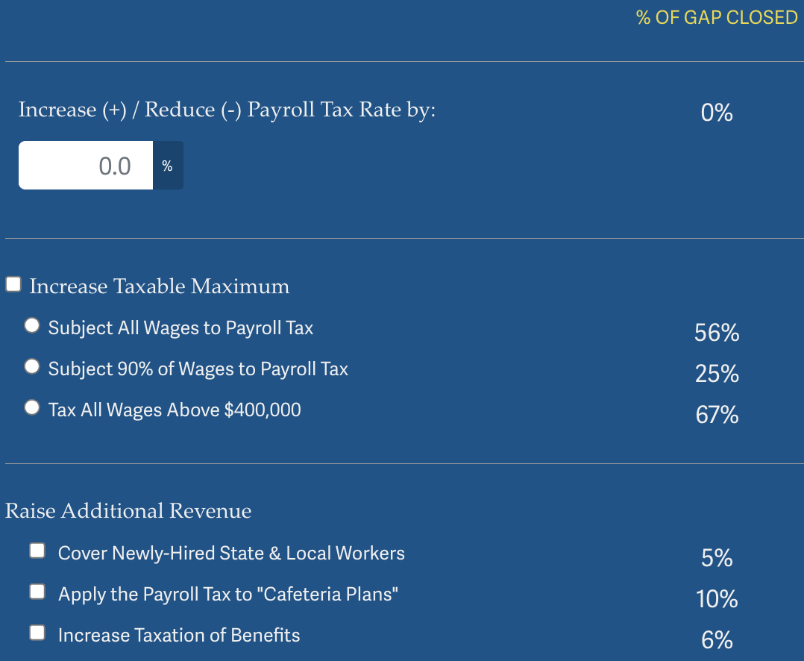
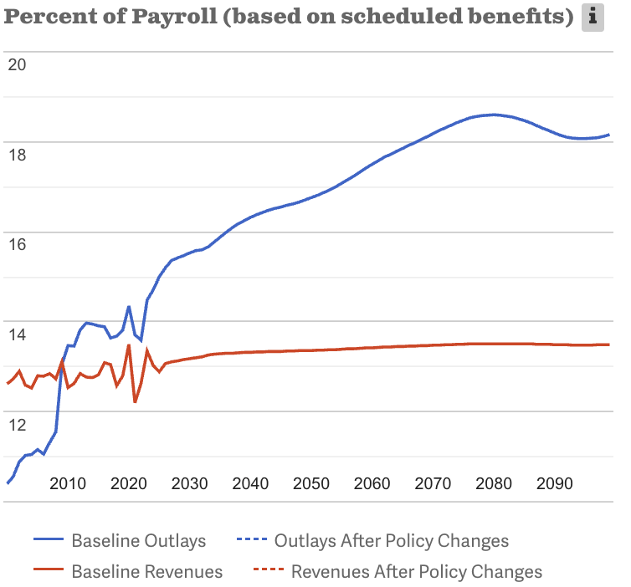
Possible Changes to Revenues
Source: https://www.crfb.org/socialsecurityreformer/

Slide 43
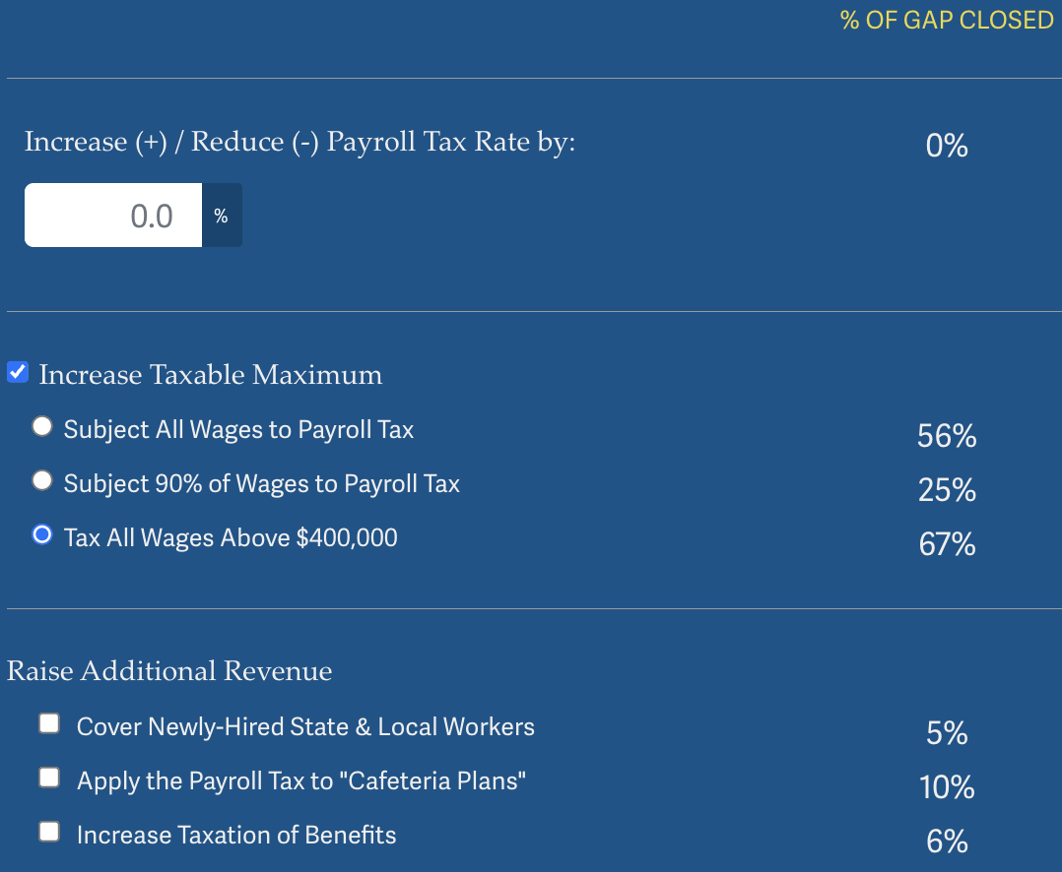
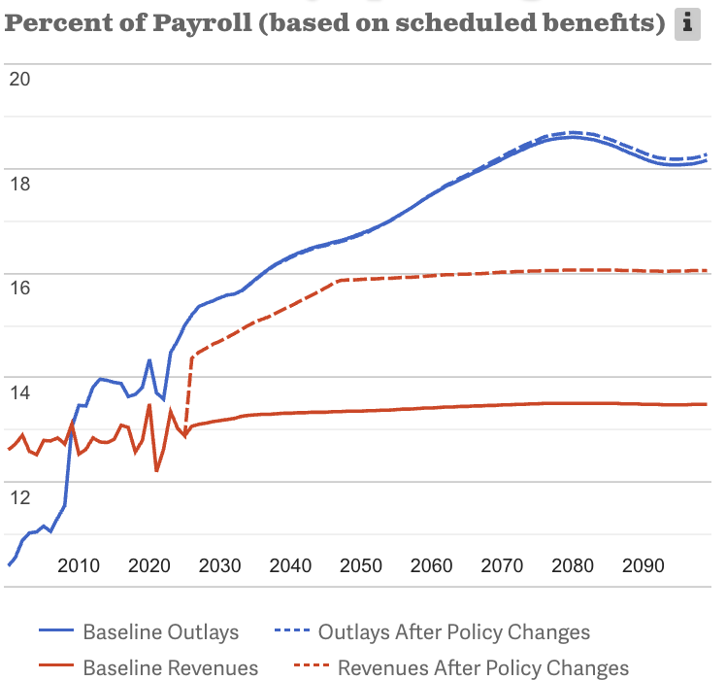
Possible Changes to Revenues: Example
Source: https://www.crfb.org/socialsecurityreformer/

Slide 44
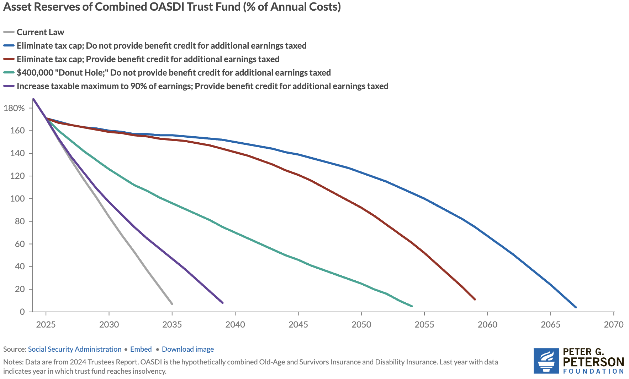
Changing the Cap Can Go A Long Way…

Slide 45
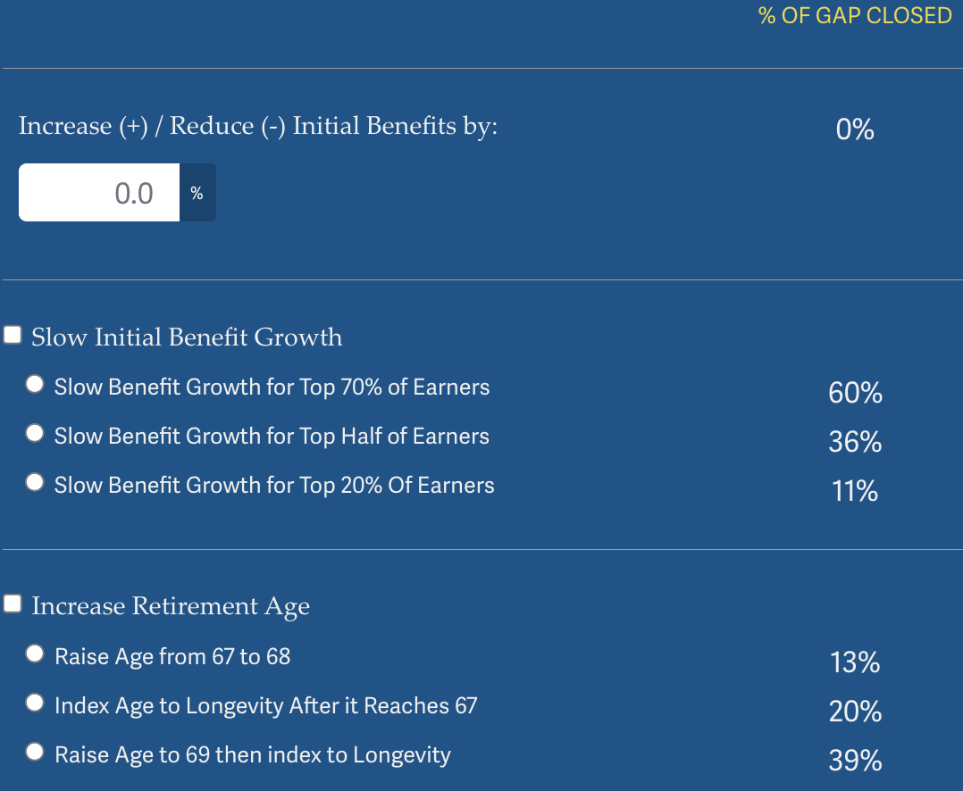
Possible Changes to Benefits
Source: https://www.crfb.org/socialsecurityreformer/

Slide 46
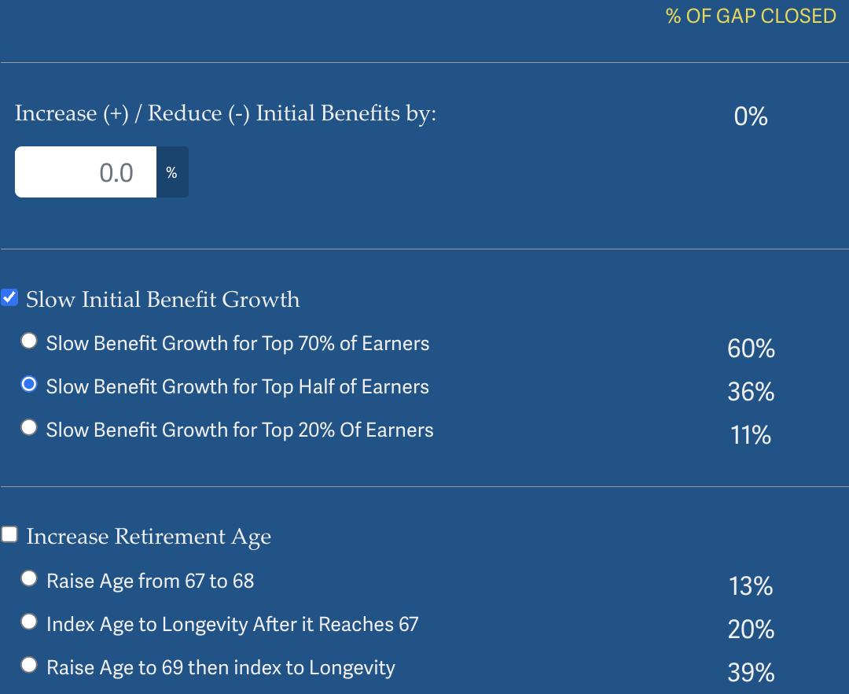
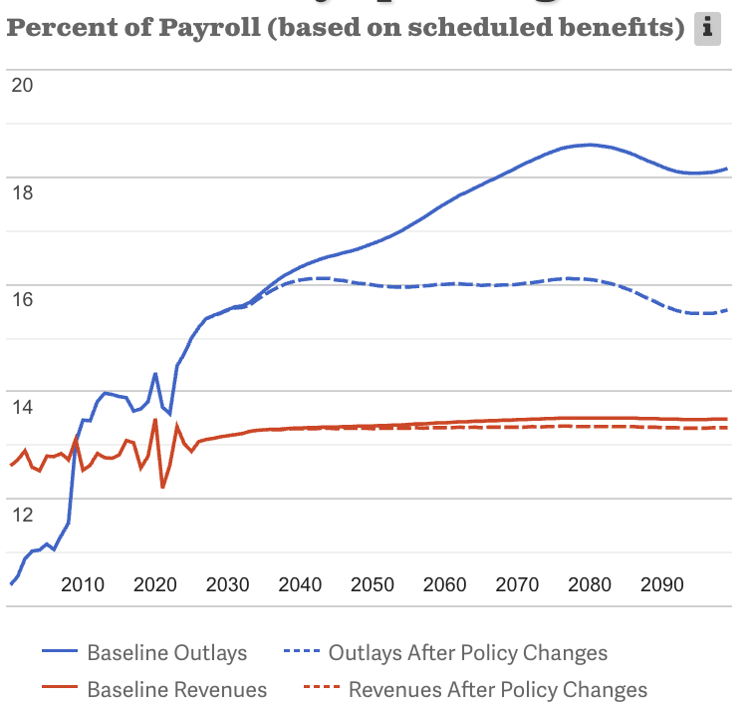
Possible Changes to Benefits: Example
Source: https://www.crfb.org/socialsecurityreformer/

Slide 47
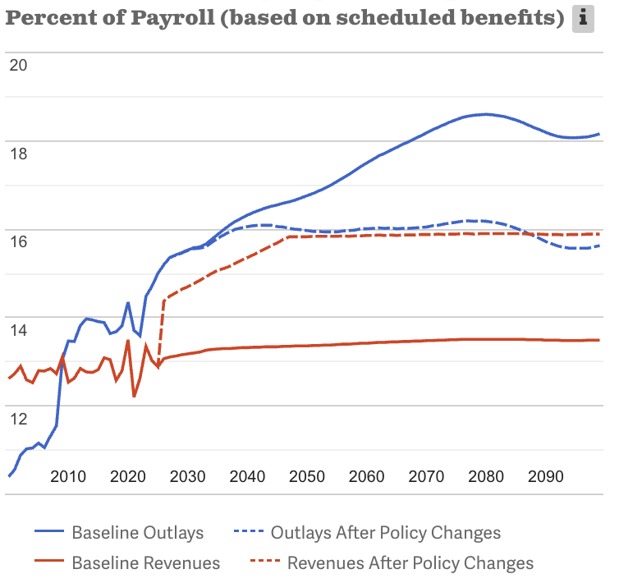
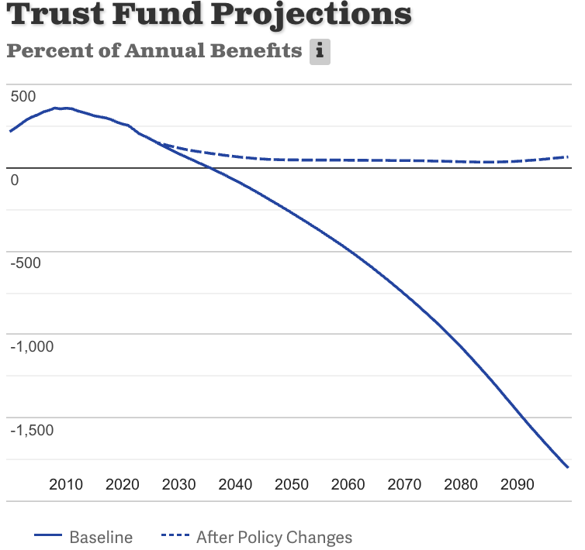
Suppose We Do Both! Problem Solved
Source: https://www.crfb.org/socialsecurityreformer/

Slide 48
Some Additional Thoughts on Options
COLAs – cost of living adjustments
Merely another way of reducing benefits
Raising the retirement age
Investing in the stock market

Slide 49
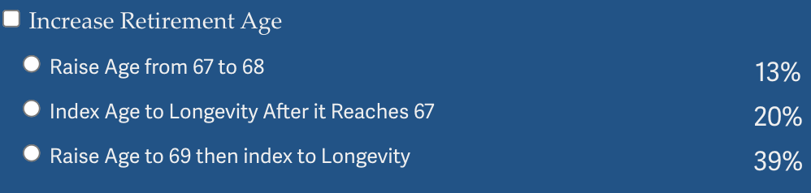
Raising the Retirement Age
Very regressive.
Larger tax on low-income workers than high income workers.

Slide 50
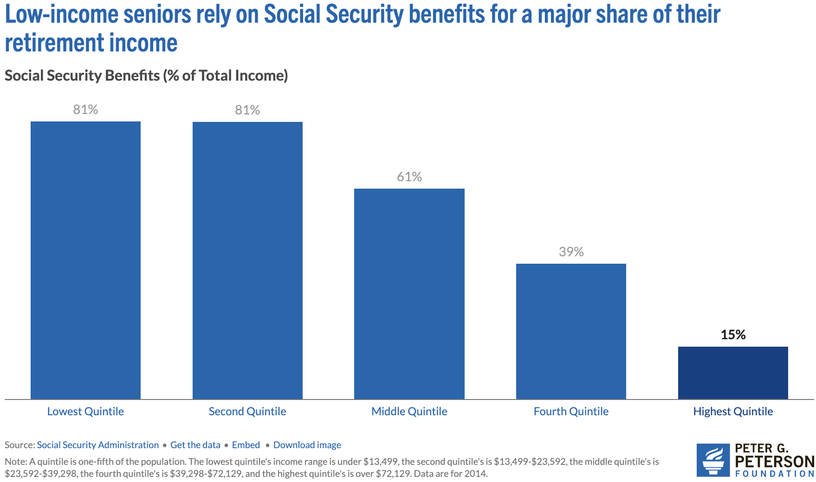
Program is VERY Important for Low-Income Retirees
Source: https://www.pgpf.org/article/9-facts-about-social-security-and-the-need-to-strengthen-it/

Slide 51
Raising the Retirement Age
Sex | Income Category | Life Expectancy (Years) | Difference High vs Low
Women | Highest Incomes (top 1%) | 88.9 | 10.1 years
 | Lowest Incomes (bottom 1%) | 78.8
Men | Highest Incomes (top 1%) | 87.3 | 14.6 years
 | Lowest Incomes (bottom 1%) | 72.7

Slide 52
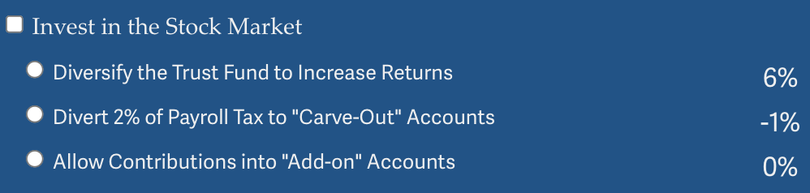
Investing in the Stock Market
Doesn’t do much to solve the problem.
Concerns with government investing in the stock market.
Logistics of allowing individuals to customize are enormous.
And subject to political influence.
May increase the fragility of the system.

Slide 53
Other Solution? Tax More Than Just Earnings
Social Security is funded through payroll taxes.
Broadening the base would increase programmatic revenues.
This begs the question of why the program is funded only by a tax on earnings.
Other sources of income: capital gains.
Social security is an economic security program.
Yet its revenue source is earnings.
Is income a better indication of economic security?

Slide 54
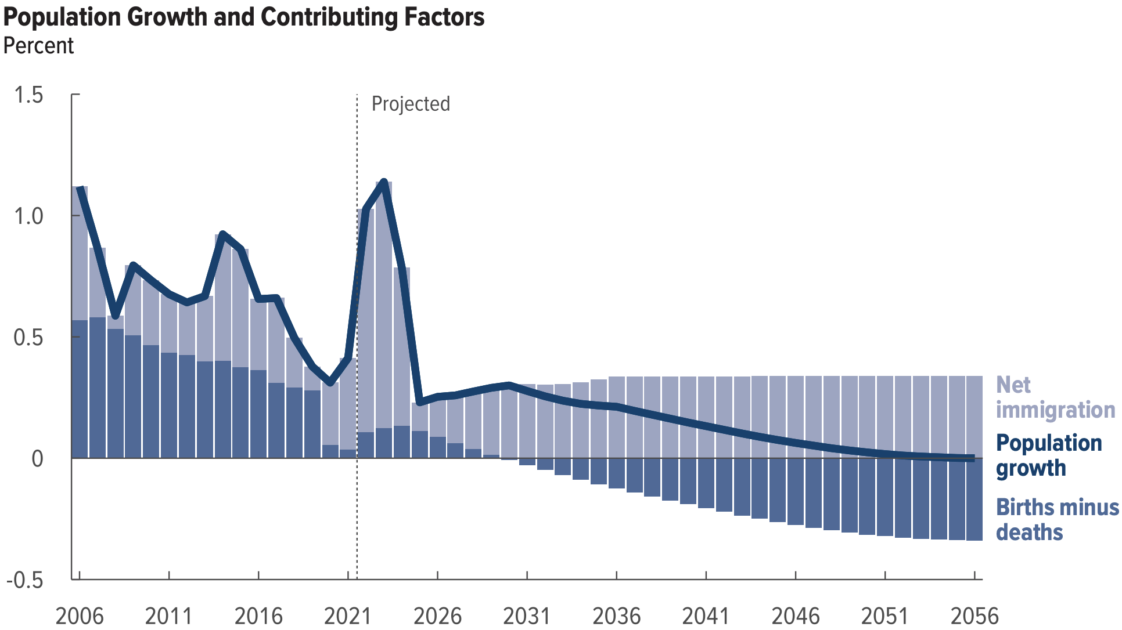
Another Solution?
Increase legal immigration of prime working age.
Source: https://www.cbo.gov/system/files/2026-01/61879-Demographic-Outlook.pdf

Slide 55
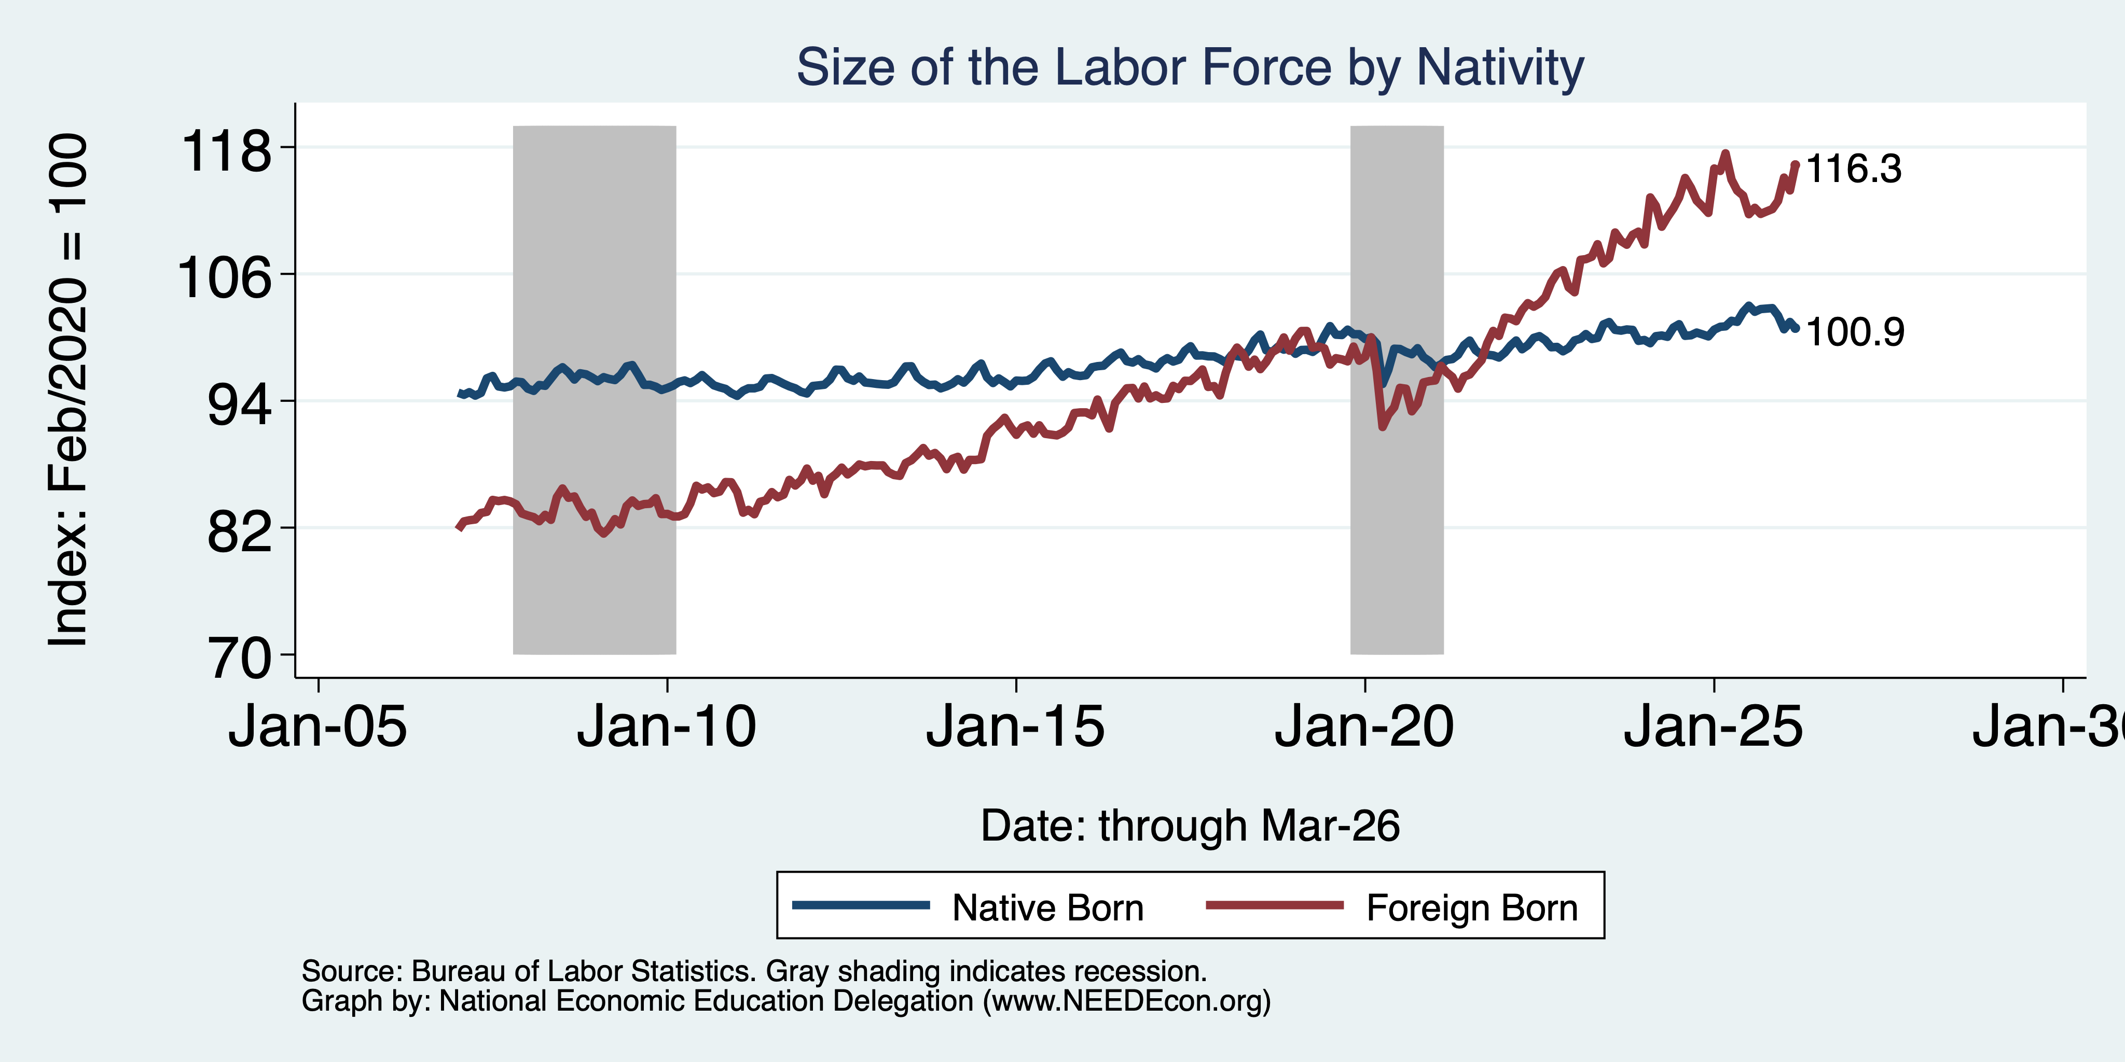
Immigrants to the Rescue?

Slide 56
General Principle of Solutions
Social security was originally created (primarily) to reduce economic instability among the elderly.
Shouldn’t solutions to the shortfall respect that original intent?
Regressive solutions are anathema to the original intent, disproportionately reducing the program’s effects on those most at risk of economic instability.
Equality of contributions to the solution increase economic instability among the elderly.
Progressive solutions are more likely to respect the original intent.

Slide 57
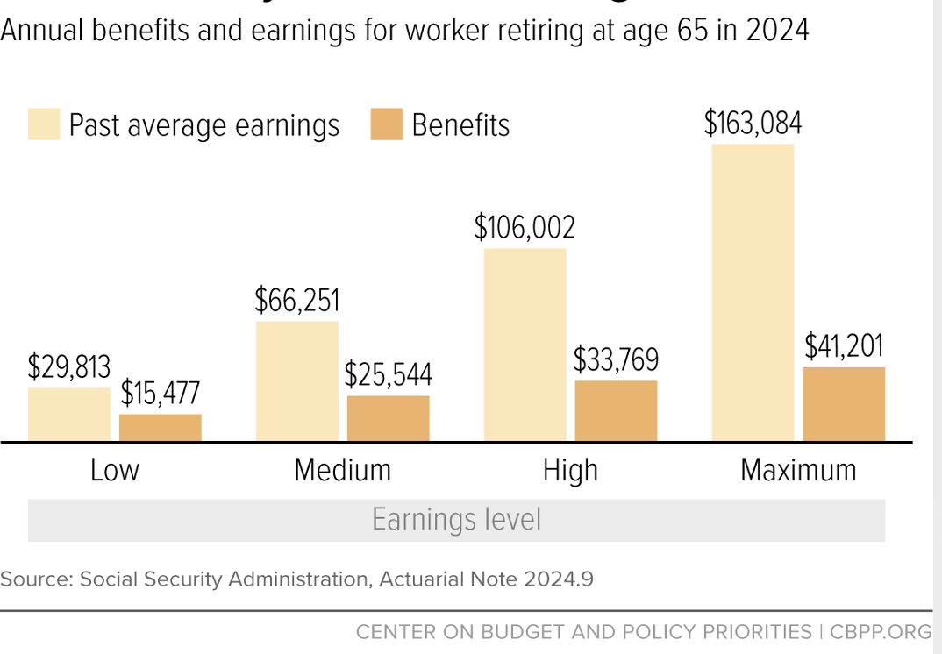
Social Security Benefits are Progressive

Slide 58
Summary
Social Security is an important part of the social safety net.
The OASDI Trust Fund is likely to be exhausted in 2033.
Why are the funds being depleted?
An aging population – fewer paying in and more taking out.
Declining birth rates - slowing the growth of the labor force.
Wage inequality – more and more wages are above the wage cap.
What happens when the funds are depleted?
Benefits may have to be reduced by 18%.
The system will continue!
Solutions abound. The problem is political will.
The needed changes will be unpopular, but they are very manageable.

Slide 59
Thank you!
Any Questions?
www.NEEDEcon.org
Jon D. Haveman
Jon@NEEDEcon.org
Contact NEED: info@NEEDEcon.org
Submit a testimonial: www.NEEDEcon.org/testimonials.php
Become a Friend of NEED: www.NEEDEcon.org/friend.php

