Slide 1
Osher Lifelong Learning Institute, Summer 2026
Contemporary Economic Policy
University of Hawaii, Manoa
Host: Geoffrey Woglom, Director
National Economic Education Delegation

Slide 2
Course Schedule
Contemporary Economic Policy
  Week 1 (7/2): Saving Social Security, Geoffrey Woglom, Amherst College
  Week 2 (7/9): Trade & Globalization, Luisa R. Blanco, Pepperdine University
  Week 3 (7/16): Economics of Immigration, Luisa R. Blanco, Pepperdine University
  Week 4 (7/23): Health Care Economics, Brandyn Churchill, American University
  Week 5 (7/30): Federal Debt and Deficits, Robert Rebelein, Vassar College
  Week 6 (8/6): Climate Change Economics, Gary Yohe, Wesleyan University

Slide 3
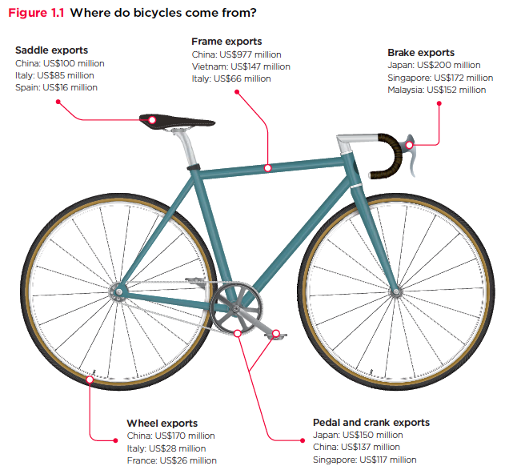
Global Supply Chains

Slide 4
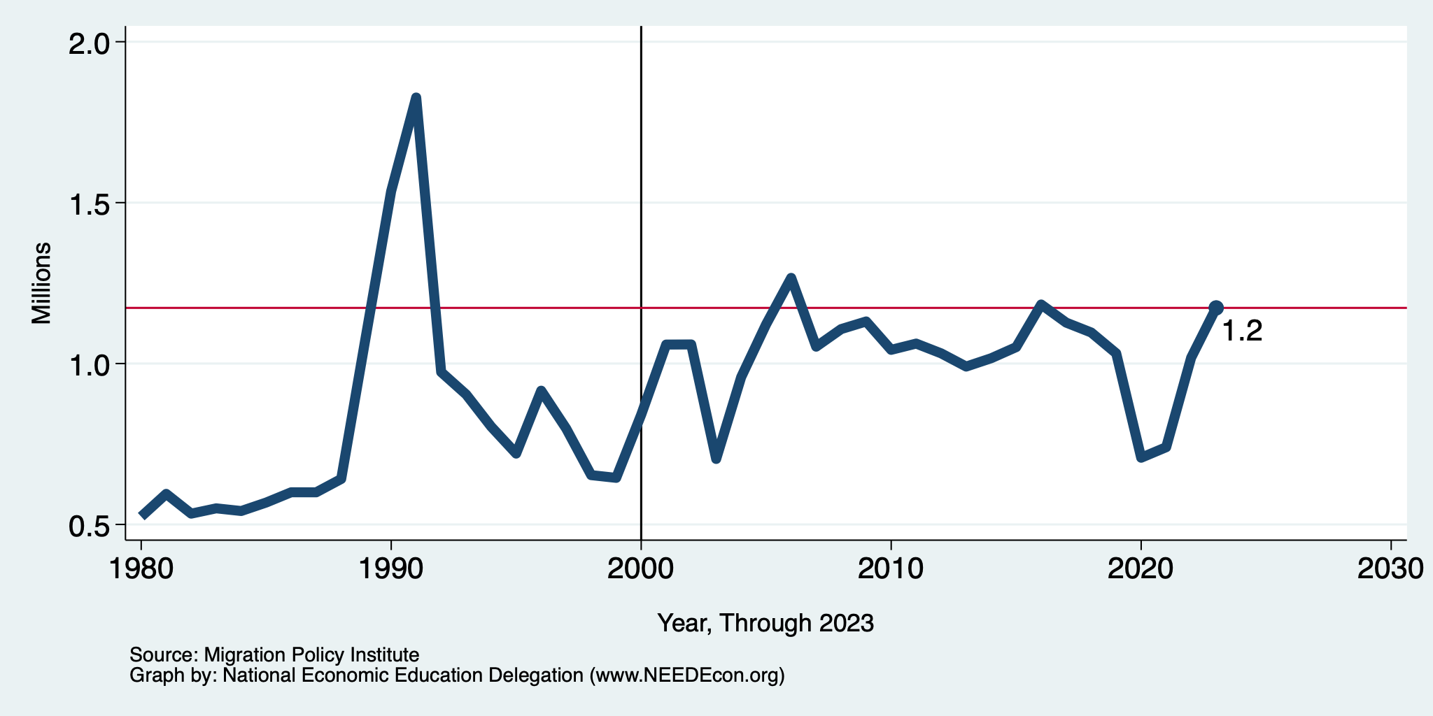
Recent Trends in Authorized Immigration
2023
1.2 Million

Slide 5
Health Care Spending as % of GDP, 1980–2018
Everybody Else
Source: Roosa Tikkanen and Melinda K. Abrams, U.S. Health Care from a Global Perspective, 2019: Higher Spending, Worse Outcomes (Commonwealth Fund, Jan. 2020).

Slide 6
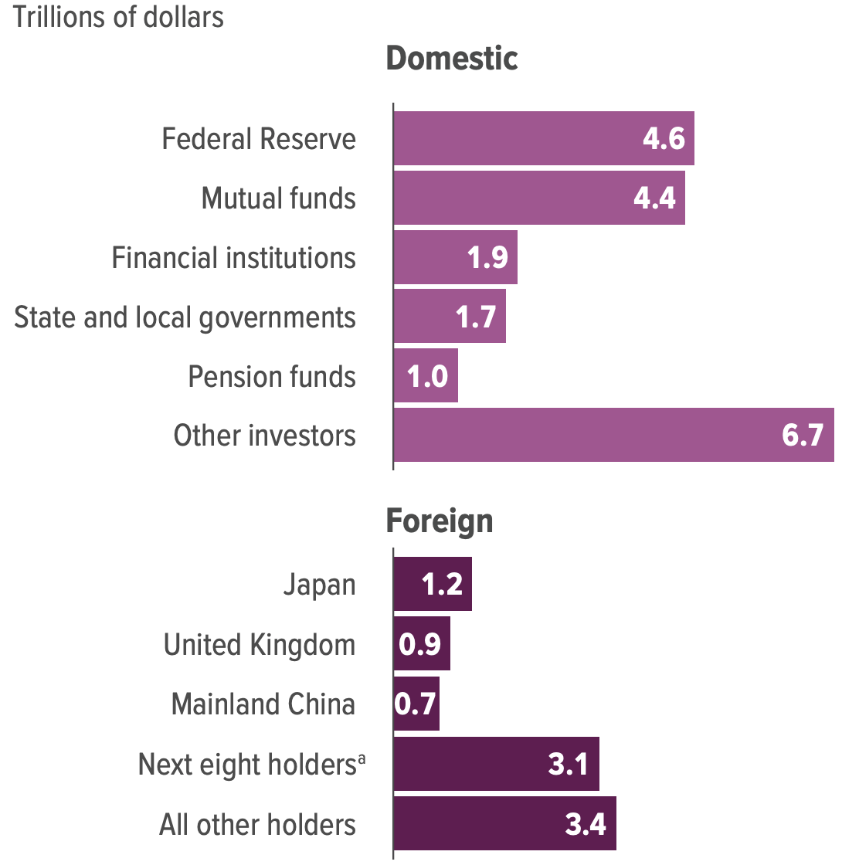
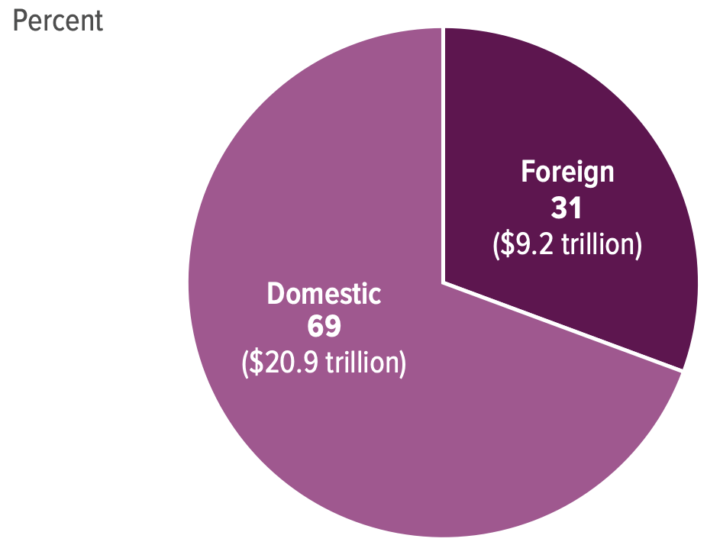
Holders of the Public Debt, 2025

Slide 7
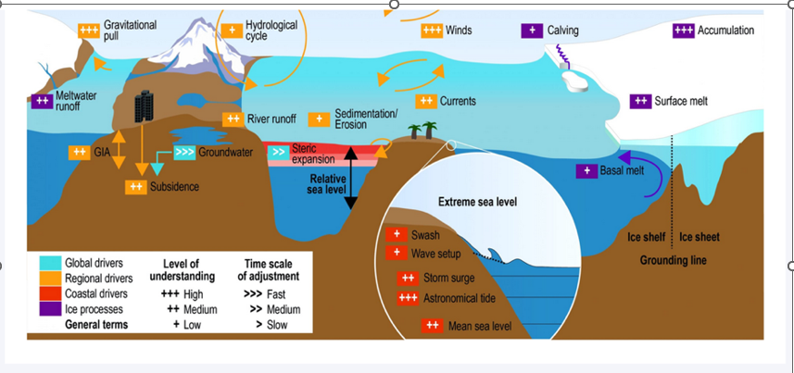
The Drivers of regional Sea Level Rise

Slide 8
Submitting Questions
Submit questions in the chat I will try to handle them as they come up.
We will do a verbal Q&A after the material has been presented.
Slides areavailable on the NEED website, (https://needelegation.org/delivered_presentations.php)
More Information about Social Security is on my website,
(https://sites.google.com/view/macro-current-issues/social-security)

Slide 9

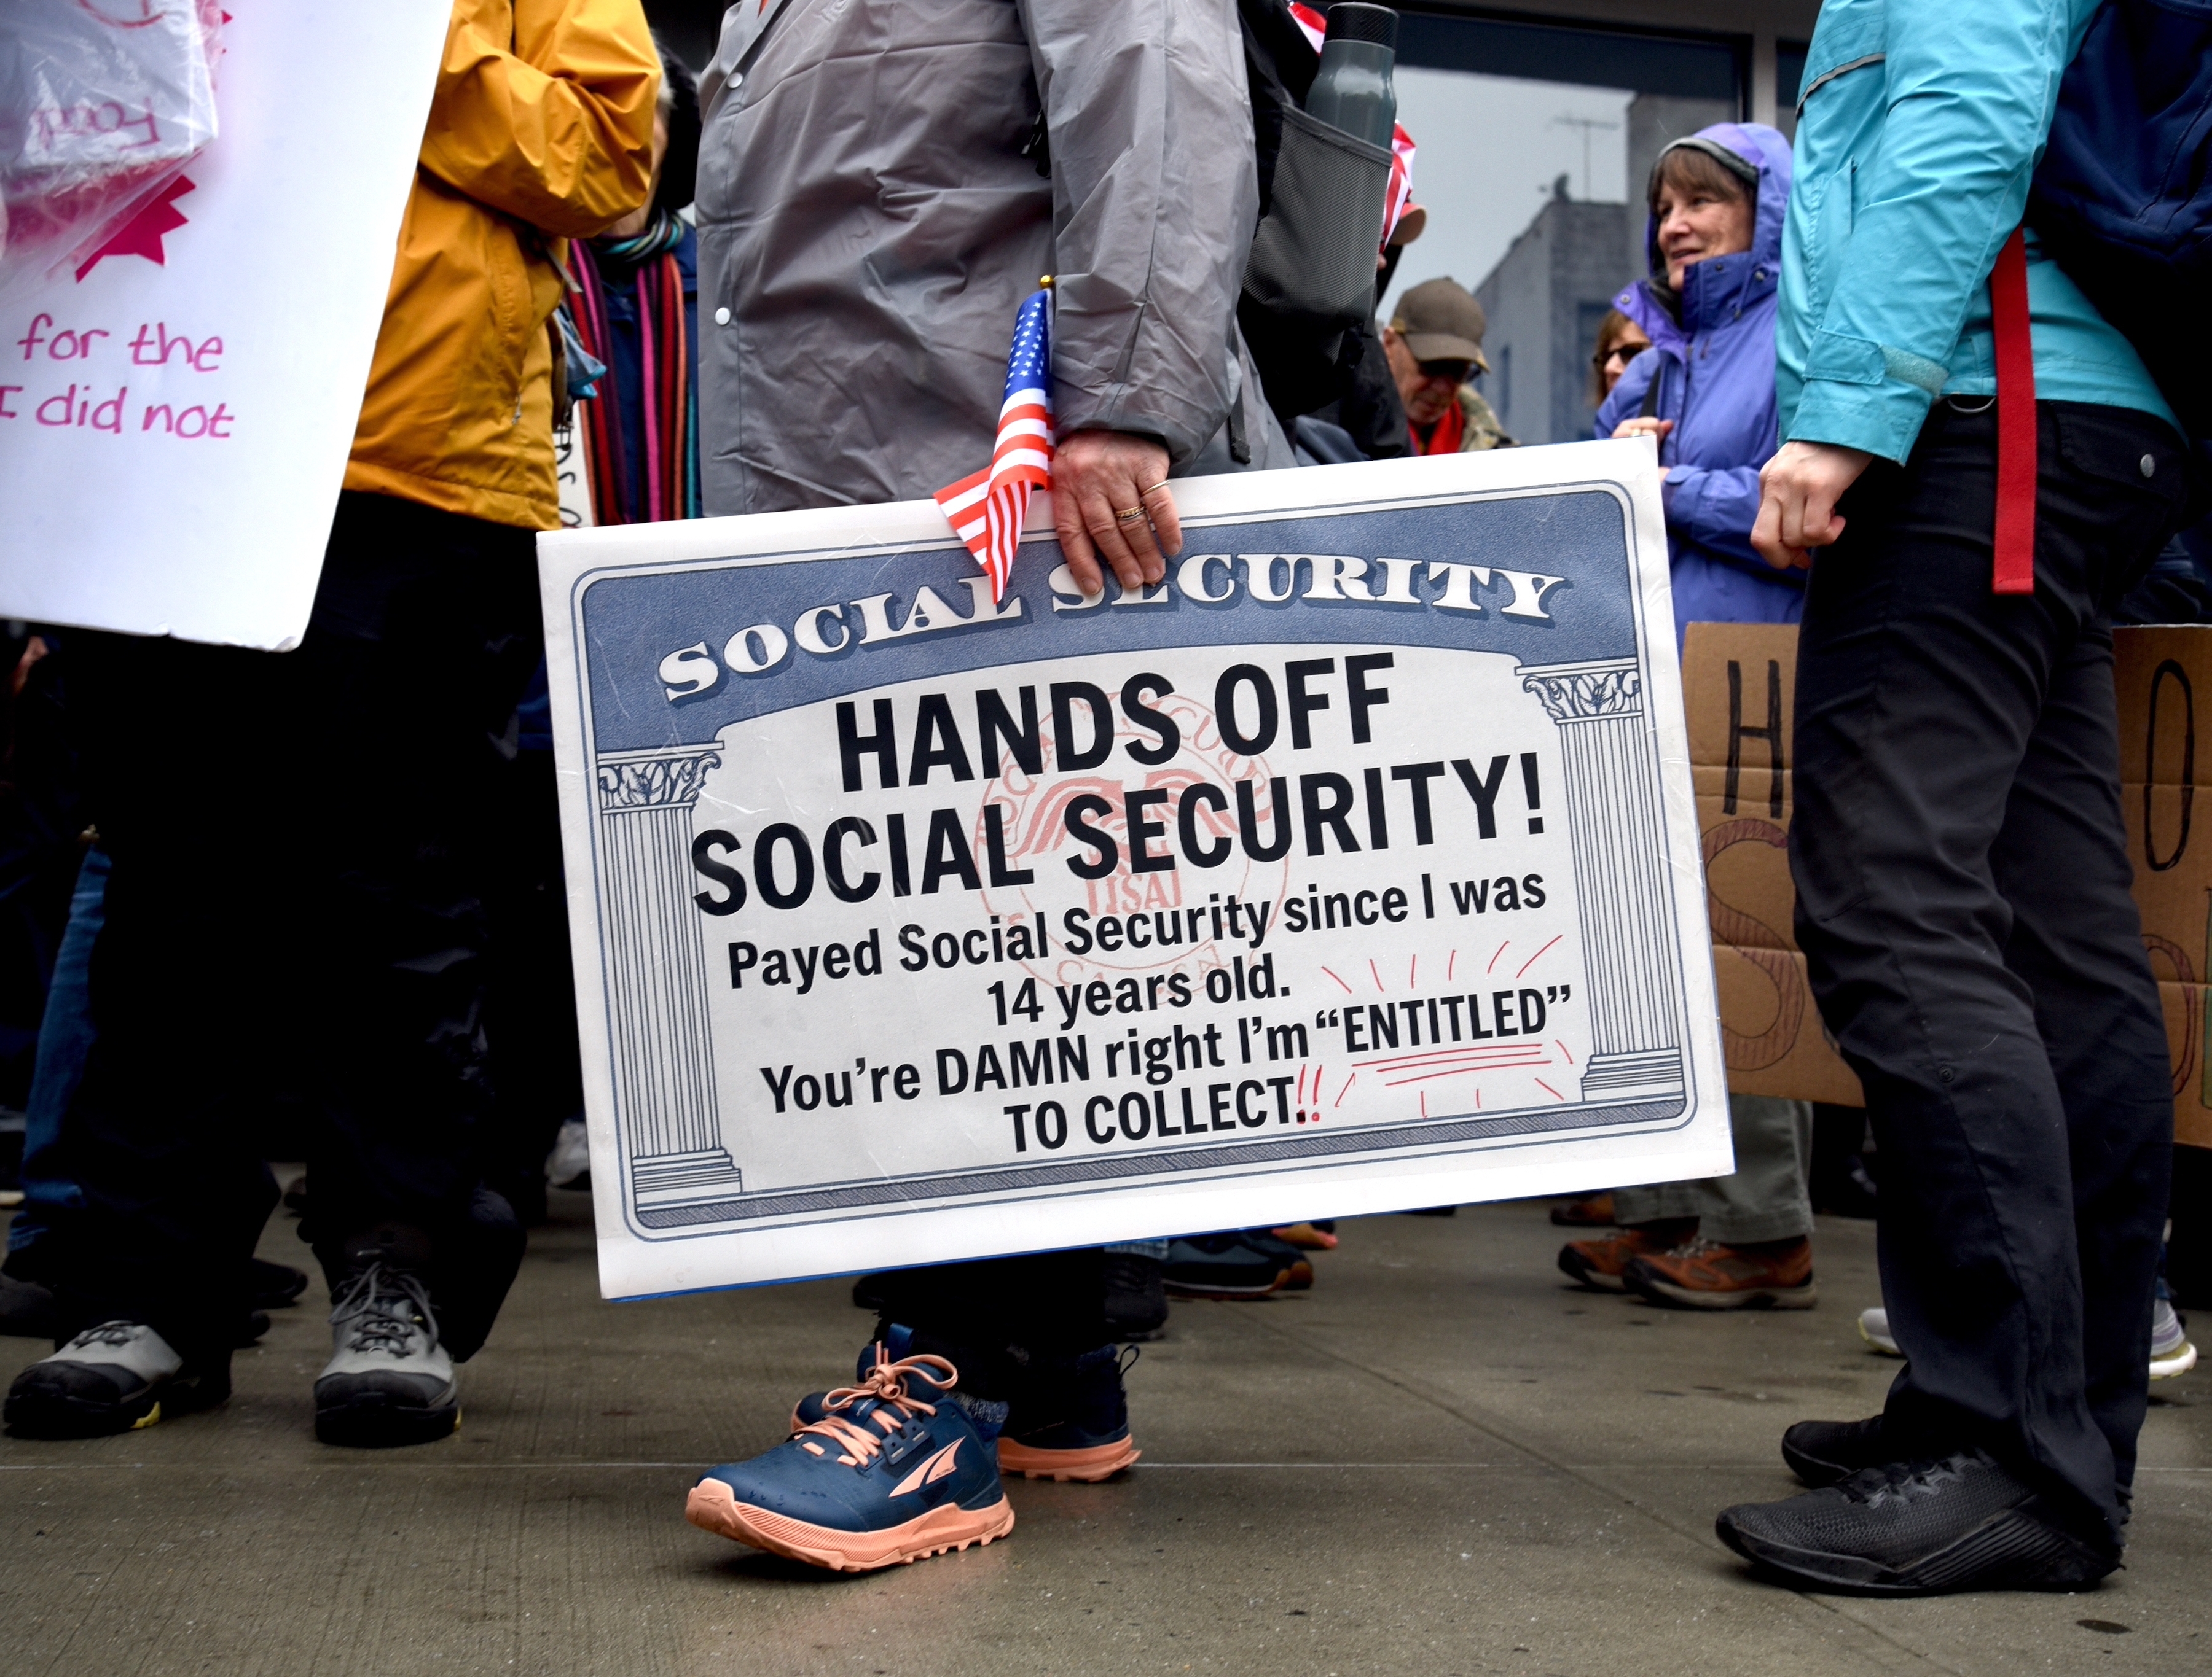
Saving Social Security
Geoffrey Woglom, emeritus Amherst College
June 24, 2026

Slide 10
Outline
What is Social Security?
What is The Trouble with Social Security?
A Closer Look at Social Security Benefits.
Principles for Saving Social Security.
A Bipartisan Solution.

Slide 11
What is Social Security?

Slide 12
What is Social Security?
Social Security is a federal social insurance program that provides financial support to workers and their families.
Different benefits:
  Retirement Benefits: Social Security provides monthly payments to qualified retirees based on their lifetime earnings.
  Disability Benefits: It provides financial support to individuals who are unable to work due to a disability.
  Survivor Benefits: Social Security offers benefits to the families of deceased workers, including spouses and children.

Slide 13
Social Security’s History
“Social insurance” as part of the “social safety net”
Created in 1935 to provide economic security to the nation’s elderly (2 % payroll tax split between employer and employee).
Expanded in 1939 to include dependent benefits.
  Benefits to families that have lost a breadwinner.
First monthly check 1/31/40 to Ida May Fuller of Ludlow Vt.
Expanded in 1950 to provide support for people with disabilities.
June 1972 Congress approved a 20 percent increase in benefits and cost-of-living adjustments to start in 1975

Slide 14
Social Security’s History (cont.)
1977 Congress corrects “double-indexing mistake” that threatened SS solvency (first benefit reduction)
1983 Greenspan Commission: up to 50% of benefits of high earners subject to income taxation, gradual increase in normal retirement age, increase in payroll tax rate.
1993 85% of benefits subject to income tax for higher earners.
Today, it is the largest federal program. In FY 2025, spending was $1.58 trillion, or 22.4% of total federal spending.
  By comparison, national defense was $917 billion.

Slide 15
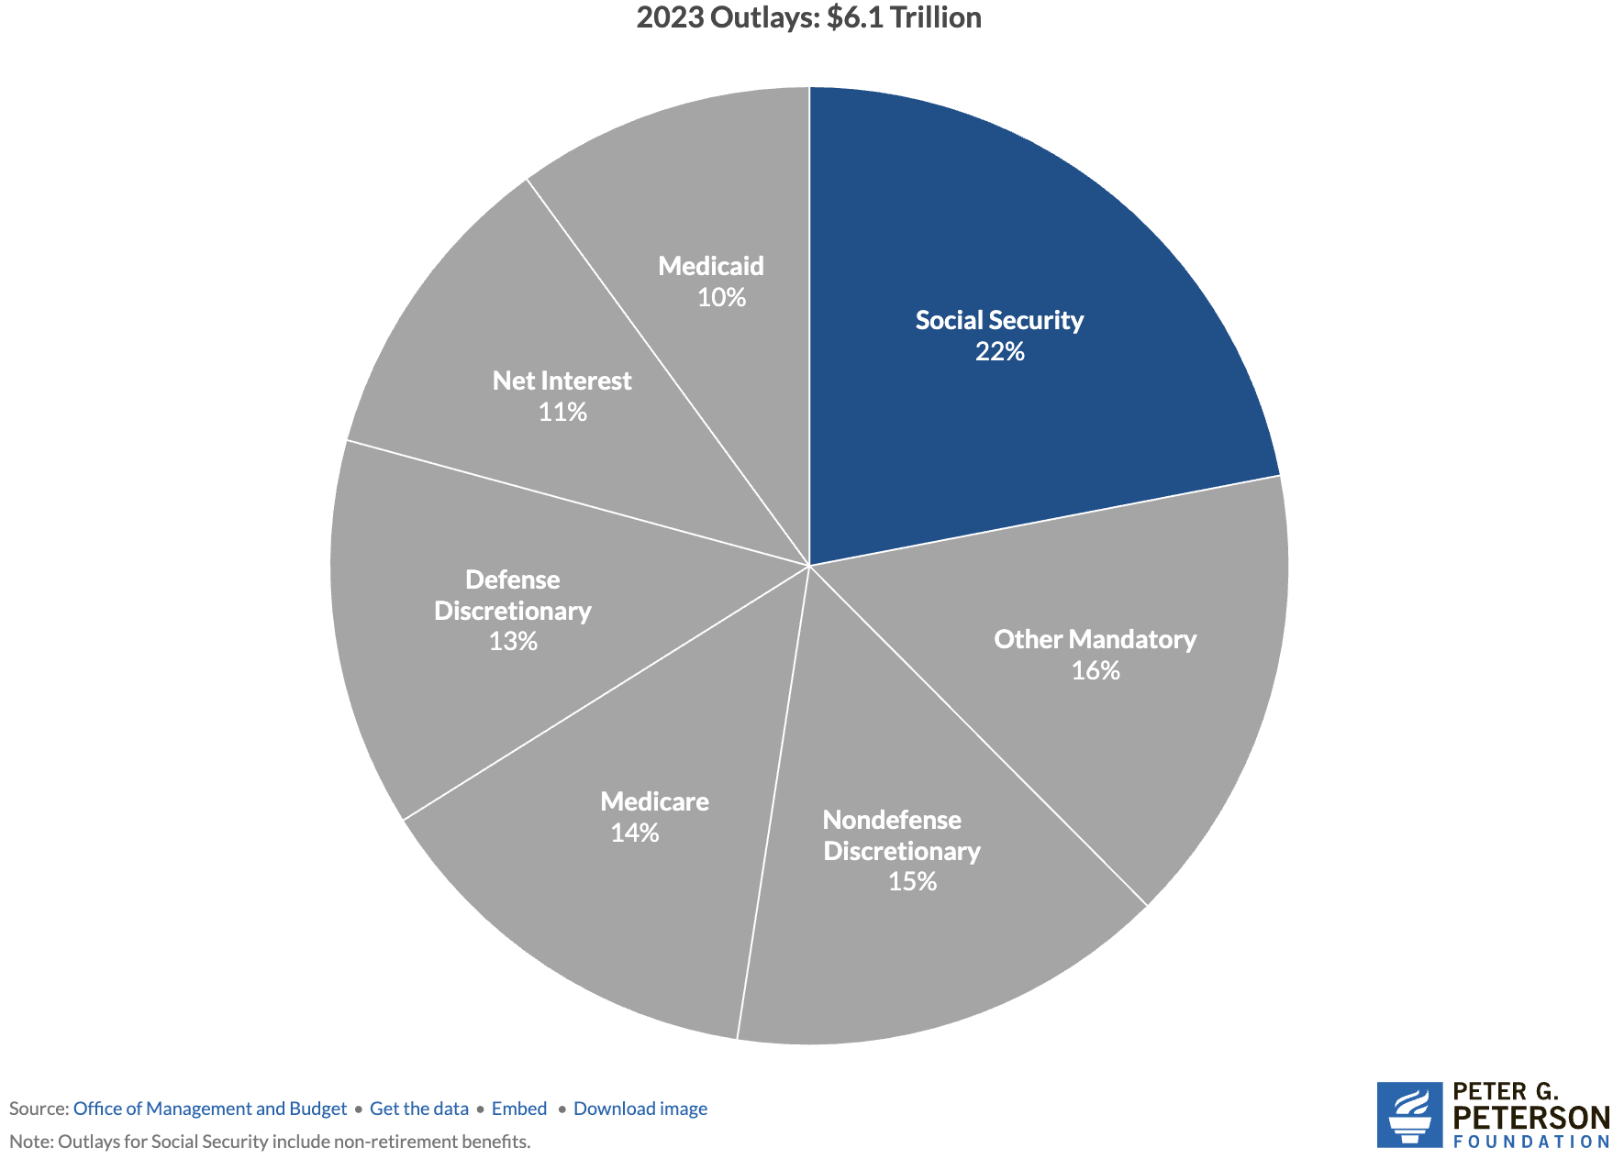
Soc Sec is The Single Largest Gov’t Program
Source: https://www.pgpf.org/article/9-facts-about-social-security-and-the-need-to-strengthen-it/

Slide 16
The Mechanics of Social Security
“pay-as-you-go” system
  Payroll taxes are collected from current workers.
  These pay for the benefits of the currently retired, or otherwise eligible.
Taxes
  Payroll taxes amount to 12.4% of earnings.
    Workers pay 6.2% of earnings as payroll taxes.
    Employers also pay 6.2% of worker’s earnings.
  Earnings Cap. Not all earnings are subject to payroll taxes.
    In 2026, only the first $184,500 of earnings are taxed.
    Earnings above that level are not taxed.

Slide 17
In Addition Income Taxes on Benefits
“Combined Income (CB):” one half SS benefit plus all other income
Single:
  CB Up to $25K: no tax
  CB $25K to $34K Up to 50% of benefit is included in taxable income
  CB More than $34K Up to 85% of benefit is included in taxable income, but extra 35% goes to Medicare.
Married Filing Jointly:
  CB Up to $32K: no tax
  CB $25K to $44K Up to 50% of benefit is included in taxable income
  CB More than $44K Up to 85% of benefit is included in taxable income, but extra 35% goes to Medicare.
Also, these income levels are NOT indexed to inflation

Slide 18
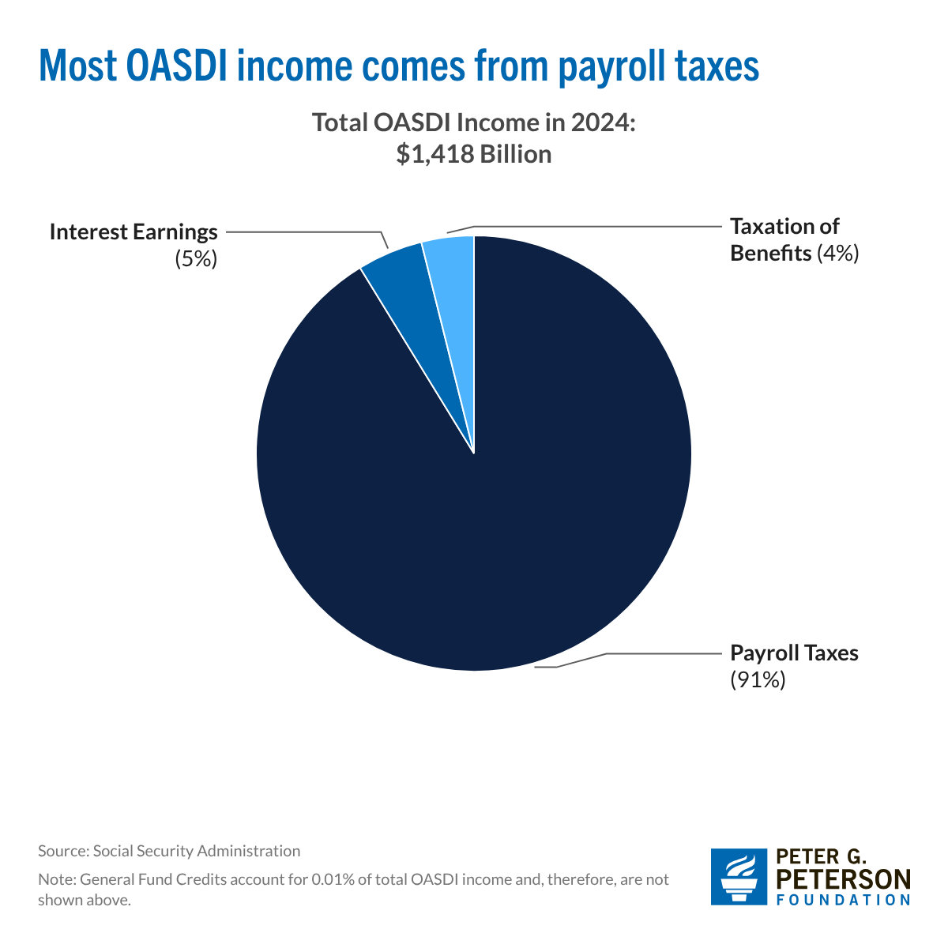
Sources of SS Revenue

Slide 19
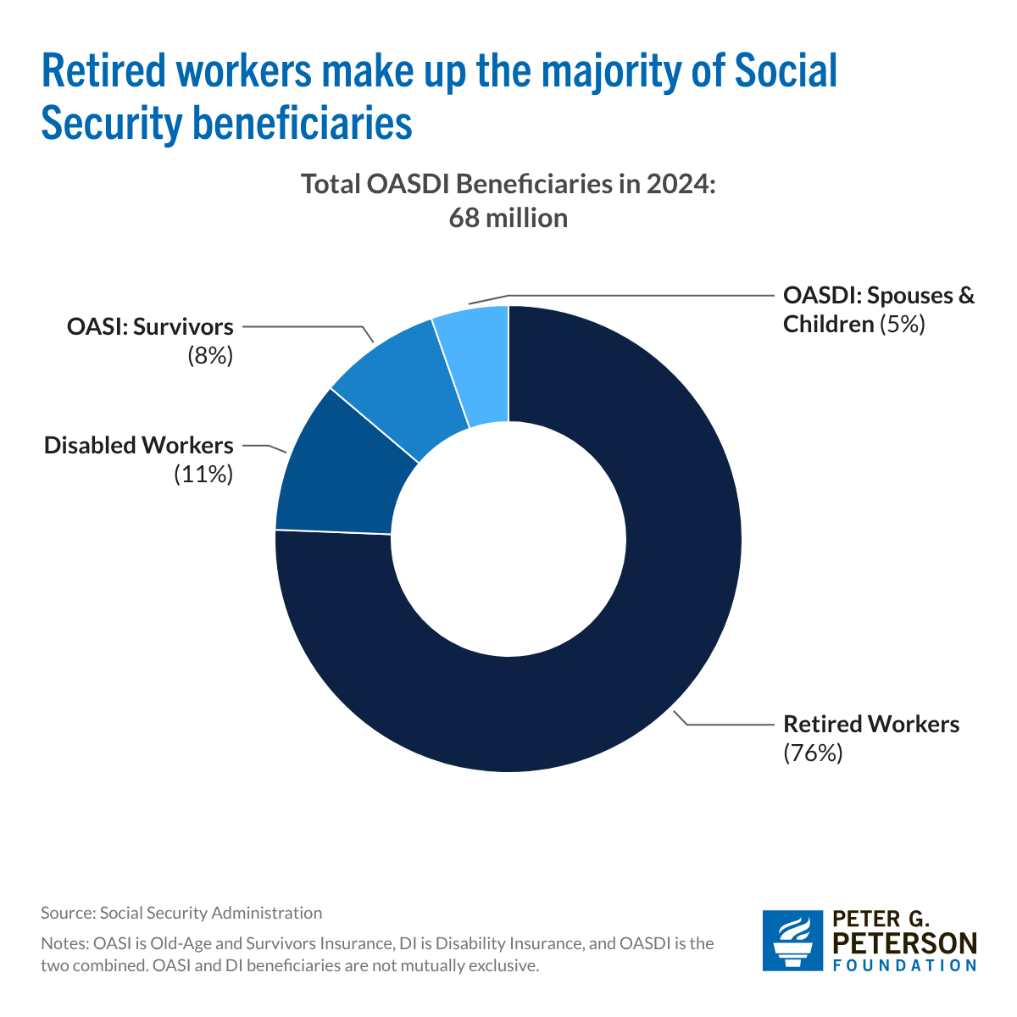
`
Where Does the Money Go

Slide 20
What is the Trouble Social Security?

Slide 21
What if Payroll Taxes Don’t Match Benefits?
The Trust Fund
  If revenues exceed benefits, the trust fund is credited with nonmarketable government securities by the amount of the surplus.
  If benefits exceed revenues, the trust fund redeems nonmarketable securities by the amount of the deficit.
  Really just one branch of government lending to another
  The existence of the trust fund has no economic significance: The amount the government must borrow depends on total federal spending (including Social Security) less total tax revenue (including Social Security taxes).
But the existence or lack thereof has enormous political significance: If the Trust fund is exhausted, Social Security benefits by current law are limited to Social Security income.

Slide 22
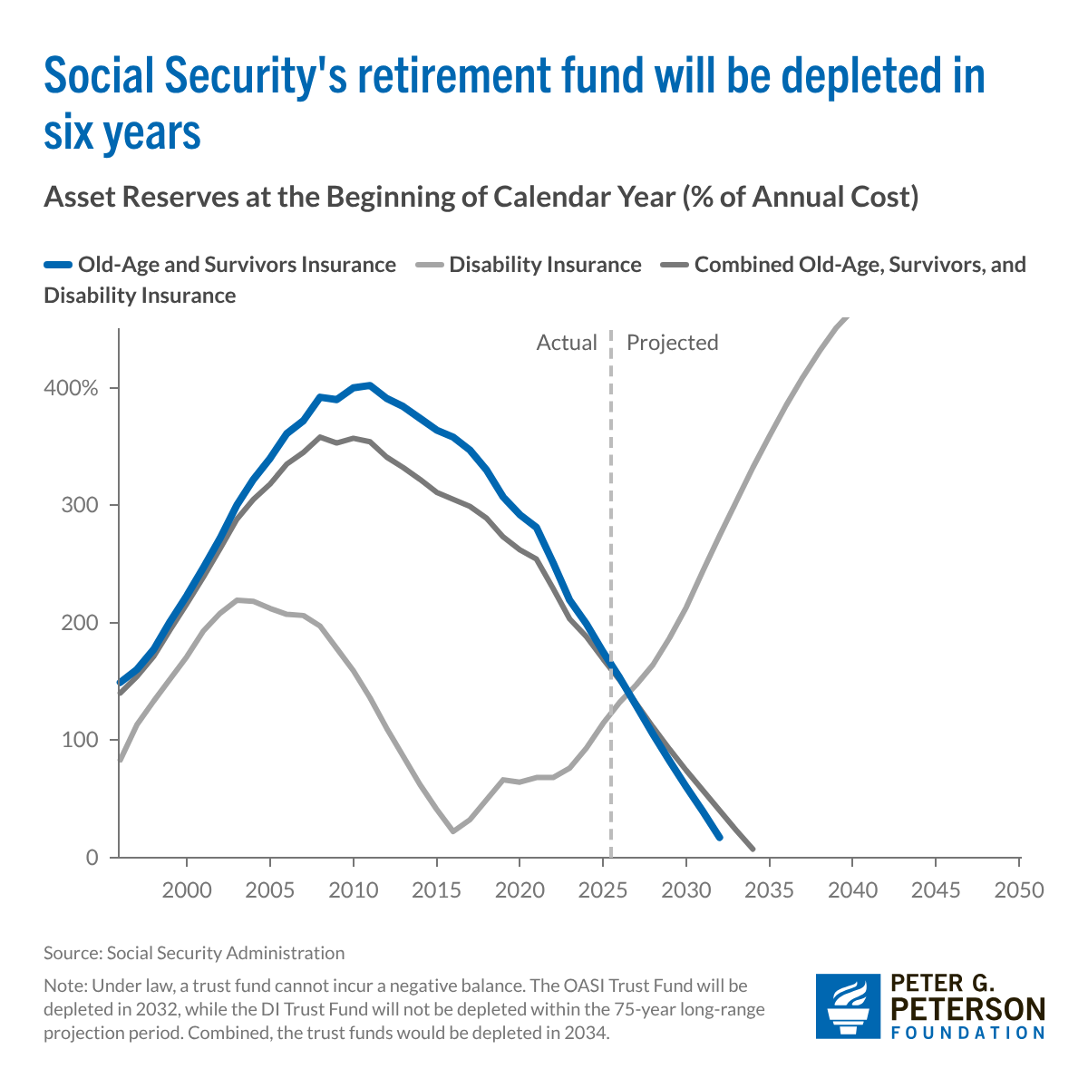
Trajectory of Funds

Slide 23
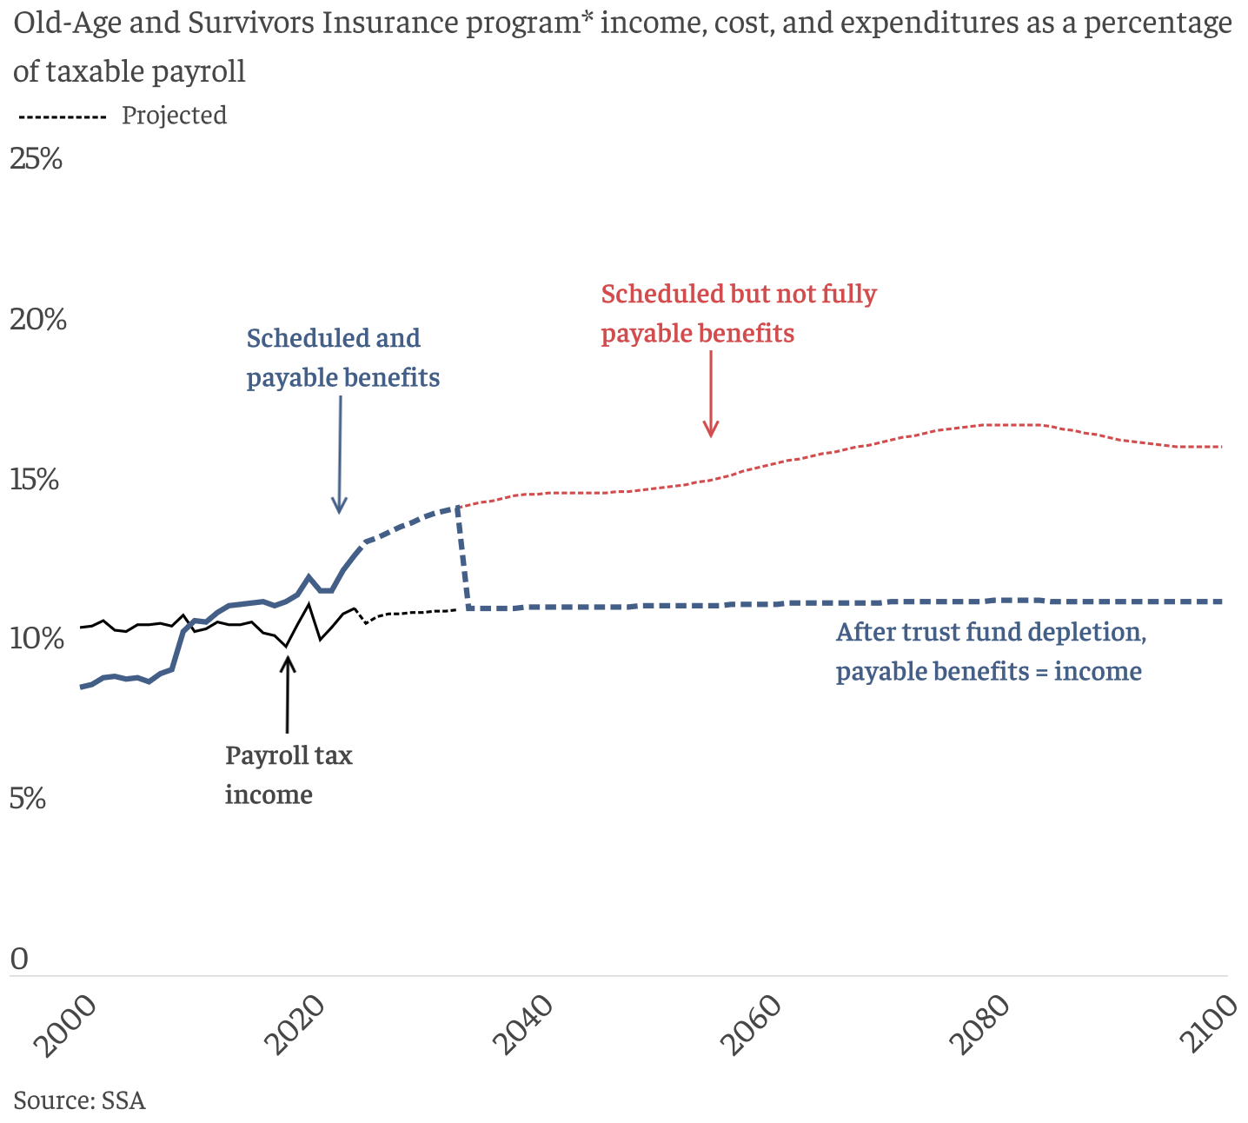
What Happens When The Trust Fund Runs Out?
Benefit Cut: 26%
2098
OASI Trust Fund Exhaustion, 2032 Benefit Cut: 22%

Slide 24
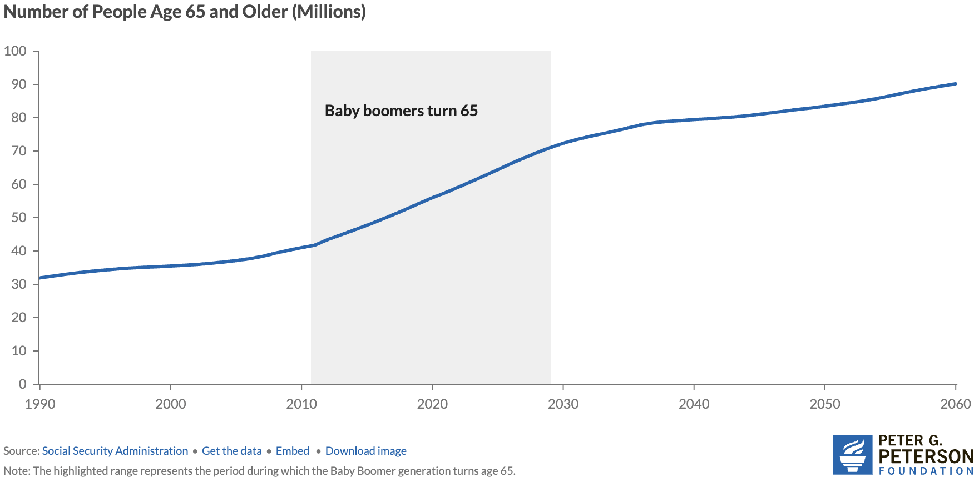
Why Are Costs Rising Rapidly? Aging Population
Source: https://www.pgpf.org/article/how-does-social-security-work/

Slide 25
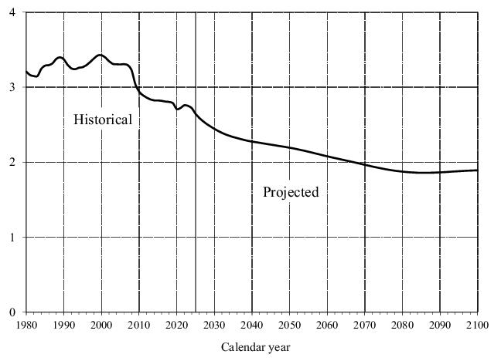
Number of Covered Workers per Beneficiary
Baby boomers started retiring.
Source: https://www.ssa.gov/OACT/TR/2024/tr2024.pdf

Slide 26
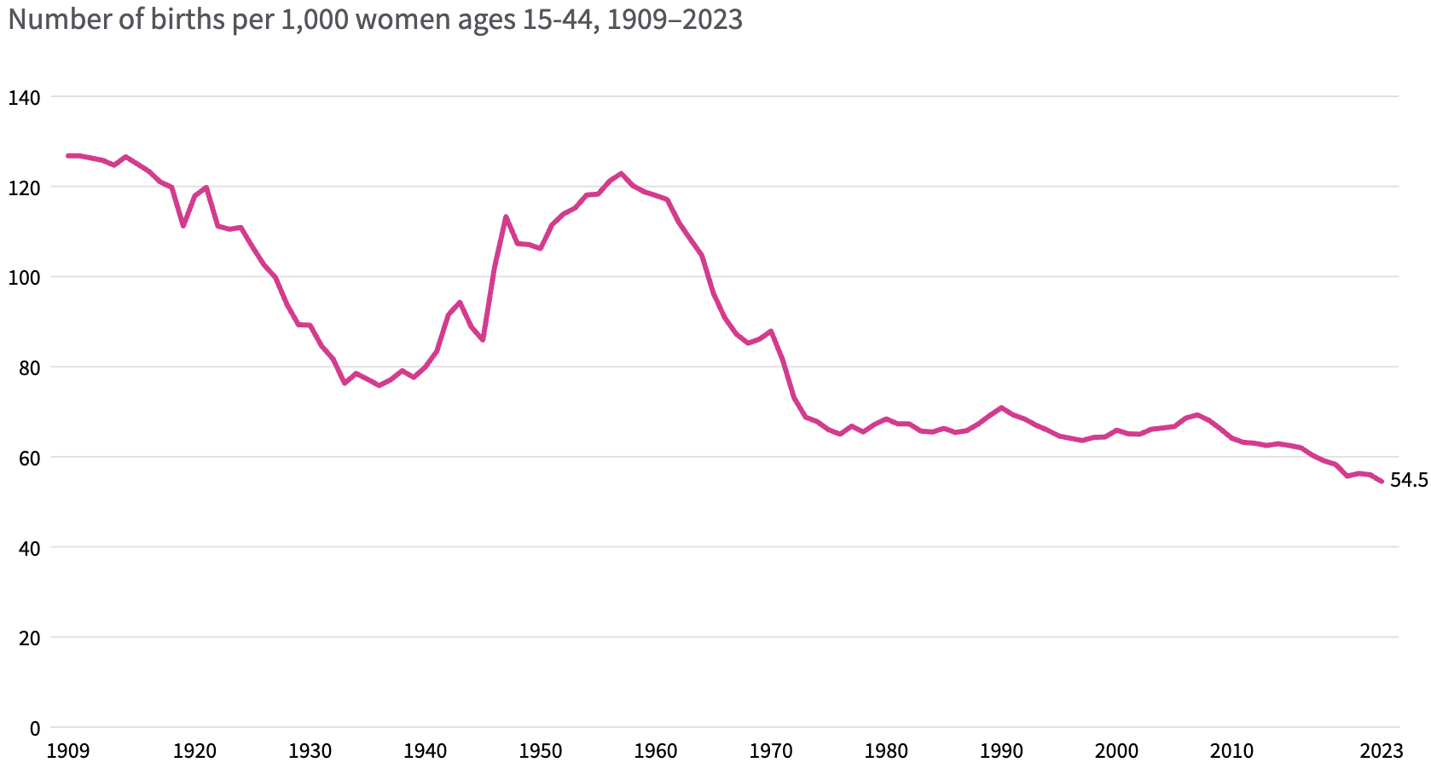
Lower Births = Slower Labor Force Growth
Source: https://usafacts.org/articles/how-have-us-fertility-and-birth-rates-changed-over-time/

Slide 27
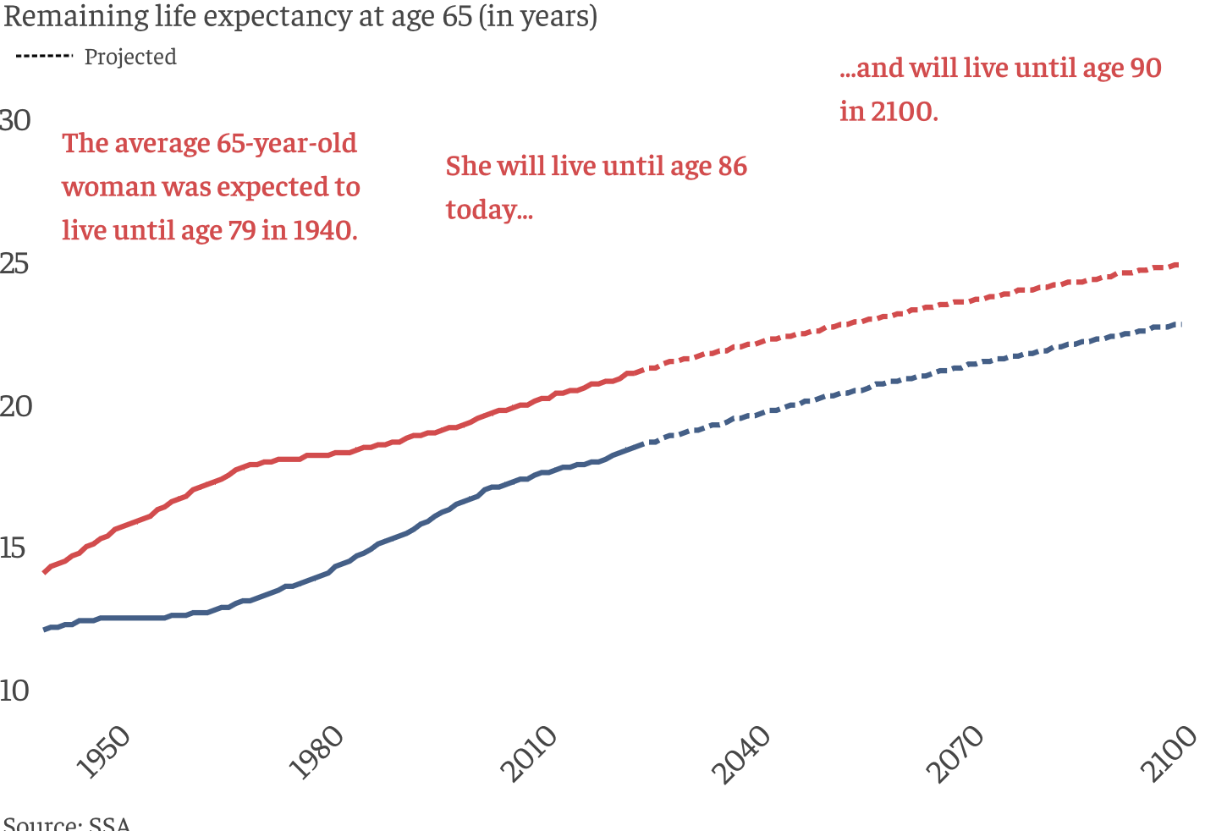
Life Expectancy Continues to Rise

Slide 28
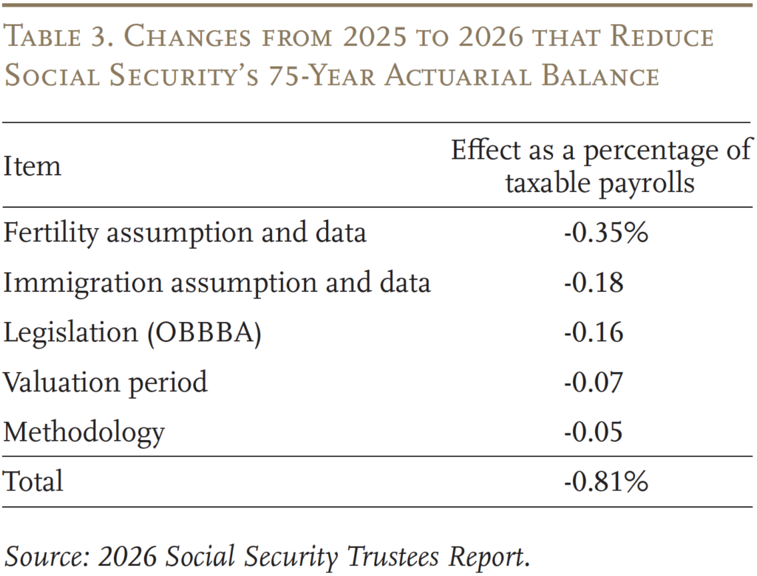
But Why Did the Depletion Date Move Up 1 Year in 2026?
These numbers reflect the deterioration of OASDI finances in the last year.
Note Items 1, 4 & 5 are not policy related.
Items 2 & 3 are policy related, and contribute 42 percent (=.34/.81) to the deterioration.
https://crr.bc.edu/social-securitys-financial-outlook-the-2026-update-in-perspective/

Slide 29
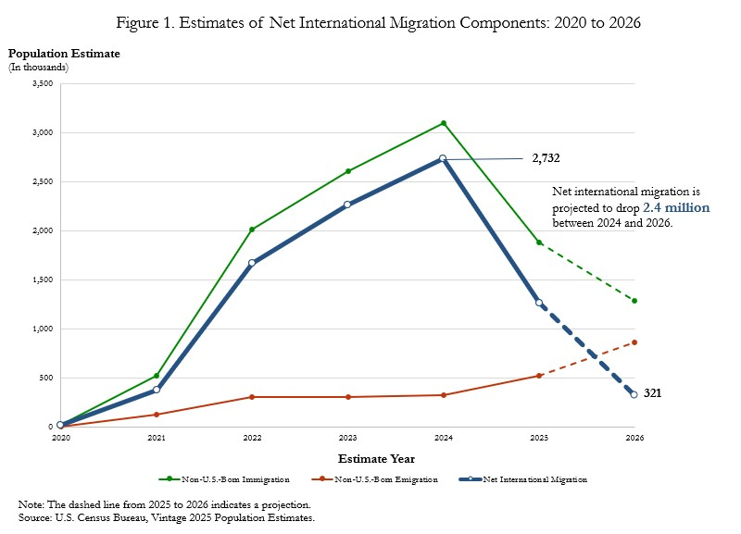
Policy Changes
One Big Beautiful Bill:
Income Tax Rates were reduced, so that the tax on Social Security benefits also fell.
In addition, the extra standard deduction of $12,000 for 65+, married filing jointly further reduced taxes collected on Social Security benefits.

Slide 30
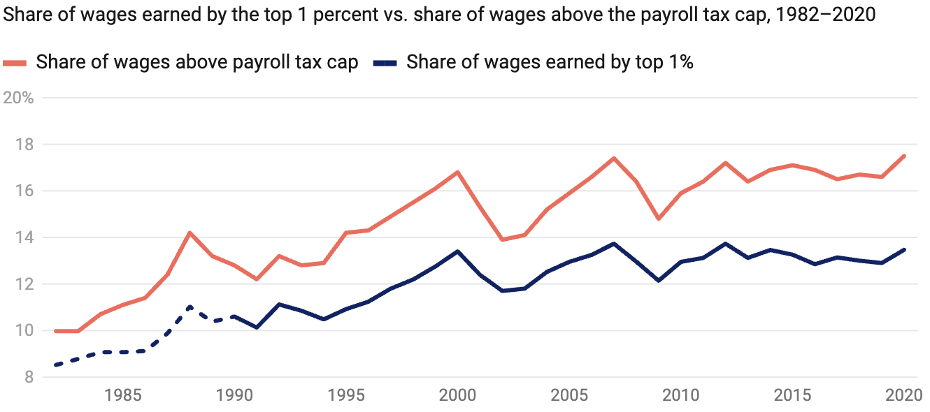
Increased Wage Inequality Is A Problem
Source: https://www.americanprogress.org/article/increased-wage-inequality-has-reduced-social-securitys-revenue
Notes:
The effect on net revenues is to reduce them.
https://www.americanprogress.org/article/the-effect-of-rising-inequality-on-social-security/#:~:text=Rising%20income%20inequality%20poses%20a,that%20higher%2Dearning%20workers%20receive.

Slide 31
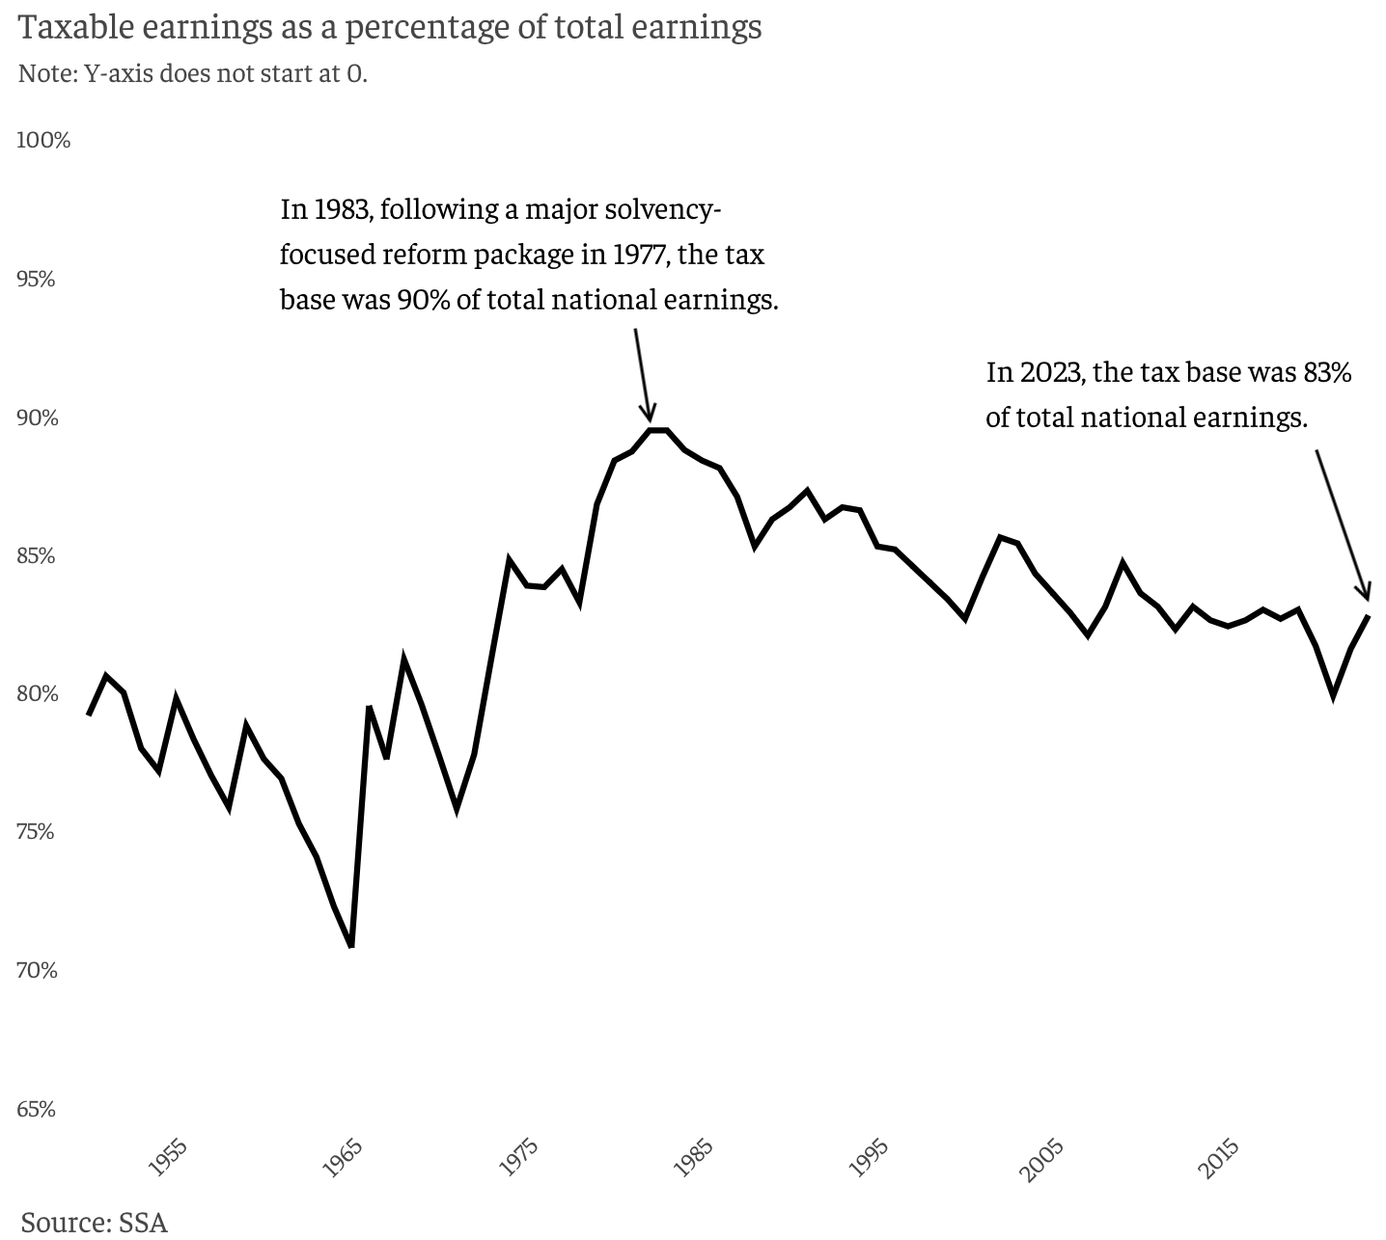
Tax Base is Falling

Slide 32
A Closer Look at Retirement Benefits?

Slide 33
Benefits are Based on Your Primary Insurance Amount (PIA)
PIA which depends on:
Your work history.
  You need 40 quarters of work credits to qualify.
  Put another way: 10 years with Social Security earnings in each year of $21,720.
Your (capped) earnings history AIME.
  Indexed (to wages) earnings from the 35 highest-earning years.
Earnings Cap ($184,500 in 2026) two roles:
  Remember earnings above the cap are not taxed.
  But, earnings above the cap do not affect individuals’ AIME.

Slide 34
PIA: SS Benefit for Unmarried at Full Retirement
Full Retirement Age is 67 for those born after 1960.
PIA is a fraction of your AIME, where the fraction decreases with AIME (progressive).

Slide 35
PIA Benefit Formula is Highly Progressive (2026)

Slide 36
Adjustments to PIA
Benefits payable for life and indexed to CPI inflation
Marital Status:
  With nonworking spouse adds 50% of PIA at full retirement age.
  Workings spouse can claim off own earnings record if it is greater
Age when claiming (born 1960 or later, so 67 is PIA).
  Early: 62, 70%; 63, 75%; 64, 80%; 65, 86.67%; 66, 93.33%
  Delayed, 68, 108%, 69, 116%; 70, 124%
  Designed to be (roughly, on average) actuarially fair.

Slide 37
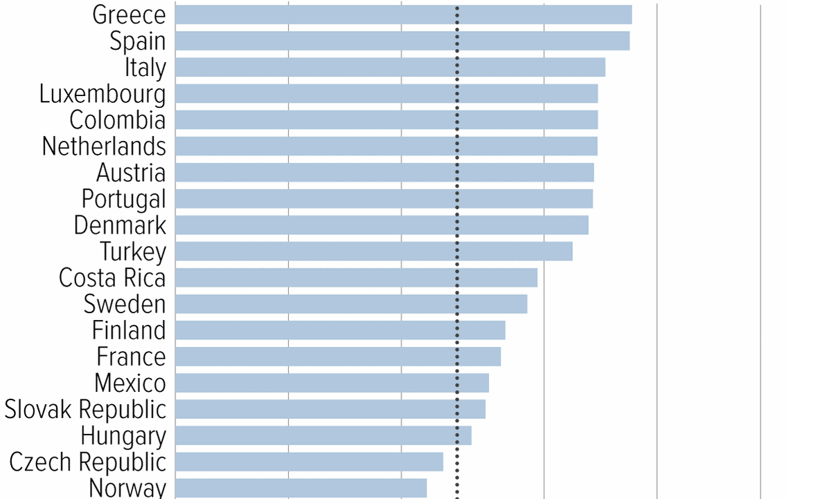
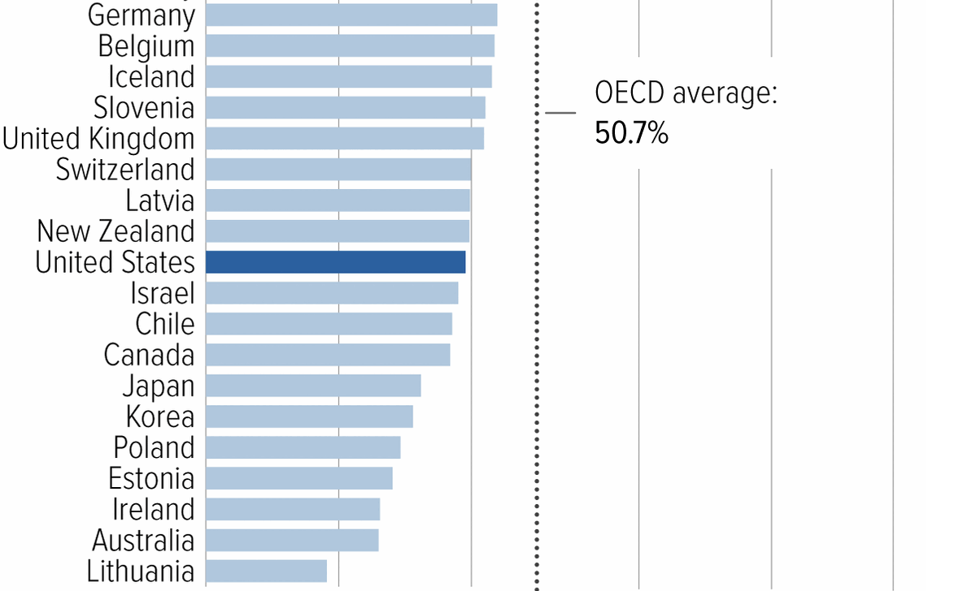
Social Security Benefits are Comparatively Low
Source: https://www.cbpp.org/research/social-security/top-ten-facts-about-social-security

Slide 38
Normal Retirement Ages in the OECD
From 2025 to 2040 China’s normal retirement age for men will rise from 60 to 63; for women 55 to 58. Japan and Korea transitioning to 65.
Notes:
Poverty Rates: Korea 40%, 20% in Japan; 13% in China, and 10% in US

Slide 39
Remember: We Have A Problem

Slide 40
“But, I earned my Social Security!”
Maybe…
Notice the progressivity of benefits; a feature not a flaw.
Money’s Worth Ratios for Hypothetical Workers born in 1949; retired in 2014 (Scheduled or Promised Benefits)
Earnings Level | AIME | Single Man | Single Woman | One-Earner Couple | Two-earner couple
Very Low | $16,556 | 1.50 | 1.93 | 3.50 | 1.95
Low | $29,800 | 1.13 | 1.38 | 2.38 | 1.37
Medium | $66,223 | 0.82 | 0.98 | 1.64 | 0.95
High | $105,957 | 0.79 | 0.82 | 1.33 | 0.79
Maximum | $163,970 | 0.62 | 0.69 | 1.12 | 0.69
K. Rose and K. Burkhalter, “Money’s Worth Ratios under the OASDI Program for Hypothetical Workers, Actuarial Note 25.7 SSA
Notes:
Come back to whether rising inequality made ss financing worse.

Slide 41
Let’s Cut to the Chase…
Solving the Social Security problem is simple:
More revenues and/or
Reduced benefits
Why hasn’t this happened?
Politics!

Slide 42
My Personal Opinion: Disingenuous
Scott Bessent, Treasury Secretary at his confirmation hearings:
"These entitlements are massive. I think the next four years isn't the time to deal with them, that we've got to deal with the discretionary portion of the budget…then the next step is for a future administration to have the confidence to be able to deal with entitlements.”
Total Federal Spending last fiscal $7 trillion: 60% Mandatory (mostly Social Security and Medicare); 27% was discretionary, and 14% was interest on the debt.
https://www.foxbusiness.com/politics/treasury-secretary-nominee-scott-bessents-3-3-3-plan-what-know

Slide 43
So, Let’s Consider Some Other Choices
Changes to revenues
Changes to benefits
But the appropriate choices depend on the goals of the program!

Slide 44
What Are The Goals of OASDI
Not mutually exclusive:
Partial earnings replacement via forced savings.
Social Insurance: protect workers against risks that are hard to insure privately.
Poverty Prevention among the elderly. (Was not an original goal)

Slide 45
1. SS as One Leg of the Three-Legged Stool
Why Forced Savings?
Private Pensions
  But, only 50-55 percent of private-sector workers are covered mostly by Defined Contribution Plans, as opposed to old-style Defined Benefit Plan.
Private Savings
  But, roughly 50 percent of workers aged 55-64 have little or no private savings (does not include housing wealth).
The weaknesses of these 2 legs is worse the poorer the household. Also, both these legs are subject to investment and inflation risk.
(From 1970-2025 the S&P 500 fell by 20% or more 7 times).

Slide 46
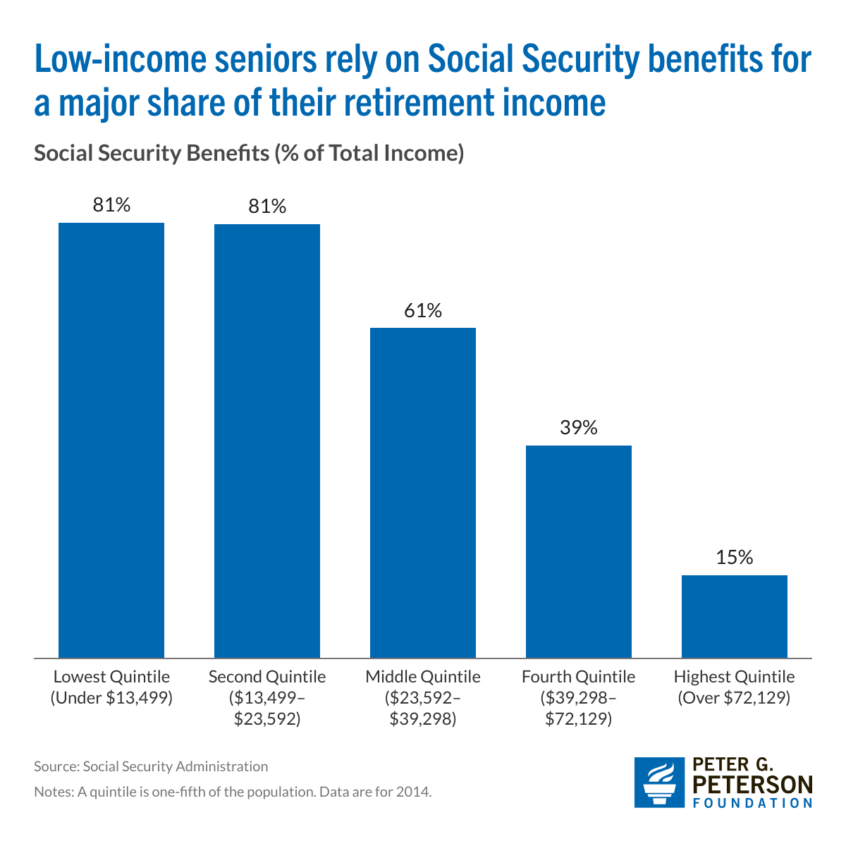
How Important Are Social Security Payments?
And Remember, Social Security is Payable for Life (Defined Benefit) and Indexed to CPI inflation

Slide 47
2. SSA Insures Against Significant Risks
Protects against becoming disabled.
Protects survivors, widow(er)s and children.
Protects against outliving resources because it acts like a lifetime annuity with the important added benefit that benefits are indexed to inflation

Slide 48
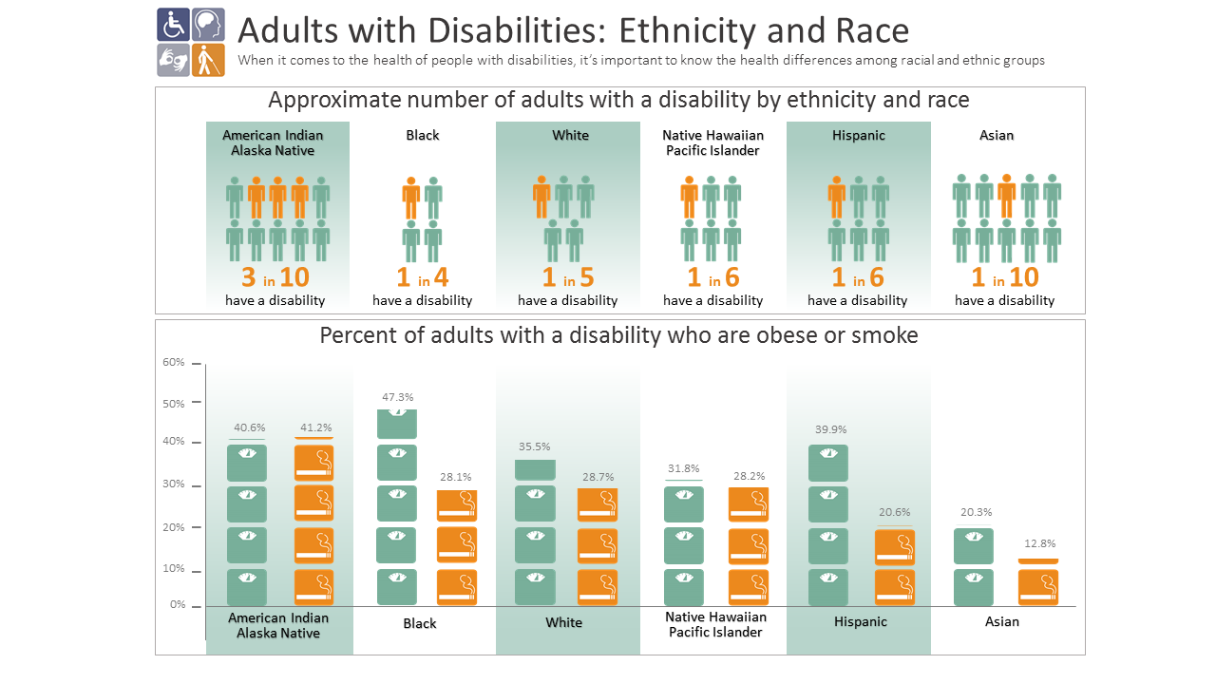
Disabilities by Race (CDC)

Slide 49
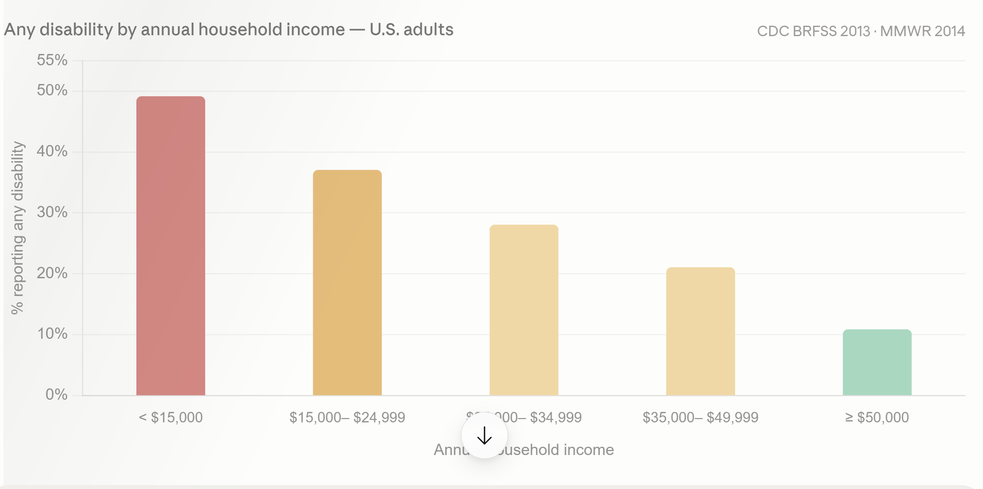
Disabilities by Income
The relationship runs in both directions. Lower income increases disability risk through occupational hazard, deferred healthcare, and chronic stress. Disability also directly reduces income through lost employment and earnings. CDC BRFSS data cannot separate these pathways.

Slide 50
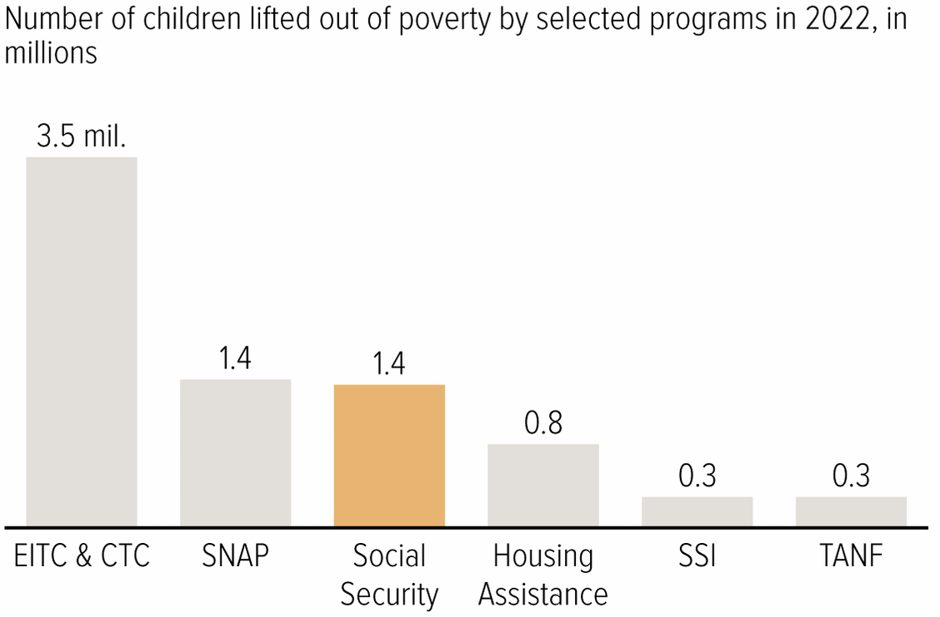
3. Soc Sec Significantly Reduces Poverty

Slide 51
Implications of 3 Different Goals
If there were only one goal (which there is not), what would be the implications for saving Social Security?
Forced Savings: Maintain a link between taxed earnings and benefits.
Social Insurance: Survivor and disability benefits are central. Progressivity in benefits is appropriate because low earners face greater risk.
Poverty Prevention: Payroll tax links to benefits is a historical artifact. Means-tested benefits.

Slide 52
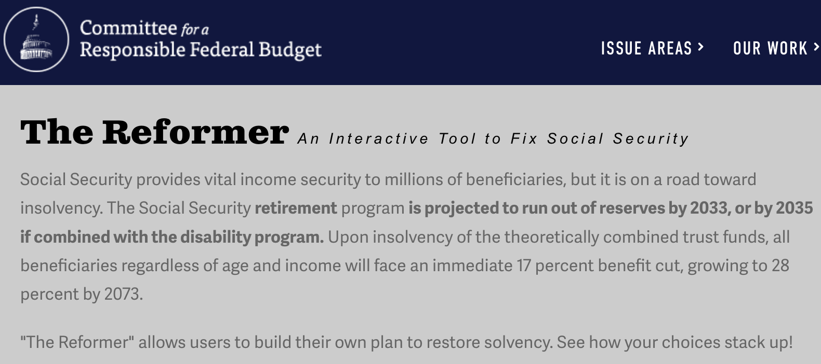
The Following Simulations Brought to you by:
https://www.crfb.org/socialsecurityreformer/

Slide 53
Brookings Principles for a Solution
Principles:
Bipartisan which means benefit cuts and tax increases.
Solvency (increase revenues and lower benefits by 3.82 % of taxable payrolls. Eliminate the “GAP”)
No benefit reduction for current recipients (?)
No general fund financing
Improve Progressivity.
Increase risk protection. (improve benefits for dependents)
Universal participation
How do these principles reflect the goals of Social Security?
https://www.brookings.edu/articles/fixing-social-security-blueprint-for-a-bipartisan-solution/

Slide 54
My Interpretation of Brookings Principles
While the goal of preventing poverty among the elderly is important, so too are the other two goals
  “this link between wages and benefits has been a central principle… and a foundation of it political support.”
  Universal participation because of social insurance.
  Increased risk protection.

Slide 55
Example: Roughly Based on Brookings
Slow Benefit Growth for High Earners (41%, of gap removed)
Index COLA to “Chained” CPI (17%)
Phase out nonworking spouse benefit (5%)
Expand Widow(er)s Benefit to 75% of combined benefit (-3%)
Eliminate earnings cap both for payroll taxes and benefits (50%)
Bipartisan because it involves benefit reductions (60%) and tax increases (50%)

Slide 56
Results

Slide 57
Two Other Good Ideas from Brookings
Raise the Retirement Age for High Earners (15.5% of gap)
Expand Legal Immigration (8.5% of gap)

Slide 58
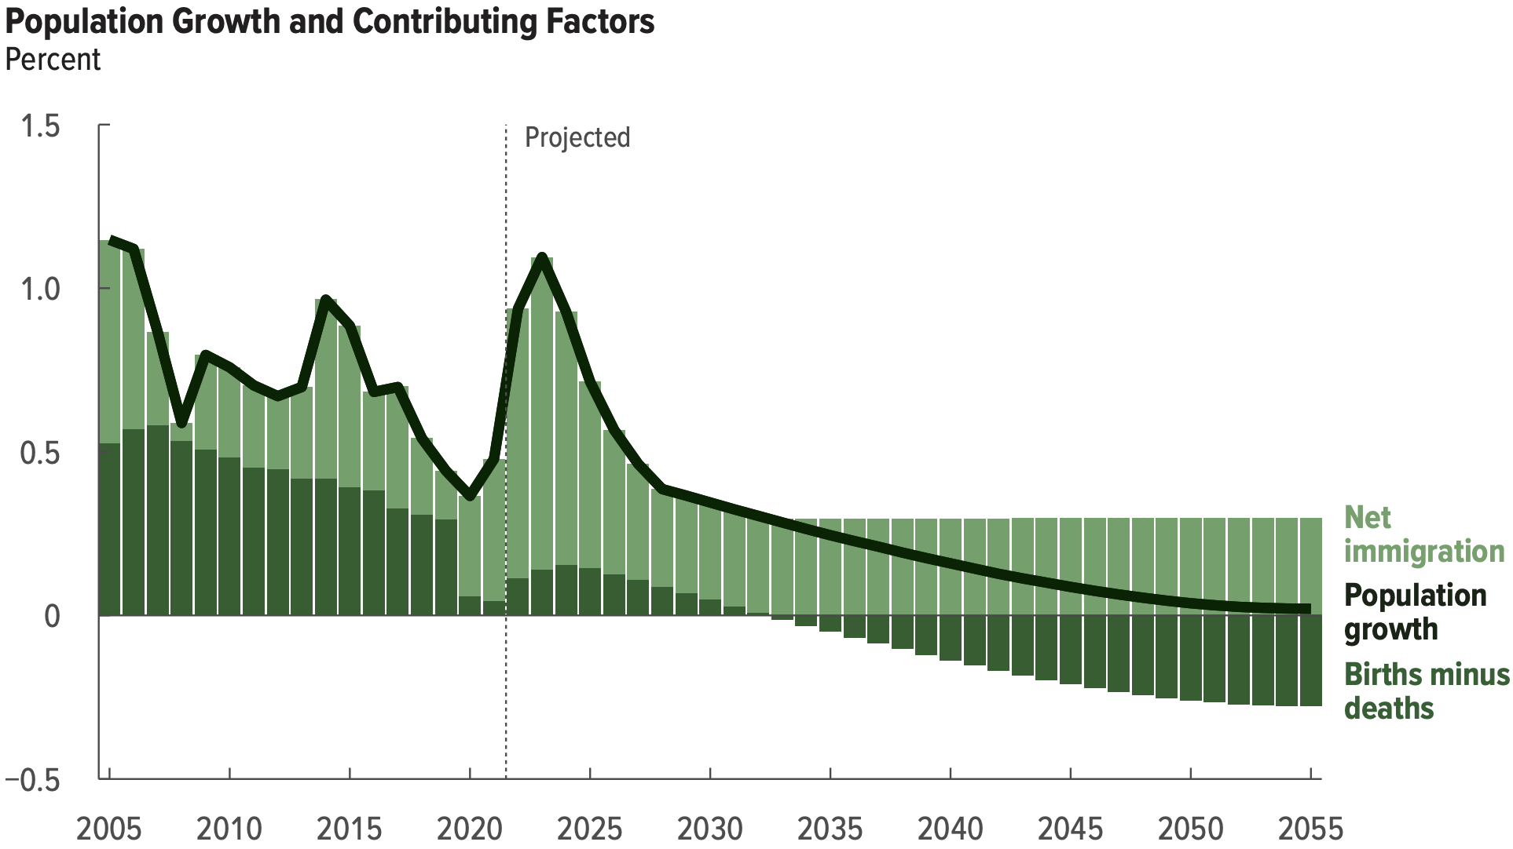
Another Solution?
Increase legal immigration of prime working age.
Source: https://www.cbo.gov/system/files/2025-01/60875-demographic-outlook.pdf

Slide 59
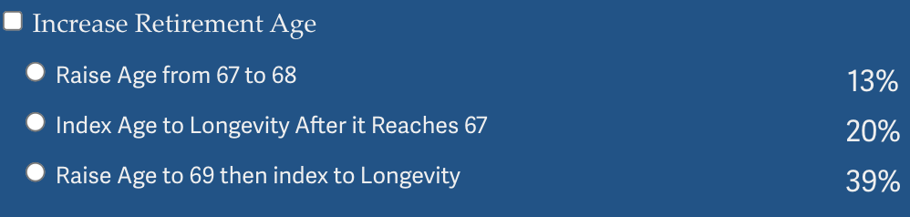
Why Not Just Raise the Retirement Age
Very regressive.
  Larger tax on low-income workers than high income workers.

Slide 60
Raising the Retirement Age
Sex | Income Category | Life Expectancy (Years) | Difference High vs Low
Women | Highest Incomes (top 1%) | 88.9 | 10.1 years
 | Lowest Incomes (bottom 1%) | 78.8
Men | Highest Incomes (top 1%) | 87.3 | 14.6 years
 | Lowest Incomes (bottom 1%) | 72.7

Slide 61
Should Current Retirees Share the Burden?
Current retirees have less flexibility to adjust income and spending.
That may argue for a smaller relative burden, but not zero.
Also, higher income retirees have more flexibility in adjusting spending.
My opinion, for intergenerational fairness and for social solidarity, the more affluent of our generation should bear some burden

Slide 62
Intergenerational Fairness
Present Value Reduction in lifetime benefits
Two Earner, High Income ($105K average lifetime earnings) Couple Collecting Benefits Starting in 2014 at age 65: 4% reduction in PV of benefits.
Same Couple Starting Benefits in 2038 22% reduction in PV of benefits
Why: 2014 couple will have already received 19 years of scheduled benefits!

Slide 63
Summary
Social Security is an important part of the social safety net.
The OASI Trust Fund is likely to be exhausted in 2032.
Why are the funds being depleted?
  An aging population – fewer paying in and more taking out.
  Declining birth rates - slowing the growth of the labor force.
What happens when the funds are depleted?
  Benefits may have to be reduced by 22%.
  The system will continue!
Solutions abound. The problem is political will.
  The needed changes will be unpopular, but they are manageable.
Should our generation contribute more to the solution?

Slide 64
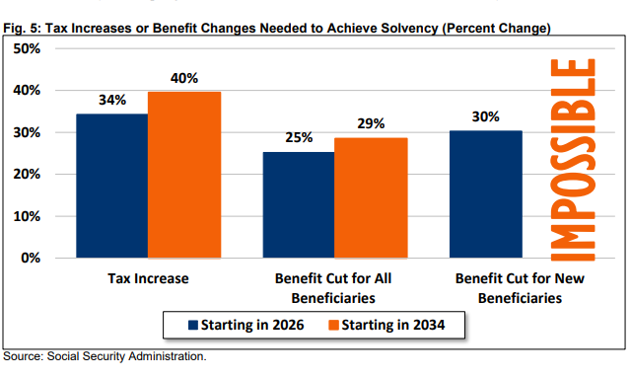
What Happens if we wait until 2032?
It gets worse: My simulations were based on the actuarial 75-year deficit in 2025 of 3.82 percent of taxable payrolls.
The 2026 Trustee’s Report estimates the deficit at 4.42%, a 16% increase.
https://www.crfb.org/sites/default/files/media/documents/Analysis%20of%20the%202026%20Social%20Security%20Trustees%20Report_7.pdf

Slide 65
Next Week: Global Supply Chains

Slide 66
Let’s Hear from You!
Geoffrey Woglom grwoglom@amherst.edu
Contact NEED: Info@NEEDEcon.org
Support NEED: www.NEEDEcon.org/donate.php

