Slide 1
Osher Lifelong Learning Institute, Winter 2026
The Economics of Public Policy Issues
Johns Hopkins University
Host: Geoffrey Woglom, Director
National Economic Education Delegation

Slide 2
Warren Buffet
“[Gold] gets dug out of the ground in Africa, or someplace. Then we melt it down, dig another hole, bury it again and pay people to stand around guarding it. It has no utility. Anyone watching from Mars would be scratching their head.”

Slide 3
Course Schedule
Contemporary Economic Policy Issues
Week 1 (2/25): Economic Update & Tariffs Geoffrey Woglom, Amherst College
Week 2 (3/04): An Introduction to Cryptocurrencies, Geoffrey Woglom
Week 3 (3/11): Saving Social Security, Geoffrey Woglom
Week 4 (3/18) Economics of Immigration, Robert Gitter, Ohio Wesleyan University
Week 5 (3/25): Climate Change Economics, Sarah Jacobson, Williams College
Week 6 (2/27): Health Care Economics, Robert Rebelein, Vassar College

Slide 4
Submitting Questions
Raise your digital hand or submit questions in the chat.
I will try to handle them as they come up.
We will do a verbal Q&A once the material has been presented.
Slides will be available from the NEED website tomorrow (https://needelegation.org/delivered_presentations.php)

Slide 5

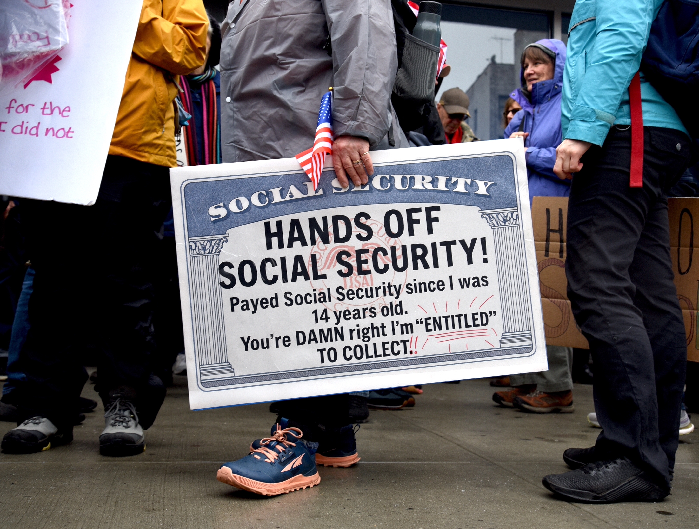
Social Security – Hard Choices (?)*
Geoffrey Woglom, emeriti Amherst College
March 11, 2026
* The majority of these slides were written by Jon Haveman, Executive Director of NEED, PhD

Slide 6
Outline
What is Social Security?
How Does Social Security Work?
What is The Trouble with Social Security?
Available Solutions
A Bipartisan Solution

Slide 7
What is Social Security?

Slide 8
What is Social Security?
Social Security is a federal social insurance program that provides financial support to workers and their families.
Different benefits:
Retirement Benefits: Social Security provides monthly payments to qualified retirees based on their lifetime earnings.
Disability Benefits: It provides financial support to individuals who are unable to work due to a disability.
Survivor Benefits: Social Security offers benefits to the families of deceased workers, including spouses and children.

Slide 9
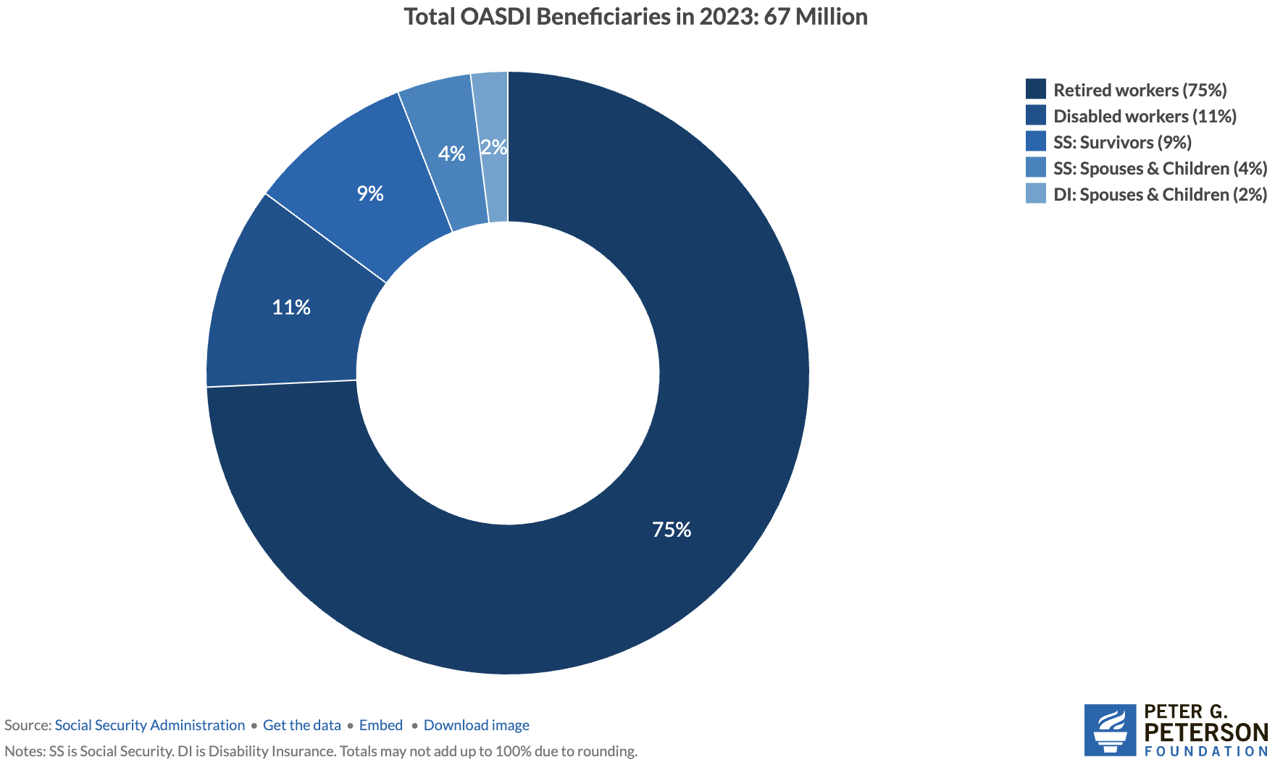
Numbers of Different Types of SS Beneficiaries
6.0 million
7.4 million
52.3 million

Slide 10
Social Security’s Origins
“Social insurance” as part of the “social safety net”
Created in 1935 to provide economic security to the nation’s elderly (2 % payroll tax split between employer and employee).
Expanded in 1939 to include dependent benefits.
Benefits to families that have lost a breadwinner.
First monthly check 1/31/40 to Ida May Fuller of Ludlow Vt.
Expanded in 1950 to provide support for people with disabilities.
June 1972 Congress approved a 20 percent increase in benefits and cost-of-living adjustments to start in 1975

Slide 11
Social Security’s Origins (cont.)
1977 Congress corrects “double-indexing mistake” that threatened SS solvency (first benefit reduction)
1983 Greenspan Commission: 50% of benefits of high earners ($32k) subject to income taxation, gradual increase in normal retirement age, increase in payroll tax rate.
1993 85% of benefits subject to income tax for higher earners ($44k).
Today, it is the largest federal program. In FY 2025, spending was $1.58 trillion, or 22.4% of total federal spending.
By comparison, national defense was $917 billion.

Slide 12
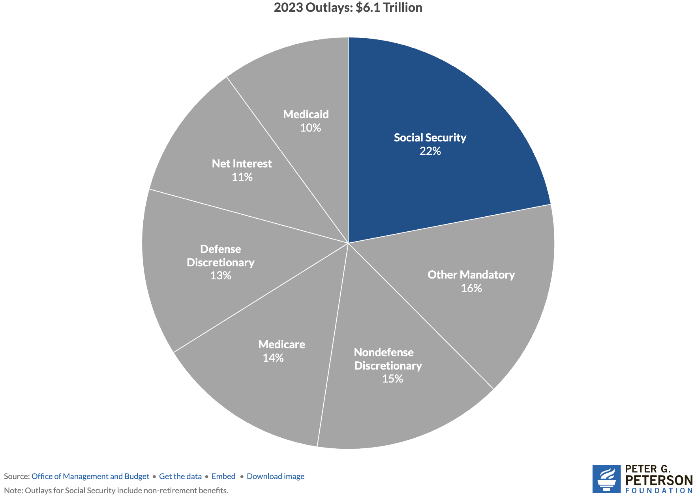
Soc Sec is The Single Largest Gov’t Program
Source: https://www.pgpf.org/article/9-facts-about-social-security-and-the-need-to-strengthen-it/

Slide 13
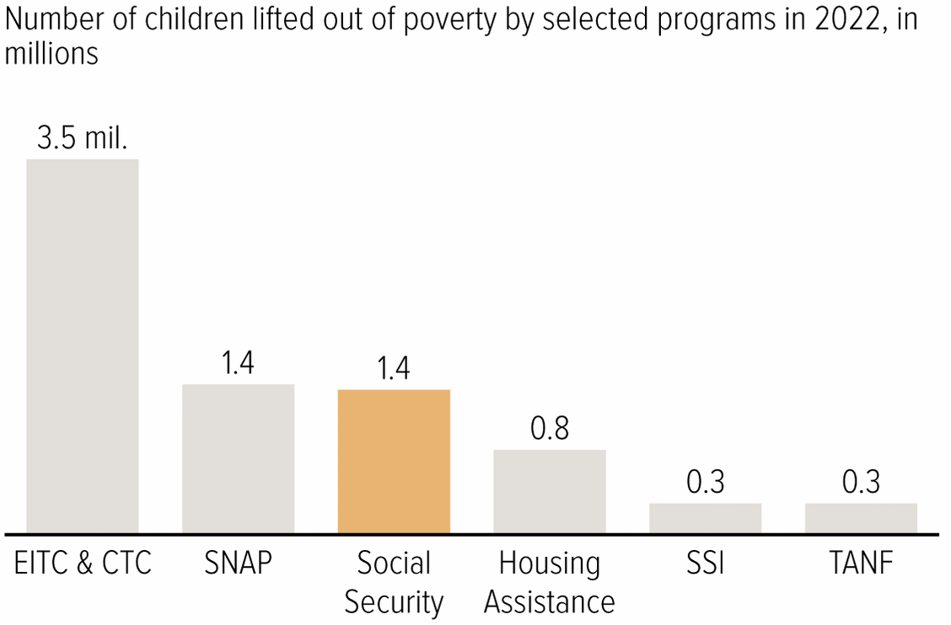
Soc Sec Significantly Reduces Poverty

Slide 14
Is Social Security Good for Just The Beneficiaries?
No, it also benefits broader society. Hence, “social” insurance.

Slide 15
Economic Impacts on Individuals and Families
Poverty reduction
Good investment for society.
Reduces income inequality among the elderly, survivors & disabled
Increases social mobility
Income stability
Helps households plan for the future.
Enables older adults to maintain independence
Reduces caregiving burdens on family members.

Slide 16
How Does it Work?

Slide 17
The Mechanics of Social Security
“pay-as-you-go” system
Payroll taxes are collected from current workers.
These pay for the benefits of the currently retired, or otherwise eligible.
Defined benefit plan, as opposed to Defined contribution (e.g., 401K)
Taxes
Payroll taxes amount to 12.4% of earnings.
Workers pay 6.2% of earnings as payroll taxes.
Employers also pay 6.2% of worker’s earnings.
Earnings Cap. Not all earnings are subject to payroll taxes.
In 2026, only the first $184,500 of earnings are taxed.
Earnings above that level are not taxed.

Slide 18
What if Payroll Taxes Don’t Match Benefits?
The Trust Fund
If revenues exceed benefits, the surplus is placed in a trust fund.
If benefits exceed revenues, the defcit is taken out of the trust fund.
The funds in the trust are invested in nonmarketable U.S. Treasuries.
So, really just bookkeeping, but major political implications.
But surpluses (deficits) lower (raise) the overall deficit
When did the Trust Fund start?
The OASI Trust Fund was created in 1939. (Old Age & Survivors Ins)
The Disability Trust Fund was created in 1956.

Slide 19
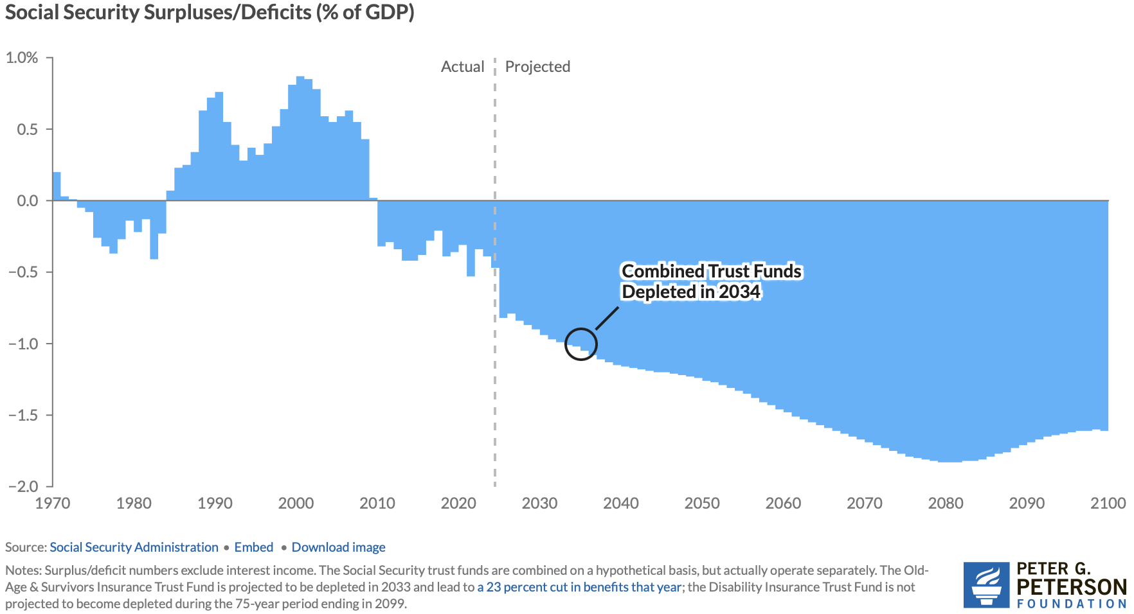
Annual Contributions to the Fund Vary
Social Security
Amendments Act
Of 1983

Slide 20
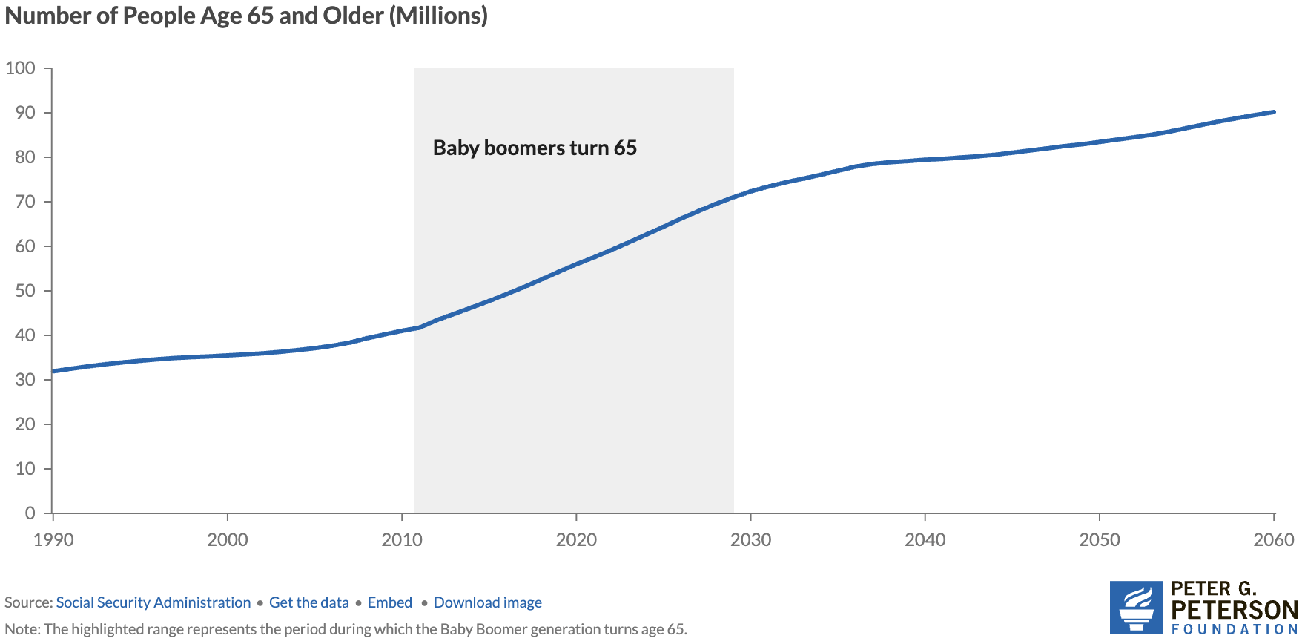
Why the Change in Direction? Aging Population
Source: https://www.pgpf.org/article/how-does-social-security-work/

Slide 21
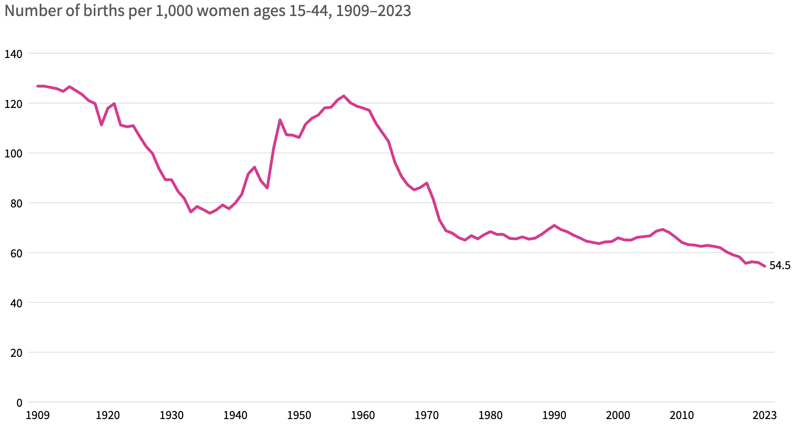
Lower Births = Slower Labor Force Growth
Source: https://usafacts.org/articles/how-have-us-fertility-and-birth-rates-changed-over-time/

Slide 22
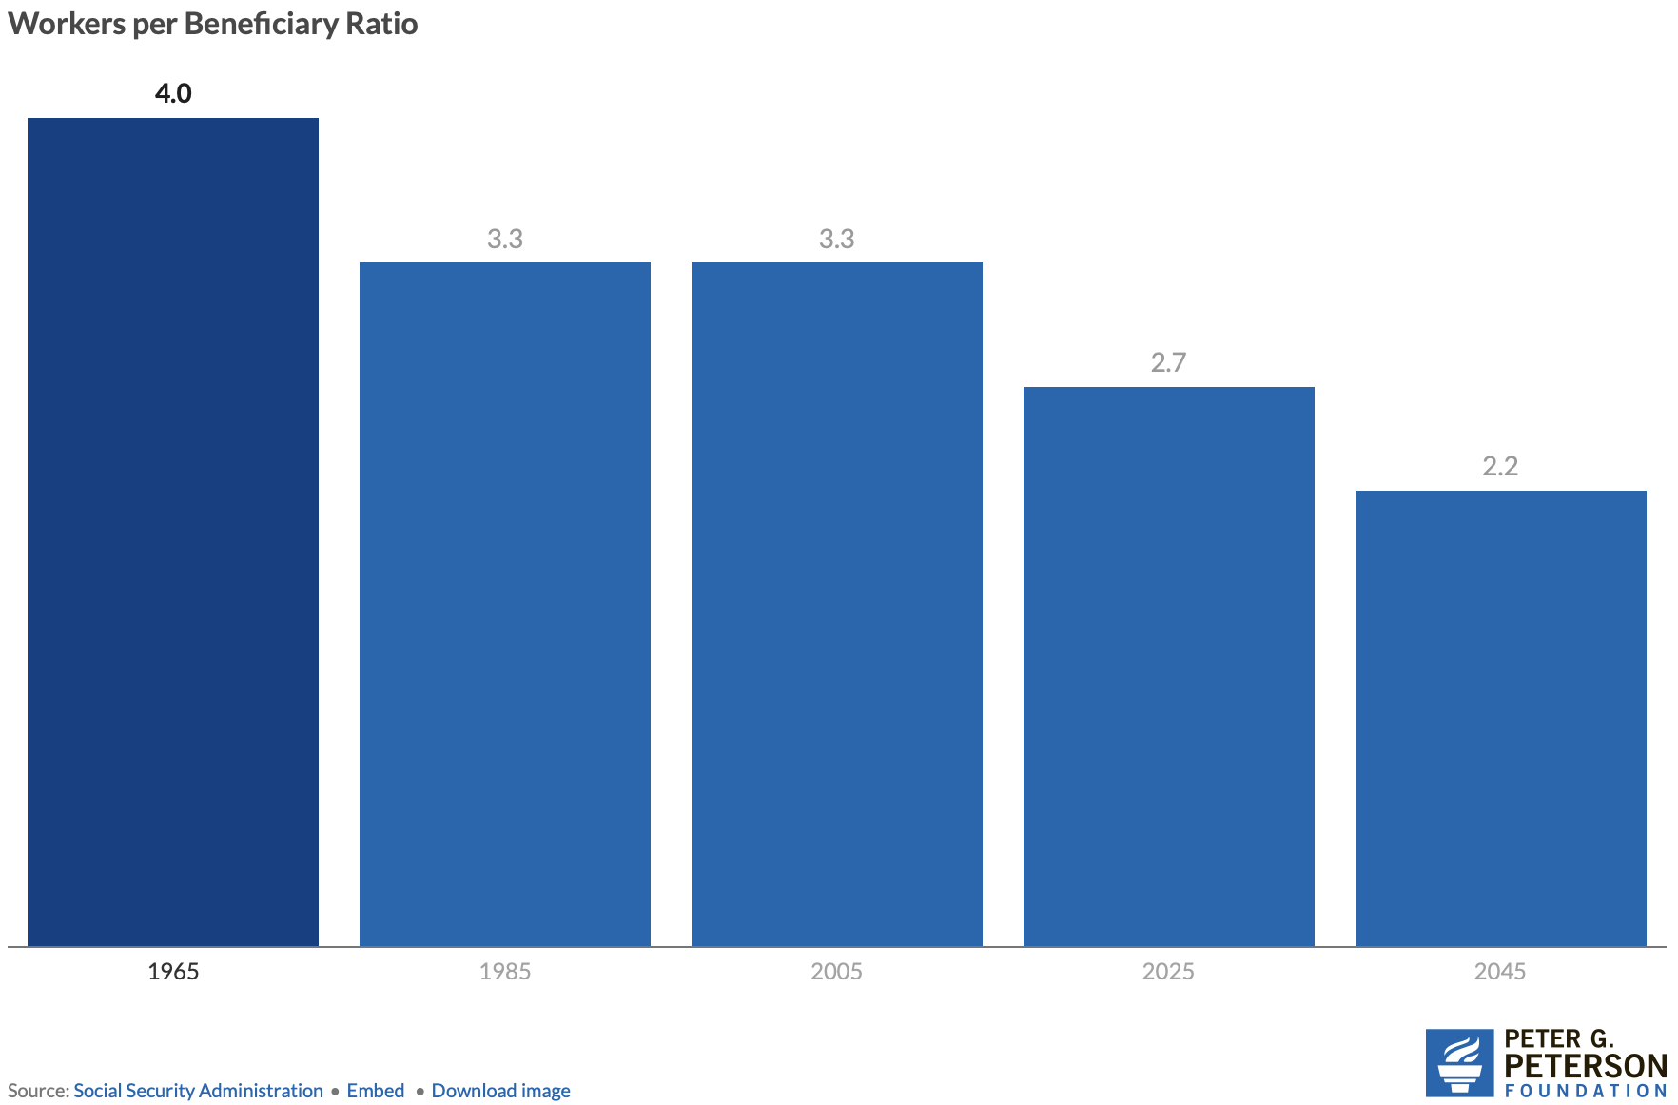
Number of Covered Workers per Beneficiary

Slide 23
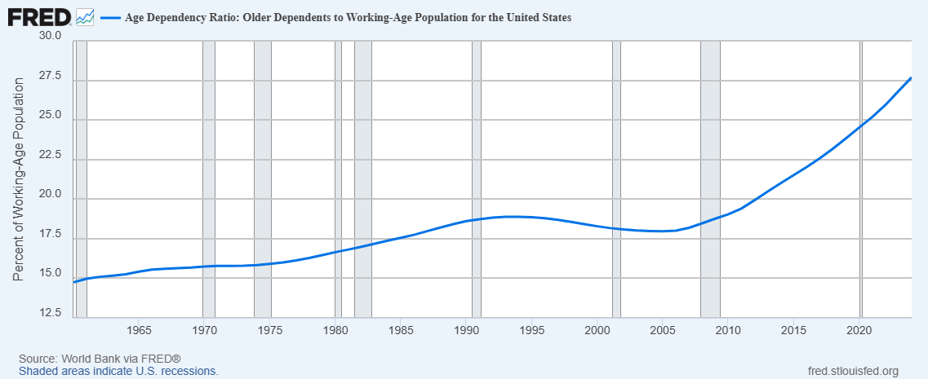
Declining

Slide 24
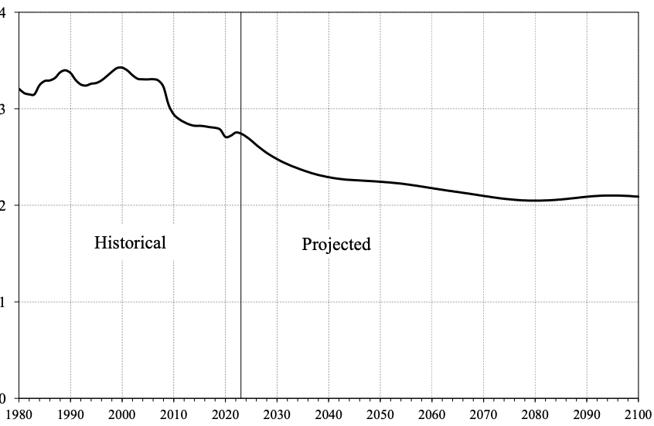
Number of Covered Workers per Beneficiary
Baby boomers started retiring.
Source: https://www.ssa.gov/OACT/TR/2024/tr2024.pdf

Slide 25
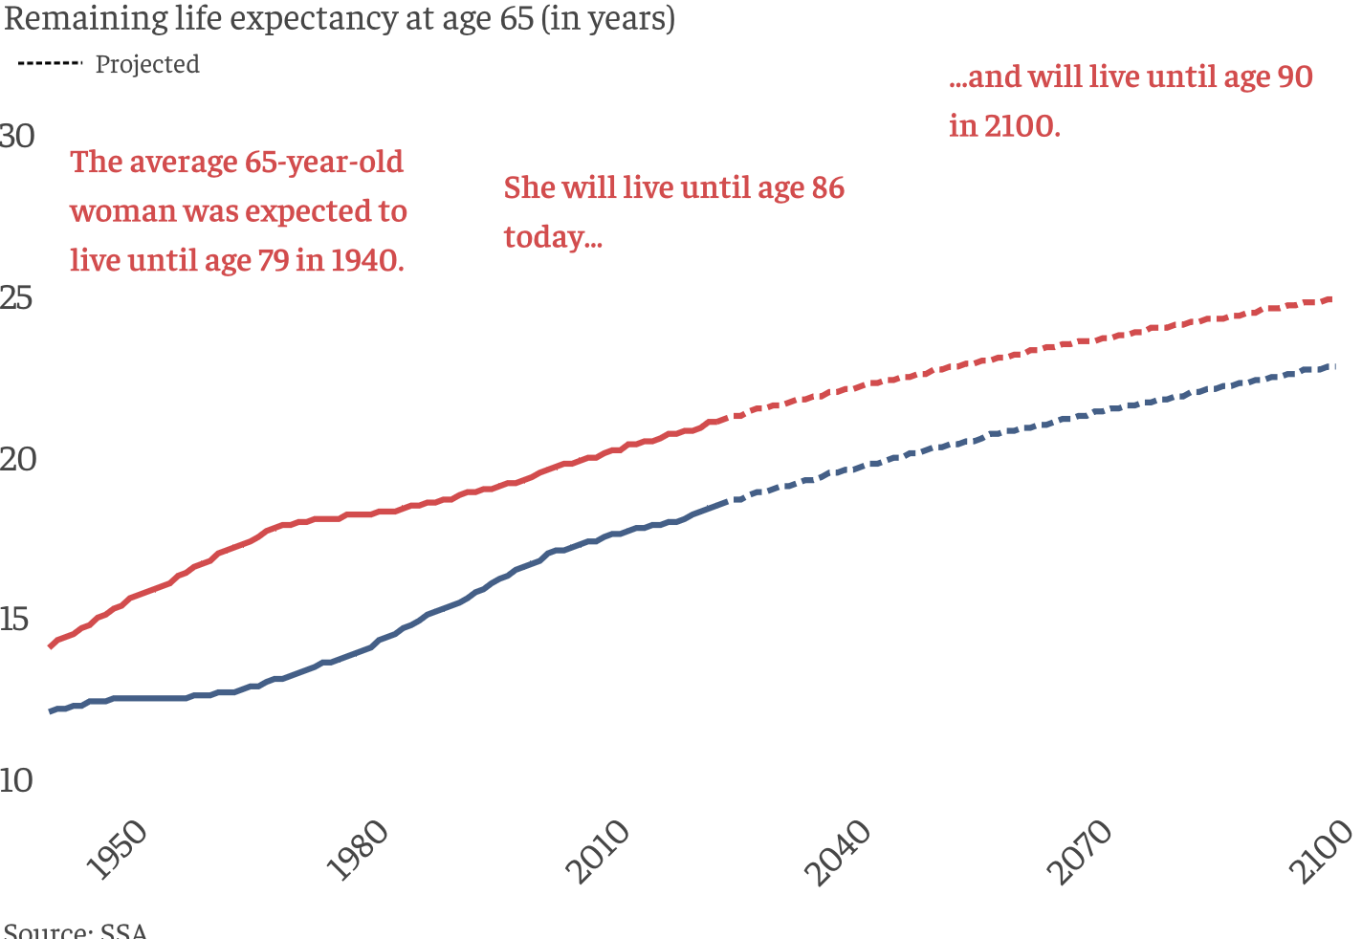
Life Expectancy Continues to Rise

Slide 26
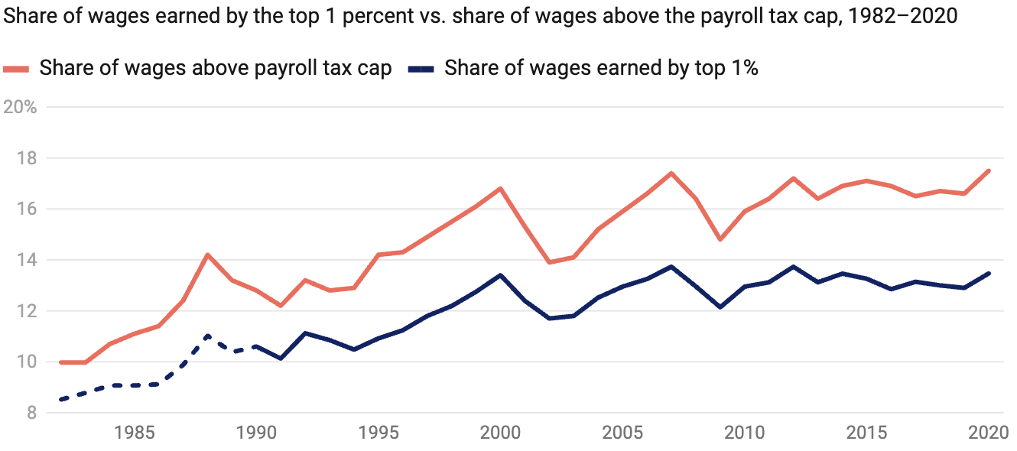
Increased Wage Inequality Is A Problem
Source: https://www.americanprogress.org/article/increased-wage-inequality-has-reduced-social-securitys-revenue
Notes:
The effect on net revenues is to reduce them.
https://www.americanprogress.org/article/the-effect-of-rising-inequality-on-social-security/#:~:text=Rising%20income%20inequality%20poses%20a,that%20higher%2Dearning%20workers%20receive.

Slide 27
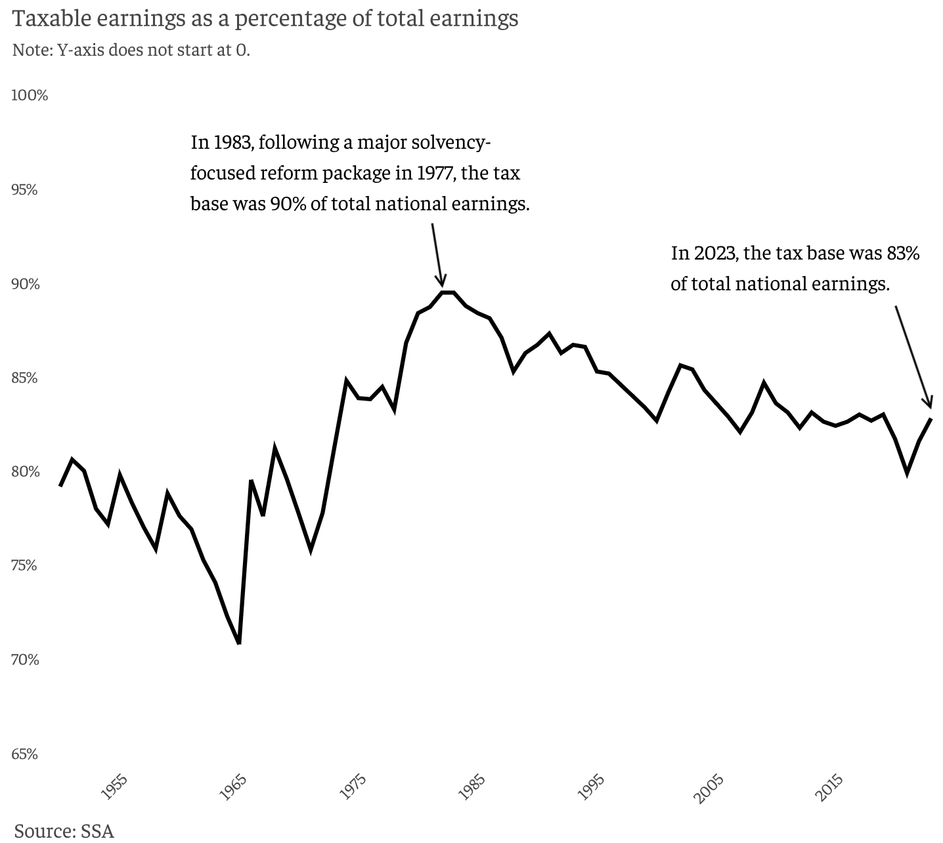
Tax Base is Falling

Slide 28
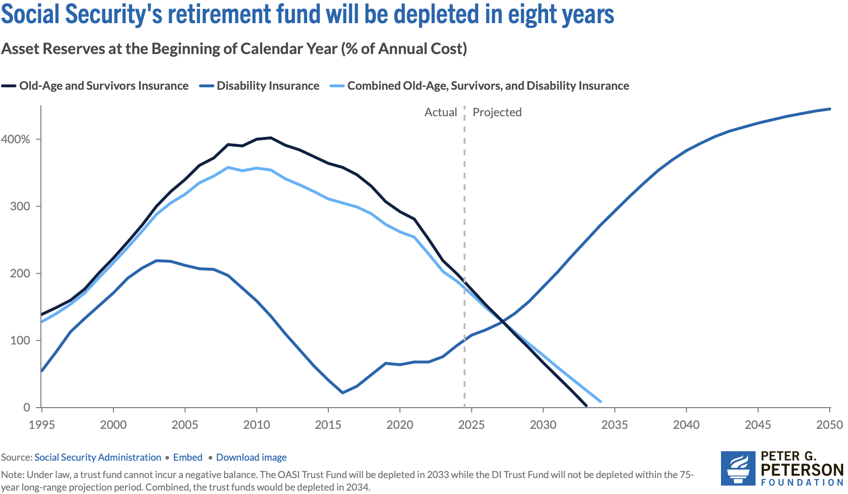
Trajectory of Funds

Slide 29
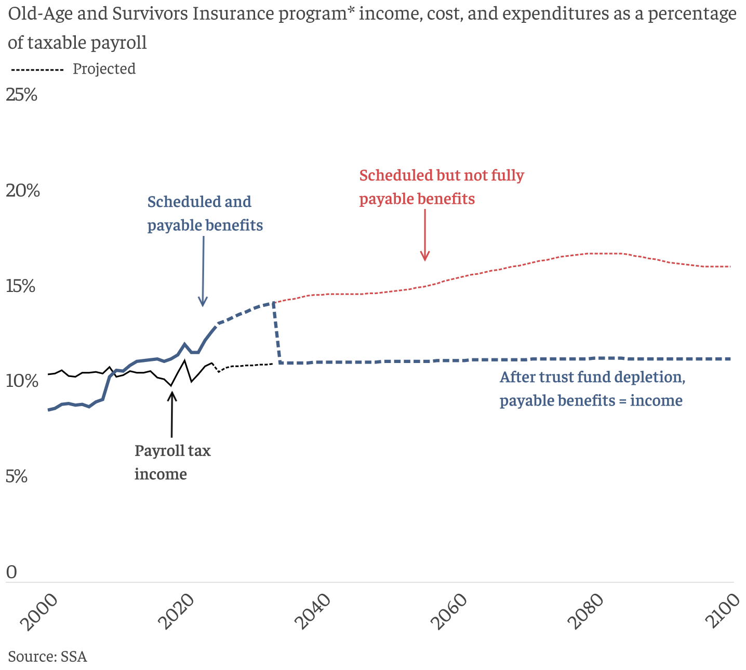
What Happens When The Trust Fund Runs Out?
Benefit Cut: 26%
2098
Trust Fund Exhaustion, 2033
Benefit Cut: 18%

Slide 30
Present Value of Benefit Cuts by Cohorts
Two Earner, High Income ($105K average lifetime earnings) Couple Collecting Benefits Starting in 2014 at age 65: 4% reduction in PV of benefits.
Same Couple Starting Benefits in 2038 21% reduction in PV of benefits
Why: 2014 couple will have already received 19 years of scheduled benefits!

Slide 31
Where Does the Money Come From?
Payroll taxes
Taxes on benefits
Interest earnings
Trust funds

Slide 32
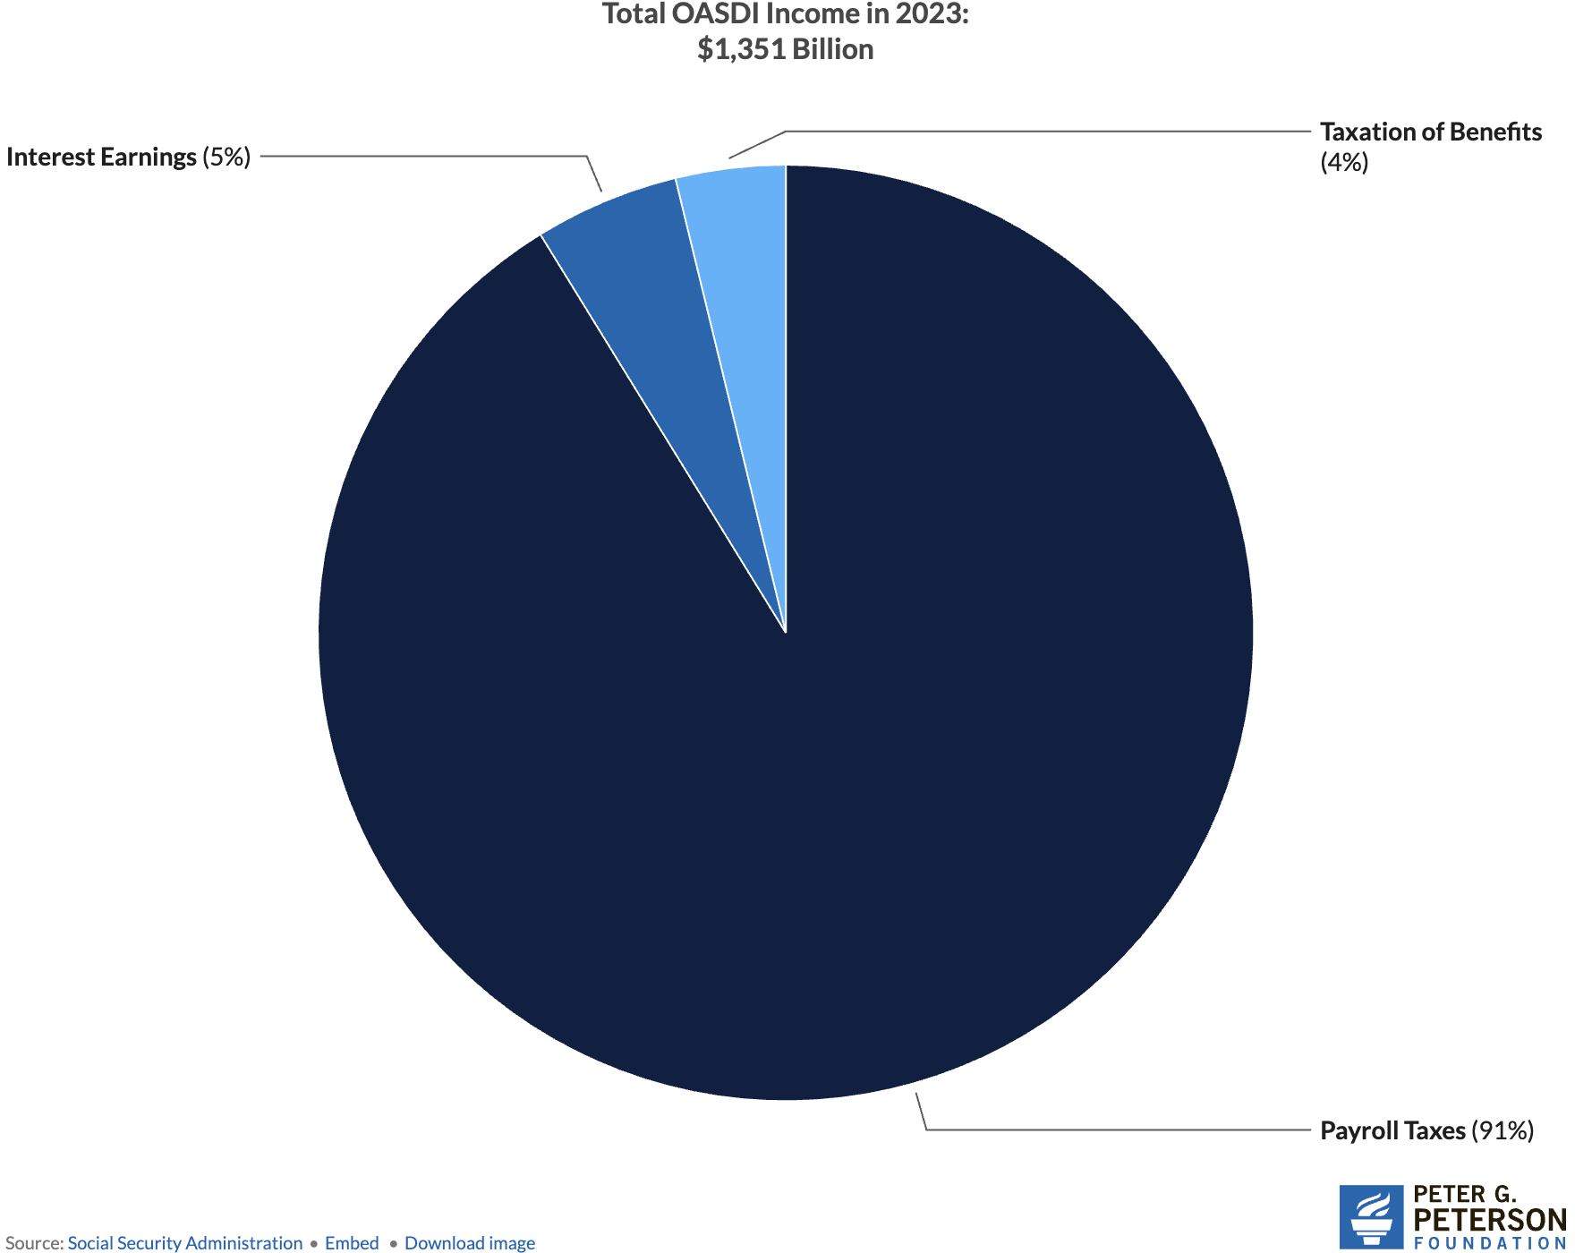
Sources of SS Revenue

Slide 33
Where Does The Money Go?

Slide 34
Where Does The Money Go?
Different benefits:
Retirement Benefits
Disability Benefits
Survivor Benefits
We will focus on retirement benefits.

Slide 35
What Determines my SS Benefit (PIA)? (Primary Insurance Amount)
Your work history.
You need 40 work credits to qualify.
In 2025, 1 credit = $1,810 in earnings.
Put another way: 10 years with social security earnings in each year of $21,720.
Your (capped) earnings history.
Indexed (to wages) earnings from the 35 highest-earning years.
Your birth year.
Determines your FRA – Full Retirement Age.
Born before 1960, it is 66-67, after 1960, it is 67.
Your claiming age.
Claiming at 62 instead of 67 reduces your benefit by 30%.
Higher if you wait until 70.
Increases approximately 8% each year that you wait.

Slide 36
What Determines my SS Payment Size (PIA)? (Primary Insurance Amount – PIA) (Adjusted Indexed Monthly Earnings - AIME)
Earnings History
Age at Which You Start Receiving SS
AIME is calculated using your 35 highest years of indexed earnings.
These earnings are then adjusted for wage inflation.
The AIME is used to determine your PIA, which is the amount you would receive if you start receiving benefits at your full retirement age.
You can start receiving benefits as early as age 62, but your monthly payment will be reduced if you choose to start before your full retirement age.
Waiting to start benefits until after your full retirement age (between 66 and 67, depending on your year of birth) will increase your monthly payment.
You receive the highest possible annual benefit by waiting until age 70.

Slide 37
How Big are Payments?
In 2026:
the average payment is $2,075.
Maximum if claim at age 62 is $2,969.
Maximum if claim at age 70 is $5,181.
Special minimum Social Security benefit:
For long-term, low-wage workers.
Minimum for 11 years of work: $53.50
Maximum for 30 years of work: $1,123.70

Slide 38
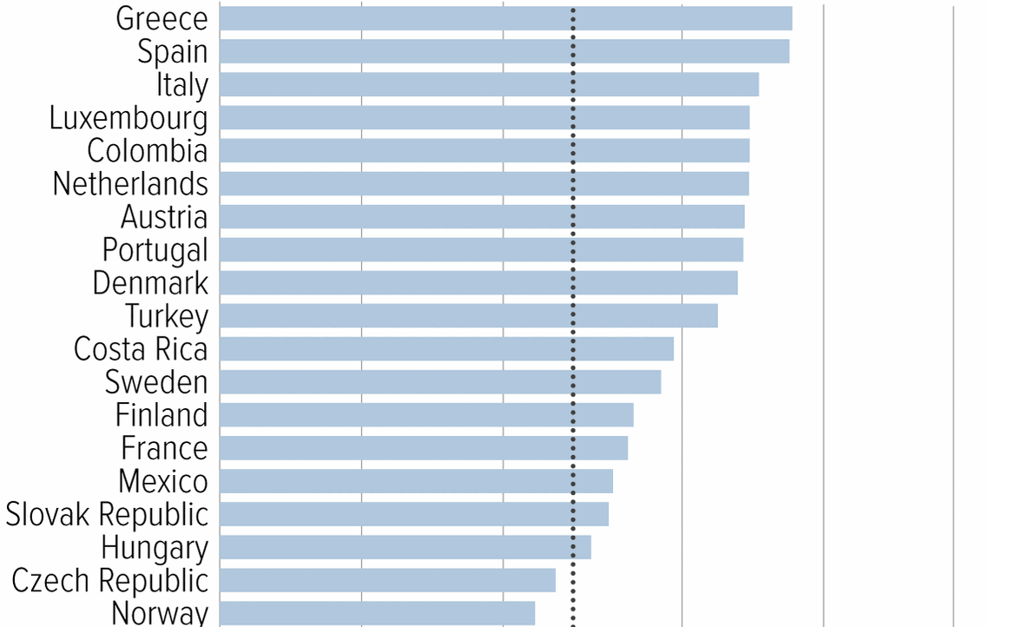
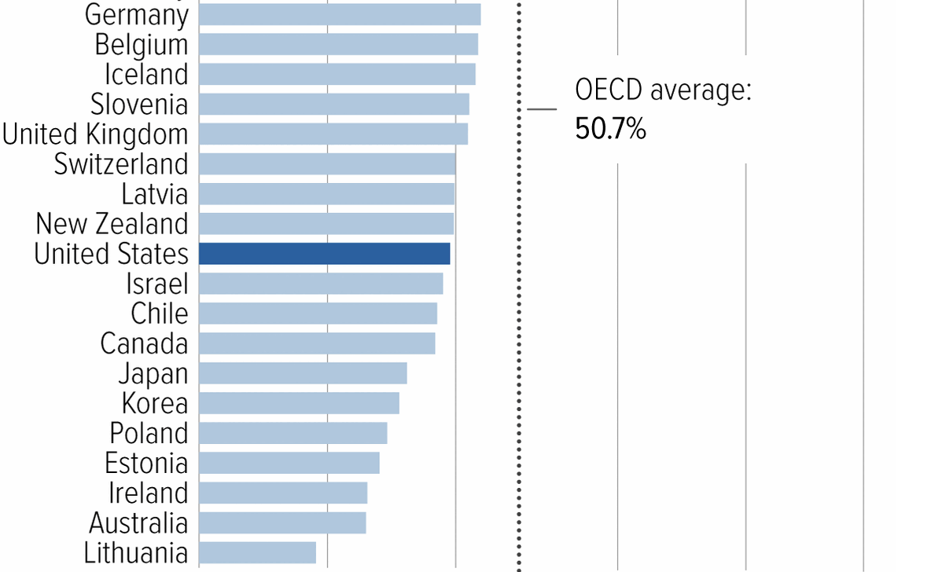
Social Security Benefits are Comparatively Low
Source: https://www.cbpp.org/research/social-security/top-ten-facts-about-social-security

Slide 39
Normal Retirement Ages in the OECD
From 2025 to 2040 China’s normal retirement age for men will rise from 60 to 63; for women 55 to 58. Japan and Korea transitioning to 65.
Notes:
Poverty Rates: Korea 40%, 20% in Japan; 13% in China, and 10% in US

Slide 40
Social Security Benefits Can Be Subject to income Tax
“Combined Income (CB):” one half SS benefit plus all other income
Single:
CB Up to $25K: no tax
CB $25K to $34K Up to 50% of benefit is included in taxable income
CB More than $34K Up to 85% of benefit is included in taxable income.
Married Filing Jointly:
CB Up to $32K: no tax
CB $25K to $44K Up to 50% of benefit is included in taxable income
CB More than $44K Up to 85% of benefit is included in taxable income.
Remember 4% of SS Revenue is from Income Taxes on Benefits.
Also, these income levels are NOT indexed to inflation

Slide 41
Remember: We Have A Problem

Slide 42
“But, I earned my Social Security!”
Maybe…
Notice the progressivity of benefits; a feature not a flaw.
Money’s Worth Ratios for Hypothetical Workers born in 1949; retired in 2014 (Scheduled or Promised Benefits)
Earnings Level | AIME | Single Man | Single Woman | One-Earner Couple | Two-earner couple
Very Low | $16,556 | 1.50 | 1.93 | 3.50 | 1.95
Low | $29,800 | 1.13 | 1.38 | 2.38 | 1.37
Medium | $66,223 | 0.82 | 0.98 | 1.64 | 0.95
High | $105,957 | 0.79 | 0.82 | 1.33 | 0.79
Maximum | $163,970 | 0.62 | 0.69 | 1.12 | 0.69
K. Rose and K. Burkhalter, “Money’s Worth Ratios under the OASDI Program for Hypothetical Workers, Actuarial Note 25.7 SSA
Notes:
Come back to whether rising inequality made ss financing worse.

Slide 43
Trust Finds Are Running Out
Source: https://www.pgpf.org/article/social-security-faces-serious-financial-shortfalls-and-other-takeaways-from-the-trustees-report/

Slide 44
At Which Point, Benefits exceed Revenue
Benefit Cut: 27%
2098
Trust Fund Exhaustion, 2033
Benefit Cut: 17%

Slide 45
Hard Choices (?)

Slide 46
Let’s Cut to the Chase…
Solving the social security problem is simple:
More revenues and/or
Reduced benefits
Why won’t this happen?
Politics!

Slide 47
My Personal Opinion: Disingenuous
Scott Bessent, Treasury Secretary at his confirmation hearings:
"These entitlements are massive. I think the next four years isn't the time to deal with them, that we've got to deal with the discretionary portion of the budget…then the next step is for a future administration to have the confidence to be able to deal with entitlements”
Total Federal Spending last fiscal $7 trillion: 60% Mandatory (mostly Social Security and Medicare); 27% was discretionary, and 14% was interest on the debt.
https://www.foxbusiness.com/politics/treasury-secretary-nominee-scott-bessents-3-3-3-plan-what-know

Slide 48
So, Let’s Consider Some Other Choices
Changes to revenues
Changes to benefits

Slide 49
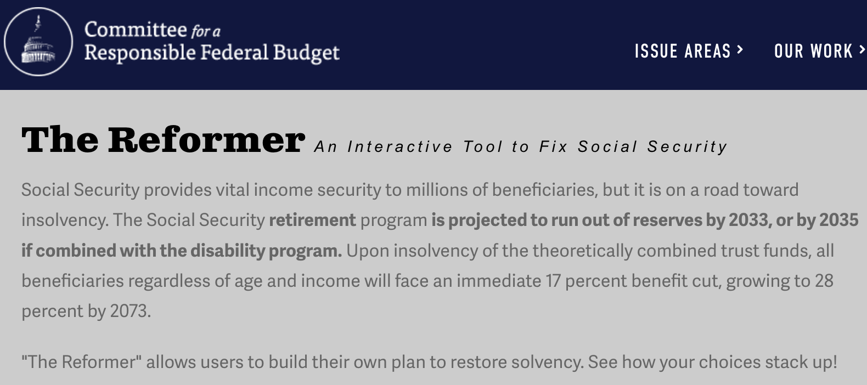
The Following Simulations Brought to you by:
https://www.crfb.org/socialsecurityreformer/

Slide 50
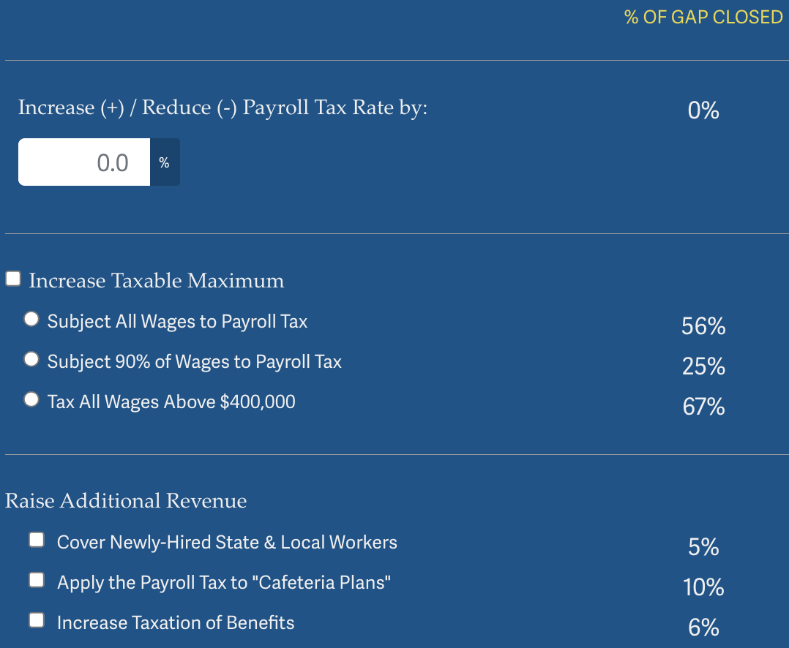
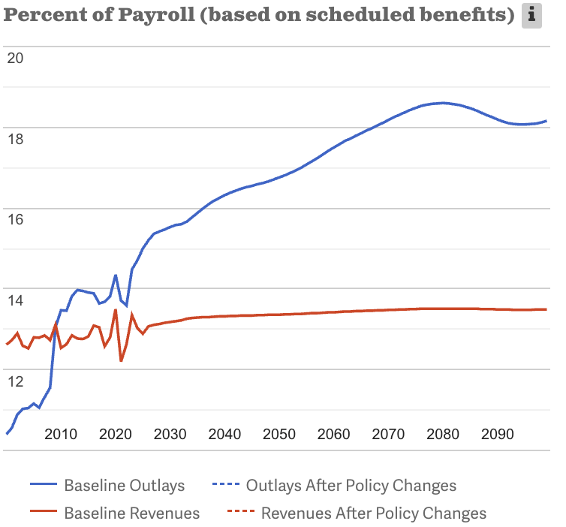
Possible Changes to Revenues
Source: https://www.crfb.org/socialsecurityreformer/

Slide 51
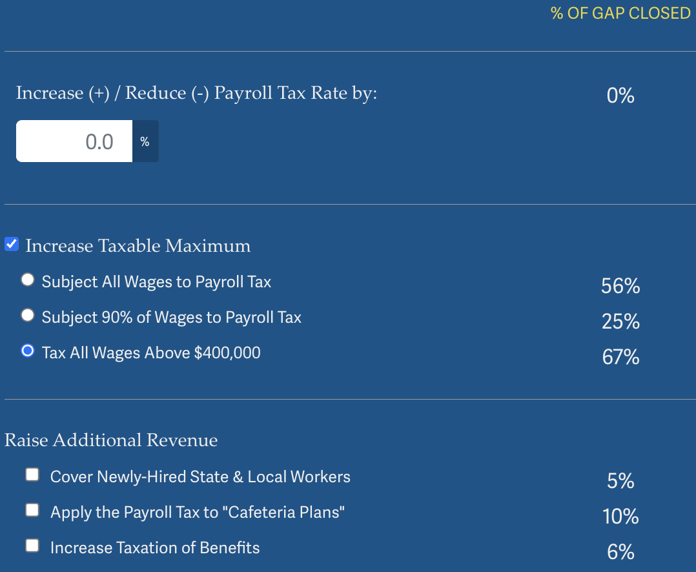
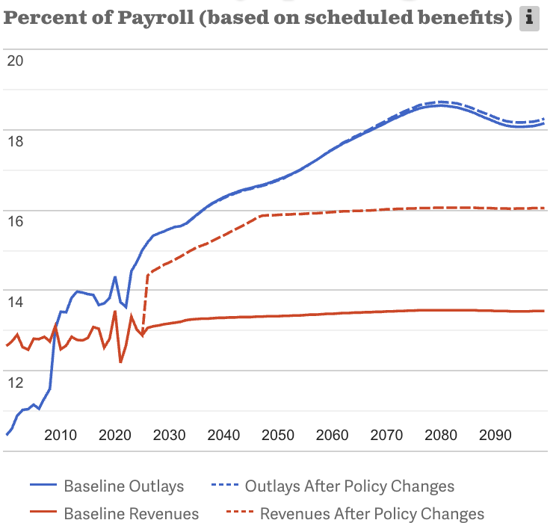
Possible Changes to Revenues: Example
Source: https://www.crfb.org/socialsecurityreformer/
Notes:
Tax wages above cap, but do not increase max benefits.

Slide 52
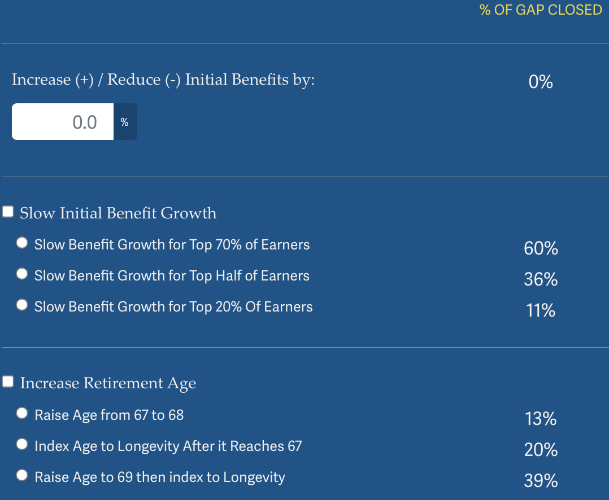
Possible Changes to Benefits
Source: https://www.crfb.org/socialsecurityreformer/

Slide 53
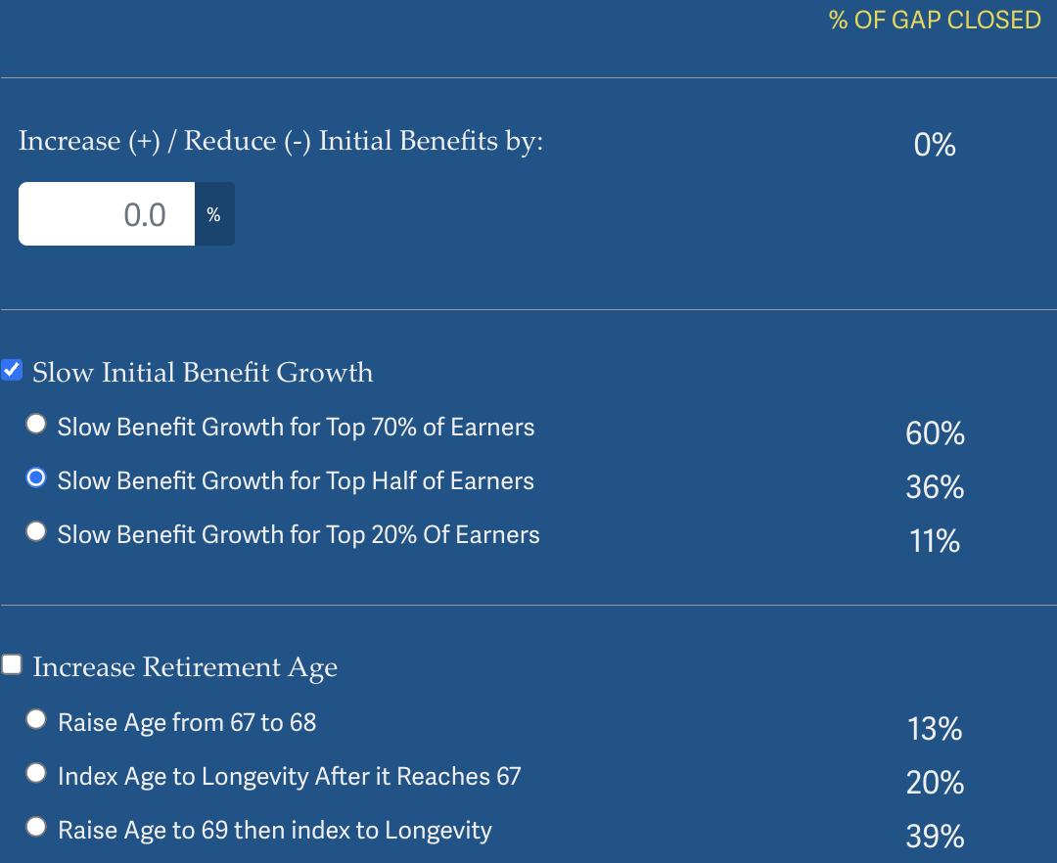
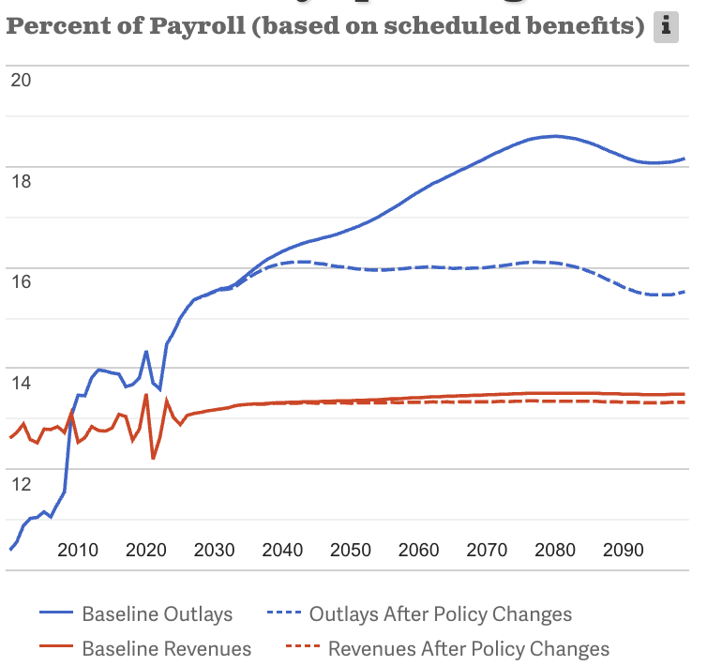
Possible Changes to Benefits: Example
Source: https://www.crfb.org/socialsecurityreformer/

Slide 54
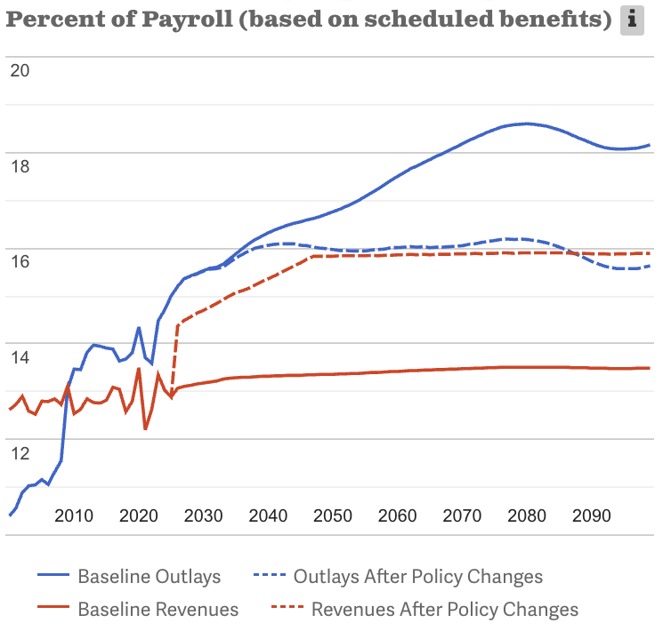
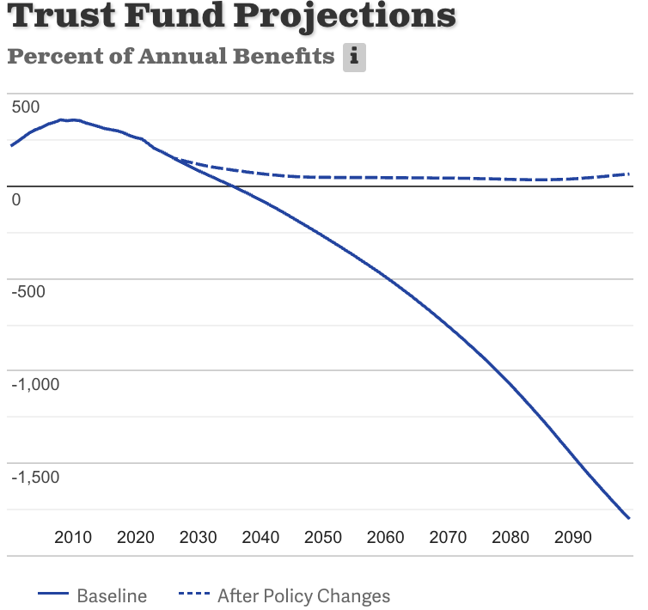
Suppose We Do Both! Problem Solved
Source: https://www.crfb.org/socialsecurityreformer/

Slide 55
Some Additional Thoughts on Options
COLAs – cost of living adjustments
Merely another way of reducing benefits
Raising the retirement age
Investing in the stock market

Slide 56
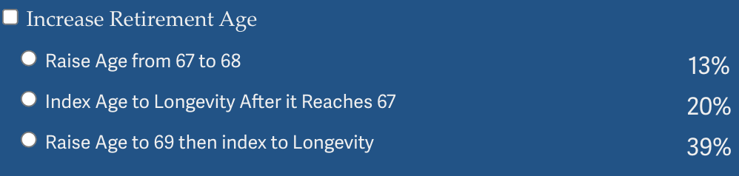
Raising the Retirement Age
Very regressive.
Larger tax on low-income workers than high income workers.

Slide 57
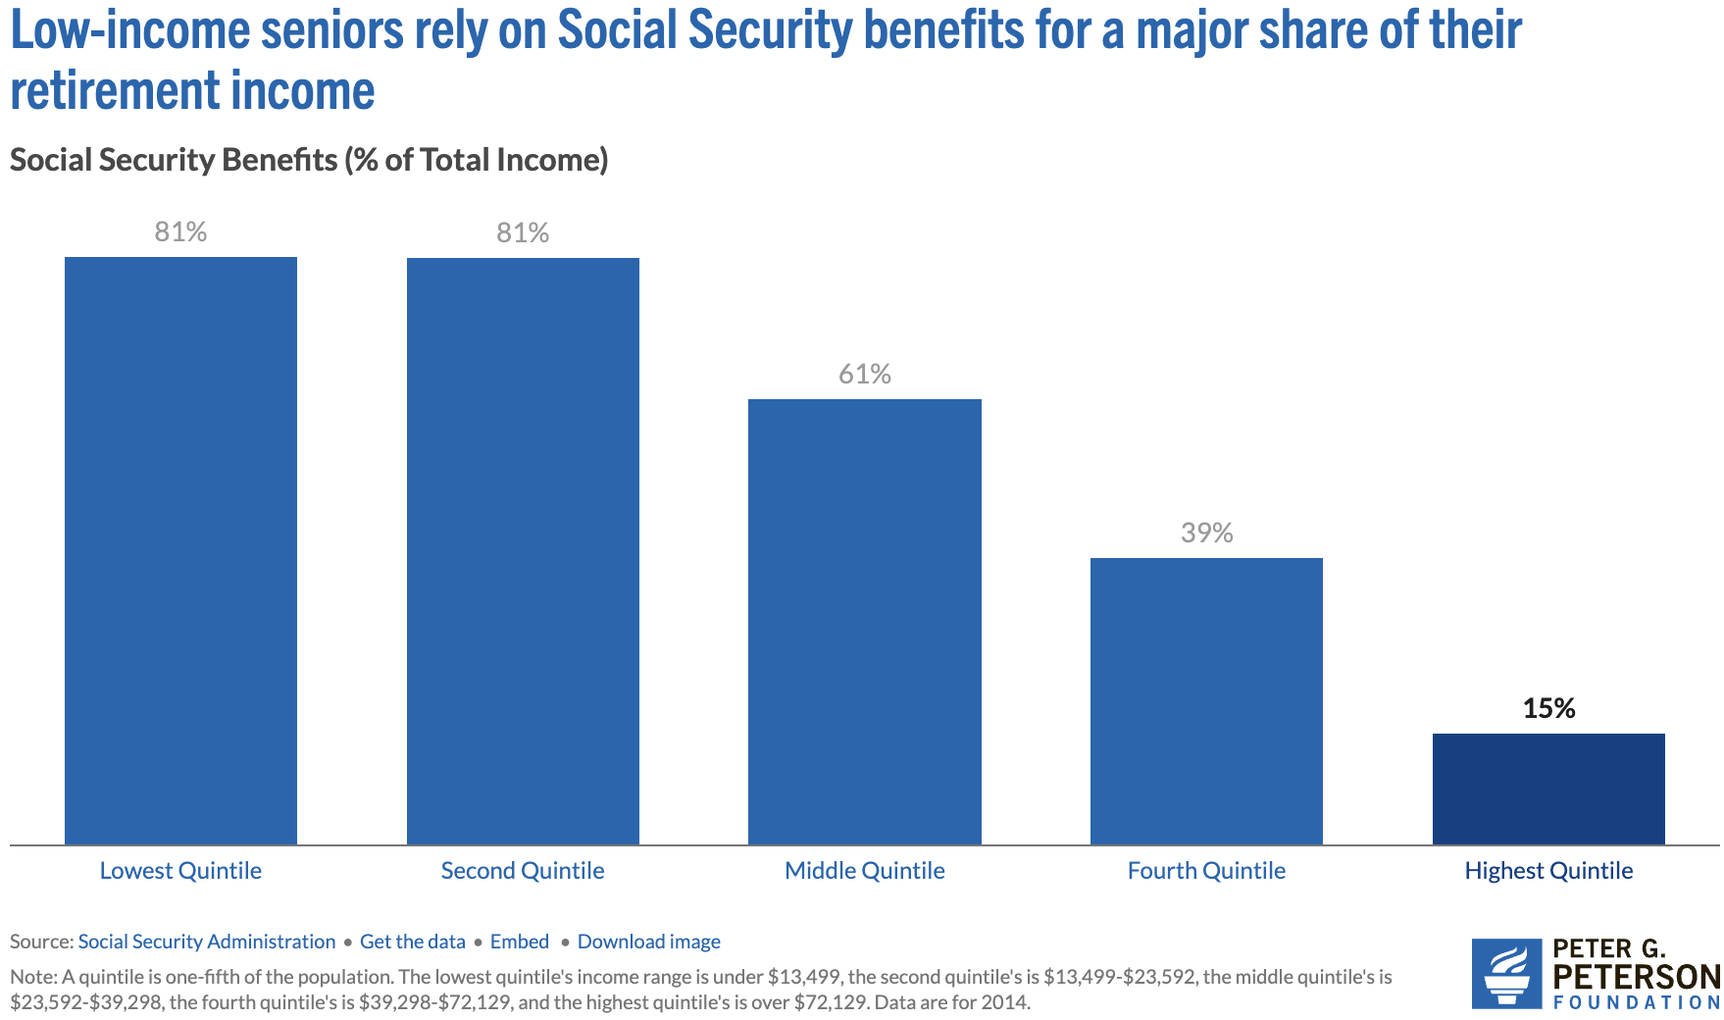
Program is VERY Important for Low-Income Retirees
Source: https://www.pgpf.org/article/9-facts-about-social-security-and-the-need-to-strengthen-it/

Slide 58
Raising the Retirement Age
Sex | Income Category | Life Expectancy (Years) | Difference High vs Low
Women | Highest Incomes (top 1%) | 88.9 | 10.1 years
 | Lowest Incomes (bottom 1%) | 78.8
Men | Highest Incomes (top 1%) | 87.3 | 14.6 years
 | Lowest Incomes (bottom 1%) | 72.7

Slide 59
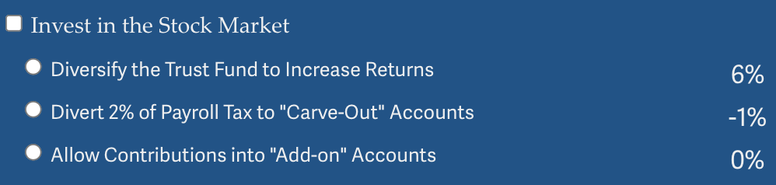
Investing in the Stock Market
Doesn’t do much to solve the problem.
Concerns with government investing in the stock market.
Logistics of allowing individuals to customize are enormous.
And subject to political influence.
May increase the fragility of the system.

Slide 60
Other Solution? Tax More Than Just Earnings
Social Security is funded through payroll taxes.
Broadening the base would increase programmatic revenues.
Other sources of income: capital gains.
Social security is an economic security program.
Yet its revenue source is earnings.
Is income a better indication of economic security?

Slide 61
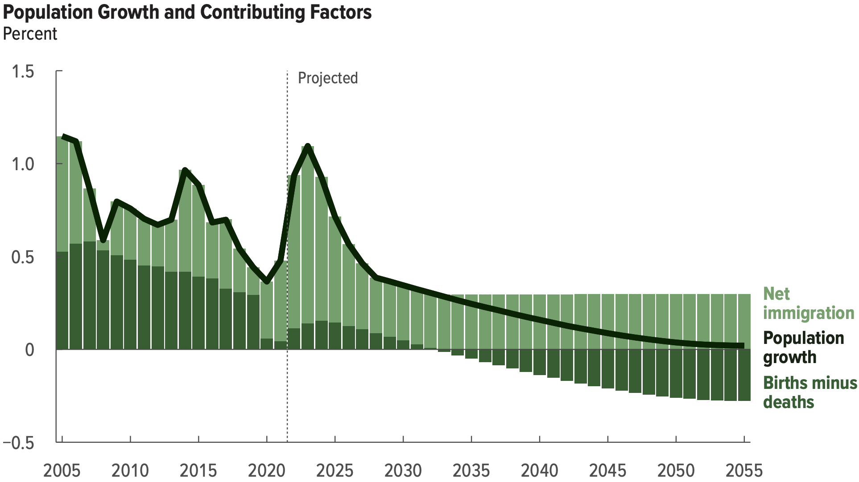
Another Solution?
Increase legal immigration of prime working age.
Source: https://www.cbo.gov/system/files/2025-01/60875-demographic-outlook.pdf

Slide 62
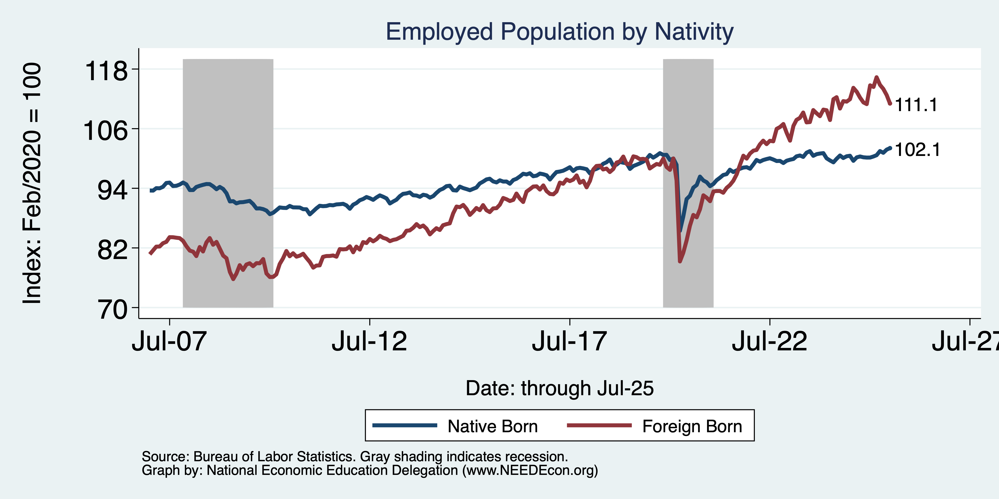
Immigrants to the Rescue?

Slide 63
Brookings Principles for a Solution
Principles:
Bipartisan which means benefit cuts and tax increases.
Solvency (increase revenues and lower benefits by 3.58 % of taxable payrolls. Eliminate the “GAP”)
No benefit reduction for current recipients (?)
No general fund financing (“this link between wages and benefits has been a central principle… and a foundation of it political support)
Improve Progressivity.
Universal participation (“social” insurance)
https://www.brookings.edu/articles/fixing-social-security-blueprint-for-a-bipartisan-solution/

Slide 64
5 Biggest “Revenue Enhancements”
Devote all proceeds from taxes on benefits to OASDI (0.87%)
Increase the taxable maximum ceiling so 90% of wages are subject to the payroll tax (0.66%)
Expand the labor force by increasing legal immigration (0.30%)
Increase payroll tax to 12.6% (0.19%)
Change the rules on pass-through self employment tax (0.19%)
Total from revenue enhancement: 2.21%

Slide 65
4 Biggest Benefit Reductions
Increase retirement age for high earners (0.55)%
Increase number of working years to 40 for calculating benefits (0.39%)
Subject 100% of high earners benefits to the income tax (0.17%)
End the dependent retiree spouse benefit (0.17%)
Total from benefit reduction 1.28%
Added Benefit: Reduces the Budget Deficit by $2,291 billion over 10 years

Slide 66
Summary
Social Security is an important part of the social safety net.
The OASDI Trust Fund is likely to be exhausted in 2034.
Why are the funds being depleted?
An aging population – fewer paying in and more taking out.
Declining birth rates - slowing the growth of the labor force.
Wage inequality – more and more wages are above the wage cap.
What happens when the funds are depleted?
Benefits may have to be reduced by 17%.
The system will continue!
Solutions abound. The problem is political will.
The needed changes will be unpopular, but they are very manageable.
Should our generation contribute more to the solution?

Slide 67
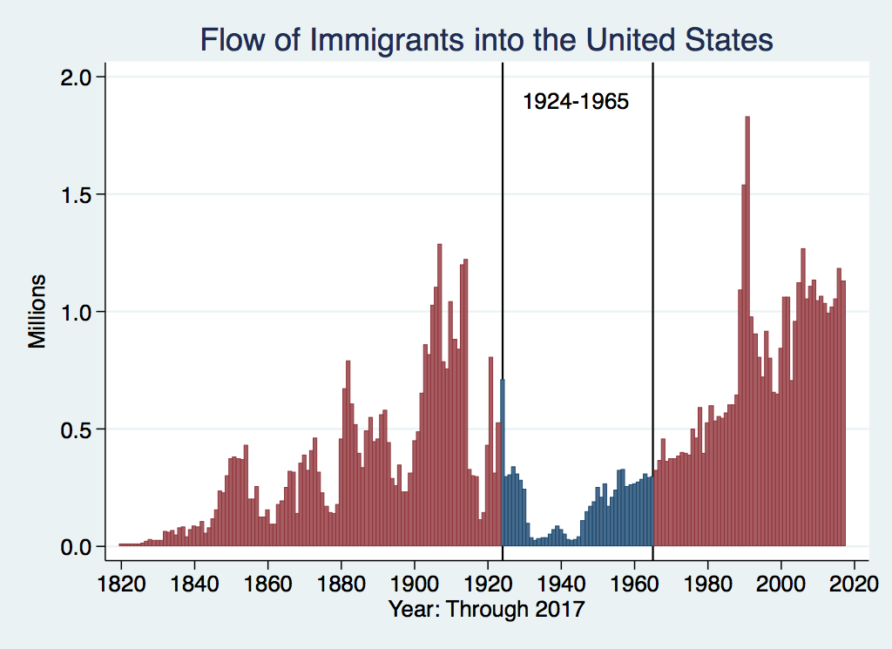
U.S. Immigration 1924-1965
Source Country | 1930-1965
Germany | 940,000
Canada | 900,000
Mexico | 610,000
Britain | 480,000
Italy | 390,000
Caribbean/ West Indies | 310,000
https://www.libertyellisfoundation.org/immigration-timeline

Slide 68
Let’s Hear from You!
Geoffrey Woglom grwoglom@amherst.edu
Contact NEED: Info@NEEDEcon.org
Support NEED: www.NEEDEcon.org/donate.php

