Slide 1

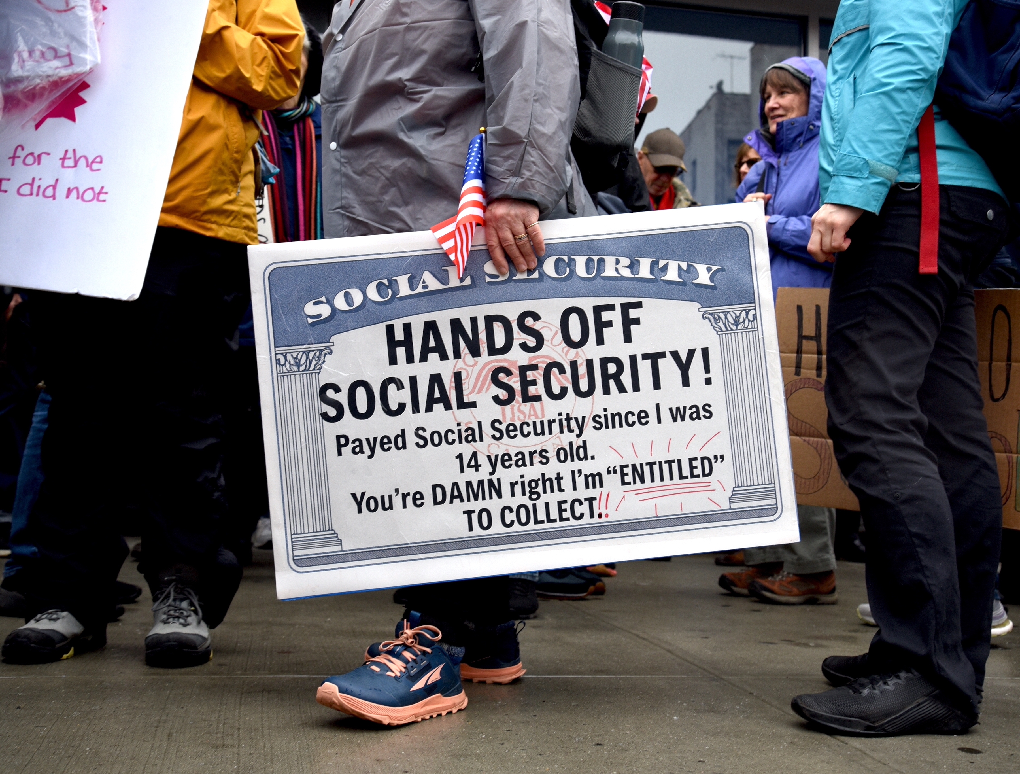
Social Security – Hard Choices (?)
Money Talks Monthly Seminar
June 16, 2025
Jon Haveman, Ph.D.

Slide 2
National Economic Education Delegation
Vision
  One day, the public discussion of policy issues will be grounded in an accurate perception of the underlying economic principles and data.
Mission
  NEED unites the skills and knowledge of a vast network of professional economists to promote understanding of the economics of policy issues in the United States.
NEED Presentations
  Are nonpartisan and intended to reflect the consensus of the economics profession.

Slide 3
Who Are We?
Honorary Board: 52 members
  2 Fed chairs: Janet Yellen, Ben Bernanke
  6 chairs of the Council of Economic Advisers
    Furman (D), Rosen (R), Bernanke (R), Yellen (D), Tyson (D), Goolsbee (D)
  3 Nobel prize winners
    Akerlof, Smith, Maskin
Delegates: 525 members
  At all levels of academia and some in government service
  All have a PhD in economics
  Crowdsource slide decks
  Give presentations
Global Partners: 44 PhD Economists
  Aid in slide deck development

Slide 4
Available NEED Topics Include:
US Economy
Healthcare Economics
Climate Change
Economic Inequality
Economic Mobility
Trade and Globalization
Minimum Wages
Immigration Economics
Housing Policy
Federal Budgets
Federal Debt
Black-White Wealth Gap
Autonomous Vehicles
US Social Policy

Slide 5
Outline
What is Social Security?
How Does Social Security Work?
What is The Trouble with Social Security?
Available Solutions

Slide 6
What is Social Security?

Slide 7
What is Social Security?
Social Security is a federal social insurance program that provides financial support to workers and their families.
Different benefits:
  Retirement Benefits: Social Security provides monthly payments to qualified retirees based on their lifetime earnings.
  Disability Benefits: It also provides financial support to individuals who are unable to work due to a disability.
  Survivor Benefits: Social Security offers benefits to the families of deceased workers, including spouses and children.
  Supplemental Security Income (SSI): SSI provides financial support to individuals who are 65 or older, blind, or disabled and have limited income and resources.

Slide 8
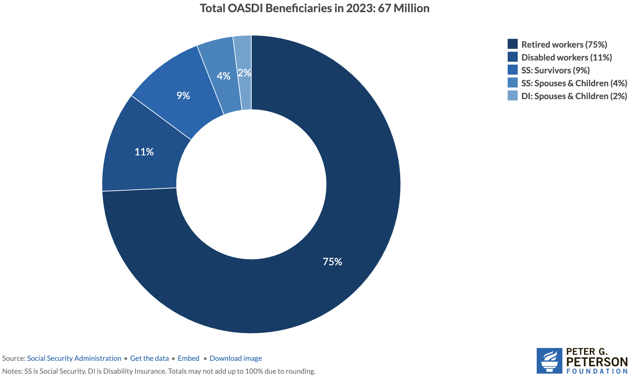
Numbers of Different Types of SS Beneficiaries
6.0 million
7.4 million
52.3 million

Slide 9
Social Security’s Origins
A part of the social safety net.
Created in 1935 to provide economic security to the nation’s elderly.
Expanded in 1939 to include dependent benefits.
  Benefits to families that have lost a breadwinner.
Expanded in 1950 to provide support for people with disabilities.
Expanded in 1974 to provide Supplemental Security Income.
  Can supplement regular social security benefits.
Today, it is the largest federal program.
  In FY 2024, spending was $1.25 trillion, or 22.4% of total federal spending.
  By comparison, national defense was $997 billion.

Slide 10
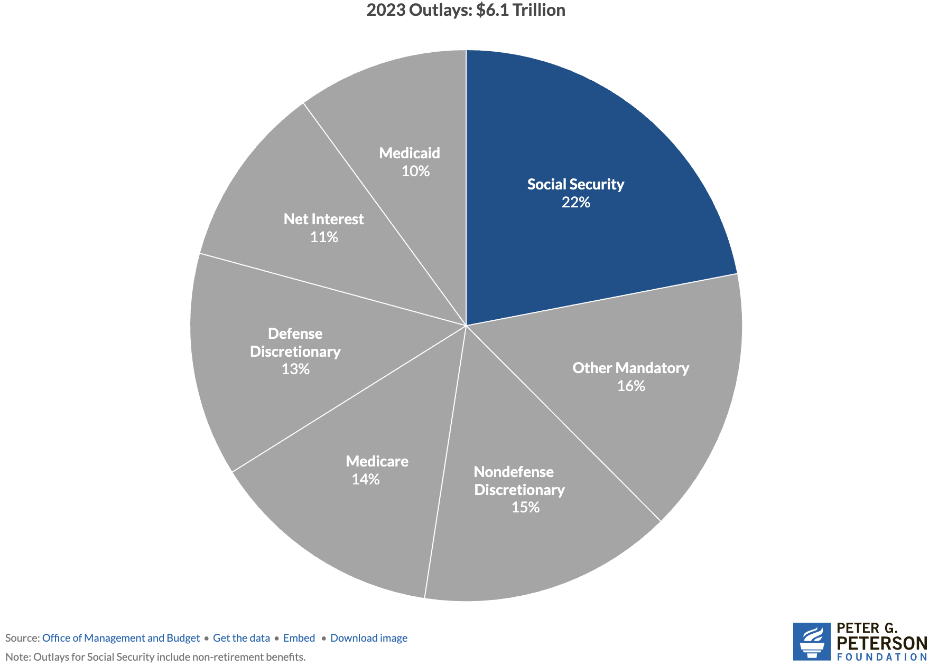
Soc Sec is The Single Largest Gov’t Program
Source: https://www.pgpf.org/article/9-facts-about-social-security-and-the-need-to-strengthen-it/

Slide 11
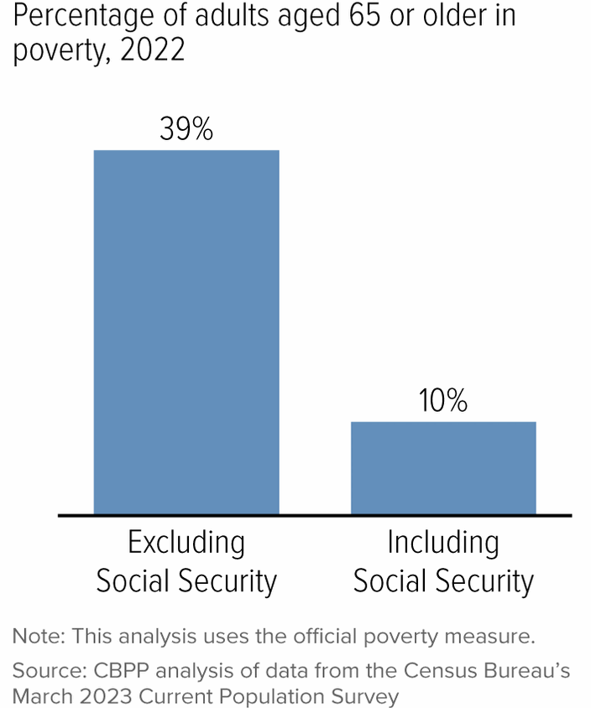
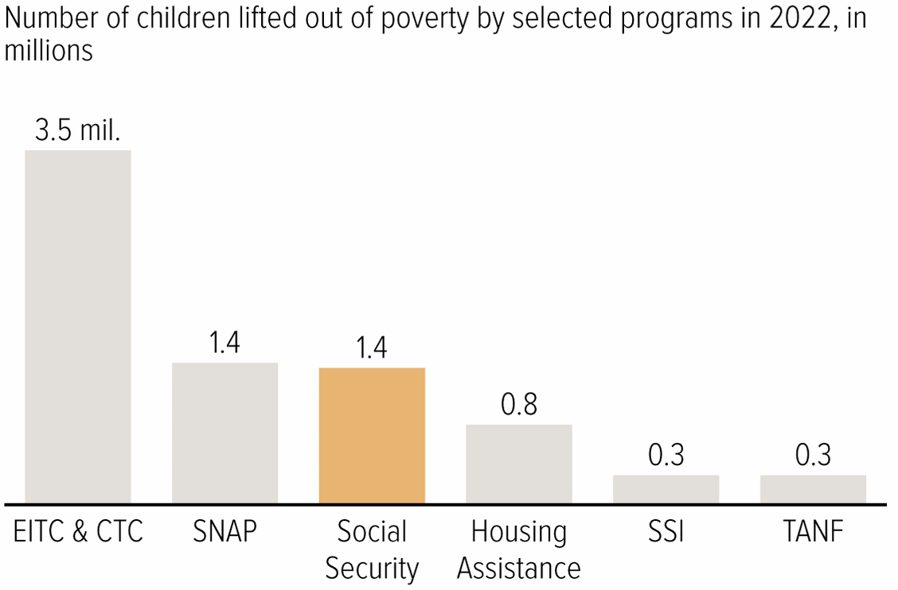
Soc Sec Significantly Reduces Poverty

Slide 12
Is Social Security Good for Just The Beneficiaries?
No, it also benefits broader society.

Slide 13
Economics Impact on Individuals and Families
Poverty reduction
  Good investment for society
Reduces income inequality among the elderly.
Increases social mobility
Income stability
  Helps households plan for the future.
Enables older adults to maintain independence.
  Reduces caregiving burdens on family members.
Consumer spending
  Supports businesses and the local economy.

Slide 14
How Does it Work?

Slide 15
The Mechanics of Social Security
“pay-as-you-go” system
  Payroll taxes are collected from current workers.
  These pay for the benefits of the currently retired, or otherwise eligible.
Taxes
  Payroll taxes amount to 12.4% of earnings.
    Workers pay 6.2% of earnings as payroll taxes.
    Employers also pay 6.2% of worker’s earnings.
  Earnings Cap. Not all earnings are subject to payroll taxes.
    In 2025, only the first $176,100 of earnings are taxed.
    Earnings above that level are not taxed.

Slide 16
What if Payroll Taxes Don’t Match Benefits?
The Trust Fund
  If revenues exceed benefits, the excess is placed in a trust fund.
  If benefits exceed revenues, the excess is taken out of the trust fund.
  The funds in the trust are invested in nonmarketable U.S. Treasuries.
When did the Trust Fund start?
  The OASI Trust Fund was created in 1939. (Old Age & Survivors Ins)
  The Disability Trust Fund was created in 1956.

Slide 17
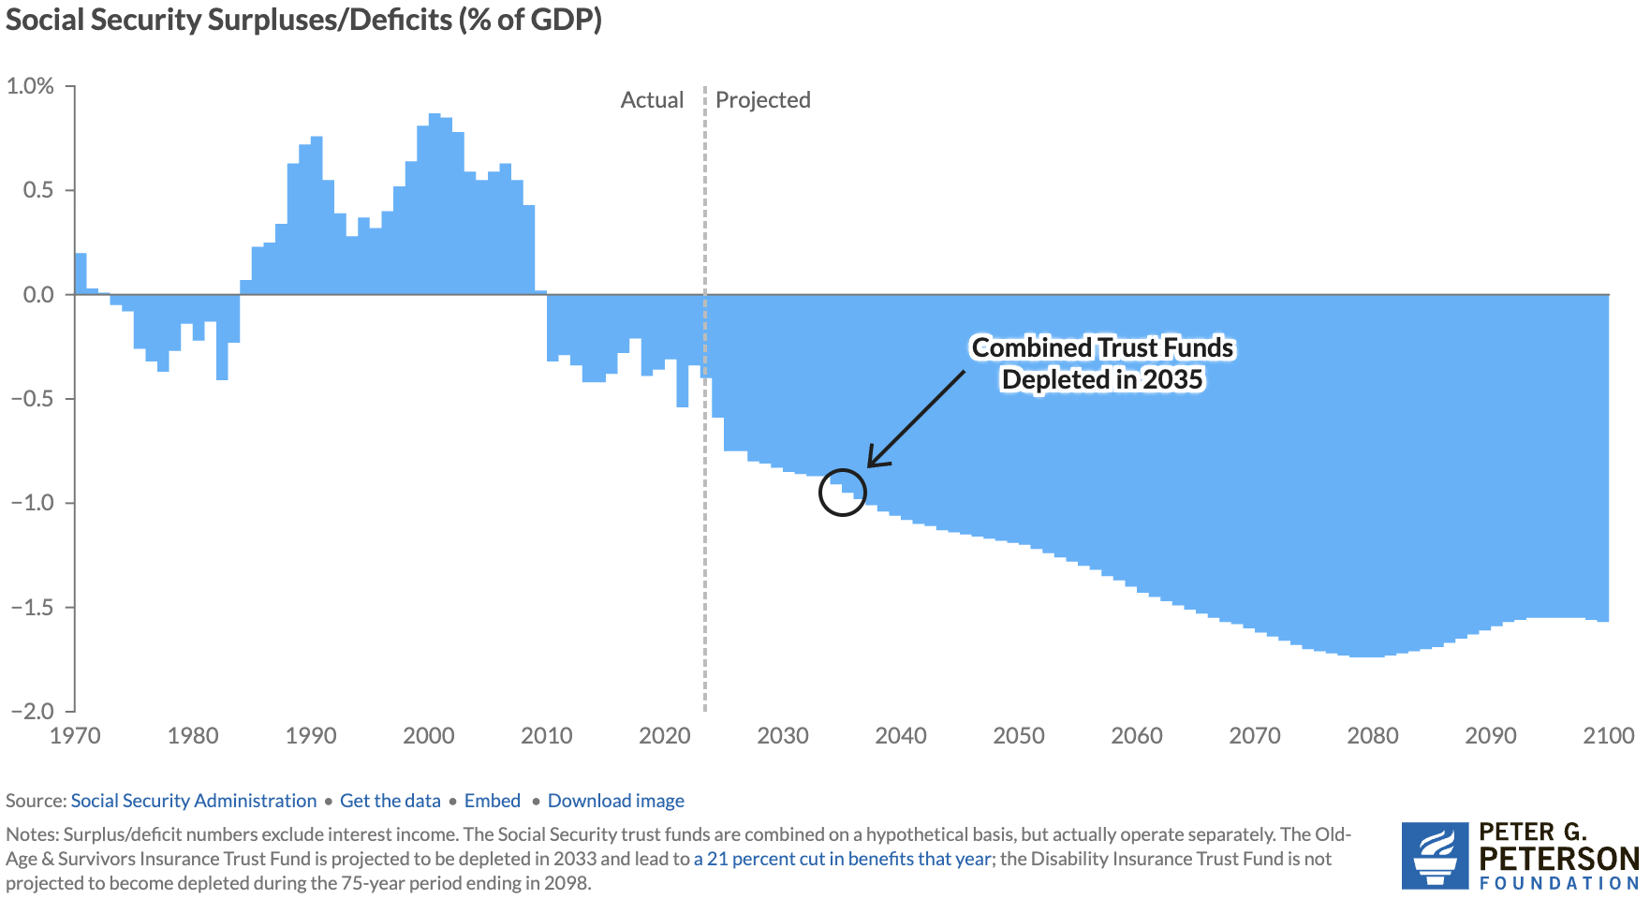
Annual Contributions to the Fund Vary
Social Security
Amendments Act
Of 1983

Slide 18
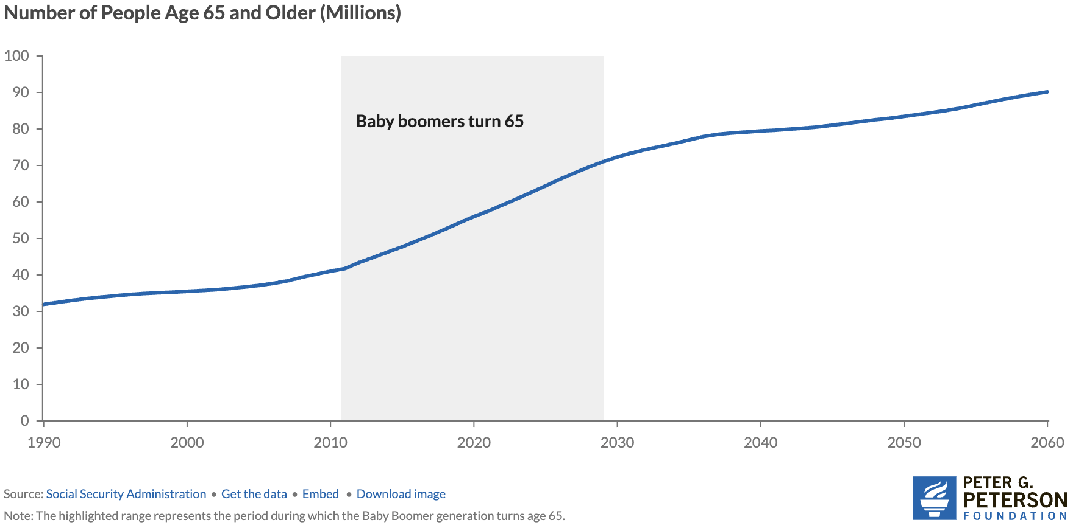
Why the Change in Direction? Aging Population
Source: https://www.pgpf.org/article/how-does-social-security-work/

Slide 19
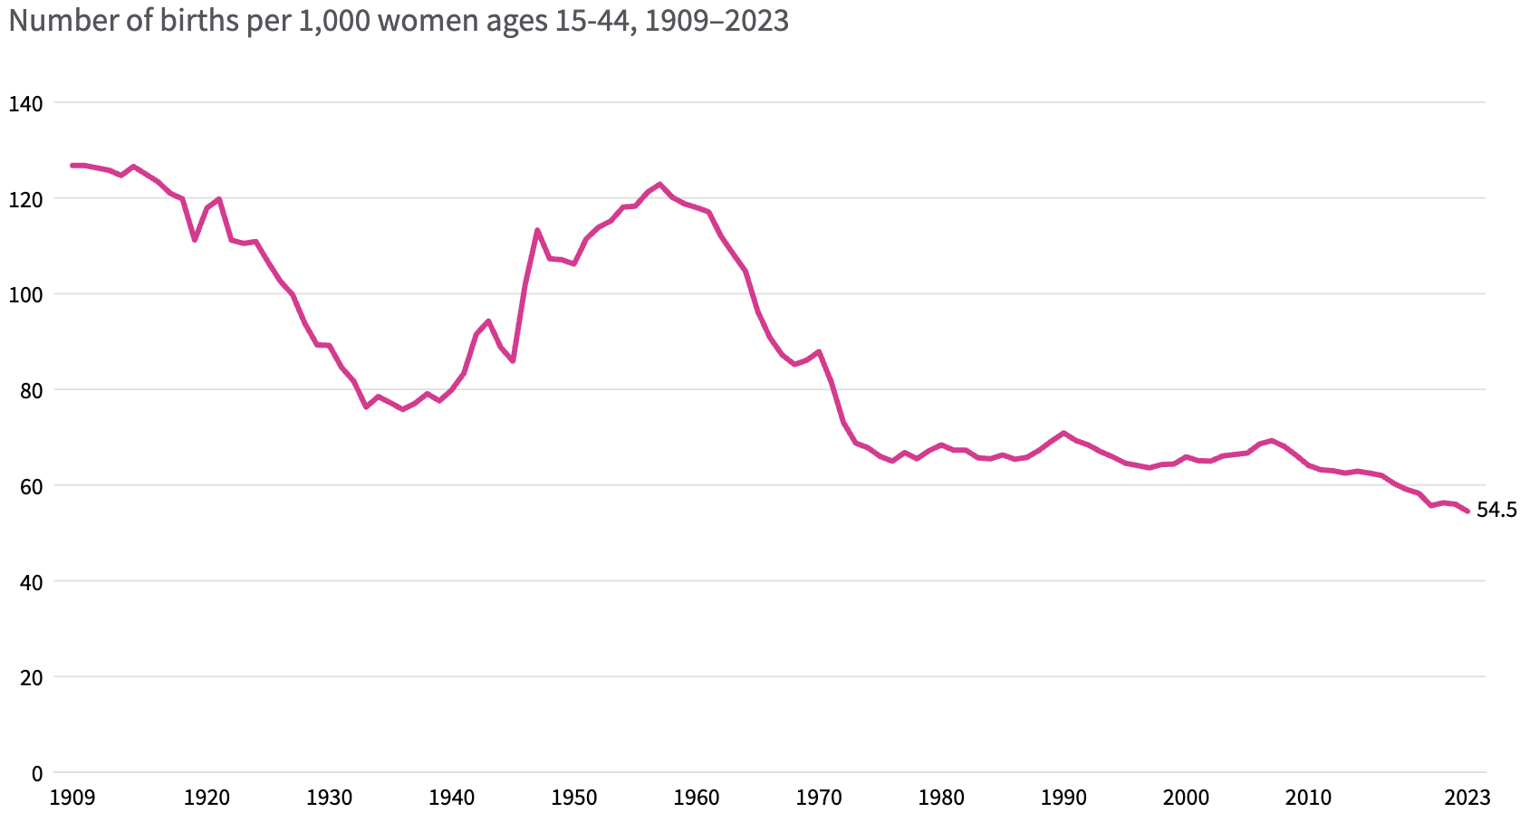
Lower Births = Slower Labor Force Growth
Source: https://usafacts.org/articles/how-have-us-fertility-and-birth-rates-changed-over-time/

Slide 20
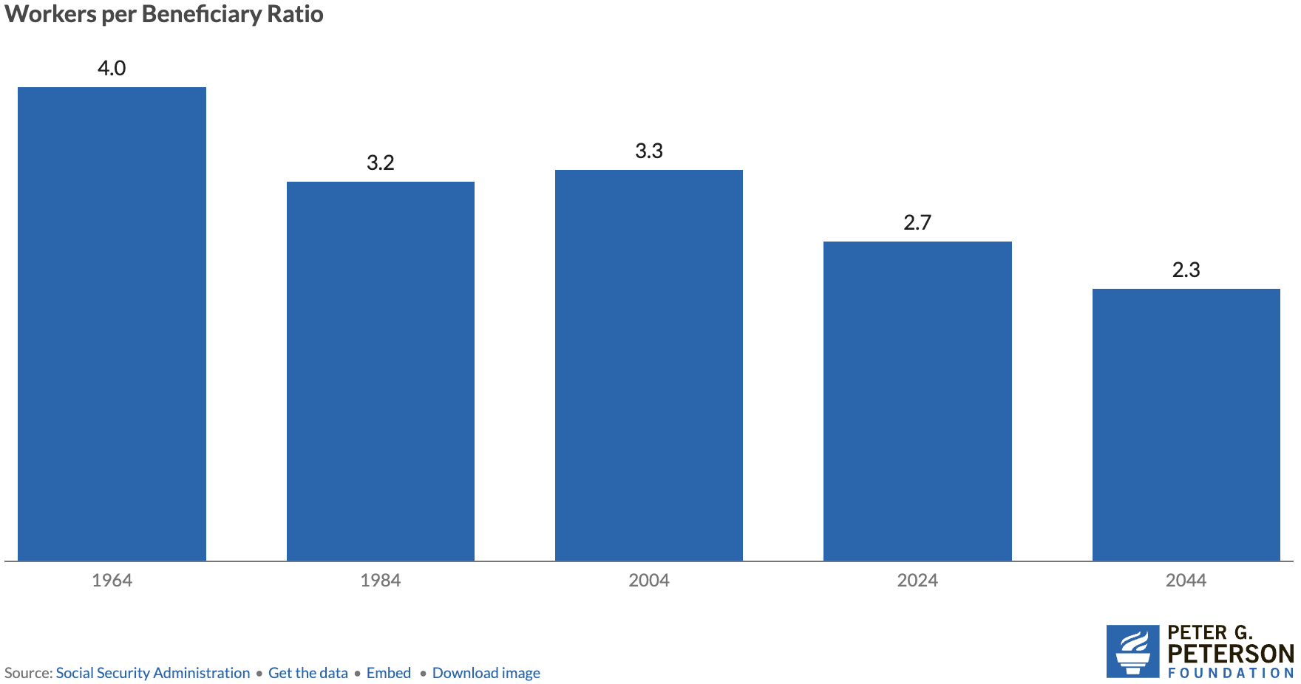
Number of Covered Workers per Beneficiary
Source: https://www.ssa.gov/OACT/TR/2024/tr2024.pdf

Slide 21
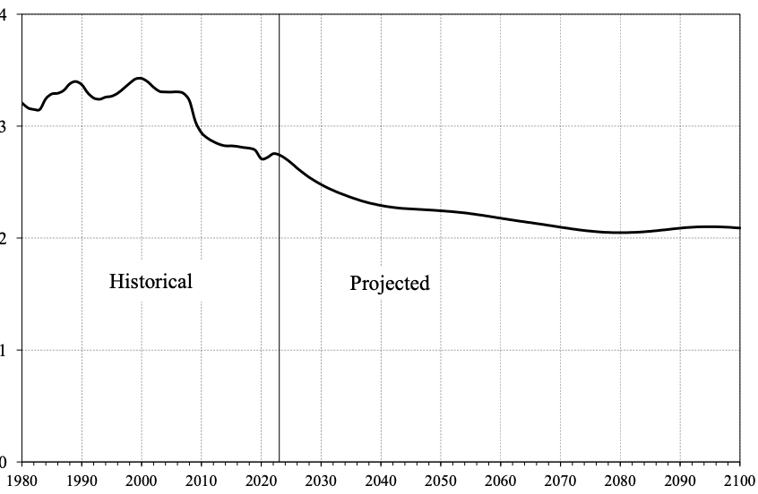
Number of Covered Workers per Beneficiary
Baby boomers started retiring.
Source: https://www.ssa.gov/OACT/TR/2024/tr2024.pdf

Slide 22
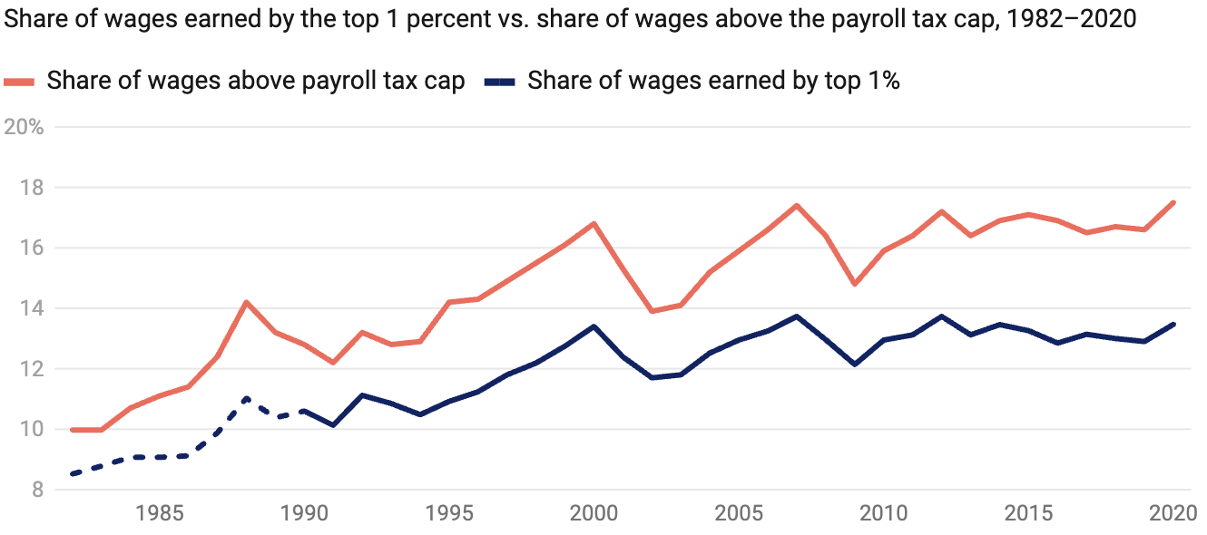
Increased Wage Inequality Is A Problem
Source: https://www.americanprogress.org/article/increased-wage-inequality-has-reduced-social-securitys-revenue
Notes:
The effect on net revenues is to reduce them.
https://www.americanprogress.org/article/the-effect-of-rising-inequality-on-social-security/#:~:text=Rising%20income%20inequality%20poses%20a,that%20higher%2Dearning%20workers%20receive.

Slide 23
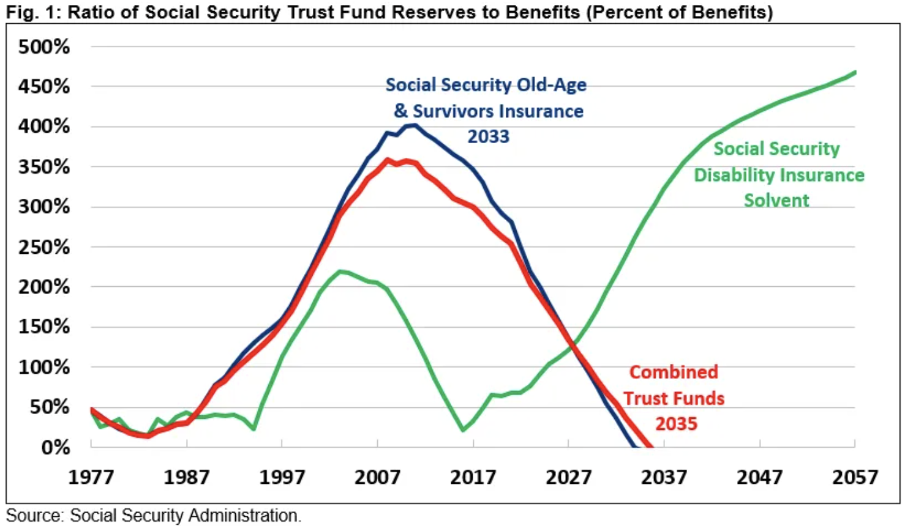
Trajectory of the Funds
Source: https://www.crfb.org/papers/analysis-2024-social-security-trustees-report

Slide 24
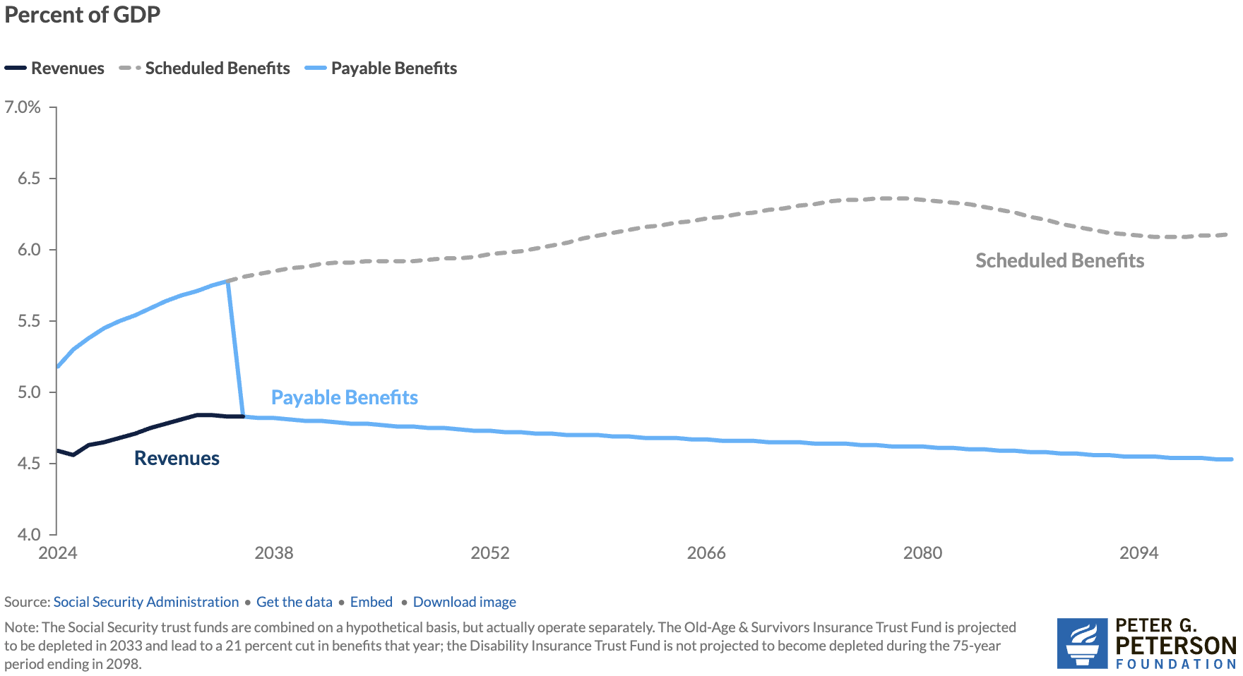
What Happens When The Trust Fund Runs Out?
Trust Fund Exhaustion, 2035
Benefit Cut: 17%
Benefit Cut: 27%
2098
Source: https://www.pgpf.org/article/how-does-social-security-work/

Slide 25
Where Does the Money Come From?
Payroll taxes
Taxes on benefits
Interest earnings
Trust funds

Slide 26
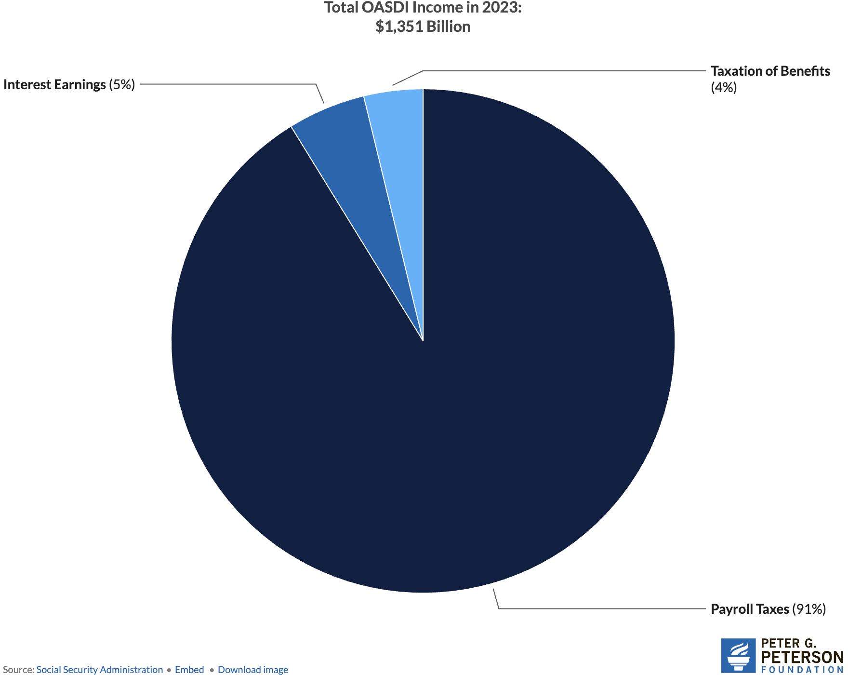
Sources of SS Revenue

Slide 27
Where Does The Money Go?

Slide 28
Where Does The Money Go?
Different benefits:
  Retirement Benefits
  Disability Benefits
  Survivor Benefits
  Supplemental Security Income (SSI)
We will focus on retirement benefits.

Slide 29
What Determines my SS Benefit (PIA)?
(Primary Insurance Amount)
Your work history.
  You need 40 work credits to qualify.
  In 2025, 1 credit = $1,810 in earnings.
  Put another way: 10 years with social security earnings in each year of $21,720.
Your (capped) earnings history.
  Indexed (to wages) earnings from 35 highest earning years.
Your birth year.
  Determines your FRA – Full Retirement Age.
  Before 1960, it is 66-67, after 1960, it is 67.
Your claiming age.
  Claiming at 62 instead of 67 reduces your benefit by 30%.
  Higher if wait until 70.

Slide 30
What Determines my SS Payment Size (PIA)?
(Primary Insurance Amount – PIA)
(Adjusted Indexed Monthly Earnings - AIME)
Earnings History
Age at Which You Start Receiving SS
AIME is calculated using your 35 highest years of indexed earnings.
These earnings are then adjusted for wage inflation.
The AIME is used to determine your PIA, which is the amount you would receive if you start receiving benefits at your full retirement age.
You can start receiving benefits as early as age 62, but your monthly payment will be reduced if you choose to start before your full retirement age.
Waiting to start benefits after your full retirement age (between 66 and 67, depending on your year of birth) will increase your monthly payment.
You can receive the highest possible benefit by waiting until age 70.

Slide 31
How Big are Payments?
In 2025:
  the average payment is $2,002.
  Maximum if claim at age 62 is $2,831.
  Maximum if claim at age 70 is $5,108.
Special minimum Social Security benefit:
  For long-term, low-wage workers.
  Minimum for 11 years of work: $52.10
  Maximum for 30 years of work: $1,093.10

Slide 32
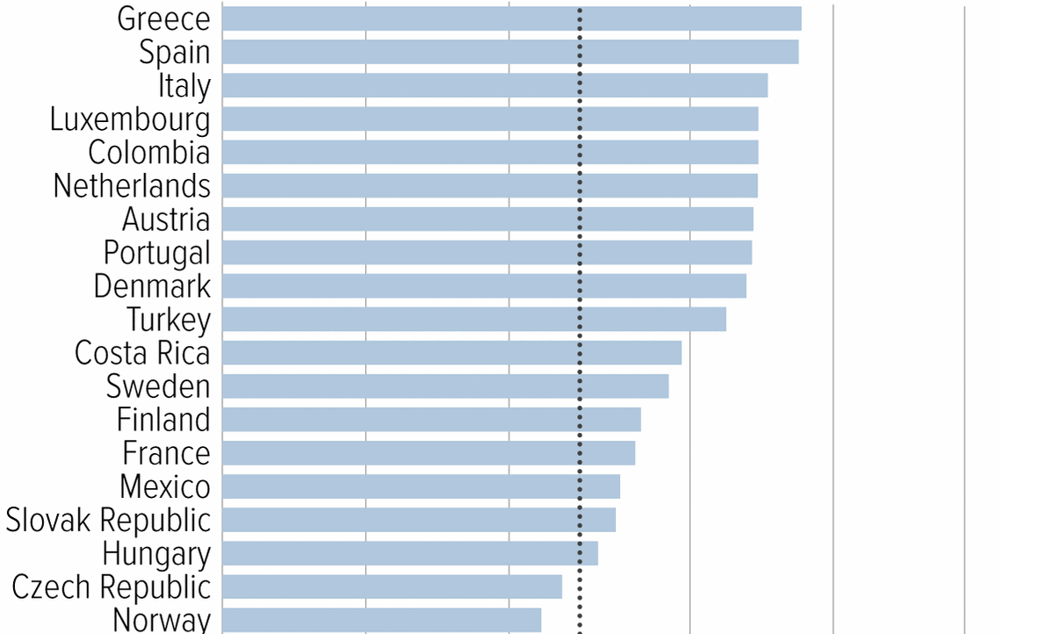
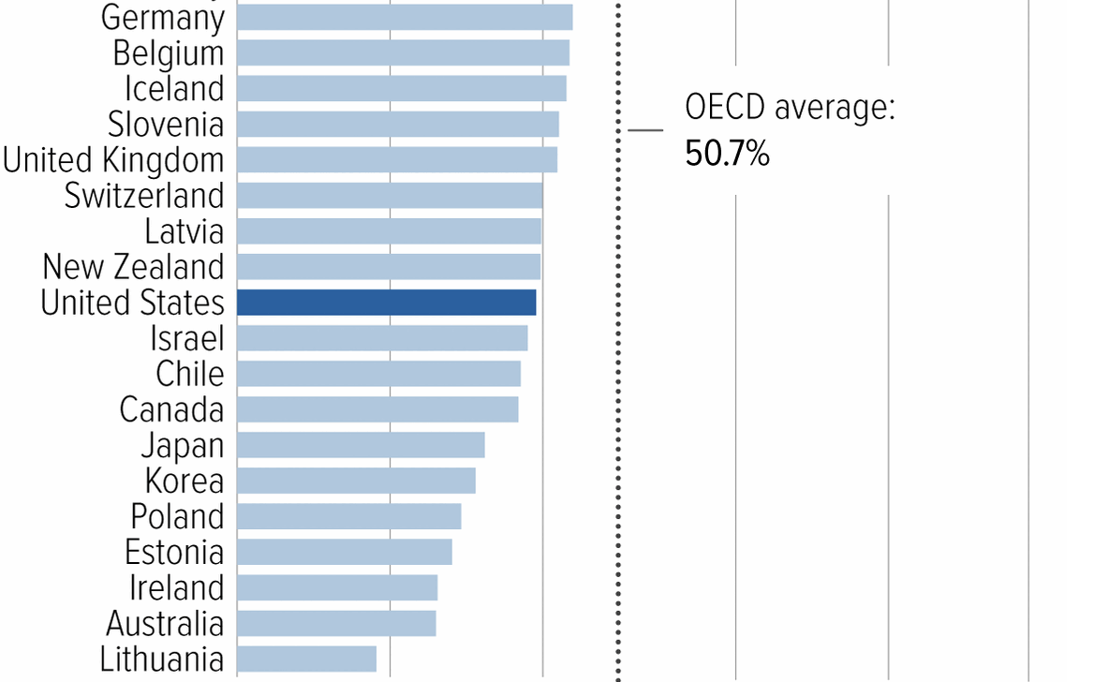
Social Security Benefits are Comparatively Low
Source: https://www.cbpp.org/research/social-security/top-ten-facts-about-social-security

Slide 33
Remember: We Have A Problem

Slide 34
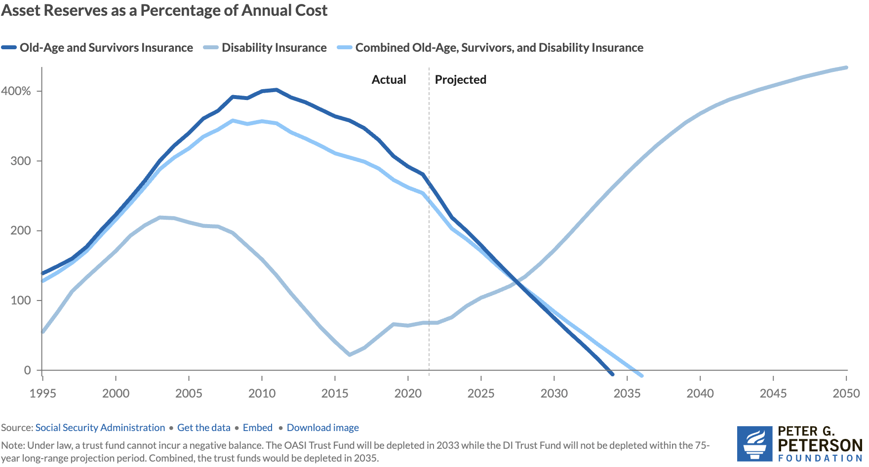
Trust Finds Are Running Out
Source: https://www.pgpf.org/article/social-security-faces-serious-financial-shortfalls-and-other-takeaways-from-the-trustees-report/

Slide 35
At Which Point, Benefits exceed Revenue
Trust Fund Exhaustion, 2035
Benefit Cut: 17%
Benefit Cut: 27%
2098
Source: https://www.pgpf.org/article/how-does-social-security-work/

Slide 36
Hard Choices (?)

Slide 37
Let’s Cut to the Chase…
Solving the social security problem is simple:
Backfill out of general revenues!
Why won’t this happen?
Politics!
Our debt situation.
Maybe it shouldn’t.

Slide 38
So, Let’s Consider Some Other Choices
Changes to revenues
Changes to benefits

Slide 39
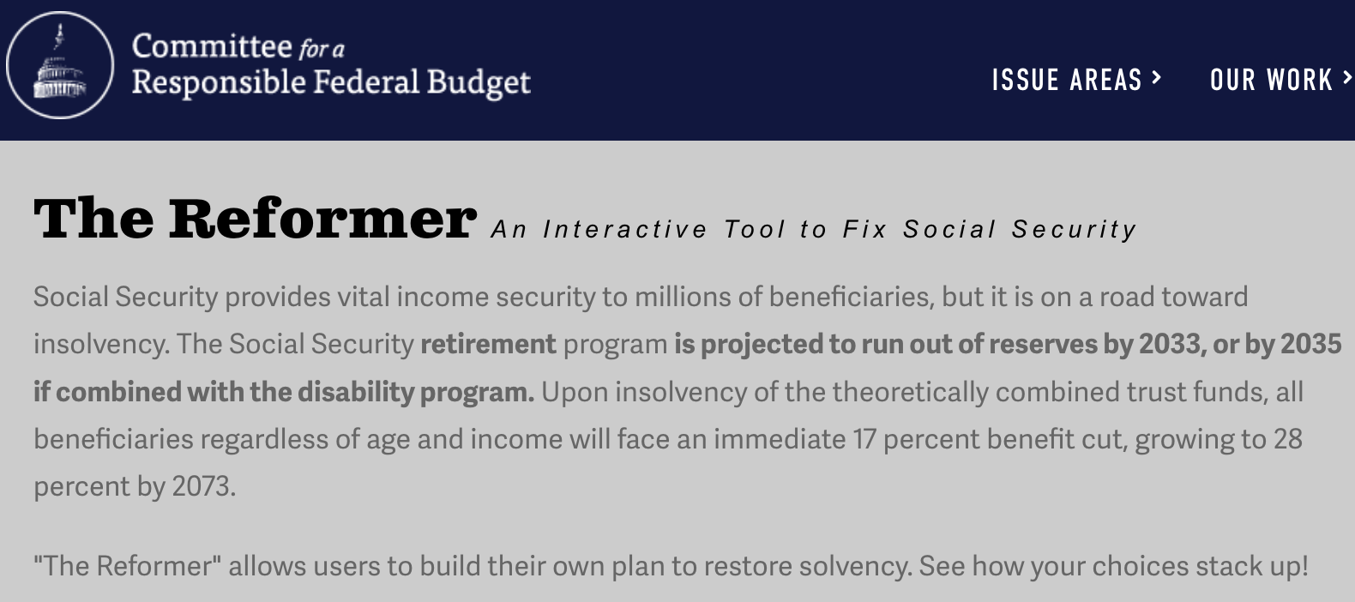
The Following Simulations Brought to you by:
https://www.crfb.org/socialsecurityreformer/

Slide 40
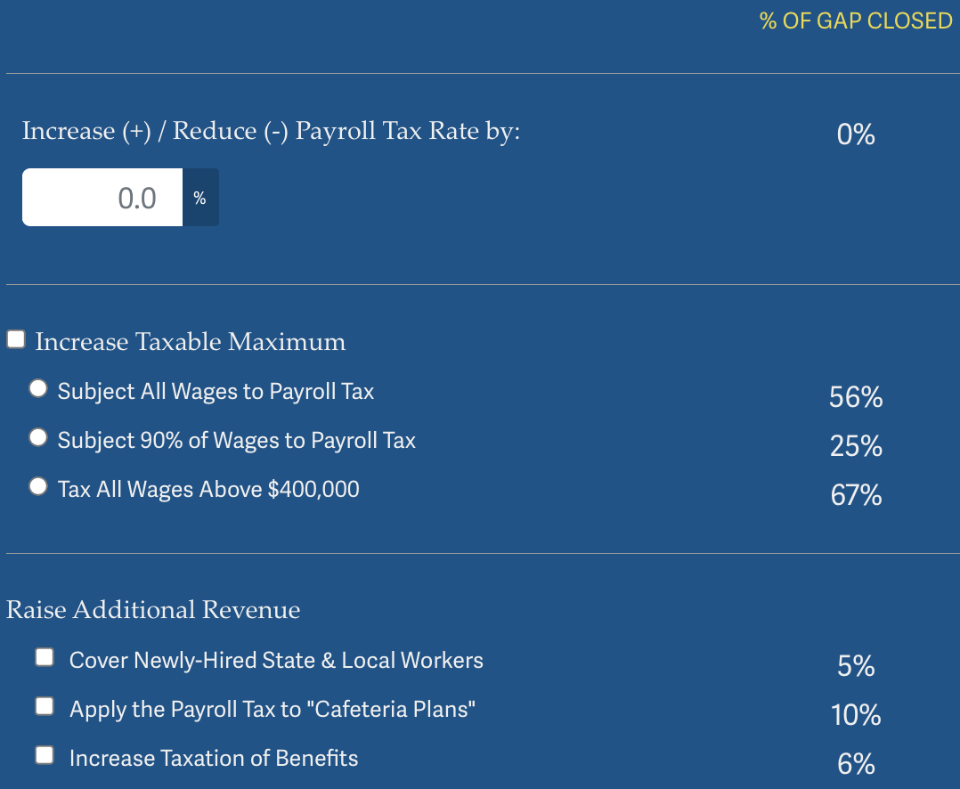
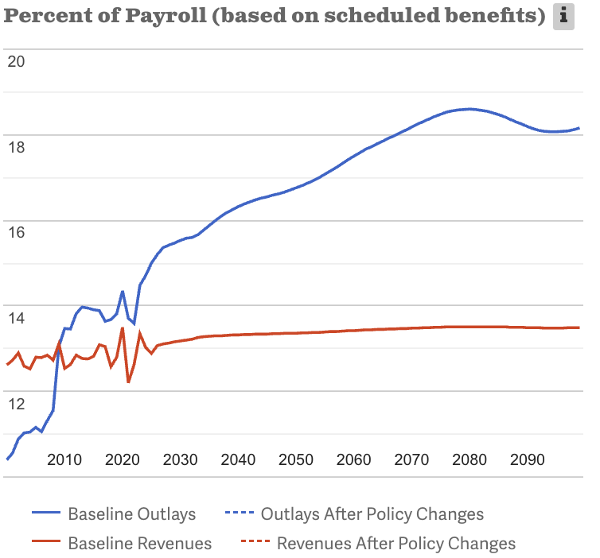
Possible Changes to Revenues
Source: https://www.crfb.org/socialsecurityreformer/

Slide 41
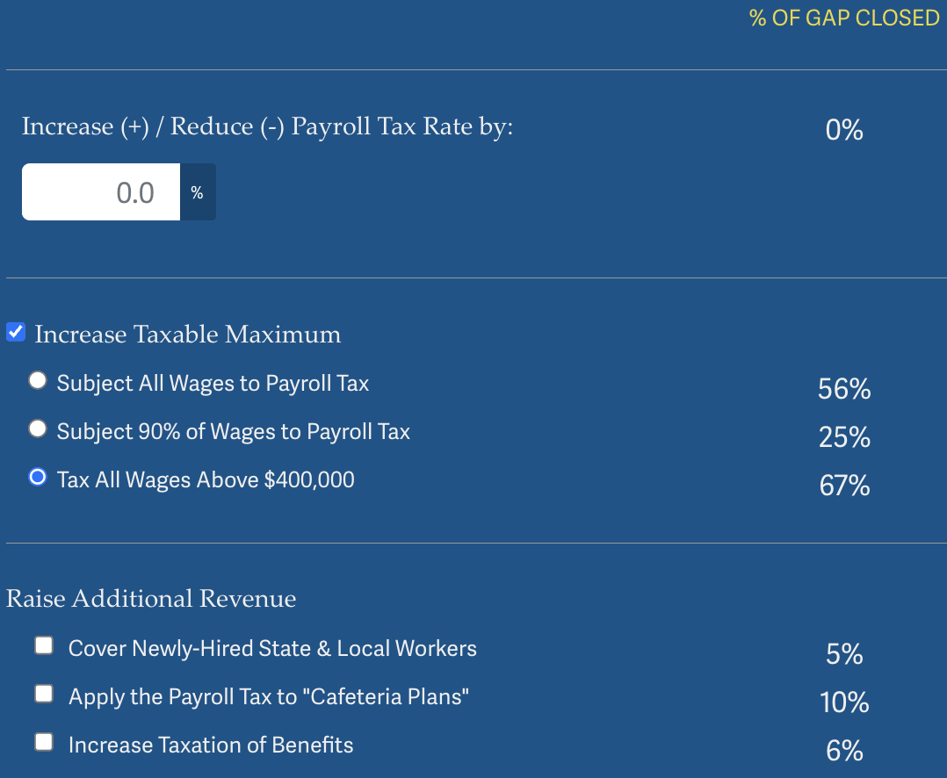
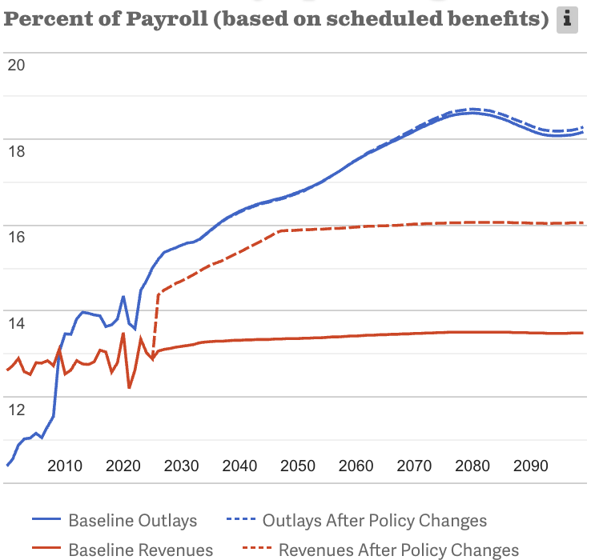
Possible Changes to Revenues: Example
Source: https://www.crfb.org/socialsecurityreformer/

Slide 42
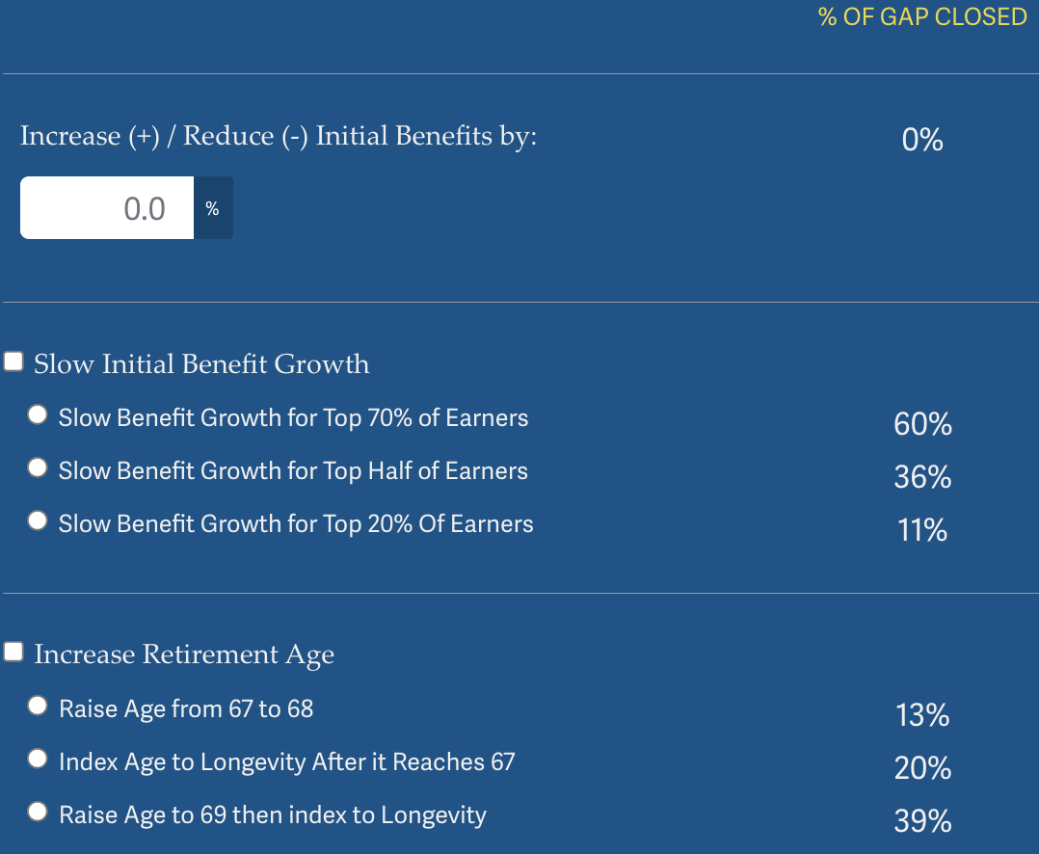
Possible Changes to Benefits
Source: https://www.crfb.org/socialsecurityreformer/

Slide 43
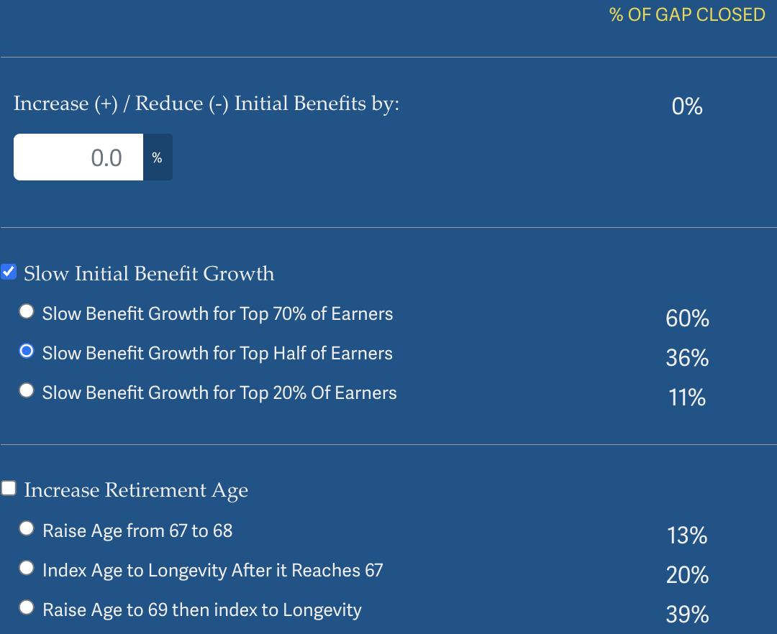
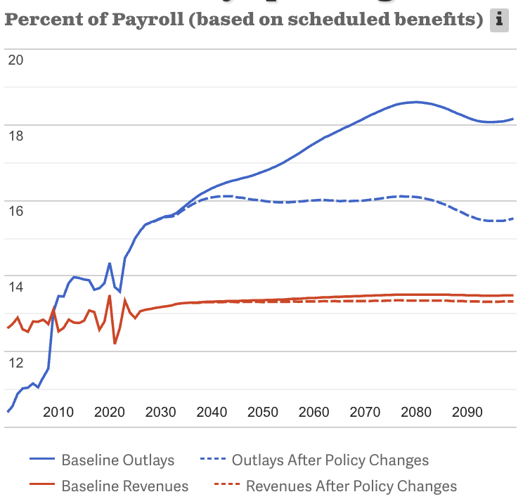
Possible Changes to Benefits: Example
Source: https://www.crfb.org/socialsecurityreformer/

Slide 44
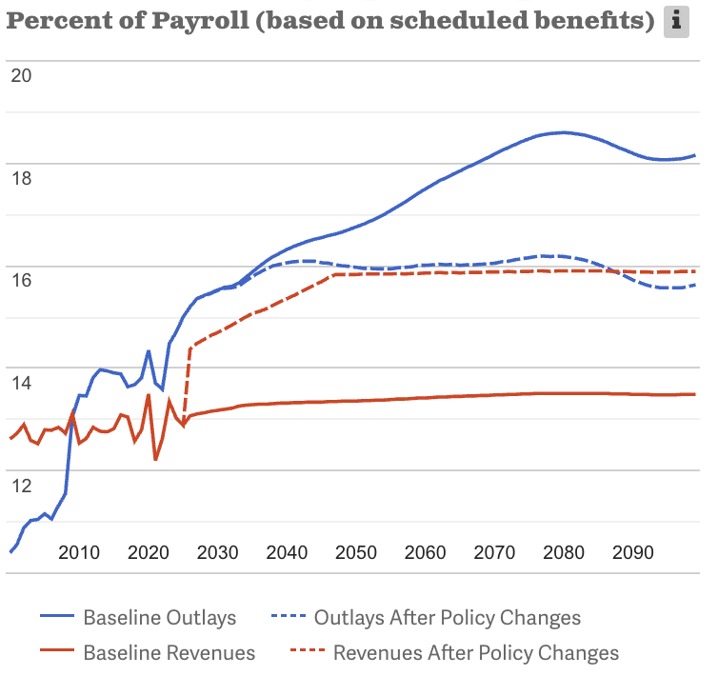
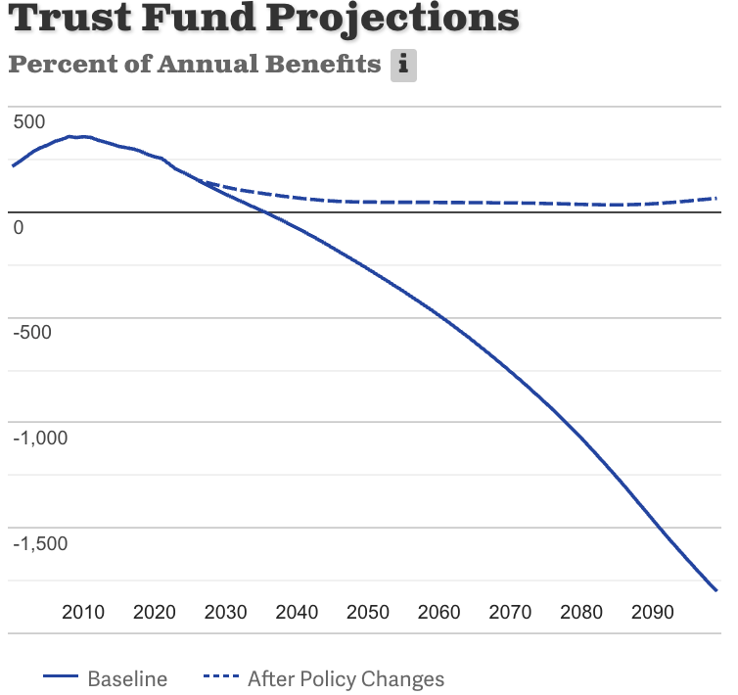
Suppose We Do Both! Problem Solved
Source: https://www.crfb.org/socialsecurityreformer/

Slide 45
Some Additional Thoughts on Options
COLAs – cost of living adjustments
  Merely another way of reducing benefits
Raising the retirement age
Investing in the stock market

Slide 46
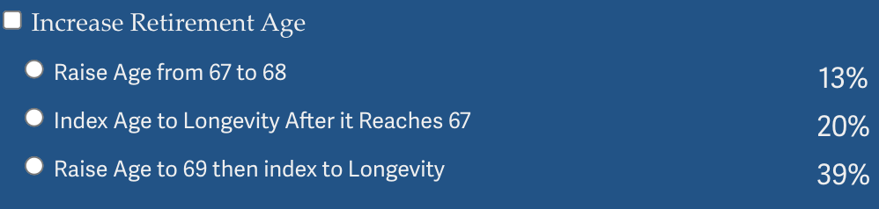
Raising the Retirement Age
Very regressive.
  Larger tax on low-income workers than high income workers.

Slide 47
Raising the Retirement Age
Sex | Income Category | Life Expectancy (Years) | Difference High vs Low
Women | Highest Incomes (top 1%) | 88.9 | 10.1 years
 | Lowest Incomes (bottom 1%) | 78.8
Men | Highest Incomes (top 1%) | 87.3 | 14.6 years
 | Lowest Incomes (bottom 1%) | 72.7

Slide 48
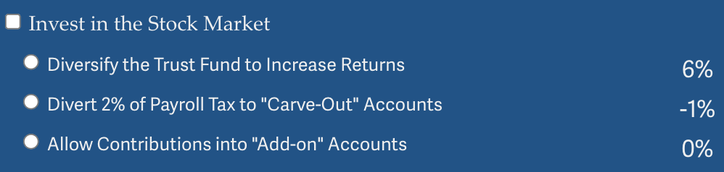
Investing in the Stock Market.
Doesn’t do much to solve the problem.
Concerns with government investing in the stock market.
Logistics of allowing individuals to customize are enormous.
  And subject to political influence.
May increase the fragility of the system.

Slide 49
Other Solution? Tax More Than Just Earnings
Social Security is funded through payroll taxes.
Broadening the base would increase programmatic revenues.
This begs the question of why the program is funded only by a tax on earnings.
Other sources of income: capital gains
Social security is an economic security program.
  Yet its revenue source is earnings.
  Is income a better indication of economic security?

Slide 50
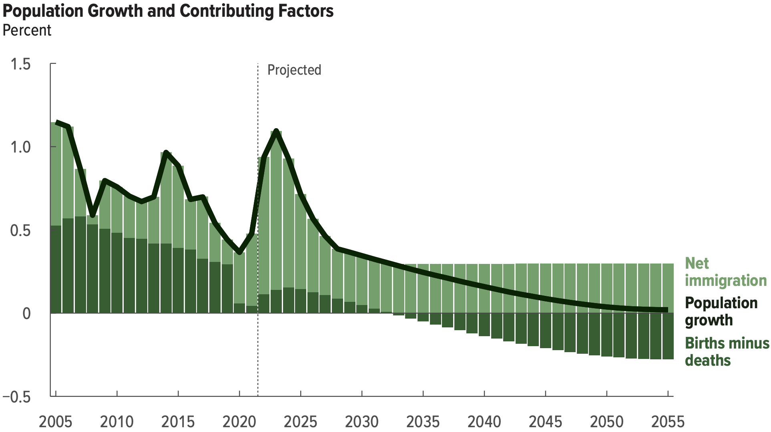
Another Solution?
Increase legal immigration of prime working age.
Source: https://www.cbo.gov/system/files/2025-01/60875-demographic-outlook.pdf

Slide 51
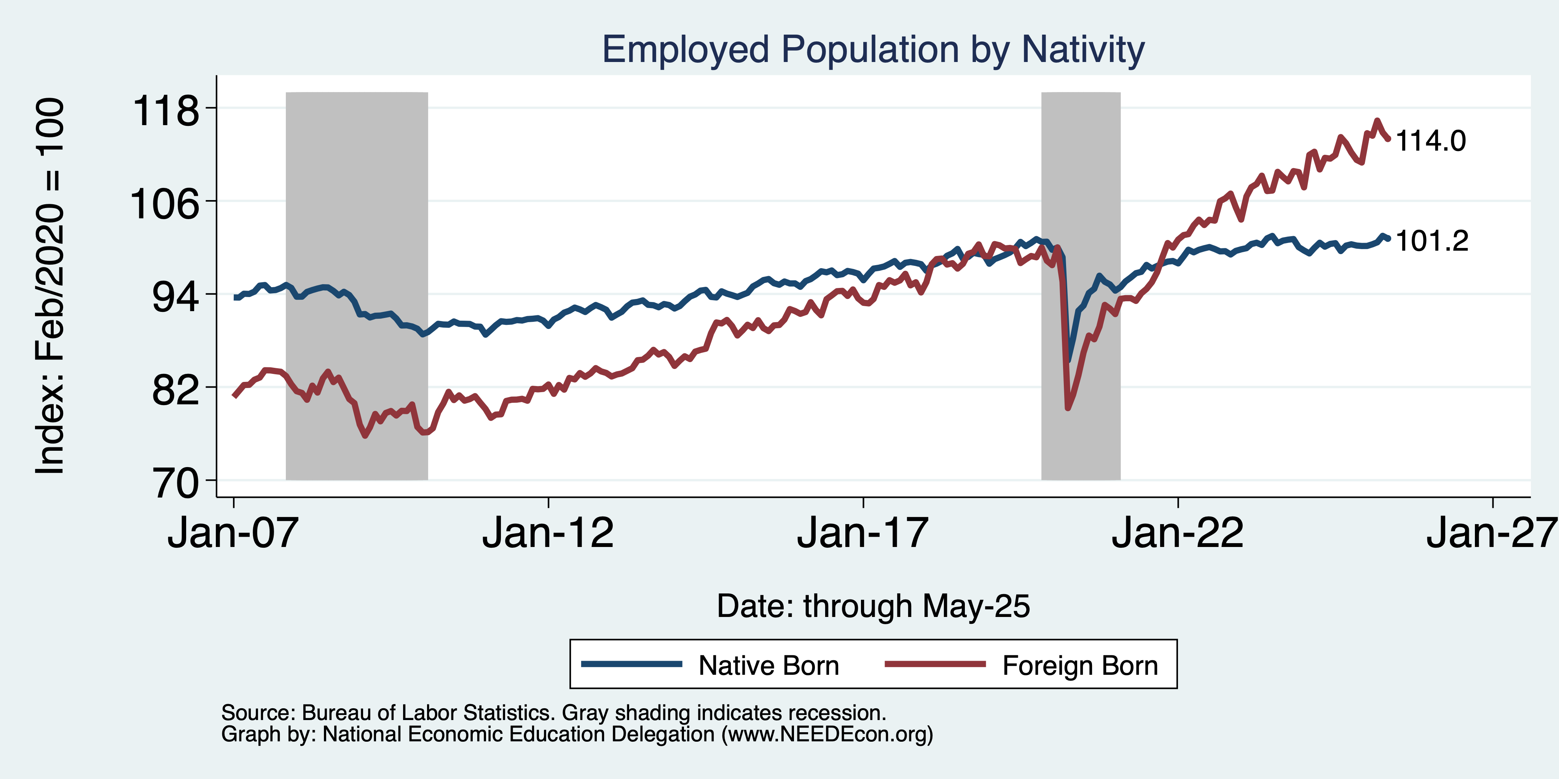
Immigrants to the Rescue?
Native: +1.5 million
Foreign Born: +3.9 million

Slide 52
General Principle of Solutions
Social security was originally created (primarily) to reduce economic instability among the elderly.
Shouldn’t solutions to the shortfall respect that original intent?
Regressive solutions are anathema to the original intent, disproportionately reducing the programs effects on those most at risk of economic instability.
Equality of contributions to the solution increase economic instability among the elderly.
Progressive solutions are more likely to respect the original intent.

Slide 53
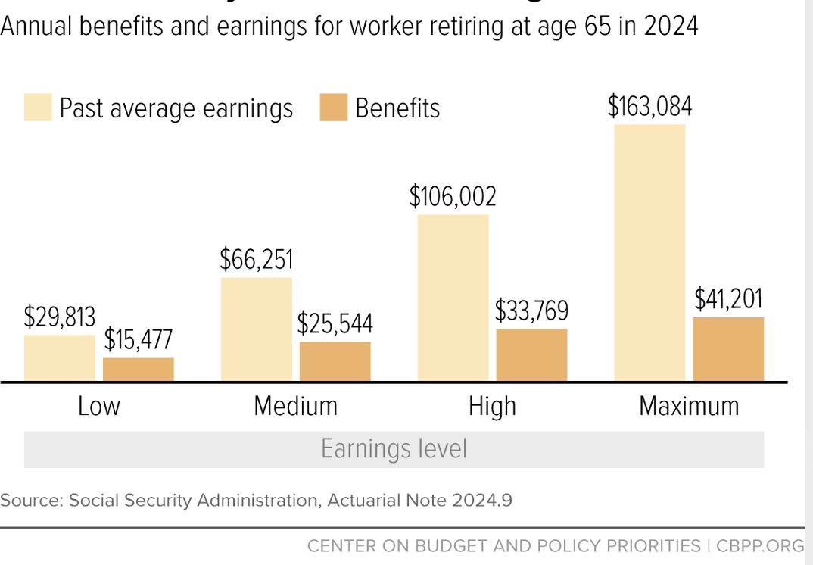
Social Security Benefits are Progressive

Slide 54
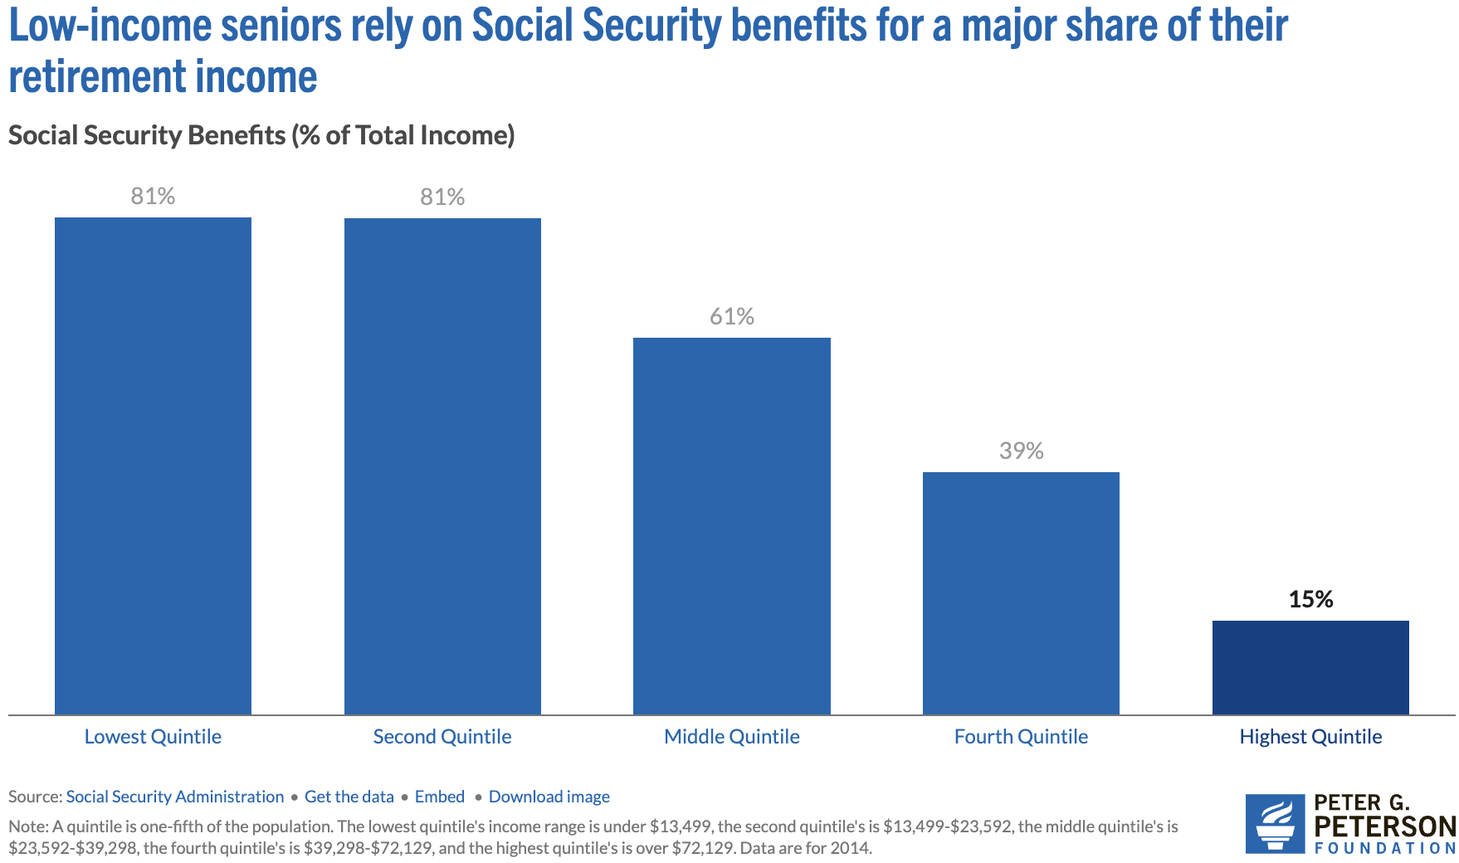
Program is VERY Important for Low-Income Retirees
Source: https://www.pgpf.org/article/9-facts-about-social-security-and-the-need-to-strengthen-it/

Slide 55
Summary
Social Security is an important part of the social safety net.
The OASDI Trust Fund is likely to be exhausted in 2035.
Why are the funds being depleted?
  An aging population – fewer paying in and more taking out.
  Declining birth rates - slowing growth of the labor force.
  Wage inequality – more and more wages are above the wage cap.
What happens when the funds are depleted?
  Benefits may have to be reduced by 17%.
  The system will continue!
Solutions abound. The problem is political will.
  Needed changes will be unpopular, but they are very manageable.

Slide 56
Thank you!
Any Questions?
www.NEEDEcon.org
Jon D. Haveman
Jon@NEEDEcon.org
Contact NEED: info@NEEDEcon.org
Submit a testimonial: www.NEEDEcon.org/testimonials.php
Become a Friend of NEED: www.NEEDEcon.org/friend.php

Slide 57
1983 Social Security Amendments Act
https://www.google.com/search?q=what+percent+of+the+budget+is+social+security&oq=what+percent+of+the+budget+is+social+&gs_lcrp=EgZjaHJvbWUqBwgAEAAYgAQyBwgAEAAYgAQyBwgBEAAYgAQyBggCEEUYOTIICAMQABgWGB4yCAgEEAAYFhgeMggIBRAAGBYYHjIICAYQABgWGB4yCAgHEAAYFhgeMggICBAAGBYYHjIICAkQABgWGB7SAQg3MDE5ajBqN6gCALACAA&sourceid=chrome&ie=UTF-8

Slide 58
Social Security: Disability
Eligibility:
  Disability or blindness that prevents you from working.
  Enough work history.

Slide 59
Social Security: Disability
Eligibility:
  Disability or blindness that prevents you from working.
  Enough work history.
    Minimum of 6 credits.

Slide 60
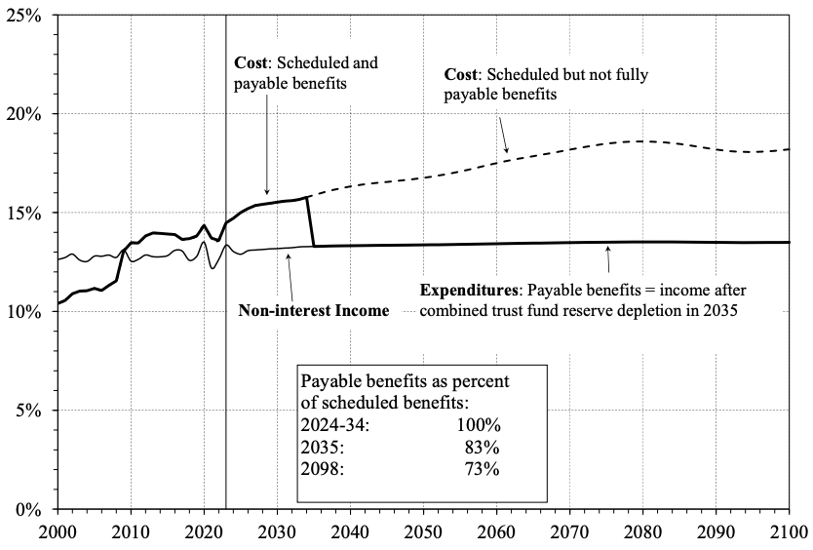
What Happens When The Trust Fund Runs Out?
Source: https://www.ssa.gov/OACT/TR/2024/tr2024.pdf

Slide 61
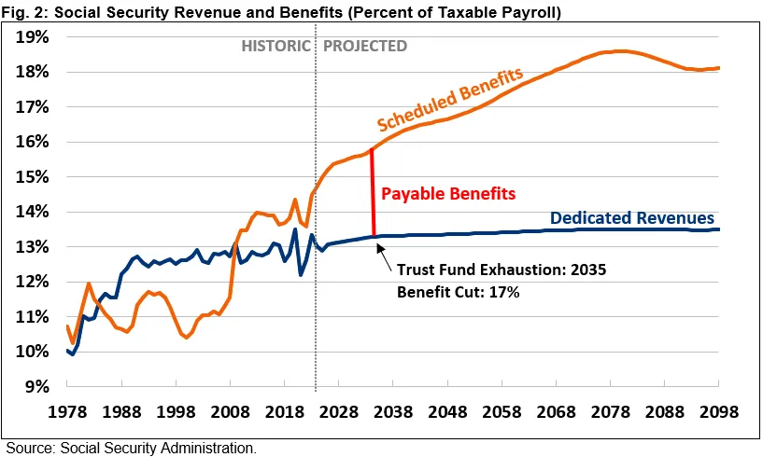
What Happens When The Trust Fund Runs Out?
Benefit Cut: 27%
2098
Source: https://www.crfb.org/papers/analysis-2024-social-security-trustees-report

Slide 62
What about widow or disabled status on the previous page?

