Slide 1

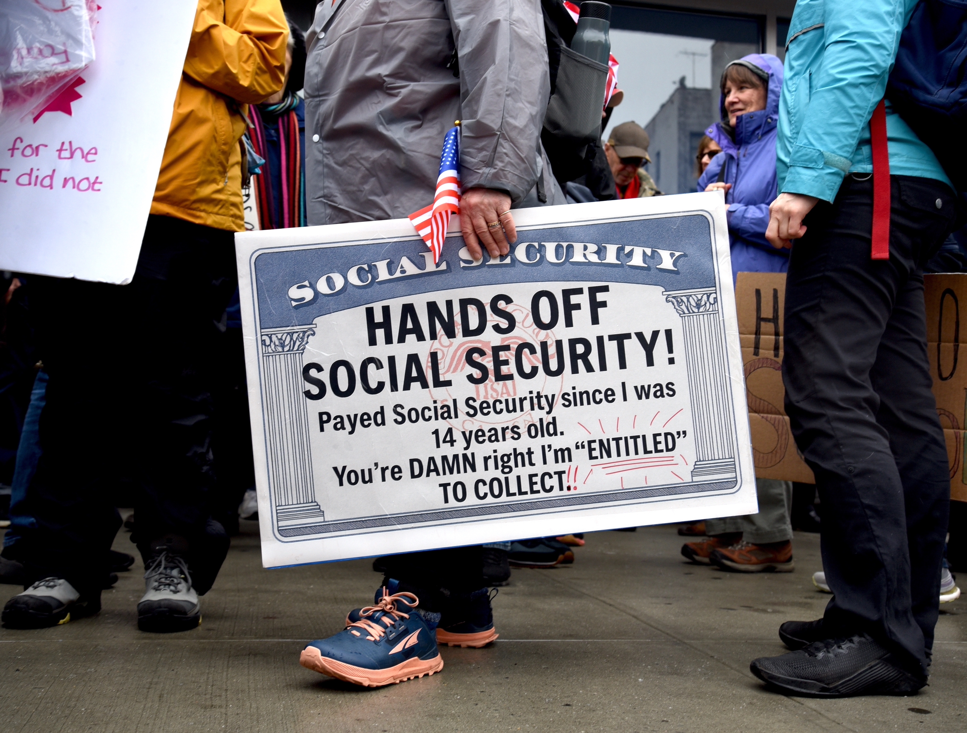
Saving Social Security
Lenox Club
September 15, 2026
Geoffrey Woglom, emeritus, Amherst College
Director, National Economic Education Delegation

Slide 2
Outline
What is Social Security?
Why is Social Security in Trouble?
Principles for Saving Social Security.
One Example of a Bipartisan Solution.

Slide 3
What is Social Security?
Social Security is a federal social insurance program that provides financial support to workers and their families.
Different benefits:
  Retirement Benefits: Social Security provides monthly payments to qualified retirees based on their lifetime earnings.
  Disability Benefits: It provides financial support to individuals who are unable to work due to a disability.
  Survivor Benefits: Social Security offers benefits to the families of deceased workers, including spouses and children.

Slide 4
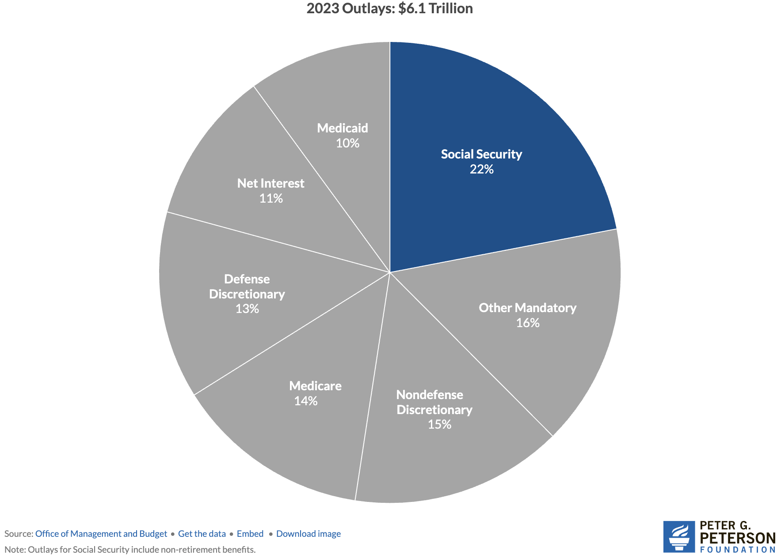
Soc Sec is The Single Largest Gov’t Program
Source: https://www.pgpf.org/article/9-facts-about-social-security-and-the-need-to-strengthen-it/

Slide 5
The Mechanics of Social Security
“pay-as-you-go” system
  Revenues come from: Payroll taxes on workers and employers, and income taxes on some social security benefits.
  Revenues pay the benefits of the currently retired, or otherwise eligible.
Payroll taxes amount to 12.4% of earnings.
  Workers pay 6.2% of earnings as payroll taxes.
  Employers also pay 6.2% of worker’s earnings.
Earnings Cap. Not all earnings are subject to payroll taxes.
  In 2026, only the first $184,500 of earnings are taxed.
  Earnings above that level are not taxed.
Income taxes on SS Benefits:
  For lowest income, benefits are not taxable
  As income rises, a fraction of benefits become taxable up to 85% at about $50,000 of AGI (not indexed).

Slide 6
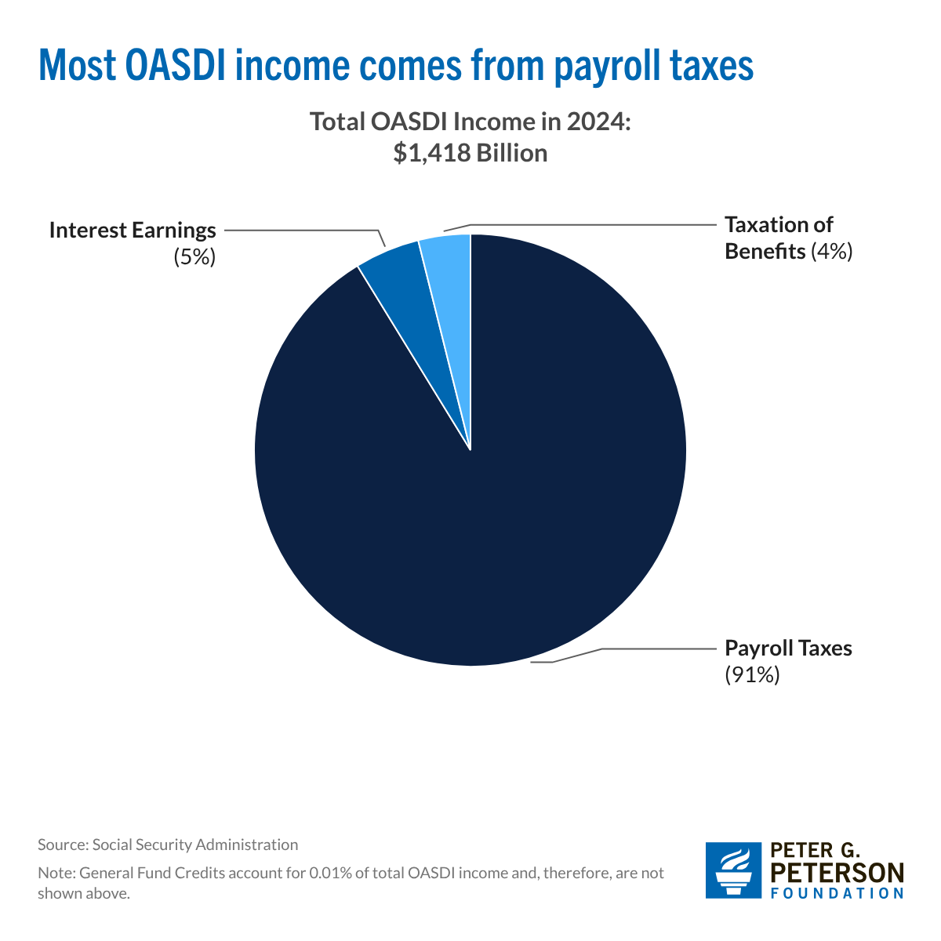
Sources of SS Revenue

Slide 7
What if SS Tax Revenues Don’t Match Benefits?
The Trust Fund
  If revenues exceed benefits, the trust fund is credited with nonmarketable government securities by the amount of the surplus.
  If benefits exceed revenues, the trust fund redeems nonmarketable securities by the amount of the deficit.
  Really just one branch of government trading Ious with another.
  The existence of the trust fund has no economic significance: The amount the government must borrow depends on total federal spending (including Social Security) less total tax revenue (including Social Security taxes).
But the existence, or lack thereof, has enormous political significance: Under current law, If the Trust fund is exhausted, Social Security benefits are limited to Social Security income.

Slide 8
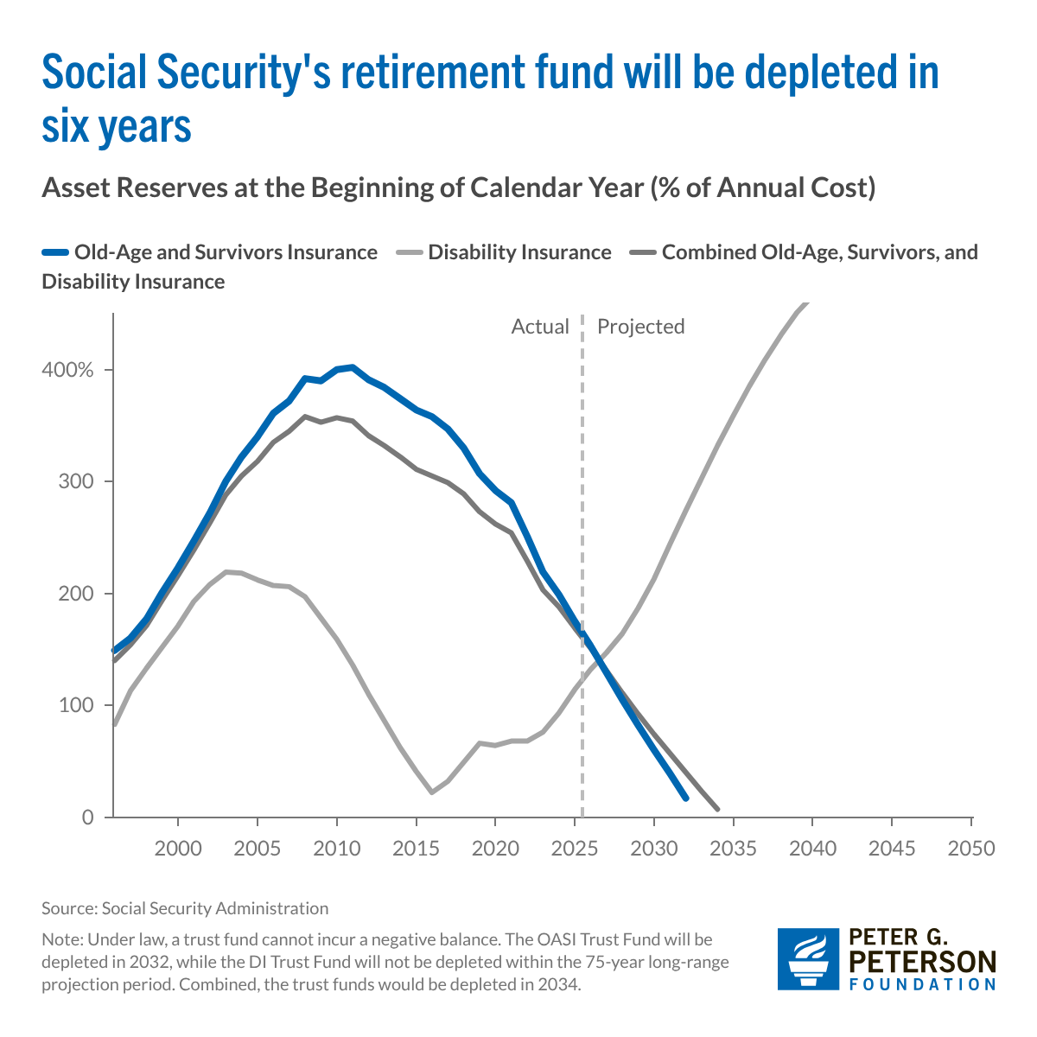
The Problem: Trust Funds are Running Out

Slide 9
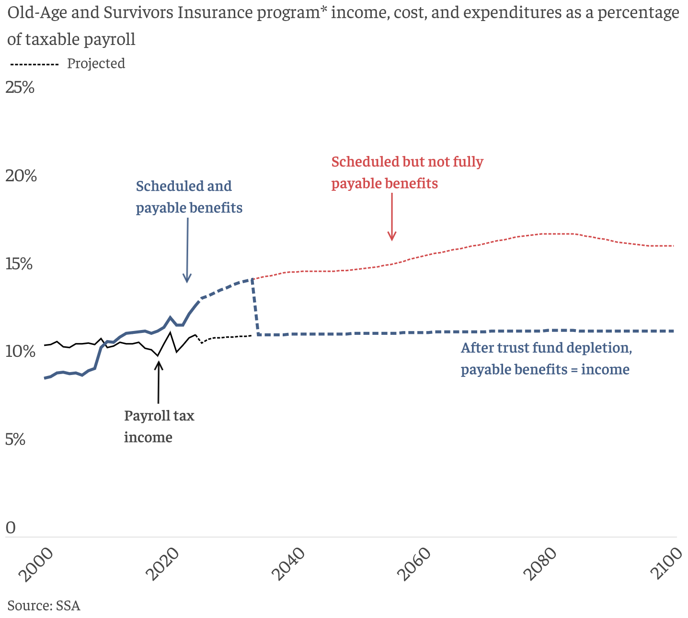
What Happens When The Trust Fund Runs Out?
OASI Trust Fund Exhaustion, 2032 Benefit Cut: 22%

Slide 10
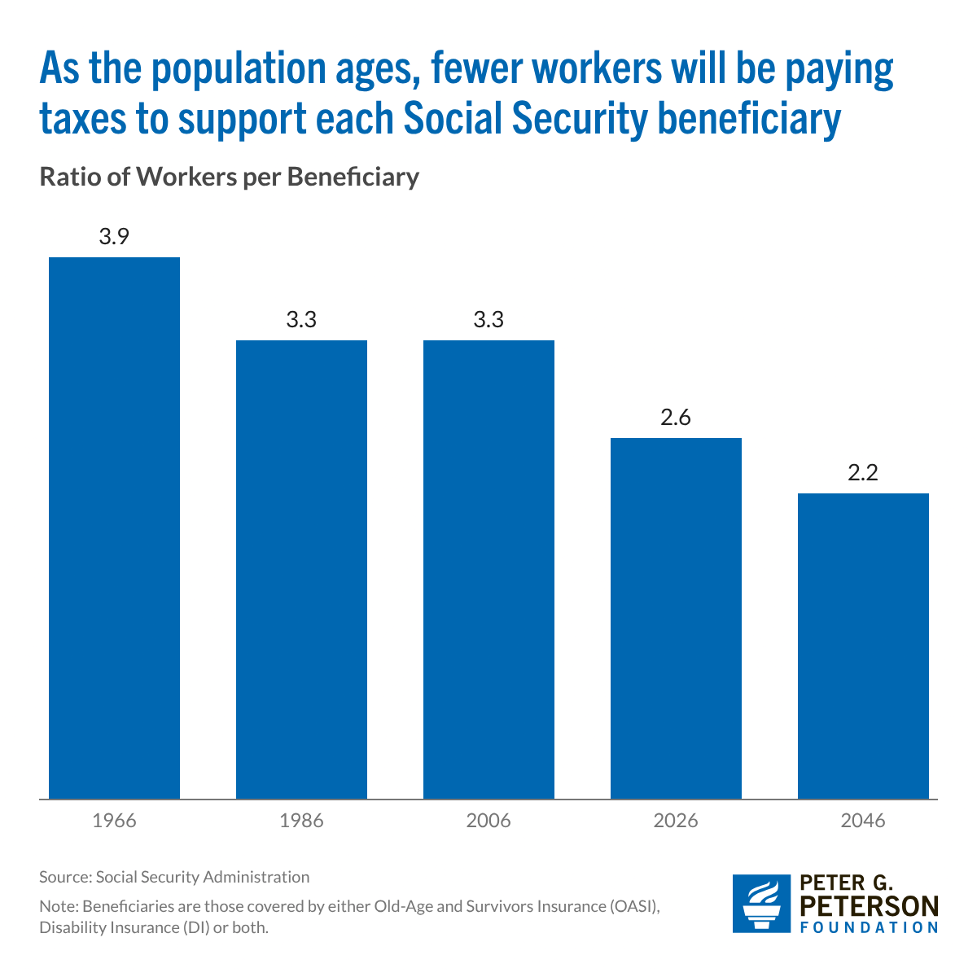
Main Problem Due to Aging Population
Baby Boomers are retiring.
Increasing Life Expectancy.
Baby Bust: By 2030, births = deaths.
Net immigration Way down
Additional Problem: Growing wage inequality means more income is not subject to the payroll tax.
Source: https://www.pgpf.org/article/how-does-social-security-work/

Slide 11
A Closer Look at Retirement Benefits?

Slide 12
Benefits are Based on Your Primary Insurance Amount (PIA)
PIA which depends on:
Your work history.
  Your average highest income over 35 years, where earlier years are indexed to wage inflation.
  Except that income for any year is “capped,” currently at $184,500
Income Cap plays two roles:
  Remember earnings above the cap are not taxed.
  But, earnings above the cap do not affect individuals’ average SS earnings.
PIA determines Retirement Benefit of a single retiree at Full Retirement age, 67

Slide 13
Benefit Formula is Highly Progressive
For every dollar average income exceeds $93K, benefits increase by 15 cents

Slide 14
Benefit Adjustments to PIA
Age when claiming
  Early: 70% at 62 to 100% bat 67.
  Delayed: 108% at 68 to 124% at 70.
  Fractions designed to be (roughly, on average) actuarially fair.
Marital Status:
  Nonworking spouse adds 50% of PIA at full retirement age.
  Working spouse claims off own earnings record if it is greater.
Benefits go up each year based on CPI inflation.

Slide 15
Solving the Social Security problem is simple
More revenues and/or
Reduced benefits
Why hasn’t this happened?
Politics!

Slide 16
Personal Opinion: Disingenuous & Unhelpful
Scott Bessent, Treasury Secretary at his confirmation hearings:
"These entitlements are massive. I think the next four years isn't the time to deal with them, that we've got to deal with the discretionary portion of the budget…then the next step is for a future administration to have the confidence to be able to deal with entitlements.”
Total Federal Spending last fiscal year $7 trillion: 60% Mandatory (mostly Social Security and Medicare); 27% was discretionary, and 14% was interest on the debt.
One Big Beautiful Bill and Immigration Policies are a substantial reason Social Security Finances got worse in 2025.
https://www.foxbusiness.com/politics/treasury-secretary-nominee-scott-bessents-3-3-3-plan-what-know

Slide 17
So, Let’s Consider Some Options
But the appropriate choices depend on the goals of the program!
Not mutually exclusive goals of Social Security:
  Partial earnings replacement via forced savings.
  Social Insurance: protect workers against risks that are hard to insure privately.
  Poverty Prevention among the elderly.

Slide 18
1. SS as One Leg of the Three-Legged Stool
Why Forced Savings?
Private Pensions
  But, only 50-55 percent of private-sector workers are covered mostly by Defined Contribution Plans.
Private Savings
  But, roughly 50 percent of workers aged 55-64 have little or no private savings (does not include housing wealth).
The weaknesses of these 2 legs is worse the poorer the household. Also, both these legs are subject to investment and inflation risk.
(From 1970-2025 the S&P 500 fell by 20% or more 7 times).

Slide 19
2. SS Insures Against Significant Risks
Protects against becoming disabled.
Protects survivors, widow(er)s and children.
Protects against outliving resources because it acts like a lifetime annuity with the important added bonus that benefits are indexed to inflation

Slide 20
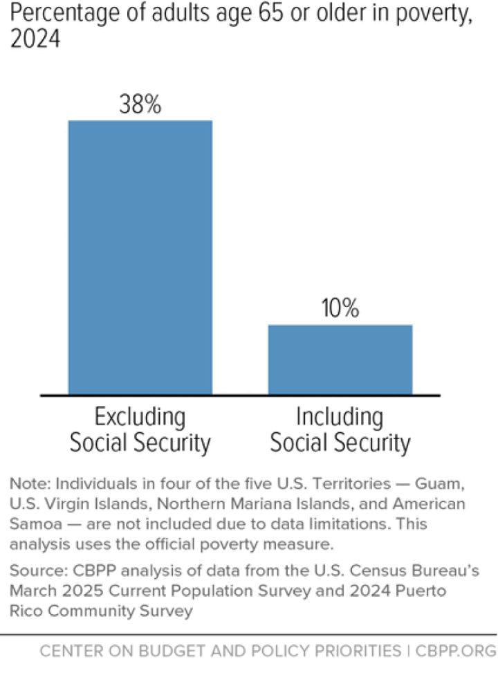
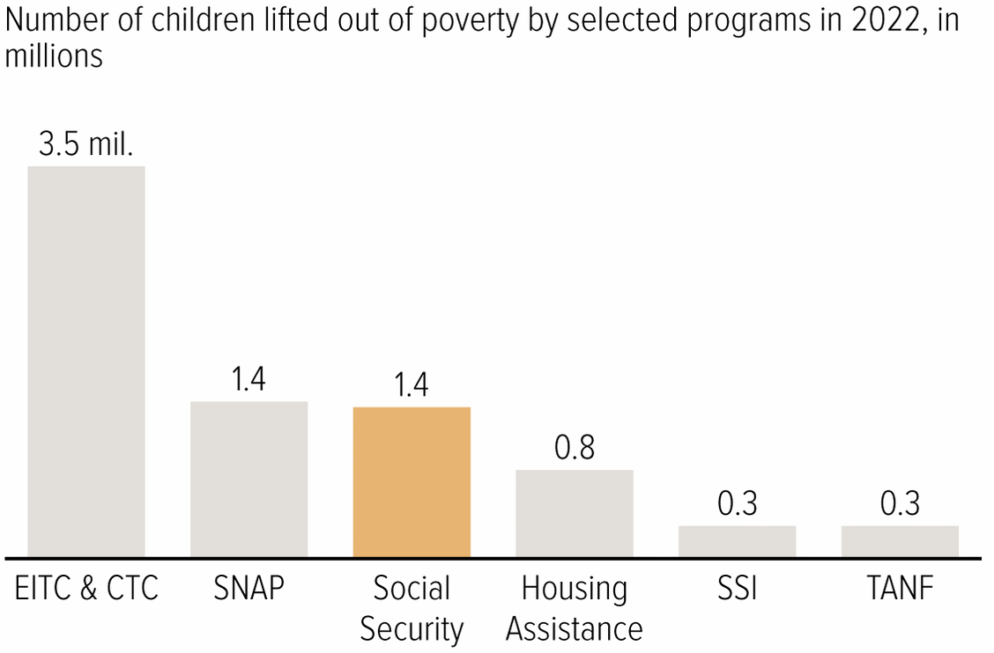
3. Soc Sec Significantly Reduces Poverty

Slide 21
Implications of 3 Different Goals
If there were only one goal (which there is not), what would be the implications for saving Social Security?
Forced Savings: Maintain a link between taxed earnings and benefits.
Social Insurance: Survivor and disability benefits are central. Progressivity in benefits is appropriate because low earners face greater risk.
Poverty Prevention: Payroll tax links to benefits is a historical artifact. Means-tested benefits. (Conflicts with 1.)

Slide 22
Brookings Principles for a Solution
Principles:
Bipartisan which means benefit cuts and tax increases.
Solvency (increase revenues and lower benefits by 4.42 % of taxable payrolls. Eliminate the “GAP”)
No benefit reduction for current recipients (?).
No general fund financing (Pay benefits from SS taxes).
Universal participation.
https://www.brookings.edu/articles/fixing-social-security-blueprint-for-a-bipartisan-solution/

Slide 23
My Interpretation of Brookings Principles
Social Security is a special program, not just poverty prevention.
  “…link between wages and benefits has been a central principle… and a foundation of its political support.”
Bipartisan: I would go further: Don’t try to fix the inequities of the federal tax system with social security reform
  Preserve the traditional view that Social Security is a different type of government program.
  SS reform is tough enough and the problem is urgent.

Slide 24
Example: Roughly Based on Brookings
Slow the benefit growth of high earners (38%, of gap removed)
Index COLA to “Chained” CPI (16%)
Phase out nonworking spouse benefit (4%)
Expand Widow(er)s Benefit to 75% of combined benefit (-3%)
Calculate PIA on a 40-year average rather than 35 (15%)
Raise earnings cap to $330,500 in 2026 to cover 90% of wages (23%)
Raise the payroll tax to 12.6% (5%)
Tax all SS Benefits for Retirees making more than $100,000. (3%)
Bipartisan because it involves benefit reductions (70%) and tax increases (31%)

Slide 25
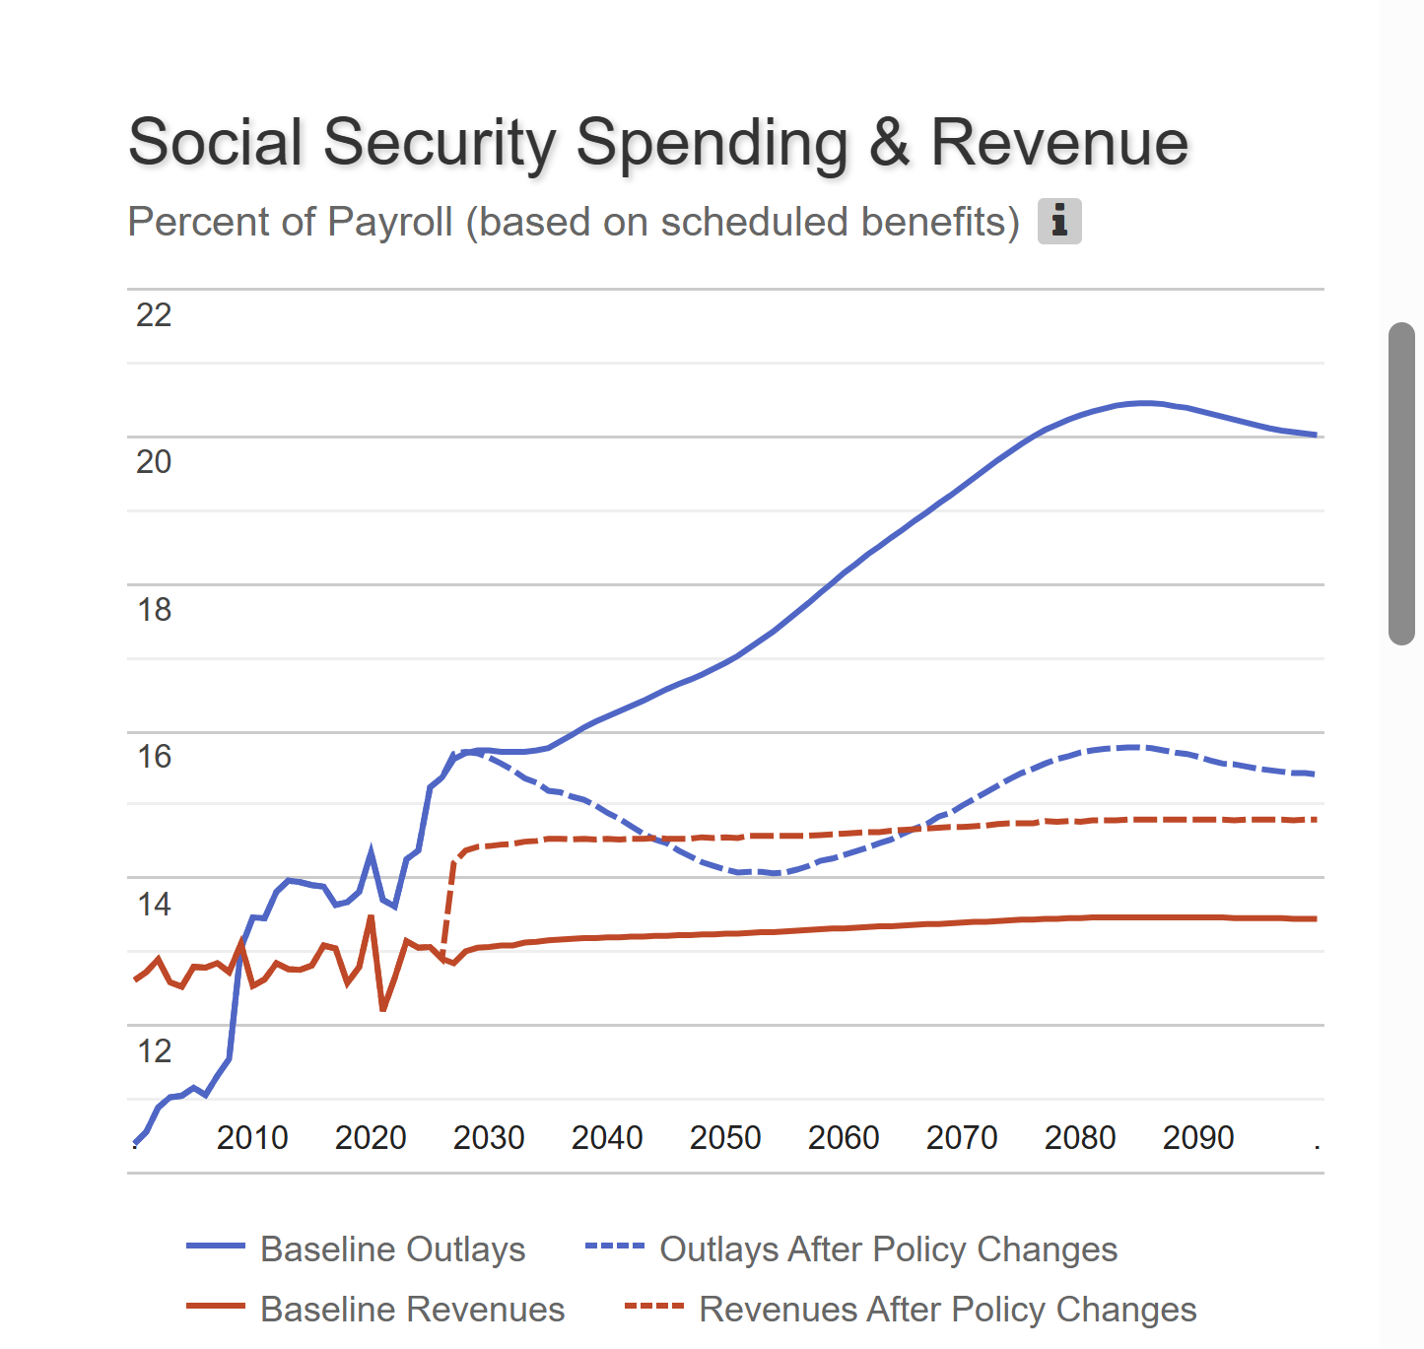
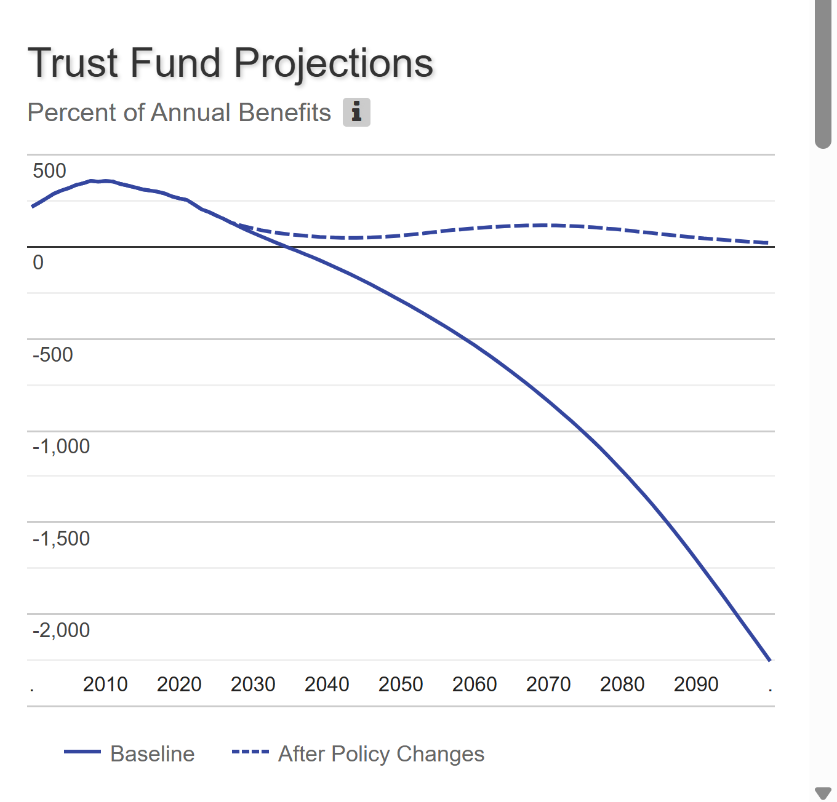
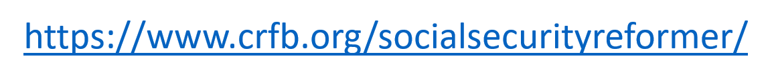
Results

Slide 26
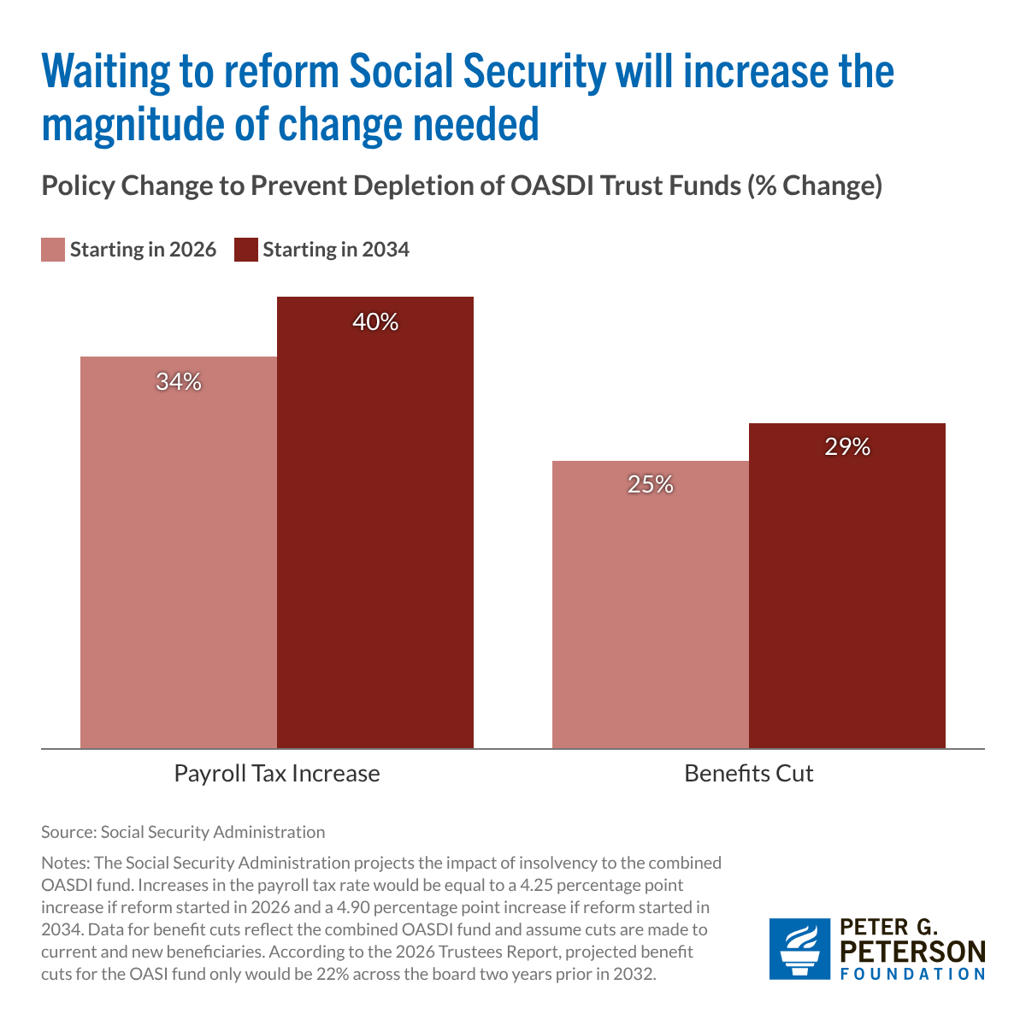
The Sooner We Act the Better
We cannot afford to let the “best” be the enemy of the “good.”

Slide 27
Should Current Retirees Share the Burden?
Current retirees have less flexibility to adjust income and spending.
That may argue for a smaller relative burden, but not zero.
Also, higher income retirees have more flexibility in adjusting spending.
My opinion, for intergenerational fairness and for social solidarity, the more affluent of our generation should bear some burden

Slide 28
Summary
Social Security is an important part of the social safety net.
The OASI Trust Fund is likely to be exhausted in 2032.
Why are the funds being depleted?
  An aging population and slower growth in the labor force.
What happens when the funds are depleted?
  Benefits may have to be reduced by 22%, but the system will continue
Solutions abound. The problem is political will.
  The needed changes will be unpopular, but they are manageable. The longer we wait the bigger the problem.
There is hope: both the Senate and House are considering different bills to form a commission to make proposals.

Slide 29
Let’s Hear from You!
Geoffrey Woglom grwoglom@amherst.edu
Slides available
https://www.needecon.org/delivered_presentations.php
Additional Material
https://sites.google.com/view/macro-current-issues/social-security

