Slide 1

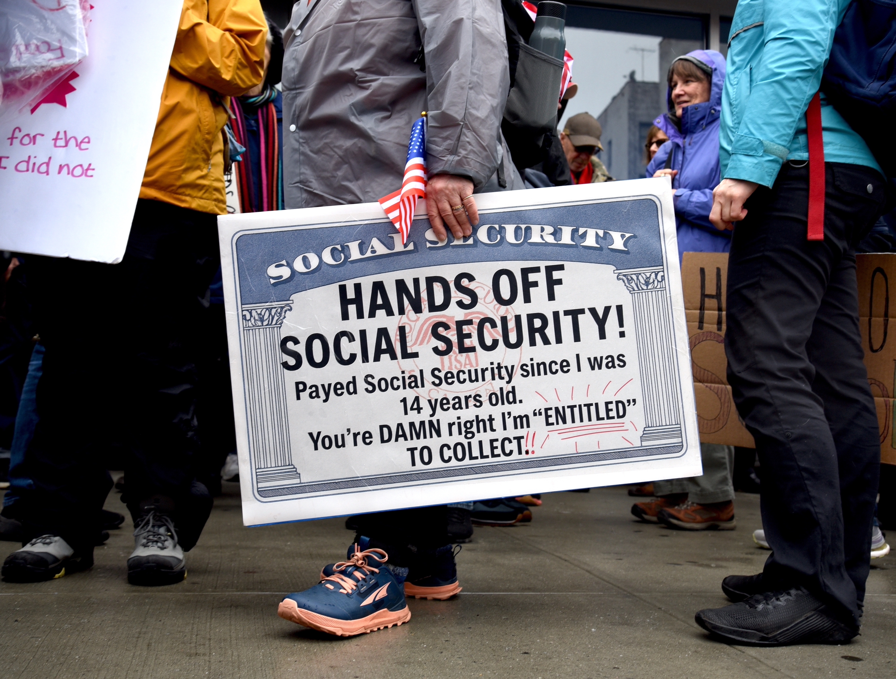
Saving Social Security
Kimball Farms
Geoffrey Woglom, emeritus, Amherst College
Director, National Economic Education Delegation
August 25, 2026

Slide 2
Outline
What is Social Security?
Why is Social Security in Trouble?
Principles for Saving Social Security.
A Bipartisan Solution.

Slide 3
What is Social Security?
Social Security is a federal social insurance program that provides financial support to workers and their families.
Different benefits:
  Retirement Benefits: Social Security provides monthly payments to qualified retirees based on their lifetime earnings.
  Disability Benefits: It provides financial support to individuals who are unable to work due to a disability.
  Survivor Benefits: Social Security offers benefits to the families of deceased workers, including spouses and children.

Slide 4
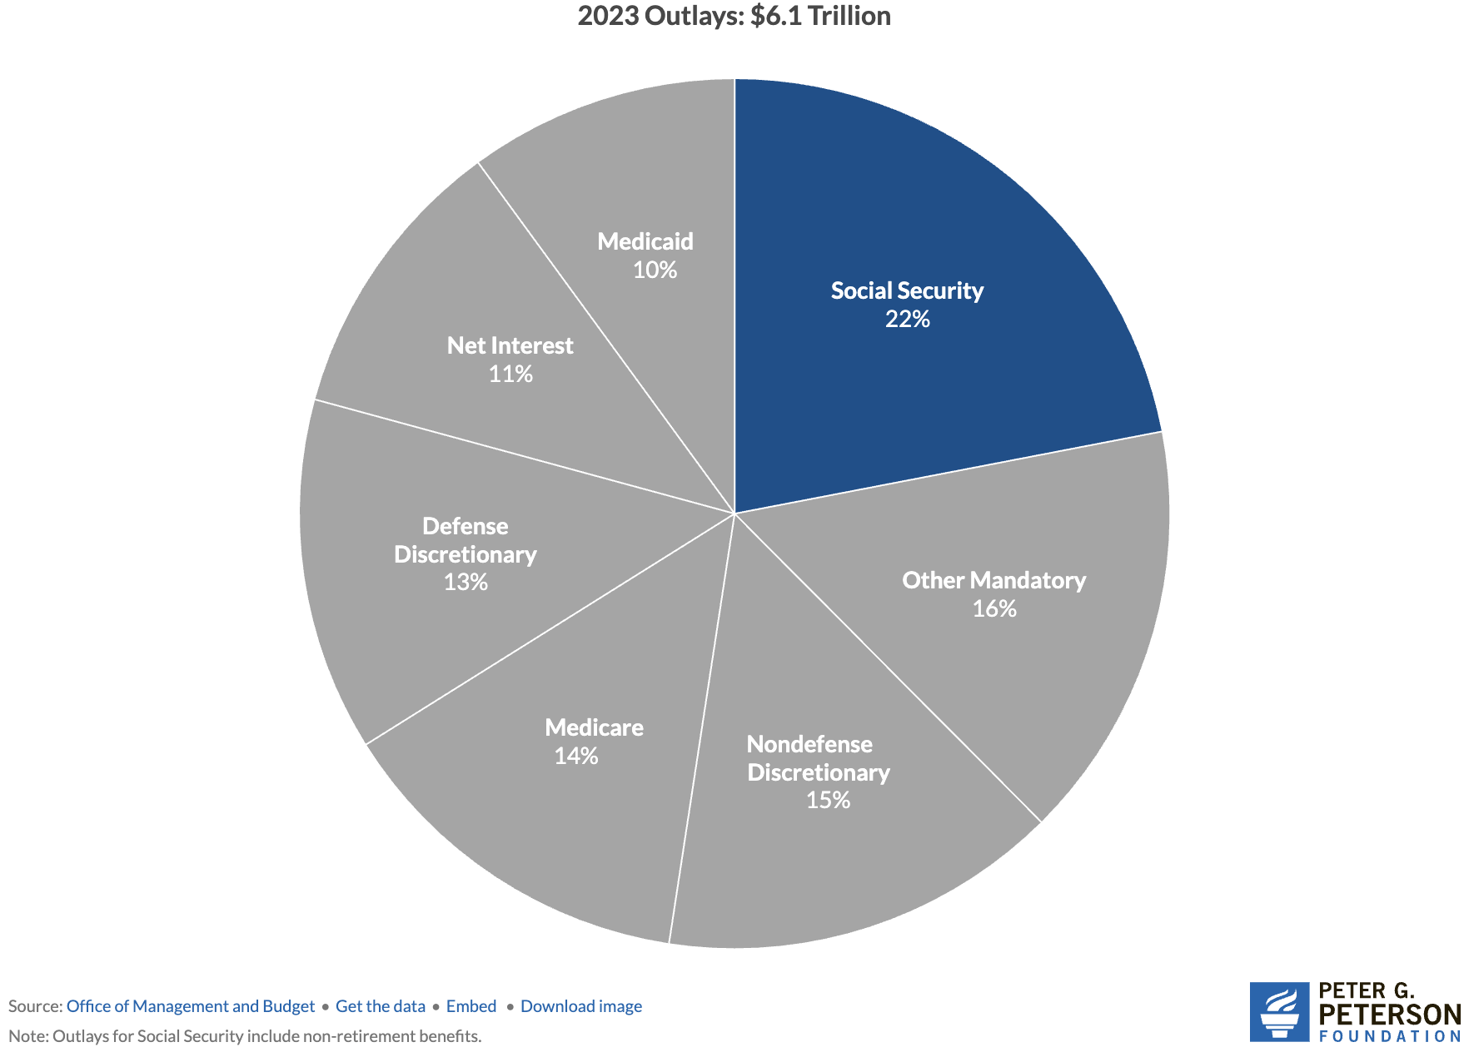
Soc Sec is The Single Largest Gov’t Program
Source: https://www.pgpf.org/article/9-facts-about-social-security-and-the-need-to-strengthen-it/

Slide 5
The Mechanics of Social Security
“pay-as-you-go” system
  Payroll taxes are collected from current workers.
  These pay for the benefits of the currently retired, or otherwise eligible.
Taxes
  Payroll taxes amount to 12.4% of earnings.
    Workers pay 6.2% of earnings as payroll taxes.
    Employers also pay 6.2% of worker’s earnings.
  Earnings Cap. Not all earnings are subject to payroll taxes.
    In 2026, only the first $184,500 of earnings are taxed.
    Earnings above that level are not taxed.

Slide 6
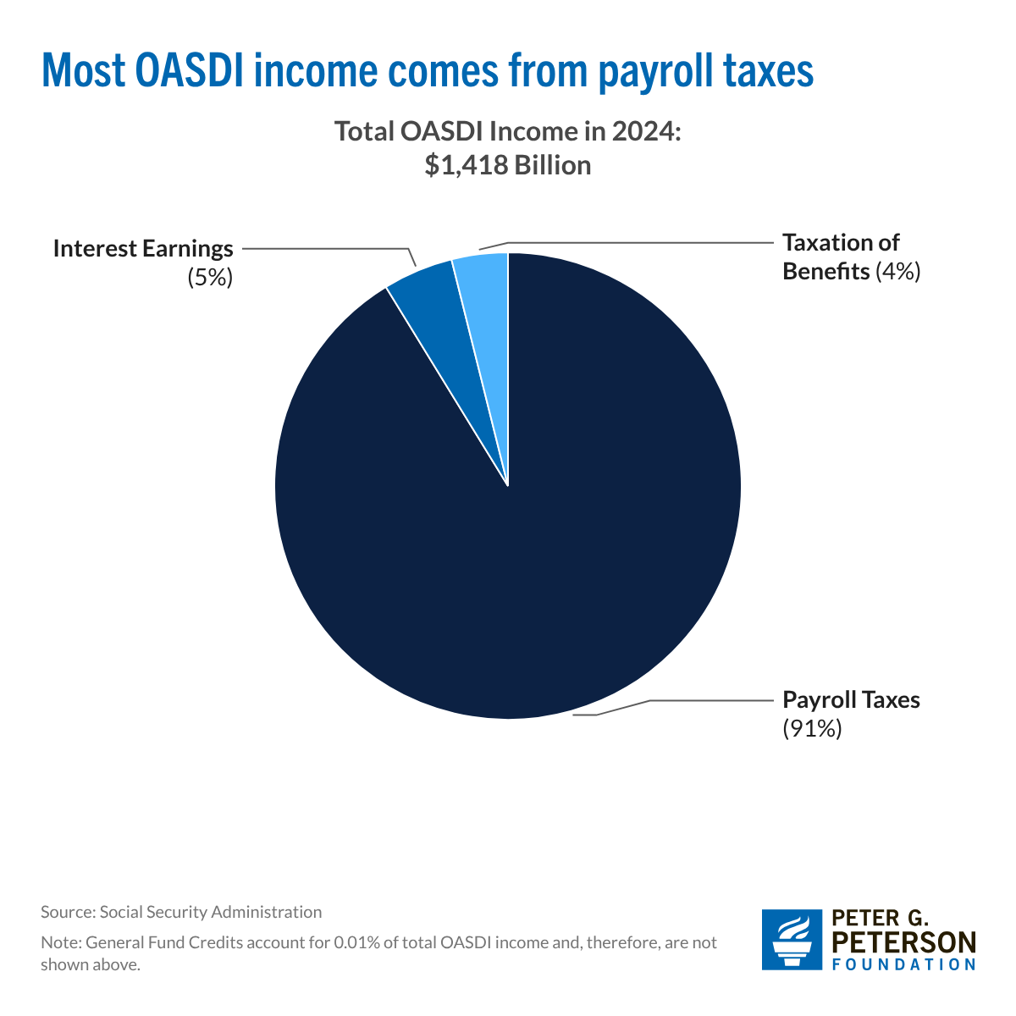
Sources of SS Revenue
In addition to payroll taxes, up to 85 percent of social security benefits are subject to income taxes.

Slide 7
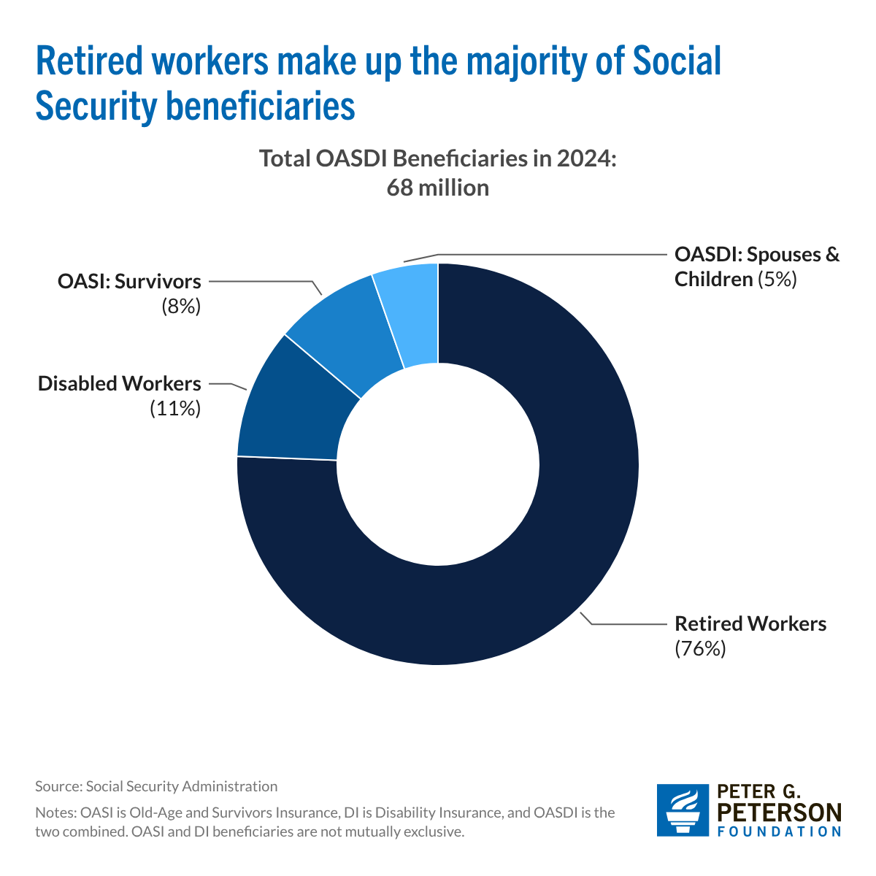
`
Where Does the Money Go

Slide 8
What if Payroll Taxes Don’t Match Benefits?
The Trust Fund
  If revenues exceed benefits, the trust fund is credited with nonmarketable government securities by the amount of the surplus.
  If benefits exceed revenues, the trust fund redeems nonmarketable securities by the amount of the deficit.
  Really just one branch of government lending to another
  The existence of the trust fund has no economic significance: The amount the government must borrow depends on total federal spending (including Social Security) less total tax revenue (including Social Security taxes).
But the existence, or lack thereof, has enormous political significance: If the Trust fund is exhausted, Social Security benefits by current law are limited to Social Security income.

Slide 9
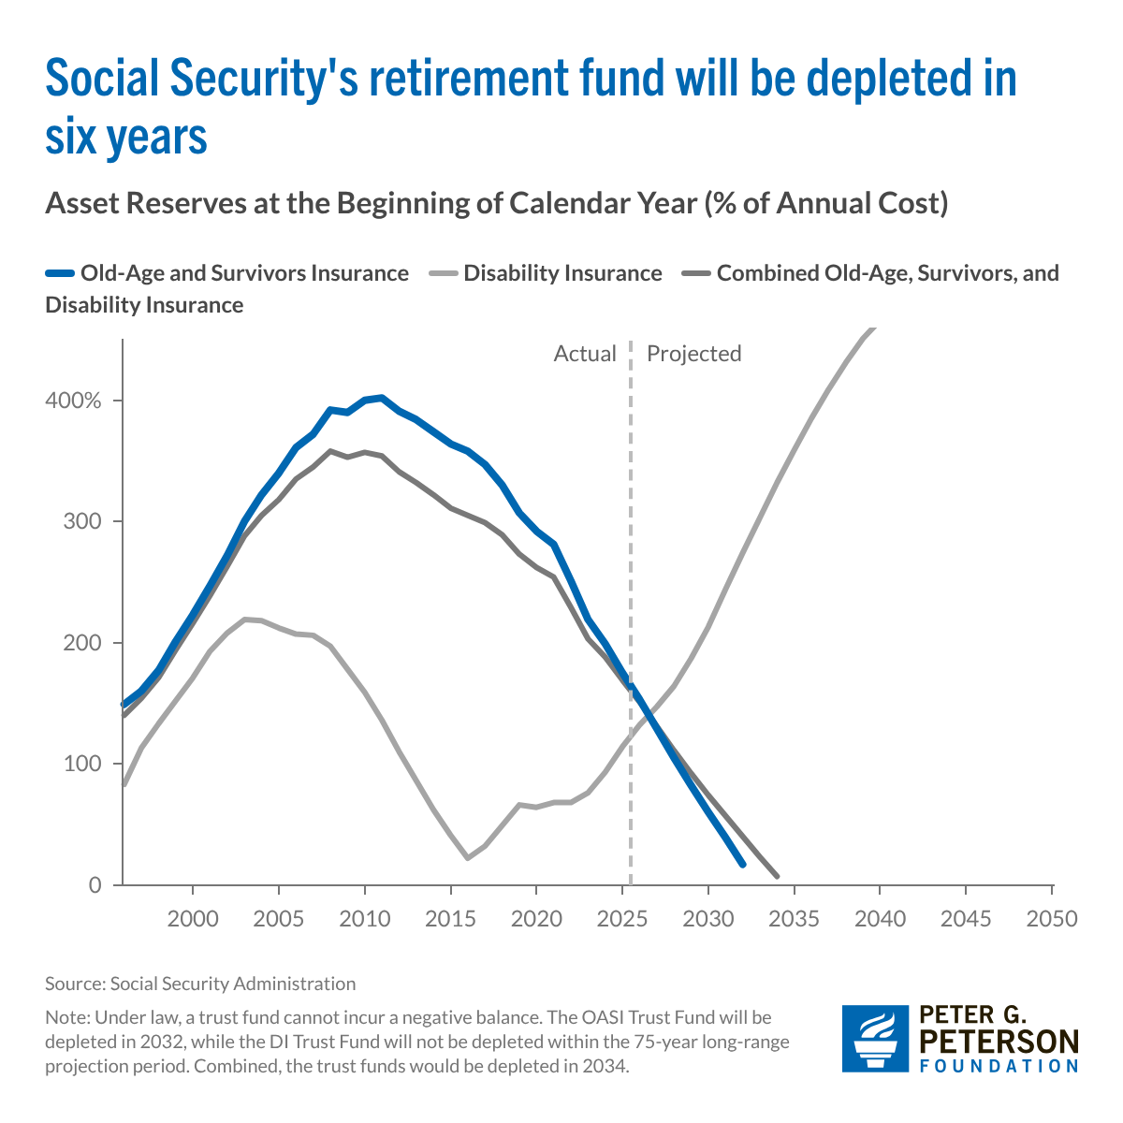
The Problem: Trust Funds are Running Out

Slide 10
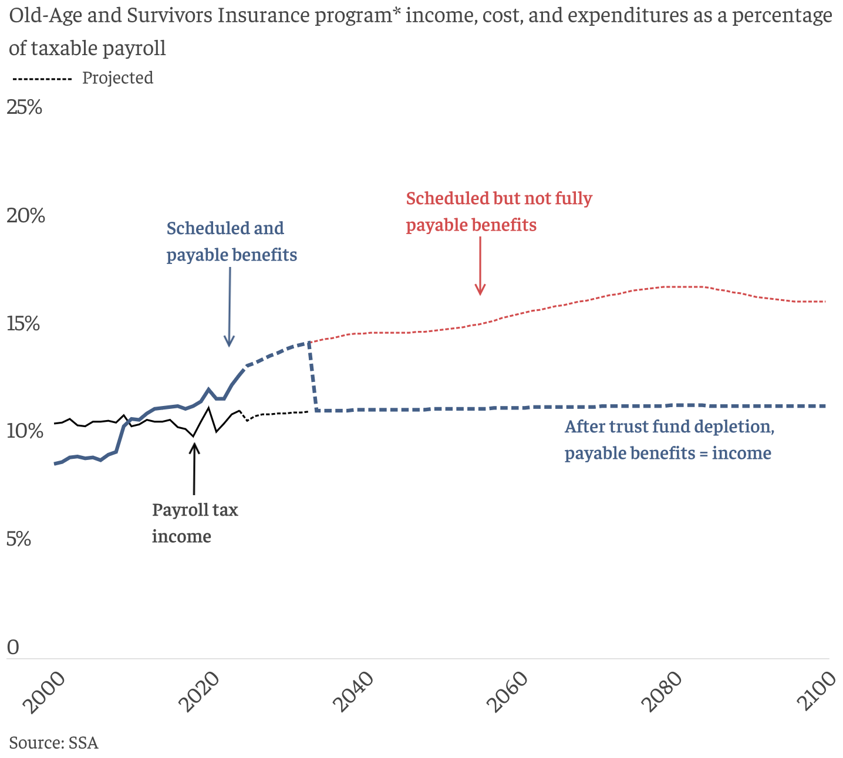
What Happens When The Trust Fund Runs Out?
Benefit Cut: 26%
2098
OASI Trust Fund Exhaustion, 2032 Benefit Cut: 22%

Slide 11
Why Are Costs Rising Rapidly
Aging population: more beneficiaries and fewer contributors (workers).
  Boomers are collecting benefits
  Baby Bust: lower birth rates: 2030 deaths will exceed births.
  Net immigration is way down.
  Life expectancy: In 1980 a 65-year old female could expect to live to 83, now 86.
  Workers per SSA beneficiary: 1966, 3.9; 2026, 2.6; 2046, 2.2.
Source: https://www.pgpf.org/article/how-does-social-security-work/

Slide 12
A Closer Look at Retirement Benefits?

Slide 13
Benefits are Based on Your Primary Insurance Amount (PIA)
PIA which depends on:
Your work history.
  Your average highest earnings over 35 years, where earlier years are indexed to wage inflation.
  Except that earnings for any year are “capped,” currently at $184,500
Income Cap roles:
  Remember earnings above the cap are not taxed.
  But, earnings above the cap do not affect individuals’ average SS Income.
PIA determines Retirement Benefit of a single retiree at Full Retirement age, 67

Slide 14
Benefit Formula is Highly Progressive
For every dollar average income exceeds $93K, benefits increase by 15 cents

Slide 15
Benefit Adjustments to PIA
Benefits payable for life and indexed to CPI inflation
Marital Status:
  With nonworking spouse adds 50% of PIA at full retirement age.
  Workings spouse can claim off own earnings record if it is greater
Age when claiming
  Early: 62, 70%; 63, 75%; 64, 80%; 65, 86.67%; 66, 93.33%
  Delayed, 68, 108%, 69, 116%; 70, 124%
  Designed to be (roughly, on average) actuarially fair.

Slide 16
Remember We Have a Problem
Solving the Social Security problem is simple:
More revenues and/or
Reduced benefits
Why hasn’t this happened?
Politics!

Slide 17
Personal Opinion: Disingenuous & Unhelpful
Scott Bessent, Treasury Secretary at his confirmation hearings:
"These entitlements are massive. I think the next four years isn't the time to deal with them, that we've got to deal with the discretionary portion of the budget…then the next step is for a future administration to have the confidence to be able to deal with entitlements.”
Total Federal Spending last fiscal year $7 trillion: 60% Mandatory (mostly Social Security and Medicare); 27% was discretionary, and 14% was interest on the debt.
One Big Beautiful Bill and Immigration Policies are a major reason Social Security Finances got worse in 2025.
https://www.foxbusiness.com/politics/treasury-secretary-nominee-scott-bessents-3-3-3-plan-what-know

Slide 18
So, Let’s Consider Some Options
But the appropriate choices depend on the goals of the program!
Not mutually exclusive goals of Social Security:
  Partial earnings replacement via forced savings.
  Social Insurance: protect workers against risks that are hard to insure privately.
  Poverty Prevention among the elderly.

Slide 19
1. SS as One Leg of the Three-Legged Stool
Why Forced Savings?
Private Pensions
  But, only 50-55 percent of private-sector workers are covered mostly by Defined Contribution Plans, as opposed to old-style Defined Benefit Plan.
Private Savings
  But, roughly 50 percent of workers aged 55-64 have little or no private savings (does not include housing wealth).
The weaknesses of these 2 legs is worse the poorer the household. Also, both these legs are subject to investment and inflation risk.
(From 1970-2025 the S&P 500 fell by 20% or more 7 times).

Slide 20
2. SS Insures Against Significant Risks
Protects against becoming disabled.
Protects survivors, widow(er)s and children.
Protects against outliving resources because it acts like a lifetime annuity with the important added benefit that benefits are indexed to inflation

Slide 21
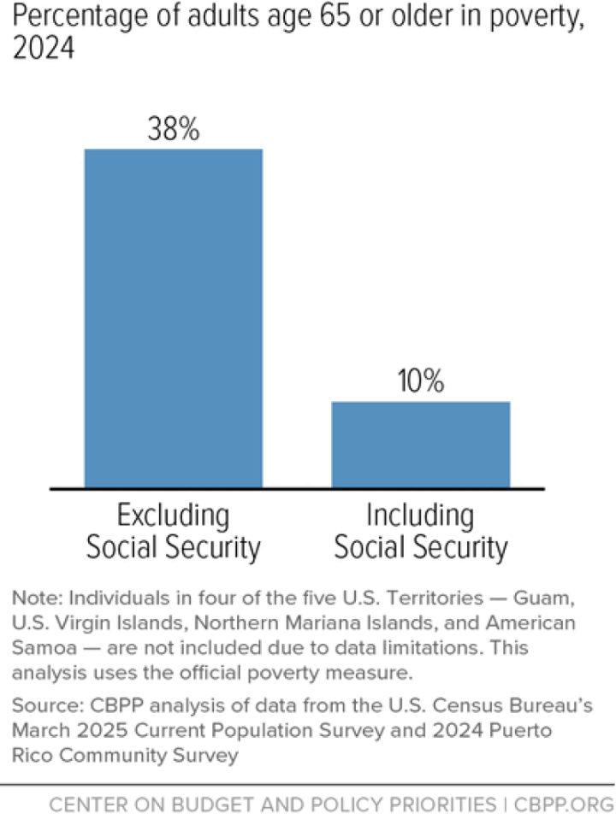
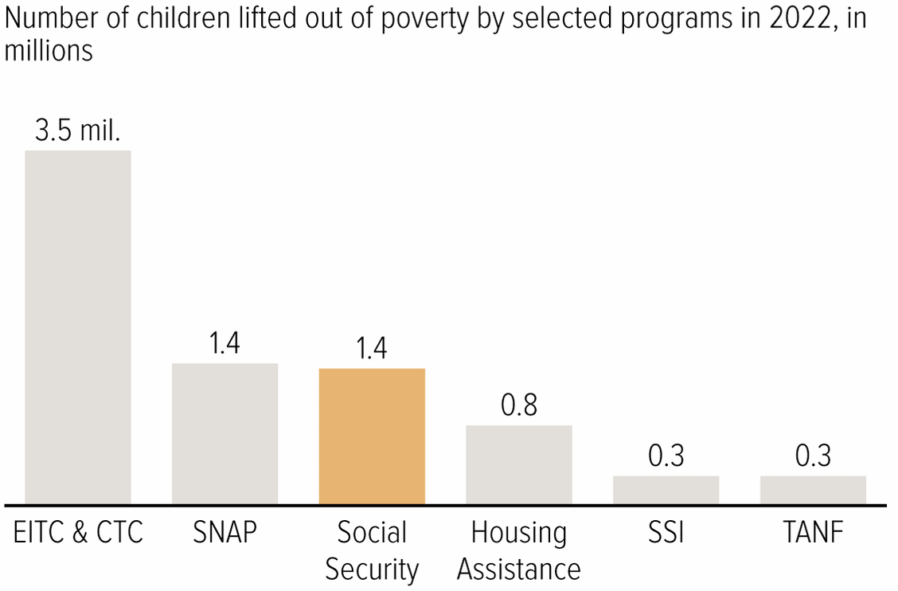
3. Soc Sec Significantly Reduces Poverty

Slide 22
Implications of 3 Different Goals
If there were only one goal (which there is not), what would be the implications for saving Social Security?
Forced Savings: Maintain a link between taxed earnings and benefits.
Social Insurance: Survivor and disability benefits are central. Progressivity in benefits is appropriate because low earners face greater risk.
Poverty Prevention: Payroll tax links to benefits is a historical artifact. Means-tested benefits. (Conflicts with 1.)

Slide 23
Brookings Principles for a Solution
Principles:
Bipartisan which means benefit cuts and tax increases.
Solvency (increase revenues and lower benefits by 4.42 % of taxable payrolls. Eliminate the “GAP”)
No benefit reduction for current recipients (?)
No general fund financing (Pay benefits from SS taxes)
Improve Progressivity.
Increase risk protection. (improve benefits for dependents)
Universal participation
How do these principles reflect the goals of Social Security?
https://www.brookings.edu/articles/fixing-social-security-blueprint-for-a-bipartisan-solution/

Slide 24
My Interpretation of Brookings Principles
While the goal of preventing poverty among the elderly is important, so too are the other two goals
  “this link between wages and benefits has been a central principle… and a foundation of it political support.”
  Universal participation because of social insurance.
  Increased risk protection.
Bipartisan: I would go further: Don’t try to fix the inequities of the federal tax system with social security reform
  Preserve the traditional view that Social Security is a different type of government program.
  SS reform is tough enough and the problem is urgent.

Slide 25
Example: Roughly Based on Brookings
Slow the benefit growth of high earners (38%, of gap removed)
Index COLA to “Chained” CPI (16%)
Phase out nonworking spouse benefit (4%)
Expand Widow(er)s Benefit to 75% of combined benefit (-3%)
Calculate PIA on a 40-year average rather than 35 (15%)
Raise earnings cap to $330,500 in 2026 to cover 90% of wages (23%)
Raise the payroll tax to 12.6% (5%)
Tax all benefits for retirees making over $100,000 (3%)
Bipartisan because it involves benefit reductions (70%) and tax increases (31%)

Slide 26
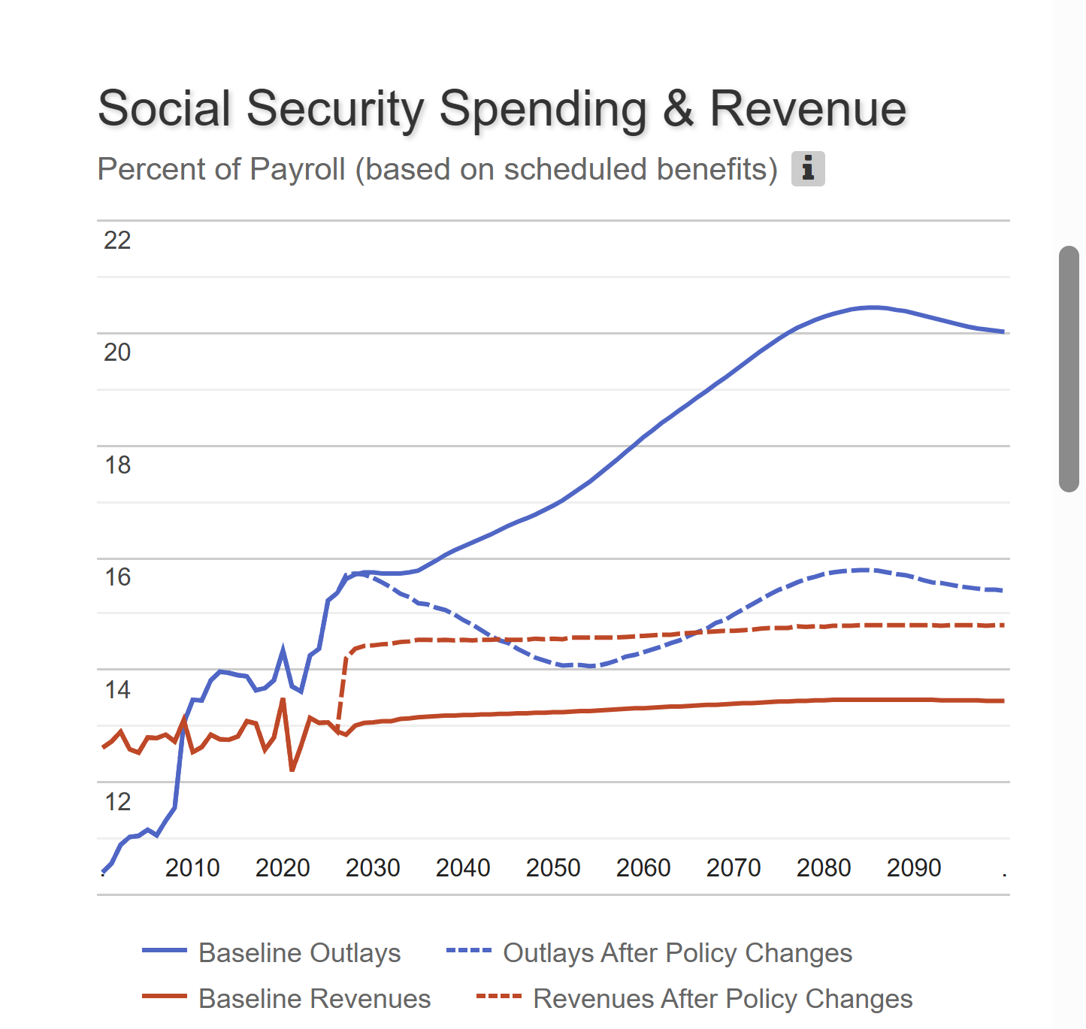
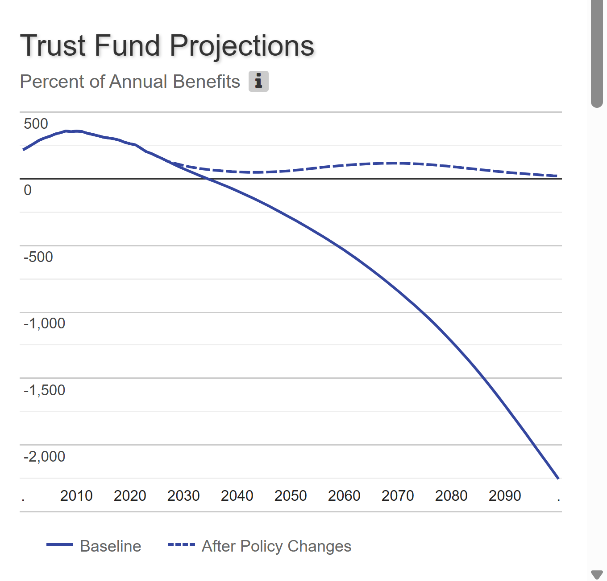

Results

Slide 27
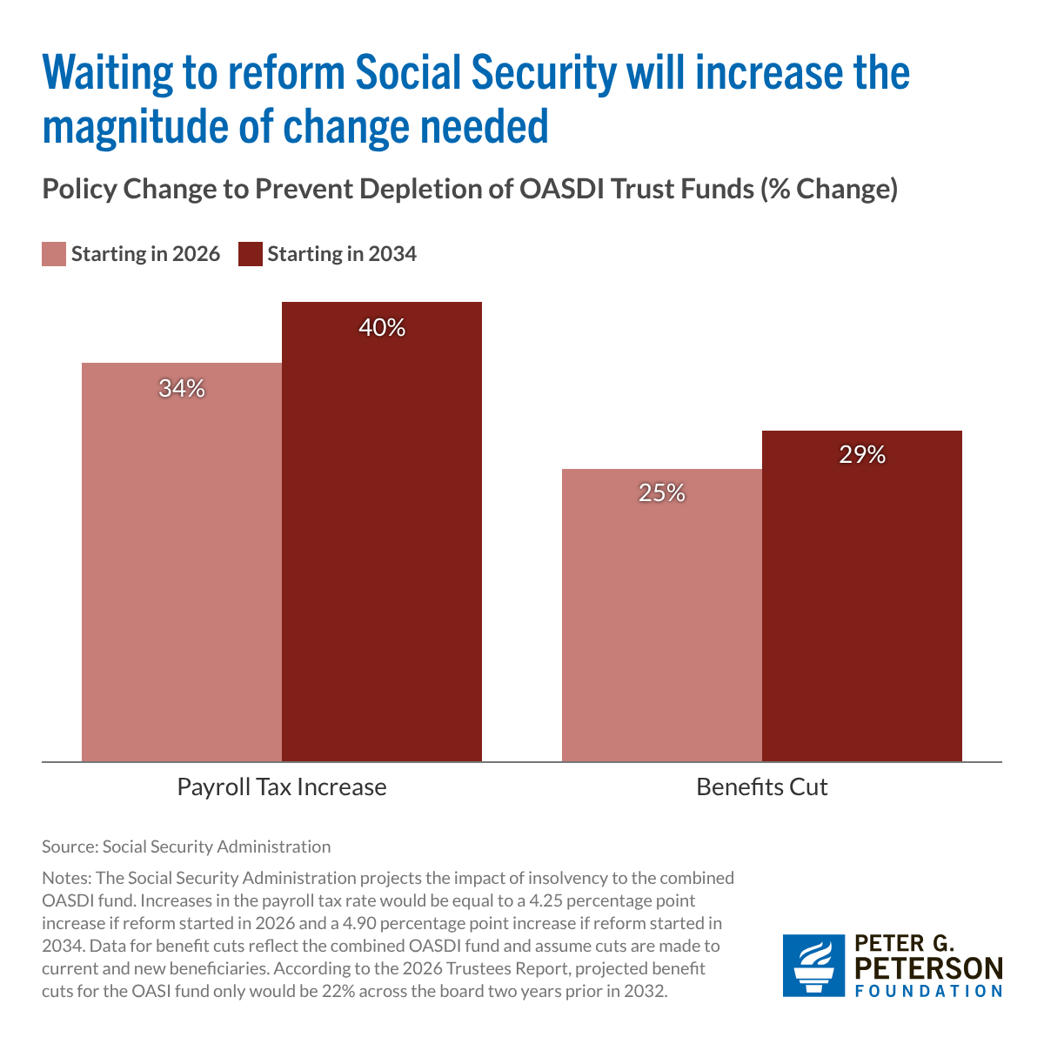
The Sooner We Act the Better
We cannot afford to let the “best” be the enemy of the “good.”

Slide 28
Should Current Retirees Share the Burden?
Current retirees have less flexibility to adjust income and spending.
That may argue for a smaller relative burden, but not zero.
Also, higher income retirees have more flexibility in adjusting spending.
My opinion, for intergenerational fairness and for social solidarity, the more affluent of our generation should bear some burden

Slide 29
Summary
Social Security is an important part of the social safety net.
The OASI Trust Fund is likely to be exhausted in 2032.
Why are the funds being depleted?
  An aging population and slower growth in the labor force.
What happens when the funds are depleted?
  Benefits may have to be reduced by 22%, but the system will continue
Solutions abound. The problem is political will.
  The needed changes will be unpopular, but they are manageable. The longer we wait the bigger the problem.
There is hope: both the Senate and House are considering different bills to form a commission to make proposals.

Slide 30
Let’s Hear from You!
Geoffrey Woglom grwoglom@amherst.edu
Slides available
https://www.needecon.org/delivered_presentations.php
Additional Material
https://sites.google.com/view/macro-current-issues/social-security

