Slide 1
Osher Lifelong Learning Institute, Winter 2022
Contemporary Economic Policy
Santa Clara University
February 9, 2022
National Economic Education Delegation

Slide 2
National Economic Education Delegation
Vision
  One day, the public discussion of policy issues will be grounded in an accurate perception of the underlying economic principles and data.
Mission
  NEED unites the skills and knowledge of a vast network of professional economists to promote understanding of the economics of policy issues in the United States.
NEED Presentations
  Are nonpartisan and intended to reflect the consensus of the economics profession.

Slide 3
Course Outline
Contemporary Economic Policy
  Week 1 (1/5): US Economy & Coronavirus Economics
  Week 2 (1/12): Climate Change Economics (Bevin Ashenmiller, Occidental College)
  Week 3 (1/19): Health Economics (Me)
  Week 4 (1/26): Economics of Immigration (Jennifer Alix-Garcia, Oregon St.)
  Week 5 (2/2): Infrastructure Economics (Mallika Pung, Univ. of New Mexico)
  Week 6 (2/9): The U.S. Safety Net (Marianne Bitler, UC Davis)

Slide 4


The U.S. Safety Net
An Overview of United States Safety Net Programs
Marianne Bitler
University of California, Davis and Federal Reserve Bank of Minneapolis

Slide 5
The views expressed are those of the author and not necessarily those of the Federal Reserve Bank of Minneapolis or the Federal Reserve System.

Slide 6
National Economic Education Delegation
Vision
  One day, the public discussion of policy issues will be grounded in an
  accurate perception of the underlying economic principles and data
Mission
  NEED unites the skills and knowledge of a vast network of professional economists to promote understanding of the economics of policy issues
  in the United States
NEED Presentations
  Are nonpartisan and intended to reflect the consensus of the economics profession

Slide 7
Who Are We?
Honorary Board: 47 members
  2 Fed Chairs: Janet Yellen, Ben Bernanke
  6 Chairs Council of Economic Advisers
    Furman (D), Rosen (R), Bernanke (R), Yellen (D), Tyson (D), Goolsbee (D)
  3 Nobel Prize Winners
    Akerlof, Smith, Maskin
Delegates: 500+ members
  At all levels of academia and some in government service
  All have a Ph.D. in economics
  Crowdsource slide decks
  Give presentations
Global Partners: 45 Ph.D. Economists
  Aid in slide deck development

Slide 8
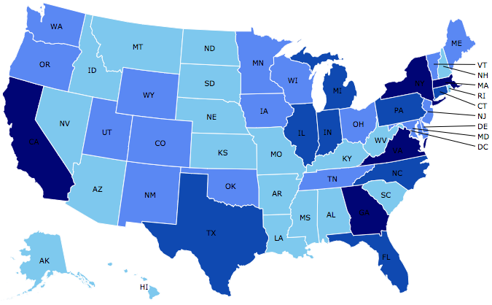
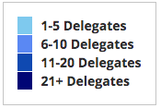
Where Are We?

Slide 9
Credits and Disclaimer
This slide deck was authored by:
  Ann Stevens, University of Texas – Austin
  Natalie Sweet, University of California – Davis
This slide deck was reviewed by:
  Diane Whitmore Schanzenbach, Northwestern University
  Ron Haskins, Brookings Institution
Disclaimer
  NEED presentations are designed to be nonpartisan
  It is, however, inevitable that the presenter will be asked for and will provide their own views
  Such views are those of the presenter and not necessarily those of the National Economic Education Delegation (NEED)

Slide 10

Overview of Major Safety Net Programs
What programs are included in the “safety net”?
  Means-tested (must have low income to receive)
  Federal programs (often with state partnership in financing
  & running programs)
  Provision of cash, services or in-kind benefits, tax credits/refunds
What programs are not included?
  Social Insurance: non-means tested, participants pay in to system
    Example: Unemployment Insurance, Social Security, Disability Insurance
    (Though these programs also assist the poor)
ü
û

Slide 11
Major Safety Net Programs
Medicaid
Supplemental Security Income (SSI)
Temporary Assistance to Needy Families (TANF)
  (formerly AFDC)
Earned Income Tax Credit (EITC)
Supplemental Nutrition Assistance Program (SNAP)
  (formerly food stamps)
School nutrition programs
Special Supplemental Nutrition Program for Women, Infants and Children (WIC)
Housing Assistance
  Vouchers
  Rental Assistance
  Public Housing
Head Start

Slide 12


Major Safety Net Programs
Medicaid
Supplemental Security income (SSI)
Temporary Assistance to Needy Families (TANF)
  (formerly AFDC)
Earned Income Tax Credit (EITC)
Supplemental Nutrition Assistance Program (SNAP)
  (formerly food stamps)
Housing Assistance
  Vouchers
  Rental Assistance
  Public Housing
School nutrition programs
Special Supplemental Nutrition Program for Women, Infants and Children (WIC)
Headstart

Slide 13


Major Safety Net Programs
Medicaid
Supplemental Security income (SSI)
Temporary Assistance to Needy Families (TANF)
  (formerly AFDC)
Earned Income Tax Credit (EITC)
Supplemental Nutrition Assistance Program (SNAP)
  (formerly food stamps)
School nutrition programs
Special Supplemental Nutrition Program for Women, Infants and Children (WIC)
Housing Assistance
  Vouchers
  Rental Assistance
  Public Housing
Headstart
EITC
TANF
SSI

Slide 14


Major Safety Net Programs
Medicaid
Supplemental Security income (SSI)
Temporary Assistance to Needy Families (TANF)
  (formerly AFDC)
Earned Income Tax Credit (EITC)
Supplemental Nutrition Assistance Program (SNAP)
  (formerly food stamps)
School nutrition programs
Special Supplemental Nutrition Program for Women, Infants and Children (WIC)
Housing Assistance
  Vouchers
  Rental Assistance
  Public Housing
Headstart

Slide 15


Major Safety Net Programs
Medicaid
Supplemental Security income (SSI)
Temporary Assistance to Needy Families (TANF)
  (formerly AFDC)
Earned Income Tax Credit (EITC)
Supplemental Nutrition Assistance Program (SNAP)
  (formerly food stamps)
School nutrition programs
Special Supplemental Nutrition Program for Women, Infants and Children (WIC)
Housing Assistance
  Vouchers
  Rental Assistance
  Public Housing
Head Start

Slide 16
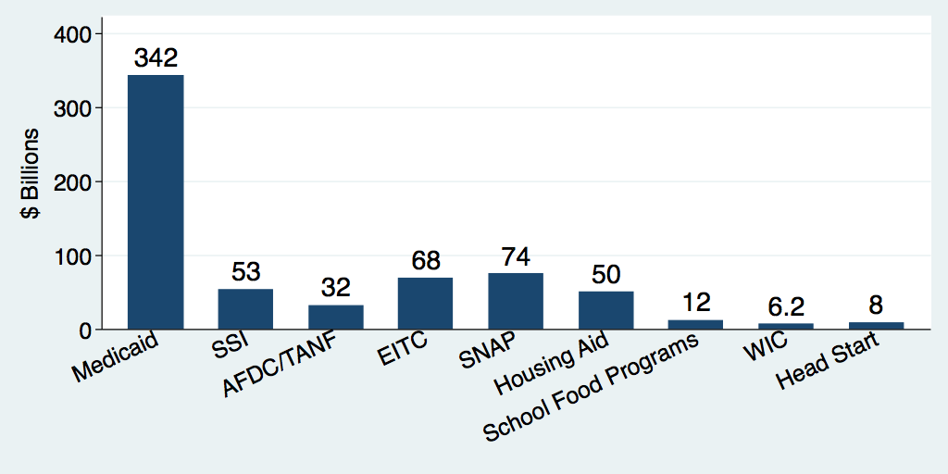
U.S. Safety Net Programs, Federal Expenditures
2014 or 2015
9% of the Federal Budget
1.8% of the Federal Budget

Slide 17
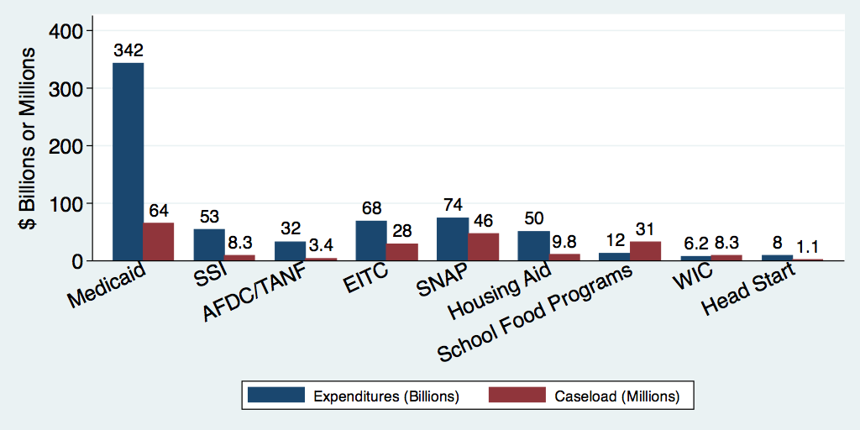
U.S. Safety Net Expenditures ($ Billions) and Caseload (Millions), 2014 or 2015

Slide 18
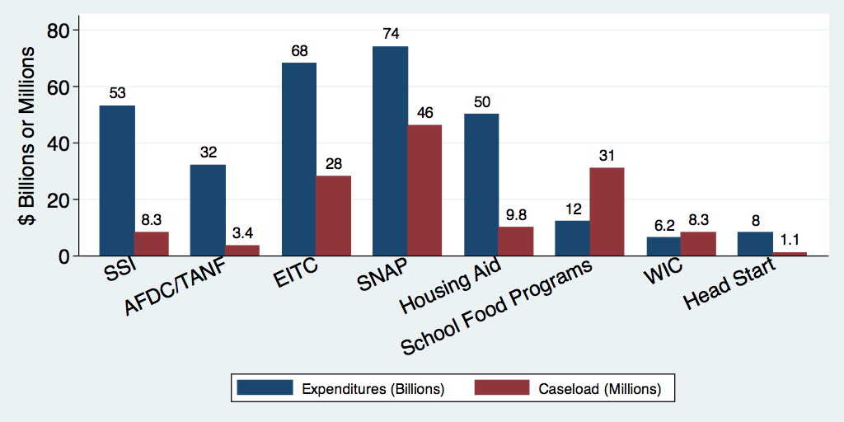
U.S. Safety Net Expenditures ($ Billions) and
Caseload (Millions) – No Medicaid, 2014 or 2015

Slide 19
MEDICAID & CHIP
Eligibility
  Expansion states: most under age of 65 with incomes < 133% of poverty line
  Non-expansion states: children with income < 133% of poverty line; parents up to lower income cutoffs, ~43% of poverty line.
  CHIP: children up to 200% of poverty line (46 states)
Participants
  74.9 million people in 2017 on Medicaid (including CHIP)
Spending
  Total spending in 2016 was $565.5 billion (63% federal)
Notes:
https://www.cms.gov/Research-Statistics-Data-and-Systems/Research/ActuarialStudies/Downloads/MedicaidReport2015.pdf
https://www.kff.org/medicaid/fact-sheet/where-are-states-today-medicaid-and-chip/

Slide 20
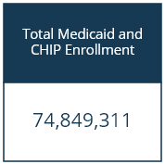
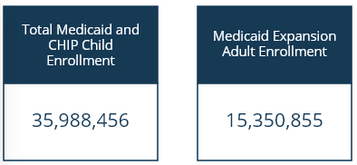
Eligibility & Enrollment
Children
Pregnant women
Very low-income adults
People with disabilities
Elderly, poor adults
23%
50%

Slide 21
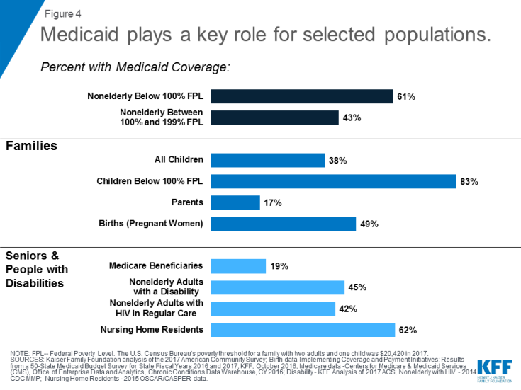

Slide 22
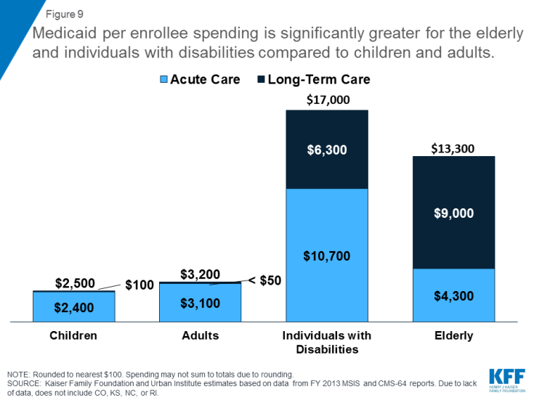

Slide 23
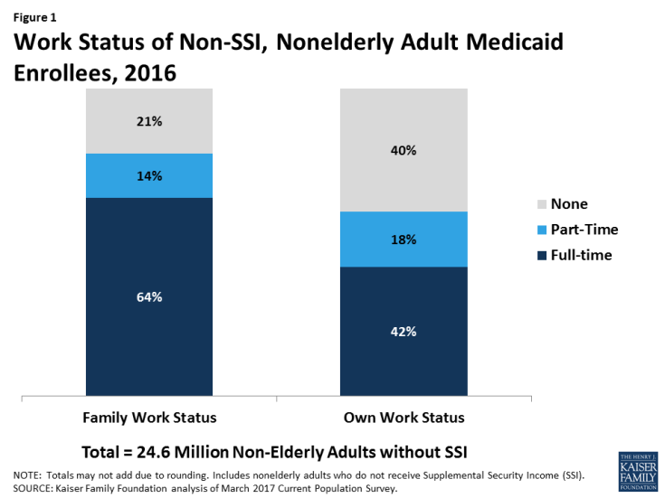
MEDICAID & WORK
21% of adult enrollees
in families with no adult worker
40% of adult enrollees do not work themselves
Notes:
https://www.cms.gov/Research-Statistics-Data-and-Systems/Research/ActuarialStudies/Downloads/MedicaidReport2015.pdf
https://www.kff.org/medicaid/fact-sheet/where-are-states-today-medicaid-and-chip/

Slide 24
Supplemental Security Income (SSI)
Eligibility: Disabled/blind adults and children with low income; people 65 and older with low income.
Participants: In 2016, 4.8 million people received SSI.
Spending: Total spending from June 2015-June 2016 was roughly $53 billion.
Notes:
https://www.ssa.gov/policy/docs/statcomps/di_asr/2016/sect05.html

Slide 25

TANF: Temporary Assistance for Needy Families
Formerly AFDC: Aid to Families with Dependent Children
Eligibility: Poor families with children, primarily single mothers
Federal limit of 60 months of lifetime benefits
  Some states have shorter limits
  Work, job search, or training requirements
Participants: In 2017, 2.5 million families
Spending: In 2017, total spending of $31.7 billion ($17.3 billion federal)
Notes:
http://www.acf.hhs.gov/sites/default/files/ofa/tanf_financial_data_fy_2015.pdf
https://www.acf.hhs.gov/ofa/resource/tanf-caseload-data-2017
https://www.cbpp.org/sites/default/files/atoms/files/tanf_spending_us.pdf

Slide 26
$1,258
Monthly income limits vary:
- $1,258 in CA
- $518 in Kansas
$518
Notes:
https://fas.org/sgp/crs/misc/R43634.pdf

Slide 27
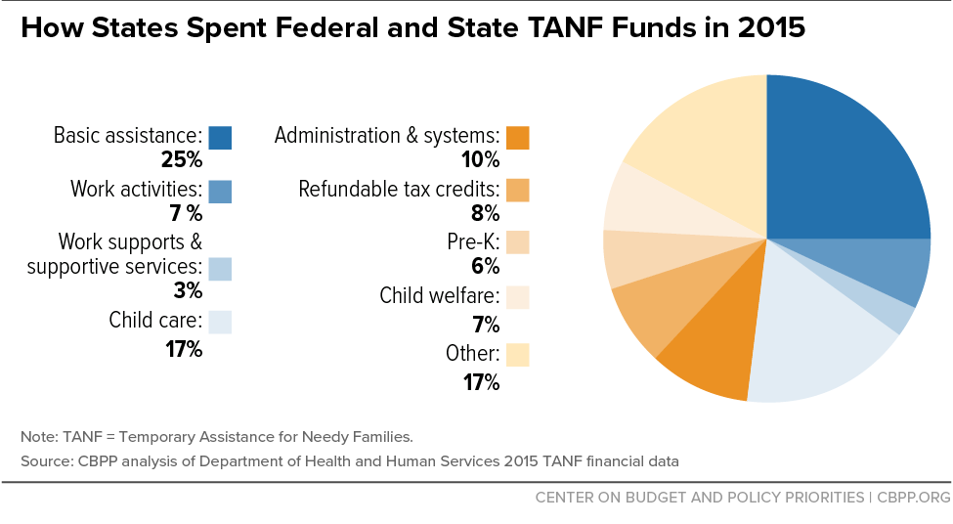

Slide 28
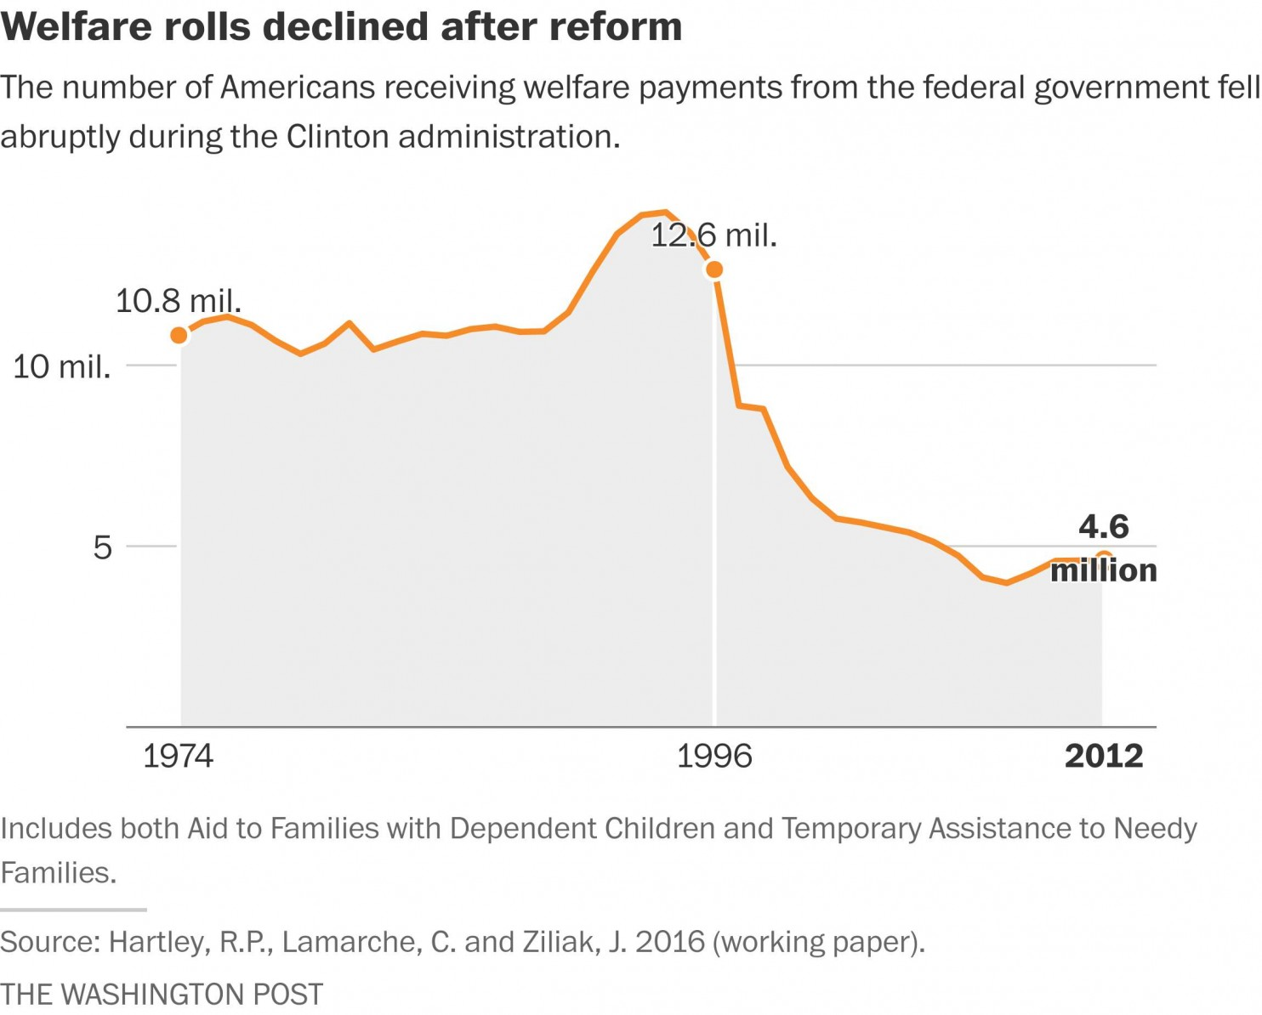
Caseloads have clearly fallen and stayed down, even during recession

Slide 29

EITC: Earned Income Tax Credit
Federal tax credit designed for low
and mid-income working people
Eligibility- Working families with
children that have annual incomes
below a range of $39,000 to $53,000
  Small credit for working individuals with no children & low incomes
Participants - In 2015, 28 million working families and individuals received EITC
Spending- In the 2015, the cost of EITC was $68.5 billion

Slide 30
SNAP: Supplemental Nutrition Assistance Program
Nutrition assistance to low-income individuals and families
Eligibility: Monthly income no higher than 130% of the poverty level for their household size.
  Some people who receive SSI are automatically eligible for SNAP, dependent on state laws.
Participants: In 2017, an average of 42.1 million receiving SNAP.
Spending: In 2017, $68 billion was spent to fund SNAP.

Slide 31
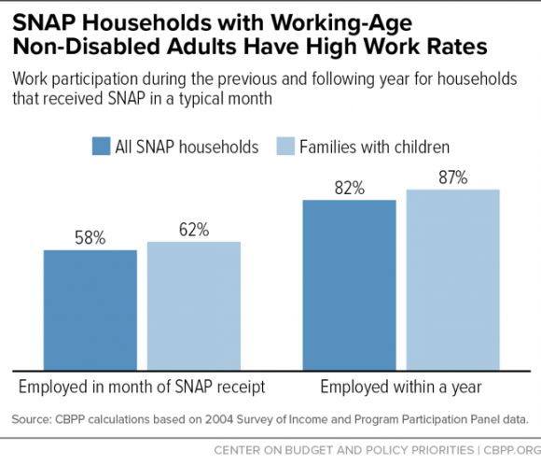
SNAP
(Supplemental Nutrition Assistance Program)
Most SNAP recipients
are employed
Notes:
http://www.fns.usda.gov/sites/default/files/pd/SNAPsummary.pdf

Slide 32

SCHOOL FOOD PROGRAMS
(National School Lunch Program)
The school lunch program serves nutritionally balanced low-cost or free lunches to children in school each day.
Eligibility: Students who attend public and non-profit private schools, as well as residential child care institutions, are potentially eligible.
Participants: Over 30.4 million children every day were served by the program in the 2016 year.
Spending: In 2016, the program cost was $13.6 billion.
Notes:
http://www.fns.usda.gov/sites/default/files/NSLPFactSheet.pdf
https://www.ers.usda.gov/topics/food-nutrition-assistance/child-nutrition-programs/national-school-lunch-program.aspx

Slide 33
WIC (Special Supplemental Nutrition Program for Women, Infants, and Children)
Eligibility: Low income women, infants, and children up to the age of 5 who are at nutritional risk.
Participants: During 2016, WIC served 8 million people.
  3.98 million participants were children,
  1.88 million were infants, and
  1.84 million were pregnant women.
Spending: In 2017, the WIC program cost $6.5 billion.
Notes:
http://www.fns.usda.gov/sites/default/files/wic/WIC-Fact-Sheet.pdf https://fns-prod.azureedge.net/sites/default/files/pd/27wilatest.pdf
https://www.fns.usda.gov/wic/frequently-asked-questions-about-wic#3

Slide 34
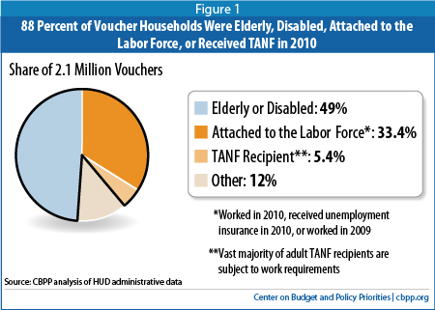
HOUSING AID
Housing Choice Voucher Program (Section 8)
Eligibility: Low income families, the elderly, and the disabled are eligible to receive the vouchers. Family income must be less than 50% of local median income.
Participants: Just over 5.3 million individuals, or 2.2 million low income families utilize the vouchers.
Spending: During the 2016 year, the amount spent was $17.5 billion.
Notes:
https://www.cbo.gov/sites/default/files/114th-congress-2015-2016/reports/50782-LowIncomeHousing-OneColumn.pdf
https://www.cbpp.org/housing-choice-voucher-fact-sheets

Slide 35

HEAD START
Eligibility: Primarily low-income children (0-5).
Participants: In 2016, 1.1 million children were served by the program.
Spending: In the 2016 year, $9.16 billion
was spent on Head Start.
Notes:
https://www.cfda.gov/index?s=program&mode=form&tab=core&id=98bf5609ee11a5a543f8f8f82f4de9f0
https://eclkc.ohs.acf.hhs.gov/hslc/data/factsheets/2014-hs-program-factsheet.html
https://eclkc.ohs.acf.hhs.gov/about-us/article/head-start-program-facts-fiscal-year-2016
2014

Slide 36




Safety Net: A Collection of Separate Programs
Medical Assistance
Cash Assistance
Nutritional Assistance
Housing Programs

Slide 37
Safety Net: A Collection of Separate Programs
Different forms of assistance
  Medical Assistance
  Cash Assistance
  Nutritional Assistance
  Housing Programs
Different eligibility (income
& categorical)
Different work rules and limits
Different agencies and funding streams

Slide 38


Social Insurance Programs: Not Means-Tested
Social Security
(Old Age and Survivors Insurance Program)
Medicare
Unemployment Insurance
Disability Insurance
Workers’ Compensation

Slide 39
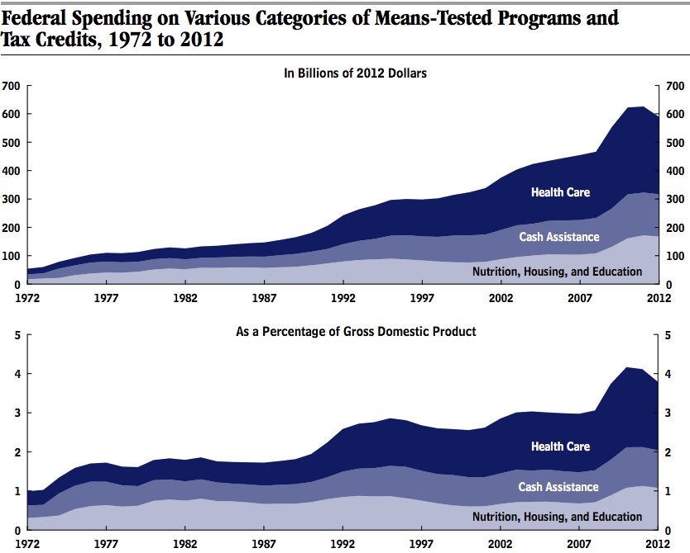
Expenditures on Means-Tested Transfers over Time
Source: Congressional Budget Office

Slide 40
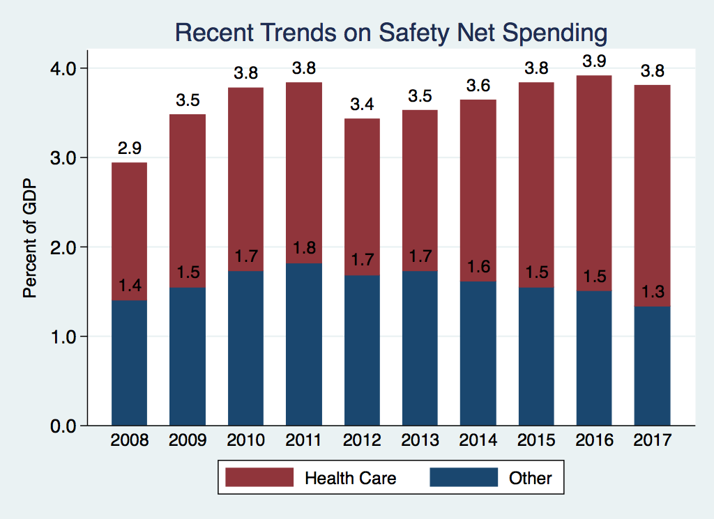
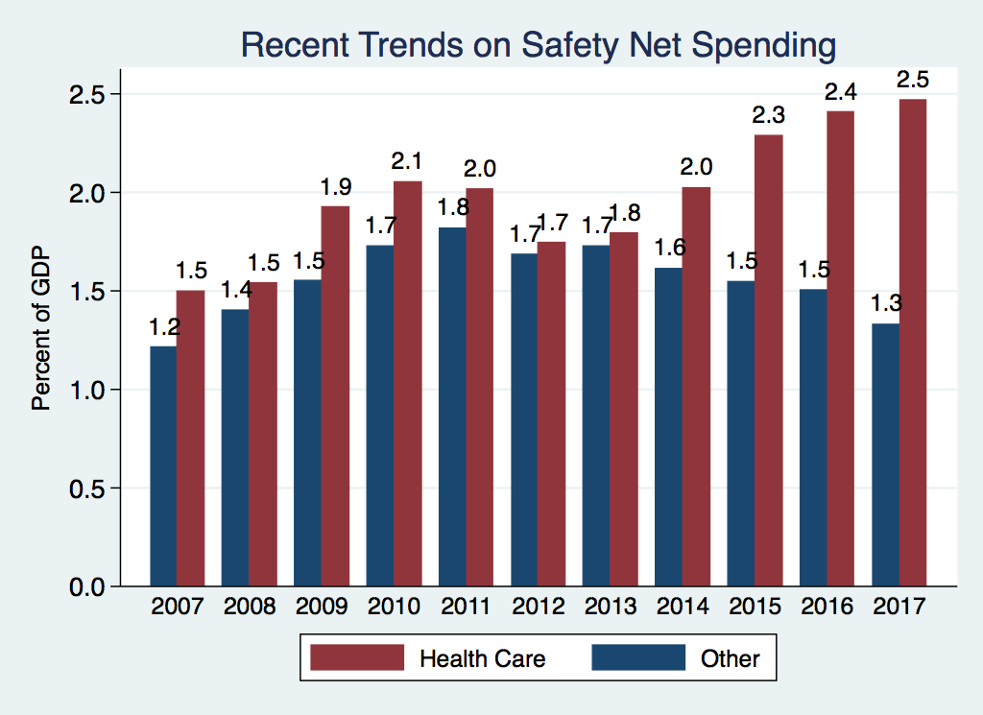
Expenditures on Means-Tested Transfers over Time
Federal Mandatory Spending for Means-Tested Programs, 2008 to 2028

Slide 41
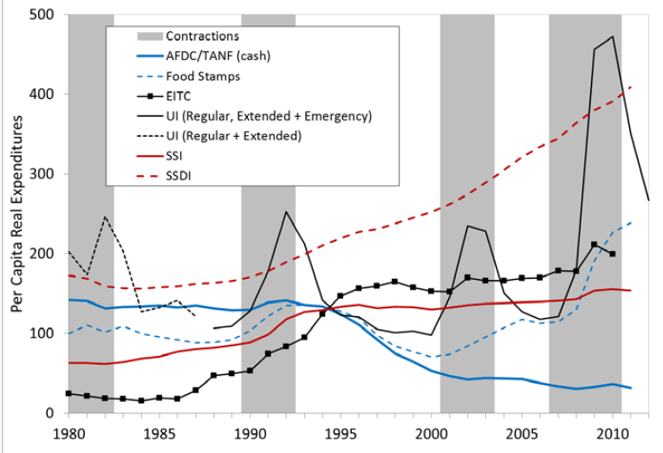
Expenditures on Specific Means-Tested Programs
Source: Bitler and Hoynes, 2010

Slide 42
Notes:
https://www.cbo.gov/sites/default/files/114th-congress-2015-2016/reports/49887-TANF.pdf

Slide 44
Effects
of Safety Net Programs
Positive
Reduced Poverty
Improved Health
Increased Mobility
Negative
Reduced Work Hours
Single Parenthood
“Dependency”
Intended
Effects
Unintended
Effects

Slide 45
Challenge: Measuring Effects of Safety Net on Poverty
Official Poverty Measures: Includes only cash income
  Excludes: SNAP, EITC, Housing Assistance
Supplemental Poverty Measure (SPM):
  Includes in-kind & after tax benefits.
SPM is a more inclusive measure of what the safety net does.

Slide 47
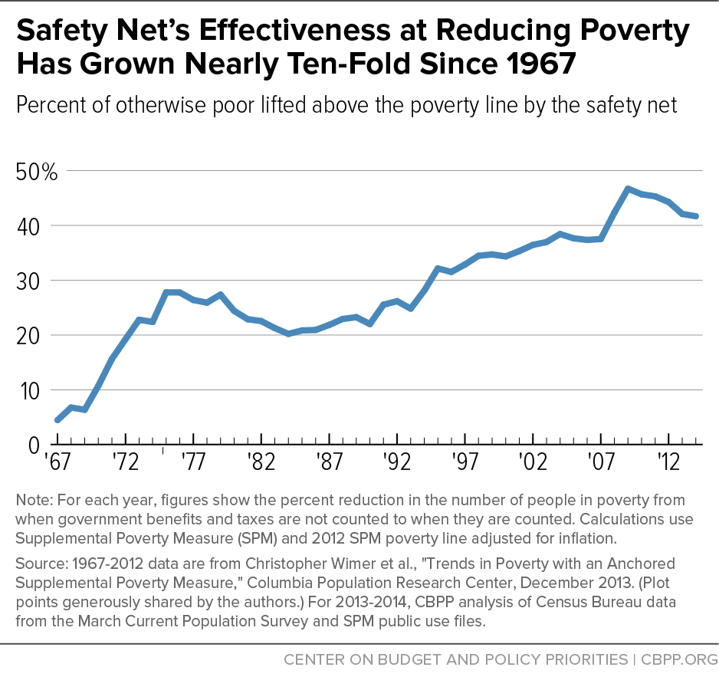

Slide 48
Total Effects are Complicated
=
+
Total Effect
of Safety Net
Mechanical Effects
of Adding Income/Resources
Changes in Behavior Due to Safety Net
By way of example:
Decrease Poverty
Increase Poverty
=
+
Total Effect
of TANF
Cash Benefits
Reduction in Work
?
48

Slide 49
Total Effects are Complicated: EITC
=
+
Total Effect
of Safety Net
Mechanical Effects
of Adding Income/Resources
Changes in Behavior Due to Safety Net
Decrease Poverty
Decrease Poverty
=
+
Total Effect
of EITC
Cash Benefits
Increase in Work
49

Slide 50
Full Effect of Safety Net: Includes Behavioral
Changes
Focus on work effects of safety net (one of several possible unintended consequences)
What does economics tell us about safety net programs and work?
Reduces benefits with earnings
Grant amount falls with earnings
TANF maximum grant
Provides benefits
Reduces benefits with earnings

Slide 51
Two Effects of Welfare Payment on Work
Welfare Provides Income
Work Reduces Welfare Payments
  More income increases consumption
  One form of consumption is leisure
  More income reduces work (by encouraging leisure)
Rising earnings reduce benefit level
Wage for working is effectively reduced
Welfare discourages work (due to benefit reduction)

Slide 52
What do we know about magnitude of work disincentives from welfare?
Many studies
Basic approach is important

Slide 53
Perfect (but Impossible) Approach to Research
Randomly divide population into two groups
Offer some individuals welfare, others no welfare
Compare how much the two groups work
Challenge of social science:
no controlled experiments

Slide 54
Challenges to Empirical Studies
Does welfare use cause low work effort?
Welfare use
Low work effort
HARD to distinguish between these two
different scenarios
??
But we know low earnings (low work) result in eligibility for welfare
Welfare use
Low work effort

Slide 55
How can we separate correlation (no direction implied) from cause and effect?
Can compare work behavior among welfare recipients
  Across states with different rules/benefit levels
  Before-after policy changes within states
  Challenge: state policies may differ in multiple ways
  Rare to implement NEW safety net programs to study

Slide 56
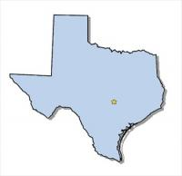
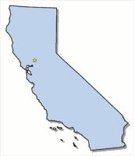
Compare Work Effort in States With Different
Benefit Levels
Benefits Year 1
Benefits Year 2
Work Year 1
Work Year 2
Benefits?
Work effort?

Slide 57
How can we separate correlation (no direction implied) from cause and effect?
Can compare work behavior among welfare recipients
  Across states with different rules/benefit levels
  Before-after policy changes within states
  Challenge: state policies may differ in multiple ways
  Rare to implement NEW safety net programs to study

Slide 58
What evidence do we have?
What does it say?
“
“
Studies across states, or across states
over time, of policy changes
~ Robert Moffitt (1983)
AFDC program as a whole reduced hours of work by participating single parents by:
    10% to 50%, 546 hours per year

Slide 59
What evidence do we have?
What does it say?
Study of food stamp program (FSP) introduction
Work hours per year fall by 183 (20%) among single-parent families in counties introducing FSP (relative to counties that did not)
About 32% of single parents received food stamps

Slide 60
What evidence do we have?
What does it say?
Overall effect = 183 hours =
fraction receiving food stamps * (effect for recipients) +
fraction not receiving * (effect for non-recipients)
183 = .32 (effect among recipients) + .68 (0)
Effect among recipients = 183/.32 or 571 hours per year
OR
Food Stamp Program as a whole reduced work for recipients by 571 hours per year

Slide 61
Welfare (TANF) today
Adds explicit work requirements to welfare program.
Increase in employment with welfare reform suggests TANF
may have smaller work disincentives than prior programs.

Slide 62
International Evidence (Developing Countries)
Abhijit Banerjee & co-authors look across many randomized experiments with cash transfers in developing countries.
Most programs were cash transfers with no benefit reduction for work.
  This is DIFFERENT than typical U.S. transfer programs.
Treatment groups received cash transfers; control groups did not.

Slide 63
Little systematic evidence that cash transfers cause
major reductions in work among the poor

Slide 64
How large are welfare/work disincentives?
United States: old-style AFDC/Food Stamp programs reduced work by around 500 hours per year among recipients.
TANF likely has smaller effects on work (designed to encourage/require work).
International evidence suggests fairly small effects of cash assistance on work.

Slide 65
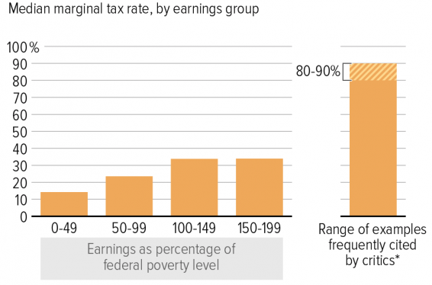
How Big Are Work Disincentives?
Source: CBPP – It Pays to Work: Work Incentives and the Safety Net

Slide 66
Alternative to multi-part safety net:
Universal Basic Income (UBI)
UBI is an unconditional cash transfer that is regularly and equally distributed to everyone over 18, regardless of income or need.
It is a significant departure from U.S.-style welfare system.
Notes:
A current solution proposed to not only help the unemployed, but all citizens, is the implementation of a universal basic income. A universal basic income is a cash transfer of a set amount given to individuals over the age of 18. This cash transfer is unconditional, meaning that it is not a means-tested program. Everyone receives the grant, not just the unemployed or those who are low income. Examples of UBI have been observed and tested around the world and have been proven to be a possible alternative to current safety net programs.

Slide 67
Examples of UBI or similar programs:
Alaska Permanent Fund:
  Alaskan residents have been receiving a percentage of the Alaskan
  natural extraction revenue.
  Showed no effect on employment
  Similar to a small UBI
Native American Casinos:
  2010 study showed that some Native American groups received a percentage
  of revenue from casinos.
  Showed that recipients didn’t decrease hours worked.
Notes:
https://www.bloomberg.com/view/articles/2018-01-23/a-basic-income-for-everyone-it-s-not-a-crazy-idea
https://www.economist.com/news/finance-and-economics/21741170-plenty-ubi-trials-are-under-way-more-come-lapsing-finlands
There are several programs that have been implemented in the US, and around the globe, that resemble a UBI.
The Alaskan Permanent Fund is one example of a unconditional cash transfer. Since 1976, Alaskan residents have been receiving payments from Alaskan natural resource revenues. This cash transfer can be compared to a UBI since it is unconditional-everyone receives it regardless of need. With cash payments of only about a couple thousand dollars a year, there was no reduction in employment observed. Though, the Alaskan Permanent Fund is an example of a smaller UBI cash transfer.
Native American casinos also provide an example of UBI. Certain Native American groups receive a percentage of revenue from running casinos. This situation is similar to UBI because it is not a means-tested program.
Most recently, at the beginning of 2017, Finland implemented a 2-year UBI trial for a group of 2000 unemployed citizens. Each individual received an income of 560 euros per month. Since the trial group only consisted of unemployed individuals, this cash transfer was not considered to be universal. As of late April 2018, the Finnish government has decided against renewing this UBI program.

Slide 68
Universal Basic Income (UBI)
PROS
Provides basic income to everyone
Will help supplement income in face of job loss or low wages
Less disincentive for work
  No benefit phase out
  (based on findings from the Alaskan Permanent Fund where Alaskan residents receive a percent of natural resource extraction profits)
ü
Notes:
https://www.forbes.com/sites/adigaskell/2018/03/05/does-a-universal-basic-income-discourage-work/2/#723c460c6e2a
https://www.bloomberg.com/view/articles/2018-01-23/a-basic-income-for-everyone-it-s-not-a-crazy-idea
UBI provides a basic income supplement to everyone-there are no categorical or income requirements needed to receive the cash transfer.
With the rapid advancement of technology, there is a growing fear of losing jobs to due to automation. UBI has become a proposed solution to help aid the unemployed as automation becomes more prevalent.
Based on several situations that closely resembled a true UBI, evidence suggests that cash grants may have less of a disincentive to work. These results were found both in the Alaskan Permanent Fund example and the Native American casino example.

Slide 69
Universal Basic Income (UBI)
û
CONS
Unaffordable: expensive because of universal nature
Does not address inequality: replaces safety net programs which would provide everyone with transfer incomes, not simply those in need
Negative Incentives on work possible: people wont be as inclined to join the workforce
Delays Discussion of Job Creation: may crowd out discussion of job creation or growth for poverty reduction
Notes:
https://www.ft.com/content/100137b4-0cdf-11e8-bacb-2958fde95e5e
While the idea of implementing a UBI has recently become more popular, there are still those who view it as an unrealistic program with potentially
negative consequences. The main argument against UBI is the high cost. Ultimately, providing every single person with a cash grant is unsustainable without proper funding. Since UBI would replace safety net programs, the inequality gap would rise. Those with high earners would be receiving the same amount of cash transfer as low earners. Some believe that it would also be socially destructive, some people would chose to stay at home instead of work. An increase in those not working could lead to negative social effects that are generally linked to unemployment such as an increase in crimes or drug use. Giving out cash grants could also eliminate incentives to join the workforce. Lastly, providing cash grants does not address the issue of job creation. If automation continues to replace jobs, cash grants can help those whose jobs are replaced, however, it will not create jobs.

Slide 70
Summary: U.S. Safety Net
The U.S. safety net is a complex set of programs to aid the poor.
  Medical, nutrition, education, housing, cash
  Different benefit amounts, eligibility rules, duration of assistance, administration
There are unintended consequences on the labor supply, and possibly on marriage and childbearing as well.
There are substantial direct effects on measured poverty under measures that fully account for benefits.

Slide 71
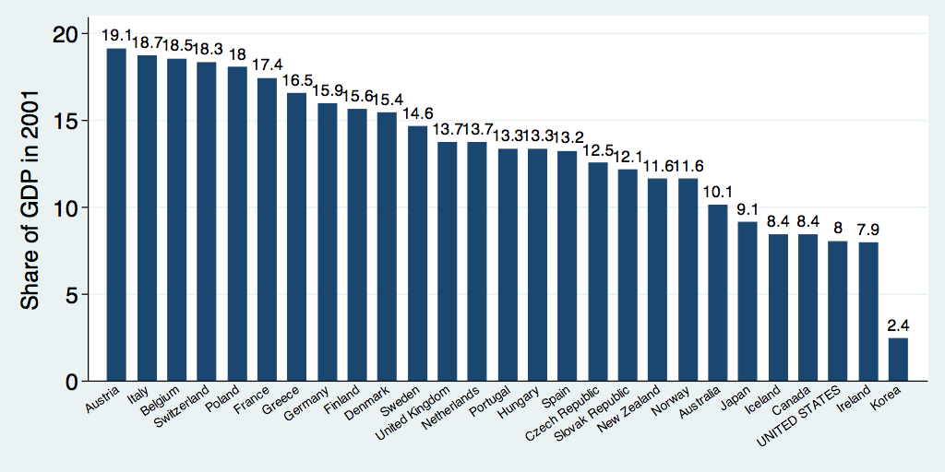
Safety Net Spending Across the OECD
U.S.: 8%
Source: World Bank Social Safety Nets Primer Notes
Notes:
http://siteresources.worldbank.org/SAFETYNETSANDTRANSFERS/Resources/281945-1124119303499/SSNPrimerNote25.pdf

Slide 72
Thank you!
Any Questions?
www.NEEDelegation.org
Marianne Bitler, Ph.D.
Bitler@UCDavis.edu
Contact NEED: info@NEEDelegation.org
Submit a testimonial: www.NEEDelegation.org/testimonials.php
Become a Friend of NEED: www.NEEDelegation.org/friend.php

