Slide 1
The State of the Recovery and the Challenges Ahead
May 21, 2021
North Marin Breakfast Club
Geoffrey Woglom
Professor of Economics (Emeritus)
Amherst College

Slide 2
Who Are We?
Honorary Board: 54 members
2 Fed Chairs: Janet Yellen, Ben Bernanke
1 Secretary of the Treasury: Yellen (D)
6 Chairs Council of Economic Advisers
Furman (D), Rosen (R), Bernanke (R), Yellen (D), Tyson (D), Goolsbee (D)
3 Nobel Prize Winners
Akerlof, Smith, Maskin
Delegates: 585+ members
At all levels of academia and some in government service
All have a Ph.D. in economics
Crowdsource slide decks
Give presentations
Global Partners: 45 Ph.D. Economists
Aid in slide deck development

Slide 3
Available NEED Topics Include:
US Economy
Climate Change
Economic Inequality
Economic Mobility
US Social Policy
Trade and Globalization
Trade Wars
Immigration Economics
Housing Policy
Federal Budgets
Federal Debt
2017 Tax Law
Autonomous Vehicles

Slide 4
Credits and Disclaimer
This slide deck was authored by:
Jon D. Haveman, NEED
Geoffrey Woglom, Amherst College (emeritus)
This slide deck was reviewed by:
Jon Haveman
Disclaimer
NEED presentations are designed to be nonpartisan.
It is, however, inevitable that the presenter will be asked for and will provide their own views.
Such views are those of the presenter and not necessarily those of the National Economic Education Delegation (NEED).

Slide 5
Outline
Where is the recovery now?
How has policy affected the recovery?
Challenges Ahead
What is the cause of the apparent “labor shortage?”
Is there a risk of an increase in inflation?
These challenges have been consuming the financial press since the April Jobs Report and CPI Report.

Slide 6
Real GDP and Potential during 2020
The “output gap” is about $400b
-2.1%
-10.1%
Source: Bureau of Economic Activity https://www.bea.gov/ & CBO

Slide 7
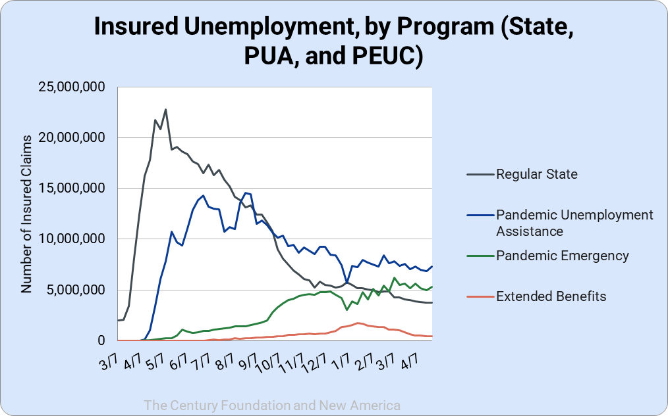
How about the Labor Market?
-8m
Initial Claims: 5/14, 444K. PUA Initial Claims: 95K

Slide 8
Aggregate Data Looks Encouraging
Recovery has been unexpectedly rapid, albeit incomplete, but slowed starting in the second half of 2020.
Why so rapid: There were no short-run macro problems at the start of the crisis.
The only obstacle to a continued recovery:
Resurgence of the virus.
Economic damage due to prolonged job losses and business failures in specific sectors

Slide 9
What Have Been Policy Effects
Monetary Policy acted quickly and effectively to prevent a financial market meltdown and to keep credit flowing. But the Fed lends and does not spend.
Fiscal policy acted quickly, but inevitably made some mistakes.
Stimulus Checks, $268b
Expanded Unemployment, $268b
Paycheck Protection Program, $525b
December and March Packages added another $2.7tr.

Slide 10
K-Shaped Recovery

Slide 11
Key Questions Raised by Previous Slide
Why were low-income households able to maintain spending better than high-income households, in spite of higher unemployment?
What is the difference in spending patterns of high- and low-income households and how did the pandemic affect these spending patterns?

Slide 12
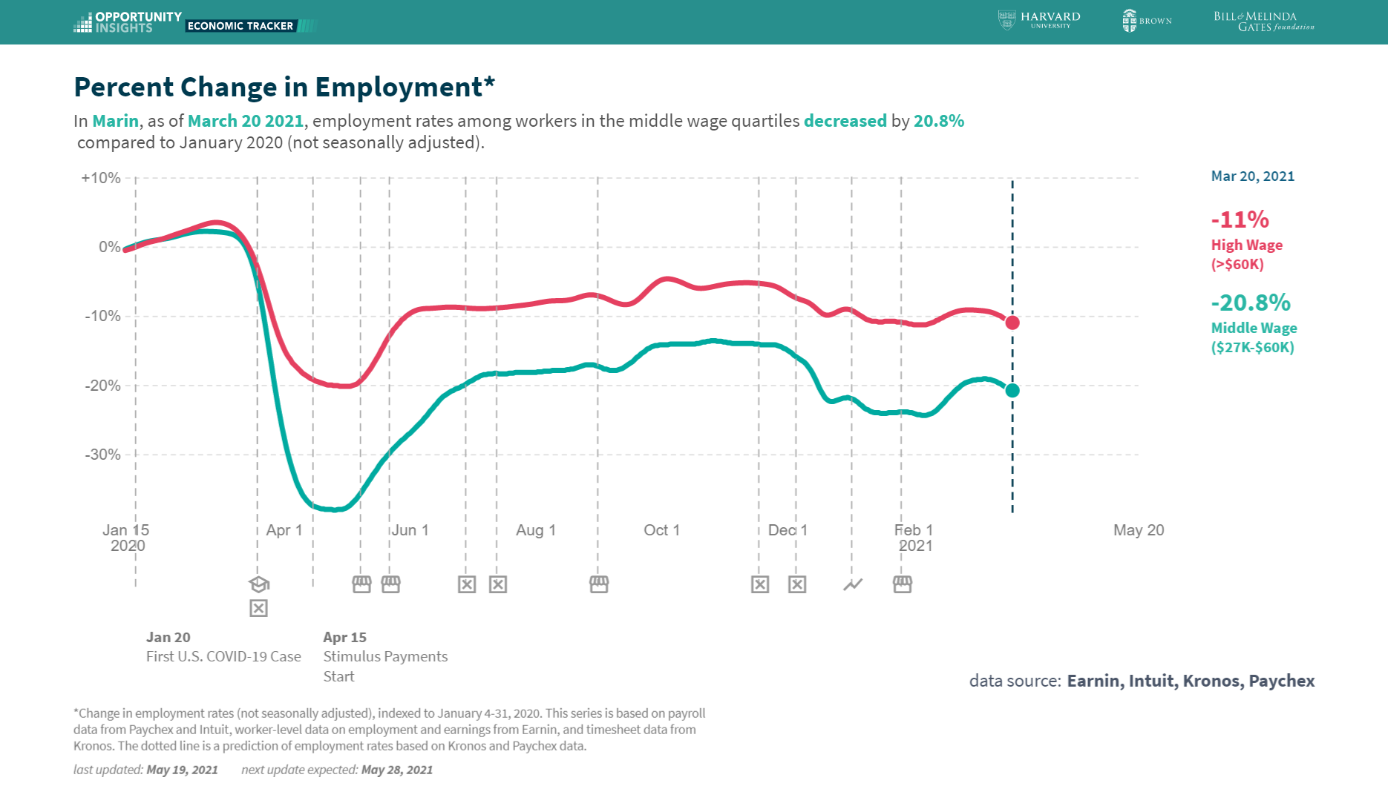
Conditions Closer to Home

Slide 13
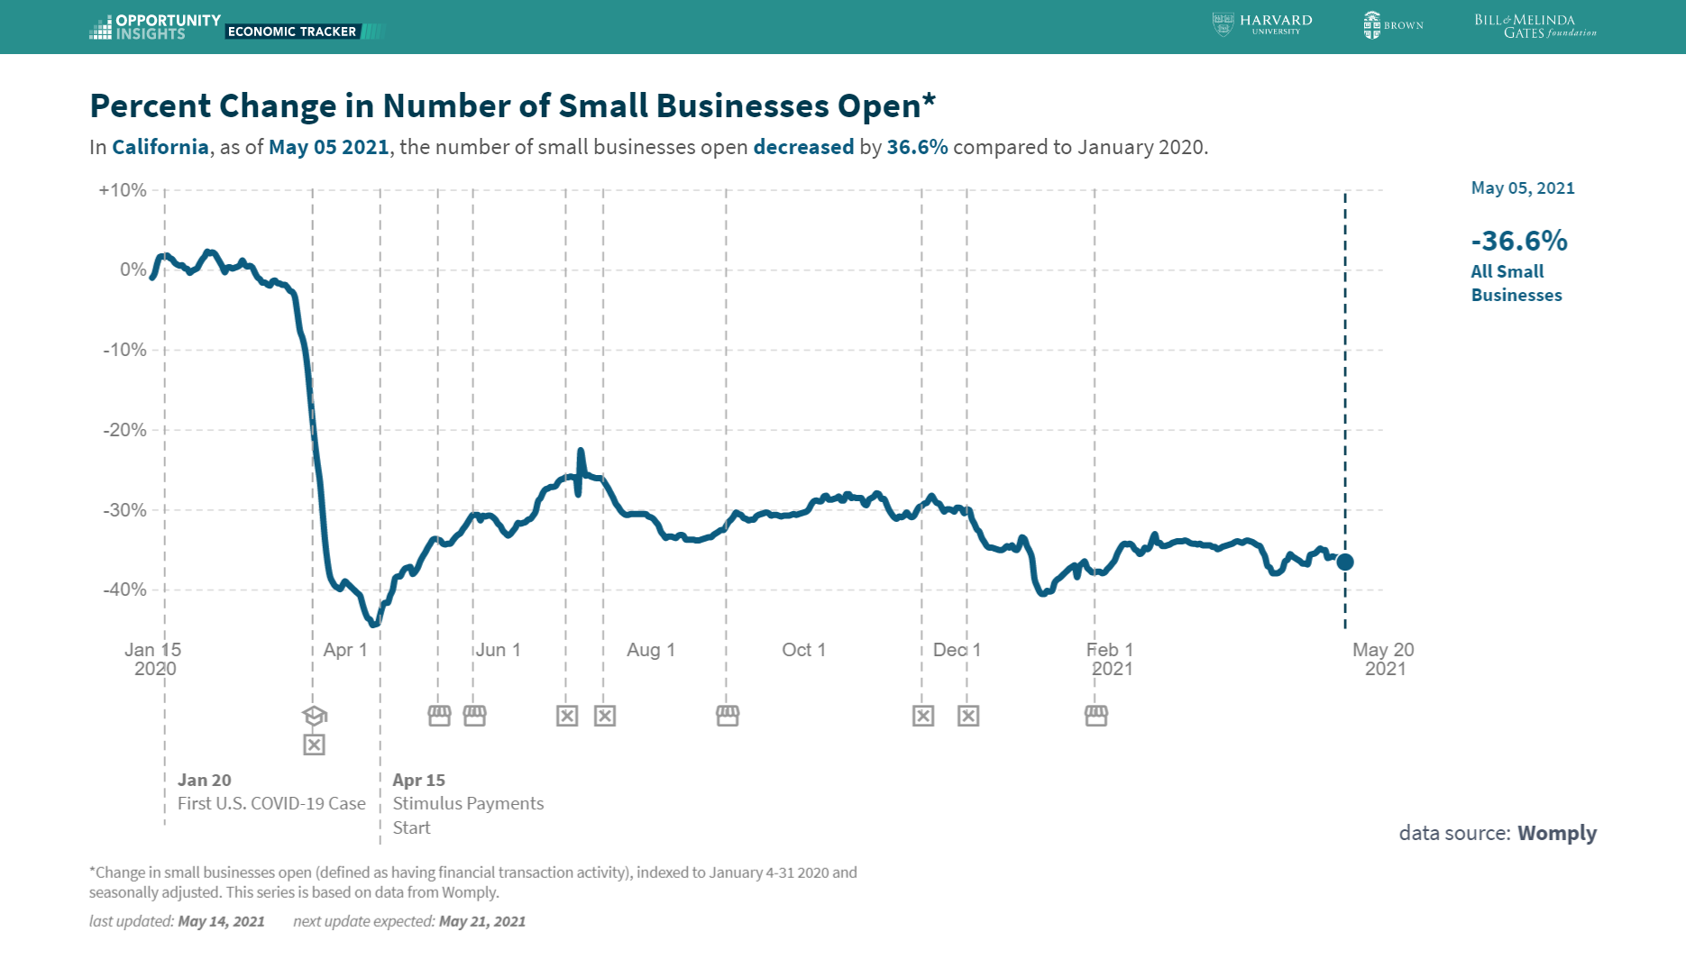
Hard-Hit Sector: Small Business
40% of all jobs are at small firms

Slide 14
Other Hard-Hit Sectors

Slide 15
Explaining the Recovery so Far
Unprecedented Fiscal Rescue Efforts Saved Hard Hit People and Sectors
Stimulus checks and expanded unemployment benefits helped the poor to maintain spending.
PPP, in spite of shortcomings saved, many small firms
Grants to airlines and state and local governments; loans to larger corporations
Inevitably, two big problems
Not everyone in need got help.
Some aid went to individuals and entities that did not need it.

Slide 16
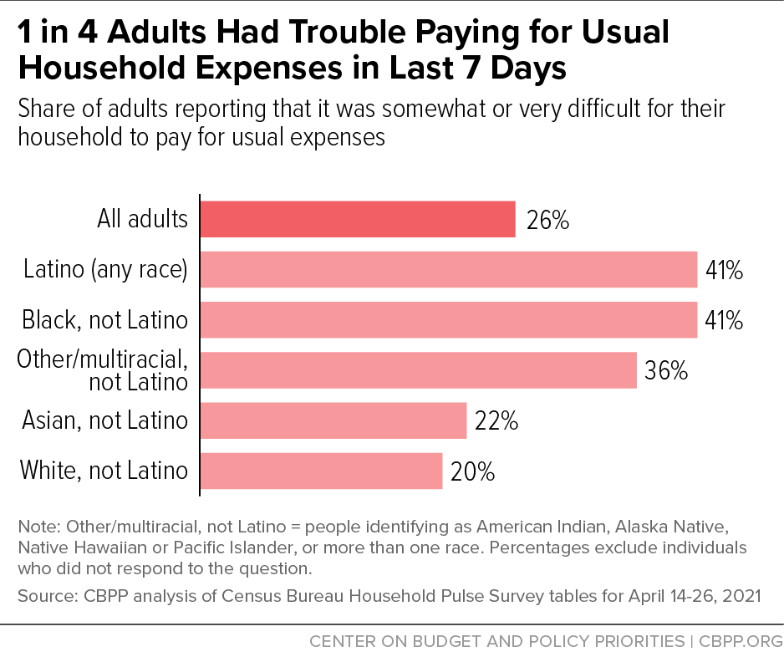
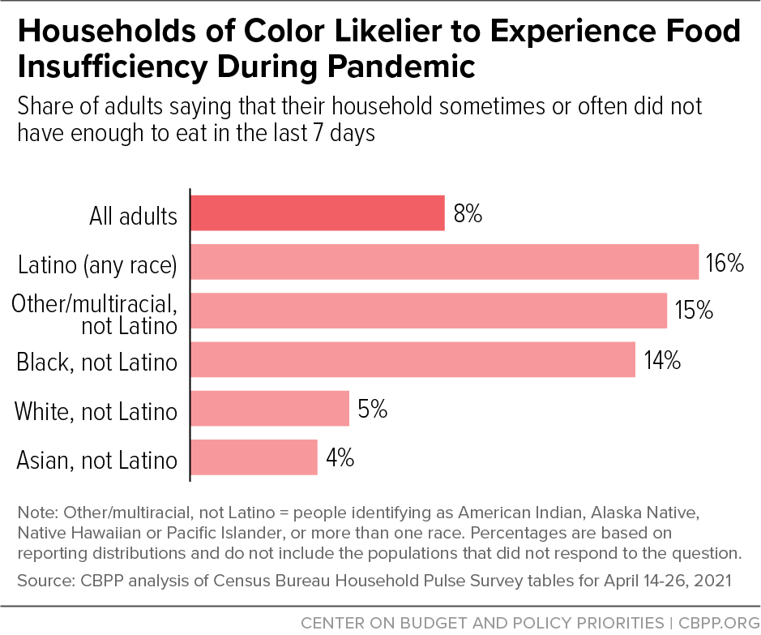
Many People Are Still Really Hurting

Slide 17
Consequence of Fiscal Stimulus So Far
Fed Aid
Saving
“Extra” Saving ~$2.2 trillion

Slide 18
Lessons from the Previous Slide
Cares Act in March 2020 prevented the initial collapse in spending due to COVID restrictions from getting worse due to job losses.
It allowed many, but not all, of the poor to maintain spending (and to stay in their rented houses).
The sharp increase in total savings, however, suggests that much of the aid went to households who did not need it to maintain spending.
Key Question: As the economy reopens, what will high-income households do with “extra” savings?

Slide 19
But What about the Lousy Jobs Report?
What a Difference a Month Makes
March: “Light at the end of the tunnel,” 770K new jobs added
April: Clunk, 266k new jobs, fewer than were added in Feb of 2020

Slide 20
Explanations
Noisy Data
Demand was great in March, but slowed in April; e.g., retail sales in March rose 10.7%, but were flat in April.
Mismatches of jobs and workers.
Supply bottlenecks in many industries
Given the length of the recession it takes time to rematch workers and firms
Workers’ reluctance to take available jobs, i.e., labor shortage
More than 50% of workers are unvaccinated.
Many schools have not reopened and parents need to provide child care.
Expanded unemployment insurance discouraged workers from taking jobs

Slide 21
Expanded Unemployment Benefit
Cares Act added an extra $600 a week to the regular state unemployment, but ended in July
American Rescue Plan reinstated an extra $300 a week benefit to expire in September. (First, $10,600 of UI nontaxable)
As of 5/18, 21 States are foregoing the extra $300 benefit for their unemployed workers.

Slide 22
What about Inflation: Two Views
Treasury Secretary Jane Yellen, 3/14:
To get a sustained high inflation like we had in the 1970s, I absolutely don’t expect that. We have had very well anchored inflationary expectations, and a Federal Reserve that’s learned how to manage inflation.
Former Treasury Secretary Larry Summers, 3/26:
It may be that a way will be found to bring it under control. But as I look at $3 trillion of stimulus, $2 trillion of savings overhang, …,rates expected by the Federal Reserve to be at zero for three years even in a booming economy, …, and much new fiscal stimulus to come — I'm worried.

Slide 23
How Does the Fed “Manage” Inflation?
The Fed has a “dual mandate”
Price stability (2% inflation)
Maximum employment consistent with price stability.
When the Fed fears a rise in inflation, they raise interest rates to lower total spending.
When the Fed fears rising unemployment, they cut interest rates to increase total spending.
At the moment, the Fed appears to be more concerned about its employment objective than in the past.

Slide 24
FOMC Policy Statement 4/28/2021
The Committee decided to keep the target range for the federal funds rate at 0 to 1/4 percent and expects it will be appropriate to maintain this target range until labor market conditions have reached levels consistent with the Committee's assessments of maximum employment and inflation has risen to 2 percent and is on track to moderately exceed 2 percent for some time.
Pretty “Dovish”: 1) Employment objective comes first; 2) Tolerate some higher inflation.

Slide 25
But Hasn’t Inflation Already Been Too High?

Slide 26
Yikes, Inflation Is Already Out of Control
Phil Gramm & Rick Scott, WSJ, May 19,
“Biden’s Plans Are Already Hurting the Recovery: As anti-production policies take hold, supply and worker shortages appear and inflation looms”
The core inflation rate, excluding food and energy, on an annual basis rose in April by 11%, a rate not exceeded since June of 1982. While the price increases are significant, broad and accelerating, are they the temporary effects of demand recovering from the pandemic shutdown more quickly than production, or is there evidence that this is the return of the inflation that plagued us for a generation and we paid such a high price to escape 40 years ago?

Slide 27
Don’t Panic Yet
April’s increase in prices was high, but one month does not an inflation make.
Also, the year-over-year increase of 3% reflects “base effects.”
The CPI in April of 2020 fell relative to March. So, some of that 3 % is a “catchup.”
Inflation measured over the last 13 months is only 2.4% at an annual rate.
More importantly, was the April increase “significant, broad and accelerating?”

Slide 28
The Details of April’s CPI Report

Slide 29
Fed’s View (FOMC Minutes released 5/19)
Participants also noted that the expected surge in demand as the economy reopens further, along with some transitory supply chain bottlenecks, would contribute to … price inflation temporarily running somewhat above 2 percent.
A number of participants remarked that supply chain bottlenecks and input shortages may not be resolved quickly and, if so, these factors could put upward pressure on prices beyond this year. …many participants commented that various measures of longer-term inflation expectations remained well anchored…
.

Slide 30
An Aside: Fed Releases Move Markets!
Guess what time the Fed released the minutes of its 4/28 meeting?

Slide 31
Here’s Why:
A number of participants suggested that if the economy continued to make rapid progress toward the Committee’s goals, it might be appropriate at some point in upcoming meetings to begin discussing a plan for adjusting the pace of asset purchases
“Adjusting the pace of asset purchases” means higher long-term interest rates.

Slide 32
What about Inflation in the Future?
Fiscal Stimulus raises total spending, and there has been over $5 trillion.
More is proposed: American Jobs Plan and American Family Plan $4 trillion over 8 years, financed with tax increases spread over 15 years.
Don’t forget the “excess” saving of $2.2 trillion.
Perspective:
The America Economy is $22 trillion, and the “output gap” is around $400 billion.
Obama stimulus was less than 6% of GDP

Slide 33
Are Inflationary Expectations Really “Anchored?”
Is the Inflation Dragon stirring?

Slide 34
So, What’s the Problem?
If the Fed sees an uptick in inflation, can’t they raise interest rates?
Economic Problems
Aggregate demand has tremendous inertia, it could take many months for a rise in interest rates to slow demand. Particularly, given the Fed’s new stance on tolerating inflation.
Significant danger of “overshooting.” What would a substantial rise in interest rates do to stock prices, financial stability, Federal deficit?
Political Economic Problem
Would the Fed raise rates with the 2022 elections pending?
A substantial rise in rates would make our deficit and debt problems much, much worse.

Slide 35
Thank you!
What Do You Think?
www.NEEDelegation.org
Geoffrey Woglom
grwoglom@amherst.edu
Contact NEED: info@needelegation.org
Submit a testimonial: www.NEEDelegation.org/testimonials.php
Become a Friend of NEED: www.NEEDelegation.org/friend.php

Slide 36
The Problem with Stimulus Checks

Slide 37
PPP, Not so Good: Didn’t Go to the Right Firms
In addition, first round loans went disproportionately to predominantly white Congressional Districts
Bloomberg, 7/30
Could a new PPP be better administered?

