Slide 1
Osher Lifelong Learning Institute, Fall 2025
Inequality and Economics
Northwestern University
Host: Geoffrey Woglom, Director
National Economic Education Delegation

Slide 2
Course Schedule
Inequality and Public Policy
  Week 1 (10/14): The New Inequality, Geoffrey Woglom, Amherst College
  Week 2 (10/21): Economics of Immigration, Robert Gitter, Ohio Wesleyan University
  Week 3 (10/28): Trade and Inequality Geoffrey Woglom, Amherst College
  Week 4 (11/04): The Black-White Wealth Gap, Jon Haveman, Exec. Director, NEED
  Week 5 (11/11): Climate Change Economics Sarah Jacobson, Williams College
  Week 6 (11/18): AI and Inequality Geoffrey Woglom, Amherst College

Slide 3
Submitting Questions
Submit questions in the chat. I will try to address questions after 10-minute intervals. We will do a verbal Q&A once the material has been presented.
Slides will be available from the NEED website tonight or tomorrow https://needecon.org/delivered_presentations.php.

Slide 4
Available NEED Topics Include:
US Economy
Healthcare Economics
Climate Change
Economic Inequality
Economic Mobility
Trade and Globalization
Minimum Wages
Immigration Economics
Housing Policy
Federal Budgets
Federal Debt
Black-White Wealth Gap
Autonomous Vehicles
Social Security

Slide 5


The Black-White Wealth Gap
OLLI – Northwestern University
November 4, 2025
Jon Haveman, Ph.D.
Executive Director, NEED

Slide 6
Credits and Disclaimer
This slide deck was authored by:
  Darrick Hamilton, Ph.D., The New School
  Jon Haveman, Ph.D., NEED
This slide deck was reviewed by:
  Patrick Mason, Florida State University
  Steven Craig, University of Houston
Disclaimer
  NEED presentations are designed to be nonpartisan.
  It is, however, inevitable that the presenter will be asked for and will provide their own views.
  Such views are those of the presenter and not necessarily those of the National Economic Education Delegation (NEED).

Slide 7
Outline
Evidence of disparities
Why wealth is important
Sources of disparities
Implications of disparities
Policy solutions

Slide 8
What is Wealth?
Income vs Wealth
  Income is the flow of funds into a household each year.
  Wealth is a household’s NET asset holdings.
    The value of all assets minus the value of all debts.
Assets include:
  Owned homes, cars, stocks, businesses, savings and checking accounts, pensions, life insurance…
Debts include:
  Home mortgages, car loans, credit cards, and any other significant financial obligations (excl regular bills)…

Slide 9
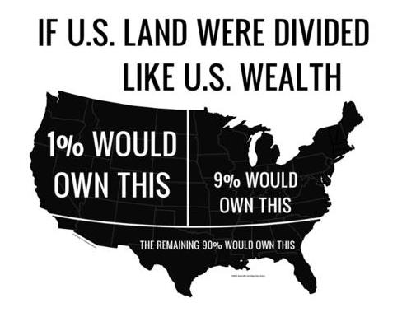
Wealth inequality in America

Slide 10
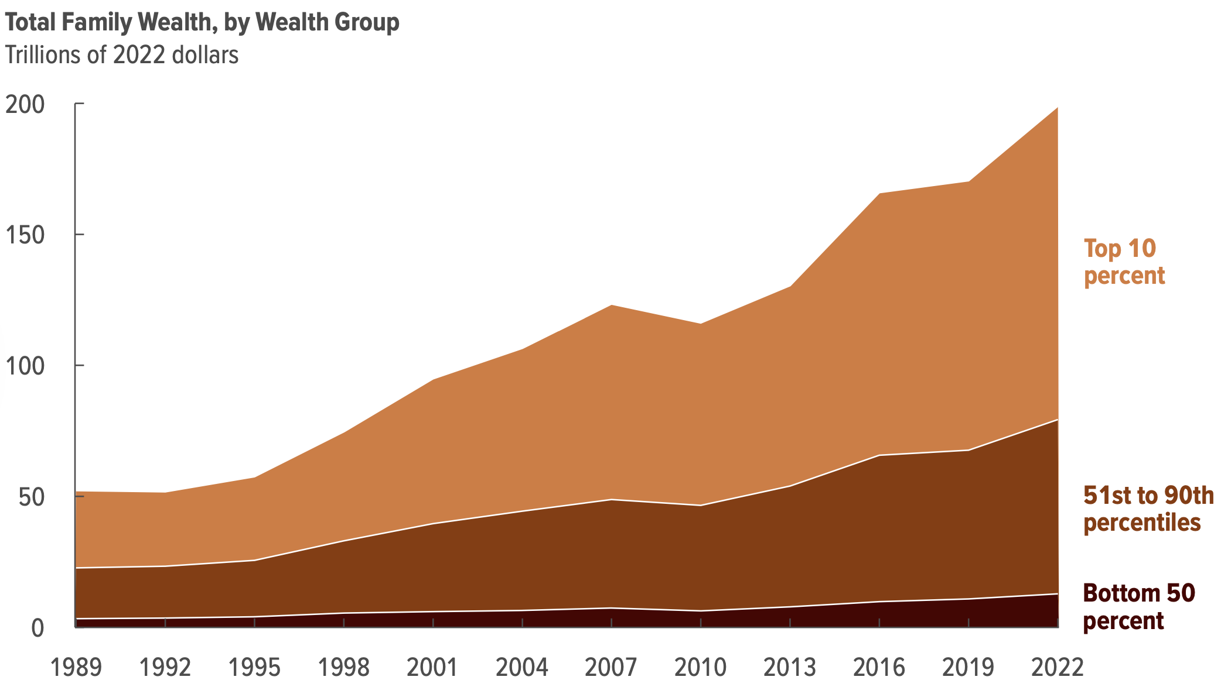
Total Family Wealth, by Wealth Group
Notes:
Tremendous growth in wealth between 1989 and 2022.
Almost all went to the top half of the wealth distribution and most of it went to the very top.
Source: CBO - Trends in the Distribution of Family Wealth, 1989 to 2022

Slide 11
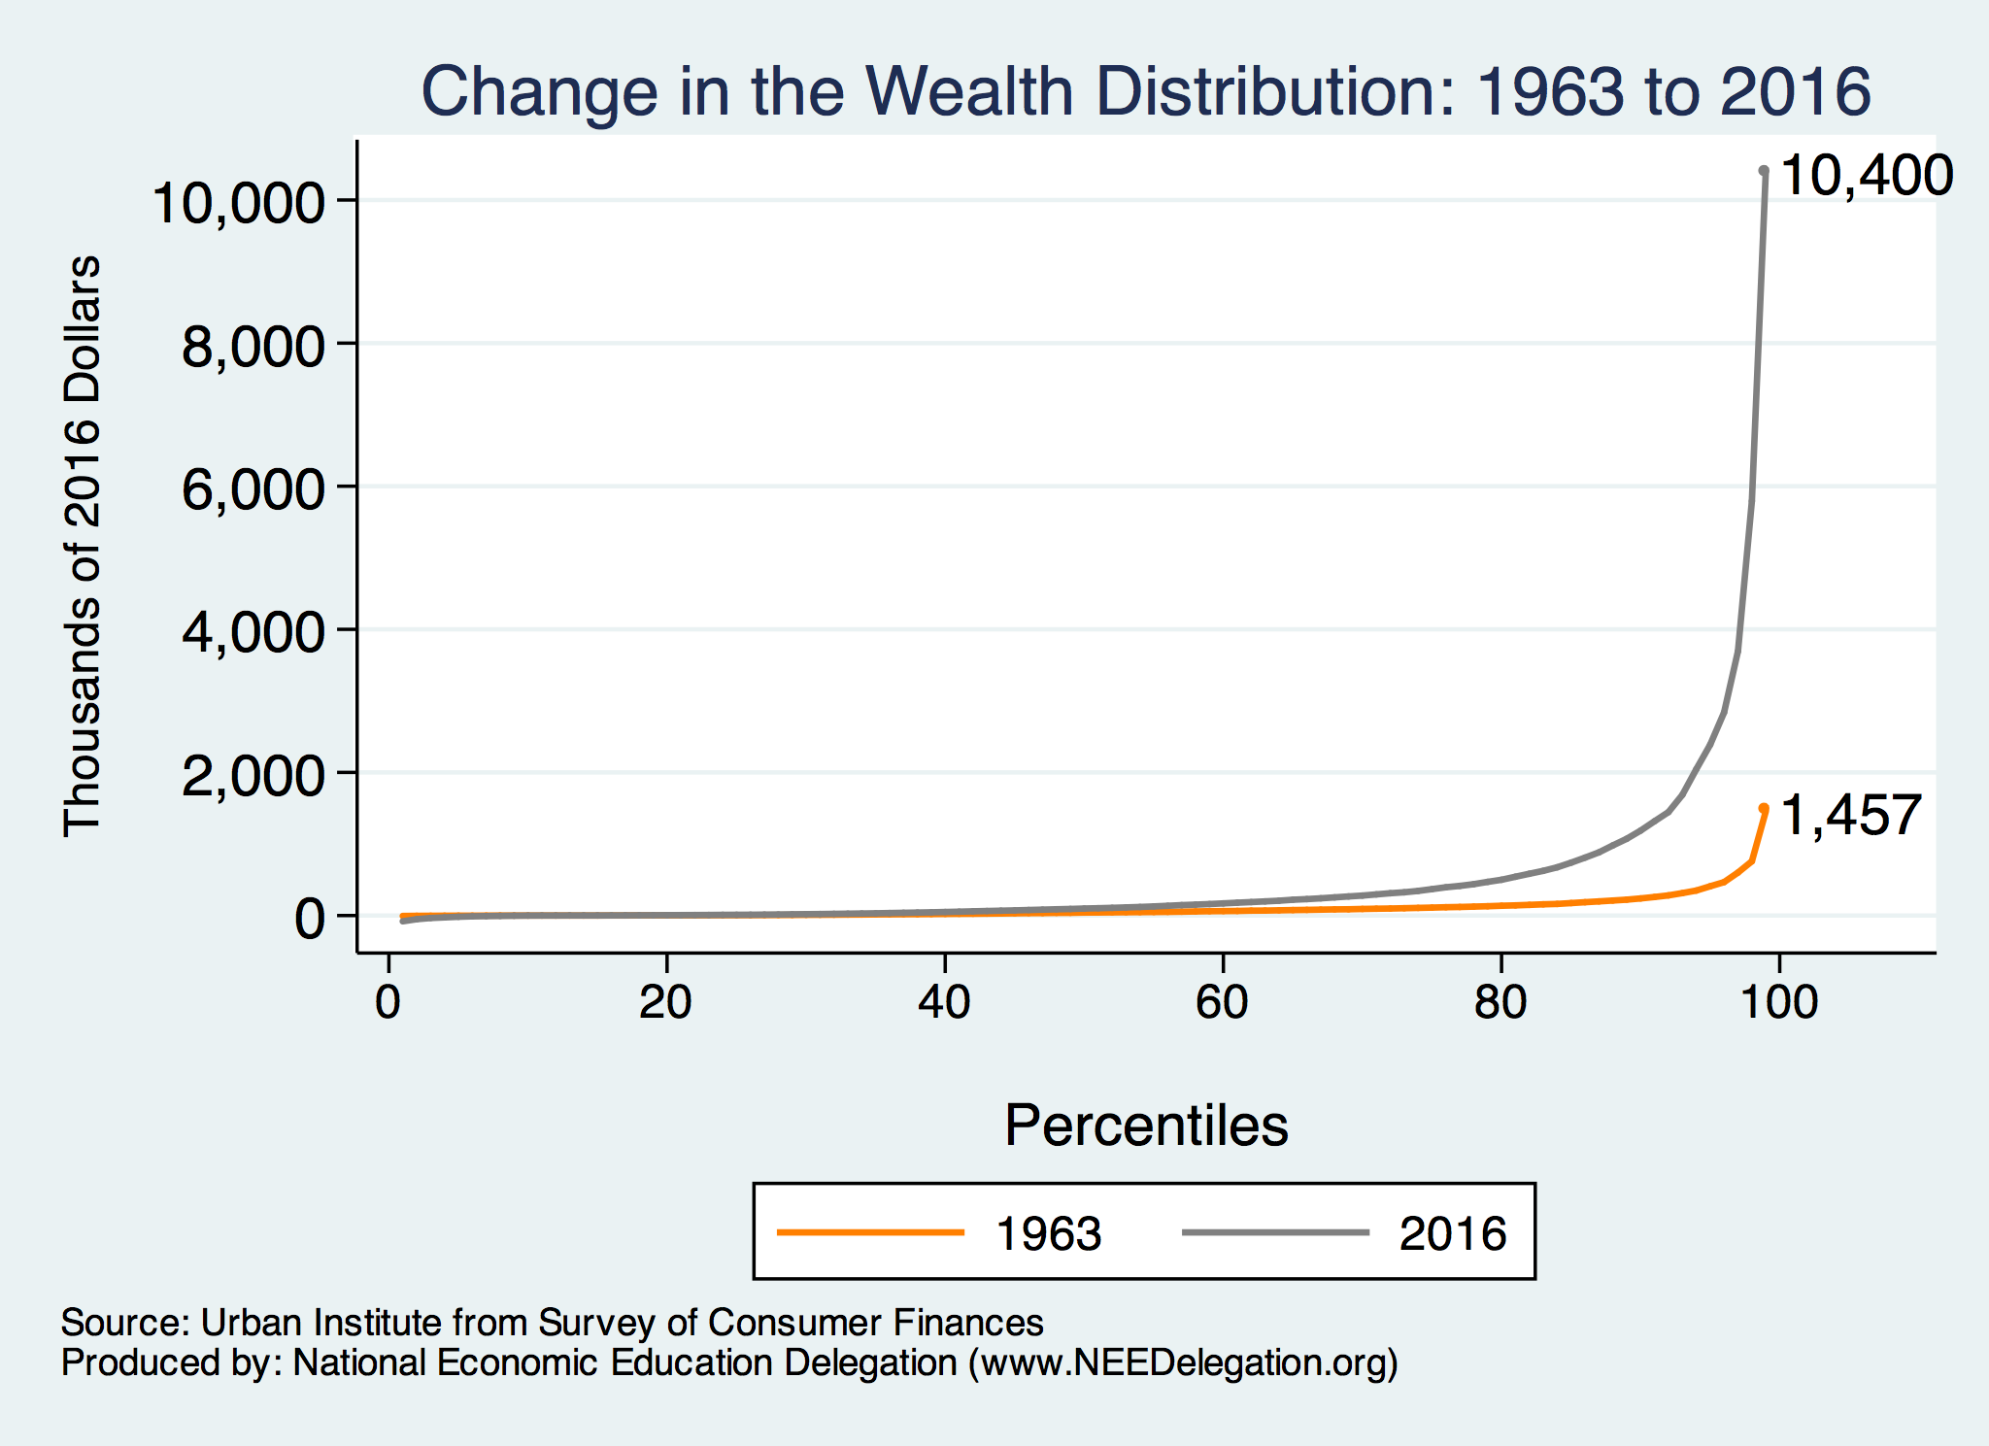
Wealth is More and More Concentrated
99th Percentile
2016 = 7x 1963
Source: Urban Institute

Slide 12
Black-White Wealth Gap

Slide 13
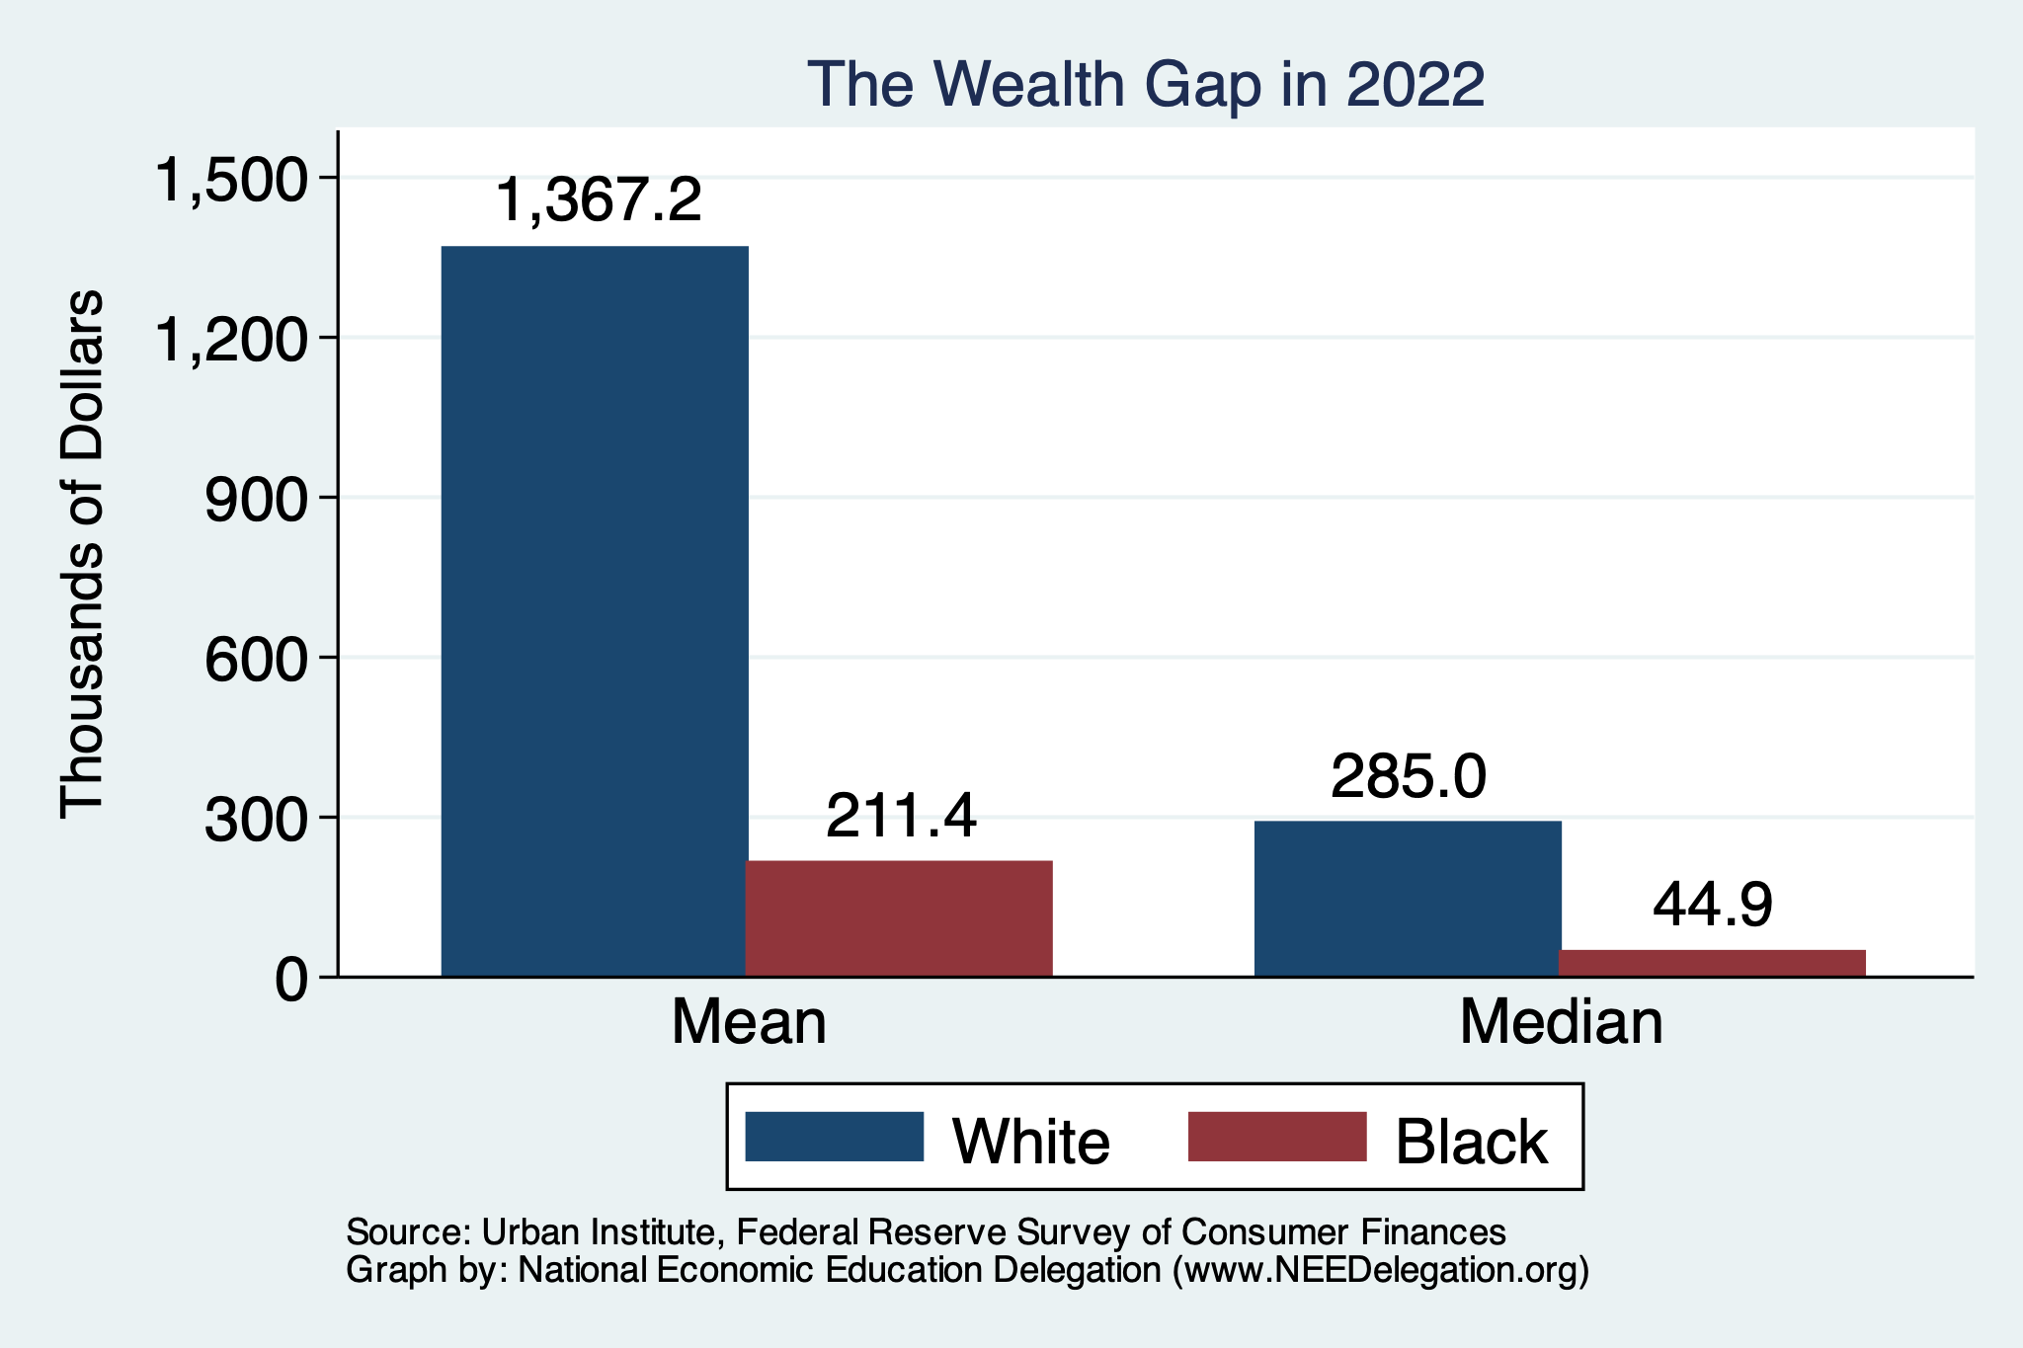
Evidence of the Gap
Mean is
6.5x Greater
Median is 6.3x Greater

Slide 14
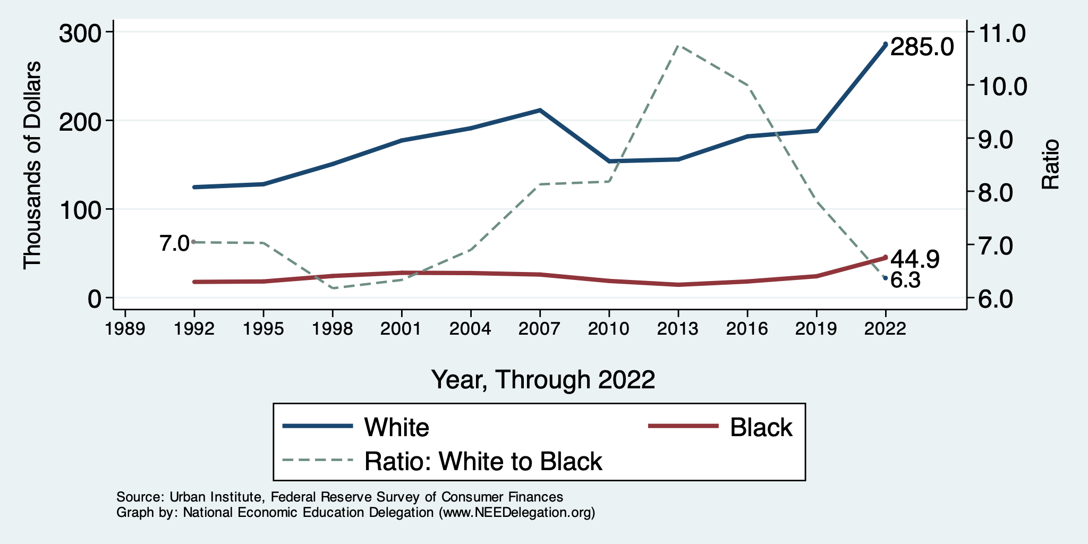
Wealth Gap Over Time: Median

Slide 15
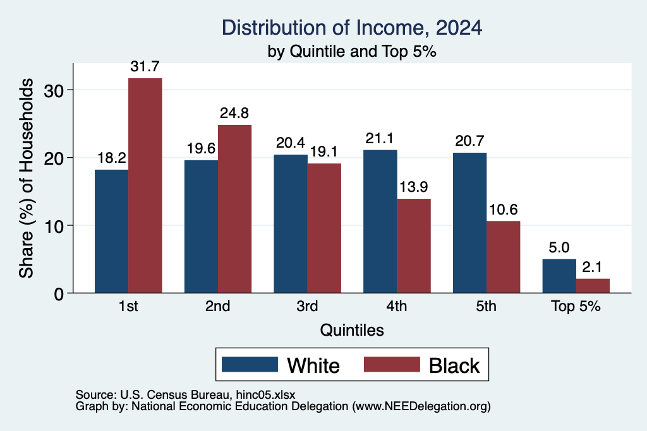
Black Household Incomes Relative to White
Source: pewsocialtrends.org

Slide 16
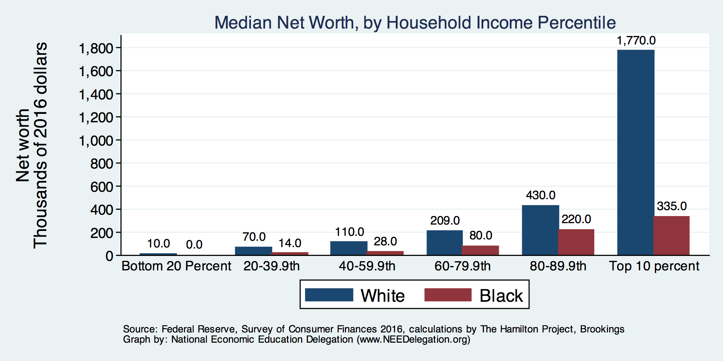
By Household Income

Slide 17
Net Worth by Age and Race
Source: https://www.brookings.edu/blog/up-front/2020/02/27/examining-the-black-white-wealth-gap/

Slide 18
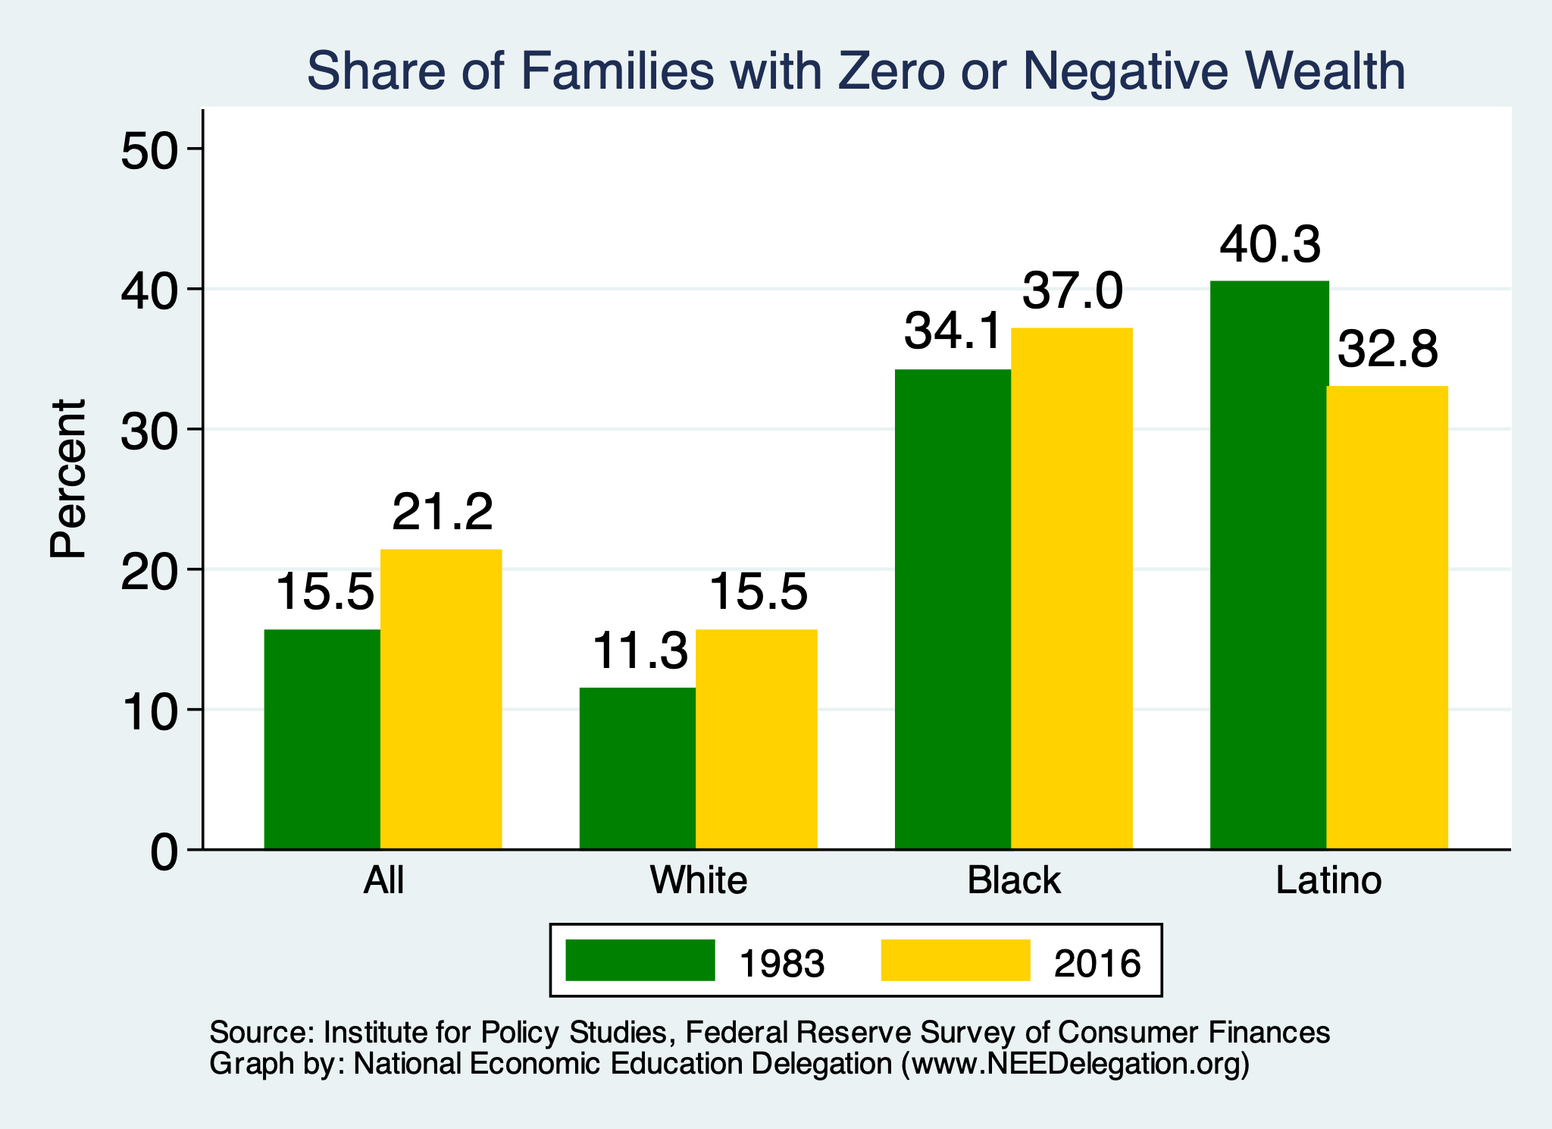
Evidence of Disparities: Zero Wealth

Slide 19
Why Wealth is Important

Slide 20
Widespread Household Wealth Pays Dividends
To individuals in the household
  Choices/Agency
  Wealth is iterative
And to broader society
  Human capital development
  Entrepreneurship and innovation

Slide 21
Household Level Benefits
Choices/Life Agency
  Finance higher education
  Living in good neighborhoods
  Saving for retirement
  Capital to start a business
  w/stand financial hardship
  Better legal counsel
  Exert political influence
  Finance costly medical procedure
  Bequests
Wealth is iterative
  Wealth begets more wealth.
    Access to higher return investments.
  Wealth transfers across generations.
    Wealth is sticky.

Slide 22
Parental Wealth is Important
Important pre-estate transfer effects on kids:
  Influences human capital accumulation.
  Influences the returns to education.
  Adult incomes of offspring.
There are clearly enormous differences in wealth held by parents of Black and White children.
And it’s clear that nurture plays a big role.

Slide 23
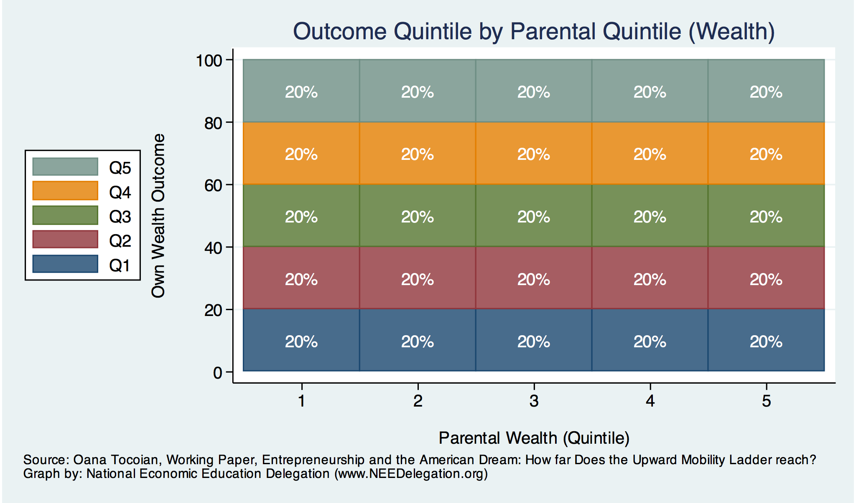
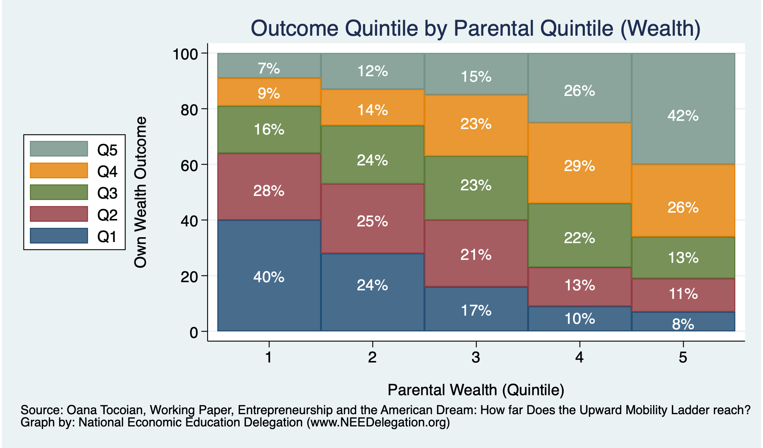
Wealth Mobility

Slide 24
Tangible Benefits for the Broader Economy
More human capital development
Increased entrepreneurship
Healthier labor force
Less social unrest
Less reliance on social programs
Smaller stock of student loans

Slide 25
Sources of Disparities

Slide 26
Events/Policies with Direct Wealth Implications
Slave trade
  The first deprivation.
Slavery
40 acres (and a mule)
  The second deprivation.
  Discriminatory distribution of land.
Freedman’s Savings Bank
  Lax oversite and dissolution.
Jim Crow Laws & Economic Policy
  Convict leasing, debt peonage, chain-gang, sharecropping, and lynching.
Homestead Act
  Discriminatory distribution of land.
Land theft and destruction
  E.g., Black Wall Street – Tulsa, 1921.
GI Bill
  Discriminatory access – Levittown
Federal Housing Authority
  Redlining
And many more.

Slide 27
Results for Black Families
Much lower accumulation of wealth than among White families.
Implications:
  Less financial contribution from parents to children.
    More difficult access to higher education.
    Less access to capital for business formation.
  More likely to live in disadvantaged neighborhoods.
    Fewer role models.
    Less access to quality education.
  Disparities in the capacity – availability of resources - to build wealth.

Slide 28
Potential Explanations: Differences in…
Educational attainment
Home ownership
Increased savings
Financial literacy
Entrepreneurship
Soft skills and personal responsibility
Wages
Labor force participation
Family structure
Initial endowment

Slide 29
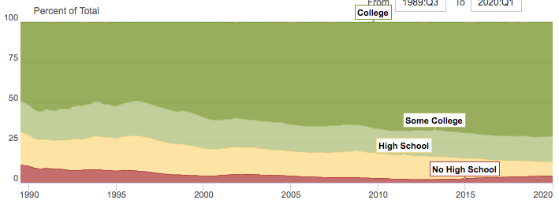
Wealth by Educational Attainment
Educational Attainment | Net Worth Median | Net Worth Mean
No High School | $22,800 | $157,200
High School | $67,100 | $249,600
Some College | $66,100 | $340,600
College | $292,100 | $1,511,100
71.0%
16.1%
8.6%
4.3%
Source: Federal Reserve Board, Table data are 2016.

Slide 30
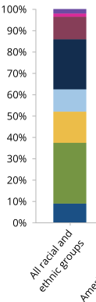


Differences in Educational Attainment, 2022
With Bachelor’s Degree+: 33% 27% 40%
Source: American Council on Education

Slide 31
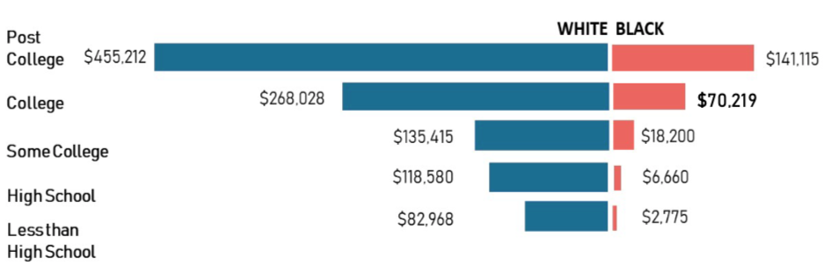
Educational Attainment
Median Household Net Worth by Race and Education
Source: Darity, et al., “What We Get Wrong About Closing the Racial Wealth Gap”

Slide 32
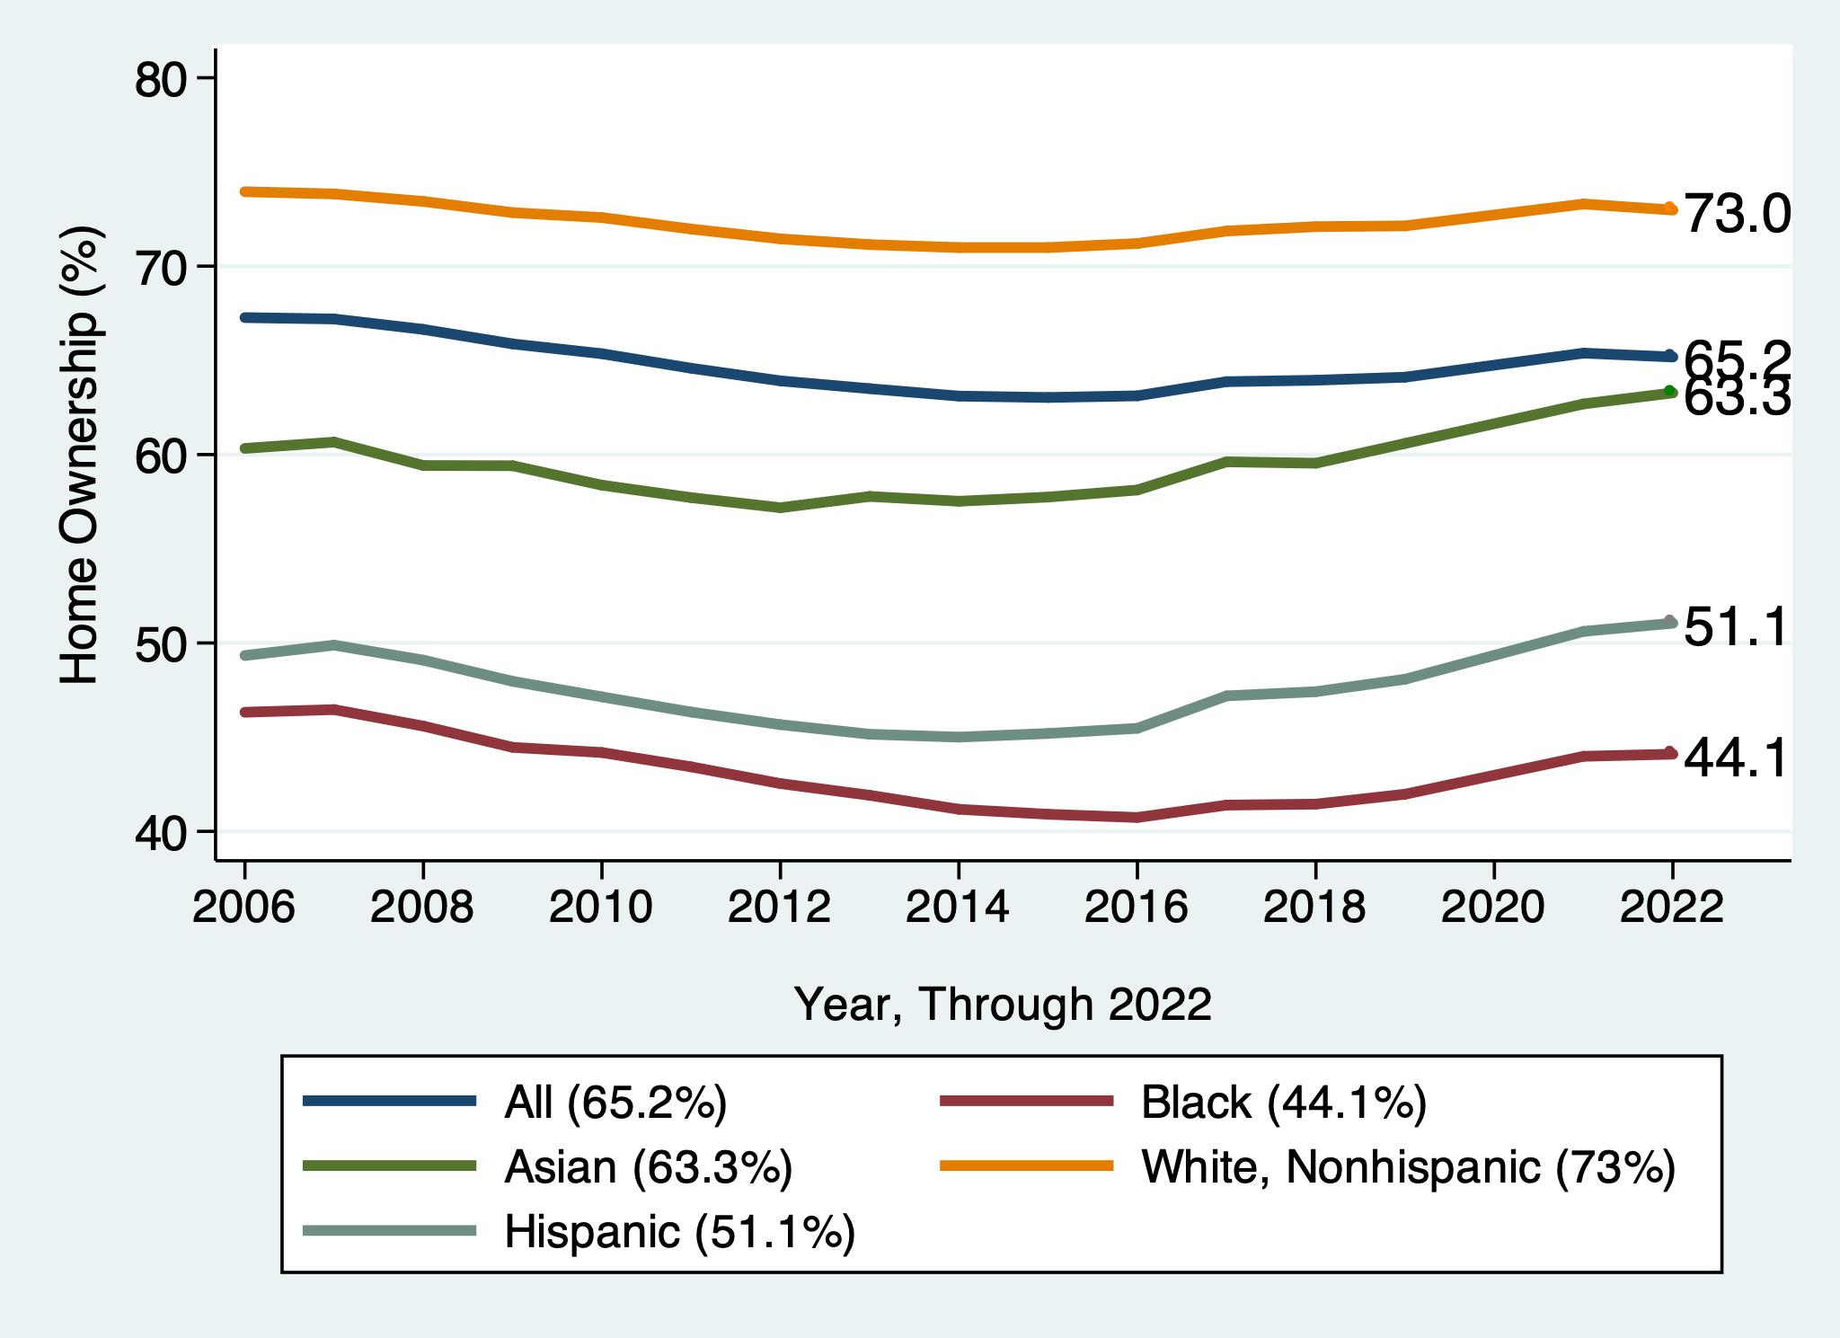
Home Ownership
White, Nonhispanic
Black

Slide 33

Home Ownership: 2016
Housing Status | Net Worth Median | Net Worth Mean
Renters | $5,200 | $91,100
Owner | $231,400 | $1,034,200

Slide 34
Wealth Equality Through Home Ownership?
Well-documented evidence of historical and ongoing housing and lending discrimination.
  Appraisals, buyers, lenders, local laws, covenants…
What about home prices in minority neighborhoods? Even if they buy, they won’t get the appreciation of White neighborhoods.
  Home values are 50% lower in majority Black neighborhoods.
    23% lower after adjusting for quality and amenities.
Source: Brookings, Home ownership while black

Slide 35
What Determines Differences in Home Ownership?
Wealth of parents
Ability to borrow – lending discrimination
  At all
  On equivalent terms to white borrowers
Local ordinances – housing discrimination
Lower appreciation rates of homes in majority Black communities.
  This makes it a less attractive investment.

Slide 36
Increased Savings
Historical evidence generated by economists ranging from Milton Friedman (1957) to Marjorie Galenson (1972) to Marcus Alexis (1971) to Gittelman and Wolff (2004)…..
  All find that after accounting for household income, Blacks have a slightly higher savings rate than Whites.
Risk and reward are higher for White investors (?).
  Controlling for income, this is not clear.
  Access to and tolerance for higher-risk investments are clearly correlated with income.

Slide 37
Financial Literacy
Financial literary helps explain individual wealth differences within racial groups, but none of the wealth differences between racial groups.
  The insufficient financial literacy argument is often leveled specifically at Black households.
    The argument holds equally with regard to all households of comparable incomes.
Controlling for household income, there is no difference in rates of asset appreciation between Black and White households.

Slide 38
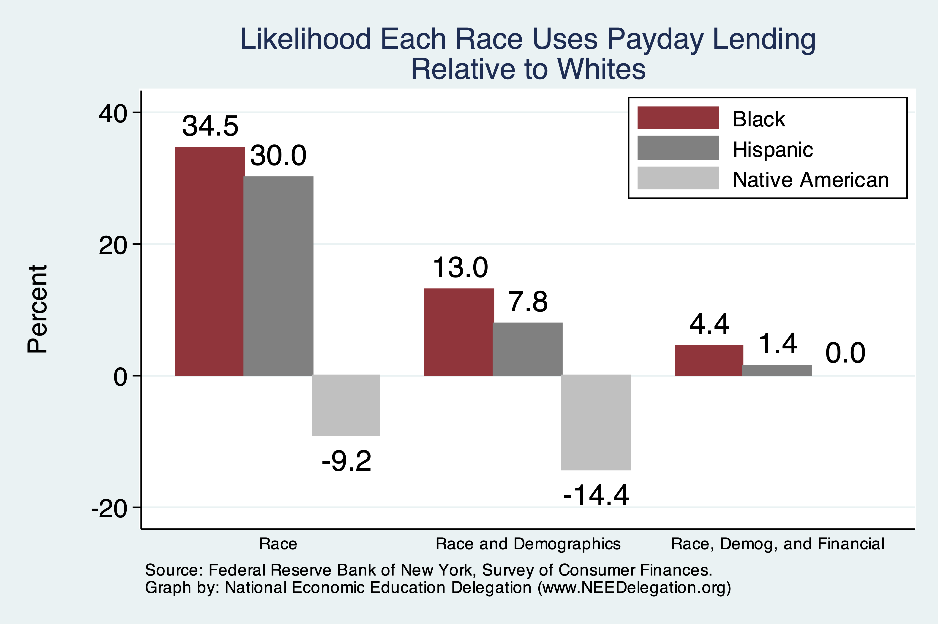
Use of Payday Lenders
Source: Federal Reserve Bank of New York; Survey of Consumer Finances

Slide 39
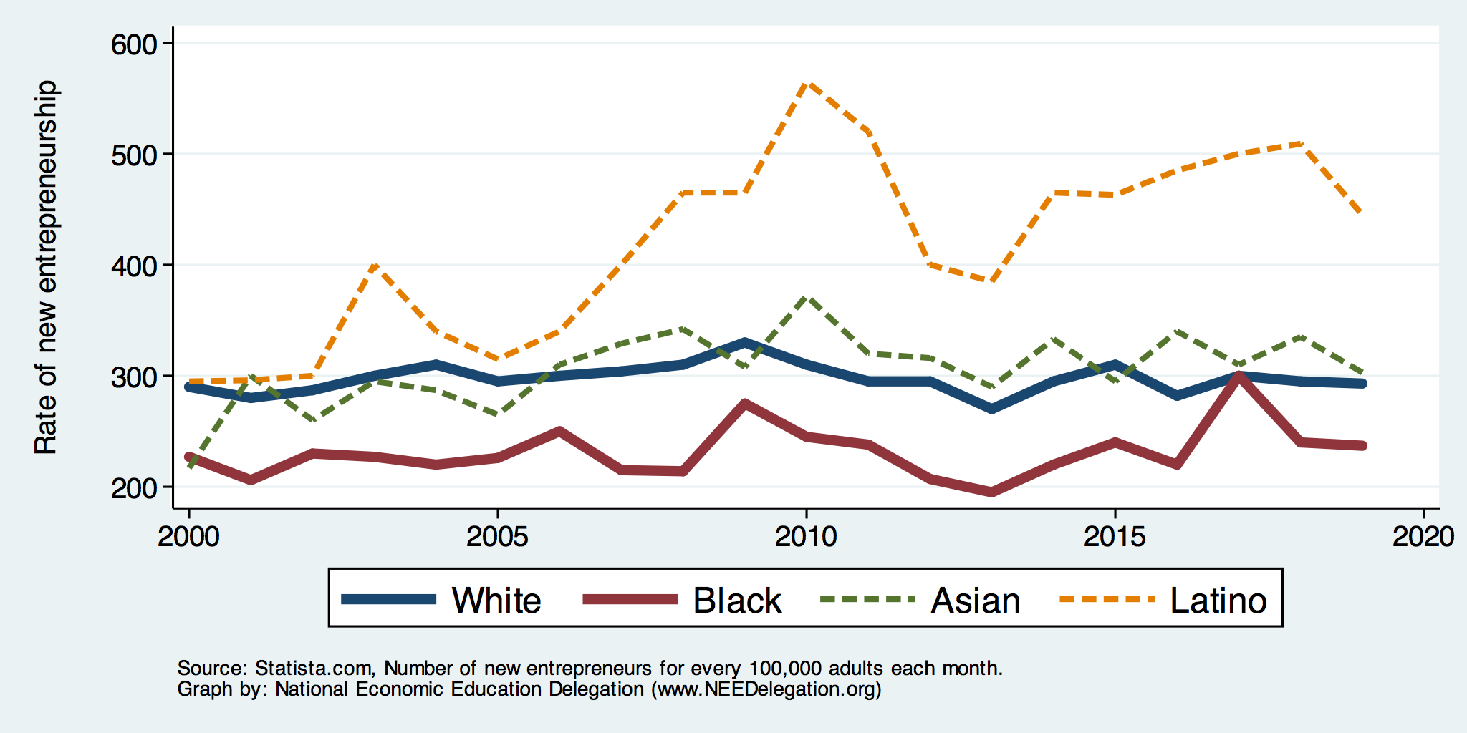
Entrepreneurship: Rate of New Entrepreneurs
Source: Statistica

Slide 40
Explaining Differences in Entrepreneurship
Disparities in access to capital:
  Wealth disparities
    Specifically differences in home equity.
    Differences in wealth levels of friends and family.
  Less likely to rely on banks and more likely to rely on credit cards.
  Loans have higher int rates and more likely to be declined.
  Less access to venture funds.
Generally lower levels of education.
Previous business ownership by family.
Different stocks of relevant social capital.

Slide 41
Soft Skills and Personal Responsibility
Employability
  Show up on time
  Eye contact with customers
  Dress well
  Collaborative skills
Reality
  Black workers are crowded into service sector jobs.
  Well represented in service, sales and office, and production, transportation, and material moving
  Relatively less well represented in construction, extraction, and maintenance.

Slide 42
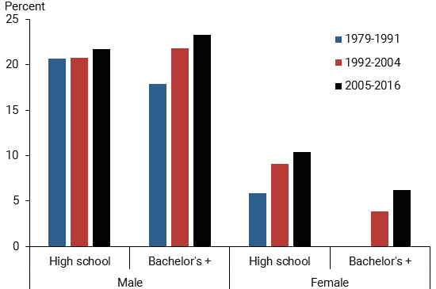
Black-White Earnings Gap by Education
Source: https://www.frbsf.org/economic-research/publications/economic-letter/2017/september/disappointing-facts-about-black-white-wage-gap/

Slide 43
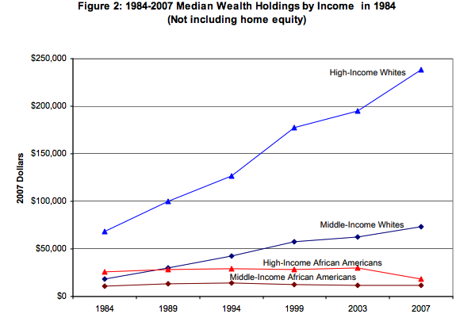
Equality of Income = Equality of Wealth
/
Source: http://hartfordinfo.org/issues/wsd/FamiliesandChildren/Racial-Wealth-Gap-Brief.pdf

Slide 44
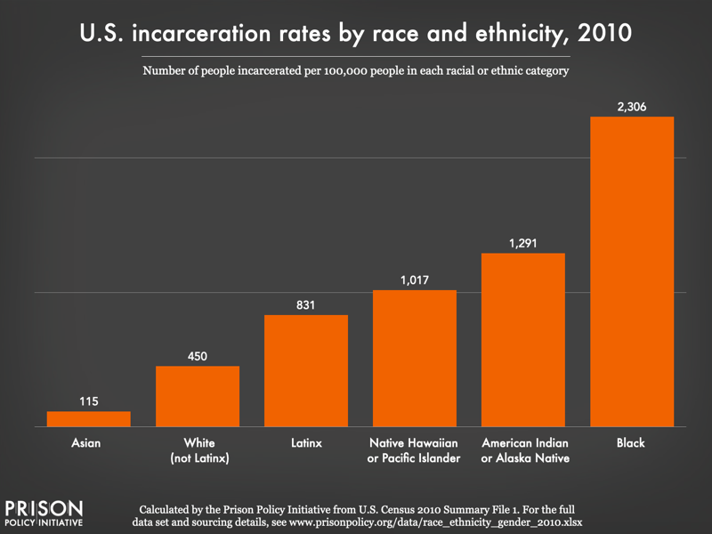
Incarceration Likely Plays A Role

Slide 45
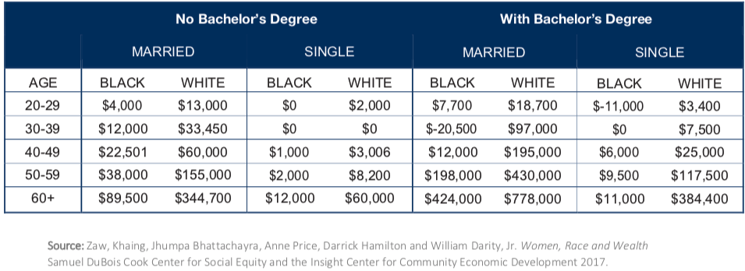
Family Structure

Slide 46
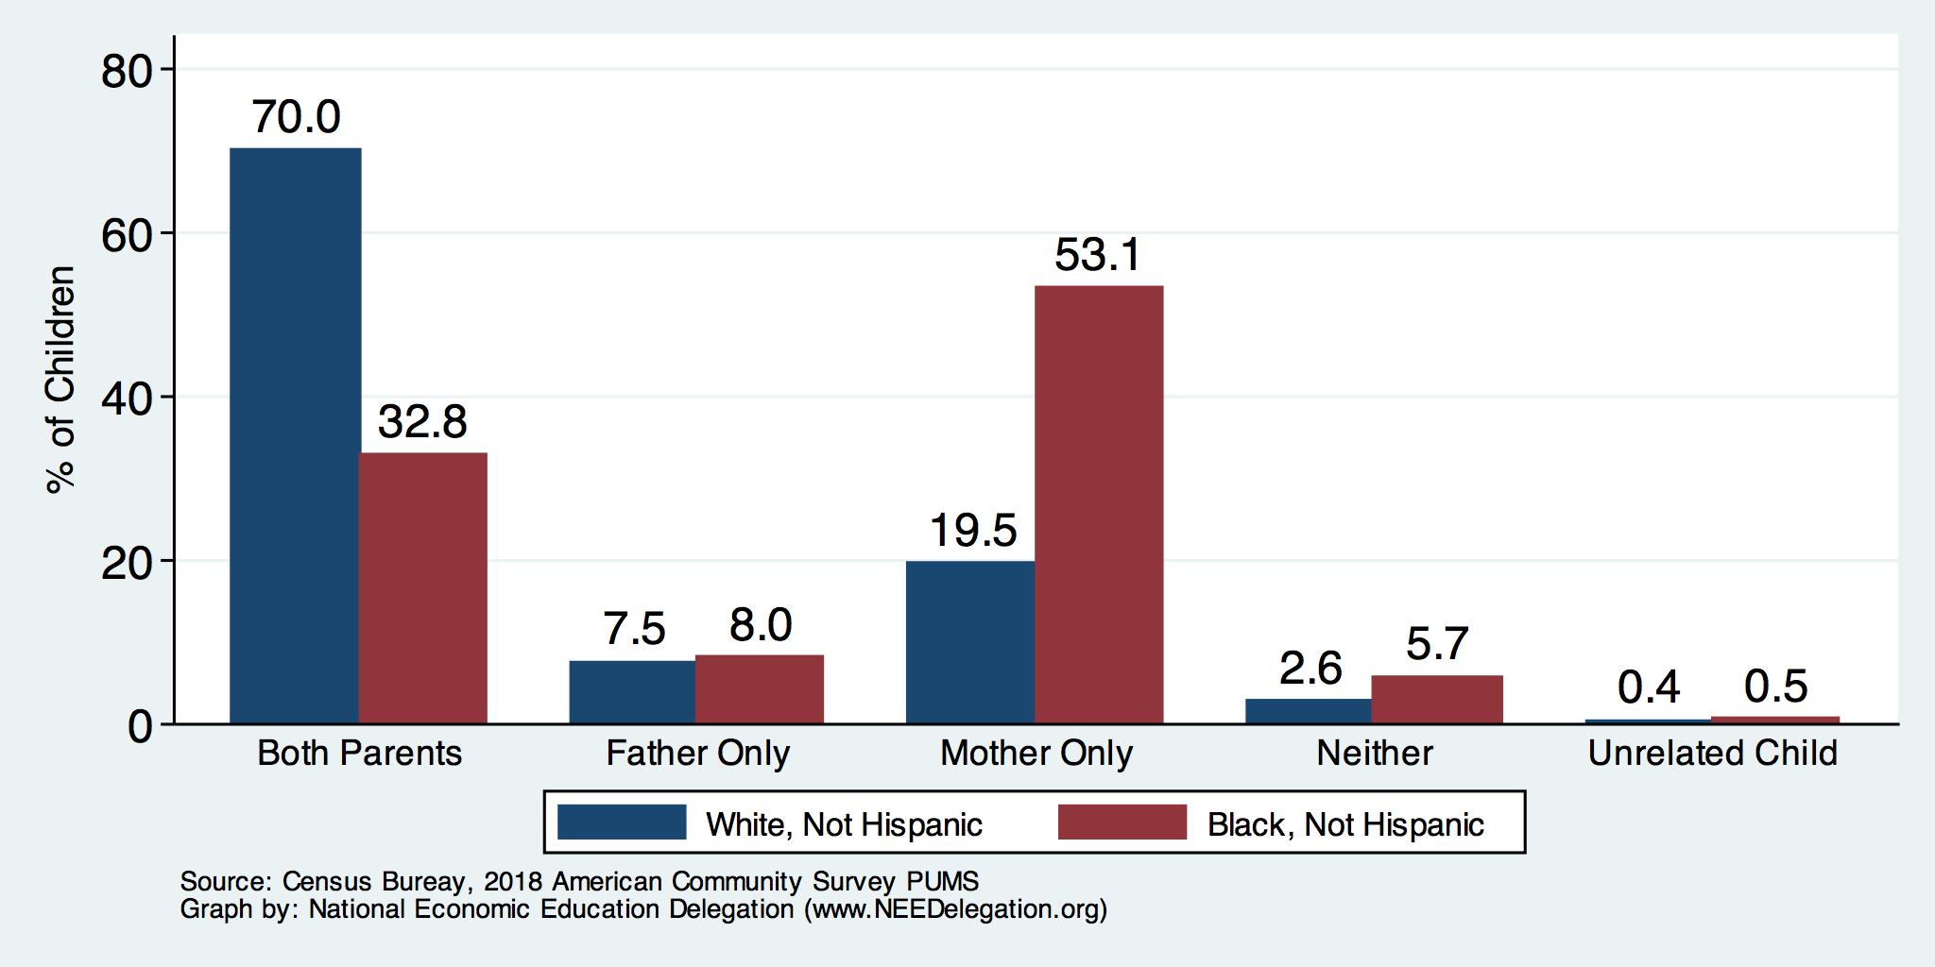
Kids – Household Types

Slide 47
Wealth Mobility

Slide 48
What is Fundamentally Responsible?
Individual behaviors?
Structural characteristics of the economy?
History – policy and otherwise?

Slide 49
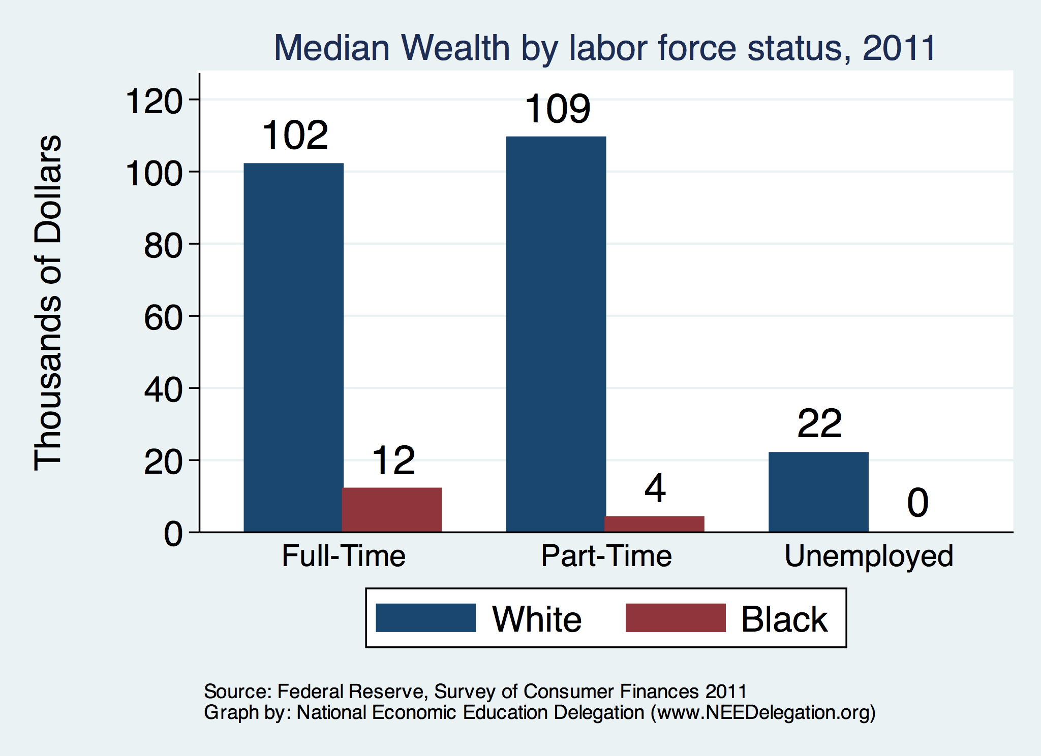

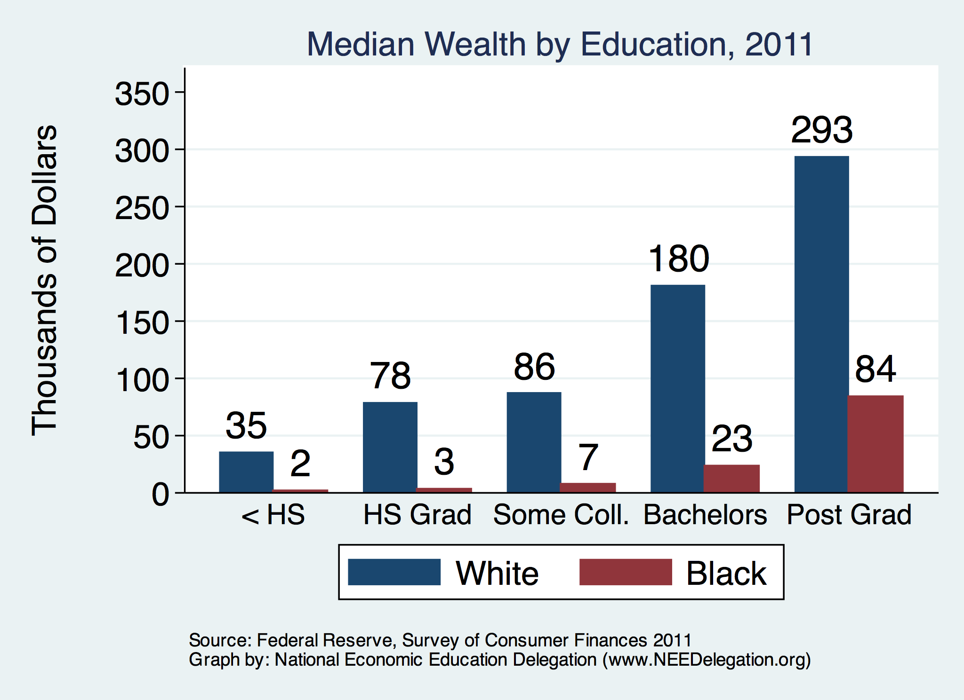
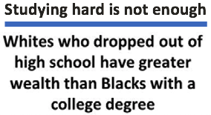
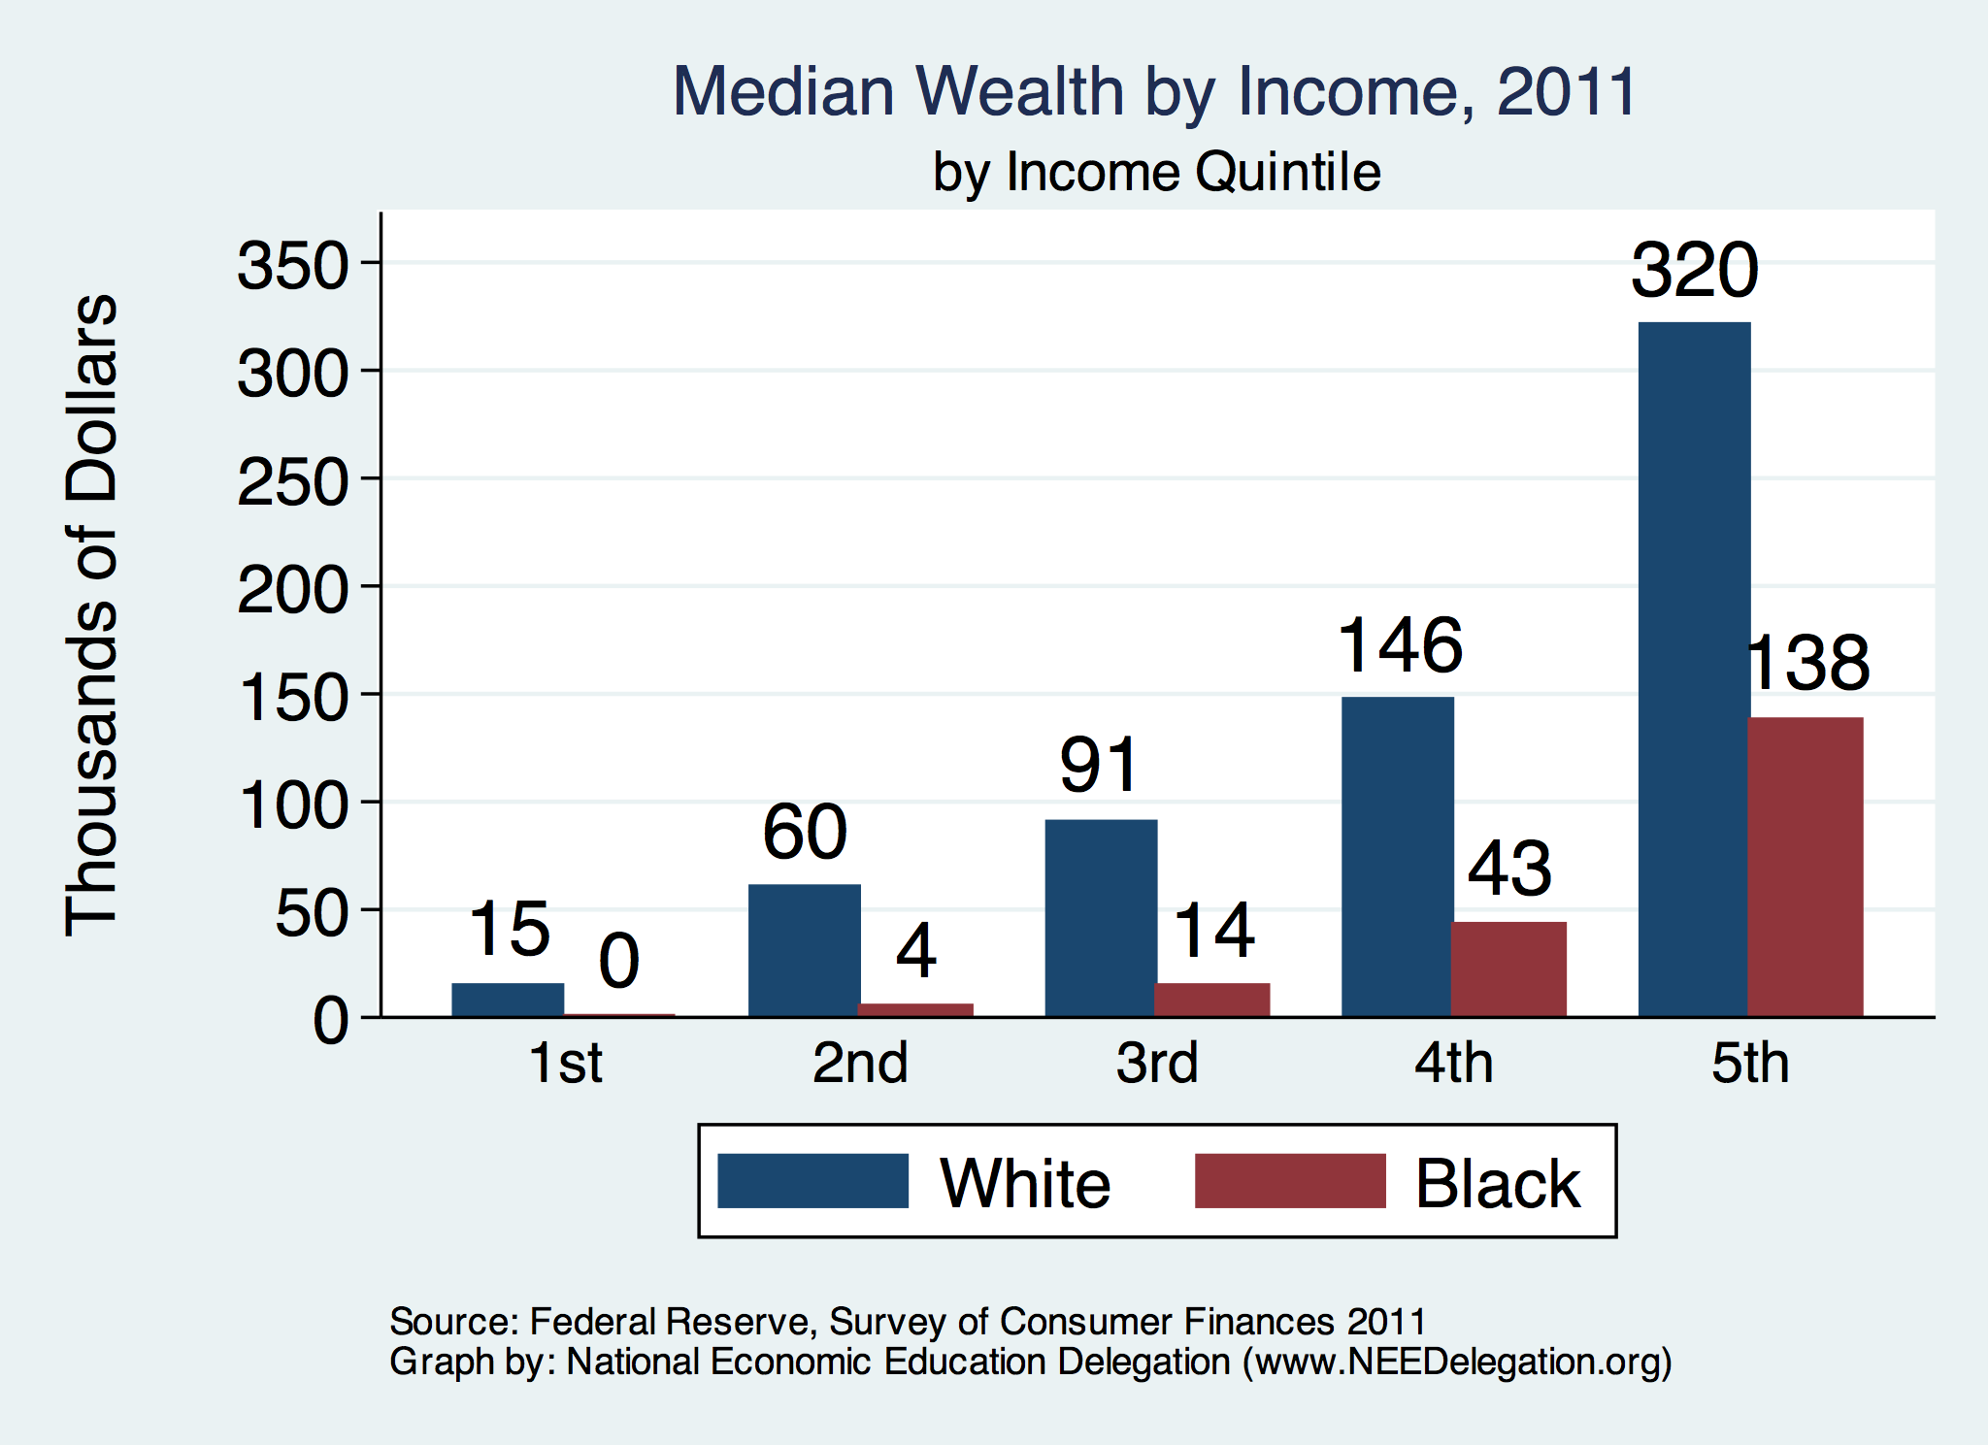


Slide 50
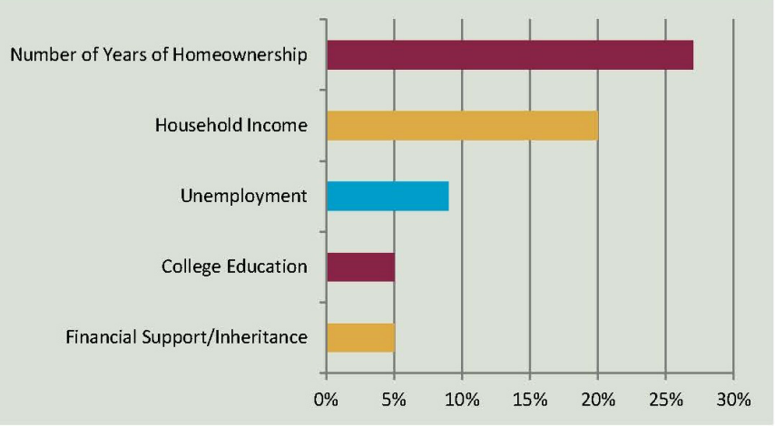
Accounting for the Wealth Gap
30%+ Left
Unaccounted for
Source: https://heller.brandeis.edu/iasp/pdfs/racial-wealth-equity/racial-wealth-gap/roots-widening-racial-wealth-gap.pdf

Slide 51
Policy Options

Slide 52
Categories of Policy Areas
Housing
  FHA and redlining
Health Care
Incarceration
  Black incarceration rates are very high.
Education
Workforce
Income support and stability
Asset accumulation

Slide 53
Reform Criminal Justice System
Legal restrictions on the rights of people who have had contact with the criminal justice system, particularly contact resulting in conviction.
Usually placed in civil and regulatory codes, collateral consequences may limit a person’s:
  ability to vote
  live in public housing
  own a firearm
  qualify for an occupational license
  serve in the military
  receive public benefits (Food Stamps, housing vouchers)
  sit on a jury
  borrow money for college
Legal restrictions on the rights of people who have had contact with the criminal justice system, particularly contact resulting in conviction.
Usually placed in civil and regulatory codes, collateral consequences may limit a person’s:
  ability to vote
  live in public housing
  own a firearm
  qualify for an occupational license
  serve in the military
  receive public benefits (Food Stamps, housing vouchers)
  sit on a jury
  borrow money for college
Legal restrictions on the rights of people who have had contact with the criminal justice system, particularly contact resulting in conviction.
Usually placed in civil and regulatory codes, collateral consequences may limit a person’s:
  ability to vote
  live in public housing
  qualify for an occupational license
  serve in the military
  receive public benefits (Food Stamps, housing vouchers)
  sit on a jury
  borrow money for college
  And many more

Slide 54
Specific Policy Options
Global solutions that affect all source areas
  Child Trust Accounts - ”Baby Bonds”
  Guaranteed minimum income
Addressing racial disparities directly
  Reparations
    Aggressive affirmative action.
    A new Homestead Act.
    Heavily investing in Black communities.
    Differential tax treatment.
  Labor and other laws that address discrimination
    Enforce more aggressively and make adjustments where necessary to increase efficacy.
  Fundamental reorientation of asset building agenda.

Slide 55
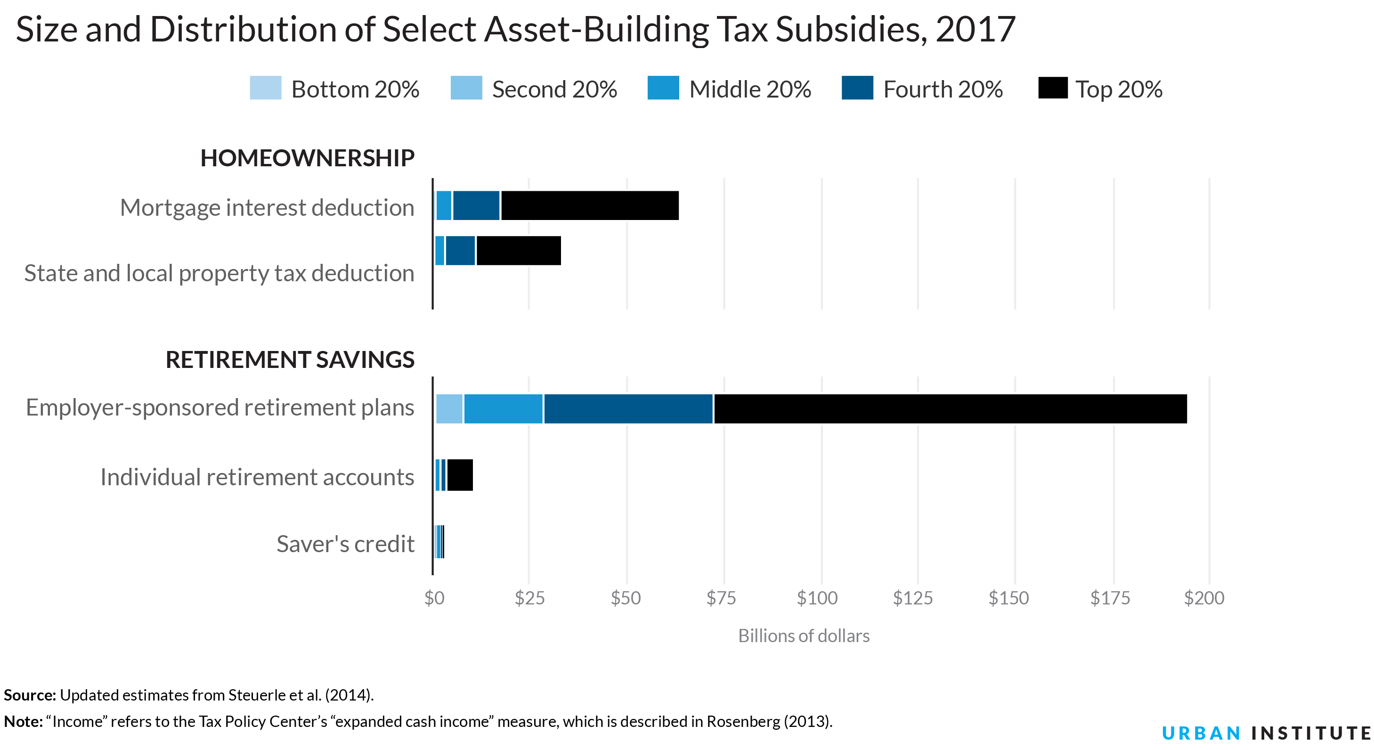
Gov’t Asset Building Policies

Slide 56
Other Concrete Policy Options
Limit the mortgage interest tax deduction and use the revenues to provide a credit for first-time homebuyers.
Establish automatic savings and retirement plans.
Reduce reliance on student loans while supporting success in postsecondary education.
Offer universal children's savings accounts.
Reform safety net program asset tests, which can act as barriers to saving among low-income families.
Provide subsidies to promote emergency savings, such as those linked to tax time.
Source: Urban Institute

Slide 57
Summary
The Black White wealth gap is enormous (2022)
  Mean: White wealth is 6.5x Black wealth.
  Median: White wealth is 6.3x Black wealth.
There are many explanations in the common narrative.
  Many do not stand up to scrutiny.
Government policies have contributed enormously this gap.
  Racial dehumanizing permitted these policies.
Wealth endowments (parental wealth) are enormously important for determining own wealth in adulthood.
  Policies that address this relationship are most likely to be effective.
Some form of policy intervention is likely necessary if the gap is to be closed.

Slide 58
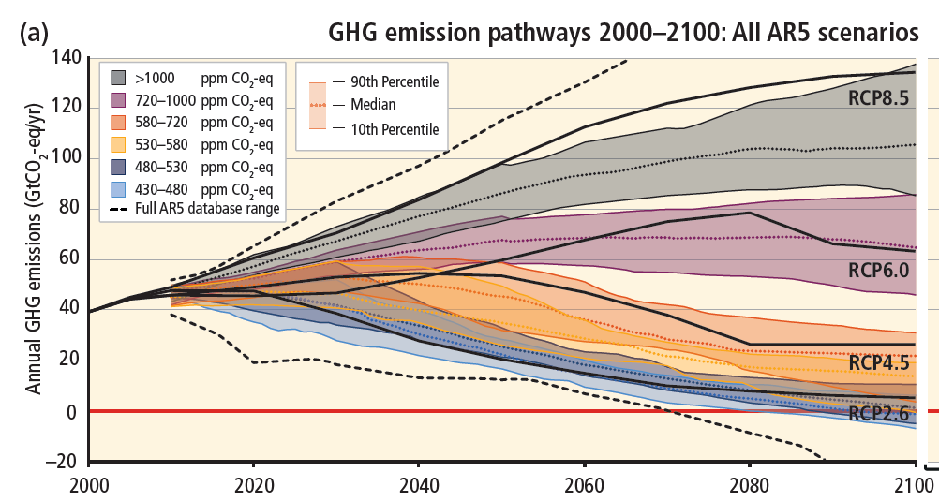
Next Week: Emissions Trajectories
Source: IPCC Assessment Report 5
Notes:
Figure SPM.11 from the Summary for Policymakers of AR5

Slide 59
Thank you!
Any Questions?
www.NEEDEcon.org
Jon D. Haveman
Jon@NEEDEcon.org
Contact NEED: info@NEEDEcon.org
Submit a testimonial: www.NEEDEcon.org/testimonials.php
Support NEED: www.NEEDEcon.org/friend.php

