Slide 1
The Black-White Wealth Gap
OLLI – University of California, Berkeley
April 12, 2024
Jon Haveman, Ph.D.
Executive Director, NEED

Slide 2
National Economic Education Delegation
Vision
One day, the public discussion of policy issues will be grounded in an accurate perception of the underlying economic principles and data.
Mission
NEED unites the skills and knowledge of a vast network of professional economists to promote understanding of the economics of policy issues in the United States.
NEED Presentations
Are nonpartisan and intended to reflect the consensus of the economics profession.

Slide 3
Who Are We?
Honorary Board: 54 members
2 Fed Chairs: Janet Yellen, Ben Bernanke
6 Chairs Council of Economic Advisers
Furman (D), Rosen (R), Bernanke (R), Yellen (D), Tyson (D), Goolsbee (D)
4 Nobel Prize Winners
Akerlof, Smith, Maskin, Bernanke
Delegates: 652+ members
At all levels of academia and some in government service
All have a Ph.D. in economics
Crowdsource slide decks
Give presentations
Global Partners: 49 Ph.D. Economists
Aid in slide deck development

Slide 4
Available NEED Topics Include:
US Economy
Healthcare Economics
Climate Change
Economic Inequality
Economic Mobility
Trade and Globalization
Minimum Wages
Immigration Economics
Housing Policy
Federal Budgets
Federal Debt
Black-White Wealth Gap
Autonomous Vehicles
Healthcare Economics

Slide 5
Credits and Disclaimer
This slide deck was authored by:
Darrick Hamilton, Ph.D., The New School
Jon Haveman, Ph.D., NEED
This slide deck was reviewed by:
Patrick Mason, Florida State University
Steven Craig, University of Houston
Disclaimer
NEED presentations are designed to be nonpartisan.
It is, however, inevitable that the presenter will be asked for and will provide their own views.
Such views are those of the presenter and not necessarily those of the National Economic Education Delegation (NEED).

Slide 6
Outline
Evidence of disparities
Why wealth is important
Sources of disparities
Implications of disparities
Policy solutions

Slide 7
What is Wealth?
Income vs Wealth
Income is the flow of funds into a household each year.
Wealth is a household’s NET asset holdings.
The value of all assets minus the value of all debts.
Assets include:
Owned homes, cars, stocks, businesses, savings and checking accounts, pensions, life insurance…
Debts include:
Home mortgages, car loans, credit cards, and any other significant financial obligations (excl regular bills)…

Slide 8
Total Family Wealth, by Wealth Group
Notes:
Tremendous growth in wealth between 1989 and 2019.
It all went to the top half of the wealth distribution and
most of it went to the very top.

Slide 9
Wealth inequality in America

Slide 10
Black-White Wealth Gap

Slide 11
Evidence of the Gap
Mean is
6.5x Greater
Median is 6.3x Greater

Slide 12
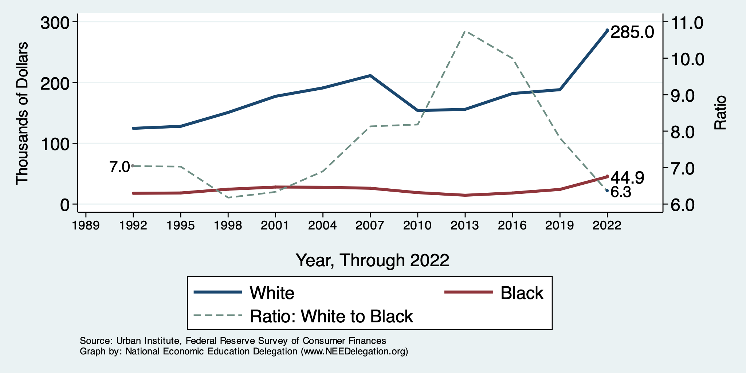
Wealth Gap Over Time: Median

Slide 13
Black Household Incomes Relative to White
Source: pewsocialtrends.org

Slide 14
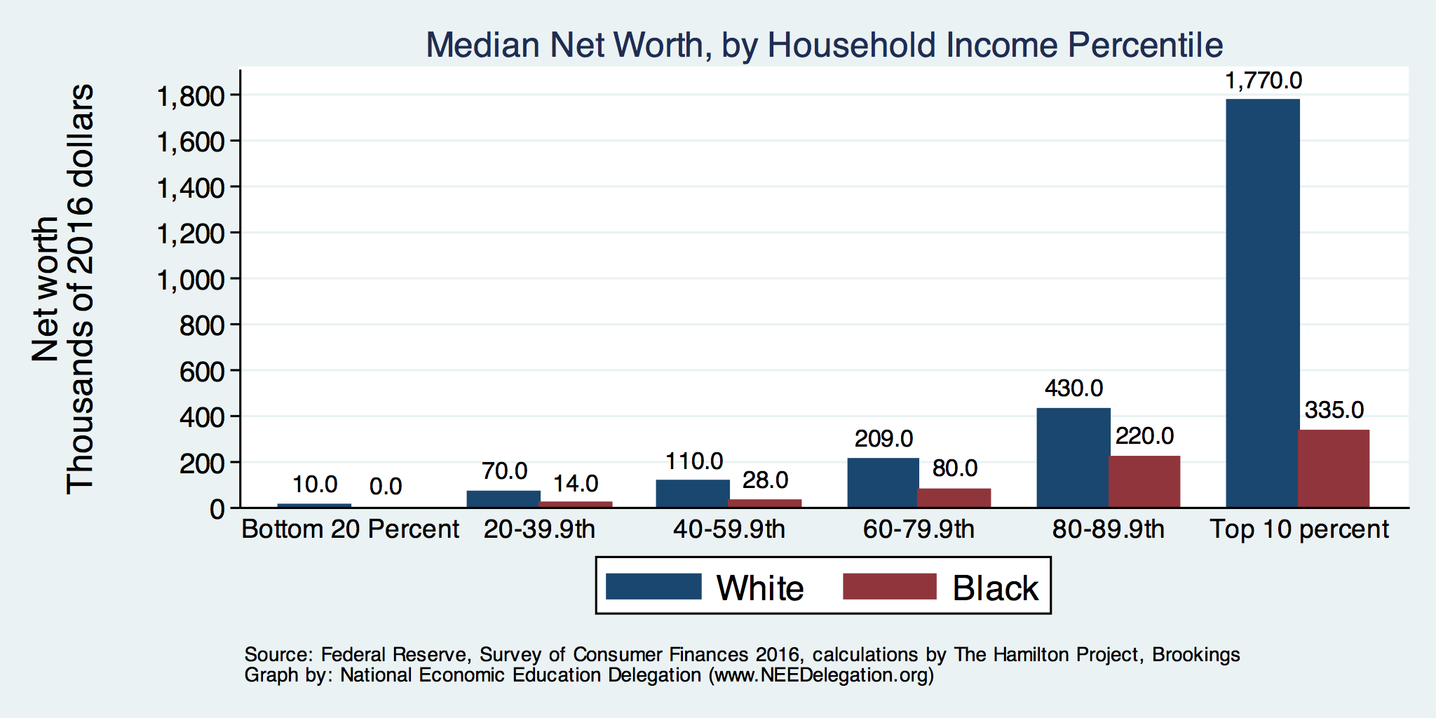
By Household Income

Slide 15
Net Worth by Age and Race
Source: https://www.brookings.edu/blog/up-front/2020/02/27/examining-the-black-white-wealth-gap/

Slide 16
Why Wealth is Important

Slide 17
Widespread Household Wealth Pays Dividends
To individuals in the household
Choices/Agency
Wealth is iterative
And to broader society
Human capital development
Entrepreneurship and innovation

Slide 18
Household Level Benefits
Choices/Life Agency
Finance higher education
Living in good neighborhoods
Saving for retirement
Capital to start a business
w/stand financial hardship
Better legal counsel
Exert political influence
Finance costly medical procedure
Bequests
Wealth is iterative
Wealth begets more wealth.
Access to higher return investments.
Wealth transfers across generations.
Wealth is sticky.

Slide 19
Parental Wealth is Important
Important pre-estate transfer effects on kids:
Influences human capital accumulation.
Influences the returns to education.
Adult incomes of offspring.
There are clearly enormous differences in wealth held by parents of Black and White children.
And it’s clear that nurture plays a big role.

Slide 20
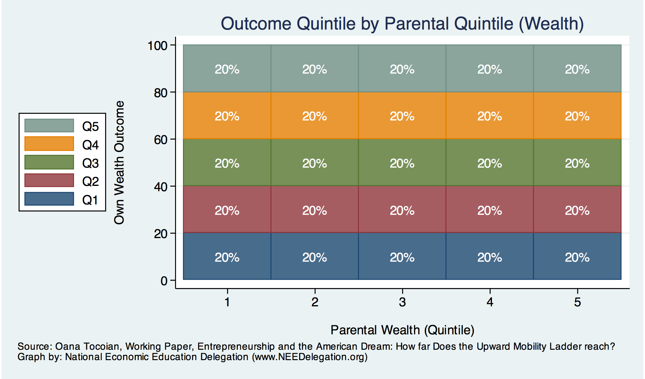
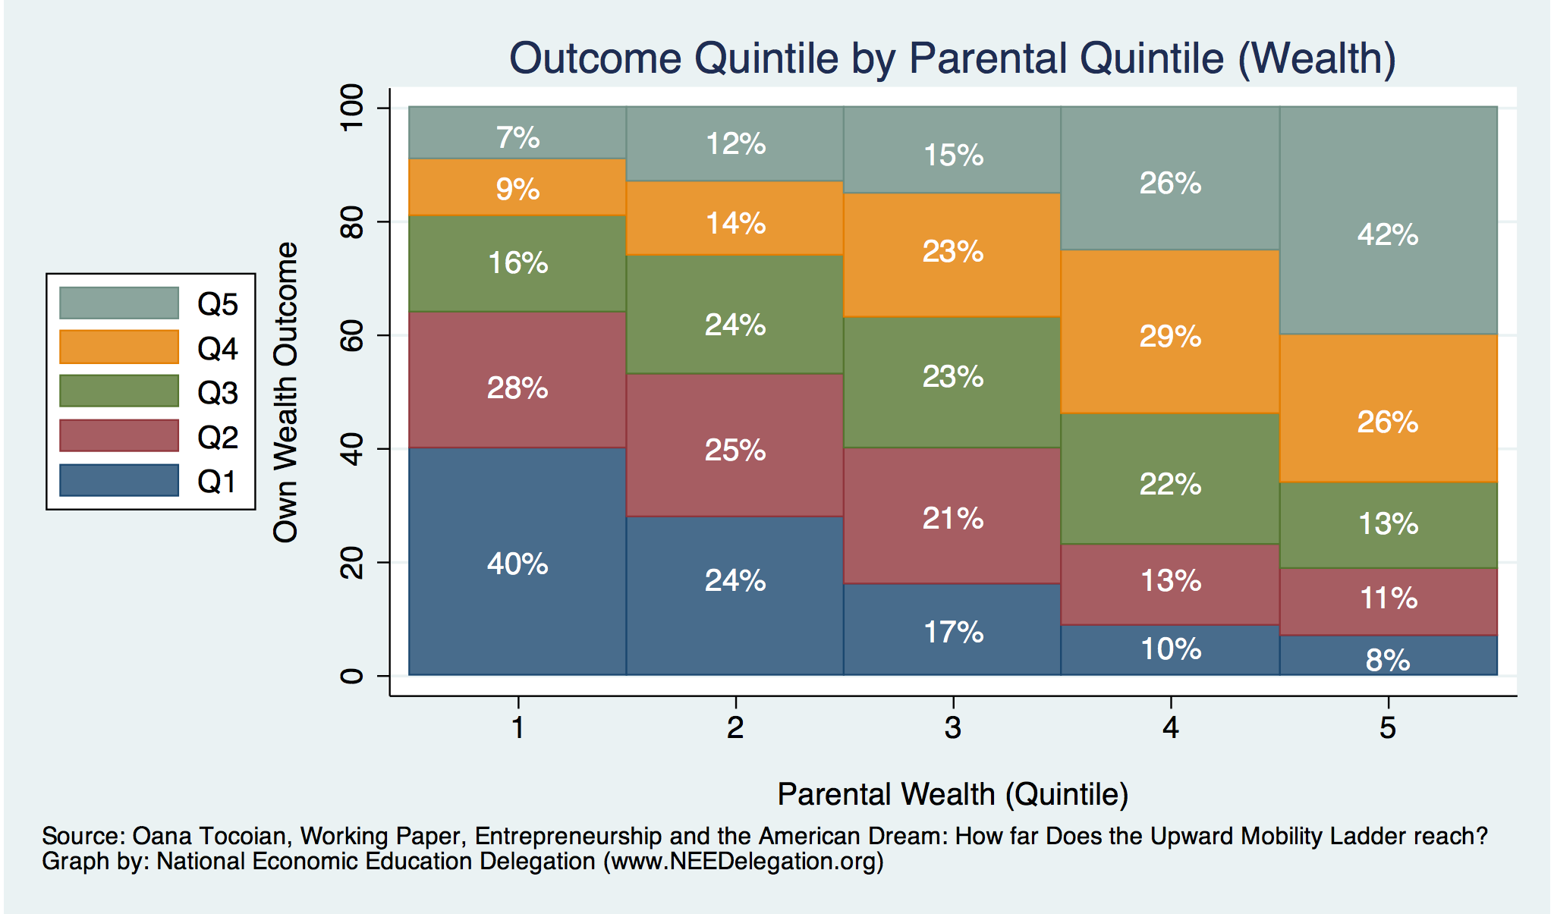
Wealth Mobility

Slide 21
Tangible Benefits for the Broader Economy
More human capital development
Increased entrepreneurship
Healthier labor force
Less social unrest
Less reliance on social programs
Smaller stock of student loans

Slide 22
Sources of Disparities

Slide 23
Events/Policies with Direct Wealth Implications
Slave trade
The first deprivation.
Slavery
40 acres (and a mule)
The second deprivation.
Discriminatory distribution of land.
Freedmen’s Bank
Lax oversite and dissolution.
Jim Crow Laws & Economic Policy
Convict leasing, debt peonage, chain-gang, sharecropping, and lynching.
Homestead Act
Discriminatory distribution of land.
Land theft and destruction
E.g., Black Wall Street – Tulsa, 1921.
GI Bill
Discriminatory access – Levittown
Federal Housing Authority
Redlining
And many more.

Slide 24
Results for Black Families
Much lower accumulation of wealth than among White families.
Implications:
Less financial contribution from parents to children.
More difficult access to higher education.
Less access to capital for business formation.
More likely to live in disadvantaged neighborhoods.
Fewer role models.
Less access to quality education.
Disparities in the capacity – availability of resources - to build wealth.

Slide 25
Potential Explanations: Differences in…
Educational attainment
Home ownership
Increased savings
Financial literacy
Entrepreneurship
Soft skills and personal responsibility
Wages
Labor force participation
Family structure
Initial endowment

Slide 26
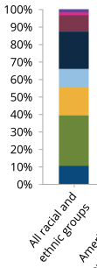
Differences in Educational Attainment, 2017
With Bachelor’s Degree+: 33% 25% 36%
Source: American Council on Education

Slide 27
Educational Attainment
Median Household Net Worth by Race and Education
Source: Darity, et al., “What We Get Wrong About Closing the Racial Wealth Gap”

Slide 28
Home Ownership

Slide 29
Home Ownership: 2016
Housing Status | Net Worth Median | Net Worth Mean
Renters | $5,200 | $91,100
Owner | $231,400 | $1,034,200

Slide 30
Wealth Equality Through Home Ownership?
Well-documented evidence of historical and ongoing housing and lending discrimination.
Appraisals, buyers, lenders, local laws, covenants…
What about home prices in minority neighborhoods? Even if they buy, they won’t get the appreciation of White neighborhoods.
Home values are 50% lower in majority Black neighborhoods.
23% lower after adjusting for quality and amenities.
Source: Brookings, Home ownership while black

Slide 31
What Determines Differences in Home Ownership?
Wealth of parents
Ability to borrow – lending discrimination
At all
On equivalent terms to white borrowers
Local ordinances – housing discrimination
Lower appreciation rates of homes in majority Black communities.
This makes it a less attractive investment.

Slide 32
Increased Savings
Historical evidence generated by economists ranging from Milton Friedman (1957) to Marjorie Galenson (1972) to Marcus Alexis (1971) to Gittelman and Wolff (2004)…..
All find that after accounting for household income, Blacks have a slightly higher savings rate than Whites.
Risk and reward are higher for White investors.
Controlling for income, this is not clear.
Access to and tolerance for higher risk investments is clearly correlated with income.

Slide 33
Financial Literacy
Financial literary helps explain individual wealth differences within racial groups, but none of the wealth differences between racial groups.
The insufficient financial literacy argument is often leveled specifically at Black households.
The argument holds equally with regard to all households of comparable incomes.
Controlling for household income, there is no difference in rates of asset appreciation between Black and White households.

Slide 34
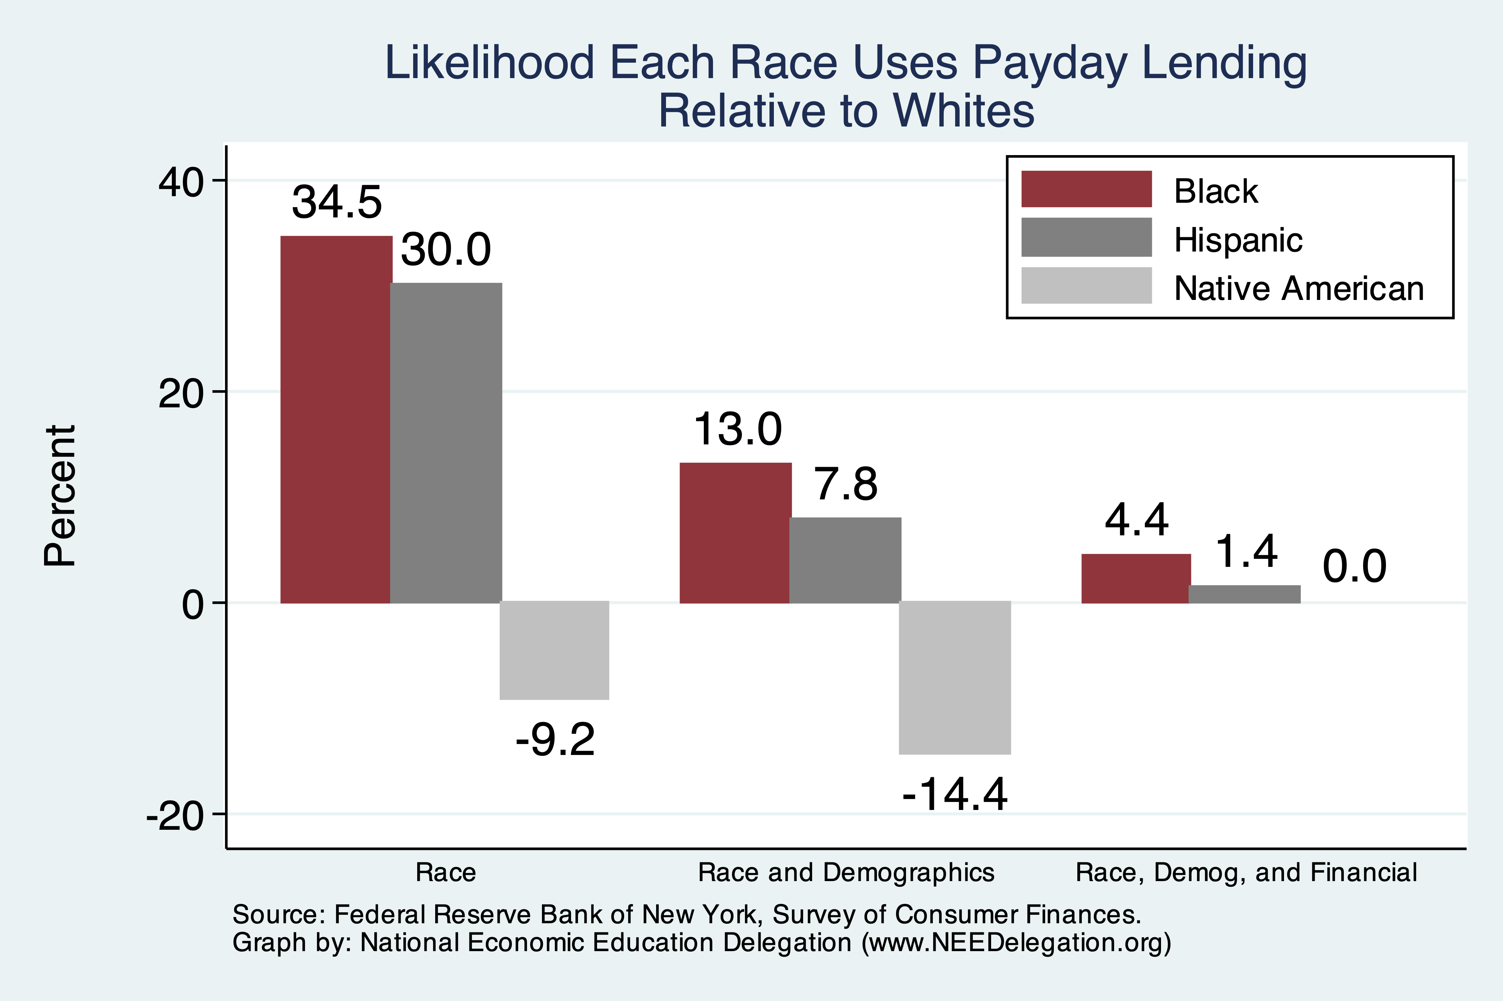
Use of Payday Lenders
Source: Federal Reserve Bank of New York; Survey of Consumer Finances

Slide 35
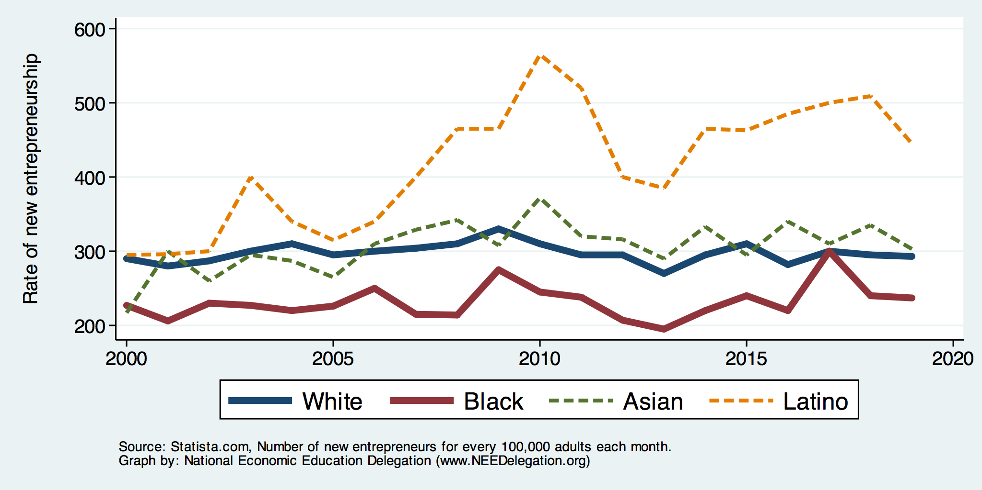
Entrepreneurship: Rate of New Entrepreneurs
Source: Statistica

Slide 36
Explaining Differences in Entrepreneurship
Disparities in access to capital:
Wealth disparities
Specifically differences in home equity.
Differences in wealth levels of friends and family.
Less likely to rely on banks and more likely to rely on credit cards.
Loans have higher int rates and more likely to be declined.
Less access to venture funds.
Generally lower levels of education.
Previous business ownership by family.
Different stocks of relevant social capital.

Slide 37
Soft Skills and Personal Responsibility
Employability
Show up on time
Eye contact with customers
Dress well
Collaborative skills
Reality
Black workers are crowded into service sector jobs.
Well represented in service, sales and office, and production, transportation, and material moving
Relatively less well represented in construction, extraction, and maintenance.

Slide 38
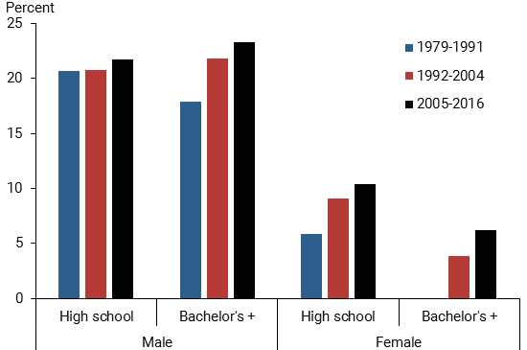
Black-White Earnings Gap by Education
Source: https://www.frbsf.org/economic-research/publications/economic-letter/2017/september/disappointing-facts-about-black-white-wage-gap/

Slide 39
Equality of Income = Equality of Wealth
/
Source: http://hartfordinfo.org/issues/wsd/FamiliesandChildren/Racial-Wealth-Gap-Brief.pdf

Slide 40
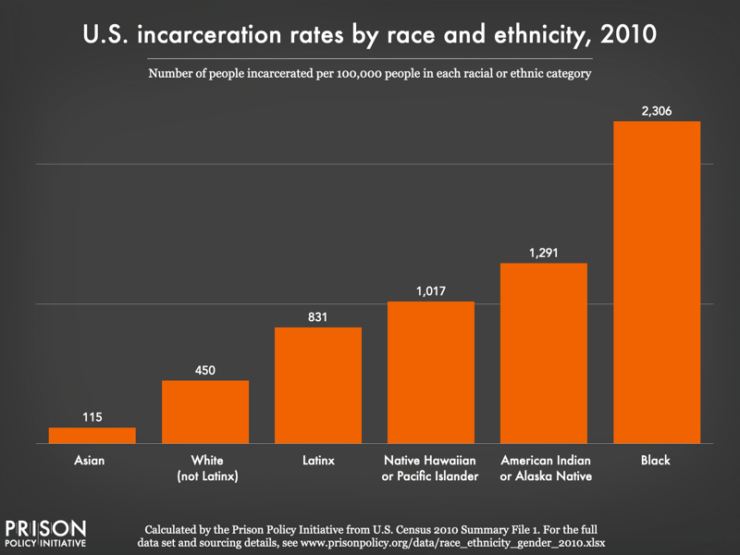
Incarceration Likely Plays A Role

Slide 41
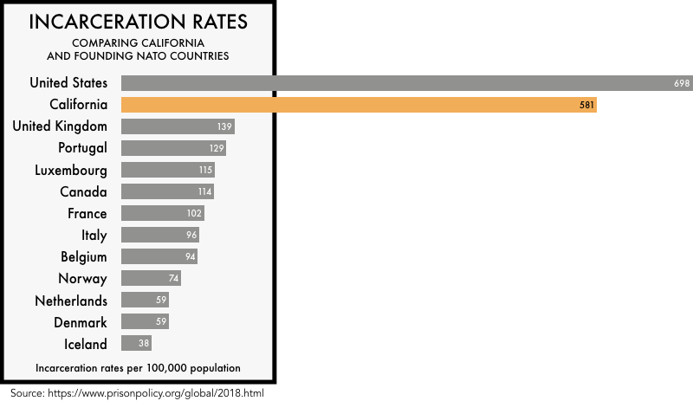

Slide 42
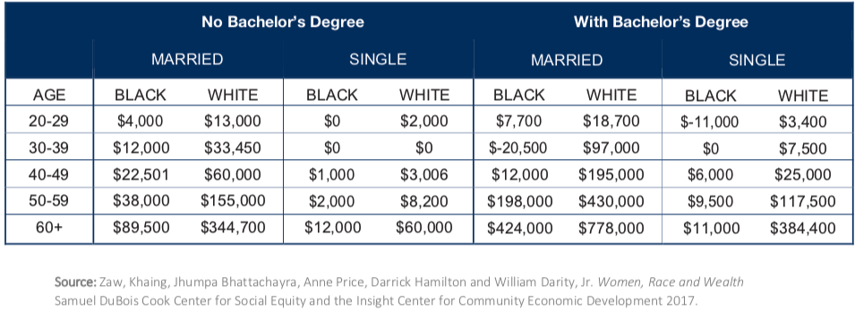
Family Structure

Slide 43
Kids – Household Types

Slide 44
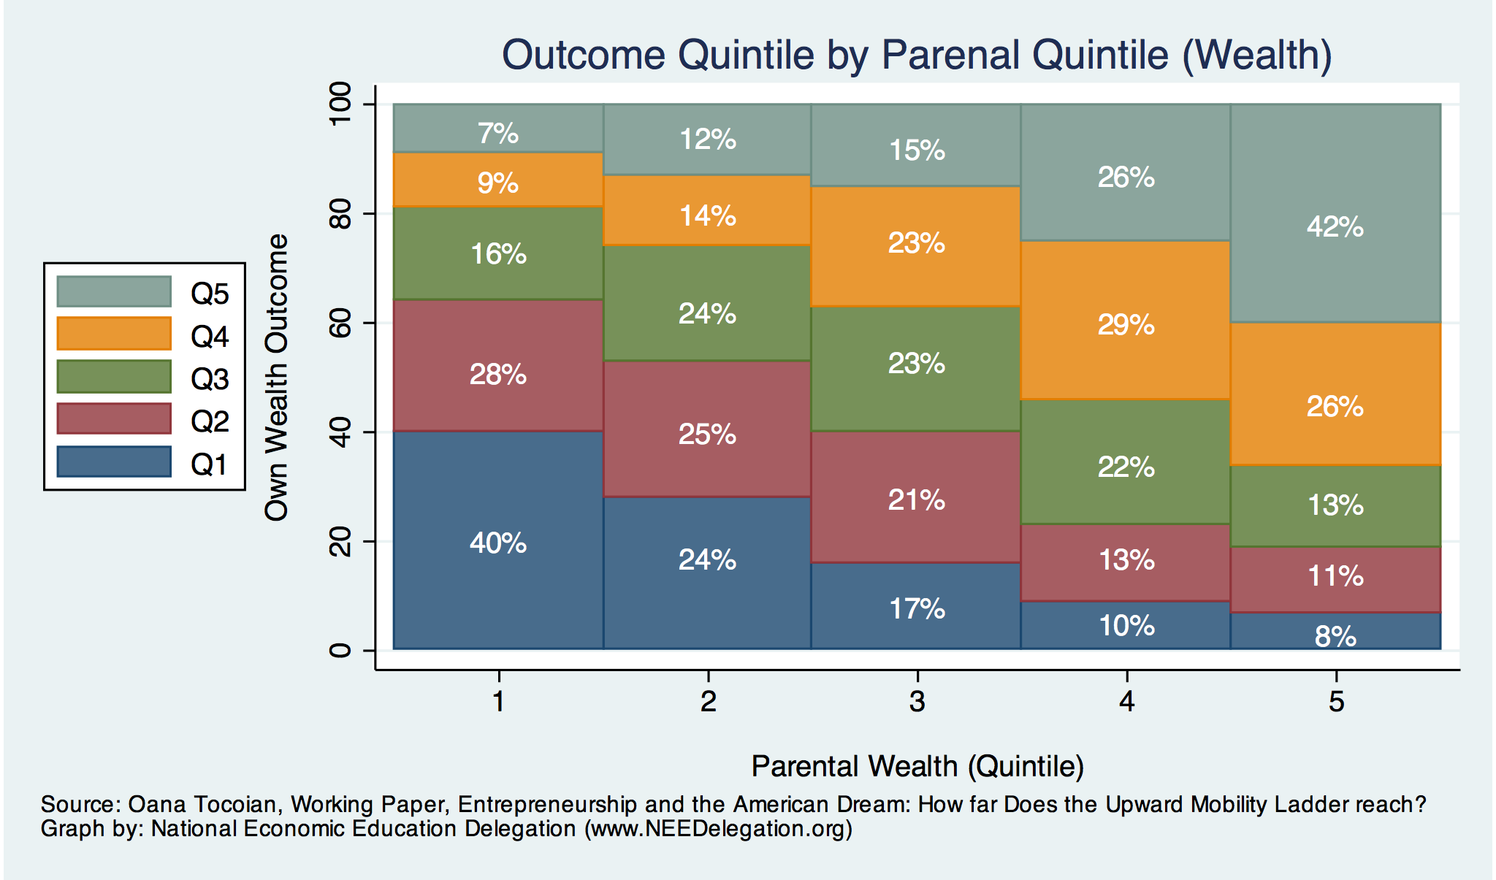
Wealth Mobility

Slide 45
What is Fundamentally Responsible?
Individual behaviors?
Structural characteristics of the economy?
History – policy and otherwise?

Slide 46
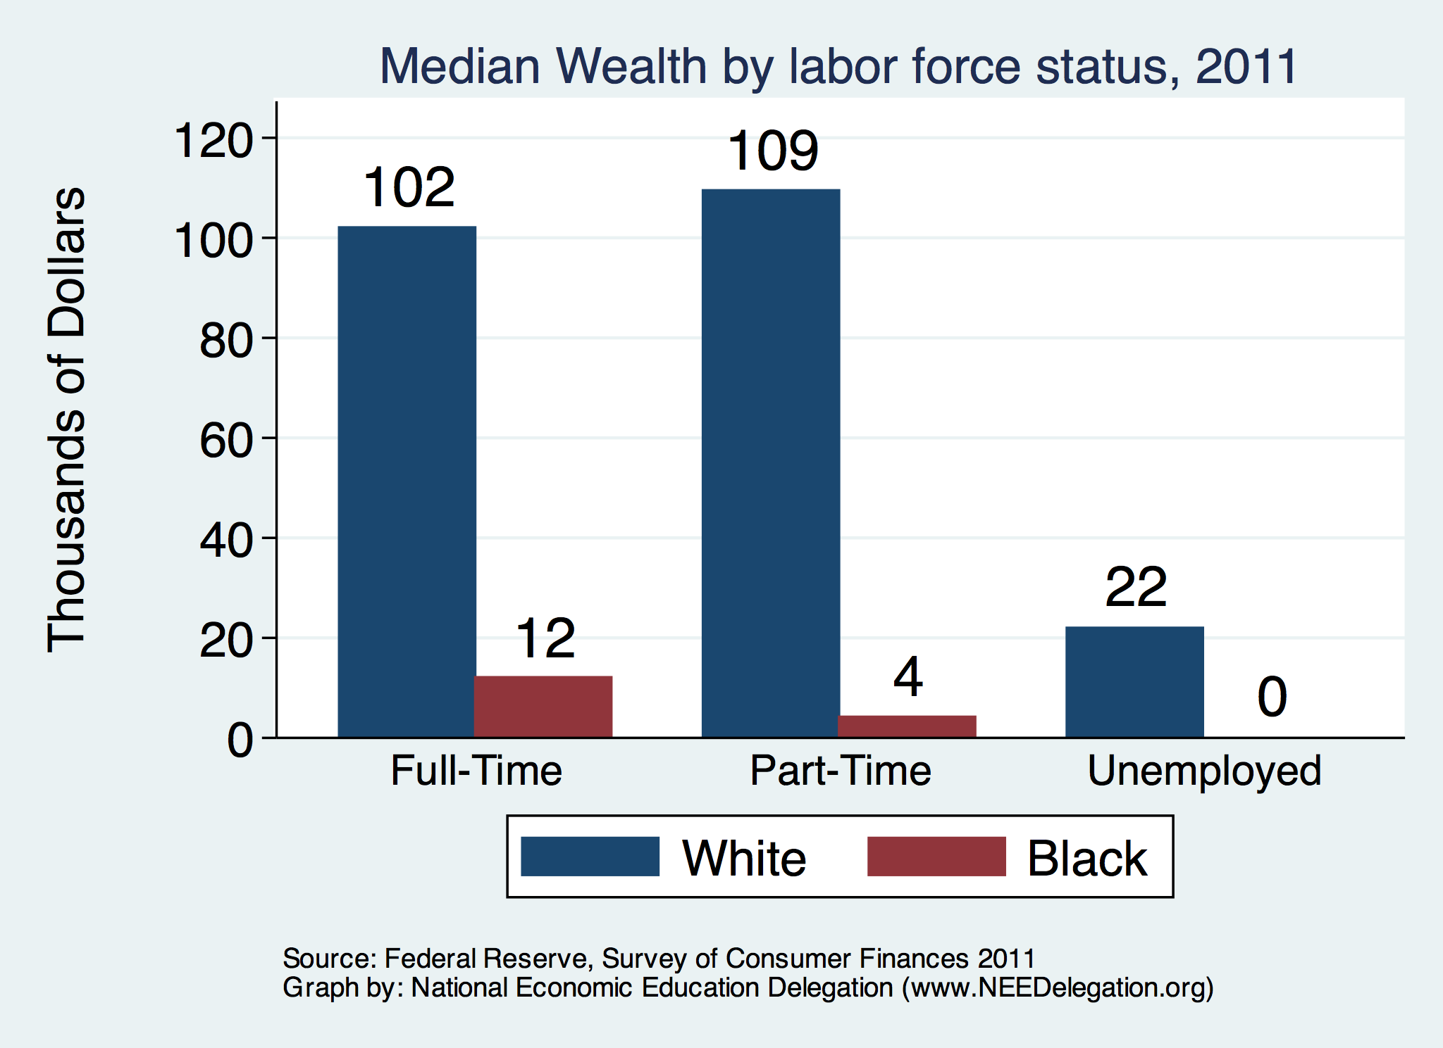
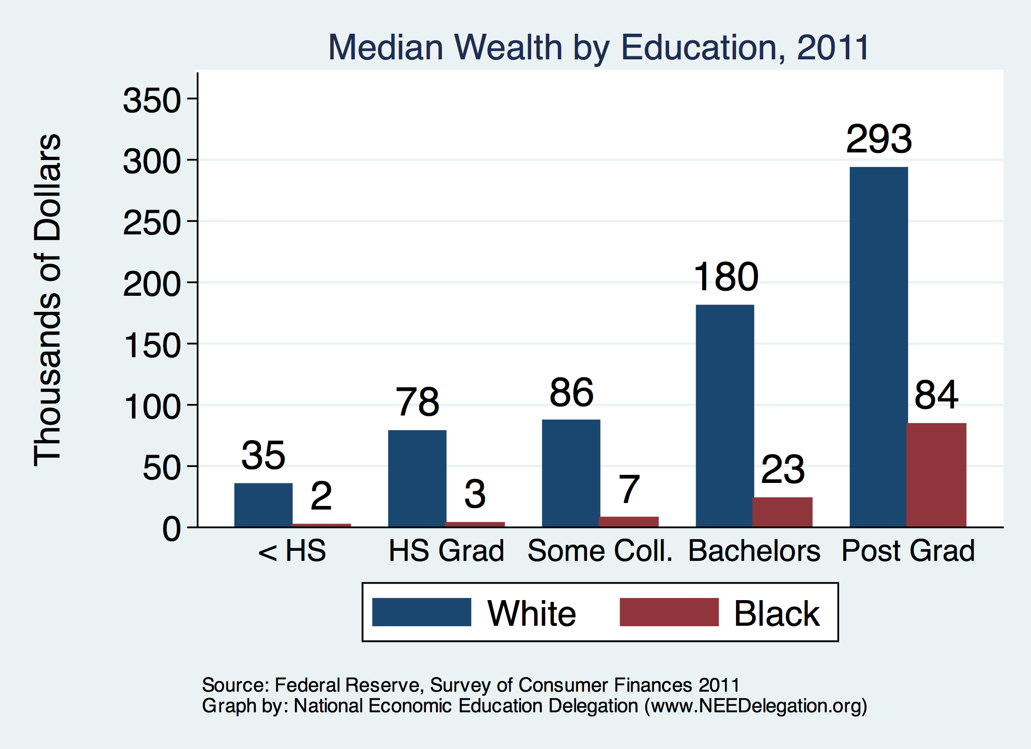
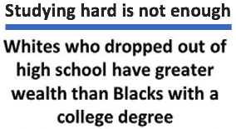
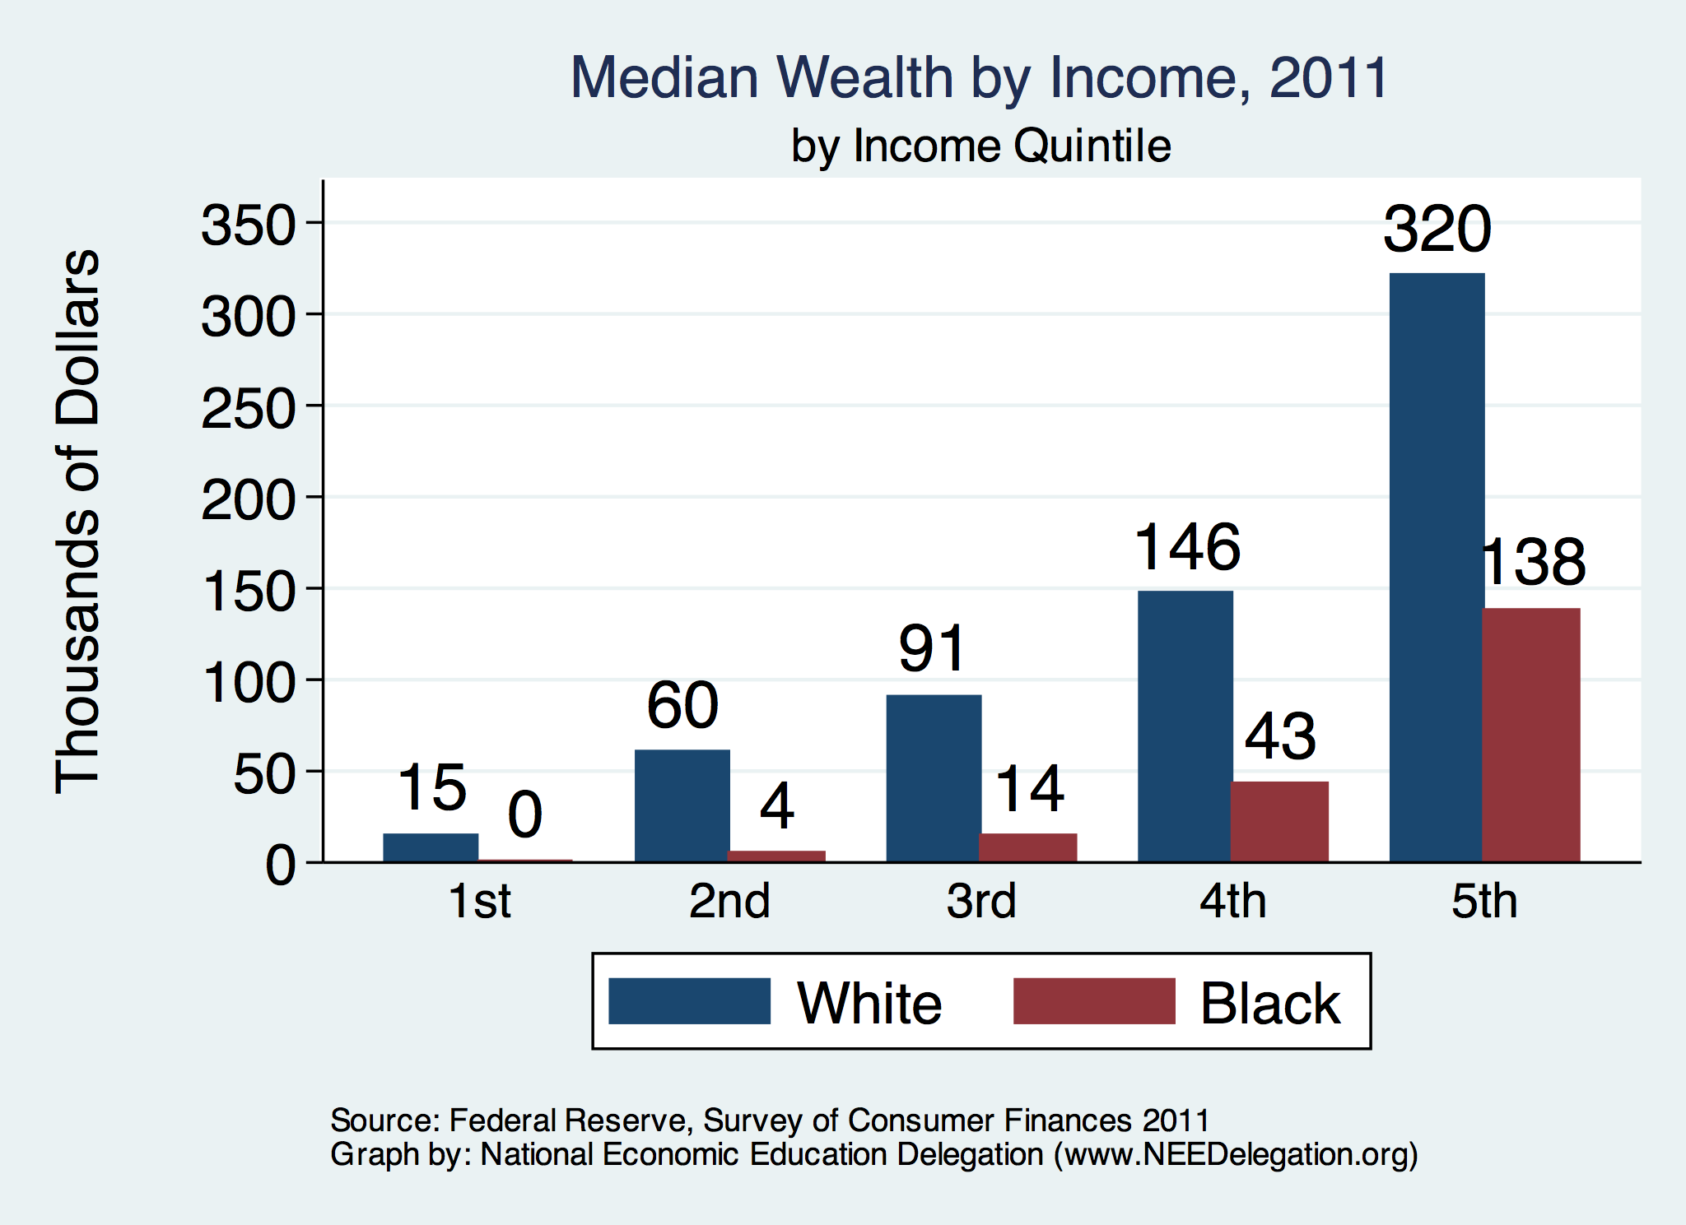

Slide 47
Accounting for the Wealth Gap
30%+ Left
Unaccounted for
Source: https://heller.brandeis.edu/iasp/pdfs/racial-wealth-equity/racial-wealth-gap/roots-widening-racial-wealth-gap.pdf

Slide 48
Policy Options

Slide 49
Categories of Policy Areas
Housing
FHA and redlining
Health Care
Incarceration
Black incarceration rates are very high.
Education
Workforce
Income support and stability
Asset accumulation

Slide 50
Specific Policy Options
Global solutions that affect all source areas
Child Trust Accounts - ”Baby Bonds”
Guaranteed minimum income
Addressing racial disparities directly
Reparations
Aggressive affirmative action.
A new Homestead Act.
Heavily investing in Black communities.
Differential tax treatment.
Labor and other laws that address discrimination
Enforce more aggressively and make adjustments where necessary to increase efficacy.
Fundamental reorientation of asset building agenda.

Slide 51
Gov’t Asset Building Policies

Slide 52
Other Concrete Policy Options
Limit the mortgage interest tax deduction and use the revenues to provide a credit for first-time homebuyers.
Establish automatic savings and retirement plans.
Reduce reliance on student loans while supporting success in postsecondary education.
Offer universal children's savings accounts.
Reform safety net program asset tests, which can act as barriers to saving among low-income families.
Provide subsidies to promote emergency savings, such as those linked to tax time.
Source: Urban Institute

Slide 53
Summary
The Black White wealth gap is enormous (2022)
Mean: White wealth is 6.5x Black wealth.
Median: White wealth is 6.3x Black wealth.
There are many explanations in the common narrative.
Many do not stand up to scrutiny.
Government policies have contributed enormously this gap.
Racial dehumanizing permitted these policies.
Wealth endowments (parental wealth) are enormously important for determining own wealth in adulthood.
Policies that address this relationship are most likely to be effective.
Some form of policy intervention is likely necessary if the gap is to be closed.

Slide 54
Thank you!
Any Questions?
www.NEEDEcon.org
Jon D. Haveman
Jon@NEEDEcon.org
Contact NEED: info@NEEDEcon.org
Submit a testimonial: www.NEEDEcon.org/testimonials.php
Support NEED: www.NEEDEcon.org/friend.php

