Slide 1


The Black-White Wealth Gap
Marin Academy
April 20, 2026
Jon Haveman, Ph.D.
Executive Director, NEED

Slide 2
Outline
Evidence of disparities
Why wealth is important
Sources of disparities
Implications of disparities
Policy solutions

Slide 3
What is Wealth?
Income vs Wealth
Income is the flow of funds into a household each year.
Wealth is a household’s NET asset holdings.
The value of all assets minus the value of all debts.
Assets include:
Owned homes, cars, stocks, businesses, savings and checking accounts, pensions, life insurance…
Debts include:
Home mortgages, car loans, credit cards, and any other significant financial obligations (excl regular bills)…

Slide 4
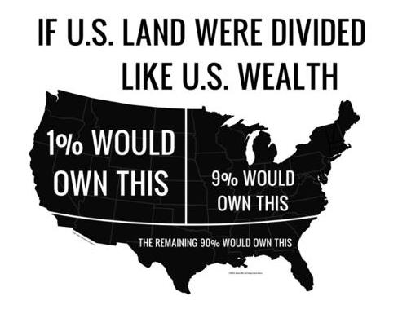
Wealth inequality in America

Slide 5
Black-White Wealth Gap

Slide 6
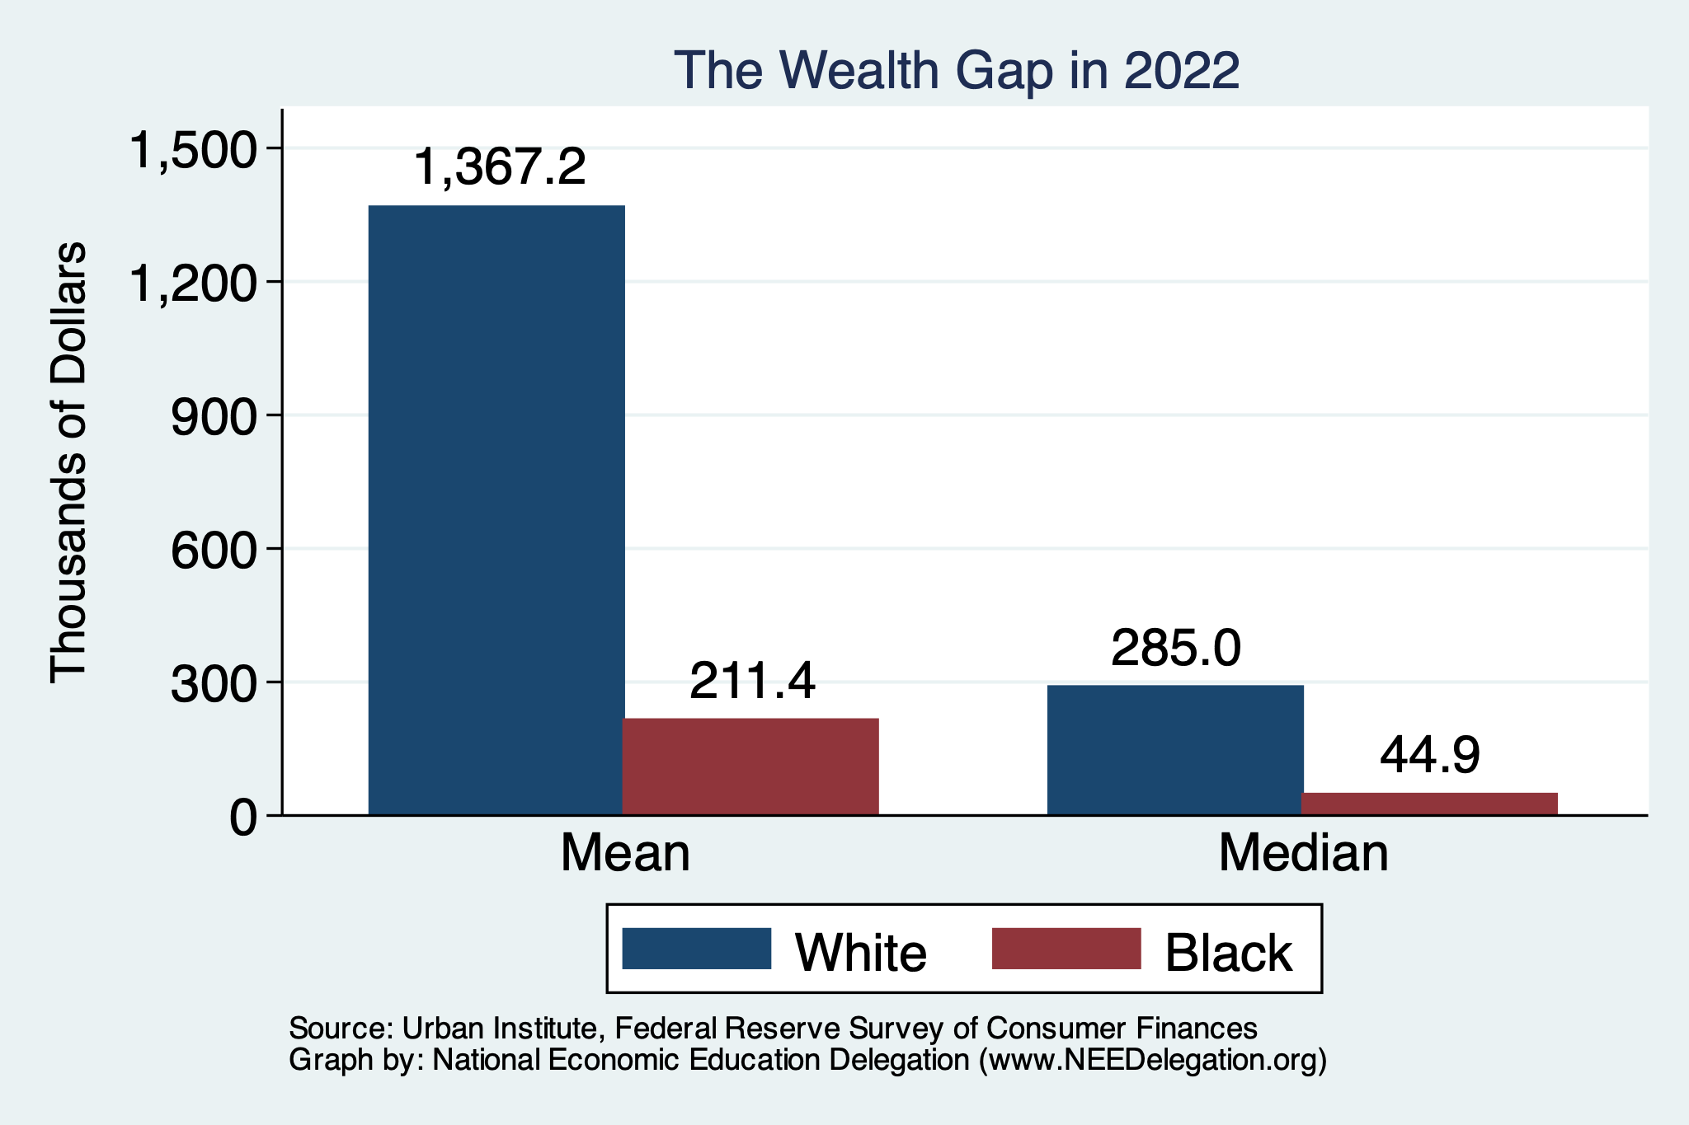
Evidence of the Gap
Mean is
6.5x Greater
Median is 6.3x Greater

Slide 7
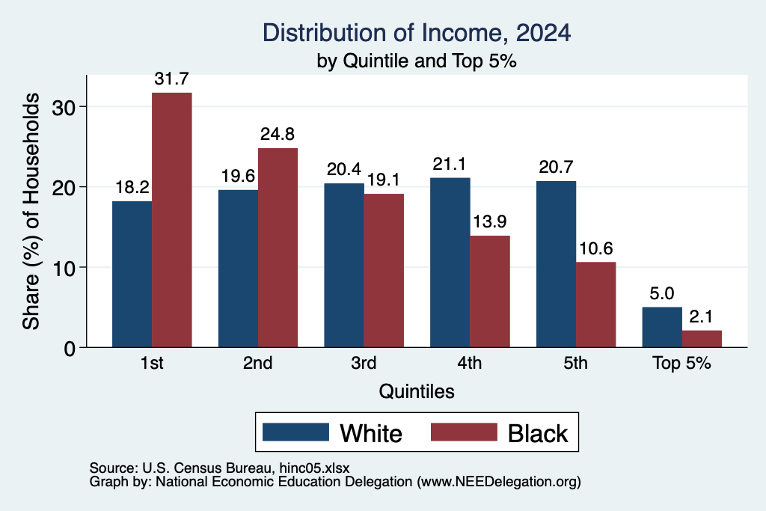
Black Household Incomes Relative to White
Median Income:
White Households: $88,000
Black Households: $55,000
Source: pewsocialtrends.org

Slide 8
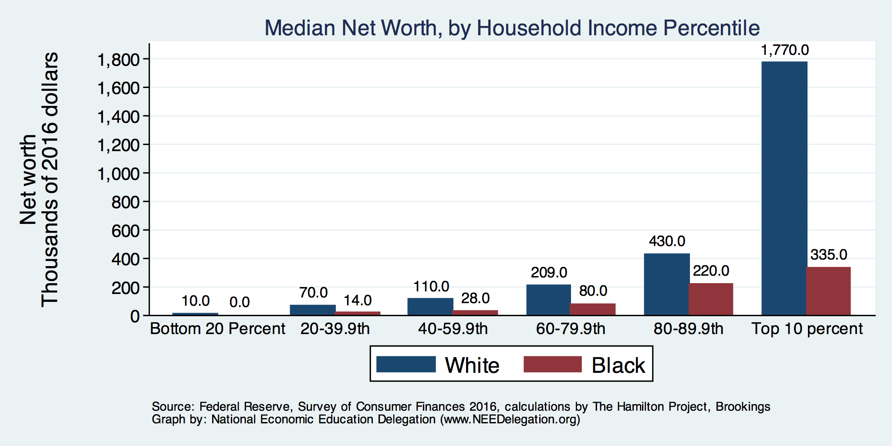
By Household Income
Income equality does not
Translate into wealth equality.

Slide 9
Why Wealth is Important

Slide 10
Widespread Household Wealth Pays Dividends
To individuals in the household
Choices/Agency
Wealth is iterative
And to broader society
Human capital development
Entrepreneurship and innovation

Slide 11
Household Level Benefits
Choices/Life Agency
Finance higher education
Living in good neighborhoods
Saving for retirement
Capital to start a business
w/stand financial hardship
Better legal counsel
Exert political influence
Finance costly medical procedure
Bequests
Wealth is iterative
Wealth begets more wealth.
Access to higher return investments.
Wealth transfers across generations.
Wealth is sticky.

Slide 12
Tangible Benefits for the Broader Economy
More human capital development
Increased entrepreneurship
Healthier labor force
Less reliance on social programs
Smaller stock of student loans

Slide 13
Sources of Disparities

Slide 14
Events/Policies with Direct Wealth Implications
Slave trade
The first deprivation.
Slavery
40 acres (and a mule)
The second deprivation.
Discriminatory distribution of land.
Freedman’s Savings Bank
Lax oversite and dissolution.
Jim Crow Laws & Economic Policy
Convict leasing, debt peonage, chain-gang, sharecropping, and lynching.
Homestead Act
Discriminatory distribution of land.
Land theft and destruction
E.g., Black Wall Street – Tulsa, 1921.
GI Bill
Discriminatory access – Levittown
Federal Housing Authority
Redlining
And many more.

Slide 15
Results for Black Families
Much lower accumulation of wealth than among White families.
Implications:
Less financial contribution from parents to children.
More difficult access to higher education.
Less access to capital for business formation.
More likely to live in disadvantaged neighborhoods.
Fewer role models.
Less access to quality education.
Disparities in the capacity – availability of resources - to build wealth.

Slide 16
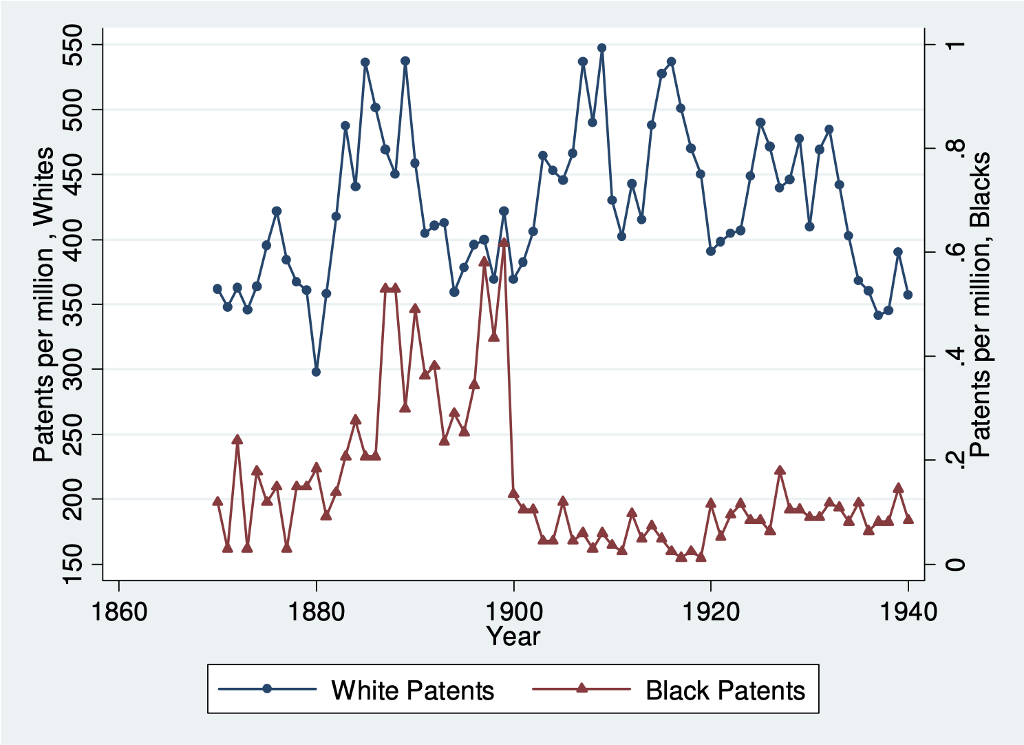
Tangible: Effect on Patenting/Innovation
Effects of:
Lynchings and Riots?

Slide 17
Potential Explanations: Differences in…
Educational attainment
Home ownership
Increased savings
Financial literacy
Entrepreneurship
Soft skills and personal responsibility
Wages
Labor force participation
Family structure
Initial endowment

Slide 18
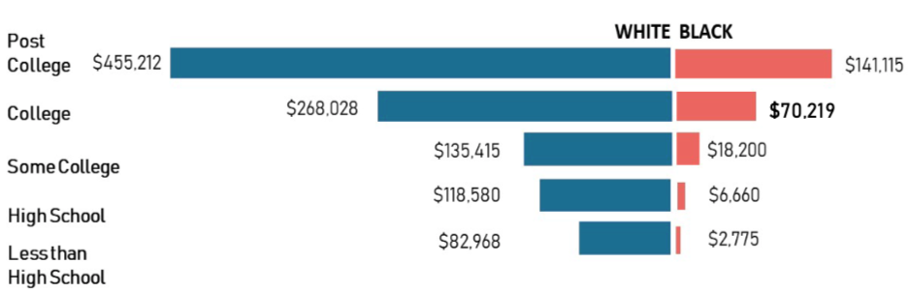
Educational Attainment
Median Household Net Worth by Race and Education
Source: Darity, et al., “What We Get Wrong About Closing the Racial Wealth Gap”

Slide 19
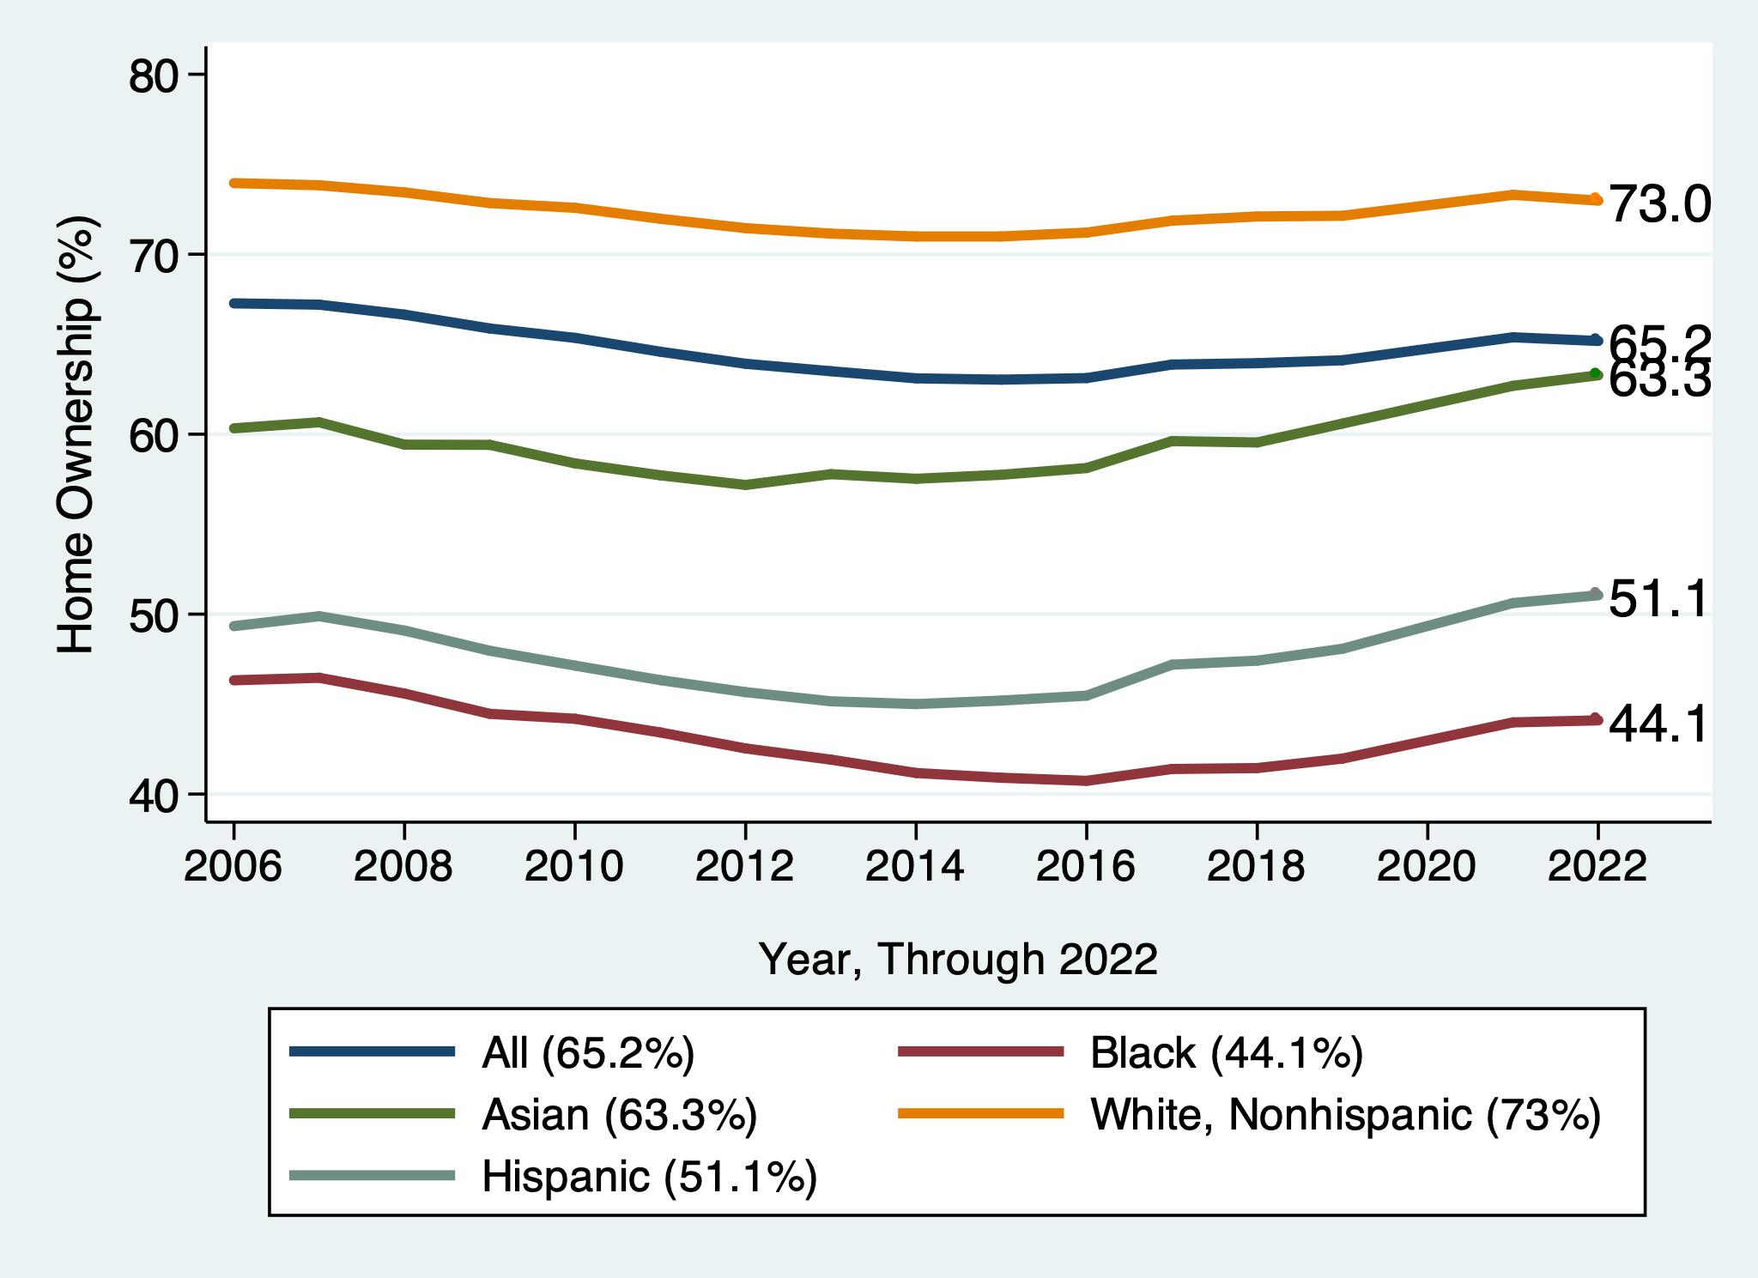
Home Ownership
White, Nonhispanic
Black

Slide 20

Home Ownership: 2016
Housing Status | Net Worth Median | Net Worth Mean
Renters | $5,200 | $91,100
Owner | $231,400 | $1,034,200

Slide 21
Financial Literacy
Financial literary helps explain individual wealth differences within racial groups, but none of the wealth differences between racial groups.
The insufficient financial literacy argument is often leveled specifically at Black households.
The argument holds equally with regard to all households of comparable incomes.
Controlling for household income, there is no difference in rates of asset appreciation between Black and White households.

Slide 22
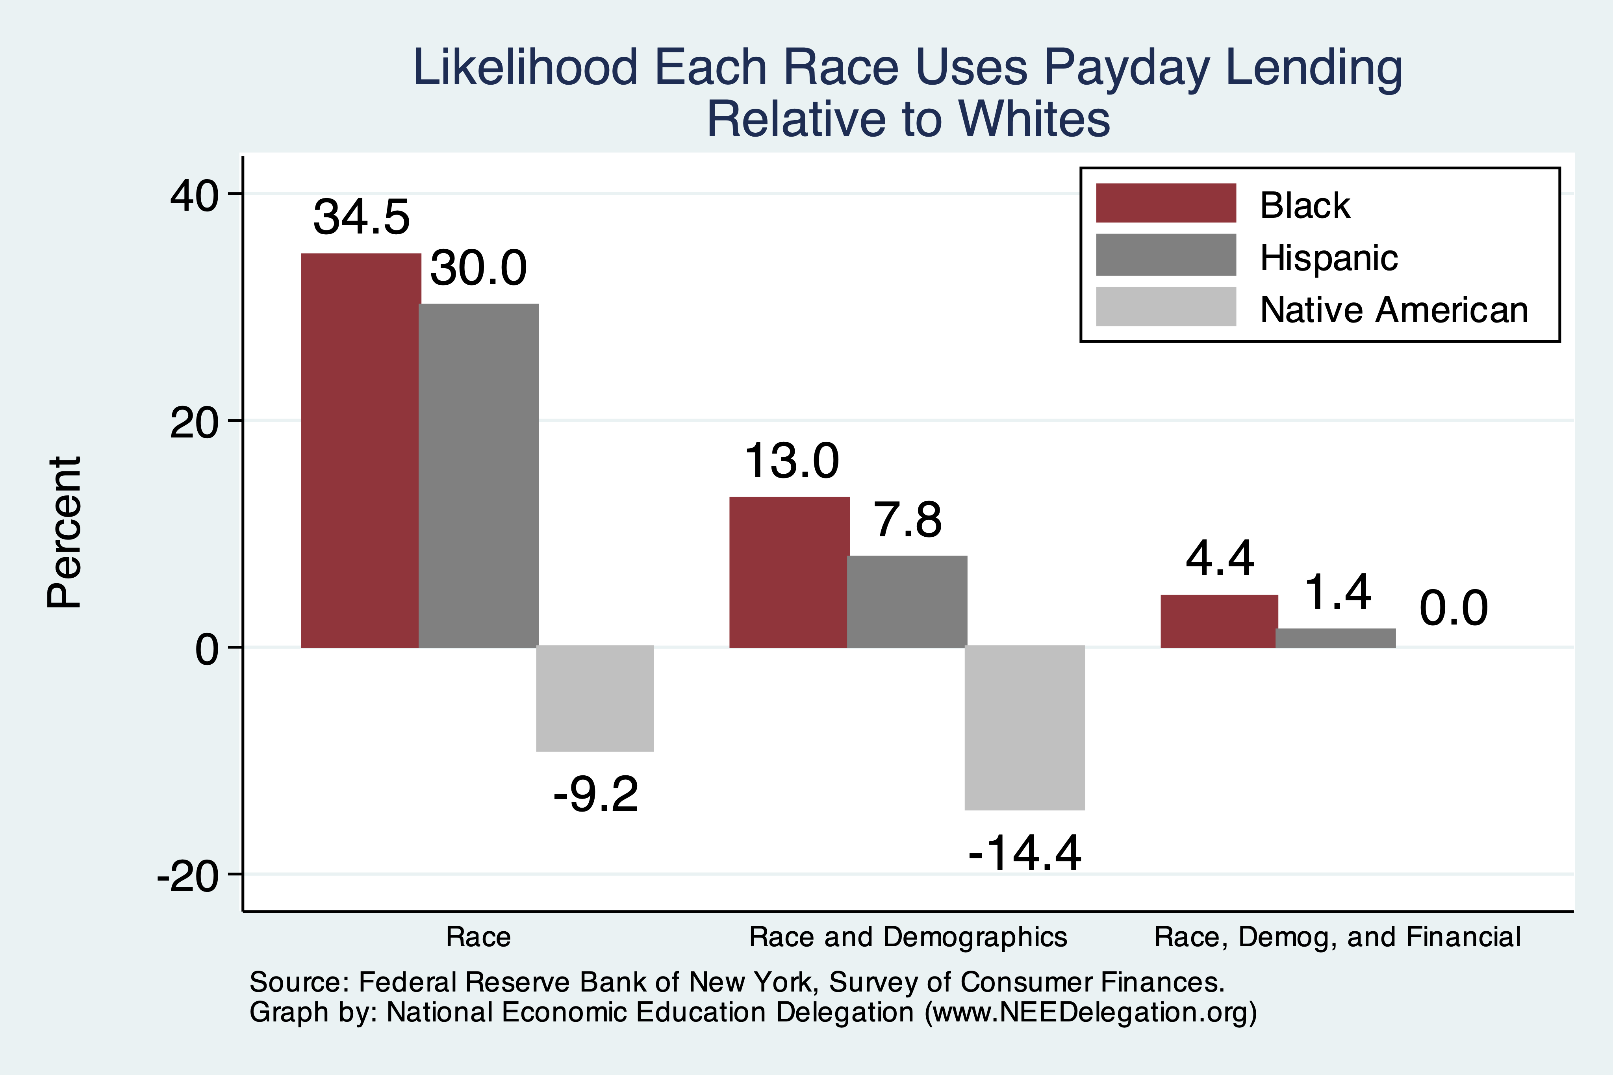
Use of Payday Lenders
Source: Federal Reserve Bank of New York; Survey of Consumer Finances

Slide 23
Soft Skills and Personal Responsibility
Employability
Show up on time
Eye contact with customers
Dress well
Collaborative skills
Reality
Black workers are crowded into service sector jobs.
Well represented in service, sales and office, and production, transportation, and material moving
Relatively less well represented in construction, extraction, and maintenance.

Slide 24
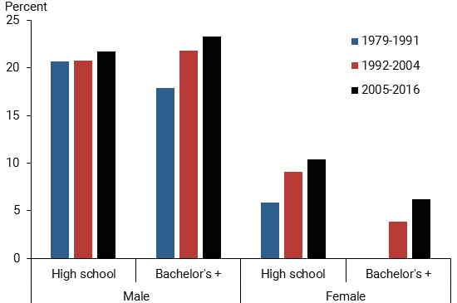
Black-White Earnings Gap by Education
Source: https://www.frbsf.org/economic-research/publications/economic-letter/2017/september/disappointing-facts-about-black-white-wage-gap/

Slide 25
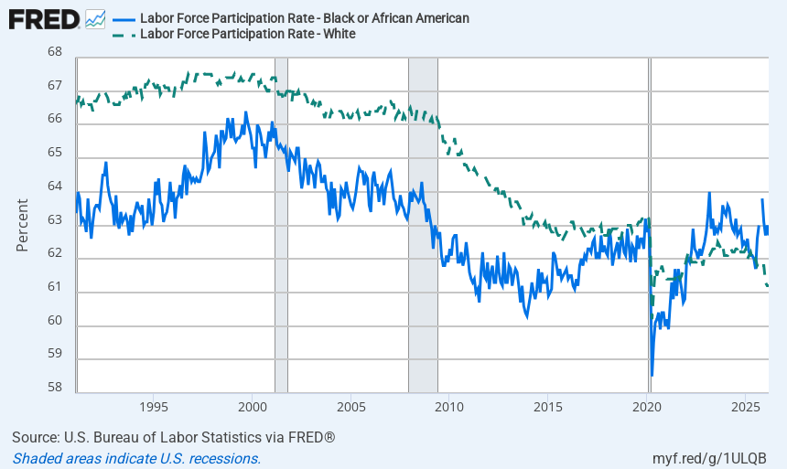
Labor Force Participation Rates by Race
Post COVID Reversal!

Slide 26
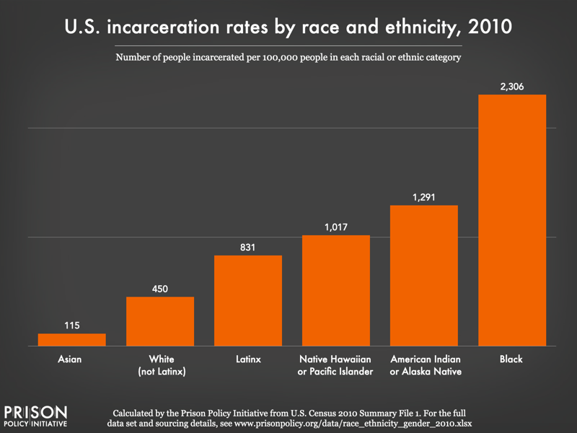
Incarceration Likely Plays A Role

Slide 27
What is Fundamentally Responsible?
Individual behaviors?
Structural characteristics of the economy?
History – policy and otherwise?

Slide 28
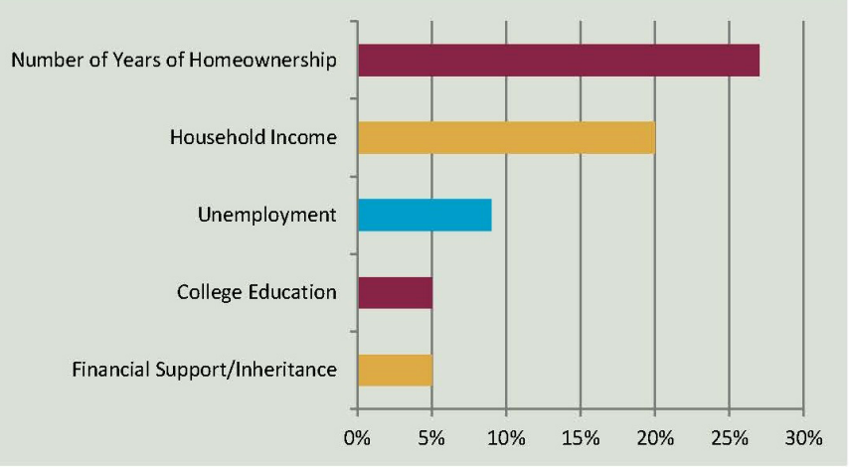
Accounting for the Wealth Gap
30%+ Left
Unaccounted for
Source: https://heller.brandeis.edu/iasp/pdfs/racial-wealth-equity/racial-wealth-gap/roots-widening-racial-wealth-gap.pdf

Slide 29
Policy Options

Slide 30
Categories of Policy Areas
Housing
FHA and redlining
Health Care
Incarceration
Black incarceration rates are very high.
Education
Workforce
Income support and stability
Asset accumulation

Slide 31
Specific Policy Options
Global solutions that affect all source areas
Child Trust Accounts - ”Baby Bonds”
Guaranteed minimum income
Addressing racial disparities directly
Reparations
Aggressive affirmative action.
A new Homestead Act.
Heavily investing in Black communities.
Differential tax treatment.
Labor and other laws that address discrimination
Enforce more aggressively and make adjustments where necessary to increase efficacy.
Fundamental reorientation of asset building agenda.

Slide 32
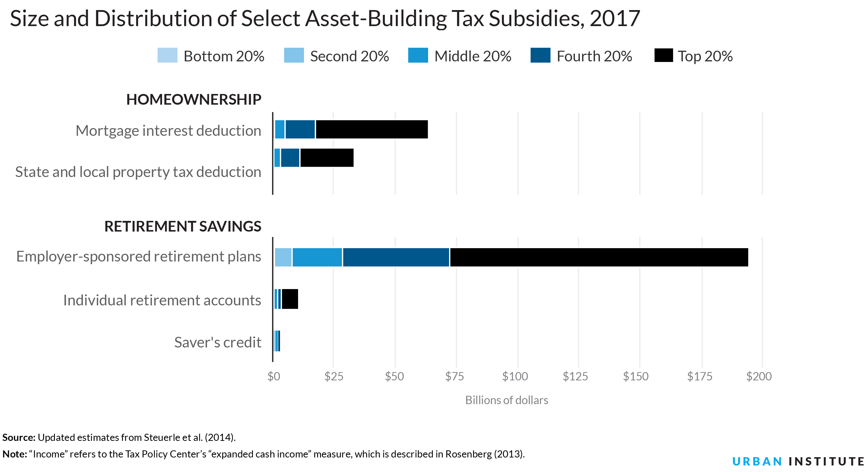
Gov’t Asset Building Policies

Slide 33
Summary
The Black White wealth gap is enormous (2022)
Mean: White wealth is 6.5x Black wealth.
Median: White wealth is 6.3x Black wealth.
There are many explanations in the common narrative.
Many do not stand up to scrutiny.
Government policies have contributed enormously this gap.
Wealth endowments (parental wealth) are enormously important for determining own wealth in adulthood.
Policies that address this relationship are most likely to be effective.
Some form of policy intervention is necessary if the gap is to be closed.

Slide 34
Thank you!
Any Questions?

