Slide 1
The Black-White Wealth Gap
Fidelity
June 18, 2021
Jon Haveman, Ph.D.
Executive Director, NEED

Slide 2
National Economic Education Delegation
Vision
One day, the public discussion of policy issues will be grounded in an accurate perception of the underlying economic principles and data.
Mission
NEED unites the skills and knowledge of a vast network of professional economists to promote understanding of the economics of policy issues in the United States.
NEED Presentations
Are nonpartisan and intended to reflect the consensus of the economics profession.

Slide 3
Who Are We?
Honorary Board: 54 members
2 Fed Chairs: Janet Yellen, Ben Bernanke
6 Chairs Council of Economic Advisers
Furman (D), Rosen (R), Bernanke (R), Yellen (D), Tyson (D), Goolsbee (D)
3 Nobel Prize Winners
Akerlof, Smith, Maskin
Delegates: 590+ members
At all levels of academia and some in government service
All have a Ph.D. in economics
Crowdsource slide decks
Give presentations
Global Partners: 45 Ph.D. Economists
Aid in slide deck development

Slide 4
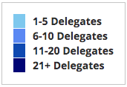
Where Are We?

Slide 5
Credits and Disclaimer
This slide deck was authored by:
Darrick Hamilton, Ph.D., The New School
Jon Haveman, Ph.D., NEED
This slide deck was reviewed by:
Patrick Mason, Florida State University
Steven Craig, University of Houston
Disclaimer
NEED presentations are designed to be nonpartisan.
It is, however, inevitable that the presenter will be asked for and will provide their own views.
Such views are those of the presenter and not necessarily those of the National Economic Education Delegation (NEED).

Slide 6
Outline
Evidence of disparities
Why wealth is important
Sources of disparities
Implications of disparities
Policy solutions

Slide 7
What is Wealth?
Income vs Wealth
Income is the flow of funds into a households each year.
Wealth is a household’s NET asset holdings.
The value of all assets minus the value of all debts.
Assets include:
Owned homes, cars, stocks, businesses, savings and checking accounts, pensions, life insurance…
Debts include:
Home mortgages, car loans, credit cards, and any other significant financial obligations (excl regular bills)…

Slide 8
Evidence

Slide 9
Evidence of the Gap
Mean is
7x Greater
Median is 8x Greater

Slide 10
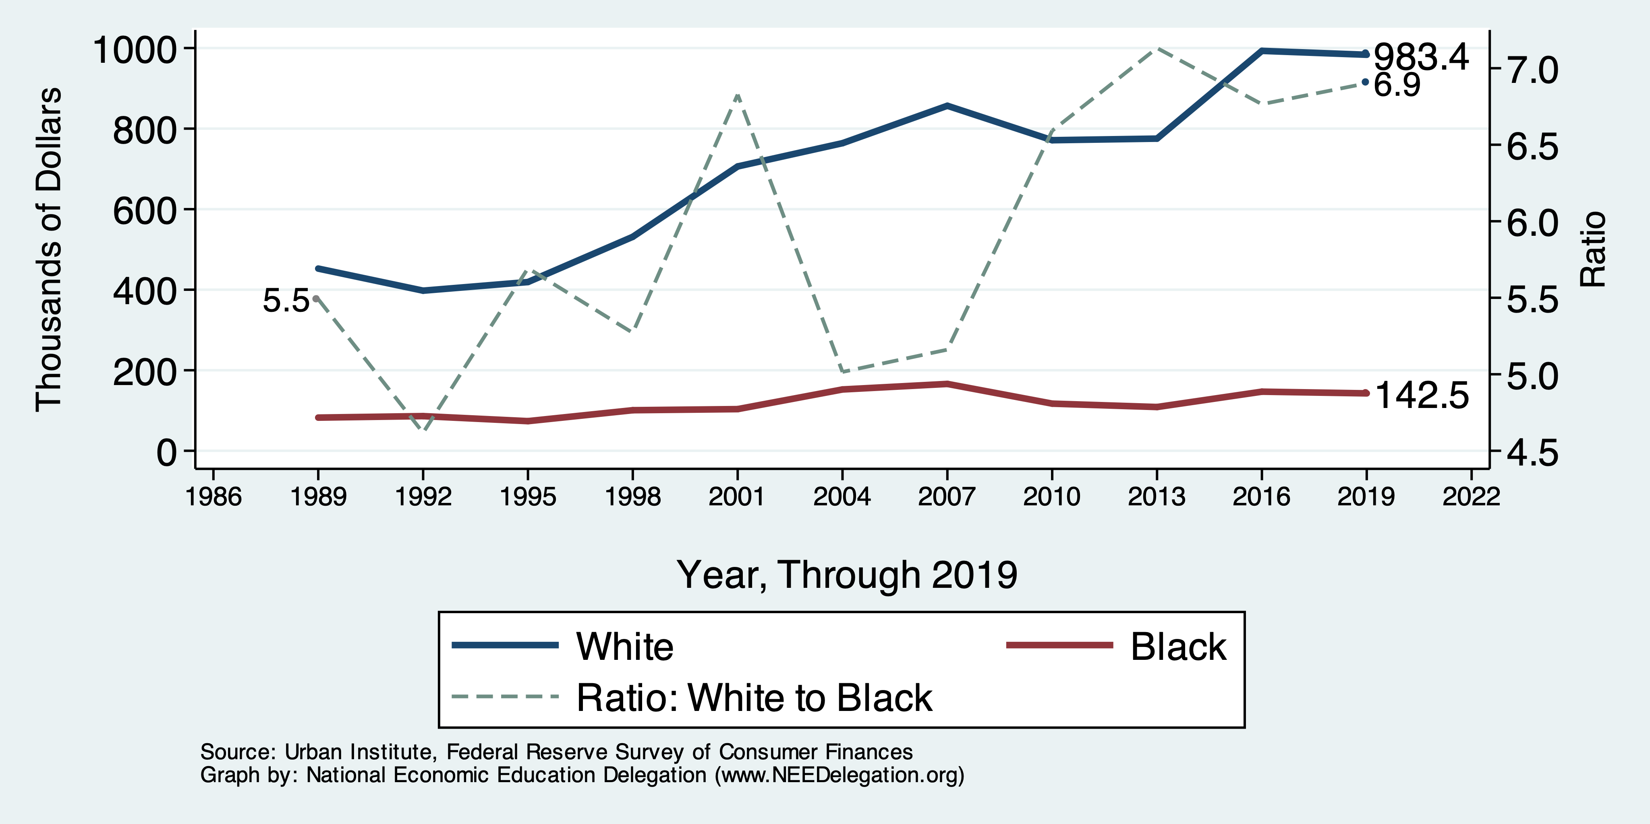
Wealth Gap Over Time: Mean

Slide 11
Wealth is More and More Concentrated
99th Percentile
2016 = 7x 1963
Source: Urban Institute

Slide 12
Black Household Incomes Relative to White
Source: pewsocialtrends.org

Slide 13
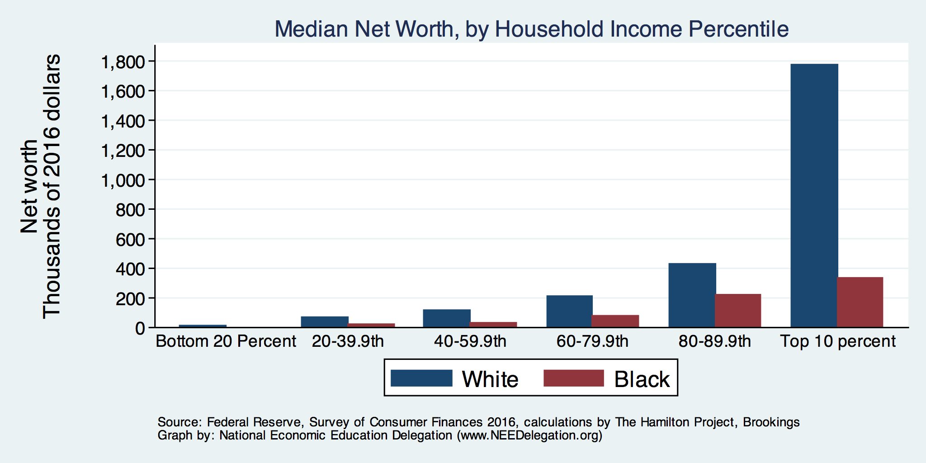
By Household Income

Slide 14
Why Wealth is Important

Slide 15
Widespread Household Wealth Pays Dividends
To individuals in the household
Choices/Agency
Wealth is iterative
And to broader society
Human capital development
Entrepreneurship and innovation

Slide 16
Household Level Benefits
Choices/Life Agency
Finance higher education
Living in good neighborhoods
Saving for retirement
Capital to start a business
w/stand financial hardship
Better legal counsel
Exert political influence
Finance costly medical procedure
Bequests
Wealth is iterative
Wealth begets more wealth.
Access to higher return investments.
Wealth transfers across generations.
Wealth is sticky.

Slide 17
Parental Wealth is Important
Important pre-estate transfer effects on kids:
Influences human capital accumulation
Influences the returns to education
Adult incomes of offspring
There are clearly enormous differences in wealth held by parents of Black and White children.
And it’s clear that nurture plays a big roll.

Slide 18
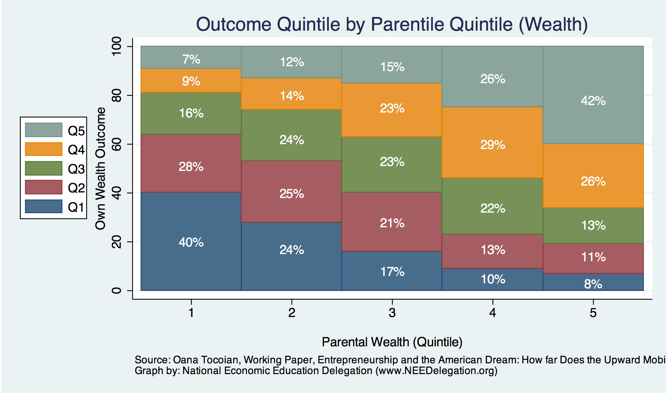
Wealth Mobility

Slide 19
Tangible Benefits for the Broader Economy
More human capital development
Increased entrepreneurship
Greater labor force participation
Healthier labor force
Less social unrest
Less reliance on social programs
Smaller stock of student loans

Slide 20
Sources of Disparities

Slide 21
Events/Policies with Direct Wealth Implications
Slave trade
The first deprivation
Slavery
40 acres (and a mule)
The second deprivation
Discriminatory distribution of land.
Freedmen’s Bank
Lax oversite and dissolution.
Jim Crow Laws & Economic Policy
Convict leasing, debt peonage, chain-gang, sharecropping, and lynching.
Homestead Act
Discriminatory distribution of land.
Land theft and destruction
E.g., Black Wall Street – Tulsa, 1921
GI Bill
Discriminatory access – Levittown
Federal Housing Authority
Redlining
And many more.

Slide 22
Results for Black Families
Much lower accumulation of wealth than among White families.
Implications:
Less financial contribution from parents to children.
More difficult access to higher education.
Less access to capital for business formation.
More likely to live in disadvantaged neighborhoods
Fewer role models.
Less access to quality education.
Disparities in the capacity – availability of resources - to build wealth.

Slide 23
Potential Explanations: Differences in…
Educational attainment
Home ownership
Increased savings
Financial literacy
Entrepreneurship
Soft skills and personal responsibility
Wages
Labor force participation
Family structure
Initial endowment

Slide 24
Wealth by Educational Attainment
Educational Attainment | Net Worth Median | Net Worth Mean
No High School | $22,800 | $157,200
High School | $67,100 | $249,600
Some College | $66,100 | $340,600
College | $292,100 | $1,511,100
71.0%
16.1%
8.6%
4.3%
Source: Federal Reserve Board, Table data are 2016.

Slide 25
Educational Attainment
Median Household Net Worth by Race and Education
Source: Darity, et al., “What We Get Wrong About Closing the Racial Wealth Gap”

Slide 26
Home Ownership: Households
White
Black

Slide 27
Home Ownership
Housing Status | Net Worth Median | Net Worth Mean
Renters | $5,200 | $91,100
Owner | $231,400 | $1,034,200

Slide 28
Wealth Equality Through Home Ownership?
Well-documented evidence of historical and ongoing housing and lending discrimination.
Appraisals, buyers, lenders, local laws, covenants…
What about home prices in minority neighborhoods? Even if they buy, they won’t get the appreciation of White neighborhoods.
Home values are 50% lower in majority Black neighborhoods.
23% after adjusting for quality and amenities.
Source: Brookings, Home ownership while black

Slide 29
What Determines Differences in Home Ownership?
Wealth of parents.
Ability to borrow – lending discrimination.
At all.
On equivalent terms to white borrowers.
Local ordinances – housing discrimination (often by income).
Lower appreciation rates of homes in majority Black communities.

Slide 30
Increased Savings
Historical evidence generated by economists ranging from Milton Friedman (1957) to Marjorie Galenson (1972) to Marcus Alexis (1971) to Gittelman and Wolff (2004)…..
All find that after accounting for household income, Blacks have a slightly higher savings rate than Whites.
Do White investors have a greater tolerance for risk?
Controlling for income, this is not clear.
Access to and tolerance for higher risk investments is clearly correlated with income.

Slide 31
Financial Literacy
Financial literary helps explain individual wealth differences within racial groups, but NONE of the wealth differences between racial groups.
The insufficient financial literacy argument is often leveled specifically at Black households.
The argument holds equally with regard to all households of comparable incomes.
Controlling for household income, there is no difference in rates of asset appreciation between Black and White households.

Slide 32
Use of Payday Lenders
Source: Federal Reserve Bank of New York; Survey of Consumer Finances

Slide 33
Use of Payday Lenders
Source: Federal Reserve Bank of New York; Survey of Consumer Finances

Slide 34
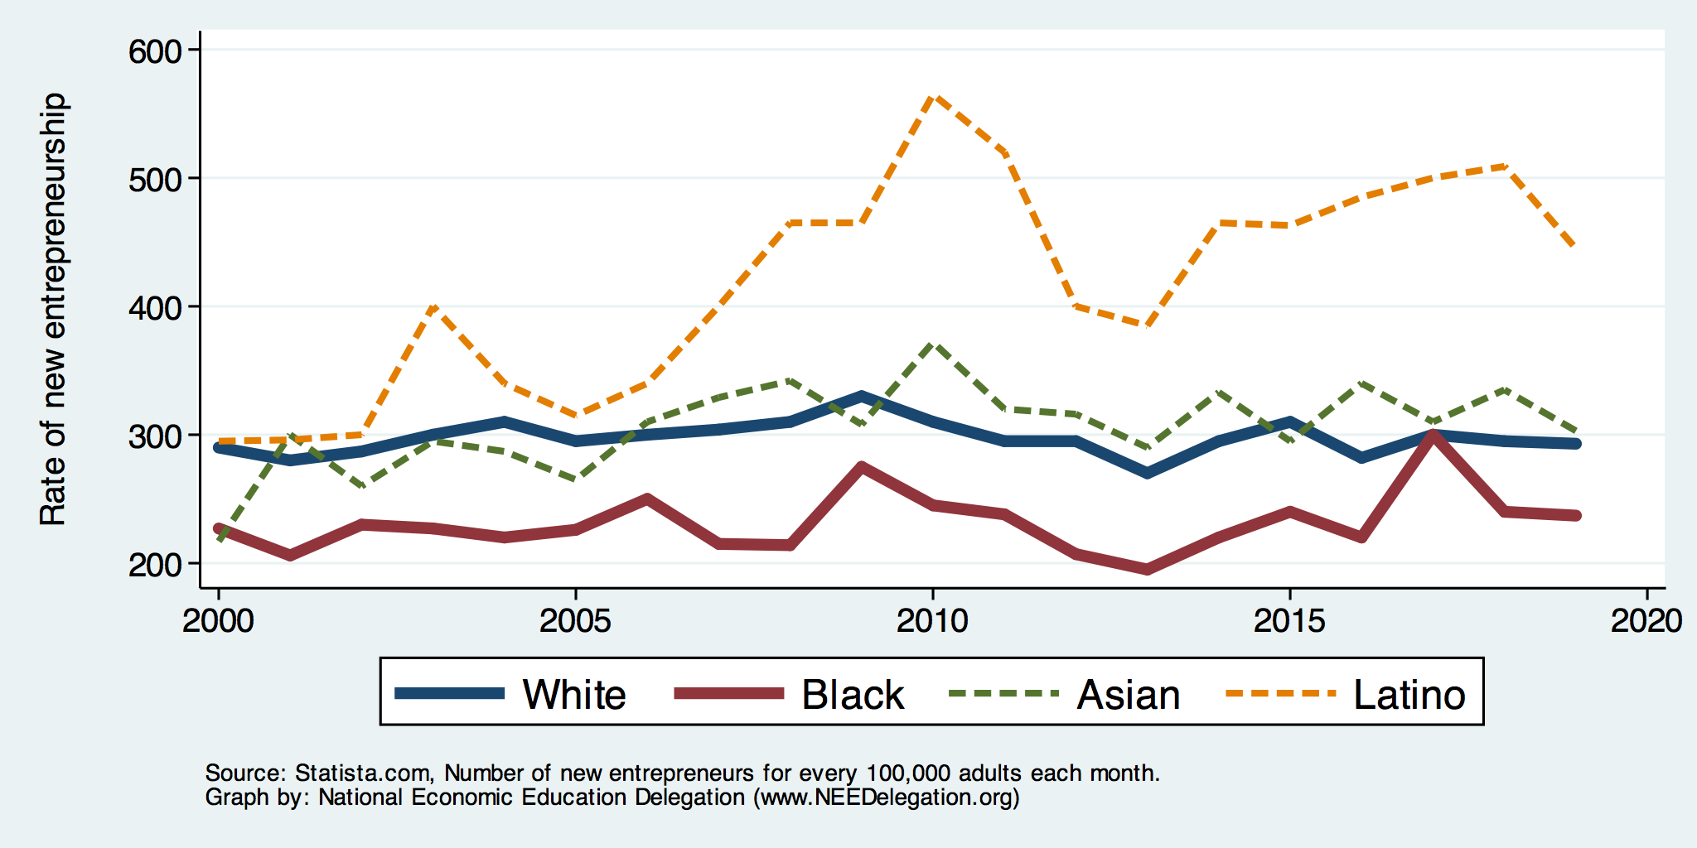
Entrepreneurship: Rate of New Entrepreneurs
Source: Statistica

Slide 35
Explaining Differences in Entrepreneurship
Disparities in access to capital:
Wealth disparities
Specifically differences in home equity.
Differences in wealth levels of friends and family.
Less likely to rely on banks and more likely to rely on credit cards.
Loans have higher int rates and more likely to be declined.
Less access to venture funds.
Generally lower levels of education.
Previous business ownership by family.
Different stocks of relevant social capital.

Slide 36
Soft Skills and Personal Responsibility
Employability
Show up on time
Eye contact with customers
Dress well
Collaborative skills
Reality
Black workers are crowded into service sector jobs.
Well represented in service, sales and office, and production, transportation, and material moving
Relatively less well represented in construction, extraction, and maintenance.

Slide 37
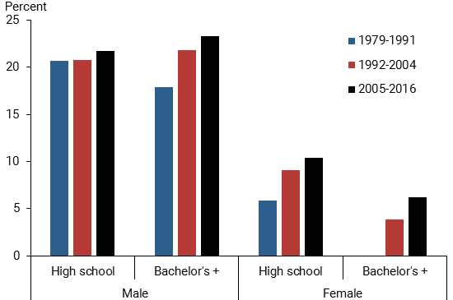
Black-White Earnings Gap by Education
Source: https://www.frbsf.org/economic-research/publications/economic-letter/2017/september/disappointing-facts-about-black-white-wage-gap/

Slide 38
Equality of Income = Equality of Wealth
/
Source: http://hartfordinfo.org/issues/wsd/FamiliesandChildren/Racial-Wealth-Gap-Brief.pdf

Slide 39
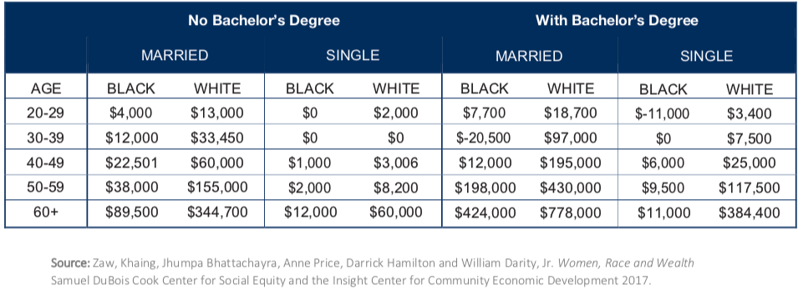
Family Structure

Slide 40
Kids – Household Types

Slide 41
What is Fundamentally Responsible?
Individual behaviors?
Structural characteristics of the economy?
History – policy and otherwise?

Slide 42
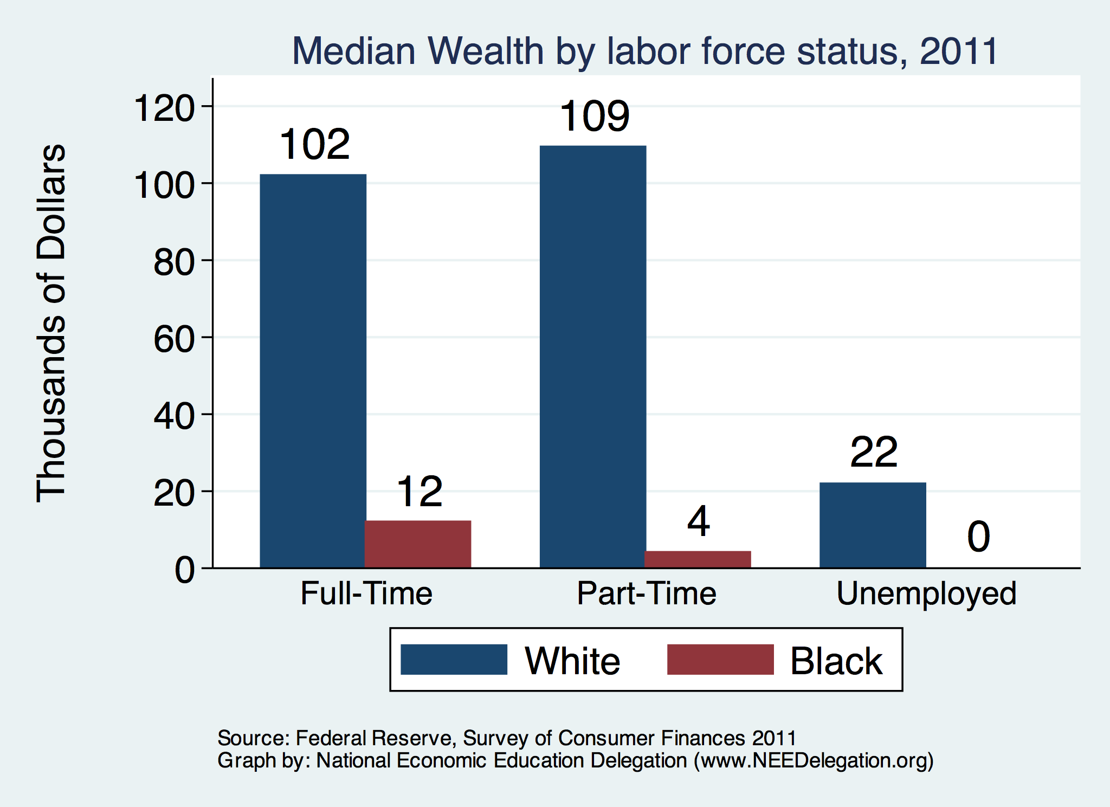
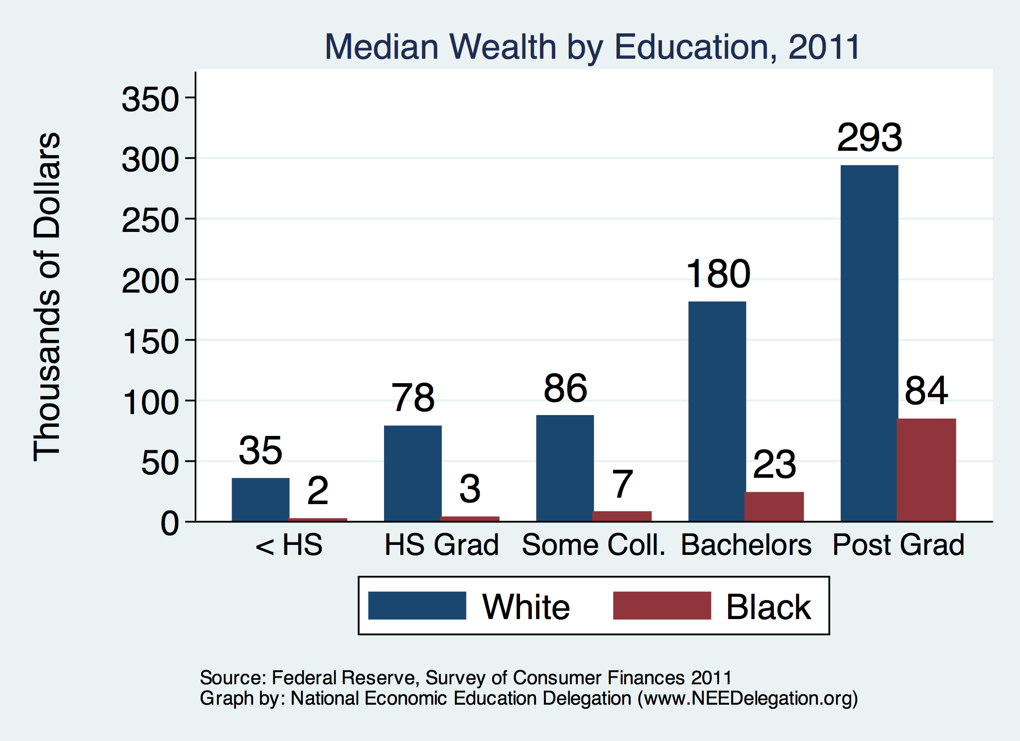
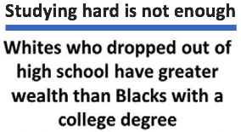
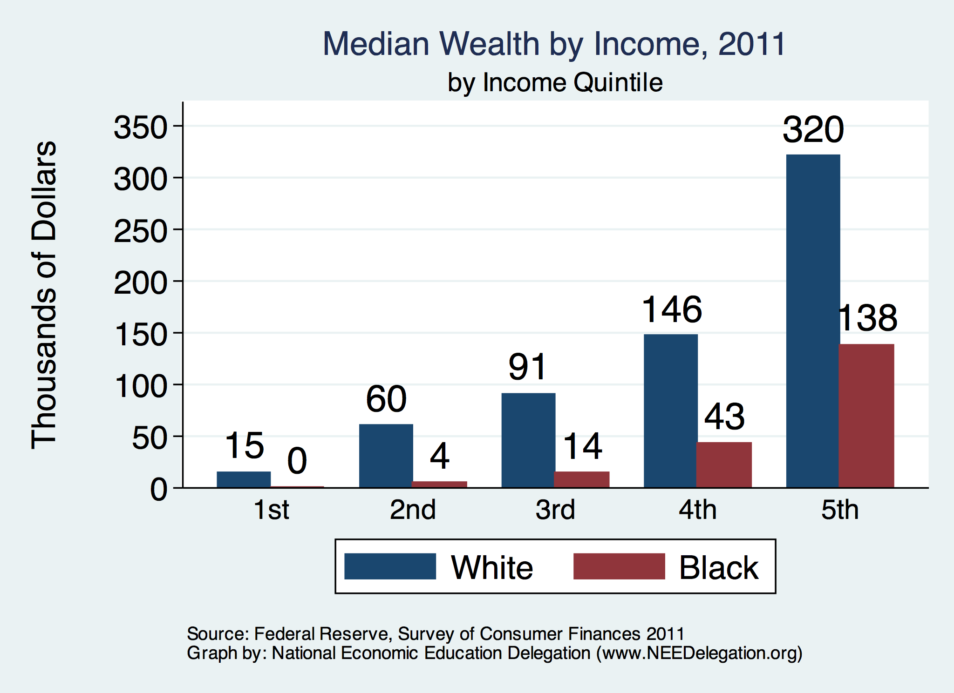

Slide 43
Accounting for the Wealth Gap
30%+ Left
Unaccounted for
Source: https://heller.brandeis.edu/iasp/pdfs/racial-wealth-equity/racial-wealth-gap/roots-widening-racial-wealth-gap.pdf

Slide 44
Policy Options

Slide 45
Categories of Policy Areas
Housing
FHA and redlining
Health Care
Incarceration
Black incarceration rates are very high.
Transportation
Interstate system
Broadband
Access is inversely related to regional income
Education
Workforce
Income support and stability
Asset accumulation

Slide 46
Gov’t Asset Building Policies

Slide 47
Policy Options
Global solutions that affect all source areas
Child Trust Accounts – “Baby Bonds”
Guaranteed minimum income
Addressing racial disparities directly
Reparations
Aggressive affirmative action.
A new Homestead Act.
Heavily investing in Black communities.
Labor and other laws that address discrimination
Enforce more aggressively and make adjustments where necessary to increase efficacy.
Fundamental reorientation of asset building agenda.

Slide 48
More Specific Policy Options
Limit the mortgage interest tax deduction and use the revenues to provide a credit for first-time homebuyers.
Establish automatic savings and retirement plans.
Reduce reliance on student loans while supporting success in postsecondary education.
Offer universal children's savings accounts.
Reform safety net program asset tests, which can act as barriers to saving among low-income families.
Provide subsidies to promote emergency savings, such as those linked to tax time.
Source: Urban Institute

Slide 49
Buying and Banking Black
Common Assertion: Marshalling the enormous purchasing power of the Black community will drive progress.
More than $1.3 trillion in buying power.*
Common Assertion: Banking is a source of wealth creation.
Combining the wealth of Black Americans in Black banks could be a source of wealth creation.
* Source: https://www.newswise.com/articles/minority-markets-have-3-9-trillion-buying-power

Slide 50
Why the Short Circuiting of Black Banking?
Category | White | Black
Home Ownership (%) | 73.7 | 45.0
Other Residential Property Ownership (%) | 15.1 | 8.2
Residential Ownership (%) | 75.8 | 12.5
Mean Asset Value (Thousands $)
- Own Home | 354.8 | 199.3
- Other Residential | 430.6 | 173.6
Share of Res. Value (%) | 80.0 | 5.7
Numbers of banks & credit unions
Total: 10,655
Black owned: 43 (0.4%)
They are very small
All Black owned: $5.8 Billion
JP Morgan Chase: $2.8 TRILLION

Slide 51
Summary
The Black White wealth gap is enormous (2019)
Mean: White wealth is 6.9x Black wealth.
Median: White wealth is 7.8x Black wealth.
There are many explanations in the common narrative.
Many do not stand up to scrutiny.
Government policies have contributed enormously to this gap.
Racial dehumanizing permitted these policies.
Wealth endowments (parental wealth) are very important for determining own wealth in adulthood.
Policies that address this relationship are most likely to be effective.
Policy intervention is likely necessary to close the gap.

Slide 52
Bottom Line
Evidence suggests:
CULTURE has little to do with it.
ACCESS to wealth building resources explains a lot.
Birth endowment.
Other resources (e.g., education and social capital).
History, policy and otherwise, and current structural issues influence access.

Slide 53
Thank you!
Any Questions?
www.NEEDelegation.org
Jon Haveman
Jon@NEEDelegation.org
Contact NEED: info@needelegation.org
Submit a testimonial: www.NEEDelegation.org/testimonials.php
Become a Friend of NEED: www.NEEDelegation.org/friend.php

Slide 54
Available NEED Topics Include:
Coronavirus Economics
Climate Change
Economic Inequality
Economic Mobility
US Social Policy
Trade and Globalization
Minimum Wage
The U.S. Economy
Immigration Economics
Housing Policy
Federal Budgets
Federal Debt
The Black-White Wealth Gap
Autonomous Vehicles

