Slide 1
Osher Lifelong Learning Institute, Winter 2022
Contemporary Economic Policy
University of Alaska, Anchorage
September-October, 2022
National Economic Education Delegation

Slide 2
Available NEED Topics Include:
Healthcare Economics
US Economy
Climate Change
Economic Inequality
Economic Mobility
Trade and Globalization
Minimum Wages
Immigration Economics
Housing Policy
Federal Budgets
Federal Debt
Black-White Wealth Gap
Autonomous Vehicles
US Social Policy

Slide 3
Course Outline
Contemporary Economic Policy
Week 1 (9/15): US Economy (Geoffrey Woglom, Amherst College)
Week 2 (9/22): Economic Inequality (Christopher Herrington, VCU)
Week 3 (9/29): The Black-White Wealth Gap (Jon Haveman, NEED)
Week 4 (10/6): Federal Debt (Joseph Carolan, Oakland University)

Slide 4
Submitting Questions
Please submit questions of clarification in the chat.
I will try to handle them as they come up.
We will do a verbal Q&A once the material has been presented.
Slides will be available on Need’s website( www.NEEDelegation.org)

Slide 5
The Black-White Wealth Gap
Jon Haveman, Ph.D.
National Economic Education Delegation
OLLI – University of Alaska, Anchorage
September 29, 2022

Slide 6
Credits and Disclaimer
This slide deck was authored by:
Darrick Hamilton, Ph.D., The New School
Jon Haveman, Ph.D., NEED
This slide deck was reviewed by:
Patrick Mason, Florida State University
Steven Craig, University of Houston
Disclaimer
NEED presentations are designed to be nonpartisan.
It is, however, inevitable that the presenter will be asked for and will provide their own views.
Such views are those of the presenter and not necessarily those of the National Economic Education Delegation (NEED).

Slide 7
Outline
Evidence of disparities
Why wealth is important
Sources of disparities
Implications of disparities
Policy solutions

Slide 8
What is Wealth?
Income vs Wealth
Income is the flow of funds into a households each year.
Wealth is a household’s NET asset holdings.
The value of all assets minus the value of all debts.
Assets can be financial and physical.
Assets include:
Owned homes, cars, stocks, businesses, savings and checking accounts, pensions, life insurance…
Debts include:
Home mortgages, car loans, credit cards, and any other significant financial obligations (excl regular bills)…

Slide 9
Evidence

Slide 10
Wealth inequality in America

Slide 11
Evidence of the Gap
Mean is
7x Greater
Median is 8x Greater

Slide 12
Wealth is More and More Concentrated
99th Percentile
2016 = 7x 1963
Source: Urban Institute

Slide 13
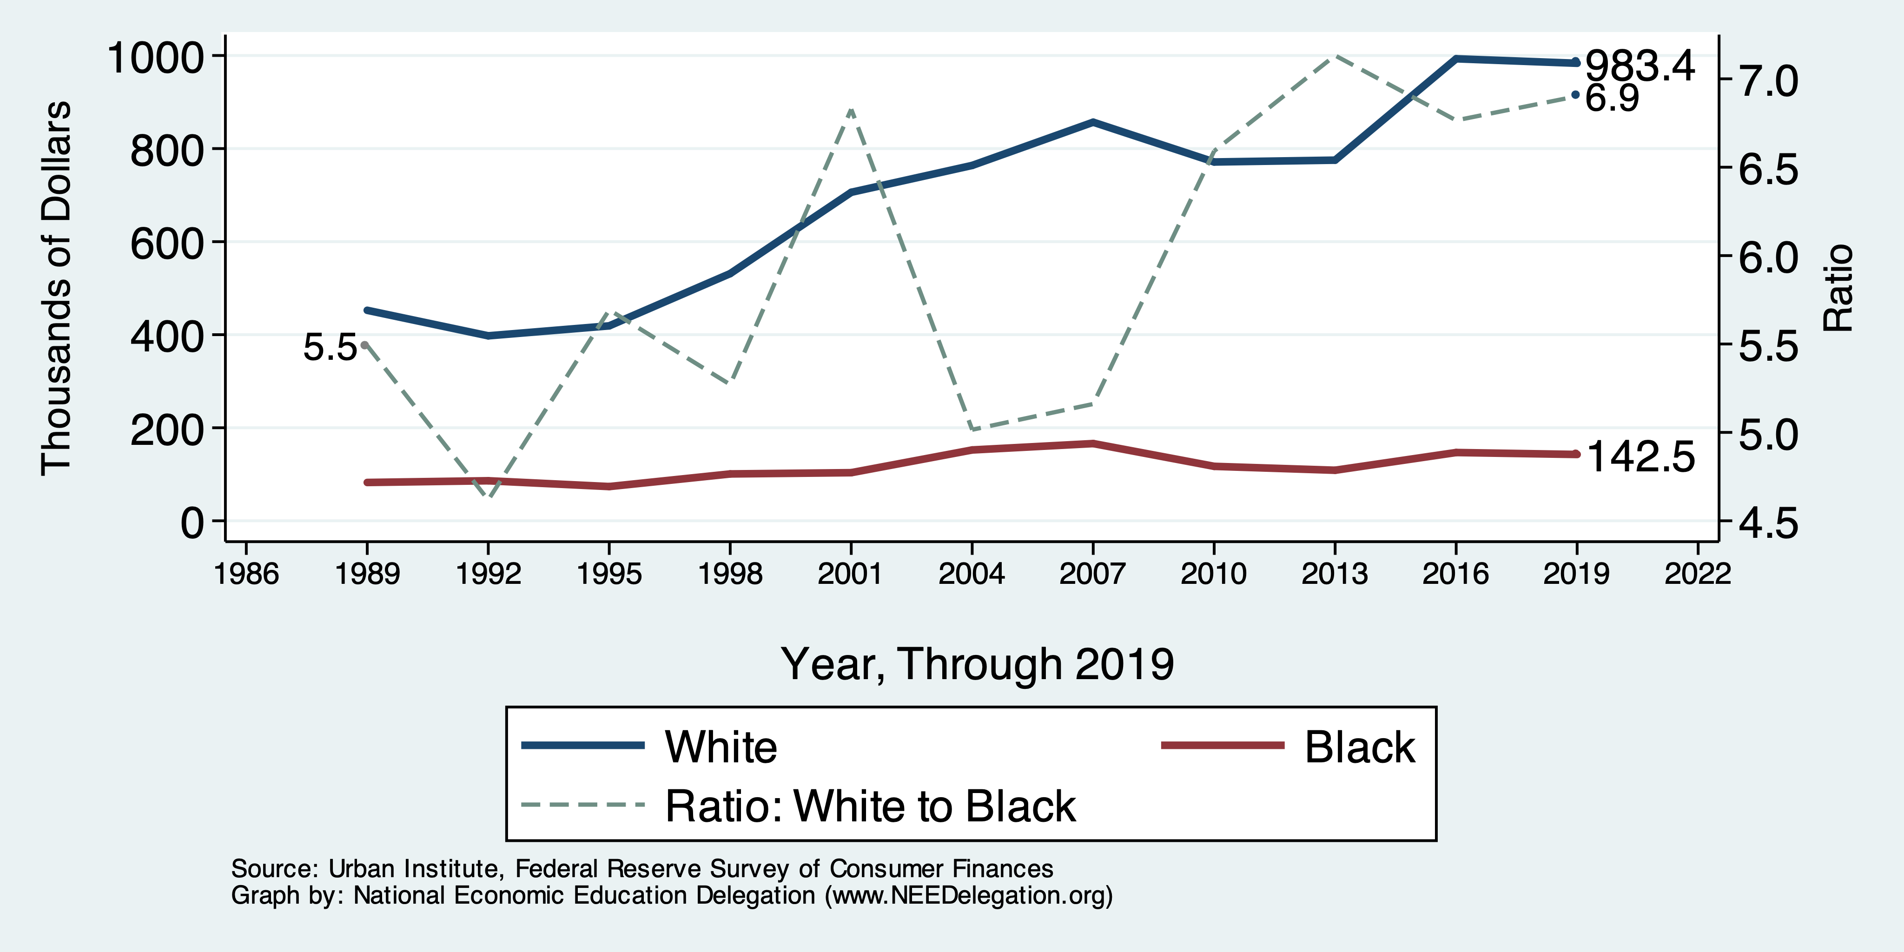
Wealth Gap Over Time: Mean

Slide 14
Net Worth by Age and Race
Source: https://www.brookings.edu/blog/up-front/2020/02/27/examining-the-black-white-wealth-gap/

Slide 15
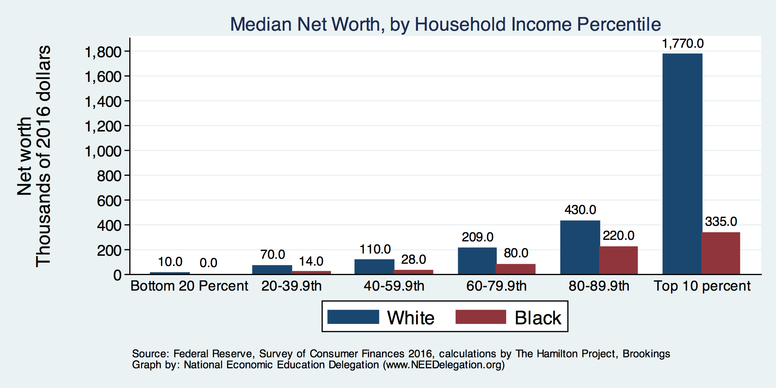
By Household Income

Slide 16
Evidence of Disparities: Zero Wealth

Slide 17
Why Wealth is Important

Slide 18
Widespread Household Wealth Pays Dividends
To individuals in the household
Choices/Agency
Wealth is iterative
And to broader society
Human capital development
Entrepreneurship and innovation

Slide 19
Household Level Benefits
Choices/Life Agency
Finance higher education
Living in good neighborhoods
Saving for retirement
Capital to start a business
Withstand financial hardship
Better legal counsel
Exert political influence
Finance costly medical procedure
Bequests
Wealth is iterative
Wealth begets more wealth.
Access to higher return investments.
Wealth transfers across generations.
Wealth is sticky.

Slide 20
Parental Wealth is Important
Important pre-estate transfer effects on kids:
Influences human capital accumulation.
Influences the returns to education.
Adult incomes of offspring.
There are clearly enormous differences in wealth held by parents of Black and White children.
Evidence suggests that nurture plays a big role.

Slide 21
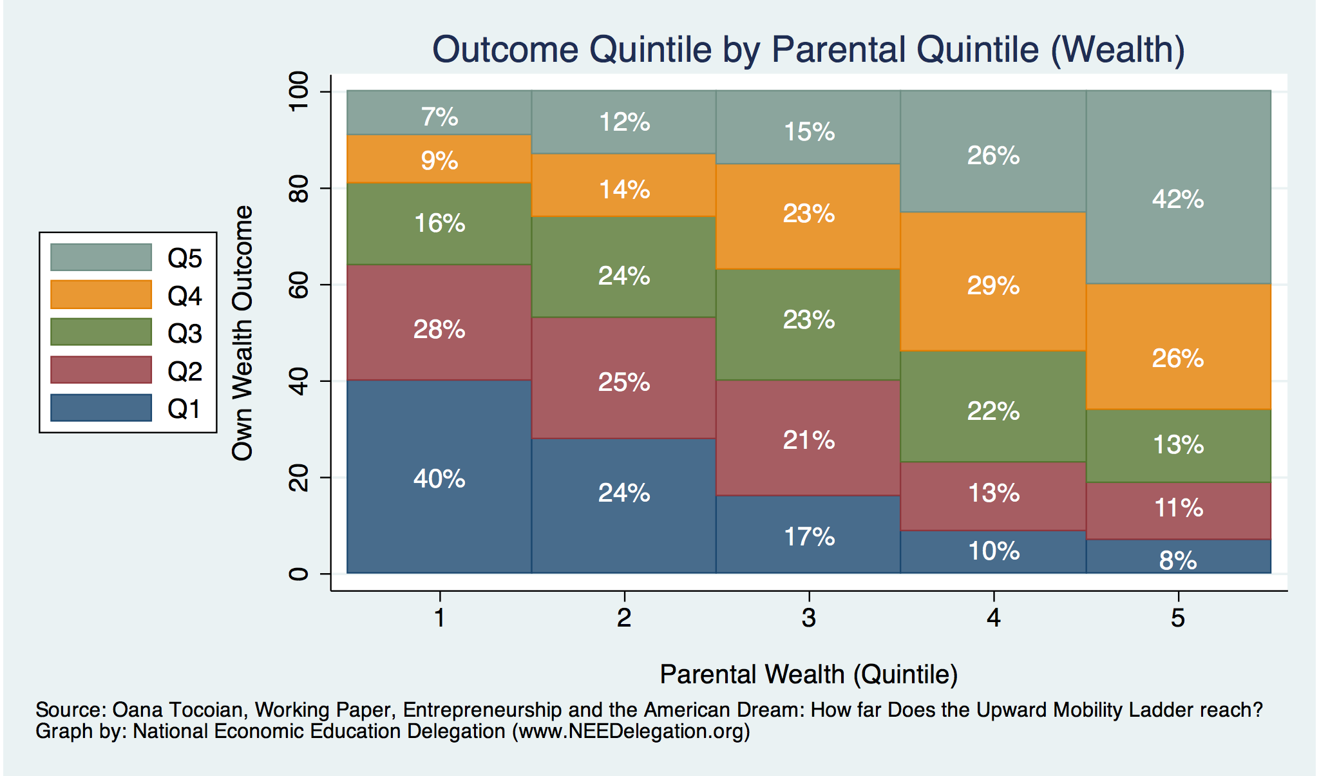
Wealth Mobility

Slide 22
Tangible Benefits for the Broader Economy
More human capital development
Increased entrepreneurship
Healthier labor force
Less social unrest
Less reliance on social programs
Smaller stock of student loans

Slide 23
Sources of Disparities

Slide 24
Events/Policies with Direct Wealth Implications
Slave trade
The first deprivation.
Slavery
40 acres (and a mule)
The second deprivation.
Discriminatory distribution of land.
Freedmen’s Bank
Lax oversite and dissolution.
Jim Crow Laws & Economic Policy
Convict leasing, debt peonage, chain-gang, sharecropping, and lynching.
Homestead Act
Discriminatory distribution of land.
Land theft and destruction
E.g., Black Wall Street – Tulsa, 1921.
GI Bill
Discriminatory access – Levittown
Federal Housing Authority
Redlining
And many more.

Slide 25
Results for Black Families
Much lower accumulation of wealth than among White families.
Implications:
Less financial contribution from parents to children.
More difficult access to higher education.
Less access to capital for business formation.
More likely to live in disadvantaged neighborhoods.
Fewer role models.
Less access to quality education.
Disparities in the capacity – availability of resources - to build wealth.

Slide 26
Potential Explanations: Differences in…
Educational attainment
Home ownership
Increased savings
Financial literacy
Entrepreneurship
Soft skills and personal responsibility
Wages
Incarceration
Family structure
Initial endowment

Slide 27
Wealth by Educational Attainment
Educational Attainment | Net Worth Median | Net Worth Mean
No High School | $22,800 | $157,200
High School | $67,100 | $249,600
Some College | $66,100 | $340,600
College | $292,100 | $1,511,100
71.0%
16.1%
8.6%
4.3%
Source: Federal Reserve Board, Table data are 2016.

Slide 28
Educational Attainment
Median Household Net Worth by Race and Education
Source: Darity, et al., “What We Get Wrong About Closing the Racial Wealth Gap”

Slide 29
Home Ownership

Slide 30
Home Ownership: 2016
Housing Status | Net Worth Median | Net Worth Mean
Renters | $5,200 | $91,100
Owner | $231,400 | $1,034,200
Median Net Worth by Race

Slide 31
Wealth Equality Through Home Ownership?
Well-documented evidence of historical and ongoing housing and lending discrimination.
Appraisals, buyers, lenders, local laws, covenants…
What about home prices in minority neighborhoods? Even if they buy, they won’t get the appreciation of White neighborhoods.
Home values are 50% lower in majority Black neighborhoods.
23% after adjusting for quality and amenities.
Source: Brookings, Home ownership while black

Slide 32
What Determines Differences in Home Ownership?
Wealth of parents
Ability to borrow – lending discrimination
At all
On equivalent terms to white borrowers
Local ordinances – housing discrimination
Lower appreciation rates of homes in majority Black communities.
This makes it a less attractive investment.

Slide 33
Increased Savings
Historical evidence generated by economists ranging from Milton Friedman (1957) to Marjorie Galenson (1972) to Marcus Alexis (1971) to Gittelman and Wolff (2004)…..
All find that after accounting for household income, Blacks have a slightly higher savings rate than Whites.
Assertion: risk and reward are higher for White investors
Controlling for income, this is not clear.
Access to and tolerance for higher risk investments is clearly correlated with income.

Slide 34
Financial Literacy
Financial literacy doesn’t matter that much when you don’t have any finances to manage.
The insufficient financial literacy argument is often leveled specifically at Black households.
The argument holds equally with regard to all households of comparable incomes.
Controlling for household income, there is no difference in rates of asset appreciation between Black and White households.

Slide 35
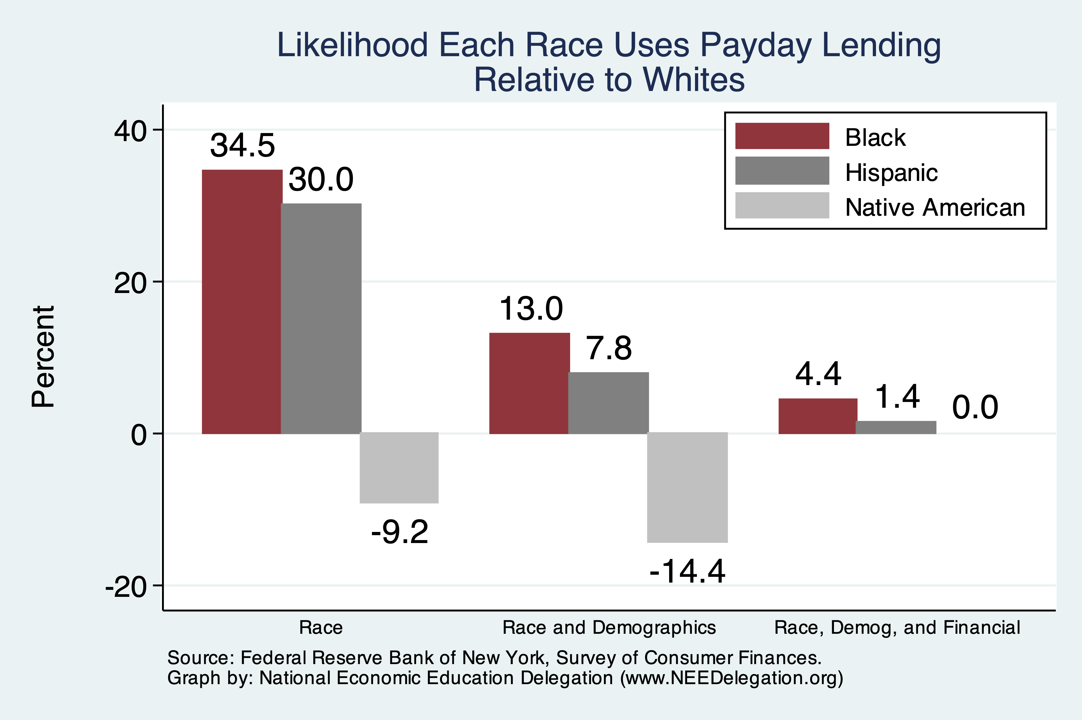
Use of Payday Lenders
Source: Federal Reserve Bank of New York; Survey of Consumer Finances

Slide 36
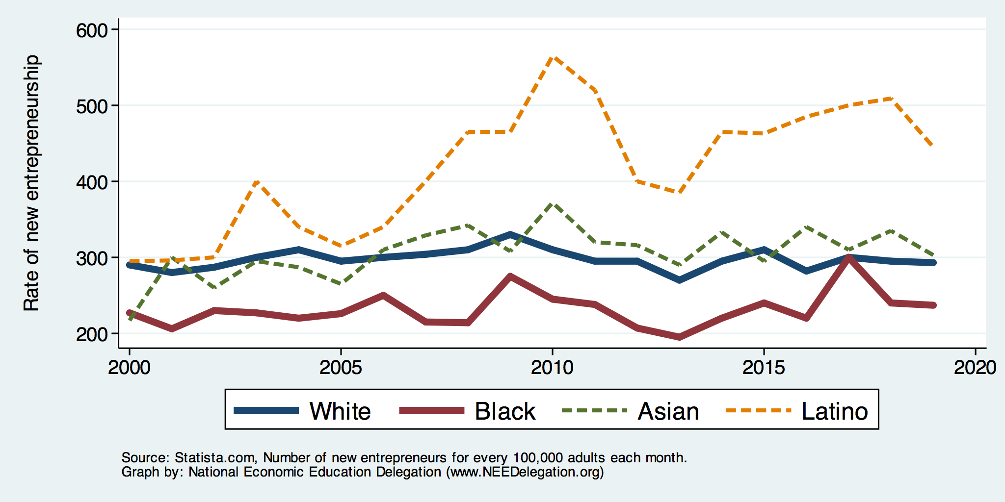
Entrepreneurship: Rate of New Entrepreneurs
Source: Statistica

Slide 37
Explaining Differences in Entrepreneurship
Disparities in access to capital:
Wealth disparities
Specifically - differences in home equity.
Differences in wealth levels of friends and family.
Less likely to rely on banks and more likely to rely on credit cards.
Loans have higher interest rates if they can get them.
Less access to venture funds.
Generally lower levels of education.
Previous business ownership by family members.
Different stocks of relevant social capital.

Slide 38
Soft Skills and Personal Responsibility
Employability
Show up on time.
Eye contact with customers.
Dress well.
Collaborative skills.
Reality
Black workers are crowded into service sector jobs.
Well represented in service, sales and office, and production, transportation, and material moving.
Relatively less well represented in construction, extraction, and maintenance.

Slide 39
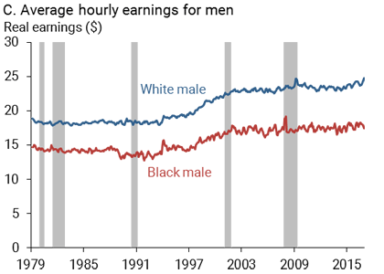
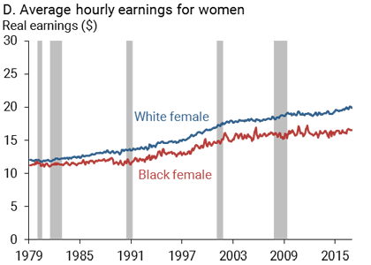
Wage Gap
Source: https://www.frbsf.org/economic-research/publications/economic-letter/2017/september/disappointing-facts-about-black-white-wage-gap/

Slide 40
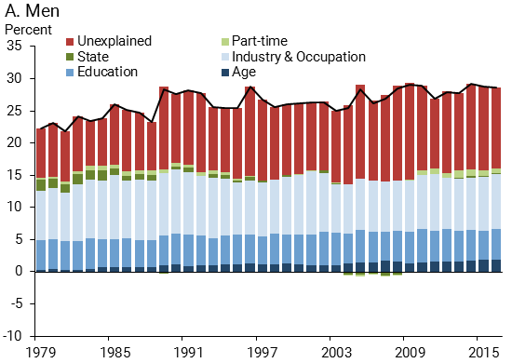
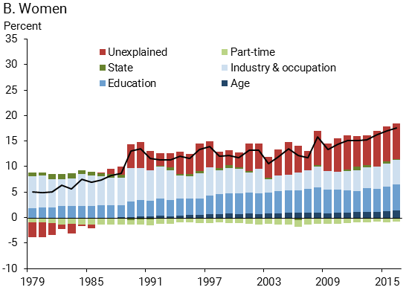
Wage Gap Broken Down
Source: https://www.frbsf.org/economic-research/publications/economic-letter/2017/september/disappointing-facts-about-black-white-wage-gap/

Slide 41
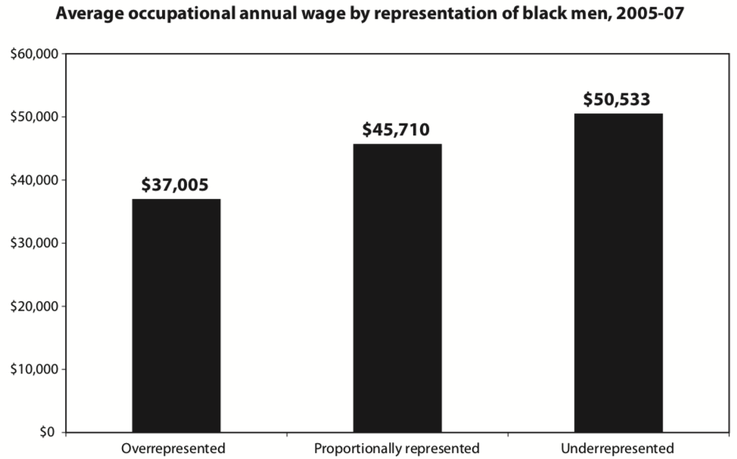
Overrepresented Where Wages are Low
Source: Hamilton Darrick, Algernon Austin, and William Darity, Jr. Whiter Jobs, Higher Wages :Occupational Segregation and the Lower Wages of Black Men Economic Policy Institute, Briefing Paper #288 2011.

Slide 42
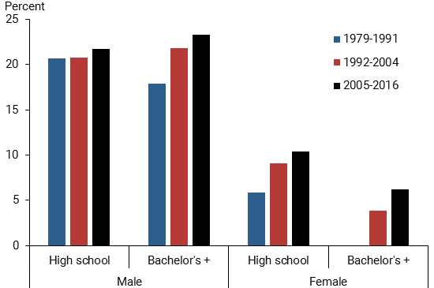
Black-White Earnings Gap by Education
Source: https://www.frbsf.org/economic-research/publications/economic-letter/2017/september/disappointing-facts-about-black-white-wage-gap/

Slide 43
Equality of Income = Equality of Wealth
/
Source: http://hartfordinfo.org/issues/wsd/FamiliesandChildren/Racial-Wealth-Gap-Brief.pdf

Slide 44
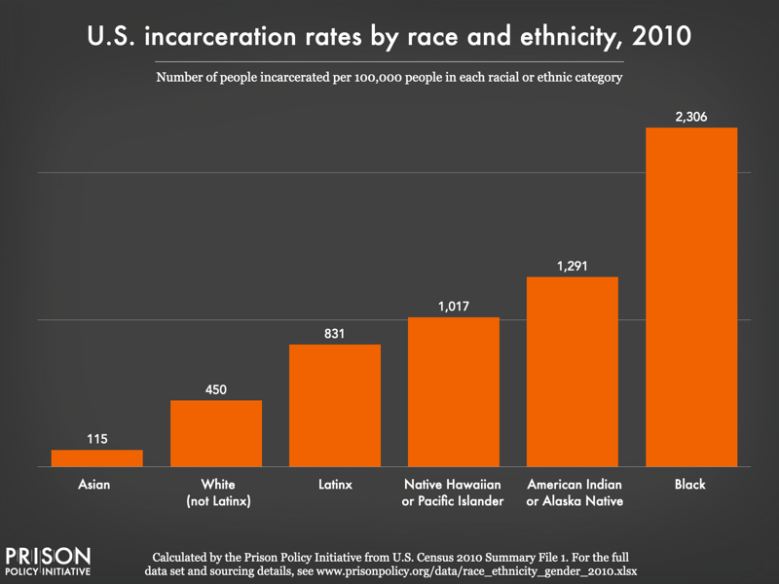
Incarceration Likely Plays A Role

Slide 45
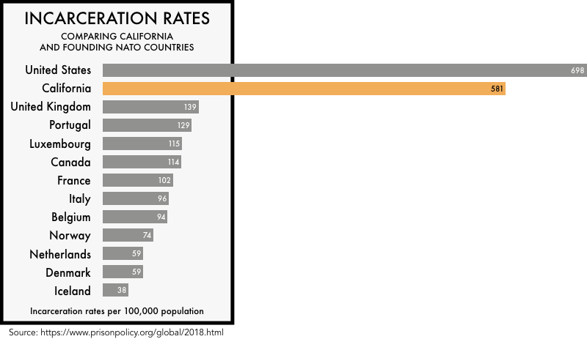

Slide 46
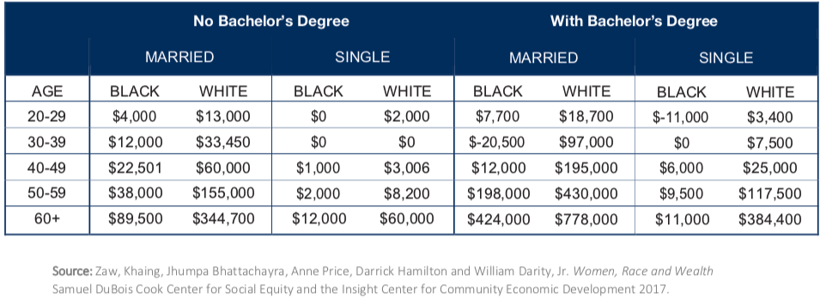
Family Structure

Slide 47
Kids – Household Types

Slide 48
Initial Endowment

Slide 49
What is Fundamentally Responsible?
Individual behaviors?
Structural characteristics of the economy?
History – policy and otherwise?

Slide 50
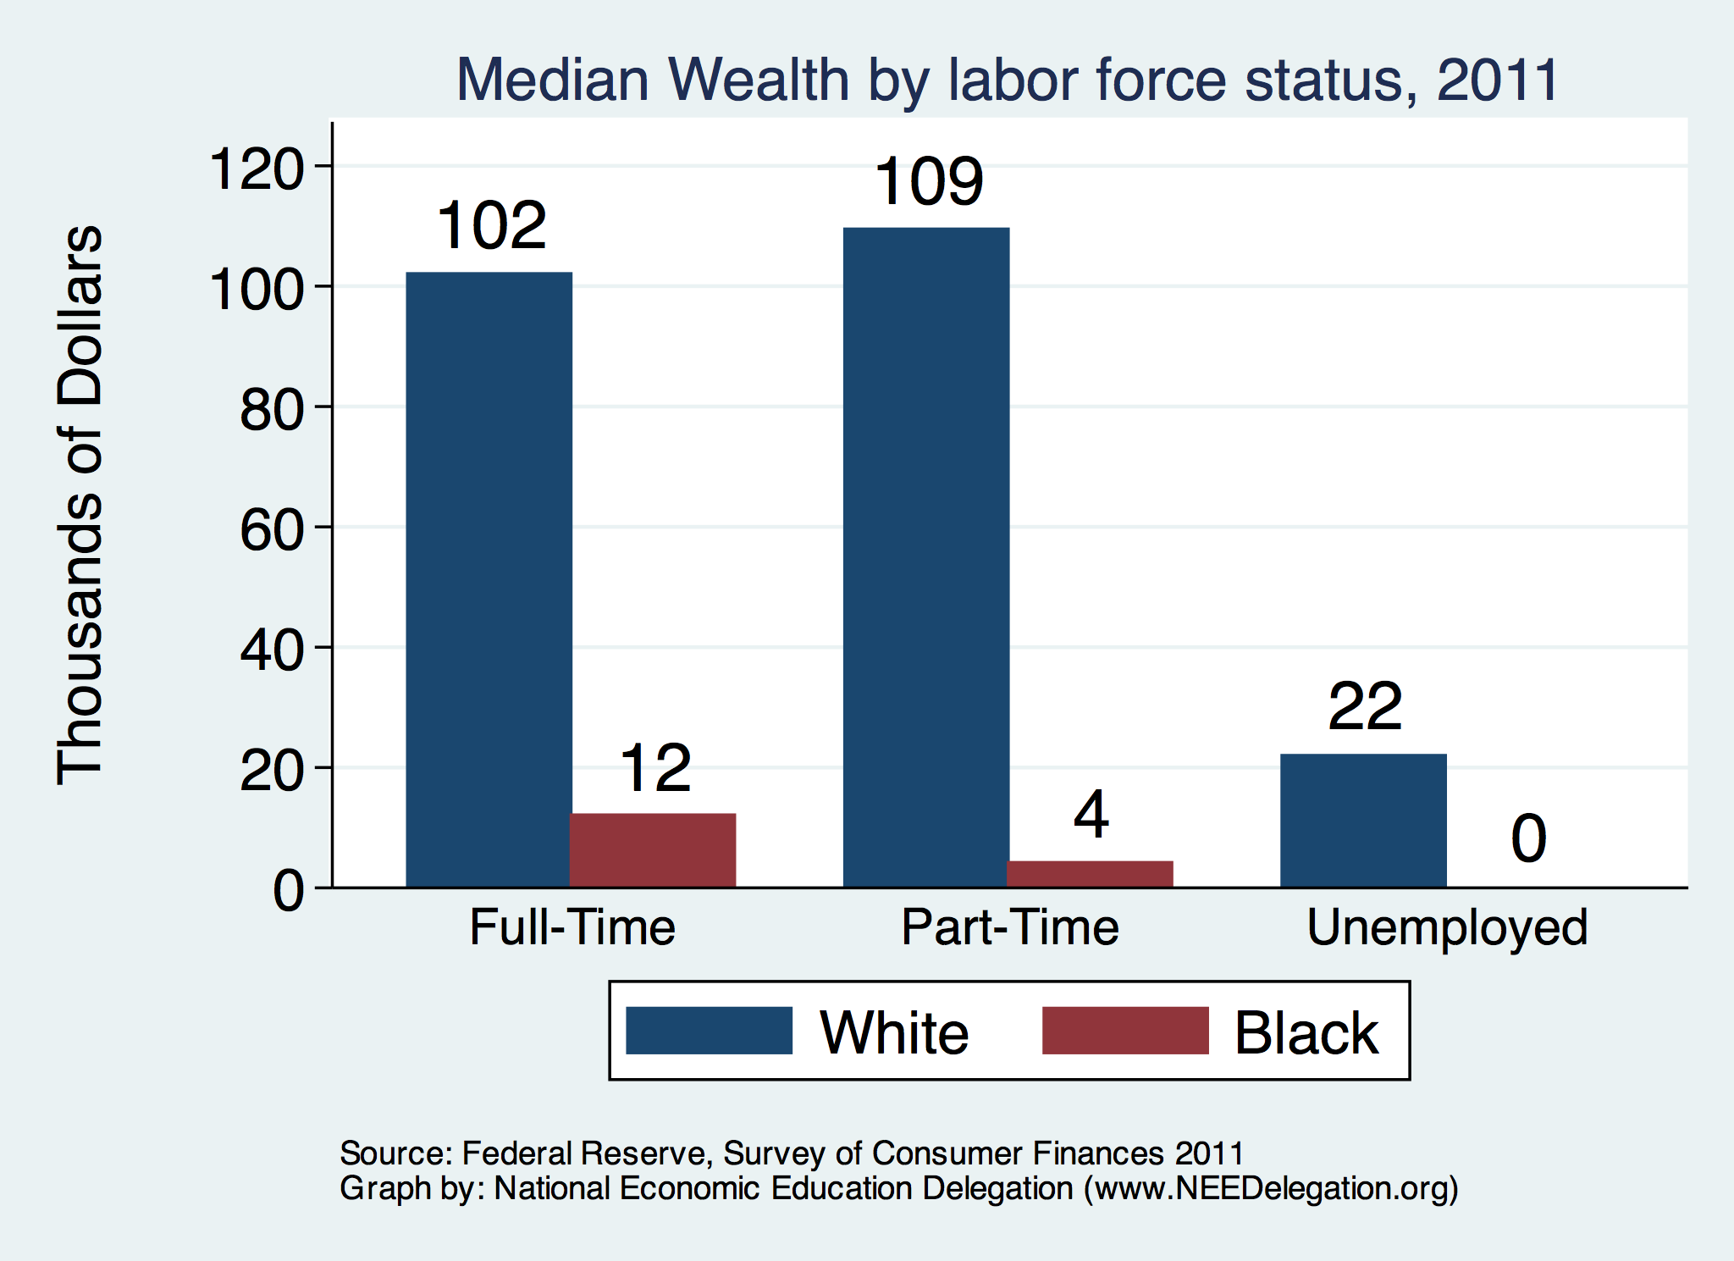
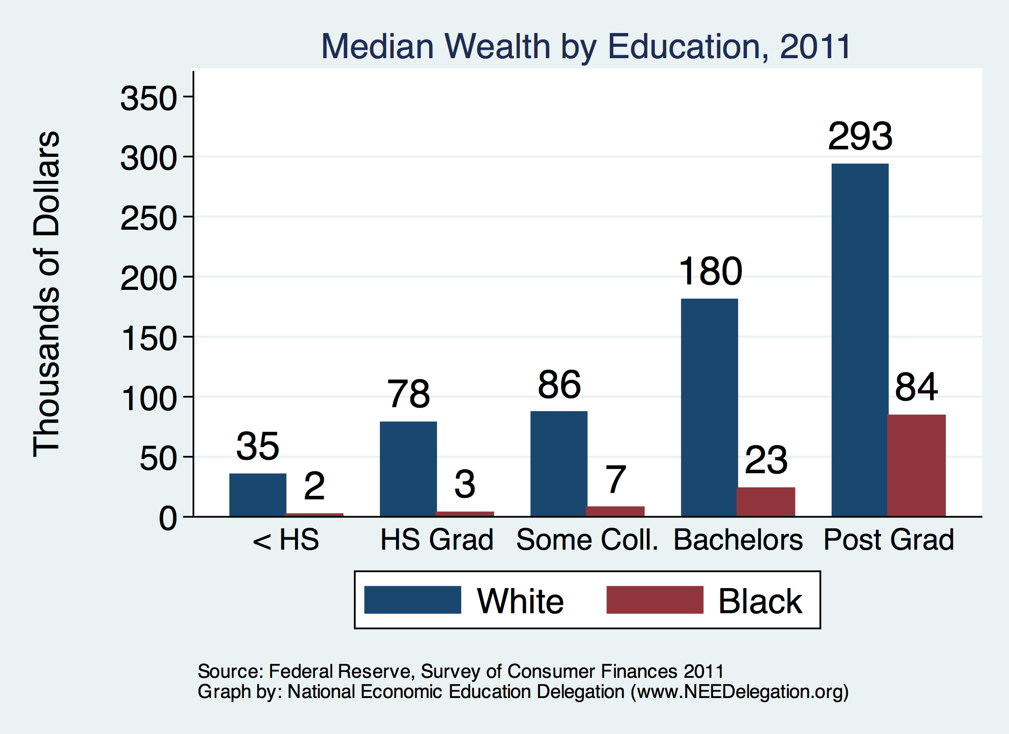
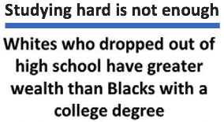
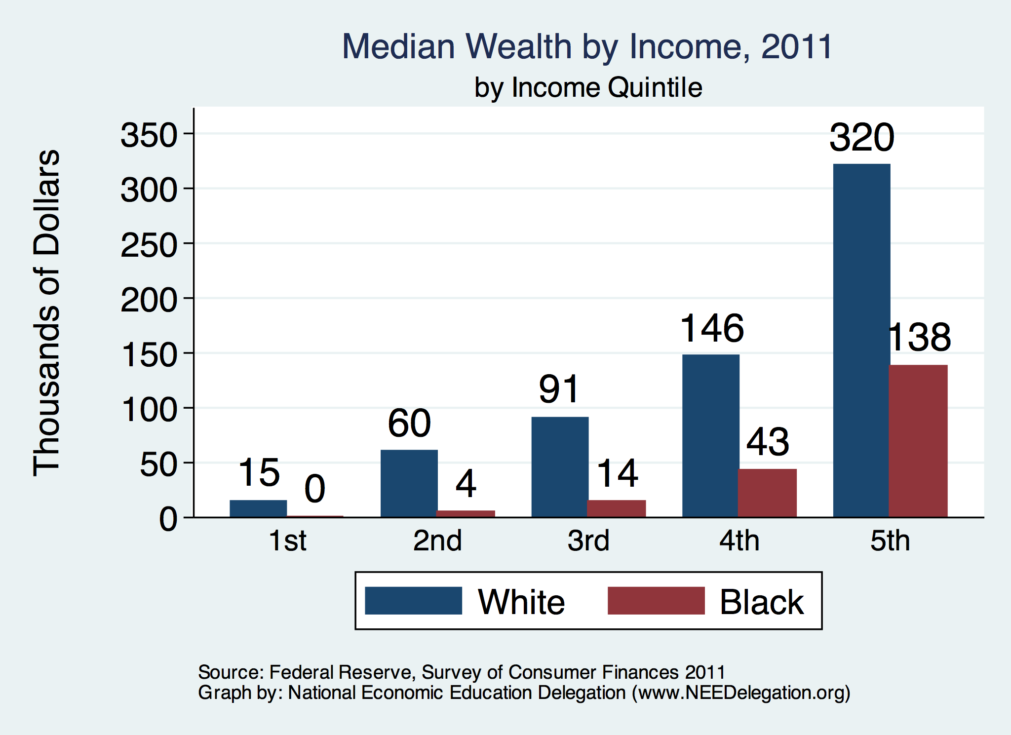

Slide 51
Accounting for the Wealth Gap
30%+ Left
Unaccounted for
Source: https://heller.brandeis.edu/iasp/pdfs/racial-wealth-equity/racial-wealth-gap/roots-widening-racial-wealth-gap.pdf

Slide 52
Policy Options

Slide 53
Categories of Policy Areas
Housing
FHA and redlining
Health Care
Incarceration
Black incarceration rates are very high.
Education
Workforce
Unintentional discrimination in policies
Tax policy
Student loans
Income support and stability
Asset accumulation

Slide 54
Specific Policy Options
Addressing racial disparities directly
Reparations
Aggressive affirmative action.
A new Homestead Act.
Heavily investing in Black communities.
Differential tax treatment.
Labor and other laws that address discrimination
Enforce more aggressively and make adjustments where necessary to increase efficacy.
Global solutions that affect all source areas
Child Trust Accounts - ”Baby Bonds”
Guaranteed minimum income
Fundamental reorientation of asset building agenda.

Slide 55
Gov’t Asset Building Policies

Slide 56
Other Concrete Policy Options
Limit the mortgage interest tax deduction and use the revenues to provide a credit for first-time homebuyers.
Establish automatic savings and retirement plans.
Reduce reliance on student loans while supporting success in postsecondary education.
Offer universal children's savings accounts.
Reform safety net program asset tests, which can act as barriers to saving among low-income families.
Provide subsidies to promote emergency savings, such as those linked to tax time.
Source: Urban Institute

Slide 57
Summary
The Black White wealth gap is enormous (2019)
Mean: White wealth is 6.9x Black wealth
Median: White wealth is 7.8x Black wealth
There are many explanations in the common narrative.
Many do not stand up to scrutiny.
Government policies have contributed enormously this gap.
Racial dehumanizing permitted these policies.
Wealth endowments (parental wealth) are enormously important for determining own wealth in adulthood.
Policies that address this relationship are most likely to be effective.
Some form of policy intervention is likely necessary if the gap is to be closed.

Slide 58
The Federal Debt: Joe Caralon

Slide 59
Thank you!
Any Questions?
www.NEEDelegation.org
Jon D. Haveman, Ph.D.
Jon@NEEDelegation.org
Contact NEED: info@needelegation.org
Submit a testimonial: www.NEEDelegation.org/testimonials.php
Become a Friend of NEED: www.NEEDelegation.org/friend.php

Slide 60
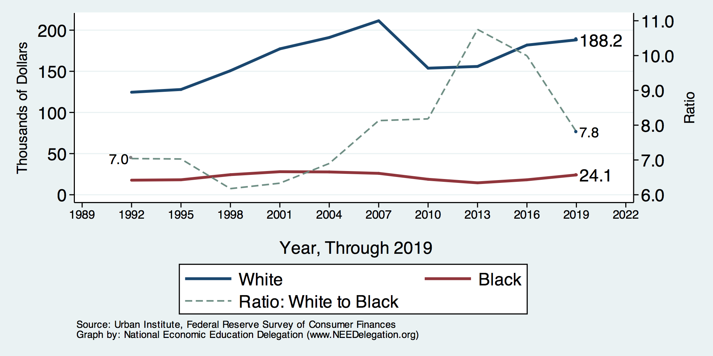
Wealth Gap Over Time: Median

Slide 61
Black Household Incomes Relative to White
Source: pewsocialtrends.org

Slide 62
Educational Attainment: Policy
How do we increase educational attainment?
Increase universal quality of public schools.
Increased/improved counseling in high schools.
Reduce costs (including living) of attending college.
Increased access to funds for education.
Make publicly available pre-k education.
Mandate kindergarten by age 5.
No one able to drop out before age 18 or at least 11 completed years of education.

Slide 63
US Drug Arrest Rates per 100,000 by Race

Slide 64
Reform Criminal Justice System
Legal restrictions on the rights of people who have had contact with the criminal justice system, particularly contact resulting in conviction.
Usually placed in civil and regulatory codes, collateral consequences may limit a person’s:
ability to vote
live in public housing
own a firearm
qualify for an occupational license
serve in the military
receive public benefits (Food Stamps, housing vouchers)
sit on a jury
borrow money for college
Legal restrictions on the rights of people who have had contact with the criminal justice system, particularly contact resulting in conviction.
Usually placed in civil and regulatory codes, collateral consequences may limit a person’s:
ability to vote
live in public housing
own a firearm
qualify for an occupational license
serve in the military
receive public benefits (Food Stamps, housing vouchers)
sit on a jury
borrow money for college
Legal restrictions on the rights of people who have had contact with the criminal justice system, particularly contact resulting in conviction.
Usually placed in civil and regulatory codes, collateral consequences may limit a person’s:
ability to vote
live in public housing
qualify for an occupational license
serve in the military
receive public benefits (Food Stamps, housing vouchers)
sit on a jury
borrow money for college

