Slide 1
Government Policies with Racial Implications
Downtown Madison Kiwanis
June 21, 2021
Jon Haveman, Ph.D.
Executive Director, NEED

Slide 2
National Economic Education Delegation
Vision
One day, the public discussion of policy issues will be grounded in an accurate perception of the underlying economic principles and data.
Mission
NEED unites the skills and knowledge of a vast network of professional economists to promote understanding of the economics of policy issues in the United States.
NEED Presentations
Are nonpartisan and intended to reflect the consensus of the economics profession.

Slide 3
Who Are We?
Honorary Board: 54 members
2 Fed Chairs: Janet Yellen, Ben Bernanke
6 Chairs Council of Economic Advisers
Furman (D), Rosen (R), Bernanke (R), Yellen (D), Tyson (D), Goolsbee (D)
3 Nobel Prize Winners
Akerlof, Smith, Maskin
Delegates: 590+ members
At all levels of academia and some in government service
All have a Ph.D. in economics
Crowdsource slide decks
Give presentations
Global Partners: 45 Ph.D. Economists
Aid in slide deck development

Slide 4
Credits and Disclaimer
This slide deck was authored by:
Jon Haveman, Ph.D., NEED
Disclaimer
NEED presentations are designed to be nonpartisan.
It is, however, inevitable that the presenter will be asked for and will provide their own views.
Such views are those of the presenter and not necessarily those of the National Economic Education Delegation (NEED).

Slide 5
Outline
Evidence of Racial Disparities
History of Policies
Discriminatory intent
Discriminatory effect
Anti-discrimination

Slide 6
Evidence of Racial Disparities

Slide 7
Life Expectancy: 3 Years Difference (W vs B)
White Women
Black Women
White Men
Black Men

Slide 8
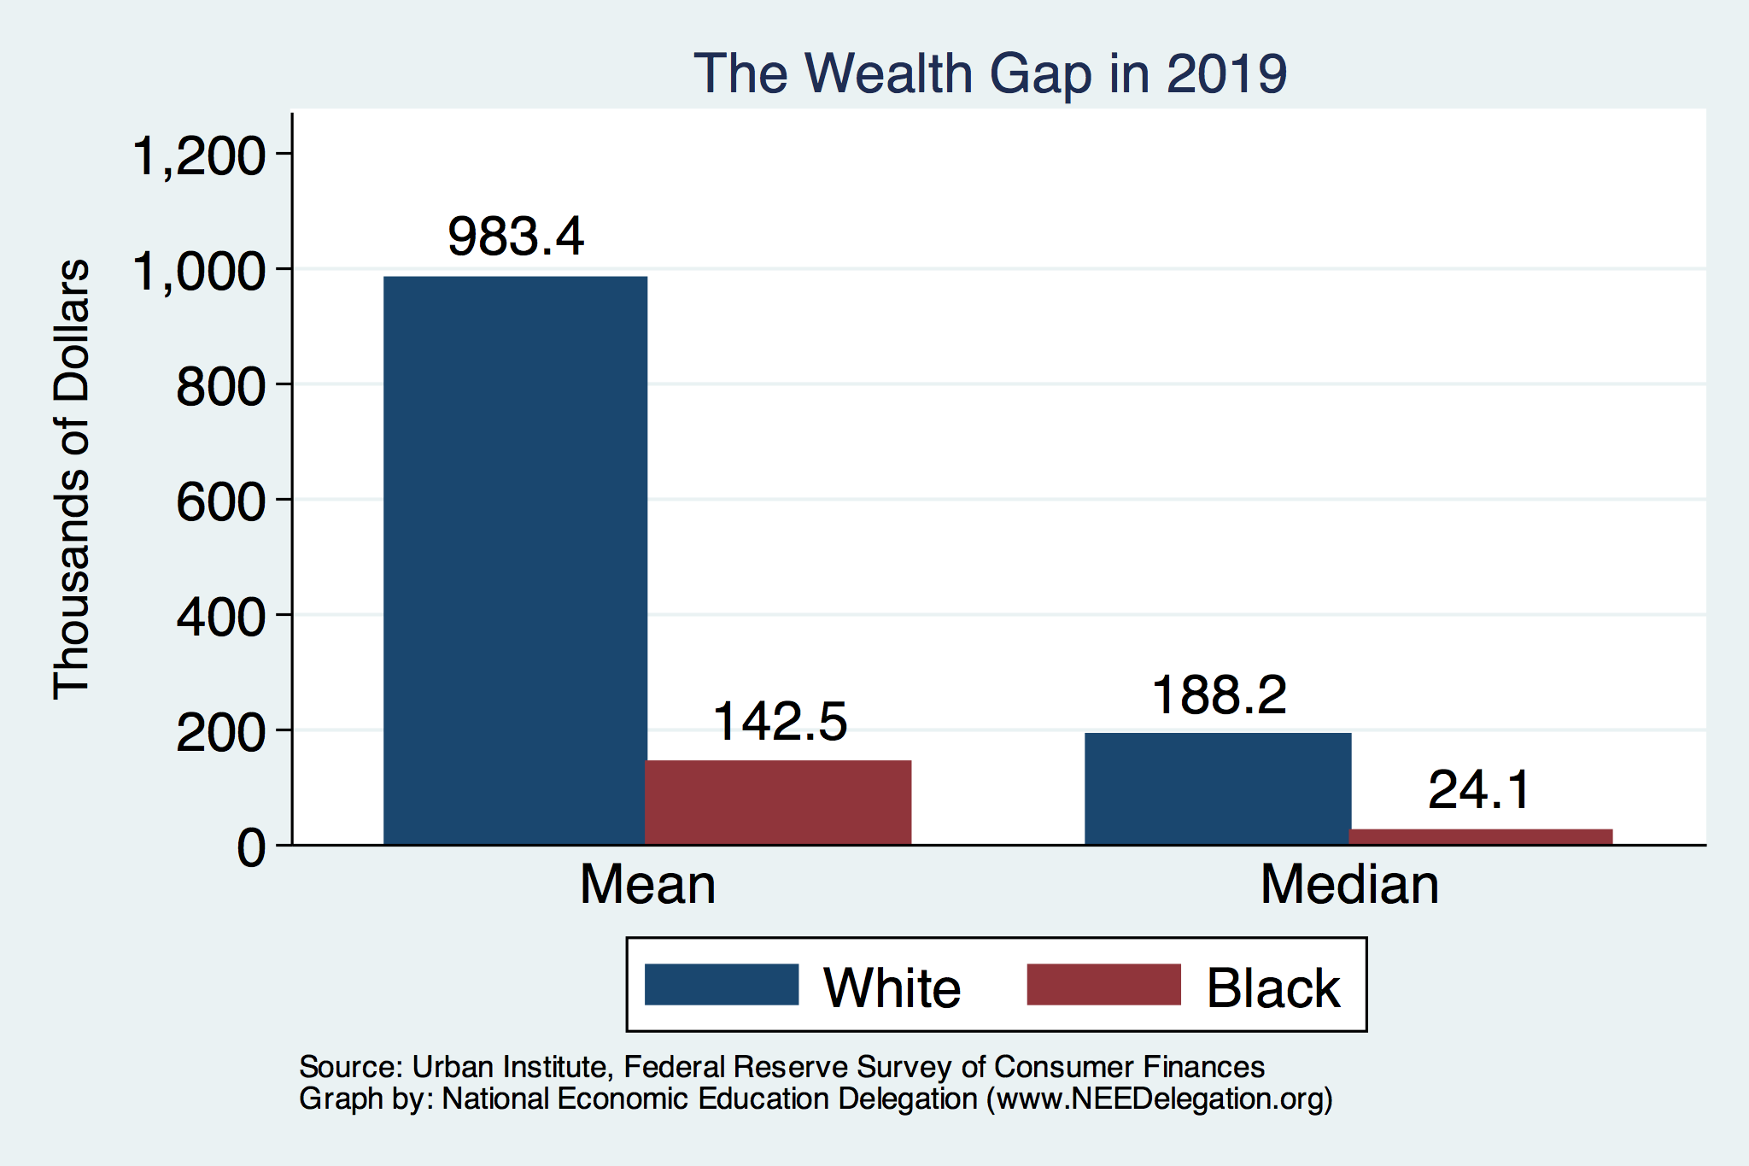
Enormous Disparity of Outcomes
Perhaps best illustrated by the difference in wealth accumulation.
Mean is
7x Greater
Median is 8x Greater

Slide 9
Maternal Mortality Rates, 2018
Source: https://www.cdc.gov/nchs/data/nvsr/nvsr69/nvsr69_02-508.pdf

Slide 10
Race in Policy
Policies with discriminatory intent
Slavery
Redlining
Policies with discriminatory effect
Perhaps highway location.
Often discrimination written in covertly.
Anti-discrimination policies
Civil Rights Act
Affirmative Action

Slide 11
Events/Policies with Direct Wealth Implications
Slave trade
The first deprivation
Slavery
40 acres (and a mule)
The second deprivation
Discriminatory distribution of land.
Freedmen’s Bank
Lax oversite and dissolution.
Jim Crow Laws & Economic Policy
Convict leasing, debt peonage, chain-gang, sharecropping, and lynching.
Homestead Act
Discriminatory distribution of land.
Land theft and destruction
E.g., Black Wall Street – Tulsa, 1921
GI Bill
Discriminatory access – Levittown
Federal Housing Authority
Redlining
And many more.

Slide 12
Policies: Discriminatory Intent
Slave trade
Slavery
Reconstruction and 40 acres
Black Codes & Vagrancy Laws
Jim Crow
Federal Housing Policy

Slide 13
FHA Discrimination
Between 1934 and 1962, the federal government backed $120 billion of home loans.
Three out of five homes between 1930 and 1959.
More than 98% went to whites.
Of the 350,000 new homes built with federal support in northern California between 1946 and 1960, fewer than 100 went to African Americans.
Government officials argued that Black occupancy of homes in White neighborhoods would reduce property values.
This would put their loans at risk.

Slide 14
HOLC Appraisal Manual Grading System
Grade A = “homogeneous,” in demand during “good times or bad.”
Grade B = “like a 1935 automobile-still good, but not what the people are buying today who can afford a new one”
Grade C = becoming obsolete, “expiring restrictions or lack of them” and “infiltration of a lower grade population.”
Grade D = “those neighborhoods in which the things that are now taking place in the C neighborhoods, have already happened.”

Slide 15
Misguided Past Policies: Redlining
Red areas were largely
Black communities,
and considered to be too risky for new home loans.
Yellow areas also suffered from discrimination resulting from FHA guidelines.

Slide 16
Clear Impact on Not Only D, but Also C Areas
Higher residential segregation
Concentration of Black families in C and D.
Lower home ownership rates in C and D
Lower home values in C and D
Lower rents and credit scores
Trends mostly reversed themselves in the wake of housing and lending legislation in the 1960s and 70s.

Slide 17
Housing Post-WWII
Residential covenants and discriminatory zoning
Single family vs multifamily zoning was an effort to segregate housing.
GI Bill – for Whites only
Discrimination at every step of the way
Appraisals, realtors, mortgage receipt and terms.
Very recent evidence exists – esp. loans during housing bubble, appraisals.

Slide 18
Policies w/Discriminatory EFFECT

Slide 19
Effect: Often Intended, But Not Overt
How?
Allow local officials to administer the program.
Exclude specific occupations where Black workers are overrepresented.

Slide 20
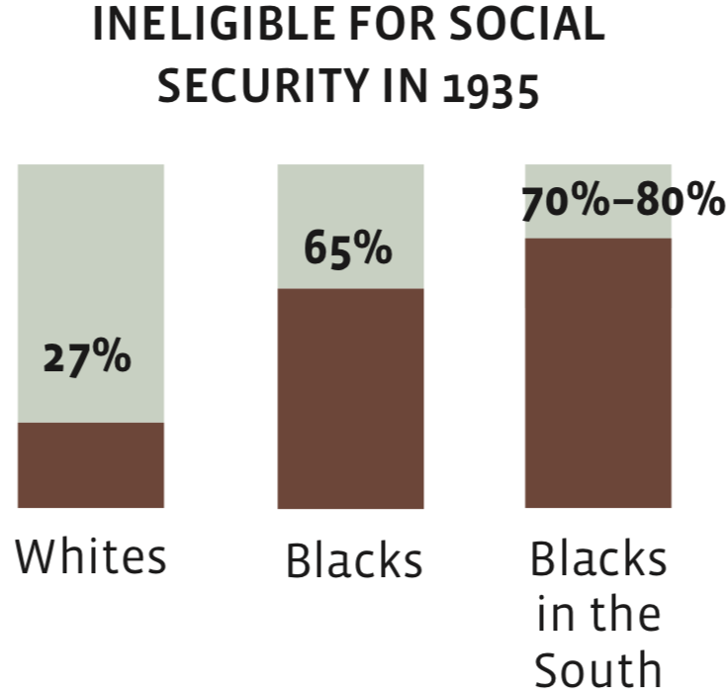
The New Deal
FHA Policy – Redlining
Explicitly discriminatory
Social Security
Discriminatory effect
Unemployment
Discriminatory effect
Minimum wages
Discriminatory effect

Slide 21
Policies: Discriminatory Effect
Homestead Act
The New Deal
Wagner Act – Unions
Minimum Wages
Social Security
GI Bill
Federal Asset Building Policies
Local zoning ordinances
Incarceration

Slide 22
GI Bill
Reintegrating 16 million veterans
1.2 million were Black
Loans: homes, farms, or business
Levittown – explicitly banned
Couldn’t get loans regardless of guaranty - covenants
Education
Steered toward vocational training, not college
HBCUs – were overcrowded and nonexistent in the north
Unemployment
Instead – a provocation for Black men to wear the uniform.
Lynchings and other violence in the wake of WWII – Red Summer after WWI

Slide 23
GI Bill: by the Numbers
Federal spending between 1944 and 1971: $95 billion (15% of budget)
200,000 small business loans.
Mortgages for 5 million new houses.
2,250,000 participated in higher education.
5,600,000 enrolled in vocational institutions.

Slide 24
GI Bill: Education
Of vets born between 1923 and 1928:
23% of Whites received GI Bill educational assistance. 12% of Blacks.
Big difference in take up rates for southern vs non-southern Black veterans.
Not for south vs non-nonsouthern White veterans.
Differences in hours of education Black v White.
Differences in quality of educational institution.
White colleges and universities actively increased enrollment.
HBCUs did not have the resources to do so.
Black veterans often pushed toward vocational training.

Slide 25
GI Bill: Housing
In 1947:
2 of 3,200 VA loans in Mississippi went to Black veterans.
100 of 67,000 loans in NY and Northern NJ went to Black veterans.

Slide 26
Gov’t Asset Building Policies

Slide 27
Anti-Discrimination

Slide 28
Note About Legislation and Other Efforts
There is always an efficiency vs equity tradeoff inherent in policies.
It is possible, but not necessarily true, that anti-discrimination laws will reduce efficiency.
However, there may be equity considerations and offsetting externalities that cause them to be in the public interest.

Slide 29
Implications for GDP of Talent Allocation
Doctors:
In 1960, 90% were white men. In 2010, just 60% were white men.
Why? Exclusion from high skilled occupations of women and minorities.
How?
Lack of access to human capital development.
Societal preferences.
Implications of this change in access to high skilled work?
Explains as much as 40% of GDP growth during this period.
Source: https://needelegation.org/Library/53/ECTA11427.pdf

Slide 30
Anti-Discrimination Legislation of the 1960s
1964 – Civil Rights Act
Ended Jim Crow and legal separation.
1965 – Voting Rights Act
Enforced the 15th Amendment.
1968 – Fair Housing Act
Addresses widespread discrimination in home sales, realtor services and rent.

Slide 31
Civil Rights Movement and Legislation
Dismantled de jure segregation and discrimination in:
Labor markets
Education voting rights
Health care
Public accommodations
Housing
Significant gains in Black men’s wages relative to White men…
Until 1980. Very little ground gained since then.

Slide 32
Little Wage Progress
Black male earnings for every $1 earned by white men

Slide 33
Affirmative Action
Education, Employment, Government Contracting.
Costs:
Potential to displace those of other races/ethnicities.
Potential to raise costs of doing business, both private and public.
Benefits:
Education: potential to lift Black and Latino students in terms of post-secondary education.

Slide 34
Affirmative Action – Economic Consequences
Some evidence specific to prop 209:
Benefits:
Government contracts fell in cost by 5.6% after prop 209
Costs:
Measurable impact of prop 209 on educational quality for Black and Latino students.
Black and Latinos had discernable increases in lifetime earnings from affirmative action.
Measurable drop in Black and Latino employment.
NO measurable impact on white students.

Slide 35
Policy Solutions

Slide 36
Categories of Policy Areas
Asset Accumulation
Education
Housing
Health Care
Incarceration/Criminal Justice
Transportation
Broadband
Hiring

Slide 37
Solutions: Must be Multi-Domain
Do persistent gaps in one domain (wealth) block progress in other domains?
Education and employment, for example
Solutions focused on a single domain (education) can be undermined by persistent disadvantages in another.
Broad based – multi-domain – solutions are necessary.

Slide 38
Summary
Discrimination in U.S. policy has been common through the post slavery years.
Overt laws were on the books until the 1960s.
Effectively discriminatory laws played a massive role in the distribution of wealth across races.
The Civil Rights Era has reduced statutory discrimination, but there is still significant evidence of economic discrimination.
The effects of more than 100 years of discrimination in policy is still readily measurable.

Slide 39
Thank you!
Any Questions?
www.NEEDelegation.org
Jon Haveman
Jon@NEEDelegation.org
Contact NEED: info@needelegation.org
Submit a testimonial: www.NEEDelegation.org/testimonials.php
Become a Friend of NEED: www.NEEDelegation.org/friend.php

Slide 40
Available NEED Topics Include:
US Economy
Climate Change
Economic Inequality
Economic Mobility
US Social Policy
Trade and Globalization
Minimum Wages
Immigration Economics
Housing Policy
Federal Budgets
Federal Debt
Black-White Wealth Gap
Autonomous Vehicles

Slide 41
Slave Trade – by the Numbers
1619 – date marked as arrival of first African slaves – Jamestown, VA
African slavery was in existence prior to this date, likely beginning with Christopher Columbus in 1490s.
Between 1525 and 1808:
12.5 million slaves departed for the New World
10.7 million survived the Middle Passage
Only 388,000 arrived directly on North American shores.
Federal government banned the importation of slaves in 1808.
There was already a population of more than 4 million slaves at the time.
Worth considering as the first deprivation of wealth.
Source: https://www.pbs.org/wnet/african-americans-many-rivers-to-cross/history/how-many-slaves-landed-in-the-us/

Slide 42
Slavery
Slave Codes
Legally considered property – a heritable condition.
Not allowed to assemble without the presence of a white person.
Slaves that lived off the plantation had a curfew.
A slave accused of any crime against a white person was doomed.
Illegal to teach a slave to read/write.
Slave marriages were not acknowledged in law.
Implications for period of reconstruction/economic independence.

Slide 43
Slavery Economics
1860:
More millionaires in the Mississippi River Valley than anywhere else in the United States – slaveholders all.
4 million slaves, worth an estimated $3.5 billion at the time.
Single largest “financial asset” at the time.
Worth more than all manufacturing and railroads combined.
Approximately equal to contemporary GDP.
More than 45% of the population in:
Alabama (45%), Louisiana (47%), Mississippi (55%), S. Carolina (57%)
Overall in the south: 32.3%

Slide 44
Value of Slaves
Source: https://eh.net/encyclopedia/the-economics-of-the-civil-war/

Slide 45
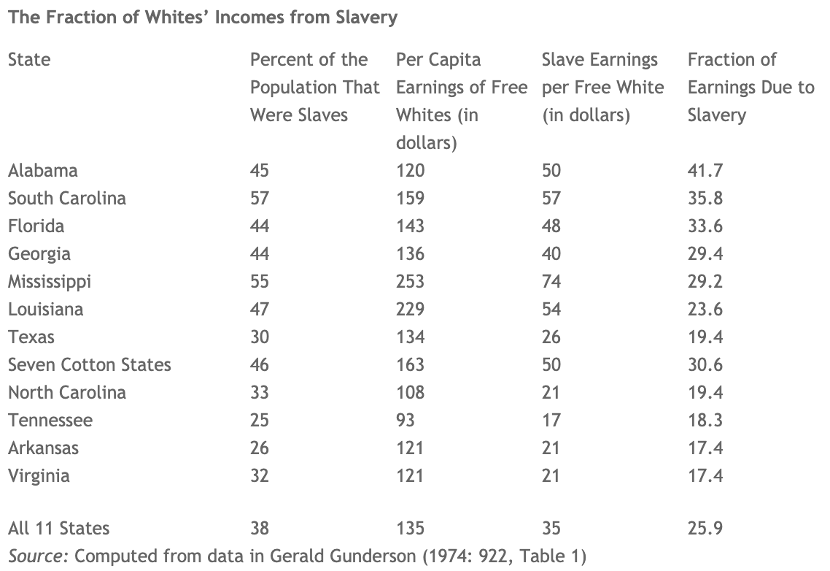
Slavery’s Contribution to Southern Income: 1860
Entire U.S. economy
benefitted from
cheap cotton.
New York’s share of
cotton revenue: ~40%.
Source: https://eh.net/encyclopedia/the-economics-of-the-civil-war/

Slide 46
Why Slavery?
Opportunity and familiarity.
Slavery had been practiced in Europe for 100 years by the time it came to the Colonies.
Cotton was a major crop in the antebellum South.
Very labor intensive.
Cheaper than paying free labor.
Seasonal.
Could not rely on free labor to wait around between the Spring planting and Fall harvest.

Slide 47
Slave Trade – Some Economics
Why Slavery?
Could have used free or indentured servitude.
Slavery won the price/productivity competition:
Free/indentured: 10-12 pounds * 4 years = 3 pounds per year.
Slaves: 16 pounds * 20 years = 1 pound per year.
Higher productivity of free/indentured did not make up for the difference.
Availability given seasonal nature of agricultural labor demand.
Source: The Atlantic Slave Trade: A Tentative Economic Model

Slide 48
Amendments Ending Slavery
13th Amendment - 1865
Nearly abolished slavery.
14th Amendment - 1867
Citizenship for those born in or naturalized in the United States.
15th Amendment - 1870
Sought to eliminate discrimination in voting.

Slide 49
Reconstruction & 40 Acres: 1865-1877
Freedmen’s Bureau, 1865, shortly before the end of the war.
Food and medical aid to former slaves.
Established schools for freedmen.
1870: A quarter million attended more than 4,000 schools in the south.
Tried to establish labor rights of freed slaves.
Fair wages and free choice of employers.
Free public education in the South
Excluded black children.
40 Acres.
Black codes.
Northern soldiers had all left by 1877.

Slide 50
40 Acres (but no Mule)
General Sherman, Jan. 16, 1865: Special Field Order No. 15
Granted some freed families land in plots no larger than 40 acres.
Implemented at the behest of Black leaders.
Some 400,000 acres were redistributed from Confederate land owners to former Black slaves.
Also:
Established Black settlements to be governed entirely by Black people themselves.
Sherman later ordered that the army could lend new settlers mules.
Overturned by Andrew Johnson in the Fall of 1865.
Land returned to former slave owners.
Imagine the implications for Black wealth.
Value of the land and the proceeds from having been able to work it independently.

Slide 51
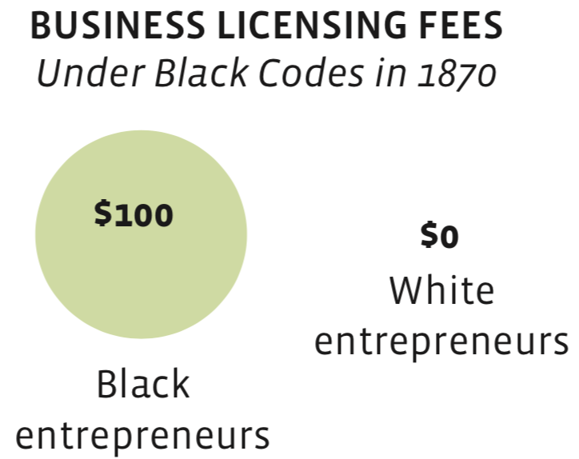
Black Codes: 1865-1877
Special laws that applied only to Black persons.
Both progressive and restrictive.
Acknowledged: Black ownership of property and marriage. Right to sue and be sued.
Included restrictive labor contracts, apprenticeships, and vagrancy laws.
Business licensing fees
Separate Black courts
Harsh penalties (death) for rebellion, arson, burglary, assaulting a White woman.
Broadly concerned with controlling former slaves.

Slide 52
Jim Crow (1877-1964)
Sets of laws
Segregation, restrictions on:
Voting, education, work, public office, juries, justice system.
Segregated use of both private and public facilities.
Sets of customs
Defining interactions between Black and Whites.
Late 19th century through 1960s.
Exploited a loophole in the 13th Amendment.
Provision allowed slavery as a punishment for a crime.

Slide 53
The Second Slavery?
Black men, women, and sometimes children were arrested and convicted of crimes under the Black Codes/Jim Crow.
Vagrancy, unemployment were crimes.
Subsequently leased to private companies.
200,000 Black Americans were forced into such labor arrangements.
Leasing turned into chain gangs in the early 20th century.
Lynching
Another form of controlling Black Americans was common.
More than 4,400 lynchings occurred during the Jim Crow years.
Land takings
Fraud, deception, and theft.
An estimated 11 million acres.

Slide 54
Jim Crow & Black Patenting
Source: https://lisadcook.net/wp-content/uploads/2014/02/pats_paper17_1013_final_web.pdf

Slide 55
Conflict and Black Patenting
Source: https://lisadcook.net/wp-content/uploads/2014/02/pats_paper17_1013_final_web.pdf

Slide 56
Misguided Past Policies: Redlining
For example, the government “redlined” heavily minority neighborhoods.
Redlining occurred when maps were drawn to show how risky investment in certain areas would be. The “riskiest” areas usually had the highest concentrations of black people.
Some argue that the government merely drew these maps, and did not discriminate in their own lending practices.
Others say private and public lenders relied on these maps to deny investment or loans in those areas.
Some relationships between redlined areas and outcomes still hold today in peer-reviewed economics research.
Note this is a failure introduced by government!
Notes:
The 1936 FHA underwriting manual included explicit instructions to not lend in areas with “inharmonious racial groups” and to respect racially biased covenant restrictions; for example, if a deed said that no black person could occupy a house, the FHA manual of 1936 respected that.
For more, see https://www.jstor.org/stable/20108708?seq=1#page_scan_tab_contents or https://ncrc.org/holc/.

Slide 57
Other Forms of Disenfranchisement
Poll taxes
Literacy tests
Other measures: https://www.history.com/news/african-american-voting-right-15th-amendment
Klan – with complicity from the police and government

Slide 58
Homestead Acts
Original Homestead Act (1868-1934)
Granted 246 million acres of western land (size of CA & TX combined)
To receive 160 acres of land:
File an application, improve the land for 5 years, file for deed of ownership.
1.5 million White families
Excluded Black Americans in practice, not letter.
Southern Homestead Act (1866-1876)
28,000 individuals, of which 4,000-5,500 were emancipated slaves.
Most were locked into year-long contracts following the war. Could not break to homestead until after special provisions for freed slaves had ended.
Land was often unfarmable – swamp or heavily wooded.
Source: https://aeon.co/ideas/land-and-the-roots-of-african-american-poverty

Slide 59
Homestead Acts – Effects on Relative Wealth
Nearly 10% of all U.S. land was given (for a filing fee) to White families in the 5 decades following the Civil War.
This is an enormous head start in terms of wealth development for White families relative to Black families.
An estimated 46 million current Americans trace their lineage back to homesteaders.
Nearly all are White.

Slide 60
Other New Deal Programs
Unemployment Insurance
Because a state run program – different levels of protection, white/black
Social Security (1935)
Exempted self employed, field hands, and domestic workers. All were heavily black. Changed in the 1950s.
65% of Black workers did not qualify.
Wagner Act (1935)
Established rights of workers to unionize, except for farm and domestic workers. Also permitted unions to exclude workers.
NRA, FHA,
https://atlantablackstar.com/2015/02/04/9-ways-franklin-d-roosevelts-new-deal-purposely-excluded-blacks-people/2/
Minimum Wage

Slide 61
Housing
Areas of potential discrimination:
Disparate treatment
Service area
Community Reinvestment Act (CRA)
Lenders are obligated to meet the needs of their entire service area.
Advertising and marketing
Prescreening mortgage applicants
Loan terms – interest rates or maturities
Adverse impact
Lending standards
What criteria are used?

Slide 62
Local Zoning
Designed to reflect the concentration of power in the hands of wealthier white residents.
Less in the way of services to minority and low income communities.
Lot size
Single Family Residence

Slide 63
What Is The Minimum Wage?
The minimum wage sets a wage floor.
It is unlawful for businesses in covered industries to pay a wage below the minimum.
The Federal minimum wage is currently $7.25.
This is the highest that it has ever been.
Adjusting for inflation:
It is no higher than it was in the late 1950s.
It is nearly $5.00 lower than it was in the late 1960s.
Many states and local governments have implemented minimum wages that are significantly higher than the Federal level.

Slide 64
Minimum Wages
Early on, they did not apply to farmworkers or domestic help.
1960s – great equalizer - MW increased in real terms 37% (8.9 to 12.24)
The 1966 Fair Labor Standards Act extended federal minimum wage coverage to agriculture, restaurants, nursing homes, and other services which were previously uncovered and where nearly a third of black workers were employed.
Since 1968 – has fallen 41% (12.24 to 7.25)
Or in 1968, was 69% higher than it is today.
Exacerbating the Black-White wage gap.

Slide 65
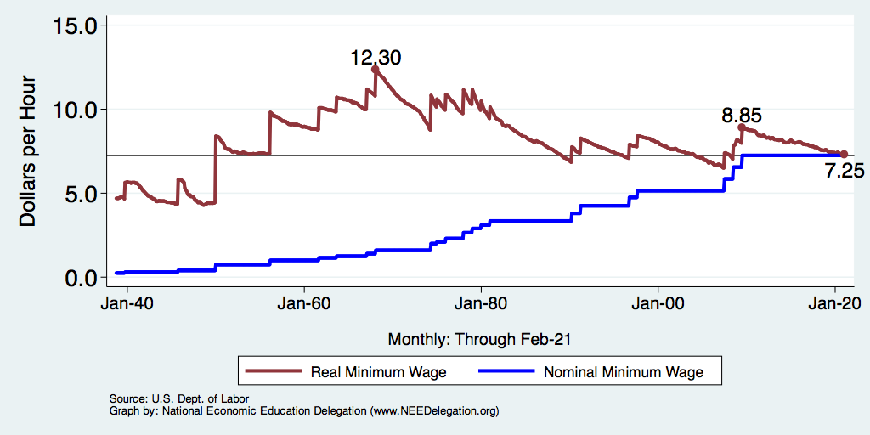
History of the Minimum Wage

Slide 66
Effects of 1966 Increase in Min Wage Coverage
Added coverage for agriculture
restaurants, nursing homes,
and other services.
These industries employed
1/3 of Black workers at the time.
Graph is the effect on wages
within these industries.
This explains 20% of reduced
Black-White wage gap during the
Civil Rights Era.

Slide 67
1954 Brown v. Board of Education
1896: Plessy v. Ferguson
Ruled that segregated public facilities were legal, so long as of equal quality.
Applied to buses, school, and other public facilities
Sanctioned Jim Crow laws.
Brown: helped to establish that separate-but-equal is not equal at all.
Lower court ruled:
“[D]etrimental effect on colored children”
Contributed to “a sense of inferiority”
But upheld separate but equal doctring.
Supreme Court: ”Separate but equal” has no place – inherently unequal.

Slide 68
Brown Impact
Was steadfastly resisted in much of the south.
Helped to fuel the civil rights movement.
Did not desegregate schools.
Schools remain highly segregated today.
Racial inequities abound.
Washington DC, a school with 11% low-income students is 1 mile from a school with primarily low-income students.

Slide 69
Economic Impact of Equalization
If southern-born Black men had attended white schools:
1920s cohort: would have earned 6 to 9% more than they actually did in 1970.
1930s cohort: gap was just 2 to 5%
Because of increasing legal activity, local officials were taking the “equal” part of “separate but equal” more seriously.
Also clear that quality affects extent of education.
Parental education is important for child’s level of education.
Lack of equality spilled over across generations.
Legal action and Brown did help to narrow the wage and education gap between Black and White workers.
Brown and desegregation narrowed southern-born and nonsouthern-born Black wage gap by 10 percentage points.

Slide 70
1957 Civil Rights
For decades after Reconstruction, the U.S. Congress did not pass a single civil rights act.
In 1957, it established within the Justice Department:
A civil rights section, and
a Commission on Civil Rights to investigate discriminatory conditions.

Slide 71
Civil Rights Act of 1964
Segregation on the grounds of race, religion or national origin was banned at all places of public accommodation, including courthouses, parks, restaurants, theaters, sports arenas and hotels.
Barred race, religious, national origin and gender discrimination by employers and labor unions, and created an Equal Employment Opportunity Commission with the power to file lawsuits on behalf of aggrieved workers.
Forbade the use of federal funds for any discriminatory program, authorized the Office of Education (now the Department of Education) to assist with school desegregation, gave extra clout to the Commission on Civil Rights and prohibited the unequal application of voting requirements.
Martin Luther King Jr.: Nothing less than a 2nd emancipation.
https://www.history.com/topics/black-history/civil-rights-act

Slide 72
Economic Consequences

Slide 73
Black Household Incomes Relative to White
Source: pewsocialtrends.org

Slide 74
Disparities in Lifetime Earnings

Slide 75
Median Income

Slide 76
Black Male Labor Force Participation is Low

Slide 77
Poverty

Slide 78
Mobility
Generally the case that Black men are:
less likely to move out of the bottom than White men.
More likely to drop out of the top than are White men.
Overall rates of mobility in the post Civil War era have been slower for Black men than for White men
Racial differences in income are persistent if race and human capital are strongly transmitted across generations.
Which they are in U.S. history.

Slide 79
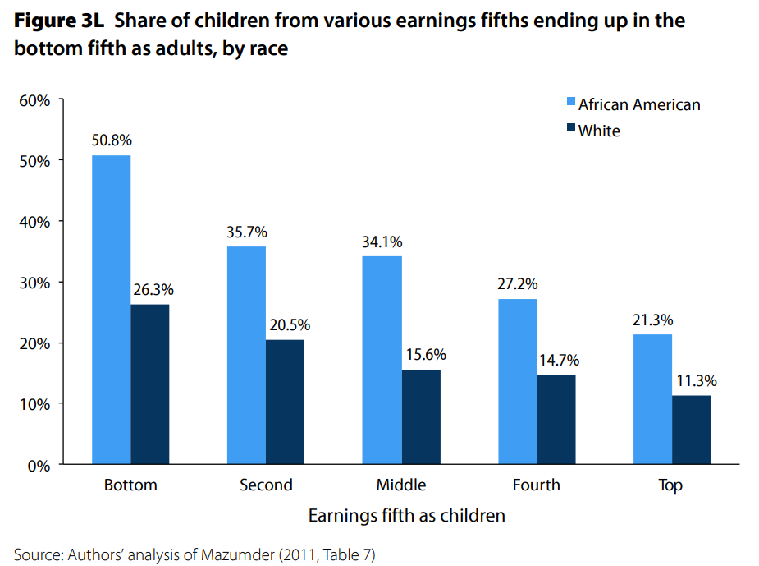
U.S. – Racial Differences in Mobility
Odds of staying poor, if born poor
Odds of becoming poor, if born rich
Economic Policy Institute, State of Working America, 2012

Slide 80
Evidence on Mobility
Had Black children from 1880 to 1900 transitioned as White children had, the income gap in 1900 would have been the same as it was in 2000.
The inheritance of race prevented 100 years worth of achievement.

