Slide 1
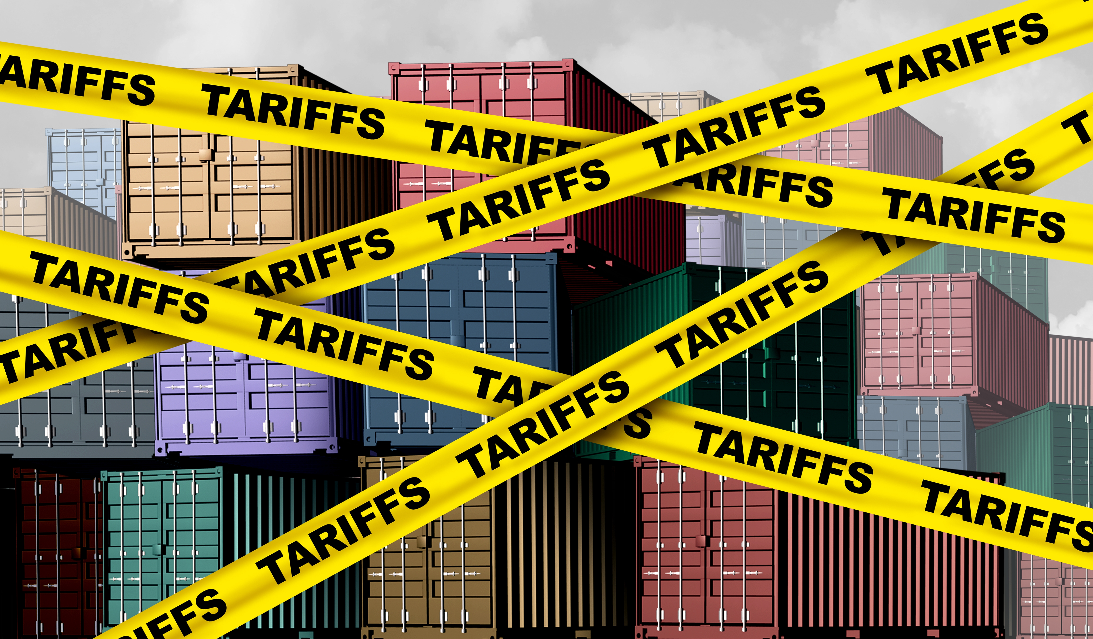

Immigration and Tariff Policy
Significant Barriers to Growth
Viamonte
June 18, 2025
Jon Haveman, Ph.D.
National Economic Education Delegation

Slide 2
National Economic Education Delegation
Vision
  One day, the public discussion of policy issues will be grounded in an accurate perception of the underlying economic principles and data.
Mission
  NEED unites the skills and knowledge of a vast network of professional economists to promote understanding of the economics of policy issues in the United States.
NEED Presentations
  Are nonpartisan and intended to reflect the consensus of the economics profession.

Slide 3
Who Are We?
Honorary Board: 54 members
  2 Fed Chairs: Janet Yellen, Ben Bernanke
  6 Chairs Council of Economic Advisers
    Furman (D), Rosen (R), Bernanke (R), Yellen (D), Tyson (D), Goolsbee (D)
  4 Nobel Prize Winners
    Akerlof, Smith, Maskin, Bernanke
Delegates: 652+ members
  At all levels of academia and some in government service
  All have a Ph.D. in economics
  Crowdsource slide decks
  Give presentations
Global Partners: 48 Ph.D. Economists
  Aid in slide deck development

Slide 4
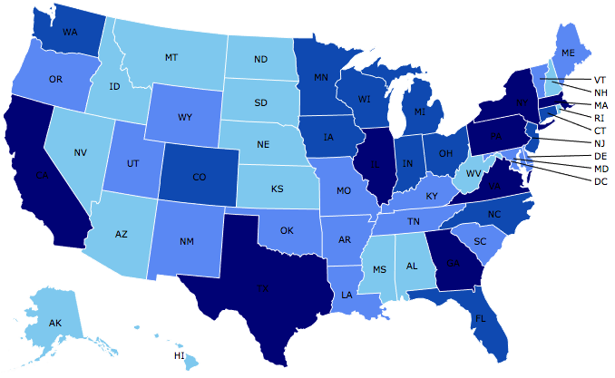
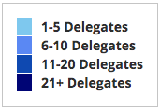
Where Are We?

Slide 5
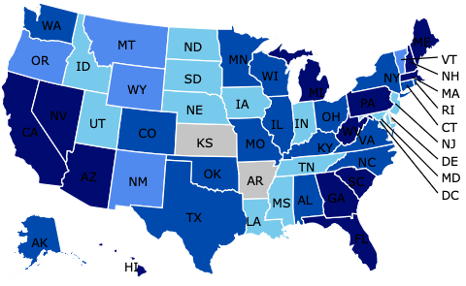
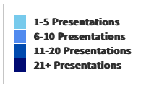
Where Have We Presented? (1,301 Talks)

Slide 6
Available NEED Topics Include:
US Economy
Healthcare Economics
Climate Change
Economic Inequality
Economic Mobility
Trade and Globalization
Minimum Wages
Immigration Economics
Social Security
Federal Budgets
Federal Debt
Black-White Wealth Gap
Autonomous Vehicles
Healthcare Economics

Slide 7
Immigration

Slide 8
Why Do People Migrate?
Push factors:
  Disparities in income/standards of living, and the availability of jobs, violence/war, climate change, natural disasters, population pressures, economic dislocation, religious persecution, and denial of political rights.
Pull factors:
  Potential for economic prosperity (higher wages, job opportunities), physical security, political freedom, and religious liberty.
Source: Gilder Lehrman Institute of American History.

Slide 9
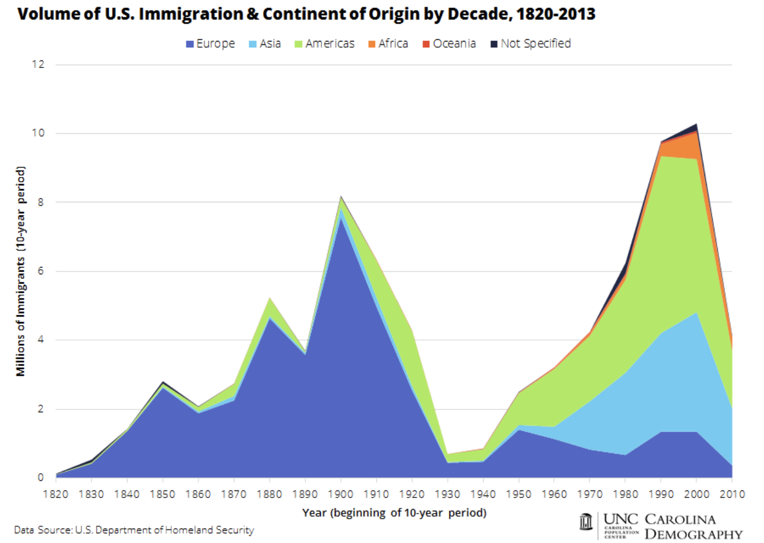

Slide 10
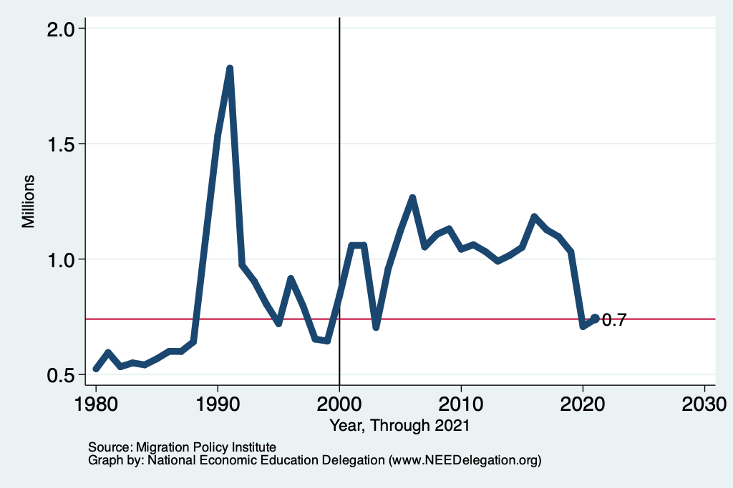
Recent Trends in Authorized Immigration

Slide 11
UNauthorized Immigration

Slide 12
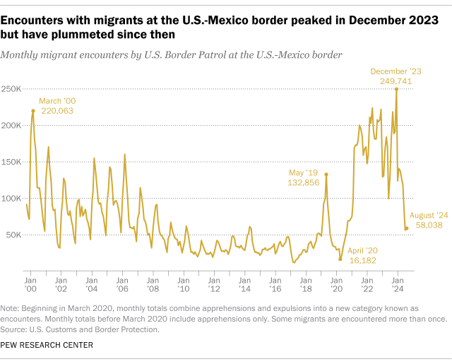
Source: Customs and Border Patrol
https://usafacts.org/articles/what-can-the-data-tell-us-about-unauthorized-immigration

Slide 13
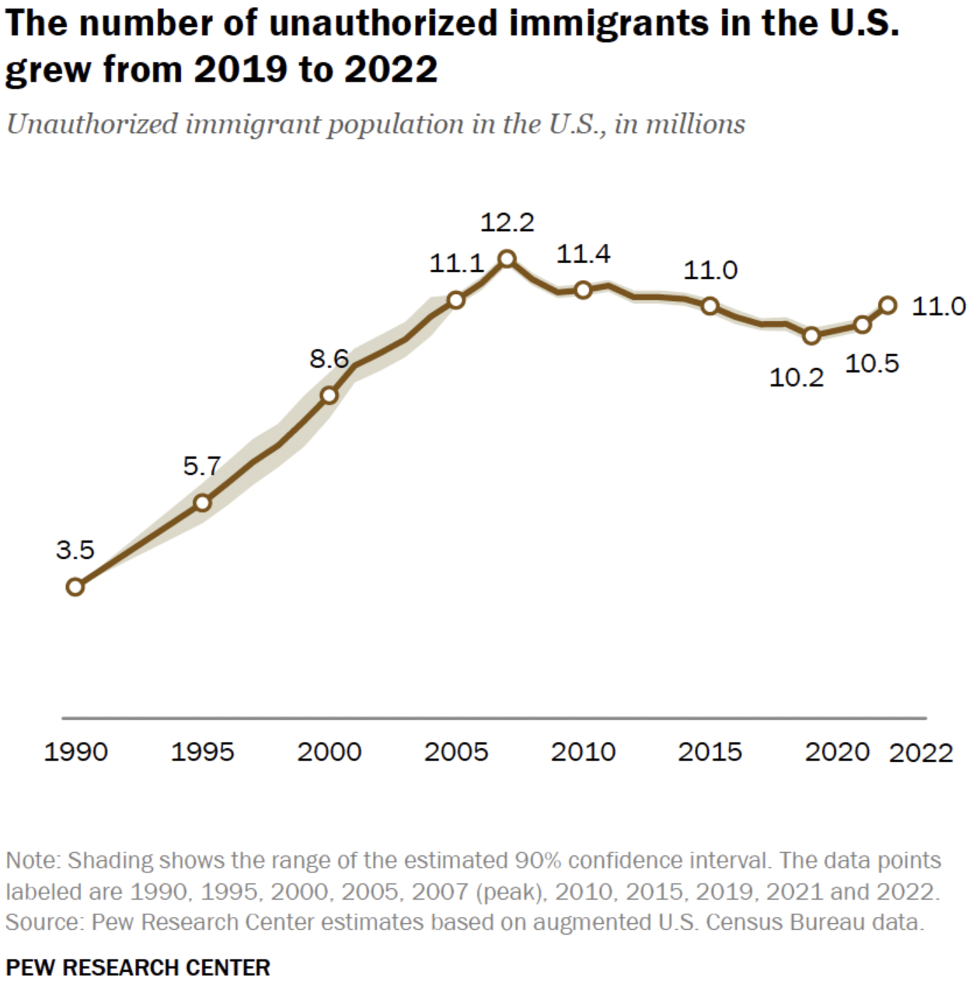
U.S. Unauthorized Immigration Totals
And is about the same
As in 2015.
Data suggest 11.7 in 2023.
Source: Pew Research Center, What we know about unauthorized immigrants living in the U.S., July 22, 2024

Slide 14
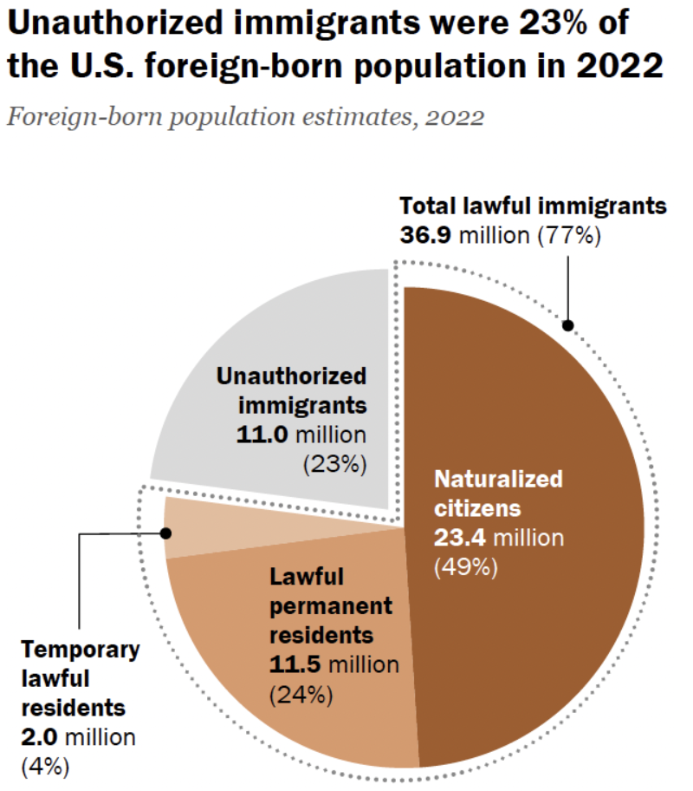
Total Foreign-Born
Population: 47.9 million
Source: Pew Research Center, What we know about unauthorized immigrants living in the U.S., July 22, 2024

Slide 15
Why Do We Care? Economic Implications
Conventional Wisdom Issues:
  Labor markets: Wages and Jobs
  Government Revenue and Spending
  Crime
Other issues (that don’t get talked about much):
  Gross Domestic Product (GDP)
  Innovation and Entrepreneurship

Slide 16
GDP: How Does This Work?
What determines the size of an economy?
  Physical capital
  Technology/productivity
  The number of workers
    Immigration adds to the number of workers.
Number of immigrants in the labor force is high
  33.0 million foreign-born persons ages 16+ in the labor force in August/24.
  19.6% of the total US workforce.
Evidence
  Immigrants added 11% to GDP ($2 trillion) in 2016.
Federal Reserve Bank of St. Louis (https://fred.stlouisfed.org/)
National Academies of Sciences, Engineering, and Medicine (2017) “The Economic and Fiscal Consequences of Immigration”.

Slide 17
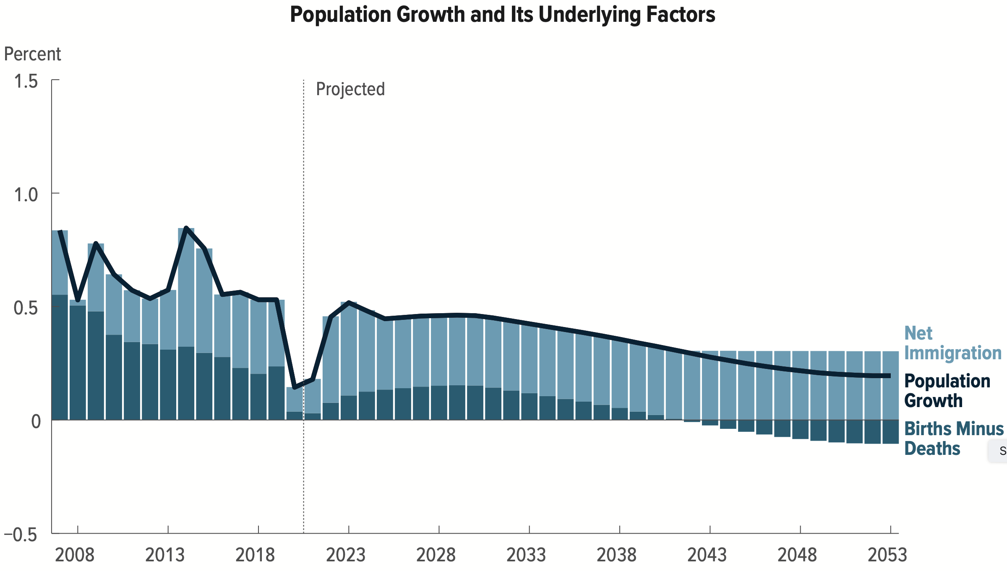
Is Immigration Saving the Day?
The vast majority of additions to the
Population in the last several years
Has been from immigration.
Source: CBO – The Demographic Outlook, 2023-2053

Slide 18
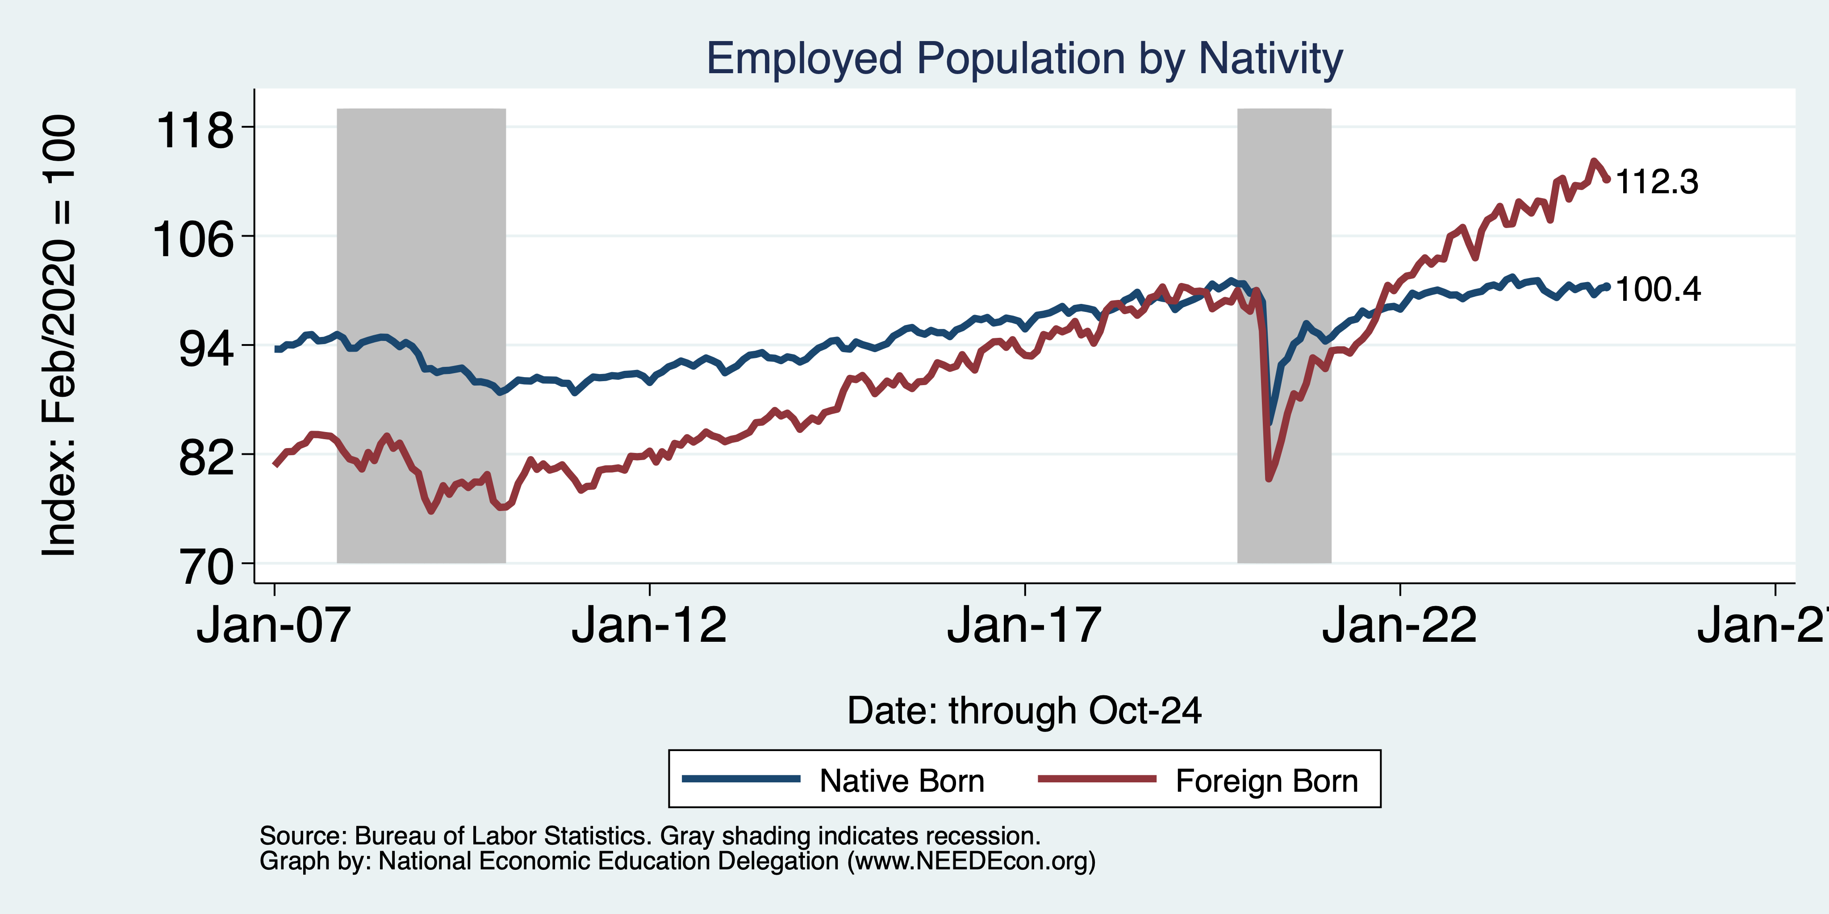
Immigrants to the Rescue?

Slide 19
Jobs: Conventional Wisdom…Upended
What is the conventional wisdom?
  Low-skilled immigrants come in and take jobs from low-skilled native-born individuals.
    1-1 tradeoff.
What does new research show?
  Low-skilled immigrants contribute positively to the economy.
    Every 100 low-skilled immigrants: create 9 jobs for low-skilled native-born.
    They create opportunities for low-skilled native-born workers.
  Low-skilled immigrants take jobs that native-born don’t want.

Slide 20
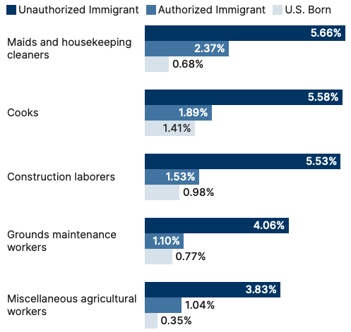
Share of Workers in Each Occupations

Slide 21
Age-Specific Taxes and Benefits
By Immigrant Generation, United States, 2012
Source: Blau & Mackie (2017), p. 325.

Slide 22
Bottom Line/Consensus of Estimates
Federal level: fiscal impact is generally positive.
State and local level: typically negative fiscal impact.
Overall: $1,300 per immigrant.
  Authorized and unauthorized.

Slide 23
Implications for Major Federal Programs
Documented immigrants are less likely to use Social Security and Medicare.
Unauthorized immigrants are ineligible.
  They will pay into the system but cannot receive benefits.
Medicaid: not available to legal residents for the first five years.
Provide a source of revenue for an aging population.
  For Social Security and Medicare

Slide 24
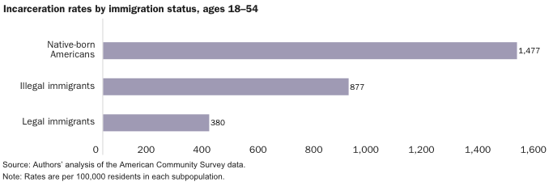
Incarceration by Immigration Status, 2018
Source: Cato Institute, Illegal Immigrant Incarceration Rates, 2010–2018: Demographics and Policy Implications, April 2020.

Slide 25
About Conventional Wisdom
Native-born unskilled workers
  There is a negative impact on wages for some.
  Creates opportunities for others.
  But who wins and loses depend on the skill mix of immigrants;
    when this skill mix changes, so do its effects.
Crime
  Immigrants, both authorized and unauthorized, commit crimes at much lower rates than do native-born residents.
Government programs
  Federal: immigrants are a source of revenue and stability for some important programs.
  State and local: because education is funded at the local level, this can be a drain on local government coffers.
  Net: is positive.

Slide 26
Mass Deportations
Immigrants work different jobs than do native-born workers.
Immigrants contribute to the local economy.
  GDP losses of up to $1.7 trillion annually.
Immigrants keep prices low: in particular, food!
Deportations impact tax revenues.
  $1,300 more in on average than out, annually.
  Unauthorized immigrants: $22.6 billion in social security and $5.7 billion in Medicare payments.
Deportations are expensive ($13,000 each).
  Total cost $315 billion.
They rob people of their dignity.

Slide 27
Tariffs

Slide 28
What Is a Tariff?
A tariff is a tax on imports.
Much like, say, the 8% sales tax in California.
  Whatever price the seller charges, the buyer pays an extra 8% that goes to the government.
A 10% tariff on all imports (such as Trump has proposed) would mean that:
  Whatever the foreign exporter charges for a product,
  US buyers will pay an extra 10% to the US government.
Might the seller charge a lower price because of the tariff?
  Perhaps, but when Trump used tariffs in 2018 on steel and China, they did NOT.

Slide 29
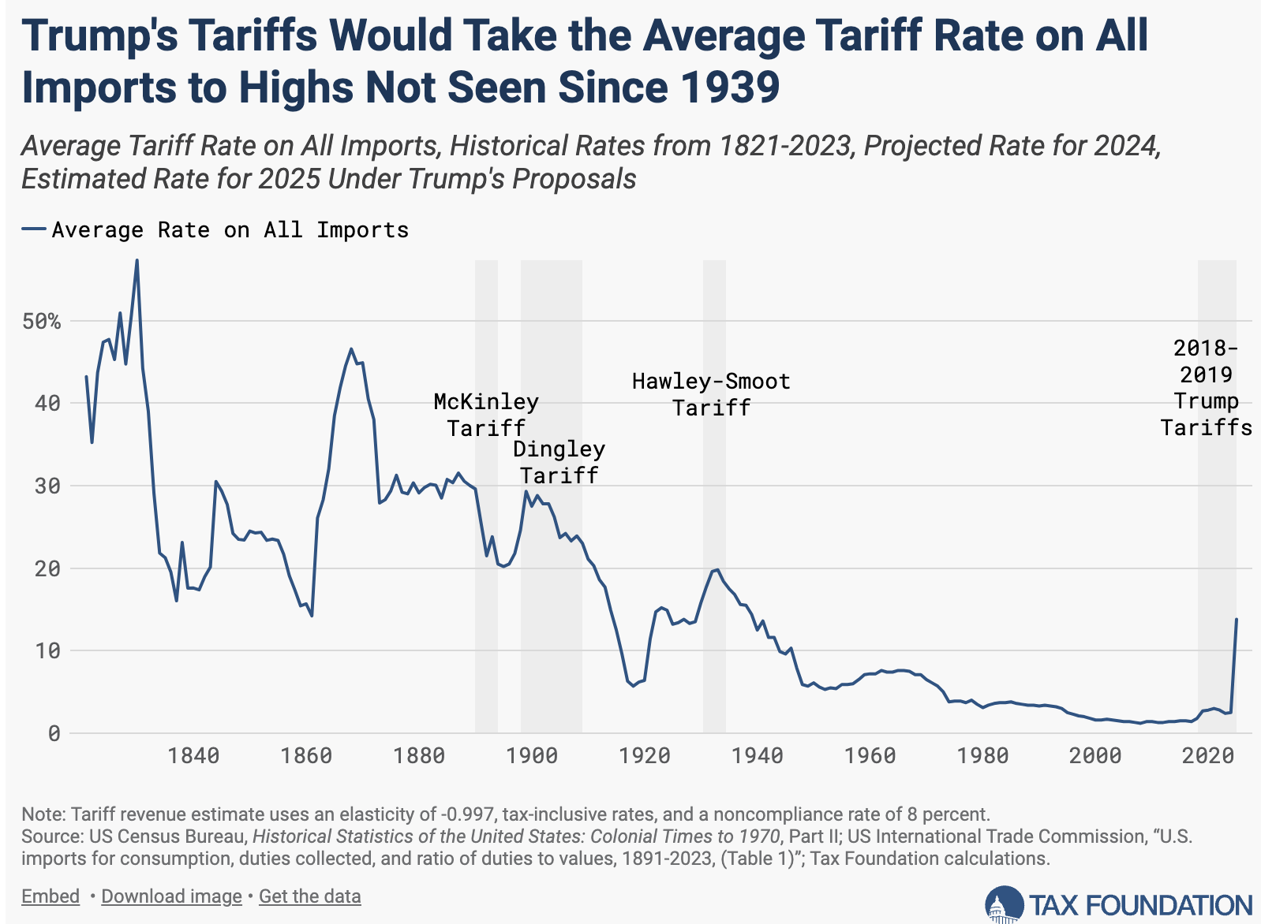
Trump points to this, and to President McKinley, as a good example.
Notes:
Source: Don’t know

Slide 30
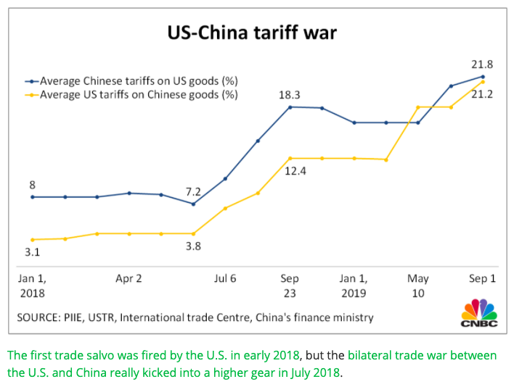
US-China Tariff War – Tariff Rates
Source: CNBC.com
Notes:
SEPTEMBER 18, 2019 | Yen Nee Lee, CNBC.com
http://nbr.com/2019/09/18/these-4-charts-show-how-us-china-trade-has-changed-during-the-tariff-dispute/

Slide 31
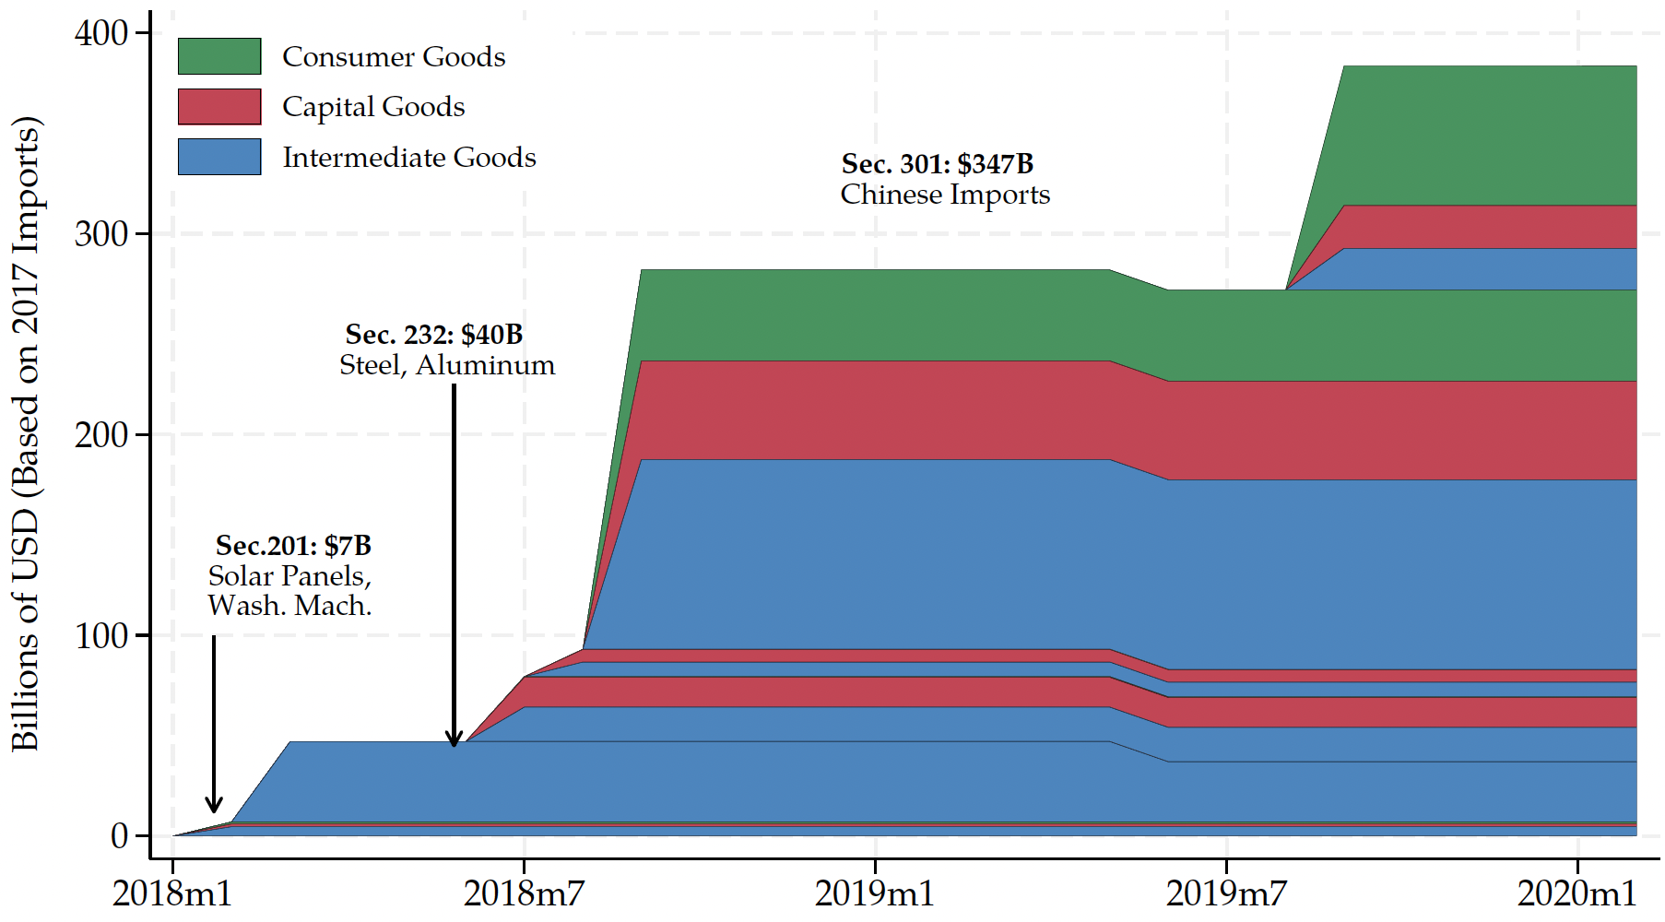
Trump I Tariffs - US Imports Covered
480
US imports from China in 2017, per World Bank:
$480 billion
Source: Flaaen & Pierce 2020
Notes:
SEPTEMBER 18, 2019 | Yen Nee Lee, CNBC.com
http://nbr.com/2019/09/18/these-4-charts-show-how-us-china-trade-has-changed-during-the-tariff-dispute/

Slide 32
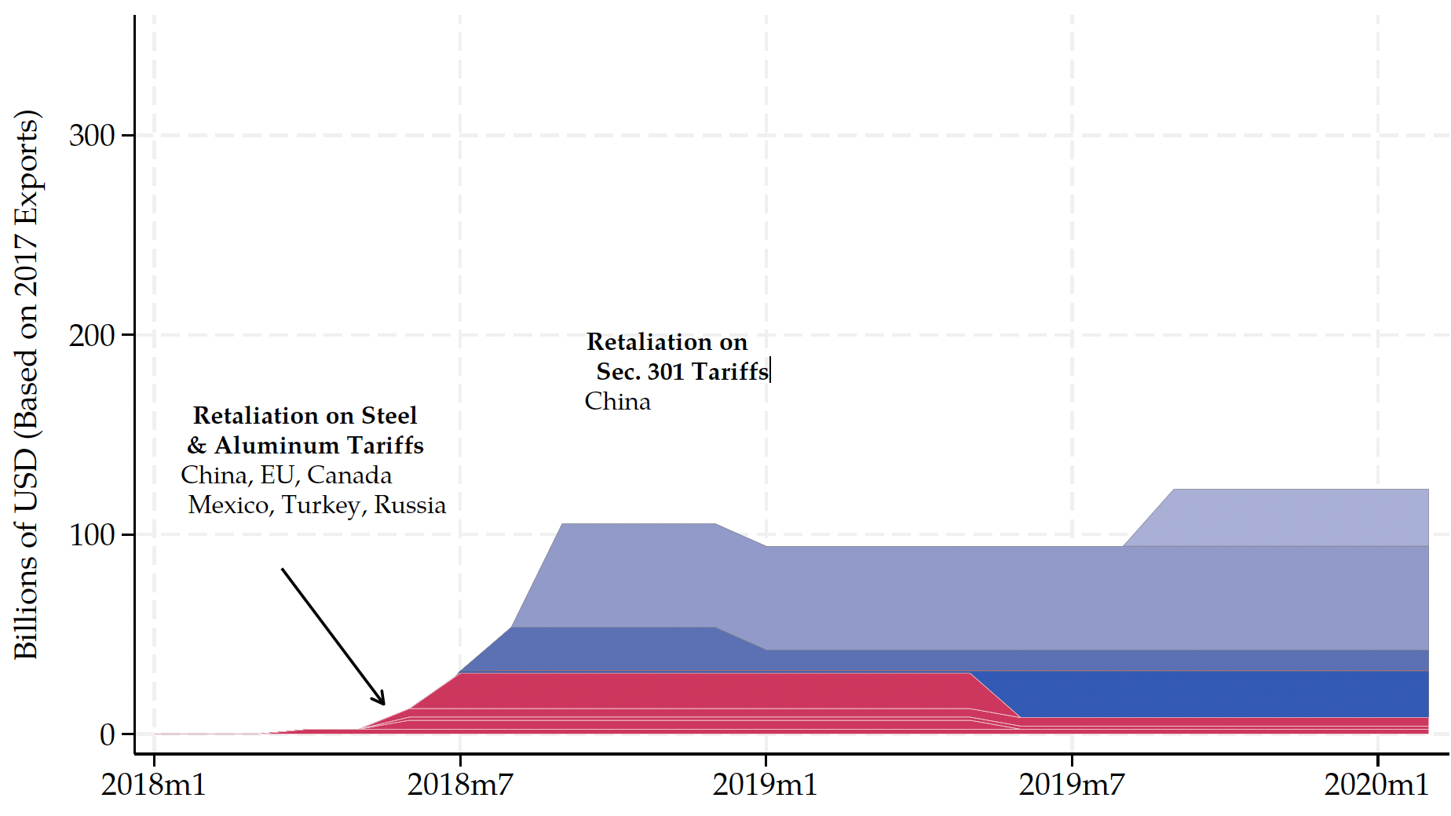
Trump I Tariff Retaliation - US Exports Covered
US exports to China in 2017, per World Bank:
$154 billion
154
Source: Flaaen & Pierce 2020
Notes:
SEPTEMBER 18, 2019 | Yen Nee Lee, CNBC.com
http://nbr.com/2019/09/18/these-4-charts-show-how-us-china-trade-has-changed-during-the-tariff-dispute/

Slide 33
Trump I Tariffs & Trade War
Summary
  Trump placed tariffs of 25% on steel and 10% on aluminum.
  Trump place multiple tariffs on China exports, covering at least ¾ of their exports to US.
  Imports from China fell while imports from others rose.
  US trade deficit did not shrink.
  Data show no fall in foreign export prices, so tariffs were paid by US buyers.
    Domestic prices DID increase.
  Jobs? Eight lost for every job created.

Slide 34
Wait…Job Losses?
Job losses come from two sources:
  Tariffs raise the price of imported intermediate goods
    E.g., steel and aluminum.
  Tariffs hit the exchange rate.
    Fewer imports means lower supply of dollars.
    Exchange rate appreciates.
    Exported products are more expensive in foreign markets.

Slide 35
Trump II Tariffs

Slide 36
Trump II Tariff Plans
“To me the most beautiful word in the dictionary is ‘tariff’”
During campaign he said he will
  Place a tariff of 10% or 20% on all imports from all countries.
  Place even higher tariffs (60%) on imports from China.
  Raise our tariffs on countries to match what they charge on our exports.
    “Reciprocal Trade Act”
    (And lower those where they charge less?)
  Raise tariffs on countries that don’t use the US dollar for international transactions.
  Place tariffs on Mexico, violating his own USMCA trade agreement
    25% on everything if they don’t stop US immigration
    100% on cars to get production in US
Notes:
McCormick, “Trump Calls Tariffs the ‘Most Beautiful Word’,” WSJ, 10/14/24
https://www.wsj.com/livecoverage/harris-trump-election-10-16-2024/card/trump-calls-tariffs-the-most-beautiful-word--YMVPAupw4EjBRp6yobOy
Swanson, “Harris and Trump Embrace Tariffs, Though Their Approaches Differ,” New York Times, Aug 27, 2024.
https://www.nytimes.com/2024/08/27/us/politics/trump-harris-tariffs.html
Toomey, “About Trump’s ‘Reciprocal’ Tariffs,” WSJ, 10/27/24
https://www.wsj.com/opinion/about-trumps-reciprocal-tariffs-he-wants-to-raise-taxes-and-thinks-im-the-stupid-one-5dc3c56c?mod=itp_wsj
Krugman, “Donald Trump on the Dollar, in His Own Words. NYT, 9/9/24
https://www.nytimes.com/2024/09/09/opinion/trump-tariffs-reserve-currency.html
Economist, “Donald Trump is poised to smash Mexico with tariffs,” 11/7/24
https://www.economist.com/the-americas/2024/11/07/donald-trump-is-poised-to-smash-mexico-with-tariffs
Ewing, “Trump’s Tariffs Could Deal a Blow to Mexico’s Car Factories,” NYT, 11/12/24
https://www.nytimes.com/2024/11/12/business/economy/trump-mexico-trade-tariffs-car-factories.html

Slide 37
Trump II Tariff Plans
What will Trump actually do?
  Beattie in FT 11/18/24: “trade policy in his first administration emerged from fierce internal battles like a victorious but bloodied rat crawling out of a sack of rodent corpses, with Trump’s caprice determining which idea survived.”
  He will surely do some of the things on this list
  But not on everybody. He’ll use threats to negotiate ”deals”
    For the benefit of the country (?)
    For the benefit of himself (!)
Notes:
McCormick, “Trump Calls Tariffs the ‘Most Beautiful Word’,” WSJ, 10/14/24
https://www.wsj.com/livecoverage/harris-trump-election-10-16-2024/card/trump-calls-tariffs-the-most-beautiful-word--YMVPAupw4EjBRp6yobOy
Swanson, “Harris and Trump Embrace Tariffs, Though Their Approaches Differ,” New York Times, Aug 27, 2024.
https://www.nytimes.com/2024/08/27/us/politics/trump-harris-tariffs.html
Toomey, “About Trump’s ‘Reciprocal’ Tariffs,” WSJ, 10/27/24
https://www.wsj.com/opinion/about-trumps-reciprocal-tariffs-he-wants-to-raise-taxes-and-thinks-im-the-stupid-one-5dc3c56c?mod=itp_wsj
Krugman, “Donald Trump on the Dollar, in His Own Words. NYT, 9/9/24
https://www.nytimes.com/2024/09/09/opinion/trump-tariffs-reserve-currency.html
Economist, “Donald Trump is poised to smash Mexico with tariffs,” 11/7/24
https://www.economist.com/the-americas/2024/11/07/donald-trump-is-poised-to-smash-mexico-with-tariffs
Ewing, “Trump’s Tariffs Could Deal a Blow to Mexico’s Car Factories,” NYT, 11/12/24
https://www.nytimes.com/2024/11/12/business/economy/trump-mexico-trade-tariffs-car-factories.html
Beattie, “Where Trump will go with his plans on trade,” FT, 11/18/24
https://www.ft.com/content/afab0fab-524b-4845-addd-bcffbe6b0b22

Slide 38
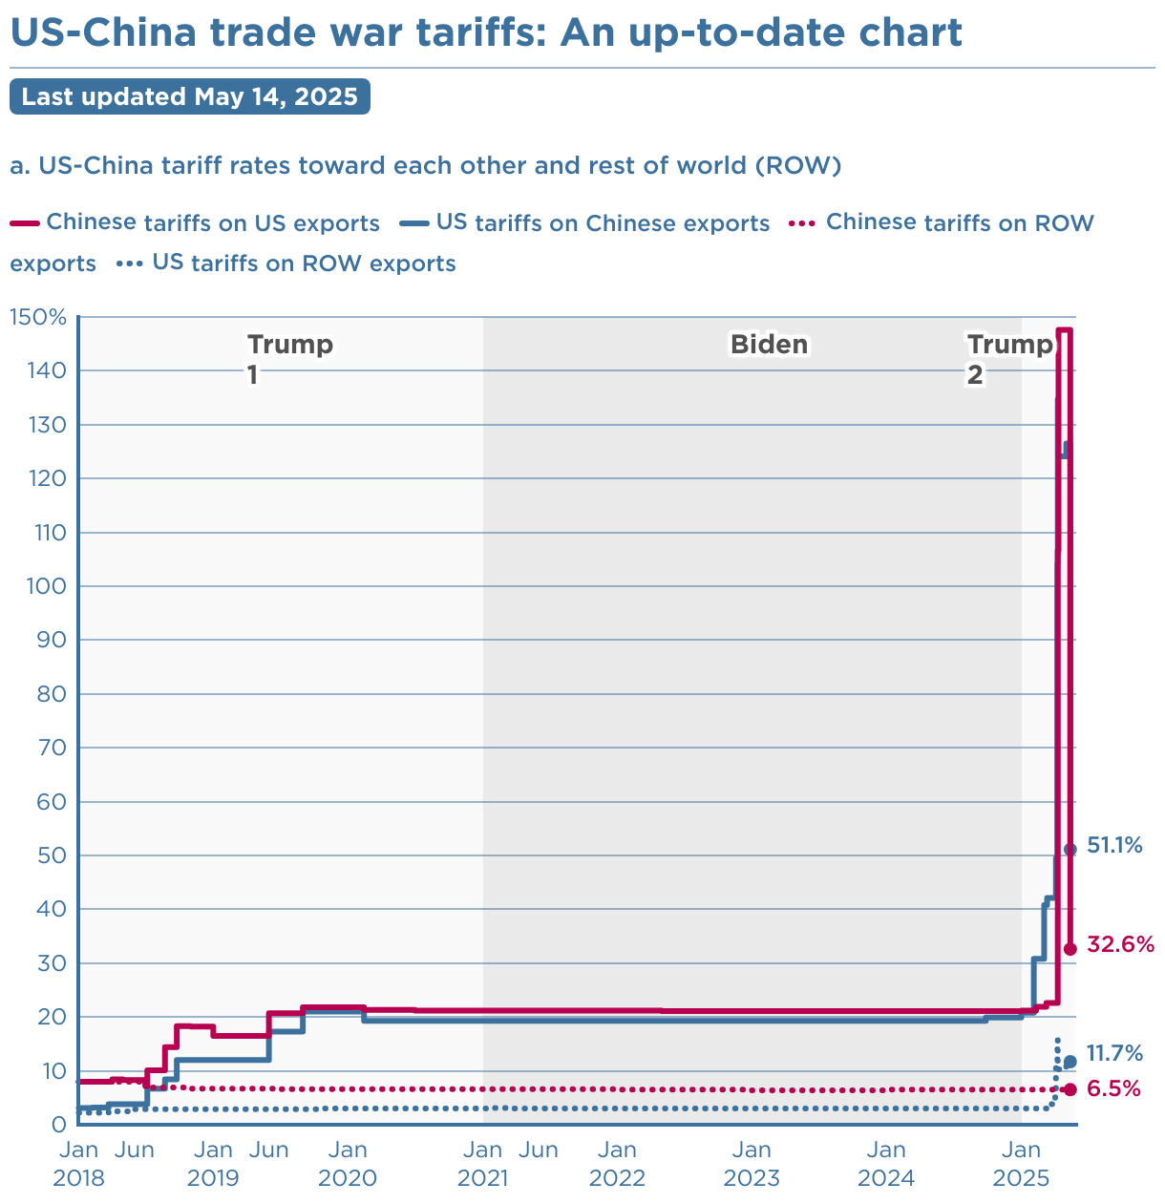
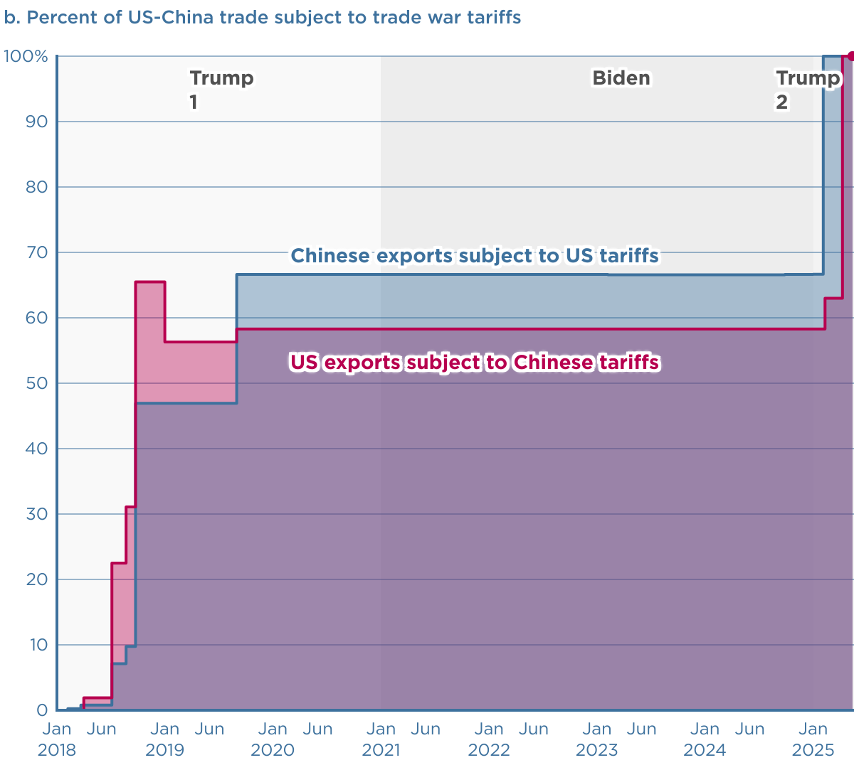
Source: Peterson Institute for International Economics (PIIE)
Notes:
https://www.piie.com/blogs/realtime-economics/2025/trumps-trade-war-timeline-20-date-guide

Slide 39
Effects of Tariffs in General

Slide 40
Economic Effects of A Tariff
A tariff is a tax on imports. It causes
  A rise in the price of the imported good in the importing country
  A fall in the price of the imported good in the exporting country
  The quantity imported to fall
  Revenue for the tariff-levying government
Almost always: the rise at home is much larger than the fall abroad
  That’s especially true if importing country is small
  But it’s also true if importing country is as large as the U.S.
    We learned this from Trump’s tariffs in 2018.
    Example: Trump’s tariffs caused US prices to rise, with hardly any perceptible fall in prices abroad.

Slide 41
Economic Effects of A Tariff
Economists’ cost-benefit analysis quantifies these and shows that the costs exceed the benefits.
Politics of tariffs.
A tariff on once country just causes displacement to another country.
Tariffs are NOT an effective tool to reduce the trade deficit.
Tariffs are NOT a good way to raise government revenue.

Slide 42
Other effects of a tariff
Income distribution
  Tariffs, especially on China, raise prices of the products disproportionately bought by low-income consumers, hurting them more than high-income consumers
Retaliation
  Other countries place tariffs on US exports
  Trade war that started in 2018 continues and gets worse
Corruption
  Historically, tariffs prompted both smuggling and bribes to customs officers
  Today, in the US, those are less likely.
  But requests for exemptions from tariffs may be accompanied by favors or political contributions

Slide 43
Possible Economic Arguments for Tariffs
Possible arguments for tariffs:
  National Defense – strategic resource.
    Do we need the capacity to make our own computer chips, just in case?
  “Infant” Industry.
  Unfair trade practices of exporting countries.

Slide 44
Effects of
Trump II Tariffs

Slide 45
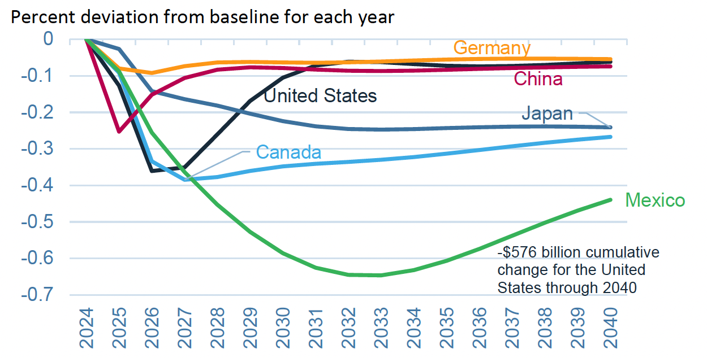
Effects of 10% Tariff on All US Imports
Real GDP
Notes:
Warwick McKibbin, Megan Hogan, and Marcus Noland, “The International Economic Implications of a Second Trump Presidency,” Working Paper 24-20, Peterson Institute of International Econnomics, September 2024.
https://www.piie.com/publications/working-papers/2024/international-economic-implications-second-trump-presidency

Slide 46
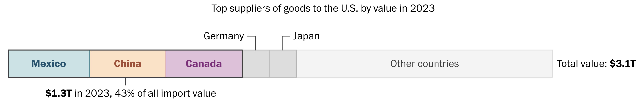
Notes:
Luis Melgar and Rachel Lerman, “See which products Trump’s tariffs could make more expensive,” Washington Post, December 5, 2024.
https://www.washingtonpost.com/business/2024/12/05/trump-china-mexico-canada-tariffs-prices/?utm_campaign=wp_evening_edition&utm_medium=email&utm_source=newsletter&carta-url=https%3A%2F%2Fs2.washingtonpost.com%2Fcar-ln-tr%2F3fd6330%2F67522261e179af1b45e73c5e%2F597273baade4e21a847d94bd%2F27%2F50%2F67522261e179af1b45e73c5e

Slide 47
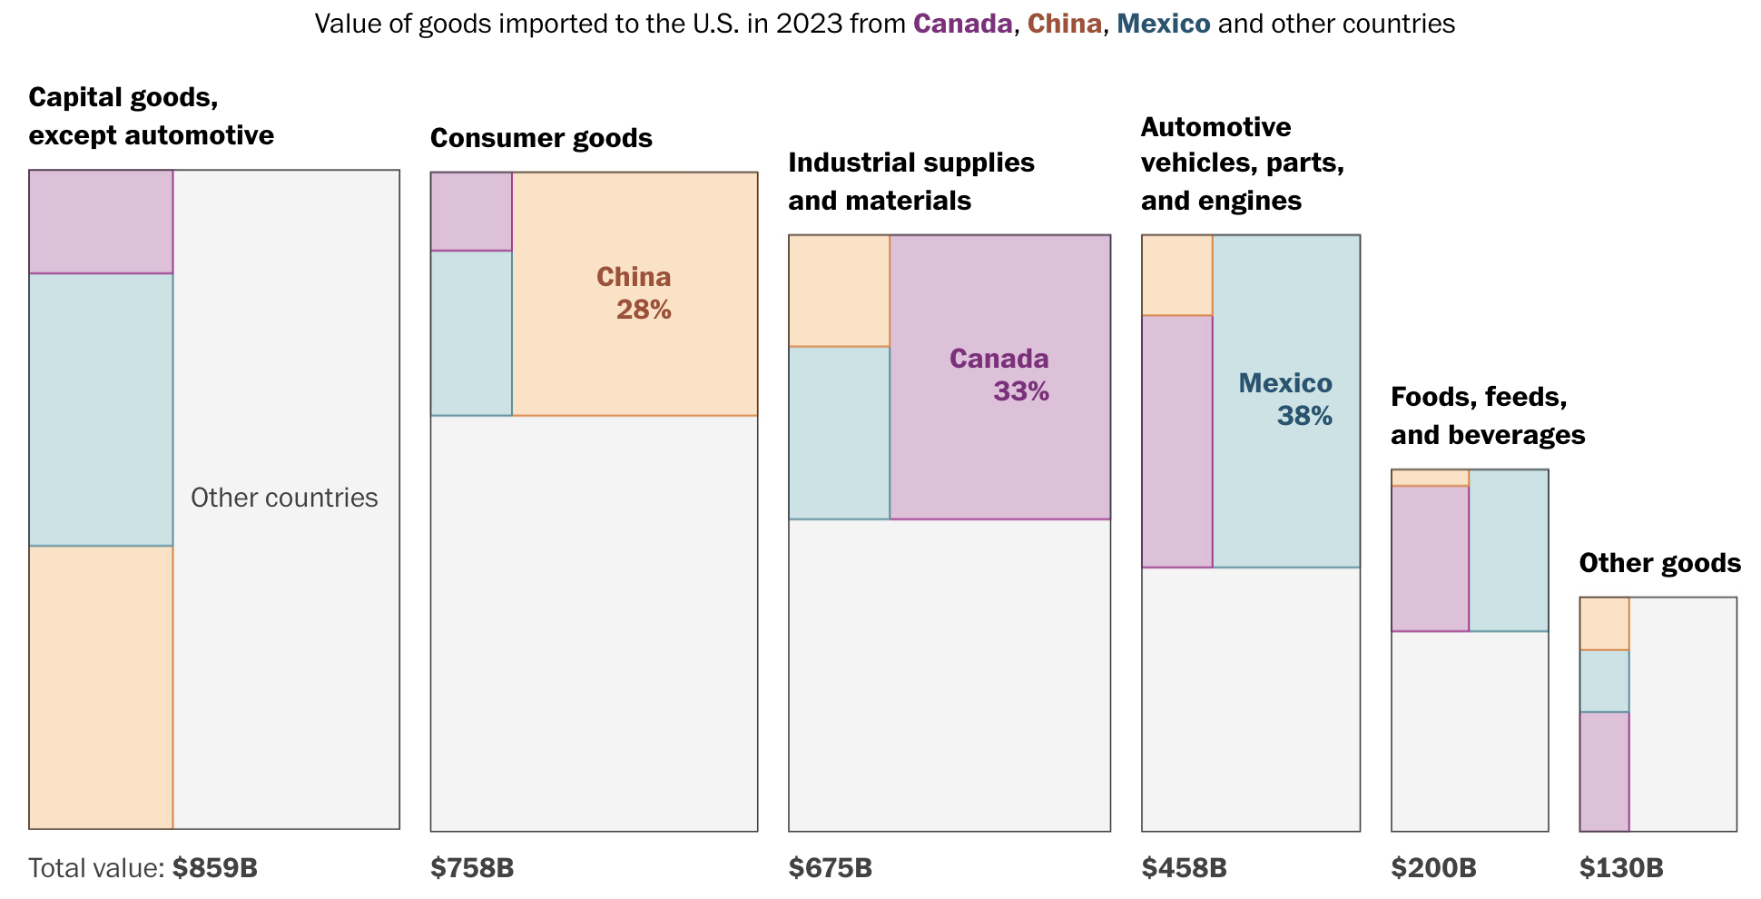
Notes:
Luis Melgar and Rachel Lerman, “See which products Trump’s tariffs could make more expensive,” Washington Post, December 5, 2024.
https://www.washingtonpost.com/business/2024/12/05/trump-china-mexico-canada-tariffs-prices/?utm_campaign=wp_evening_edition&utm_medium=email&utm_source=newsletter&carta-url=https%3A%2F%2Fs2.washingtonpost.com%2Fcar-ln-tr%2F3fd6330%2F67522261e179af1b45e73c5e%2F597273baade4e21a847d94bd%2F27%2F50%2F67522261e179af1b45e73c5e

Slide 48
Summary
Immigration: deportations tax the economy and are expensive.
  Many, many ag workers are unauthorized immigrants.
Tariffs: are a tax.
  Taxes raise prices. Period. Full Stop.

Slide 49
Thank you!
Any Questions?
www.NEEDEcon.org
Jon D. Haveman, Ph.D.
Jon@NEEDEcon.org
Contact NEED: info@needecon.org
Submit a testimonial: www.NEEDEcon.org/testimonials.php
Become a Friend of NEED: www.NEEDEcon.org/friend.php

Slide 50
Effects of a tariff
The rise in price in the importing country causes
  A rise in price of competing goods produced there
  Benefits to those producers
  Harm to buyers of both the import and the competing goods
    Including producers that use the higher-priced goods as inputs
      Their prices also rise, hurting their buyers
  Employment changes:
    Increase in the protected industry
    Decrease in industries that use the protected product as inputs
  Example: Trump’s 25% tariff on steel
    Helped US steel firms and their workers
    Hurt US auto firms and workers
      and many other industries that use steel
    Study found it cost more jobs lost outside steel than gained inside

Slide 51
Effects of a tariff
Economists’ cost-benefit analysis quantifies these and shows that
  Unless there are market distortions, the costs of a tariff always exceed the benefits
  Even when distortions give potential for tariff to be net beneficial
    It is just as likely to be net harmful
    And there does exist another policy, not a tariff, that would be better
  But
    Costs of tariffs are spread over many buyers, and are small for each
    Benefits of tariffs are concentrated for domestic producers and are large for each
    That’s often why we
      Get tariffs
      Find them very hard to remove

Slide 52
Effects of a tariff
Politics of tariffs
  Political forces favor tariffs
  Tariffs were reduced during 1934-1995 only by slow reciprocal negotiation among countries

Slide 53
Effects of a tariff
If a tariff is on exports of only one country (e.g., China), then
  Some imports shift to another country
  Price rises by less, to that other country’s higher cost
  Example: See next slide for Christmas Lights

Slide 54
Effects of a tariff
Do tariffs reduce a trade deficit?
  Trump thinks so, but the US deficit grew under him (see above)
  A trade deficit equals Expenditure minus Income
  There is no reason for tariffs to reduce expenditure
  And unless in a recession, also no reason for tariffs to raise income
  So NO!

Slide 55
Effects of a tariff
Government revenue
  Could Trump’s proposed tariffs replace the US income tax?
  NO!
  If imports did not fall (they would!), his tariffs would have collected in 2023:
    60% on US goods imports from China, 0.6✕$0.43tr = $0.26tr
    20% on US goods imports from non-China, 0.2✕$3.40tr = $0.68tr
    Total: $0.94tr
  US federal income tax revenue in 2023 was $2.18tr
  So his tariffs would collect AT MOST less than half of the income tax

