Slide 1
Osher Lifelong Learning Institute, Summer 2021
Contemporary Economic Policy
Summer, 2021, San Francisco State University
Jon Haveman, Ph.D.
National Economic Education Delegation

Slide 2
Course Outline
Contemporary Economic Policy
  Week 1 (6/8): US Economy & Coronavirus Economics
  Week 2 (6/15): Climate Change Economics (Jennifer Alix-Garcia, Oregon St.)
  Week 3 (6/22): Health Economics (Veronika Dolar, SUNY)
  Week 4 (6/29): Economic Inequality
  Week 5 (7/6): The Black-White Wealth Gap
  Week 6 (7/20): Autonomous Vehicles

Slide 3


Economic Inequality

Slide 4
Credits and Disclaimer
This slide deck was authored by:
  Jon Haveman, Executive Director of NEED
This slide deck was reviewed by:
  Timothy Smeeding, University of Wisconsin
  Robert Wright, Augustana University
Disclaimer
  NEED presentations are designed to be nonpartisan
  It is, however, inevitable that the presenter will be asked for and will provide their own views
  Such views are those of the presenter and not necessarily those of the National Economic Education Delegation (NEED)

Slide 5
Outline
Definition
Measurement
How does it happen?
Does it matter?
Is it a problem?
What to do about it

Slide 6

Economic Inequality: Income
Definition:
  The extent to which the distribution of income deviates from complete equality
  The dispersion of income throughout the economy

Slide 7
Different Ways of Thinking About Inequality
Income Inequality
  Before taxes and transfers
  After taxes and transfers
Wealth Inequality
Consumption Inequality

Slide 8
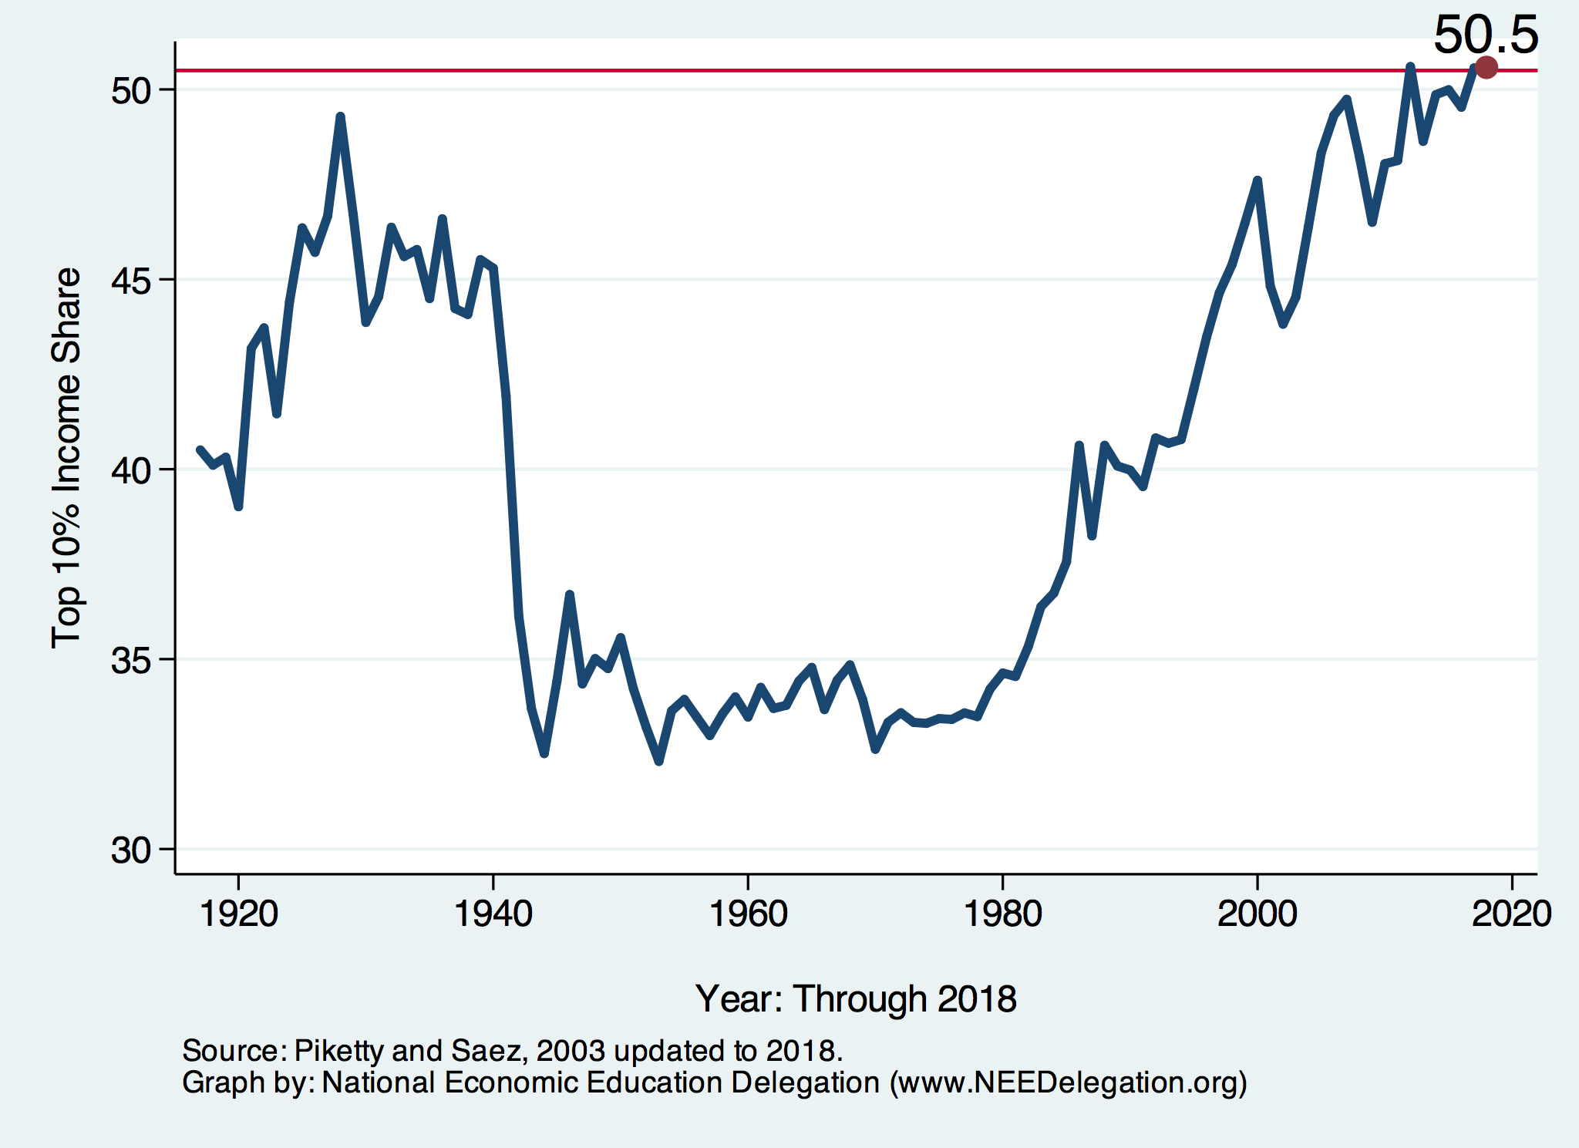
National Income Inequality: Share of Top 10%
Stock Market Crash
WWII
Housing Bubble
Dot-com Bubble

Slide 9
Recent Facts on Income Inequality
Beginning in the 1970s, the income gap widened.
  Income growth in the middle and lower parts of the distribution slowed.
  Incomes at the top continued to grow strongly.
  Income shares at the very top of the distribution rose to levels last seen more than 80 years ago.
Source: Chad Stone, Danilo Trisi, Arloc Sherman, and Roderick Taylor, “A Guide to Statistics on Historical Trends in Income Inequality,”
Center on Budget and Policy Priorities, Policy Futures, May 15, 2018.

Slide 10

The Abrupt Increase in Inequality
Source: Chad Stone, Danilo Trisi, Arloc Sherman, and Roderick Taylor, “A Guide to Statistics on Historical Trends in Income Inequality,”
Center on Budget and Policy Priorities, Policy Futures, Dec. 11, 2018.
Notes:
Slide taken from page 10, Chad Stone, Danilo Trisi, Arloc Sherman, and Roderick Taylor, “A Guide to Statistics on Historical Trends in Income Inequality,” May 15, 2018

Slide 11

Most of the Action Is at the Top: PRE-Tax
Projected 2021
CBO: Projected Changes in the Distribution of Household Income, 2016 to 2021

Slide 12
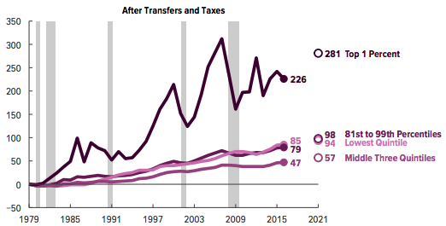
Most of the Action Is at the Top: POST-Tax
Projected
CBO: Projected Changes in the Distribution of Household Income, 2016 to 2021

Slide 13
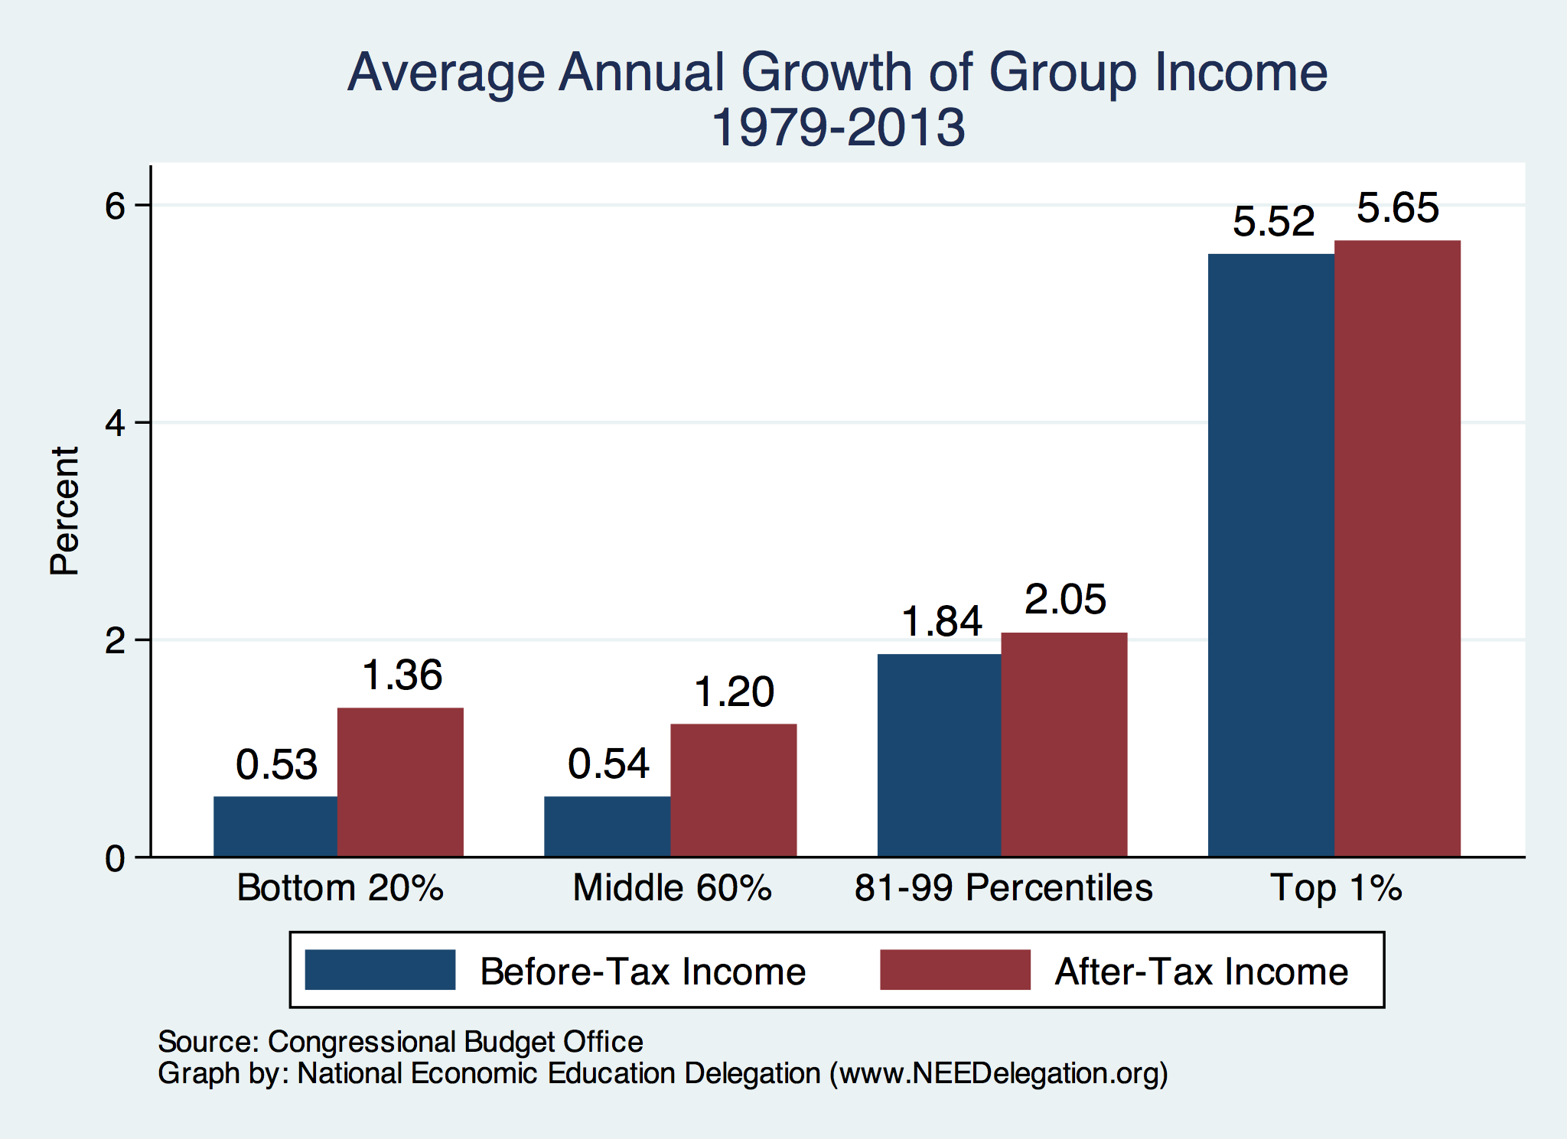
Growth Has Been Primarily at the Very Top

Slide 14
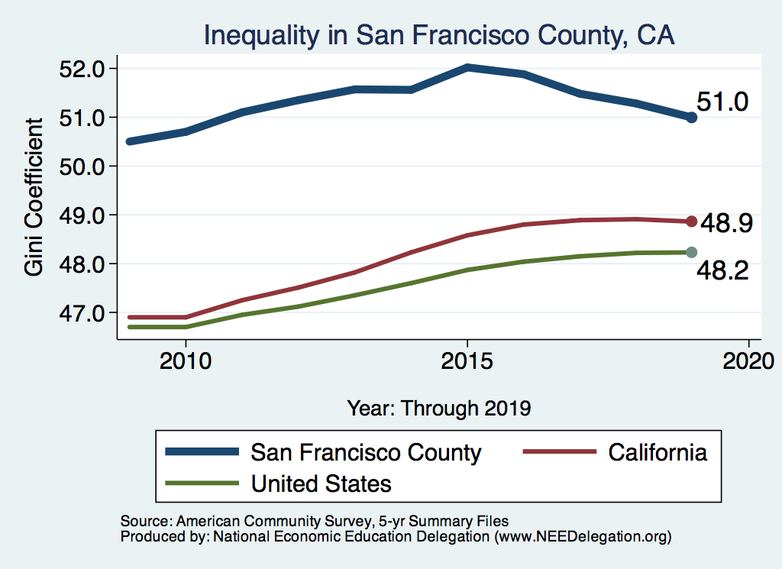
Measuring Inequality: The Gini Coefficient

Slide 15
Measuring Inequality: The Gini Coefficient
100%
A
Gini =
x 100
A + B
% of
All Income
50%
Equality (45 degrees)
A
Bigger A: More inequality
Smaller A: Less inequality
Inequality
B
Extreme
50%
100%
% of Population

Slide 16
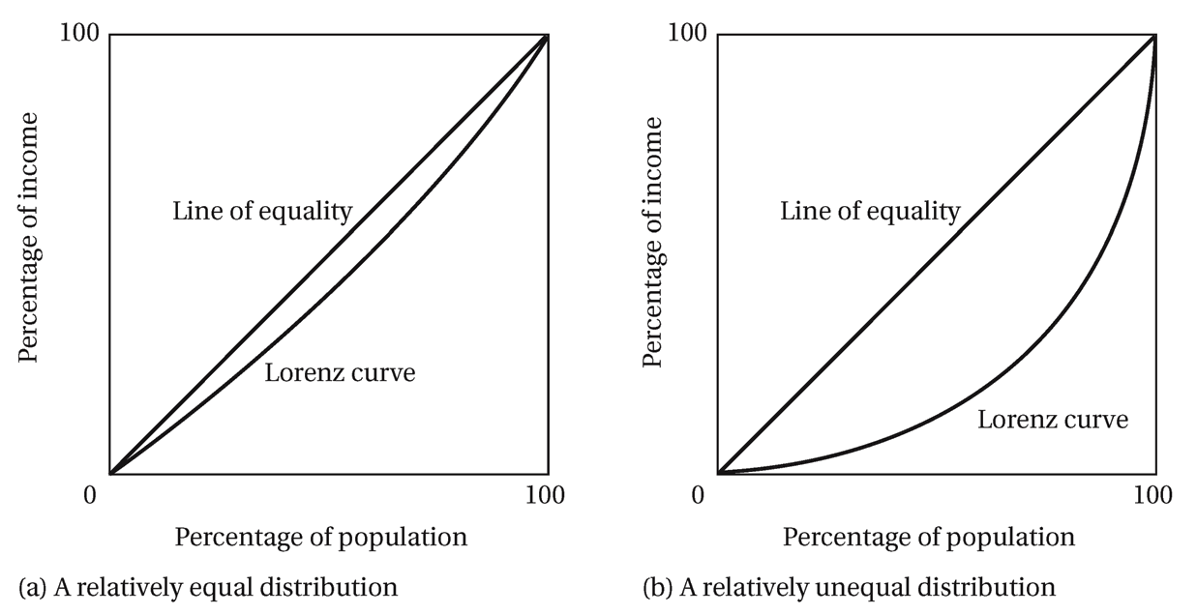
Equal, Unequal, & the Gini
Small Gini
Big Gini

Slide 17
Forming the GINI Coefficient: 2015
Quintile Shares of Income
CUMULATIVE Quintile Shares of Income
Income Quintiles
Income Quintiles
Source: 2015 1-year American Community Survey, based on pre-tax household income.

Slide 18
Income Share Changes Between 1970 and 2017
1970
2017
Share of All Income
% of Population
Income Quintiles
Source: U.S. Census Bureau, Current Population Survey, Annual Social and Economic Supplements.

Slide 19
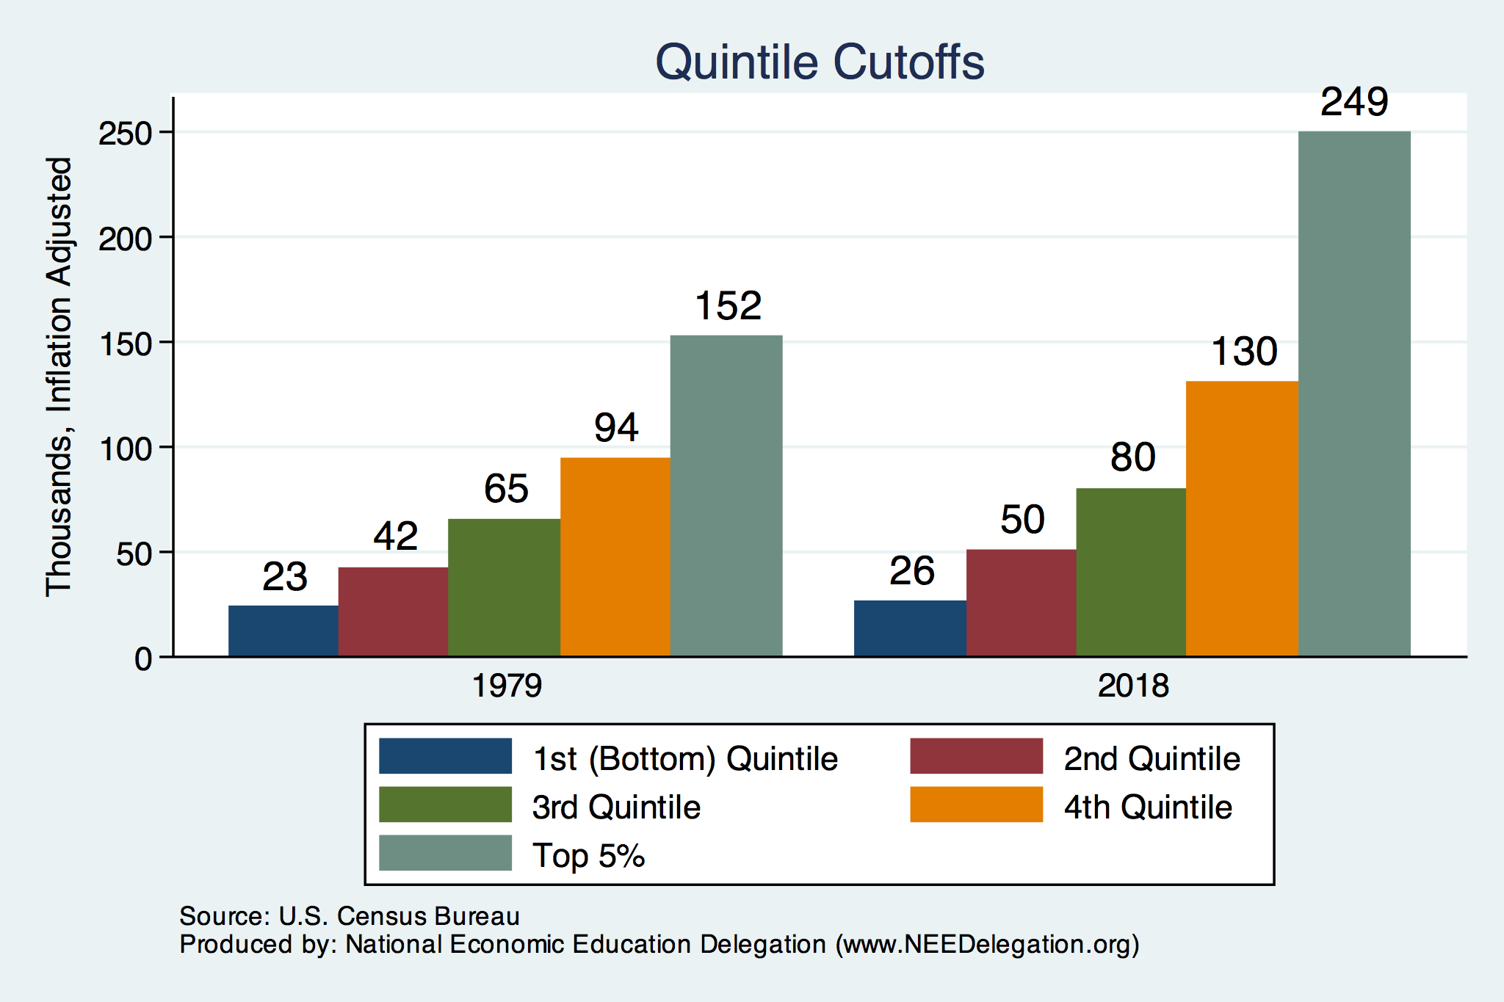
Quintile Income Cutoffs
Top 5%

Slide 20
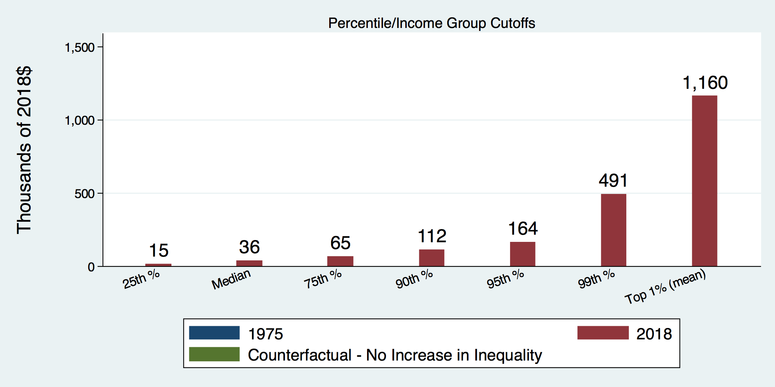
How Has Inequality Influenced Incomes?

Slide 21
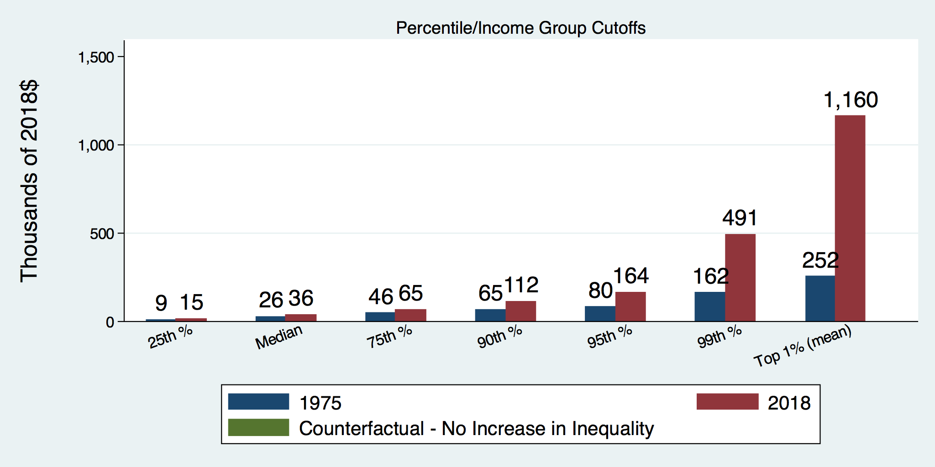
How Has Inequality Influenced Incomes?

Slide 22
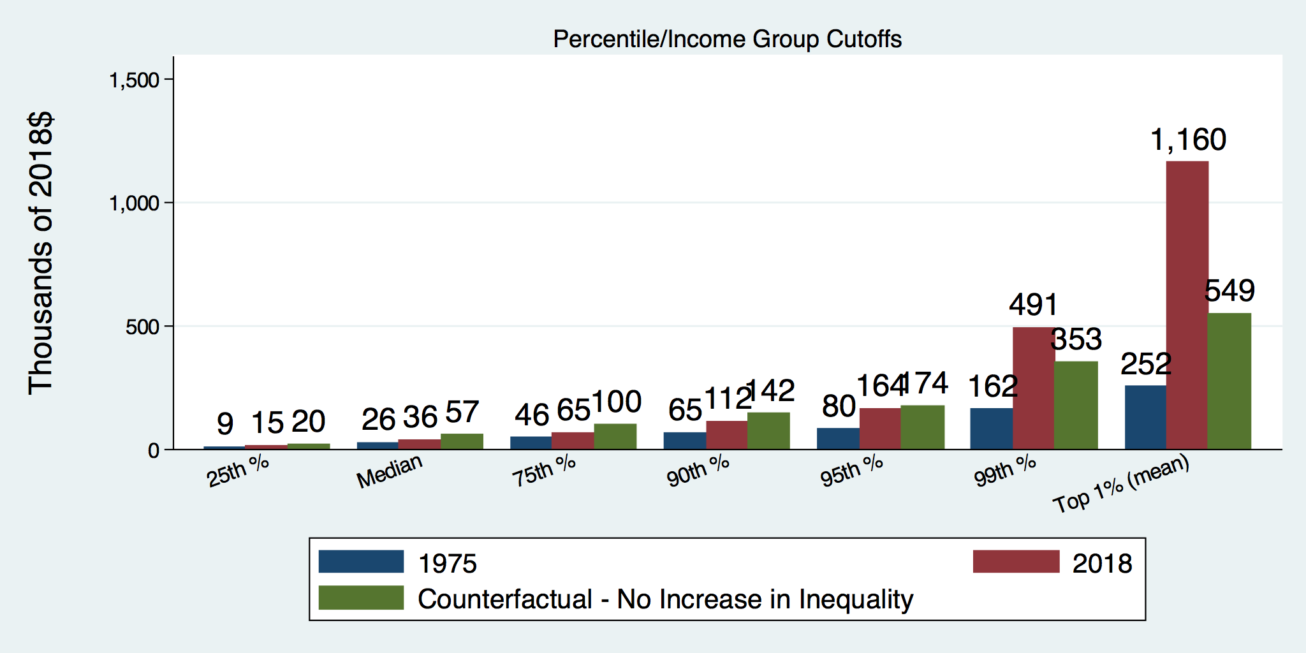
How Has Inequality Influenced Incomes?

Slide 23
Income Changes from Growing Inequality
Bottom 90%
of Households

Slide 24
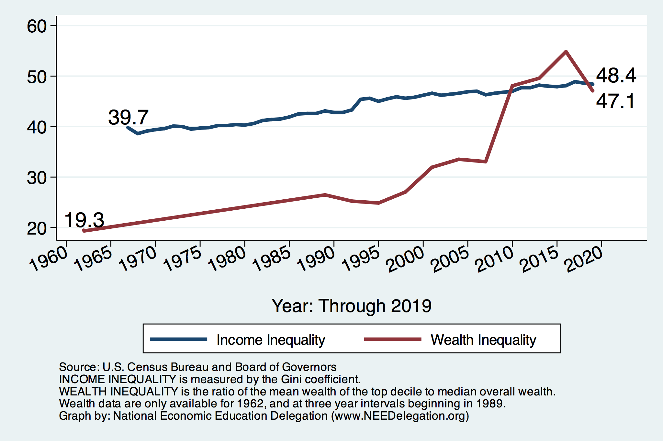
Income and Wealth Inequality
Income Inequality (Gini)
US: 48.4%
CA: 48.9%
San Francisco: 51.0%

Slide 25
Wealth Inequality Exceeds Income Inequality
Source: Chad Stone, Danilo Trisi, Arloc Sherman, and Roderick Taylor, “A Guide to Statistics on Historical Trends in Income Inequality,”
Center on Budget and Policy Priorities, Policy Futures, Dec. 11, 2018.

Slide 26

Evidence of the Gap
Mean is
7x Greater
Median is 8x Greater

Slide 27

Wealth is More and More Concentrated
99th Percentile
2016 = 7x 1963
Source: Urban Institute

Slide 28
Where Does Inequality Come From?
Labor Characteristics
  Demographics
    Age distribution
  Personal Choices
    Educational attainment
    Effort
    Priorities
    Household composition
  Immigration
Market Forces
  Technology
  Changing demand patterns
  Competition for labor
Government Policy
  Market influence
  Redistribution

Slide 29
Government Policy and Inequality
Market Influence: PRE-distribution
  Characteristics of labor
    Access to education
  Effects on labor demand
    Market regulation
      Competition policy
    Labor regulations
      Minimum wage, overtime, health insurance, etc.
RE-distribution
  Tax Rates
  Income support
    Direct aid
    Food stamps

Slide 30
Tax and Transfer Programs and Inequality
2014
Source: U.S. Congressional Budget Office, “The Distribution of Household Income, 2014”, Average Income Before and After Means-Tested Transfers and
Federal Taxes, by Income Group, 2014.

Slide 31
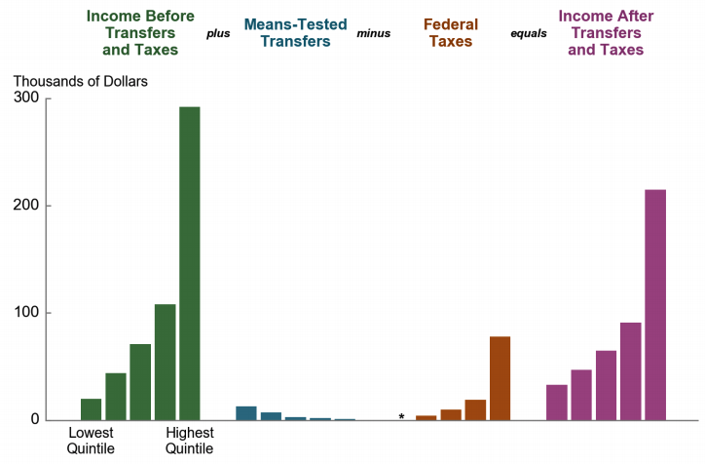
Taxes, Transfers, and Income: 2017
Source: U.S. Congressional Budget Office, “The Distribution of Household Income, 2016”.

Slide 32
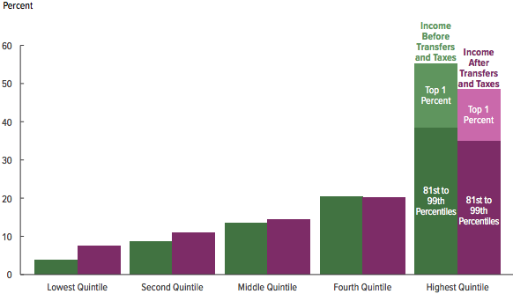
Tax and Transfer Programs: Income Shares
2017
Source: U.S. Congressional Budget Office, “The Distribution of Household Income, 2016”, Average Income Before and After Means-Tested Transfers and
Federal Taxes, by Income Group, 2016.

Slide 33
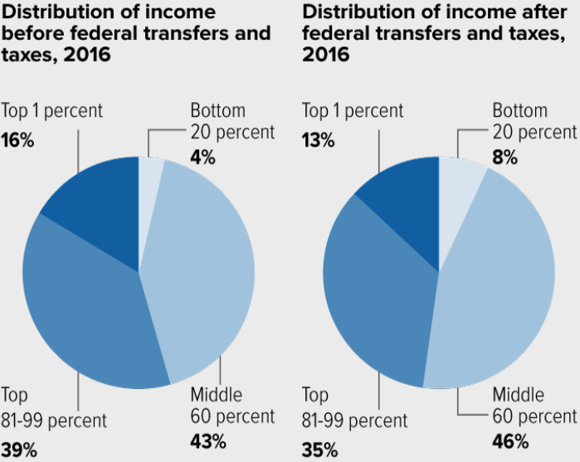
Tax and Transfer Programs: Income Shares

Slide 34
What About Tax Rates?
400 Taxpayers with highest incomes
1992-2007
+
392%
1992-2014
Average
Tax Rate
+310%
Average
Income
-12%
-
37%
Source: IRS
Source: IRS, Statistics of Income Division, December 2016.

Slide 35
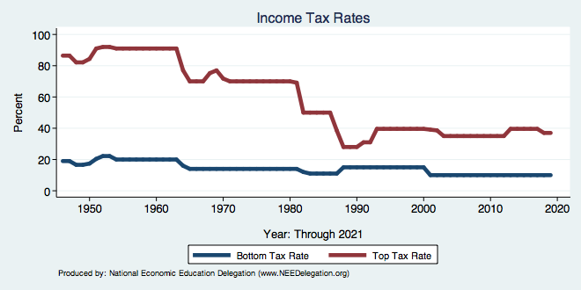
Tax Rates Over Time

Slide 36
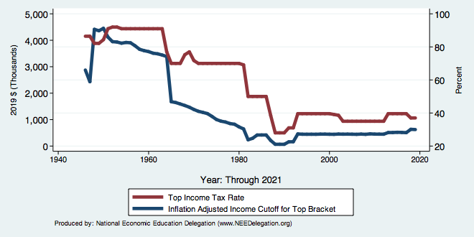
The Top Tax Rate and Income Cutoff

Slide 37

Dramatically Less Progressivity in the Tax Code
1961 to 2011
Source: New York Times, from Thomas Piketty, Emmanuel Saez and Gabriel Zucman, “
Distributional National Accounts: Methods and Estimates for the United States”

Slide 38
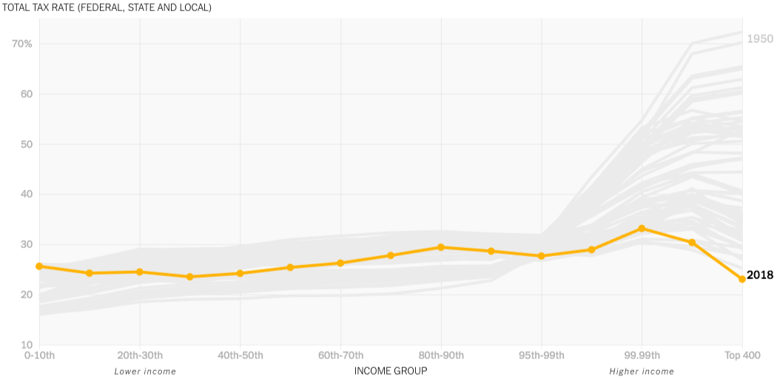
The Rich Really do Pay Lower Taxes
1950
Top 400
Lower Income
Higher Income

Slide 39
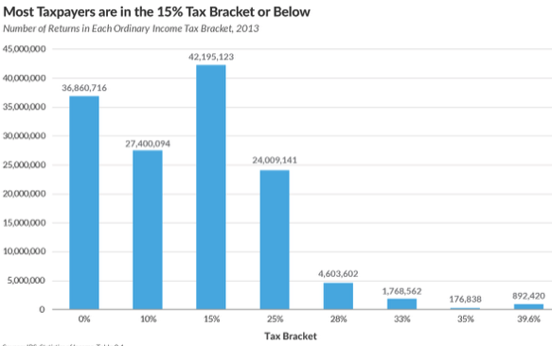
Households by Tax Rate

Slide 40
Market Forces and Inequality
Changing demand patterns
  Technology
  Globalization
  Industry composition
    PCs instead of typewriters
    Services instead of goods
    Professional services instead of personal services
Competition in labor markets
  Unionization
  Market concentration

Slide 41
Where Does Inequality Come From? Summary
Labor characteristics
  What do workers bring to the market?
Market forces
  How does the market value the labor characteristics?
Government policies
  PRE-distribution – affecting markets
  Redistribution – affecting incomes

Slide 42

Labor Income is Unhinged from Productivity
Why?
Declining unionization
Globalization
Immigration
Competition policy
Cheap technology

Slide 43

Declining Unionization
Unionization Rates
1983: 20.1%
2020: 10.8%
Unionization Rates
Public: 34.8%
Private: 6.3%
Source: https://inequality.org/facts/income-inequality/, Bureau of Labor Statistics and Emmanueul Saez, University of Califonria, Berkeley
Notes:
https://voxeu.org/article/forms-and-sources-inequality-united-states

Slide 44

Growing Revenue Concentration
Source: The Hamilton Project, Brookings: The State of Compention and dynamism.

Slide 45
Competition in the Economy
Return on invested capital excluding goodwill –
US publicly-traded nonfinancial firms, 1965-2014
Source: Jason Furman, ”Forms and sources of inequality in the United States”, VOX, March 17, 2016, Figure 6.
Notes:
Note: The return on invested capital definition is based on Koller et al (2015), and the data presented here are updated and augmented versions of the figures presented in Chapter 6 of that volume. The McKinsey data includes McKinsey analysis of Standard & Poor’s data and exclude financial firms from the analysis because of the practical complexities of computing returns on invested capital for such firms. ​
Source: Koller et al. (2015); McKinsey & Company; Furman and Orszag (2015). , by way of https://voxeu.org/article/forms-and-sources-inequality-united-states
Furman, J and P Orszag (2015), “A Firm-Level Perspective on the Role of Rents in the Rise in Inequality”, Presentation at “A Just Society” Centennial Event in Honor of Joseph Stiglitz Columbia University, October 16, 2015.

Slide 46

CEO Pay Has Been Growing Rapidly

Slide 47

CEO Pay Has Been Growing Rapidly

Slide 48
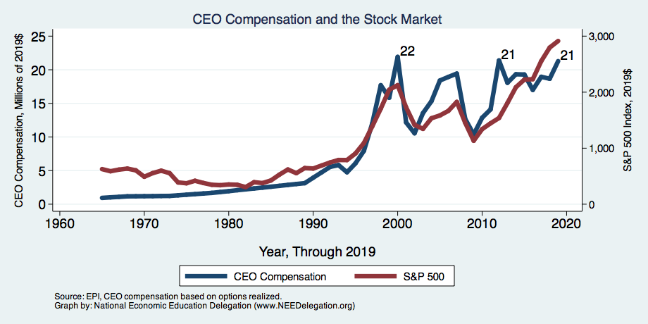
CEO Compensation – Tied to Stock Prices

Slide 49
Immigration and Inequality
Source: Ping Xu, James C. Garand, and Ling Zhu, “How immigration makes income inequality worse in the U.S.”, October, 2015, Figure 1.

Slide 50
Immigration and Inequality- Summary
Beginning in about 1970, the immigrant share of the U.S.
Population increased dramatically.
  5% in 1970 and 14% in 2016
Immigration tends to happen most often among:
  Low-skilled low-wage workers
  High-skilled high-wage workers
Immigration has likely increased income inequality.
Its effect has likely been small.
  ~5% between 1980 and 2000
  No reason to think it has been bigger since

Slide 51
Technological Change and Inequality
Much of the technology adopted in the last 30 years has eliminated low-skill or low-wage jobs.
  Computers, advanced manufacturing equipment, steel mini-mills, automation
There is a “winner take all” aspect of the technology-driven economy.
  This likely favors a small group of individuals.
Both aspects increase inequality by increasing the rewards to:
  Those with significant labor market skills.
  Owners over workers

Slide 52
Technology Benefits Ownership over Labor

Slide 53


Technology can Hurt Low Income Workers
Early on, technology was good to low income workers
Until it was bad for them….

Slide 54
A Modern Example: Uber & Lyft
Technology:
  Facilitates market power for owners.
  Reduces bargaining power for labor.
  Shifts costs of doing business onto labor.
Modern day Robber Barons?
  Ruthlessly absorbing as much income as they can.
  Lack of regard for labor.

Slide 55
Globalization
What is globalization?
  Flow of goods, services, capital, and labor across international borders
How does it affect inequality?
  Through a differential impact on low-skilled workers and hence their wages
  For the United States, globalization is thought to lower the wages of low skilled and hence low-wage workers relative to those of high-skilled workers

Slide 56
Mechanisms for the Effects of Globalization
Merchandise trade
  Importing goods that are made with low-skilled workers and exporting goods that are made with high-skilled workers
    Lowers the wages of unskilled relative to skilled
      making the distribution of income less equal
Outsourcing
  Similar channel as with merchandise trade
Trade in services
  US imports of middle-skill services: business and some professional services
Intuitively: The same as if we were to move the actual workers.

Slide 57
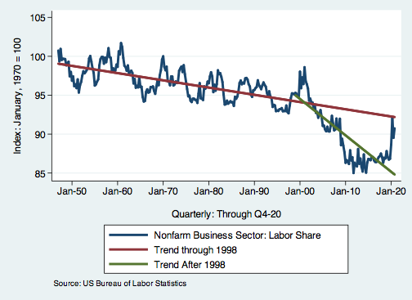
Effects of the Unhinging?
Labor’s Share of Income
1960: 66%
2011: 56%
2016: 58%
Source: Bureau of Labor Statistics

Slide 58
What is driving increasing inequality?
Primary drivers:
  Technology
  Globalization
  Institutions
These drivers can also influence personal choices in ways that affect measured income inequality.
  For example, educational choices or labor force participation

Slide 59
Sources of Inequality Through Late 1990s

Slide 60

Why Does Inequality Matter?
Too little inequality can:
  Reduce individual motivation
  Slow economic growth
Too much inequality can:
  Reduce individual motivation
  Slow economic growth
Too much inequality may also:
  Divide society
  Distort political environment
  Reduce political participation
  Reduce investments in public goods
    Education
    Environmental protections

Slide 61
How Much Inequality Is too Much?
?
?
Equity
Efficiency
Efficiency
Equity
Efficiency
Equity
0
100
Z’’
Z
Z’
X
Gini Coefficient

Slide 62
An International Perspective
Source: Data taken from the 2014 CIA World Factbook.

Slide 63
An International Perspective: Comparables
U.S.: 17-18
Canada, UK, Germany: 12-13
Italy, France, Japan: 7-9

Slide 64
Addressing Inequality: Is It A Problem?
Why it might be a problem.
  Economic issues (Efficiency)
    There is evidence that at some level, increased inequality slows economic growth.
    Or, inequality concentrates resources among investors.
  Noneconomic issues (Equity)
    Values, ethics and morals will drive individual evaluations of the level of inequality.
      E.g., inequality is primarily a function of market outcomes, so should be left alone.
      Or, a solid middle class is important for maintaining a civil society, which runs contrary to a high degree of inequality.
Suppose you think it’s a problem. How might it be addressed?

Slide 65

Addressing Inequality:
Immediately Available Policy Solutions (1/2)
RE-distribution
  Tax and transfer programs
PRE-distribution
  Strengthen labor unions
  Collective bargaining
  Other policies that favor labor over business owners
  Minimum wages

Slide 66
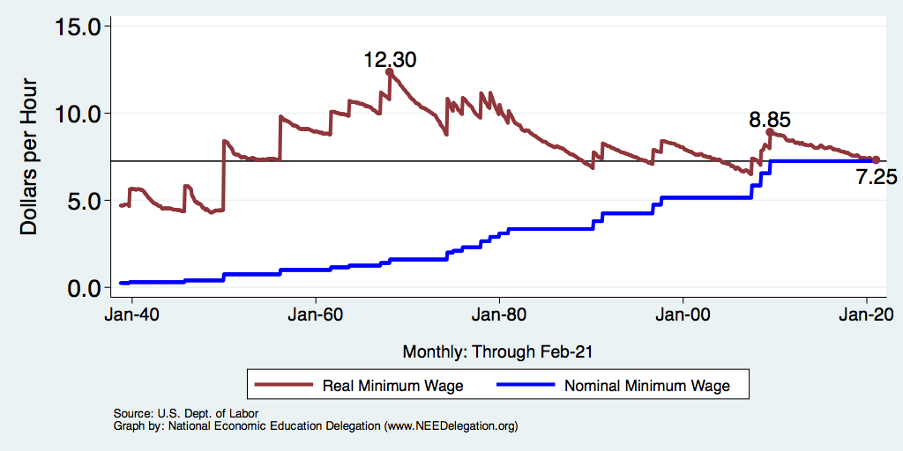
Historical Values of Minimum Wages

Slide 67
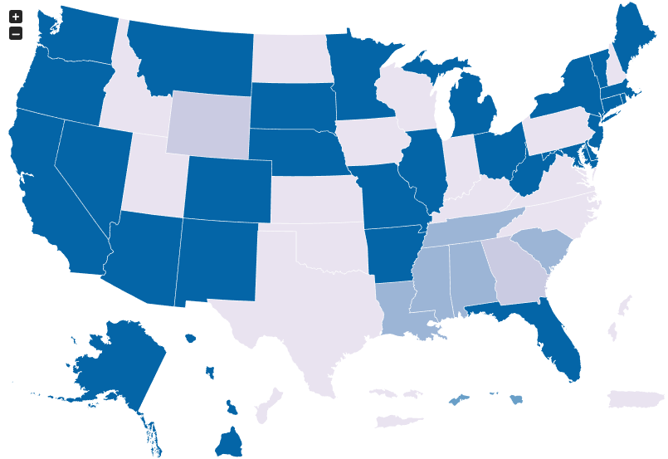
Many States Have A Higher Min Wage
NY: $12.50/hour
CA: $13/hour
States with Higher
Minimum Wage
than Federal
As of Jan 1, 2021
Source: U.S. Department of Labor

Slide 68
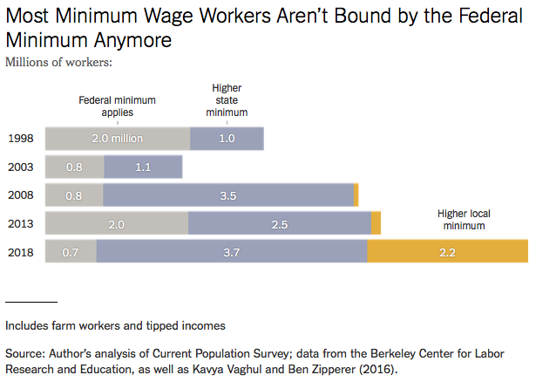
Notes:
https://www.nytimes.com/2019/04/24/upshot/why-america-may-already-have-its-highest-minimum-wage.html?action=click&module=RelatedLinks&pgtype=Article

Slide 69
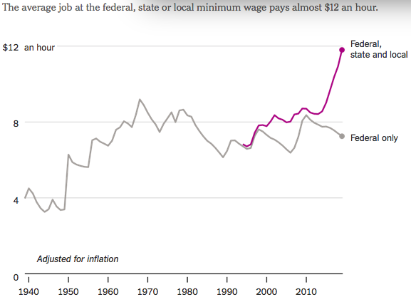
States and Local Gov’ts are Raising Min Wages
Source: NY Times - Americans Are Seeing Highest
Minimum Wage in History (Without Federal Help)
Notes:
https://www.nytimes.com/2019/04/24/upshot/why-america-may-already-have-its-highest-minimum-wage.html?action=click&module=RelatedLinks&pgtype=Article

Slide 70
Addressing Inequality:
Immediately Available Policy Solutions (2/2)
Other
  Reverse trends in market power.
Locally
  Employment services: job training, interview skills, or assistance with day-to-day issues, such as child care.
  Cognizance of the potential for technologies to affect worker/employer power dynamics.
    Uber, Lyft, etc.
Notes:
Reference your own experience at FTC

Slide 71
Addressing Inequality:
Long Term
It’s all about access to resources:
  Education, in particular.
    Improve public education.
    Reduce disparities in quality of public education.
    Improve counseling in low-income schools.
      With respect to college – paths to success and funding.
  Investments are needed in early education, not later.
    Universal pre-K.
    Upgrade quality of elementary schools in low-income areas.

Slide 72

What to do About Inequality?
Nothing?
Redistribution?
PRE-distribution?
Access to resources?

Slide 73
Tension in Policy Solutions
Is it possible to increase growth at the same time that you reduce income inequality?
  Common refrain among some that government intervention in the economy is always and everywhere bad for growth.
Possibly: expanding equality of access promotes the full utilization of resources.
  Expanding equality of access requires resources likely from the well-to-do.

Slide 74
Summary
Income inequality is clearly increasing.
  The economy is clearly favoring owners of productive resources over labor.
The causes appear to be largely driven by:
  The market – technology, competition, and trade
  Changing institutions.
Open questions are:
  To act or not to act?
  If so, how?
The level of inequality is a policy choice.

Slide 75
Inequality and the Pandemic

Slide 76
Coronavirus and Inequality
Primarily low wage jobs are at risk
Racial inequities
Telecommuting
Resources to weather the storm
Educational inequities

Slide 77
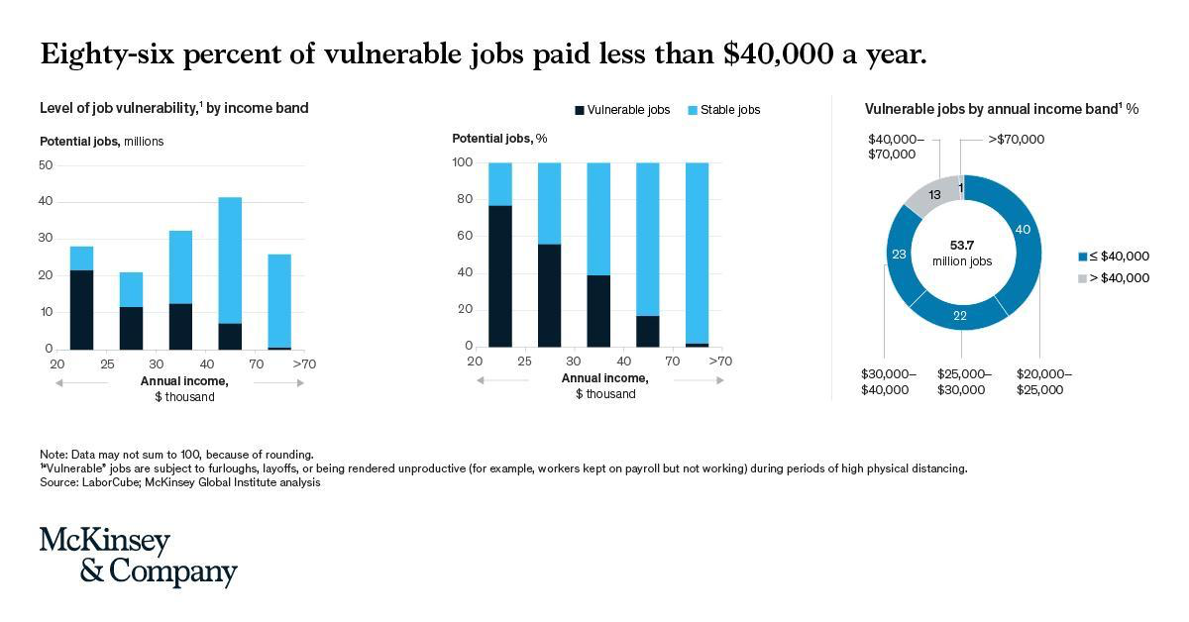

Slide 78
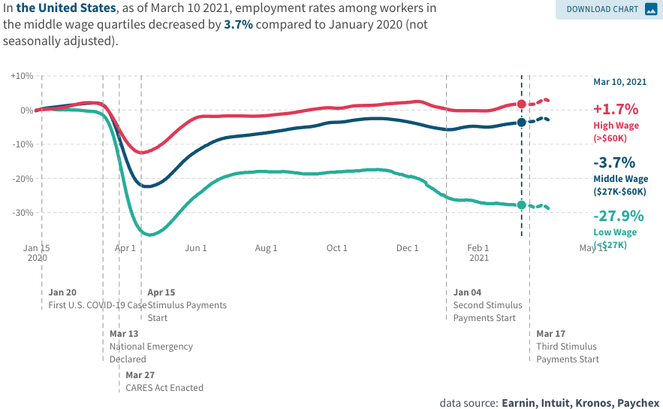
Low Wage Employment is Lagging

Slide 79
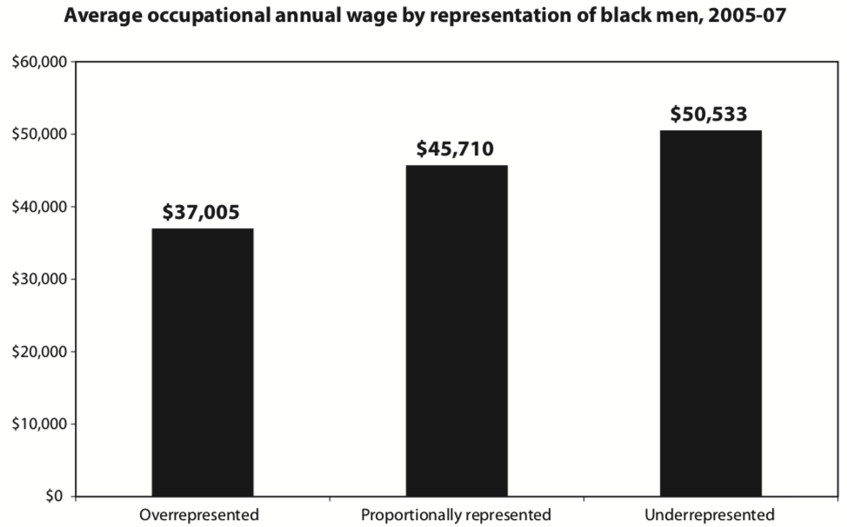
Overrepresented Where Wages are Low
Source: Hamilton Darrick, Algernon Austin, and William Darity, Jr. Whiter Jobs, Higher Wages :Occupational Segregation and the Lower Wages of Black Men Economic Policy Institute, Briefing Paper #288 2011.

Slide 80
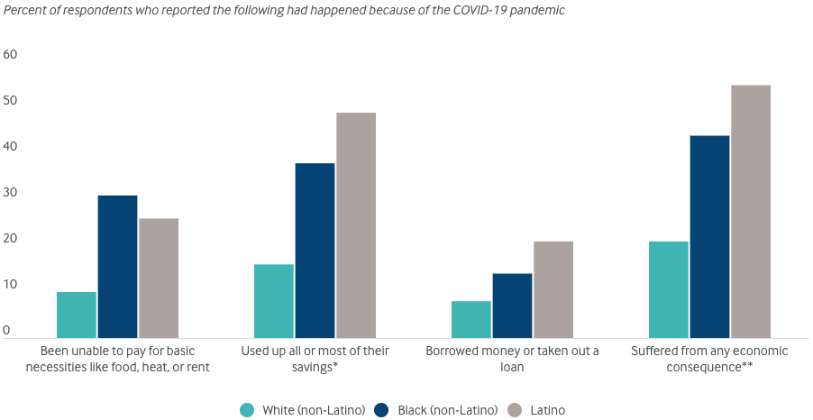
Economic Impacts by Race – May 25, 2020
Source: Commonwealthfund.org, Beyond Case Count Disparities…

Slide 81
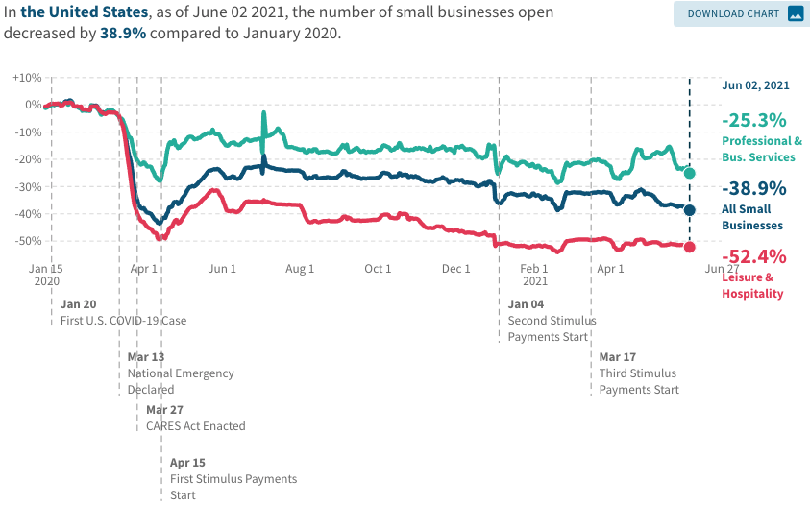
Small Businesses are Struggling
Many small business have closed (Temporary? Permanent?)
Source: https://tracktherecovery.org/

Slide 82
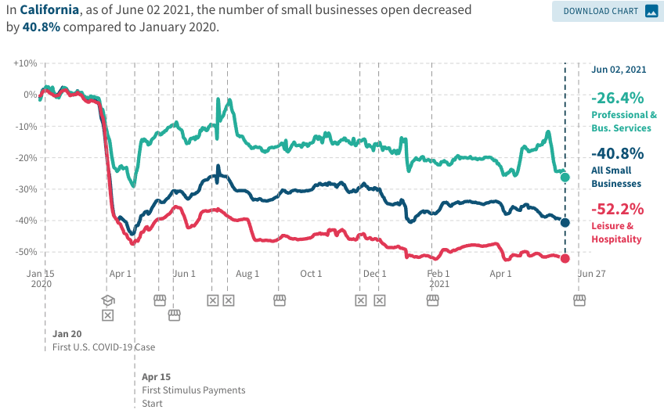
Small Businesses are Struggling
Many small business have closed (Temporary? Permanent?)
Source: https://tracktherecovery.org/

Slide 83
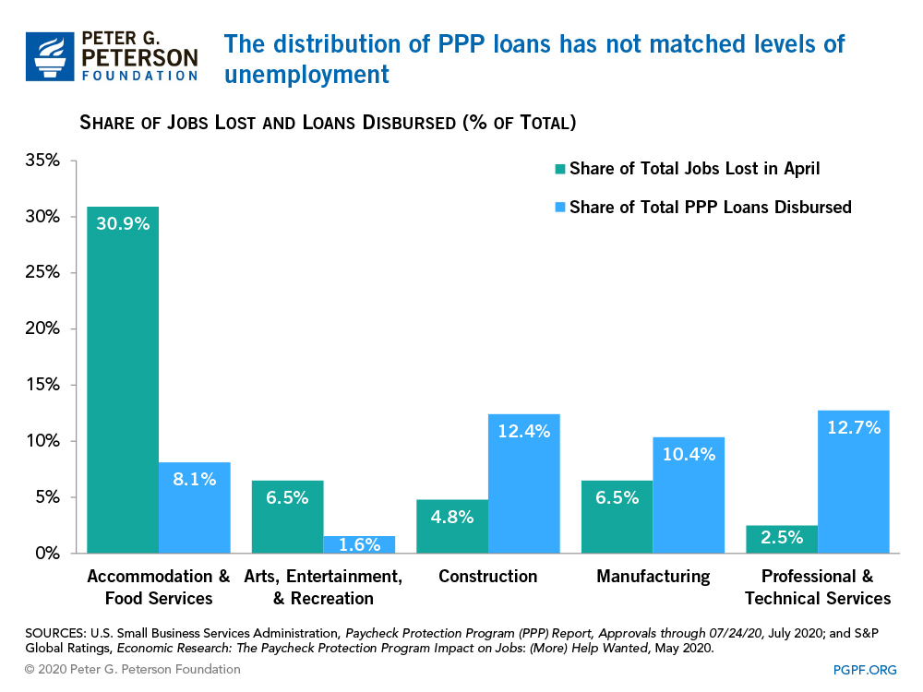
PPP Loans Didn’t Go to the Right Firms
In addition, first round loans went disproportionately to predominantly white Congressional Districts
Bloomberg, 7/30
Improvements to the program in the second stimulus bill

Slide 84
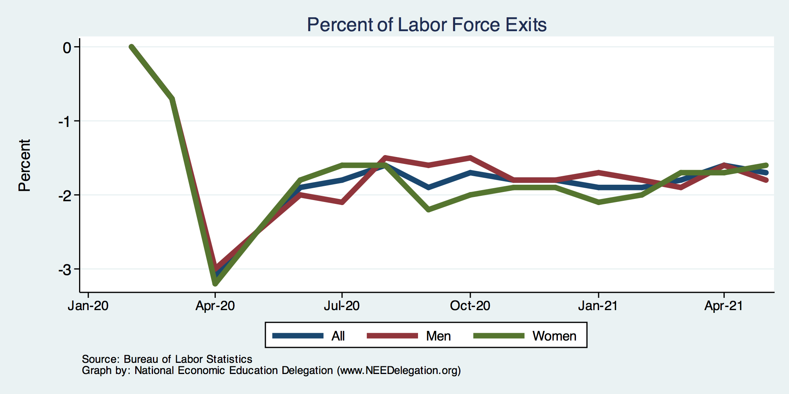
Affecting Women More Than Men
Women
Men
Long term implications for women?

Slide 85
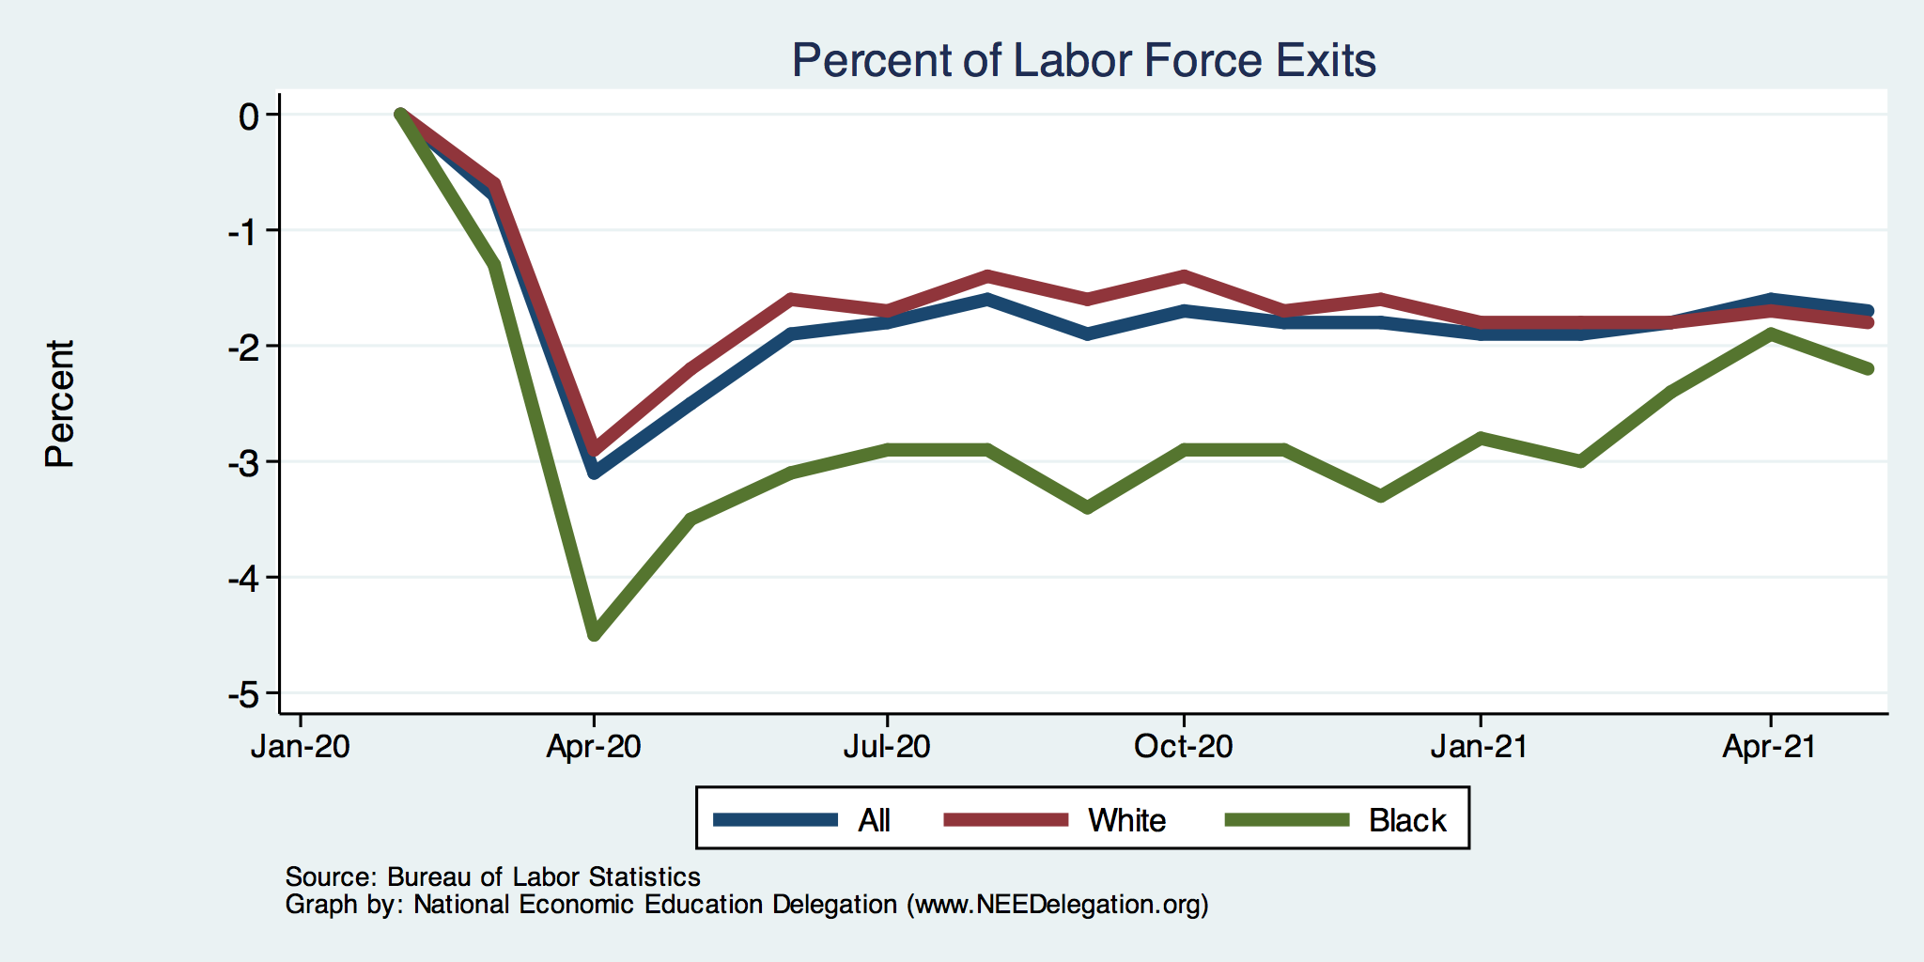
Affecting Black Workers More than White
White
Black

Slide 86
Financial Insecurity Before Coronavirus
40% of Americans don’t have the cash to pay for a $400 emergency expense
25% have no retirement or pension savings
Less than 60% can answer at least three basic financial literacy questions correctly.
1 in 5 of adults knows someone impacted by the opioid crisis.
About 25% of borrowers who attended a for-profit college are behind on student loan payments compared with about 10% who attended a public or private college
Source: The Federal Reserve, Survey of Household Economics and Decisionmaking,

Slide 87
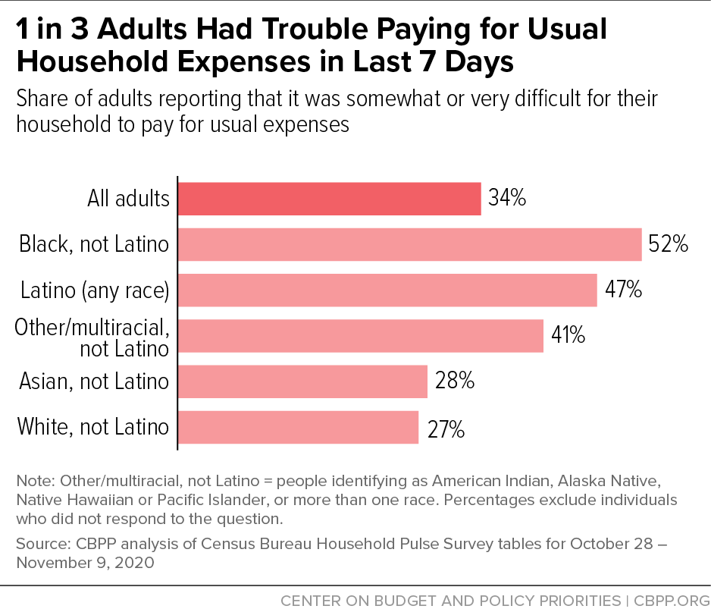
Low Income Troubles

Slide 88
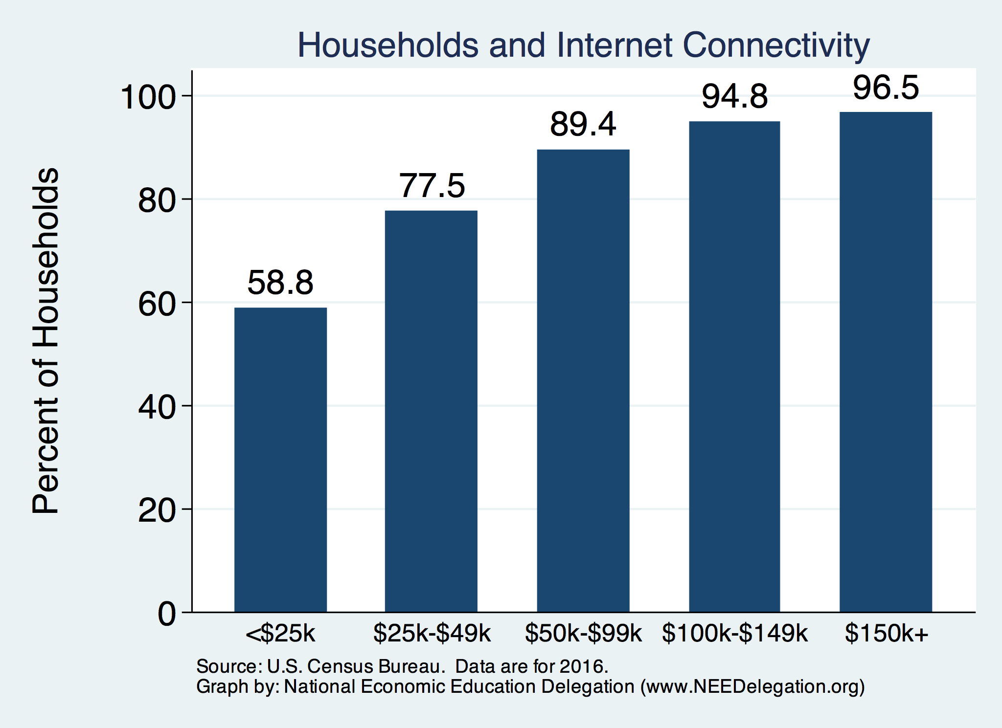
Home Schooling - Access to the Internet

Slide 89
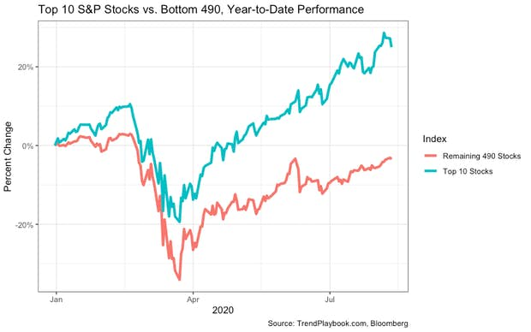
Recovery/Recession for Whom?
Top 10 S&P Stocks:
Apple
Microsoft
Amazon
Facebook
Alphabet Class A shares
Alphabet Class C shares
Berkshire Hathaway
Johnson & Johnson
Visa
Procter & Gamble

Slide 90
Rich Getting Richer
As of November 17, the combined wealth of 647 U.S. billionaires increased by almost $960 billion since mid-March, the beginning of the pandemic lockdown.
Since March, 2020, there are 33 new billionaires in the U.S.
Driving this exploding inequality are 12 companies whose profits are coming at the expense of workers and communities.
They include retailers like Walmart, Amazon, Target, and Dollar Tree and Dollar Store, gig economy companies like Instacart, and food producers like Tyson Foods and private equity firms like BlackRock.
Source: Inequality.org

Slide 91
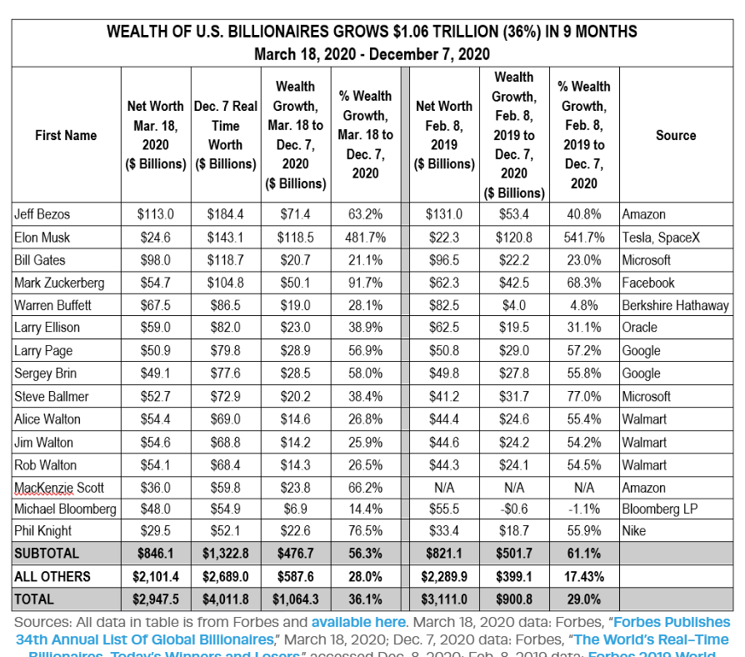
Gains by American Billionaires

Slide 92
Thank you!
Any Questions?
www.NEEDelegation.org
Jon D. Haveman
Jon@NEEDelegation.org
Contact NEED: info@NEEDelegation.org
Submit a testimonial: www.NEEDelegation.org/testimonials.php
Become a Friend of NEED: www.NEEDelegation.org/friend.php

