Slide 1
Inequality and Poverty
The US Housing Market:
Facts, Trends, and Policy Questions
Daniel Marcin, George Washington University
Dmitriy Stolyarov, University of Michigan
with contributions by
Fudong Zhang, Tsinghua University

Slide 2
National Economic Education Delegation
Vision
One day, the public discussion of policy issues will be grounded in an accurate perception of the underlying economic principles and data.
Mission
NEED unites the skills and knowledge of a vast network of professional economists to promote understanding of the economics of policy issues in the United States
NEED Presentations
Are nonpartisan and intended to reflect the consensus of the economics profession

Slide 3
Credits and Disclaimer
This slide deck was authored by:
Daniel Marcin, George Washington University
Dmitriy Stolyarov, University of Michigan
This slide deck was reviewed by:
Jon Haveman, PhD, NEED
Disclaimer
The views presented today are those of the presenter and not necessarily those of the National Economic Education Delegation (NEED)

Slide 4
Outline
COVID and housing
Home prices
Housing as a store of wealth
Housing as an Investment
Understanding home prices
Affordability
Government Regulation of Housing
Notes:
This talk has three parts. The first part presents facts that can be found in national-level, city level and household level data. We will discuss facts about home prices across cities and over time, looks at house values, home equity and homeownership rate by age, income and net worth group, discusses costs and benefits of homeownership with illustrative numerical examples.
In the second part, we discuss why house prices are so different across cities and why they outpace the cost of living. We will look at construction costs as a possible explanation and see whether construction of one dollar’s worth of single-family and multi-family housing requires increasingly more hours of labor.
We will also look at the correlation between housing permits issued and house prices. Building and zoning restrictions will emerge as a primary explanation for why house prices rise faster than the cost of living and why they are so different across cities. We will point out the concentration of political power with local homeowners as a driving force of a vicious cycle of escalating restrictions and rising prices.
In the last part of the talk, we will discuss the role of the federal and state governments in regulating the housing market, helping the needy with housing, promoting affordability through mortgage insurance and protecting from discrimination in housing.

Slide 5
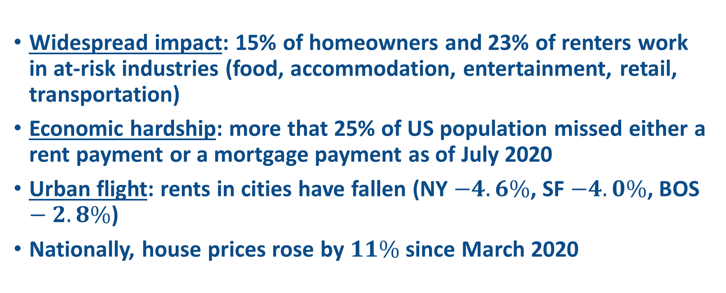
COVID and housing
Widespread impact: 15% of homeowners and 23% of renters work in at-risk industries (food, accommodation, entertainment, retail, transportation)
Economic hardship: more that 25% of US population missed either a rent payment or a mortgage payment as of July 2020
Urban flight: rents in cities have fallen (NY $−4.6\%$, SF $−4.0\%$, BOS $−2.8\%$)
Nationally, house prices rose by $11\%$ since March 2020
Notes:
https://www.usatoday.com/story/money/2020/07/23/missed-housing-payments-are-piling-up-in-nearly-every-state/41791933/
https://time.com/5851978/pandemic-plague-henry-viii/
https://www.usatoday.com/story/money/2020/09/28/rent-where-rents-rising-and-falling-most-big-cities/3519979001/

Slide 6
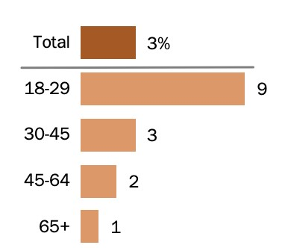
COVID and relocation
3% of population moved for COVID related reasons, mostly college students moving in with parents
Source: Pew Research Center, June 2020
Notes:
Six percent of households had someone move in with them. The share of 18-29 y.o. living with parents rose from 47% to 52% since 2019.
https://www.pewresearch.org/fact-tank/2020/07/06/about-a-fifth-of-u-s-adults-moved-due-to-covid-19-or-know-someone-who-did/

Slide 7
COVID and housing: policy response
120 day eviction moratorium (March-July), most recently extended, but no specific rent relief provisions
Borrowers with federally backed mortgages can receive 180 days of forbearance
Notes:
https://www.washingtonpost.com/dc-md-va/2020/12/19/covid-eviction-unemployment/

Slide 8
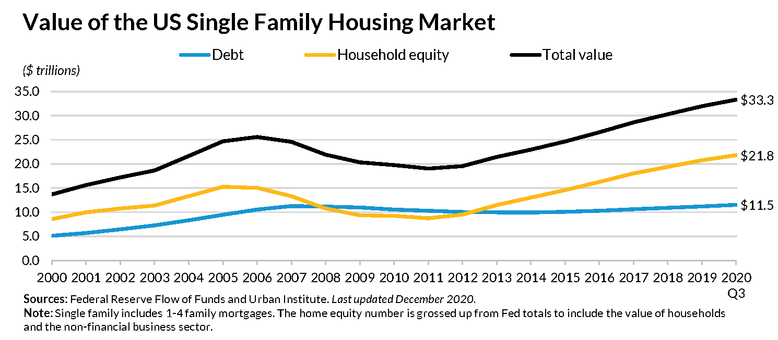
Total value of homes
Sources: Federal Reserve Board, BEA, FHFA
Notes:
https://www.urban.org/research/publication/housing-finance-glance-monthly-chartbook-december-2020/view/full_report
The value of owner-occupied housing (27 trillion) is almost as large as the rest of the privately owned assets in the US economy. By way of comparison, private fixed assets (excluding owner-occupied housing) NIPA fixed asset tables 1.1 L3 minus 5.1 L12 were worth 28.3 trillion 2017 dollars

Slide 9
Home Price Trends
On average, home prices outpaced inflation by 1.4% per year
Sources: BEA, FHFA
Notes:
At national level, home prices have been rising faster than the cost of living, and they outpaced inflation by 1.4 percent per year. Put differently, the Americans’ purchasing power for housing erodes at a rate of 1.4 percent per year, and has been cut almost in half over the past 43 years.

Slide 10
Home Prices and homes on the market
Right now, supply of homes on the market is the lowest since 1982
Notes:
Drop in supply of homes is leading the price rise by about a year

Slide 11
Price appreciation varies by city
Prices in coastal cities outpaced inflation by 2.8% per year
Source: S&P Dow Jones Indices LLC
Notes:
The time paths of house prices vary substantially across cities. The coastal cities have experienced a much faster house price appreciation that national average, with household purchasing power in housing cut in half or more over the past 27 years

Slide 12
Price appreciation varies by city
Prices in Atlanta, Chicago,
Detroit, barely kept up with inflation
Source: S&P Dow Jones Indices LLC
Notes:
By way of comparison, prices in Atlanta, Chicago and Detroit outpaced inflation by about 0.8 percent over the past 27 years. This is a rate of house price appreciation that is more than 3X slower than that in the three coastal cities shown

Slide 13
Homeownership and income by age
Source: Survey of Consumer Finances, 2019
Notes:
Home value is roughly 3 times the annual income
Home equity rises with age
Homeownership rate rises with age, and it peaks at 65-74 age, then falls somewhat for 75 +

Slide 14
Homes and household net worth
Notes:
Home equity is quite low for households with low net worth. This is probably because they use the house as a collateral for borrowing. Annual household income is strongly positively correlated with net worth. However, households with negative new worth have a higher income than those in the zero net worth group. Households with negative net worth spend about 23% of their income on mortgage payment, whereas the top wealth group spends only about 10%.

Slide 15
Benefits and costs of homeownership
Financial benefits of homeownership
Money saved on rent
House price appreciation (if any)
Financial costs of homeownership
Maintenance/upkeep, insurance, property tax
Mortgage interest (if any)
House price depreciation (if any)

Slide 16
Benefits and costs of homeownership
Tax benefits of owning a home
Money saved on rent is not considered taxable income
Homeowners typically pay lower property taxes than landlords
Mortgage interest and property tax can sometimes be deducted from taxable income (same is true for landlords)
Capital gains from selling a primary house are tax-free (up to a point)

Slide 17
Is housing a “good investment”?
Most of the financial return on housing comes from the amount saved on rent
Sources: BEA, FHFA, OECD, S&P
Notes:
Here, we compare the financial rates of return on three popular investments – a 3-month CD, stocks in the S&P 500 and housing. The grey bar show the risks associated with each of the investments. The returns shown are adjusted for inflation, so the bar show the growth in purchasing power associated with each investment. The CD is actually a risky investment, because inflation is unpredictable. Inflation can eat into returns, making them negative in some cases when the nominal rate is below inflation rate.
The return on housing is split into the price appreciation rate – 1.4% above inflation and the dividend (the orange bar) the dividend is the amount saved on rent less property tax and maintenance. Housing is a good investment primarily because it pays a large, stable dividend.

Slide 18
Why are house prices rising?
Is it becoming more expensive to build?
What are restrictions on building and how do they vary by location?

Slide 19
Productivity growth comparisons
Source: Bureau of Labor Statistics
Notes:
This chart compares single family and multi family construction to other sectors in the economy. It shows cumulative percentage productivity change over the past 30 years. It appears that multi-family construction has above-average productivity growth – compared to 30 years ago, it 2.7 X less labor to produce a dollar’s worth of multi-family housing. by contrast, it takes about as many hours as 30 years ago to produce one dollar’s worth of single-family housing

Slide 20
New construction permits and house prices
House prices are generally higher where fewer permits are issued
Source: Glaeser and Gyouko (2018)
Notes:
The vertical axis measures the housing price in a city relative to the normal construction cost. The normal construction cost is location specific cost of building the structure, plus 20% for the normal price of land it sits on, plus 17% builder’s profit.
All locations with abnormally high prices have a small number of new construction permits issued between 2000 and 2013

Slide 21
Local restrictions on new construction
Why is there so little new construction in some areas?
Edward Glaeser (Harvard economist): “Arguably, land use controls have a more widespread impact on the lives of ordinary Americans than any other regulation. These controls, typically imposed by localities, make housing more expensive and restrict the growth of America’s most successful metropolitan areas.”
Notes:
https://www.brookings.edu/research/reforming-land-use-regulations/

Slide 22
Building restrictions and economic inequality
Glaeser, continued: “These regulations have accreted over time with virtually no cost-benefit analysis. Restricting growth is often locally popular. Promoting affordability is hardly a financially attractive aim for someone who owns a home. Yet the maze of local land use controls imposes costs on outsiders, and on the American economy as a whole.”
“There is no better way to reduce inequality than building more housing.”

Slide 23
Policy Issues
Restrictions on new housing construction
Affordability
Government Intervention

Slide 24
The vicious NIMBY political cycle
Zoning restrictions
Building restrictions
Exactment fees
Multiple layers of approval
Approval delays
Current residents granted political power
Short supply and high cost of new construction
Policy is decided at local level
Incentives to lobby for more restrictions
High home prices
Notes:
Some aspects of NIMBYism are a cost of democratic political system. The potential residents are not represented in local politics
The housing regulations are decided at local level, so only interests of current residents are taken into account.
The zoning and building restrictions running wild is a symptom. the deep cause is concentration of political power with local residents who have a financial incentive to impose ever more onerous restrictions.
Some examples of housing policies from CA
https://www.nytimes.com/2021/02/11/opinion/california-san-francisco-schools.html

Slide 25
Home prices: summary
Housing market is not a free market
Differences in home prices across locations mostly have to do with local building restrictions in the face of economic growth
US coastal areas experienced an economic boom and tightening of building restrictions at the same time
For example, there were 13,000 new housing units permitted in Manhattan in the single year of 1960 alone. Compare this to 21,000 new units permitted throughout the entire decade of the 1990s.
Source: Glaeser, Gyourko and Saks 2005.

Slide 26
Economic damage from building restrictions
National income would have been higher if workers could afford to move to high-wage locations
The economists’ estimate of potential income lost to low housing affordability caused by building restrictions is 2-9 % of US output (400-1800 billion current dollars per year)
By way of comparison, the cost on the entire Medicare (health care for 65+ population) program is about 600 billion annually
Notes:
Source: Gouyrko and Glaeser (2018)

Slide 27
Inequality and Poverty
Policy reforms and debates
Government regulation of the housing market

Slide 28
Affordability
What is the best way to make affordable housing?
Mandates?
Free market?
Rent control?

Slide 29
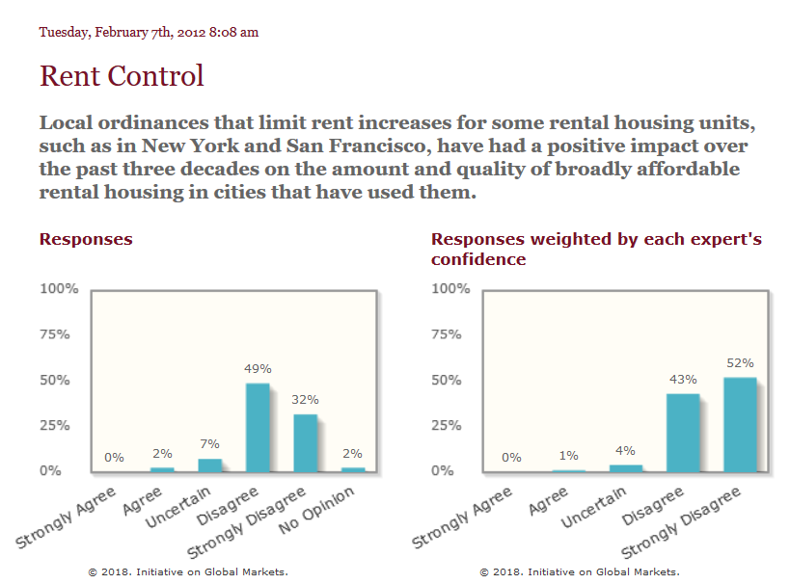
Rent Control
Notes:
http://www.igmchicago.org/surveys/rent-control

Slide 30
Rent Control
Why don’t economists like rent control?
We usually think housing costs too much because there’s not enough of it to go around.
Landlords raise rent because they can; if somebody moves out, somebody else is willing to move in.
If there were more places to live, the landlord could not raise rent as easily.
Rent control does nothing to stop the increase in prices in uncontrolled units. And controlled units may see neglect, since they will often lose their owners money.
Notes:
A 2018 study of San Francisco rent control showed:
Renters were 20% more likely to stay at their address
But, landlords stopped renting 15% of rent-controlled units
The lower number of units was related to a 5.1% citywide rent increase.
The Effects of Rent Control Expansion on Tenants, Landlords, and Inequality: Evidence from San Francisco
Rebecca Diamond, Timothy McQuade, Franklin Qian, NBER Working Paper No. 24181, Issued in January 2018, https://www.nber.org/papers/w24181

Slide 31
Rent Control
A 2018 study of San Francisco rent control showed:
Renters were 20% more likely to stay at their address
But, landlords stopped renting 15% of rent-controlled units
The lower number of units was related to a 5.1% citywide rent increase.
The Effects of Rent Control Expansion on Tenants, Landlords, and Inequality: Evidence from San Francisco
Rebecca Diamond, Timothy McQuade, Franklin Qian, NBER Working Paper No. 24181, Issued in January 2018, https://www.nber.org/papers/w24181

Slide 32
Government Regulation
There is a federal agency involved in housing, commonly known as HUD (Department of Housing and Urban Development).
HUD has a few main ways in which it acts in the housing market
Public Housing
FHA Mortgage Insurance
Housing vouchers
Community Development Block Grants
Fair Housing
Some of these solve issues like discrimination, and some address affordability issues

Slide 33
HUD
Affordability
FHA Mortgage Insurance
Makes loans available to those who have lower credit scores, or cannot afford a 20% down payment
Section 8 Vouchers
Allows households to find rental housing, but the waiting lists are too long and many landlords do not accept the vouchers
Public Housing
Notes:
The complaint (https://www.hud.gov/sites/dfiles/PIH/documents/HUD_01-18-0323_Complaint.pdf) says, “Facebook unlawfully discriminates by enabling advertisers to restrict which Facebook users receive housing-related ads based on race, color, religion, sex, familial status, national origin and disability. Facebook mines extensive user data and classifies its users based on protected characteristics. Facebook’s ad targeting tools then invite advertisers to express unlawful preferences by suggesting discriminatory options, and Facebook effectuates the delivery of housing-related ads to certain users and not others based on those users’ actual or imputed protected traits.”

Slide 34
HUD
Discrimination
Fair Housing: the market may include discriminatory landlords, realtors, mortgage brokers, etc., and the government needs to correct this
For example, HUD sued Facebook in April 2019, since Facebook was (allegedly) allowing landlords to only show their apartment listings to certain racial groups.
Notes:
The complaint (https://www.hud.gov/sites/dfiles/PIH/documents/HUD_01-18-0323_Complaint.pdf) says, “Facebook unlawfully discriminates by enabling advertisers to restrict which Facebook users receive housing-related ads based on race, color, religion, sex, familial status, national origin and disability. Facebook mines extensive user data and classifies its users based on protected characteristics. Facebook’s ad targeting tools then invite advertisers to express unlawful preferences by suggesting discriminatory options, and Facebook effectuates the delivery of housing-related ads to certain users and not others based on those users’ actual or imputed protected traits.”

Slide 35
HUD
Fair Housing
Some argue that the Fair Housing Act allows the federal government to prohibit exclusionary and burdensome zoning regulations, as they disproportionately work against the classes protected by the FHA.
This has been a popular idea with both left-wing and right-wing HUD secretaries.

Slide 36
Proposed reforms – state and local
Spread property tax revenue more equitably
Currently, parents essentially buy spaces in desirable public schools for their children. This method of school finance may perpetuate economic privilege across generations.
Loosen zoning
Minneapolis has recently made it legal to build triplexes almost citywide. In contrast, it is illegal to build a duplex or triplex in most space in most American cities.
Mixed use zoning: it is also currently illegal in many places to have a first floor grocery store (or any kind of commercial use) with apartments or condominiums on top. Why?

Slide 37
Conclusions
A modest-size house is a relatively good investment: money saved on rent is a tax-free dividend
Government stimulates homeownership through tax policy and mortgage insurance
Housing market is not a free market
Zoning and building regulations decided at local level contribute to economic inequality and may cause substantial economic damage

