Slide 1
U.S. Economic Outlook
Scott Baier, Ph.D.
Clemson University
National Economic Education Delegation

Slide 2
National Economic Education Delegation
Vision
  One day, the public discussion of policy issues will be grounded in an accurate perception of the underlying economic principles and data.
Mission
  NEED unites the skills and knowledge of a vast network of professional economists to promote understanding of the economics of policy issues in the United States.
NEED Presentations
  Are nonpartisan and are intended to reflect the consensus of the economics profession.

Slide 3
Credits and Disclaimer
This slide deck was authored by:
  Jon Haveman, Executive Director of NEED
  Allison Roehling, DePauw University
This slide deck was reviewed by:
  Jeffrey Frankel, Harvard University
  Scott Baier, Clemson University
  Rob Eyler, Sonoma State University
Disclaimer
  NEED presentations are designed to be nonpartisan
  It is, however, inevitable that the presenter will be asked for and will provide their own views.
  Such views are those of the presenter and not necessarily those of the National Economic Education Delegation (NEED).

Slide 4
Outline – U.S. Economic Outlook
Behavior of GDP
Labor Market
Monetary Policy/Interest Rates
Other Indicators
Summary

Slide 5
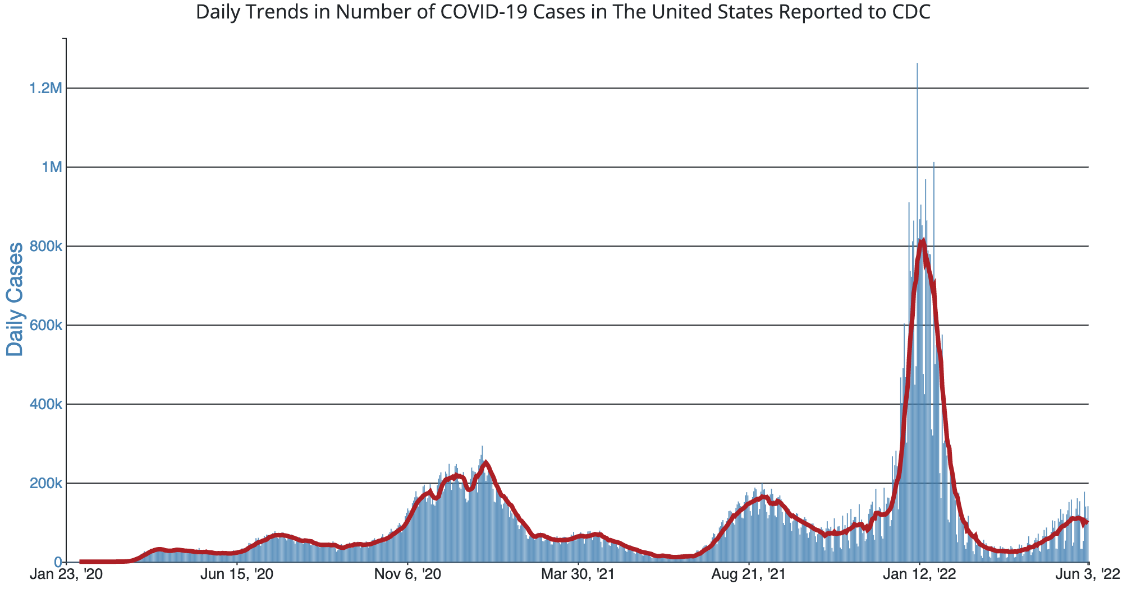
COVID-19 Cases US
Source: Center for Disease Control

Slide 6
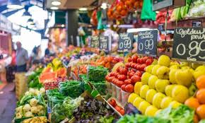

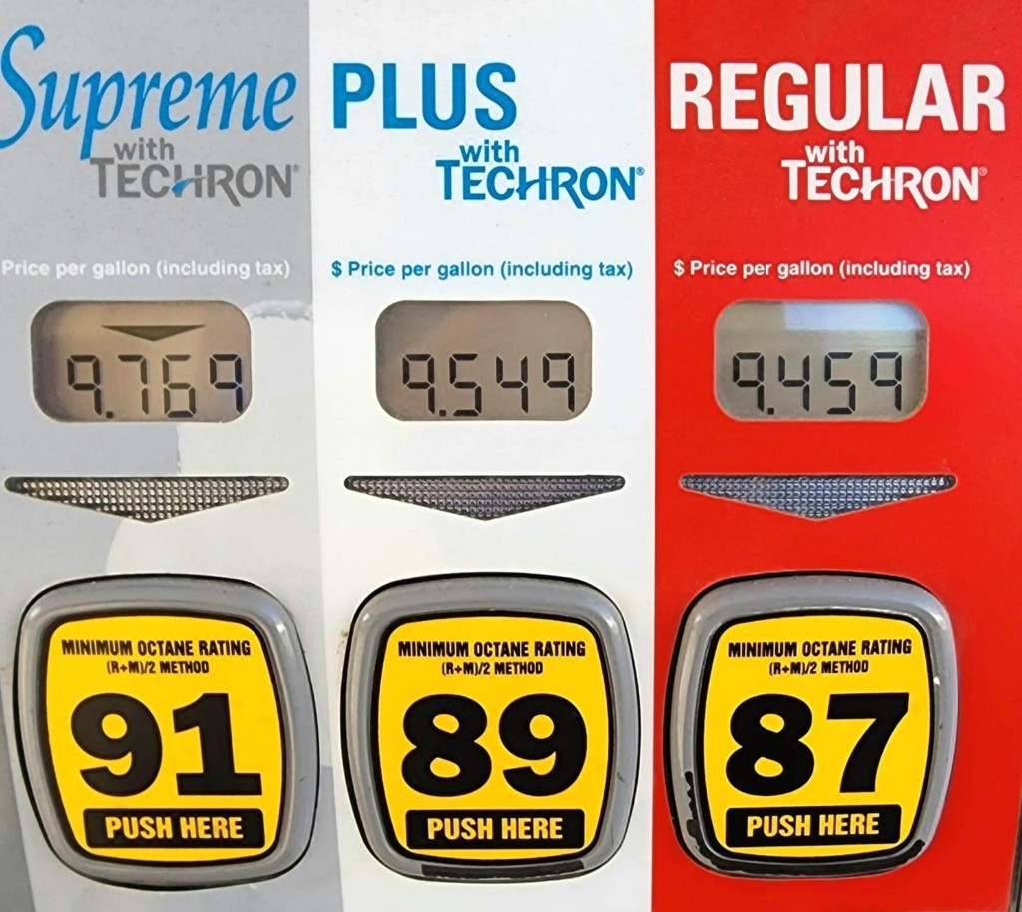
Prices and Inflation
Source: US Energy Information Association

Slide 7
Takeaways
Economic Growth: The recovery has been a V-shaped recovery
The economic recovery should continue through 2022.
  IMF expects US growth to be 3.78% -- downward revision from 5.2%
  Economic growth in 2022:Q1 was muted for the reasons discussed below.
  Tailwinds: Strong consumer demand
  Headwinds: Inflation, supply chain disruptions, rising commodity prices, labor market challenges
The labor market still faces some challenges
  The unemployment rate is low.
  In many sectors, we have not reached pre-pandemic employment levels.
Inflation: What is fueling inflation?
  Supply chain disruptions
  Changes in the composition of demand

Slide 8
Takeaways
Is a recession on the horizon?
  Larry Summers, Jamie Dimon, and Elon Musk are worried about a recession.
  While the chances of slipping into a recession have increased, I think on many dimensions the economy is doing quite well.
    Consumer’s have been driving the recovery, and consumer’s account for two-thirds of GDP.
    Job creation remains robust – Friday’s job report indicated that the US added 390k jobs.
What about first-quarter GDP?
  2022:Q1 was -1.5%
  Some of this lower growth was driven by Omicron variant.
  Much of this lower growth was driven by reversions, the pandemic, and seasonality.

Slide 9
V-Shaped Recovery Labor Market
Months since the start of the recession
Source: Bureau of Labor Statistics (BLS)

Slide 10
Behavior of GDP

Slide 11
US GDP Level and GDP Trend
11% Gap
Income per person
would be about
$5,000 higher.
Source: BEA

Slide 12
V-Shaped Recovery GDP Recovery

Slide 13
GDP Growth by Decade
Source: BEA annualized GDP growth over the decade

Slide 14
GDP Recovery

Slide 15
What Is “Accounting” for the Recovery?
Expenditures drive GDP growth.
  GDP is the sum of four categories of spending:
    Consumption
    Investment
    Government spending
    Net Exports: Exports – Imports
Notes:
Recall: GDP is measures production of an economy; we often measure GDP as the sum of spending on final goods/services produced within an economy. The first three categories (C,I,G) contain spending on both domestically and foreign produced goods. To accurately measure domestic production, we subtract domestic consumption of foreign goods (imports).
The Point: Analysis of components of GDP as well as the production side of the economy should provide a comprehensive picture of the US economic landscape

Slide 16
A Note on Imports and GDP
GDP = Consumption + Investment + Government + Net Exports
  Net Exports = Exports – Imports
Give the impression that IMPORTS are bad for GDP
  They are not.
  GDP measures domestic production / income.
  From a practical, it easier to measure everything we buy at the stores (consumer, business, or government pruchases).
  and then subtract off the value of imports.
Calculating Gross DOMESTIC Production must exclude IMPORTS
  It is merely an accounting identity.

Slide 17
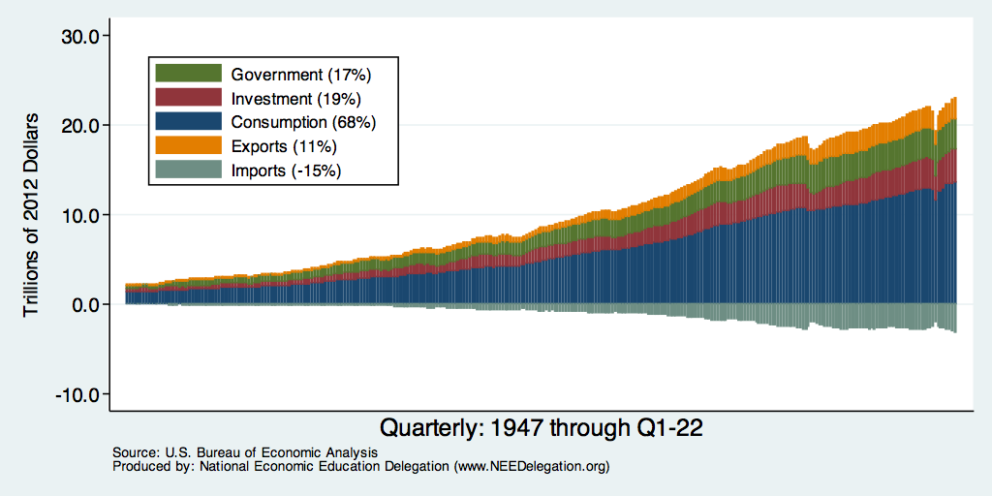
Composition of GDP – Inflation Adjusted
Notes:
Components sum to GDP
Average % of GDP for each component from 1960-Present: C = 64%, I=15%, G=24%, NX = 2% (X = 7%, M=9%)
Net Exports as a % of GDP has increased over the sample period, but it’s contribution to GDP is relatively small

Slide 18
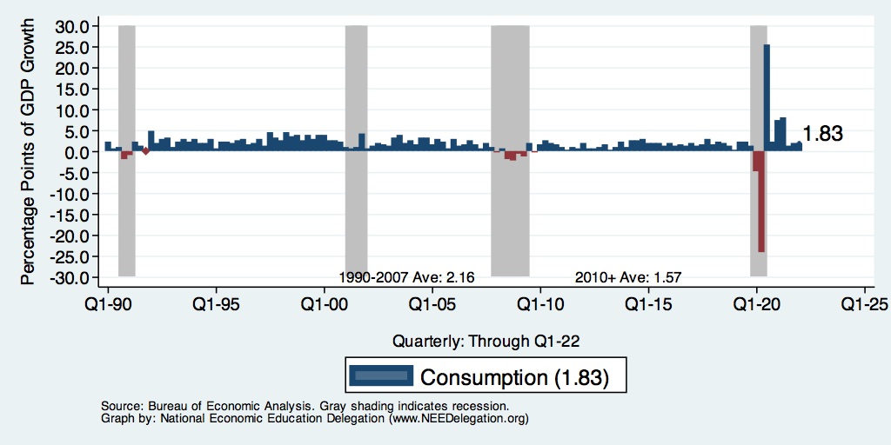
Contribution to GDP Growth: Consumption
Notes:
Average GDP growth from 1990-2007 is 2.99% and from 2010+ is 2.19%
Average Consumption contribution from 1990-2007 is 2.16 percentage points and from 2010+ is 1.67 percentage points

Slide 19
Personal Consumption Expenditures

Slide 20
Real Disposable Income

Slide 21
Real Disposable Income and Real Consumption

Slide 22
National Spending
25%
-30%
Opportunity Insights

Slide 23
Spending by Income Groups
25%
Lower Income
High Income
Middle Income
Source: Opportunity Insights

Slide 24
Spending Patterns – Hardest Hit Sectors
Health
Food & Accom
Arts & Entertain
Nearly 80% Drop
Source: https://tracktherecovery.org/

Slide 25
Goods Consumption
20% higher

Slide 26
Service Consumption

Slide 27
Take Away: Consumption
Consumption has rebounded rapidly coming out of the recession.
The rebound in consumption was supported by the stimulus packages that were passed by the Trump and Biden Administration.
Compared to before the pandemic consumption has shifted more toward the consumption of goods and away from services.
  This a demand effect that is causing some of the supply chain disruptions
Can consumers continue to help drive GDP growth?

Slide 28
Consumers: Excess Saving

Slide 29
Why was GDP Growth So Low in 2022:Q1
Omicron Variant impacted GDP growth
Changes in Business Inventories (part of Investment) has less persistence than other components of GDP.
  In 2021:Q4 Changes in Business Inventories were one of the main drivers of GDP growth.
  It seemed likely that this would slow in 2022:Q1.
Net Exports also were one of the reasons that GDP growth was slow.
  Much of this had to to with increased processing of imports at the ports.

Slide 30
Contributions to GDP Growth Business Inventories

Slide 31
Net Exports

Slide 32
Labor Market

Slide 33
Unemployment Rate

Slide 34
Employment Changes: Nonfarm Payroll
1990-2019
From 1990 -2007, average gain in employment each month averaged about 131,000
Source: BLS
The next slides adds in 2020 and 2021

Slide 35
Employment Changes: Nonfarm Payroll
1990-2022
The size of the shock induced by the pandemic distorts the data from previous periods
Source: BLS

Slide 36
Employment Changes
In March and April of 2020, the US economy lost nearly than 22 million jobs.
Since that time, the economy has recovered about 21 million jobs.
Still roughly 882 jobs below where we were in 2/2020
If you consider the normal addition of 131k jobs per month, we about 4 million below where we could be.
Source: BLS

Slide 37
Net Employment Changes by Industry

Slide 38
Employment: Changes by Age Group
Employment Change from 2/20 to 5/22
Source: BLS

Slide 39
Employment Dynamics: Quits and Layoffs
QUITS
Source: BLS

Slide 40
Employment Dynamics
Job Openings
Job Hires
Source: BLS

Slide 41
Pre-COVID Quit Rates by Industry
Source: BLS

Slide 42
Pre & Post COVID Quit Rates by Industry
Source: BLS

Slide 43
Wage Growth by Industry
Inflation Rate

Slide 44
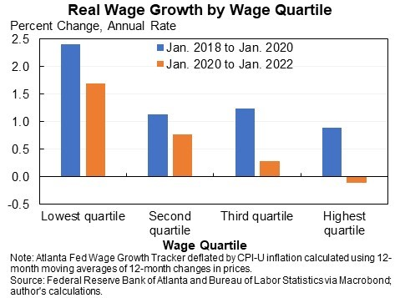
Wage Growth Adjusted for Inflation

Slide 45
Inflation

Slide 46
Inflation

Slide 47
What is Driving Current Inflation?
Profiteering / Greed: President Biden and Senator Elizabeth Warren.
Supply Chains Disruptions:
  the pandemic has impacted the ability to get parts and supplies.
  Labor shortages and rising wages have raised costs and help push up prices.
Increased Demand:
  During the pandemic there has been an increase in demand for goods. For many of these goods, it is not easy to ramp up production.
  The fiscal and monetary authorities have provided lots of stimulus.
Increase in Cost of Producing Goods and Transportation (future)

Slide 48
Profits: Profit Margins
No historical correlation between profit margins and inflation
After-Tax Profit Margins

Slide 49
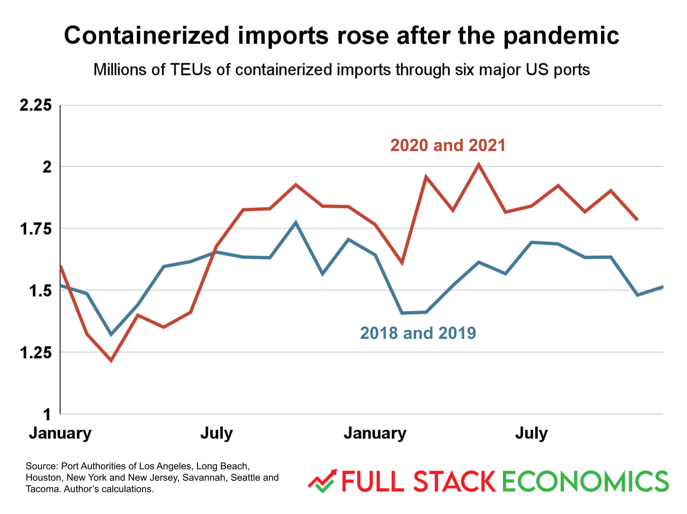
Supply Chain Delays: It is Not All Supply Shortages

Slide 50
Supply Chain Delays: ISM Delivery Days

Slide 51
Money Growth: M2
6 percent

Slide 52
Pandemic Monetary Policy
Historically, the Federal Reserve does not have direct control of M2
Recent increase is something different
  Federal government transfers to checking accounts
  Helicopter drop
Generally, faster growth of M2 associated with higher inflation
  Here?
The Federal Reserve has started to increase interest rates.
  Over the next year, it is predicted we will see 5-7 interest rate increases
  Designed to slow down inflation by increasing the cost of borrowing

Slide 53
Annualized Money Growth
Growth Rate of Money Stock (percent per year) | Beginning of Period | End of Period
6.15 | January 2000 | March 2020
37.3 | March 2020 | July 2020
12.44 | July 2020 | December 2021

Slide 54
Disposable Income and Expenditures
Income
Spending

Slide 55
Nominal Spending on Durable Goods and Services
Consumption of durable goods is about 35% higher than its pre-pandemic levels
Consumption of services is almost back to pre-pandemic levels.
Note: PC Expenditures Services are nearly 6.5 times greater than PC expenditures on Durables

Slide 56
PCE Inflation: Goods and Services

Slide 57
Monetary Policy

Slide 58
Federal Funds Rate

Slide 59
Future Fed Rate Hikes
The Federal Reserve will likely continue to raise interest rates this summer
  Half-percentage point in June and July → Federal Funds rate 1.75-2.00 range.
  Whether they pause in September will depend on the economic data between now and then.
  The higher interest rates may slow down (Consumer and Business) spending and cool inflation.

Slide 60
Credit Risk: Chicago Fed NFCI

Slide 61
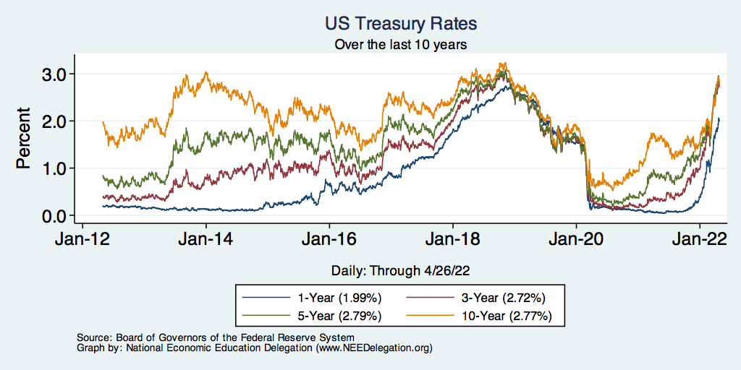
Treasuries
Notes:
treas_recent.png

Slide 62
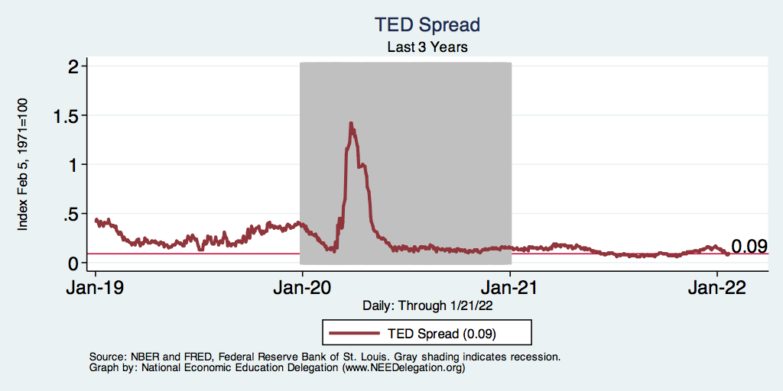
TED Spread
Notes:
TEDRATE_recent.png

Slide 63
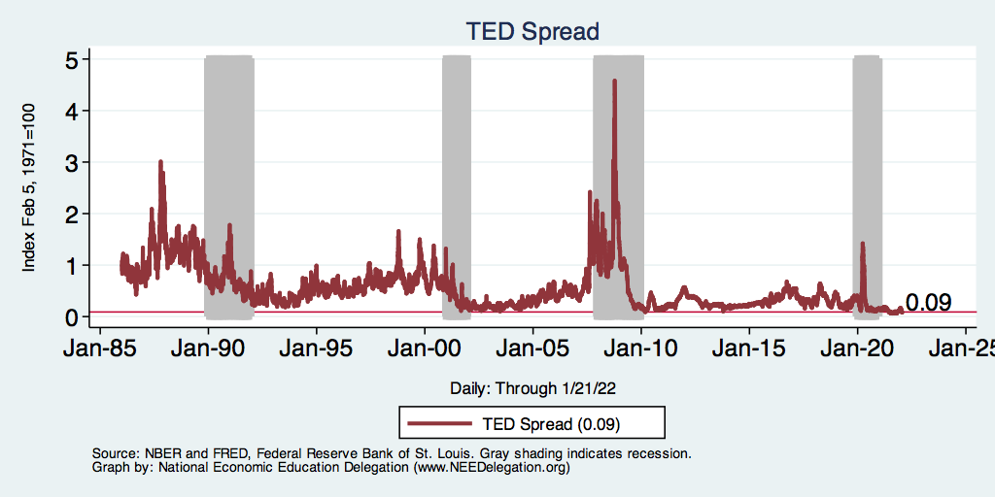
TED Spread
Notes:
Last 10 years?
TEDRATE_recession.png

Slide 64
Other Indicators

Slide 65
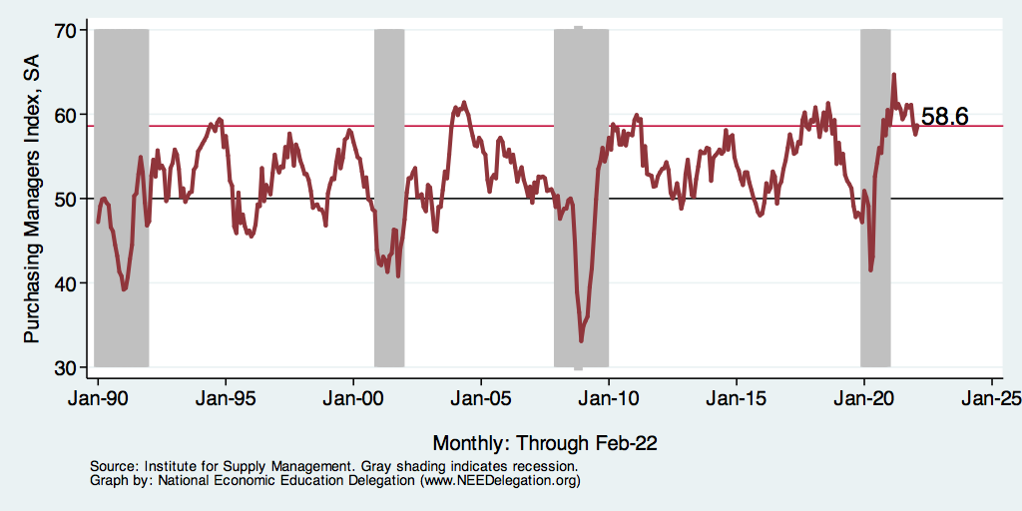
Producer Confidence: Gaining Steam?

Slide 66
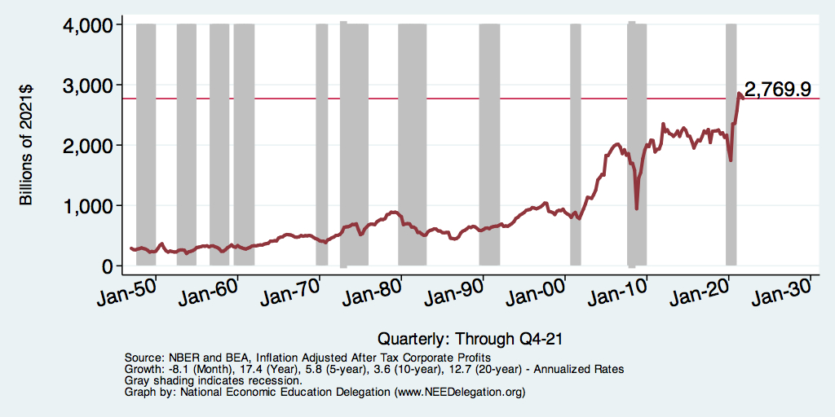
Corporate Profits – Inflation Adjusted
Notes:
corporateprofits_recession.png

Slide 67
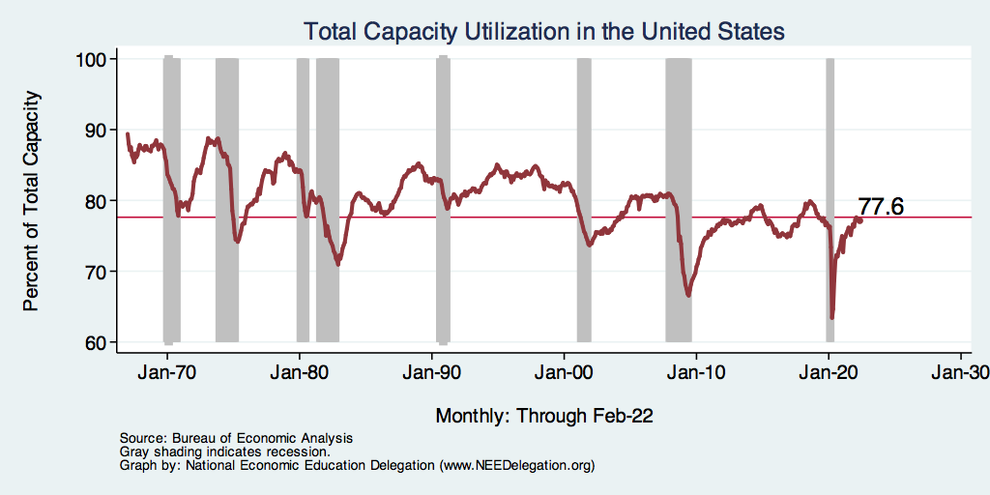
Capacity Utilization

Slide 68
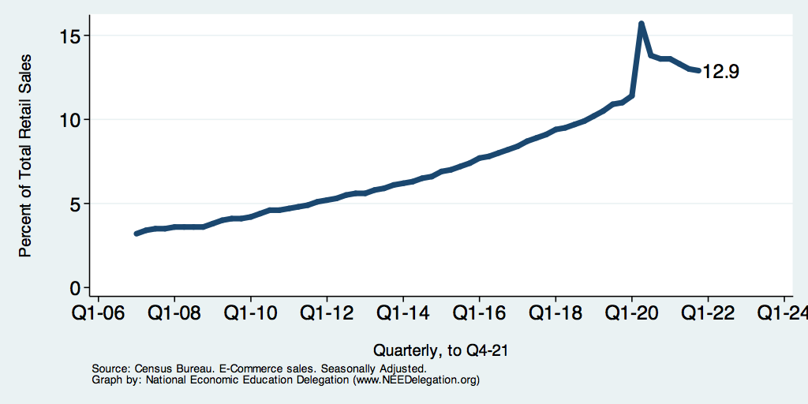
E-Commerce Inroads

Slide 69
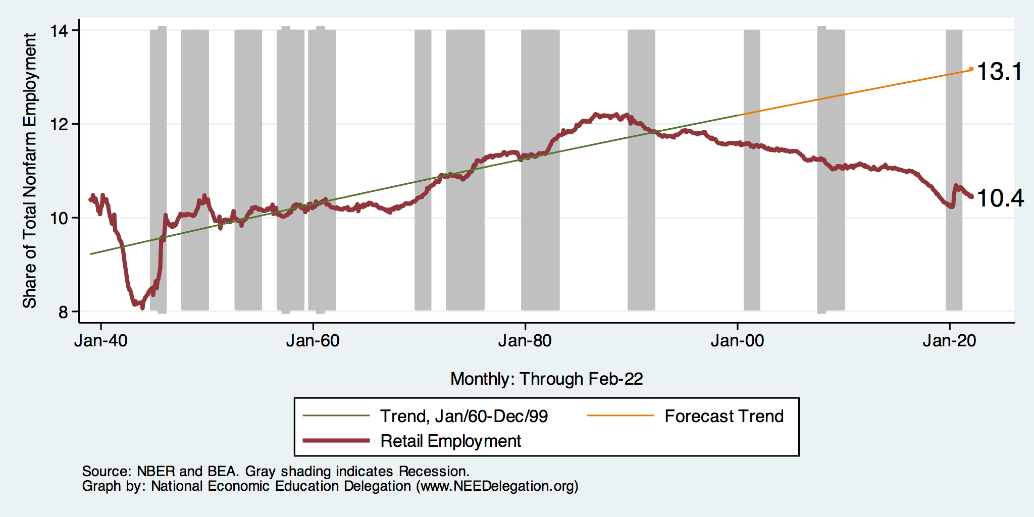
Employment in Retail Trade
Notes:
Retailemp.do

Slide 70
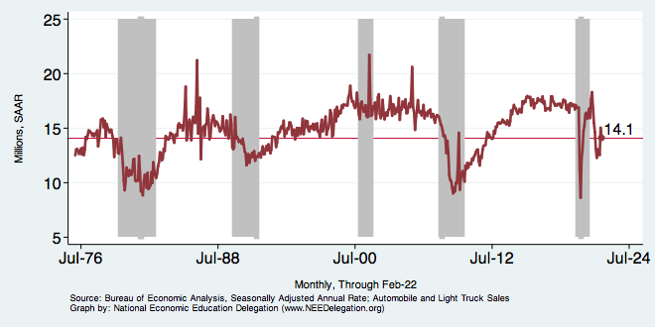
Automobile and Light Truck Sales

Slide 71
Stock Markets

Slide 72
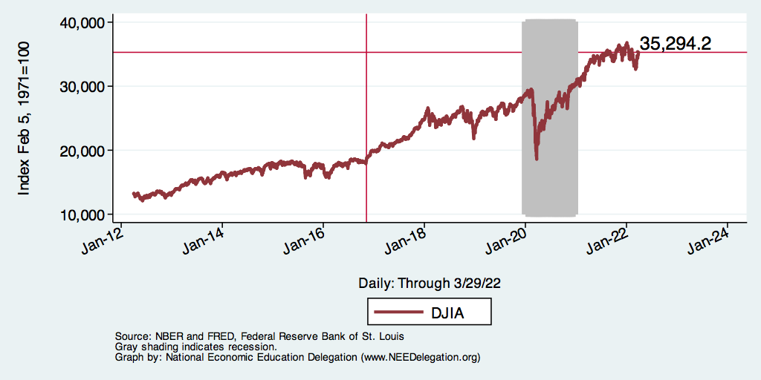
Dow Jones

Slide 73
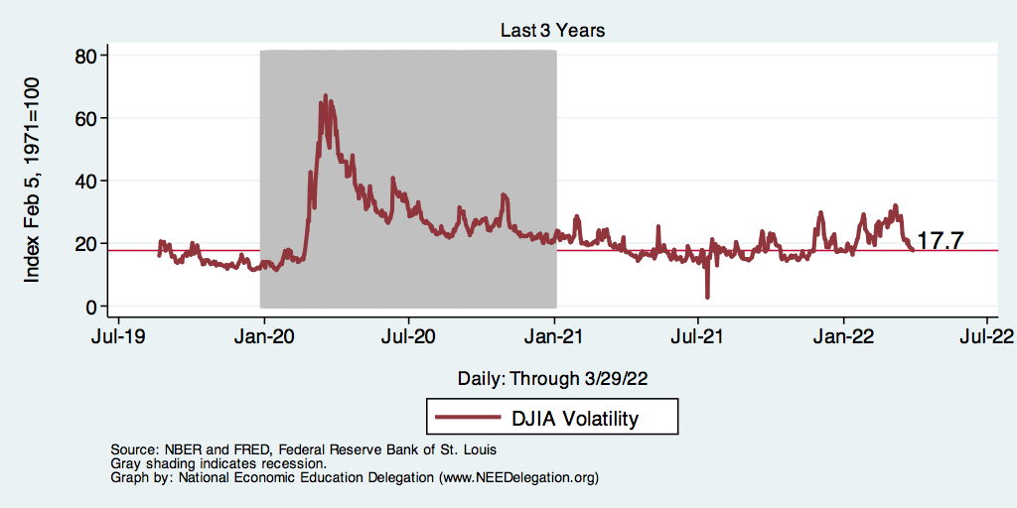
Dow Jones - Volatility

Slide 74
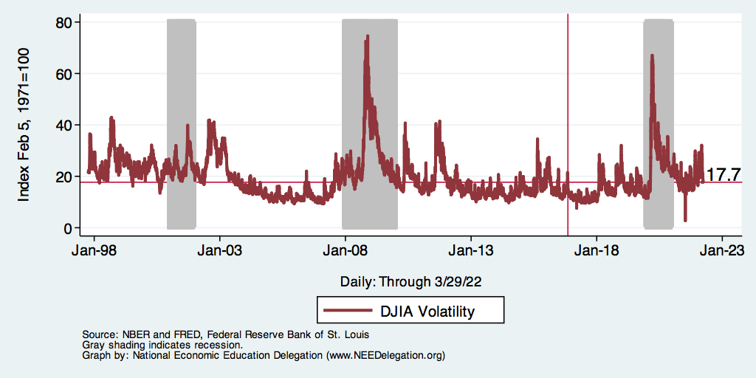
Dow Jones - Volatility

Slide 75
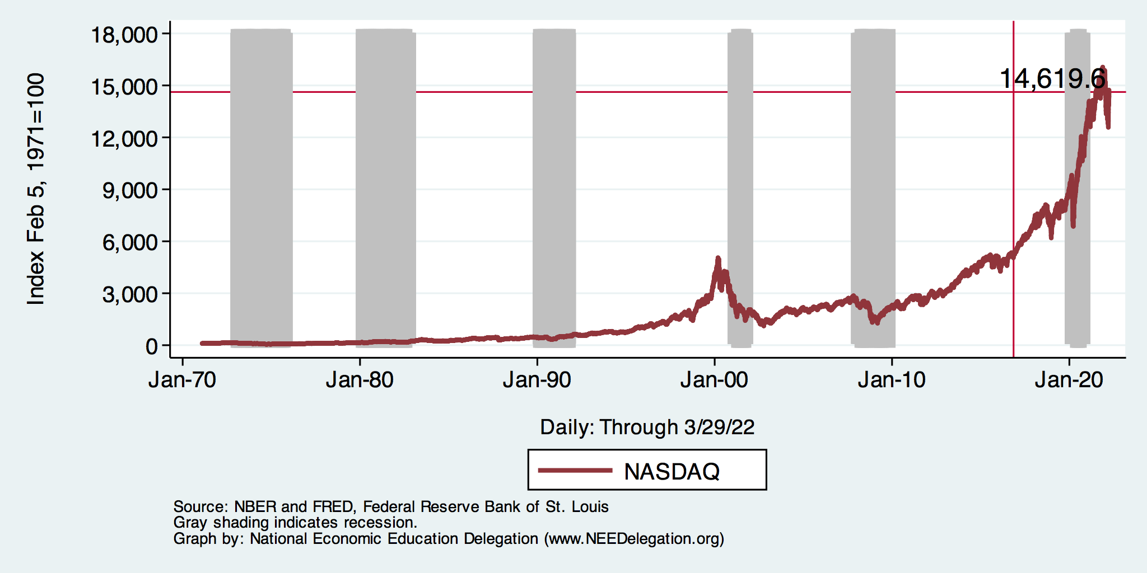
NASDAQ

Slide 76
Summary of GDP, Employment and Monetary Policy
Behavior of GDP
  Behavior of expenditure components matter.
  On average, post-recession consumption, government, and export. expenditures are contributing less to GDP therefore slowing the recovery.
  In contrast, investment expenditures are contributing more.
Labor Market
  Unemployment is low, labor force participation is stagnant
  Real wages may be starting to grow.
Monetary Policy
  Interest rates are rising.
  Policy normalization is underway.

Slide 77
Things to Be Worried About
Yield Curve
Government Debt
Growth Abroad
Income and Wealth Inequality
Infrastructure
Savings
Policy Uncertainty
  Trade and immigration policy, especially

Slide 78
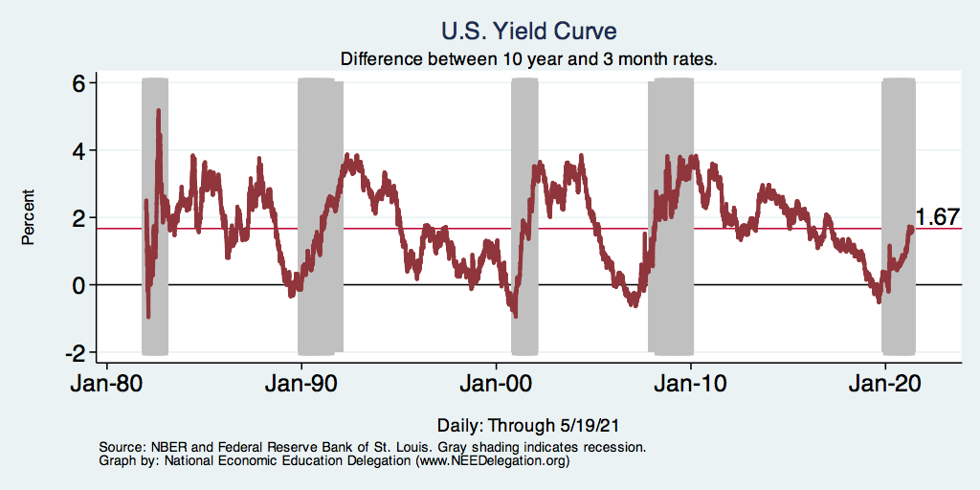
Alarming Compression of Interest Rates
Inverted Yield Curves (negative values) Have Projected Recent Recessions

Slide 79
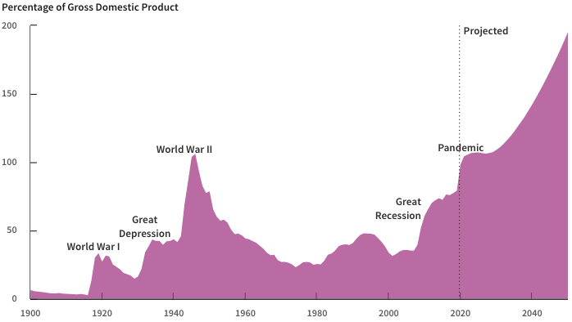
Record Levels of Debt are Forecast
Source: Congressional Budget Office, The Budget and Economic Outlook: 2020 to 2030

Slide 80
Cautious Outlook
Job growth remains robust
Labor force is in decline
Wage growth, but not too much
Business investment is robust, but will uncertainty bite?
Inflation and interest rates remain favorable
Potential source of concern:
  Auto and light truck sales are slowing
  Home building is slowing

Slide 81
Overall Summary
Tailwinds and headwinds both exist
  Economic forecasts for near term are favorable
  Later 2019 and 2020 forecasts are less sanguine
There remains room for the economy to grow
  Labor force growth is available
  Consumption has room to grow, but there is evidence of slowing
  Business investment may be slowing
  Return to productivity growth? But how? What’s the next big idea?
Long term concerns unaddressed
  Demographics, climate change
  Federal government debt
  International trade policy

Slide 82
Thank you!
Any Questions?
www.NEEDelegation.org
<presenter name>
<presenter email>
Contact NEED: info@needelegation.org
Submit a testimonial: www.NEEDelegation.org/testimonials.php
Become a Friend of NEED: www.NEEDelegation.org/friend.php

Slide 83
Available NEED Topics Include:
US Economy
Economic Inequality
Climate Change
US Social Policy
Trade and Globalization
Economic Mobility
Trade Wars
Housing Policy
Federal Budgets
Federal Debt
2017 Tax Law
Autonomous Vehicles

Slide 84
The Local Economy
These graphs area available for your local area at www.NEEDelegation.org/LocalGraphs
They are not up to date in this deck, but the graphs online are kept constantly up to date. If they are not, please let me know.

Slide 85
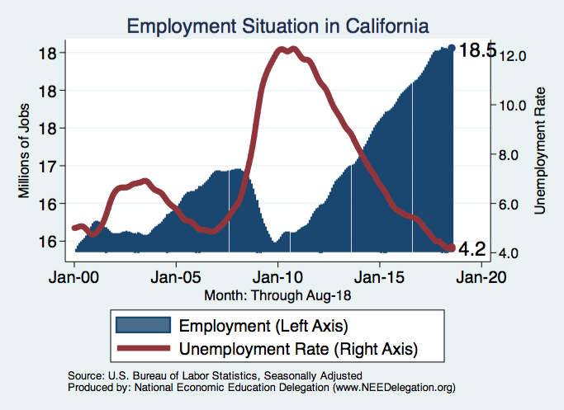
Employment Situation: California

Slide 86
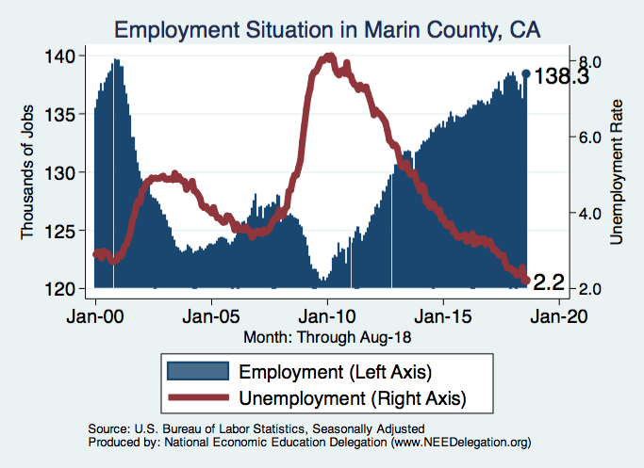
Employment Situation: Marin County

Slide 87
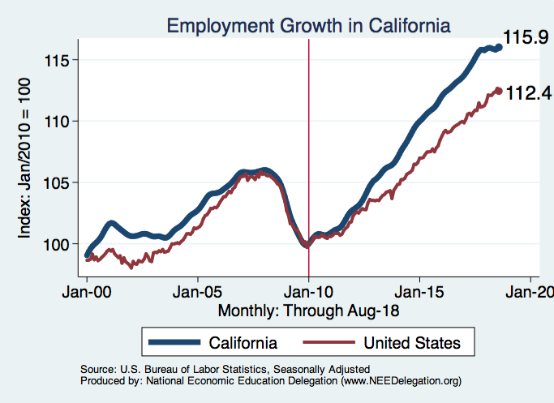
Employment Growth: California

Slide 88
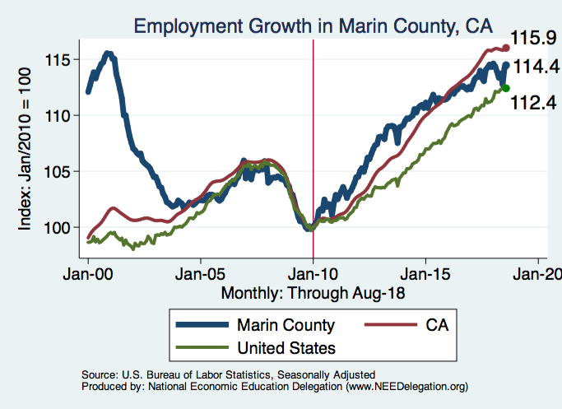
Employment Growth: Marin County

Slide 89
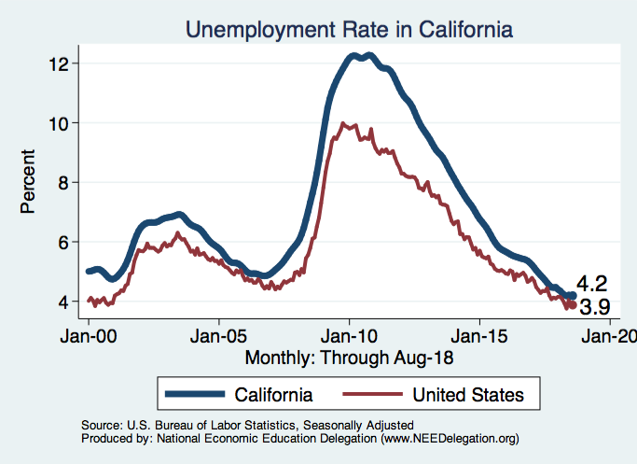
Unemployment: California

Slide 90
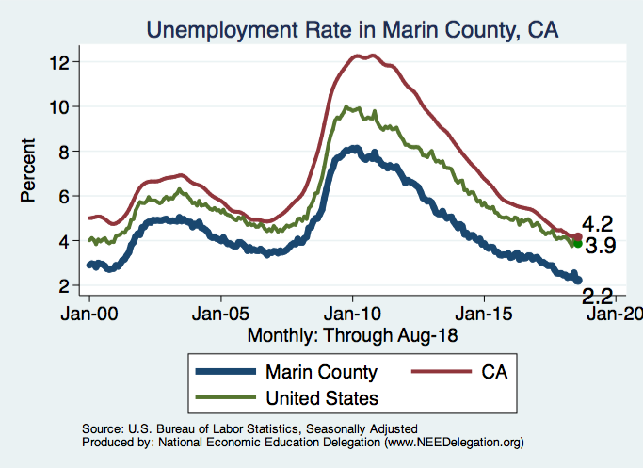
Unemployment: Marin County

Slide 91
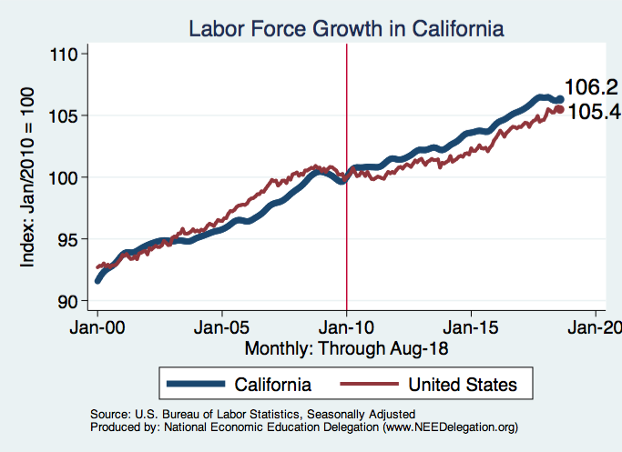
Labor Force: California

Slide 92
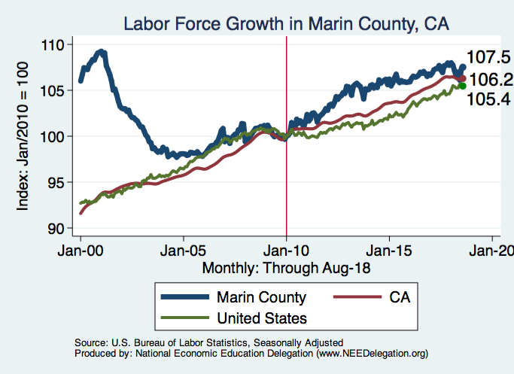
Labor Force: Marin County

Slide 93
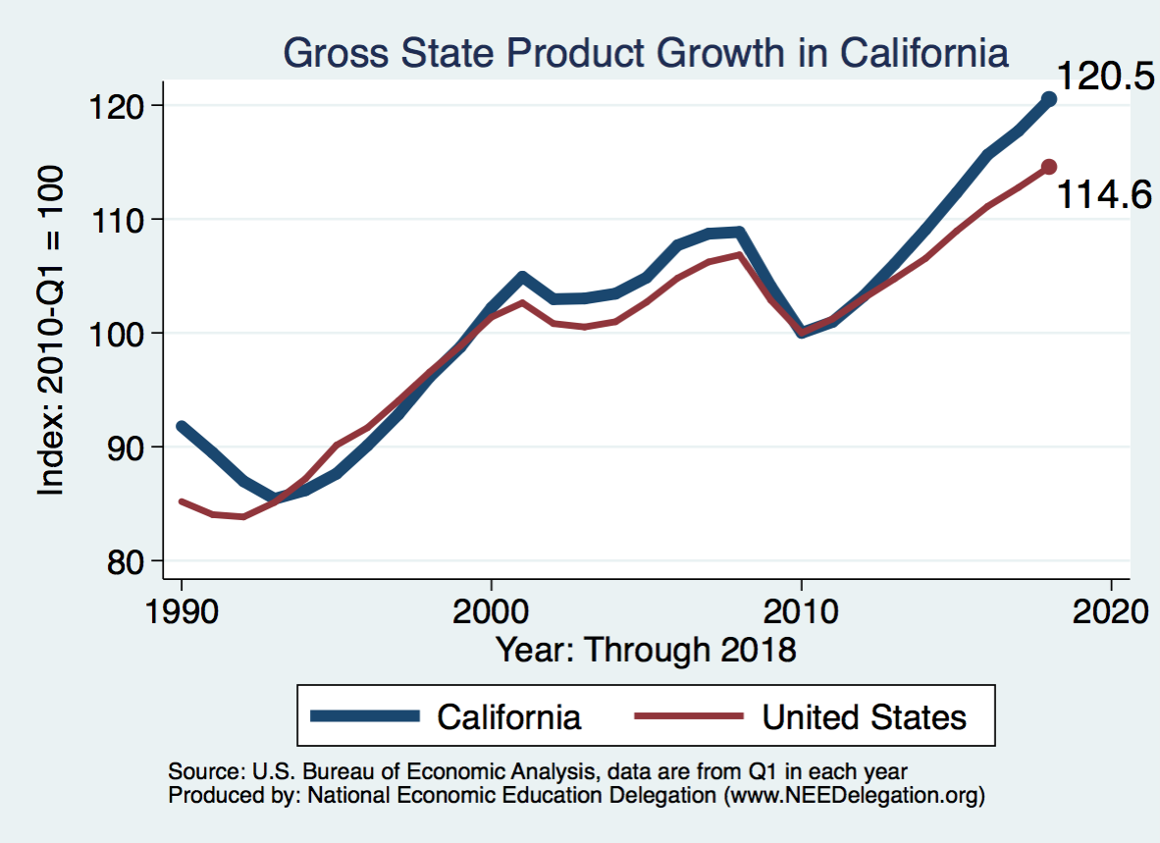
Gross Regional Product: California

Slide 94
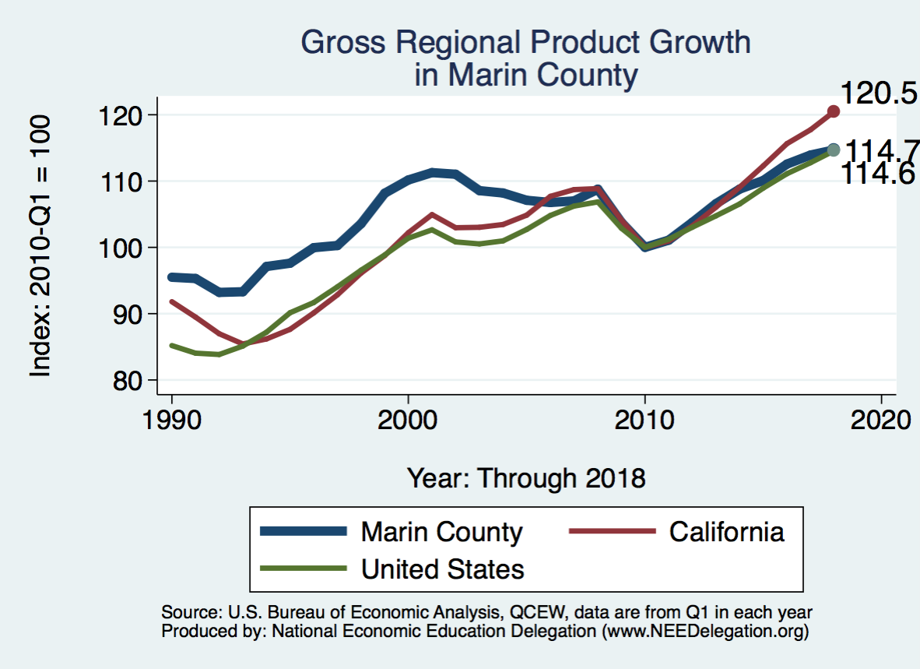
Gross Regional Product: Marin County

Slide 95
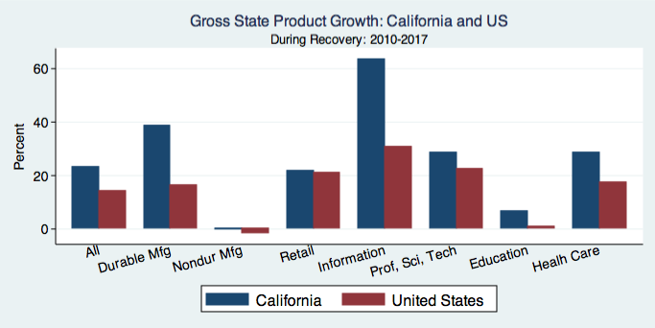
Gross Regional Product Detail: California

Slide 96
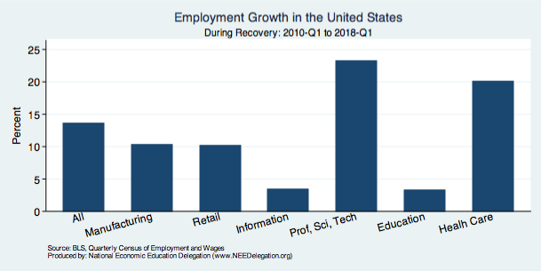
Employment Growth Detail

Slide 97
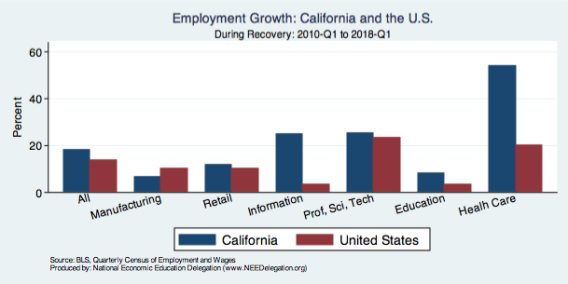
Employment Growth Detail: California

Slide 98
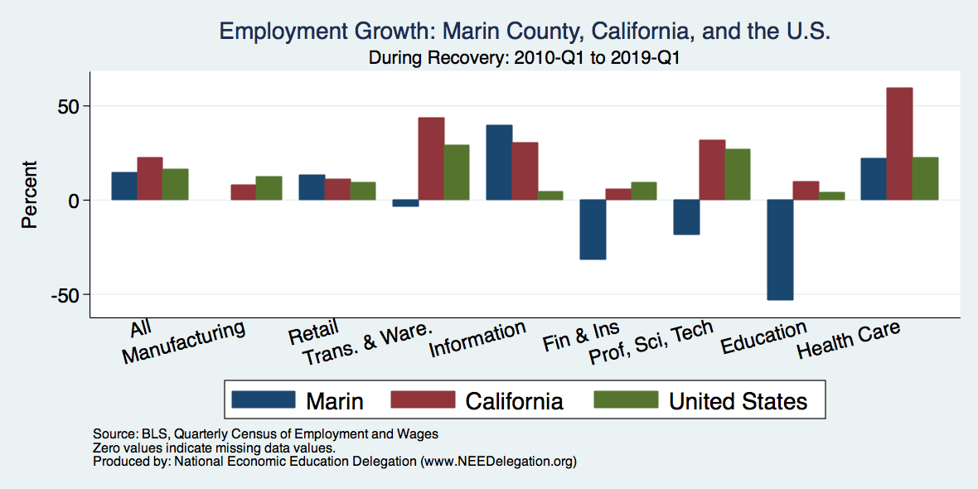
Employment Growth Detail: Marin County

Slide 99
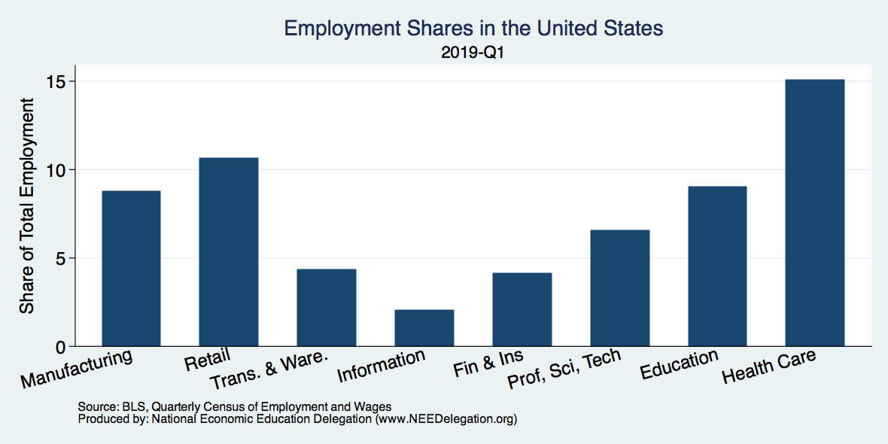
Employment Shares

Slide 100
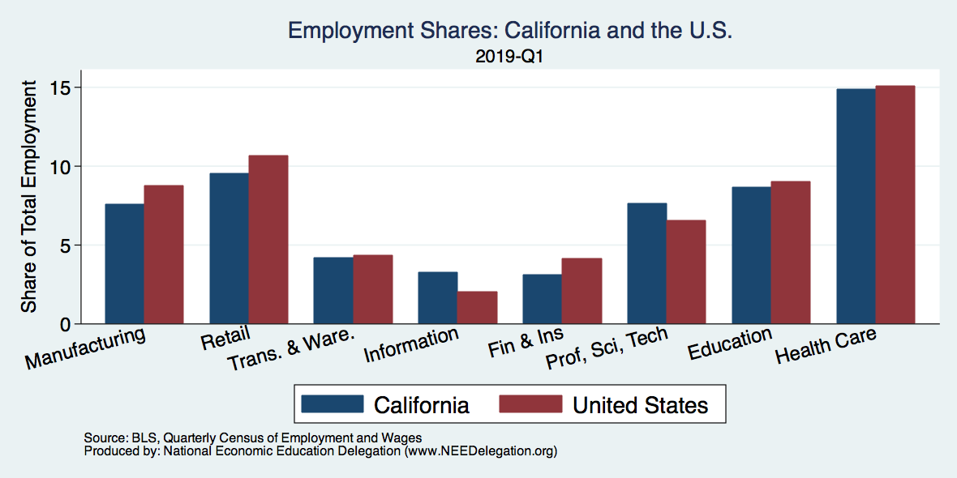
Employment Shares: California

Slide 101
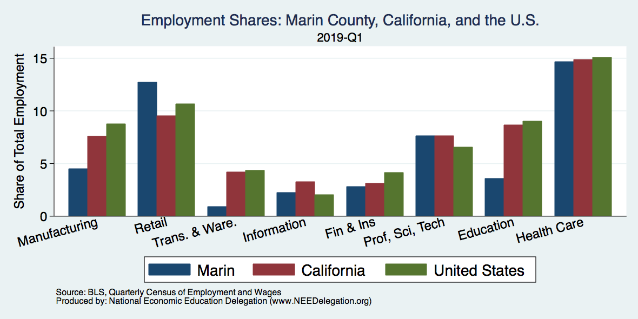
Employment Shares: Marin County

Slide 102
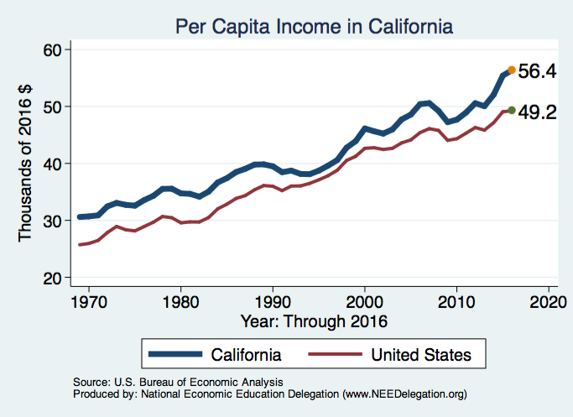
Per Capita Income: California

Slide 103
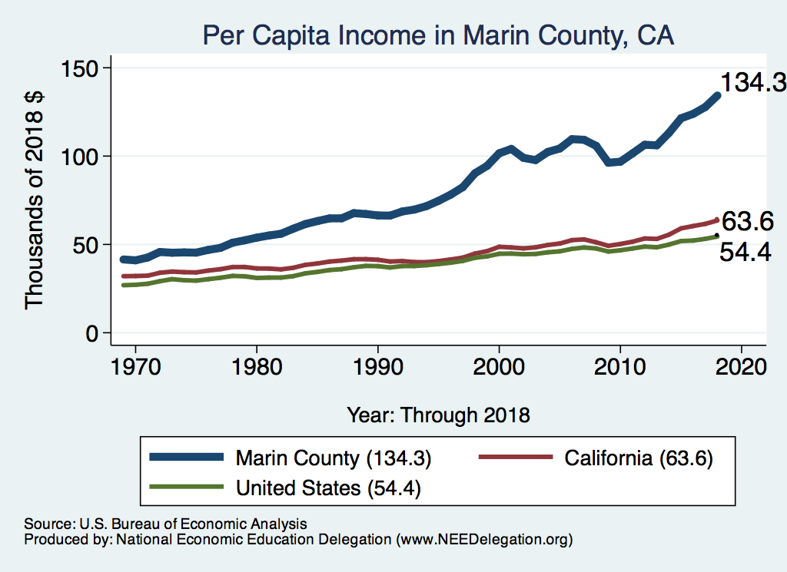
Per Capita Income: Marin County

Slide 104
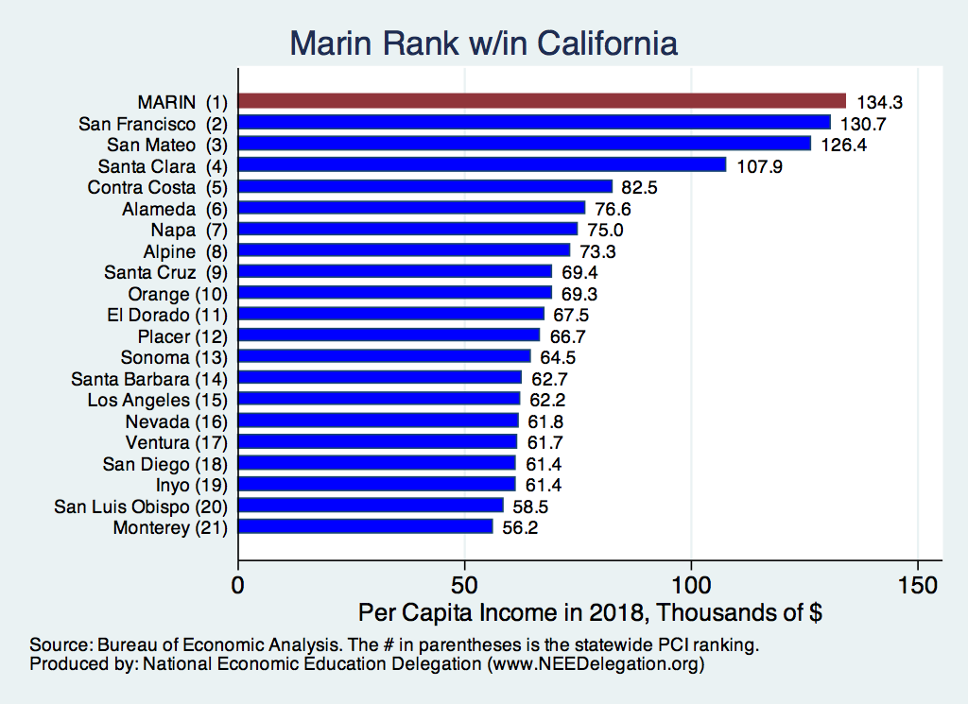
Per Capita Income: Marin County

Slide 105
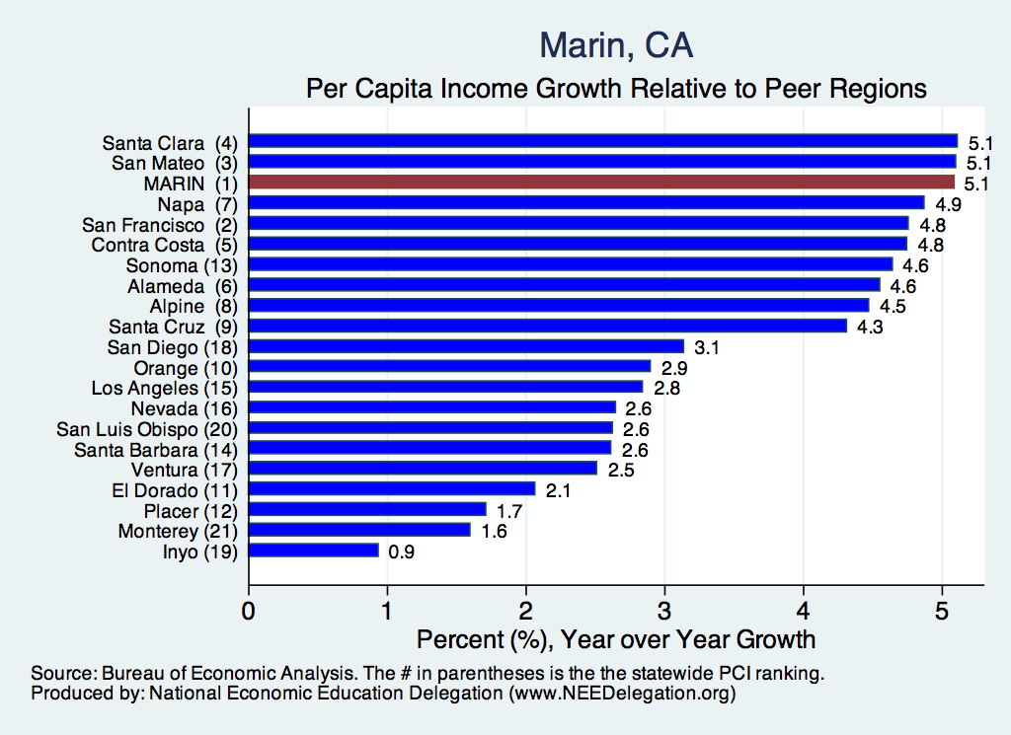
Per Capita Income: Marin County

Slide 106
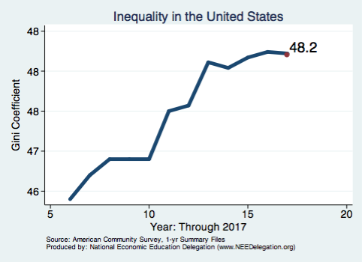
Income Inequality: Nationwide

Slide 107
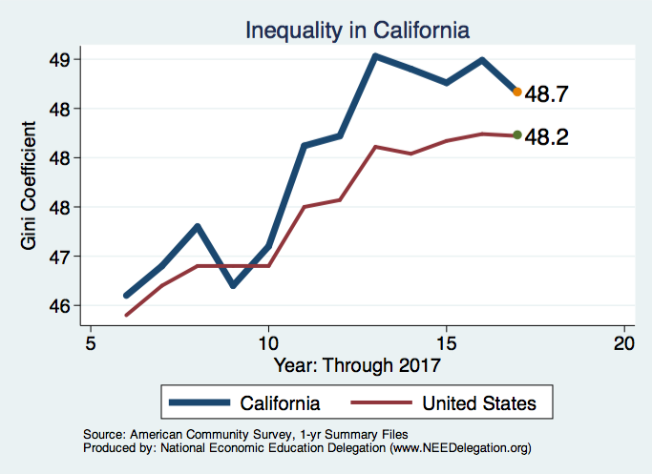
Income Inequality: California

Slide 108
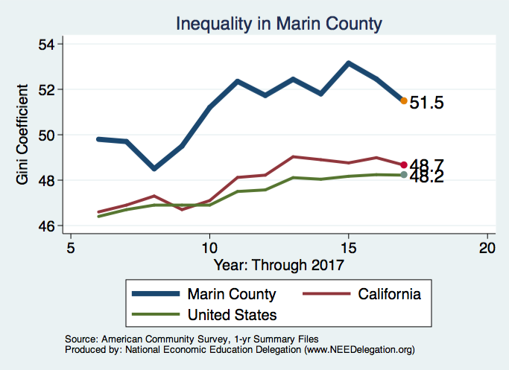
Income Inequality: Marin County

Slide 109
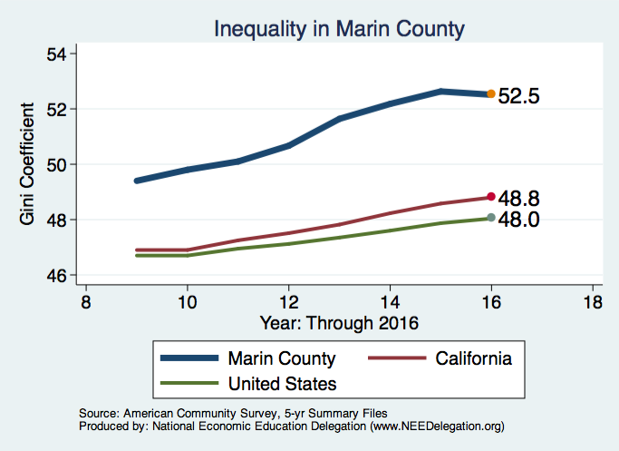
Income Inequality: Marin County (5-yr ACS)

Slide 110
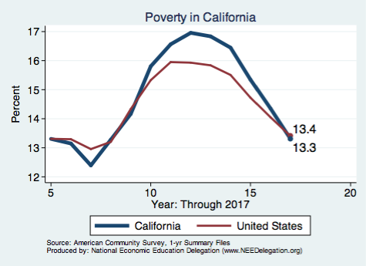
Poverty: California

Slide 111
Child Poverty: California

Slide 112
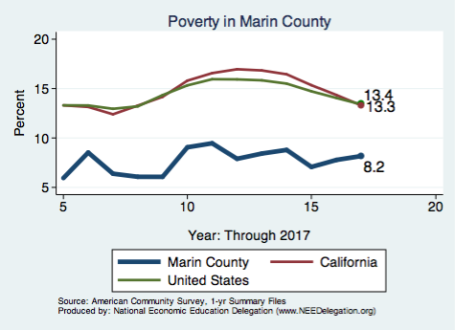
Poverty: Marin County (1-yr ACS)

Slide 113
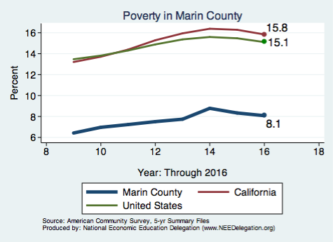
Poverty: Marin County (5-yr ACS)

Slide 114

Child Poverty: Marin County (1-yr ACS)

Slide 115

Child Poverty: Marin County (5-yr ACS)

Slide 116

Home Prices: California

Slide 117

Home Prices: Marin County

Slide 118

Rents: California

Slide 119

Rents: Marin County

Slide 120

Home Permitting: Nationwide

Slide 121

Home Permitting: California

Slide 122

Home Permitting: Marin County

Slide 123

Population Growth: California

Slide 124

Population Growth: Marin County (1yr ACS)

Slide 125

Population Growth: Marin County (5yr ACS)

Slide 126

Jobs-Housing Ratio

