Slide 1
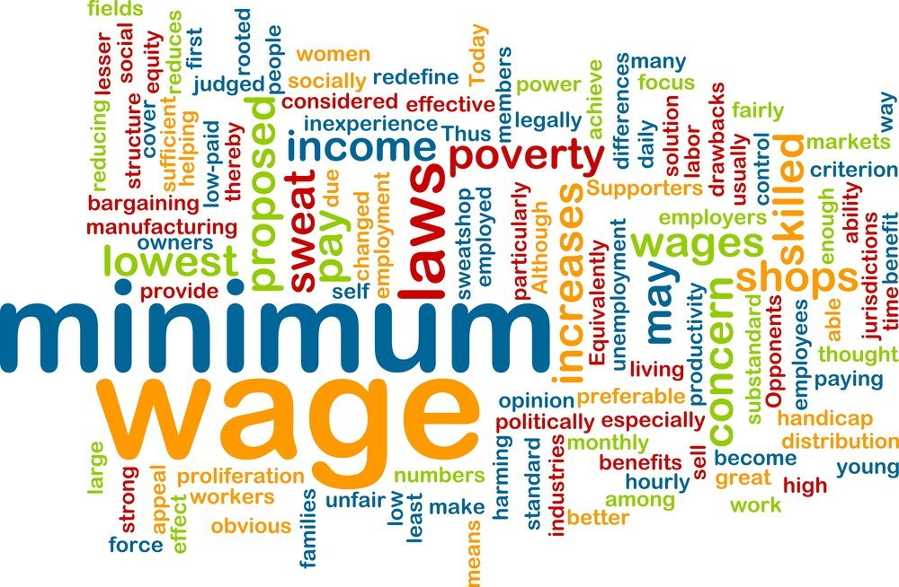
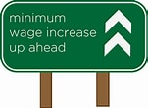
Minimum Wage – Part 2
Rotary Club of Austin University Area
June 7, 2021
Veronika Dolar, Ph.D.
SUNY Old Westbury

Slide 2
National Economic Education Delegation
Vision
One day, the public discussion of policy issues will be grounded in an accurate perception of the underlying economic principles and data.
Mission
NEED unites the skills and knowledge of a vast network of professional economists to promote understanding of the economics of policy issues in the United States.
NEED Presentations
Are nonpartisan and intended to reflect the consensus of the economics profession.

Slide 3
Who Are We?
Honorary Board: 53 members
2 Fed Chairs: Janet Yellen, Ben Bernanke
6 Chairs Council of Economic Advisers
Furman (D), Rosen (R), Bernanke (R), Yellen (D), Tyson (D), Goolsbee (D)
3 Nobel Prize Winners
Akerlof, Smith, Maskin
Delegates: 585+ members
At all levels of academia and some in government service
All have a Ph.D. in economics
Crowdsource slide decks
Give presentations
Global Partners: 44 Ph.D. Economists
Aid in slide deck development

Slide 4
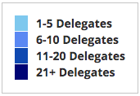
Where Are We?

Slide 5
Available NEED Topics Include:
Coronavirus Economics
US Economy
Climate Change
Economic Inequality
Economic Mobility
Trade and Globalization
Trade Wars
Immigration Economics
Housing Policy
Federal Budgets
Federal Debt
Black-White Wealth Gap
Autonomous Vehicles
US Social Policy

Slide 6
Credits and Disclaimer
This slide deck was authored by:
Jon Haveman, NEED
Veronika Dolar, SUNY Old Westbury
Disclaimer
NEED presentations are designed to be nonpartisan.
It is, however, inevitable that the presenter will be asked for and will provide their own views.
Such views are those of the presenter and not necessarily those of the National Economic Education Delegation (NEED).

Slide 7
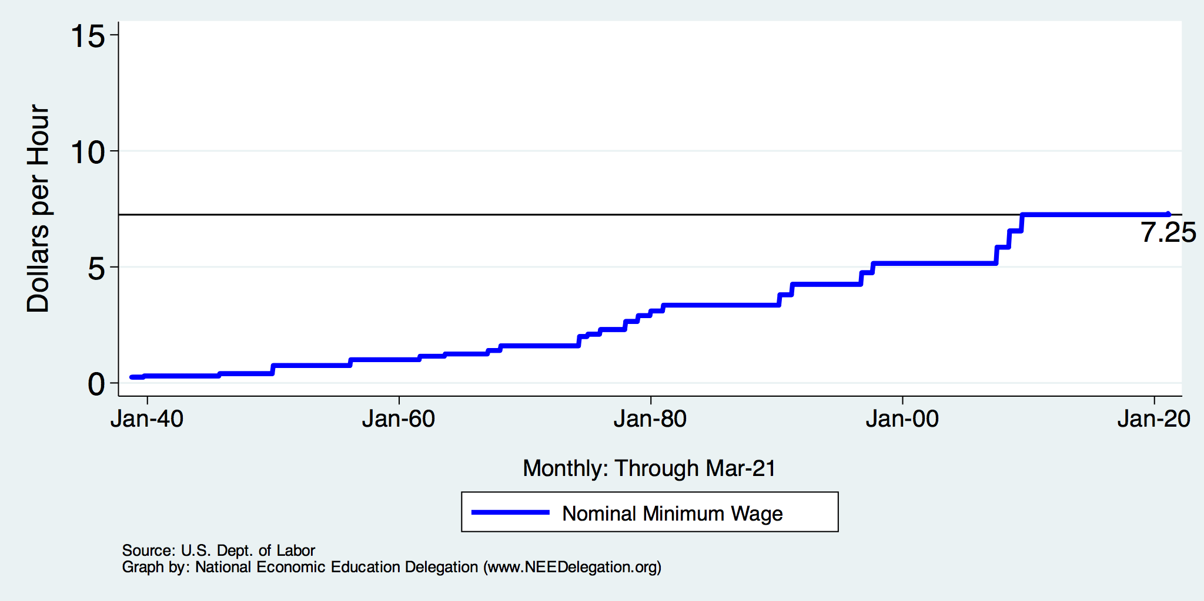
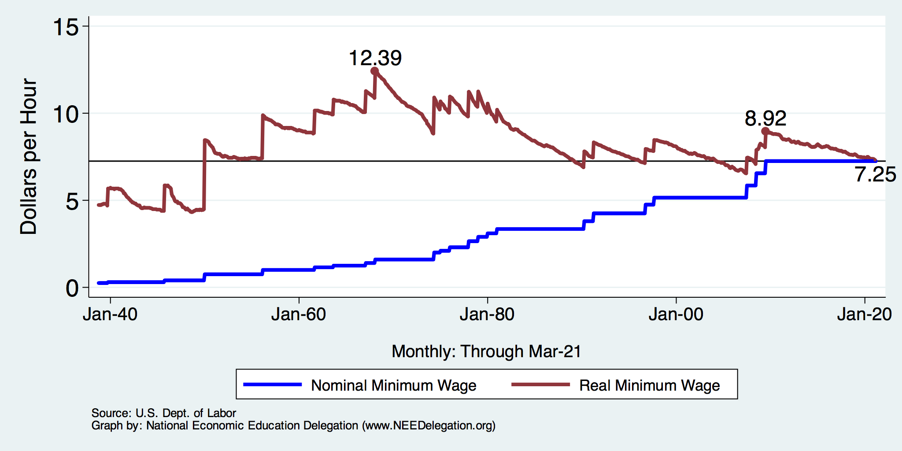
History of the Minimum Wage

Slide 8
Common View of Minimum Wage
Wages go up.
Labor costs go up.
Employment falls and Unemployment increases.
Bottom line: are the increased wages worth the drop in employment?
This is a very SIMPLE view of the minimum wage.
Economics is complicated.

Slide 9
How Much Unemployment will the MW Create?
Very Elastic Supply and Demand
Very Inelastic Supply and Demand

Slide 10
Empirical Evidence
Belman and Wolfson perform meta-analysis combining results from 23 different studies that present their results in the same units (employment or hours of employment) and that report estimates for elasticities and their standard errors, and obtain 439 point estimates.
They find that once a correction for the publication bias and article-specific effects are incorporated, overall elasticities for the United States are statistically insignificant or are very close to zero and hence not economically meaningful. This result is true even when restricting the focus to teenagers and young adults.
More precisely, they find that a 10 percent increase in the minimum wage is associated with a reduction in employment or hours of employment between −0.0 and −2.6 percent but less than half of the estimates are statistically significant.
Of those estimates that are statistically significant, the range is between −0.1 percent and −0.03 percent.

Slide 11
Market Structure
The previous graphs and analysis using Supply and Demand assumes perfectly competitive labor market.
Numerous employers
Numerous workers
Each behaving as price taker and with no market power
Data shows that labor markets are very monopsonistic
Monopsony is when there is only one buyer or a single buyer that dominates the market.
Similar to monopoly, where there is only one seller.
Both monopoly and monopsony are an example of a market failure and provide inefficient market allocations.

Slide 12
What types of markets are there?
More Competition
Less Competition
Perfect Competition
Monopolistic Competition
Monopoly
Oligopoly
Duopoly
Monopsony
Less Concentration
More Concentration

Slide 13
Monopsony in the Labor Market and MW
Coal mine owner in town where coal mining is the primary source of employment.
The government in the employment of civil servants, nurses, police and army officers.
Walmart, Amazon, Uber
Universities
Hospitals
Even if a firm is not a pure monopsony, it may have a degree of monopsony power, due to geographical and occupational immobilities, which make it difficult for workers to switch jobs and find alternative employment.

Slide 14
Monopsony in the Labor Market and MW
Higher, well chosen minimum wage can raise employment in a labor market where firms enjoy monopsony power.
Seminal paper by Stigler (1946)

Slide 15
Real Minimum Wage and Productivity
If minimum wage would keep up with productivity increases and keep up with inflation it would be over $24 per hour.

Slide 16
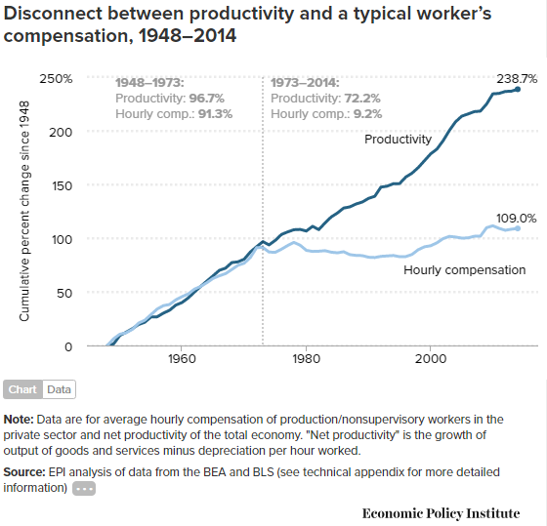

Slide 17
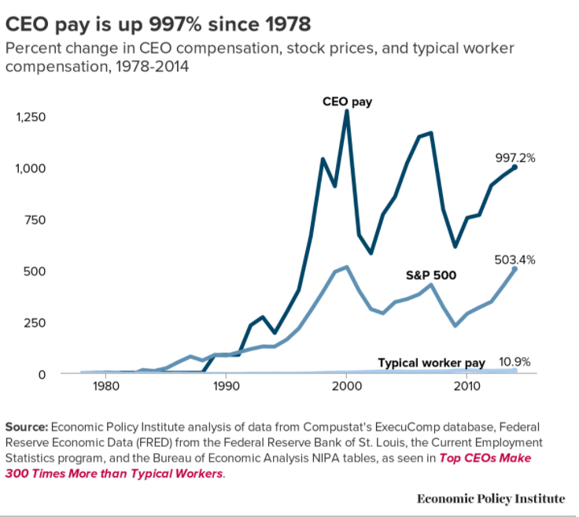
CEO compensation has grown 940% since 1978
Typical worker compensation has risen only 10.9% during that time
CEOs now earn 320 times as much as a typical worker. Until 1975, this number was around 50.

Slide 18
Simple Views are Incomplete
A minimum wage need not reduce employment.
An increase in the minimum wage can hurt its intended beneficiaries - even with no employment effect.
This incompleteness comes from potential firm responses:
Output prices
Nonwage compensation
Other job attributes:
Effort requirements, safety measures, quality of working environment.
Because business settings vary, the responses across these areas will differ across industries and between firms within an industry.
No single answer is possible.

Slide 19
Responses by Employer
Reduce employment of low wage workers.
Produce less.
Reduce dependence on low skilled labor
Using more capital or more of labor with higher skills.
Raise prices to consumers.
Offsets the increase in labor costs, blunting the drop in employment.
However, it also erodes the income gains of min wage increase.
Reduce nonwage compensation.
Health care, paid leave, etc.
Alter other job attributes.
Effort requirements, safety, general quality of the work environment, flexibility of schedules.
Offshore production.
Experience lower profits.
Close down.

Slide 20
Responses by Employee
Increase their supply of labor.
Growing the labor force.
Value the job more highly.
Increased effort.
Reduced job search.
Use the increased income to:
Better the lives of their family.
Invest in training and education.

Slide 21
Arguments FOR a Minimum Wage
Basic:
It raises the standard of living for minimum wage workers.
In 2019, CBO projected increases for 17 million people with an increase to $15/hour by 2025.
Secondary - Less consensus:
Improved employee morale.
Less turnover, greater productivity.
Economic growth potential.
Increased purchasing power among low wage workers may increase aggregate demand.
Reduce gender disparities in wages.
A greater proportion of female workers are paid the minimum wage.
Proportions across race and ethnicity do not differ significantly.
Source: https://www.investopedia.com/articles/markets-economy/090516/what-are-pros-and-cons-raising-minimum-wage.asp

Slide 22
Arguments AGAINST a Minimum Wage Hike
Basic:
Increased labor costs lowers employment among low wage workers.
Particular effect on:
Small businesses.
Labor intensive industries.
Secondary:
Increases the cost of living – inflation.
Producers may raise prices to offset the increase in labor costs.
May change the nature of the workplace environment.
Source: https://www.investopedia.com/articles/markets-economy/090516/what-are-pros-and-cons-raising-minimum-wage.asp

Slide 23
Who Wins? No Clear Answer
Minimum wage is more likely to be beneficial at lower wages and with smallish changes.
The spillover effects of an increase in the minimum wage are not well understood:
Increased effort and employee retention.
Increase in prices/inflation.
Reduction of nonmonetary compensation.
“Conservative/Liberal” divide in the profession
Conservatives – emphasize job losses
Liberals – minimize job losses
Both are incomplete…..

Slide 24
Raise the Wage Act 2021 (RWA)
Raise the federal minimum wage from $7.25 to $15 by 2025;
Index the federal minimum wage to median wage growth;
Eliminate multiple minimum wages:
End tipped workers lower minimum wage;
End teen worker lower minimum wage;
End subminimum wage certificates for workers with disabilities.

Slide 25
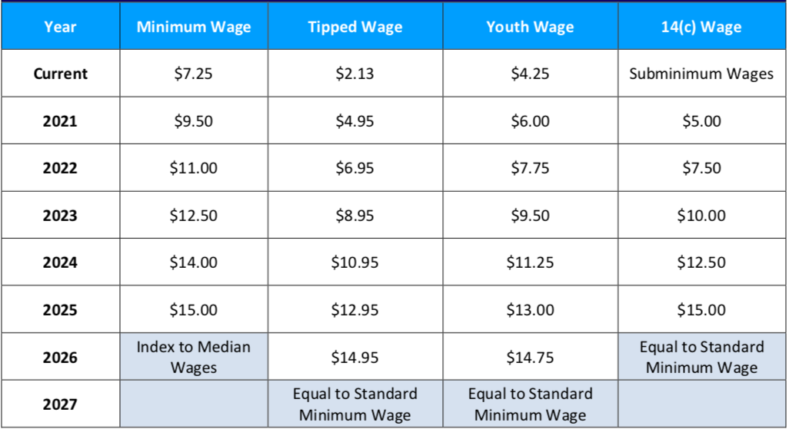
Scheduled Min Wage Increases Under RWA

Slide 27
Economic Consensus on $15/hour? NO
Increases are well outside the range of previous experience.
Ambiguous impact on affected worker’s living standards:
Negative: unemployment, lower on the job amenities, inflation
Positive: higher wages
Likely NOT an improvement for business owners.
Unless it induces implausibly high levels of increased worker effort.
Implications for broader society are unclear.
But the minimum wage is implemented as an efficiency tradeoff for equity.
It is a policy that reflects society’s values regarding the welfare of workers.

Slide 28
CBO Analysis
Effects of increase to $15 – summary:
Increased wages for 27 million people in 2025.
17 million who would be below $15/hour.
10 million who would have earned just above $15/hour.
Increased labor compensation of $333 billion between 2021 and 2031.
$509B in increased pay.
$175B less because of job losses.
Put 1.4 million out of work (0.9% of workers).
Primarily young, less educated workers.
Lift 900,000 out of poverty.
2019: 34 million people lived in poverty.
https://www.cbo.gov/system/files/2021-02/56975-Minimum-Wage.pdf

Slide 29
What to make of the CBO results?
Primary Results
Increased wages for 27 million people.
1.4 million fewer low wage jobs.
900,000 lifted out of poverty.
Reasonable people can, and do, disagree about whether or not the tradeoff is worth it.
Important question: Is there a better policy instrument?
Up for consideration: expanding the Earned Income Tax Credit.
Also raises the incomes of low wage workers, but puts taxpayers on the hook instead of businesses.
Again, reasonable people can, and do disagree about whether this is better.
Up for consideration: Can trade unions do a better job in wage negotiation?

Slide 30
Summary
The minimum wage has been around since 1938.
The comprehensiveness of its coverage has steadily increased.
The Federal minimum wage is currently $7.25/hour.
It’s level has fluctuated, both up and down in inflation adjusted terms.
It is currently 41% below it’s peak in the 1960s.
There are perfectly valid arguments for and against it.
Economics is not currently able to provide a definitive answer.
Depends on the tradeoff between higher wages and employment.
The textbook exposition (price up -> quantity down) is a gross simplification.
The reality of its evaluation is much more complicated.
The FEDERAL minimum wage is waning in importance.
States take up the mantel.
Economists do not have a clear position or anything like consensus on the issue.
But the research is trending in the direction toward benefits (improved living standards) and away from direct costs (unemployment).

Slide 31
Most Important Point: It’s Complicated
Minimum wage helps some (many) workers, but has negative consequences.
Little or no evidence of net benefits for low-income families.
There are winners and losers from a higher minimum wage.
Policymakers and the public then have to decide if enough of the gains are going to those they want to help, to offset the losses for others.
There are other policies that likely work better.

Slide 32
Thank you!
Any Questions?
www.NEEDelegation.org
<presenter name>
<presenter email>
Contact NEED: info@needelegation.org
Submit a testimonial: www.NEEDelegation.org/testimonials.php
Become a Friend of NEED: www.NEEDelegation.org/friend.php

