Slide 1
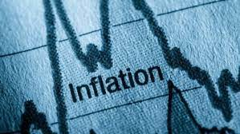
Inflation
Rotary Club of West Marin
July 13, 2022
Scott Baier
Professor and Chair
John E. Walker Department of Economics

Slide 2
National Economic Education Delegation
Vision
One day, the public discussion of policy issues will be grounded in an accurate perception of the underlying economic principles and data.
Mission
NEED unites the skills and knowledge of a vast network of professional economists to promote understanding of the economics of policy issues in the United States.
NEED Presentations
Are nonpartisan and intended to reflect the consensus of the economics profession.

Slide 3
Inflation as measured by the CPI Index
9.1

Slide 4
Inflation as measured by the CPI Index
9.1
5.9

Slide 5
Inflation: More Broad-based
Category | Inflation | Weight in CPI
All Items | 9.1
Food | 10.4 | 13.4
Energy | 41.6 | 8.7
Apparel | 5.2 | 2.5
Shelter | 5.6 | 32.3
New Vehicles | 11.4 | 4.0
Used Vehicles | 7.1 | 4.0

Slide 6
Quick Outline
Causes of Inflation in the United States
Demand Side Effects and the Fed
Supply Side Effects
Profiteering and Greed
Global Inflation: Are their differences?
What is next for Inflation and what does the Fed do next.

Slide 7
Demand Side Effects and the Recovery
Consumer spending bounced back quite dramatically as the economy was reopening
Remember Consumer Spending is roughly two-thirds of GDP

Slide 8
Demand Side Effects: Disposable Income

Slide 9
Nominal Consumer Spending on Goods and Services
Normalize
value to 100
at start of the pandemic
Source: Bureau of Economic Analysis

Slide 10
PCE Inflation: Goods and Services
Source: Bureau of Economic Analysis

Slide 11
M2 Growth:
6 percent

Slide 12
M2 Growth
Growth Rate of Money Stock (percent per year) | Beginning of Period | End of Period
6.15 | January 2000 | March 2020
28.8 | March 2020 | December 2020
9.50 | December 2020 | May 2022

Slide 13
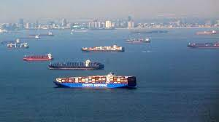
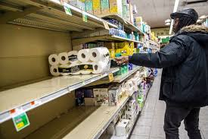
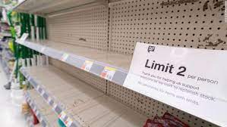
Supply Chain Disruptions

Slide 14
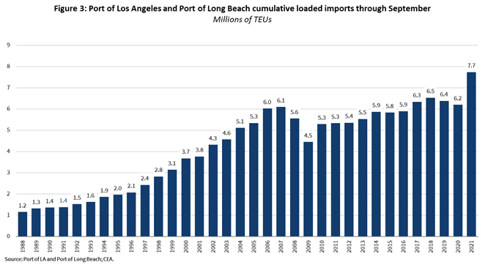
Supply Chain Disruptions: LA and Long Beach

Slide 15
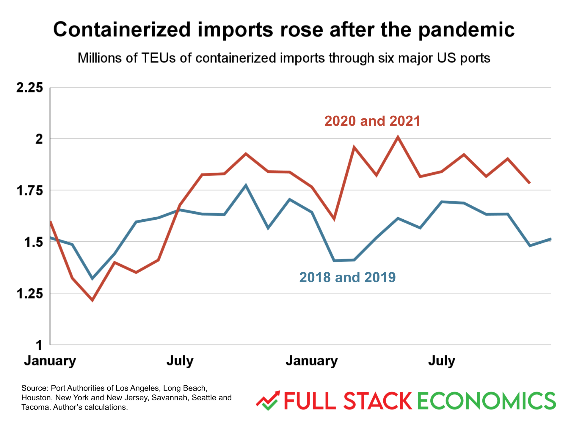
Supply Chain Disruptions: Containerized Imports

Slide 16
Supply Chain Disruptions: Retail Inventories

Slide 17
Profits: Profit Margins
No historical correlation between profit margins and inflation
Rise in profit margins partly due to change in ta codex
After-Tax Profit Margins
After-Tax and Before Tax Profit Margins

Slide 18
Wage Growth by Industry
Inflation Rate

Slide 19
Prices at the Pump
While inflation is defined as a general rise an overall increase in prices across a wide range of goods and services, it is difficult to not mention, at least in passing, gas prices.
Why have gasoline prices increased so much and where are they heading?
An increase in the price of crude oil: Part demand-driven and part supply-driven.
Refineries are just getting back to productive capacity
Disruptions have caused refiners to find oil from different sources.
Will gas prices fall in the near future?

Slide 20
Is Inflation a Global Phenomenon?
Yes, but the sources may be different.
In terms of basic supply and demand …..
If the price increases are demand-driven, we will see higher prices and higher quantities – positive demand shocks
If the price increases are supply-driven, we will see higher prices and lower quantities – negative supply shocks.
We can look at real GDP and Nominal GDP
If real GDP is at or above trend, supply shocks are likely to be less important.
If nominal GDP is above trend, it is likely the case that demand shocks are more important.

Slide 21
Is Inflation a Global Phenomenon?
It looks like Supply shocks are more important in the EURO area
Source: BLS / FRED

Slide 22
Is Inflation a Global Phenomenon?
For the US it looks like demand shocks are more important

Slide 23
Outlook: Where do we go from here
There is some momentum to inflation and inflationary expectations and it may take time to bring down inflation and inflationary expectations.
After today’s release, the market assessment it is likely that the Fed will increase rates by 75 to 100 basis points at the next meeting.

Slide 24
Who Are We?
Honorary Board: 54 members
2 Fed Chairs: Janet Yellen, Ben Bernanke
6 Chairs Council of Economic Advisers
Furman (D), Rosen (R), Bernanke (R), Yellen (D), Tyson (D), Goolsbee (D)
3 Nobel Prize Winners
Akerlof, Smith, Maskin
Delegates: 645+ members
At all levels of academia and some in government service
All have a Ph.D. in economics
Crowdsource slide decks
Give presentations
Global Partners: 49 Ph.D. Economists
Aid in slide deck development

Slide 25
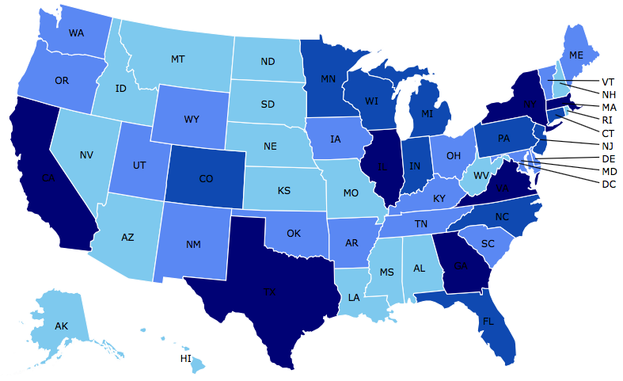
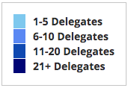
Where Are We?

Slide 26
Credits and Disclaimer
This slide deck was authored by:
<name>, <affiliation>
This slide deck was reviewed by:
<name>, <affiliation>
<name>, <affiliation>
Disclaimer
NEED presentations are designed to be nonpartisan.
It is, however, inevitable that the presenter will be asked for and will provide their own views.
Such views are those of the presenter and not necessarily those of the National Economic Education Delegation (NEED).

Slide 27
Thank you!
Any Questions?
www.NEEDelegation.org
<presenter name>
<presenter email>
Contact NEED: info@needelegation.org
Submit a testimonial: www.NEEDelegation.org/testimonials.php
Become a Friend of NEED: www.NEEDelegation.org/friend.php

Slide 28
Available NEED Topics Include:
Coronavirus Economics
US Economy
Climate Change
Economic Inequality
Economic Mobility
Trade and Globalization
Minimum Wages
Immigration Economics
Housing Policy
Federal Budgets
Federal Debt
Black-White Wealth Gap
Autonomous Vehicles
US Social Policy

