Slide 1
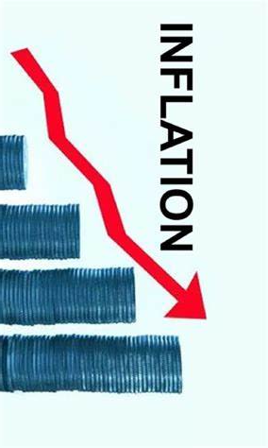
Inflation
Northern Marin Breakfast Club
May 30, 2024
Jon Haveman, Ph.D.
Executive Director
National Economic Education Delegation

Slide 2
National Economic Education Delegation
Vision
One day, the public discussion of policy issues will be grounded in an accurate perception of the underlying economic principles and data.
Mission
NEED unites the skills and knowledge of a vast network of professional economists to promote understanding of the economics of policy issues in the United States.
NEED Presentations
Are nonpartisan and intended to reflect the consensus of the economics profession.

Slide 3
Who Are We?
Honorary Board: 54 members
2 Fed Chairs: Janet Yellen, Ben Bernanke
6 Chairs Council of Economic Advisers
Furman (D), Rosen (R), Bernanke (R), Yellen (D), Tyson (D), Goolsbee (D)
4 Nobel Prize Winners
Akerlof, Smith, Maskin, Bernanke
Delegates: 652+ members
At all levels of academia and some in government service
All have a Ph.D. in economics
Crowdsource slide decks
Give presentations
Global Partners: 49 Ph.D. Economists
Aid in slide deck development

Slide 4
Outline
The Current State of Inflation
Root Causes of Inflation
A Little Bit of History
Solutions: The Fed
What Happens Next?

Slide 5
Inflation: Latest Figures – Headline - CPI

Slide 6
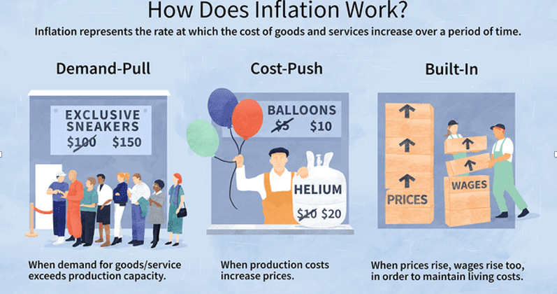
Source: Investopedia

Slide 7
Spending Patterns Changed - More Goods!
Demand-Pull

Slide 8
Inflation: Concentrated
Cost-Push

Slide 9
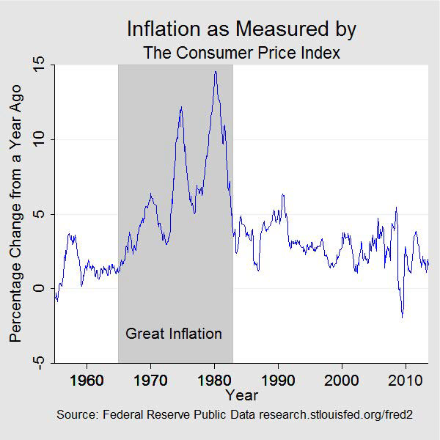
The Great Inflation: 1965-1982
Proximate causes
Collapse of the gold standard
Fiscal imbalances (Great Society)
Runaway monetary policy (for Nixon)
Price controls – after they were lifted
Energy shortages
Lots of “demand pull”
Great society, easy money
Some “cost push”
Energy shortages
Notes:
https://www.federalreservehistory.org/essays/great-inflation

Slide 10
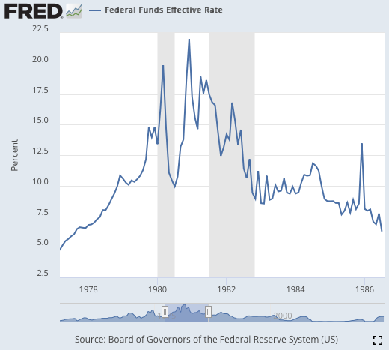
Low Inflation Period: 1980-2021
Volcker – stranglehold on inflation in 1980.
Causes a recession through high interest rates.
Harnesses inflation.
Next 4 decades
Globalization – lower import prices.
Deunionization (private sector)
21% in 1980
6% in 2019

Slide 11
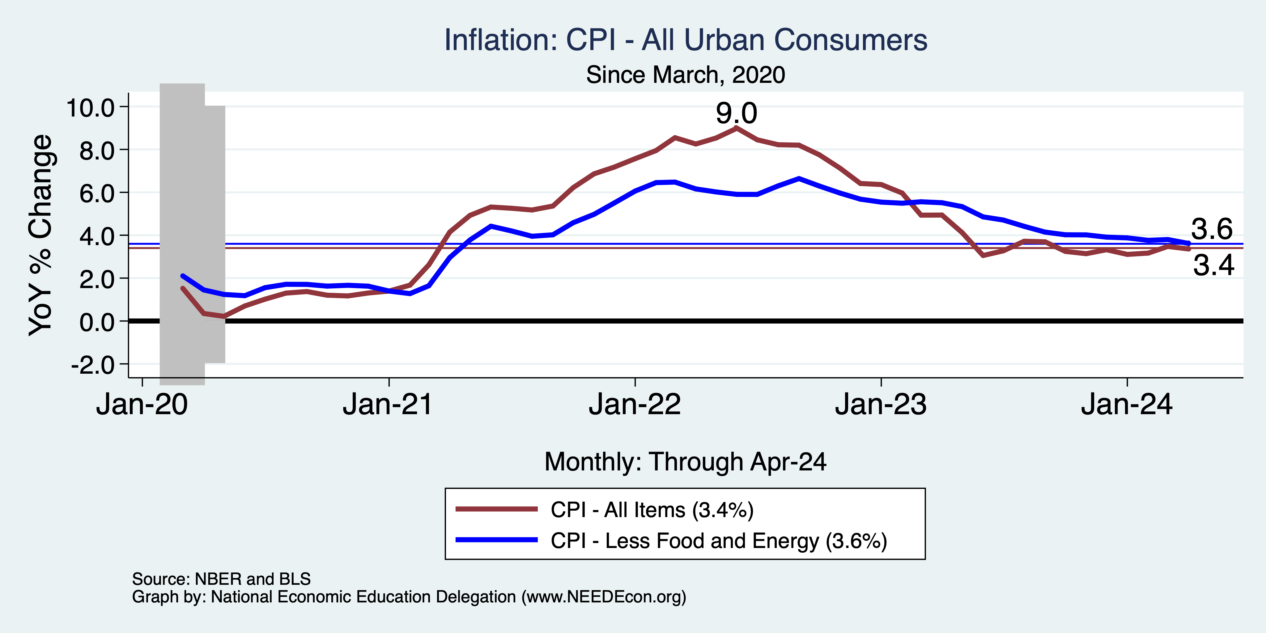
That Brings us to the Pandemic
Notes:
Cpi_recent.png

Slide 12
Which Prices?
Car Costs
Housing Costs

Slide 13
Gas Prices: National Average at the Pump
Rising demand
Refinery maintenance
“summer blends”

Slide 15
Housing is the Primary Problem

Slide 16
The Importance & Problems with Rents
Shelter is 36% of CPI
- 45% of Core CPI.
About half as much in PCE.
Notes:
Shelter is 36% of CPI and 45% of Core CPI. About half as much in PCE. CPI less shelter is 2.3% sine March of last year. Shelter is up 5.8%

Slide 17
Fed’s Preferred Measure: PCE

Slide 18
PCE Deviation from Target

Slide 19
CPI Deviation from Target

Slide 20
PCE vs CPI – What’s the Difference?
Scope
CPI – urban PCE – more comprehensive
Formulas
Many different formulas to choose from. BEA vs BLS.
Important: PCE updates purchasing patterns more frequently.
Weights
E.g., housing
Other reasons
Sometimes choose to measure prices differently.
Notes:
https://www.whitehouse.gov/cea/written-materials/2023/09/29/crosswalk-talk-whats-the-difference-between-the-pce-and-the-cpi/#:~:text=The%20CPI%20also%20focuses%20exclusively,to%20measure%20the%20same%20item.

Slide 21
About that 2% Target
There is no specific basis for it.
Head of the New Zealand central bank said: I’m targeting 2%.
Everybody else said: ok, let’s do that.
Will it be ok if inflation stays at around 3.5%?
Probably.
Unless you’re running for president.

Slide 22
High Prices versus Inflation

Slide 23
Wage Growth – Exceeds Inflation
Notes:
Is this necessary given the previous slide?

Slide 24
Sources of Pandemic Inflation
Supply Chain issues were significant – less so now.
Composition of spending changed significantly.
Is now bouncing back, as are prices.
But there was too much total spending.
Fiscal stimulus led households to increase saving over 2021 by more than $2 trillion. Strong retail sales numbers suggest they are prepared to spend it.
Whose to Blame: ARP probably too big, but the Fed could have acted sooner.
Bottom line: Recovery from a dramatic economic disruption is seldom painless.

Slide 25
Supply Chains
Cost-Push

Slide 26
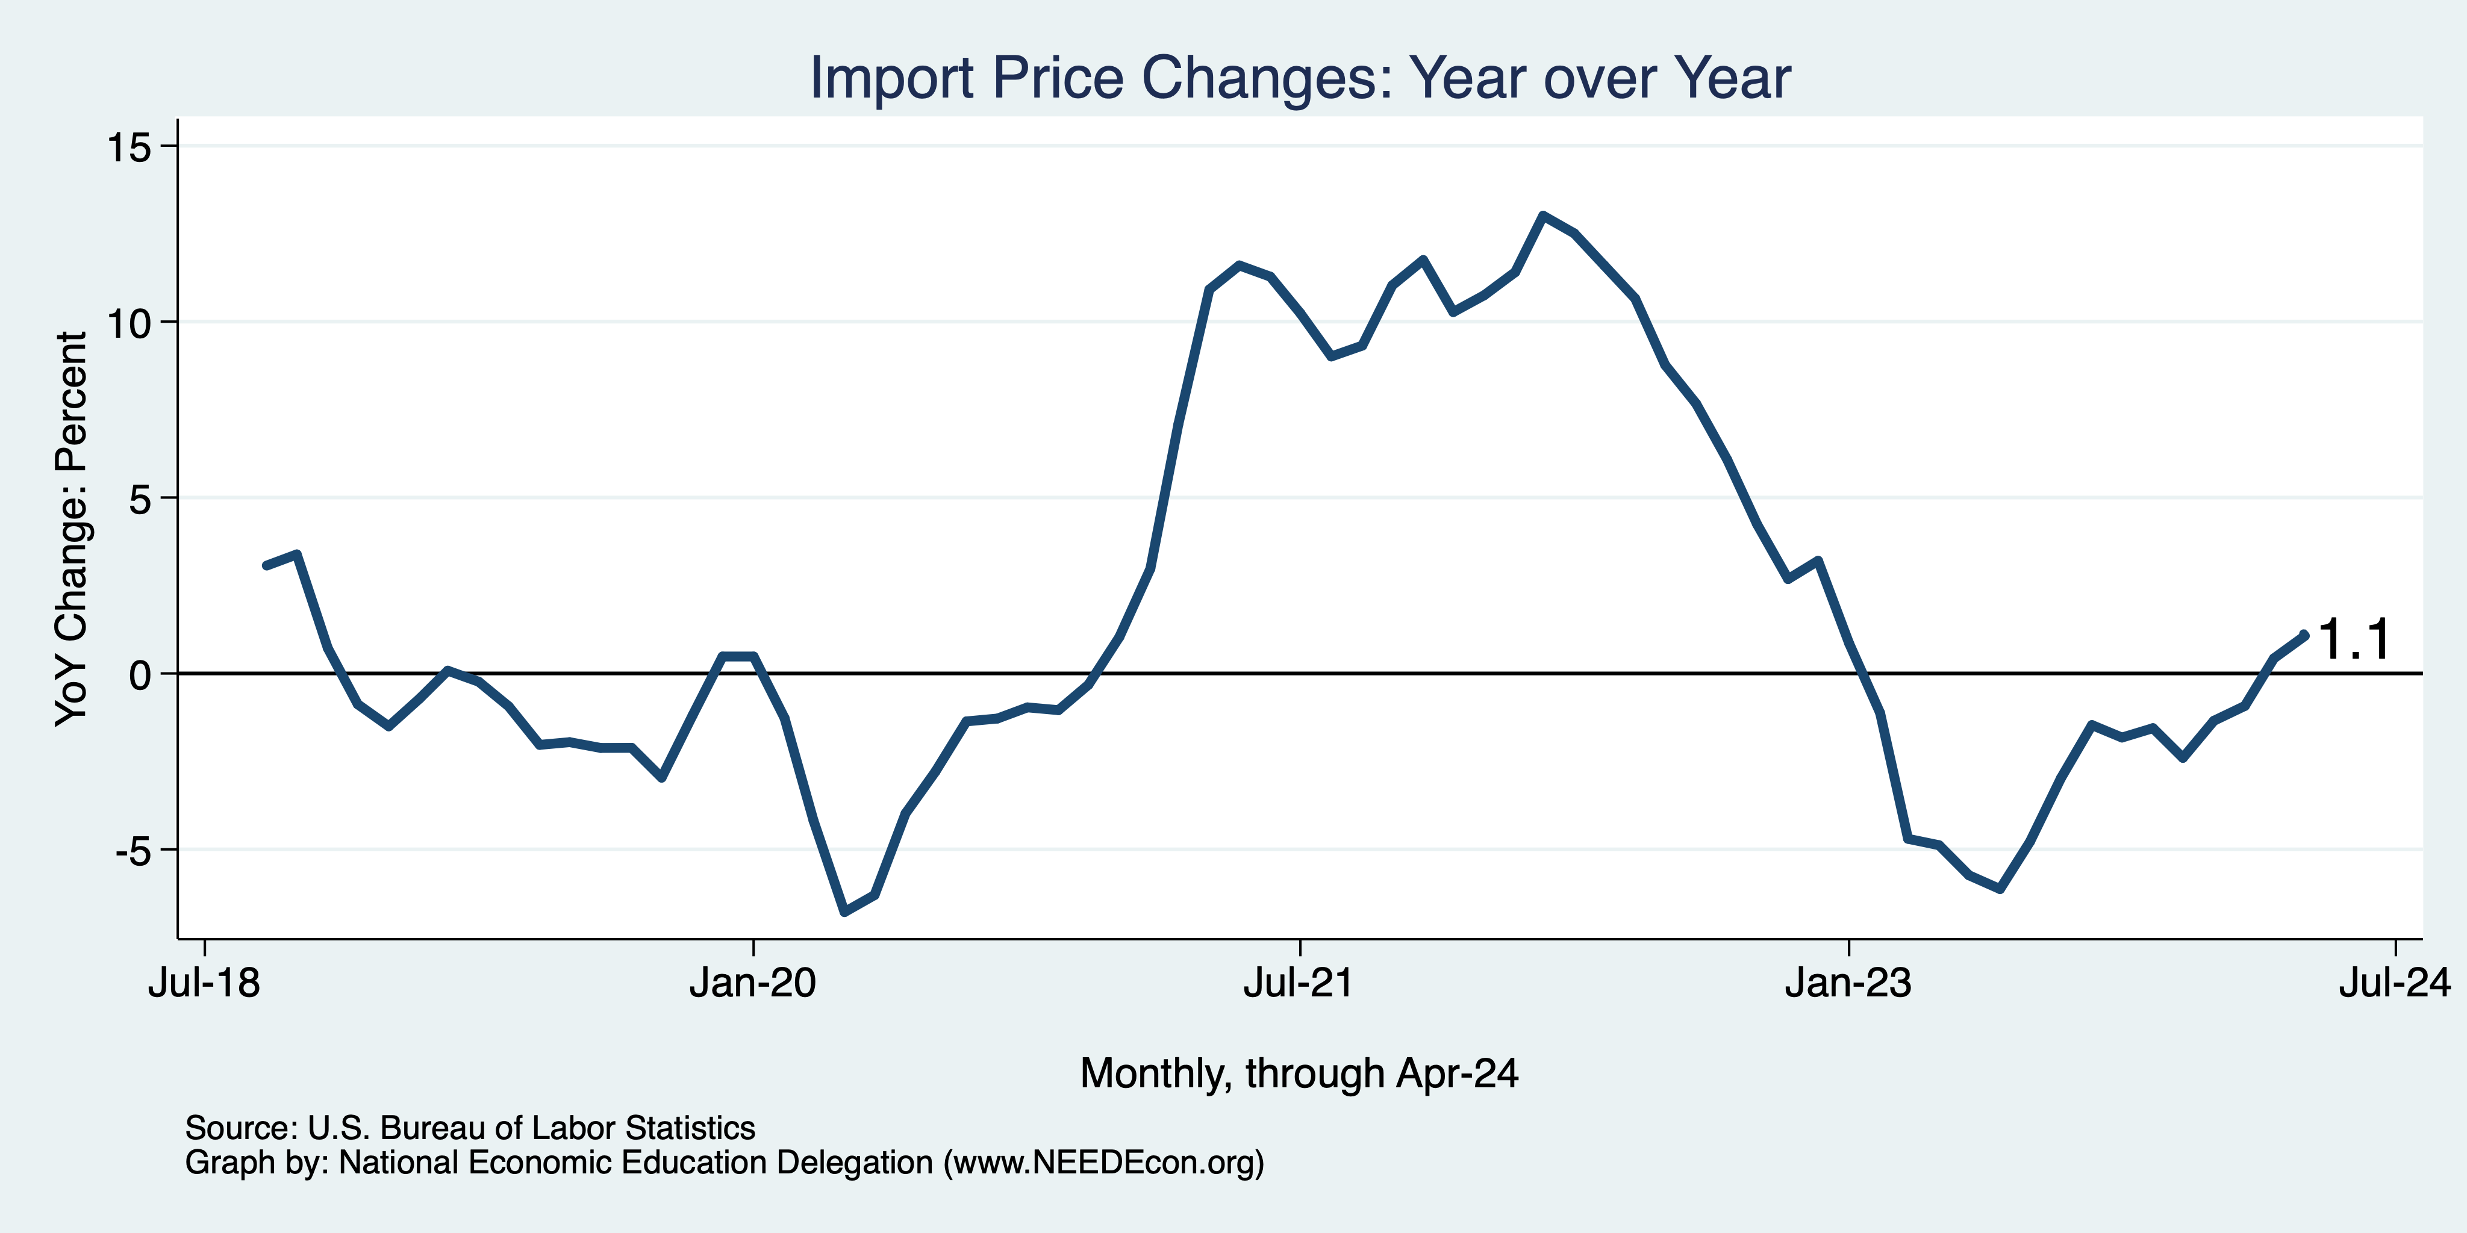
Import Prices Are Elevated
Inflation – Imported Products: 9-10%

Slide 27
Corporations Have Pricing Power!
Corporate Profits

Slide 28
Shrinkflation
Notes:
https://www.nytimes.com/2024/04/10/learning/whats-going-on-in-this-graph-april-17-2024.html

Slide 29
The Fed: Reining in Inflation!

Slide 30
Fed: Reducing its Asset Holdings
Quantitative Tightening

Slide 31
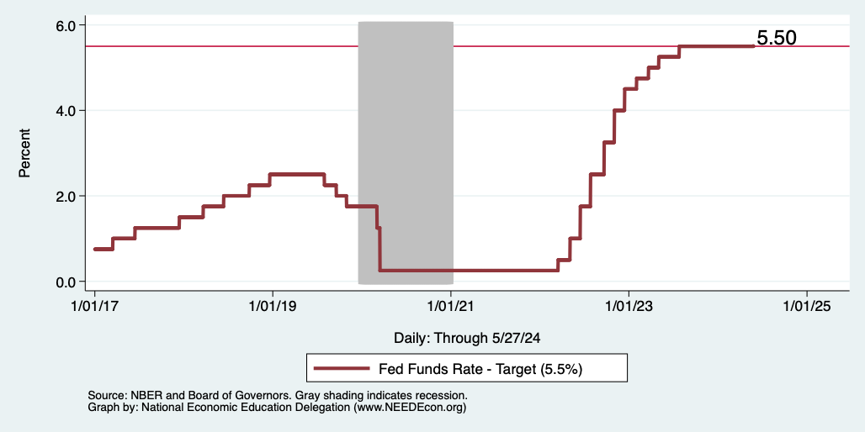
Federal Funds Rate
Notes:
The fed funds rate is the interest rate on overnight loans between banks. Think of it as the baseline interest rate on which banks base all other interest rates (e.g. mortgage rates)
FOMC lowers the fed funds rate during recessions and raises the fed funds rate during expansions
Fed funds rate peaked in the 1980s as then Chairman Paul Volcker sought to reign in “run away” inflation of the 1970s; doing so resulted in a recession in the early 1980s.
Since the 2008-09 recession, the fed funds rate has been kept near zero.
During the 2008-09 recession, Federal Reserve turned to unconventional tools to influence longer term interest rates to further stimulate the economy - QE
FedFunds.png

Slide 32
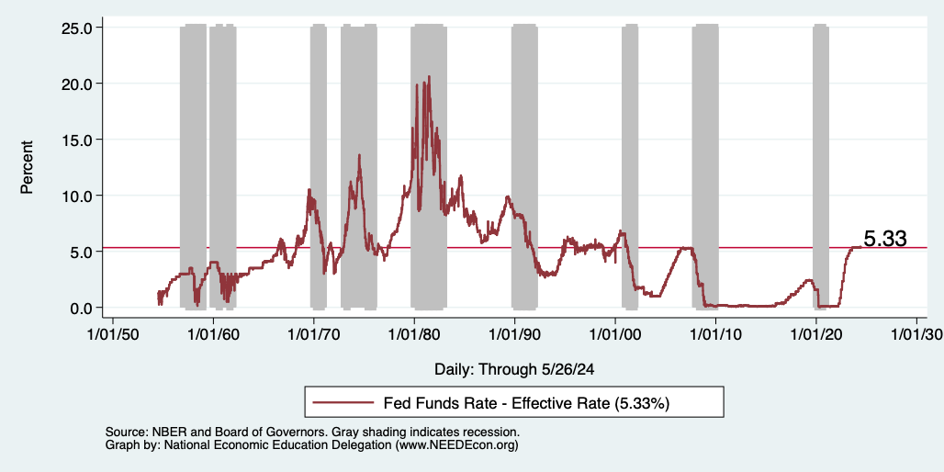
Federal Funds Rate
Notes:
The fed funds rate is the interest rate on overnight loans between banks. Think of it as the baseline interest rate on which banks base all other interest rates (e.g. mortgage rates)
FOMC lowers the fed funds rate during recessions and raises the fed funds rate during expansions
Fed funds rate peaked in the 1980s as then Chairman Paul Volcker sought to reign in “run away” inflation of the 1970s; doing so resulted in a recession in the early 1980s.
Since the 2008-09 recession, the fed funds rate has been kept near zero.
During the 2008-09 recession, Federal Reserve turned to unconventional tools to influence longer term interest rates to further stimulate the economy - QE
FedFunds.png

Slide 33
Treasuries
Notes:
treas_recent.png

Slide 34
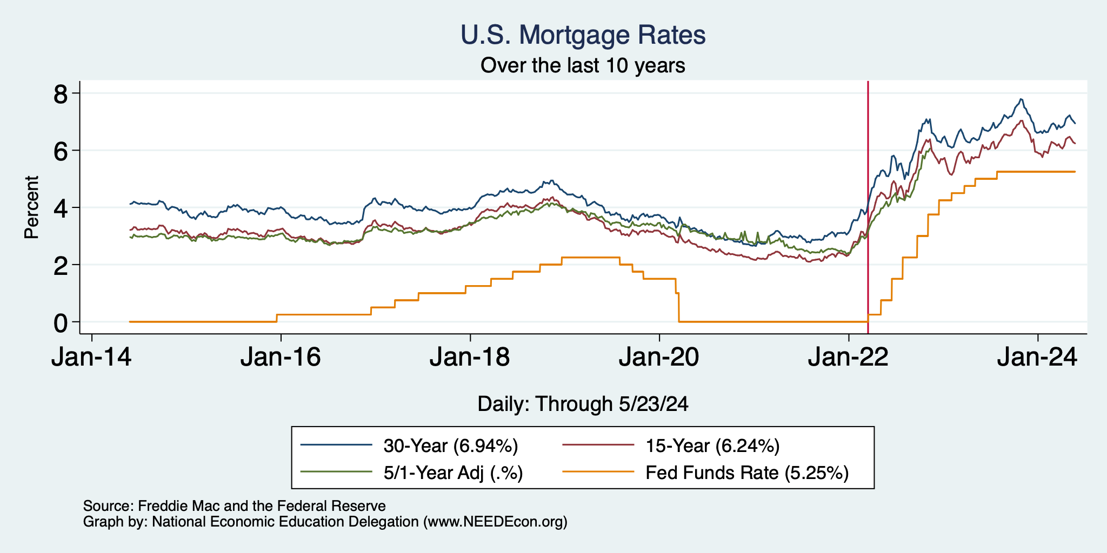
Mortgage Rates

Slide 35
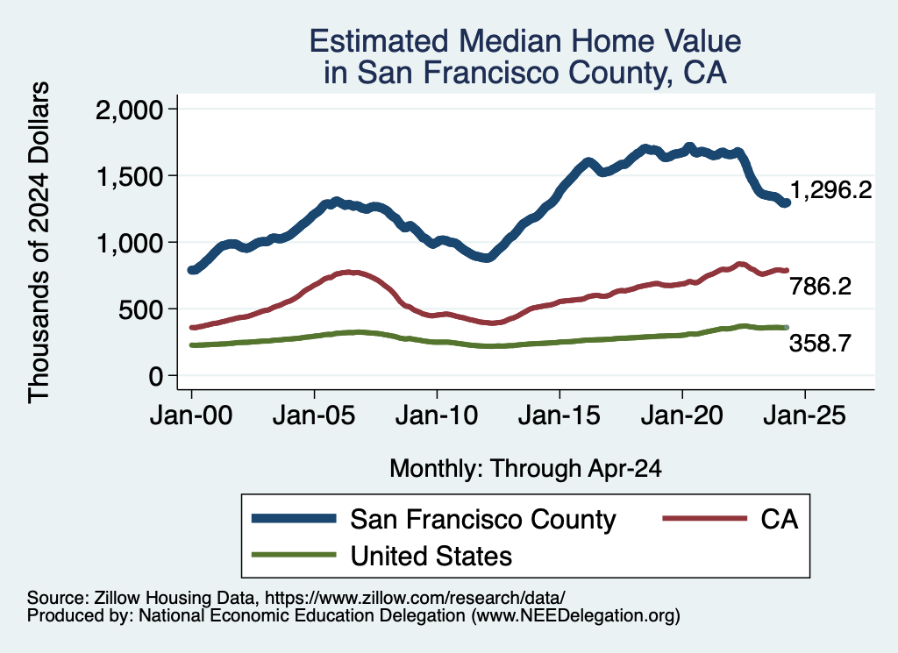
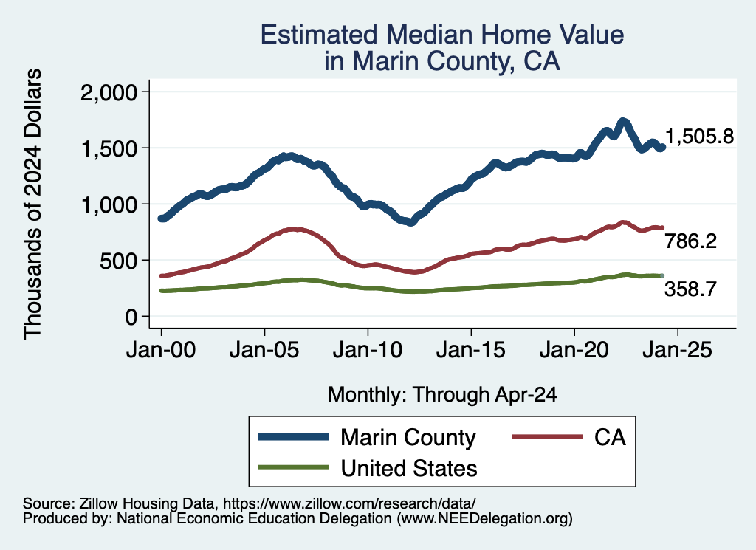
Home Prices … in Northern CA
Notes:
Charts:
homeprices_recession.png
housing.png

Slide 36
What will the Fed Do?
Pending Developments:
May- June 12 full set of inflation and unemployment for April.
Wednesday, June 12 Fed policy meeting with new economic projections.
Will likely hold rates fixed unless there is significant progress on PCE.
Notes:
GDPNow 2.4%; blue chips consensus 1.5% implies 2.9%, or 2.7%

Slide 37
Parting Thoughts on Inflation
Was Milton Friedman right?
“Inflation is always and everywhere a monetary phenomenon.”
As a generalization, but not ”always and everywhere”.
See price changes from disruptions in the economy.
What did we see during the pandemic?
Lots of causes that had nothing (?) to do with monetary policy.
Where is inflation going?
I expect back down to close to 2% sometime next year.

Slide 38
Thank you!
Any Questions?
www.NEEDEcon.org
Jon D. Haveman
Jon@NEEDEcon.org
Contact NEED: info@NEEDEcon.org
Submit a testimonial: www.NEEDEcon.org/testimonials.php
Become a Friend of NEED: www.NEEDEcon.org/friend.php

