Slide 1
Introduction to NEED
I-NeXT Kiwanis Club
February 20, 2022
Jon Haveman, Ph.D.
Executive Director
National Economic Education Delegation

Slide 2
National Economic Education Delegation
Vision
One day, the public discussion of policy issues will be grounded in an accurate perception of the underlying economic principles and data.
Mission
NEED unites the skills and knowledge of a vast network of professional economists to promote understanding of the economics of policy issues in the United States.
NEED Presentations
Are nonpartisan and intended to reflect the consensus of the economics profession.

Slide 3
Who Are We?
Honorary Board: 54 members
2 Fed Chairs: Janet Yellen, Ben Bernanke
6 Chairs Council of Economic Advisers
Furman (D), Rosen (R), Bernanke (R), Yellen (D), Tyson (D), Goolsbee (D)
3 Nobel Prize Winners
Akerlof, Smith, Maskin
Delegates: 649+ members
At all levels of academia and some in government service
All have a Ph.D. in economics
Crowdsource slide decks
Give presentations
Global Partners: 49 Ph.D. Economists
Aid in slide deck development

Slide 4
Where Are We?

Slide 5
On the Need for NEED
“
I’ve never seen the disjunction between the political debate about economics and the consensus of economists be as large as it is today.
Justin Wolfers, University of Michigan
“
The misuse of economic data is widespread and there is no countering, clarifying force.
This leads to continued misunderstanding of economics and poorly researched and implemented economic policy.

Slide 6
Examples Where Economics Could Help More
Example of the use of economics to push agendas:
Job creators
Tax cuts for the wealthy
Trade policy
Examples of the lack of use of economics to push agendas:
Climate change
Infrastructure
Examples where it is simply misunderstood or underused:
Inequality
Economic mobility
Minimum wage

Slide 7
Example: Minimum Wages
Minimum wage increases are “sold” as beneficial to people with low incomes. However:
A higher minimum wage may lead to unemployment.
Even among those who remain employed, their overall compensation might be lower. Their work environment might be less pleasant.
Minimum wage increases are “sold” as antipoverty programs, However:
They lift relatively few out of poverty.
We should be talking about programs that directly address poverty.
Minimum wages are expensive. Is this the best way to spend money to help the poor?

Slide 8
Example: Tax Cuts for the Wealthy
The wealthy are the investor class, so if we reduce their taxes, they will have more money to invest! This will create jobs!
This may be true, but is it the best way to create jobs? Economic studies have NEVER suggested that the answer is yes.
Giving money to low income individuals increases demand for goods and services.
It is this increase in demand that leads the investor class to invest more.
The United States used to pursue policies that grew the middle class.
Perhaps investing in these policies would be a wiser use of the money from the tax cuts.
Tax cuts for the wealthy are expensive. Is this the best way to spend money to grow the economy?

Slide 9
The Problem: Intuition
The tax cuts argument is intuitive.
The minimum wage argument is intuitive.
The world … is not intuitive. It is highly complex.
Economists and economics help to sort through the complexity.

Slide 10
Another Problem: Economists
We just need to get out more…
…and tell people what we know about important economic policy issues.
That is what NEED is designed to promote.

Slide 11
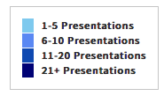
And We Are Having Some Success
Total Audience: 27,078

Slide 12
Available NEED Topics Include:
Coronavirus Economics
US Economy
Climate Change
Economic Inequality
Economic Mobility
Trade and Globalization
Minimum Wages
Immigration Economics
Housing Policy
Federal Budgets
Federal Debt
Black-White Wealth Gap
Autonomous Vehicles
US Social Policy

Slide 13
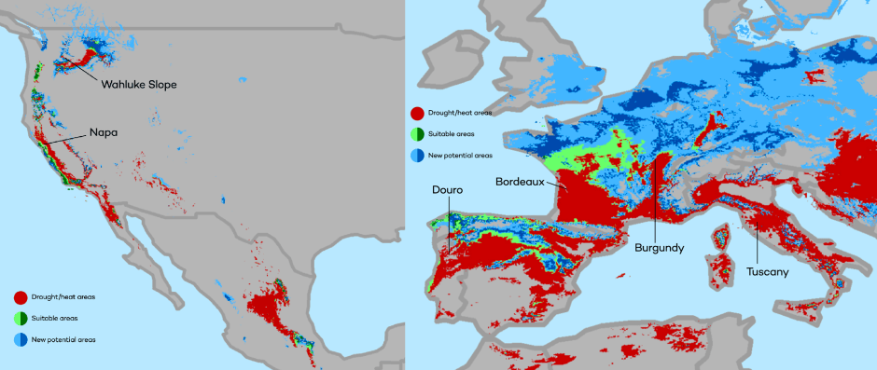
Climate Change Economics
The changing map of the world’s wine-growing regions.

Slide 14
Immigrant Population in 2017
Categories of the total number
of immigrants in the United States.
https://www.pewresearch.org/fact-tank/2019/07/12/how-pew-research-center-counts-unauthorized-immigrants-in-us/

Slide 15
Current State of Infrastructure in the US
Source: https://www.infrastructurereportcard.org/

Slide 16
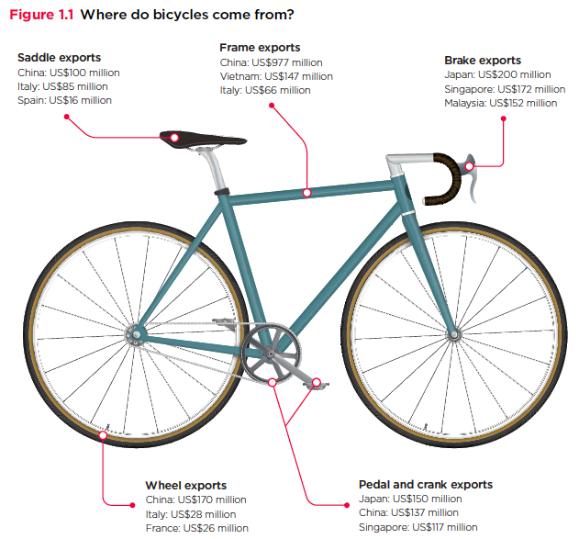
Trade: Bicycle Supply Chain
Source: World Development Report 2020

Slide 17
Evidence of the B-W Wealth Gap
Mean is
7x Greater
Median is 8x Greater

Slide 18
National Income Inequality: Share of Top 10%
Stock Market Crash
WWII
Housing Bubble
Dot-com Bubble

Slide 19
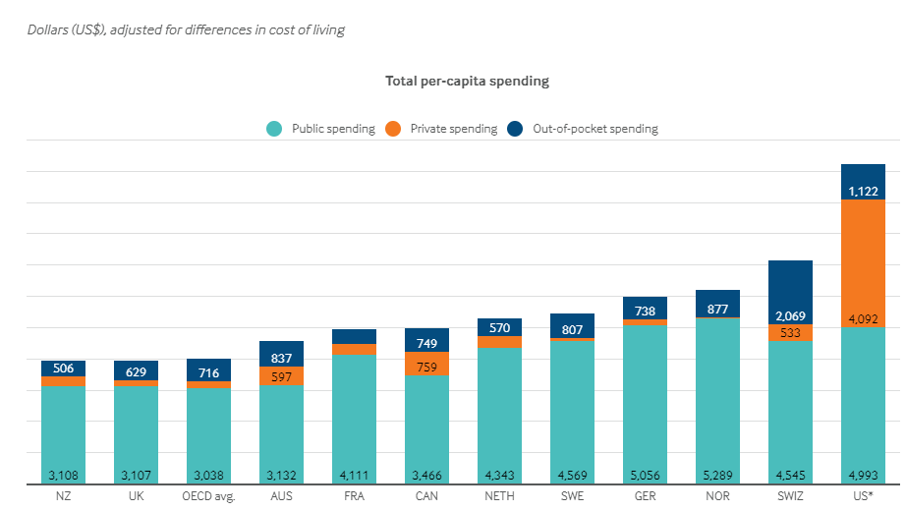
International Comparison: Health Spending
Notes:
Some good resources:
https://www.commonwealthfund.org/publications/issue-briefs/2020/jan/us-health-care-global-perspective-2019
A bit older report: https://www.commonwealthfund.org/publications/issue-briefs/2015/oct/us-health-care-global-perspective
https://www.healthsystemtracker.org/chart-collection/quality-u-s-healthcare-system-compare-countries/#item-overall-age-specific-potential-years-of-life-lost-per-100000-population-1990-2017
https://axenehp.com/international-healthcare-systems-us-versus-world/

Slide 20
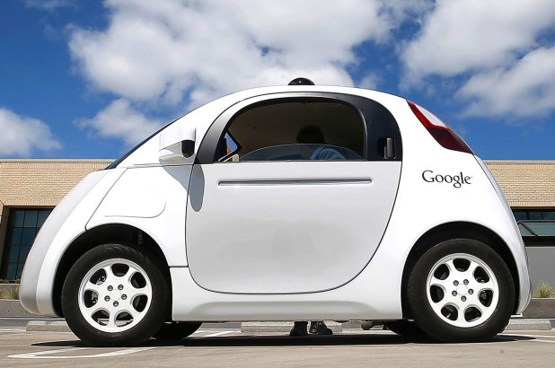
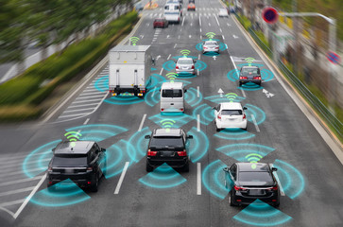
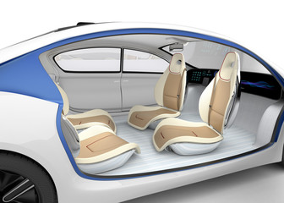
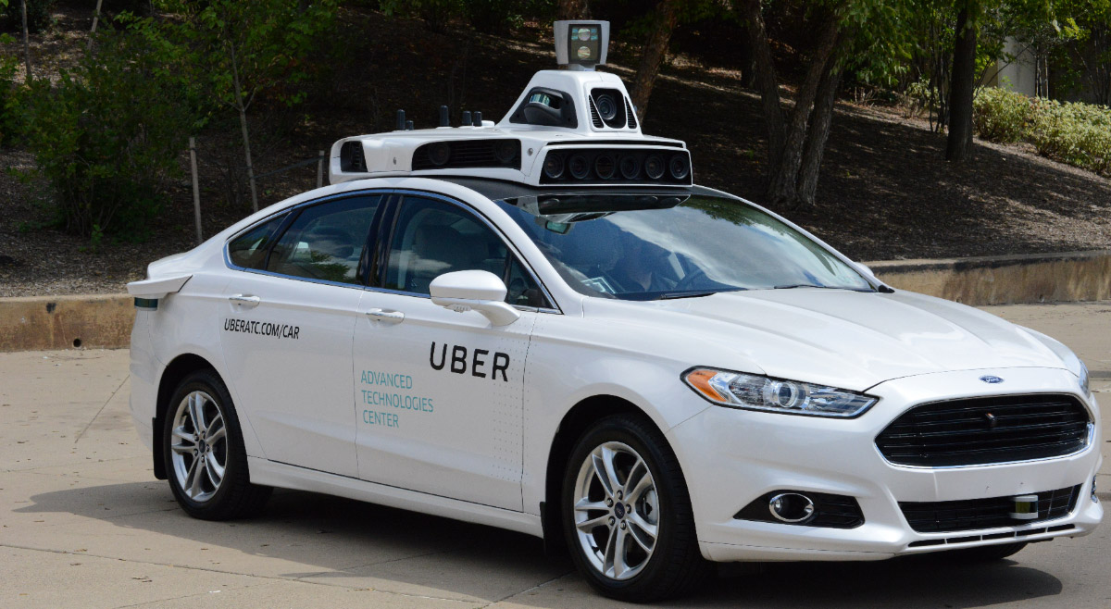
Autonomous Vehicles

Slide 21
Next Steps:
Hi ho, hi ho, it’s off to Congress we go!
Going after the kids in High schools!

Slide 22
Thank you!
Any Questions?
www.NEEDelegation.org
Jon D. Haveman
Jon@NEEDelegation.org
Contact NEED: info@NEEDelegation.org
Submit a testimonial: www.NEEDelegation.org/testimonials.php
Become a Friend of NEED: www.NEEDelegation.org/friend.php

