Slide 1
Can the Fed Prevent a Surge in Inflation?
Geoffrey Woglom
Professor of Economics (Emeritus)
Amherst College
Kiwanis Club of Newberg
May 13, 2021

Slide 2
National Economic Education Delegation
Vision
One day, the public discussion of policy issues will be grounded in an accurate perception of the underlying economic principles and data.
Mission
NEED unites the skills and knowledge of a vast network of professional economists to promote understanding of the economics of policy issues in the United States.
NEED Presentations
Are nonpartisan and intended to reflect the consensus of the economics profession.

Slide 3
Who Are We?
Honorary Board: 54 members
2 Fed Chairs: Janet Yellen, Ben Bernanke
1 Secretary of the Treasury: Yellen (D)
6 Chairs Council of Economic Advisers
Furman (D), Rosen (R), Bernanke (R), Yellen (D), Tyson (D), Goolsbee (D)
3 Nobel Prize Winners
Akerlof, Smith, Maskin
1 Secretary of the Treasury Yellen (D)
Delegates: 585+ members
At all levels of academia and some in government service
All have a Ph.D. in economics
Crowdsource slide decks
Give presentations
Global Partners: 45 Ph.D. Economists
Aid in slide deck development

Slide 4
Available NEED Topics Include:
US Economy
Climate Change
Economic Inequality
Economic Mobility
US Social Policy
Trade and Globalization
Trade Wars
Immigration Economics
Housing Policy
Federal Budgets
Federal Debt
2017 Tax Law
Autonomous Vehicles

Slide 5
Battling Democratic Economists
Treasury Secretary Jane Yellen, 3/14:
To get a sustained high inflation like we had in the 1970s, I absolutely don’t expect that. We have had very well anchored inflationary expectations, and a Federal Reserve that’s learned how to manage inflation.
Former Treasury Secretary Larry Summers, 3/26:
It may be that a way will be found to bring it under control. But as I look at $3 trillion of stimulus, $2 trillion of savings overhang, …,rates expected by the Federal Reserve to be at zero for three years even in a booming economy, …, and much new fiscal stimulus to come — I'm worried.
Can the Fed prevent an increase in inflation?

Slide 6
Reading the Tea Leaves
Job losses over 22 million, since then we have regained only 11million
Uh-Oh!!
Not So Fast!

Slide 7
The Fed’s Evolving Role in the Macro Economy
Employment Act of 1946: Full Employment is Federal Government responsibility
Humphrey Hawkins Act 1978: the Fed’s “Dual” mandate
Maximum employment, consistent with
“Price stability, ” i.e., 2% inflation as measured by the PCE

Slide 8
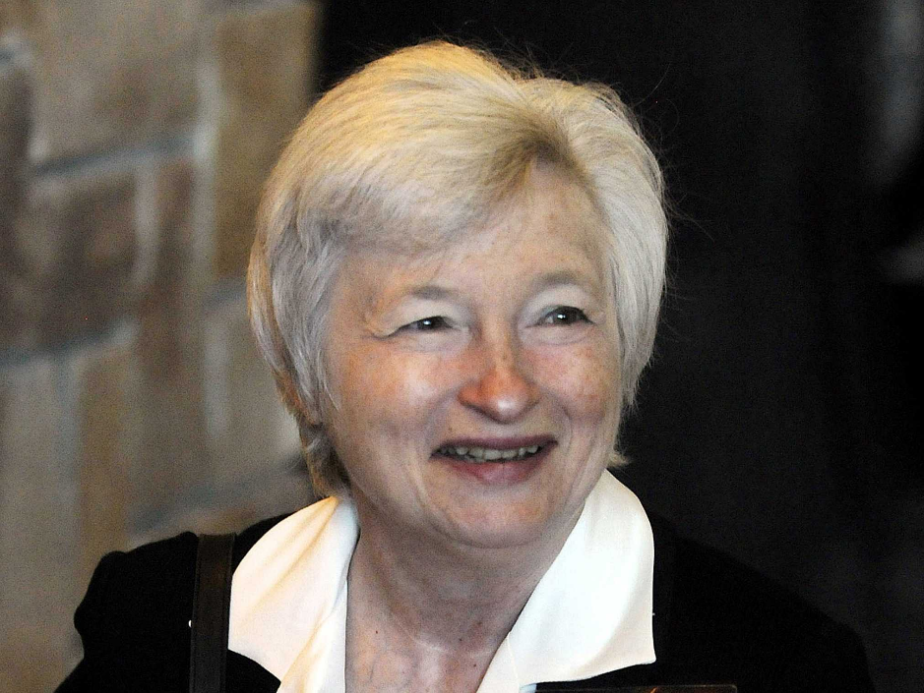
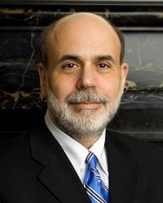
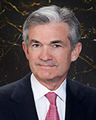
Monetary Policy at the Fed
0
Jerome Powell
February 2018
The Federal Reserve System consists of:
Board of Governors (7 members), located in Washington, DC
12 regional Fed banks, located around the U.S.
Federal Open Market Committee (FOMC), includes the Bd of Govs and presidents of some of the regional Fed banks
The FOMC has 8 scheduled meetings a year to set monetary policy.
Ben S. Bernanke Chair of FOMC, Feb 2006 – Jan 2014
Janet Yellen Chair of FOMC, Jan 2014 – Jan 2018
Notes:
8
In subsequent chapters (including the chapter immediately following this one), students will learn that the Federal Reserve’s monetary policy can have huge effects on many macroeconomic variables, like inflation, interest rates, unemployment, and even stock price indexes and exchange rates.
As chair of the FOMC, Ben Bernanke is in the news quite frequently.

Slide 9
Monetary Policy is About Interest Rates (Not the Money Supply)
The Minutes of the 3/16/2021 FOMC Meeting mentions:
Money Supply, M1, M2 – 0 times
Interest rates – over 20 times
Why: The relationship between the money supply and short-run macroeconomic variables was never very tight. With the advent of bitcoin and other innovations, it is almost non-existent.
To be fair, the behavior of inflation over the last 20 years has been a bit of a mystery. But, it has little to do with money growth

Slide 10
Monetary Policy Is About the Interest Rate
The FOMC does not set an exact number for the Federal funds rate. Instead, it sets an upper (green line) and lower (blue) range.
“The Committee decided to keep the target range for the federal funds rate at 0 to 1/4 percent…” (4/28/2021)
Grey bars are recessions

Slide 11
Quantitative Easing (QE): A New Tool
The Fed can buy long term Treasury bonds, or risky securities (MBS) to raise bond prices which are inversely related to interest rates.
And, boy did they!
9/08: Fed holdings of Treasury bonds, $0.5 tr; MBS, 0
10/14: US Treasury Bonds, $2.5 tr; MBS, $1.7 tr.
5/21 US Treasury Bonds $5.0 tr.; MBS $2.2 tr.
Presently, the Fed is buying $120 billion a month in long-term and risky bonds

Slide 12
Causes of Inflation
Excess aggregate demand: total desired spending in excess of the economy’s ability to produce, potential GDP. (Vietnam inflation)
Supply Shocks: Increase in the price of a key input. (Oil prices in the 1970s & 80s)
Expectations of inflation: expected inflation becomes self fulfilling (late 70s inflation persistence)
It is supposed to work the other way too!

Slide 13
Examples
#2
#1, in reverse
#1
#3

Slide 14
Central Banking in One Slide (Prepandemic)
Aggregate demand falls when interest rates rise. Therefore:
When aggregate demand is too high, raise interest rates to prevent inflation from rising in the future.
When aggregate demand is too low, lower interest rates to prevent rising unemployment.
Communicate clearly and consistently your intention to control inflation; to “anchor” inflationary expectations.
Pray for no supply shocks.

Slide 15
Recent Mysteries: The Stability of Inflation
Between 4/11 and 2/20: Inflation bounces between 1.2 and 2.2 percent with no apparent trend

Slide 16
Pre-pandemic problems with Monetary Policy
By aiming for future inflation at 2%, realized inflation turned out to be too low.
Which, among other things, led to very low interest rates.
Low interest rates mean that the Fed does not have much ammunition (i.e., interest rate cuts) to fight recessions.
Low interest rates encourage speculation in a “search for yield.”
4.6 % too low

Slide 17
Interest Rates are Too Low

Slide 18
Low on Ammo
In the Great recession, the Fed cut interest rates by 5 percentage points and it still wasn’t enough.

Slide 19
Innovations under Powell
Abandon “normalizing the balance sheet”
Put more emphasis on the maximum employment goal.
Conduct monetary policy to achieve average, realized average inflation of 2%, which requires tolerating times where inflation exceeds 2%.
In contrast, Ben Bernanke and Janet Yellen both wanted to normalize the balance sheet and adamantly refused to raise the inflation target during the Great Recession

Slide 20
FOMC Policy Statement 4/28/2021
The Committee decided to keep the target range for the federal funds rate at 0 to 1/4 percent and expects it will be appropriate to maintain this target range until labor market conditions have reached levels consistent with the Committee's assessments of maximum employment and inflation has risen to 2 percent and is on track to moderately exceed 2 percent for some time.

Slide 21
But Fiscal Stimulus Raises Aggregate Demand!
And, there has been a lot of it:
Roughly $4 trillion in 2020 much of which was saved and may be spent this year.
American Rescue Plan, $1.9 trillion.
Proposed:
American Jobs Plan and American Family Plan $4 trillion over 8 years, financed with tax increases spread over 15 years.
The America Economy is $22 trillion.
Obama stimulus was less than 6% of GDP

Slide 22
Forecasts of the Recovery
2.8%

Slide 23
Inflation Has Been Stable so Far, but…
Remember the first graph.
But the Inflation Dragon may be stirring

Slide 24
So, What’s the Problem?
If the Fed sees an uptick in inflation, can’t they raise interest rates?
Economic Problems
Aggregate demand has tremendous inertia, it could take many months for a rise in interest rates to slow demand. Particularly, given the Fed’s new stance on tolerating inflation.
Significant danger of “overshooting.” What would a substantial rise in interest rates do to stock prices, financial stability, Federal deficit?
Political Economic Problem
Would the Fed raise rates with the 2022 elections pending?
A substantial rise in rates would make our deficit and debt problems much, much worse.

Slide 25
Thank you!
What Do You Think?
www.NEEDelegation.org
Geoffrey Woglom
grwoglom@amherst.edu
Contact NEED: info@needelegation.org
Submit a testimonial: www.NEEDelegation.org/testimonials.php
Become a Friend of NEED: www.NEEDelegation.org/friend.php

Slide 26
The Great Moderation: Inflation

Slide 27
The Great Moderation: Unemployment

