Slide 1
Osher Lifelong Learning Institute, Winter 2022
Contemporary Economic Policy
Berkshire Community College
January-February, 2022
Jon Haveman, Ph.D.
National Economic Education Delegation

Slide 2
Available NEED Topics Include:
Coronavirus Economics
US Economy
Climate Change
Economic Inequality
Economic Mobility
Trade and Globalization
Minimum Wages
Immigration Economics
Housing Policy
Federal Budgets
Federal Debt
Black-White Wealth Gap
Autonomous Vehicles
US Social Policy

Slide 3
Course Outline
Contemporary Economic Policy
Week 1 (1/24): US Economy & Coronavirus Economics
Week 2 (1/31): Climate Change Economics (Sarah Jacobson, Williams College)
Week 3 (2/7): Monetary Policy (Geoffrey Woglom, Amherst College)
Week 4 (2/14): Cryptocurrencies (Geoffrey Woglom, Amherst College)
Week 5 (2/28): Federal Debt (Geoffrey Woglom, Amherst College)
Week 6 (3/7): Health Economics (Veronika Dolar, SUNY, Old Westbury)

Slide 4
Outline for the Talk
Questions in the Chat.
History of Central Banks and the Fed.
Institutional Structure of the Fed.
Monetary Policy Effects on Employment and Inflation.
The Conduct of Monetary Policy
The Current Danger Posed by Persistent Inflation

Slide 5
Federal Reserve: The US Central Bank
Central Banks are the government’s banks and were typically established to manage currency [Riksbank (1668)] or to help governments to fund wars [Bank of England(1694)].
First and Second Banks of the United States (1791) & (1816).
Late 19th century financial crise culminating in the panic of 1907 leads to the creation of the Federal Reserve System in 1913 to act as a “lender of last resort.”
Now all developed economies have central banks .
Notes:
The War of the Grand Alliance, EU and national central banks

Slide 6
Federal Reserve Responsibilities
Currency Issue.
Fiscal Agent for the Treasury.
Maintain and oversee “Payments System.”
Bank Regulation and Supervision.
Lender of Last Resort.
Monetary Policy.
Notes:
Maintain accounts and sell new bond issues. ACH, Fed wire

Slide 7
Three LOL Episodes
Great Depression.
Great Recession, September through December 2008.
March 2020.
Notes:
Hoover’s RFC lends more to banks than does the Fed.

Slide 8
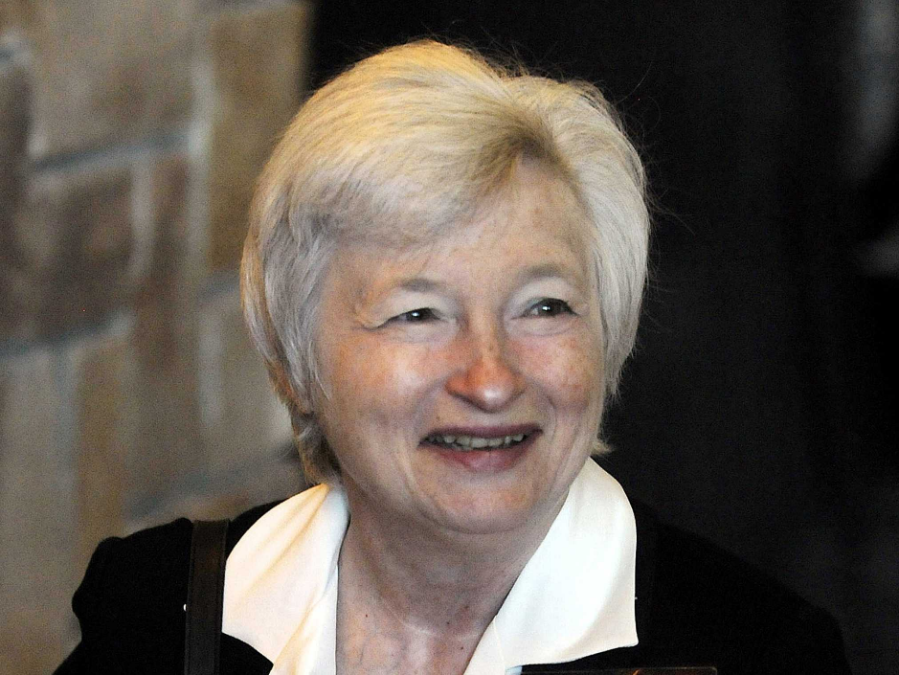
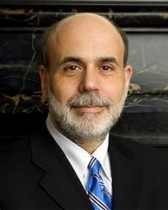
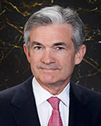
Monetary Policy at the Fed
0
Jerome Powell
February 2018
The Federal Reserve System consists of:
Board of Governors (7 members), located in Washington, DC
12 regional Fed banks, located around the U.S.
Federal Open Market Committee (FOMC), includes the Bd of Govs and presidents of 5 of the regional Fed banks on a rotating basis
The FOMC has 8 scheduled meetings a year to set monetary policy.
Ben S. Bernanke Chair of FOMC, Feb 2006 – Jan 2014
Janet Yellen Chair of FOMC, Jan 2014 – Jan 2018
Notes:
8
Board is public, Banks are private, Governors are appointed by Pres and confirmed by the Senate for 14 year terms. President selects one to act as Chair. Powell to get a second term

Slide 9
Congressionally Mandated Goals for the Fed
The “Dual Mandate:”
“Stable prices” which has been interpreted as a 2% rate of inflation in the Personal Consumption Price Index (which corresponds to about 2.5% inflation in the more well-known CPI).
“Maximum” employment is the highest level of employment (lowest unemployment rate) consistent with mandate 1.
Notes:
Easier to talk about unemployment than employmnet

Slide 10
Track Record on Unemployment
Red Line is “Natural” Unemployment
Blue Line Actual Unemployment
Notes:
Define natural 3 episodes. Great Moderation

Slide 11
Track Record on “Price Stability”
Notes:
Shaded lines are recessions . Vietnam, oil shocks stagflation 1981 (stagflation). Then 13.

Slide 12
A Few Definitions
GDP and inflation.
Total Spending or “Aggregate Demand.”
“Potential GDP” measures what the economy could produce at normal capacity.
The “Natural Rate” of unemployment is the unemployment rate when the economy is at potential (the “full-employment,” unemployment rate.)
Short and Long runs

Slide 13
Determinants of Unemployment & Inflation
Short run:
Unemployment: The higher the level of total spending (“aggregate demand”), the lower the unemployment rate.
Inflation:
Total spending above the economy’s normal capacity (“potential output”) tends to increase inflation.
Increase in production costs (e.g., “supply chain bottlenecks.”)
Expectations of high inflation can cause inflation to be high.

Slide 14
Determinants of Unemployment & Inflation
Long run:
Unemployment: Is determined by labor supply and demand and is independent of monetary policy; unemployment will be at the natural rate.
Inflation is totally determined by the Fed!
Notes:
Go back to 8

Slide 15
Economic Determinants in FOMC Projections.
Economic Projections of the FOMC 12/2019
Variable: | Central Tendency (excludes top and bottom 3)
 | 2019 | 2020 | 2021 | 2022 | Longer run
Unemployment rate | 3.5-3.6 | 3.5-3.7 | 3.5-3.9 | 3.5-4.0 | 3.9-4.3
Inflation | 1.4-1.5 | 1.8-1.9 | 2.0-2.1 | 2.0-2.1 | 2.0
Notes:
Long run first. Unemployment below the natural rate in 20 and 21 inflation rising. Explain Long Run including unemployment range.

Slide 16
The Fed’s Affects the Economy via Interest Rates
Higher Interest rates discourage firms from buying new plant and equipment, households from buying new homes and tend to lower stock prices (!).
Lower spending tends to raise unemployment and eventually lowers inflation.

Slide 17
Become a Central Banker in One Slide!
If you are more concerned that inflation is too high, raise interest rates.
If you are more concerned that unemployment is too high, lower interest rates.
Inflation and unemployment just right: keep rates the same.

Slide 18
Fed Policymaking in Action
Economic Projections of the FOMC 12/2019
Variable: | Central Tendency (excludes top and bottom 3)
 | 2019 | 2020 | 2021 | 2022 | Longer run
Unemployment rate | 3.5-3.6 | 3.5-3.7 | 3.5-3.9 | 3.5-4.0 | 3.9-4.3
Inflation | 1.4-1.5 | 1.8-1.9 | 2.0-2.1 | 2.0-2.1 | 2.0
Interest rate | 1.6 | 1.6-1.9 | 1.6-2.1 | 1.9-2.6 | 2.4-2.8

Slide 19
One Big Complication: Lags
Milton Friedman: Monetary Policy affects GDP and Inflation with Long and Variable (Unpredictable) Lags.
Raising interest rate today does nothing to spending today nor to inflation.
But over time spending slows and eventually inflation falls.
Friedman believed that lags led to the Fed to “oversteering” the economy consistently.

Slide 20
What about Fiscal Policy (tax rates and govt spending)?
Fiscal Policy can also affect aggregate demand, but the Fed has been given primary responsibility:
Fiscal Policy should focus on the government spending and tax rates that will allow the economy to function efficiently with equity.
The Fed has the necessary tools to achieve the dual mandate, except when it needs help in big recessions.
Reasons:
The Fed can act more quickly and is apolitical.
In the long run, monetary policy does not affect the composition or level of GDP.
Notes:
President’s get too much responsibility for the short-run behavior of the economy,

Slide 21
A Closer Look at Interest Rate Control
Primary Tool: the Fed targets the federal funds rate (or fed funds rate for short), the interest rate on overnight loans between banks.
From the bank’s perspective these loans are very close substitutes to other short-term, safe assets such as Treasury Bills.
Therefore, controlling the fed funds rate gives the Fed close control over all safe, short-term interest rates.
Notes:
Target range for the fed funds rate

Slide 22
The Fed and Short-term Interest Rates
Blue is the rate on fed funds.
Green is the rate on 1 month Treasuries
Red is the rate on 3-month commercial paper

Slide 23
What about the Money Supply?
Notice the absence of the money supply. The Fed does not believe there is a reliable, short-run link between the money supply and total spending or inflation.
The Minutes of the 6/16/2021 FOMC Meeting mentions:
Money Supply, M1, M2 – 0 times
Interest rate – over 20 times

Slide 24
“Don’t Listen to This Nonsense”
Robert Bartley, Editor of the Editorial page of the Wall Street Journal in the 1980s (paraphrased):
“Ronald Reagan proved that economists know nothing about inflation and unemployment. During his first term he was able to do what economists said was impossible: simultaneously reducing inflation and unemployment.”
You will probably not be surprised that I disagree. What do you think I would say?

Slide 25
Two Secondary Tools to affect Interest Rates
Forward Guidance: Communicating the Fed’s intentions for the future path of short-term interest rates.
Long-term Asset Purchases better known as quantitative easing or QE.
Both of these tools also affects interest rates, and thereby aggregate demand. But their effect is on interest rates on longer term and riskier assets.

Slide 26
Long-Term Interest Rates
Interest rates on longer term assets (e.g., 10-yr Treasury bond) and on risky assets (e.g., corporate bond rates, home mortgages) have a stronger effect on spending and aggregate demand.
Unfortunately, the current fed funds rate has much less influence on these interest rates.
Instead, long-term interest rates depend on two factors
The average of expected, future short-term rates over the life of the long-term bond.
“Risk” premia that reflect the possibility of unexpected changes in interest rates and the possibility of default.
The Secondary Tools are aimed at affecting these factors.

Slide 27
Forward Guidance
The Fed “guides” financial market participants about what they intend to do in the future. From the 1/26/22 Policy Statement announced at 2PM:
With inflation well above 2 percent and a strong labor market, the Committee expects it will soon be appropriate to raise … the federal funds rate.
By telling markets that they intend to raise the fed funds rate soon, they hope to raise expectations of future short-term rates, thereby raising long-term interest rates immediately.

Slide 28
When the Fed Speaks, Markets Listen
2:00PM
2:54PM
Notes:
Why wasn’t the rate increase baked in in the AM? Why did it rise between 2 and 3?

Slide 29
Asset Purchases or QE
The Fed since 2009 has purchased long-term (e.g, 10-year Treasury bonds) and risky securities (e.g., Mortgage-backed securities) to directly affect longer-term and risky interest rates.
The Fed purchases of these securities raises the total market demand and thereby lowers the required interest rates that these securities need to offer.

Slide 30
QE Was a Big Deal
Initially, $80 billion per month in longer-term Treasuries and $40 billion per month in mortgage-backed securities
As of 2/3/22, the Fed holds over:
$5.7 trillion in US Treasury Bonds, which is almost 25 percent of the total Federal debt held by the public.
$2.7 trillion in mortgage-backed securities, about 15 percent of total mortgages outstanding
Notes:
Define an MBS. It is being wound down quickly, started in Noivember

Slide 31
Interest Rates that the Fed Cares About
Why this exception?
Blue: 30-yr mortgage rate
Green: corporate bond rate
Purple: Prime Loan Rate
Red: fed funds rate
Notes:
Notice how, in general, all the rates move in the same direction. But some rates, e.g., the prime rate, track the fed funds rate more closely than do the others, e.g., corporate bond rate

Slide 32
A Policy Strategy: Stabilize Expectations of Inflation
Monetary Policy is much easier if the people believe that the Fed will achieve its inflation target.
Ben Bernanke (2007):
”…if inflation expectations respond less than previously to variations in economic activity, then inflation itself will become relatively more insensitive to the level of activity…”
In central bank jargon, stable expectations are “well anchored.”

Slide 33
“Anchoring” Inflation Expectations
Forecasts: Philadelphia Fed, “Survey of Professional Forecasters”
Notes:
Livingston Survey. 75-78. Unemployment 7% and 6% inflation. Look at the stability in the post 2001 period and the 2003-2005 period

Slide 34
Anchoring Requires Credibility
Credibility, the public believes that the Fed will achieve its goals.
Requirements for Credibility
Transparency (Communication)
Accountability (Performance)
Political Independence
Notes:
Communication releases; accountability, Congrtessional Testimony and 5 year full release. Political independence 14 year terms, but fragile.

Slide 35
How Has the Fed Been Doing Recently?
Unemployment Rate

Slide 36
What about Supply Chain Disruptions?
Notes:
Too much spending in the economy.

Slide 37
Macro Imbalances & Inflation
Notes:
Explain why economists expects slowing inflation

Slide 38
What’s at Stake: Inflationary Expectations
Even the Fed at their Dec 15th meeting admitted, “… that inflation readings had been higher and were more persistent and widespread than previously anticipated,” and noted
…the risk that recent elevated levels of inflation could increase the public’s longer-term expectations for inflation to a level … Committee’s longer-run inflation objective.
Paul Volcker put the world into a costly and deep recession in 1982 to bring down inflation and to “anchor” inflationary expectations. Could we be on the verge of losing these hard-won gains?
Notes:
Jnauaryt Meeting minutes will be released on Feb 16th

Slide 39
Why DidPowell Do It?
Notes:
On average inflation is less than 2% And Fred raises rates before inflation exceeds 2.%. But, very credible. Latest tightening was begun before Powell became Chair

Slide 40
Policy Changes under Powell
In the Fed’s dual mandate put more emphasis on the employment goal relative to the inflation goal.
Inflation goal switched from targeting forecasted future inflation to trying to achieve average realized inflation of 2%
Have they forgotten about Lags!
Notes:
Description of Policy goals reversed the order of the inflation and employment objectivesw

Slide 41
What Have They Done So Far?
Since November, they have slowed the rate of QE (slowed the rate at which they are adding stimulus!)
At the January meeting, they recognized that, “the Committee expects it will soon be appropriate to raise … the federal funds rate.”

Slide 42
So Far Inflationary Expectations Look Stable
Professional forecasters, financial markets and the Fed itself think that inflation in 2022 will be slightly above 2.5%
Variable: | Medians
 | 2022 | 2023 | 2024 | Longer run
Unemployment rate | 3.5 | 3.5 | 3.5 | 4.0
Inflation | 2.7 | 2.3 | 2.1 | 2.0
Interest rate | 0.9 | 1.6 | 2.1 | 2.5

Slide 43
If Expectations Start to Increase
The Fed will have a very difficult choice
Raise interest rates a lot (in an election year) to slow inflation
stalling the recovery.
disrupting financial markets.
Raise interest rates slowly and moderately to cushion the effect on employment
avoids a recession (maybe).
inflationary expectations become unanchored

Slide 44
Is the Fed Already Losing Credibility?
John Waldron, President of Goldman Sachs Group Inc. in Bloomberg, (1/27/2022):
What’s gone on in the past couple of years has brought “into question the independence of the Fed,” … He questioned the Fed’s strength to act as an “independent, monetary policy engine that is doing what it thinks is right and not what’s expedient.”
“We might need to bring back Paul Volcker, and have somebody that would be willing to kind of stay the course without regard to exactly what’s going on in the markets.”

Slide 45
Bitcoins: What is the Excitement About?
Almost 500% increase in 6 months
Blue Line Price of Bitcoin
Red Line: Price of Gold
On, 2/7, 3PM 1 bitcoin = $44.5k
Notes:
Bitcoin today was trading at $56,850

Slide 46
Let’s Hear from You!
www.NEEDelegation.org
Geoffrey Woglom
grwoglom@amherst.edu
Contact NEED: Info@NEEDelegation.org
Submit a testimonial: www.NEEDelegation.org/testimonials.php
Support NEED: www.NEEDelegation.org/donate.php

Slide 47
Monetary Policy Glossary
Gross Domestic Product (GDP): the value of national production during the course of year.
Real Gross Domestic Product (RGDP): GDP adjusted for inflation. RGDP measures the quantity of national production.
Potential GDP: What RGDP would be if the economy was operating at normal, full capacity.
Inflation: The average percentage change in prices. The most popular measure is the Consumer Price Index or CPI rate of inflation.
Natural Rate of Unemployment: What the unemployment rate would be if RGDP was equal to potential.
Short run: The current situation of the economy and its prospects over the next year or so. The business cycle reflects the short run
Long run: The average behavior of the economy over a complete business cycle.

Slide 48
Monetary Policy Glossary
Aggregate Demand: Total domestic spending by households, firms and government on newly produced goods.
Interest Rates: The cost of borrowing by government (Treasury bonds), by firms (corporate bonds and bank loans), by households (mortgages) and by others.
Short-term interest rates the interest rate on bonds and loans of 1 year or less.
Long-term interest rates: more than 1 year.
Risky interest rates: on bonds and loans that may not be paid back (Corporate bonds, Bank Loans)
Federal Funds rate: The interest rate of overnight loans between banks. It is the primary policy instrument of the Fed.
Political Independence: The extent to which the Fed’s decisions are affected by politics.
Credibility: Explaining what actions you are taking and why.

