Slide 1
Osher Lifelong Learning Institute, Fall 2023
Contemporary Economic Policy
University of Southern Maine
January/February 2024
Jon Haveman, Ph.D.
National Economic Education Delegation

Slide 2
Available NEED Topics Include:
US Economy
Healthcare Economics
Climate Change
Economic Inequality
Economic Mobility
Trade and Globalization
Minimum Wages
Immigration Economics
Housing Policy
Federal Budgets
Federal Debt
Black-White Wealth Gap
Autonomous Vehicles
US Social Policy

Slide 3
Course Outline
Contemporary Economic Policy
  Week 1 (1/09): Economic Update (Geoffrey Woglom Amherst College)
  Week 2 (1/16): Climate Change Economics (Sarah Jacobson, Williams College)
  Week 3 (1/23): Federal Debt and Deficits (Brian Peterson, LaGrange College)
  Week 4 (1/30): International Institutions (Alan Deardorff U of Michigan)
  Week 5 (2/6): Monetary Policy and Inflation (Geoffrey Woglom)
  Week 5 (2/13): Is College Worth It? (Geoffrey Woglom)

Slide 4
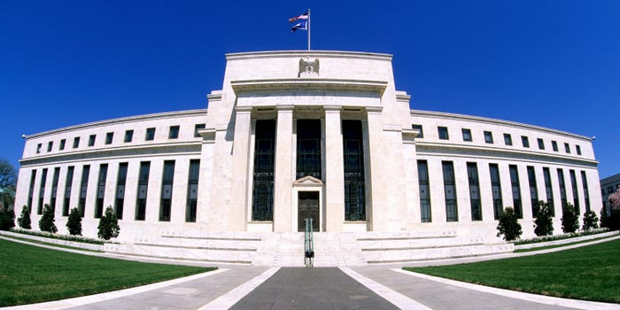
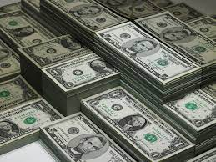
Monetary Policy & The Fed
Geoffrey Woglom,
Professor of Economics
Amherst College, emeritus
February 6, 2024
Notes:
Jump to 6

Slide 5
Submitting Questions
Please submit questions in the chat or raise your digitalhand.
  I will try to handle them as they come up, but may take them in a bunch as time permits.
We will do a verbal Q&A once the material has been presented.
  And the questions in the chat have been addressed.
After talk, I hope there will be time for more extended questions.
Slides will be posted at https://needecon.org/delivered_presentations.php

Slide 6
Credits and Disclaimer
This slide deck was authored by:
  Geoffrey Woglom
Disclaimer
  NEED presentations are designed to be nonpartisan.
  It is, however, inevitable that the presenter will be asked for and will provide their own views.
  Such views are those of the presenter and not necessarily those of the National Economic Education Delegation (NEED).

Slide 7
Outline for the Talk
History of the origin and development of central banks
The economic determinants of inflation and unemployment.
The Fed’s policy tools for influencing interest rates and thereby affecting aggregate demand and the economy.
A closer look at changes that Chair Powell made in Fed policy that contributed to the run up in inflation.
The January 30-31 Fed monetary policy meeting and what comes next.

Slide 8
What Is a Central Bank?
Government’s Bank.
  Regulate currency and manage the payment system.
  Help with government finance.
“Lender of Last Resort” (LOL) in financial crises.
Responsible for stabilizing the macro economy: i.e., low, stable inflation and full employment
Notes:
Jump to 14.

Slide 9
Origins
Sveriges Riksbank (Sweden), 1668, currency regulation.
Bank of England, 1694, debt finance for the War of Grand Alliance.
Banks of the US, First (1791-1811) and Second (1816-1836) did a little of both.

Slide 10
Financial Crises in the 19th Century
Financial Panics (and recessions) in the 19th century: 1819, 1837, 1857, 1873, 1893.
Financial Panics are caused by a shortage of liquidity.
illiquidity: the value of liquid assets (cash, short-term Treasuries) are less than the value of liquid liabilities (short-term debt, bank deposits)
Insolvency: the value of assets is less than liabilities, so unless thins change, the liabilities will not be paid off.

Slide 11
Illiquidity Can Lead to Insolvency
Most banks are technically illiquid, which is not a problem in normal times because money is being deposited to offset the money that is being withdrawn.
But during a panic solvency is no guarantee of survival (As George Bailey learned in It’s a Wonderful Life)
To meet pressing demands for cash, the bank may have to sell assets in a “fire sale,” leading to insolvency and a bank failure.

Slide 12
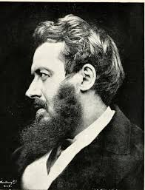
Walter Bagehot’s and his Famous Dictum
Walter Bagehot (1826-77): Lombard Street, 1873
Save the solvent institutions while allowing the
insolvent to fail.
His “Dictum” during a panic the Central Bank should:
  Lend freely,
  At a high interest rate,
  To solvent institutions,
  On good collateral.

Slide 13
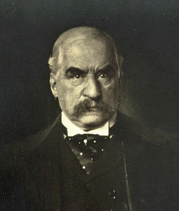
JP Morgan, “Lender of Last Resort?” (LOL)
October 1907, JP Morgan cuts short his vacation to deal with a financial panic
  Market falls by 50%
  Runs on banks threaten a complete collapse of financial markets.
Morgan calls a number of bankers to his offices to pledge money to provide liquidity to markets.

Slide 14
The Aftermath: Federal Reserve Act of 1913
Original Roles of the Fed
  Oversee Currency & Regulate Banks; 2. Lender of Last Resort.
Great Depression and the Banking Panics of the 30s
  Fed fails miserably.
  RFC lent more money to the banks than did the Fed
Footnote on later LOL Roles:
  2008: Bernanke saves the world, but Congress is not happy.
  2020: Powell goes even bigger, but the verdict is still out.
  2022: Silicon Valley Bank aftermath

Slide 15
The Evolution of the Fed’s Role in the Macro Economy
Employment Act of 1946
  “Full employment” is a Executive Government Responsibility.
  Council of Economic Advisors.
  Economic Report of the President.
Humphrey Hawkins Act 1978 & the Fed’s “Dual” mandate
  Full employment
  Price stability
Division of Labor between Monetary and Fiscal Policies.

Slide 16
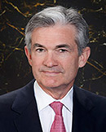
Stabilizer in Chief: the Fed
The Fed’s Dual Mandate:
  “Stable prices” which means 2% rate of inflation in the Personal Consumption Price Index (which corresponds to about 2.5% inflation in the more well-known CPI).
  “Maximum employment” which means the highest level of employment (lowest unemployment rate) consistent with mandate 1.
Monetary policy is made by the Federal Open Market Committee (FOMC), comprised of the 7 Fed Governors and 5 of the 12 Presidents of the Regional Federal Reserve Banks on a rotating basis.
The FOMC has scheduled meetings 8 times a year, but can hold unscheduled meetings at a moments notice (e..g., March of 2020)
Jerome Powell
February 2018
Notes:
Define inflation as the rate of increase in the average level of prices not gasoline price inflation. Exceptions Deep Recesssions. ARP we will talk about later.

Slide 17
Why is “Price Stability” 2% Inflation?
It started in 1990 when New Zealand was the first country to adopt an inflation target: 0-2%
Why not 0?
  “Greasing the Wheels.”
  Zero Lower Bound for Interest Rates
Why 2%- New Zealand raised it to 3%?

Slide 18
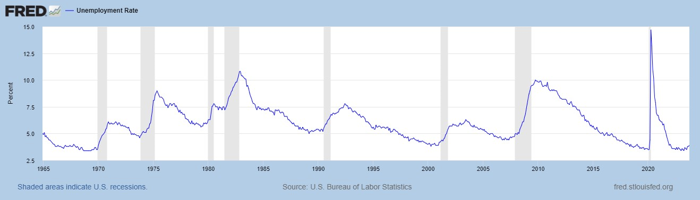
Track Record on Unemployment
Shaded Bars are Recessions

Slide 19
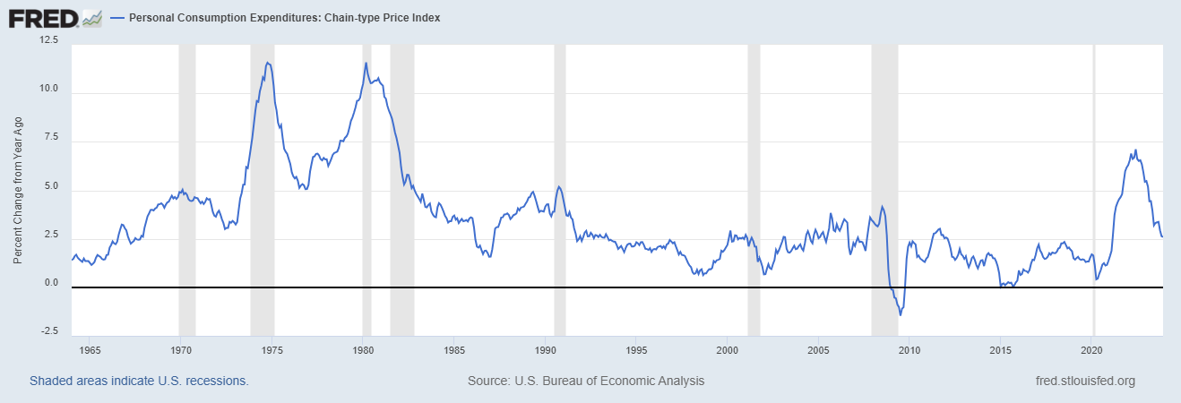
Track Record on “Price Stability”
Notes:
Shaded lines are recessions . 1970S THE Great Moderation

Slide 20
Determinants of Unemployment & Inflation
Short run:
Unemployment: The higher the level of total spending the lower the unemployment rate.
Inflation:
  “Too much Spending:” Total spending above the economy’s normal capacity (“potential output”) tends to increase inflation.
  Increase in production costs (e.g., “supply chain bottlenecks.”)
  Expectations of high inflation can cause inflation to be high.
In the absence of 1.and 2., inflation will equal expected.
Notes:
One sign of too much spending is a very low unemployment rate. Go back to 19 and 20 then to 21

Slide 21
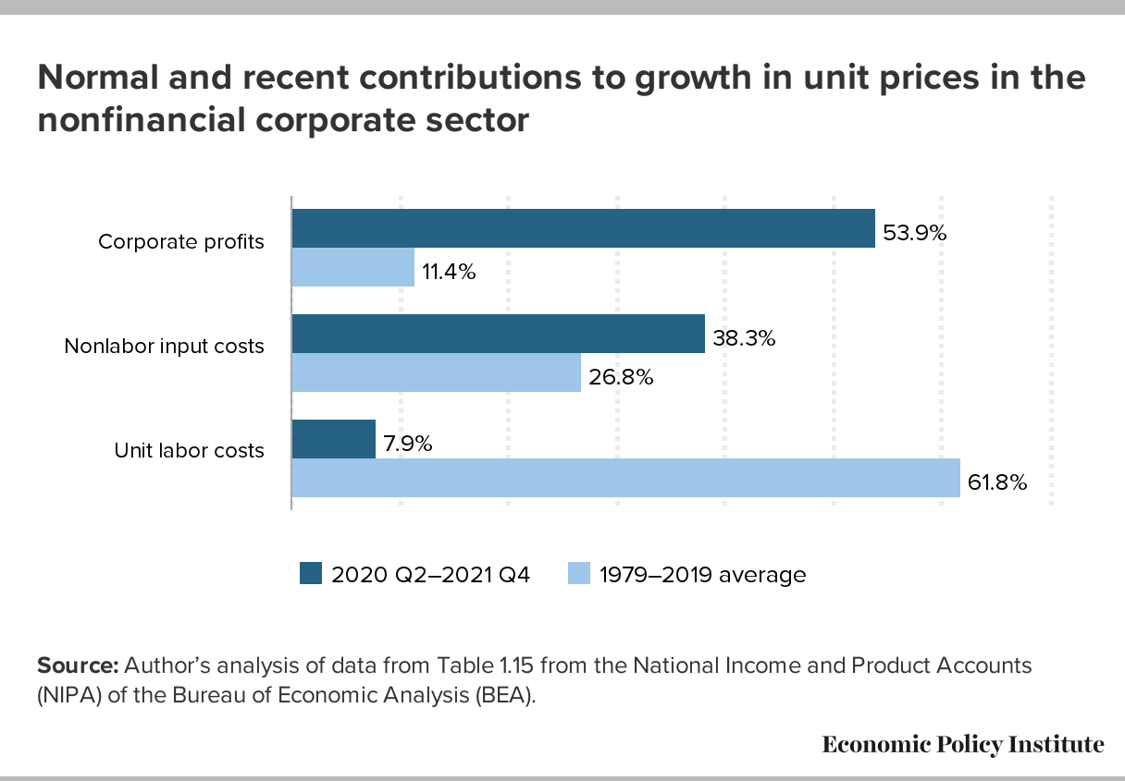
Corporate “Greed” and Inflation?

Slide 22
Determinants of Unemployment & Inflation
Long run: what the economy would look like if real GDP were at potential (average behavior of the economy over a number of years):
Unemployment: Is determined by labor supply and demand and is independent of monetary policy; unemployment will be at the natural rate.
Inflation is totally determined by the Fed!

Slide 23
What about the Money Supply?
Notice the absence of the money supply. The Fed does not believe there is a reliable, short-run link between the money supply and total spending or inflation.
The Minutes of the 12/12-13/2023 FOMC Meeting mentions:
  Money Supply, M1, M2 – 0 times
  Federal funds rate – 13 times

Slide 24
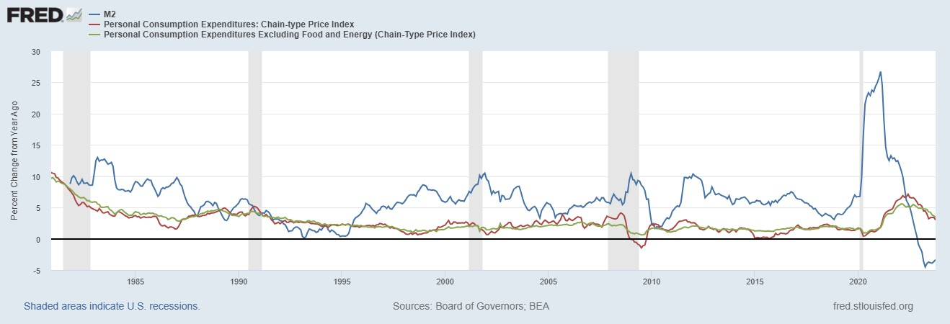
Do You See a Relationship?

Slide 25
The Fed’s Affects the Economy via Interest Rates
Higher Interest rates discourage firms from buying new plant and equipment, households from buying new homes, and tend to lower stock and housing prices (!).
Lower spending tends to raise unemployment and eventually lowers inflation.

Slide 26
Become a Central Banker in One Slide!
If you are more concerned that inflation is too high, raise interest rates to lower total spending below potential output.
If you are more concerned that unemployment is too high, lower interest rates to raise total spending.
Inflation and unemployment just right: keep rates the same.
Sounds Easy! But…

Slide 27
One Big Complication: Lags
Milton Friedman: Monetary Policy affects GDP and Inflation with Long and Variable (Unpredictable) Lags.
Raising interest rates today does nothing to spending today nor to inflation.
But over time spending slows and eventually inflation falls.
Friedman believed that lags led to the Fed to “oversteering” the economy consistently.

Slide 28
“Don’t Listen to This Nonsense”
Robert Bartley, Editor of the Editorial page of the Wall Street Journal in the 1980s (paraphrased):
“Ronald Reagan proved that economists know nothing about inflation and unemployment. During his first term, he was able to do what economists said was impossible: simultaneously reduce inflation and unemployment.”(from January of 1983 to the end of his first term unemployment fell from 10.4 to 7.3% and inflation from 4.7 to 3.7%).
You will probably not be surprised that I disagree. What do you think I would say?

Slide 29
Determinants of Unemployment & Inflation
Short run:
Unemployment: The higher the level of total spending the lower the unemployment rate.
Inflation:
  “Too much Spending:” Total spending above the economy’s normal capacity (“potential output”) tends to increase inflation.
  Increase in production costs (e.g., “supply chain bottlenecks.”)
  Expectations of high inflation can cause inflation to be high.
In the absence of 1.and 2., inflation will equal expected.
Notes:
One sign of too much spending is a very low unemployment rate. Go back to 19 and 20 then to 21

Slide 30
A Closer Look at Interest Rate Control
Primary Tool: the Fed targets the federal funds rate (or fed funds rate for short), the interest rate on overnight loans between banks.
The Fed adjusts bank reserves so that the federal funds rate is within a target range 25 basis points wide; e.g., 5.5-5.25%
From the bank’s perspective these loans are very close substitutes to other short-term, safe assets such as Treasury Bills.
Therefore, controlling the fed funds rate gives the Fed close control over all safe, short-term interest rates.
Notes:
Target range for the fed funds rate

Slide 31
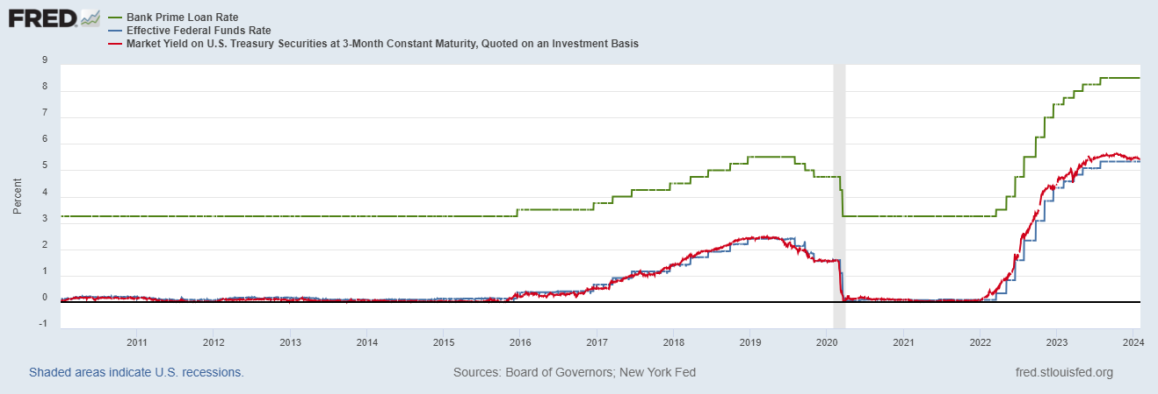
The Fed and Short-term Interest Rates
Blue is the fed funds rate.
Red is the rate on 3 month Treasuries.
Green is the prime bank lending rate
Notes:
Take note over the redline peeking above the others

Slide 32
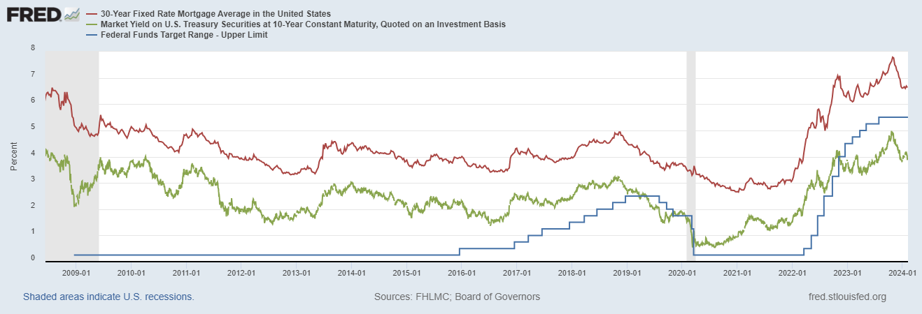
The Importance of Long-Term Interest Rates
Nobody buys a house because of the level overnight interest rates.
Notes:
Red line was 90-day cp, the TBIll line was 1 month rate

Slide 33
Long-Term Interest Rates
Unfortunately, the current fed funds rate has much less influence on long term interest rates.
Instead, long-term interest rates depend on two factors
  The average of expected, future short-term rates over the life of the long-term bond. Yesterday 10AM, US Treasuries: 1-Y 4.87; 2-Y 4.43. Why?
  “Risk” premia that reflect the possibility of unexpected changes in interest rates and the possibility of default.
The Secondary Tools are aimed at affecting these factors.
Notes:
Red line was 90-day cp, the TBIll line was 1 month rate

Slide 34
Two Secondary Tools to Affect Interest Rates
Forward Guidance: Communicating the Fed’s intentions for the future path of short-term interest rates.
Long-term Asset Purchases better known as quantitative easing or QE.
Both of these tools also affect interest rates, and thereby aggregate demand. But their effect is on the interest rates of longer-term and riskier assets.
Notes:
Forward guidance occurs not just with the FOMC policy statments

Slide 35
Here Is What They Did 1/31
https://drive.google.com/file/d/1GyIvOIwlDVR9RA3C_ljzD-g5KCCbafJW/view

Slide 36
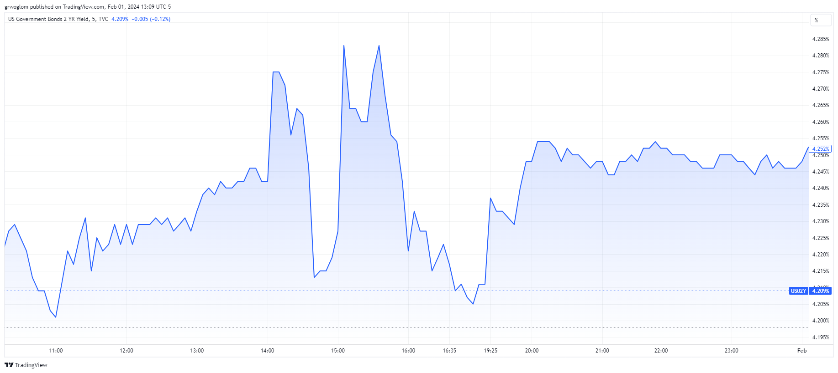
When EF Hutton Talks…
2:05 2:40
People Get Confused

Slide 37
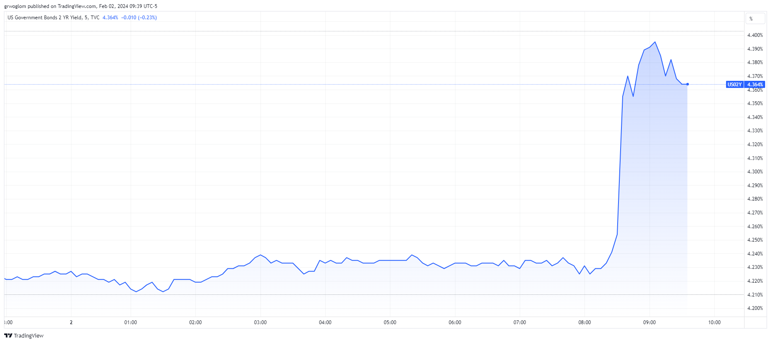
But, When the BLS Talks…
8:30 AM

Slide 38
Evolution of Market Opinion
Probability for the Target Range after the March 20th FOMC Meeting
Target Range | As of 2/5 | 2/2 | 2/1 | 1/28
4.75-5.00% | 0.0% | 0.0% | 0.0% | 1.0%
5.00-5.25% | 16.5% | 20.0% | 38.0% | 46.2%
5.25-5.00%* | 83.5% | 80.0% | 62.0% | 52.9%
* Current Range

Slide 39
QE And Long-term, Risky Rates
Financial investors require a higher interest rate on risky bonds, than on safe short-term Treasuries.
The lower the supply of risky bonds, the lower the required risk premia needed to get enough private investors to buy them.
QE lowers the supply of long-term bonds held by private investors and thereby lowers to required risk premia and the interest rate on these bonds.
QE is particularly important when the federal funds rate has hit the zero (ZLB)

Slide 40
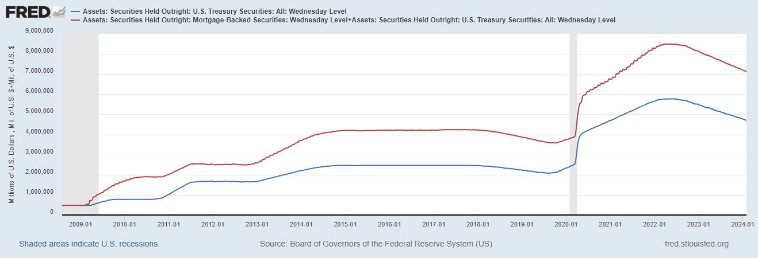
QE Had Been a Big Deal
Quantitative
Tightening!
Source: Federal Reserve Board
Notes:
25% of marketable Federal Debt; 20 percent of household mortgages. Total Fed assets increase by over 1.2 tr in 9 weeks;
Then by over 2.6 tr second time.

Slide 41
A Policy Strategy: Stabilize Expectations of Inflation
Monetary Policy is much easier if the people believe that the Fed will achieve its inflation target.
Ben Bernanke (2007):
”…if inflation expectations respond less than previously to variations in economic activity, then inflation itself will become relatively more insensitive to the level of activity…”
In central bank jargon, stable expectations are “well anchored.”

Slide 42
Anchoring Requires Credibility
Credibility, the public believes that the Fed will achieve its goals.
Requirements for Credibility
  Transparency (Communication)
  Accountability (Performance) BOE Letter?
  Political Independence
Things to think about: The Fed through monetary policy has the most influence on the short-run behavior of the economy. These governmental decisions are made “technocratically” and not democratically. Is that a problem? What would Sen Warren say?
Notes:
Communication releases; accountability, Congressional Testimony and 5 year full release. Political independence 14 year terms, but fragile.

Slide 43
Inflation and Expectations of Inflation

Slide 44
The Great Moderation
Volcker paid a price in the early 1980s, but the price paid dividends from 1990 through 2008.
During that period the performance of the US economy was extraordinary and even Milton Friedman gave kudos to the Alan Greenspan.
Has Powell jeopardized Volcker’s legacy?
Notes:
Go back to 16

Slide 45
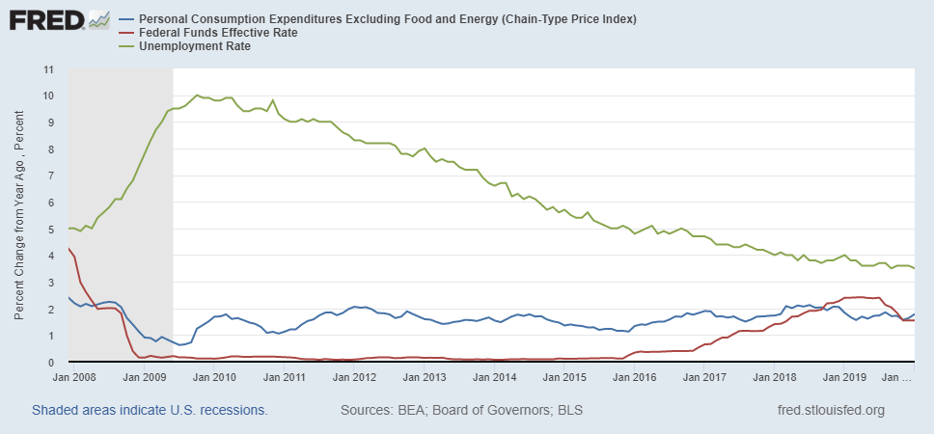
Why Did Powell Do It?
Powell Replaces
Yellen as Chair
Notes:
On average inflation is less than 2% And Fed raises rates before inflation exceeds 2.%. But, very credible. Latest tightening was begun before Powell became Chair. Tightening is very gradual 1.5 pct pts in 2 years.

Slide 46
Policy Changes under Powell
In the Fed’s dual mandate FOMC put more emphasis on the employment goal relative to the inflation goal.
Inflation goal switched from targeting forecasted future inflation to:
“In order to anchor longer-term inflation expectations at this [2 percent], the Committee seeks to achieve inflation that averages 2 percent over time, and therefore judges that, following periods when inflation has been running persistently below 2 percent, appropriate monetary policy will likely aim to achieve inflation moderately above 2 percent for some time.”
Notes:
Description of Policy goals reversed the order of the inflation and employment objectives

Slide 47
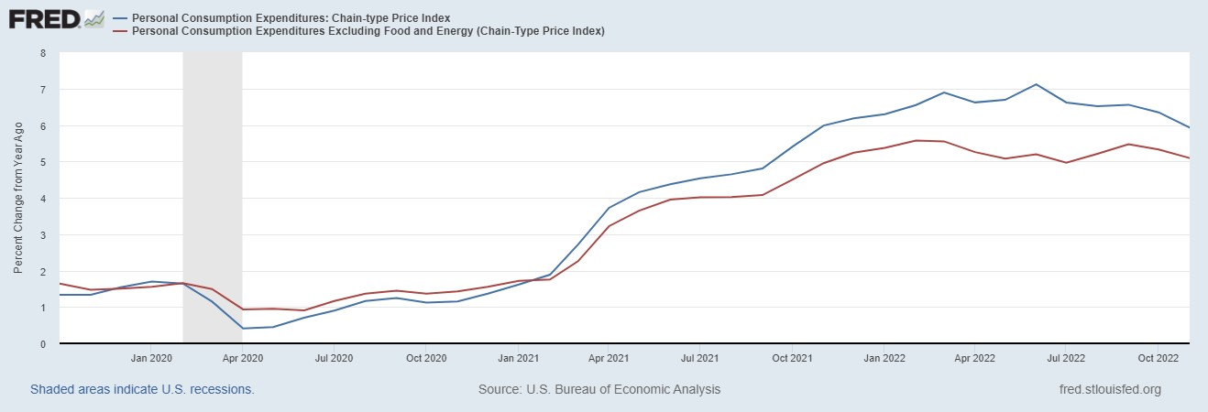
Why Didn’t the Fed Act by April 2021?
Have They Forgotten about Policy Lags!!
But, by March 2022 Things Changed!

Slide 48
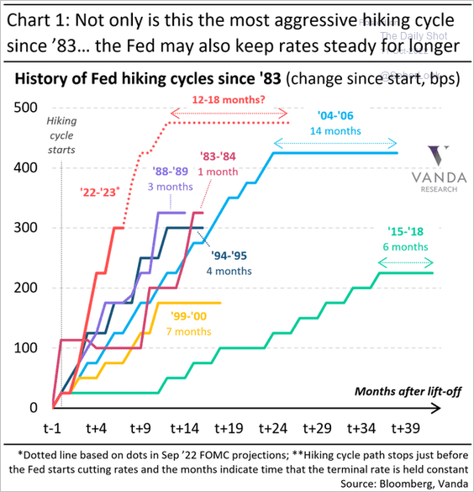
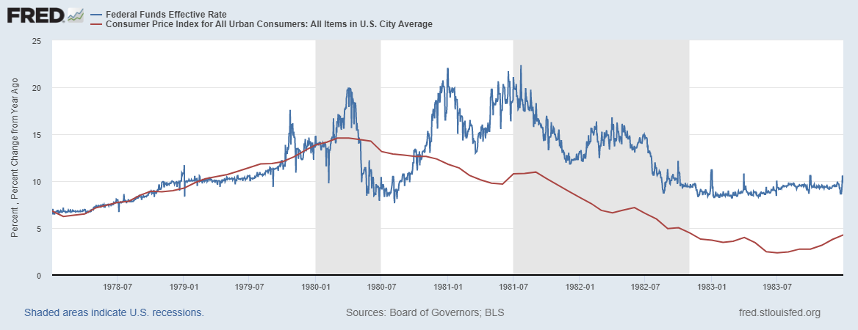
Is Powell Now Channeling Volcker?
Notes:
Current Fed funds rate 525 basis points higher!

Slide 49
OK, But What Explains Powell’s Reversal?
Congress asked Powell, if like Volcker, he would do whatever was necessary to bring inflation down.
‘I knew Paul Volcker,’ Powell responded. ‘I think he was one of the great public servants of the era — the greatest economic public servant of the era.’ Making it clear that his own legacy was on his mind, Powell continued, ‘I hope that history will record that the answer to your question is yes.’ Peter Coy, NYTimes, “Economic Theory Alone May Not Explain Jerome Powell’s Actions,” 9/23/2022
Could Powell be “Oversteering?”

Slide 50
Has Powell Learned His Lesson
Letting inflation exceed the target causes lots of problems.
Because of lags you must act in advance of a potential problem.
But, in January of this year the Fed reaffirmed that it was targeting average realized inflation!
But where does the economy go from here?

Slide 51
Fed Economic Projections
1/31/2024
3/22/2023
Austin Goolsbee, President of the Chicago Fed. The economy is on a “golden path” and will achieve the “mother of all soft landings.”
For me, the mystery is why inflationary expectations have remained so contained
Notes:
Survey of Professional Forecasters from early August: GDP and unemployment much like the June Fed forecast. Inflation much like the Fed’s September forecast.

Slide 52
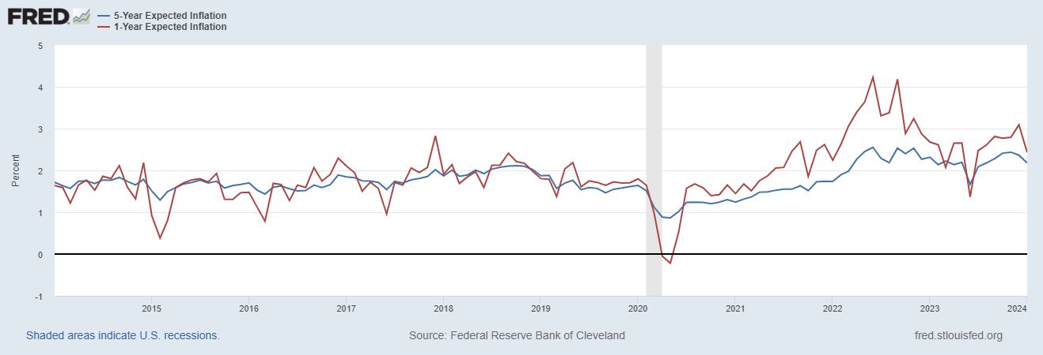
Long-Term Inflation Expectations Remained “Well Anchored”

Slide 53
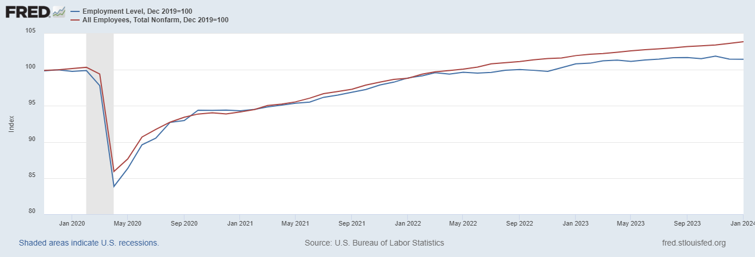
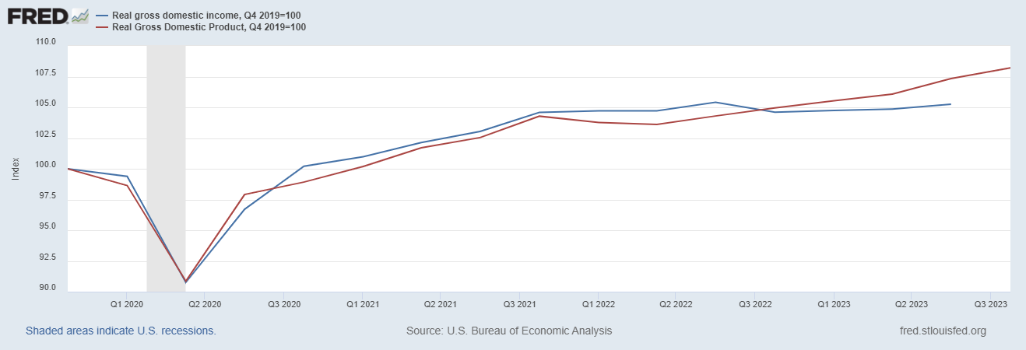
The Future: Conflicting Signals
Hot or Cooling?

Slide 54
Above My Pay Grade
To Cut or Not To Cut.
Don’t Forget about Lags.
Political Reaction once Rates Start Coming Down?
Stay Tuned: The 2024 election may hinge on what the Fed does and when.

Slide 55
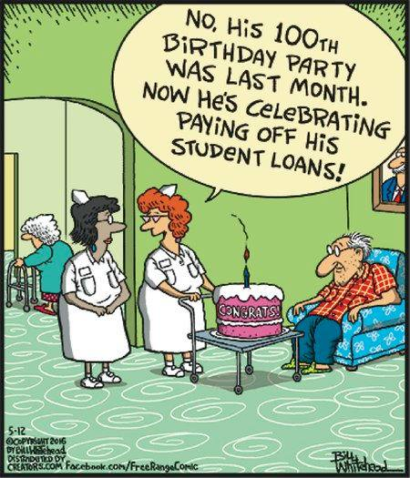
3. Student Debt

Slide 56
Let’s Hear from You!
Geoffrey Woglom grwoglom@amherst.edu
https://sites.google.com/view/macro-current-issues/monetary-policy
Contact NEED: Info@NEEDEcon.org
Submit a testimonial: www.NEEDEcon.org/testimonials.php
Support NEED: www.NEEDEcon.org/donate.php

