Slide 1
Osher Lifelong Learning Institute, Winter 2023
Contemporary Economic Policy
University of Rhode Island
January-February, 2023
Host: Jon Haveman, Ph.D.
National Economic Education Delegation
Notes:
Jump to 6

Slide 2
National Economic Education Delegation
Vision
  One day, the public discussion of policy issues will be grounded in an accurate perception of the underlying economic principles and data.
Mission
  NEED unites the skills and knowledge of a vast network of professional economists to promote understanding of the economics of policy issues in the United States.
NEED Presentations
  Are nonpartisan and intended to reflect the consensus of the economics profession.

Slide 3
Who Are We?
Honorary Board: 54 members
  2 Fed Chairs: Janet Yellen, Ben Bernanke
  6 Chairs Council of Economic Advisers
    Furman (D), Rosen (R), Bernanke (R), Yellen (D), Tyson (D), Goolsbee (D)
  3 Nobel Prize Winners
    Akerlof, Smith, Maskin
Delegates: 652+ members
  At all levels of academia and some in government service
  All have a Ph.D. in economics
  Crowdsource slide decks
  Give presentations
Global Partners: 49 Ph.D. Economists
  Aid in slide deck development

Slide 4


Where Are We?

Slide 5
Available NEED Topics Include:
US Economy
Healthcare Economics
Climate Change
Economic Inequality
Economic Mobility
Trade and Globalization
Minimum Wages
Immigration Economics
Housing Policy
Federal Budgets
Federal Debt
Black-White Wealth Gap
Autonomous Vehicles
Healthcare Economics

Slide 6
Course Outline
Contemporary Economic Policy
  Week 1 (1/10): Trade and Globalization (Alan Deardorff, Univ. Michigan)
  Week 2 (1/17): Trade Deficits and Exchange Rates (Alan Deardorff)
  Week 3 (1/24): US Economic Update (Geoffrey Woglom, Amherst College)
  Week 4 (1/31): Monetary Economics (Geoffrey Woglom)
  Week 5 (2/7): Autonomous Vehicles (Jon Haveman, NEED)
  Week 6 (2/14): Health Care Economics (Jon Haveman)

Slide 7
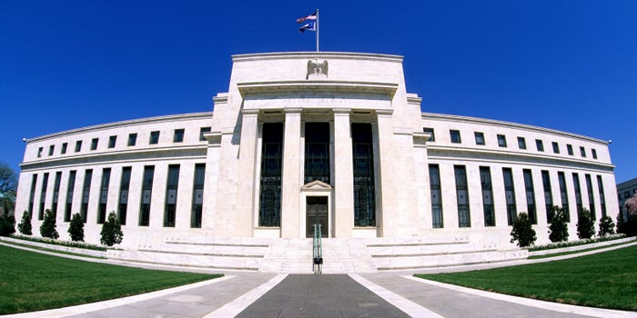
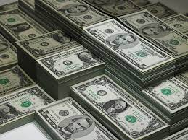
Monetary Policy & The Fed
Geoffrey Woglom,
Professor of Economics
Amherst College, emeritus
January 31, 2023

Slide 8
Outline for the Talk
History of the origin and development of central banks.
The economic determinants of inflation and unemployment.
The Fed’s policy tools for influencing interest rates and thereby affecting aggregate demand and the economy.
A closer look at changes that Chair Powell made in Fed policy that contributed to the run up in inflation.
Update on Inflation and what comes next.

Slide 9
What Is a Central Bank?
Government’s Bank.
  Regulate currency and manage the payment system.
  Help with government finance.
“Lender of Last Resort” (LOL) in financial crises.
Responsible for stabilizing the macro economy: i.e., low, stable inflation and full employment
Notes:
Jump to 14.

Slide 10
Origins
Sveriges Riksbank (Sweden), 1668, currency regulation.
Bank of England, 1694, debt finance for the War of Grand Alliance.
Banks of the US, First (1791-1811) and Second (1816-1836) did a little of both.

Slide 11
Financial Crises in the 19th Century
Financial Panics (and recessions) in the 19th century: 1819, 1837, 1857, 1873, 1893.
Financial Panics are caused by a shortage of liquidity.
illiquidity: the value of liquid assets (cash, short-term Treasuries) are less than the value of liquid liabilities (short-term debt, bank deposits)
Insolvency: the value of assets is less than liabilities, so unless thins change, the liabilities will not be paid off.

Slide 12
Illiquidity Can Lead to Insolvency
Most banks are technically illiquid, which is not a problem in normal times because money is being deposited to offset the money that is being withdrawn.
But during a panic solvency is no guarantee of survival (As George Bailey learned in It’s a Wonderful Life)
To meet pressing demands for cash, the bank may have to sell assets in a “fire sale,” leading to insolvency and a bank failure.

Slide 13
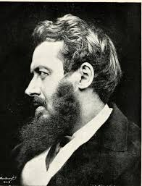
Walter Bagehot’s and his Famous Dictum
Walter Bagehot (1826-77): Lombard Street, 1873
Save the solvent institutions while allowing the
insolvent to fail.
His “Dictum” during a panic the Central Bank should:
  Lend freely,
  At a high interest rate,
  To solvent institutions,
  On good collateral.

Slide 14
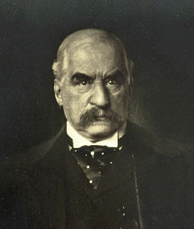
JP Morgan, “Lender of Last Resort?” (LOL)
October 1907, JP Morgan cuts short his vacation to deal with a financial panic
  Market falls by 50%
  Runs on banks threaten a complete collapse of financial markets.
Morgan calls a number of bankers to his offices to pledge money to provide liquidity to markets.

Slide 15
The Aftermath: Federal Reserve Act of 1913
Original Roles of the Fed
  Oversee Currency & Regulate Banks; 2. Lender of Last Resort.
Great Depression and the Banking Panics of the 30s
  Fed fails miserably.
  RFC lent more money to the banks than did the Fed
Footnote on later LOL Roles:
  2008: Bernanke saves the world, but Congress is not happy.
  2020: Powell goes even bigger, but the verdict is still out.

Slide 16
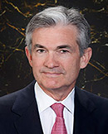
Stabilizer in Chief: the Fed
The Fed’s Dual Mandate:
  “Stable prices” which means 2% rate of inflation in the Personal Consumption Expenditure Price Index (which corresponds to about 2.5% inflation in the more well-known CPI).
  “Maximum employment” which means the highest level of employment (lowest unemployment rate) consistent with mandate 1.
Monetary policy is made by the Federal Open Market Committee (FOMC), comprised of the 7 Fed Governors and 5 of the 12 Presidents of the Regional Federal Reserve Banks on a rotating basis.
The FOMC has scheduled meetings 8 times a year, but can hold unscheduled meetings at a moments notice (e..g., March of 2020)
Jerome Powell
February 2018
Notes:
Define inflation as the rate of increase in the average level of prices not gasoline price inflation. Exceptions Deep Recesssions. ARP we will talk about later.

Slide 17
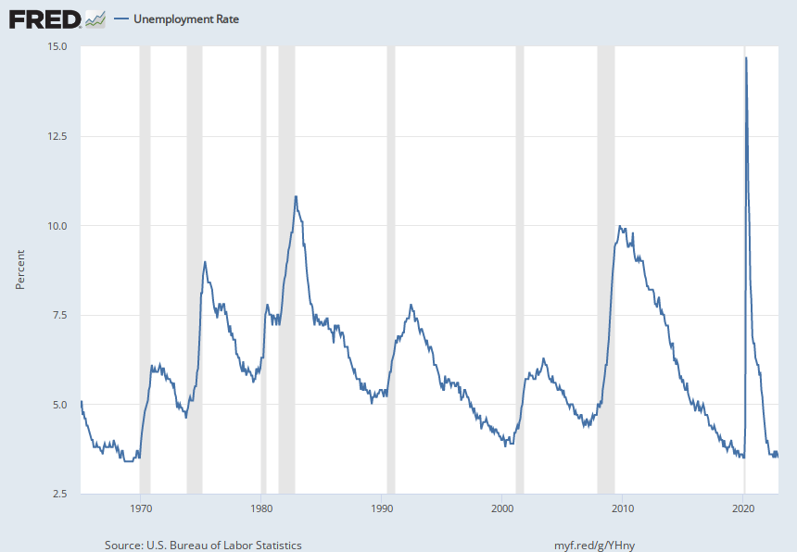
Track Record on Unemployment
Shaded Bars are Recessions

Slide 18
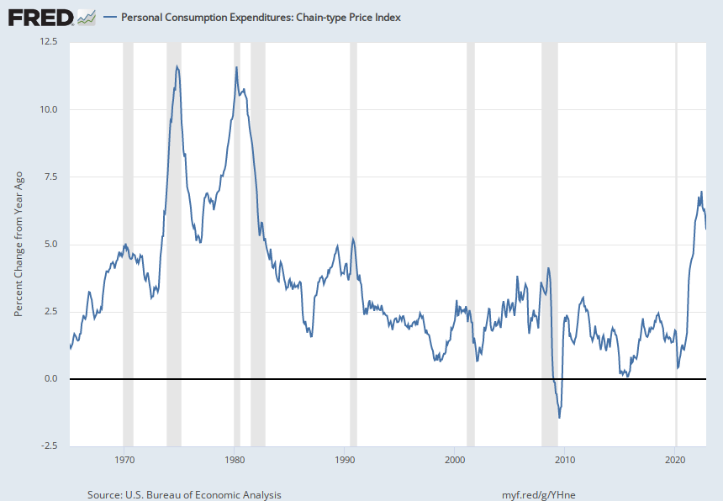
Track Record on “Price Stability”
Notes:
Shaded lines are recessions . 1970S THE Great Moderation

Slide 19
Determinants of Unemployment & Inflation
Short run:
Unemployment: The higher the level of total spending the lower the unemployment rate.
Inflation:
  “Too much Spending:” Total spending above the economy’s normal capacity (“potential output”) tends to increase inflation.
  Increase in production costs (e.g., “supply chain bottlenecks.”)
  Expectations of high inflation can cause inflation to be high.
Notes:
One sign of too much spending is a very low unemployment rate. Go back to 17 and then to 20

Slide 20
Determinants of Unemployment & Inflation
Long run: what the economy would look like if real GDP were at potential (average behavior of the economy over a number of years):
Unemployment: Is determined by labor supply and demand and is independent of monetary policy; unemployment will be at the natural rate.
Inflation is totally determined by the Fed!

Slide 21
The Fed’s Affects the Economy via Interest Rates
Higher Interest rates discourage firms from buying new plant and equipment, households from buying new homes, and tend to lower stock and housing prices (!).
Lower spending tends to raise unemployment and eventually lowers inflation.

Slide 22
Become a Central Banker in One Slide!
If you are more concerned that inflation is too high, raise interest rates.
If you are more concerned that unemployment is too high, lower interest rates.
Inflation and unemployment just right: keep rates the same.

Slide 23
One Big Complication: Lags
Milton Friedman: Monetary Policy affects GDP and Inflation with Long and Variable (Unpredictable) Lags.
Raising interest rates today does nothing to spending today nor to inflation.
But over time spending slows and eventually inflation falls.
Friedman believed that lags led to the Fed to “oversteering” the economy consistently.

Slide 24
A Closer Look at Interest Rate Control
Primary Tool: the Fed targets the federal funds rate (or fed funds rate for short), the interest rate on overnight loans between banks.
The Fed adjusts bank reserves so that the federal funds rate is within a target range 25 basis points wide.
From the bank’s perspective these loans are very close substitutes to other short-term, safe assets such as Treasury Bills.
Therefore, controlling the fed funds rate gives the Fed close control over all safe, short-term interest rates.
Notes:
Target range for the fed funds rate

Slide 25
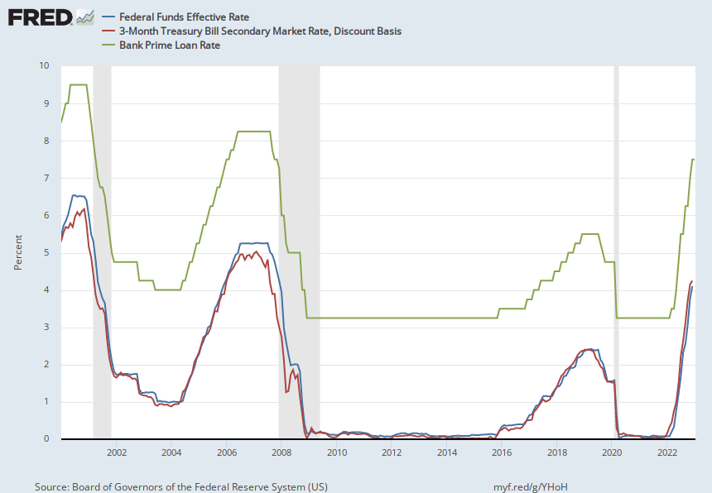
The Fed and Short-term Interest Rates
Blue is the fed funds rate.
Red is the rate on 3 month Treasuries.
Green is the prime bank lending rate
Notes:
Take note over the redline peeking above the others

Slide 26
What about the Money Supply?
Notice the absence of the money supply. The Fed does not believe there is a reliable, short-run link between the money supply and total spending or inflation.
The Minutes of the 12/13-14/2022 FOMC Meeting mentions:
  Money Supply, M1, M2 – 0 times
  Federal funds rate – 16 times

Slide 27
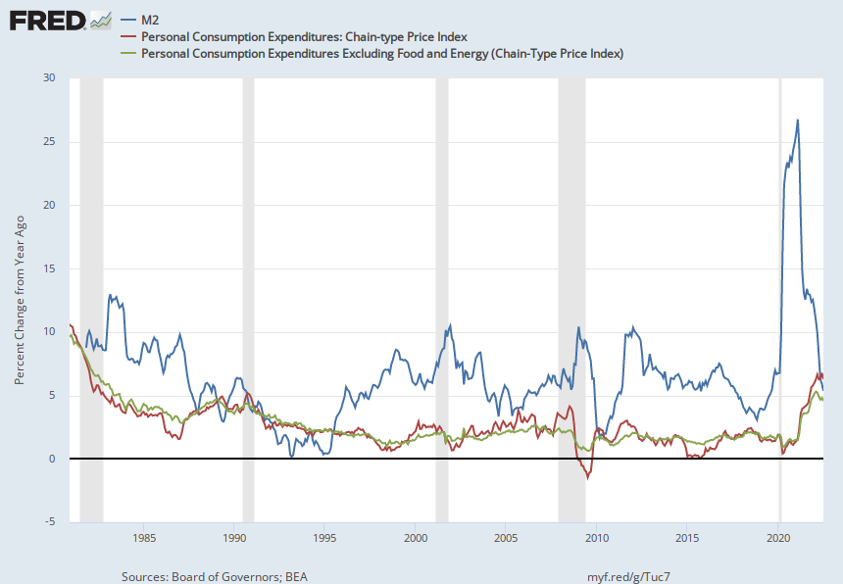
Do You See a Relationship?

Slide 28
“Don’t Listen to This Nonsense”
Robert Bartley, Editor of the Editorial page of the Wall Street Journal in the 1980s (paraphrased):
“Ronald Reagan proved that economists know nothing about inflation and unemployment. During his first term he was able to do what economists said was impossible: simultaneously reducing inflation and unemployment.”
What do you think would be my response?
Notes:
Show 17 and then break

Slide 29
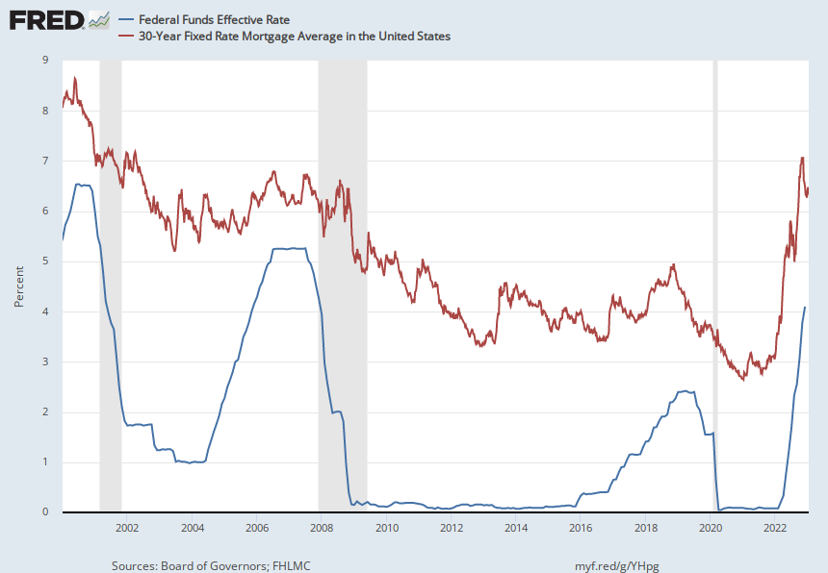
The Importance of Long-Term Interest Rates
Nobody buys a house because of the level of 1-yr interest rates, and unfortunately, the current federal funds rate has much less influence on the rates that matter.
Notes:
Red line was 90-day cp, the TBIll line was 1 month rate

Slide 30
Long-Term Interest Rates
Long-term interest rates depend on two factors
  The average of expected, future short-term rates over the life of the long-term bond.
  “Risk” premia that reflect the possibility of unexpected changes in interest rates and the possibility of default.
The Secondary Tools are aimed at affecting these factors.
Notes:
Red line was 90-day cp, the TBIll line was 1 month rate

Slide 31
Two Secondary Tools to Affect Interest Rates
Forward Guidance: Communicating the Fed’s intentions for the future path of short-term interest rates.
Long-term Asset Purchases better known as quantitative easing or QE.
Both of these tools also affect interest rates, and thereby aggregate demand. But their effect is on the interest rates of longer-term and riskier assets.
Notes:
Forward guidance occurs not just with the FOMC policy statments

Slide 32
Forward Guidance
The Fed “guides” financial market participants about what they intend to do in the future. From the 9/13-14/22 Policy Statement:
“The Committee anticipates that ongoing increases in the target range will be appropriate in order to attain a stance of monetary policy that is sufficiently restrictive to return inflation to 2 percent over time.”
Notes:
In May, 4th 1%; ;

Slide 33
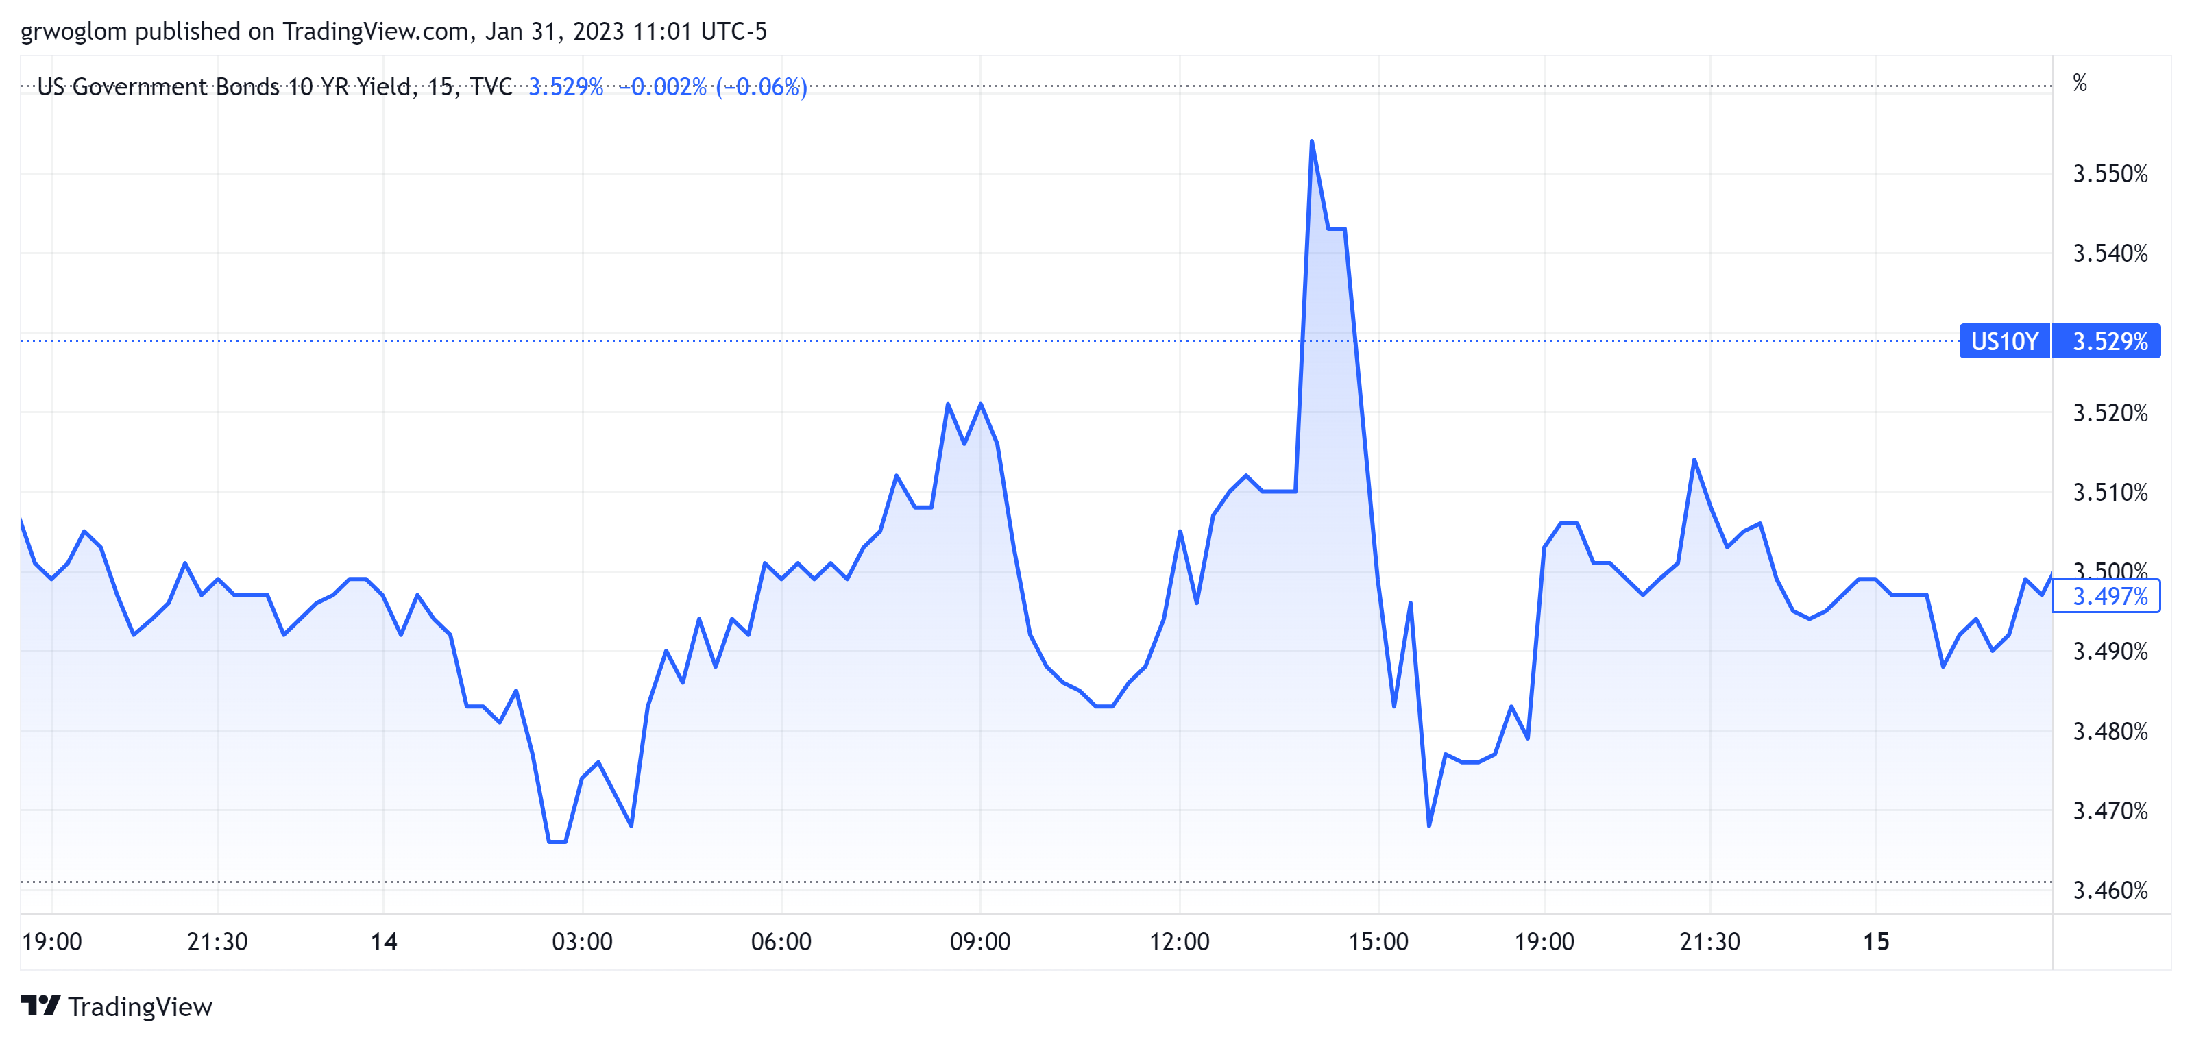
When the Fed Talks, Wall St Listens!
2 PM
At least for a while

Slide 34
QE And Long-term, Risky Rates
Financial investors require a higher interest rate on risky bonds, than on safe short-term Treasuries.
The greater the supply of risky bonds, the higher the required risk premia needed to get enough private investors to buy them.
QE lowers the supply of long-term bonds held by private investors and thereby lowers to required risk premia and the interest rate on these bonds.
QE is particularly important when the federal funds rate has hit the zero (ZLB)

Slide 35
QE Has Been a Big Deal
Source: Federal Reserve Board
Notes:
25% of marketable Federal Debt; 20 percent of household mortgages. Total Fed assets increase by over 1.2 tr in 9 weeks;
Then by over 2.6 tr second time.

Slide 36
A Policy Strategy: Stabilize Expectations of Inflation
Monetary Policy is much easier if the people believe that the Fed will achieve its inflation target.
Ben Bernanke (2007):
”…if inflation expectations respond less than previously to variations in economic activity, then inflation itself will become relatively more insensitive to the level of activity…”
In central bank jargon, stable expectations are “well anchored.”

Slide 37
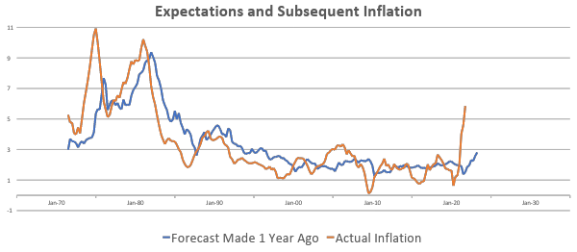
“Anchoring” Inflation Expectations
Forecasts: Philadelphia Fed, “Survey of Professional Forecasters”
Notes:
Livingston Survey. 75-78. Unemployment 7% and 6% inflation. Look at the stability in the post 2001 period and the 2003-2005 period

Slide 38
Anchoring Requires Credibility
Credibility, the public believes that the Fed will achieve its goals.
Requirements for Credibility
  Transparency (Communication)
  Accountability (Performance)
  Political Independence
Things to think about: The Fed through monetary policy has the most influence on the short-run behavior of the economy. These governmental decisions are made “technocratically” and not democratically. Is that a problem?
Notes:
Communication releases; accountability, Congressional Testimony and 5 year full release. Political independence 14 year terms, but fragile.

Slide 39
The Great Moderation
Volcker paid a price in the early 1980s, but the price paid dividends from 1990 through 2008.
During that period the performance of the US economy was extraordinary and even Milton Friedman gave kudos to the Alan Greenspan.
Has Powell jeopardized Volcker’s legacy?
Notes:
Go back to 16

Slide 40
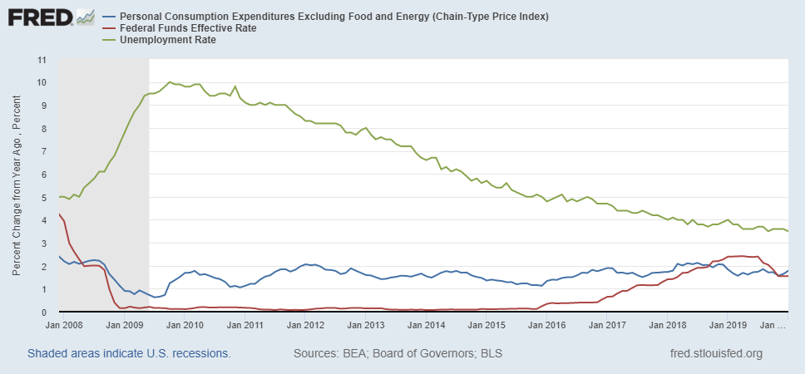
Why Did Powell Do It?
Powell Replaces
Yellen as Chair
Notes:
On average inflation is less than 2% And Fred raises rates before inflation exceeds 2.%. But, very credible. Latest tightening was begun before Powell became Chair. Tightening is very gradual 1.5 pct pts in 2 years.

Slide 41
Policy Changes under Powell
In the Fed’s dual mandate put more emphasis on the employment goal relative to the inflation goal.
Inflation goal switched from targeting forecasted future inflation to trying to achieve average realized inflation of 2%
Have they forgotten about Lags!
Notes:
Description of Policy goals reversed the order of the inflation and employment objectives

Slide 42
OK, But What Explains Powell’s Reversal?
“I knew Paul Volcker,” Powell responded. “I think he was one of the great public servants of the era — the greatest economic public servant of the era.” Making clear that his own legacy was on his mind, Powell continued, “I hope that history will record that the answer to your question is yes.” Peter Coy, NYTimes, “Economic Theory Alone May Not Explain Jerome Powell’s Actions,” 9/23/2022
Could Powell be “Oversteering?”
(Larry Summers doesn’t think so)

Slide 43
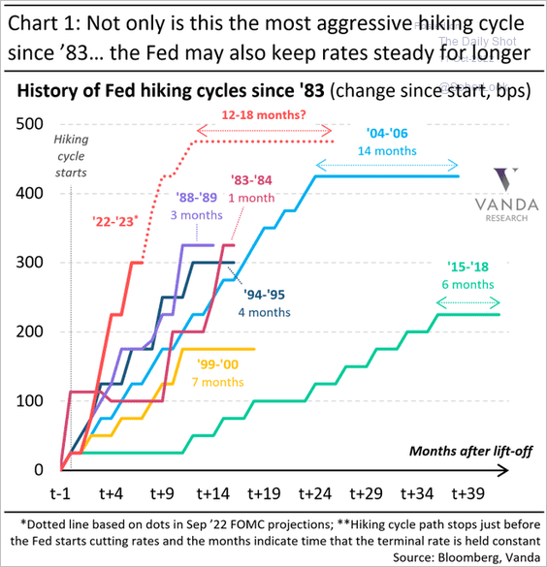
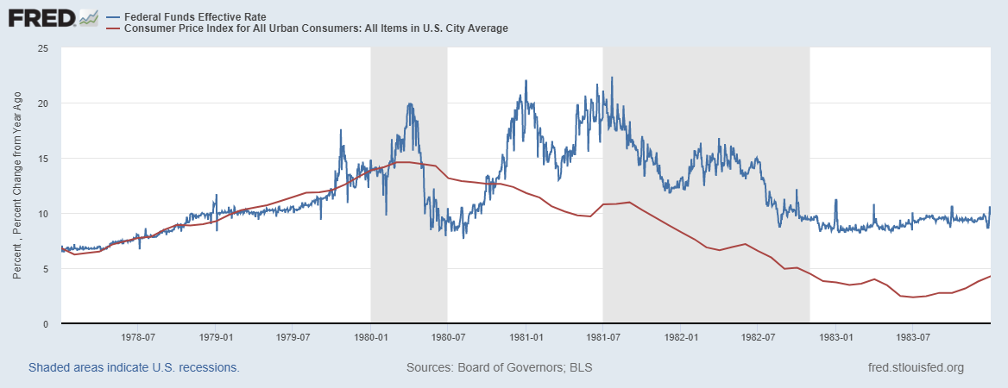
Is Powell Channeling Volcker?
Notes:
Inflation more persistent and rising, but to get inflationary expectations down, Volcker had to push the funds rate well over the rate of inflation

Slide 44
Olivier Blanchard 12/30 Twitter Post
Inflation is fundamentally the outcome of the distributional conflict, between firms, workers, and taxpayers… The source of the conflict may be too hot an economy. But in the end, forcing the players to accept the outcome, and thus stabilizing inflation, is typically left to the central bank… It is a highly inefficient way to deal with distributional conflicts…

Slide 45
FOMC Had Been of Two Minds (December 14, 2022)
Many participants highlighted that the Committee needed to continue to balance two risks.
One risk was that an insufficiently restrictive monetary policy could cause inflation to remain above the Committee’s target for longer than anticipated, leading to unanchored inflation expectations
The other risk was that the lagged cumulative effect of policy tightening could end up being more restrictive than is necessary to bring down inflation to 2 percent and lead to an unnecessary reduction in economic activity, potentially placing the largest bur-dens on the most vulnerable groups of the population.
No participants anticipated that it would be appropriate to begin reducing the federal funds rate target in 2023.

Slide 46
FOMC Economic Projections
Variable (in percent) | Medians
 | 2022 | 2023 | 2024 | 2025 | Longer Run
RGDP growth | 0.5 | 0.5 | 1.6 | 1.8 | 1.8
Sept. | 0.2 | 1.2 | 1.7 | 1.8 | 1.8
Unemployment | 3.7 | 4.6 | 4.6 | 4.5 | 4.0
Sept. | 3.8 | 4.4 | 4.4 | 4.3 | 4.0
Inflation | 5.6 | 3.1 | 2.5 | 2.1 | 2.0
Sept. | 5.4 | 2.8 | 2.3 | 2.0 | 2.0
Core Inflation | 4.8 | 3.5 | 2.5 | 2.1 | 2.0
Sept. | 5.4 | 2.8 | 2.3 | 2.0 | 2.0
Federal Funds | 4.4 | 5.1 | 4.1 | 3.1 | 2.5
Sept | 4.4 | 4.6 | 3.9 | 2.9 | 2.5
Notes:
Survey of Professional Forecasters from early August: GDP and unemployment much like the June Fed forecast. Inflation much like the Fed’s September forecast.

Slide 47
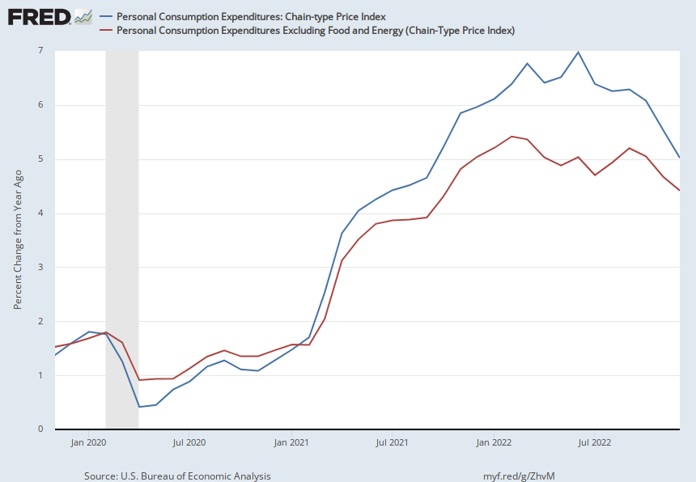
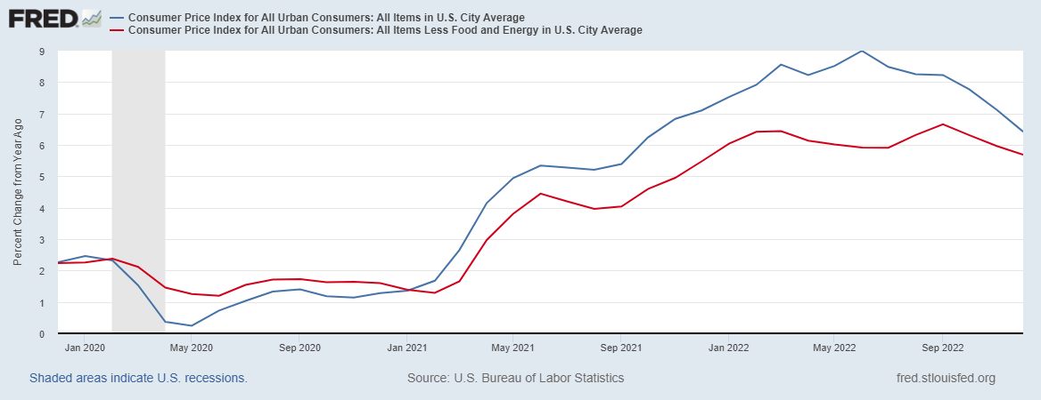
Fed’s Preferred Measure of Inflation (1/27)

Slide 48
Fiscally Driven Recovery (1/27)
Saving

Slide 49
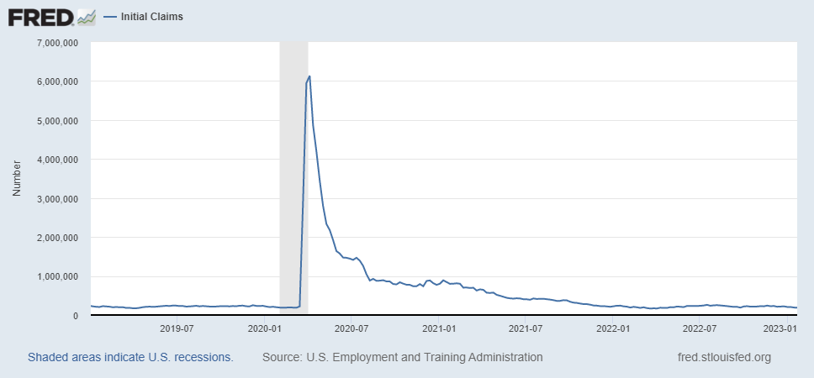
Initial Unemployment Claims (1/26)

Slide 50
Employment Cost Index (1/31, 8:30 AM)

Slide 51
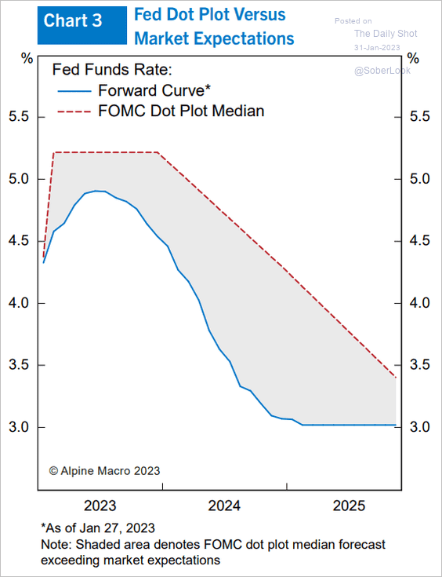
Wall Street Doesn’t Believe the Fed

Slide 52
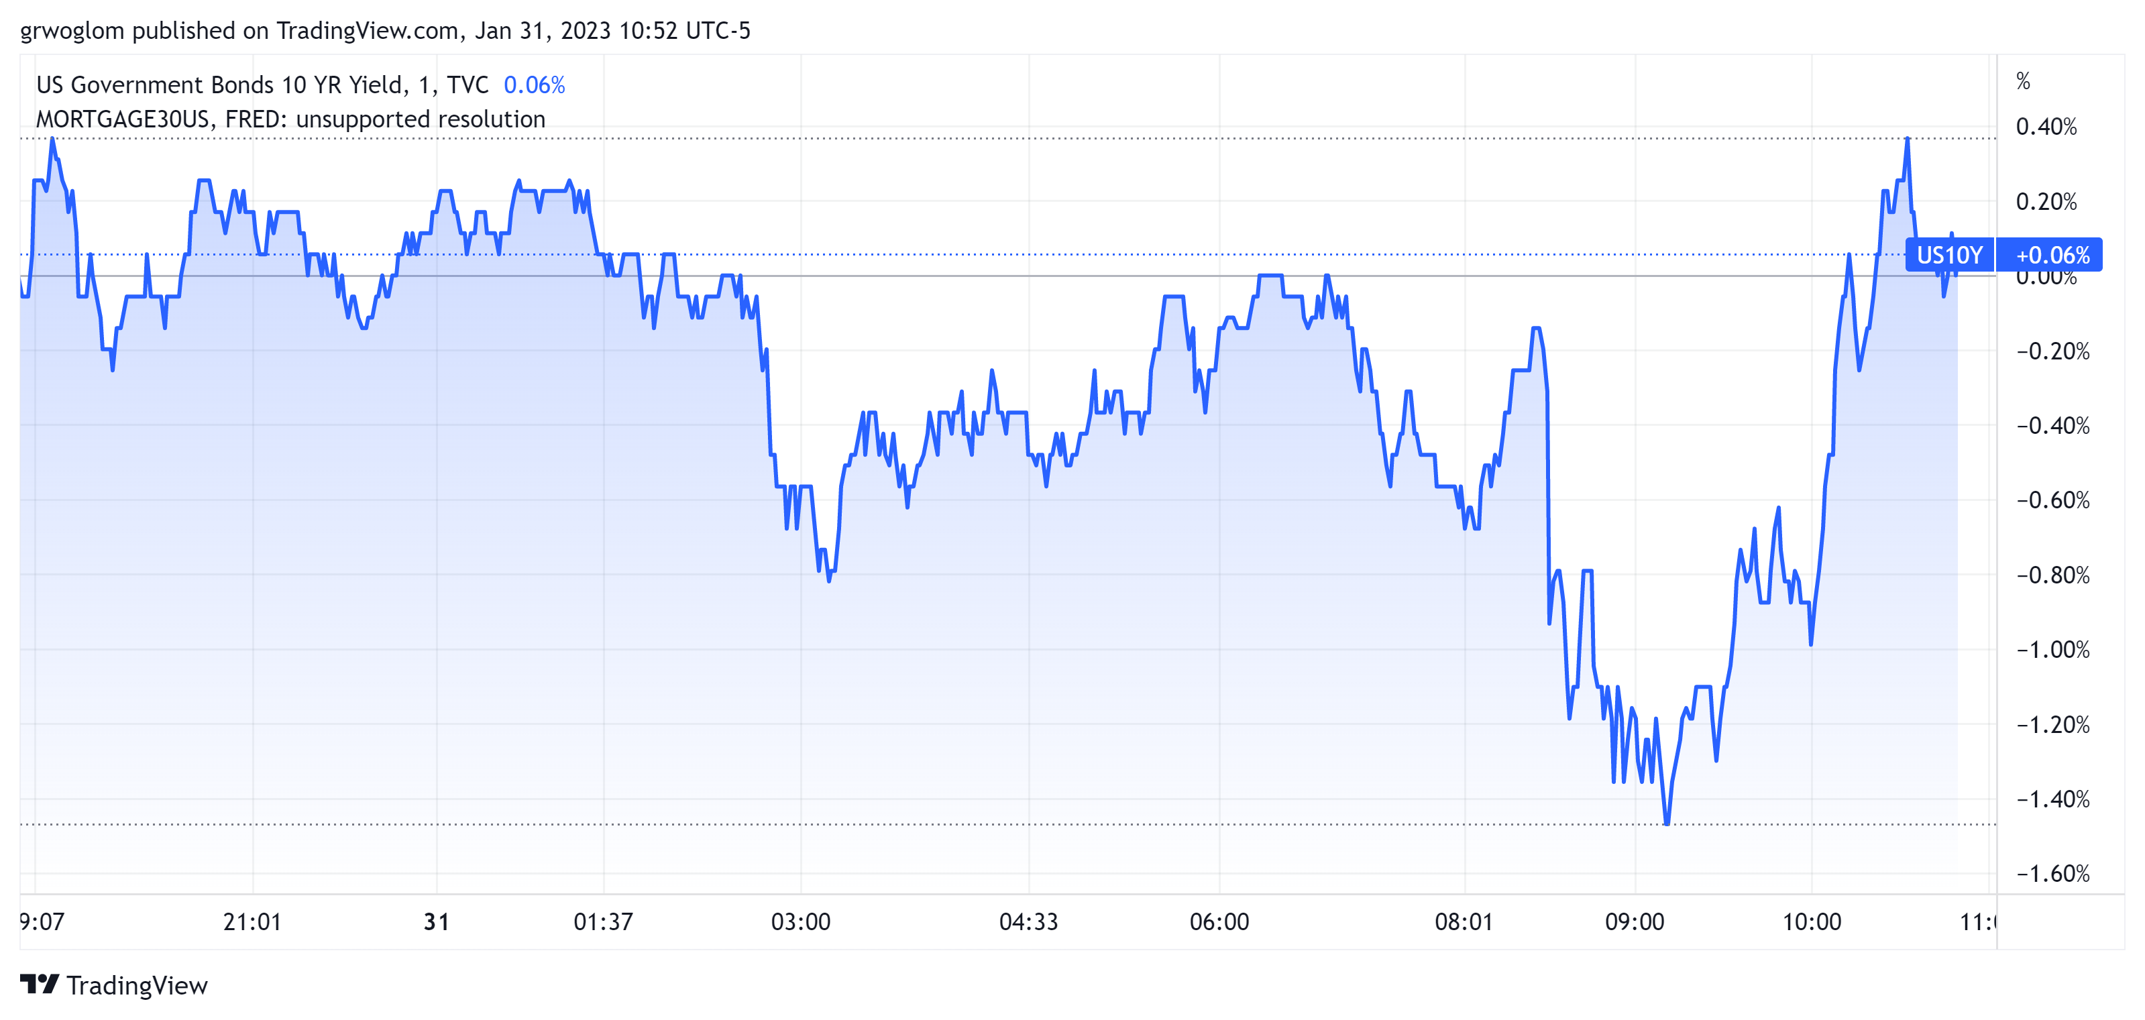
Reading Today’s Tea Leaves
8:30 AM

Slide 53
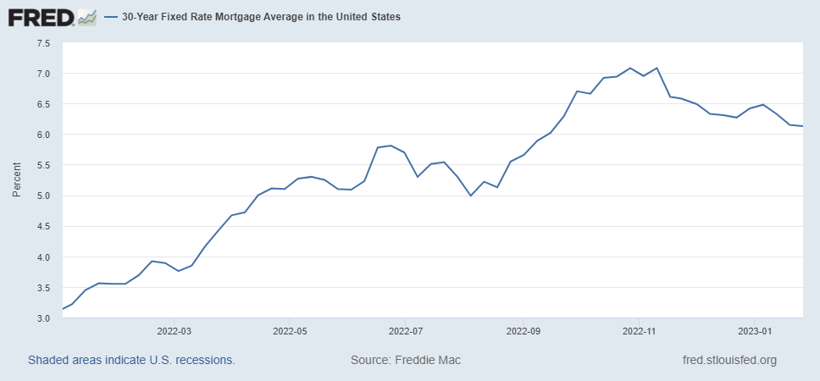
Is the Fed Happy with this Chart?

Slide 54
Now, it is Your Turn
www.NEEDelegation.org
Geoffrey Woglom
grwoglom@amherst.edu
Contact NEED: Info@NEEDelegation.org
Submit a testimonial: www.NEEDelegation.org/testimonials.php
Support NEED: www.NEEDelegation.org/donate.php

