Slide 1
Osher Lifelong Learning Institute, Winter 2023
Contemporary Economic Policy
University of Massachusetts, Boston
March-April, 2023
Host: Jon Haveman, Ph.D.
National Economic Education Delegation

Slide 2
National Economic Education Delegation
Vision
  One day, the public discussion of policy issues will be grounded in an accurate perception of the underlying economic principles and data.
Mission
  NEED unites the skills and knowledge of a vast network of professional economists to promote understanding of the economics of policy issues in the United States.
NEED Presentations
  Are nonpartisan and intended to reflect the consensus of the economics profession.

Slide 3
Who Are We?
Honorary Board: 54 members
  2 Fed Chairs: Janet Yellen, Ben Bernanke
  6 Chairs Council of Economic Advisers
    Furman (D), Rosen (R), Bernanke (R), Yellen (D), Tyson (D), Goolsbee (D)
  3 Nobel Prize Winners
    Akerlof, Smith, Maskin
Delegates: 652+ members
  At all levels of academia and some in government service
  All have a Ph.D. in economics
  Crowdsource slide decks
  Give presentations
Global Partners: 48 Ph.D. Economists
  Aid in slide deck development

Slide 4
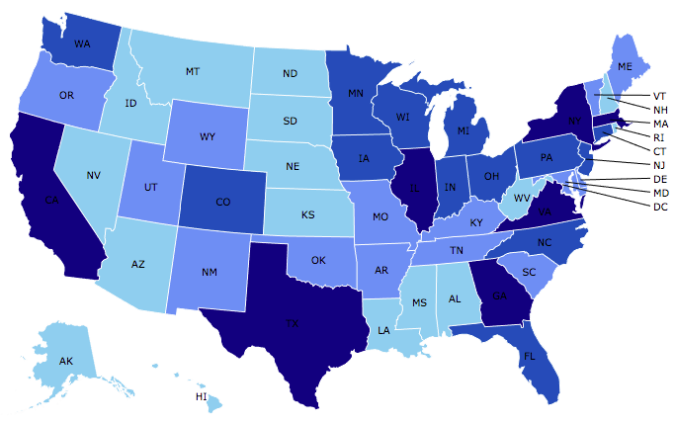

Where Are We?

Slide 5
Available NEED Topics Include:
US Economy
Healthcare Economics
Climate Change
Economic Inequality
Economic Mobility
Trade and Globalization
Minimum Wages
Immigration Economics
Housing Policy
Federal Budgets
Federal Debt
Black-White Wealth Gap
Autonomous Vehicles
Healthcare Economics

Slide 6
Course Outline
Contemporary Economic Policy
  Week 2 (3/20): Monetary Economics (Geoffrey Woglom)
  Week 3 (3/27): Trade and Globalization (Alan Deardorff, Univ. Michigan)
  Week 4 (4/3): Trade Deficits and Exchange Rates (Alan Deardorff)
  Week 5 (4/10): Healthcare Economics (Jon Haveman, NEED)
  Week 6 (4/17): Climate Change Economics (Sarah Jacobson, Williams College)

Slide 7
Outline for the Talk
The economic determinants of inflation and unemployment.
The Fed’s policy tools for influencing interest rates and thereby affecting aggregate demand and the economy.
A closer look at changes that Chair Powell made in Fed policy that contributed to the run up in inflation.
Monetary Policy Challenges ahead,

Slide 8
What Is a Central Bank, such as the Fed?
Government’s Bank.
  Regulate currency and manage the payment system.
  Help with government finance.
“Lender of Last Resort” (LOL) in financial crises.
Responsible for stabilizing the macro economy: i.e., low, stable inflation and full employment
Notes:
Jump to 14.

Slide 9
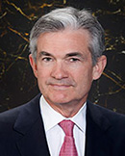
Stabilizer in Chief: the Fed
The Fed’s Dual Mandate:
  “Stable prices” which means 2% rate of inflation in the Personal Consumption Expenditure Price Index (which corresponds to about 2.5% inflation in the more well-known CPI).
  “Maximum employment” which means the highest level of employment (lowest unemployment rate) consistent with mandate 1.
Monetary policy is made by the Federal Open Market Committee (FOMC), comprised of the 7 Fed Governors and 5 of the 12 Presidents of the Regional Federal Reserve Banks on a rotating basis.
The FOMC has scheduled meetings 8 times a year, but can hold unscheduled meetings at a moments notice (e..g., March of 2020)
Jerome Powell
February 2018
Notes:
Define inflation as the rate of increase in the average level of prices not gasoline price inflation. Exceptions Deep Recesssions. ARP we will talk about later.

Slide 10
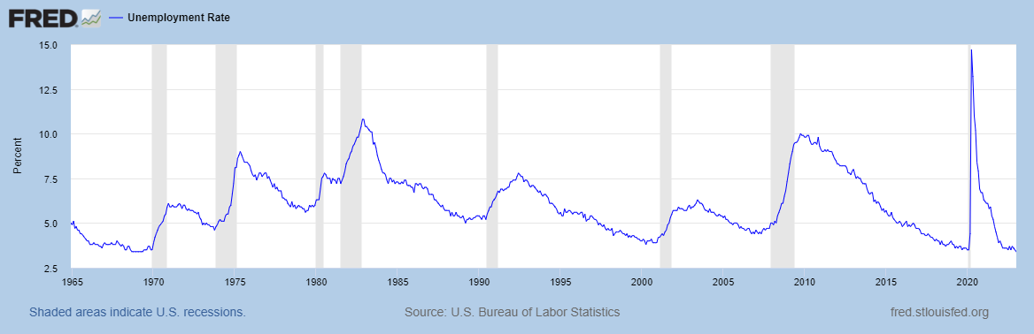
Track Record on Unemployment
Shaded Bars are Recessions

Slide 11
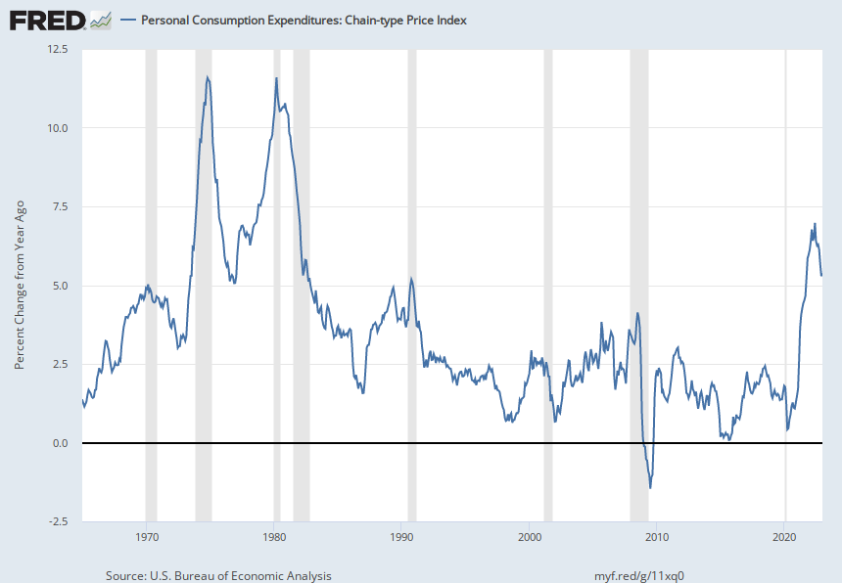
Track Record on “Price Stability”
Notes:
Shaded lines are recessions . 1970S THE Great Moderation

Slide 12
Determinants of Unemployment & Inflation
Short run:
Unemployment: The higher the level of total spending the lower the unemployment rate.
Inflation:
  “Too much Spending:” Total spending above the economy’s normal capacity (“potential output”) tends to increase inflation.
  Increase in production costs (e.g., “supply chain bottlenecks.”)
  Expectations of high inflation can cause inflation to be high.
Notes:
One sign of too much spending is a very low unemployment rate. Go back to 13 and then to 16

Slide 13
The Fed’s Affects the Economy via Interest Rates
Higher Interest rates discourage firms from buying new plant and equipment, households from buying new homes, and tend to lower stock and housing prices (!).
Lower spending tends to raise unemployment and eventually lowers inflation.

Slide 14
Become a Central Banker in One Slide!
If you are more concerned that inflation is too high, raise interest rates.
If you are more concerned that unemployment is too high, lower interest rates.
Inflation and unemployment just right: keep rates the same.
Note: in deciding on appropriate interest rates you must take account of what fiscal policy is doing that affects total spending

Slide 15
One Big Complication: Lags
Milton Friedman: Monetary Policy affects GDP and Inflation with Long and Variable (Unpredictable) Lags.
Raising interest rates today does nothing to spending today nor to inflation.
But over time spending slows and eventually inflation falls.
Friedman believed that lags led to the Fed to “oversteering” the economy consistently.

Slide 16
A Closer Look at Interest Rate Control
Primary Tool: the Fed targets the federal funds rate (or fed funds rate for short), the interest rate on overnight loans between banks.
The Fed adjusts bank reserves so that the federal funds rate is within a target range 25 basis points wide.
From the bank’s perspective these loans are very close substitutes to other short-term, safe assets such as Treasury Bills.
Therefore, controlling the fed funds rate gives the Fed close control over all safe, short-term interest rates.
Notes:
Target range for the fed funds rate

Slide 17
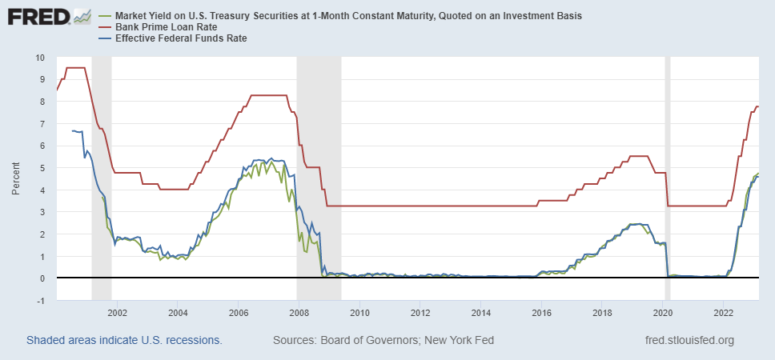
The Fed and Short-term Interest Rates
Blue is the fed funds rate.
Red is the prime bank lending rate.
Green is the rate on 3 month Treasuries.
Notes:
Take note over the redline peeking above the others

Slide 18
What about the Money Supply?
Notice the absence of the money supply. The Fed does not believe there is a reliable, short-run link between the money supply and total spending or inflation.
The Minutes of the 1/31-2/1/2023 FOMC Meeting mentions:
  Money Supply, M1, M2 – 0 times
  Federal funds rate – 13 times

Slide 19
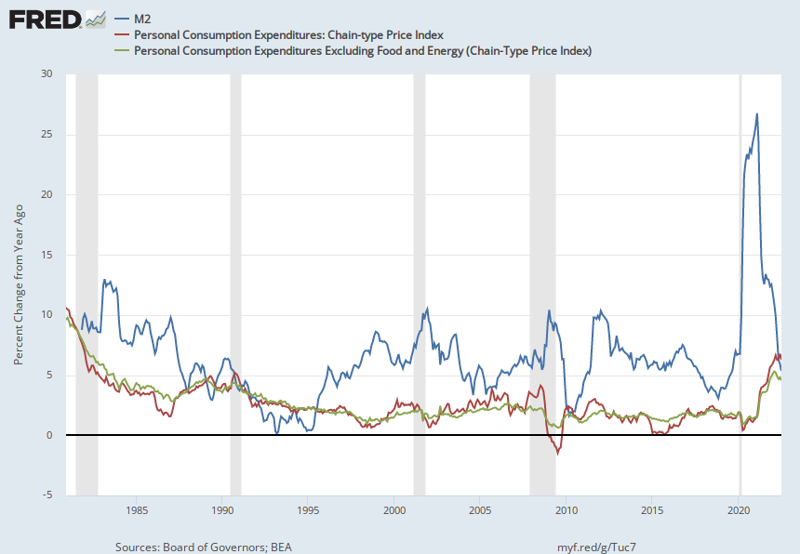
Do You See a Relationship?

Slide 20
The Importance of Long-Term Interest Rates
Nobody buys a house because of the level of 1-yr interest rates, and unfortunately, the current federal funds rate has much less influence on the rates that matter.
Notes:
Red line was 90-day cp, the TBIll line was 1 month rate

Slide 21
Long-Term Interest Rates
Long-term interest rates depend on two factors
  The average of expected, future short-term rates over the life of the long-term bond.
  “Risk” premia that reflect the possibility of unexpected changes in interest rates and the possibility of default.
The Secondary Tools are aimed at affecting these factors.
Notes:
Red line was 90-day cp, the TBIll line was 1 month rate

Slide 22
Two Secondary Tools to Affect Interest Rates
Forward Guidance: Communicating the Fed’s intentions for the future path of short-term interest rates.
Long-term Asset Purchases better known as quantitative easing or QE.
Both of these tools also affect interest rates, and thereby aggregate demand. But their effect is on the interest rates of longer-term and riskier assets.
Notes:
Forward guidance occurs not just with the FOMC policy statments

Slide 23
Forward Guidance
The Fed “guides” financial market participants about what they intend to do in the future. From the Policy Statement since September:
“The Committee anticipates that ongoing increases in the target range will be appropriate in order to attain a stance of monetary policy that is sufficiently restrictive to return inflation to 2 percent over time.”
“In determining the pace of future increases in the target range, the Committee will take into account the cumulative tightening of monetary policy, the lags with which monetary policy affects economic activity and inflation, and economic and financial developments.”
extent
Notes:
In May, 4th 1%; ;

Slide 24
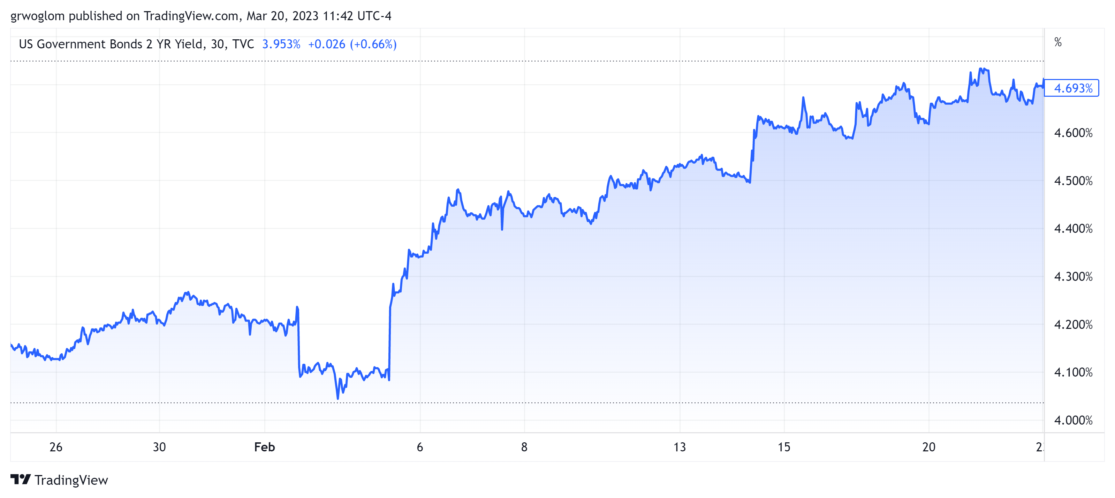
The Meaning of “Extent”

Slide 25
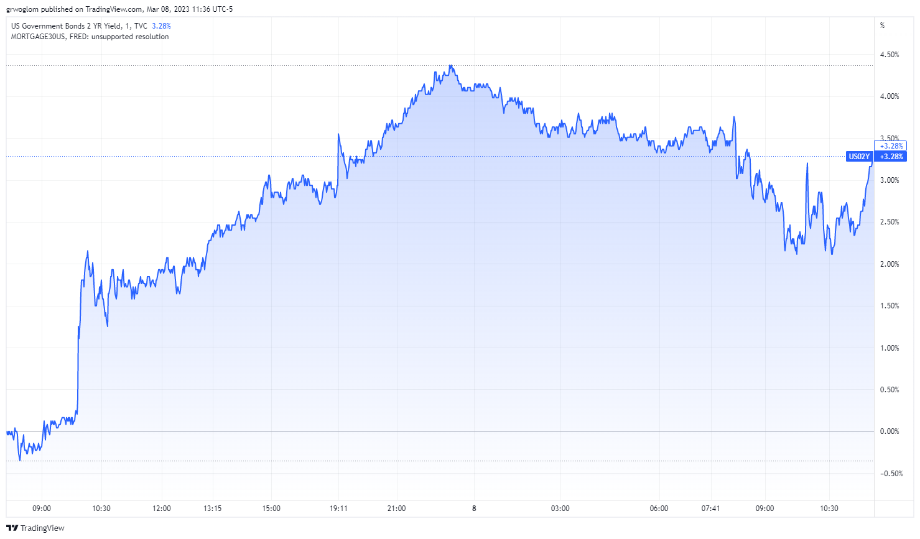
When the Fed Talks, Wall St Listens!
2Yr Treasury Rate, March 7th
In light of recent strong data, Jerome H. Powell said that the Federal Reserve is likely to raise rates higher than expected. NYTimes, 3/7, 10:37
10AM

Slide 26
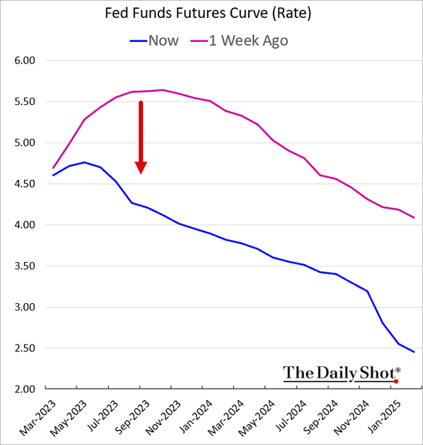
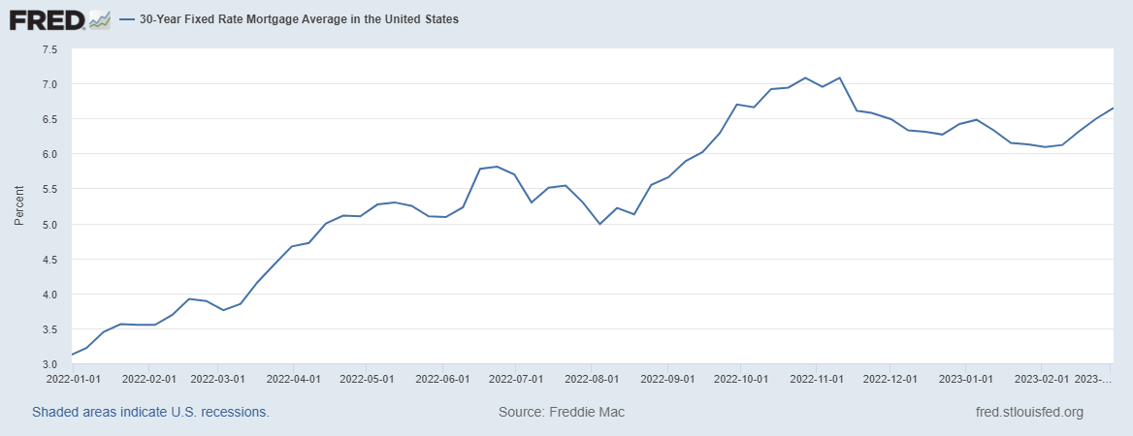
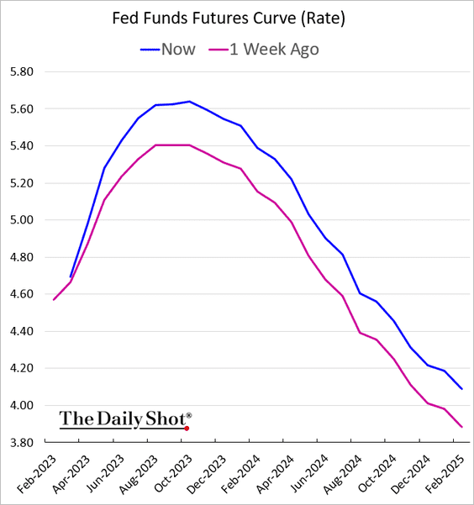
On March 7 Powell Emphasized Rate Hikes?
Blue last week
Red two weeks ago
Terminal rate
2/2, 6.09%

Slide 27
QE And Long-term, Risky Rates
Financial investors require a higher interest rate on risky bonds, than on safe short-term Treasuries.
The greater the supply of risky bonds, the higher the required risk premia needed to get enough private investors to buy them.
QE lowers the supply of long-term bonds held by private investors and thereby lowers to required risk premia and the interest rate on these bonds.

Slide 28
QE Has Been a Big Deal
Source: Federal Reserve Board
Notes:
25% of marketable Federal Debt; 20 percent of household mortgages. Total Fed assets increase by over 1.2 tr in 9 weeks;
Then by over 2.6 tr second time.

Slide 29
A Policy Strategy: Stabilize Expectations of Inflation
Monetary Policy is much easier if people believe that the Fed will achieve its inflation target.
In central bank jargon, if expectations are stable and “well anchored.”

Slide 30
“Anchoring” Inflation Expectations
Forecasts: Philadelphia Fed, “Survey of Professional Forecasters”
Notes:
Livingston Survey. 75-78. Unemployment 7% and 6% inflation. Look at the stability in the post 2001 period and the 2003-2005 period

Slide 31
Anchoring Requires Credibility
Credibility, the public believes that the Fed will achieve its goals.
Requirements for Credibility
  Transparency (Communication)
  Accountability (Performance)
  Political Independence
Things to think about: The Fed through monetary policy has the most influence on the short-run behavior of the (world) economy. These governmental decisions are made “technocratically” and not democratically. Is that a problem?
The Fed is mandated to not consider effects on other countries.
Notes:
Communication releases; accountability, Congressional Testimony and 5 year full release. Political independence 14 year terms, but fragile.

Slide 32
The Great Moderation
Volcker paid a price in the early 1980s, but the price paid dividends from 1990 through 2008.
During that period the performance of the US economy was extraordinary and even Milton Friedman gave kudos to the Alan Greenspan.
Has Powell jeopardized Volcker’s legacy?
Notes:
Go back to 16

Slide 33
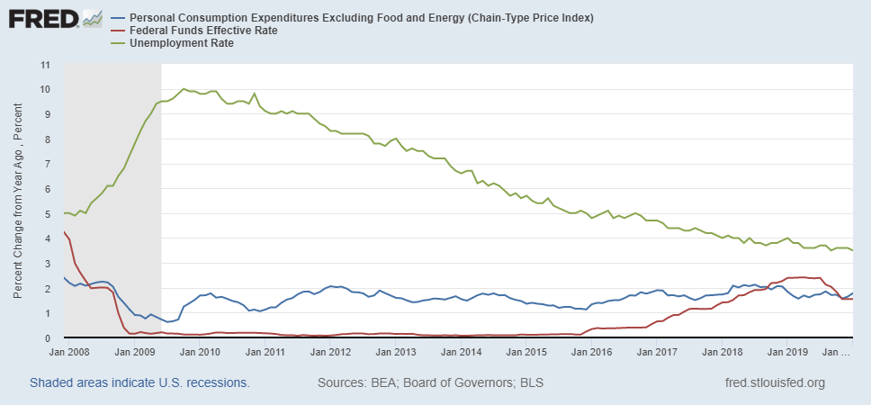
Why Did Powell Do It?
Powell Replaces
Yellen as Chair
Notes:
On average inflation is less than 2% And Fred raises rates before inflation exceeds 2.%. But, very credible. Latest tightening was begun before Powell became Chair. Tightening is very gradual 1.5 pct pts in 2 years.

Slide 34
Policy Changes under Powell
In the Fed’s dual mandate put more emphasis on the employment goal relative to the inflation goal.
Inflation goal switched from targeting forecasted future inflation to trying to achieve average realized inflation of 2%
Have they forgotten about Lags!
Notes:
Description of Policy goals reversed the order of the inflation and employment objectives

Slide 35
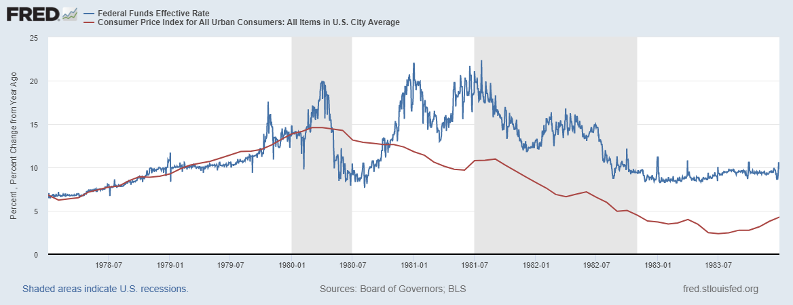
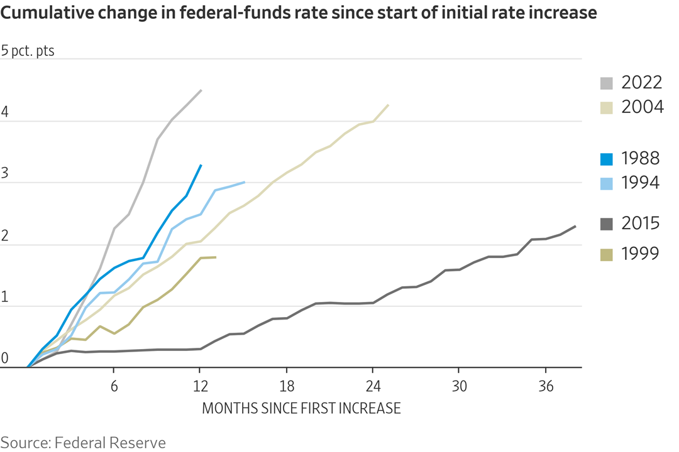
Is Powell Now Channeling Volcker?
Amazingly, (to me anyway), the Fed reaffirmed targeting average realized inflation!
Notes:
Inflation more persistent and rising, but to get inflationary expectations down, Volcker had to push the funds rate well over the rate of inflation

Slide 36
What’s at Stake
A rise in inflationary expectations would probably mean higher and more variable inflation (unlikely).
Oversteering leading to a steep recession.
And, the Fed needs to navigate:
At the start of a presidential election cycle, with
Pervasive uncertainty.
And there is more work to be done on inflation!

Slide 37
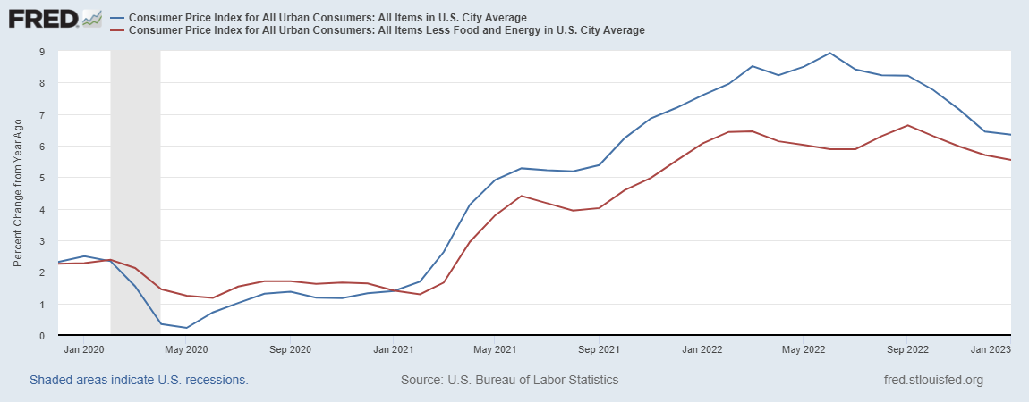
Inflation during the Recovery
Looks Promising?
Notes:
August CPI yoy 8.3% down from 8.5 and Core 6.3 up from 6.3 in JUly

Slide 38
Inflation: A Closer Look
Source: BLS accessed from Fred

Slide 39
Sadly, It Looks as if Things Could Get Worse
Credit Suisse a large Bank (45th largest in the world) with a significant US presence is in trouble
  WSJ, 3/15: “Credit Suisse has been the problem child of European banking for several years. Repeated scandals and financial losses have hammered the 166-year-old bank, which combines a wealth-management business catering to the world’s elite rich with a Wall Street investment bank.”
But, the danger is contagion and European bank shares were down.

Slide 40
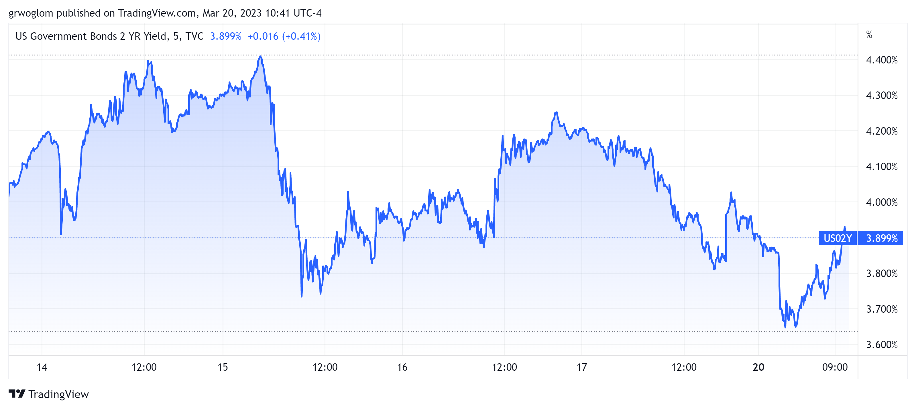
Turbulence in the Treasury Market

Slide 41
The Fed Has Been Providing Liquidity
An Additional $143 billion in New Lending Program

Slide 42
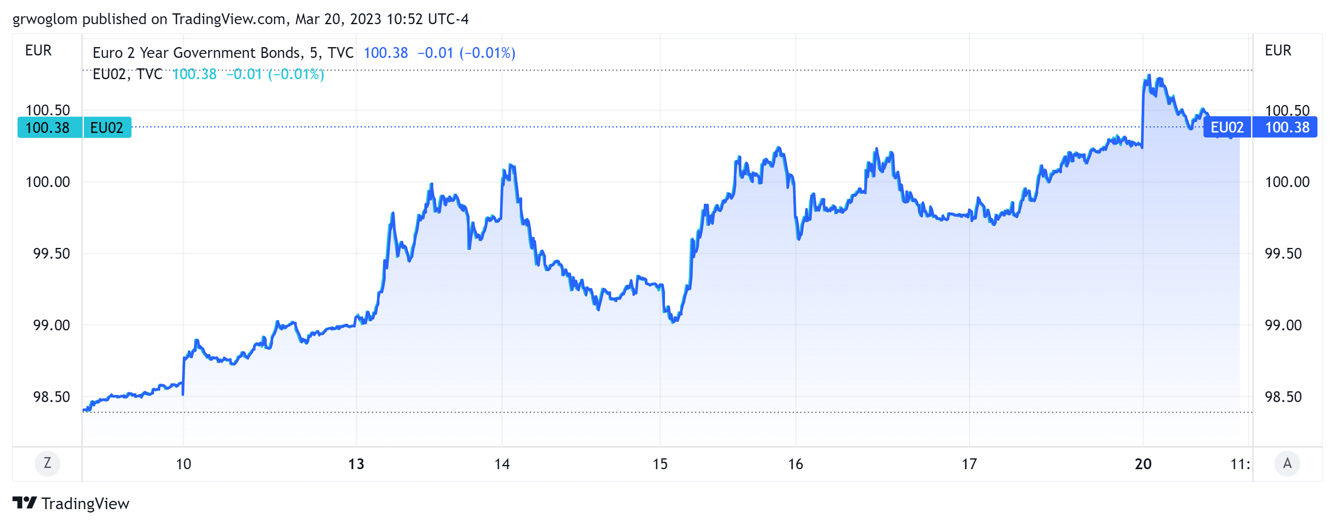
Recent Developments: ECB 50 bp rate increase
ECB raised their policy interest rate by 50 basis points in spite of Credit Suisse problems.
FOMC meets on 3/21-22.
Stay tuned.

Slide 43
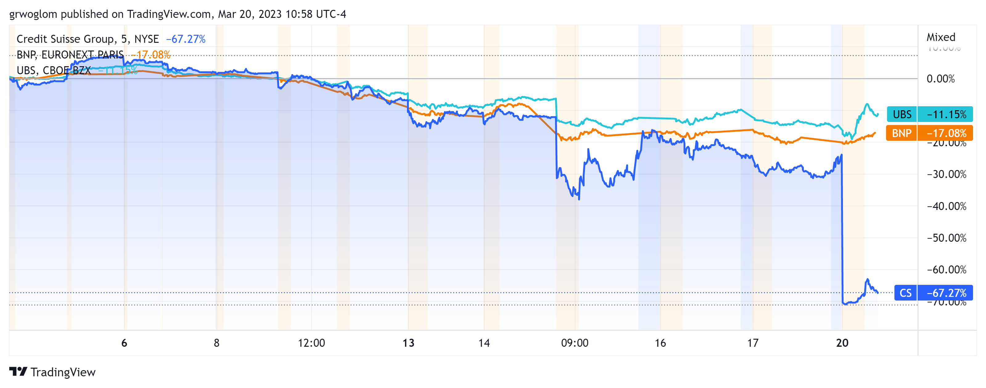
European Banking May be Calming

Slide 44
Finally, the Fed Meets this Week
Widely anticipated 25 basis point increase in the fed funds rate.
More important will be the forward guidance.
Policy statement announced 2:15 on Wednesday.

Slide 45

Trade: Bicycle Supply Chain
Source: World Development Report 2020

Slide 46
Let’s Hear from You!
Geoffrey Woglom
grwoglom@amherst.edu
Contact NEED: Info@NEEDelegation.org
Submit a testimonial: www.NEEDelegation.org/testimonials.php
Support NEED: www.NEEDelegation.org/donate.php

