Slide 1
Osher Lifelong Learning Institute, Spring 2023
Contemporary Economic Policy
University of Arizona
May-June, 2023
Jon Haveman, Ph.D.
National Economic Education Delegation

Slide 2
National Economic Education Delegation
Vision
  One day, the public discussion of policy issues will be grounded in an accurate perception of the underlying economic principles and data.
Mission
  NEED unites the skills and knowledge of a vast network of professional economists to promote understanding of the economics of policy issues in the United States.
NEED Presentations
  Are nonpartisan and intended to reflect the consensus of the economics profession.

Slide 3
Who Are We?
Honorary Board: 54 members
  2 Fed Chairs: Janet Yellen, Ben Bernanke
  6 Chairs Council of Economic Advisers
    Furman (D), Rosen (R), Bernanke (R), Yellen (D), Tyson (D), Goolsbee (D)
  3 Nobel Prize Winners
    Akerlof, Smith, Maskin
Delegates: 652+ members
  At all levels of academia and some in government service
  All have a Ph.D. in economics
  Crowdsource slide decks
  Give presentations
Global Partners: 48 Ph.D. Economists
  Aid in slide deck development

Slide 4


Where Are We?

Slide 5
Available NEED Topics Include:
US Economy
Healthcare Economics
Climate Change
Economic Inequality
Economic Mobility
Trade and Globalization
Minimum Wages
Immigration Economics
Housing Policy
Federal Budgets
Federal Debt
Black-White Wealth Gap
Autonomous Vehicles
US Social Policy

Slide 6
Course Outline
Contemporary Economic Policy
  Week 2 (5/23): Monetary Policy (Geoffrey Woglom)
  Week 3 (5/30): Health Care Economics (Kelley Cullen, E. Washington University)
  Week 4 (6/6): Trade and Globalization (Alan Deardorff, University of Michigan)
  Week 5 (6/13): Trade Deficits and Exchange Rates (Alan Deardorff)
  Week 6 (6/20): Cryptocurrencies (Jon Haveman, NEED)

Slide 7
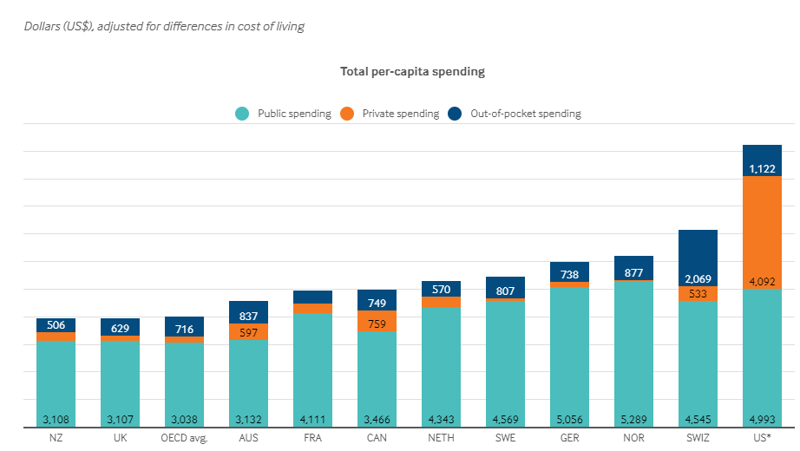
International Comparison: Health Spending
Notes:
Some good resources:
https://www.commonwealthfund.org/publications/issue-briefs/2020/jan/us-health-care-global-perspective-2019
A bit older report: https://www.commonwealthfund.org/publications/issue-briefs/2015/oct/us-health-care-global-perspective
https://www.healthsystemtracker.org/chart-collection/quality-u-s-healthcare-system-compare-countries/#item-overall-age-specific-potential-years-of-life-lost-per-100000-population-1990-2017
https://axenehp.com/international-healthcare-systems-us-versus-world/

Slide 8

Trade: Bicycle Supply Chain
Source: World Development Report 2020

Slide 9
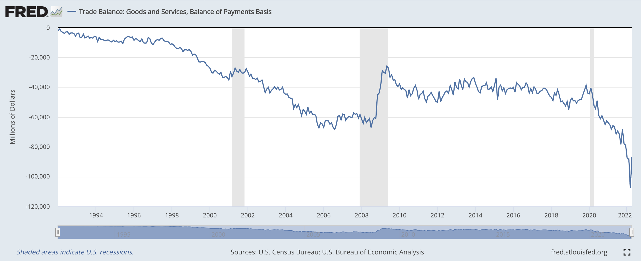
Trade Deficits and Exchange Rates

Slide 10
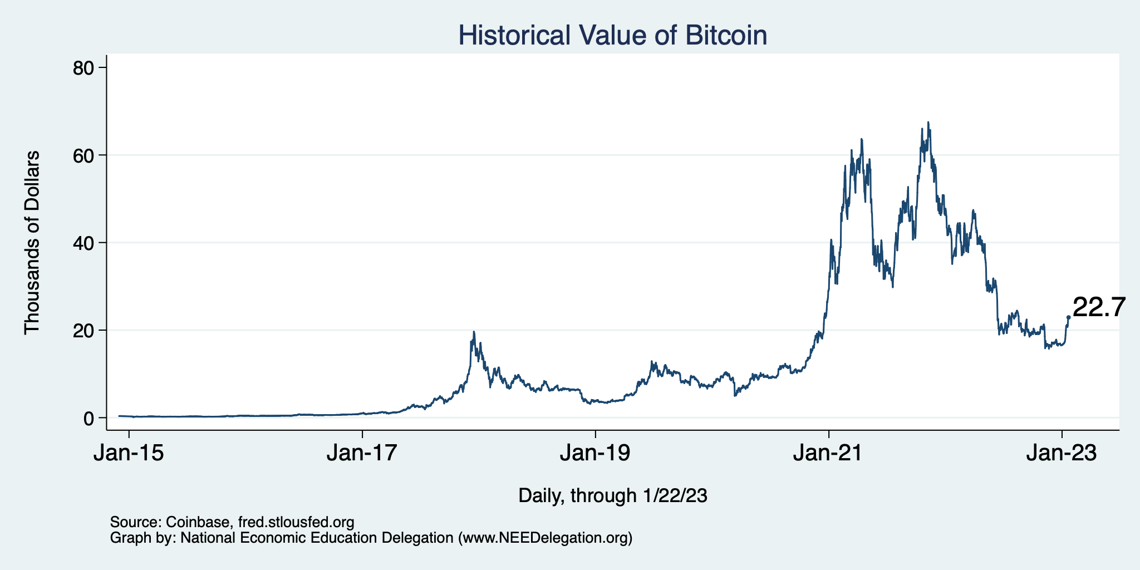
Bitcoins: What Is All the Excitement About?
Was

Slide 11
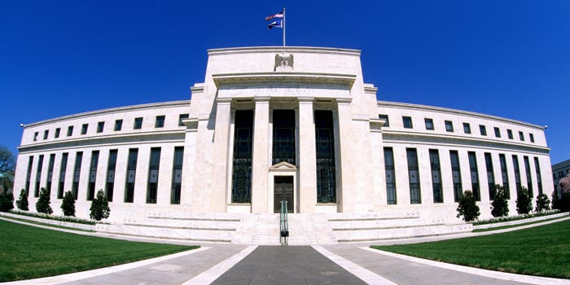
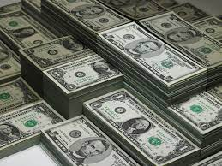
Monetary Policy & The Fed
Geoffrey Woglom
Professor of Economics (emeritus)
Amherst College

Slide 12
Credits and Disclaimer
This slide deck was authored by:
  Geoffrey Woglom, Amherst College (Emeritus)
Disclaimer
  NEED presentations are designed to be nonpartisan.
  It is, however, inevitable that the presenter will be asked for and will provide their own views.
  Such views are those of the presenter and not necessarily those of the National Economic Education Delegation (NEED).

Slide 13
Submitting Questions
Please submit questions of clarification in the chat.
  I will try to handle them as they come up, but may take them in a bunch as time permits.
We will do a verbal Q&A once the material has been presented.
  And the questions in the chat have been addressed.
OLLI allowing, we can stay beyond the end of class to have further discussion.

Slide 14
Outline for the Talk
What is the Fed.
The economic determinants of inflation and unemployment.
The Fed’s policy tools for influencing interest rates and thereby affecting aggregate demand and the economy.
A closer look at changes that Chair Powell made in Fed policy that contributed to the run up in inflation.
What’s at stake if we don’t get inflation under control.

Slide 15
What Is a Central Bank?
Government’s Bank.
  Regulate currency and manage the payment system.
  Help with government finance.
“Lender of Last Resort” (LOL) in financial crises.
Responsible for stabilizing the macro economy: i.e., low, stable inflation and full employment
Notes:
Jump to 14.

Slide 16
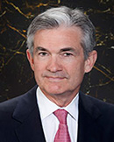
Stabilizer in Chief: the Fed
The Fed’s Dual Mandate:
  “Stable prices” which means 2% rate of inflation in the Personal Consumption Expenditure Price Index (which corresponds to about 2.5% inflation in the more well-known CPI).
  “Maximum employment” which means the highest level of employment (lowest unemployment rate) consistent with mandate 1.
Monetary policy is made by the Federal Open Market Committee (FOMC), comprised of the 7 Fed Governors and 5 of the 12 Presidents of the Regional Federal Reserve Banks on a rotating basis.
The FOMC has scheduled meetings 8 times a year, but can hold unscheduled meetings at a moments notice (e..g., March of 2020)
Jerome Powell
February 2018
Notes:
Define inflation as the rate of increase in the average level of prices not gasoline price inflation. Exceptions Deep Recesssions. ARP we will talk about later.

Slide 17
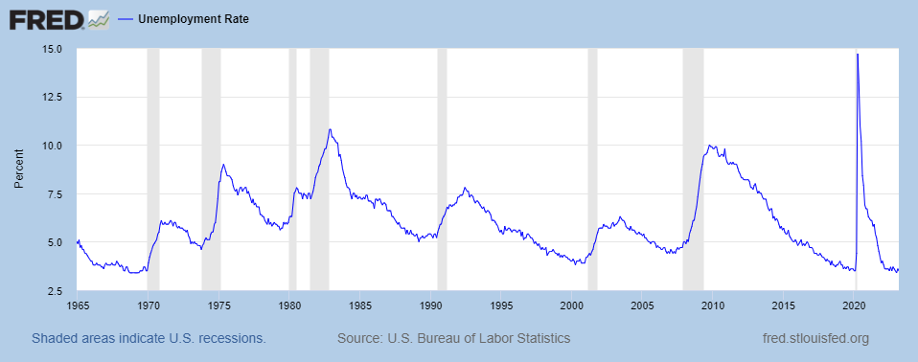
Track Record on Unemployment
Shaded Bars are Recessions

Slide 18
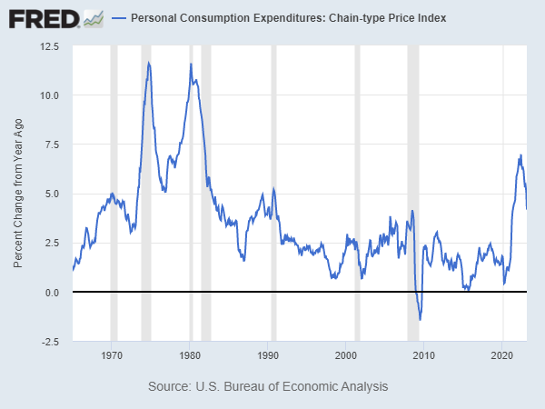
Track Record on “Price Stability”
Notes:
Shaded lines are recessions . 1970S THE Great Moderation

Slide 19
Determinants of Unemployment & Inflation
Short run:
Unemployment: The higher the level of total spending the lower the unemployment rate.
Inflation:
  “Too much Spending:” Total spending above the economy’s normal capacity (“potential output”) tends to increase inflation.
  Increase in production costs (e.g., “supply chain bottlenecks.”)
  Expectations of high inflation can cause inflation to be high.
Notes:
One sign of too much spending is a very low unemployment rate. Go back to 13 and then to 16

Slide 20
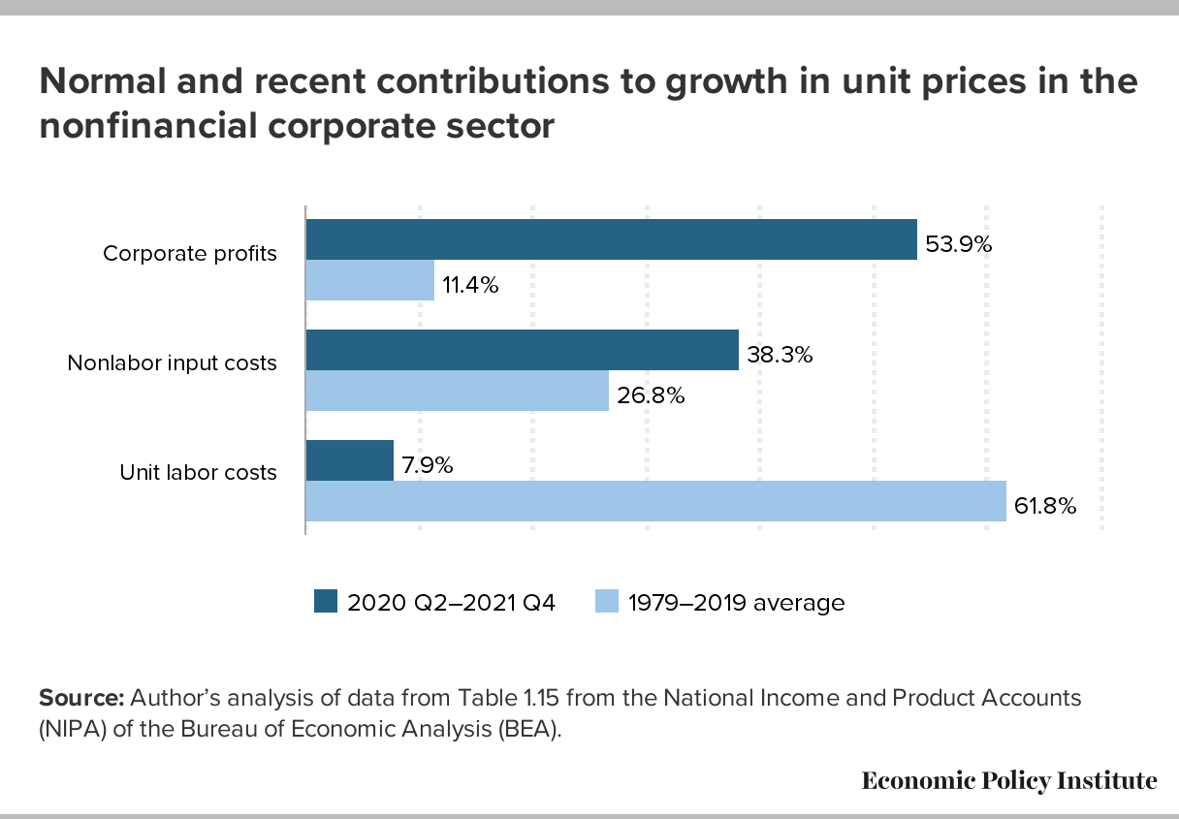
Corporate Profits and Inflation?

Slide 21
The Fed’s Affects the Economy via Interest Rates
Higher Interest rates discourage firms from buying new plant and equipment, households from buying new homes, and tend to lower stock and housing prices (!).
Lower spending tends to raise unemployment and eventually lowers inflation.

Slide 22
Become a Central Banker in One Slide!
If you are more concerned that inflation is too high, raise interest rates.
If you are more concerned that unemployment is too high, lower interest rates.
Inflation and unemployment just right: keep rates the same.
Note: in deciding on appropriate interest rates you must take account of what fiscal policy is doing that affects total spending

Slide 23
One Big Complication: Lags
Milton Friedman: Monetary Policy affects GDP and Inflation with Long and Variable (Unpredictable) Lags.
Raising interest rates today does nothing to spending today nor to inflation.
But over time spending slows and eventually inflation falls.
Friedman believed that lags led to the Fed to “oversteering” the economy consistently.

Slide 24
A Closer Look at Interest Rate Control
Primary Tool: the Fed targets the federal funds rate (or fed funds rate for short), the interest rate on overnight loans between banks.
The Fed adjusts bank reserves so that the federal funds rate is within a target range 25 basis points wide.
From the bank’s perspective these loans are very close substitutes to other short-term, safe assets such as Treasury Bills.
Therefore, controlling the fed funds rate gives the Fed close control over all safe, short-term interest rates.
Notes:
Target range for the fed funds rate

Slide 25
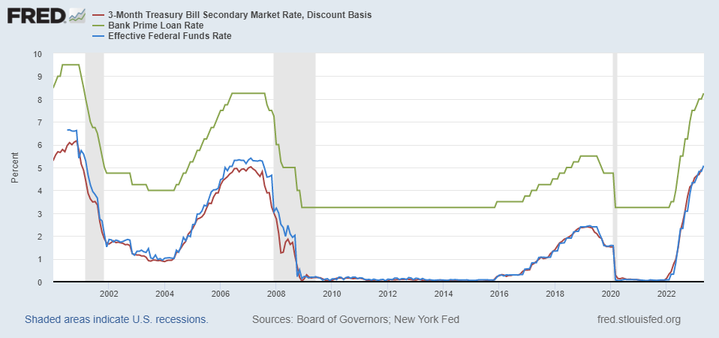
The Fed and Short-term Interest Rates
Blue is the fed funds rate.
Green is the prime bank lending rate.
Red is the rate on 3 month Treasuries.
Notes:
Take note over the redline peeking above the others

Slide 26
What about the Money Supply?
Notice the absence of the money supply. The Fed does not believe there is a reliable, short-run link between the money supply and total spending or inflation.
The Minutes of the 3/21-3/22/2023 FOMC Meeting mentions:
  Money Supply, M1, M2 – 0 times
  Federal funds rate – 15 times

Slide 27
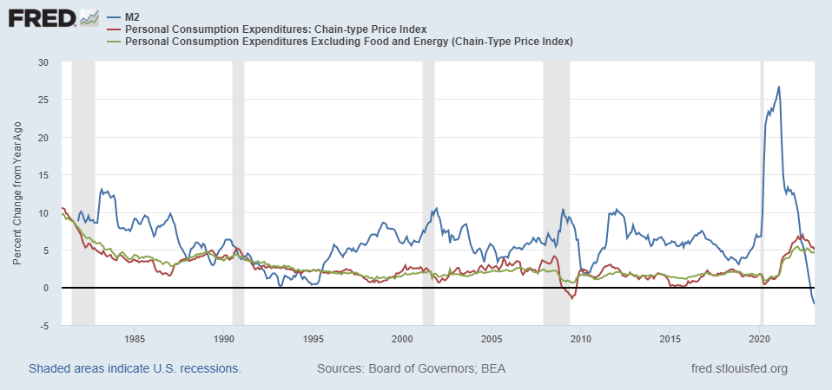
Do You See a Relationship?

Slide 28
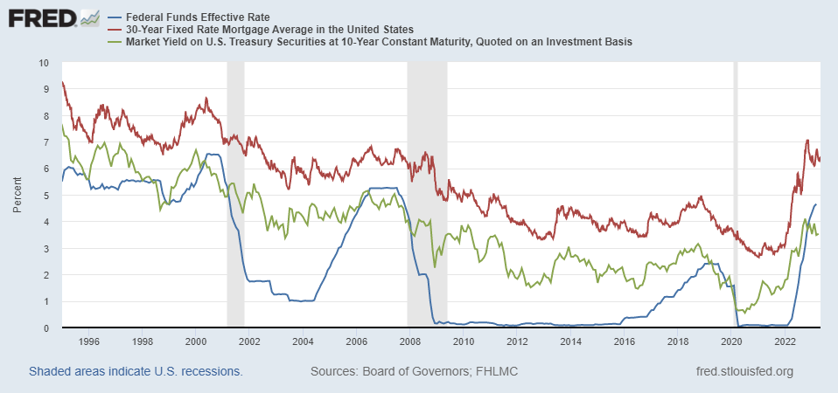
The Importance of Long-Term Interest Rates
Nobody buys a house because of the level of 1-yr interest rates, and unfortunately, the current federal funds rate has much less influence on the rates that matter.
Notes:
Red line was 90-day cp, the TBIll line was 1 month rate

Slide 29
Long-Term Interest Rates
Long-term interest rates depend on two factors
  The average of expected, future short-term rates over the life of the long-term bond.
  “Risk” premia that reflect the possibility of unexpected changes in interest rates and the possibility of default.
The Secondary Tools are aimed at affecting these factors.
Notes:
1 year bond is over 5 %, 3yr bond is less than 4%

Slide 30
Two Secondary Tools to Affect Interest Rates
Forward Guidance: Communicating the Fed’s intentions for the future path of short-term interest rates.
Long-term Asset Purchases better known as quantitative easing or QE.
Both of these tools also affect interest rates, and thereby aggregate demand. But their effect is on the interest rates of longer-term and riskier assets.
Notes:
Forward guidance occurs not just with the FOMC policy statments

Slide 31
Changes to the Policy Statement in May

Slide 32
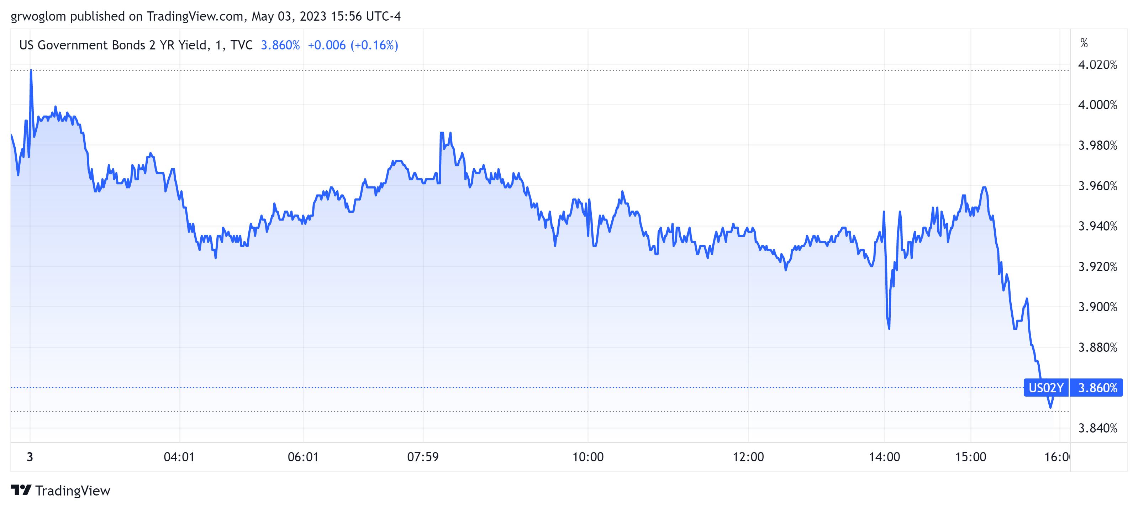
Forward Guidance: May 3rd

Slide 33
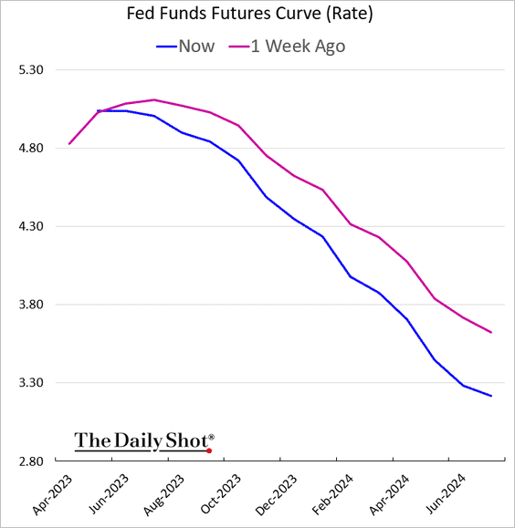
Forward Guidance: May 3rd

Slide 34
QE And Long-term, Risky Rates
Financial investors require a higher interest rate on risky bonds, than on safe short-term Treasuries.
The greater the supply of risky bonds, the higher the required risk premia needed to get enough private investors to buy them.
QE lowers the supply of long-term bonds held by private investors and thereby lowers to required risk premia and the interest rate on these bonds.

Slide 35
QE Has Been a Big Deal
Source: Federal Reserve Board
Notes:
25% of marketable Federal Debt; 20 percent of household mortgages. Total Fed assets increase by over 1.2 tr in 9 weeks;
Then by over 2.6 tr second time.

Slide 36
A Policy Strategy: Stabilize Expectations of Inflation
Monetary Policy is much easier if people believe that the Fed will achieve its inflation target.
In central bank jargon, if expectations are stable and “well anchored.”

Slide 37
“Anchoring” Inflation Expectations
Forecasts: Philadelphia Fed, “Survey of Professional Forecasters”
Notes:
Livingston Survey. 75-78. Unemployment 7% and 6% inflation. Look at the stability in the post 2001 period and the 2003-2005 period

Slide 38
Anchoring Requires Credibility
Credibility, the public believes that the Fed will achieve its goals.
Requirements for Credibility
  Transparency (Communication)
  Accountability (Performance)
  Political Independence
Notes:
Communication releases; accountability, Congressional Testimony and 5 year full release. Political independence 14 year terms, but fragile.

Slide 39
The Great Moderation
Volcker paid a price in the early 1980s, but the price paid dividends from 1990 through 2008.
During the latter period the performance of the US economy was extraordinary and even Milton Friedman gave kudos to the Alan Greenspan.
Has Powell jeopardized Volcker’s legacy?
Notes:
Go back to 16

Slide 40
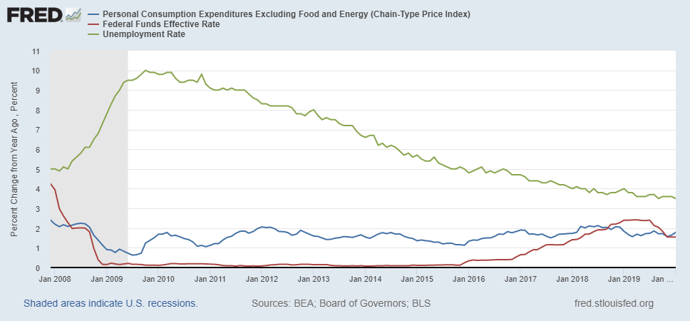
Why Did Powell Do It?
Powell Replaces
Yellen as Chair
Notes:
On average inflation is less than 2% And Fred raises rates before inflation exceeds 2.%. But, very credible. Latest tightening was begun before Powell became Chair. Tightening is very gradual 1.5 pct pts in 2 years.

Slide 41
Policy Changes under Powell
In the Fed’s dual mandate put more emphasis on the employment goal relative to the inflation goal.
Inflation goal switched from targeting forecasted future inflation to trying to achieve average realized inflation of 2%
Have they forgotten about Lags!
Notes:
Description of Policy goals reversed the order of the inflation and employment objectives

Slide 42
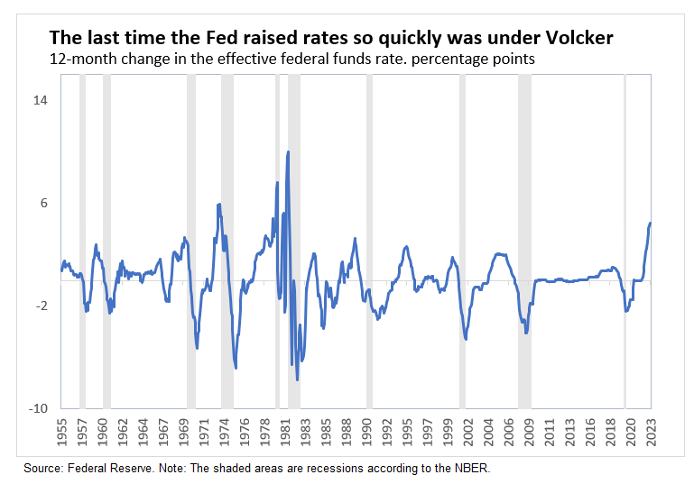
Is Powell Now Channeling Volcker?
What or Who causes Recessions?
Amazingly, (to me anyway), the Fed reaffirmed targeting average realized inflation!
Notes:
What

Slide 43
What’s at Stake
A rise in inflationary expectations would probably mean higher and more variable inflation.
Oversteering leading to a steep recession (“hard” landing).
Curbing inflation could lead to widespread bank failures (Pacific West?).
And, the Fed needs to navigate:
At the start of a presidential election cycle, with
Pervasive uncertainty. (e.g., credit crunch)

Slide 44
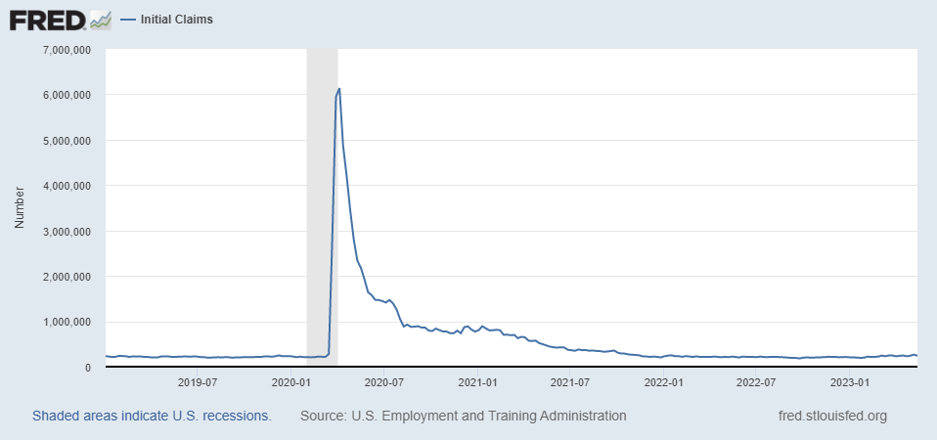
Since We Last Met
Labor Market Still Looks Very Strong

Slide 45
Fed Plans, as of March 22
Variable (in percent) | Medians
 | 2023 | 2024 | 2025 | Longer Run
RGDP growth | 0.4 | 1.2 | 1.9 | 1.8
Dec. | 0.5 | 1.6 | 1.8 | 1.8
Unemployment | 4.5 | 4.6 | 4.6 | 4.0
Dec. | 4.6 | 4.6 | 4.5 | 4.0
Inflation | 3.2 | 2.5 | 2.1 | 2.0
Dec. | 3.1 | 2.5 | 2.1 | 2.0
Core Inflation | 3.6 | 2.6 | 2.1
Dec. | 3.5 | 2.5 | 2.1
Federal Funds | 5.1 | 4.3 | 3.1 | 2.5
Dec. | 5.1 | 4.1 | 3.1 | 2.5
Is this a so-called “soft” landing?
Why is the Fed forecasting a rise in the unemployment rate and can’t they do something about it?

Slide 46
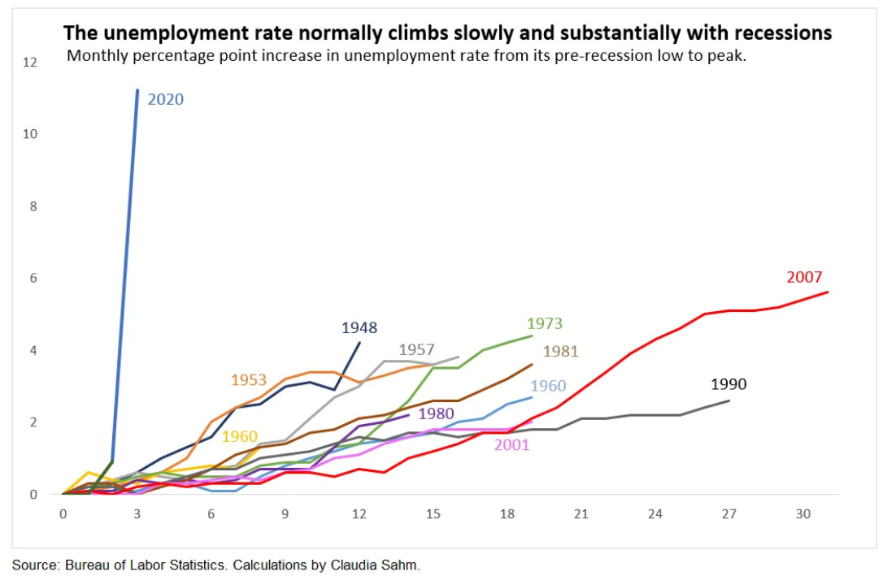
Remember Senator Warren: She is Right

Slide 47
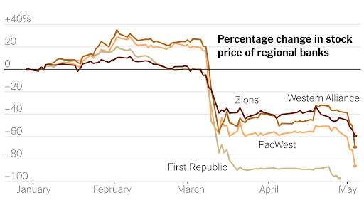
The Banking Crisis is Not Over

Slide 48
Short-term and Long-Term Problem?

Slide 49
And, Then There is the Debt Ceiling Fiasco
Biden Can:
  Declare Debt Ceiling unconstitutional due to 14th amendment.
  Direct the Treasury to Mint a $5 trillion coin.
  Direct the Treasury to replace existing bonds with very high coupon payments, so that they sell for more than their face value.

Slide 50
Recommended Reading
https://www.nytimes.com/interactive/2023/05/18/opinion/jobs-inflation-economy.html?smid=nytcore-ios-share&referringSource=articleShare

Slide 51
International Comparison: Health Spending
Notes:
Some good resources:
https://www.commonwealthfund.org/publications/issue-briefs/2020/jan/us-health-care-global-perspective-2019
A bit older report: https://www.commonwealthfund.org/publications/issue-briefs/2015/oct/us-health-care-global-perspective
https://www.healthsystemtracker.org/chart-collection/quality-u-s-healthcare-system-compare-countries/#item-overall-age-specific-potential-years-of-life-lost-per-100000-population-1990-2017
https://axenehp.com/international-healthcare-systems-us-versus-world/

Slide 52
Let’s Hear from You!
Geoffrey Woglom
grwoglom@amherst.edu
Contact NEED: Info@NEEDelegation.org
Submit a testimonial: www.NEEDelegation.org/testimonials.php
Support NEED: www.NEEDelegation.org/donate.php

