Slide 1
Osher Lifelong Learning Institute, Winter 2022
Contemporary Economic Policy
Dartmouth College
April-May, 2023
Host: Jon Haveman, Ph.D.
National Economic Education Delegation

Slide 2
National Economic Education Delegation
Vision
  One day, the public discussion of policy issues will be grounded in an accurate perception of the underlying economic principles and data.
Mission
  NEED unites the skills and knowledge of a vast network of professional economists to promote understanding of the economics of policy issues in the United States.
NEED Presentations
  Are nonpartisan and intended to reflect the consensus of the economics profession.

Slide 3
Who Are We?
Honorary Board: 54 members
  2 Fed Chairs: Janet Yellen, Ben Bernanke
  6 Chairs Council of Economic Advisers
    Furman (D), Rosen (R), Bernanke (R), Yellen (D), Tyson (D), Goolsbee (D)
  3 Nobel Prize Winners
    Akerlof, Smith, Maskin
Delegates: 653+ members
  At all levels of academia and some in government service
  All have a Ph.D. in economics
  Crowdsource slide decks
  Give presentations
Global Partners: 48 Ph.D. Economists
  Aid in slide deck development

Slide 4
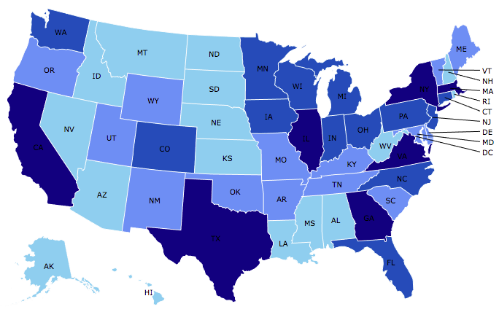

Where Are We?

Slide 5
Available NEED Topics Include:
US Economy
Healthcare Economics
Climate Change
Economic Inequality
Economic Mobility
Trade and Globalization
Minimum Wages
Immigration Economics
Housing Policy
Federal Budgets
Federal Debt
Black-White Wealth Gap
Autonomous Vehicles
Healthcare Economics

Slide 6
Course Outline
Contemporary Economic Policy
  Week 2 (4/10): Monetary Policy (Geoffrey Woglom)
  Week 3 (4/17): Healthcare Economics (Jon Haveman, NEED)
  Week 4 (4/24): Trade and Globalization (Alan Deardorff, University of Michigan)
  Week 5 (5/1): Trade Deficits and Exchange Rates (Alan Deardorff)
  Week 6 (5/8): Cryptocurrencies (Jon Haveman)

Slide 7
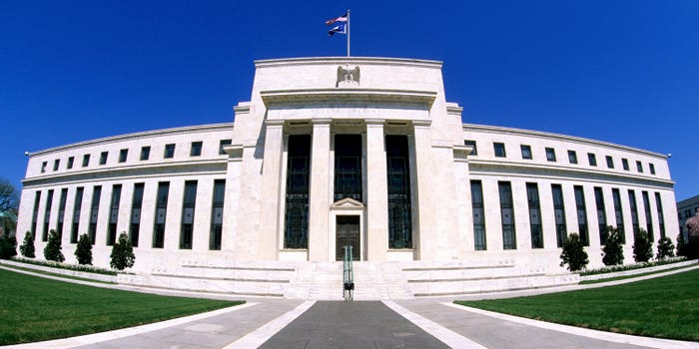
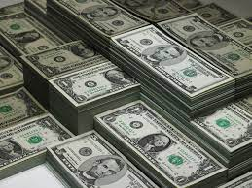
Monetary Policy & The Fed
Geoffrey Woglom,
Professor of Economics
Amherst College, emeritus
April 10, 2023

Slide 8
Credits and Disclaimer
This slide deck was authored by:
  Geoffrey Woglom, Amherst College (Emeritus)
Disclaimer
  NEED presentations are designed to be nonpartisan.
  It is, however, inevitable that the presenter will be asked for and will provide their own views.
  Such views are those of the presenter and not necessarily those of the National Economic Education Delegation (NEED).

Slide 9
Submitting Questions
Please submit questions in the chat, or by raising your digital hand.
  I will try to handle them as they come up.
We will do a verbal Q&A once the material has been presented.
Slides will be available from the NEED website tomorrow (https://needelegation.org/delivered_presentations.php)

Slide 10
Outline for the Talk
History of the origin and development of central banks
The economic determinants of inflation and unemployment.
The Fed’s policy tools for influencing interest rates and thereby affecting aggregate demand and the economy.
A closer look at changes that Chair Powell made in Fed policy that contributed to the run up in inflation.
What’s at stake if we don’t get inflation under control.

Slide 11
What Is a Central Bank?
Government’s Bank.
  Regulate currency and manage the payment system.
  Help with government finance.
“Lender of Last Resort” (LOL) in financial crises.
Responsible for stabilizing the macro economy: i.e., low, stable inflation and full employment
Notes:
Jump to 14.

Slide 12
Origins
Sveriges Riksbank (Sweden), 1668, currency regulation.
Bank of England, 1694, debt finance for the War of Grand Alliance.
Banks of the US, First (1791-1811) and Second (1816-1836) did a little of both.

Slide 13
Financial Crises in the 19th Century
Financial Panics (and recessions) in the 19th century: 1819, 1837, 1857, 1873, 1893.
Financial Panics are caused by a shortage of liquidity.
illiquidity: the value of liquid assets (cash, short-term Treasuries) are less than the value of liquid liabilities (short-term debt, bank deposits)
Insolvency: the value of assets is less than liabilities, so unless thins change, the liabilities will not be paid off.

Slide 14
Illiquidity Can Lead to Insolvency
Most banks are technically illiquid, which is not a problem in normal times because money is being deposited to offset the money that is being withdrawn.
But during a panic solvency is no guarantee of survival (As George Bailey learned in It’s a Wonderful Life)
To meet pressing demands for cash, the bank may have to sell assets in a “fire sale,” leading to insolvency and a bank failure.

Slide 15
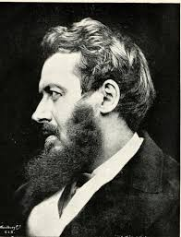
Walter Bagehot’s and his Famous Dictum
Walter Bagehot (1826-77): Lombard Street, 1873
Save the solvent institutions while allowing the
insolvent ones to fail.
His “Dictum” during a panic the Central Bank should:
  Lend freely,
  At a high interest rate,
  To solvent institutions,
  On good collateral.

Slide 16
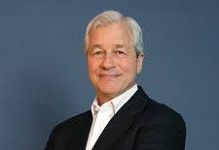
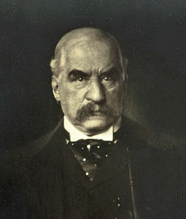
JP Morgan, “Lender of Last Resort?” (LOL)
October 1907, JP Morgan cuts short his vacation to deal with a financial panic
  Market falls by 50%
  Runs on banks threaten a complete collapse of financial markets.
Morgan calls a number of bankers to his offices to pledge money to provide liquidity to markets.

Slide 17
The Aftermath: Federal Reserve Act of 1913
Original Roles of the Fed
  Oversee Currency & Regulate Banks; 2. Lender of Last Resort.
Great Depression and the Banking Panics of the 30s
  Fed fails miserably.
  RFC lent more money to the banks than did the Fed
Footnote on later LOL Roles:
  2008: Bernanke saves the world, but Congress is not happy.
  2020: Powell goes even bigger, but the verdict is still out.

Slide 18
The Evolution of the Fed’s Role in the Macro Economy
Employment Act of 1946
  “Full employment” is a Executive Government Responsibility.
  Council of Economic Advisors.
  Economic Report of the President.
Humphrey Hawkins Act 1978 & the Fed’s “Dual” mandate
  Full employment
  Price stability
Division of Labor between Monetary and Fiscal Policies.

Slide 19
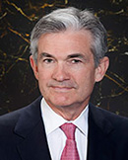
Stabilizer in Chief: the Fed
The Fed’s Dual Mandate:
  “Stable prices” which means 2% rate of inflation in the Personal Consumption Expenditure Price Index (which corresponds to about 2.5% inflation in the more well-known CPI).
  “Maximum employment” which means the highest level of employment (lowest unemployment rate) consistent with mandate 1.
Monetary policy is made by the Federal Open Market Committee (FOMC), comprised of the 7 Fed Governors and 5 of the 12 Presidents of the Regional Federal Reserve Banks on a rotating basis.
The FOMC has scheduled meetings 8 times a year, but can hold unscheduled meetings at a moments notice (e..g., March of 2020)
Jerome Powell
February 2018
Notes:
Define inflation as the rate of increase in the average level of prices not gasoline price inflation. Exceptions Deep Recesssions. ARP we will talk about later.

Slide 20
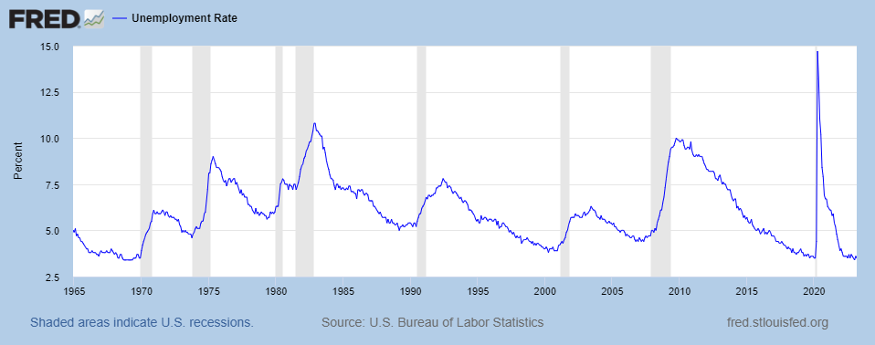
Track Record on Unemployment
Shaded Bars are Recessions

Slide 21
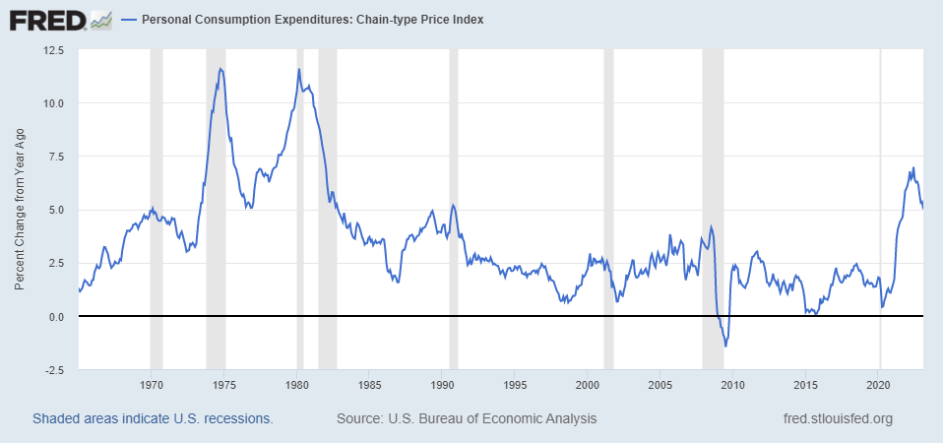
Track Record on “Price Stability”
Notes:
Shaded lines are recessions . 1970S THE Great Moderation

Slide 22
Determinants of Unemployment & Inflation
Short run:
Unemployment: The higher the level of total spending the lower the unemployment rate.
Inflation:
  “Too much Spending:” Total spending above the economy’s normal capacity (“potential output”) tends to increase inflation.
  Increase in production costs (e.g., “supply chain bottlenecks.”)
  Expectations of high inflation can cause inflation to be high.
Notes:
One sign of too much spending is a very low unemployment rate. Go back to 13 and then to 16

Slide 23
The Fed’s Affects the Economy via Interest Rates
Higher Interest rates discourage firms from buying new plant and equipment, households from buying new homes, and tend to lower stock and housing prices (!).
Lower spending tends to raise unemployment and eventually lowers inflation.

Slide 24
Become a Central Banker in One Slide!
If you are more concerned that inflation is too high, raise interest rates.
If you are more concerned that unemployment is too high, lower interest rates.
Inflation and unemployment just right: keep rates the same.
Note: in deciding on appropriate interest rates you must take account of what fiscal policy is doing that affects total spending

Slide 25
One Big Complication: Lags
Milton Friedman: Monetary Policy affects GDP and Inflation with Long and Variable (Unpredictable) Lags.
Raising interest rates today does nothing to spending today nor to inflation.
But over time spending slows and eventually inflation falls.
Friedman believed that lags led to the Fed to “oversteering” the economy consistently.

Slide 26
“Don’t Listen to This Nonsense”
Robert Bartley, Editor of the Editorial page of the Wall Street Journal in the 1980s (paraphrased):
“Ronald Reagan proved that economists know nothing about inflation and unemployment. During his first term Reagan was able to do what economists said was impossible: simultaneously reducing inflation and unemployment.”
What do you think would be my response?
Notes:
Show 12 and then to 24

Slide 27
A Closer Look at Interest Rate Control
Primary Tool: the Fed targets the federal funds rate (or fed funds rate for short), the interest rate on overnight loans between banks.
The Fed adjusts bank reserves so that the federal funds rate is within a target range 25 basis points wide.
From the bank’s perspective these loans are very close substitutes to other short-term, safe assets such as Treasury Bills.
Therefore, controlling the fed funds rate gives the Fed close control over all safe, short-term interest rates.
Notes:
Target range for the fed funds rate

Slide 28
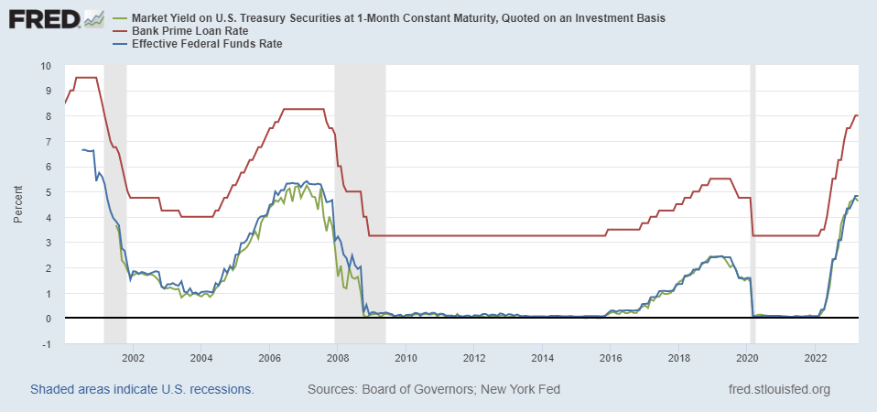
The Fed and Short-term Interest Rates
Blue is the fed funds rate.
Red is the prime bank lending rate.
Green is the rate on 3 month Treasuries.
Notes:
Take note over the redline peeking above the others

Slide 29
What about the Money Supply?
Notice the absence of the money supply. The Fed does not believe there is a reliable, short-run link between the money supply and total spending or inflation.
The Minutes of the 1/31-2/1/2023 FOMC Meeting mentions:
  Money Supply, M1, M2 – 0 times
  Federal funds rate – 13 times

Slide 30
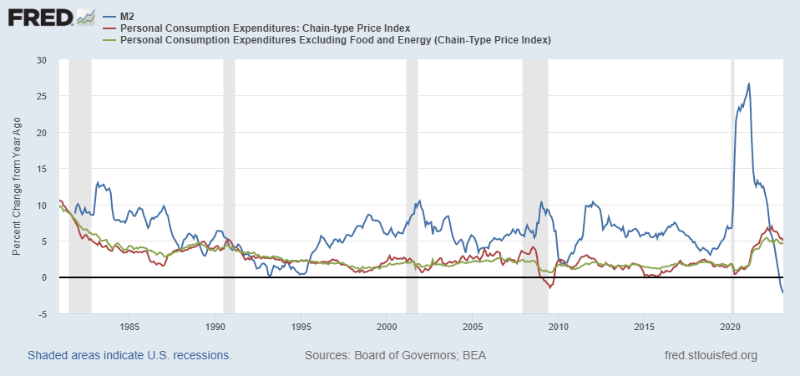
Do You See a Relationship?

Slide 31
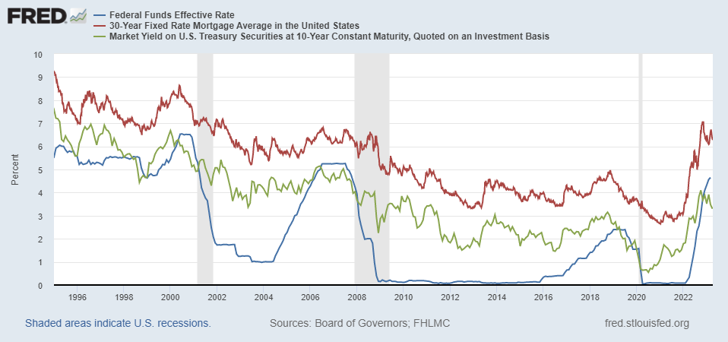
The Importance of Long-Term Interest Rates
Nobody buys a house because of the level of 1-yr interest rates, and unfortunately, the current federal funds rate has much less influence on the rates that matter.
Notes:
Red line was 90-day cp, the TBIll line was 1 month rate

Slide 32
Long-Term Interest Rates
Long-term interest rates depend on two factors
  The average of expected, future short-term rates over the life of the long-term bond.
  “Risk” premia that reflect the possibility of unexpected changes in interest rates and the possibility of default.
The Secondary Tools are aimed at affecting these factors.
Notes:
Red line was 90-day cp, the TBIll line was 1 month rate

Slide 33
Two Secondary Tools to Affect Interest Rates
Forward Guidance: Communicating the Fed’s intentions for the future path of short-term interest rates.
Long-term Asset Purchases better known as quantitative easing or QE.
Both of these tools also affect interest rates, and thereby aggregate demand. But their effect is on the interest rates of longer-term and riskier assets.
Notes:
Forward guidance occurs not just with the FOMC policy statments

Slide 34
Forward Guidance
The Fed “guides” financial market participants about what they intend to do in the future. From the Policy Statement since September until February:
Recent indicators point to modest growth in spending and production. Job gains have been robust in recent months, and the unemployment rate has remained low. Inflation remains elevated,…
“The Committee anticipates that ongoing increases in the target range will be appropriate in order to attain a stance of monetary policy that is sufficiently restrictive to return inflation to 2 percent over time.”
“In determining the pace of future increases in the target range, the Committee will take into account the cumulative tightening of monetary policy, the lags with which monetary policy affects economic activity and inflation, and economic and financial developments.”
has eased somewhat but remains elevated
extent

Slide 35
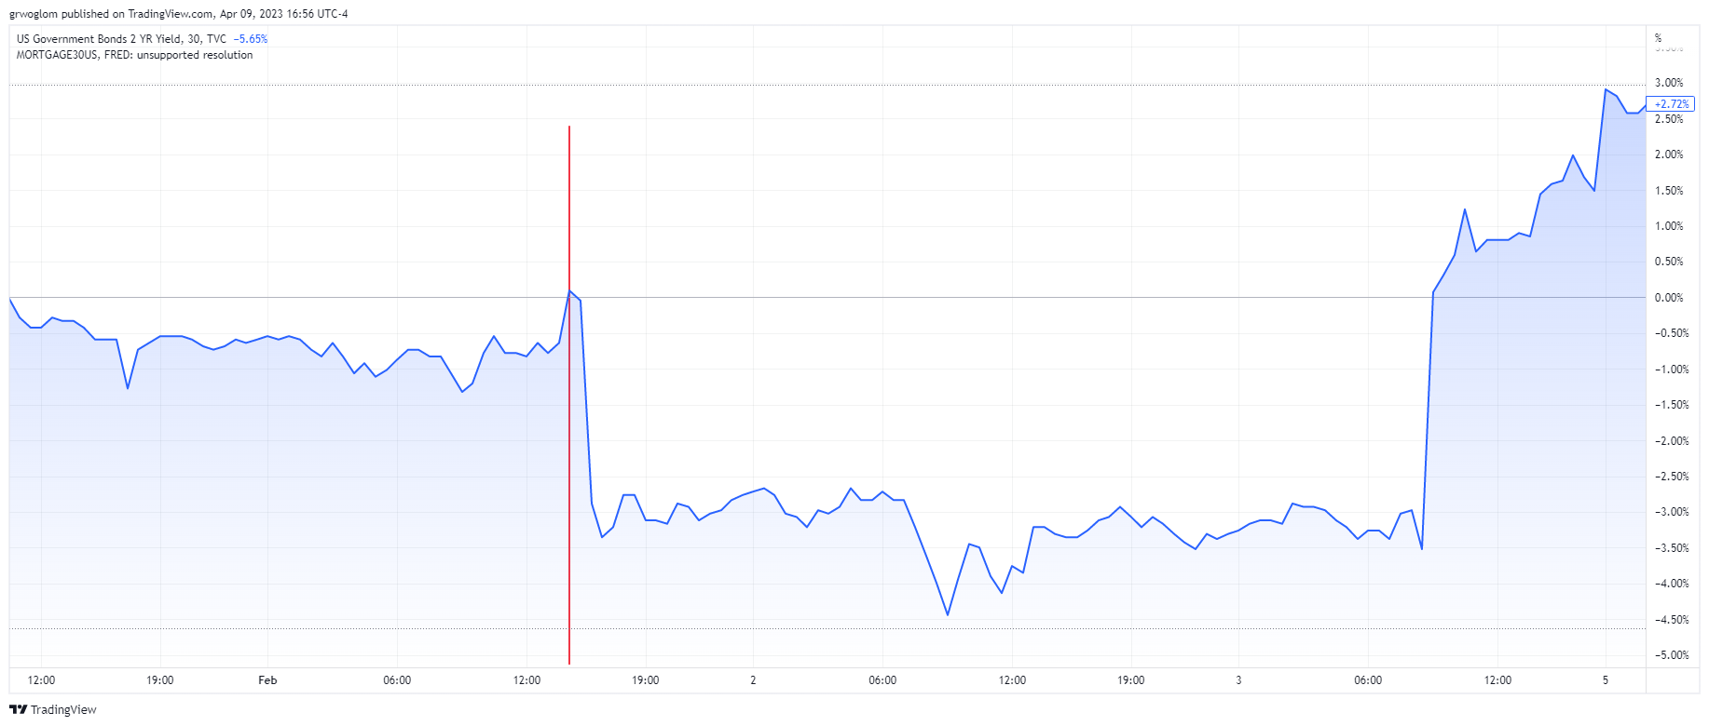
When the Fed Talks, Wall St Listens!
2 PM, 2/1/23

Slide 36
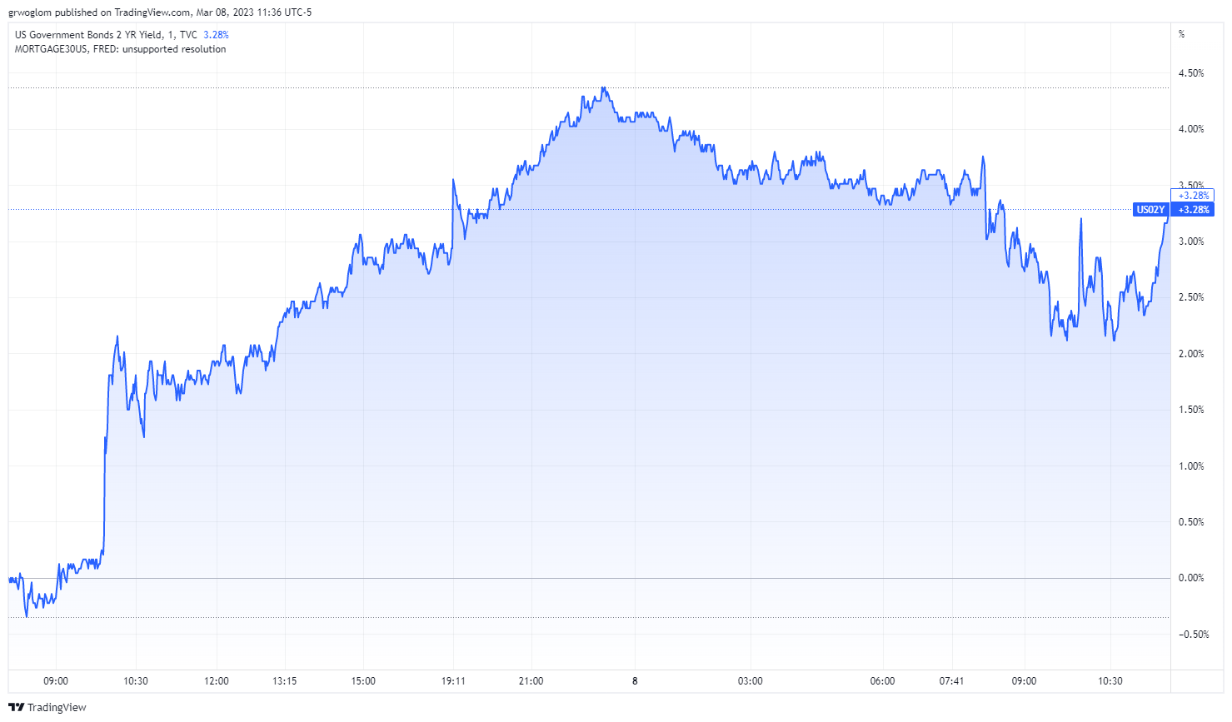
But Wall Street Got the Wrong Message
2Yr Treasury Rate, March 7th
In light of recent strong data, Jerome H. Powell said that the Federal Reserve is likely to raise rates higher than expected. NYTimes, 3/7, 10:37
10AM

Slide 37
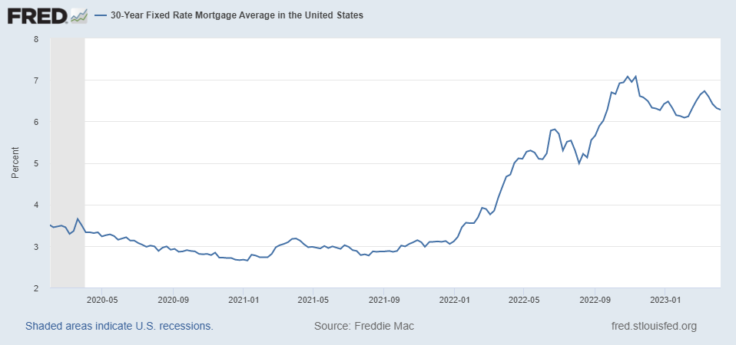
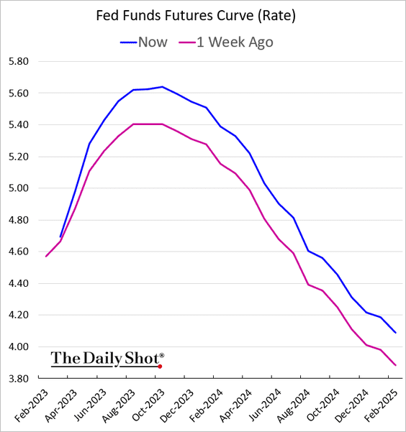
On March 7th Powell Gives More Guidance
Pre 3/7
Post 3/7
Terminal rate

Slide 38
QE And Long-term, Risky Rates
Financial investors require a higher interest rate on risky bonds, than on safe short-term Treasuries.
The greater the supply of risky bonds, the higher the required risk premia needed to get enough private investors to buy them.
QE lowers the supply of long-term bonds held by private investors and thereby lowers to required risk premia and the interest rate on these bonds.

Slide 39
QE Has Been a Big Deal
Source: Federal Reserve Board
Notes:
25% of marketable Federal Debt; 20 percent of household mortgages. Total Fed assets increase by over 1.2 tr in 9 weeks;
Then by over 2.6 tr second time.

Slide 40
A Policy Strategy: Stabilize Expectations of Inflation
Monetary Policy is much easier if people believe that the Fed will achieve its inflation target.
In central bank jargon, if expectations are stable and “well anchored.”

Slide 41
“Anchoring” Inflation Expectations
Forecasts: Philadelphia Fed, “Survey of Professional Forecasters”
Notes:
Livingston Survey. 75-78. Unemployment 7% and 6% inflation. Look at the stability in the post 2001 period and the 2003-2005 period

Slide 42
Anchoring Requires Credibility
Credibility, the public believes that the Fed will achieve its goals.
Requirements for Credibility
  Transparency (Communication)
  Accountability (Performance)
  Political Independence
Notes:
Communication releases; accountability, Congressional Testimony and 5 year full release. Political independence 14 year terms, but fragile.

Slide 43
The Great Moderation
Volcker paid a price in the early 1980s, but the price paid dividends from 1990 through 2008.
During that period the performance of the US economy was extraordinary and even Milton Friedman gave kudos to the Alan Greenspan.
Has Powell jeopardized Volcker’s legacy?
Notes:
Go back to 16

Slide 44
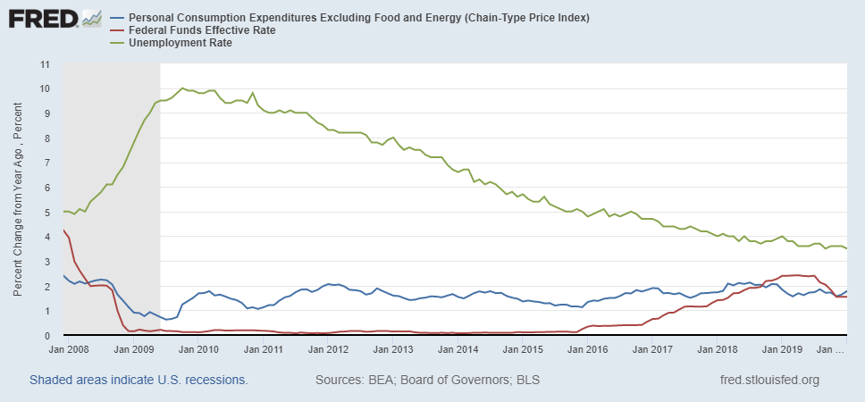
Why Did Powell Do It?
Powell Replaces
Yellen as Chair
Notes:
On average inflation is less than 2% And Fred raises rates before inflation exceeds 2.%. But, very credible. Latest tightening was begun before Powell became Chair. Tightening is very gradual 1.5 pct pts in 2 years.

Slide 45
Policy Changes under Powell
In the Fed’s dual mandate put more emphasis on the employment goal relative to the inflation goal.
Inflation goal switched from targeting forecasted future inflation to trying to achieve average realized inflation of 2%
Have they forgotten about Lags!
Notes:
Description of Policy goals reversed the order of the inflation and employment objectives

Slide 46
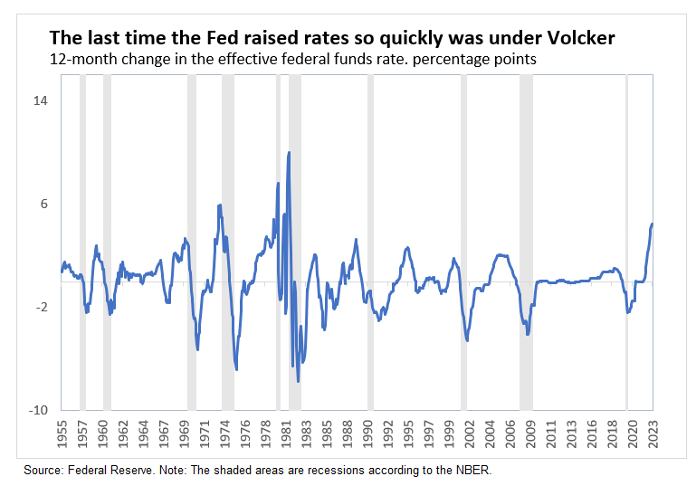
Is Powell Now Channeling Volcker?
What or Who causes Recessions?
Amazingly, (to me anyway), the Fed reaffirmed targeting average realized inflation!
Notes:
What

Slide 47
What’s at Stake
A rise in inflationary expectations would probably mean higher and more variable inflation.
Oversteering leading to a steep recession (“hard” landing).
Curbing inflation could lead to the demise of small banks.
And, the Fed needs to navigate:
At the start of a presidential election cycle, with
Pervasive uncertainty. (e.g., credit crunch)

Slide 48
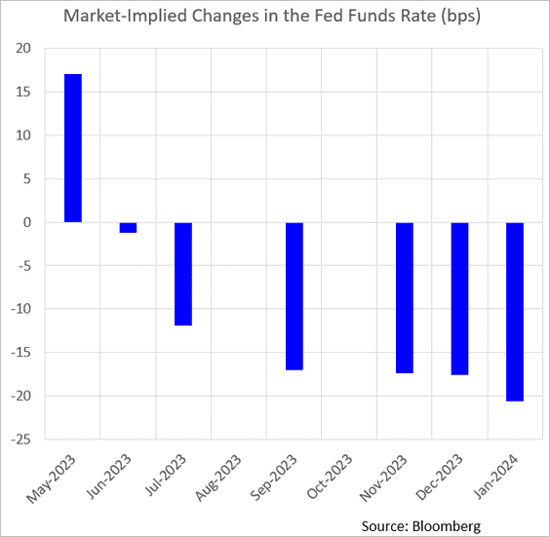
Forward Guidance: Reverse March!
Policy Statement March 22:
Recent indicators point to modest growth in spending and production. Job gains have been robust in recent months, and the unemployment rate has remained low. Inflation remains elevated.
has eased somewhat
but remains elevated

Slide 49
Fed Plans, as of March 22
Variable (in percent) | Medians
 | 2023 | 2024 | 2025 | Longer Run
RGDP growth | 0.4 | 1.2 | 1.9 | 1.8
Dec. | 0.5 | 1.6 | 1.8 | 1.8
Unemployment | 4.5 | 4.6 | 4.6 | 4.0
Dec. | 4.6 | 4.6 | 4.5 | 4.0
Inflation | 3.2 | 2.5 | 2.1 | 2.0
Dec. | 3.1 | 2.5 | 2.1 | 2.0
Core Inflation | 3.6 | 2.6 | 2.1
Dec. | 3.5 | 2.5 | 2.1
Federal Funds | 5.1 | 4.3 | 3.1 | 2.5
Dec. | 5.1 | 4.1 | 3.1 | 2.5
Are these projections consistent with this lecture?
Interest rates above the “longer-run” rate.
Two years of growth below potential.
Rising unemployment, so that unemployment is above the “longer-run” rate.
Falling inflation
Is this a so-called “soft” landing?
Why is the Fed forecasting a rise in the unemployment rate and can’t they do something about it?

Slide 50
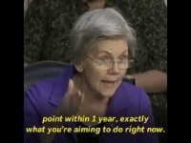
This Is Why Powell Gets the Big Bucks

Slide 51
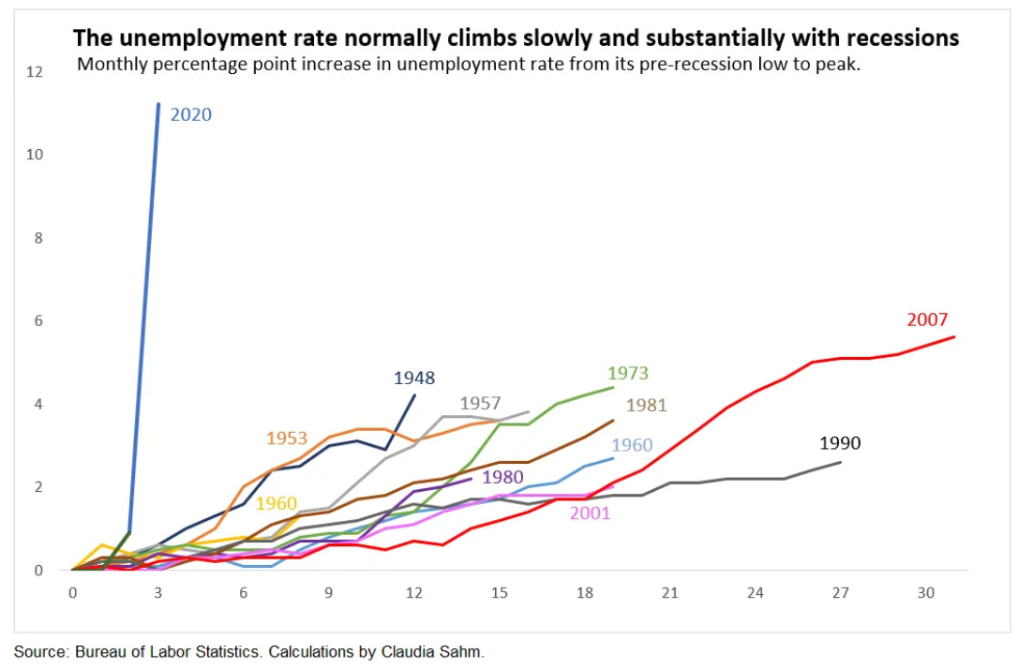
Sen Warren is Right

Slide 52
Wednesday is a Big Day!
Wednesday
  8:30 AM, BLS reports on CPI Inflation for March
  2 PM, Minutes of the March FOMC meeting released.

Slide 53
Economists’ Frustration with MP & Inflation
Olivier Blanchard 12/30 Twitter Post:
Inflation is fundamentally the outcome of the distributional conflict, between firms, workers, and taxpayers… The source of the conflict may be too hot an economy. But in the end, forcing the players to accept the outcome, and thus stabilizing inflation, is typically left to the central bank… It is a highly inefficient way to deal with distributional conflicts…

Slide 54
Things to Ponder
The Fed through monetary policy has the most influence on the short-run behavior of the (world?) economy. These governmental decisions are made “technocratically” and not democratically.
Congress has mandated the Fed to pursue:
Both the inflation goal and the unemployment goal.
The mandate does not include anything about the effects of Fed policy on other countries.
Is there a better way to conduct monetary policy?

Slide 55
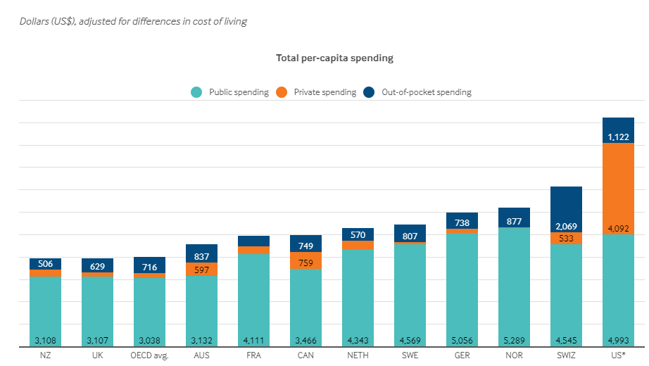
International Comparison: Health Spending
Notes:
Some good resources:
https://www.commonwealthfund.org/publications/issue-briefs/2020/jan/us-health-care-global-perspective-2019
A bit older report: https://www.commonwealthfund.org/publications/issue-briefs/2015/oct/us-health-care-global-perspective
https://www.healthsystemtracker.org/chart-collection/quality-u-s-healthcare-system-compare-countries/#item-overall-age-specific-potential-years-of-life-lost-per-100000-population-1990-2017
https://axenehp.com/international-healthcare-systems-us-versus-world/

Slide 56
Let’s Hear from You!
Geoffrey Woglom
grwoglom@amherst.edu
Contact NEED: Info@NEEDelegation.org
Submit a testimonial: www.NEEDelegation.org/testimonials.php
Support NEED: www.NEEDelegation.org/donate.php

