Slide 1
Osher Lifelong Learning Institute, Fall 2023
Contemporary Economic Policy
American University
Fall, 2023
Jon Haveman, Ph.D.
National Economic Education Delegation

Slide 2
Available NEED Topics Include:
US Economy
Healthcare Economics
Climate Change
Economic Inequality
Economic Mobility
Trade and Globalization
Minimum Wages
Immigration Economics
Housing Policy
Federal Budgets
Federal Debt
Black-White Wealth Gap
Autonomous Vehicles
Healthcare Economics

Slide 3
Course Outline
Contemporary Economic Policy
  Week 1 (9/28): US Federal Budget (Jon Haveman, NEED)
  Week 2 (10/5): Trade and Globalization (Arkadiusz Mironko, Indiana Univ. East)
  Week 3 (10/12): International Institutions (Alan Deardorff U of Michigan)
  Week 4 (10/19): Economic Update (Geoffrey Woglom Amherst College)
  Week 5 (10/26): Monetary Policy (Geoffrey Woglom)
  Week 6 (11/02): Intro to Financial Economics(Geoffrey Woglom)

Slide 4
Submitting Questions
Please submit questions in the chat.
  I will try to handle them as they come up, but may take them in a bunch as time permits.
We will do a verbal Q&A once the material has been presented.
  And the questions in the chat have been addressed.
After talk, I hope there will be time for more extended questions.
Slides will be available from the NEED website shortly after the talk (https://NEEDEcon.org/delivered_presentations.php)

Slide 5
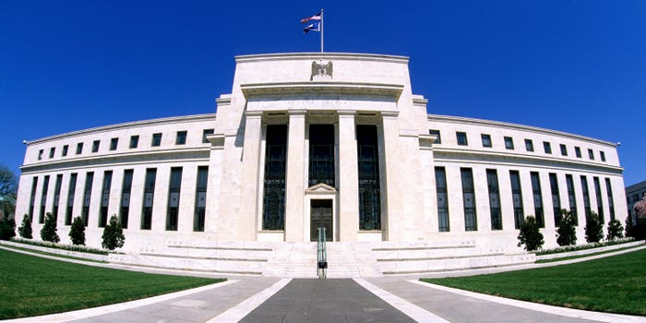
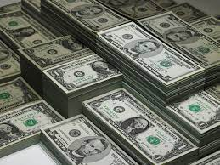
Monetary Policy & The Fed
Geoffrey Woglom,
Professor of Economics
Amherst College, emeritus
October 26, 2023
Notes:
Jump to 6

Slide 6
Credits and Disclaimer
This slide deck was authored by:
  Geoffrey Woglom
Disclaimer
  NEED presentations are designed to be nonpartisan.
  It is, however, inevitable that the presenter will be asked for and will provide their own views.
  Such views are those of the presenter and not necessarily those of the National Economic Education Delegation (NEED).

Slide 7
Outline for the Talk
The economic determinants of inflation and unemployment.
The Fed’s policy tools for influencing interest rates and inflation and unemployment.
A closer look at changes that Chair Powell made in Fed policy that contributed to the run up in inflation.
The October 31st Fed monetary policy meeting and what comes next.

Slide 8
What Is a Central Bank?
Government’s Bank.
  Regulate currency and manage the payment system.
  Help with government finance.
“Lender of Last Resort” (LOL) in financial crises.
Responsible for stabilizing the macro economy: i.e., low, stable inflation and full employment
Notes:
Jump to 14.

Slide 9
Central Banking in the US
First and Second Banks of the US: 1791-1811; 1816-1836.
Wildcat banking (little bank regulation) with financial crises in: : 1819, 1837, 1857, 1873, 1893 and 1907.

Slide 10
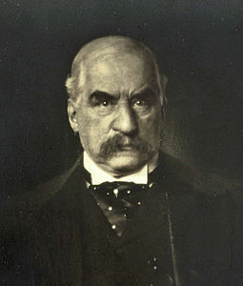
JP Morgan, “Lender of Last Resort?” (LOL)
October 1907, JP Morgan cuts short his vacation to deal with a financial panic
  Market falls by 50%
  Runs on banks threaten a complete collapse of financial markets.
Morgan calls a number of bankers to his offices to pledge money to provide liquidity to markets.

Slide 11
The Aftermath: Federal Reserve Act of 1913
Original Roles of the Fed
  Oversee Currency & Regulate Banks; 2. Lender of Last Resort.
Great Depression and the Banking Panics of the 30s
  Fed fails miserably.
  RFC lent more money to the banks than did the Fed
Footnote on later LOL Roles:
  2008: Bernanke saves the world, but Congress is not happy.
  2020: Powell goes even bigger, but the verdict is still out.
  Silicon Valley Bank.

Slide 12
The Evolution of the Fed’s Role in the Macro Economy
Employment Act of 1946
  “Full employment” is a Executive Government Responsibility.
  Council of Economic Advisors.
  Economic Report of the President.
Humphrey Hawkins Act 1978 & the Fed’s “Dual” mandate
  Full employment
  Price stability
Division of Labor between Monetary and Fiscal Policies.

Slide 13
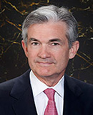
Stabilizer in Chief: the Fed
The Fed’s Dual Mandate:
  “Stable prices” which means 2% rate of inflation in the Personal Consumption Price Index (which corresponds to about 2.5% inflation in the more well-known CPI).
  “Maximum employment” which means the highest level of employment (lowest unemployment rate) consistent with mandate 1.
Monetary policy is made by the Federal Open Market Committee (FOMC), comprised of the 7 Fed Governors and 5 of the 12 Presidents of the Regional Federal Reserve Banks on a rotating basis.
The FOMC has scheduled meetings 8 times a year, but can hold unscheduled meetings at a moments notice (e..g., March of 2020)
Jerome Powell
February 2018
Notes:
Define inflation as the rate of increase in the average level of prices not gasoline price inflation. Exceptions Deep Recesssions. ARP we will talk about later.

Slide 14
Why is “Price Stability” 2% Inflation
It started in 1990 when New Zealand was the first country to adopt an inflation target: 0-2%
Why not 0?
  “Greasing the Wheels.”
  Zero Lower Bound for Interest Rates
Why 2%- New Zealand raised it to 3%?

Slide 15
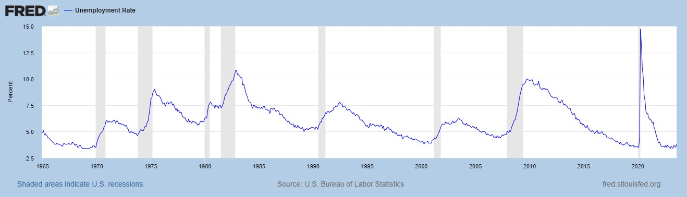
Track Record on Unemployment
Shaded Bars are Recessions

Slide 16
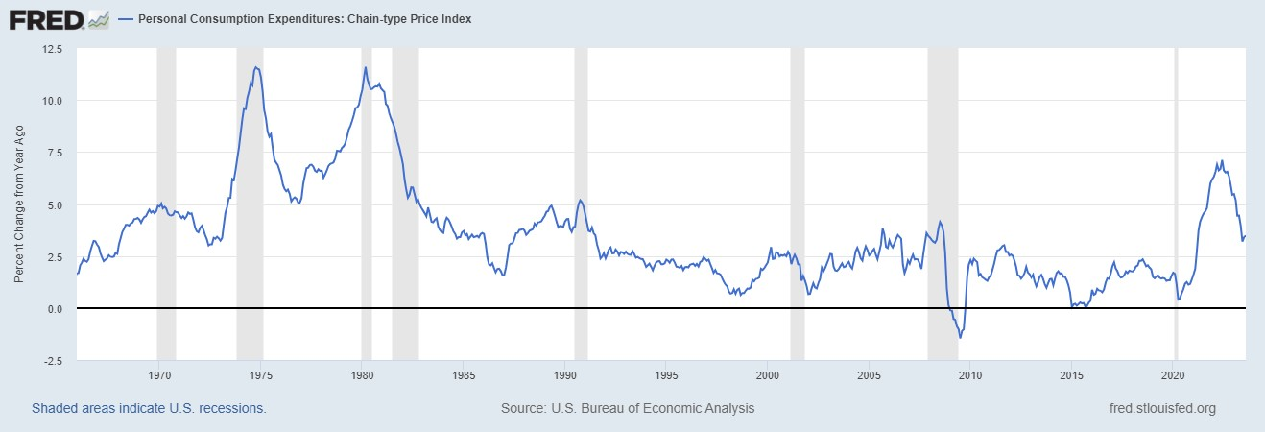
Track Record on “Price Stability”
Notes:
Shaded lines are recessions . 1970S THE Great Moderation

Slide 17
Determinants of Unemployment & Inflation
Short run:
Unemployment: The higher the level of total spending the lower the unemployment rate.
Inflation:
  “Too much Spending:” Total spending above the economy’s normal capacity (“potential output”) tends to increase inflation.
  Increase in production costs (e.g., “supply chain bottlenecks.”)
  Expectations of high inflation can cause inflation to be high.
In the absence of 1.and 2., inflation will equal expected.
Notes:
One sign of too much spending is a very low unemployment rate. Go back to 19 and 20 then to 21

Slide 18
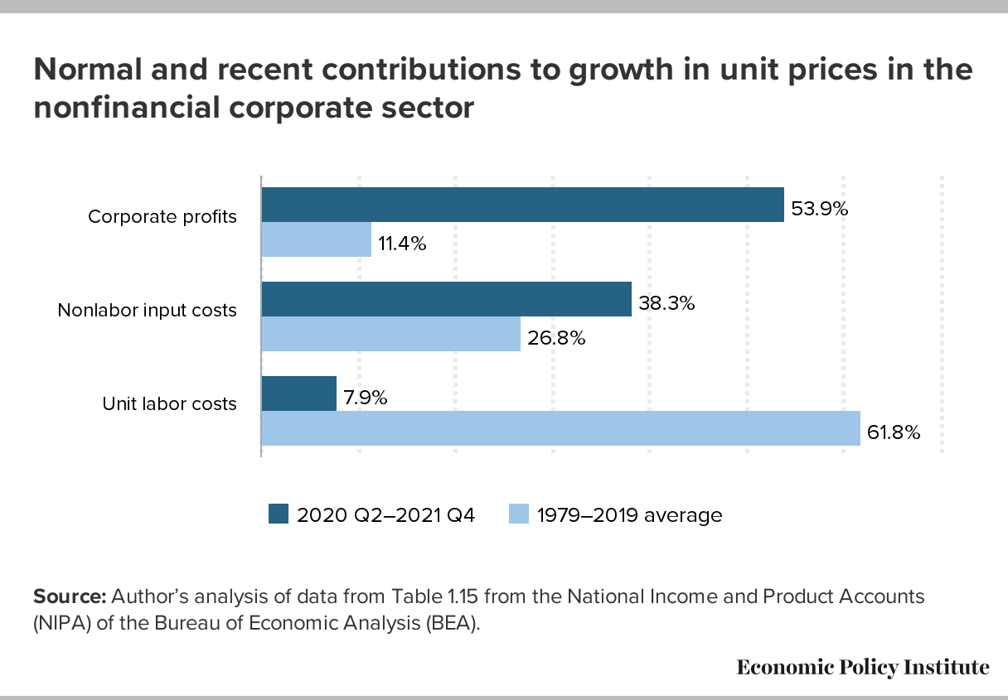
Corporate “Greed” and Inflation?

Slide 19
Determinants of Unemployment & Inflation
Long run: what the economy would look like if real GDP were at potential (average behavior of the economy over a number of years):
Unemployment: Is determined by labor supply and demand and is independent of monetary policy; unemployment will be at the natural rate.
Inflation is totally determined by the Fed!

Slide 20
What about the Money Supply?
Notice the absence of the money supply. The Fed does not believe there is a reliable, short-run link between the money supply and total spending or inflation.
The Minutes of the 9/19-20/2023 FOMC Meeting mentions:
  Money Supply, M1, M2 – 0 times
  Federal funds rate – 11 times

Slide 21
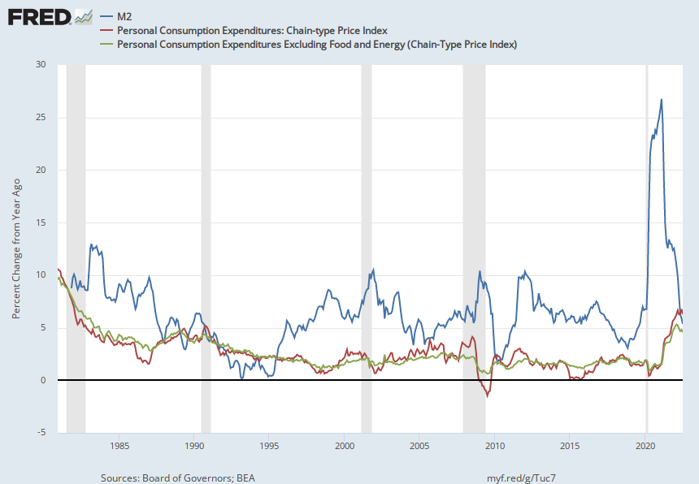
Do You See a Relationship?

Slide 22
The Fed’s Affects the Economy via Interest Rates
Higher Interest rates discourage firms from buying new plant and equipment, households from buying new homes, and tend to lower stock and housing prices (!).
Lower spending tends to raise unemployment and eventually lowers inflation.

Slide 23
Become a Central Banker in One Slide!
If you are more concerned that inflation is too high, raise interest rates to lower total spending below potential output.
If you are more concerned that unemployment is too high, lower interest rates to raise total spending.
Inflation and unemployment just right: keep rates the same.
Sounds Easy! But…

Slide 24
One Big Complication: Lags
Milton Friedman: Monetary Policy affects GDP and Inflation with Long and Variable (Unpredictable) Lags.
Raising interest rates today does nothing to spending today nor to inflation.
But over time spending slows and eventually inflation falls.
Friedman believed that lags led to the Fed to “oversteering” the economy consistently.

Slide 25
A Closer Look at Interest Rate Control
Primary Tool: the Fed targets the federal funds rate (or fed funds rate for short), the interest rate on overnight loans between banks.
The Fed adjusts bank reserves so that the federal funds rate is within a target range 25 basis points wide; e.g., 5.5-5.25%
From the bank’s perspective these loans are very close substitutes to other short-term, safe assets such as Treasury Bills.
Therefore, controlling the fed funds rate gives the Fed close control over all safe, short-term interest rates.
Notes:
Target range for the fed funds rate

Slide 26
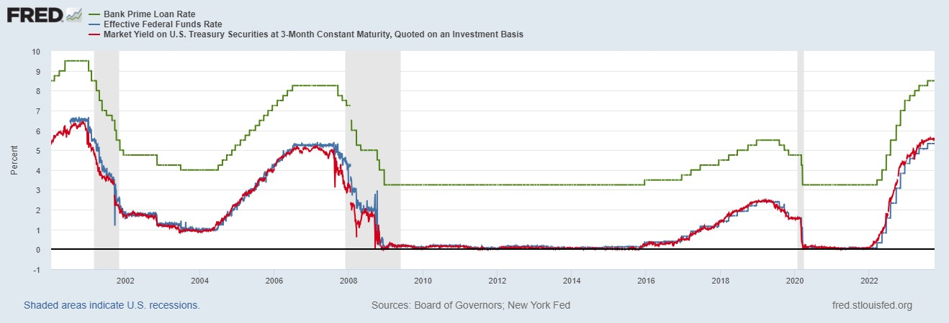
The Fed and Short-term Interest Rates
Blue is the fed funds rate.
Red is the rate on 3 month Treasuries.
Green is the prime bank lending rate
Notes:
Take note over the redline peeking above the others

Slide 27
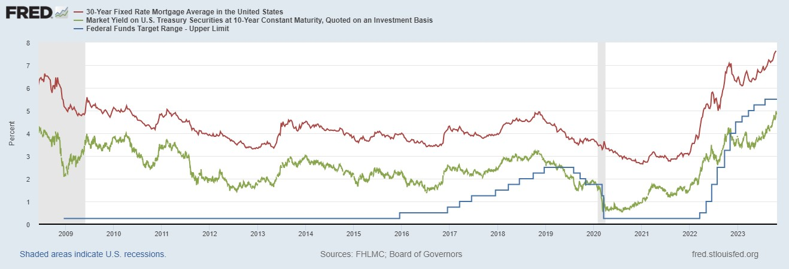
The Importance of Long-Term Interest Rates
Nobody buys a house because of the level of 1-yr interest rates, and unfortunately, the current federal funds rate has much less influence on the rates that matter.
Notes:
Red line was 90-day cp, the TBIll line was 1 month rate

Slide 28
Long-Term Interest Rates
Unfortunately, the current fed funds rate has much less influence on long term interest rates.
Instead, long-term interest rates depend on two factors
  The average of expected, future short-term rates over the life of the long-term bond. Yesterday, US Treasuries: 1yr 5.43%; 2yr, 5.08%. Why?
  “Risk” premia that reflect the possibility of unexpected changes in interest rates and the possibility of default.
The Secondary Tools are aimed at affecting these factors.
Notes:
Red line was 90-day cp, the TBIll line was 1 month rate

Slide 29
Two Secondary Tools to Affect Interest Rates
Forward Guidance: Communicating the Fed’s intentions for the future path of short-term interest rates.
Long-term Asset Purchases better known as quantitative easing or QE.
Both of these tools also affect interest rates, and thereby aggregate demand. But their effect is on the interest rates of longer-term and riskier assets.
Notes:
Forward guidance occurs not just with the FOMC policy statments

Slide 30
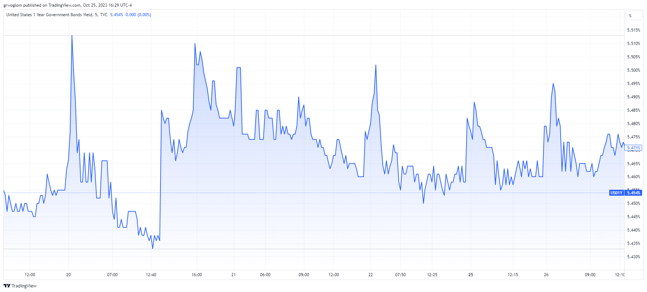
Forward Guidance: 9/20 Policy Meeting
2 4
Notes:
In May, 4th 1%; ;

Slide 31
Changes in the Policy Statement: July to Sept.
“Recent indicators suggest that economic activity has been expanding at a moderate solid pace. Job gains have been robust slowed in recent months, and the unemployment rate has remained low. Inflation remains elevated.”
Fed funds rate range maintained at 5.25-5.5.
What was the message?
Why the second jump at 4?

Slide 32
QE And Long-term, Risky Rates
Financial investors require a higher interest rate on risky bonds, than on safe short-term Treasuries.
The lower the supply of risky bonds, the lower the required risk premia needed to get enough private investors to buy them.
QE lowers the supply of long-term bonds held by private investors and thereby lowers to required risk premia and the interest rate on these bonds.
QE is particularly important when the federal funds rate has hit the zero (ZLB)

Slide 33
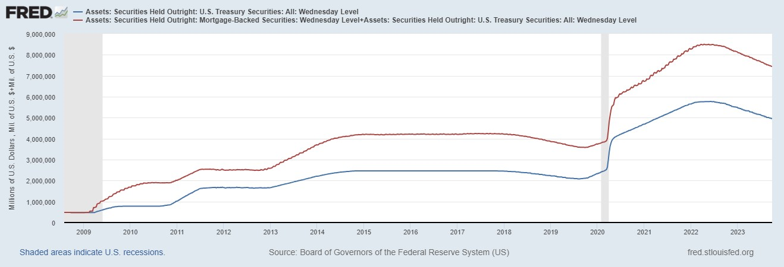
QE Has Been a Big Deal
Source: Federal Reserve Board
Notes:
25% of marketable Federal Debt; 20 percent of household mortgages. Total Fed assets increase by over 1.2 tr in 9 weeks;
Then by over 2.6 tr second time.

Slide 34
A Policy Strategy: Stabilize Expectations of Inflation
Monetary Policy is much easier if the people believe that the Fed will achieve its inflation target.
Ben Bernanke (2007):
”…if inflation expectations respond less than previously to variations in economic activity, then inflation itself will become relatively more insensitive to the level of activity…”
In central bank jargon, stable expectations are “well anchored.”

Slide 35
Anchoring Requires Credibility
Credibility, the public believes that the Fed will achieve its goals.
Requirements for Credibility
  Transparency (Communication)
  Accountability (Performance) BOE Letter?
  Political Independence
Things to think about: The Fed through monetary policy has the most influence on the short-run behavior of the economy. These governmental decisions are made “technocratically” and not democratically. Is that a problem? What would Sen Warren say?
Notes:
Communication releases; accountability, Congressional Testimony and 5 year full release. Political independence 14 year terms, but fragile.

Slide 36
The Great Moderation
Volcker paid a price in the early 1980s, but the price paid dividends from 1990 through 2008.
During that period the performance of the US economy was extraordinary and even Milton Friedman gave kudos to the Alan Greenspan.
Has Powell jeopardized Volcker’s legacy?
Notes:
Go back to 16

Slide 37
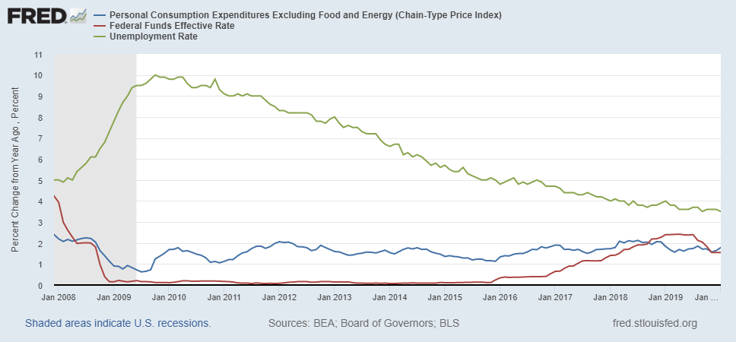
Why Did Powell Do It?
Powell Replaces
Yellen as Chair
Notes:
On average inflation is less than 2% And Fed raises rates before inflation exceeds 2.%. But, very credible. Latest tightening was begun before Powell became Chair. Tightening is very gradual 1.5 pct pts in 2 years.

Slide 38
Policy Changes under Powell
In the Fed’s dual mandate FOMC put more emphasis on the employment goal relative to the inflation goal.
Inflation goal switched from targeting forecasted future inflation to:
“In order to anchor longer-term inflation expectations at this [2 percent], the Committee seeks to achieve inflation that averages 2 percent over time, and therefore judges that, following periods when inflation has been running persistently below 2 percent, appropriate monetary policy will likely aim to achieve inflation moderately above 2 percent for some time.”
Notes:
Description of Policy goals reversed the order of the inflation and employment objectives

Slide 39
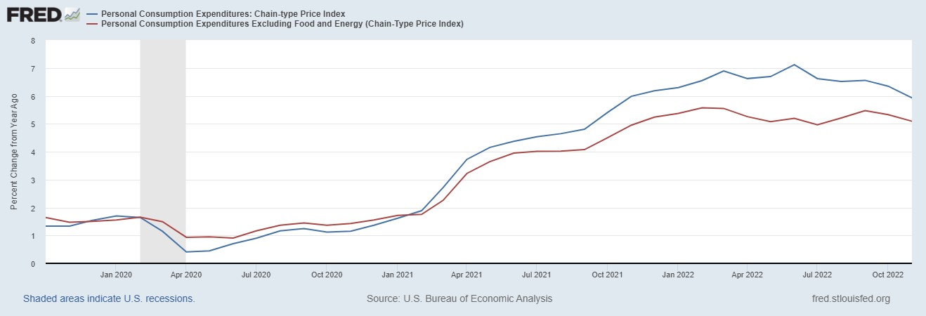
Why Didn’t the Fed Act by April 2021?
Have They Forgotten about Policy Lags!!
But, by March 2022 Things Changed!

Slide 40
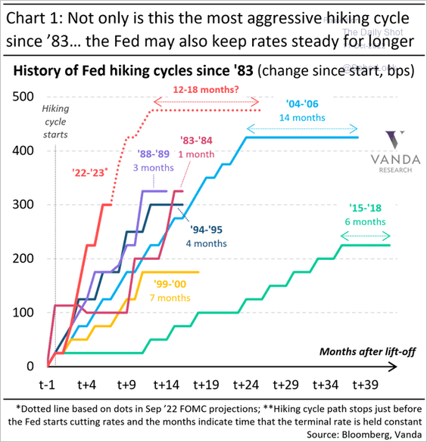
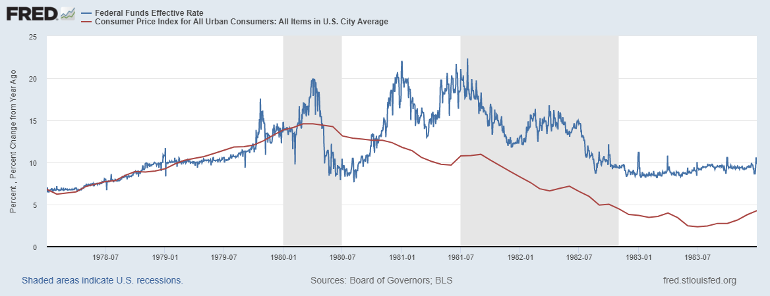
Is Powell Now Channeling Volcker?
Notes:
Current Fed funds rate 525 basis points higher!

Slide 41
OK, But What Explains Powell’s Reversal?
Congress asked Powell, if like Volcker, he would do whatever was necessary to bring inflation down.
‘I knew Paul Volcker,’ Powell responded. ‘I think he was one of the great public servants of the era — the greatest economic public servant of the era.’ Making it clear that his own legacy was on his mind, Powell continued, ‘I hope that history will record that the answer to your question is yes.’ Peter Coy, NYTimes, “Economic Theory Alone May Not Explain Jerome Powell’s Actions,” 9/23/2022
Could Powell be “Oversteering?”

Slide 42
Has Powell Learned His Lesson
Letting inflation exceed the target causes lots of problems.
Because of lags you must act in advance of a potential problem.
But, in January of this year the Fed reaffirmed that it was targeting average realized inflation!
But where does the economy go from here?

Slide 43
Fed Economic Projections
Austin Goolsbee, President of the Chicago Fed. The economy is on a “golden path” and will achieve the “mother of all soft landings.”
What part of the traditional model is Goolsbee criticizing?
In the absence of supply shocks with spending at potential, what does the traditional theory say will be the inflation rate?
Notes:
Survey of Professional Forecasters from early August: GDP and unemployment much like the June Fed forecast. Inflation much like the Fed’s September forecast.

Slide 44
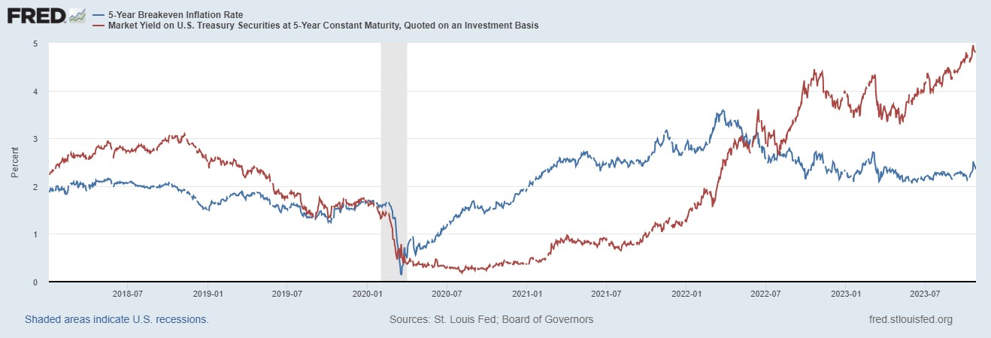
Reading Treasury Tea Leaves

Slide 45
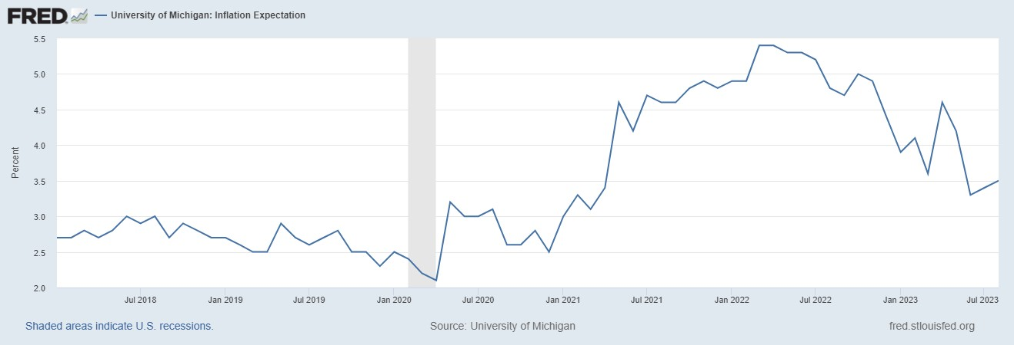
Consumers Disagree

Slide 46
Previous Graph Implications
Explaining Goolsbee: When the supply shocks and excess spending were eliminate inflation fell back to expected – no mystery.
Remaining mystery – why didn’t inflationary expectations rise?
Implications for Powell: The 50 basis point increase in the long rate may have done your inflation fighting work for you.
Remaining mystery – what caused the rise in the 10 year rate?
Next week we will see review what the FOMC has to say about these mysteries.

Slide 47
Latest News: Q3, Real GDP numbers

Slide 48
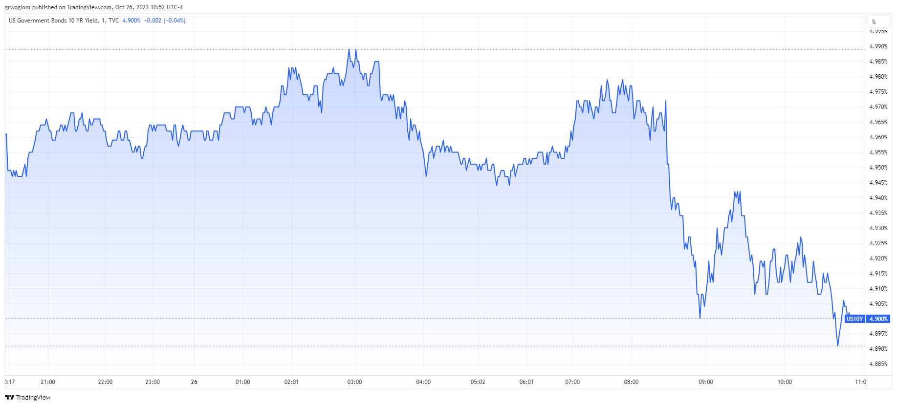
What is the Message for the 10-Yr Treasury?

Slide 49
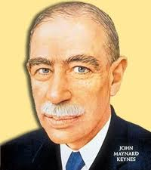
Information about What?
Pessimist: John Maynard Keynes
Asset prices reflect investor psychology and bear little relation to fundamental value
Beauty Contest: Pick the girl that other people think is the prettiest
“Animal Spirits” cause irrational and inefficient swings in investment and cause macroeconomic instability

Slide 50
Now, it is Your Turn
www.NEEDelegation.org
Geoffrey Woglom: grwoglom@amherst.edu
https://sites.google.com/view/macro-current-issues/home -
Contact NEED: Info@NEEDelegation.org
Submit a testimonial: www.NEEDelegation.org/testimonials.php
Support NEED: www.NEEDelegation.org/donate.php

